Slide 1
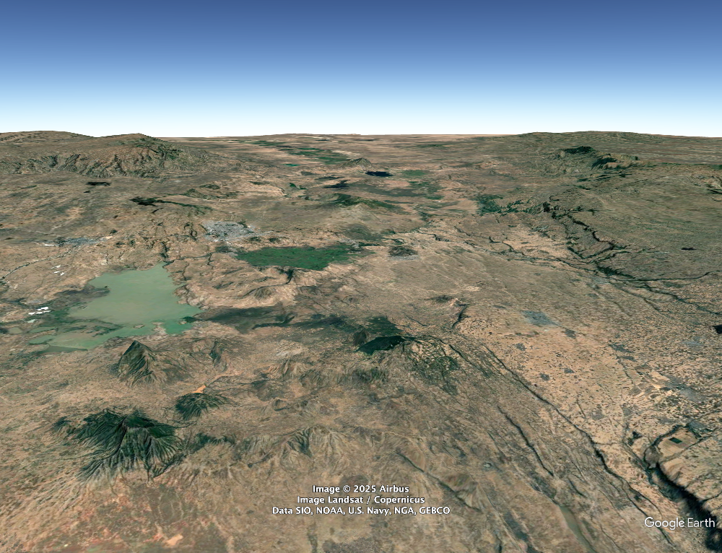
Seismicity and ground motion at volcanic systems of geothermal interest: an example from Tulu Moye in Ethiopia
Tulu Moye
Derek Keir - Univ. Southampton / Univ. Florence
& Carolina Pagli, Birhan Kebede; Atalay Ayele, Elias Lewi Tim Greenfield

Slide 2
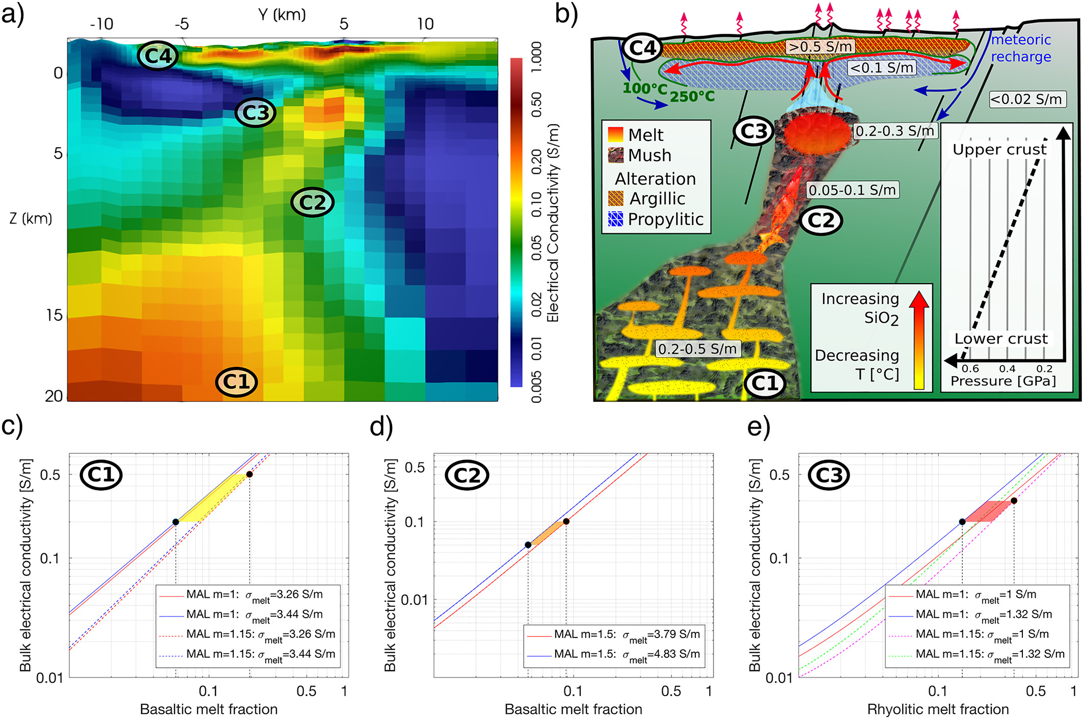
Seismicity and ground motion at volcanic systems of geothermal interest: an example from Tulu Moye in Ethiopia
Geothermal systems
Heat source - magma body
Fault and fracture system
Hydrothermal fluid circulation
Cap of impermeable rock
Samrock et al., 2018
Tulu Moye
Derek Keir - Univ. Southampton / Univ. Florence
& Carolina Pagli, Birhan Kebede; Atalay Ayele, Elias Lewi Tim Greenfield

Slide 3
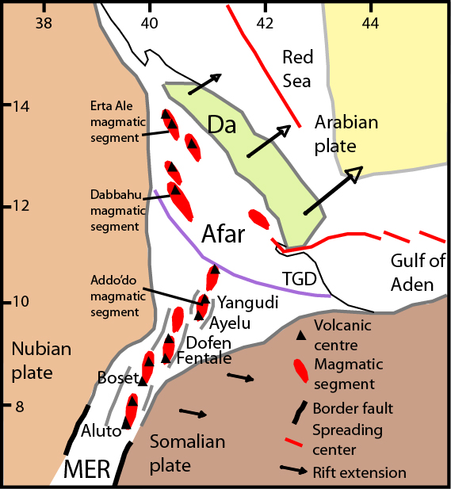
Magma-rich rifting in the Ethiopian rift
Northern end of the East African Rift
Formed ~20-10 Ma from separation of
Somalian and Nubian plates
Extension rates of ~5 mm/yr
Extension localized since 2 Ma to magmatic segments

Slide 4
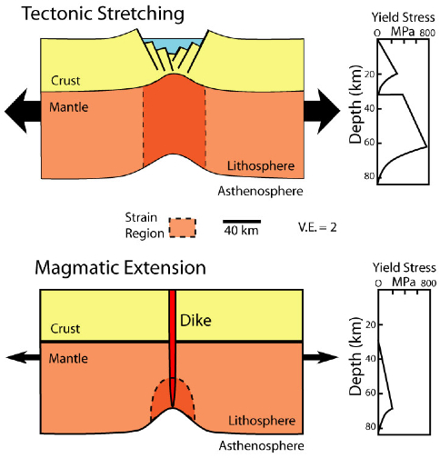
Magma-rich rifting in the Ethiopian rift
McKenzie, 1978, EPSL
Magma intrusion accommodates at lower stresses than faulting
If magma is available it is the preferred
mechanism of extension
We know little about how diking happens in space in and time in continental rifts
This is especially the case in young rifts with slow rate (<1 cm/yr) extension
Buck et al., 2006

Slide 5
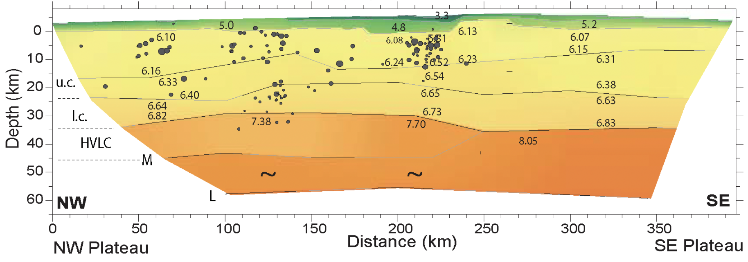
Evidence for magma intrusion from seismic reflection and gravity
Crustal structure shows very little crustal thinning
Seismic velocities are high - interpreted as mafic intrusion
Rees et al., 2025
Mackenzie et al., 2005

Slide 6
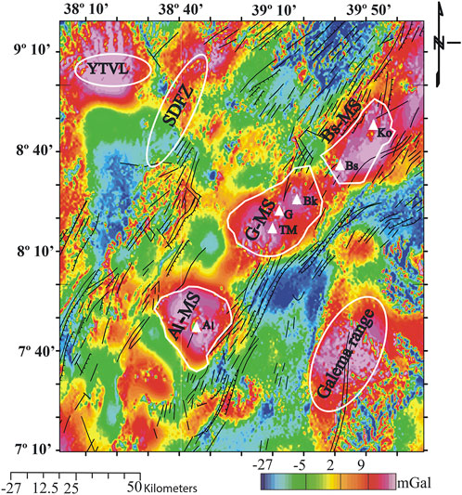
Gravity highs at magmatic segments
Bouguer gravity filtered to crustal depths shows gravity highs beneath segments
Interpreted as dense mafic intrusion in upper half of the crust
Similar to gravity signal of slow spreading
ocean ridges
Nigussie et al., 2022
Ebinger et al., 2001

Slide 7
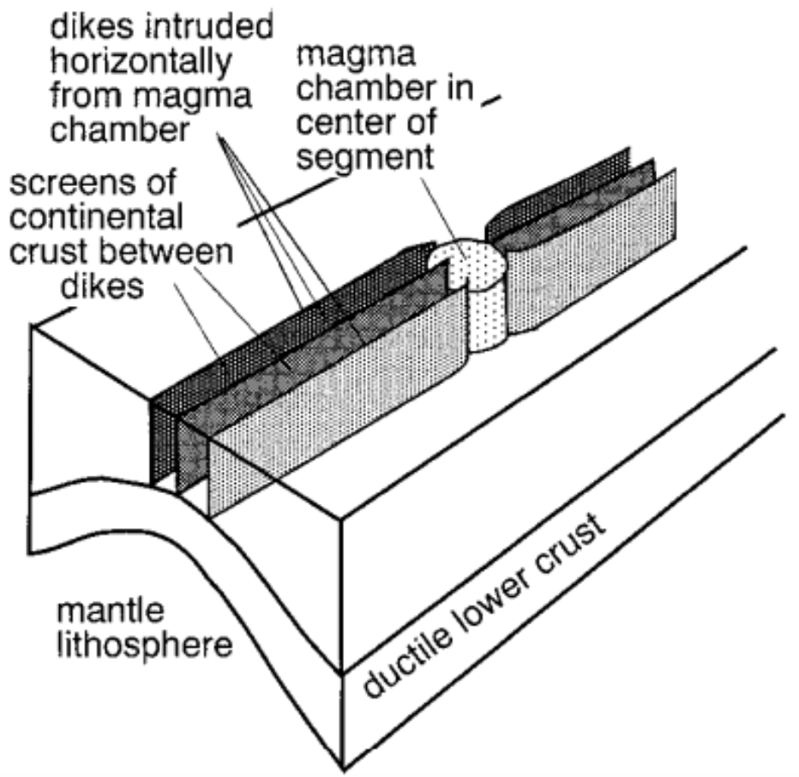
Gravity highs at magmatic segments
Bouguer gravity filtered to crustal depths shows gravity highs beneath segments
Interpreted as dense mafic intrusion in upper half of the crust
Similar to gravity signal of slow spreading
ocean ridges
Nigussie et al., 2022
Ebinger et al., 2001
Ebinger et al., 2001

Slide 8
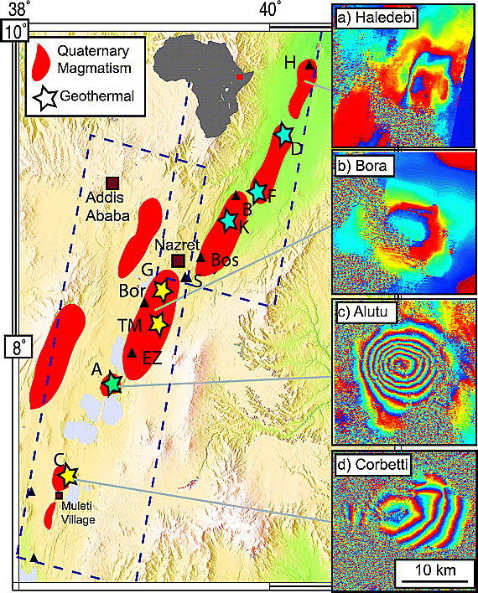
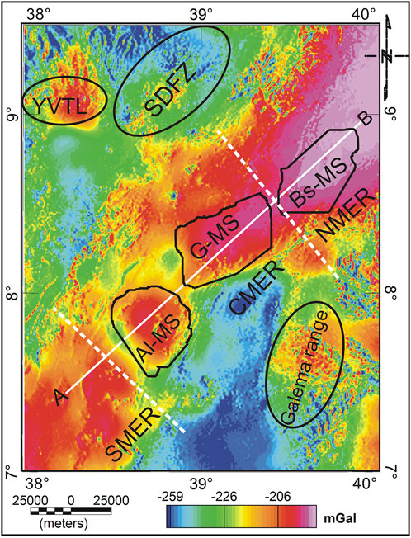
Rift volcanic systems are active & geothermal prospects
Rees et al., 2025
Biggs et al., 2011

Slide 9
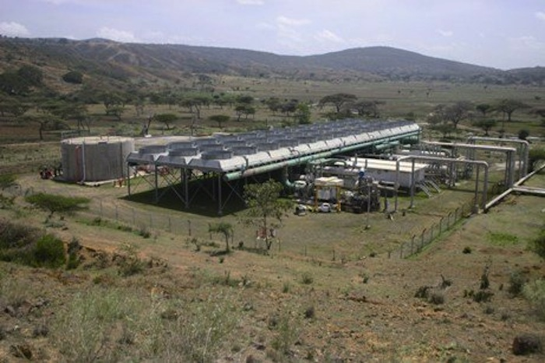
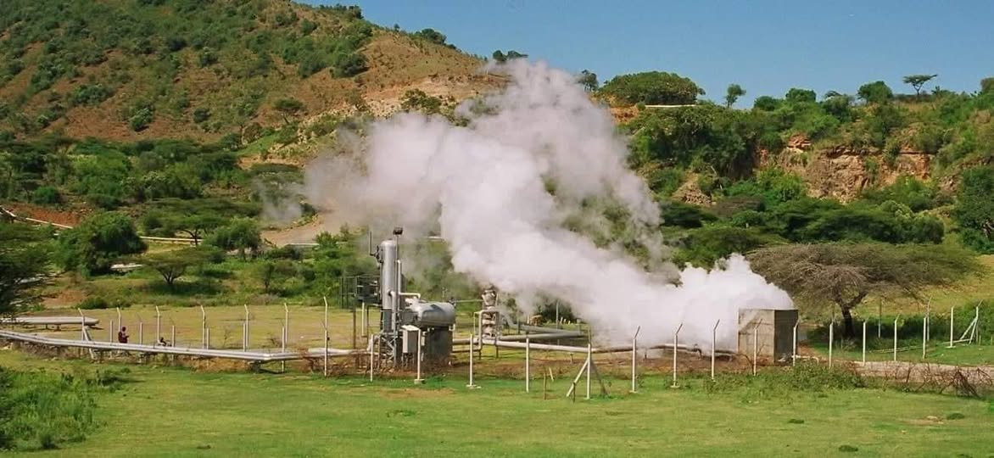
Aluto pilot geothermal power plant
Biggs et al., 2011

Slide 10
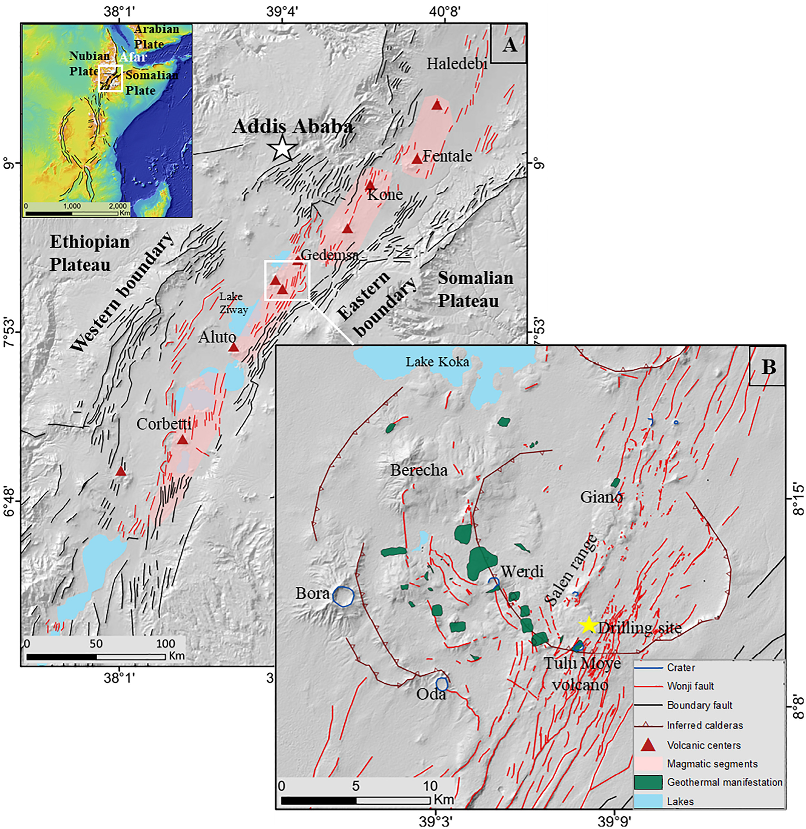
Tulu Moye volcanic centre
Bericha
Bericha
Tulu Moye
Bora
Tulu Moye
Bora
Kebede et al., 2019

Slide 11
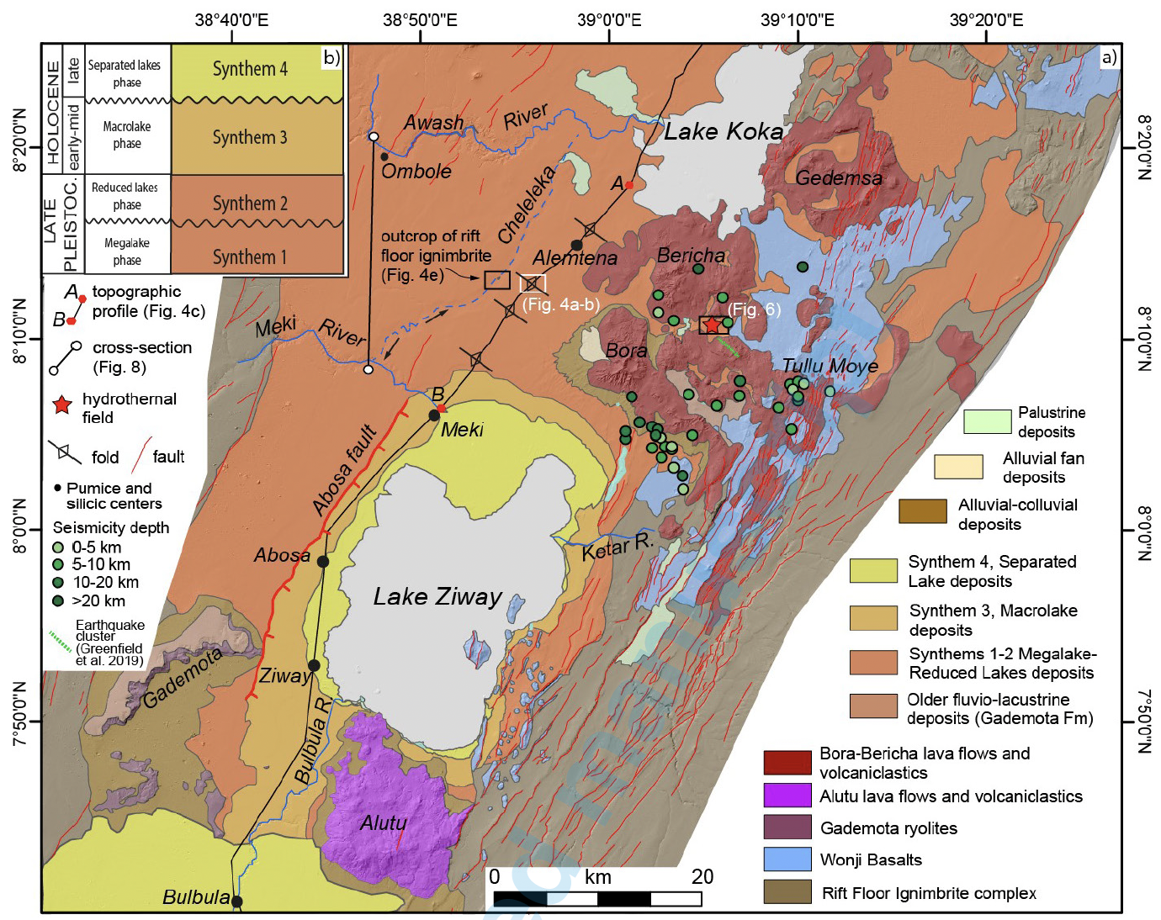
Tulu Moye volcanic centre
Bericha
Bora
Tulu Moye
Kebede et al., 2019
Benvenuti et al., 2023

Slide 12
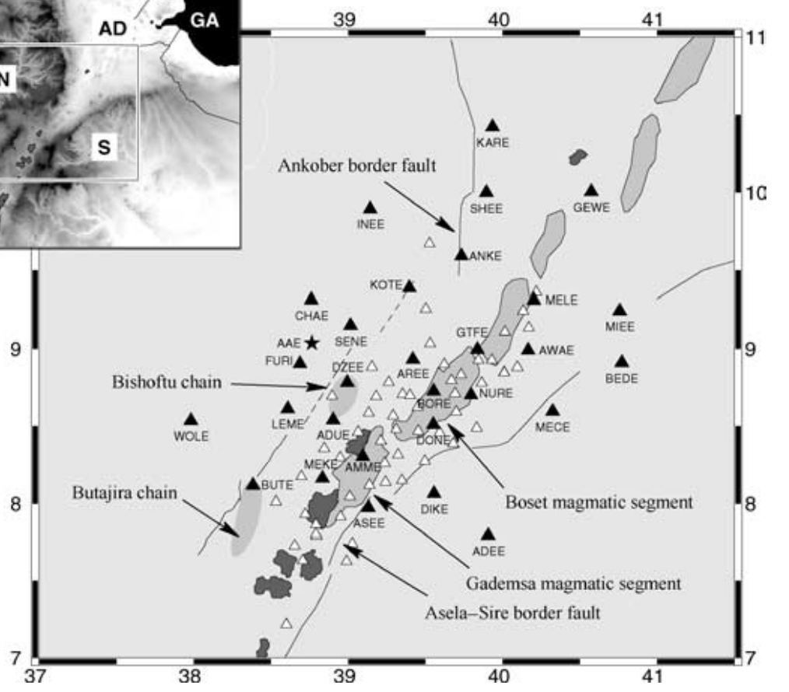
Seismicity from a regional seismic network in 2001-2003
Bastow et al., 2005
Benvenuti et al., 2023

Slide 13
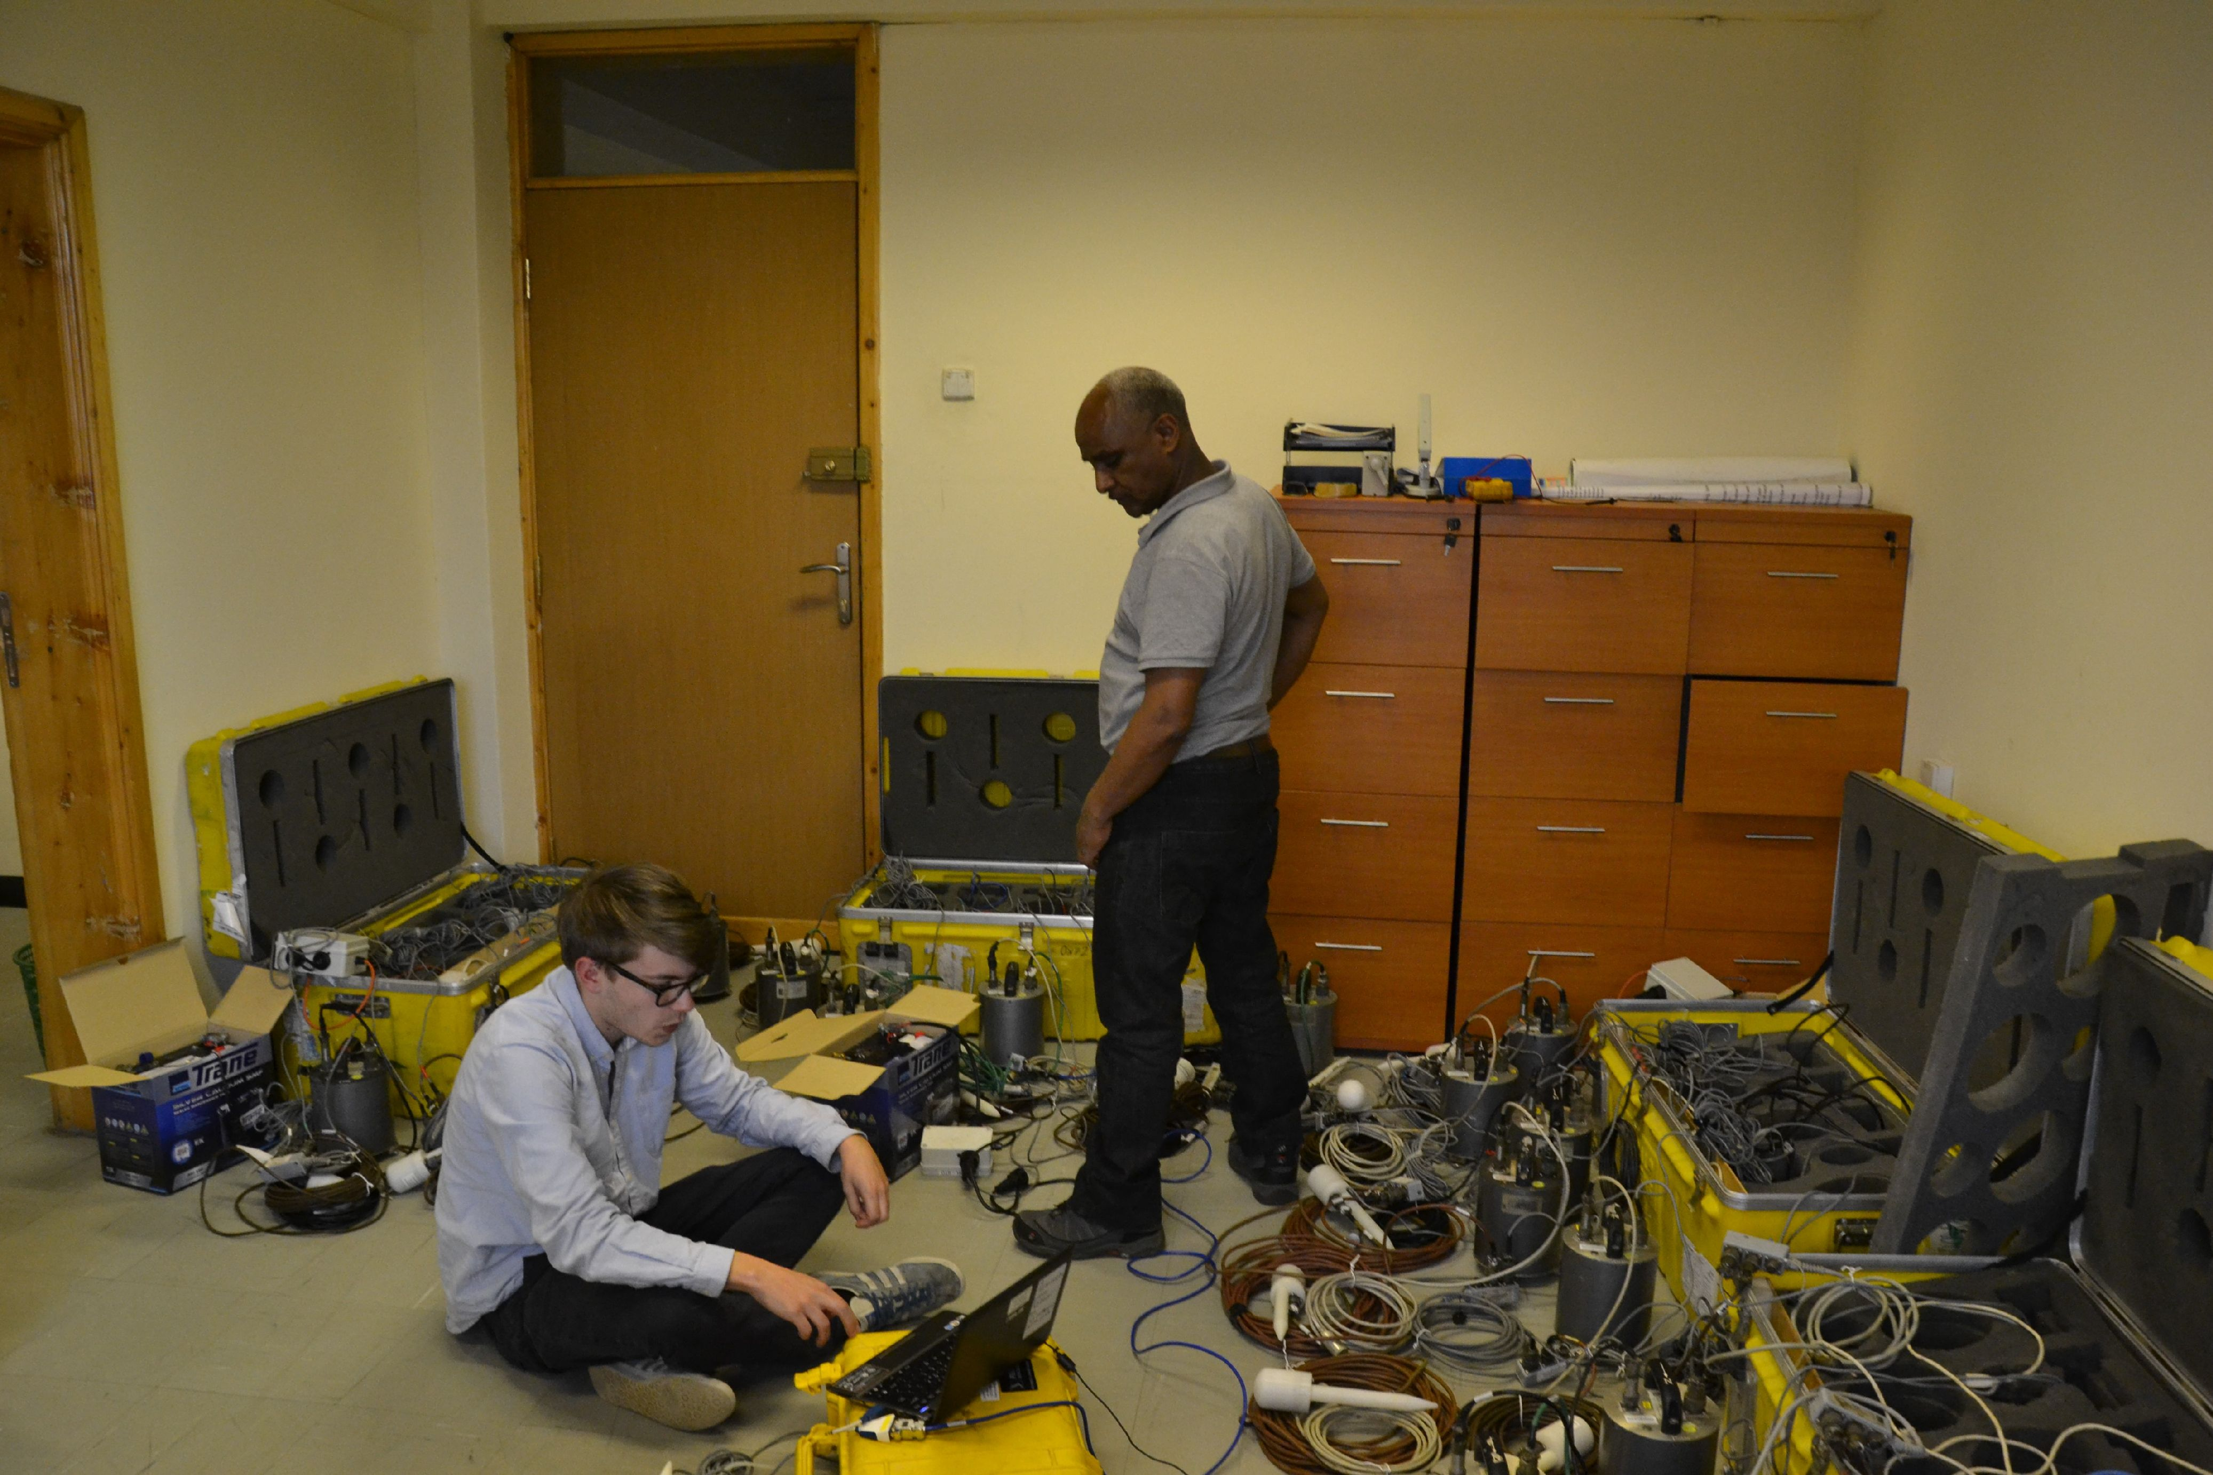
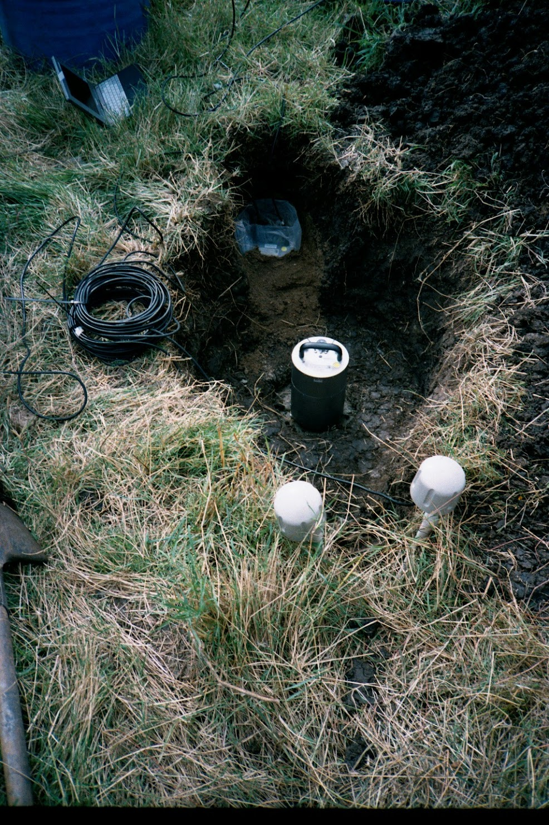
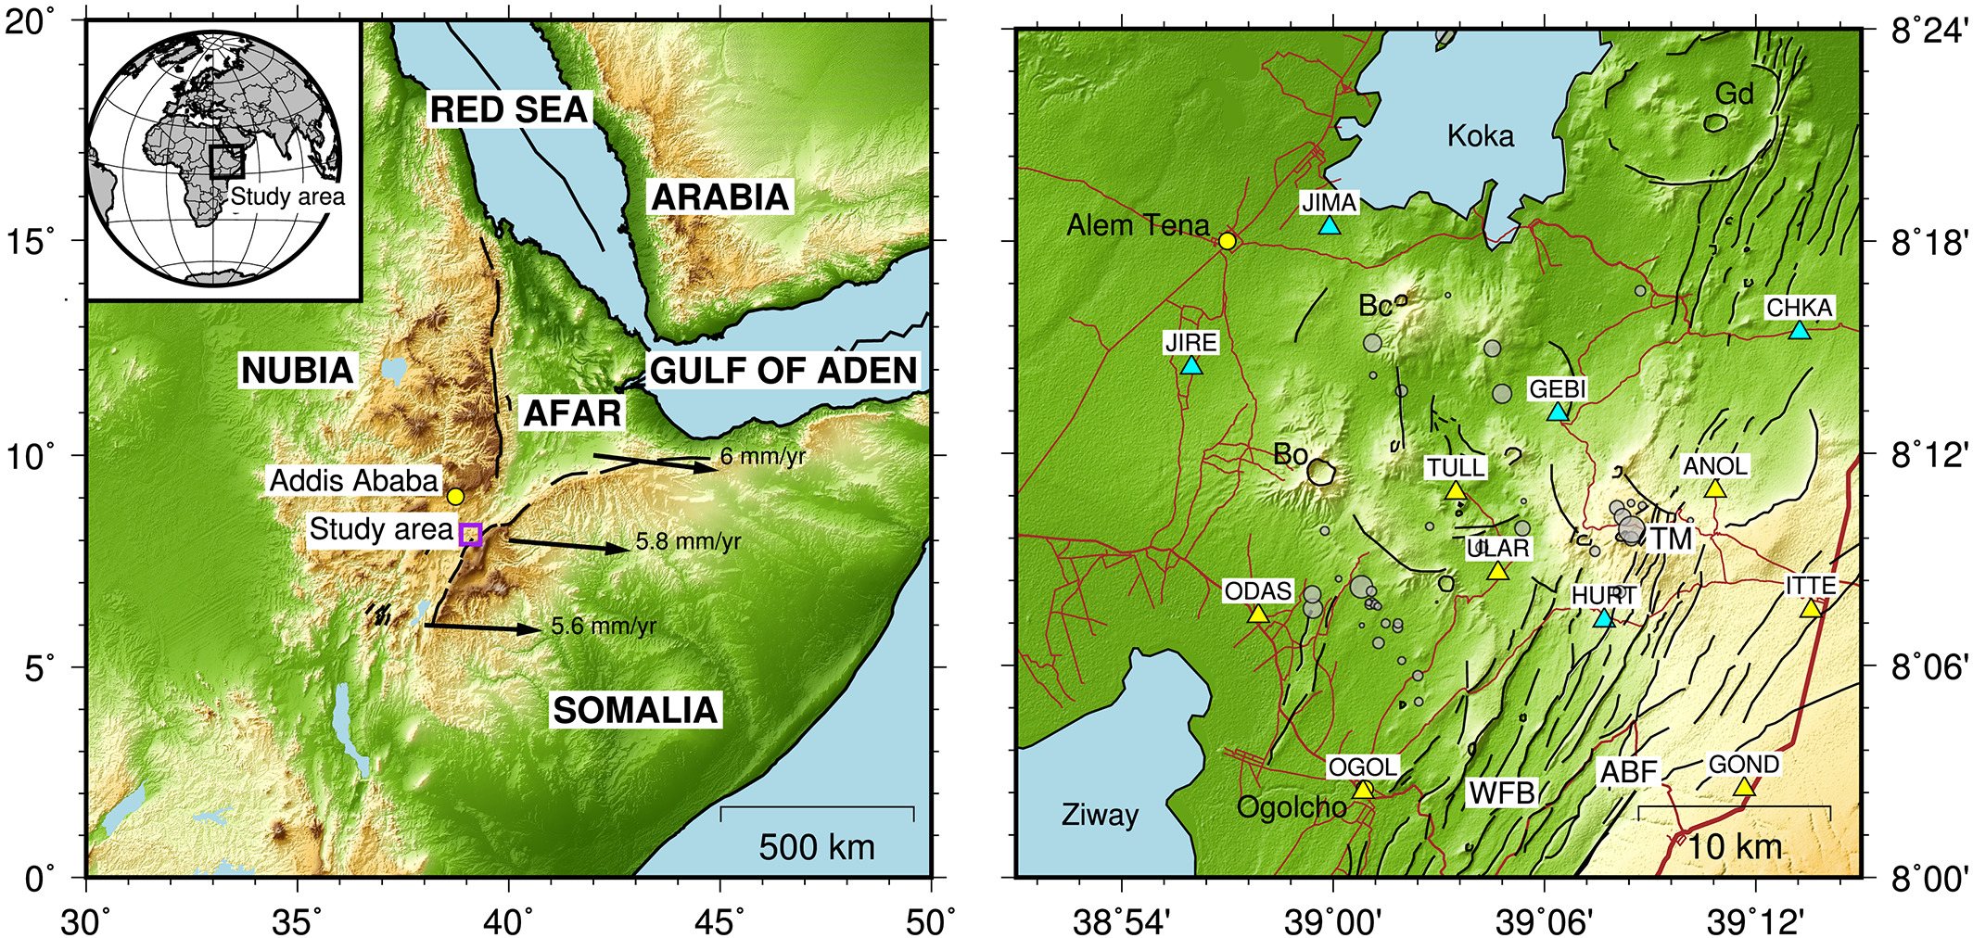
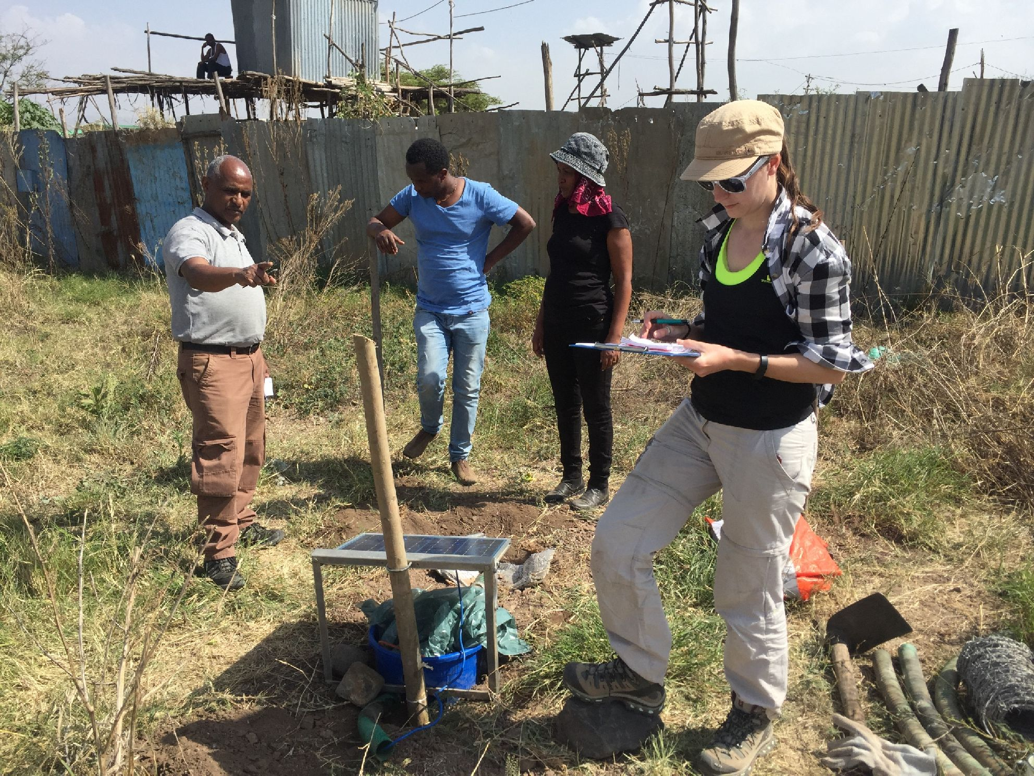
Tulu Moye volcanic system and the seismic network 2016 - 2017
Greenfield et al., 2019

Slide 14
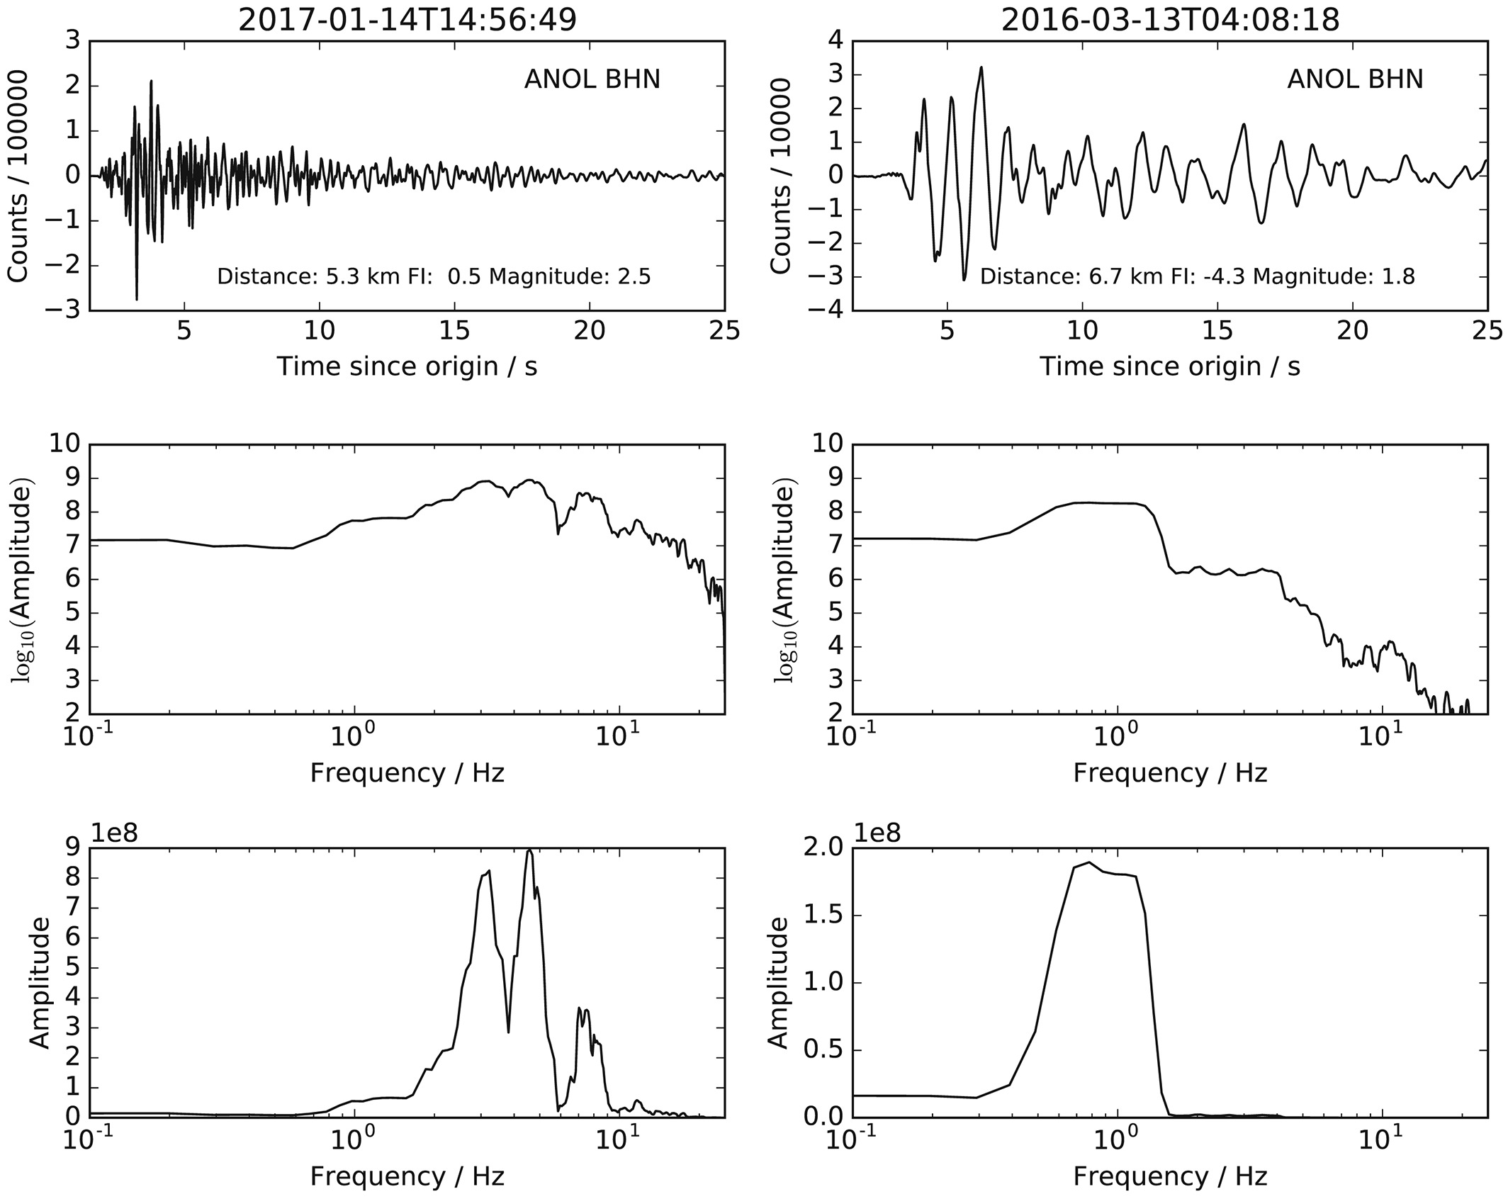
Seismic signals recorded from Tulu Moye
FI:-3
Frequency of 1-10 Hz
Regular earthquakes
Volcano-tectonic (VT)
Frequency of 0.5-1.5 Hz
Low frequency earthquakes
Greenfield et al., 2019

Slide 15
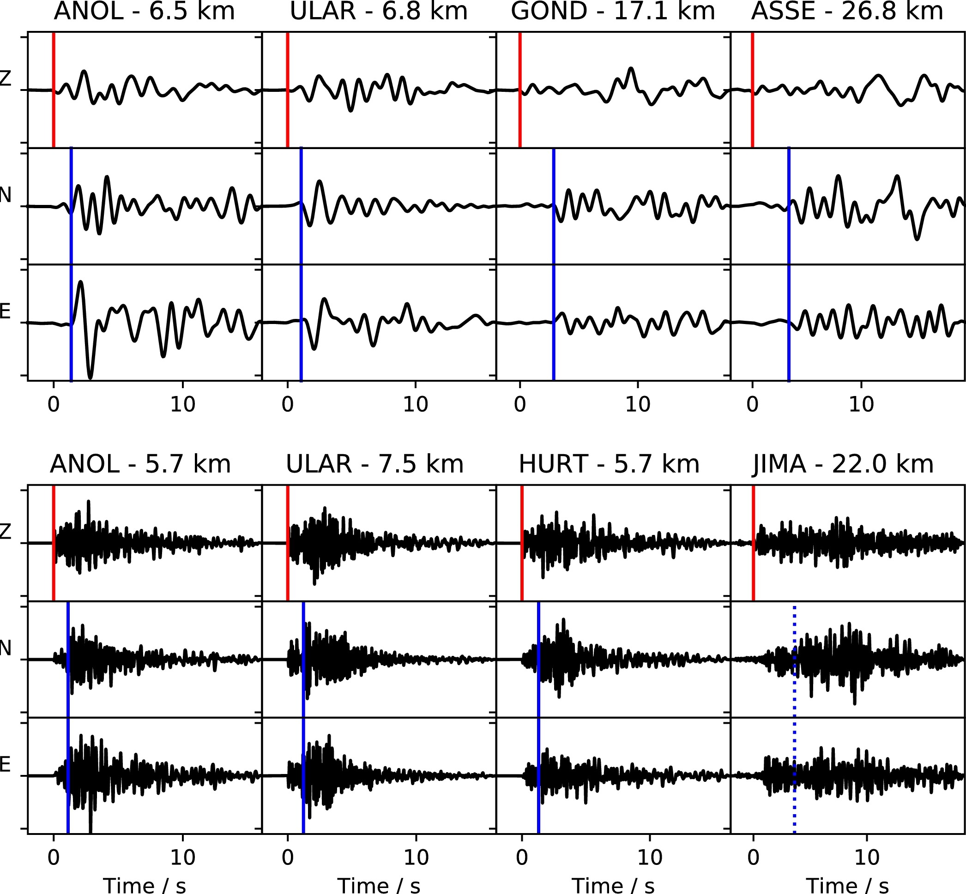
Seismic signals recorded from Tulu Moye
FI:-3
Greenfield et al., 2019

Slide 16
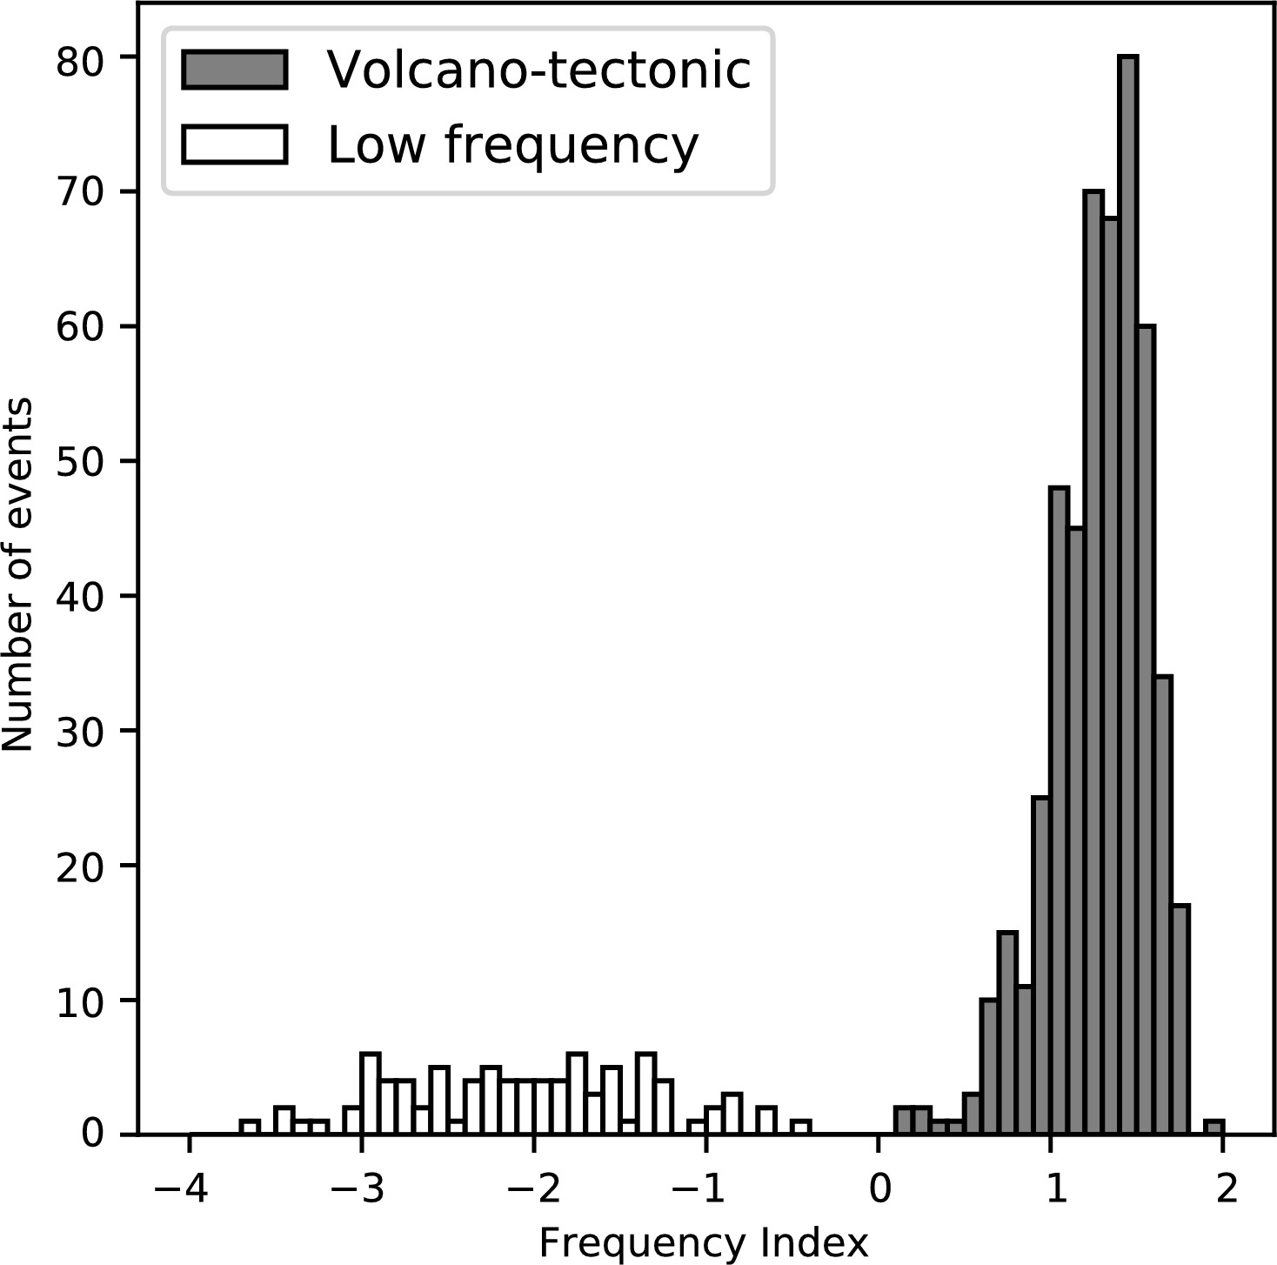
Seismic signals recorded from Tulu Moye
FI:-3
Frequency index (FI)
A_{upper} 6-12 Hz
A_{lower} 0.6-1.2 Hz
Examples
left FI = log (3) = 0.5
right FI = log (0.001) = -3
Greenfield et al., 2019

Slide 17
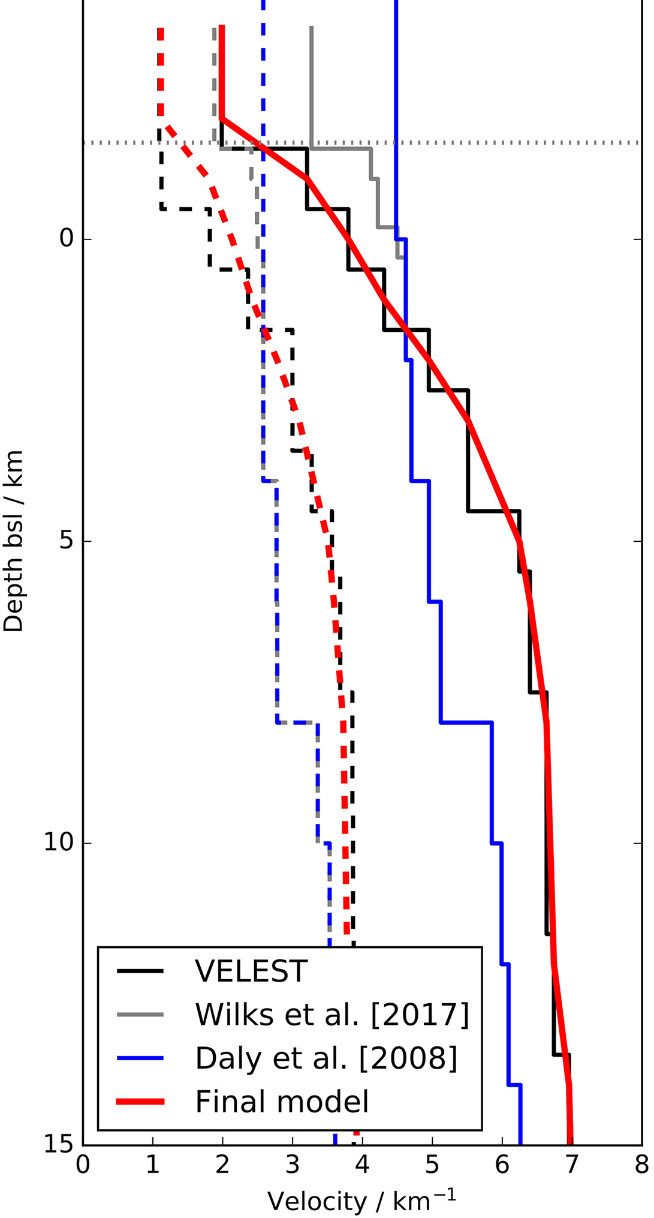
Earthquake location at Tulu Moye
Automatic detection
Pick P- and S- waves
Invert for model and locations
Greenfield et al., 2019

Slide 18
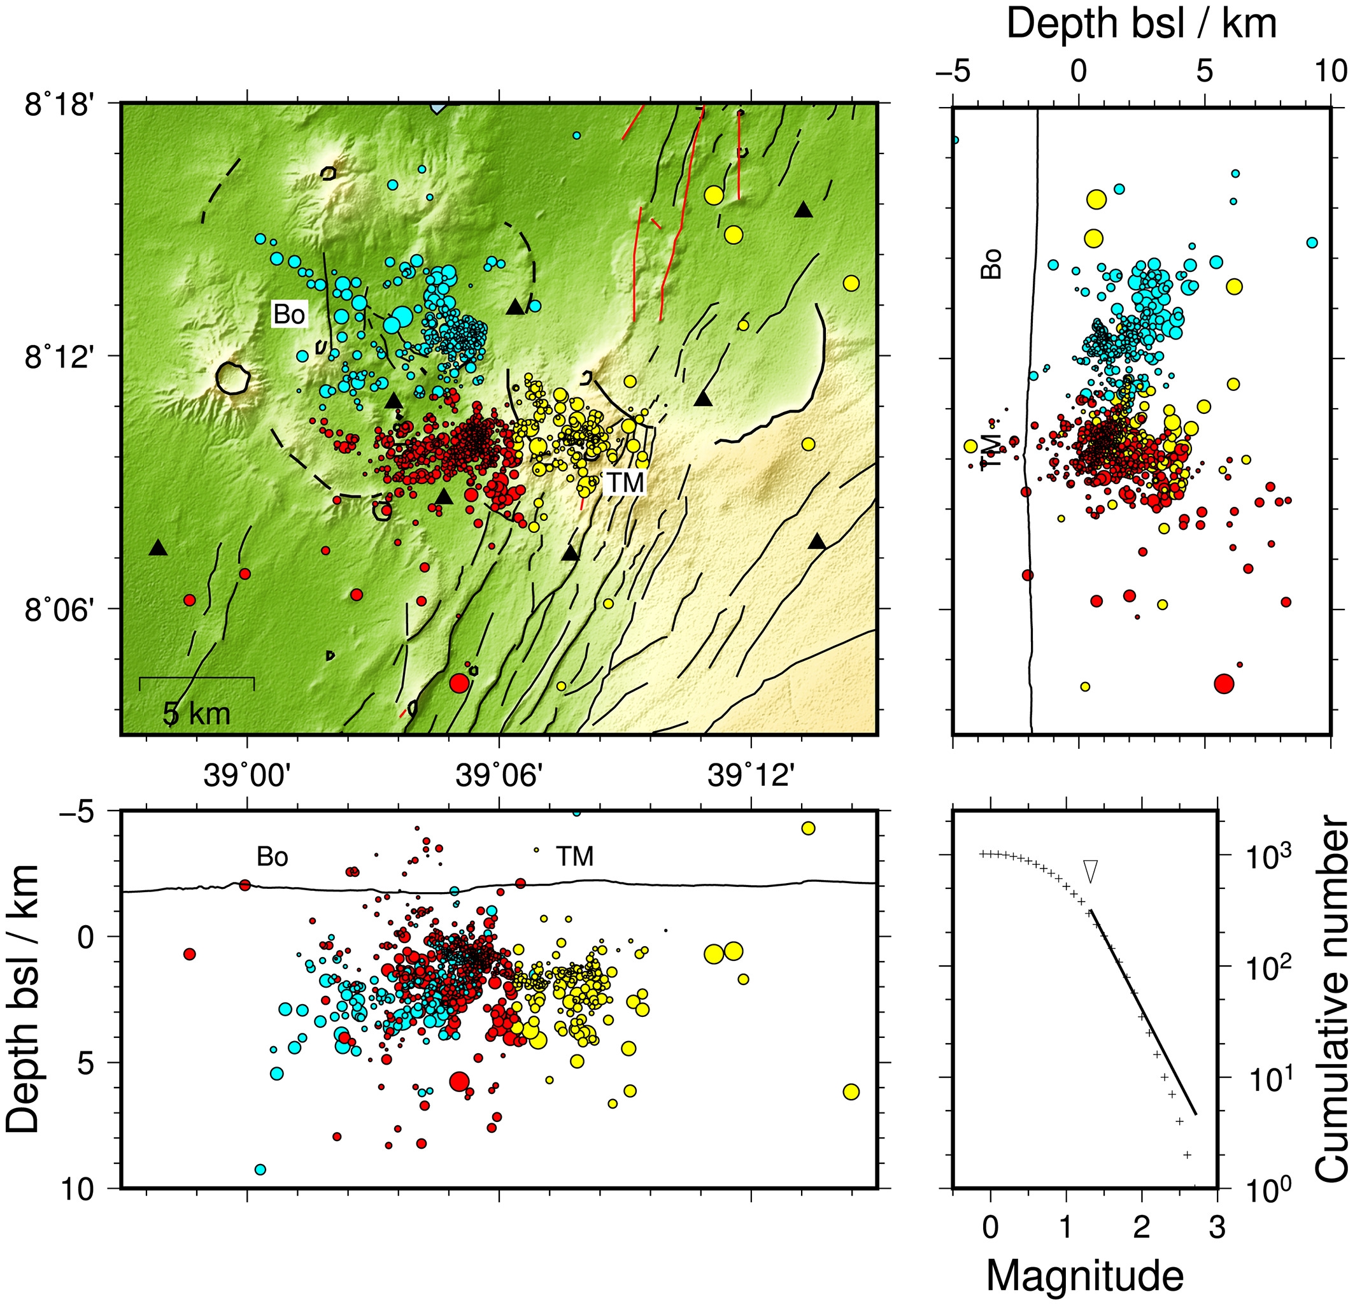
Earthquake location at Tulu Moye
Red and blue - high frequency
Yellow - low frequency
Gutenberg - Richter plot shows magnitude
of completeness of M 1.3
Greenfield et al., 2019

Slide 19
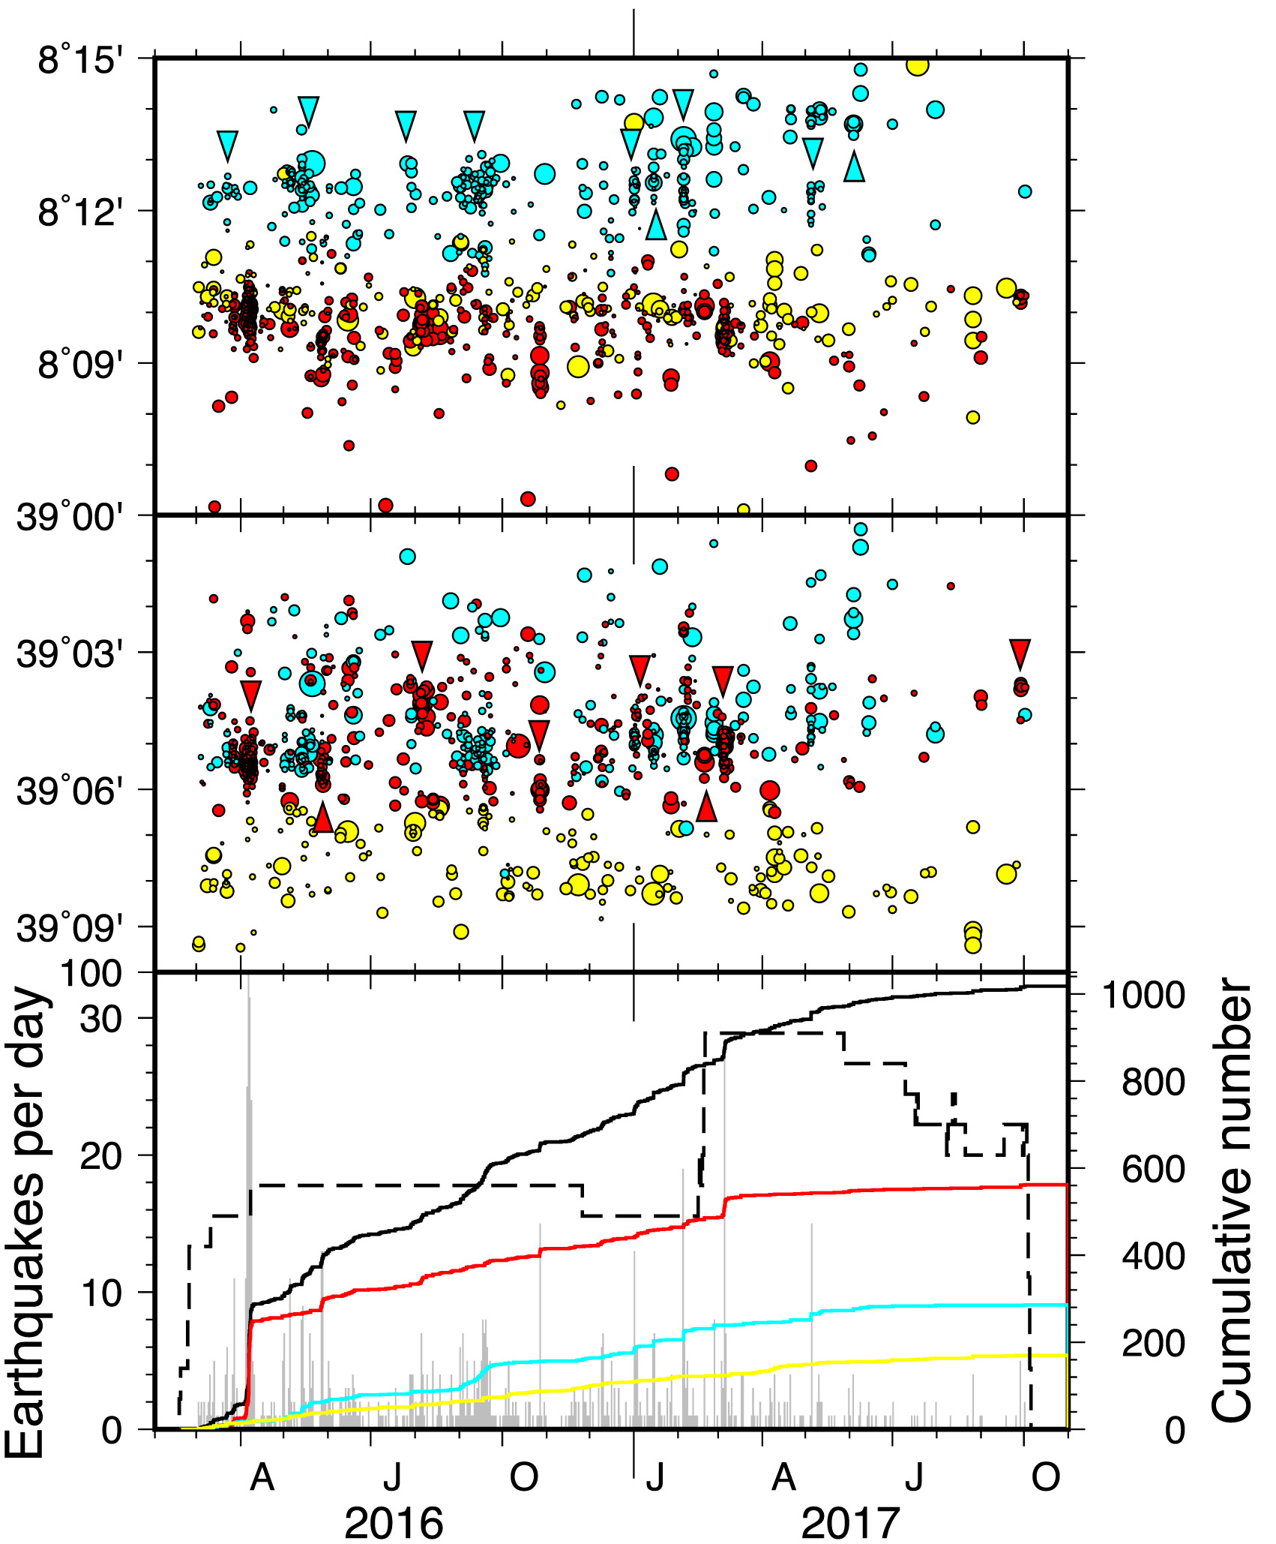
Earthquake location at Tulu Moye
Red and blue - high frequency
Yellow - low frequency
Gutenberg - Richter plot shows magnitude
of completeness of M 1.3
More than 50% of earthquakes in red group
Greenfield et al., 2019

Slide 20
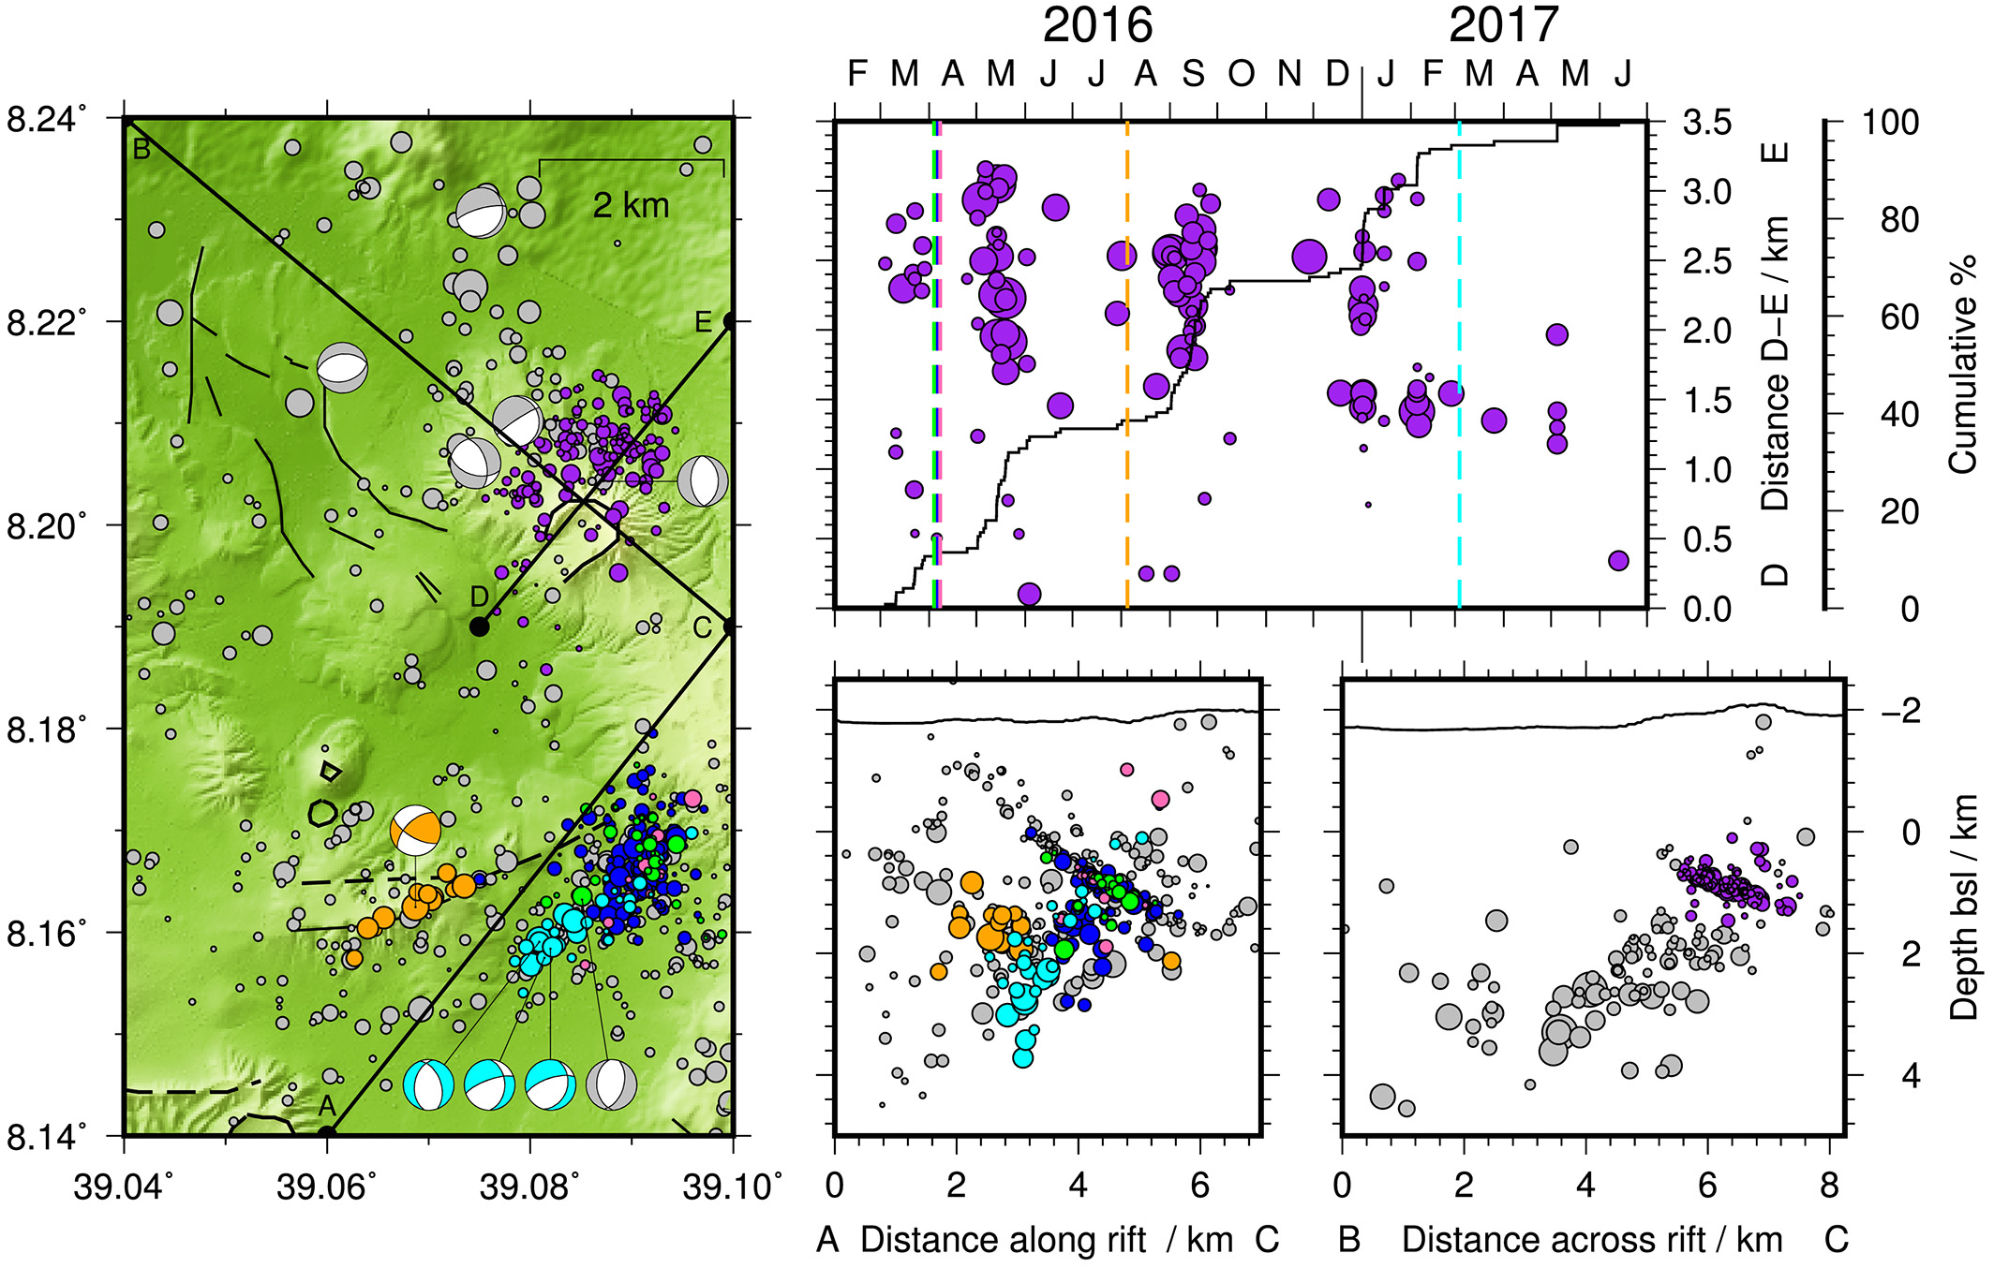
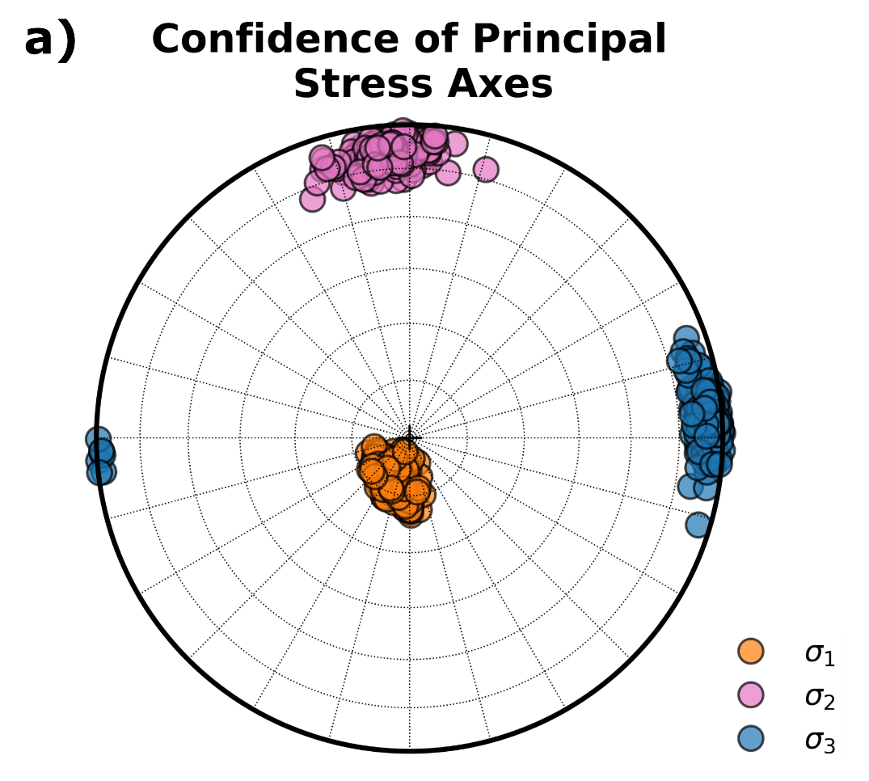
Earthquake location at Tulu Moye
Greenfield et al., 2019

Slide 21
Earthquakes at Tulu Moye related to hydrothermal fluid flow
Greenfield et al., 2019

Slide 22
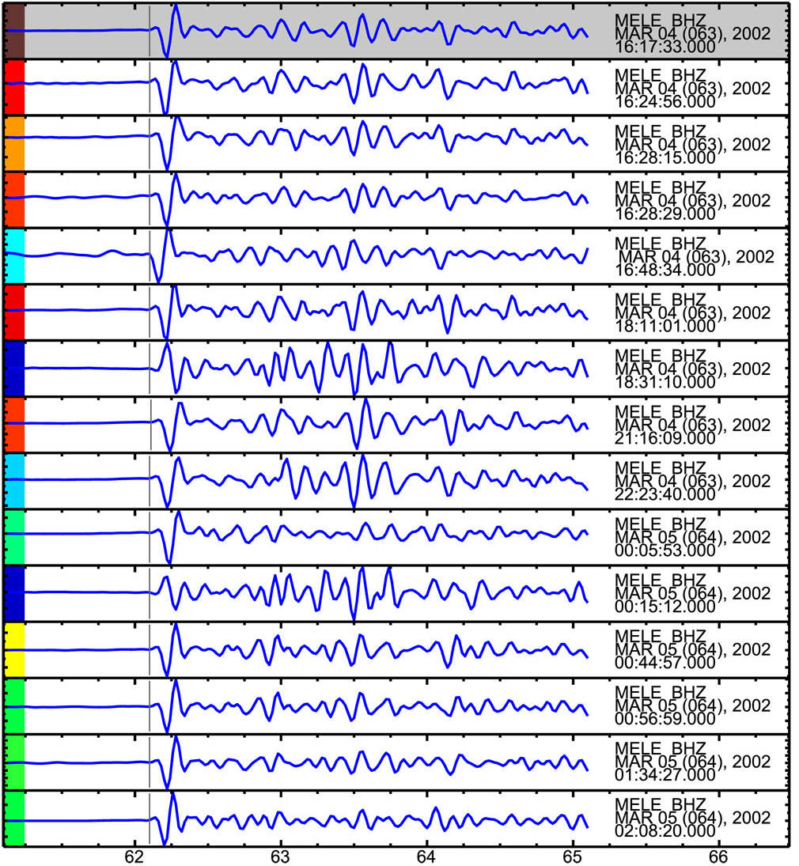
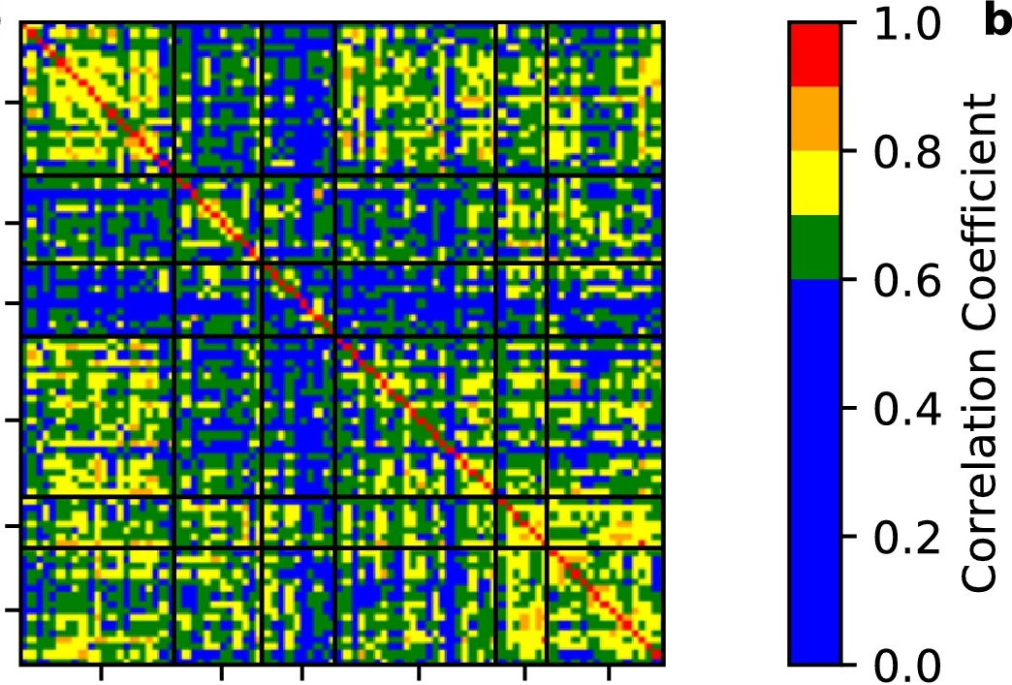
Low frequency earthquakes at Tulu Moye
Cross-correlation (cc) analysis
Greenfield et al., 2019

Slide 23
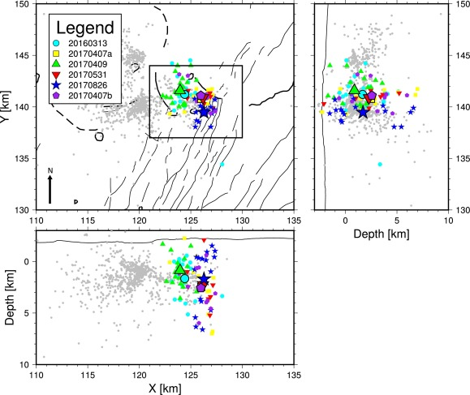
Low frequency earthquakes at Tulu Moye due to magma motion
Cross-correlation (cc) analysis identifies groups of self similar earthquakes
Greenfield et al., 2019

Slide 24
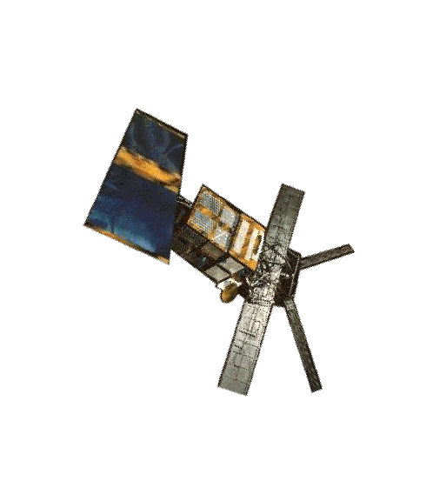
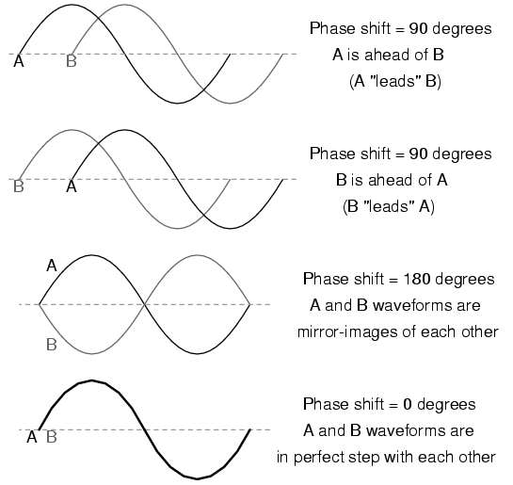
Ground deformation at Tulu Moye from InSAR
Ground movement
}
By combining two satellite images, the space geodesists can create maps of ground movements
Notes:
24

Slide 25
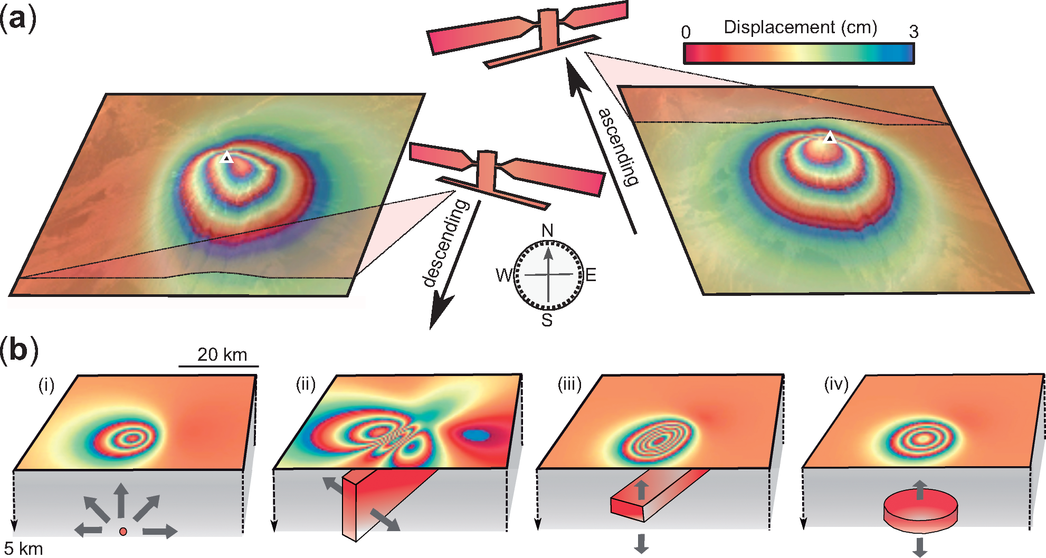
Ground deformation at Tulu Moye from InSAR
Magee et al., 2019
Maps of ground motion can be modelled using a deformation source - e.g. Mogi, dike, sill, fault

Slide 26
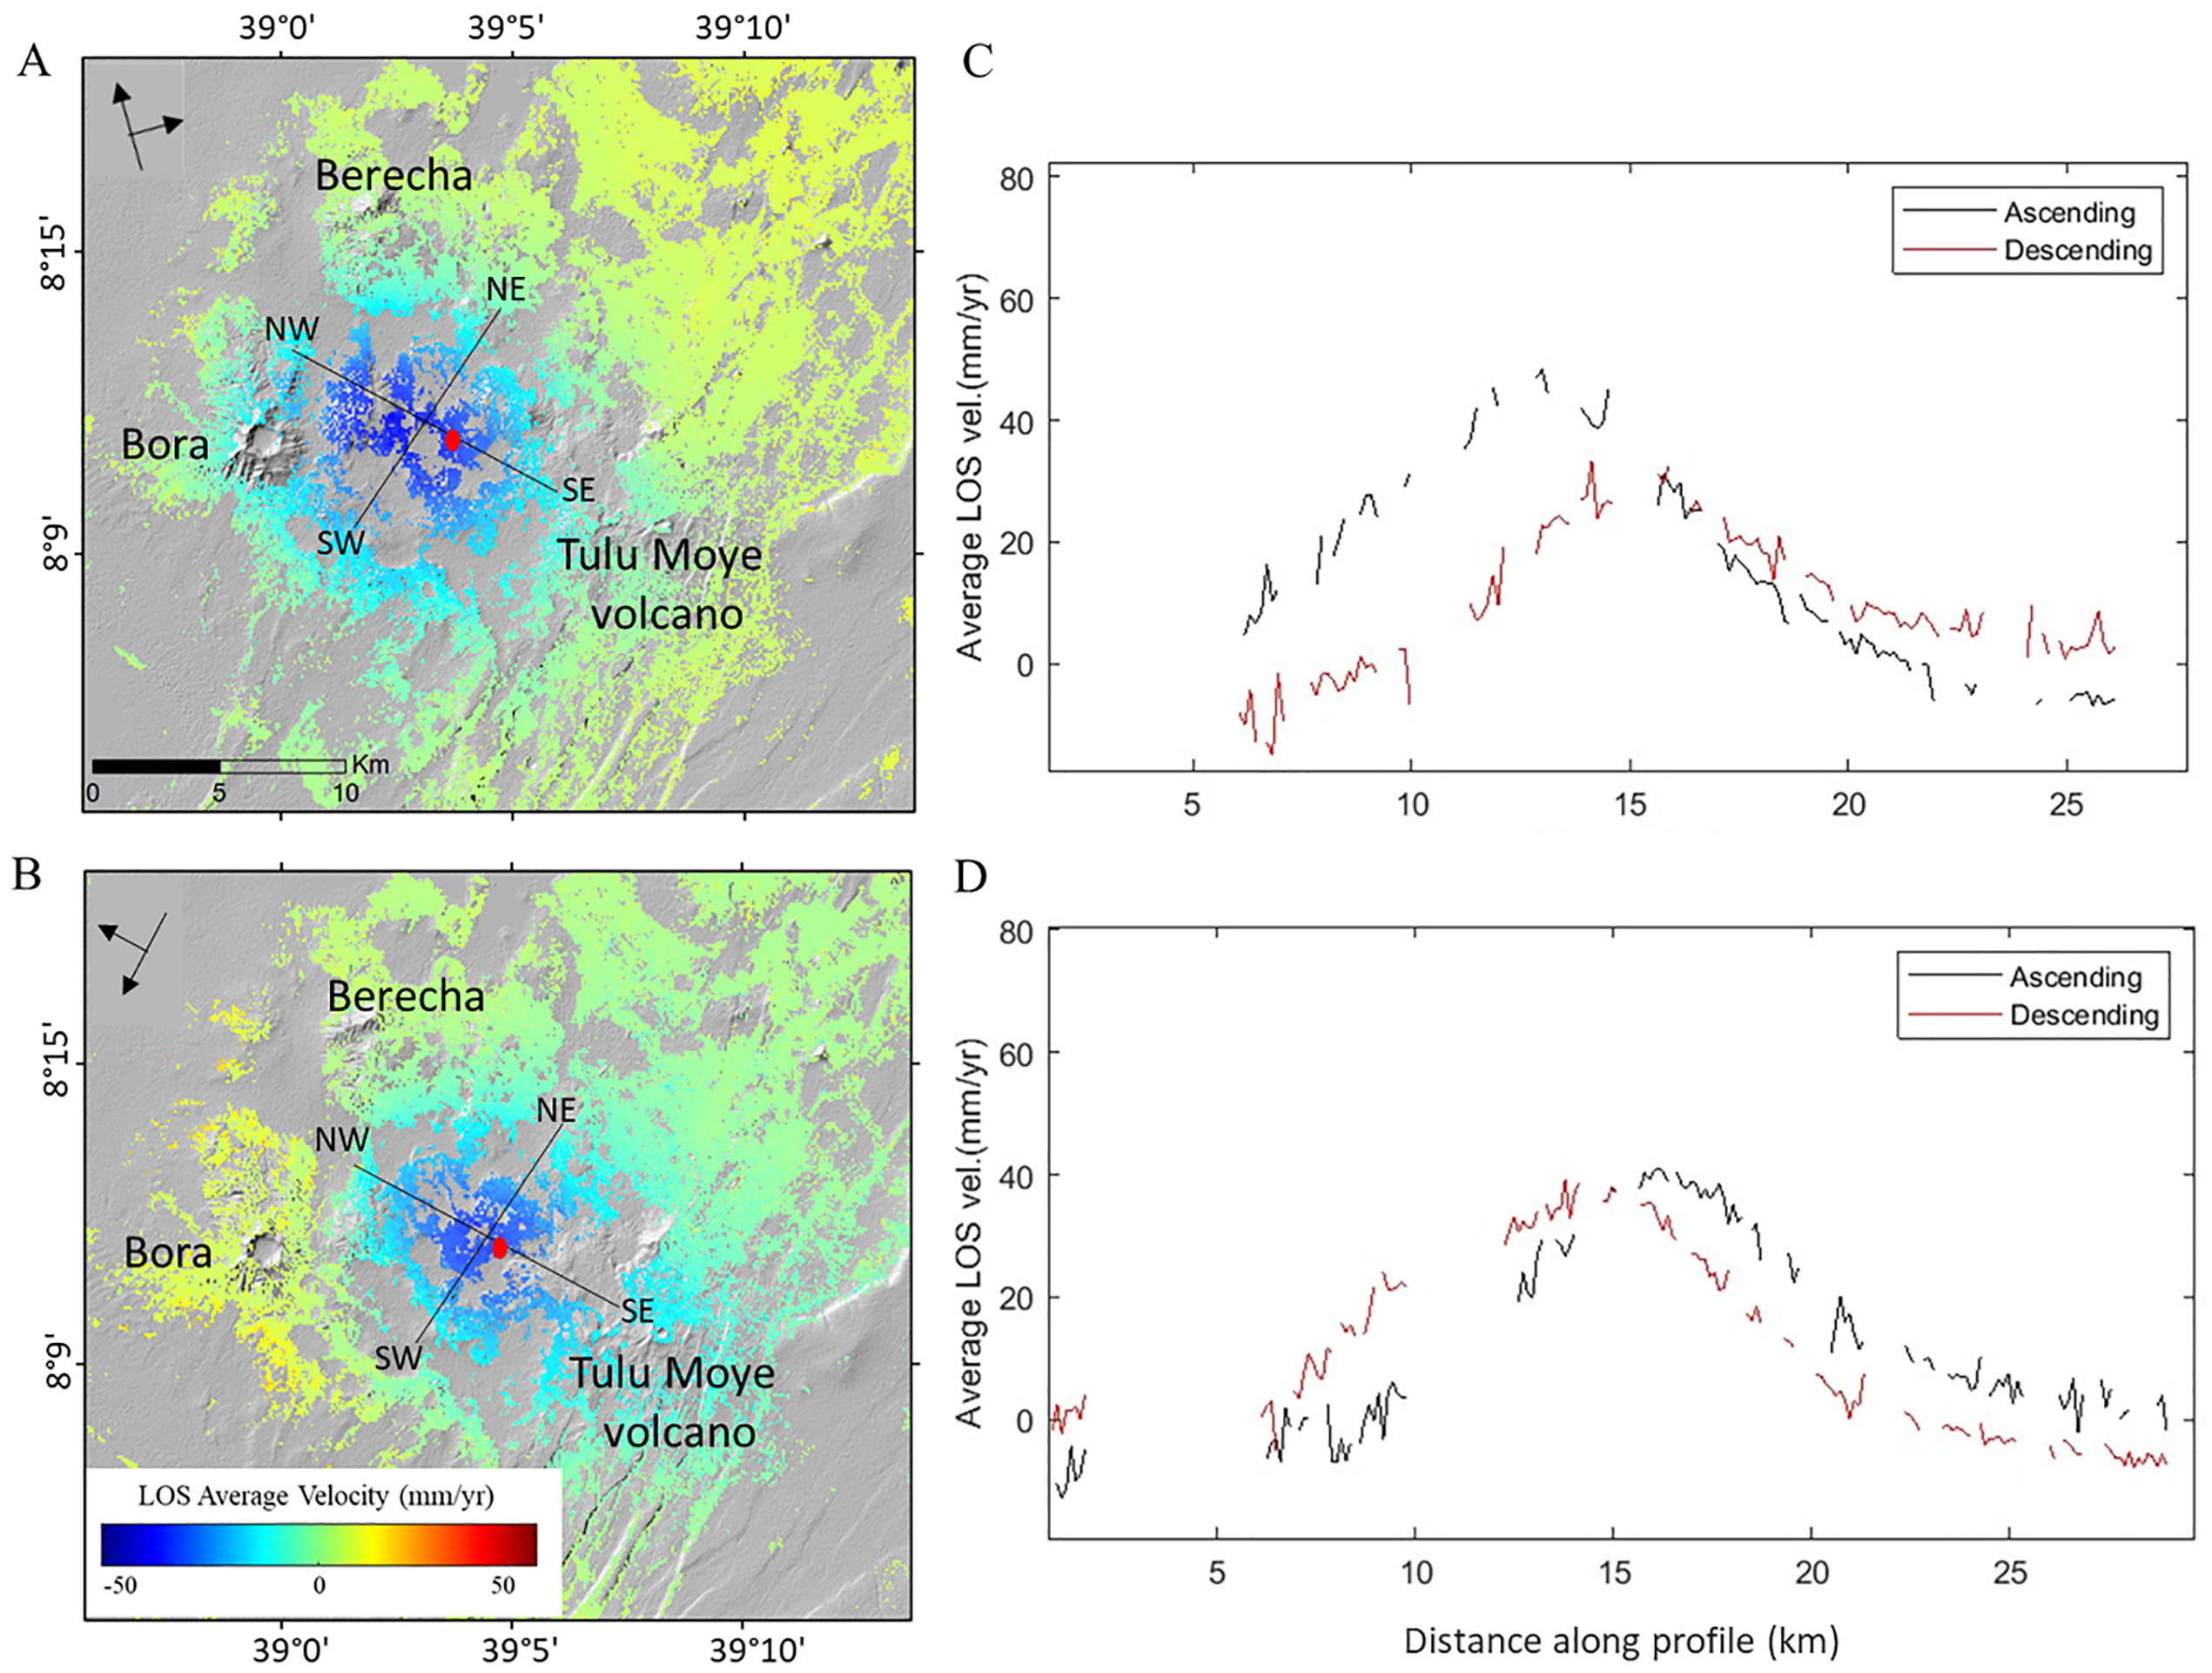
Ground deformation at Tulu Moye from InSAR
Ascending 2015-2017
W-E
N-S
Descending 2015-2017
Kebede et al., 2023

Slide 27
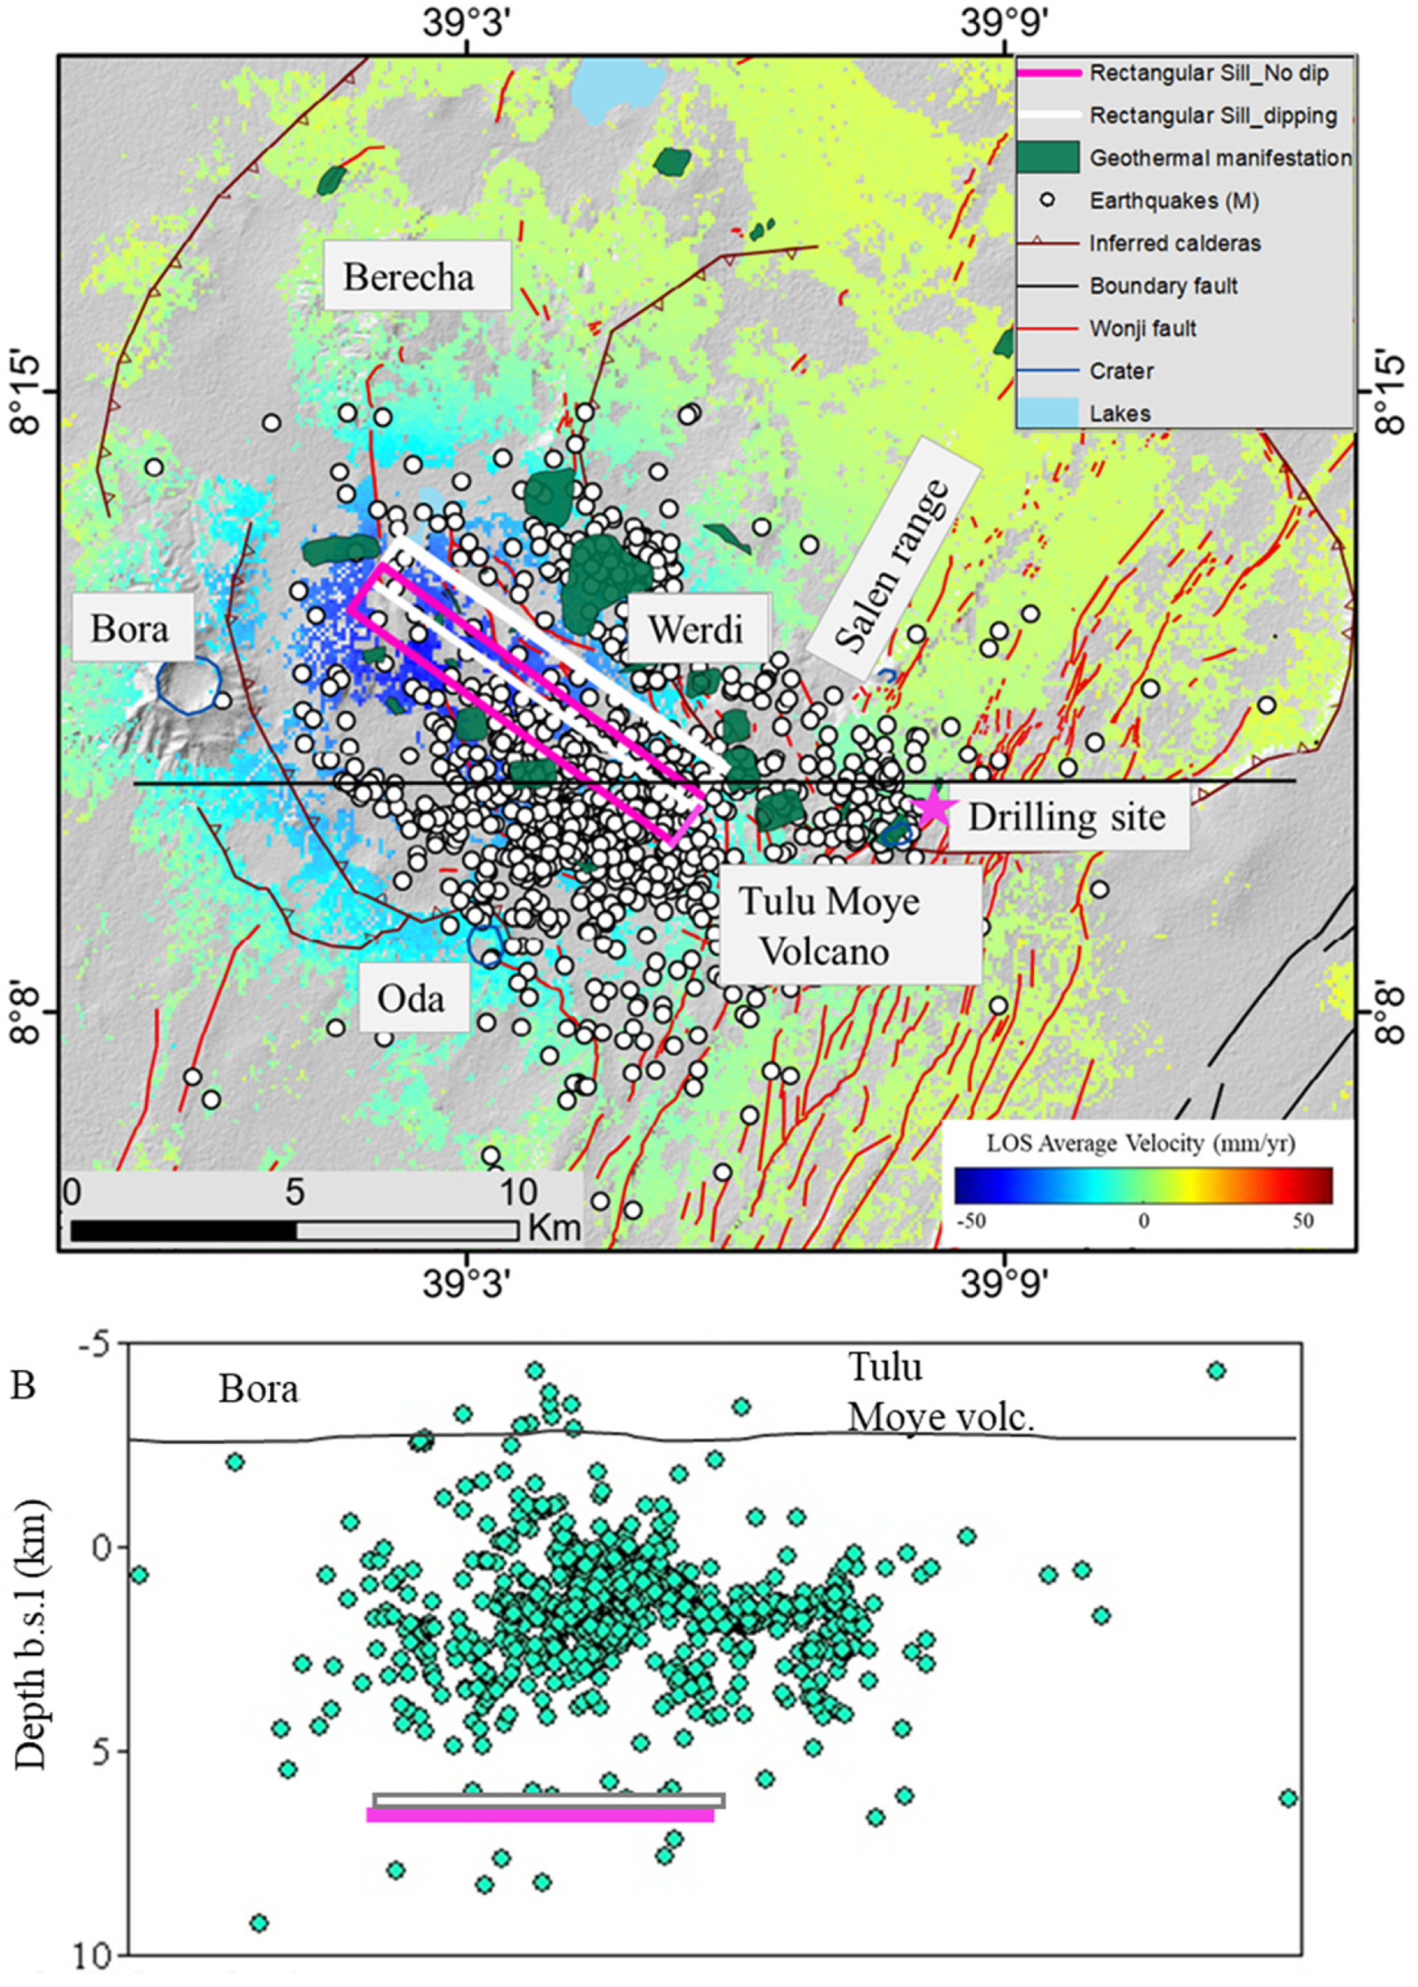
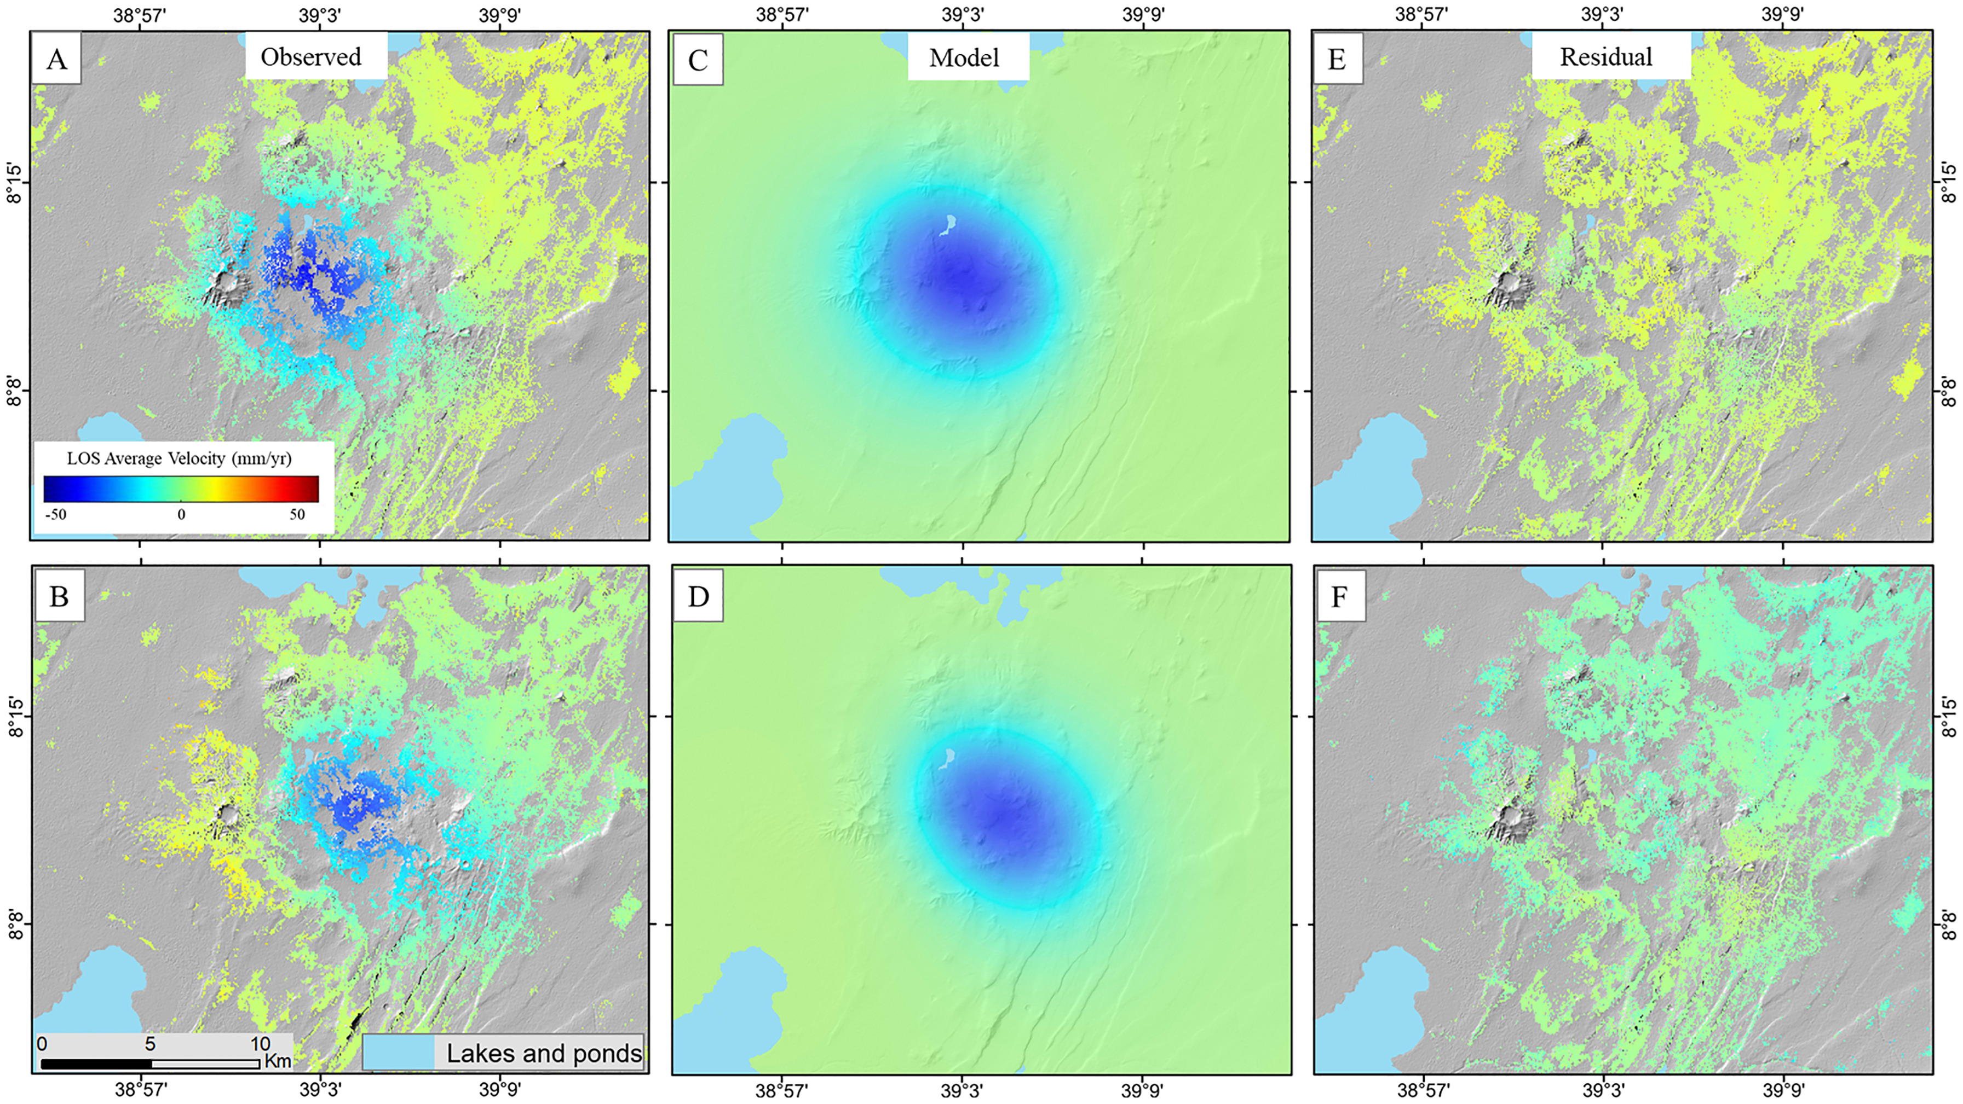
Modelling ground deformation at Tulu Moye
Ascending 2015-2017
Descending 2015-2017
Kebede et al., 2023

Slide 28
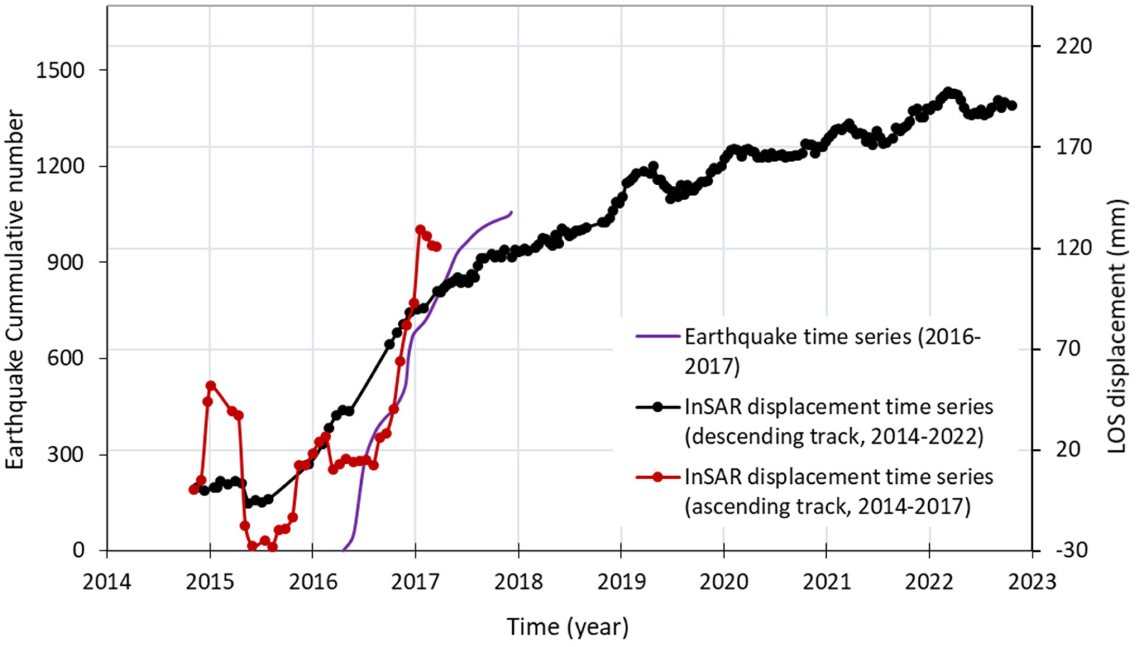
Modelling ground deformation at Tulu Moye
Ascending 2015-2017
Descending 2015-2017
Kebede et al., 2023

Slide 29
Magnetotelluric (MT) imaging beneath Tulu Moye
Samrock et al., 2018
Kebede et al., 2023

Slide 30
Magnetotelluric (MT) imaging beneath Tulu Moye
Samrock et al., 2018
Kebede et al., 2023

Slide 31
Conclusions
Seismology - VT earthquakes caused by hydrothermal fluid flow
Low frequency earthquakes caused by magma motion
InSAR - protracted uplift modelled by a sill
Magnetotellurics - high conductivities show evidence for a clay cap and heat source
Integration of results from multiple methods shows a complex melt system and overlying hydrothermal system
Samrock et al., 2018
Kebede et al., 2023

