Slide 1

Global Empirical Model of Sporadic-E Occurrence Rates: GEMSOR
IRI and NeQuick — Improving the Representation of the Real-Time Ionosphere
Oct 2025
Dan Emmons, AFIT
Eli Parsch, USAFA
Dong Wu, NASA Goddard
Nimalan Swarnalingam, NASA Goddard
Corenelius “Jude” Salinas, NASA Goddard
Eugene Dao, AFRL
Anthony Franz, AFIT
Notes:
-

Slide 2
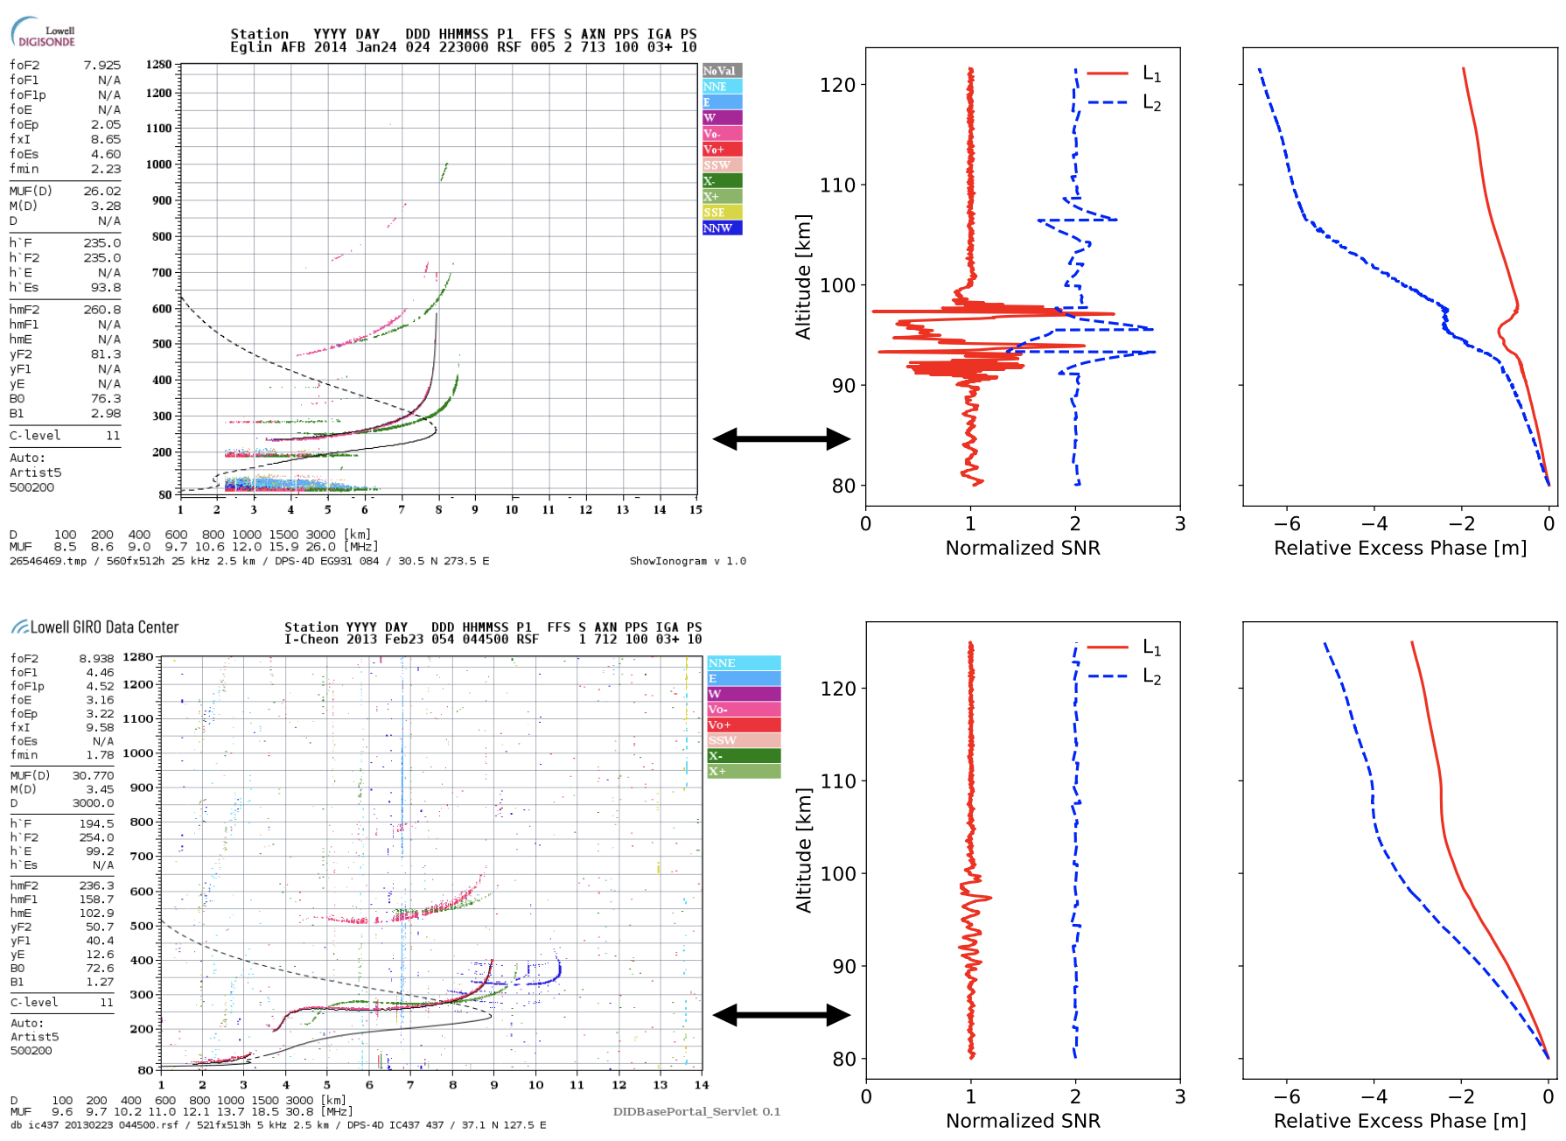
The Problem
Sporadic-E measurements are not available in locations without sounders or radars
GNSS Radio Occultation (RO) has shown promise, but the mapping between RO perturbations & sporadic-E characteristics is non-trivial
Solution: improve RO techniques by comparing & combining with ionosondes
[Emmons et al., 2023]

Slide 3
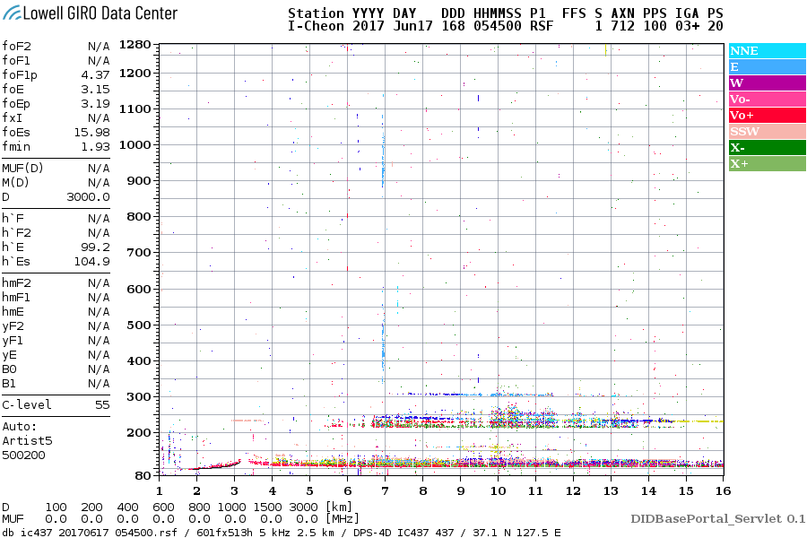
Overview
Sporadic-E Observations
  Ionosondes
  GNSS Radio Occultation
  Combined
Global Empirical Model of Sporadic-E Occurrence Rates (GEMSOR)
[https://giro.uml.edu/didbase/]

Slide 4
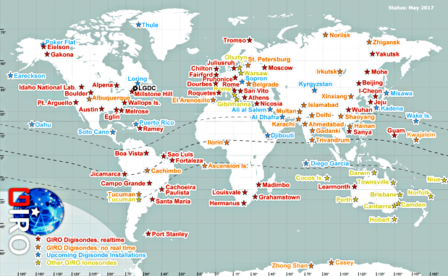
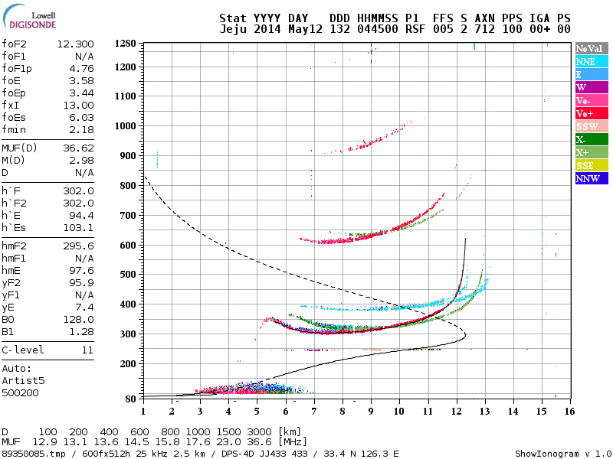
Measuring Sporadic-E: Ionosondes
Ionosondes provide a direct measurement of sporadic-E layers
Global coverage with large gaps (oceans, arctic, etc.)
[https://ulcar.uml.edu/DIDBase/]
[http://giro.uml.edu/]

Slide 5
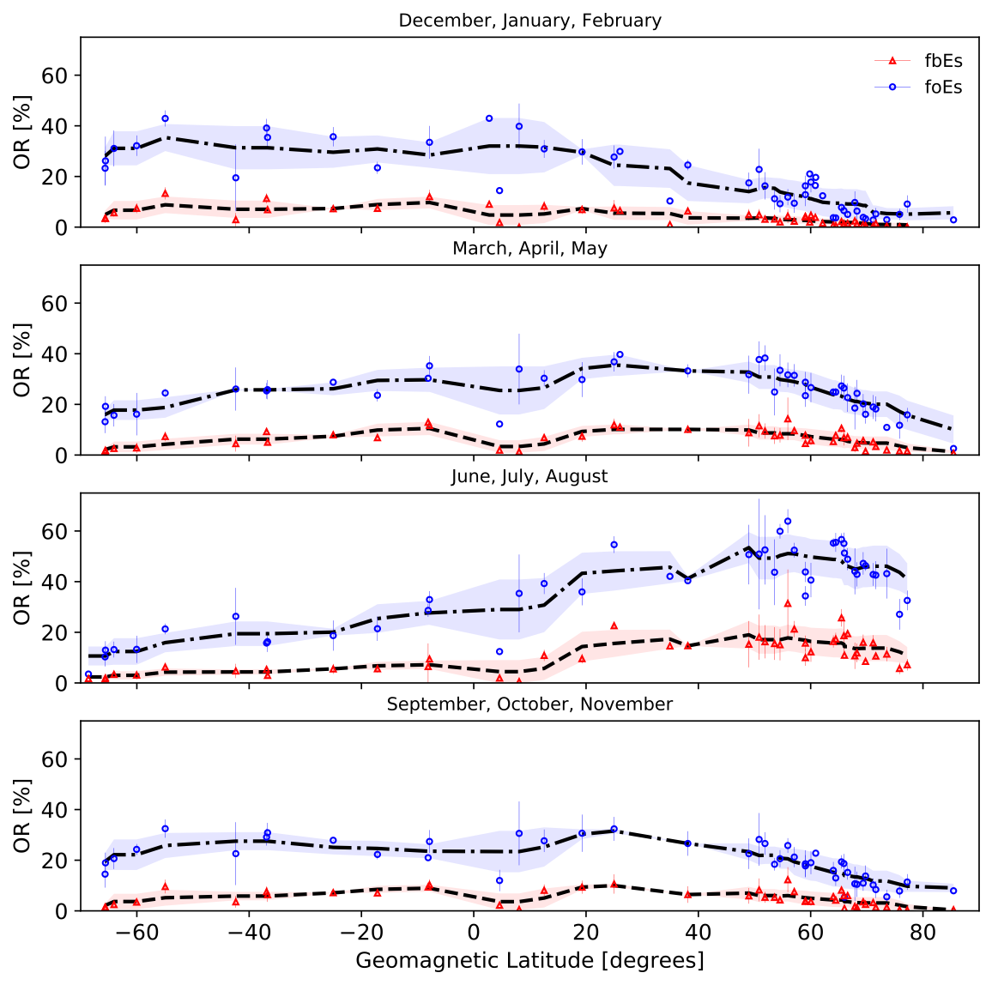
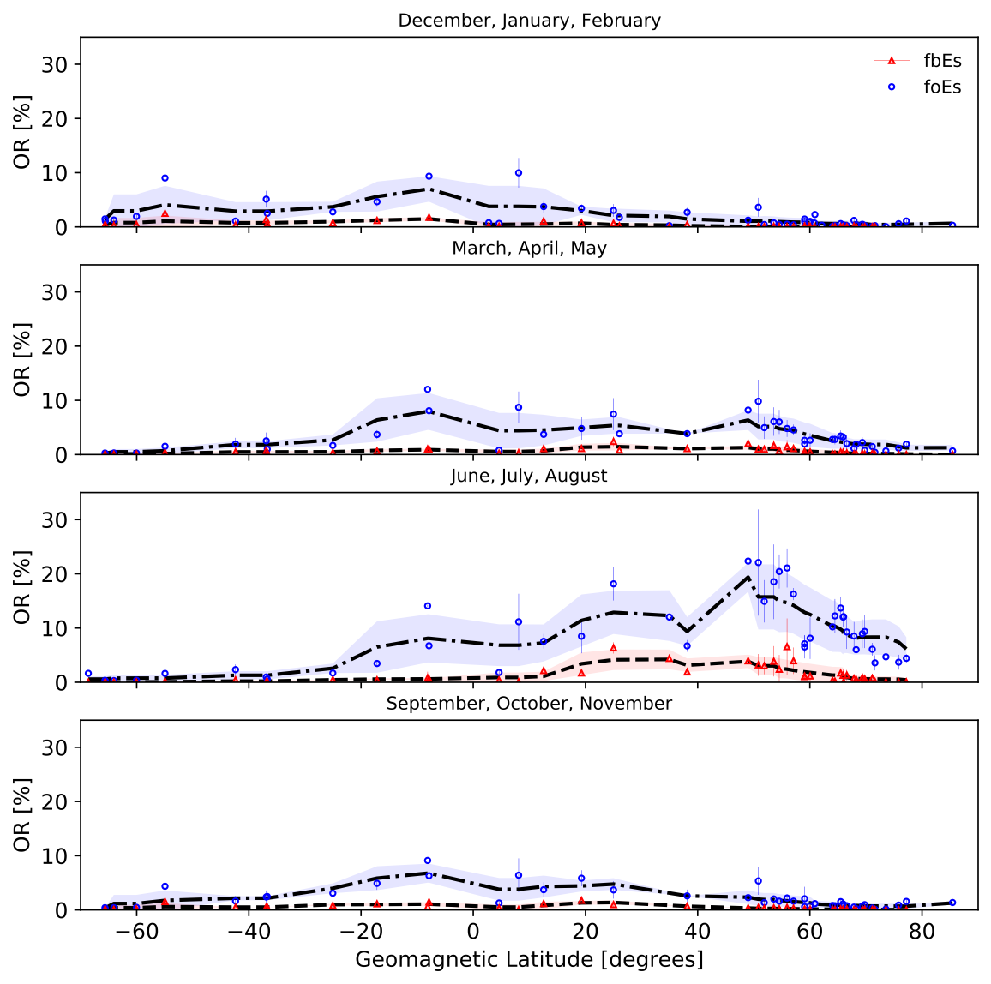
Ionosonde Es Occurrence Rates (mostly ARTIST-5 autoscaled)
foEs/fbEs > 3 MHz
foEs/fbEs > 5 MHz
[Merriman et al., 2021]

Slide 6
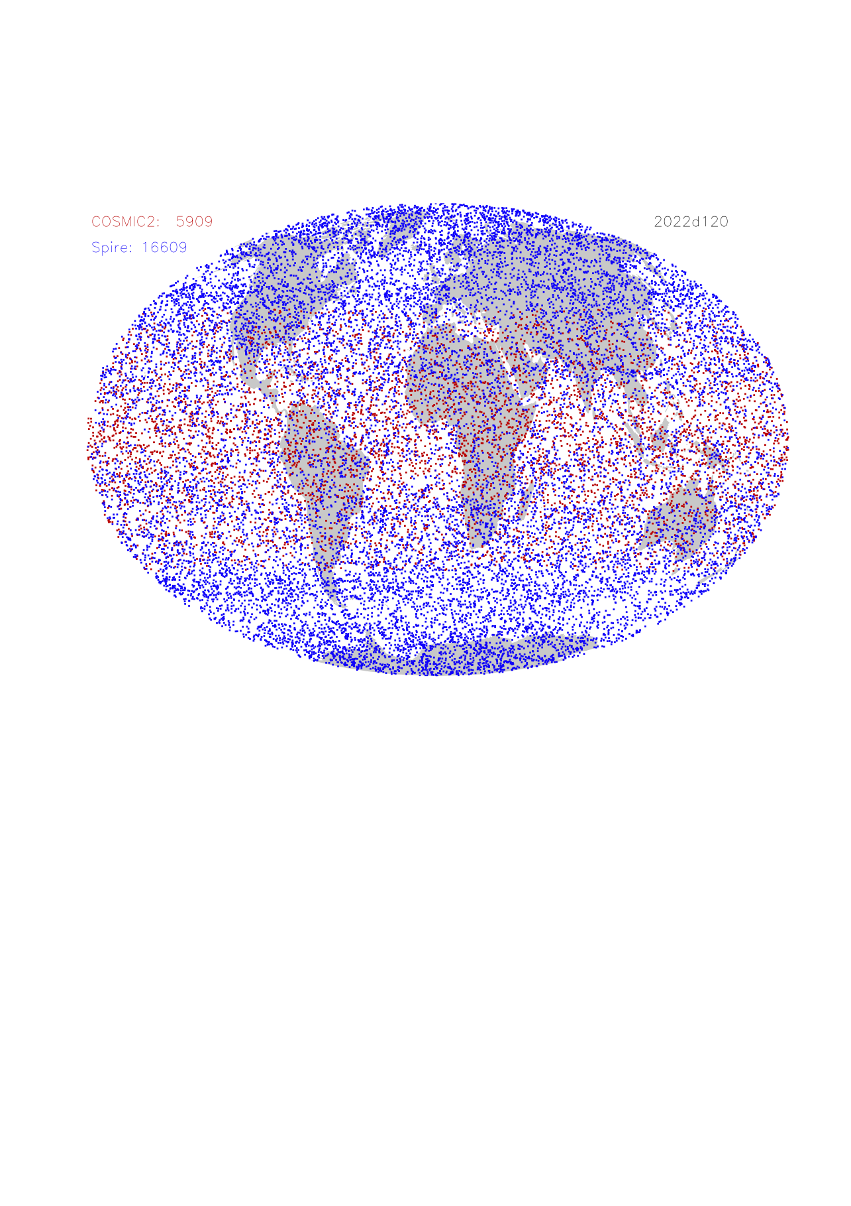
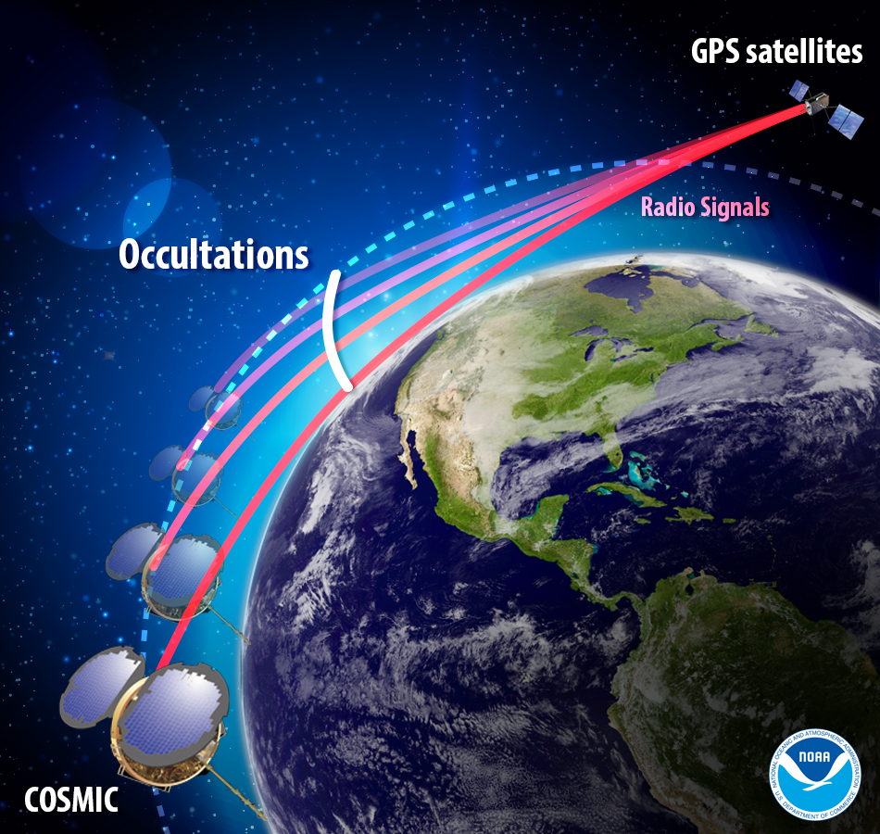
GNSS Radio Occultation
GNSS-RO techniques use two satellites (GNSS and LEO) to probe the path between
COSMIC-II and Spire (commercial CubeSats) currently provide over 20K daily occultations
[https://www.nesdis.noaa.gov/current-satellite-missions/currently-flying/cosmic-2]
[Courtesy of Dong Wu]

Slide 7
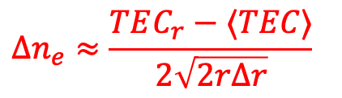
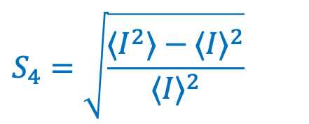
GNSS-RO Measurements of Es
GNSS-RO has ideal geometry for locating/monitoring thin ionospheric disturbances like Es
Two overarching approaches for characterizing Es
  Phase perturbations (TEC)
  Amplitude fluctuations (S4)
$$S_{4}=\sqrt{\frac{⟨I^{2}⟩−⟨I⟩^{2}}{⟨I⟩^{2}}}$$
$$Δn_{e}≈\frac{TEC_{r}−⟨TEC⟩}{2\sqrt{2rΔr}}$$
[Gooch et al., 2020]

Slide 8
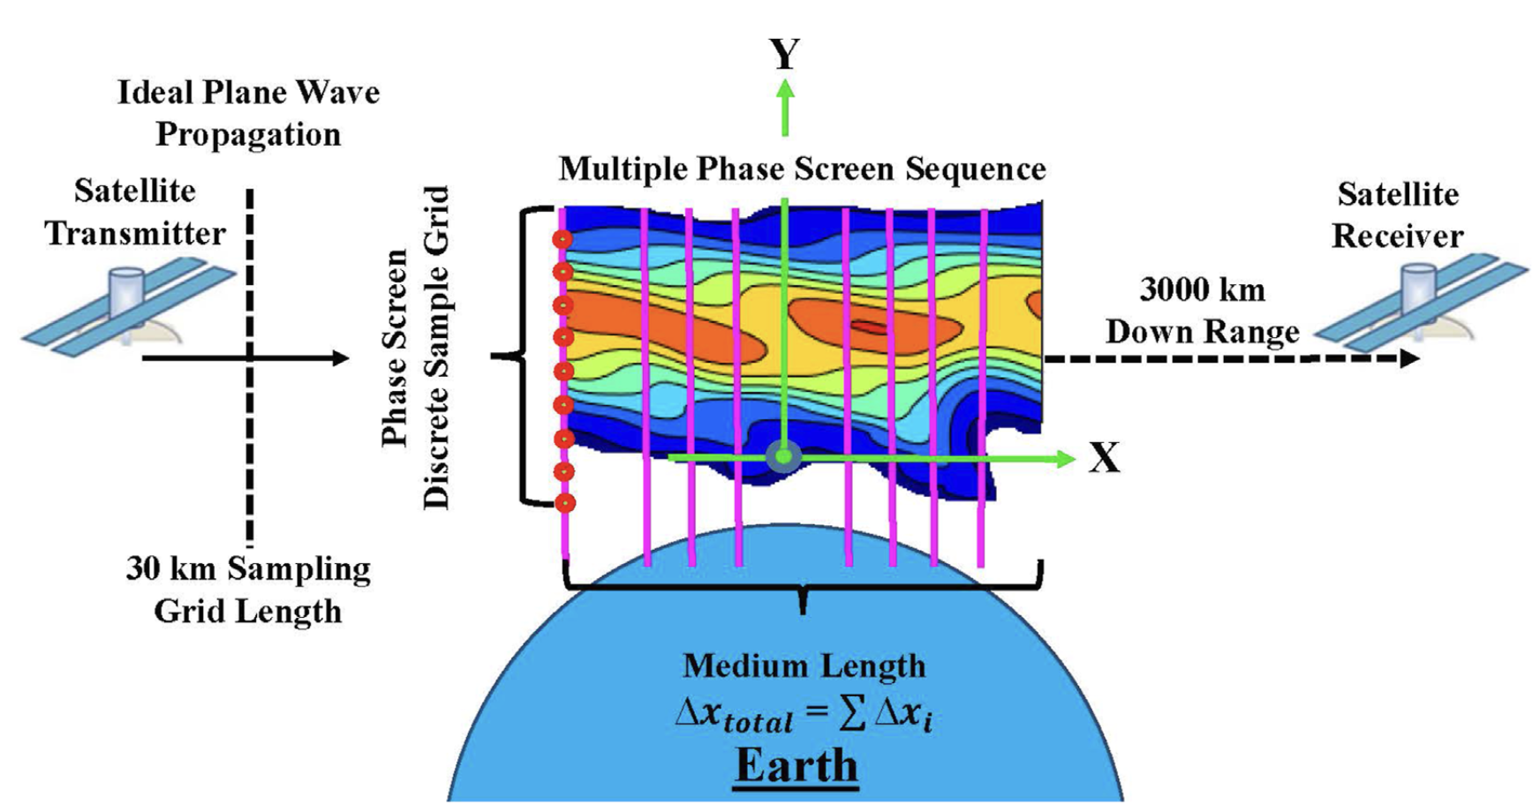
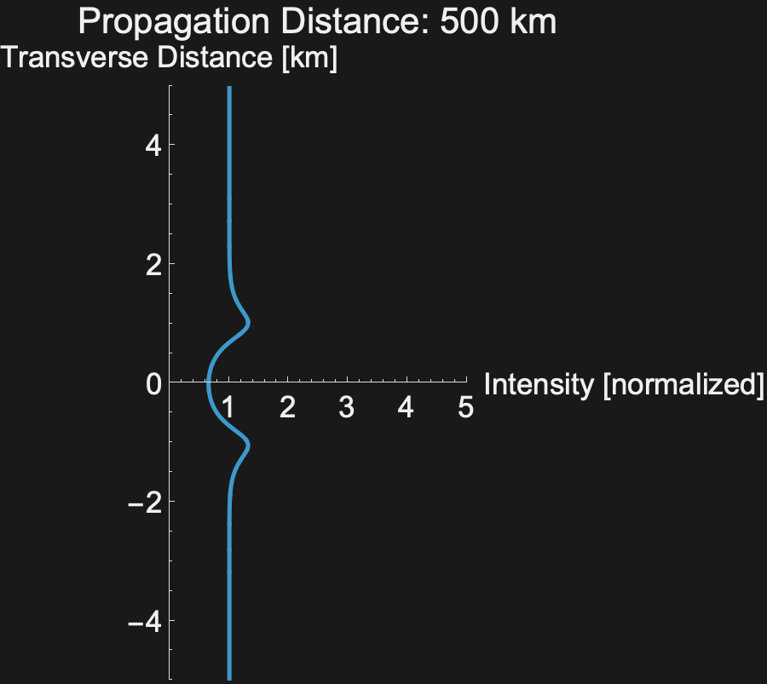
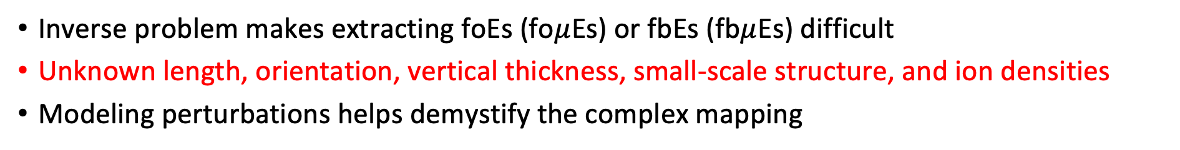
Modeling RO Perturbations from Sporadic-E
Inverse problem makes extracting foEs (fo$μ$Es) or fbEs (fb$μ$Es) difficult
Unknown length, orientation, vertical thickness, small-scale structure, and ion densities
Modeling perturbations helps demystify the complex mapping
[Knisely and Emmons, 2023]

Slide 9
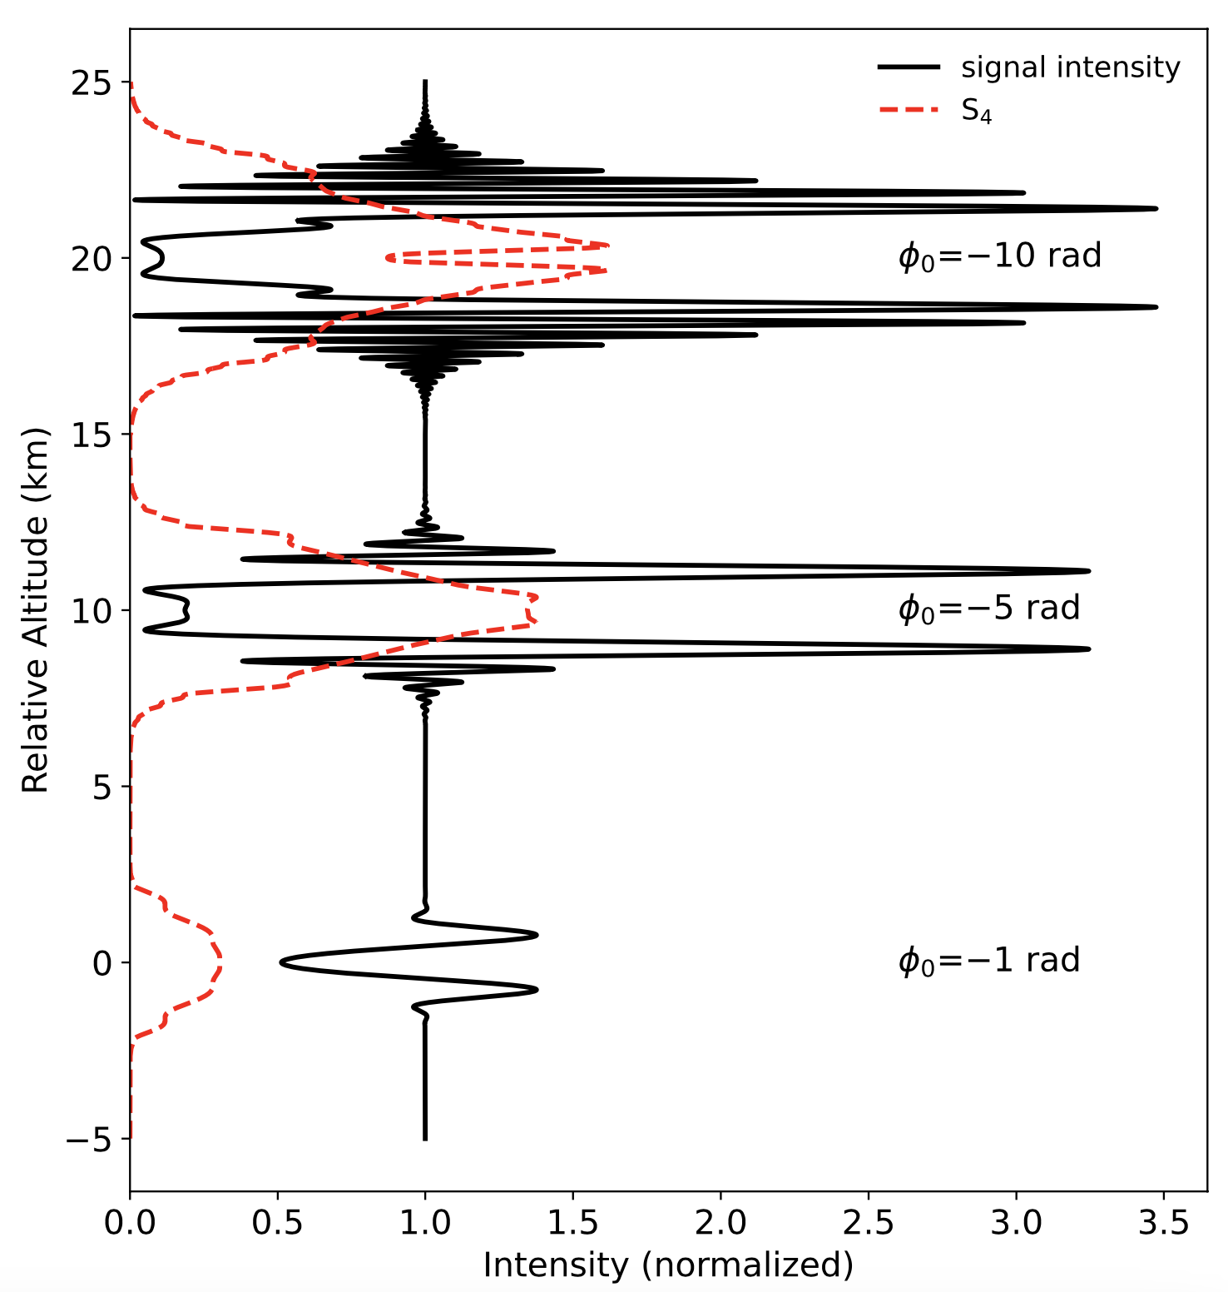
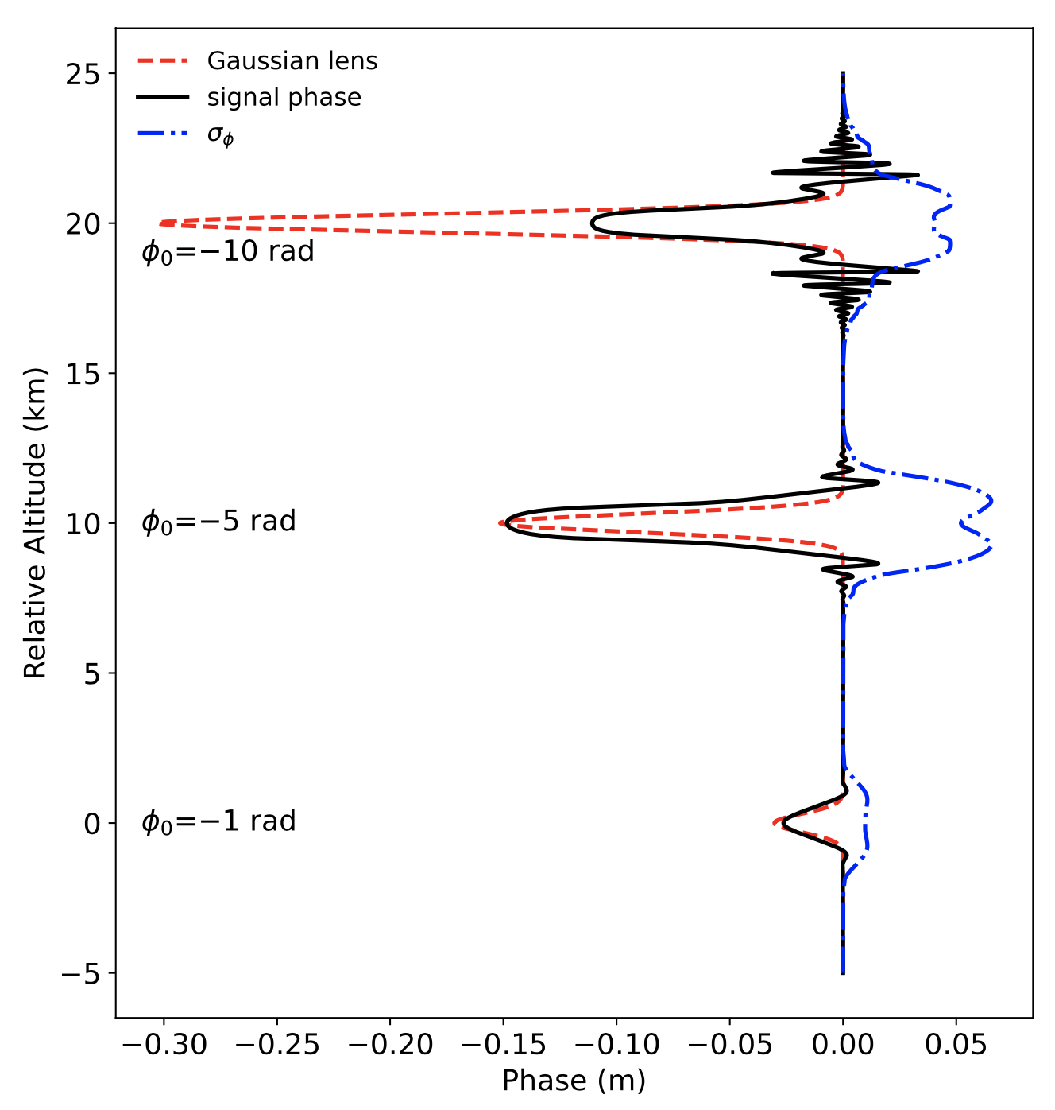

GPS L1 Amplitude & Phase for Various Es Lens Strengths - Gaussian Lens
GPS L1 Amplitude and Phase for Various Lens Strengths
$Δalt$ = 2.2 km
[Emmons et al., 2022]

Slide 10
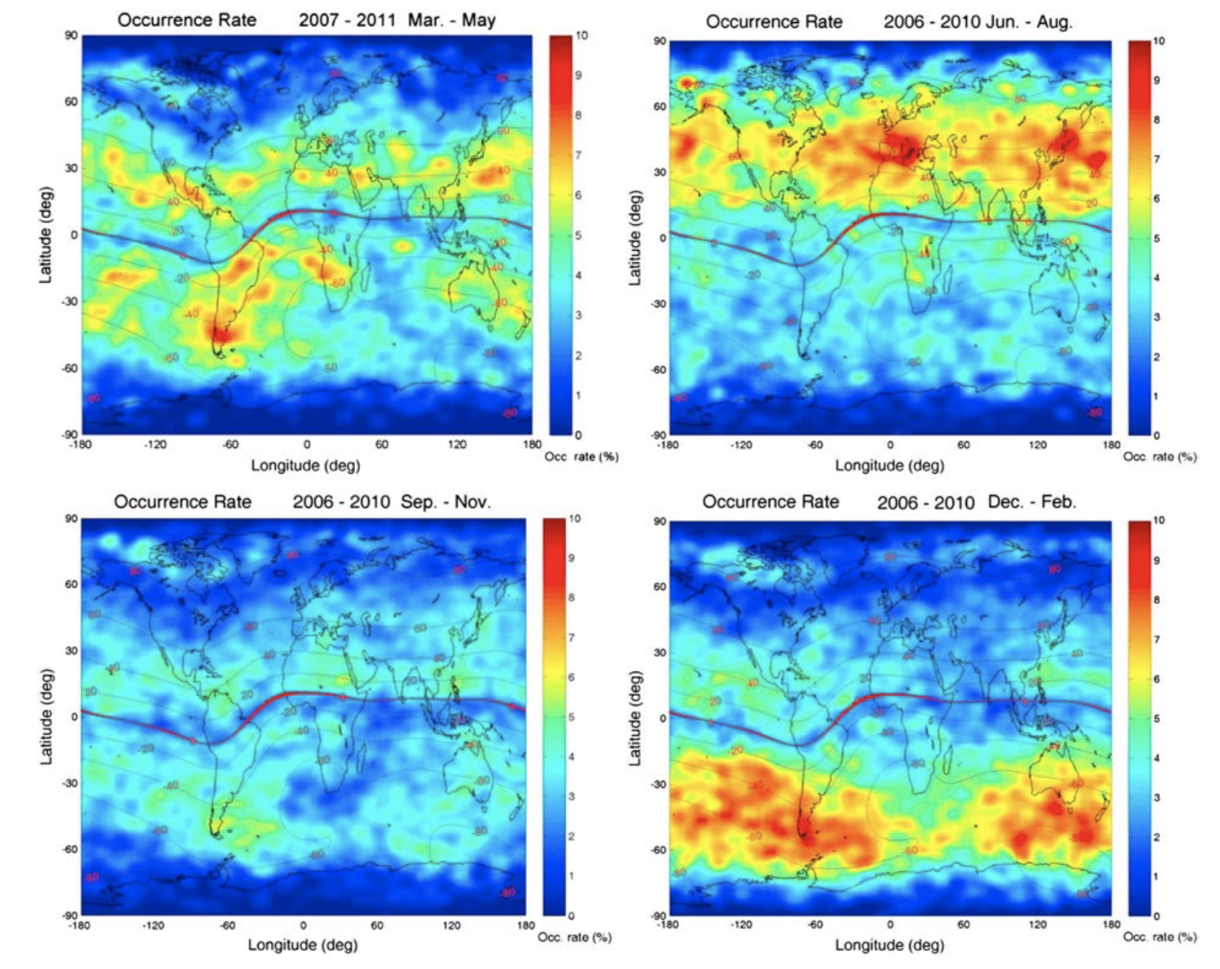
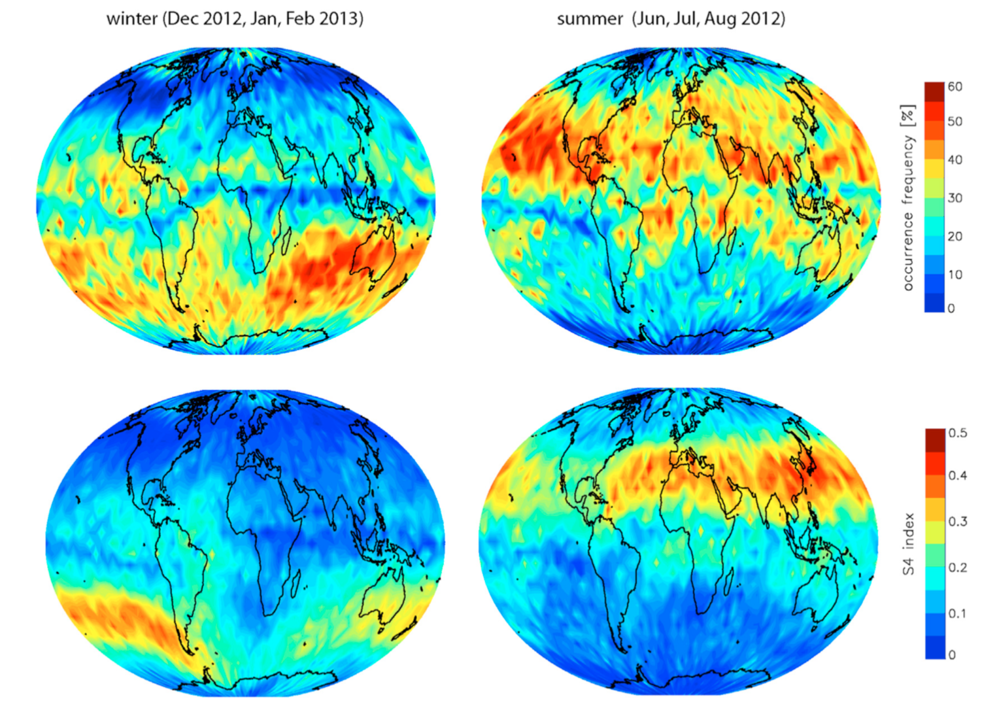
Previous Es Climatologies from GNSS-RO
Amplitude-based
Phase-based
[Arras and Wickert, 2018]
[Chu et al., 2014]
GNSS-RO provides global coverage of E_{s} but signal analysis is non-trivial and previous E_{s} occurrence rate estimates vary by a factor of ~5
Need a way to validate GNSS-RO occurrence rates: compare with Ionosondes

Slide 11
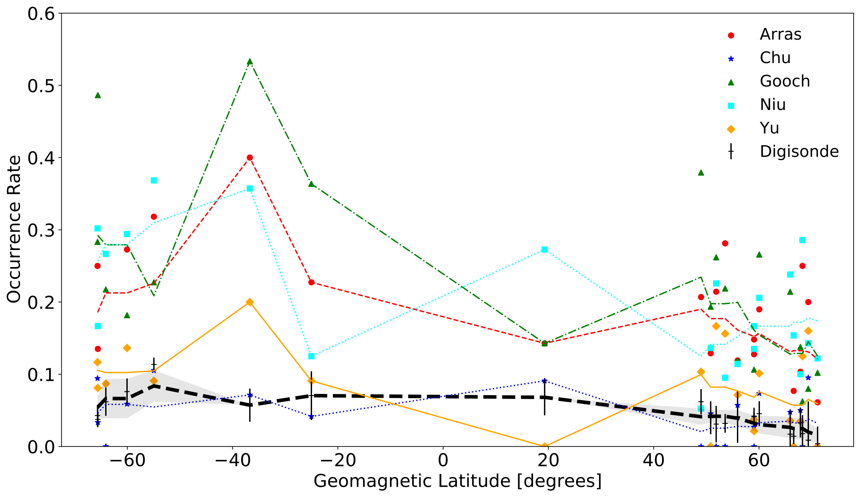
GNSS-RO vs Ionosonde Es Occurrence Rates
Chu et al. (2014) GNSS-RO technique aligns well with ionosonde fbEs $≥$ 3 MHz (moderate-Es)
Dec, Jan, Feb 2010-2017
[Carmona et al., 2022]

Slide 12
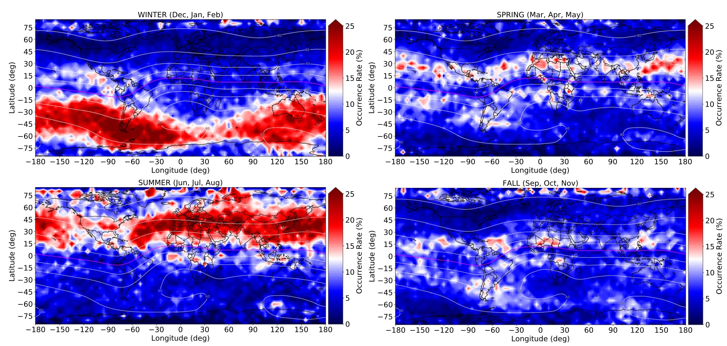
Global Climatology: Combining Ionosonde & GNSS-RO
3.2 million ionograms with 3 million COSMIC-I occultations from 2006-2019
fbEs $≥$ 3 MHz Occurrence Rates
[Hodos et al., 2022]

Slide 13
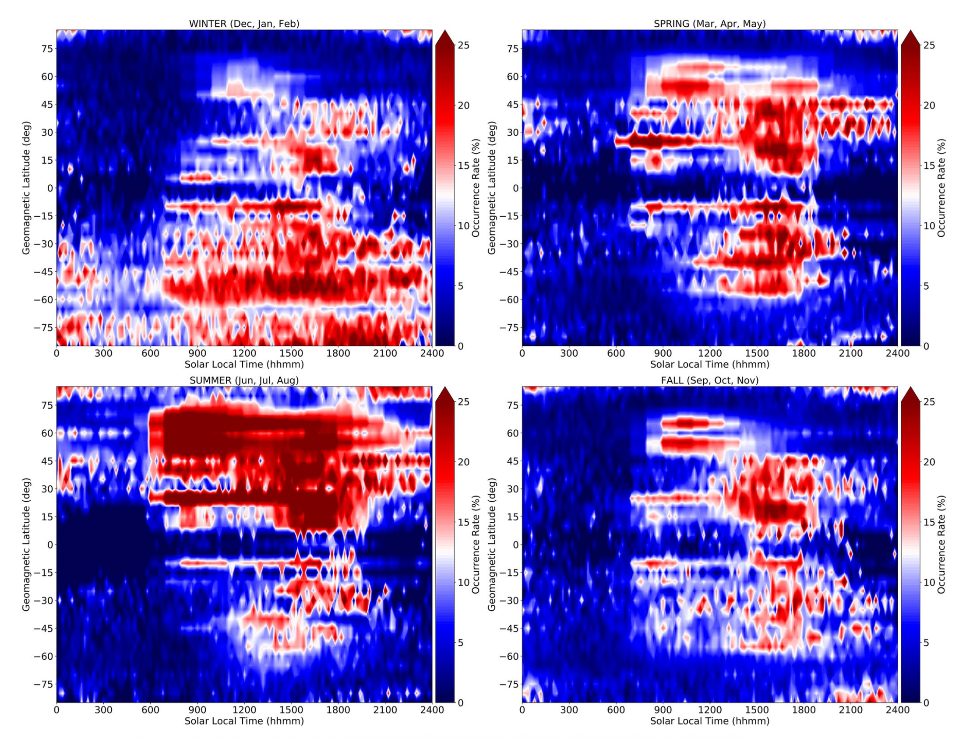
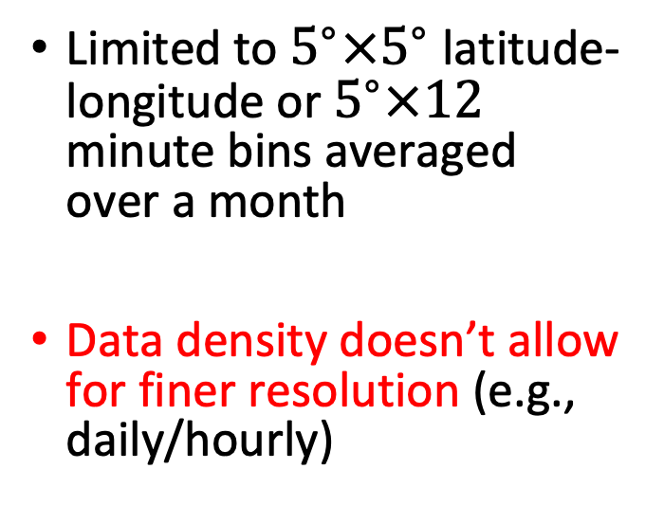
Diurnal Trends: fbEs $≥$ 3 MHz
Limited to $5^{∘}×5^{∘}$ latitude-longitude or $5^{∘}×12$ minute bins averaged over a month
Data density doesn’t allow for finer resolution (e.g., daily/hourly)
[Hodos et al., 2022]

Slide 14
Overview
Sporadic-E Observations
  Ionosondes
  GNSS Radio Occultation
  Combined
Global Empirical Model of Sporadic-E Occurrence Rates (GEMSOR)
[https://giro.uml.edu/didbase/]

Slide 15
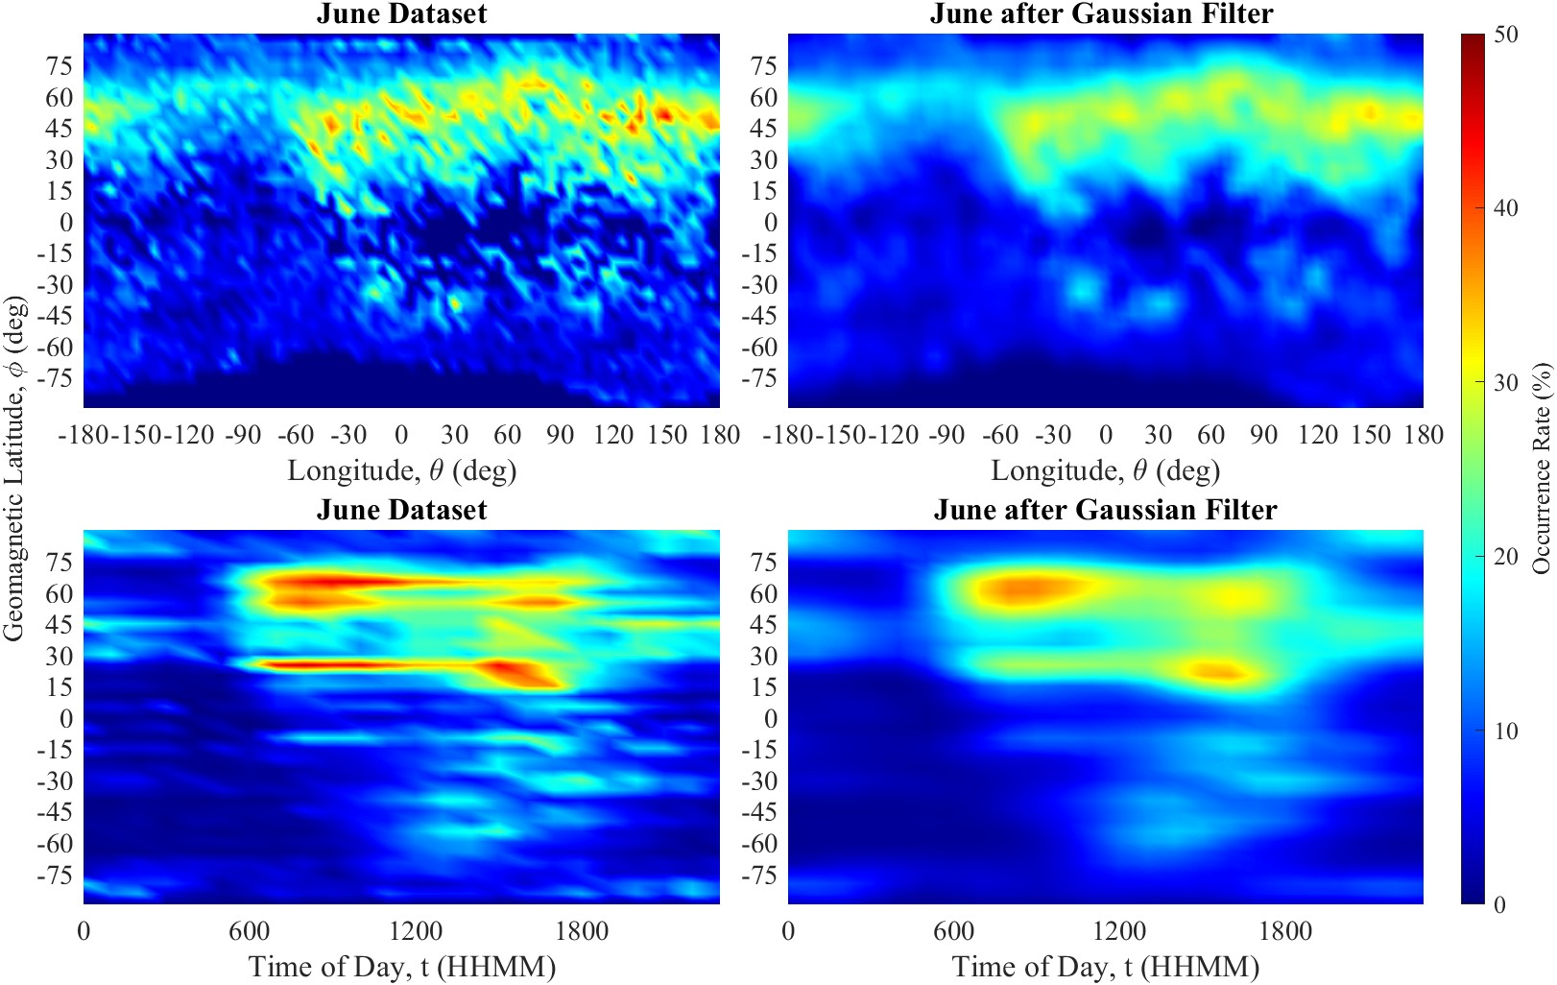
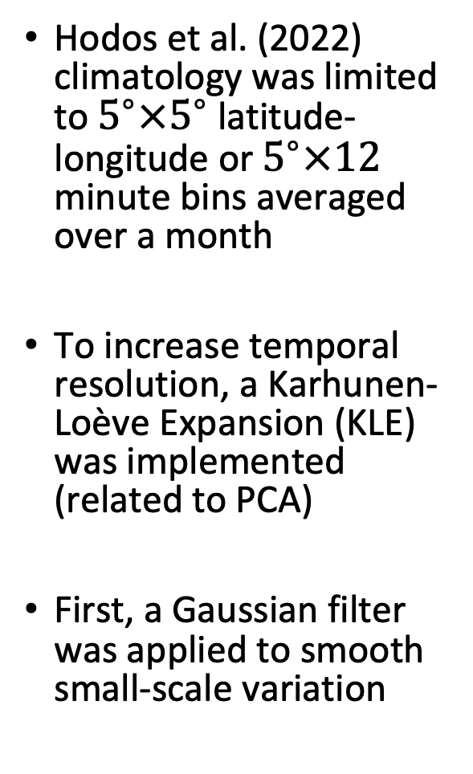
GEMSOR
Hodos et al. (2022) climatology was limited to $5^{∘}×5^{∘}$ latitude-longitude or $5^{∘}×12$ minute bins averaged over a month
To increase temporal resolution, a Karhunen-Loève Expansion (KLE) was implemented (related to PCA)
First, a Gaussian filter was applied to smooth small-scale variation
[Parsch, 2024]

Slide 16
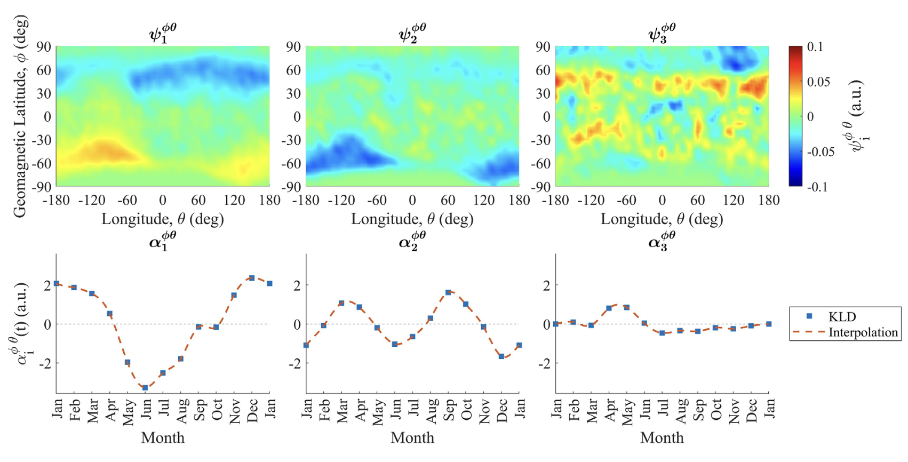
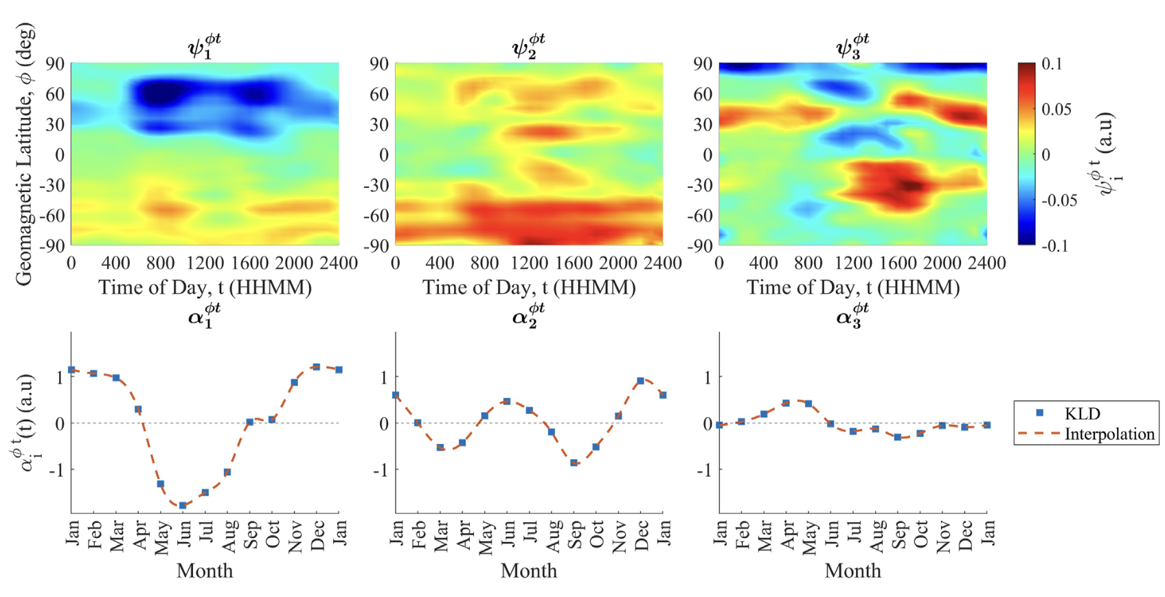
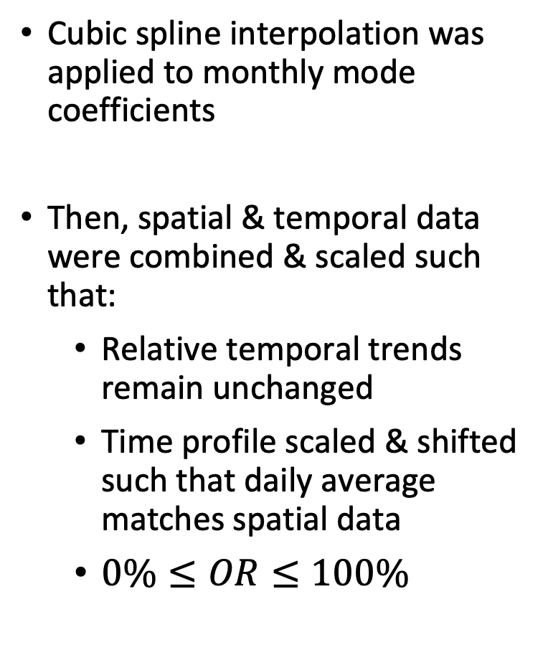
KLE Modes & Combining Datasets
Cubic spline interpolation was applied to monthly mode coefficients
Then, spatial & temporal data were combined & scaled such that:
  Relative temporal trends remain unchanged
  Time profile scaled & shifted such that daily average matches spatial data
  $0\%≤OR≤100\%$
[Parsch et al., 2024]

Slide 17

Global Empirical Model of Es Occurrence (GEMSOR)

Slide 18
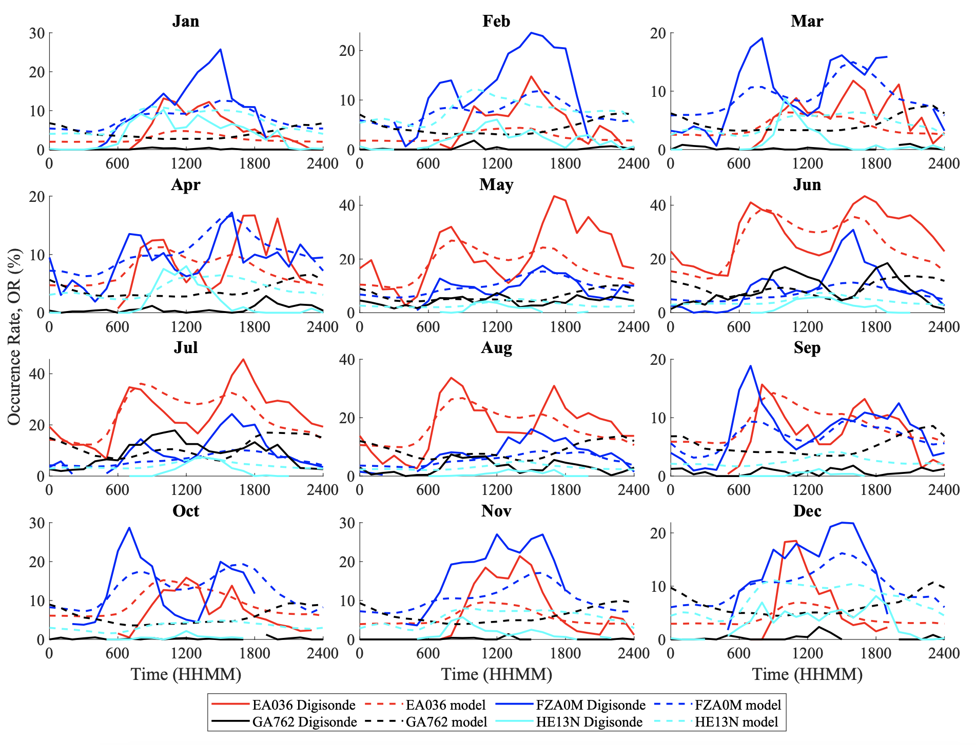
Preliminary Validation
Results compared against ionosonde data from 2020-2022 (not used in model development)
  El Arenosillo, Spain
  Fortaleza, Brazil
  Gakona, Alaska
  Hermanus, South Africa
Monthly averaged diurnal trends matched by model, but model underestimates many peak values

Slide 19
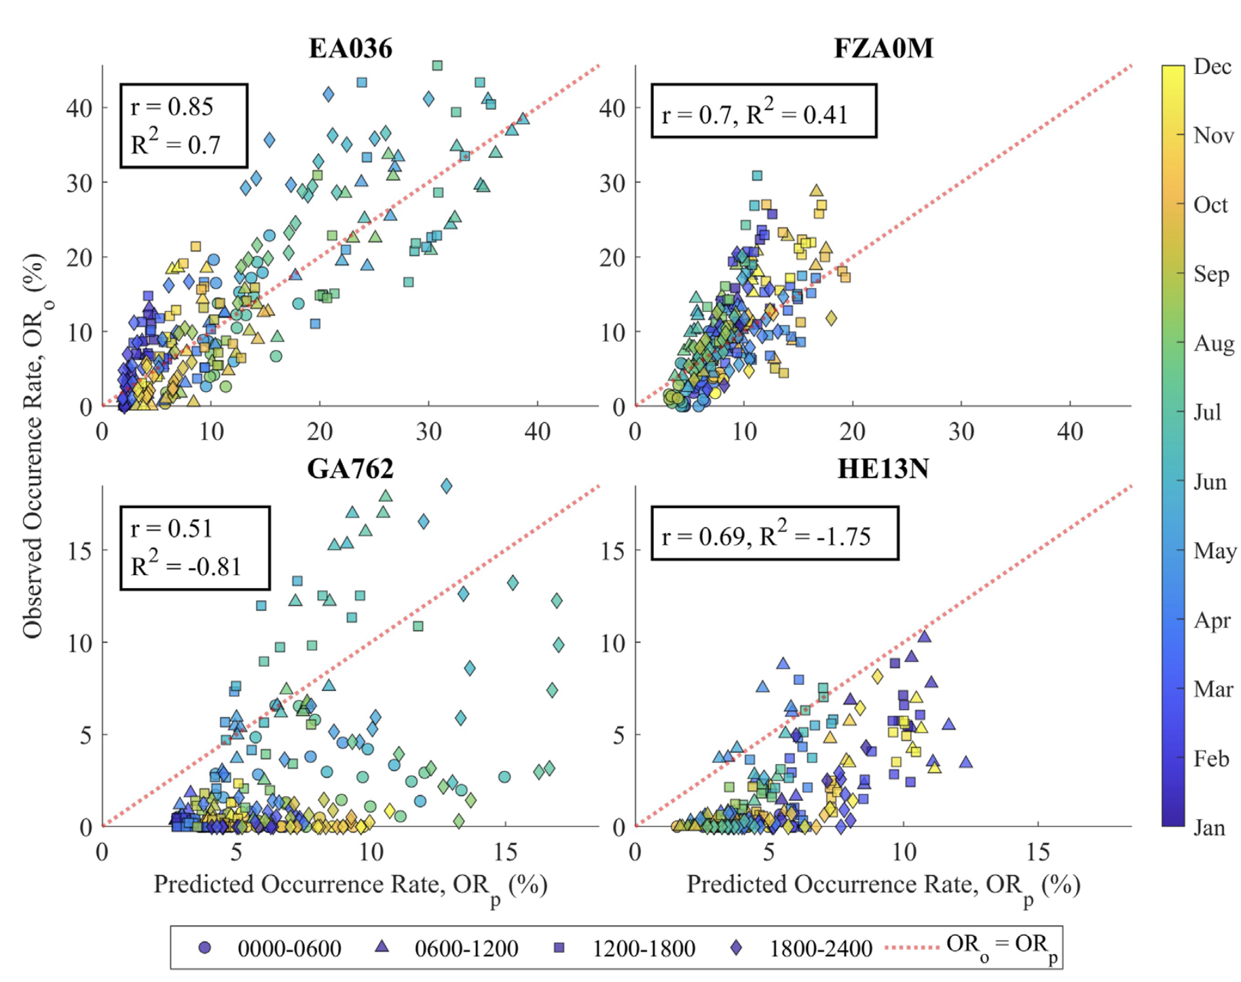
Results
Uncertainty:
  Propagated: 8.8 %, (2σ = +/- 17.6%)
  Validation: 10.5%, (2σ = +/- 21%)
  Standard error cap: 10% (2σ = +/- 20%)
Observe peaks in uncertainty in the afternoon
Model is more likely to slightly overestimate OR, large errors (>20%) are more likely to be underestimates (~1/20)
Assumes no error in the measurement method

Slide 20
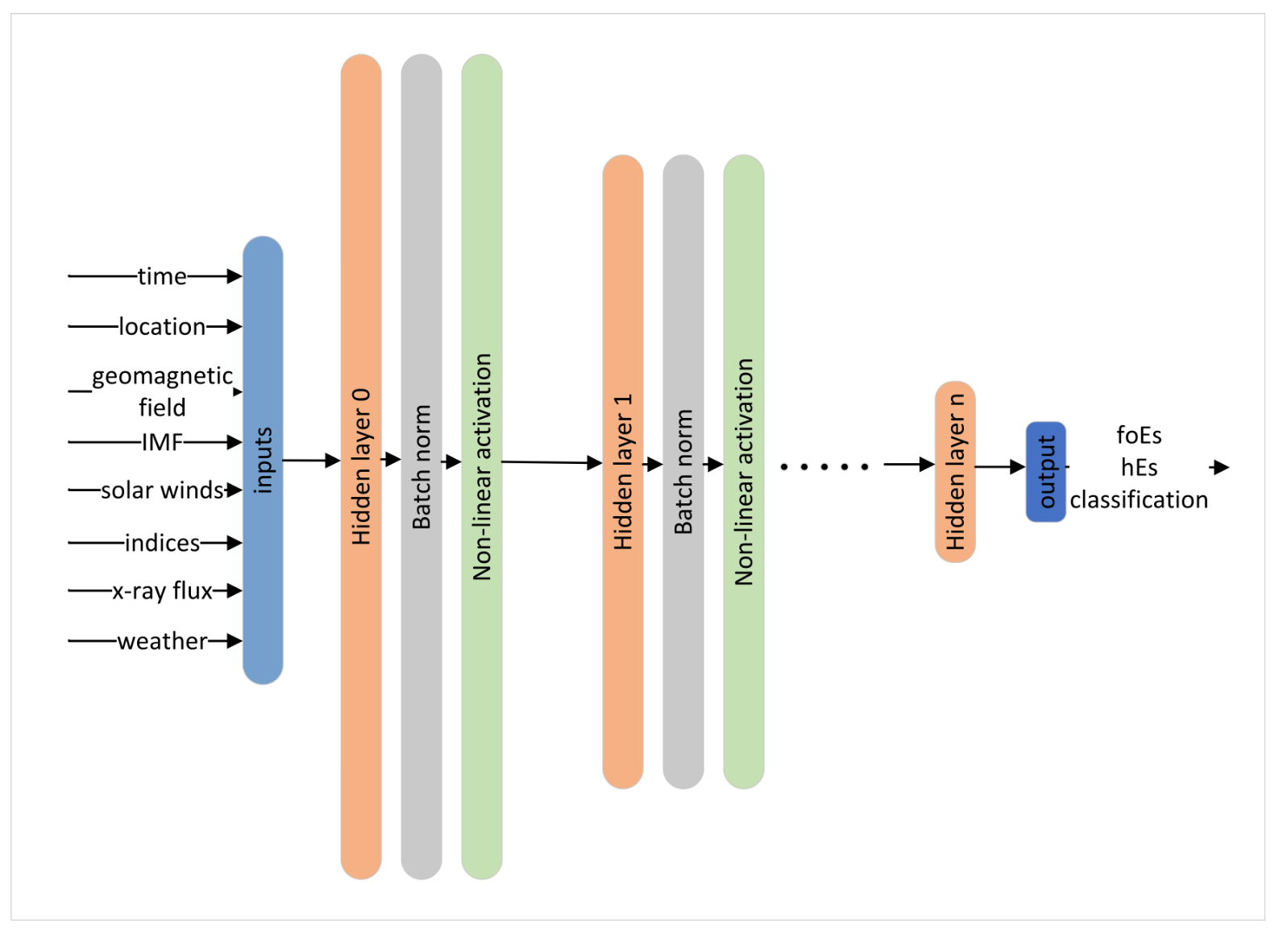
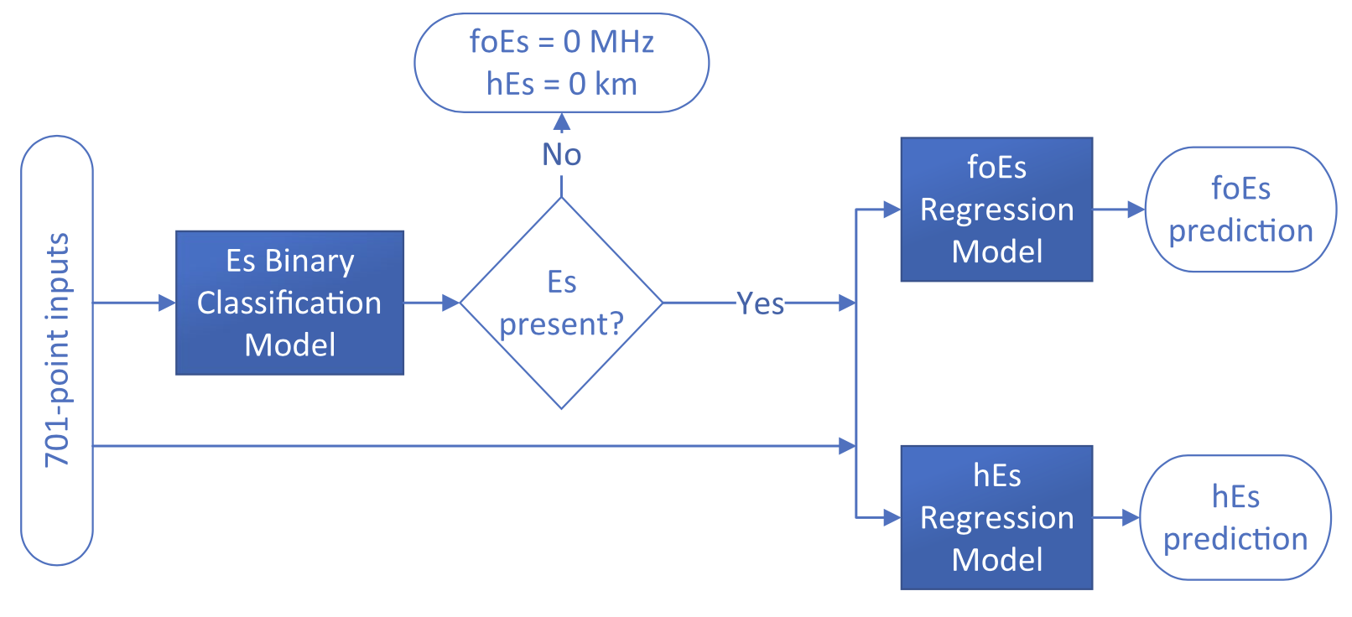
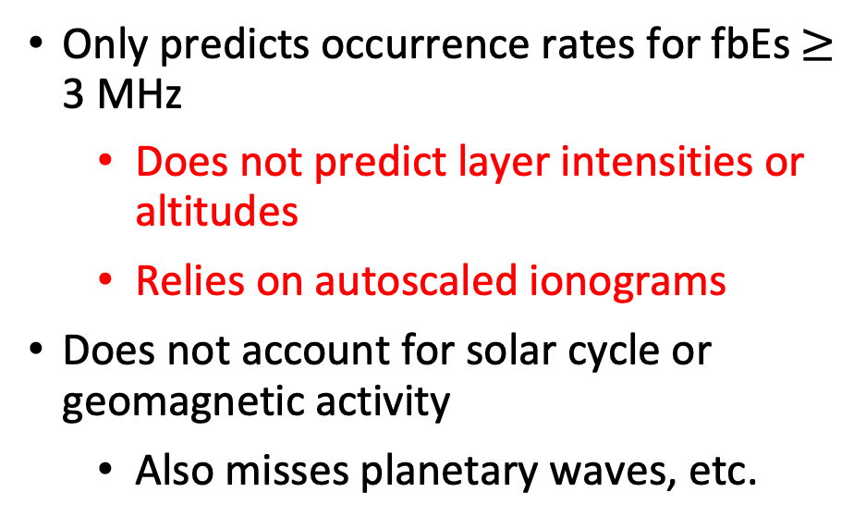
GEMSOR Limitations
Only predicts occurrence rates for fbEs $≥$ 3 MHz
  Does not predict layer intensities or altitudes
  Relies on autoscaled ionograms
Does not account for solar cycle or geomagnetic activity
  Also misses planetary waves, etc.
[Ellis et al., 2025]
Sophisticated models using Convolutional Neural Networks have also been developed
  More difficult to run but appropriate for certain applications
[Ellis et al., 2024]

Slide 21
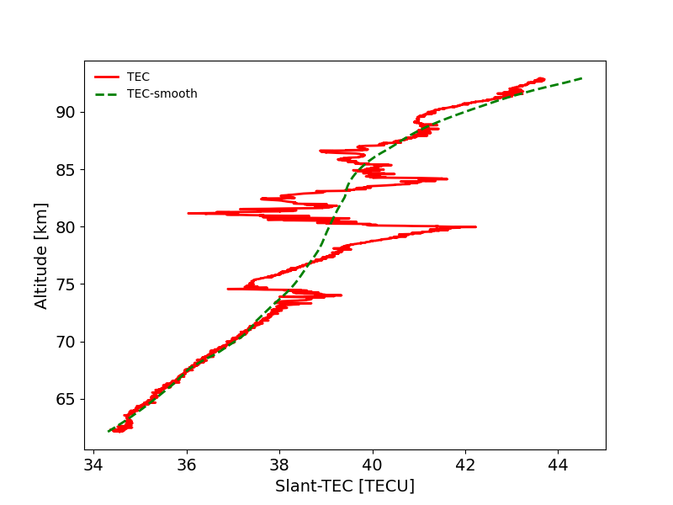
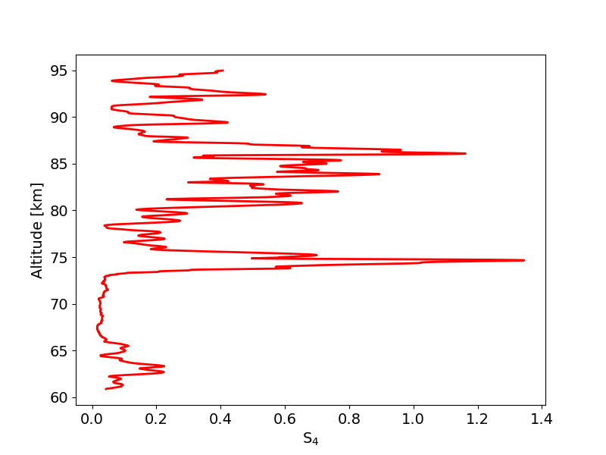
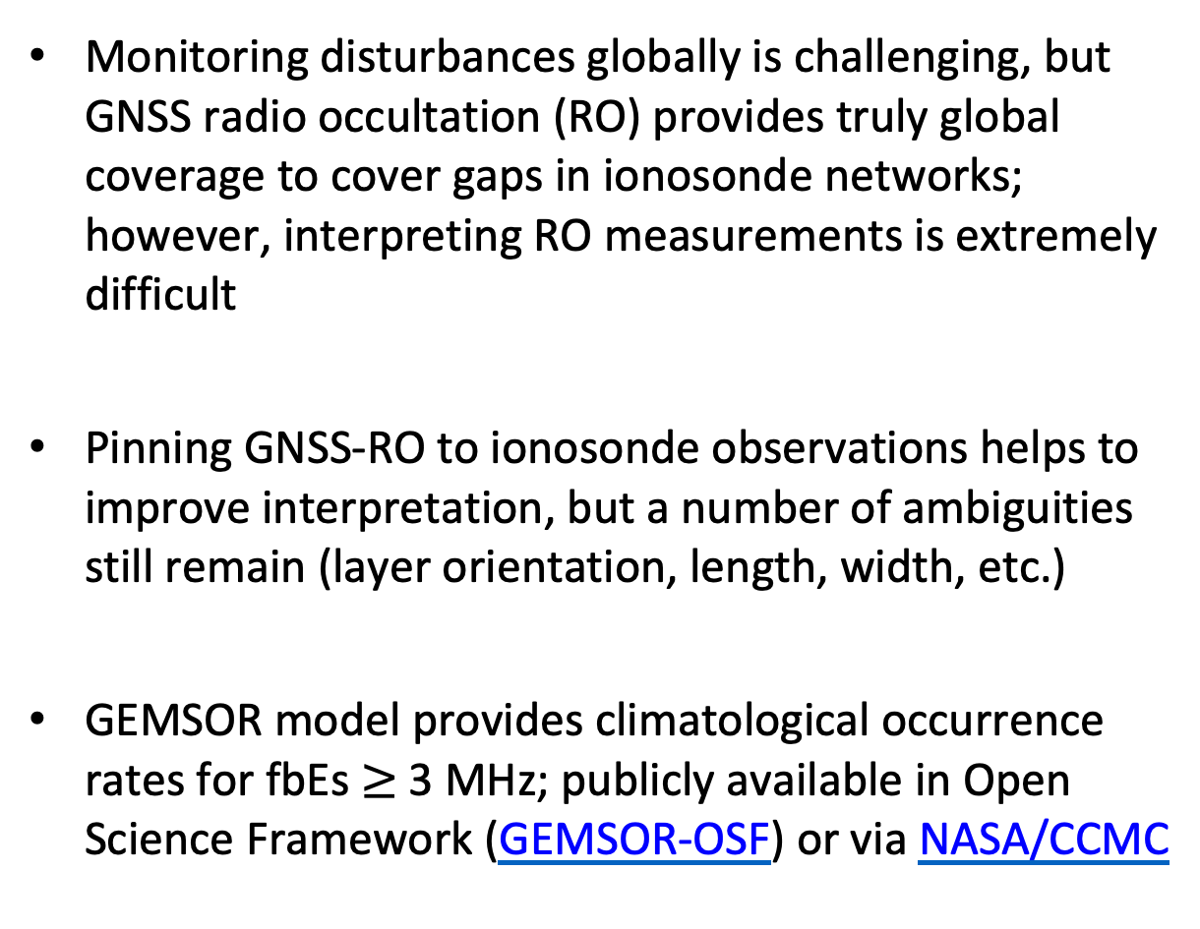
Summary
Monitoring disturbances globally is challenging, but GNSS radio occultation (RO) provides truly global coverage to cover gaps in ionosonde networks; however, interpreting RO measurements is extremely difficult
Pinning GNSS-RO to ionosonde observations helps to improve interpretation, but a number of ambiguities still remain (layer orientation, length, width, etc.)
GEMSOR model provides climatological occurrence rates for fbEs $≥$ 3 MHz; publicly available in Open Science Framework (GEMSOR-OSF) or via NASA/CCMC
Multi-layer Sporadic-E

Slide 22
References
Emmons, D., Wu, D., Swarnalingam, N., Ali, A. F., Ellis, J. A., Fitch, K. E., & Obenberger, K. S. (2023) Improved models for estimating sporadic-E intensity from GNSS radio occultation measurements. Frontiers in Astronomy and Space Sciences, 10, 1327979.
Gooch, J. Y., Colman, J. J., Nava, O. A., & Emmons, D. J. (2020). Global ionosonde and GPS radio occultation sporadic-E intensity and height comparison. Journal of Atmospheric and Solar-Terrestrial Physics, 199, 105200.
Knisely, A., & Emmons, D. J. (2023). Impacts of Kelvin-Helmholtz Billow Formation on GNSS Radio Occultation Measurements of Sporadic-E. Frontiers in Astronomy and Space Sciences, 10, 1280228.
Emmons, D. J., Wu, D. L., & Swarnalingam, N. (2022). A Statistical Analysis of Sporadic-E Characteristics Associated with GNSS Radio Occultation Phase and Amplitude Scintillations. Atmosphere, 13(12), 2098.
Merriman, D. K., Nava, O. A., Dao, E. V., & Emmons, D. J. (2021). Comparison of seasonal foEs and fbEs occurrence rates derived from global Digisonde measurements. Atmosphere, 12(12), 1558.
Arras, C., & Wickert, J. (2018). Estimation of ionospheric sporadic E intensities from GPS radio occultation measurements. Journal of Atmospheric and Solar-Terrestrial Physics, 171, 60-63.
Chu, Y. H., Wang, C. Y., Wu, K. H., Chen, K. T., Tzeng, K. J., Su, C. L., Feng, W., Plane, J. M. C. (2014). Morphology of sporadic E layer retrieved from COSMIC GPS radio occultation measurements: Wind shear theory examination. Journal of Geophysical Research: Space Physics, 119(3), 2117-2136.
Carmona, R. A., Nava, O. A., Dao, E. V., & Emmons, D. J. (2022). A Comparison of Sporadic-E Occurrence Rates Using GPS Radio Occultation and Ionosonde Measurements. Remote Sensing, 14(3), 581.
Hodos, T. J., Nava, O. A., Dao, E. V., & Emmons, D. J. (2022). Global sporadic‐E occurrence rate climatology using GPS radio occultation and ionosonde data. Journal of Geophysical Research: Space Physics, e2022JA030795.
Parsch, E. V., Franz, A. L., Dao, E. V., Wu, D. L., Swarnalingam, N., Salinas, C. C., & Emmons, D. J. (2024). Global Empirical Model of Sporadic-E Occurrence Rates. Frontiers in Astronomy and Space Sciences (e-ISSN 2296-987X).
Ellis, J. A., Emmons, D. J., & Cohen, M. B. (2024). Detection and classification of sporadic E using convolutional neural networks. Space Weather, 22(1), e2023SW003669.
Ellis, J. A., Emmons, D. J., & Cohen, M. B. (2025). Global sporadic‐E prediction and climatology using deep learning. Space Weather, 23(5), e2025SW004366.

