Slide 1





IRI
Introduction
Current Status
Recent Developments
International Reference Ionosphere
International Reference Ionosphere
Dieter Bilitza
George Mason University, Fairfax, Virginia, USA
irimodel.org

Slide 2

What is IRI ?
IRI is the ISO international standard for the representation of Earth’s ionosphere (ISO = International Standardization Organization)
IRI is the result of several decades of international collaborations in the framework of a project jointly sponsored by the Committee on Space Research (COSPAR) and the International Union of Radioscience (URSI) starting in 1969.
COSPAR’s prime interest is in a general description of the ionosphere as part of the terrestrial environment for the evaluation of environmental effects on spacecraft and experiments in space.
URSI’s prime interest is in a reference model for defining the background ionosphere for radiowave propagation studies and applications.
By charter the model should be primarily based on experimental evidence using all available ground and space data sources and should not depend on the evolving theoretical understanding of ionospheric processes.
As new data become available and as older data sources are fully evaluated and exploited, the model should be revised in accordance with these new results.
Where discrepancies exist between different data sources the IRI team has facilitate critical review and discussions to determine the reliability of the different data sets and to establish guidelines on which data should be used for IRI modeling.
irimodel.org

Slide 3
Which Parameters in what Range
IRI describes monthly averages of
electron density (N_{e} [m-3])
electron temperature (T_{e} [K])
ion temperature (T_{i} [K])
ion composition (C_{i} [%]: O⁺, H⁺, He⁺, N⁺, NO⁺, O₂⁺)
IRI represents variations with
date and time of day
latitude, longitude (geographic or geomagnetic)
altitude (N_{e}: 65 – 30,000 km, T_{e} T_{i}: 60 – 3,000 km, C_{i}: 75 – 2,000 km)
External drivers:
solar indices: F10.7 (daily, 81-day, 365-day), R (13 month)
ionospheric index: IG (13 month)
magnetic indices: ap and kp (3-hour, daily, 39-hour history)
Additional output parameters:
vertical total electron content (vTEC) between user-specified
boundaries
ion drift at magnetic equator
occurrence probability for sporadic-E, spread-F and for F1 layer
equatorward auroral boundary
ratio of plasma frequency to electron gyro frequency
irimodel.org
Notes:
Cluster ions in the ionosphere are electrically charged molecules, atoms, and molecular clusters. They are thought to be formed from cluster ions such as O2+·(H2O)n and NO+·(H2O)n, which are present in the D-region of the ionosphere.

Slide 4
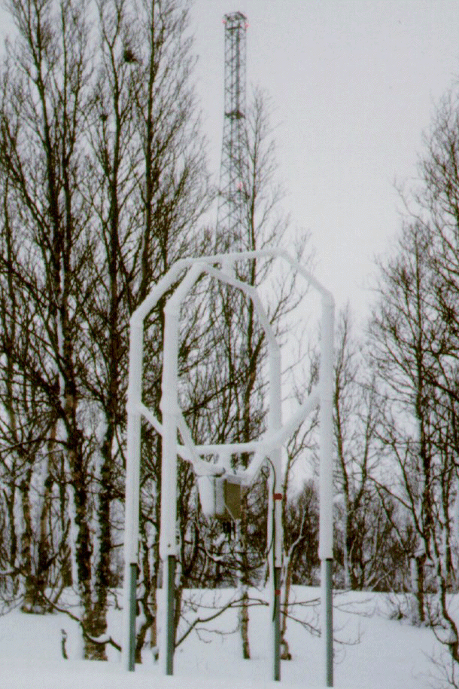
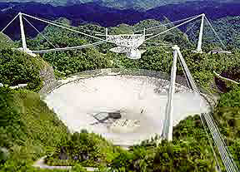
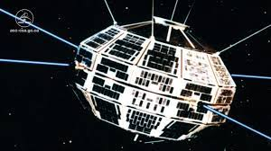
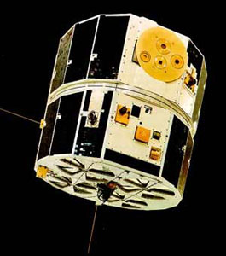
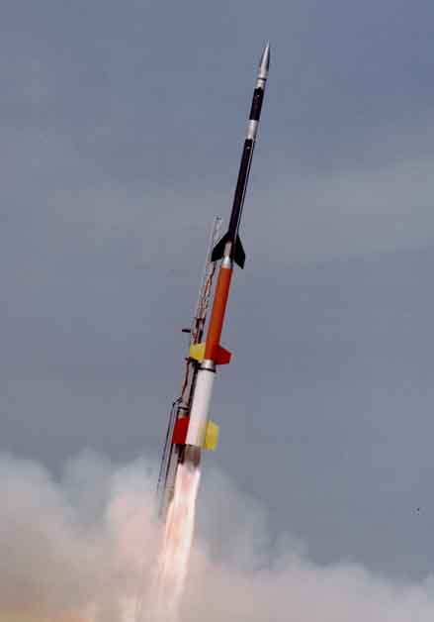
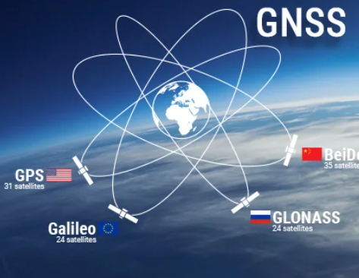
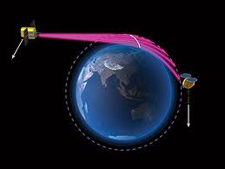
Ionospheric measurements used for the development of IRI
The worldwide network of ionosondes (150–170 stations) going back to the
fifties, and in recent years aided by the steadily increasing network of digisondes
(~70): F2 peak density and height and the profile below the peak (bottomside);
spread-F occurrence probability
Incoherent scatter radars (ALTAIR, AMISR, EISCAT, Jicamarca, Millstone Hill,
Kharkiv, QJISR, RISR, Shigaraki): N_{e} , T_{e} , N_{i} , T_{i} profile from bottomside to topside
Topside sounder satellites (Alouette-1, -2, ISIS-1 and -2, Intercosmos 19, ISS-b):
N_{e} topside profile
Satellite in situ measurements from the 60s to the present extending over more than five solar cycles: Global morphology of N_{e} , T_{e} , N_{i} , T_{i}
Rocket data: N_{e} , N_{i} in the D region and bottomside E region
Global Navigation Satellite System (GNSS: GPS, GLONASS, BEIDOU): Slant and
vertical TEC and GIMs for updating and data assimilation procedures
Radio occultation (RO) with LEO satellites with GNSS receiver (CHAMP, GRACE, SAC-C, C/NOFS, COSMIC): hmF2; N_{e} profile evaluation; sporadic-E occurrence probability
The IRI working group has used all these data sources for IRI development and has been proactive in finding new data sources and in fully exploiting older data sources (like the Alouette/ISIS topside sounder data). Special IRI workshops discussed the most reliable data sources for the lower ionosphere and helped to resolve discrepancies that existed early on between measurements from the ground and in space.
Notes:
MU radar uses VHF radio waves with a frequency of 46.5 MHz (3.5 MHz bandwidth and 1 MW peak output power)

Slide 5
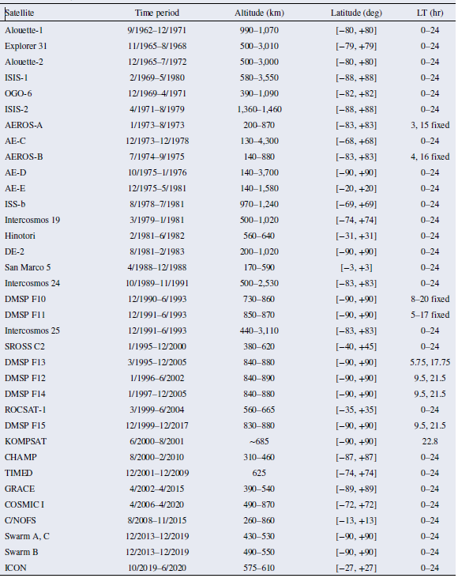
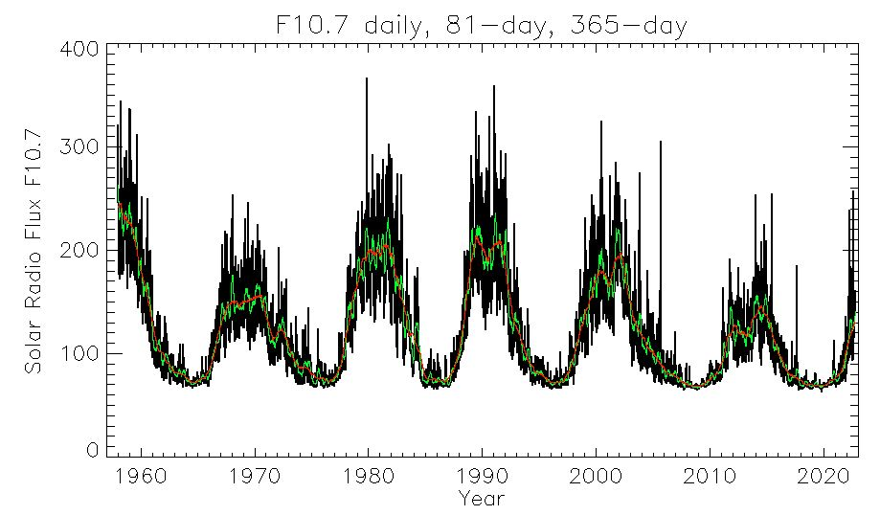
In-situ Satellite Data Used for developing IRI
Covering 5 solar cycles (58 years)
Altitudes range from 200 km to 4,300 km
Mostly high inclination orbits with a few low inclination satellites.

Slide 6
Empirical Models Theoretical Models
Based on ground and/or space data
Use appropriate mathematical functions to represent the characteristic variation patterns seen in long data records.
Do not depend on our evolving understanding of the processes that shape the ionosphere environment
Empirical models are, in general, available to users in the form of a computer program, and can be readily adapted to a specific problem.
Depend on an evenly distributed data base covering a wide range of conditions.
Consider the production, loss, and transport of ionospheric electrons and ions, and obtain the electron and ion densities, temperatures and velocities from the balance of these processes
Use a numerical (iterative) scheme to solve Boltzmann equations for the different moments (N, T, v) for electrons, ions and neutrals and the coupling between them.
Theoretical models are primarily used in an investigative mode, to elucidate specific processes and their effects on the ionosphere
Theoretical models require considerable computer time, even on fast machines, and their complex computer code and logic make it difficult for people other than the model developers themselves to apply the model to a specific problem.
In actual fact, most ionospheric models are hybrids, using empirical as well as theoretical elements. An empirical model, for example, may use theoretical values to fill data gaps, whereas a theoretical model may use a data-based mapping for specific parameters as input (e.g., to represent neutral densities and temperature), or to define boundary conditions and/or starting conditions for a numerical scheme.

Slide 7
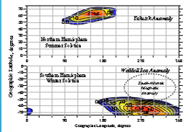
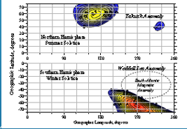
Advantage of Empirical Models
Being an empirical model IRI has the advantage that it already included some of the newly discovered phenomena that theoretical models did not yet include.
foF2_{midnight} – foF2_{noon}
Weddell Sea and Yakutsk Anomalies: foF2 in summer larger during nighttime than during daytime. The meridional component of the neutral wind reaches maximum values at the anomaly sites (during summer nights) because of the combined effect of solar EUV heating (sunlit magnetic pole in summer) and heating from precipitating auroral electrons.
IK-19
IRI
Longitudinal 4-peak wave pattern near the magnetic equator:
First observed with IMAGE/EUV and then confirmed with data from CHAMP, TOPEX and TIMED/GUVI. This phenomena is thought to being caused by non-migrating diurnal atmospheric tides that are, in turn, driven mainly by weather in the tropics.

Slide 8
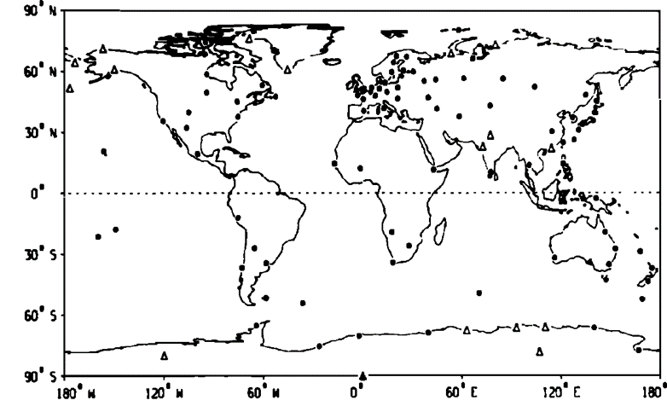
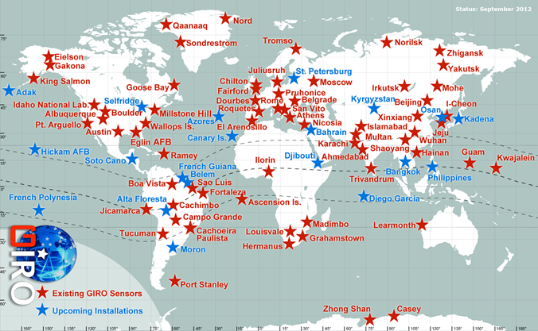
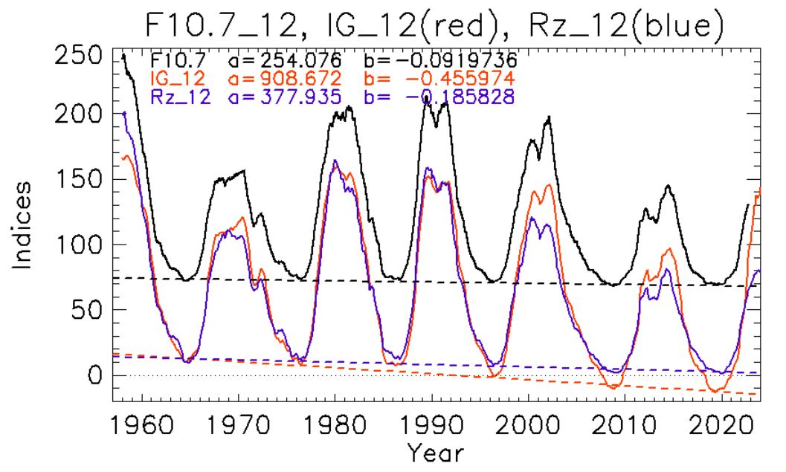
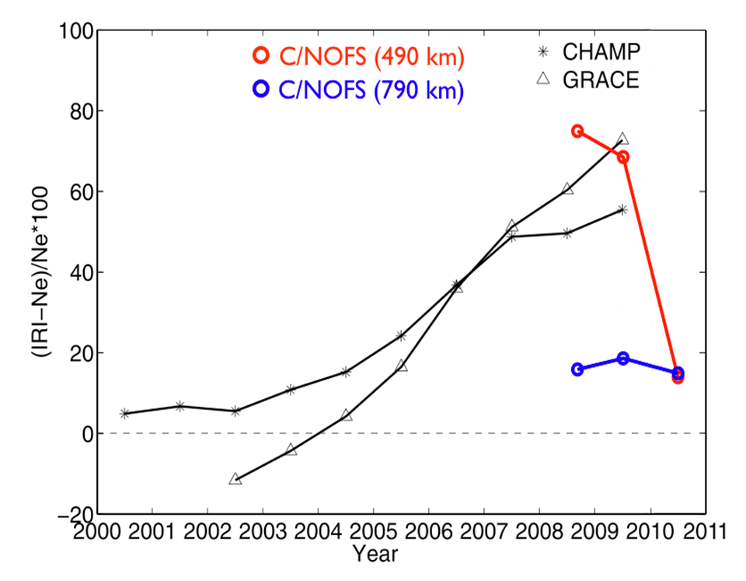
Disadvantage of Empirical Models
Only as good as the data base available for its development.
Bias towards Northern mid-latitudes due to global ground stations distribution.
~1962 2012
Ionosondes digisondes
Recent very low and broad solar minima brought conditions not covered by data available from previous solar minima leading to overestimations by the model.
(400 km)
(500 km)
Lühr & Xiong, Geophys. Res. Lett., 37, 2010
Klenzing,
2011

Slide 9
Assimilative Models Machine Learning Models
Using a mathematical technique (Kalman filter, 3D-Var) to assimilate measurements into a theoretical or empirical model and thereby bringing the model closer to the actual (measured) conditions.
Performance depends on the availability of data and good global and temporal coverage, especially in regions of steep spatial gradients and time periods with steep temporal gradients.
If different data sources are used their compatibility has to be assessed, so conflicts do not arise in overlapping regions.
Model codes are often proprietary and not meant to be shared.
These are techniques that train a black box algorithm (NeuralNet etc.) with a large volume of data, finding internally the relationship between a set of input parameters and the specific output parameter.
Large number of papers, recently, using different ML techniques.
Improvements with newer data require a re-training with the full data base (old and new).
Strong dependance on a well-balanced, bias-free training data set.
The model codes are quite large
and not easy to share.

Slide 10
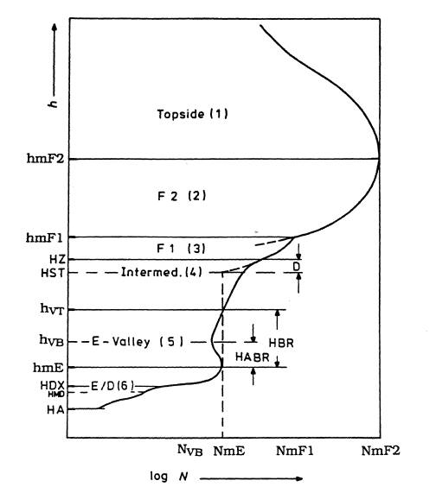
Built-up of the IRI electron density model
Build-up of IRI electron density profile
Global Variations:
Spherical harmonics using
modified magnetic coordinates
(modip, invdip)
Interpolation between grid points
(Epstein functions, others)
Time Variations:
Harmonics of different order
Smooth transitions between day
and night values
Height Variations:
Epstein functions
Polynomials
Topside parameters
F2 bottomside: B0, B1
F1 ledgeF1 region: C1
Intermediate region:
E-Valley: HBR, HABR, Depth,
Slope at HEF
E bottomside:
D region:
Normalized to E and F peaks
Global models for anchor points:
foF2/NmF2 foF1/NmF1, foE/NmE, foD/NmD,
hmF2/M(3000)F2, hmF1 , hmE, hmD

Slide 11
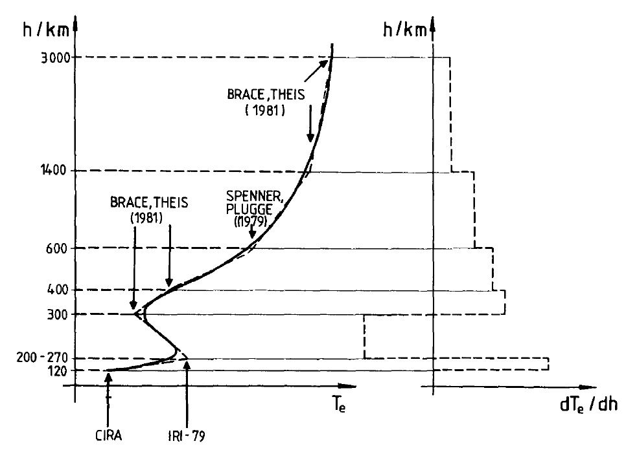
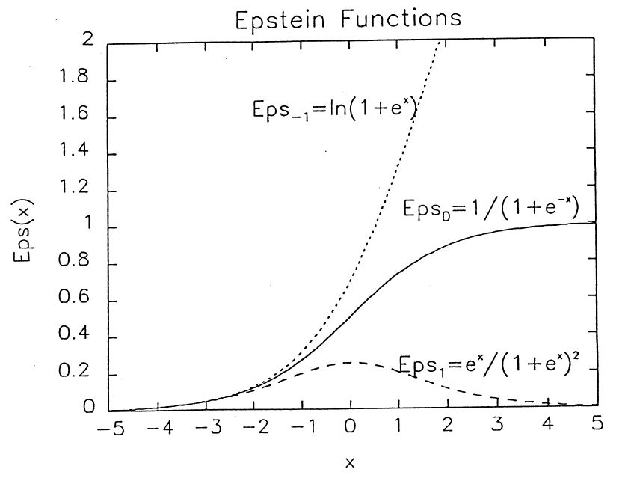
Epstein functions
Eps₋₁ describes a transition.
Eps₀ describes a step.
Eps₁ describes a layer.
With x=(h-h_{i})/d_{i} each of these functions is centered at h = h_{i} with d_{i} describing the width of the specific feature.
Eps₀ is used in IRI for:
Stepping from day to night values
Connecting regions of constant gradient (Booker function)
dT/dh = m₁+Σ_{i} (m_{i+1} – m_{i})/(1+exp[-(h-h_{i})/d_{i}])
T = T(h₀) + m1 (h-h₀)+
+ Σ_{i} (m_{i+1} – m_{i}) d_{i} ln -------------------------
= T
1 + exp[(h -h_{i})/d_{i}]
1 + exp[(h₀-h_{i})/d_{i}]
m_{i} = ( T(h_{i}) – T(h_{i-1})/(h_{i} – h_{i-1})
11

Slide 12
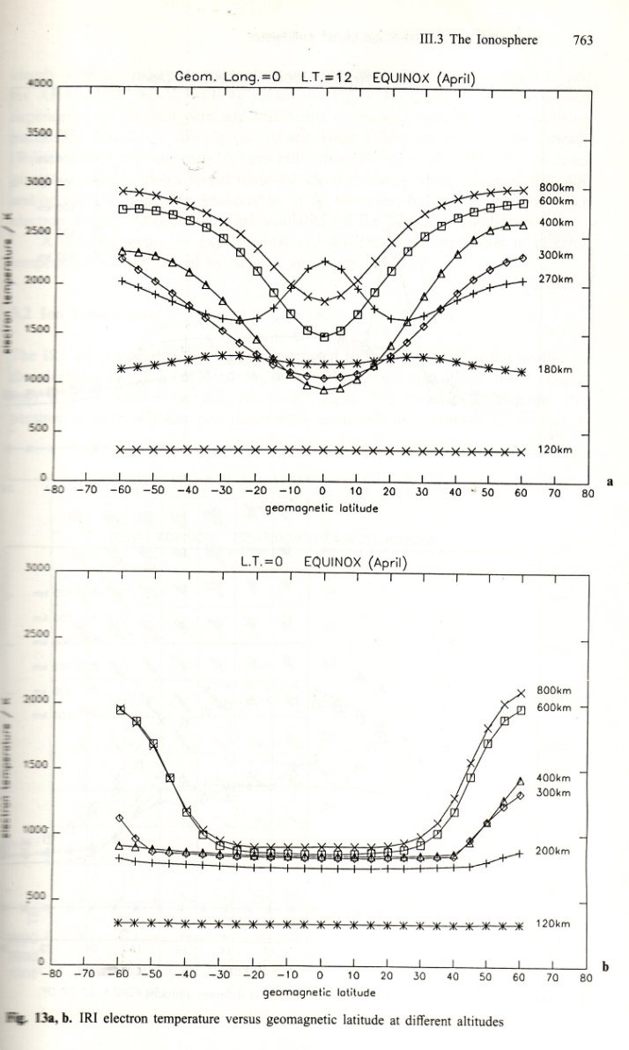
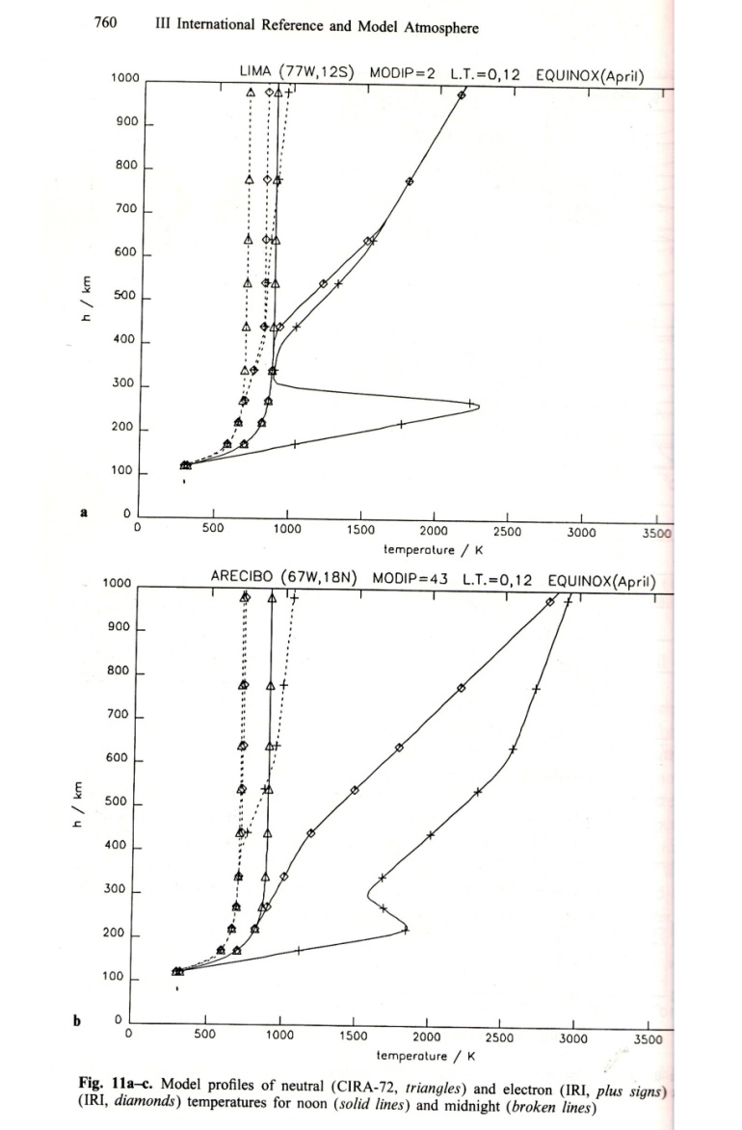
Electron and Ion Temperatures
Build-up of IRI electron density profile
International Reference Ionosphere - IRI
--------- Plasma Temperature ---------------
night
day
Global models at fixed heights (mostly from satellite observations at circular orbits) are connected with the Booker approach (Epstein functions) to obtain the altitudinal profiles.
T_{e}
Height / km
Equator
Temperatures / K
night
day
T_{i}
T_{e}
Mid-latitudes
Geomagnetic Latitude
Temperatures / K

Slide 13
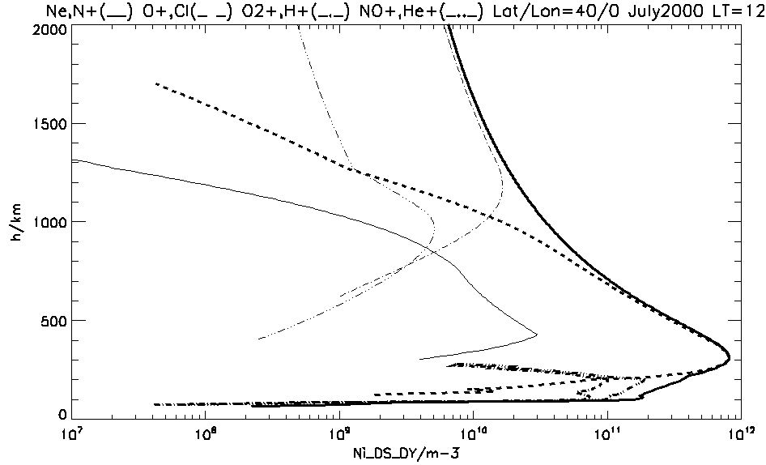
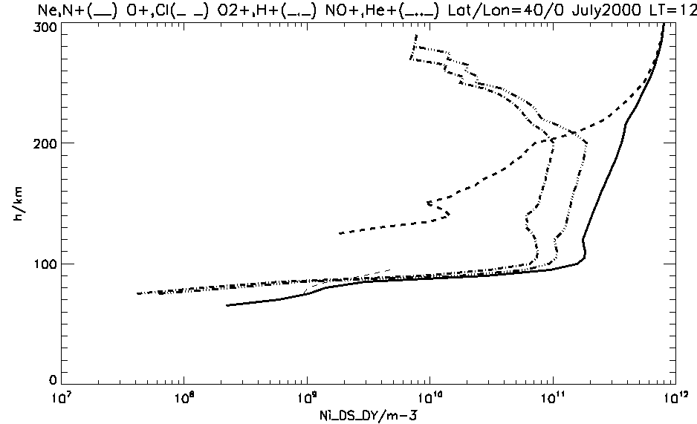
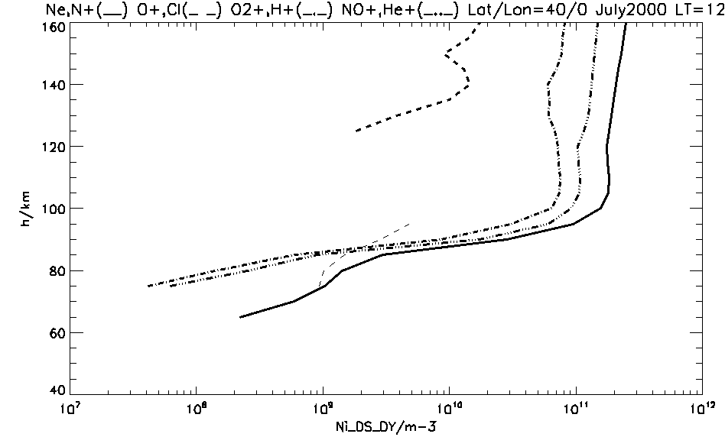

Ion Composition
IRI assumes charge neutrality N_{e} = $\sum_{i}{n\text{i}}$
and provides the ion composition
C_{i} = n_{i}/N_{e} .
In the topside (h>300 km) IRI models the ion composition of O⁺, H⁺, He⁺, and N⁺ ions.
N⁺
N_{e}
O⁺
He⁺
H⁺
N⁺
H⁺
N_{e}
O⁺
NO⁺
N_{e}
O₂⁺
NO⁺
O⁺
O₂⁺
N_{e}
Cluster⁺
Cluster ions
In the bottomside (h<300 km) IRI models the ion composition of O⁺, O₂⁺, and NO⁺.
In the D-region (h<100km) Cluster ions (e.g., H₃O⁺(H₂O)_{n} ) become important.

Slide 14
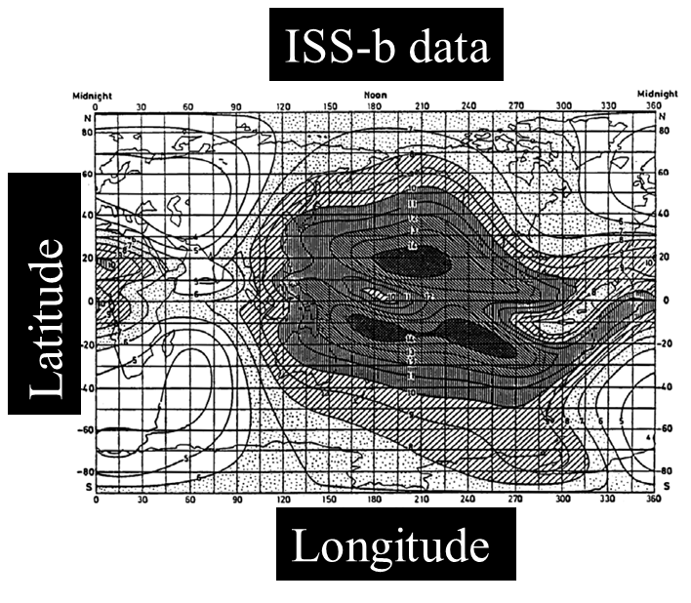
Global Variation – foF2

Slide 15
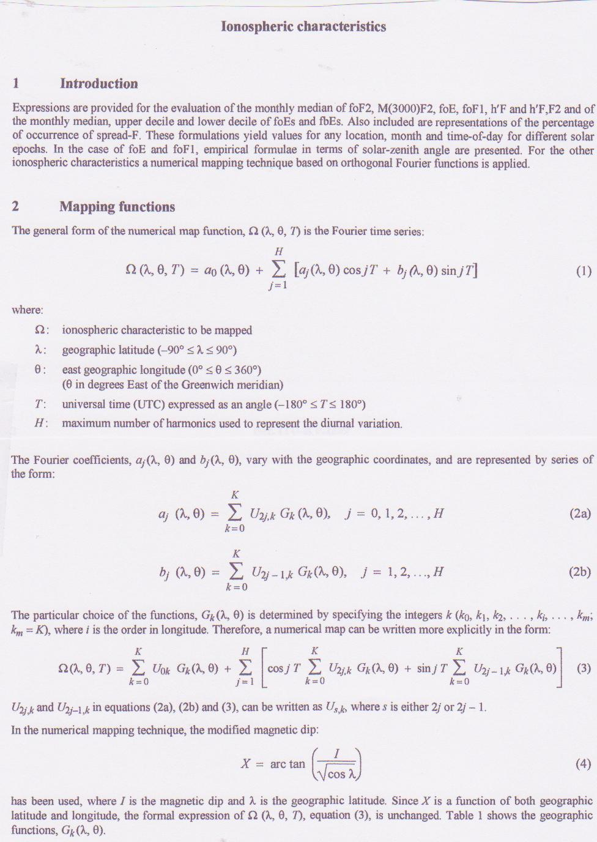
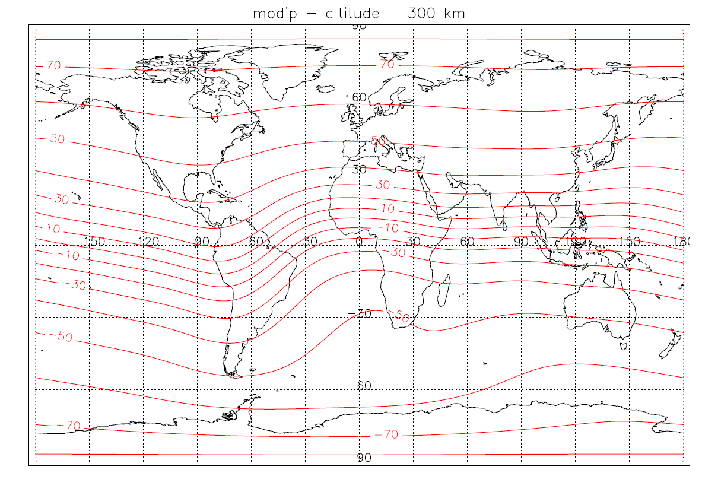
CCIR (1967) global model for foF2
Jones and Gallet 1962
Jones et al., 1969
Ionosonde 1954–1958
plus screen points in ocean areas
Comité Consultatif International
Radio-communication
of the
International Telecommunication
Union
..using a special coordinate: modified dip latitude
Order 6 for foF2
Order 4 for M(3000)F2

Slide 16
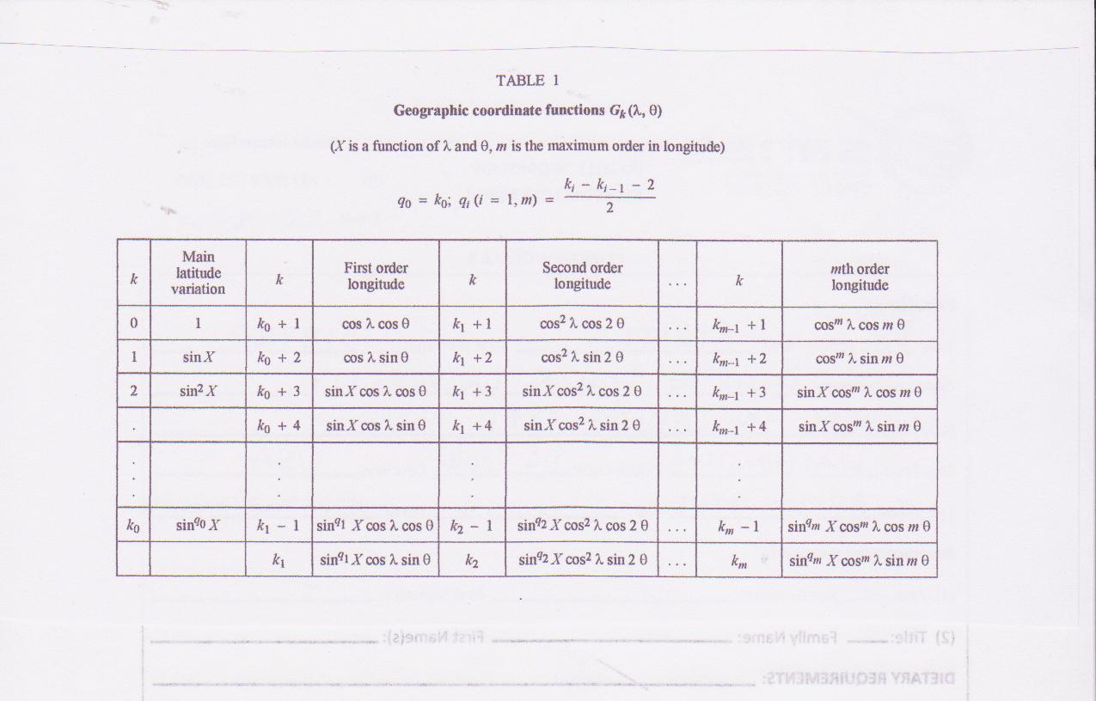
… and a special set of geographic coordinate functions
76 coefficients for foF2
49 coefficinets for M(3000)F2

Slide 17
CCIR 1967
Jones and Gallet, 1962
Jones et al., 1969
Ionosondes 1954-1958
Screen points, especially over the oceans and southern hemisphere, through extrapolation along lines of constant modified magnetic dip angle
6th order harmonics in UT and special functions for global specification
Recommended over continents
URSI 1988
Fox and McNamara,1988
Rush et al.,1989
45,000 station months of ionosonde data
Theoretical model was adjusted such that it agreed with measured foF2 values over land, and then was used to compute screen points over oceans and in data sparse regions
Same functions as CCIR
Recommended over ocean areas
Room for improvement: Large volume of more recent data, better models for screen point analysis, better functions, better computers

Slide 18
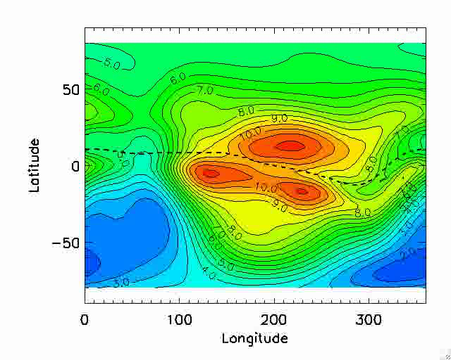
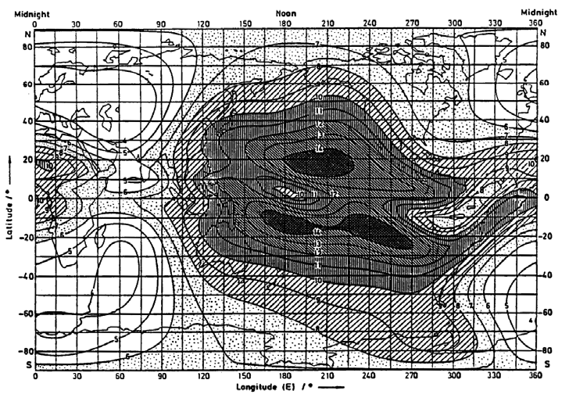
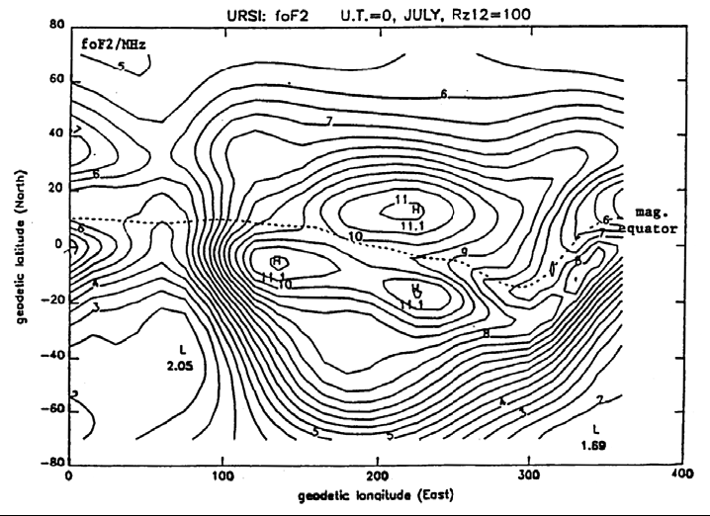
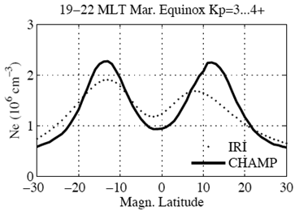
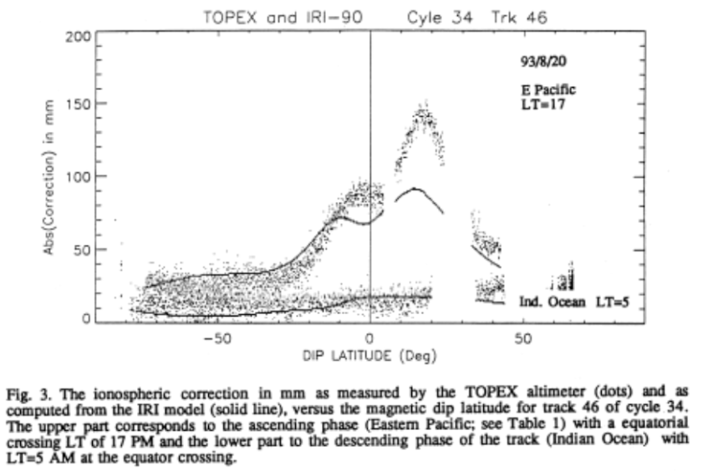
ISS-b data
IRI URSI-88
Latitude
Longitude
Damboldt and Suessmann (2012) validation with large volume of ionosonde data over 7 solar cycles finds average foF2 error of just a few %.

Slide 19
IRI Drivers – Indices used
Electron
Density (N_{e})
D-Region Bilitza, 1981 R12
Friedrich et al., 2018 F10.7D
Danilov et al., 1995 F10.7D, K_{p}
E-Peak Kouris & Muggleton, 1973 COV
Mertens et al., 2013 a_{p}
F1-Region Ducharme et al. 1973 R12
Scotto et al. 1997 R12
Bottom- Bilitza et al., 2000 R12
-side Altadill et al. 2009 R12
F-Peak Jones&Gallet, 1965 IG12
Rush et al., 1989 IG12
Fuller-Rowell et al., 2000 a_{p}*
hmF2 Bilitza et al. 1979 R12
Altadill et al. 2013 R12
Shubin 2015 F10.7_81
Topside Rawer et al. 1978 COVSAT
Nava et al. 2008 R12
Bilitza & Xiong, 2021 PF10.7
Spread-F Abdu et al. 2003 F10.7D
T_{e} ,T_{i} Truhlik et al. 2011, 2021 PF10.7
T_{n} CIRA Picone et al. 2002 F10.7_81o, F10.7DPo
N_{i}(h < 300km) Richards et al. 2010 F10.7_81o, F10.7DPo
N_{i}(h > 300km) Triskova et al. 2003 PF10.7
N_{i}(h < 300km) Danilov&Smirnova 95 F10.7_12
N_{i}(h > 300km) Danilov&Yaichnikov 85 F10.7_12
v_{i} Fejer et al. 2007 F10.7D
Zhang et al., 2010 K_{p}
R12 = 12-month running mean of
sunspot number
F10.7D = daily F10.7 index (adjusted to AU)
F10.7DP = daily F10.7 index of previous day
F10.7DPo = F10.7DP observed
F10.7_81 = 81-day running mean of F10.7 F10.7_12 = 12-month running mean of F10.7
PF10.7 = (F10.7_81 + F10.7D)/2
COV= F10.7_365
COVSAT= COV if(COV.gt.188.) COVSAT=188
IG = Global Ionospheric index
IG12 = 12-month running mean of IG
*a_{p} = 3-hr a_{p} index for current time and the
12 preceding 3-hr ap indices
Temperatures
(T_{e}, T_{i}, T_{n})
Ion
composition
and velocity
(N_{i}, v_{i})
Auroral Boundary

Slide 20
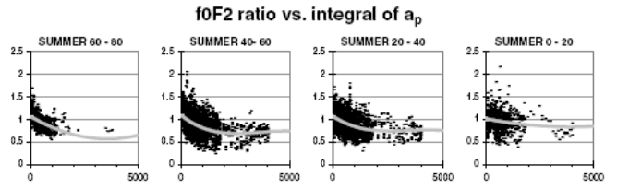
foF2 STORM MODEL
foF2 Storm Model
• Developed by Fuller-Rowell et al., 1998, 2000 and Aruajo-Pradere et al., 2003, 2004.
• Based on data from 75 ionosonde stations for 43 storms prior to 2001.
• Tested meanwhile with many more storms and stations.
• Uses an index based on the weighted integral of the a_{p} index over the previous 33 hours.
• Describes quite well the mostly negative ionospheric storm effects at mid-latitude summer.
• An evaluation with ionosonde data for 2001 storm periods showed an overall improvement of IRI by 50%.
foF2_{storm}(t)/foF2_{quiet}(t) = a₀ + a₁ X(t) + a₂ X²(t) + a₃ X³(t)
X(t) = ∫ F(τ) a_{p}(t- τ ) dτ taken over the preceding 33 hours foF2_{quiet}(t) is monthly mean
The optimum shape and length of the filter F(τ) was obtained by singular value decomposition, minimizing the mean square difference between the ap index and the ionospheric ratios

Slide 21
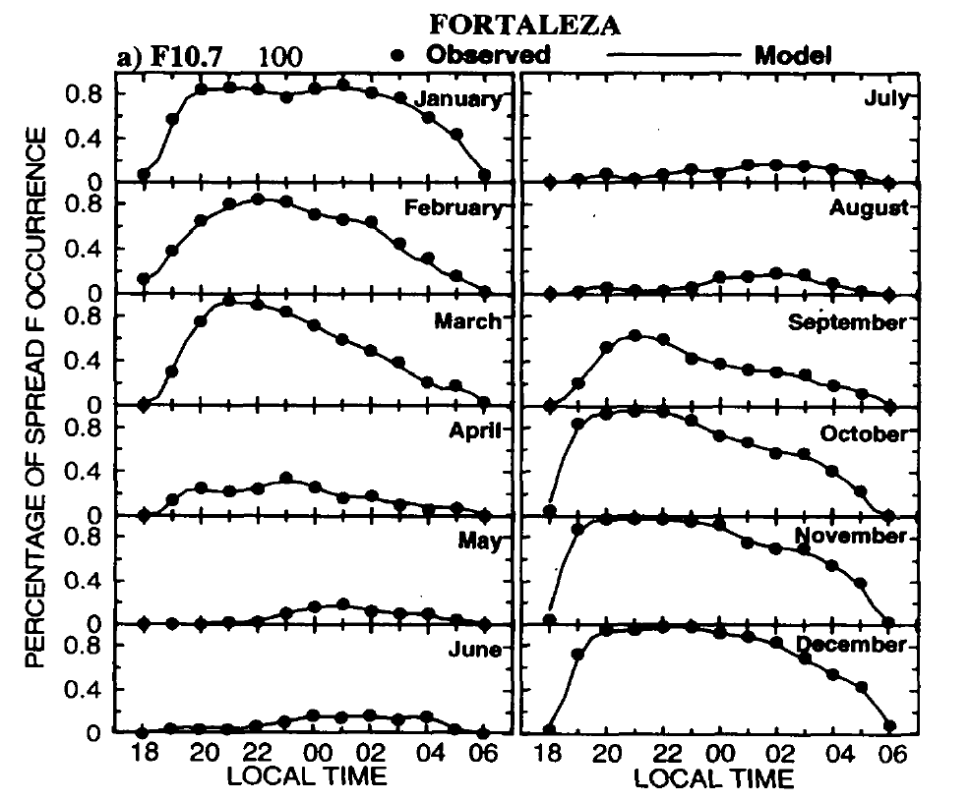
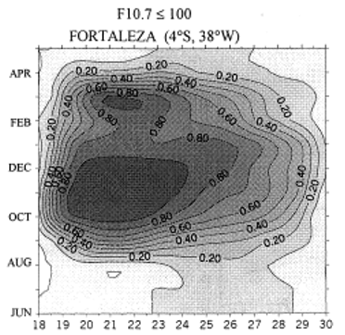
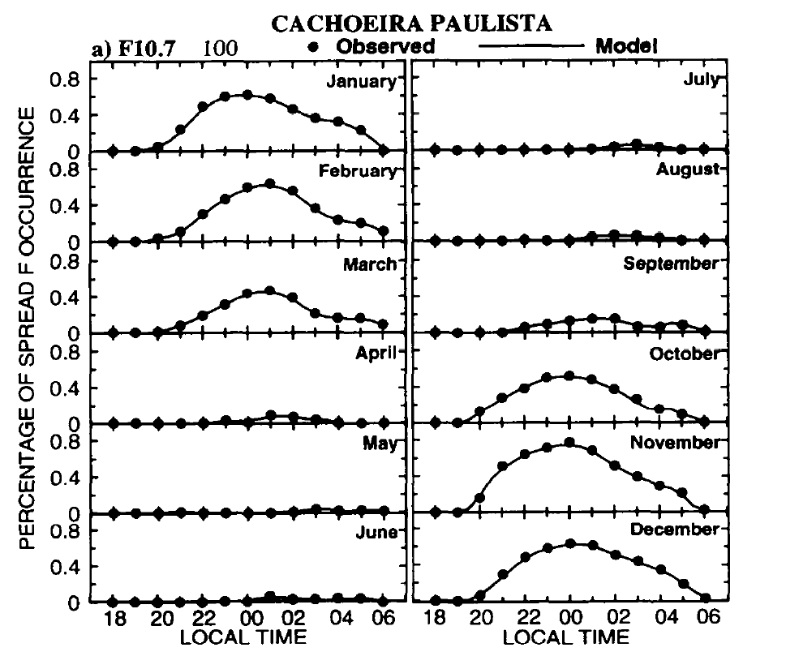
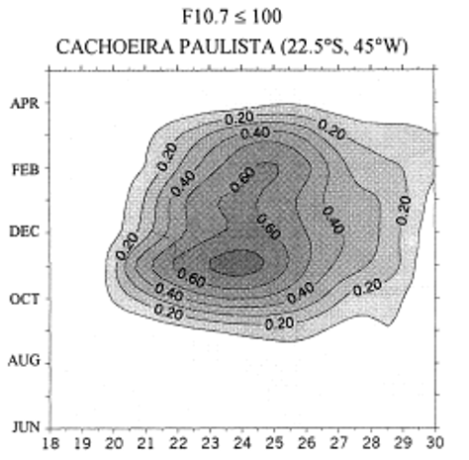
Spread-F Occurrence Probability Model
Abdu et al. (2003) doi:10.1016/S0273-1177(03)00031-0
Spread-F occurrence probability model
as a function of
Latitude (-4 to -23)
Local Time (18:00 to 7:00)
Day of Year
F10.7 (daily value)
Fitting cubic-B spline function of order four applied for Local Time and of order two for Day of Year, F10.7, and Latitude.
13 years of range spread observations at Fortaleza (-3.7, 321.5) and Cachoeira Paulista (-22.7, 315.0)

Slide 22
Recent Improvements
International Reference Ionosphere - IRI
------------ Ion Composition ------------------
He⁺
O⁺
D-Region: An updated model for the electron density based on a carefully selected compilation of rocket data (120 radio propagation profiles and 207 Langmuir probe profiles) and by adjusting the Graz ion-chemical model to the data (Friedrich, Pock & Torkar, 2018).
E-Region: Model for the occurrence probability of Sporadic-E based on GNSS radio occultation data. Es layers are formed by tide-driven wind shears that confine long-lived metal ions (Mg+, Fe+, Ca+) from ablated meteors in very thin and dense layers at around 90-130 km. These irregular layers can exceed the E- and F-layer densities and can reflect or degrade radio waves propagating through the ionosphere and thus impacting the many applications that rely on such waves (HF communication, satellite navigation, GNSS positioning, OTH radar, etc.). Model describes variation with latitude, longitude, local time, and season.
Topside: Improved representation of the topside electron density during low solar activity based on Alouette, ISIS, CHAMP, Grace, and Swarm data (Bilitza & Xiong, 2021).
Plasmasphere extension: Using the IMAGE-RPI model of Ozhogin et al. (2012) or the DE-RIMS model of Gallagher et al. (2000) to determine the electron density at selected fixpoints (5,000, 10,000, 20,000, 30,000km) and using Epstein functions to construct the profile (Bilitza, Truhlik, Omura & Moldwin, 2024). Newer plasmasphere models are being currently assessed and may lead to significant improvements including the models of Zhelavskaya et al. (2021), Hartley et al. (2023) and Watanabe et al. (2025) based on VAP and Arase data.
Ion temperature: New model based on in-situ observations from 18 satellites (from OGO-6 to ICON) inter-calibrated with ISR data and consisting of global maps at 350, 430, 600, and 850 km (Truhlik et al., 2021)
New Output Parameter: Ratio of plasma frequency to electron gyro frequency. A parameter important for whistler mode waves and for defining energy and frequency ranges of effective wave-particle interactions.

Slide 23
sporadic–E (E_{s}) Layer – A Brief Intro
FORMATION: E_{s} layers are formed by tide-driven wind shears that confine long-lived metal ions (Mg⁺, Fe⁺, Ca⁺) from ablated meteors in very thin and dense layers at around 90-130 km. E_{s} occurrence exhibits a strong summer maximum that does to some extent correlate with the seasonal changes in wind shear and meteoric deposition.
IMPACT: These irregular layers can exceed the E- and F-layer densities and can reflect or degrade radio waves propagating through the ionosphere and thus impacting the many applications that rely on such waves (HF communication, satellite navigation, GNSS positioning, OTH radar, etc.).
OBSERVATION: E_{s} has been observed from the ground by ISRs and ionosondes (direct measurement, but limited global coverage), by GNSS-RO (global coverage, but indirect measurement), and by rockets (accurate in situ, but campaigns only). Important study by Sobhkhiz-Miandehi et al. (2023) finding discrepancies in the detection of E_{s} by ionsondes vs GNSS-RO. Feng et al. (2024) discuss the special characteristics of Es over Japan based on multi-station data.
THEORETICAL MODELS: Krall et al. (2020) were able to simulate E_{s} layers with SAMI3 and HWM14, that resembled Arecibo observations. Andoh et al. (2022) were able to reproduce the E_{s} day-to-day variations with their GAIA model.
EMPIRICAL MODELS: CCIR/ITU involvement because of effect on HF and VHF. Ionosonde-based work by E.K. Smith (1955, 1957, 1976) and Leftin et al. (1968,1969) resulted in ITU-R 1999 and 2000 recommended global maps of E_{s} characterictics (fEs, foEs, fbEs) and graphs of percentage of time for which values of foEs are exceeded (Review by Bradley, 2003). GEMSOR a new model recently published by Parsch et al. (2024) based on GNSS-RO and ionsonde data.
23

Slide 24
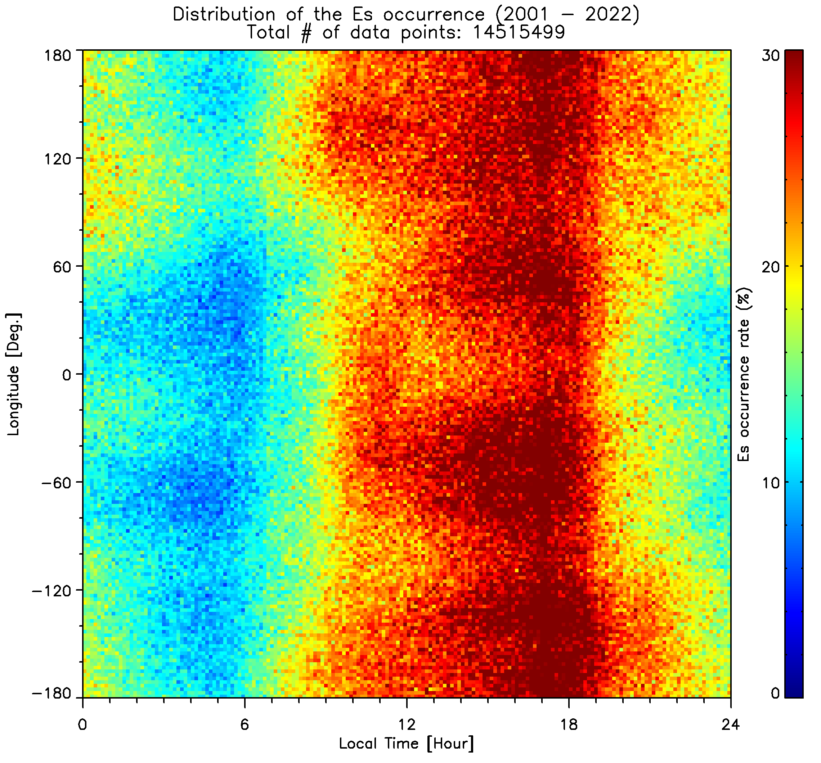
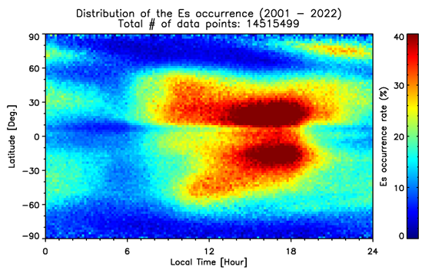
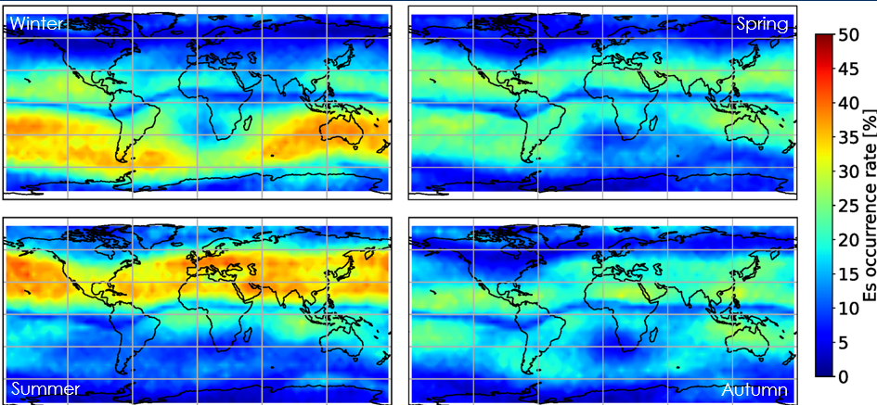
IRI Occurrence Probability Model for sporadic–E (E_{s}) Layer
Data Used: Automatic detection from normalized S/N profiles of the GNSS L1 (1.575 MHz) phase measurements, if standard deviation is greater than 0.2 (CHAMP, Spire, KOMPSAT-5, COSMIC 1 & 2, TANDEM-X, and TerraSAR-X: 19,419,036 data points; Arras et al., 2008, 2009; Arras, 2010; Arras & Wickert, 2018).
Modelling Approach: Spherical harmonics in MLT and magnetic dip latitude. Separate base models for different seasons and for different magnetic longitude sectors (every 15 degrees)
Variation with LT and longitude
Variation with LT and latitude
Seasonal variation
24
Notes:
Renewed interest in Sporadic-E modeling because of the importance for many applications. Recent papers about observations and modelling. ITU/CCIR efforts already in the fifties. Good review of these early efforts by the late Peter Bradley (2003), a very active IRI Working Group member.

Slide 25
IRI citations
Build-up of IRI electron density profile
IRI Real-Time Algorithms
Build-up of IRI electron density profile
SOME APPLICATIONS
ADJUSTING IRI DRIVERS (INDICES) UNTIL
IRI AGREES WITH OBSERVATIONS
ASSIMILATING REAL-TIME DATA INTO
BACKGROUND IRI
BOTH TECHNIQUES CAN BE USED ALSO
FOR RETROSPECTIVE ANALYSIS
FORECAST REQUIRES INDICES FORECAST

Slide 26
Adjusting IRI Drivers (Indices)
International Reference Ionosphere - IRI
------------ Ion Composition ------------------
He⁺
O⁺
Indices used to drive the IRI model:
Solar indices: F10.7 (daily, 81-day, 365-day), R (12-month running mean)
Ionospheric (ionosonde) index: IG (12 month running mean)
Magnetic indices: ap and kp (3-hour, daily)
Updating algorithms using effective indices:
Bilitza et al. (1997) - Effective IG12 index (EIG12) determined with ionosonde foF2 data
Komjathy et al. (1998),– EIG12 with GPS vTEC map
Hernandez-Pajares et al. (2002) - EIG12 with GPS slant TEC
Zhang et al. (2010) – Effective Kp from GUVI/SSUSI for auroral boundary model
Pezzopane et al. (2011) – EIG12 from ionosondes plus assimilation of bottomside profiles
Migoya-Orué et al. (2015) – EIG12 with GIM and using interpolation within a grid
Ssessanga et al. (2015) – Regional IRI update with EIG12 from South-Korean TEC data
Habarulema and Ssessanga (2016) - ER12 and EIG12 for IRI with African TEC data
Pignalberi et al. (2018) - ER12 and EIG12 grid from ionosonde data and Kriging method
Brown et al. (2018) – Hemispheric monthly EIG indices from ionosonde foF2
Pignalberi et al. (2019) – Updated their method with ER12/EIG12 to also rely on vTEC data

Slide 27
Assimilating Data into IRI
International Reference Ionosphere - IRI
------------ Ion Composition ------------------
He⁺
O⁺
Direct input into IRI model:
Observations of foF2/NmF2, hmF2/M(3000)F2, foF1/NmF1, foE/NmE, hmE, B0, B1
Assimilation of GNSS TEC data into IRI:
Schmidt et al. (2008), Weijing et al. (2015) - Multi-dimensional B-spline with GNSS and TOPEX/Jason
Fridman et al. (2006) – GPSII, Tikhonov method with GPS data
Angling et al. (2009) - EDAM assimilates GPS data with a minimum variance estimation technique
An et al. (2019) - Assimilating Jason-2/-3 and > 300 GNSS stations from 2014 and 2018 using a two-dimensional spherical harmonic expansion in a sun-fixed geomagnetic reference frame.
Assimilation of ionosonde data into IRI:
Galkin et al. (2012, 2020),– IRI Real-Time Assimilative Mapping (IRTAM): Assimilative Mapping with GIRO ionosonde data using CCIR formalism for data-model difference maps and NECTAR model morphing algorithm.
Assimilation of a combination of different data sources:
Yue et al. (2012) – Assimilating GPS and Jason 1,2 vTEC, and Radio Occultation (RO) from
CHAMP, GRACE, COSMIC, SAC-C, Metop-A, and TerraSAR-X with the Kalman filter technique for
2002-2011.
Aa et al. (2016) – Regional model using 3-dimensional variational technique to assimilate GNSS
data from Chinese and International networks, and COSMIC RO data.
Lin et al. (2017) – Gauss-Markov Kalman filter assimilation of GPS and RO data into IRI.
Mengist et al. (2019) – Assimilating GNSS and COSMIC RO data into IRI using a 3D-Var Algorithm
(IDA4D) for a regional model.

Slide 28
IRI citations
Build-up of IRI electron density profile
Model Assessments
Build-up of IRI electron density profile
SOME APPLICATIONS
CEDAR ETI Challenge: Assessment of 9 ionospheric models including empirical, theoretical, and assimilative models:
Shim et al. (2011). Space Weather, 9(12), doi:10.1029/2011SW000727
Shim et al. (2012). Space Weather, 10(10). doi:10.1029/2012SW000851
Shim et al. (2017). Space Weather, doi:10.1002/2017SW001649
Shim et al. (2018). Space Weather. doi:10.1029/2018SW002034
RESULT: IRI did very well. If not first than second or third in all events and cases considered using a variety of performance measures and skill scores.
Validation of ionospheric modeled TEC in the equatorial ionosphere during the 2013 March and 2021
November geomagnetic storms
Chou et al. (2023).. Space Weather, doi:10.1029/2023SW003480
RESULT: “GloTEC, JPL GIM, and IRI-2016 are the top three ionospheric models during the 2013 March and 2021 November storms” with an “important caveat: GloTEC and JPL GIM are not independent of the Madrigal TEC. Thus, GloTEC and JPL GIM are expected to perform better than other models.”
Performance of ionospheric models in estimating foF2
Kumar et al. (2025).. Space Weather, doi:10.1029/2025SW004330
RESULT: “Our findings indicate that, on average, IRI‐2020 demonstrated superior performance
compared to the other models (TIEGCM, WAMIPE, and GITM) under conditions with maximum Kp < 7 in low‐ and mid‐latitude regions. Although IRI‐2020 was weakest in the low‐latitude post‐sunset sector, it still outperformed the other models.”

Slide 29
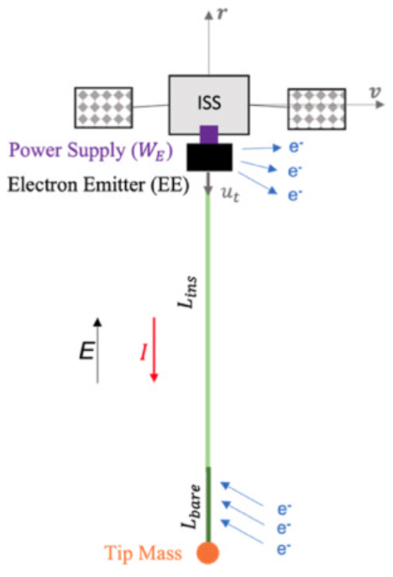
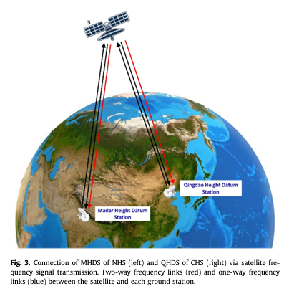
Brunello A., G. Anese, G. Borderes-Motta, A. Valmorbida, G. Sánchez-Arriaga, E.C. Lorenzini, Optimal design and current control strategies of an electrodynamic tape for ISS station-keeping, Acta Astronautica, 2024, doi:10.1016/j.actaastro.2024.07.024
Electrodynamic tethers are proposed as a promising technology for ISS station-keeping
“Given a full set of input parameters, including the initial orbit and tether geometry, the software uses models (IRI[29], IGRF[30], NLRMSISE-00[31]) to obtain the environmental variables and computes the evolution of the orbit by solving the equations of motion of the satellite and the tether.”
Hohensinn R., M. Aichinger-Rosenberger, M.F. Wareyka-Glaner, M. Ravanelli, Natural-hazard monitoring with global navigation satellite systems (GNSS), Advances in Geophysics, Elsevier, 2024, https://doi.org/10.1016/bs.agph.2024.06.002. GNSS-enabled natural hazard monitoring and early warning.
“…hmF2 can be derived from physical models such as the International Reference Ionosphere (IRI) model.”
Shanker K.C., Ziyu Shen, Wen-Bin Shen, Unifying the Nepal height system and China height system based on gravity frequency shift approach, Geodesy and Geodynamics, 2024, doi:10.1016/j.geog.2024.04.005 .
“To acquire information on electron density, we employ the International Reference Ionosphere 2016 (IRI 2016) model.”
Li Z, Guo J, Ji B, Wan X, Zhang S. A Review of Marine Gravity Field Recovery from Satellite Altimetry. Remote Sensing. 2022; 14(19):4790. https://doi.org/10.3390/rs14194790
“In coastal areas or inland water, the ionospheric correction is derived from global ionospheric models when the dual-frequency range measurements are contaminated by land or invalid. The global models include the International References Ionosphere (IRI).”
Notes:
Highly accurate international height reference frames with long-term stability, global consistency, and homogeneity are crucial for monitoring sea level variations, understanding climate change, managing disasters, and supporting other applications that benefit scientific research and societal well-being. Currently, there are over 100 local height reference systems worldwide. Unifying these systems is a pivotal step toward constructing international height reference frames. The method introduced in this study—the gravity frequency shift via Satellite Frequency Signal Transfer (SFST)—represents a groundbreaking relativistic geodetic approach, demonstrating its potential to surpass the constraints of conventional techniques.
The frequency of microwave signals undergoes alterations as they traverse the troposphere and ionosphere. To acquire information on electron density, we employ the International Reference Ionosphere 2016 (IRI 2016) model

Slide 30
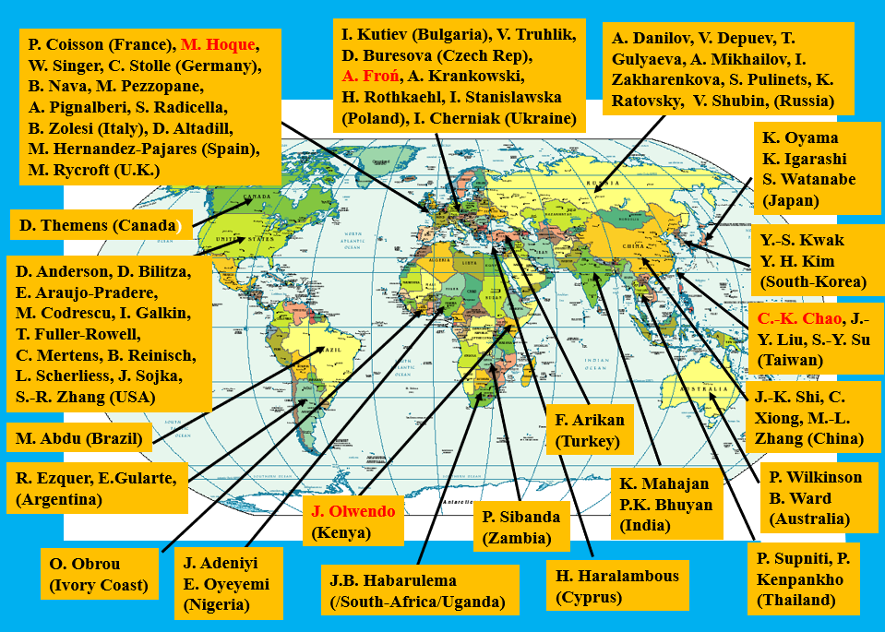
IRI Working Group Members (67/29)
IRI team’s global distribution guarantees access to the global data base

Slide 31
IRI Workshops and Publications
IRI progress is discussed during sessions at URSI and COSPAR General Assemblies and during special bi-annual IRI Workshops (listed below).
Advances in Space Research Earth, Planets and Space
Annals of Geophysics
YEAR LOCATION TOPIC
1983 Stara Zagora, Bulgaria Towards an Improved IRI ASR 4( 1) 1984
1985 Louvain, Belgium IRI - Status 1985/86 ASR 5(10) 1985
1987 Novgorod, Russia Ionospheric Informatics ASR 8( 4) 1988
1989 Abingdon, UK Development of IRI-90 ASR 10(11) 1990
1991 Athens, Greece Advances in Description of Ionospheric Parameter ASR 12( 7) 1992
1993 Trieste, Italy Off-Median Phenomena and IRI ASR 14(12) 1994
1995 New Dehli, India Low and Equatorial Latitudes in IRI ASR 18( 6) 1996
1997 Kühlungsborn, Germany New Developments in Ionospheric Modeling ASR 22( 6) 1998
1999 Lowell, MA, USA IRI- Workshop 1999 ASR 27( 1) 2001
2001 Sao Jose dos Campos, Brazil Low Latitude Ionosphere in the IRI ASR 31( 3) 2003
2003 Grahamstown, South Africa Quantifying ionospheric variability ASR 34( 9) 2004
2005 Roquetes, Spain New Data and Regional Models ASR 39( 5) 2007
2006 Buenos Aires, Argentina Improved IRI TEC Representation ASR 42( 4) 2008
2007 Prague, Czech Rep. IRI/COST Workshop ASR 43(11) and 44(06) 2009
2009 ColoradoSprings, USA Task Force Activity: Real-Time IRI ASR 46(08) 2010
2009 Kagoshima, Japan IRI'2009 Workshop EPS 63(4) 2011 and 64(4) 2012
2011 Hermanus, South Africa IRI over Africa ASR 51(04) 2013
2012 Prague, Czech Republic Task Force Activity: Real-Time IRI
2013 Olztyn, Poland IRI and GNSS ASR 55(08) 2015
2015 Bangkok, Thailand Representing scintillations in IRI ASR 60(02) 2017
2017 Taoyuan City, Taiwan Real-time Predictions with IRI , COSMIC and Other GNSS Data ASR 63(06) 2019
2019 Frederick U., Nicosia, Cyprus Real-time ionos. modeling in the European and African sector ASR 68(05) 2021
2023 KASI, Daejeon, South Korea Real-Time Predictions with Data from Spaceborne Sensors ASR 75(05) 2025
Pwani U., Kilifi, Kenya Modeling the ionosphere over Africa and improvements of IRI AoG in prep.
2025 ICTP, Trieste, Italy IRI and NeQuick – Improving the Representation of the Real-Time Ionosphere

Slide 32
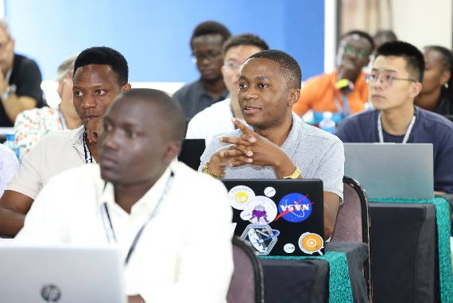
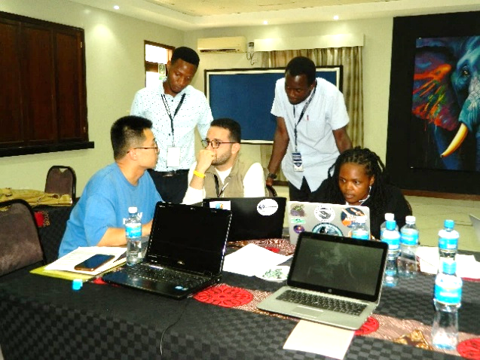
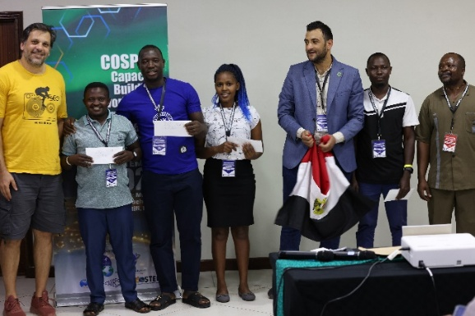
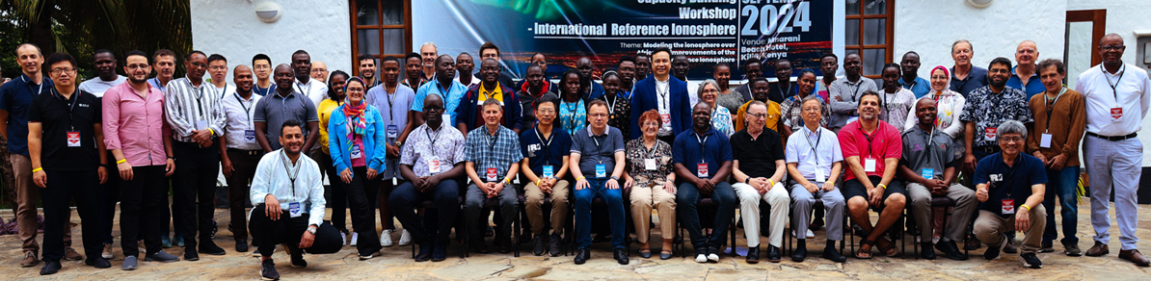
COSPAR Capacity-Building Workshop (CCBW) on IRI
Pwani University, Kilifi, Kenya, Sep 2 – 13, 2024
During the first week tutorials, lectures and hands-on demonstra-tions taught the students the basics and recent advances in observation techniques and modelling approaches for the Earth’s ionosphere. An important goal is to familiarize the students with the access to and usage of ionospheric data sets and models so they will be able to continue their research interests at their home institutions.
Lectures in the morning and students work on projects in the afternoon
First Place Team (from left to right): Haris Haralambous (Advisor), Kisembo Francis (Uganda), Mefe Moses (Nigeria), Nahum Maundu (Kenya), Mostafa Hegy (Egypt), Wilberforce Muniafu (Kenya), Joseph Olwendo (LOC). PROBLEM: Study the occurrence probability of sporadic-E for future inclusion in IRI.
During the second week IRI expert meeting took place with close to 100 participants. The newest results of IRI-related studies were presented including comparisons with new data sources, IRI improvements, application of the model, the latest information regarding the Real-Time IRI and talks and posters on many more topics related to ionospheric observations and modelling.
Notes:
Mary Dusabe, JOMO KENYATTA UNIVERSITY

Slide 33

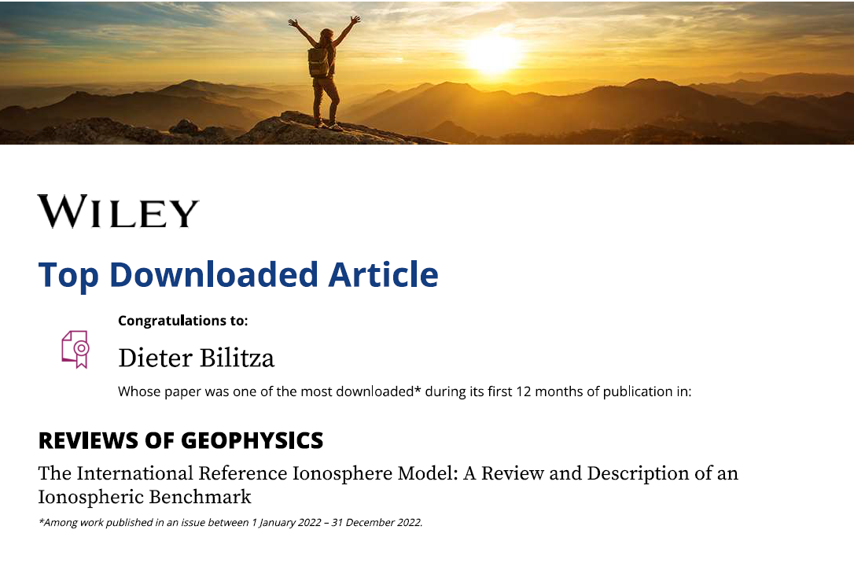
IRI Model Details
Bilitza, D., Pezzopane, M., Truhlik, V., Altadill, D., Reinisch, B. W., & Pignalberi, A. (2022) “The International Reference Ionosphere model: A review and description of an ionospheric benchmark”, Reviews of Geophysics, 60,e2022RG000792, 65 pages. https://doi.org/10.1029/2022RG000792

Slide 35

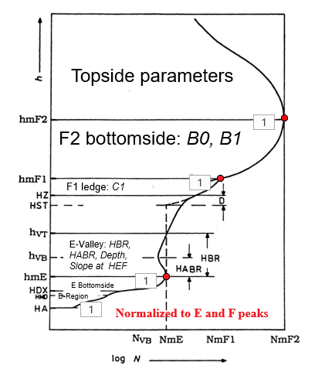
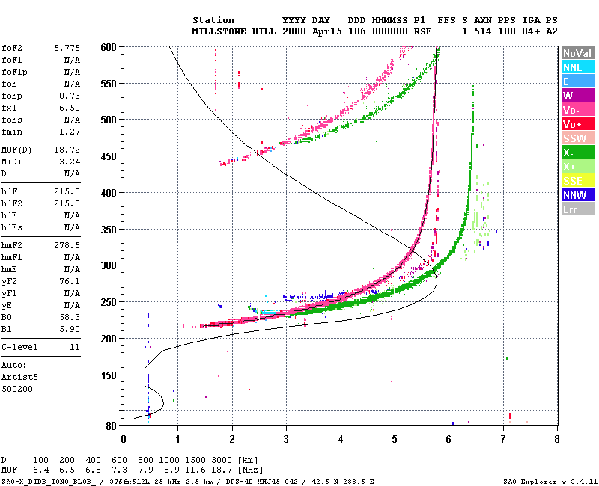


IRI Real-Time Assimilative Mapping
Assimilating real-time data from 60+ Digisondes into IRI
foF2, hmf2
B0, B1
foF1, hmF1, C1
foE, hmE

Slide 36















IRI-Real-Time: foF2, hmF2, B0
f_{o}F2
h_{m}F2
B0
Δf_{o}F2
Δ h_{m}F2
Δ B0
Galkin et al. (2012): Assimilating 24-hour history of digisonde measure-ments from GIRO network. Updates every 15 minutes.

Slide 37



IRI highly cited in wide range of journals
Over 250 citations per year in many different journals (139 and counting)

Slide 38

IRI citations
Build-up of IRI electron density profile
IRI Usage in AGU Journals
Build-up of IRI electron density profile
SOME APPLICATIONS
Notes:
Every 7th RS paper used IRI and every 14th JGR, and every 10th SW

Slide 39
IRI Specifics
IRI Specifics
Build-up of IRI electron density profile
Combining the global picture recorded by satellites for different local times and for different levels over solar activity with the 24/7 365 analysis provided by ground stations.
Modular approach, e.g., global models for profile anchor points: T_{e} at different heights from ISIS, AE, IK connected by Epstein functions.
Switches to choose different model options; e.g. hmF2 models using different data sources, topside N_{e} profile models using different mathematical formalisms.
New, better models are easily phased in with validation help from the users
Avoiding introduction of interdependence between parameters because replacing one parameter model will affect the related parameter.
User input of measured N_{e} peak and profile parameters: NmF2 or foF2, hmF2 or M(3000)F2, NmF1 or foF1, NmE or foE, hmE, B₀, B₁
irimodel.org

Slide 40


Problems with solar indices R and F10.7
Problems with R and F10.7:
R is related to the number spots observed in sun’s photosphere. F10.7 is related to the solar irradiance at 10.7cm wavelength while the irradiance responsible for ionospheric ionization is in the range 1-120nm (X-ray to EUV).
□ F10.7
+ R
Correlation between F10.7 (R) and EUV fluxes measured by the EUV spectrometer on the AEROS-A satellite at different wavelengths.
R was recently significantly revised; a factor ~1.5 increase (Clette et al., SW, 2015). Since the IRI models were developed with the ‘old’ R12 we use a scale factor of 0.7 with the new R12.

Slide 41


Problems with EUV indices I
Problems with EUV indices:
Only available since satellite measurements became feasible. Long time gap with no EUV measurements.
Inter-calibration issues between different satellites are still being debated.
Solar cycle amplitude varies with wavelength and is still uncertain because of the calibration uncertainties.

Slide 42


Problems with EUV Indices II
Problems with EUV indices:
Tai, Rawer, Bilitza and v. d. Mühle, KB 1983
Correlation between the Lyman-β flux and the EUV fluxes at other wave-lengths (measured by the AEROS-A satellite) weakens towards smaller wavelengths.
A time delay of 2-5 days has been observed between foF2 and TEC measurements and F10.7 as well as EUV indices. Most likely caused by the very long lifetime of O in the F-region.
Solar indices describe only solar influence (ionization) not dynamics of F region. Good in solar-controlled E and F1 region.

Slide 43
Ionosonde Index IG
Based on work of Liu et al., Telecomm. J., 1988:
Using noontime measurements of foF2 from 13 globally
distributed ionosondes.
Adjust R12 in CCIR foF2 model until agreement is achieved
between data and model.
Take median of the 13 adjusted R12 values.
PROBLEMS:
Stations have varied over time and are now down to 4
(Chilton, Port Stanley, Kokubunji, and Canberra)
IG-CCIR but not an equivalent IG-URSI
Only noon time data are being used.
Ionosonde indices work best locally or regionally; averaging over too wide a latitude range greatly diminishes the usefulness of these indices.
43

Slide 44




Forecasting Indices

Slide 45



Effect of Prediction Uncertainties on IRI
IG-12
N_{e}(400km)
Nov 2007
Nov 2008
Feb 2010
Feb 2011
(N_{e}^{yyyy}(400)-N_{e}²⁰¹¹(400))/N_{e}²⁰¹¹(400)
During the 2007-2010 minimum period:
Using indices forecasted one year ahead resulted in an overestimation of N_{e}(400 km) by 20%.
Using indices forecasted two years ahead results in an overestimation by 70%.
For TEC the corresponding numbers are 15% and 50%.

