Slide 1


Introduction to ionospheric irregularities studies
Lucilla Alfonsi, PhD
Istituto Nazionale di Geofisica e Vulcanologia
(INGV, Italy)
lucilla.alfonsi@ingv.it
The International Reference Ionosphere and NeQuick
Improving the Representation of the Real-Time Ionosphere

Slide 2
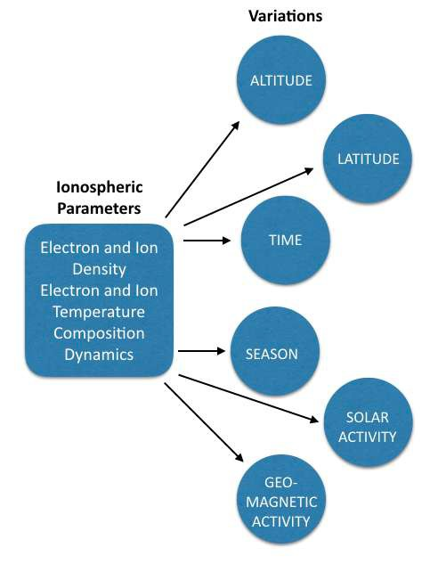
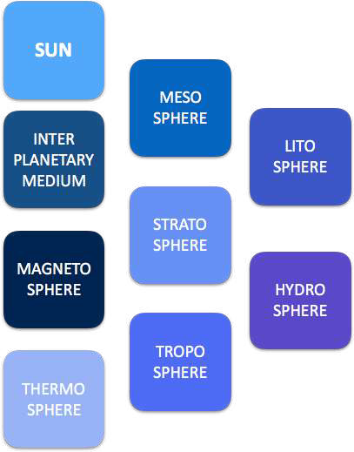
Ionospheric variability
Result of Coupling with

Slide 3
?
«Regular» and «Irregular» ionosphere
What does «irregular» mean?
What is the difference between «regular» and «irregular»?

Slide 4
Ionospheric variability
Regular (mostly predictable) variability
Irregular (mostly unpredictable) variability
Sometimes it is not easy to catalogue the variability as only regular or irregular
Quiet and disturbed variability vs height
Quiet and disturbed variability vs latitude
Day-night and storm time variability
Seasonal variability
11-years solar activity and space weather variability
Variability induced by existence of geomagnetic field and by space weather

Slide 5
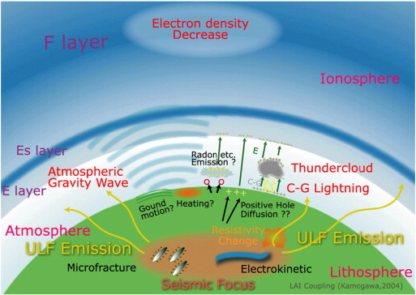
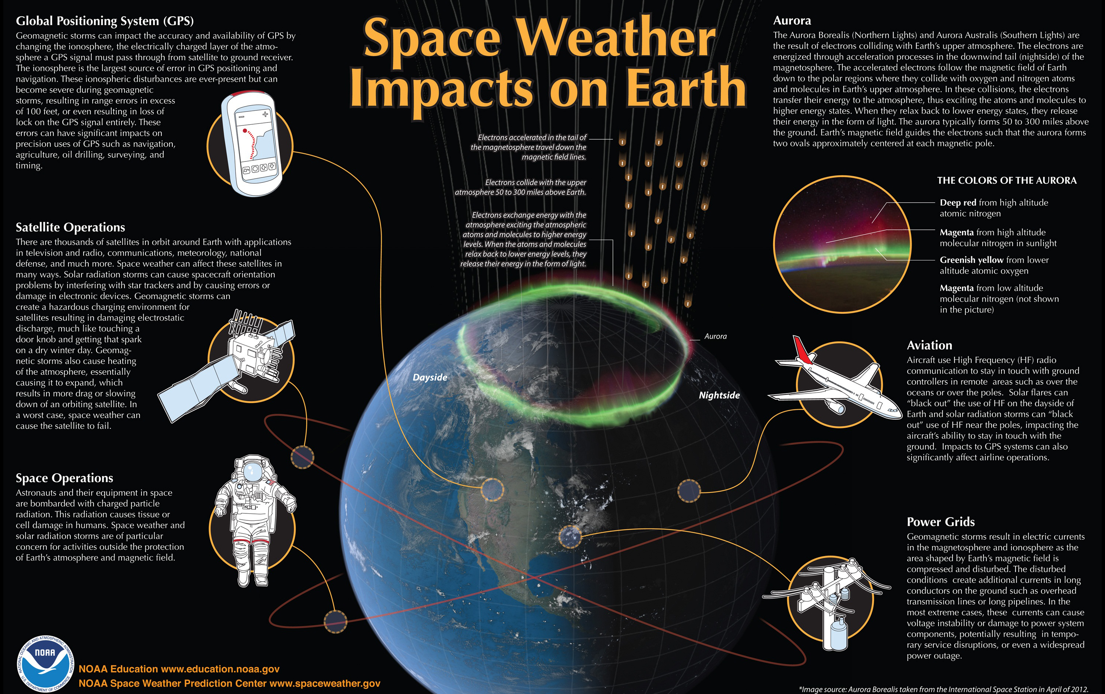
Ionospheric irregular variability
Neutral atmosphere variability
Earthquake, volcanic and tsunami events
Eclipses
Anthropogenic sources
Space weather events
From Jin et al., 2015 (adapted from Kamogawa, 2004)

Slide 6
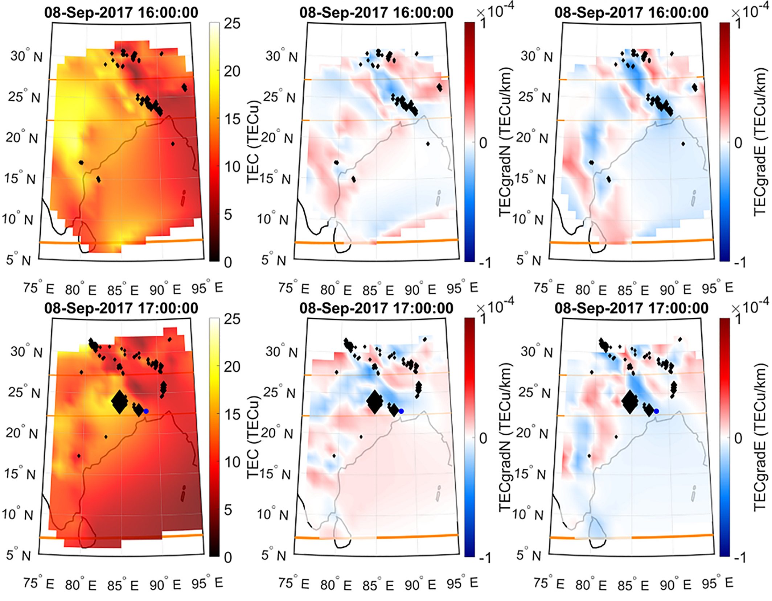
Ionospheric irregularities: regions of uneven electron density distribution
Alfonsi et al., 2021

Slide 7
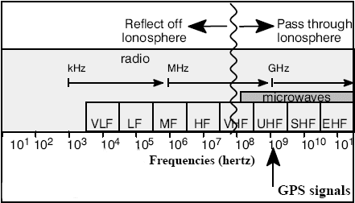
The ionospheric electron density and the height can be derived from radio probing (ground and space-based) exploiting the ionosphere property of influencing the radio wave propagation (by working frequencies spanning from kHz to GHz range).
VHF, HF radars and receivers provide several information on plasma structuring and variability but the devices are sparse and offer poor coverage (in time and space)
L-band (eg. GNSS) is a very powerful diagnostic tool but often does not provide a complete picture in time and space

Slide 8

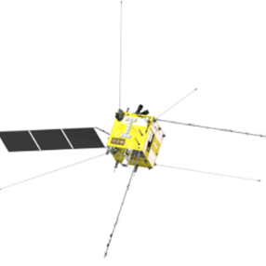
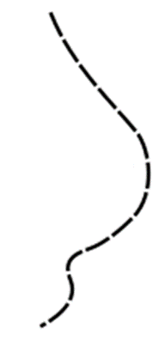
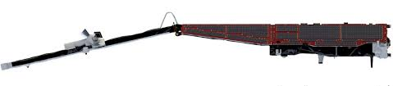
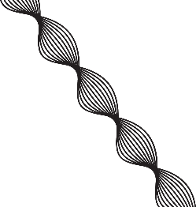
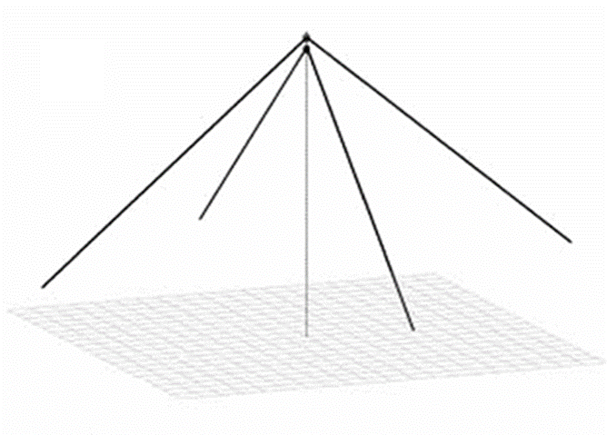
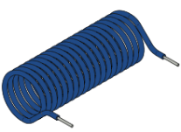
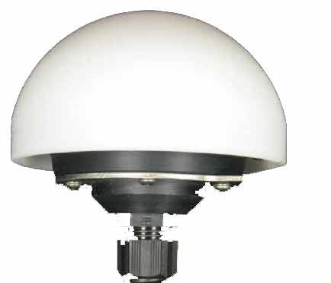

Multi-sensor observation
Bottom-side ionosphere
information
In-situ information of
the topside ionosphere
Equatorial Electrojet
1000 km
⁓ 510 km
CSES / Swarm B
⁓ 440 km
Swarm A/C
Ne
Ionosphere
Integrated information
foF2
hmF2
TEC
$${\vec{J}}_{E}^{}$$
50 km
GNSS receivers
Ionosonde
Magnetometer

Slide 9
WHY RELYING ON DIFFERENT MEASUREMENTS?
Detection of perturbation effects on ionosphere
Investigation of the cause-effect mechanisms through post-processing analysis
Gap analysis on what is still missing for a better understanding
ADVANCEMENT OF KNOWLEDGE
IMPROVEMENT IN MODELING
IMPROVEMENT IN ALERTING
IMPROVEMENT IN MITIGATING

Slide 10
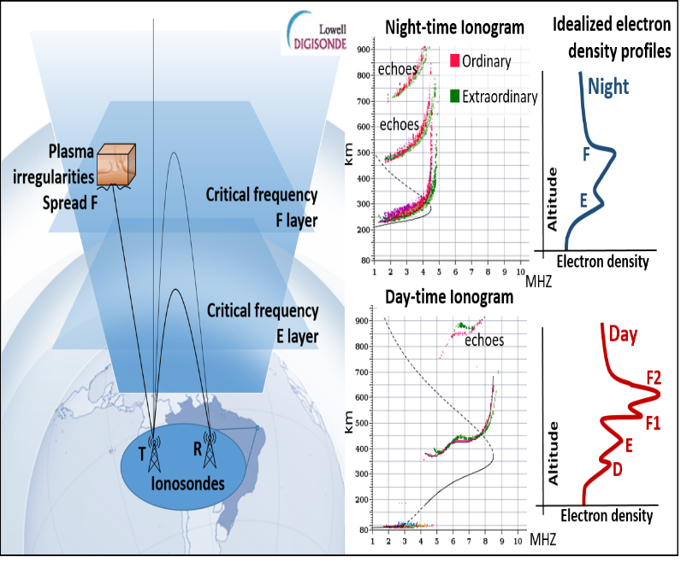
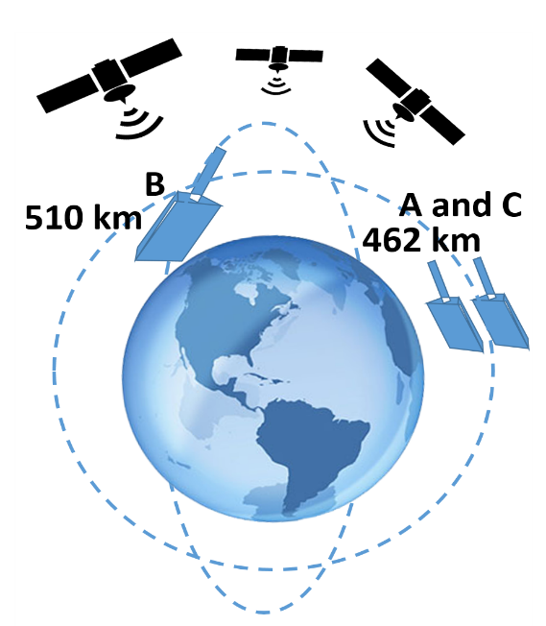
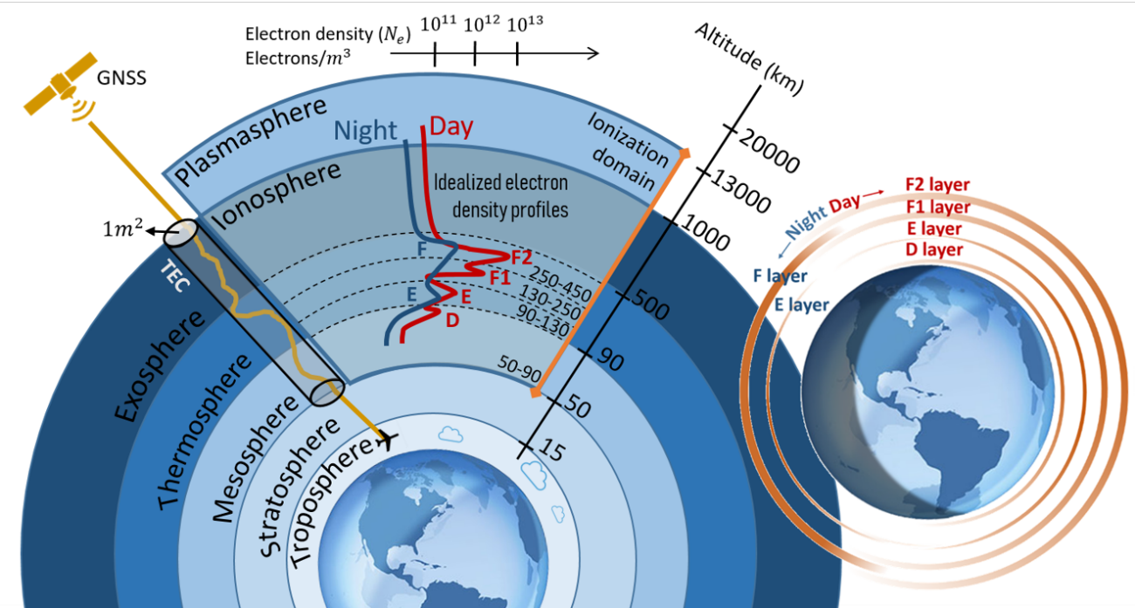
The combination of different kind of measurements is very informative, but…
…BUT
Different observation geometry
Different sampling
Different working frequency
Different spatial coverage
Different temporal coverage
Different metrics and standard
…
Courtesy J. Damaceno

Slide 11
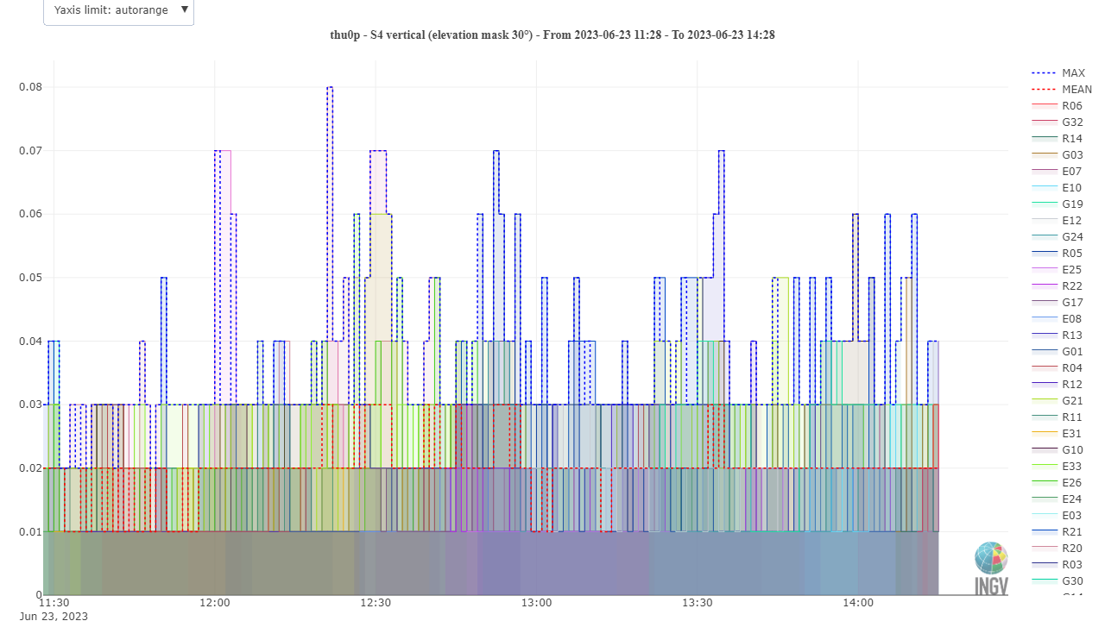
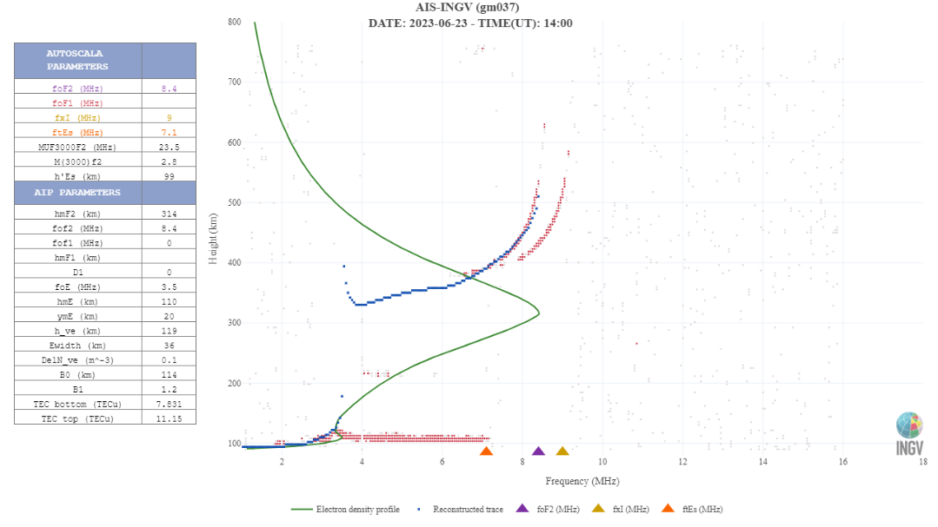
Once the case event is decided we know where and when the event is
First step: fill in a checklist
Instrument | Geographic/ Geomagnetic sector (known) | Temporal coverage (known) | Considered (C)/ Not considered (NC)
Ionosondes
Inchoerent Scatter radars
HF-backscattering radars
Ground-based GNSS receivers
Space-based GNSS receivers
In situ LP/TI
SAR
Others?...
An example of checklist
www.eswua.ingv.it

Slide 12
Once the case event is decided we know where and when the event is
First step: fill in a checklist
Instrument | Geographic/ Geomagnetic sector (known) | Temporal coverage (known) | Considered (C)/ Not considered (NC)
Ionosondes |  | X | NC
Inchoerent Scatter radars |  |  | C
HF-backscattering radars | X |  | NC
Ground-based GNSS receivers |  |  | C
Space-based GNSS receivers | X | X | NC
In situ LP/TI |  |  | C
SAR |  | X | NC
Others?...
An example of checklist
www.eswua.ingv.it

Slide 14
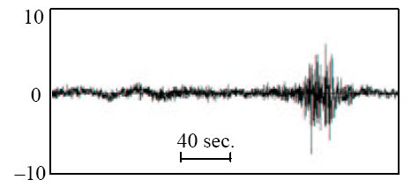
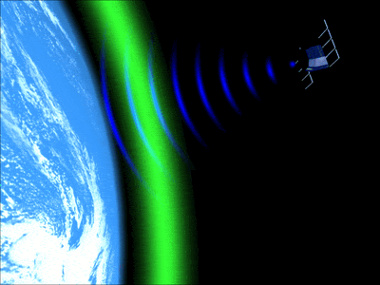
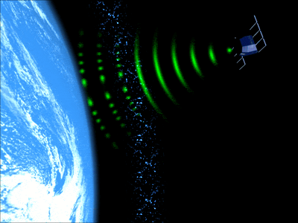
The Ionospheric Scintillation on GNSS signals
If the signal meets the irregularities of the ionosphere the signal can scintillate
The scintillations can induce loss of satellite lock and reduced accuracy of the positioning
Credits: Univ. of Bath (UK)

Slide 15
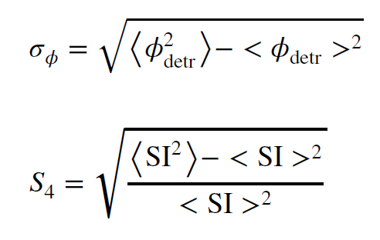
The study of the ionospheric irregularities from the GNSS perspective
Ionospheric scintillations: sudden and rapid fluctuations of phase and amplitude of the GNSS signals triggered by ionospheric plasma irregularities due to the diffraction of the signal.
How to quantify the scintillation intensity
Phase (a.u.)
L. Alfonsi - An attempt of adaptive phase detrending for GNSS scintillation detection

Slide 16
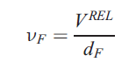
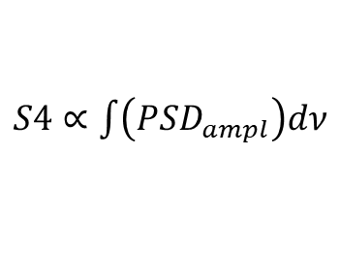
What about the irregularities scale-size triggering scintillations on GNSS signals?
Amplitude scintillation:
Diffraction triggered by small-scale irregularities
What does “small” means?
Small for GNSS signals:
scale-sizes up to hundreds of meters
ν_{F}: Fresnel’s Frequency
V^{REL}: relative velocity ray-path-ionosphere
d_{F}=sqrt(2*λ*h_{IPP})
λ∼19 cm for L1, assuming h_{IPP} = 350 km
d_{F} is about 250 m
Log(PSD)
$S4∝\int{\left({PSD}_{ampl}\right)dν}$
ν_{Fresnel}
ν_{Nyquist}
Log(ν)

Slide 17

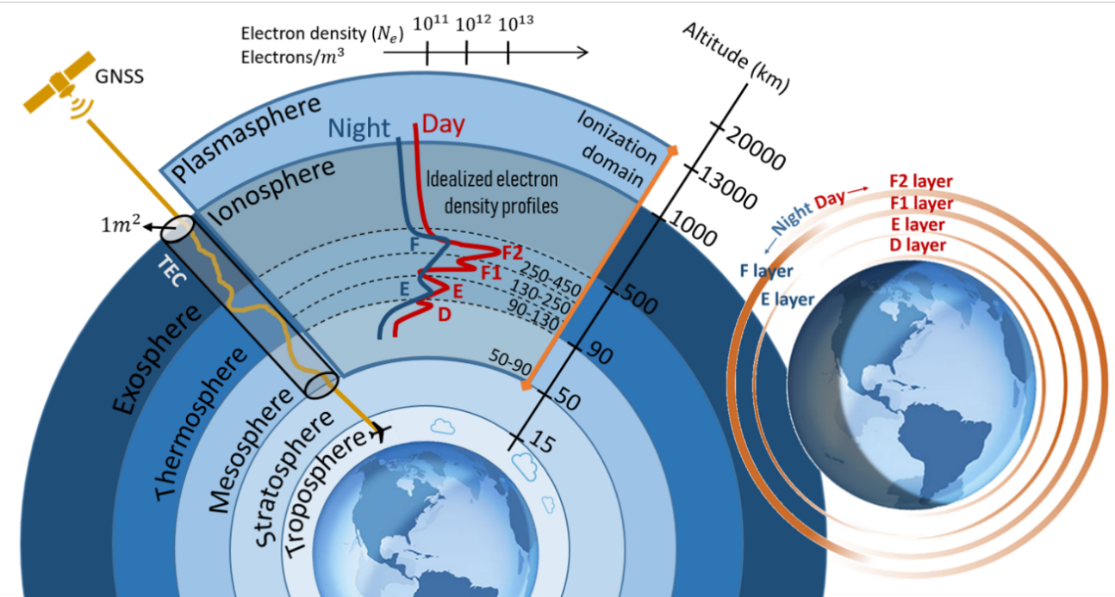





From GNSS receivers we can derived ROTI
A simplified picture…
$$\vec{V_{IPP}}$$
$$\vec{V_{irr}}$$
… so large scales with respect to what revealed by S4, i.e. up to hundreds of meters
$$r_{irr}^{ROTI}= {V_{irr}}/{f_{irr}^{ROTI}}$$
$$f_{irr}^{ROTI}$$
Is the Nyquist frequency of the ROTI observation (2 x 30 s)⁻¹
$$V_{irr}≈100\frac{m}{s}$$
$$r_{irr}^{ROTI}=100 \frac{m}{s}×60 s=6 km$$

Slide 19
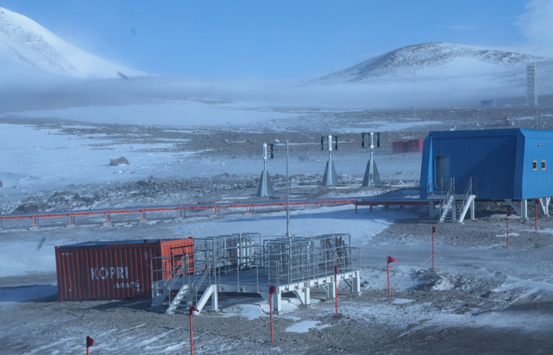
What scale sizes of the ionospheric irregularities from vertical sounding?
ν_{F}: Fresnel’s Frequency
V^{REL}: relative velocity ray-path-ionosphere
d_{F}=sqrt(2*λ*h_{IPP})
In this case we can assume h_{IPP} ~h_{MAX}
Computing from working frequencies of few MHz
d_{F} is of the order of 1-10 Kilometers
University of Colorado/KOPRI

Slide 20
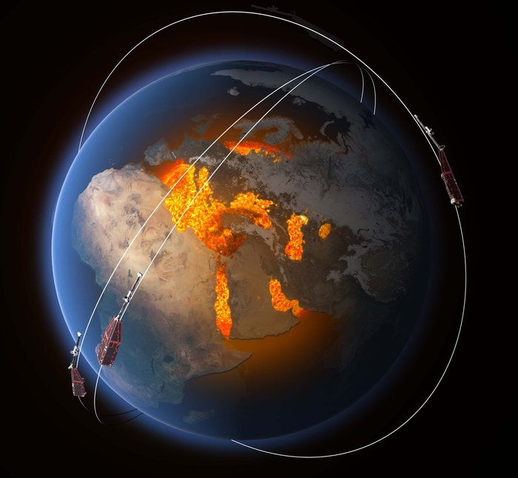
IONOSPHERIC ELECTRON DENSITY FROM LANGMUIR PROBE AND FACEPLATE ON BOARD LEO SATELLITES:
The Swarm measurements
Mission
Launched: 22 November 2013
Initial constellation of the mission: 17 April 2014
Duration: 4 years but still in orbit!
Type: Low Earth; near-polar Configuration: constellation of three identical satellites: two orbit side-by-side, decaying naturally from an initial altitude of 460 km to 300 km over 4 years; the third maintains an altitude of about 530 km.
Swarm A and C form the lower pair of satellites flying side-by-side (1.4° separation in longitude at the equator) at an (initial) altitude of 462 km and inclination angle equal to 87.35°, whereas Swarm B is cruising at higher orbit of about 511 km (initial altitude) and inclination angle is equal to 87.75°.
Velocity of Swarm satellites: 7.5 km/s
Sampling frequency of the electron density by onboard Langmuir probes: 2Hz
Sampling frequency of the electron density by onboard Faceplate: 16Hz
Maximum resolution of the ionospheric irregularities scale-size:
7.5·10³ (m/s) x 0.5 (s) ≈ 4·10³ m 7.5·10³ (m/s) x 0.0625 (s) ≈ 4·10² m
By Swarm data analysis we can identified irregularities of few kilometers-scale size or bigger/hundreds meters-scale size or bigger

Slide 21
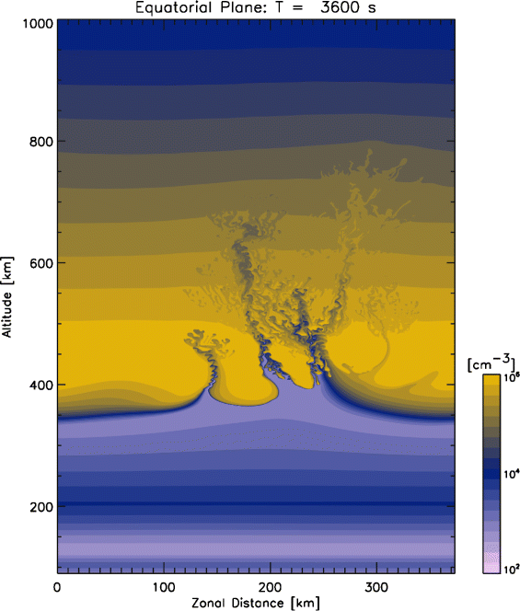
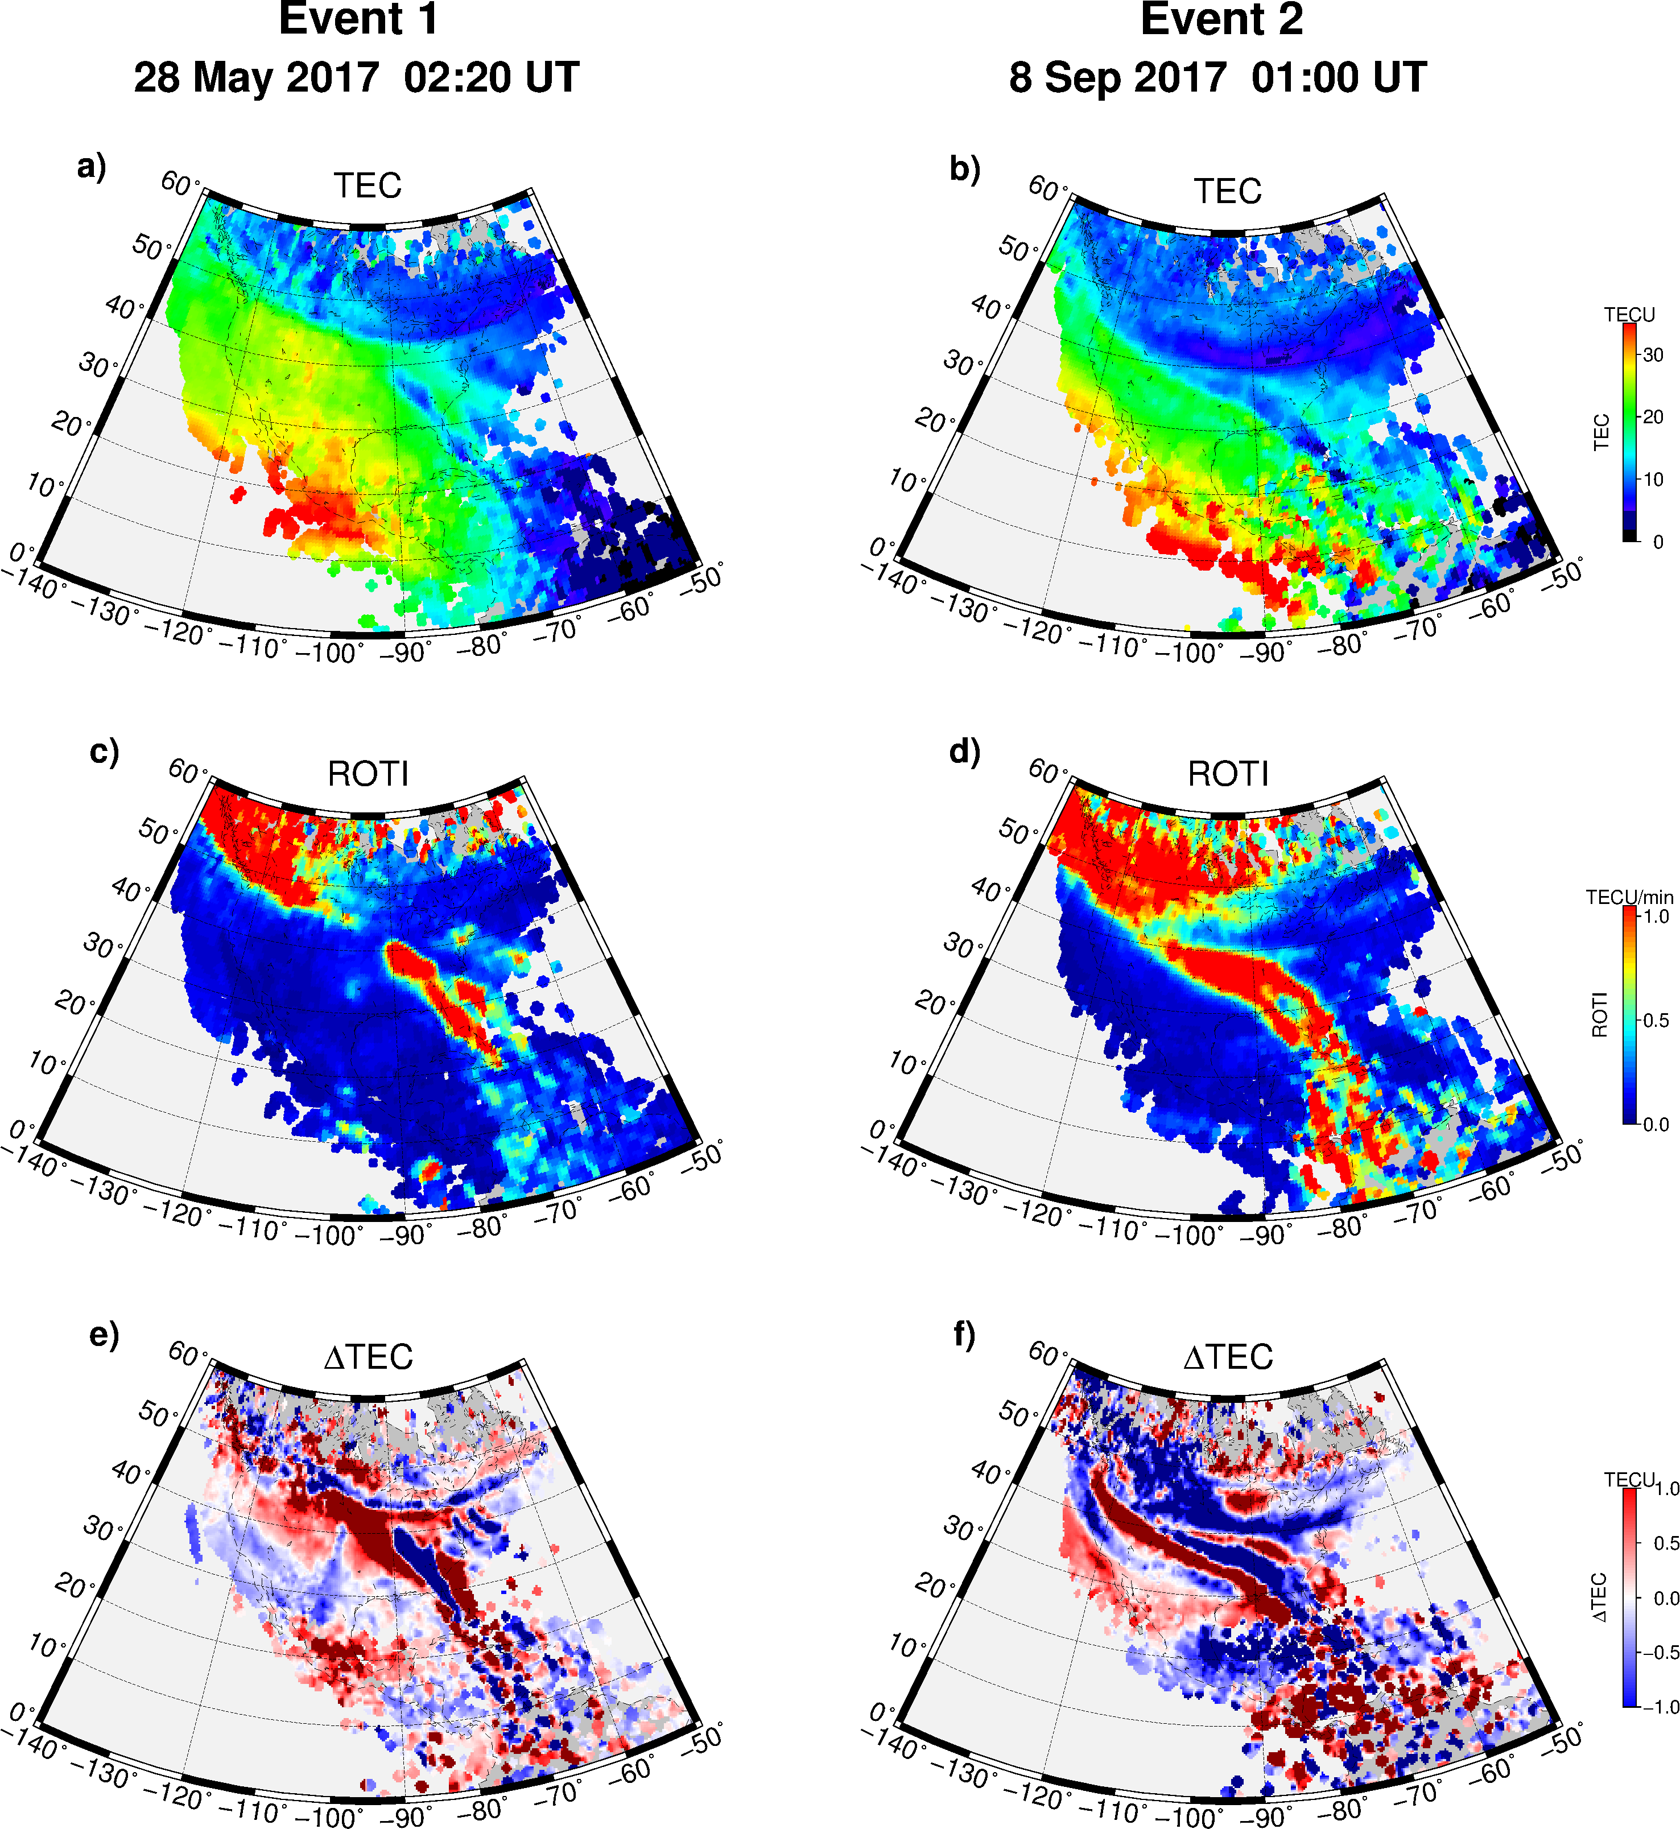
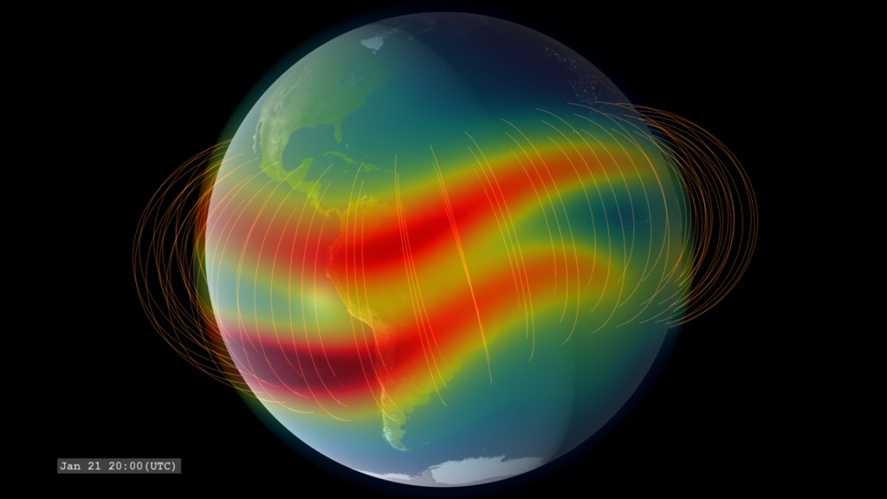
The study of the ionospheric irregularities
Credits: Cherniak
Credits: NASA
Credits: Yokoyama
100 m
1 km
10 km
100 km
1000 km
*Small scale
(Fresnel’s scale)
*Medium scale
*Large scale
*from a GNSS perspective

Slide 22
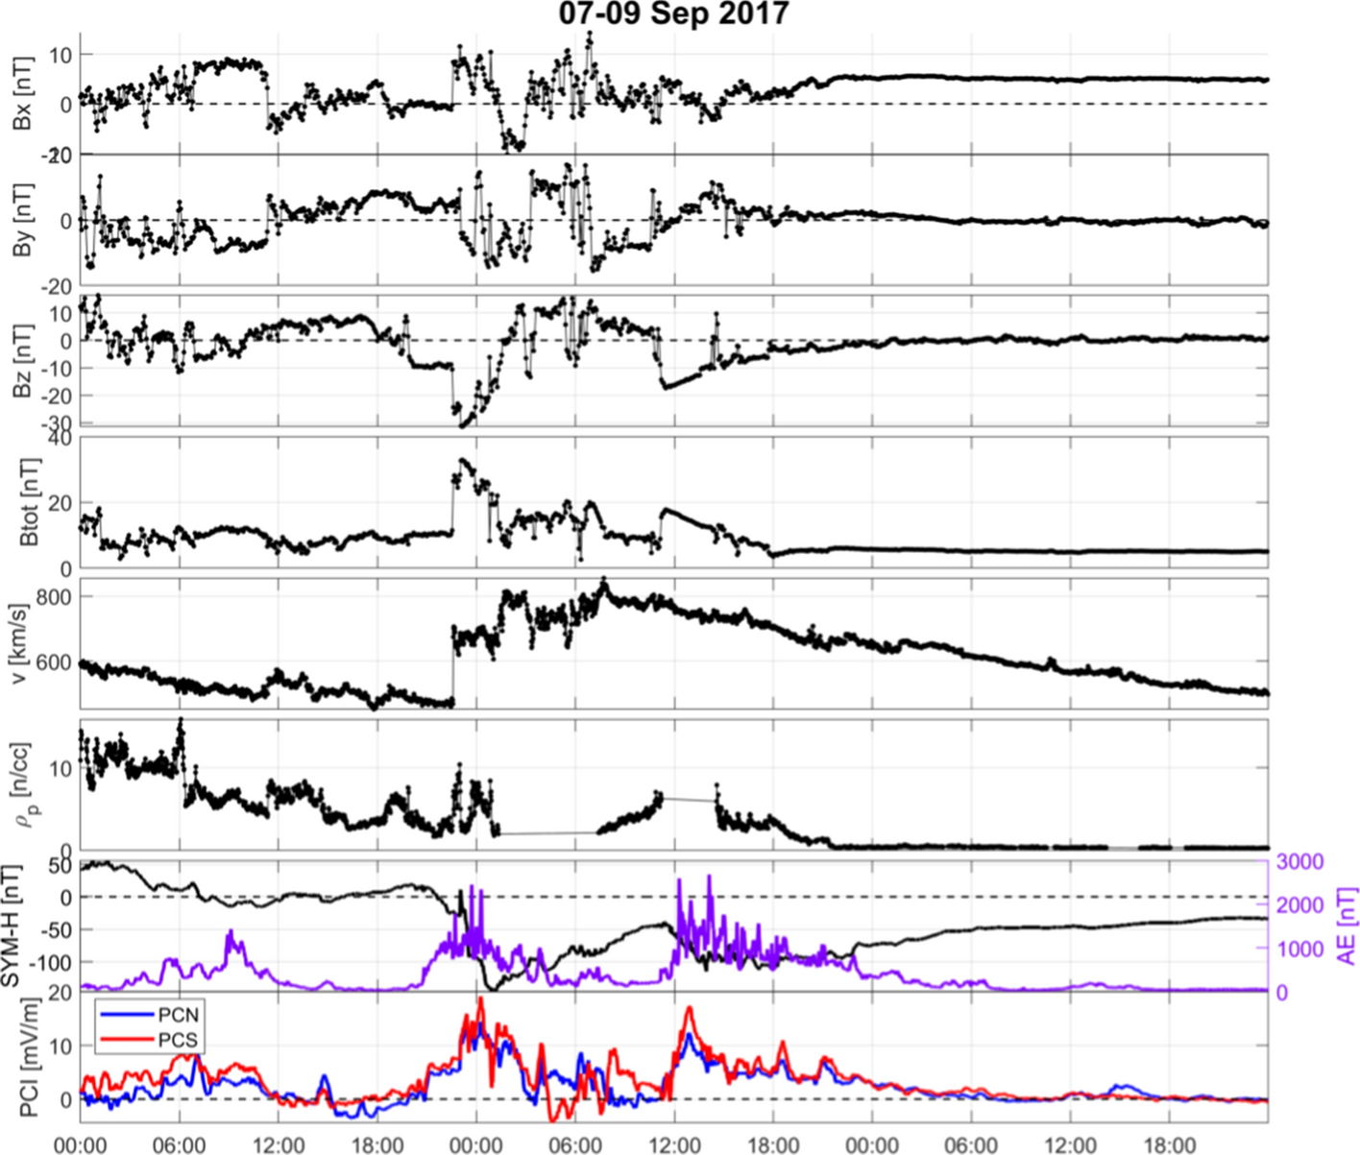
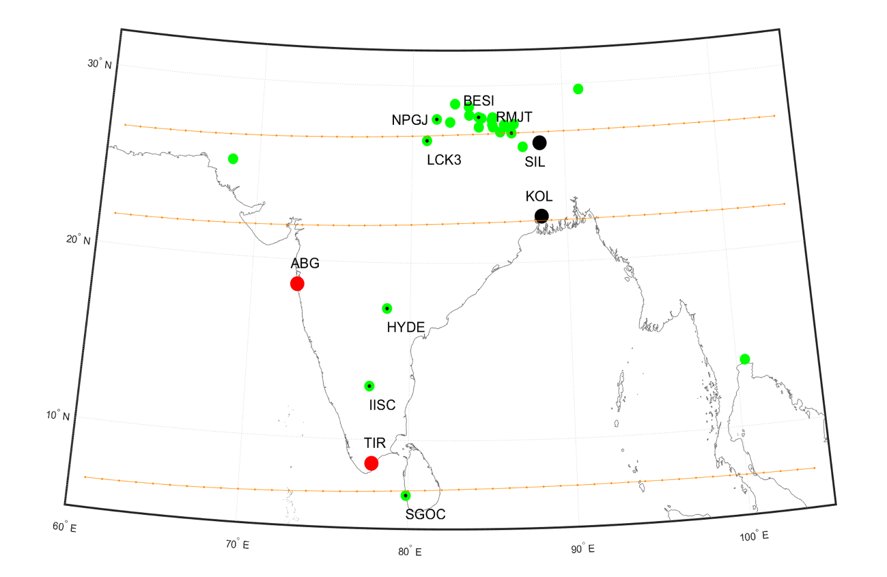
Space weather event of September 2017 - ionospheric response from India
GEOSPACE
EARTH
Geodetic receivers
Scintillation receivers
Magnetometers

Slide 23
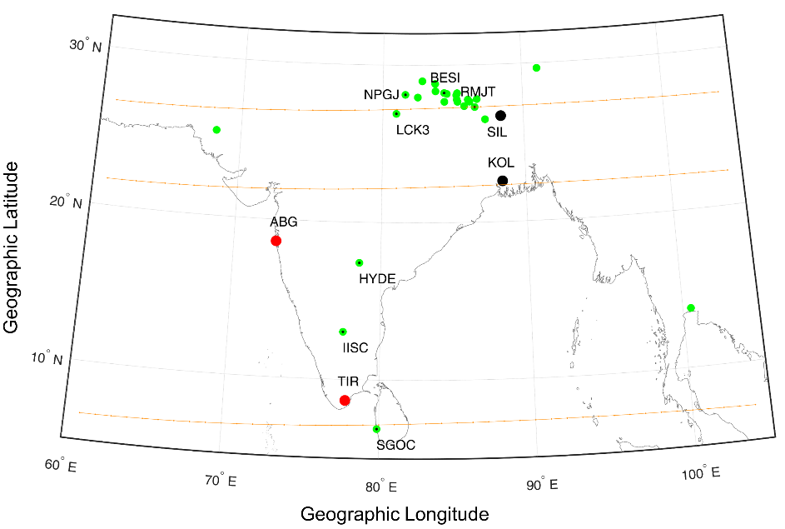
Space weather event of September 2017 - ionospheric response from India
Observing system | System output or derived product | Expected Information
GNSS ground-based receivers | DTEC, TEC, scintillation indices | Ionospheric irregularities
Swarm satellites | Ion density | In-situ electron density variations
Ground-based magnetometers | Geomagnetic field components | Geomagnetic field variations

Slide 24
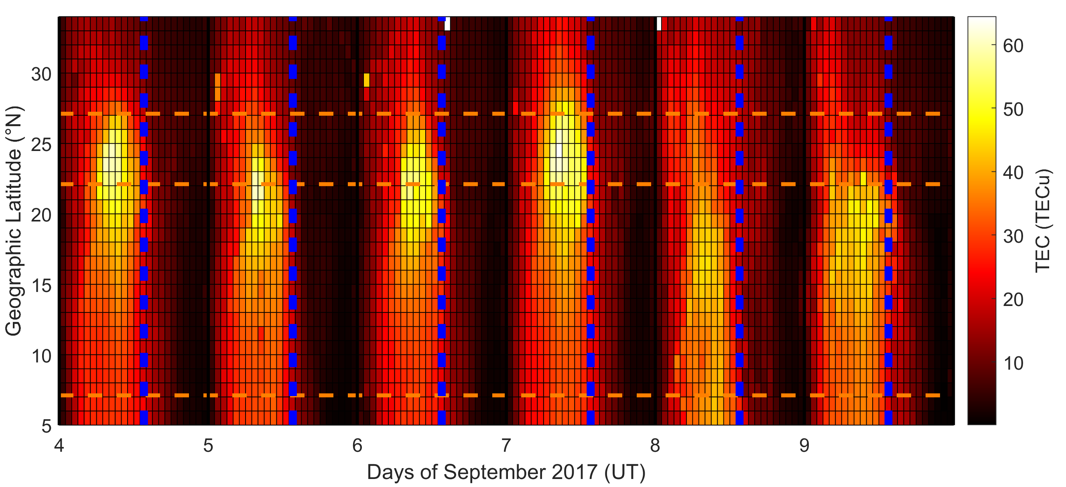
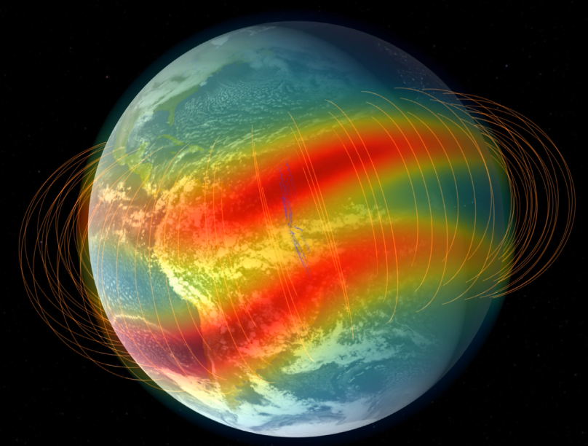
From Alfonsi et al., 2021

Slide 25

Space weather event of September 2017 - India
From Alfonsi et al., 2021
Notes:
TEC difference between 8 September and quiet reference
Green diamonds represent the time and latitude of IPP having ROTI>0.5 TECu/min, while black dots are for IPP having S4>0.3.

Slide 26
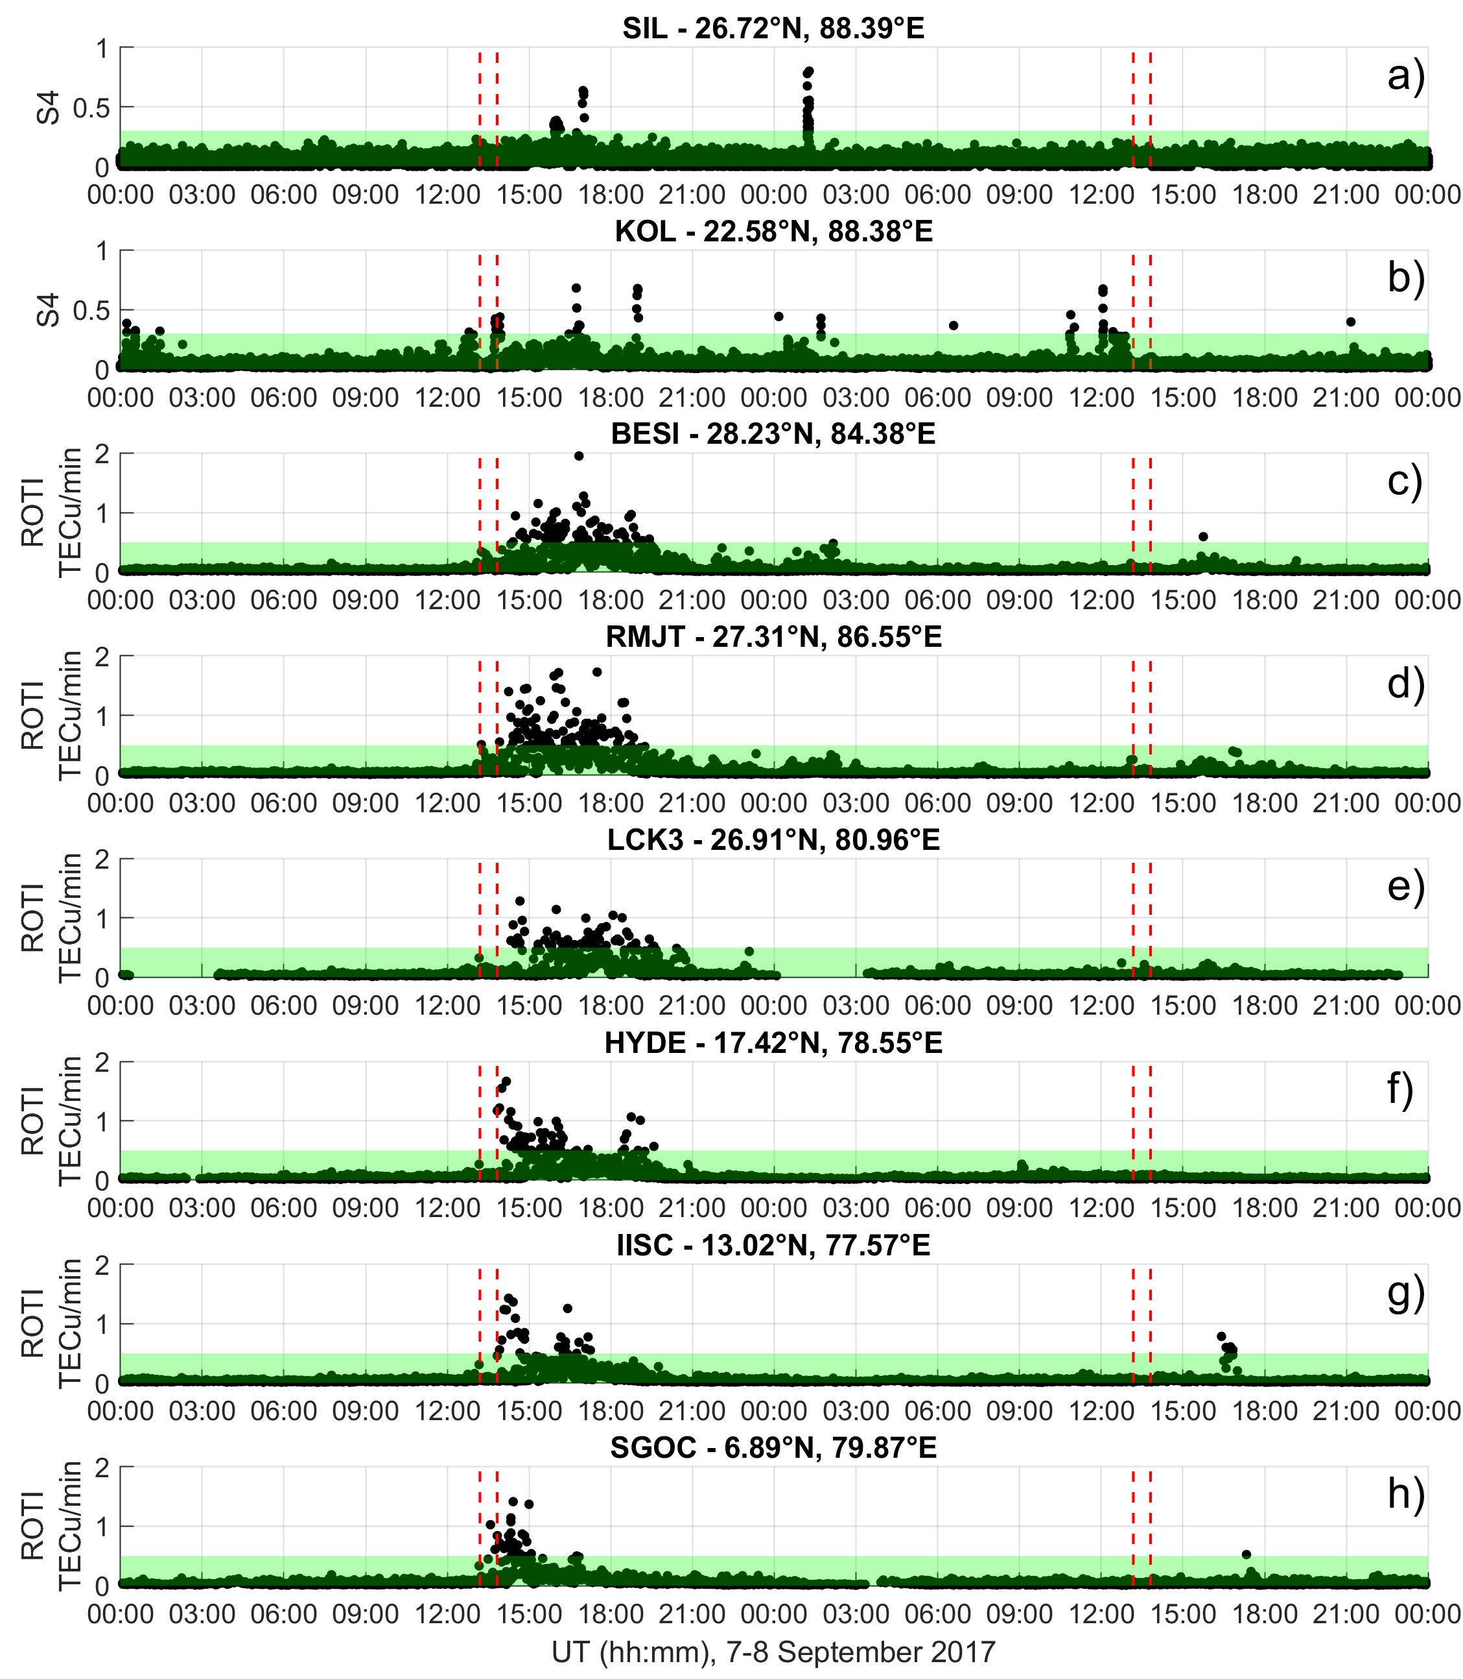
Space weather event of September 2017 - India
From Alfonsi et al., 2021
Notes:
TEC difference between 8 September and quiet reference
Green diamonds represent the time and latitude of IPP having ROTI>0.5 TECu/min, while black dots are for IPP having S4>0.3.

Slide 27
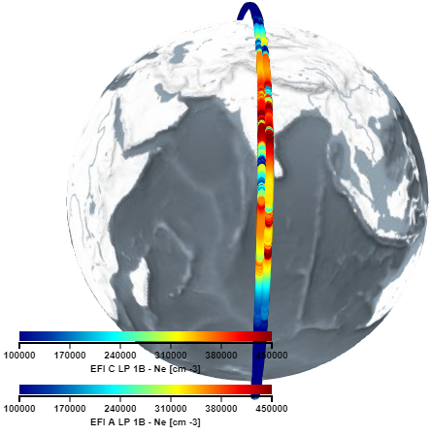
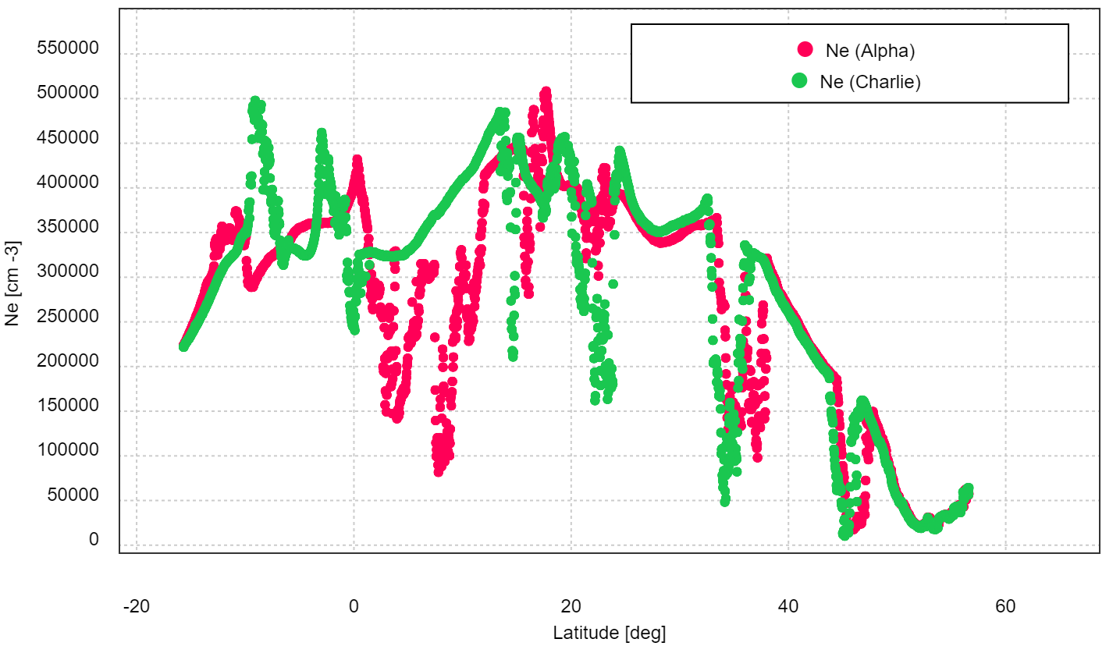
From Swarm satellites other scale sizes can be identified
Velocity of Swarm satellites: 7.5 km/s
Sampling frequency of the electron density by onboard Langmuir probes: 2Hz
Maximum resolution of the ionospheric irregularities scale-size:
7.5·10³ (m/s) x 0.5 (s) ≈ 4·10³ m
By Swarm data analysis we can identified irregularities of few kilometers-scale size or bigger
With faceplate electron density measurements sampled at 16 Hz, the maximum resolution of the ionospheric irregularities scale-size ≈400 m

Slide 28
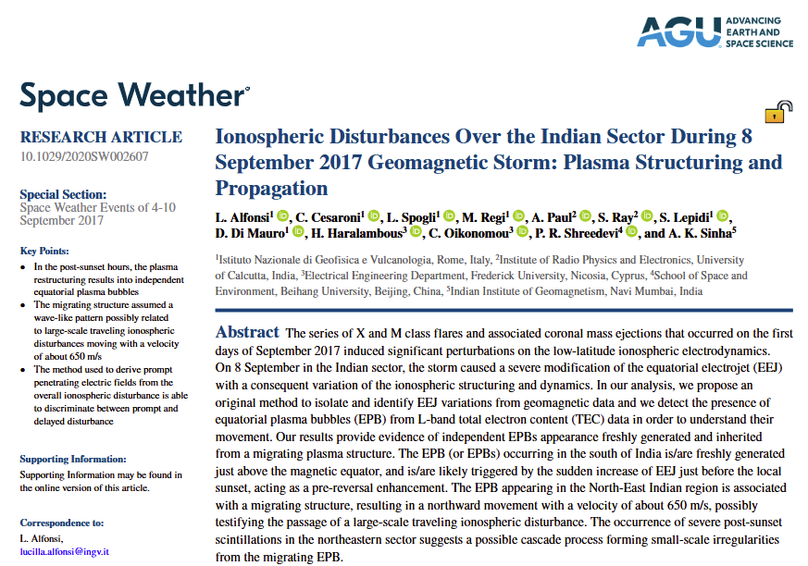
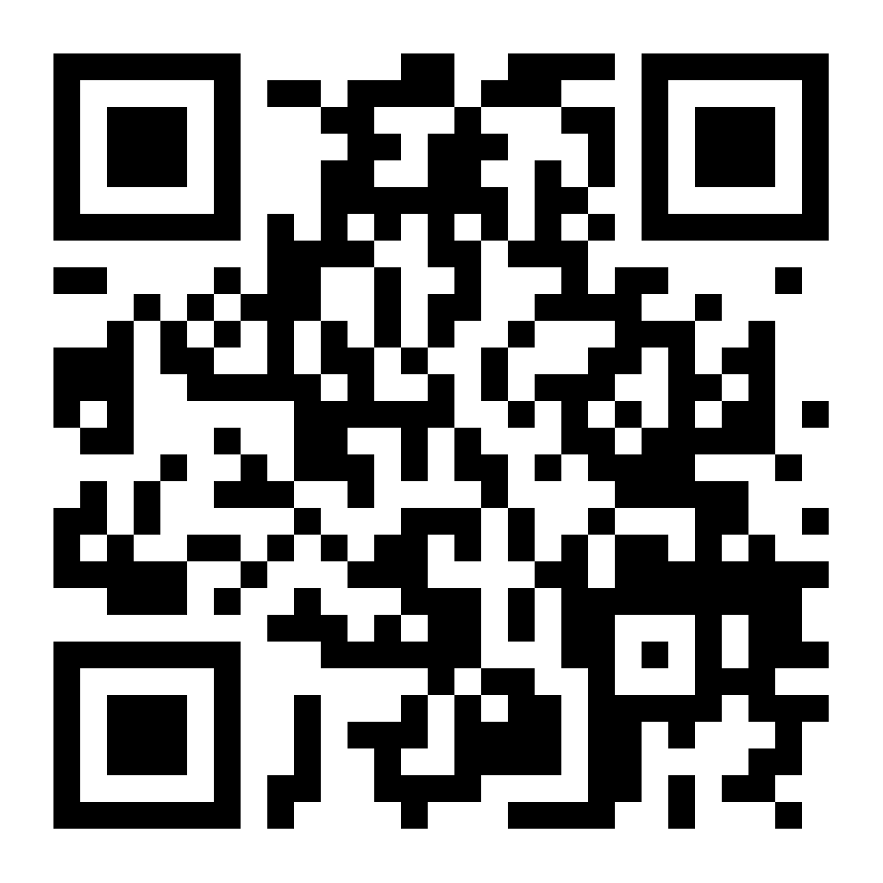

Slide 29
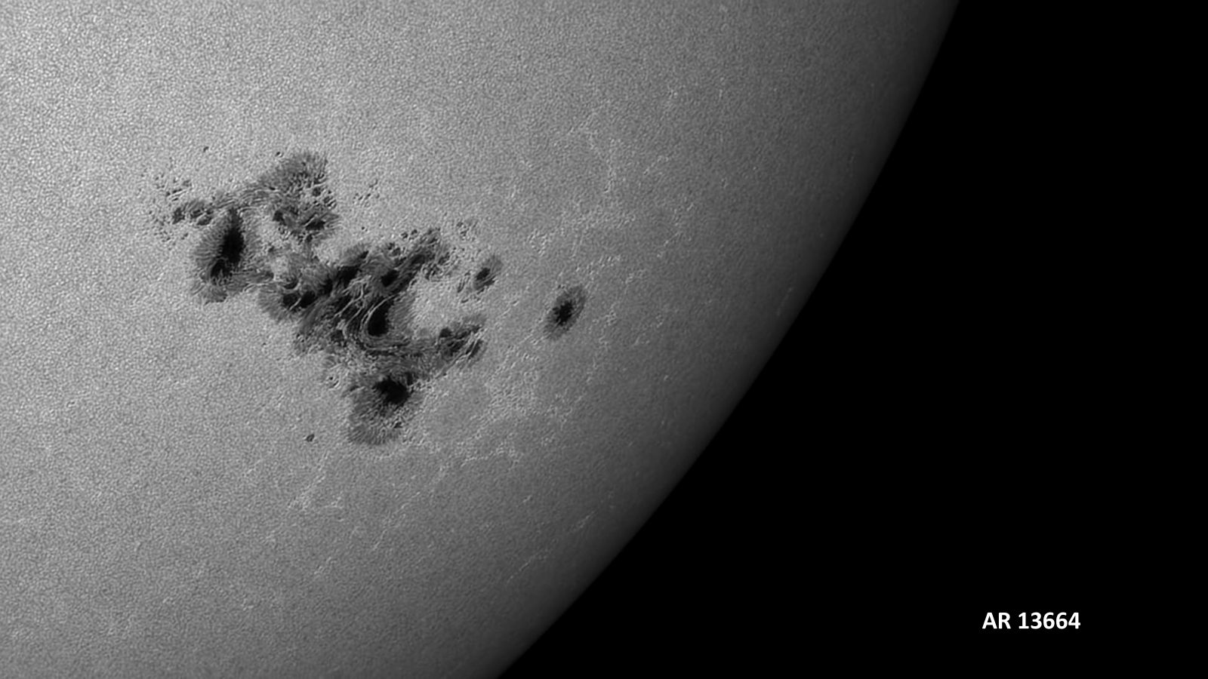
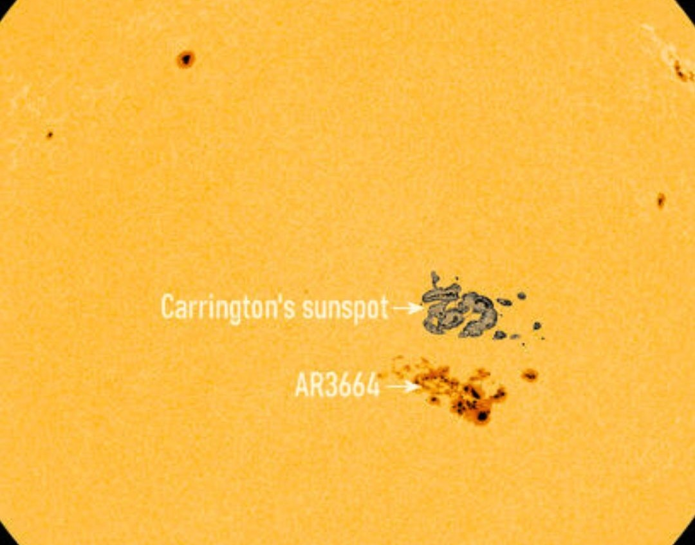
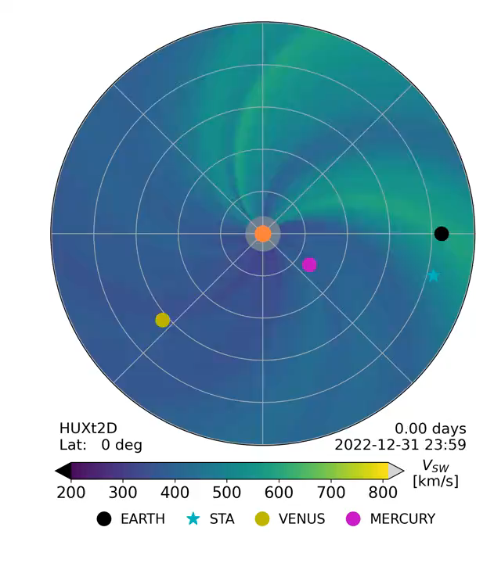

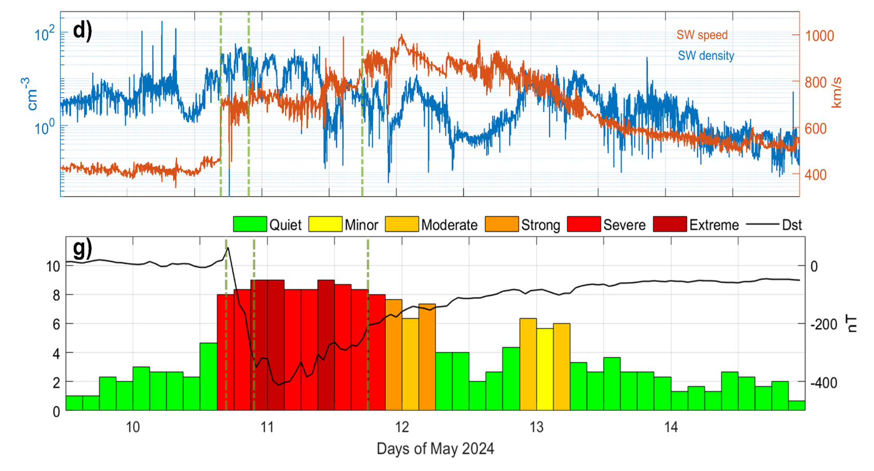
More on AR13664 in Romano et al. (2024), The Astrophysical Journal Letters, 973(1), L31.
May 2024 Mother’s Day superstorm
@mathewjowens.bsky.social
EARTH
Courtesy of Paolo Romano
Spogli et al. (2024) doi:10.4401/ag-9117

Slide 30
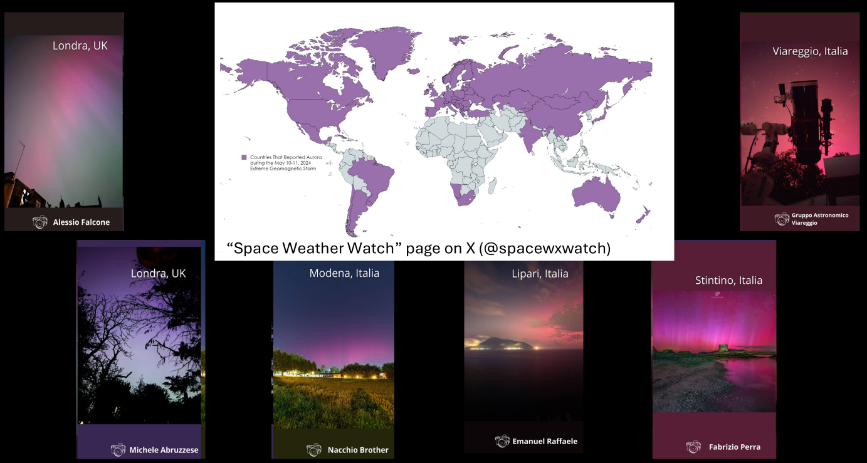
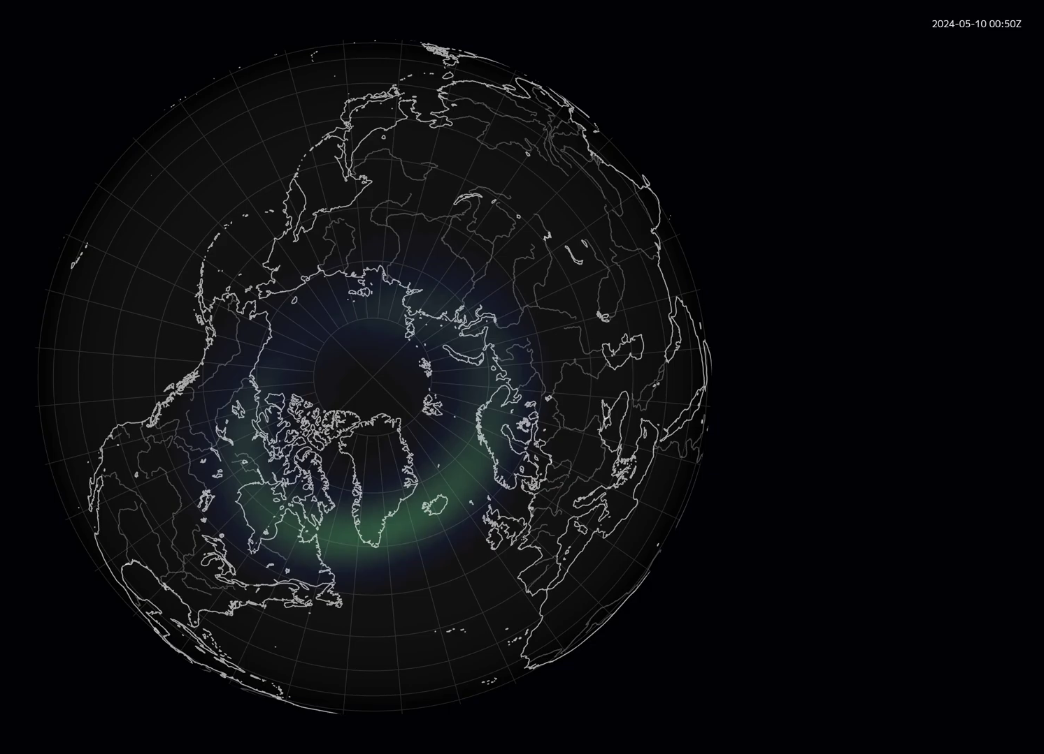
OVATION

Slide 31
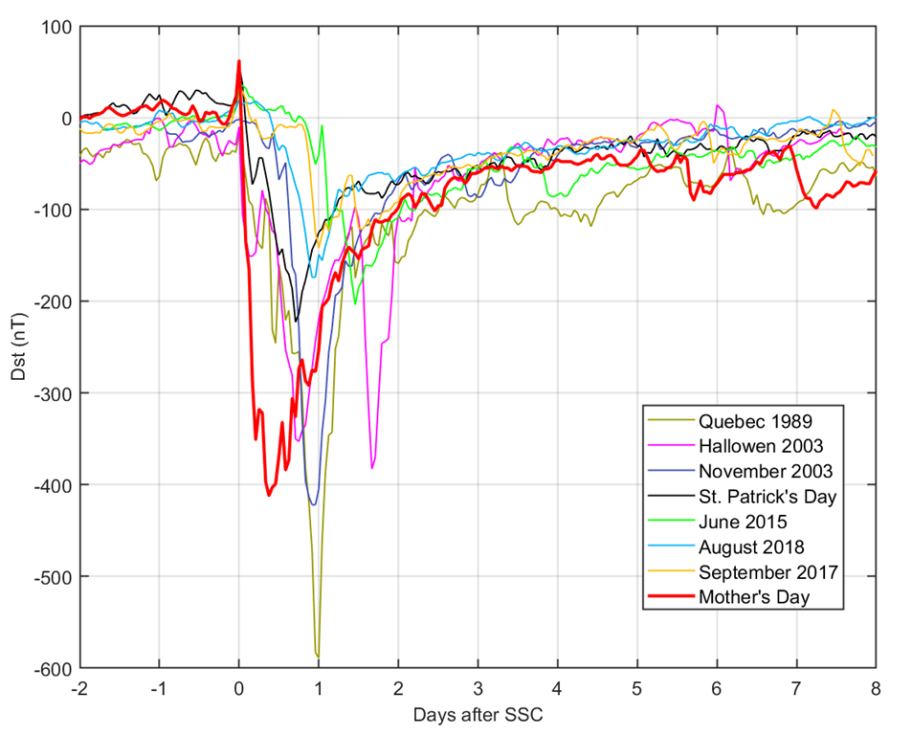
May 2024 Mother’s Day superstorm
A Storm Two Decades in the Making: First major storm of this magnitude in ~20 years
“Mother” of a New Generation of Storms: A unique and unprecedented stress test for the Space Weather (SW) community, encompassing science, technology, and services
Scientific Opportunity: Enhanced understanding of ionospheric dynamics in the Mediterranean region
Citizen Science in Action: Large public engagement (“I saw the aurora over Rome!”) highlighting the power of community observations
Statistical Rarity:
Magnitude: A 1-in-12.5-year event
Duration: A 1-in-41-year event
Elvidge and Themens, https://doi.org/10.22541/essoar.172411905.51539634/v1
May 2024 Mother’s days superstorm

Slide 32
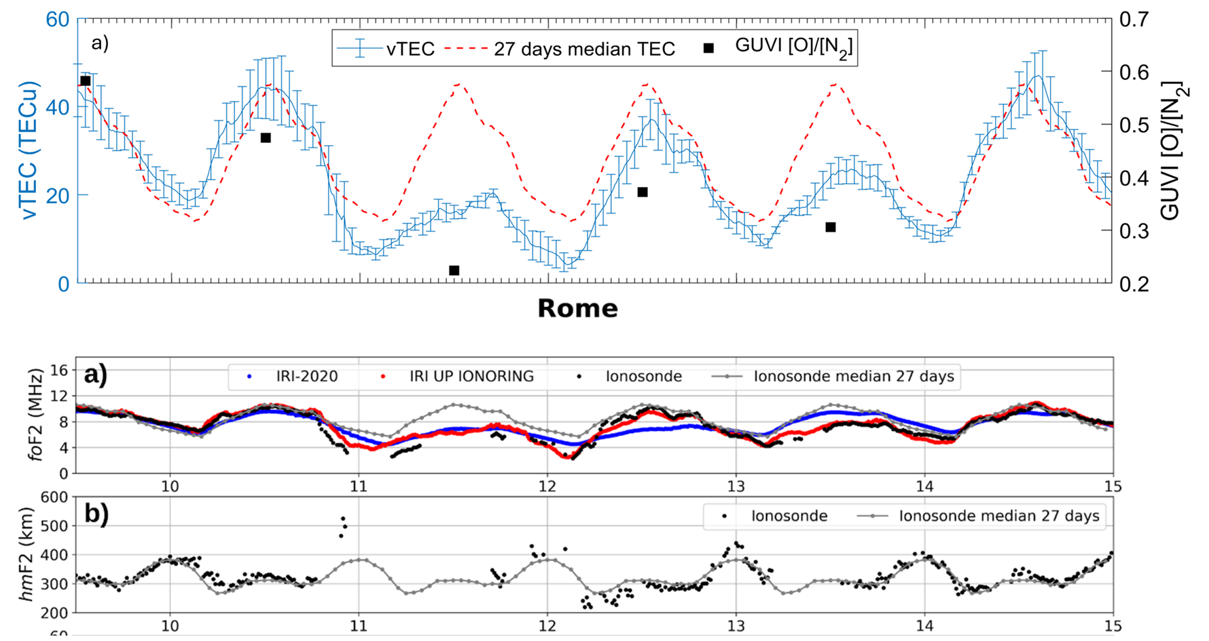
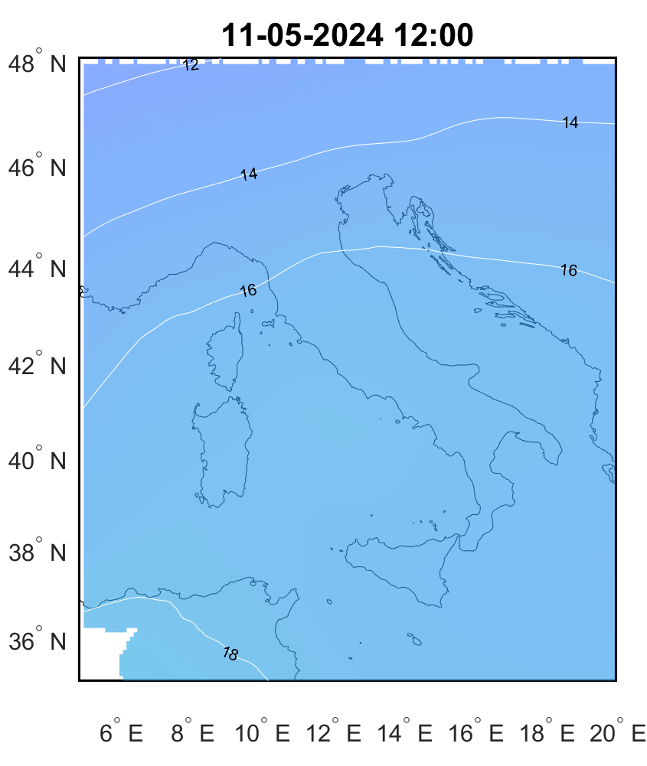
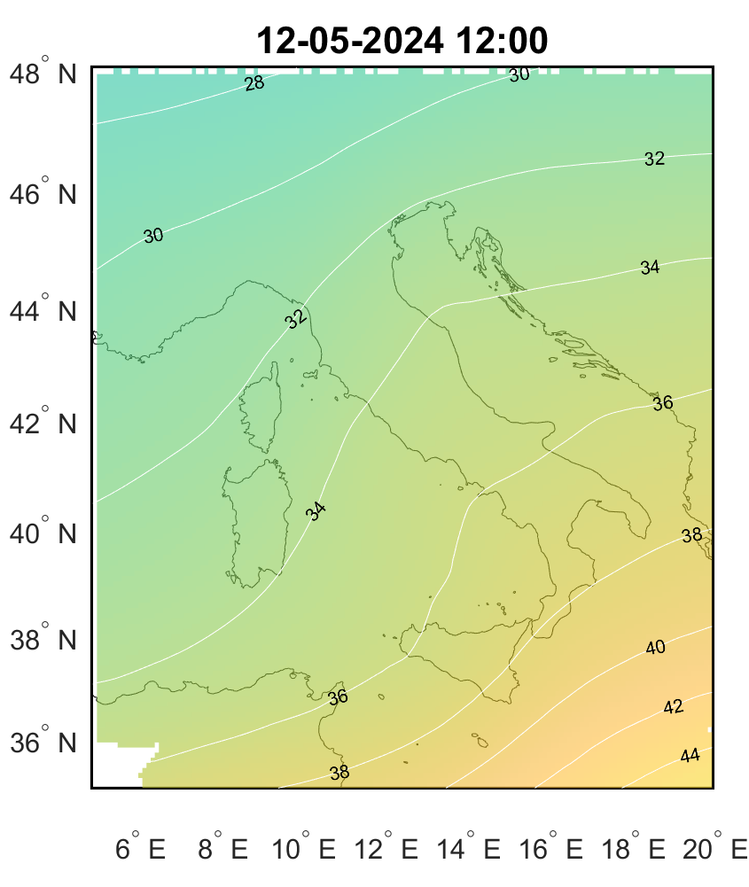


How the ionosphere reacted to the storm?
10
11
12
13
14
Long-lasting negative storm conditions
No positive storm signatures (which is very rare!)
IONORING Maps, Cesaroni et al. (2021)

Slide 33
How the ionosphere reacted to the storm?
10
11
12
13
14
*Pignalberi et al. (2024),
https://doi.org/10.1029/2023SW003838
Ionosphere almost disappeared (4 TECu)!
Strong decrease of the [O]/[N2] ratio
*
About 33% of the ratio under quiet conditions

Slide 34

How the ionosphere reacted to the storm?
*Pignalberi et al. (2024), Space Weather
*

Slide 35





How the ionosphere reacted to the storm?
- Upward displacement of the ionosphere
- foF2 down to 2 MHz
Absorption
+
Spread F
+
G conditions

Slide 36


Ionospheric structuring (irregularities)
1 minute S4:
Small Scale irregularitites (hundreds of meters)
5 minutes ROTI (from 30 s TEC):
Medium Scale irregularities (few kilometers) at low/mid latitudes (slow plasma)

Slide 37



A collaborative effort
Space Weather Monitoring Group (SWMG)
INGV - Environment Department
Featuring:
The Mother’s Day series of Space Weather events
Ionospheric and geomagnetic response
Event communication to the public

Slide 38





Registration form:
Join us!
Lucilla Alfonsi (INGV, Italy), Wojciech J. Miloch (university of Oslo)
on behalf of the AGATA Community
https://nettskjema.no/a/agata-registration
AGATA is a new SCAR Scientific Research Programme (SRP) aiming to significantly advance the current knowledge of the Antarctic atmosphere and geospace, also in the bipolar, interhemispheric context.
How are different atmospheric layers coupled in the polar regions?
How does the upper polar atmosphere respond to increased geomagnetic activity, including energy transfer from space?
How does the whole polar atmosphere impact short- and long-term climate variations?
www.scar.org/science/agata/home/

