Slide 1
High-Frequency (HF) Vertical Ionospheric Soundings:
Main Features and their Interpretation
Michael Pezzopane
michael.pezzopane@ingv.it
Istituto Nazionale di Geofisica e Vulcanologia, 00143, Rome, Italy

Slide 2
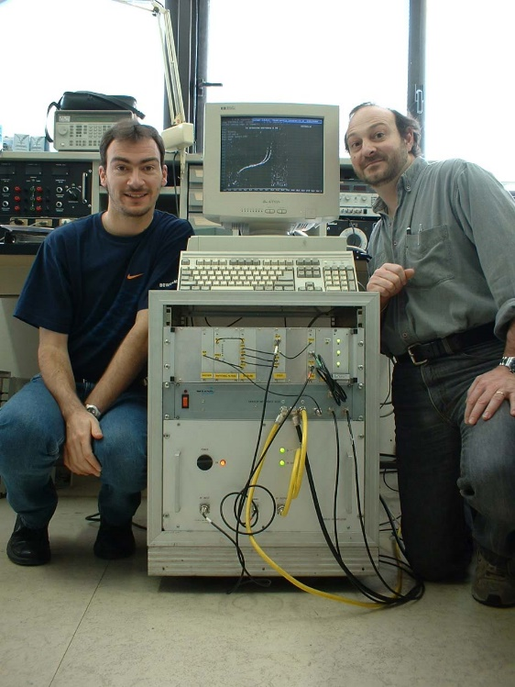
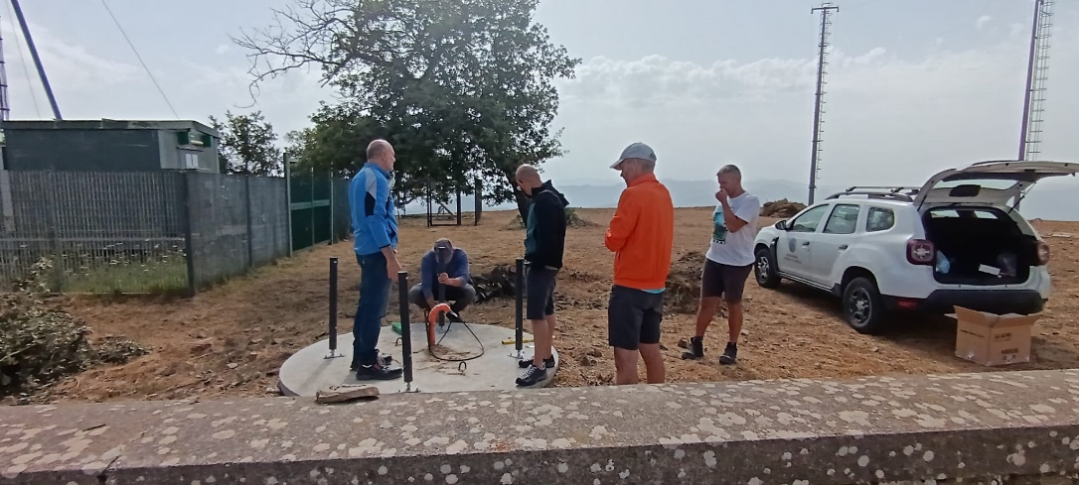
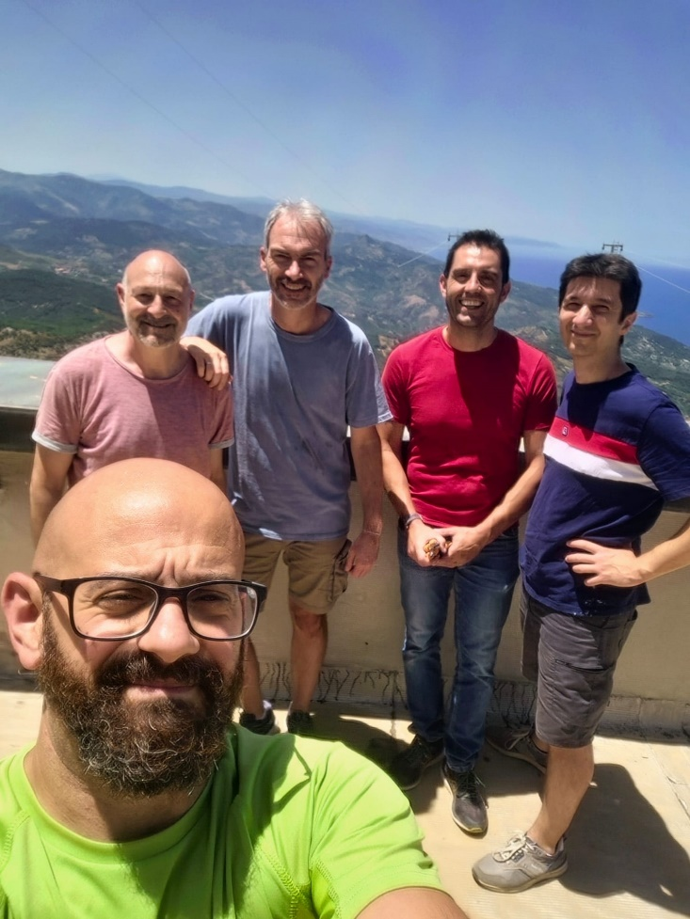
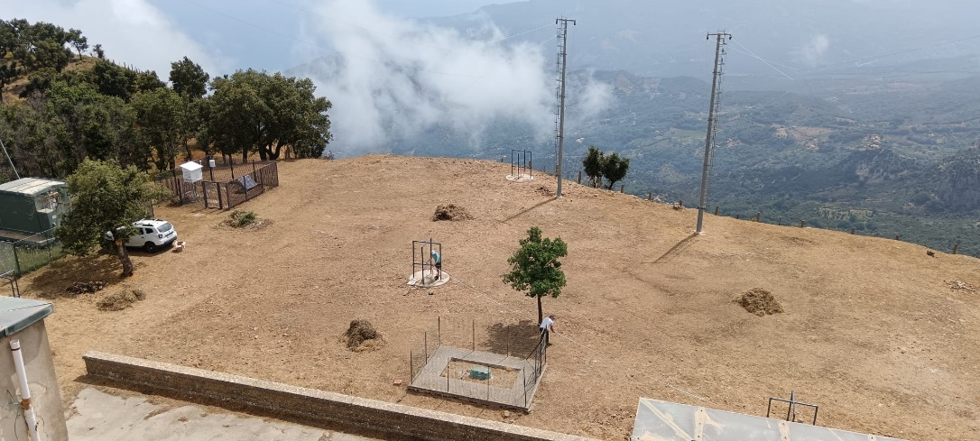
From the very beginning to now……….
2003 - Rome
2024 – Gibilmanna (Sicily)
Enrico
me
Enrico
me
Antonio
Gioacchino
Claudio

Slide 3
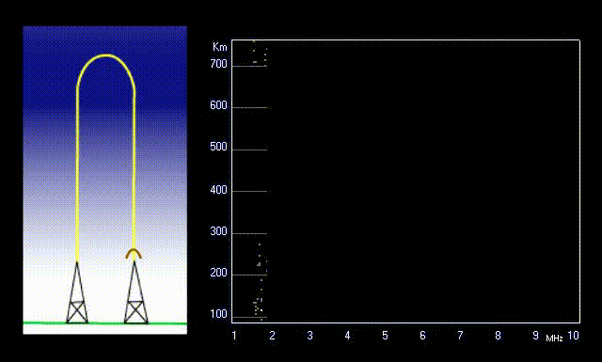
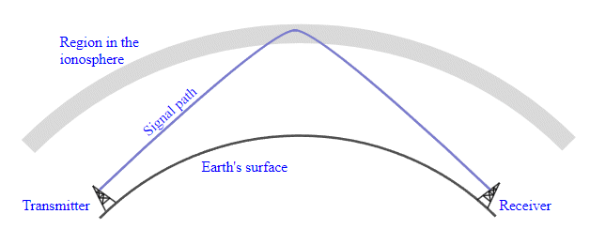
Possible Ionospheric Propagations: Oblique and Vertical
Vertical propagation
Oblique propagation
Rx
Tx
Increasing the transmitted frequency, in the oblique case we go farther, in the vertical case we go higher.
Anyhow, for both cases there will be a value of the frequency beyond which the signal penetrates the ionosphere without being reflected.
We will focus
on this method

Slide 4
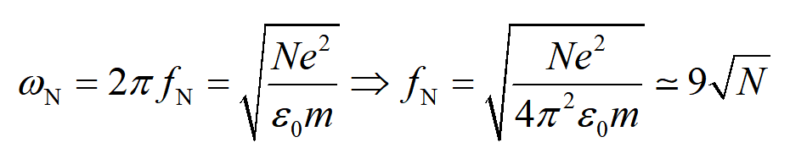
The Plasma Frequency
N is the electron density per unit volume, m the electron mass, e the electron charge and ε₀ the electric permittivity of the free space.
f_{N} is called plasma frequency and represents the frequency with which the electrons oscillate around the ions if displaced from their equilibrium position, for instance because of the the perturbing electric field E of the electromagnetic wave propagating through the ionospheric plasma.
A plasma can be considered neutral over temporal scales greater than the corresponding oscillation period τ>>1/ω_{N}.

Slide 5
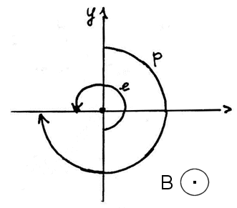
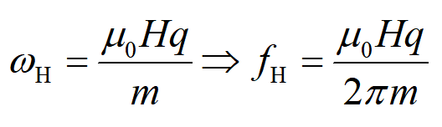
The Gyrofrequency
The gyrofrequency is the angular frequency of the circular motion of a charged particle in the plane perpendicular to the magnetic field defined by the following relation:
H is the magnetic field, μ₀ the magnetic permeability of the free space, q the charge of the particle, and m the mass of the charged particle.

Slide 6
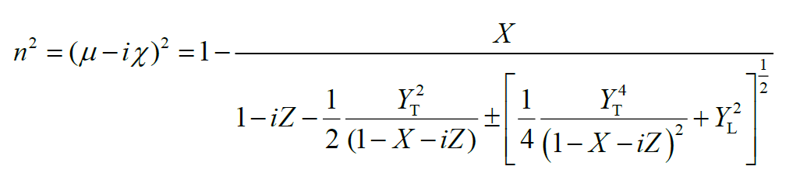
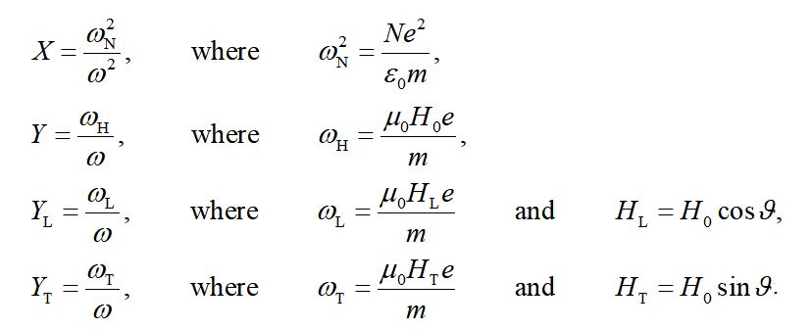
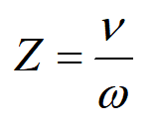
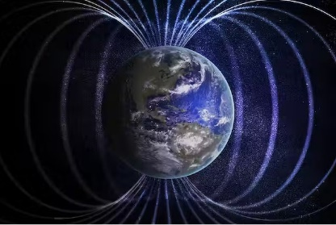
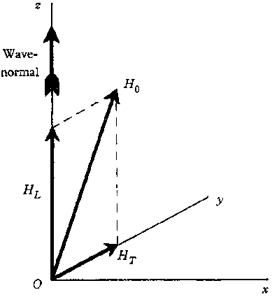
The magnetoionic theory -> the Altar-Appleton equation
The magnetoionic theory is concerned with the propagation of electromagnetic waves through a magnetoplasma.
Specifically, the reflection of the wave occurs when the ionospheric refractive index is equal to 0 → n = 0.
Altar-Appleton
equation
plasma frequency
collision frequency
wave frequency
gyrofrequency

Slide 7
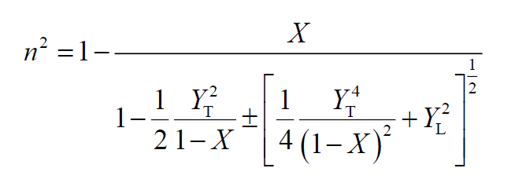
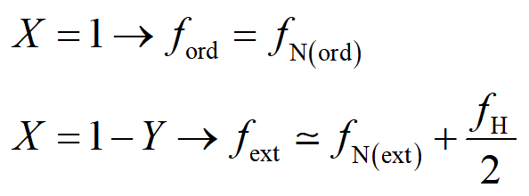

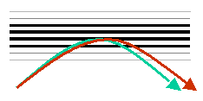
The Altar-Appleton equation neglecting collisions→ reflection conditions
→
After transmitting through a magnetoionic medium an electromagnetic wave with a certain polarisation, two waves (called ordinary and extraordinary) propagate through it; these two waves have the same frequency, different phase velocity and different polarisation. This phenomenon is called magnetoionic birefraction of the electromagnetic wave into the magnetoplasma.
Simply speaking, a wave with a generic polarisation can be thought as the resultant of two waves;
if the wave propagates through an isotropic medium the two components cannot be observed;
if the wave propagates through an anisotropic medium (as it is the case of a magnetoionic medium) the two components are instead observable.
ext
ord

Slide 8
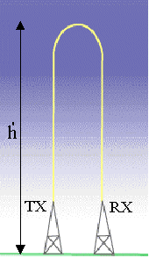

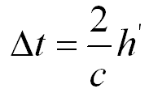
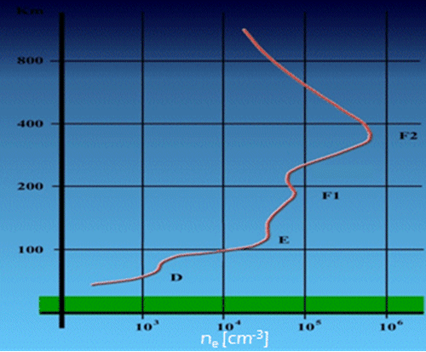
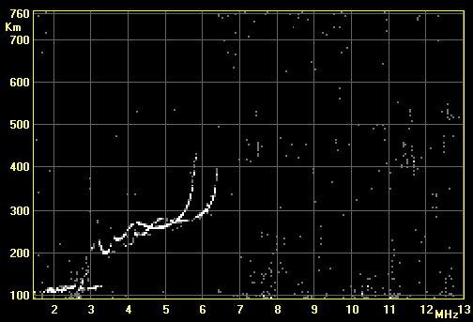


Vertical Ionospheric Soundings - Ionograms
Radiowaves of variable frequency are transmitted vertically towards the atmosphere. The ordinary mode of the transmitted wave is reflected from the ionosphere when the transmitted frequency matches the electron plasma frequency:
Depending on the reflection height there will be a definite time delay according to the relation:
The experimental trace is then a plot of the virtual height of reflection vs the transmitted frequency, which is called ionogram.
km
ordinary
extraordinary

Slide 9
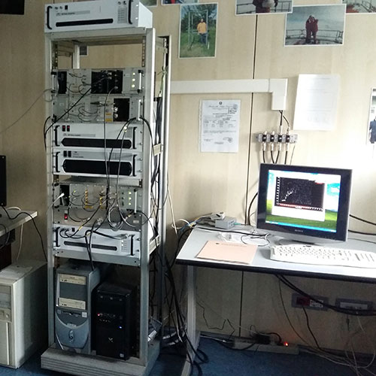
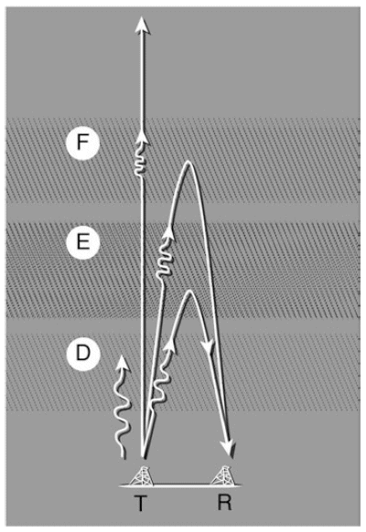
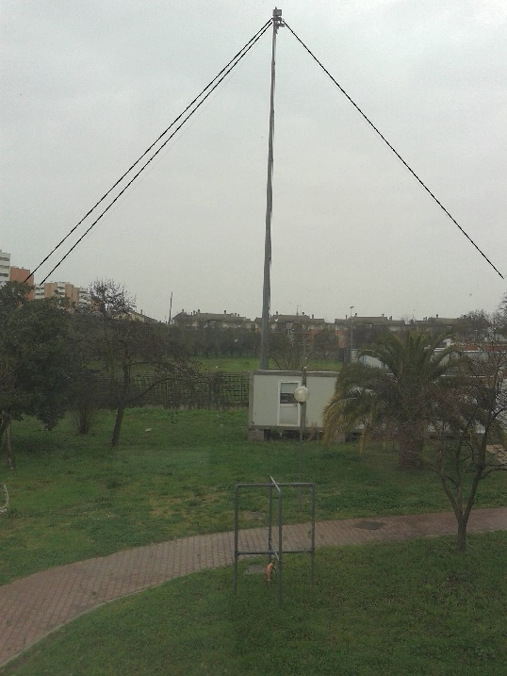
Vertical Ionospheric Soundings - Ionograms
f>fNmax
km
f≤fNmax
MHz

Slide 10
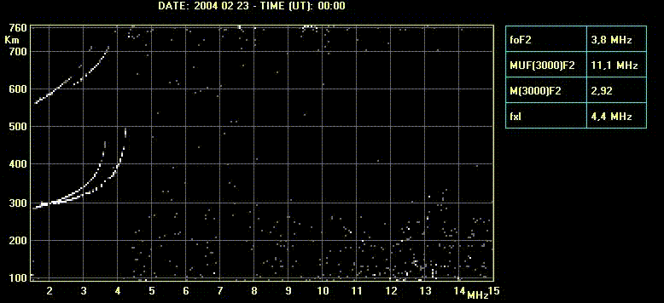
How the Ionogram trace varies along the day
km
AIS-INGV ionosonde

Slide 11
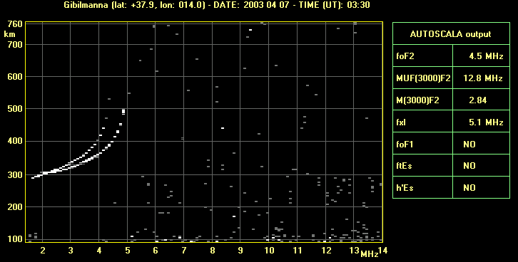
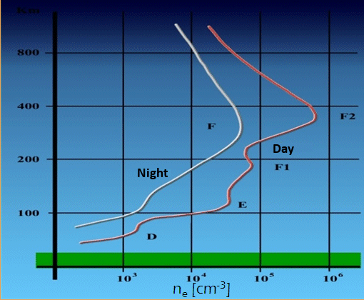
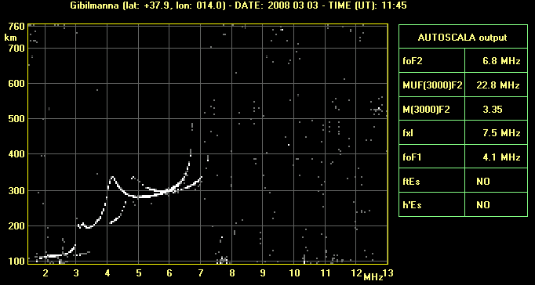
Daytime and Nighttime ionograms
Nighttime ionogram
AIS-INGV ionosonde
Daytime ionogram
AIS-INGV ionosonde

Slide 12
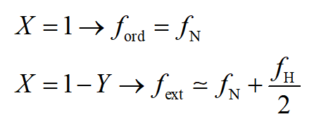

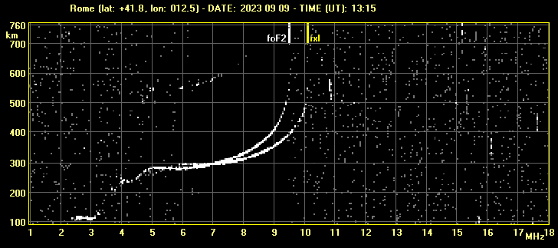
Influence of the geomagnetic field on the ionogram trace
AIS-INGV ionosonde

Slide 13

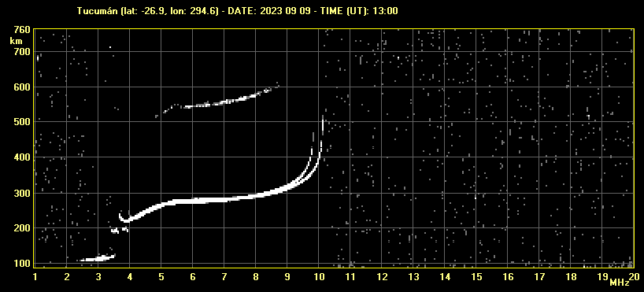
Influence of the geomagnetic field on the ionogram trace
AIS-INGV ionosonde

Slide 14
Basic rules for scaling the most important characteristics
Today we will focus mainly on mid-latitude ionograms but we will see also some equatorial ones. This is because most scalers start dealing with mid-latitude ionograms, and because when compared to high- and low-latitude ones their interpretation is simpler.
RULES
• recognise and scale some of the conventional parameters: critical frequencies of the three ionospheric layers, foF2, foF1, foE and their corresponding heights, h’F2, h’F1, h’E.
First, nighttime ionograms are considered, because they are the least complicated → there is only one layer present.
After looking at nighttime ionograms, daytime ionograms are considered → two/three ionospheric layers are now present.

Slide 15
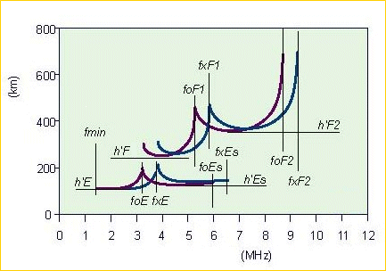


The ionogram scaling
The necessary work to obtain the ionospheric characteristics from an ionogram is called “ionogram interpretation or ionogram scaling”.
Till a few decades ago this interpretation was performed only manually by expert operators with a ruler and a pencil.
Now, luckily, there are softwares that help the operators to accomplish this demanding (but valuable) work.
extraordinary ray
ordinary ray

Slide 16
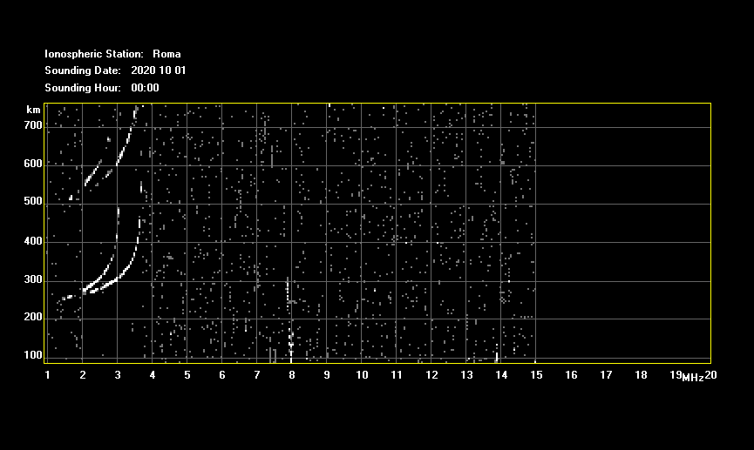
Scaling the most important characteristics – Nighttime ionograms
2X
Nighttime ionogram
Ionosphere
multiple reflections
Earth
foF2
F2
1X
Ionosphere
h’F2 = h’F
Earth
AIS-INGV ionosonde
From the analysis of one ionogram several important characteristics (like the critical frequencies and the heights of the different ionospheric layers) can be found, that have a significant role in the studies concerning ionospheric physics, space weather and related phenomena.

Slide 17
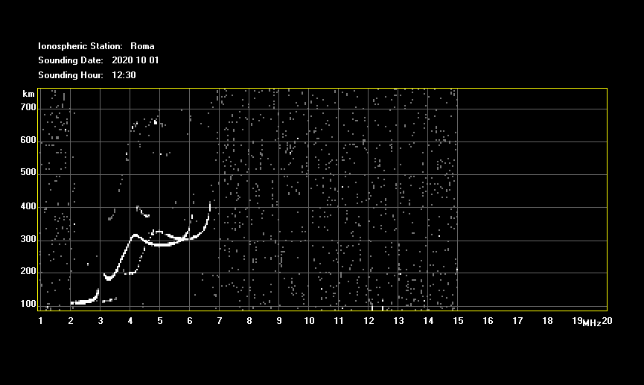
Scaling the most important characteristics – Daytime ionograms
Daytime ionogram
foF2
foF1
foE
F2
F1
h’F2
E
h’F1 = h’F
h’E
AIS-INGV ionosonde
From the analysis of one ionogram several important characteristics (like the critical frequencies and the heights of the different ionospheric layers) can be found, that have a significant role in the studies concerning ionospheric physics, space weather and related phenomena.

Slide 18
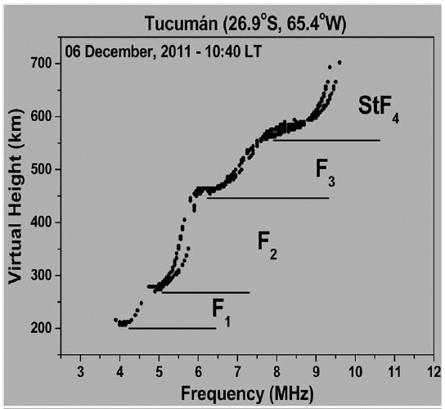
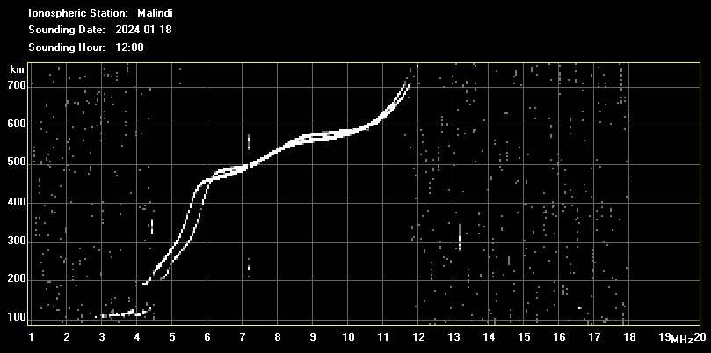
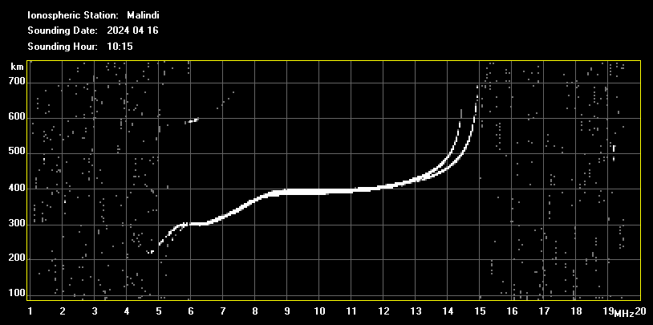
Multiple stratifications of the F layer
F3
F2
F1
F3
F2
F1
AIS-INGV ionosonde

Slide 19
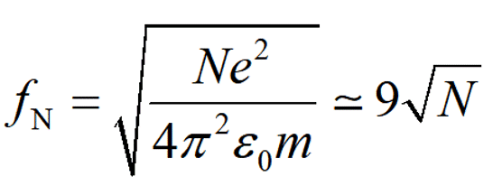
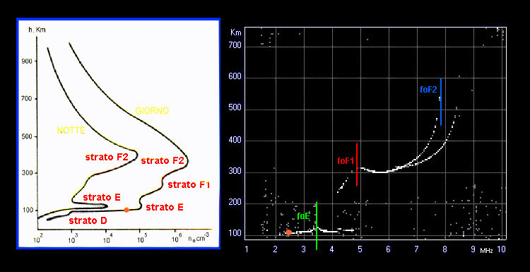
Correspondence vertical electron density profile – ionogram trace
AIS-INGV ionosonde
km
km
500
Day
400
Night
300
F2 layer
NmF2
200
NmF1
F1 layer
100
NmE
E layer
10²
10³
10⁴
10⁵
Ne (cm-3)

Slide 20
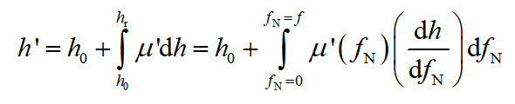
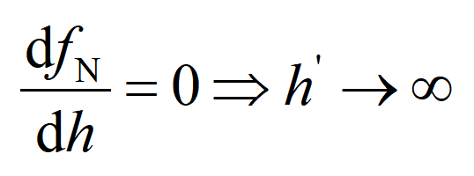
Why electron density maxima of the profile correspond to ionogram cusps?
NmF2
NmF1
NmE
km
foF2
foE
foF1
AIS-INGV ionosonde

Slide 21
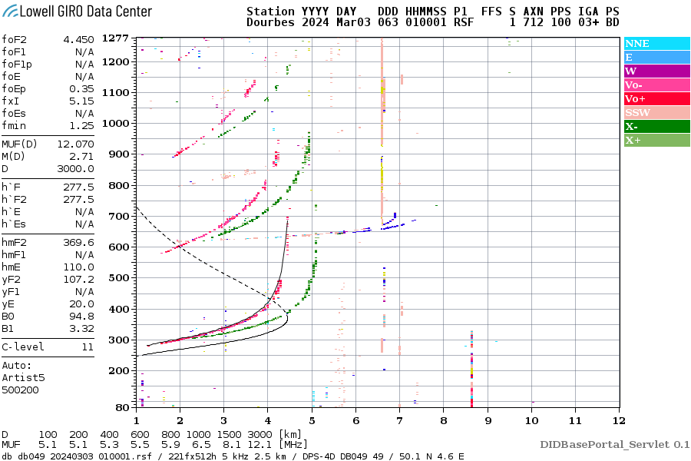
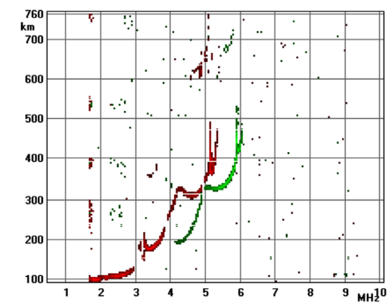
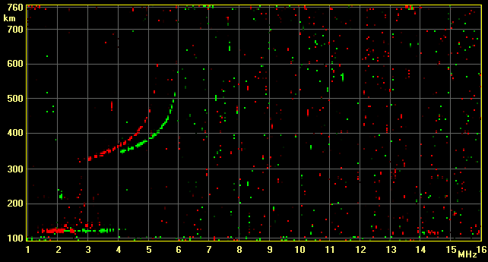
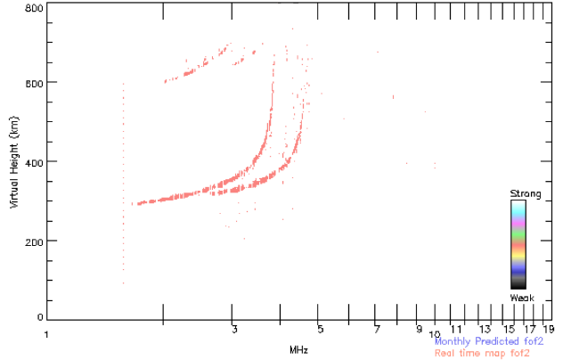
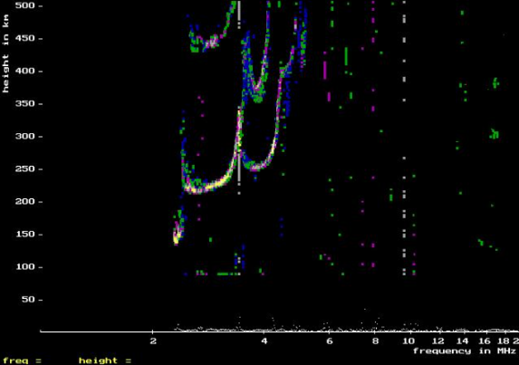
Different types of sounders
Digisonde - Space Science Laboratory, University of Massachusetts, Lowell, USA
Vertical Incidence Pulsed Ionospheric Radar (VIPIR), Boulder, CO, USA
Advanced Ionospheric Sounder-INGV Ionosonde, Italy
VISRC2 - Space Research Center of Warsaw, Poland
KEL Aerospace’s Digital Ionosonde System IPS-42, Australia
Canadian Advanced Digital Ionosonde (CADI)

Slide 22
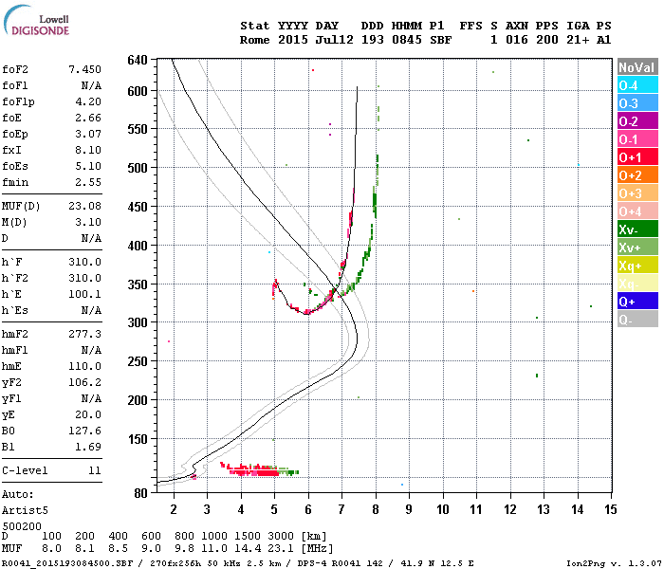
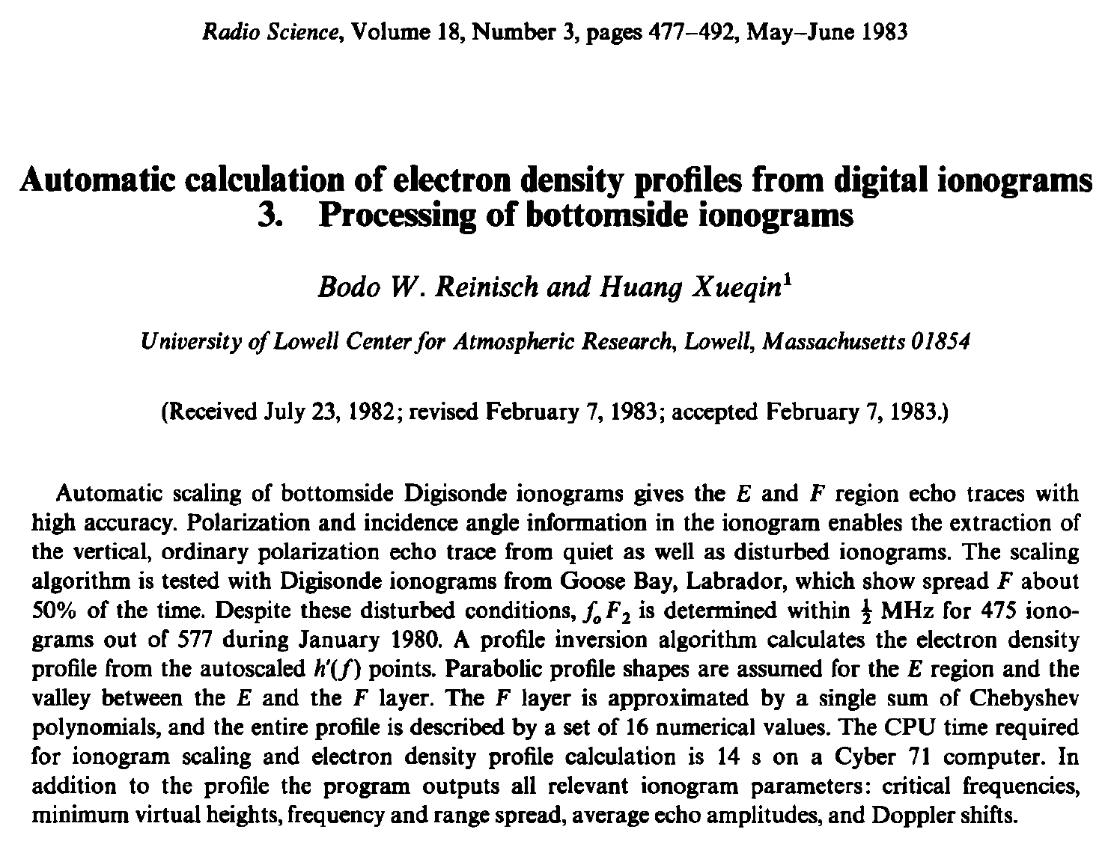
Autoscaling of an ionogram
In the last decades, the importance of having real-time ionospheric data for Space Weather purposes has greatly increased. For this reason since 80s much work has been performed to develop computer programs able to automatically scale the ionograms giving as output the standard ionospheric characteristics along with an estimate of the electron density profile.
Although much progress has been made, still today a significant effort is invested to increase the reliability of these programs.

Slide 23
Scaling the most important characteristics – Nighttime ionograms
multiple reflections
h’F2 = h’F
foF2
Digisonde

Slide 24
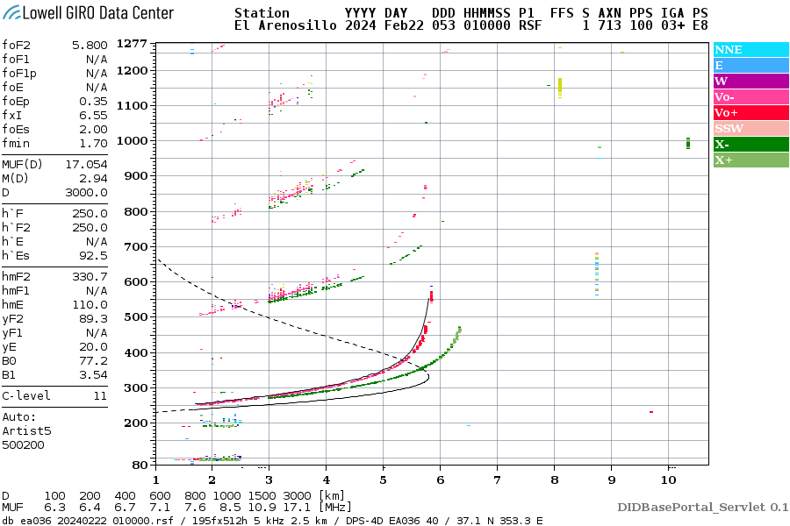
Scaling the most important characteristics – Nighttime ionograms
h’F2 = h’F
foF2
Digisonde

Slide 25
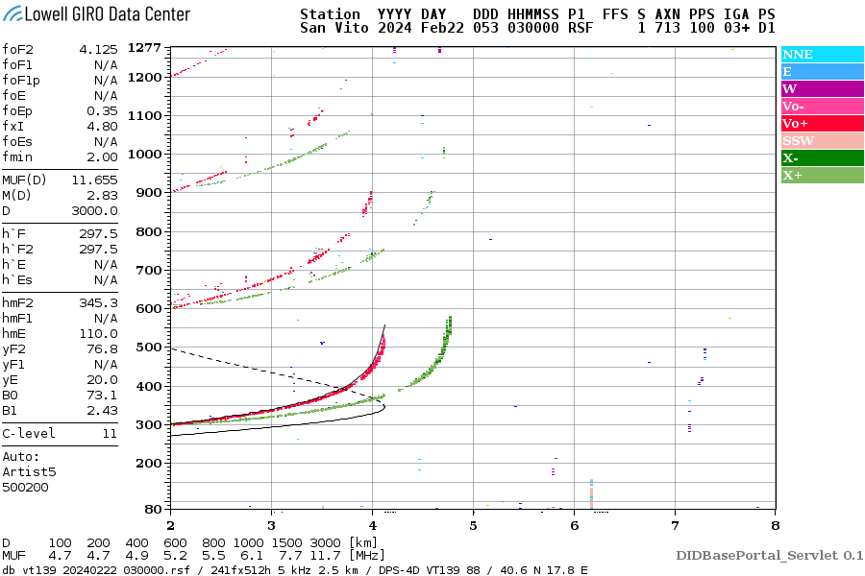
Scaling the most important characteristics – Nighttime ionograms
h’F2 = h’F
foF2
Digisonde

Slide 26

Scaling the most important characteristics – Nighttime ionograms
h’F2 = h’F
foF2
Digisonde

Slide 27

Scaling the most important characteristics – Nighttime ionograms
foF2
h’F2 = h’F
Digisonde

Slide 28

Scaling the most important characteristics – Nighttime ionograms
h’F2 = h’F
foF2
Digisonde

Slide 29
























Diurnal evolution of an ionogram
nighttime
00
nighttime
01
nighttime
02
nighttime
03
nighttime
04
sunrise - early morning
05
F2
F2
F2
F2
F2
F2
E
06
daytime
07
daytime
08
daytime
09
daytime
10
daytime
11
sunrise - early morning
F2
F2
F2
F2
F2
F1
F1
F2
F1
E
E
E
F1
F1
E
E
E
daytime
12
daytime
13
daytime
14
daytime
15
late evening - sunset
16
late evening - sunset
17
F2
F2
F2
F2
F2
F2
F1
F1
F1
F1
E
E
E
E
E
E
late evening - sunset
18
nighttime
19
nighttime
20
nighttime
21
nighttime
22
nighttime
23
F2
F2
F2
F2
F2
F2
E

Slide 30

The ionogram scaling – sunrise/early morning - late evening/sunset
foF2
foE
h’F2 = h’F
h’E

Slide 31

The ionogram scaling – sunrise/early morning - late evening/sunset
foF2
foE
h’F2 = h’F
h’E

Slide 32

The ionogram scaling – sunrise/early morning - late evening/sunset
foF2
foE
h’F2 = h’F
h’E

Slide 33

The ionogram scaling – sunrise/early morning - late evening/sunset
foF2
foE
h’F2 = h’F
h’E

Slide 34

The ionogram scaling – Daytime ionograms
foF2
foF1
foE
h’F2
h’F1 = h’F
h’E

Slide 35

The ionogram scaling – Daytime ionograms
foF2
foF1
foE
h’F2
h’F1 = h’F
h’E

Slide 36

The ionogram scaling – Daytime ionograms
foF2
foF1
foE
h’F2
h’F1 = h’F
h’E

Slide 37

The ionogram scaling – Daytime ionograms
foF2
foF1
foE
h’F2
h’F1 = h’F
h’E

Slide 38



Ionograms characterized by spread-F phenomena
Spread F
flat reflector
AIS-INGV ionosonde
AIS-INGV ionosonde
Notes:
Presence of plasma irregularities that causes the reflection of the same frequency at different heights and so with different delay times. Consequently, the trace is not defined, spread.

Slide 39



Ionograms showing sporadic E layers
Sporadic E layer
The term sporadic E (Es) layer refers to thin (a few km) layer of anomalous values of ionization occurring between 90 and 130 km, whose critical frequency is often very high.
These layers form in the ionospheric dynamo region, when metallic ions of meteoric origin converge vertically, mainly due to vertical shears in the horizontal wind (e.g., Haldoupis, 2011, 2012).
AIS-INGV ionosonde

Slide 40

Ionograms showing sporadic E layers – multiple reflections
4X
Ionosphere
3X
2X
Ionosphere
Ionosphere
Earth
Earth
Earth
1X
Ionosphere
AIS-INGV ionosonde
Earth

Slide 41



Ionograms showing no trace because of absorption - May 2024 Mother’s Day superstorm
11 May 2024
8:00
8:15
8:30
8:45
9:00
9:15
9:30
normal propagation
9:45
ionosphere
10:00
10:15
10:30
absorption
10:45
11:00
11:15
11:30
11:45

Slide 42
Qualifying and descriptive letters
The interpretation of a parameter can, if necessary, be qualified by a letter indicating the extent of the uncertainty characterizing the interpretation. A descriptive letter is added to indicate why this reduced level of accuracy has affected your interpretation.
The most used descriptive letters are:
A measurement influenced by, or impossible because of, the presence of a sporadic E layer
C measurement influenced by, or impossible because of, any non-ionospheric reason
F measurement influenced by, or impossible because of, the presence of spread-F echoes
R measurement influenced by, or impossible because of, attenuation close to the critical frequency
S measurement influenced by, or impossible because of, interference
X measurement refers to the extraordinary component
The most used qualifying letters are:
D greater than
U uncertain or doubtful value

Slide 43

Qualifying and descriptive letters

Slide 44


Now it’s your turn!
≃6.7 MHz
Is there a sporadic E layer?
YES
sporadic E layer (Es)

Slide 45

Now it’s your turn!
Is it possible to validate a reliable
value for foF2?
NO

Slide 46


Now it’s your turn!

Slide 47

Now it’s your turn!
Is it possible to validate a reliable
value for foF2?
NO

Slide 48

Now it’s your turn!
≃12.2 MHz
Is it possible to validate a reliable
value for foF2?
YES

Slide 49

Now it’s your turn!
≃13.9 MHz
Is it possible to validate a reliable
value for foF2?
YES

Slide 50

Now it’s your turn!

Slide 51

Now it’s your turn!
Is it possible to validate a reliable
value for foF2?
NO

Slide 52

Now it’s your turn!

Slide 53

Now it’s your turn!
Is it possible to validate a reliable
value for foF2?
NO

Slide 54

Thank you

Slide 55
BACKUP SLIDES

Slide 56

The AIS-INGV Malindi ionosonde
The AIS-INGV ionosonde was installed in Malindi (3.1° S, 40.1° E) in July 2023.
This new installation is extremely important for two main reasons: 1) it fills a gap in terms of data coverage over the African region; 2) it is located within the equatorial ionization anomaly (EIA) and close to its trough.
Before the NORISK project 5 ionosondes (digisondes) were installed in the African continent. Only 3 of them are operational.
Ilorin(stopped NOV 2021)
Malindi (6.48 S; 111.94 E)
operating since August 2023
Louisvale (stopped JUL 19)
Madimbo (stopped AUG 2019)
Hermanus
Grahamstown
Blue dashed curves depict the QD magnetic parallels. (modified from Pignalberi, Pietrella & Pezzopane, 2021)

Slide 57



Importance of ionosonde stations – Estimation of the plasma vertical drift
Considered period: hourly ionograms from August 2023 to July 2024 for which the virtual height of the base of the F layer (h’F), when possible, was manually validated through the Interpre software (Pezzopane, 2004).
h’F = 366 km
h’F = 357 km

Slide 58



Importance of ionosonde stations – Estimation of the plasma vertical drift
(Fejer et al. (2008) model)
(Fejer et al. (2008) model)
(Fejer et al. (2008) model)
12:30 – 19:00
12:30 – 19:00
12:30 – 19:00
The apparent vertical F-layer drift, inferred from ionosonde measurements as Δ(h'F)/Δt is, as theoretically predicted (Bittencourt and Abdu, 1981) and experimentally verified (e.g., Batista et al., 1986), representative of the vertical ExB plasma drift velocity only around the times of pre-reversal vertical drift enhancements, when the layer is high (around 300 km or more).
For smaller heights, the apparent vertical velocity starts to depart significantly from the vertical ExB drift velocity, because of the increasing dominance of the recombination process at these lower heights.
According to the literature, the time window considered reliable is: 12:30 – 19:00 UT

Slide 59

Importance of ionosonde stations – Estimation of the plasma vertical drift

Slide 60


Importance of ionosonde stations - May 2024 Mother’s Day superstorm
They are essential for monitoring the ionospheric plasma in real time for Space Weather purposes and to better understand the ionospheric storm dynamics at different latitudes.
INGV Ionospheric portal→http://eswua.ingv.it/
Malindi
negative ionospheric phase

Slide 61

Importance of ionosonde stations - May 2024 Mother’s Day superstorm
They are essential for monitoring the ionospheric plasma in real time for Space Weather purposes and to better understand the ionospheric storm dynamics at different latitudes.
INGV Ionospheric portal→http://eswua.ingv.it/
Rome
negative ionospheric phase

Slide 62


Importance of ionosonde stations – effects of the solar eclipse
They are essential for monitoring the ionospheric plasma in real time for Space Weather purposes and to better understand the ionospheric storm dynamics.

