Slide 1
SESAME:
A Source of Light in the Middle East
Dr. Khaled Toukan
Director of SESAME
January 12, 2026

Slide 2
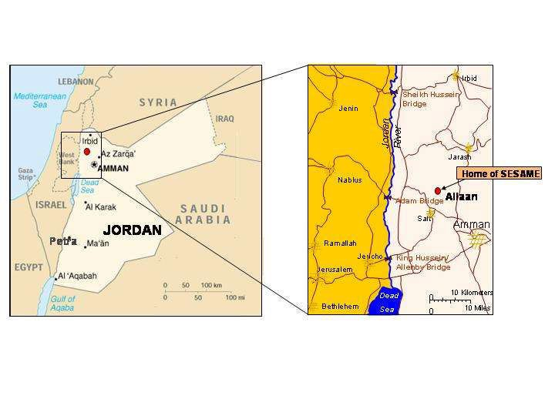
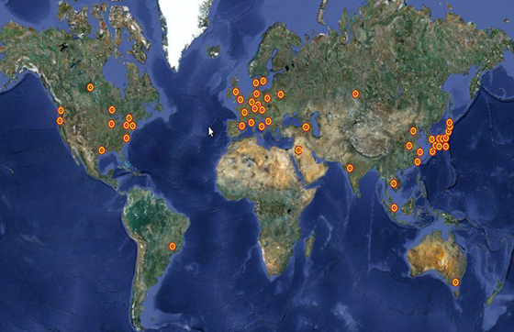
SESAME‘s location
Allan, Jordan
www.sesame.org.jo
There are about 60 light sources around the world;
SESAME is the only one in the
Middle East

Slide 3
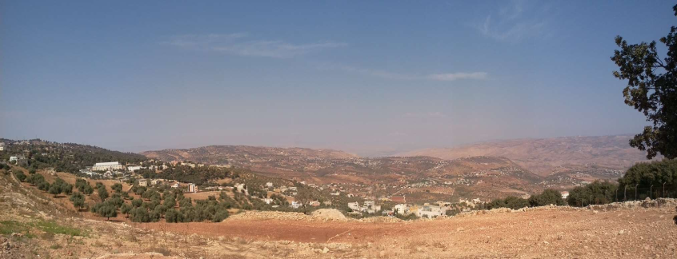
Why Build a Synchrotron Facility?
International collaboration is an obvious way for countries with relatively small scientific communities and/or limited science budgets to build a synchrotron-light source.
Broad programs make synchrotron-light sources ideal facilities for building scientific capacity.
SESAME will be a user facility; scientists will typically go to SESAME two or three times a year for a week or two to carry out experiments, in collaboration with scientists from other institutions/countries.

Slide 4

SESAME as a Project
SESAME is a cooperative venture by scientists and governments of the region set up on the model of CERN (European Organization for Nuclear Research), although it has very different scientific aims.
It was developed under the auspices of UNESCO (United Nations Educational, Scientific and Cultural Organization) following the formal approval given for this by the Organization's Executive Board (164th session, May 2002).

Slide 5
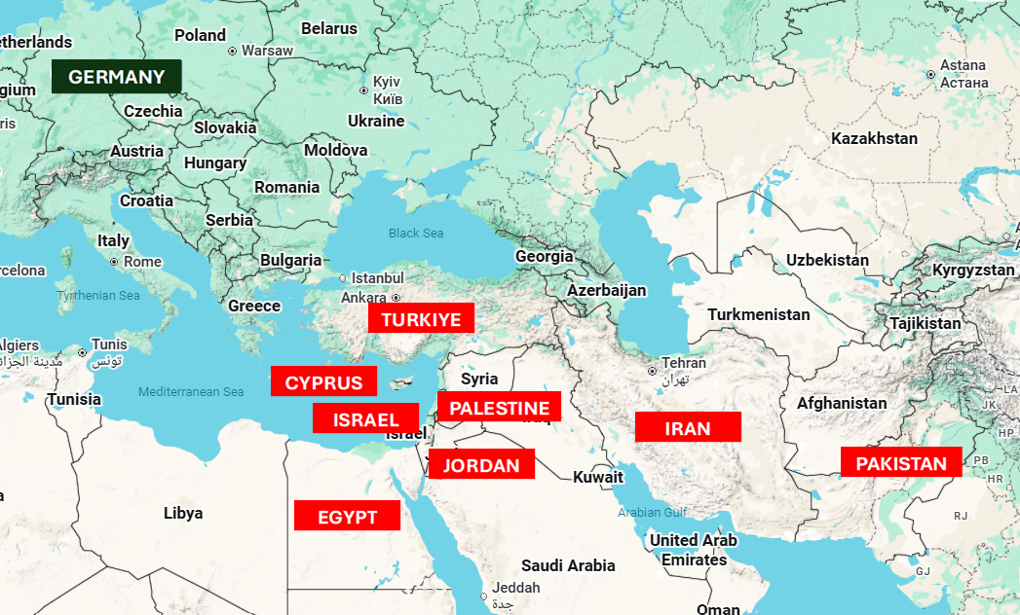
SESAME Members and Observers
Members:
Cyprus
Egypt
Iran
Israel
Jordan
Pakistan
Palestine
Türkiye
Associate Members:
Germany
Observers:
Brazil, Canada, CERN, China, COMSTECH, EU, France, Greece, Italy, Japan, Kuwait, Portugal, Russia, Spain, Sweden, Switzerland, UAE, UK and USA

Slide 6
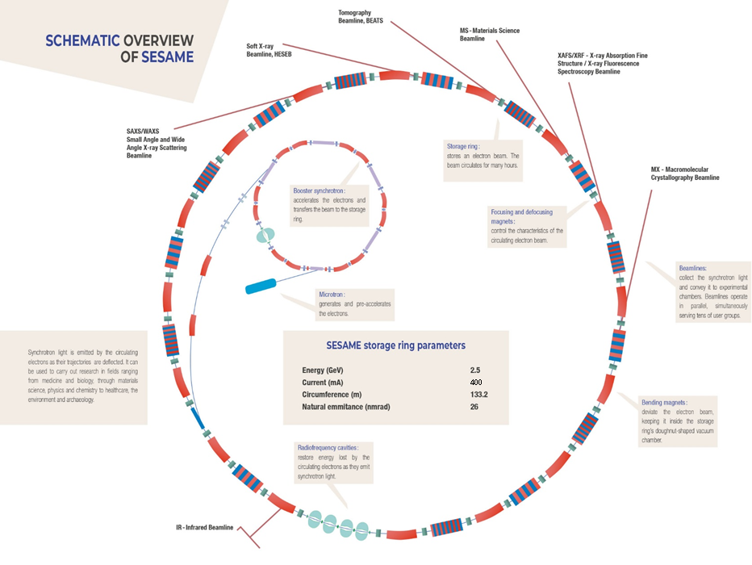

Slide 7
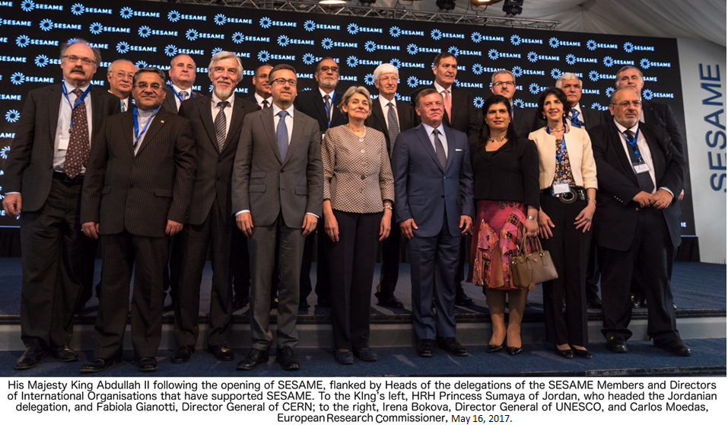

Slide 8
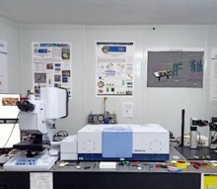
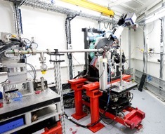
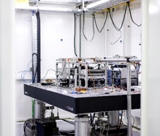
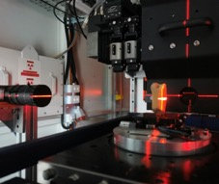
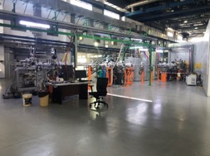
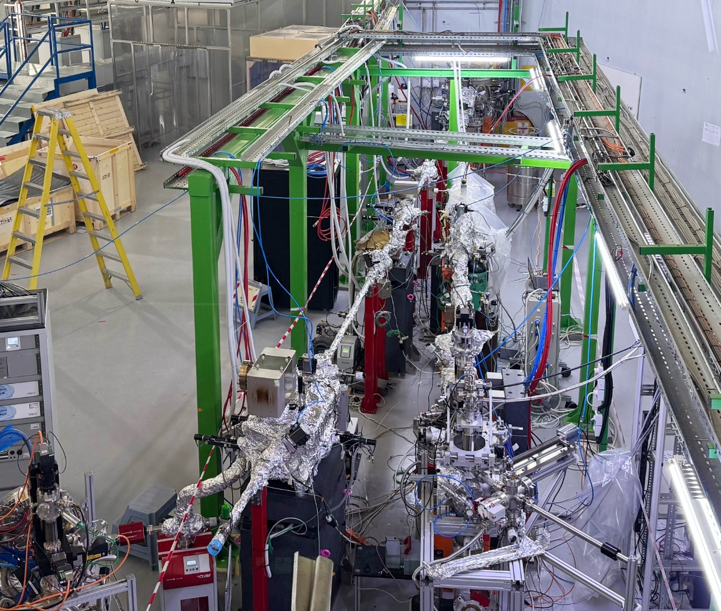
Six Beamlines are in Operation
BM02 – IR
Infrared Spectromicroscopy
BM08 – XAFS/XRF
X-ray Absorption Fine Structure
X-ray Fluorescence Spectroscopy
BM02 – IR
Infrared Spectromicroscopy
ID09 – MS/XPD
Materials Science X-ray Powder Diffraction
ID10 – BEATS
X-ray Tomography
ID11R – TXPES
X-ray Photoemission Spectroscopy
ID11L – HESEB
Soft X-ray Absorption Spectroscopy

Slide 9

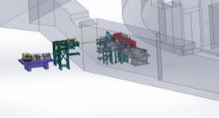
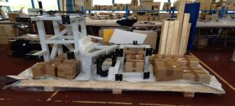
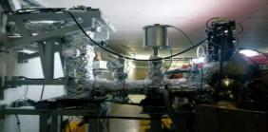
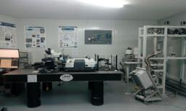
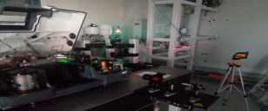
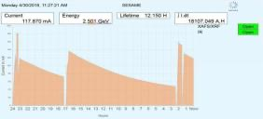
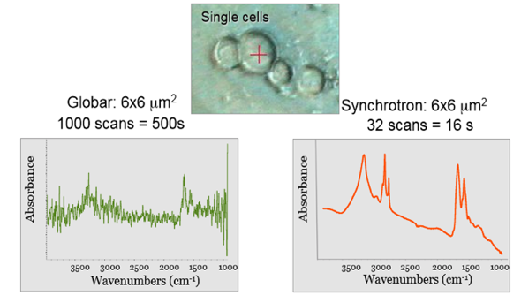

1. BM02 - IR
SESAME’s First Fully Designed Beamline
in collaboration with the French Synchrotron, SOLEIL
2016: Design Validation
2017: Fabrication (France)
2018: Installation
2018: Experimental Hutch
2018: Optical Alignment
2018: SR-Commissioning
DAY-1 Beamline
BEAMLINE SERVING SESAME USERS SINCE NOVEMBER 2018
FIRST RESULTS (April 2018)

Slide 10
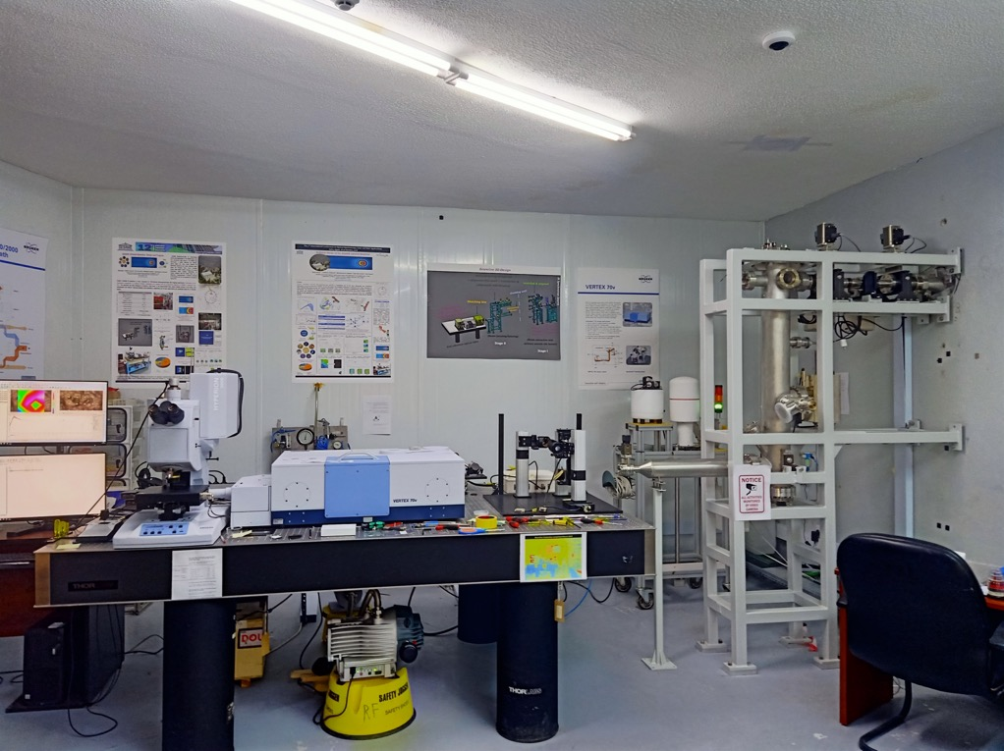

1. BM02 - IR cont.
2022: New Microscope and Spectrometer installed in the Experimental Hutch as part of INFN-CHNet.

Slide 11
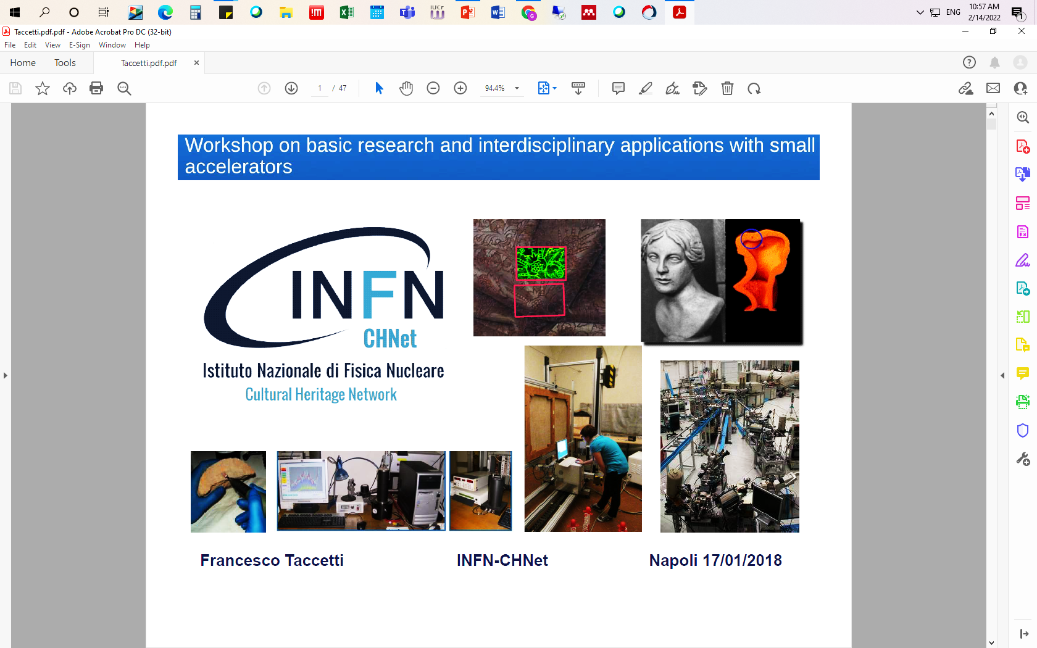
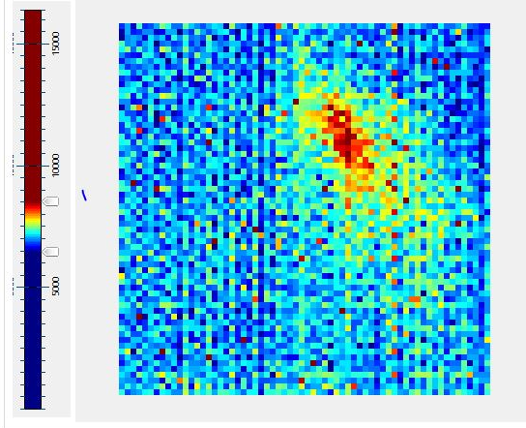
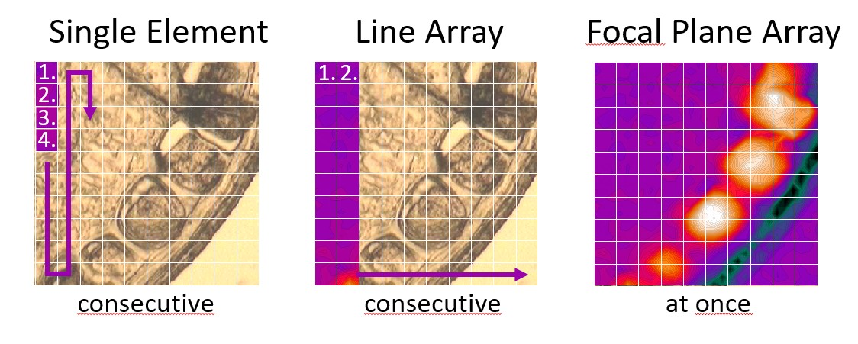
1. BM02 – IR: Focal Plane Array Detector
All at once
Point-by-point detector,
Long data acquisition.
State-of-the-art imaging detector,
Parallel acquisition,
An array of IR detectors arranged in a square (64 x 64 pixels),
Thousands of spectra captured in a single shot.
SR beam @ the detector
2025: A new state-of-the-art imaging detector installed in the microscope completes the INFN-CHNet equipment.

Slide 12
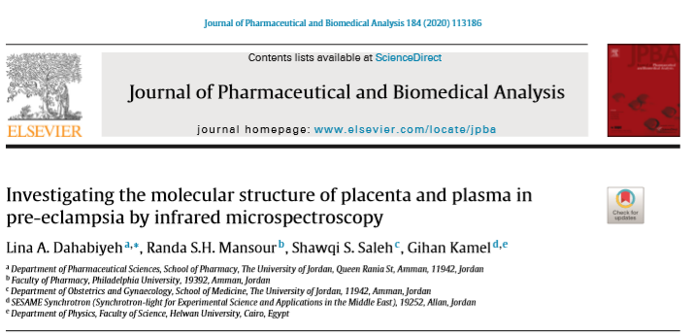
First Publication from the IR Beamline in Feb, 2020

Slide 13
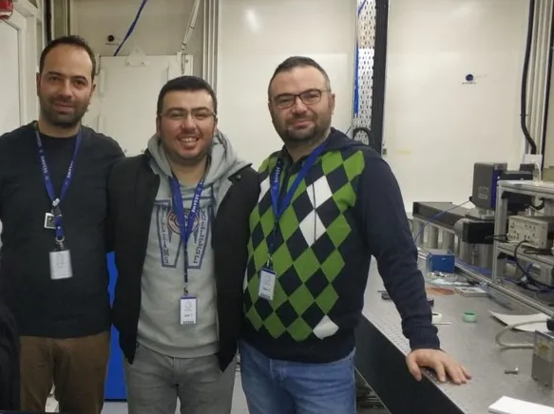
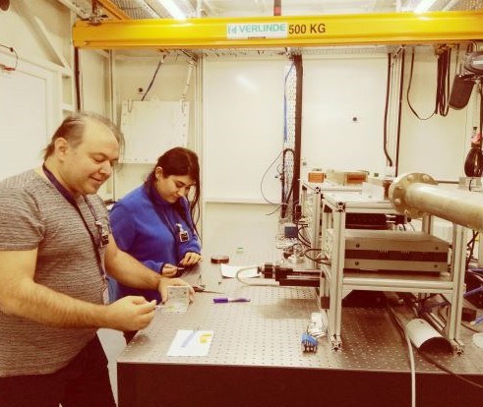
2. BM08 - XAFS/XRF
The XAFS/XRF beamline is the first operational beamline at SESAME, and it has been open for external users since July 2018.
Ozensoy’s team during a beamtime campaign (group of PhD students) from Bilkent University
Dr. Murat Osman Ozkendir and his MSc. student from Mersin University while changing samples

Slide 14
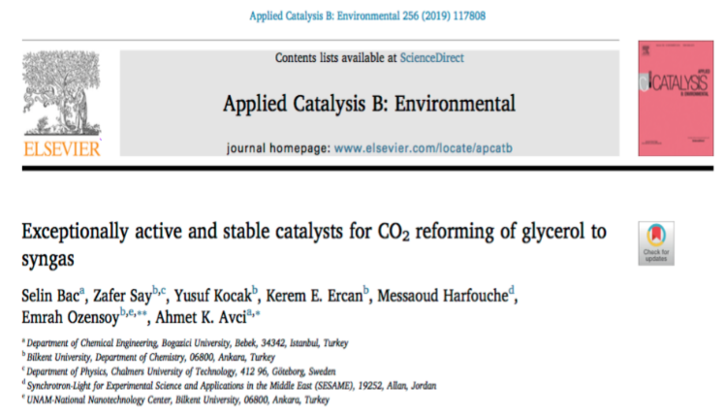
First Scientific Paper Published in June, 2019
in a High Impact Factor Journal (11.6)

Slide 15
79 Scientific Publications as of January, 2026
Many in High Impact Factor Journals
IF = 26.8

Slide 16
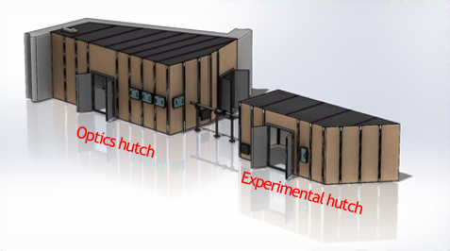
3. ID09 - Materials Science X-ray Powder Diffraction
Speaking of industry and commercial applications, MS beamline is the first to come to mind. This beamline makes use of use X-ray diffraction techniques for investigating materials atomic structure.

Slide 17
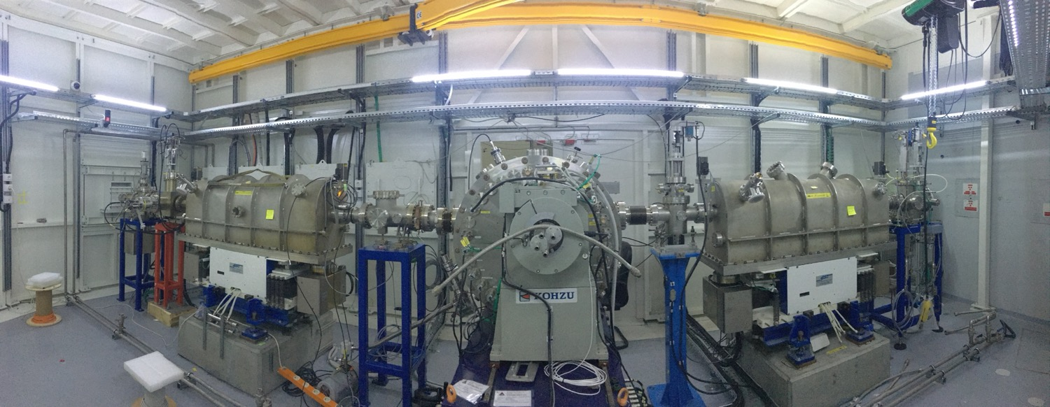

3. ID09 - Materials Science X-ray Powder Diffraction ….cont.

Slide 18
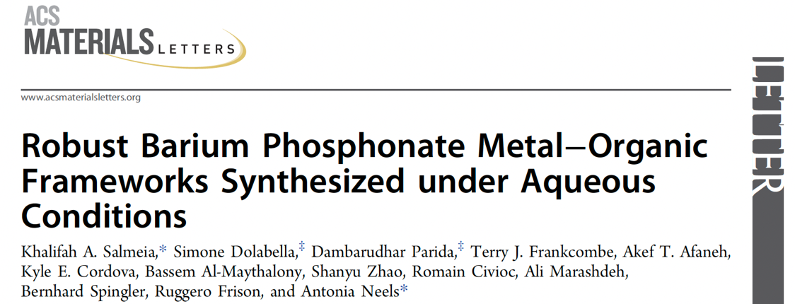
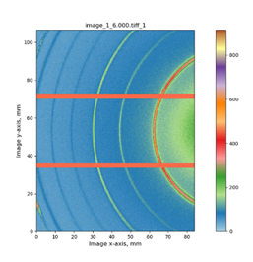
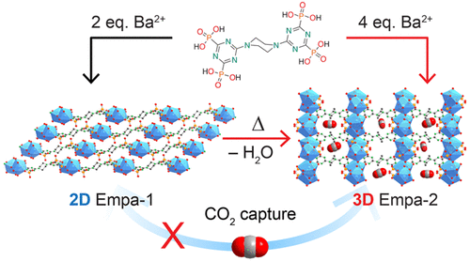
3. ID09 - Materials Science X-ray Powder Diffraction ….cont.
18
June 2021 First article, on novel material for CO₂ binding

Slide 19









4. ID10 - Beamline for Tomography at SESAME (BEATS)
The project is an H2020-EU funded project of €6.0 million to pave the way for an efficient and sustainable operation of SESAME.
Led by the ESRF, the European synchrotron (France), BEATS involves leading research facilities in the Middle East (SESAME and the Cyprus Institute), and European synchrotron radiation facilities ALBA-CELLS (Spain), DESY (Germany), the ESRF (France), Elettra (Italy), INFN (Italy), PSI (Switzerland), SESAME (Jordan) and SOLARIS (Poland).
Aimed at serving user communities in the region, in particular the cultural heritage and archaeology communities. It is an obvious advantage for these communities to be able to access a state-of-the-art beamline close to the source of samples or remains to be analyzed.

Slide 20
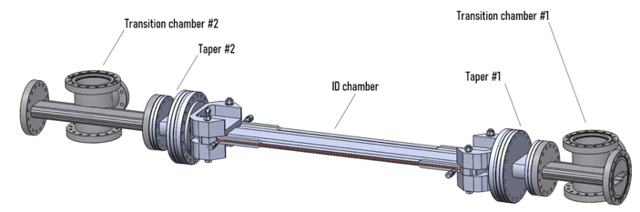
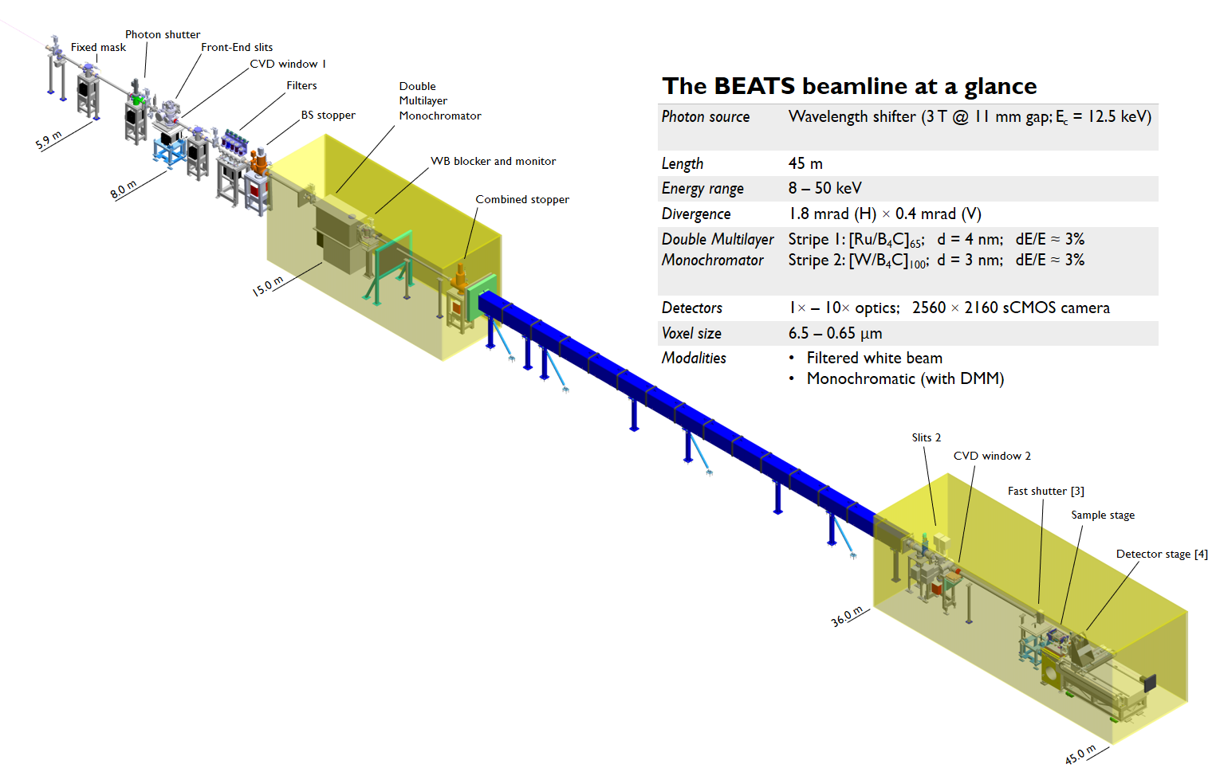
4. ID10 - BEATS cont.
Multilayers (ESRF)
Optics hutch
Vacuum:
Gauges
Controllers
Cables
Rad. Protection Collimator
Transfer pipe CF150 / CF200
Pumping unit 3
Total Length | 45 m
Energy range | 8 – 100 keV
Divergence | 1.8 mrad (H) × 0.4 mrad (V)
Detectors | 0.5× – 10× optics; 5.5MP sCMOS camera
Available voxel size | 13 – 0.65 μm
Beam size @ sample | 72 mm (H) × 15 mm (V) (white beam)
Modalities | Filtered white beam Monochromatic (with DMM)
Experimental hutch
Notes:
Collect quotations for the collimator and for the 16m-long transfer pipe

Slide 21
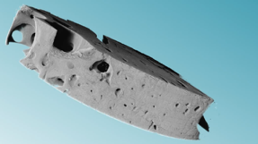
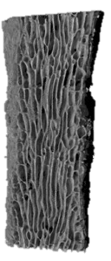
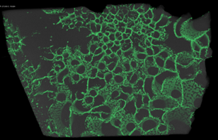
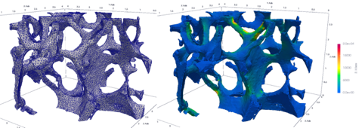
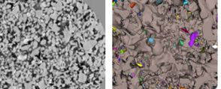
4. ID10 - BEATS ……cont.
Mineralized algae (red sea)
Bone implant
Archaeology and Cultural Heritage
Archaeological Materials
Human bio-archaeology
Plant remains
Animal remains and artifacts
Health, Biology and Food
Musculoskeletal research
Bone and dental implants
Soft tissue imaging
Animal and plant characterization
Food science
Roman glass
Agriculture and Environment
Simulation of rock properties
Soil characterization
Sustainable agriculture
Synchrotron
Tomography
@ BEATS
Materials Science and Engineering
Light materials and alloys
Materials under mechanical stress
Energy materials research
Sandstone core
Services to Industry and Private Sector
BEATS scientific case

Slide 22
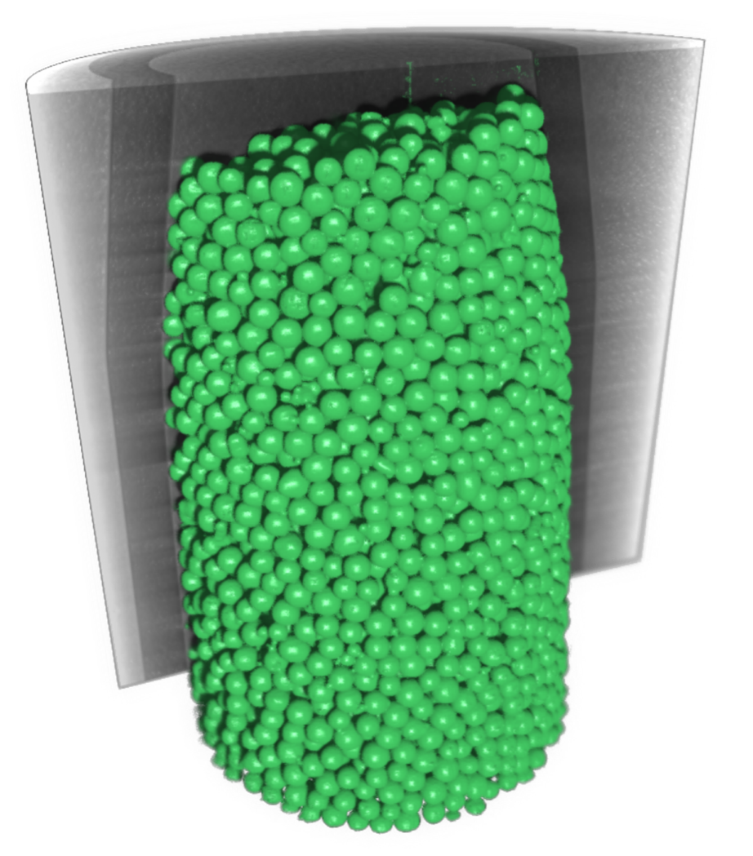
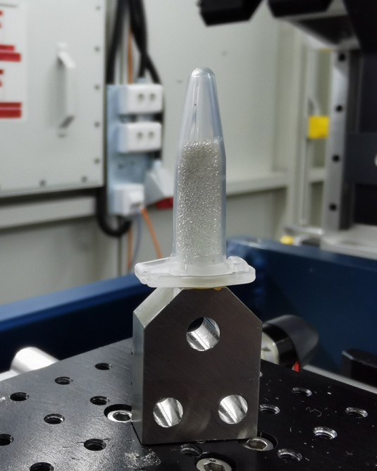
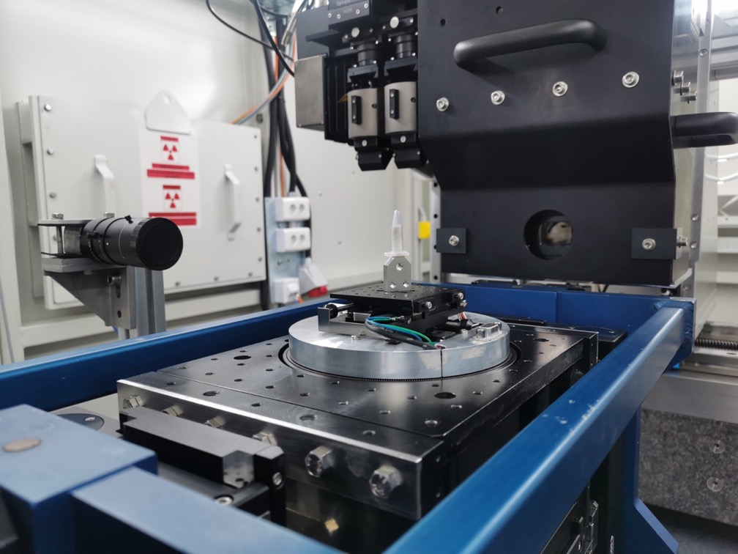
4. ID10 - BEATS ……cont.
11 May 2023 – First BEATS scan
Glass spheres (diameter ~300 micron)
4.5 micron voxel size
Phase contrast image obtained from 1000 radiographs; 180 degrees rotation
Total scan time: 12 s

Slide 23
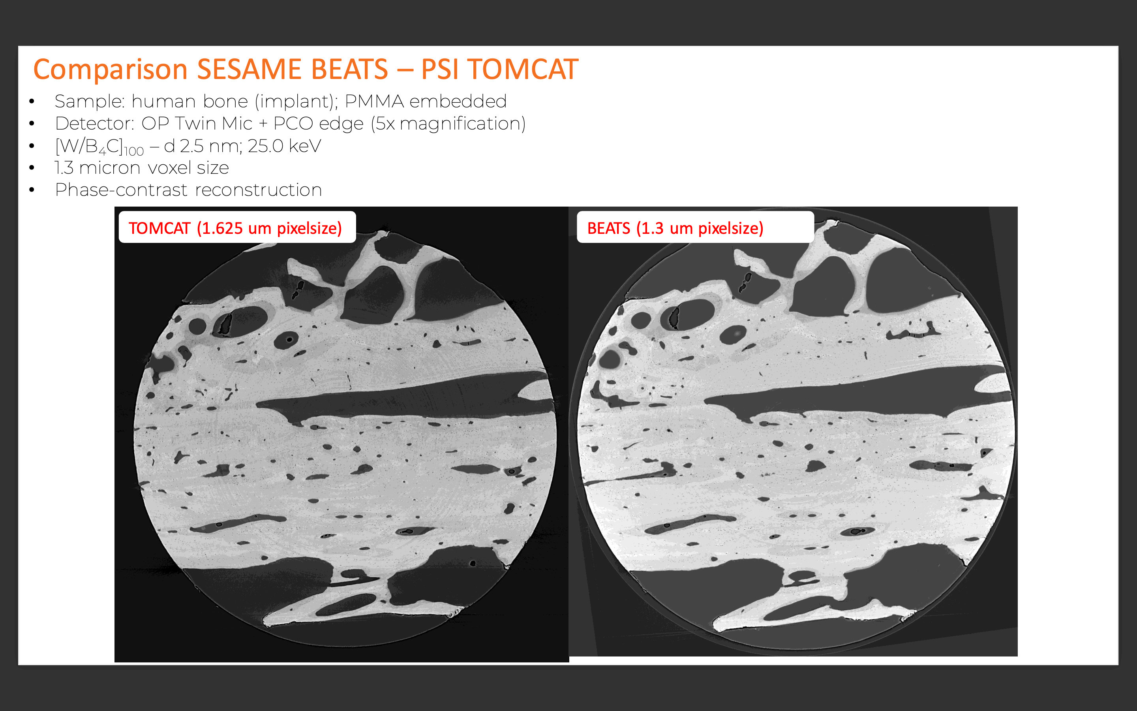
4. ID10 - BEATS ……cont.
BEATS: Comparison BEATS – PSI TOMCAT

Slide 24
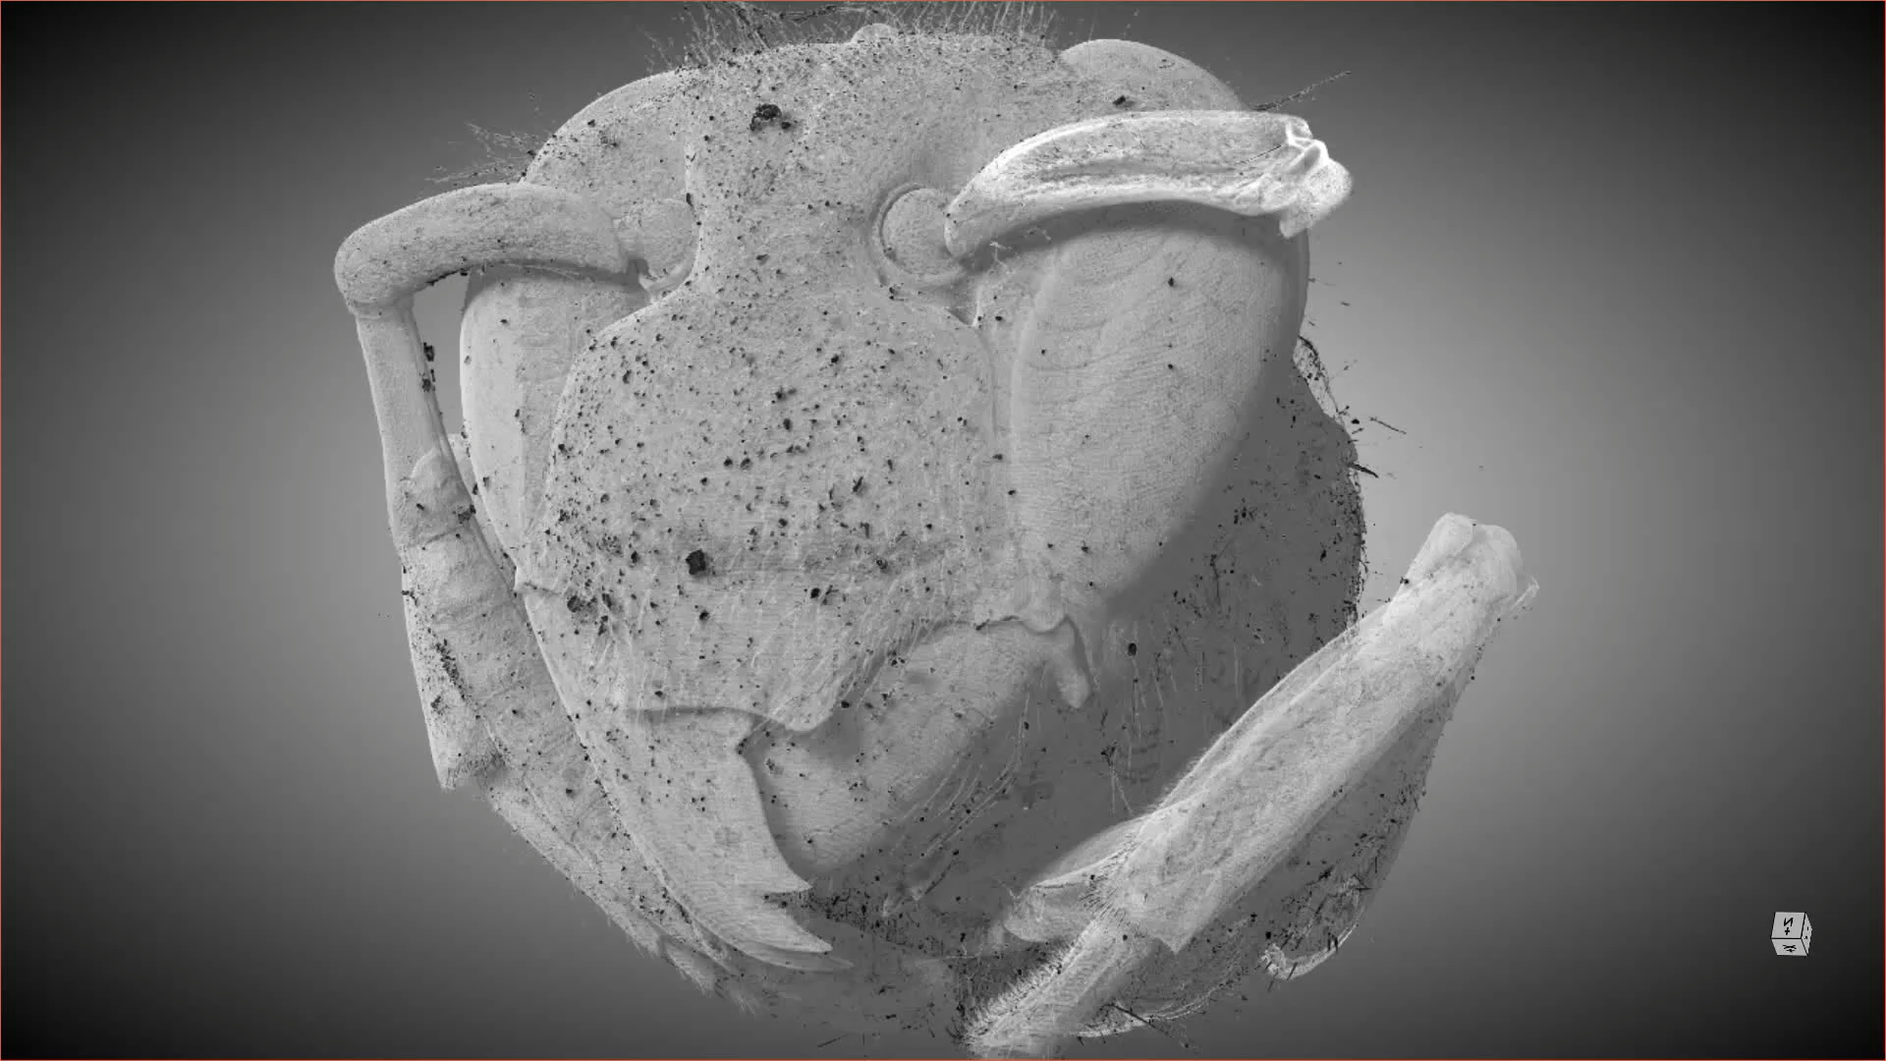
4. ID10 - BEATS ……cont.

Slide 25
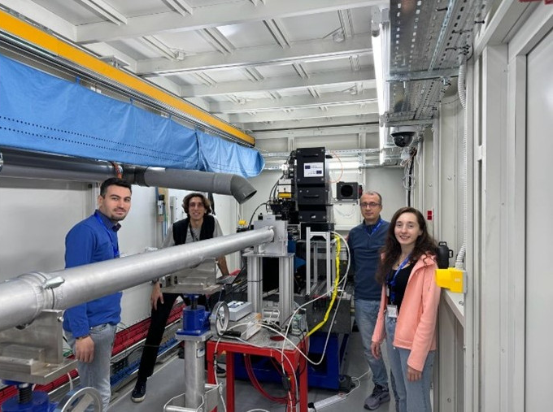
4. ID10 - BEATS ……cont.
11 February 2023 – First users at BEATS
Bilkent University UNAM (National Nanotechnology Research Center), Ankara, Türkiye
Dr. Ali Karatutlu (Principal Investigator)
Dr. Bülend Ortaç
Ms. Zehra Gizem Mutlay (PhD Student)
Nanotechnology, fiber laser research
The measurements lasted three days, resulting in almost 500 Gigabytes of data, containing 3D pictures of different samples with a voxel size of 650 nanometers. These images provide insight into the manufacturing and applications of polarization-maintaining fiber glass products.

Slide 26
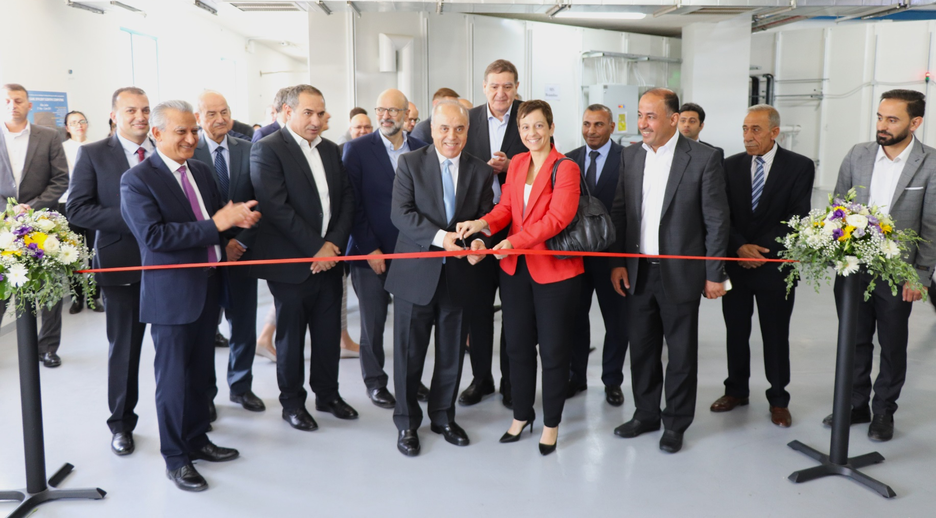
June 6, 2023: Official Inauguration
4. ID10 - BEATS ……cont.
Cutting the ribbon (left to right): Prof. Azmi Mahafzah, Minister of Higher Education and Scientific Research of Jordan, SESAME Director, Khaled Toukan and H.E. Ms. Maria Hadjitheodosiou, Ambassador of the European Union to Jordan

Slide 27
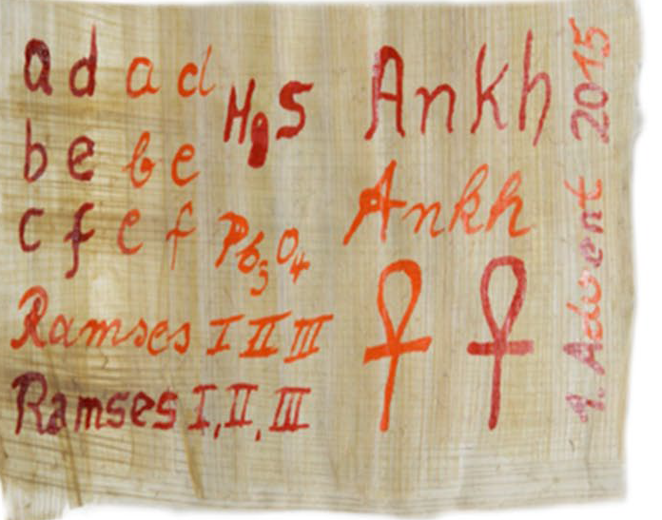
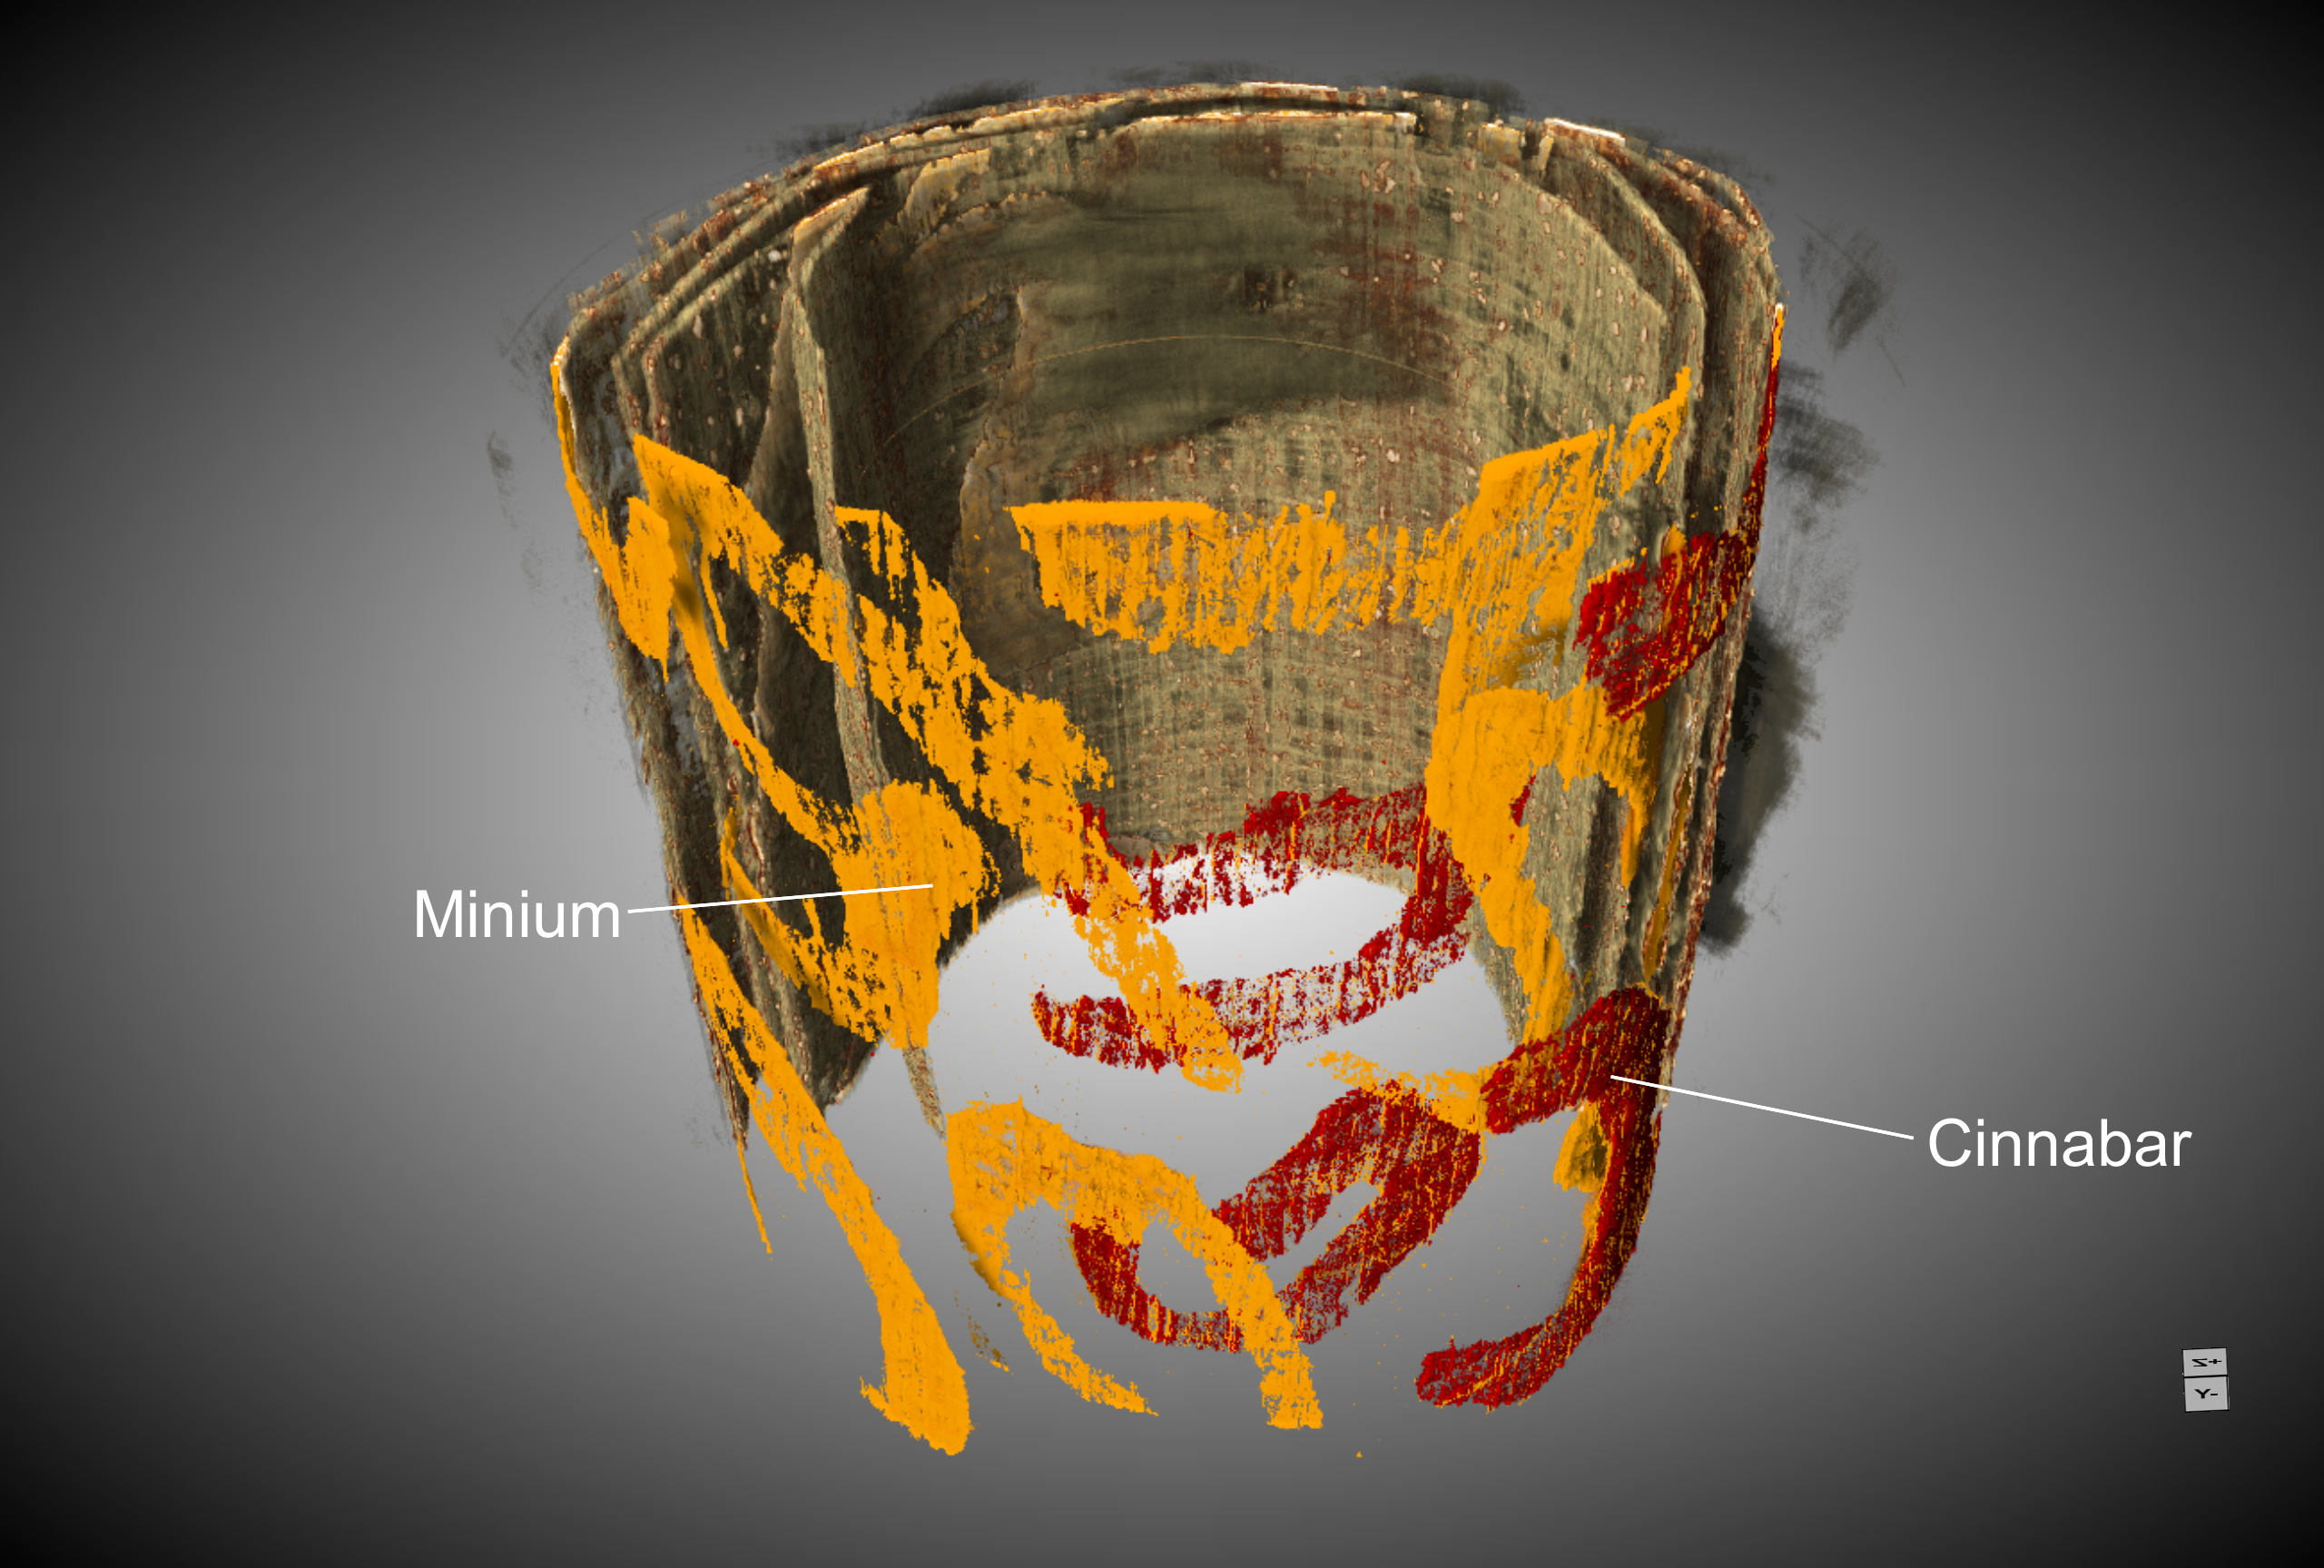
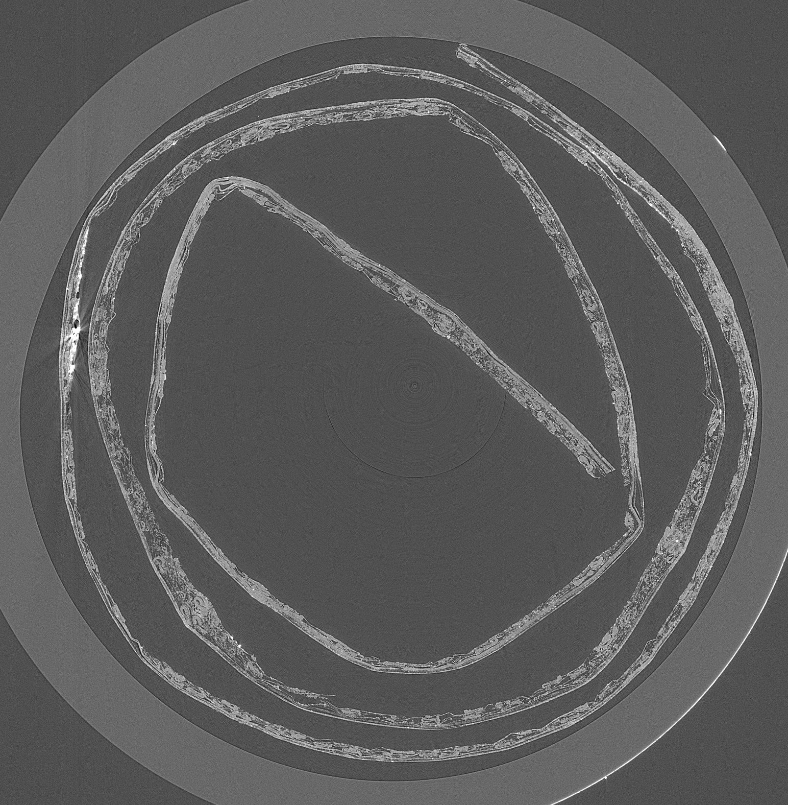
4. ID10 - BEATS ……cont.
Absorption edge sensitive tomography
Pb₃O₄ and HgS
Proposal # 20235045 (Ägyptisches Museum und Papyrussammlung Berlin, HZB, FU) Heinz-Eberhard Mahnke et al., Gianluca Iori, Philipp Hans

Slide 28
5. ID11 - HESEB
(Helmholtz-SESAME Beamline)
On 25th of October 2018, SESAME hosted a delegation from the Helmholtz Association of German Research Centers consisting of 43 persons. It was headed by Professor Otmar Wiestler, President of the Association.
During the visit, Otmar Wiestler informed SESAME that five research centers of the Helmholtz Association will be taking part in construction of a soft X-ray beamline for SESAME under the leadership of DESY (Deutsches Elektronen-Synchrotron). This is another one of SESAME’s Phase I beamlines.

Slide 29
5. ID11 - HESEB …..cont.
The five research centers are:
DESY (Deutsches Elektronen-Synchrotron)
FZJ (Forschungszentrum Jülich)
HZB (Helmholtz-Zentrum Berlin)
HZDR (Helmholtz-Zentrum Dresden-Rossendorf)
KIT (Karlsruher Institut für Technologie)
A complete undulator beamline with monochromator and refocusing optics and a small chamber to conduct absorption and fluorescence yield experiments. The capital value of this beamline is €3.5 million

Slide 30
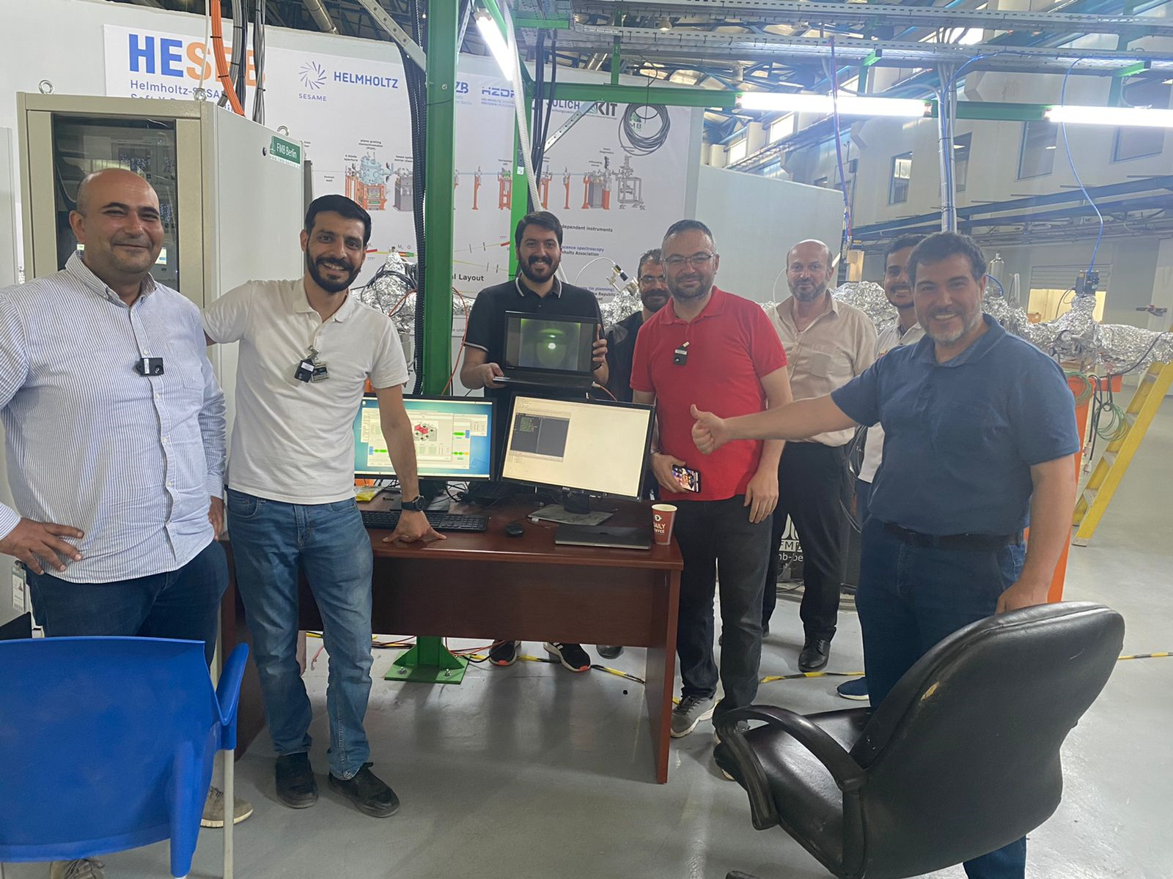
First Beam in HESEB Beamline
5. ID11 - HESEB …..cont.
June 8, 2022:

Slide 31

5. ID11 - HESEB …..cont.
H.E. Prof. Wajih Owais, Minister of Higher Education and Scientific Research of Jordan
Professor Otmar Wiestler, President of the Helmholtz Association of German Research Centres
H.E. Mr. Bernhard Kampmann, Ambassador of Germany to Jordan
June 12, 2022: Official Inauguration

Slide 32

5. ID11 - HESEB …..cont.
12 February 2023 – First users at HESEB
A collaboration among Jordanian Universities:
Dr. Yusuf Selim Ocak (Institute of Nanotechnology, Jordan University of Science and Technology, Principal Investigator)
Dr. Borhan Aldeen Albiss (Institute of Nanotechnology, Jordan University of Science and Technology)
Dr. Bashar Aljawrneh (Al-Zaytoonah University)
Use the HESEB beamline to study the electronic structure of samples and investigate the effects of dopants on semiconductor thin films
Data collected during three days for 9 samples at the absorption edges of O, Co, Ni, and Cu

Slide 33





















5. ID11 - HESEB …..cont.
Characterisation and Conservation of Paintings on Walls and
Sculpture from Nabataean Petra
B. Kanngiesser and M. Naes
Analytical Investigations of wall paintings and sculpture: in-situ and ex-situ; organic and inorganic, non-invasive & ND
Development of experimental conservation material for gold: synthesis, characterisation, validation, evaluation
Gold
Lead, Copper
Siq al-Barid
Az-Zantur IV
Wadi Suyyagh
Painted Staircase – near PGT

Slide 34





6. ID11R-TXPES
Turkish X-ray PhotoEmission Spectroscopy Beamline
TXPES

Slide 35







6. ID11R-TXPES …..Cont.
6. TXPES X-ray Optics Design
20,98 m
21,99 m
25,99 m
HESEB
TXPES
22 m
23 m
27 m
TXPES
XPS
End Station
Emrah Ozensoy, Bilkent University
Chemistry Department, Ankara, Turkey

Slide 36
6. ID11R-TXPES …..Cont.
6. TXPES End Station Components: Chamber Modules
Preparation Chamber
Analysis Chamber
Load Lock Chamber
High-Pressure Chamber
PHOIBOS 150 CMOS XPS/LEIS Analyzer
XR 50: Dual Anode X-ray Source
UVS 10: UV Source (for UPS)
Electron Flood Gun
Rastering Ion Gun for LEIS/Depth Profiling
4-Axis Manipulator with LN₂ Cooling & Resistive Heating to 1200 K
Ion Gun for Sputtering
RF-Plasma Source
Hydrogen Cracker
LEED
QMS
Metal/Metal Oxide Evaporators
Gas Dosers
4-Axis Manipulator with LN₂ Cooling & Resistive Heating to 1200 K
HPC-20 High
Pressure Cell
for Reactive
Sample
Pretreatment
Sample Loading/Removal
TXPES
Emrah Ozensoy, Bilkent University
Chemistry Department, Ankara, Turkey

Slide 37


6. ID11R-TXPES …..Cont.
Official Inauguration on 8 December 2025

Slide 38

New Beamline Initiatives
7. Macromolecular Crystallography
The first macromolecular crystallography beamline in the Middle East to facilitate experiments in the medical and pharmaceutical fields in the region as well as in Asia-Pacific.
Currently a proposal has been submitted to construct the beamline through IAEA/SESAME intergovernmental project based on cost sharing approach.

Slide 39

New Beamline Initiatives
8. Small-Angle X-ray Scattering
The first SAXS beamline at SESAME to support structural investigations of biological systems, nanostructured materials, and soft matter, serving users from the Middle East and neighbouring regions.
Preparatory studies are ongoing to define a construction proposal based on an intergovernmental cost-sharing approach.

Slide 40

1299 proposals, 48 Countries

Slide 41
Proposals
1299 in total since “call 0”
Proposals from 48 Countries

Slide 42
SESAME Proposal Review Committee
Samar HASNAIN (Chair), University of Liverpool, UK
Archaeological and Heritage Sciences
Mariangela CESTELLI GUIDI (coordinator) | INFN, Italy
Francois FAUTH | ALBA Synchrotron, Spain
Caroline JACKSON | University of Sheffield, UK
Costanza MILIANI | CNR, Italy
Chemical Sciences
Sofia DIAZ-MORENO (coordinator) | Diamond Light Source, UK
Thomas ELLIS | University of Saskatchewan, Canada
Antonella GLISENTI | Univertity of Padova, Italy
Sarp KAYA | Koç University, Turkey
Life Sciences
Michel HOUGH | Diamond Light Source, UK
Christophe SANDT | Synchrotron SOLEIL, France
Zehra SAYERS | Sabancı University, Turkey
Lisa VACCARI (coordinator) | Elettra Sincrotrone Trieste, Italy
Materials and Physical Sciences
Muhammad Javed AKHTAR | PINSTECH, Pakistan
Andrew FITCH (coordinator) | ESRF, France
Bruce RAVEL | NIST and NSLS II, USA
Brian ROSEN | Tel Aviv University, Israel

Slide 43
2024-2
2024-1
2023-2
2023-1
2022
2021
2019
2018
2016
Proposals distribution by sub-committee
2023-1
2022
2021
2019
2018
2016
Materials and Physical Sciences
Life Sciences
Chemical Sciences
Archeological and Heritage Sciences

Slide 44
Publications
161
peer-reviewed publications
Average scientific IF ~ 5
20% of publications have IF > 7

Slide 45


Guest-House Inauguration on December 4, 2019
SESAME Guest-House was funded by the Italian Ministry of Education, Universities and Research through INFN (total of 1.75 M Euro).
The Guest-House includes a canteen, large meeting room and 48 Guestrooms.

Slide 46
Year | Cost, US$ |  | Savings, US$ | Saved CO₂, Ton
 | With SPP | Without SPP
2019 | 112,041 | 2,677,801 | 2,565,760 | 6,233
2020 | 108,182 | 2,132,704 | 2,024,522 | 6,087
2021 | 137,238 | 3,654,179 | 3,516,941 | 7,531
2022 | 127,778 | 3,125,207 | 2,997,429 | 7,062
2023 | 295,274 | 4,036,313 | 3,741,039 | 7,021
2024 | 353,219 | 4,356,952 | 4,003,733 | 7,134
2025 Jan-Sept | 264,167 | 2,546,991 | 2,603,798 | 5,397
Total | 1,397,900 | 22,851,121 | 21,396,414 | 46,464
Solar Power Plant
Total Initial Investment
7.34 million US$
Funded by EU
First Accelerator in the World Fully Powered by
Renewable Energy

Slide 47

SUNSTONE
SESAME'S UPGRADING NETWORK FOR SCIENTIFIC USER TRAINING AND OUTREACH INTO THE NEXT ERA
Special call: "Strengthening the international dimension of ESFRI and/or ERIC research infrastructures - consolidating the SESAME facility"
Coordinator: ESRF
Budget: 1.5M€, of which 1.0M€ to SESAME (staff, other costs, overheads) + 0.5M CHF from State Secretariat for Education, Research and Innovation (PSI)
Project duration: 42 months
Beneficiaries (as named in the EC call): ALBA, CYI, DESY, ELETTRA, ESRF, INFN, SESAME and SOLEIL; and PSI as Associate
Start 01 June 2024

Slide 48
SUNSTONE
SESAME'S UPGRADING NETWORK FOR SCIENTIFIC USER TRAINING AND OUTREACH INTO THE NEXT ERA
Project management, communication, dissemination and exploitation
SESAME as a training centre
Strengthen SESAME user services
Foster SESAME sustainability
WP1
LEAD: ESRF with co-leader SESAME
WP2
LEAD: PSI with co-leaders DESY and SESAME
Action
toward
Africa
included
in all
WPs
WP2
LEAD: SOLEIL with co-leader INFN
Terms of reference in preparation, organization phase to start soon
WP3
LEAD: ALBA-CELL, with co-leader Elettra
Some changes in IT training plans
Communication Officer: Selection phase completed
Negotiation in progress
WP4

Slide 49

12 December 2025
UNESCO Headquarters, Paris, France
From Collaboration to Empowerment: Science
Diplomacy and Capacity Building through
Synchrotron Science in Africa
Building an African Beamline at SESAME

Slide 50

Palestinian-European Laboratory at SESAME
Sep 2025
extended visit of Profs. Abu Saa (AAUP), Hawash (Birzeit U.), and Saadeddin (Al Najah U.) to MPI Stuttgart
Drs. Omareya and Adballah begin postdoctoral training at MPI
Jan 2026
transfer of sputtering chamber and atomic force microscope to SESAME
Dr. Omareya moves to SESAME
Jan – Mar 2026
commissioning of instruments at SESAME
submission of initial joint publications
preparation of funding proposals
Apr 7-9, 2026 workshop in Stuttgart
Palestinian and German PEL partners
collaboration partners at SESAME
potential collaboration partners in Italy, Spain, Belgium, …
Infrastructure:
A reactive sputter chamber and a Bruker Multimode AFM is contributed from MPI Stuttgart. Moreover a SEM with FIB is being delivered from CNR-IOM in Trieste.
Scientific Focus:
Functional metal oxides for energy, electronics, and environment, with advanced synthesis and characterization methods, including synchrotron techniques.

Slide 51
19th Users Meeting – SAVE THE DATE
SESAME’s 19th Users Meeting
New Date: 26-28 April 2026
Venue: SESAME
Goals: To bring together scientists from the region and world experts in the various fields of synchrotron applications. Provide platform for information exchange and discussion of ongoing collaborative efforts within the community, and to present research results, obtained by experiments conducted at SESAME beamlines. Highlight the SUNSTONE, EUMEDplus, INT0104, Cybersecurity activities.
Coordinated with the SUNSTONE Hands-on workshops

Slide 52
SESAME’s Key Messages
SESAME is now operational and performing well
SESAME is producing world class science
SESAME is continuously growing

Slide 53
Thank You

