Slide 1





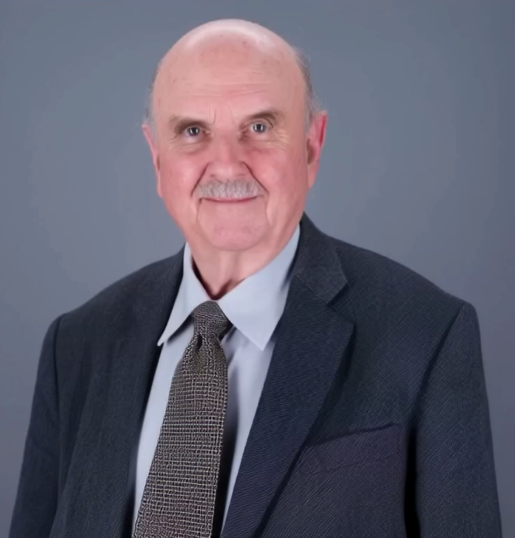
(1) Fundamentals of Synchrotron Radiation from Storage Rings
(2) Fundamentals of X-ray Interactions with Matter
Giorgio Margaritondo
Ecole Polytechnique Fédérale de Lausanne (EPFL)
and Istituto Italiano di Tecnologia (IIT)
(3) Bonus: Free Electron Lasers, a short primer

Slide 2
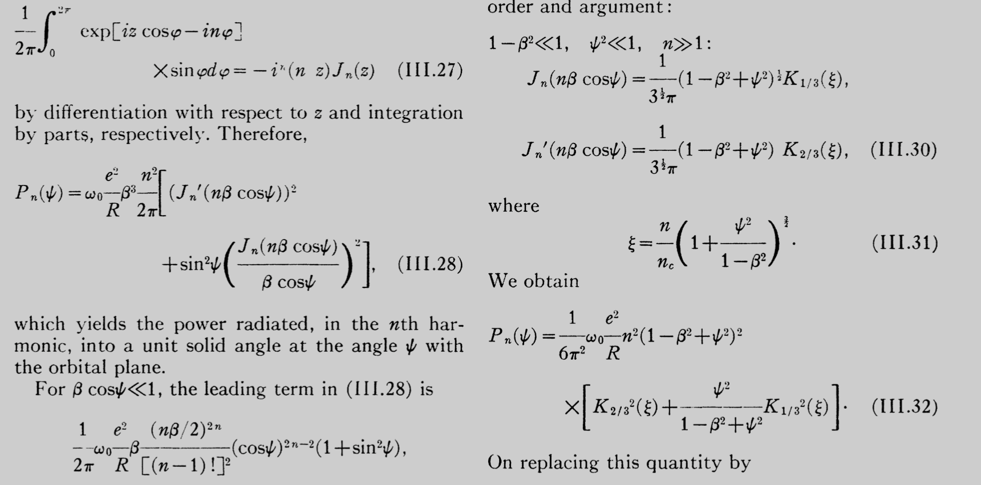
Synchrotron radiation users no longer include only physicists, but scientists from many disciplines.
This diversified community needs descriptions both simple and accurate, not relying on
complicated
math but on
fundamental
facts: this is
our objective!
λ ≈ L /(2γ ²)
NOT THIS...
...BUT THIS!

Slide 3
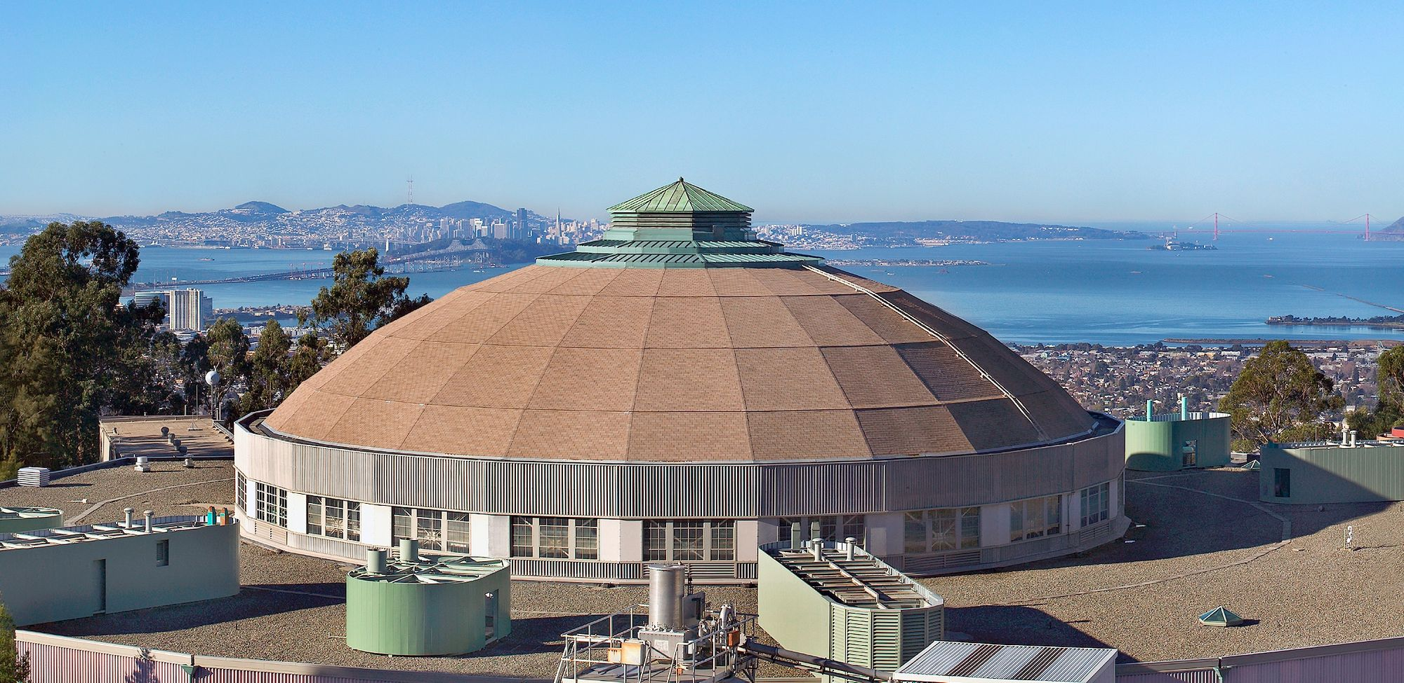
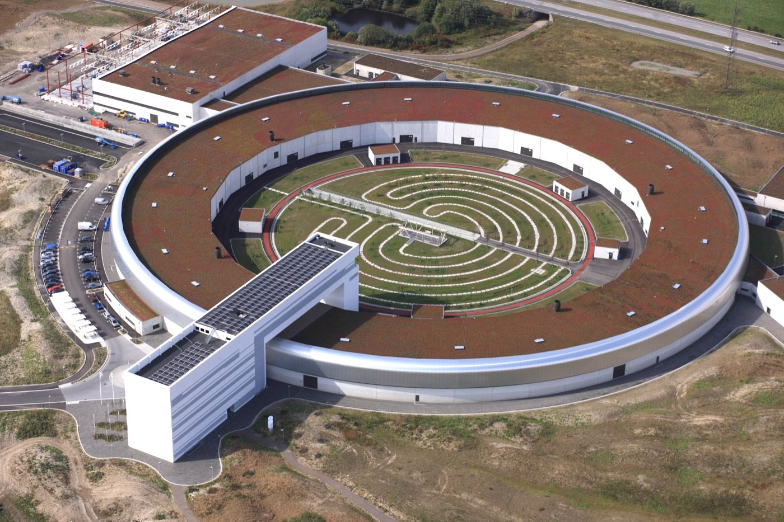
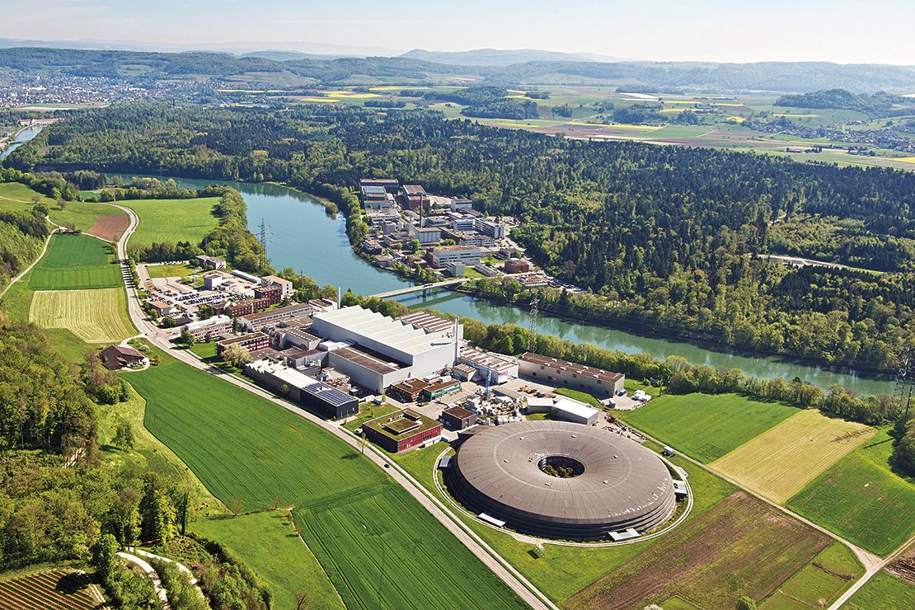
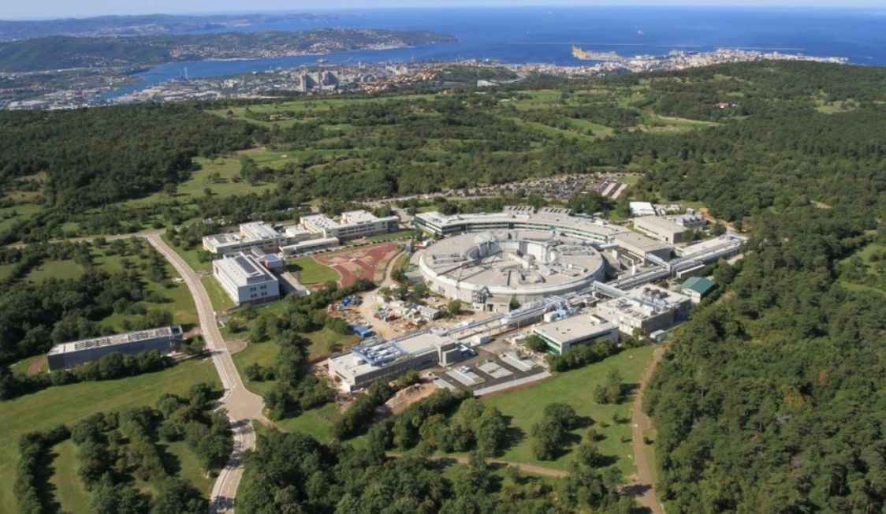
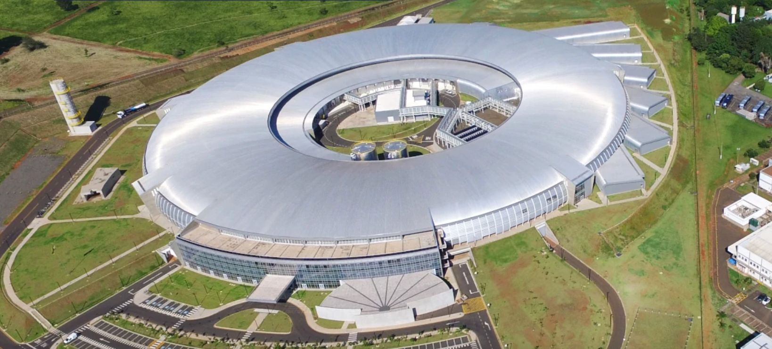





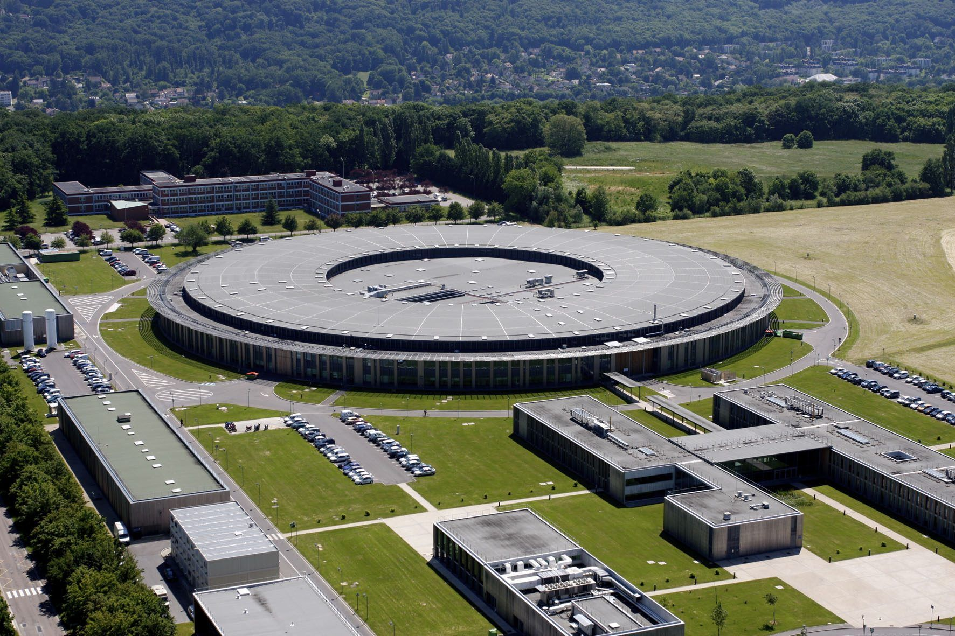
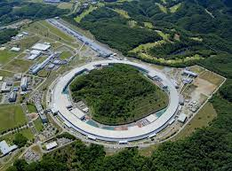

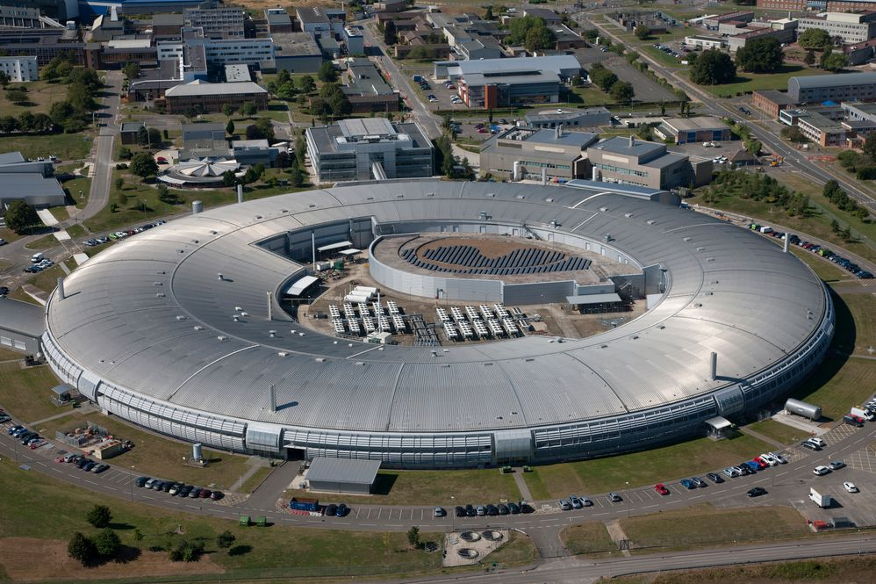
Facts about synchrotron radiation, the world largest research network!
ALS, USA
    Hundreds of thousands of users
Over 60 active centers, more underway
SLS,
Switzerland
Investments of 35 billion dollars, total expenditures of over 100 billion dollars
Literature: >1,250,000 Google Scholar citations
Max-IV, Sweden
Elettra, Italy
SIRIUS, Brazil
SSRF, China
SESAME,
Jordan
PAL, Korea
In recent years, a factory of Nobel prizes: Agostini, Agre, Baker, Boyer, Huillier, Kobilka, Kornberg, Krausz, L'Huillier, Mackinnon, Ramakrishnan, Steitz, Yonath, Walker…
Alba, Spain
BESSY II, Germany
Spring-8, Japan
DIAMOND, UK
Soleil, France
DESY, Germany

Slide 4
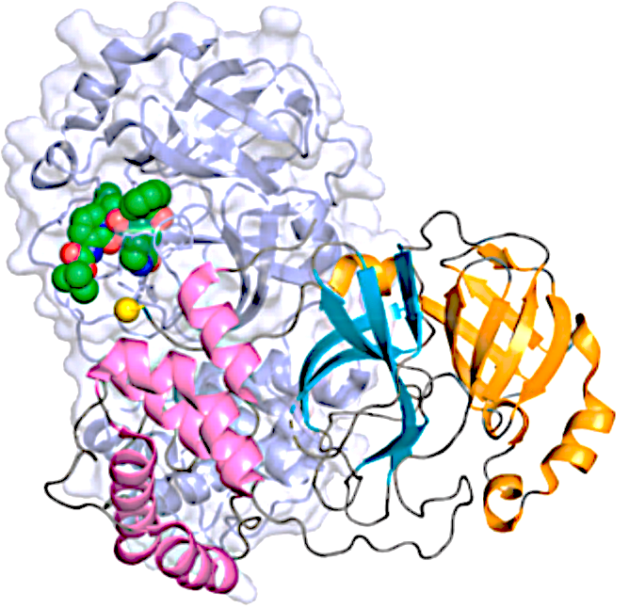

Can you guess the cash benefits of this network?
2020: COVID exploded!
Information on the virus structure was needed to
develop vaccines and drugs. The worldwide system
of synchrotron sources was immediately activated: in a few weeks results started, opening a fast way to vaccines.
This sharply reduced premature deaths: the recently evaluated cash benefits
incredibly exceeded
I want a synchrotron!!!
$7.2 TRILLIONS!!!
The worldwide investments in synchrotron sources were <$35 billions, thus the ratio benefits/cost ratio was >200, not including all other uses!
Note: $7.2 trillions is 7% of the world GDP. And Elon Musk, the world richest person, has "only" < $0.5 trillions

Slide 5
What is the aspect that makes synchrotron sources essential? They notably emit x-rays, very important because of what we can probe with their wavelengths and photon energies
0.1
10
1000
x-rays
100000
10000
1000
100
10
chemical
bond lengths
core electrons
energies of electrons affected by chemical bonds
wavelength
photon
energy
wavelength (Å)
photon energy (eV)
Spectrum of electromagnetic waves
valence electrons
…in short, x-rays are the best tools to explore
chemical bonds, foundation of the majority of science and technology: thus, we need excellent x-ray sources!

Slide 6
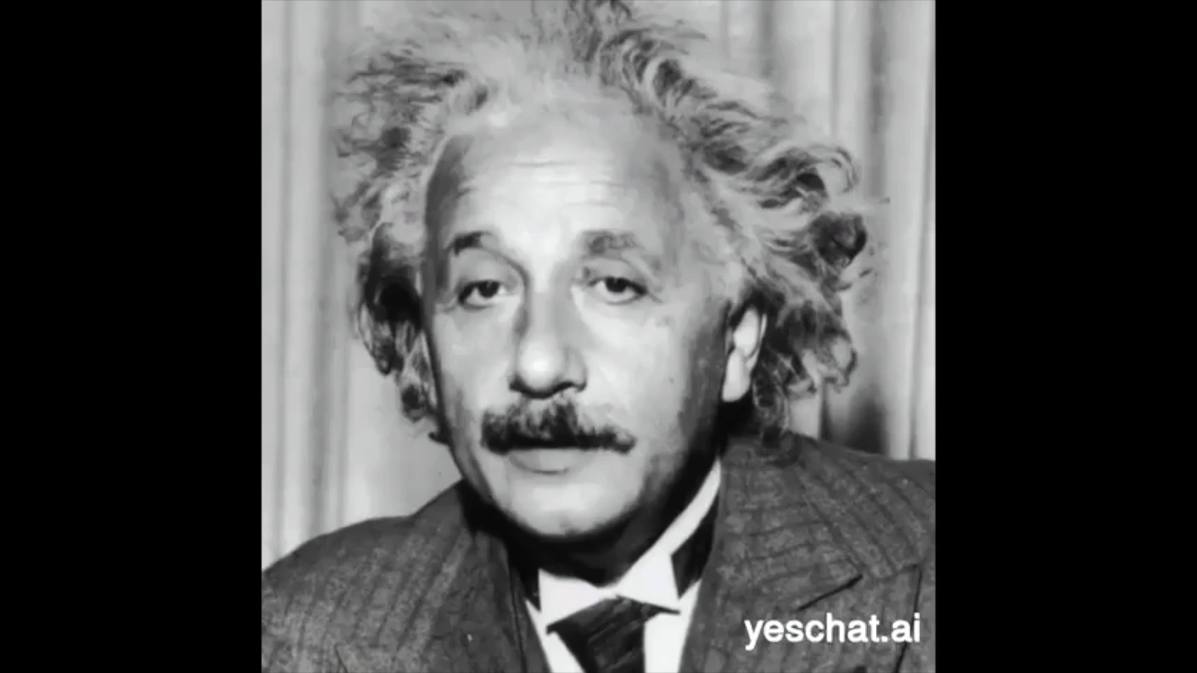
But conventional x-ray sources are very bad:
how can we get better ones?
Could we, perhaps, use oscillating electrons in antennas as for radio waves?
NO! Antennas can produce the long wavelengths of radio
waves, but not the very short wavelengths of x-rays!
Why not? Because the electronic devices inducing the
oscillations cannot reach the required high frequencies
(say, 10¹⁸ hertz: electronic oscillators stop at 10¹⁰ hertz)
waves
To get x-rays, we need a different strategy, combining oscillations and a wavelength-shortening mechanism!
Cheer up! My relativity has two such phenomena at least: Doppler effect and the Lorentz contraction

Slide 7

The relativistic "Lorentz contraction": what is it?
1
γ =
1–v ²/c ²
Seen by a motionless observer, the length L of an object moving towards it with speed v decreases to ≈L /γ
What is this
"gamma
factor”? Ask
Albert Einstein!
NOTE: m = γ m_{e} ,
γ = mc ²/(m_{e}c ²)
= energy/rest energy
v
≈ L /γ
L

Slide 8

Let us look now at the “Doppler effect”:
To introduce it, we start with a non-relativistic analogy: a moving train
Moving train
The
motion
of the
source
(train) (1) shifts the sound
to higher frequencies
(shorter wavelengths), and
Wooooooof!
Wiiiiiiiiiiiiif!
v
Stationary train: low-frequency whistle
(2) projects ahead” the sound
causing angular collimation
Take now an electron emitting
radiation of wavelength λ_{e} in its
own reference frame because
of transverse oscillations…
λ_{e}
λ_{L}
and
add a relativistic longitudinal
speed v ≈ c : the Doppler effect gives again short wavelengths plus collimation
v ≈ c
...and one can show that the wavelength in the lab is λ_{L} ≈ λ_{e}/(2γ )

Slide 9
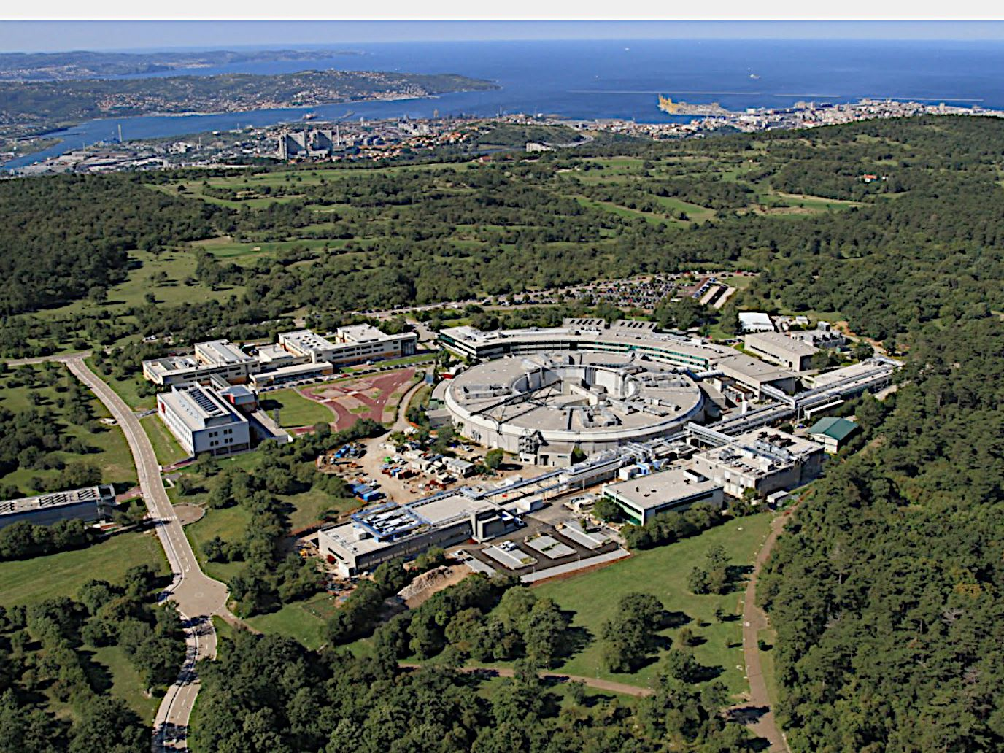
…where radiation is emitted by electrons that circulate in a “storage ring”
under vacuum
at almost the
speed of light
Elettra,
Trieste,
Italy
So: to emit x-rays using the Lorentz contraction and the Doppler effect, we must combine transverse oscilations with a longitudinal relativistic speed ≈c.
To see how, let us visit a leading synchrotron facility

Slide 10

Great! but how can I mix the longitudinal speed ≈c and transverse oscillations?
L
the undulator causes transverse oscillations that force the electron to emit radiation
Then add an “undulator”: a periodic series of magnets, period L
…whose wavelength,
of course,
is related to
the period L,
relativistic electron,
v ≈ c
Here is a good
strategy: for the
longitudinal relativistic
motion, use (as for Elettra) a
storage ring, with a system (not shown) of electric devices and magnets that forces electrons to circulate in ultrahigh vacuum at almost the speed of light
but it is not
equal to L!

Slide 11
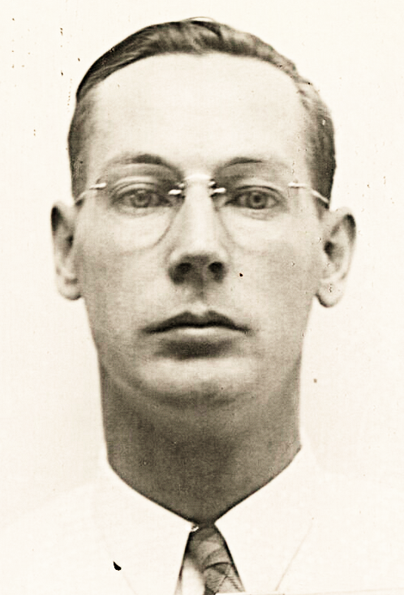
From its point of view, the electron “sees” the undulator arriving with velocity -v ≈ -c
To build an electron accelerator, you got to think like an electron!
Don Kerst, inventor of the betatron
-v ≈ -c
L
…so, the electron “sees” the undulator period L shrunk to ≈L /γ
…and, due to the “Lorentz contraction”, the lengths appear shortened by ≈γ
-v ≈ -c
this equals the emitted wavelength as “seen” by the electron, λ_{e} = L /γ
≈L /γ

Slide 12
…However, λ_{e} is not the wavelength seen in the laboratory!
In fact, the Doppler effects further reduces it by ≈2γ
In summary, an undulator in a storage ring forces electrons to emit short wavelengths by combining oscillations, Lorentz contraction and Doppler shift
NOTE again: γ is proportional to the energy.
So, high energy → short λ
Lorentz contraction: L → L /γ
Numerical example:
L = 1 cm,
γ = 5000
λ ≈ 2 x 10⁻¹⁰ m:
yes, x-rays!!!
Doppler shift: L /γ → (L /γ )/(2 γ )
overall: λ ≈ L /(2γ ²)
Factor found
everywhere in synchrotron radiation theories

Slide 13
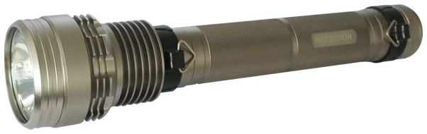
OK, relativity produces x-rays… however, our goal is not generic sources but excellent ones: are we getting them?
First, what is an “excellent source”?
To quantify this notion,
consider the source parameters:
we obtain an "excellent"
flashlight not only by enhancing its
emission but also by increasing
its concentration in space, thus
making it more effective
Area, A
Angular divergence
(solid angle Ω )
Flux, F
F
…and define the
“Brightness” = constant
A Ω
A source is “excellent” if it has high brightness:
large flux, small area, small divergence

Slide 14
Do synchrotron sources reach high brightness?
YEEES! Over one million billion times
more than conventional x-ray sources!
How? Because of four causes, two of which relativistic:
Relativity, as we shall see, sharply reduces the angular divergence
And we shall also see that relativity boosts the emitted power
Electrons in a storage ring, being in vacuum, can handle more emitted power than those in a solid, which can be damaged
Source size: not the cross section of one
electron, since the electrons in the ring
travel in bunches (we shall see why), along
slightly different paths.
The source size is the transverse cross
section of the entire bunch, kept small by very effective controls

Slide 15

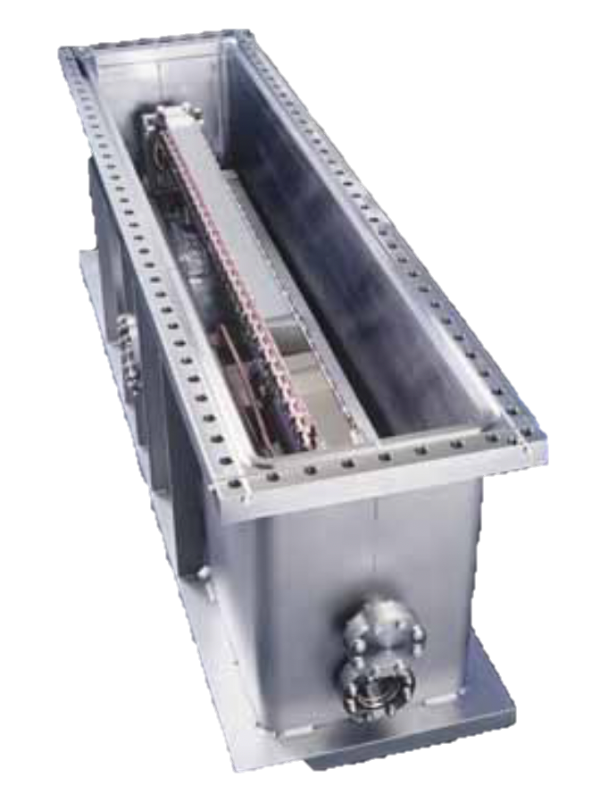
Relativity at work: the emitted power is huge!
“Larmor law”: the emitted power is proportional to a_{e}², the square of the transverse acceleration in
the electron frame R_{e}.
oscillating electron
If v = zero, then a_{e} is
the same as a_{L}, the transverse acceleration in
the lab frame R_{L}: the power is proportional to a_{L}²
a_{e}
v
emission
if v ≠ zero: going from R_{e} to R_{L} the relativistic time dilation multiplies the time by γ , while the transverse coordinate, not affected by the longitudinal motion of R_{e}, remains invariant: the acceleration = coordinate/time² is divided by γ ²: a_{L} = a_{e}/γ ², and a_{e} = γ ²a_{L}
Mirror with
cooling
system to
prevent
damage
from the
huge radiation power
…the power is proportional to a_{e}² = (γ ²a_{L})², thus to γ ⁴ = (energy)⁴/(m_{o}c ²)⁴
…and decreases as 1/m_{o}⁴: electrons emit a lot, protons much less
The emission grows as the 4th power of the electron energy, reaching very high levels

Slide 16

Relativity continues to work: angular collimation
…but in the laboratory frame R_{L} it shrinks to a small forward cone, like the sound of a train in motion (as we have seen) but much narrower
R_{e}
v ≈ c
R_{L}
Seen in the electron frame R_{e} , the angular range of the emission is broad, like radio waves from an antenna
wave velocity vector in R_{e}: magnitude
c, zero longitudinal component
How? Take the extreme cse: an x-ray wave emitted in R_{e} in a transverse direction
With my relativity,
the magnitude c is
invariant, so from
R_{e} to R_{L} the velocity
vector just rotates
θ
c
And, going from R_{e} to R_{L} , the electron motion with speed v ≈ c “projects ahead” the emission: the forward wave velocity component is ≈v
≈v
Very small
angular spread ≈1/γ :
milliradians!!!
Since θ is small: θ ≈ sinθ
≈ c ² -v ² /c = 1-v ²/c ² θ ≈ 1/γ

Slide 17
So, the electrons in an undulator act as ultranarrow flashlights:
This explains the overall emitted spectrum around the "central wavelenght" L/(2γ ²):
weak magnetic field →
small transverse undulations
detector
continuously illuminated
[ TOP VIEW ]
(small) detector
long signal pulse
N periods
the emitted spectrum is a narrow band
Fourier theorem
Δλ or Δν
wavelength (λ) or frequency (ν )
time
L/(2γ ²)
going through the N undulator periods, the electron emits a wave with N wavelengths, of length Nλ_{L}.
Bandwidth:
Pulse duration: Δt_{L}= Nλ_{L}/c. Fourier: Δν_{L}= 1/Δt_{L}= c /(Nλ_{L}). Relative bandwidth: Δν_{L}/ν_{L} = [c /(Nλ_{L})]/(c /λ_{L}) = 1/N
(NOTE: this is the same bandwidth formula as that of a diffraction grating)

Slide 18
Can we change the wavelengths emitted by an undulator?
Suppose that we increase the magnetic field strength B by reducing the
magnet gaps:
the wavelengths change: why?
A stronger magnetic field B increases the Lorentz force on the electrons,
the transverse oscillations and their transverse speed, proportional to B
But the Lorentz force cannot do work and cannot change the total kinetic energy, so the increase in the transverse speed requires a decrease in the longitudinal speed
This affects the Doppler shift: one can show that λ_{L} changes from L /(2γ ²) to
λ_{L} = [L /(2γ ²)](1+ constant x B ²)
Yes, we can tune the wavelength !

Slide 19
The combined Doppler effect and Lorentz contraction plus the "ultranarrow flashlight" effect determine the emitted spectra of other types of sources besides undulators:
beamline
experimental chamber
undulator
bending magnet
wiggler
bending magnet
wiggler
experimental chamber
Specifically, of bending
magnets and wigglers: what are they?

Slide 20
A wiggler, as an undulator, is a periodic magnet array -- but its magnetic field is stronger and causes larger transverse oscillations of the electrons:
strong magnetic field →
large transverse undulations
[ TOP VIEW ]
(small) detector
series of short pulses
broad band
Fourier theorem
time
Multiple pulses → strong emission
L/(2γ ²)
ν or λ

Slide 21
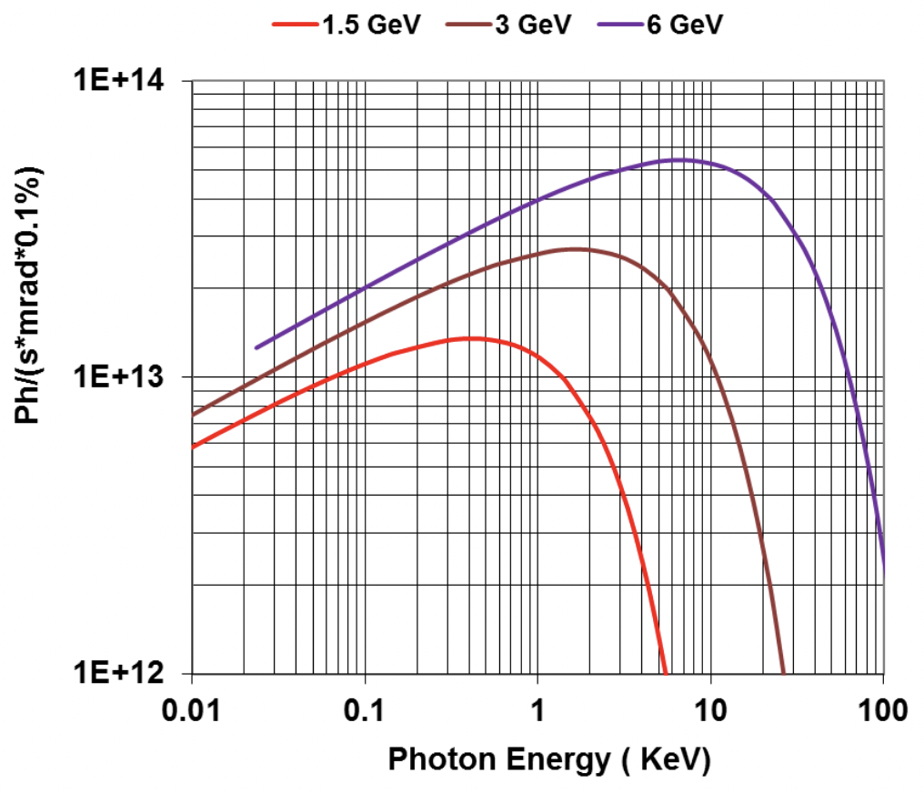
Third type of synchrotron sources: bending magnets, the dipoles that also keep the electrons circulating in the storage ring
[ TOP VIEW ]
(small) detector
short
signal pulse
broadband
log-log plot
Fourier theorem
time
λ_{L}
ν or λ
BUT: wait a moment! This does not look like well-known bending magnet synchrotron spectrum!
EXPLANATION: the "well-known spectrum" is just the log-log plot of the peak!
... and one can easily show [G. Margaritondo, J. Synchr. Rad. 25, 1271 (2018)] that λ_{L} ≈ 2πcm_{e}/[(2γ ²)eB]

Slide 22
The time structure of storage ring emission
The cause: as mentioned, the electrons travel in bunches
Why? To keep the electrons in the ring, the energy they lose by emitting synchrotron
radiation is restored by the periodic
force of a radiofrequency (RF) cavity:
but this only works for electrons that pass through the cavity in bunches, in synchrony with the periodic force; the others decay
radiofrequency (RF) cavity
at every turn, each
electron bunch sends a
short pulse of radiation in
each beamline: this time structure is useful for
special experiments
nanoseconds (ns)
source
tenths
of ns
detector
time

Slide 23
Polarization: another key synchrotron light feature
Consider an electron traveling through an undulator or a wiggler:
[ SIDE VIEW ]
[ FRONT VIEW ]
The waves emitted along the undulator axis correspond to electric field perturbations in the horizontal plane
...thus, they are linearly polarized
…likewise, on-axis waves from bending magnets are also linearly polarized in the horizontal plane
and special (elliptical) wigglers/undulators can produce intense elliptically polarized radiation

Slide 24
We must now discuss one last, very important feature of synchrotron light: COHERENCE
screen with two slits
fluorescent screen
What is the difference?
Laser radiation has "coherence", whereas the radiation from
a light bulb does not
radiation from
a light bulb
laser radiation
no diffraction
diffraction!
But what is coherence? In simplified terms, it is “the property that enables radiation to produce detectable wave-like effects such as interference or diffraction”
X-rays from synchrotron sources have high coherence, which is exploited for revolutionary new techniques, notably in radiology!

Slide 25
Simple introduction to
coherence:
Time coherence:
To describe it, we can use any wave-like effect, such as diffraction by a pinhole
Δλ
point source
fluorescent screen
if the source emits not one wavelength but a wavelength band Δλ, each λ in Δλ gives a fringe pattern; their combination blurs the fringes, so they may not be visible. If they are, there is time (“longitudinal”) coherence
λ
diffraction pattern
point source
a point source emitting only one wavelength λ always produces a visible pinhole diffraction pattern: it has full coherence
Spatial coherence:
Each point of
a source with
finite size ξ
produces a
different pattern:
the combination blurs
the fringes. If they are still seen,
there is “spatial” (“lateral”) coherence
extended source
ξ
λ
More realistic sources reveal TWO aspects: “time coherence” and “spatial coherence”

Slide 26
Multiple wavelengths: longitudinal (time) coherence
…and the combination blurs the fringes
different wavelengths produce different patterns…
what is the condition to still see a fringe pattern?
Spacing of adjacent fringes (from elementary optics):
x ≈ (H/δ )λ ;
if λ is replaced by a band Δλ, x is “blurred” to:
Δx ≈ (H/δ )Δλ
Condition to see the pattern:
Δx < x → Δλ/λ < 1(time coherence)
We can express this rule using the "coherence length” L_{c} = λ²/Δλ:
time coherence requires
L_{c} > λ
δ
H

Slide 27
Each point of an extended source produces a diffraction pattern
Spatial
coherence:
→ whose superposition causes blurring
what is the condition for a pattern to still be visible?
Maximum distance between centers of patterns produced by different source points: M ≈ ξ H/D
D
H
Fringe spacing x ≈ (H/δ )λ
Fringes can be seen if M ≤ x :
ξ H/D ≤ (H/δ )λ → δ ≤ λD/ξ
ξ
solid angle Ω
δ
condition for spatial coherence
An alternate way to describe spatial coherence: diffraction is produced only by the waves passing through the pinhole, emitted in the solid angle ≈ δ ²/D ²
≤ (λD/ξ )²/D ² = λ ²/ξ ²,
...which corresponds to a fraction of the total emission ≈(λ ²/ξ ²)/Ω
= λ² /(ξ ²Ω )
...“coherent power factor”: its value measures spatial coherence

Slide 28
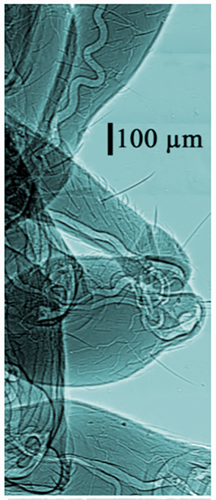
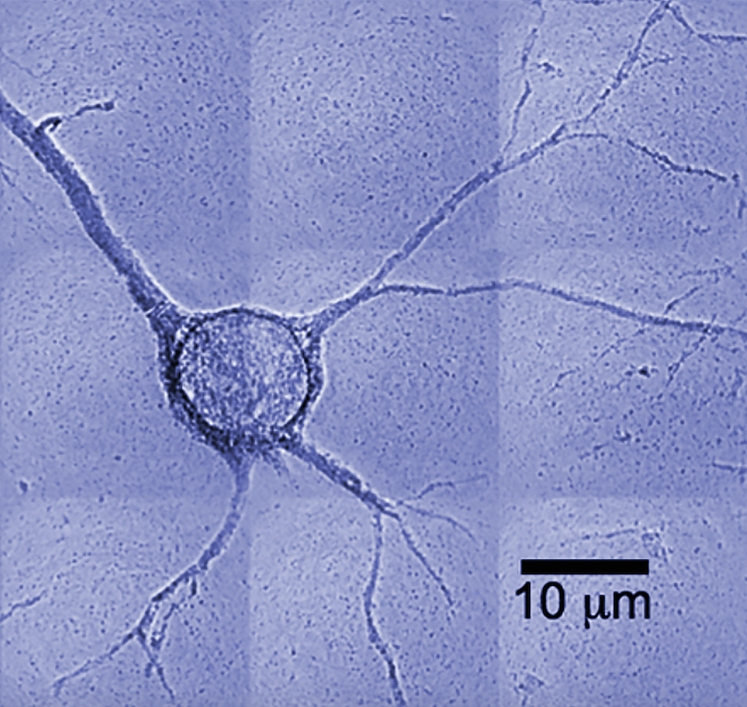
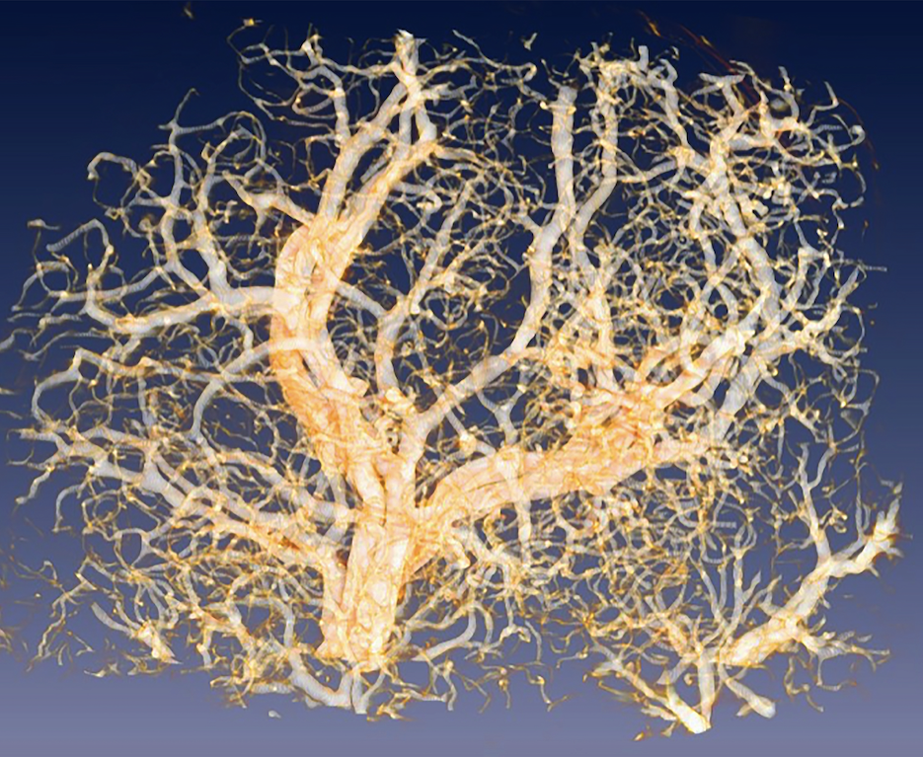
Are synchrotron sources spatially coherent?
YEEES! Their small size ξ and small angular spread Ω enhance the coherent power factor λ²/ (ξ ²Ω )
Note, however: the λ² term in this factor makes spatial coherence very difficult to obtain for the short λ’s of x-rays: synchrotron sources are required to keep ξ ²Ω small!
…And λ² is also present in the (time) coherence length, causing a similar problem for time coherence!
And: the brightness is proportional to 1/ (ξ ²Ω ) like the coherent power factor
The historical efforts to enhance the brightness by lowering
ξ and Ω also boosted spatial coherence
radiograph of a neuron: world record spatial resolution
The spatial coherence of synchrotron x-rays is very good for imaging: it notably produces phase-contrast radiographs, with sharp features and very small details -- we shall see how
cancer-related
microvasculature
body of an ant

Slide 29
…in conclusion, we explained key synchrotron radiation properties with simple arguments, mostly from relativity:
Emission of short wavelengths
Angular collimation
Huge emitted power
Very high brightness
Spectra of undulators, wigglers
and bending magnets
Pulsed time structure
Polarization, linear of elliptical
Time and spatial oherence

Slide 30
(1) Fundamentals of Synchrotron Radiation from Storage Rings
(2) Fundamentals of X-ray Interaction with Matter
Giorgio Margaritondo
Ecole Polytechnique Fédérale de Lausanne (EPFL)
and Istituto Italiano di Tecnologia (IIT)
(3) Bonus: Free Electron Lasers, a short primer

Slide 31
Using synchrotron x-rays: different interactions with matter, mostly involving electrons, lead to many experimental techniques
scattered photons, fluorescence
small-angle scattering
…in this lecture, we focus our attention on the
most widely used solid-state synchrotron techniques
atom or
molecule
X-rays
fluorescence spectroscopy
Synchrotrons sources are NOT narrowly specialized tools, but versatile facilities serving in parallel many different applications and many users, thus spreading the costs
photoelectrons, Auger electrons
photoelectron and Auger spectroscopy
molecular
fragments
scattered photons
X-ray scattering
solid
transmitted photons
absorption spectroscopy, EXAFS
X-rays
diffracted photons
crystallography
fragmentation spectroscopy
fluorescence
fluorescence spectroscopy
scattered photons
X-ray scattering
solid
X-rays
transmitted photons
imaging, absorption spectroscopy, EXAFS
photoelectrons
diffracted photons
crystallography
photoemission spectroscopy
fluorescence
fluorescence spectroscopy
photoelectrons
transmitted photons
imaging, absorption spectroscopy, EXAFS
Auger electrons
photoemission spectroscopy
Auger spectroscopy
atoms,
molecules
desorption spectroscopy

Slide 32
Interactions of x-rays with solids:
general picture and formal background
Then, traveling in the solid, its intensity can be progresively decreased by absorption
Wave function in vacuum: we could use a sine function, Asin(k•r – ωt );
but for effetive math it is better to adopt an imaginary exponential:
Aexp[i (k•r – ωt )]
In vacuum, a wave propagates with constant intensity at the speed of light
All such phenomena are described by one parameter: the (complex) refractive index
“AMPLITUDE”
“PHASE”
Inside the solid, k changes to nk , with n = n_{R} + in_{I} (complex refractive index)
Wave function: Aexp{i [(n_{R}+in_{I})k•r – ωt ]} = Aexp(-n_{I}k•r )exp[i (n_{R}k•r – ωt )]
And it can be affected by other "phase effects" such as interference or diffraction
When it passes the vacuum-solid interface, it changes its direction due to refraction
SOLID
Exponential with negative real argument: it decreases with the distance and describes absorption
n_{R}k determines the "phase", affecting refraction and other phase effects: diffraction,
interference…
Synchrotron radiation techniques can be
based on absorption effects, phase effects, or both

Slide 33
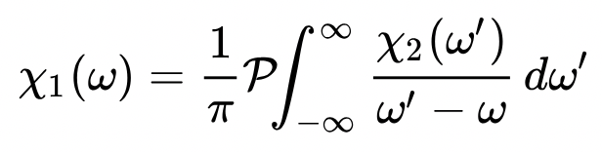
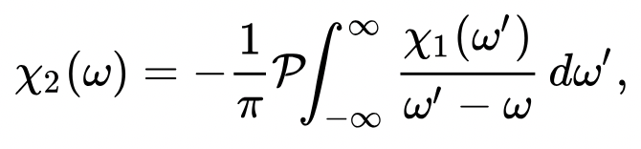
Important aspects of the complex refractive index:
(1) n_{I} is small for x-rays, so absorption is very weak: x-rays pass through solids
(2) n_{R} is ≈1 for x-rays: very weak refraction
10⁻¹
10⁻³
10⁻⁵
10⁻⁷
(3) n_{I} and n_{R} are not independent, but linked by the so-called “Kramers-Kroenig equations”
Si₃N₄
This explains the relations
between different phenomena:
Strong reflection corresponds
to strong absorption (think
about a metal-coated mirror)
X-ray
absorption edges
1-n_{R}
n_{I}
Phase and absorption features occur for the same photon energies
10² 10³ 10⁴
Photon Energy (eV)

Slide 34
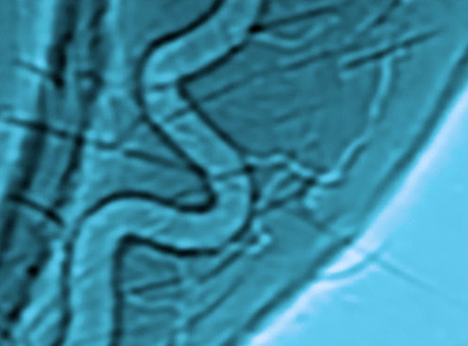
We shall now treat imaging, the oldest and most common use of x-rays, due to both absorption and phase effects.
Originally, it only used absorption. But the spatial coherence of synchrotron light now leads to novel "phase contrast" techniques
The mechanism of these powerful techniques is complex, but we can grasp key features with a simple analogy: “seeing” a glass of wine.
We see the wine itself because it absorbs and/or
scatters certain wavelengths and looks colored
But we also see the edges of the (transparent) glass
because they deviate the light by refraction/scattering
Likewise, phase contrast (refraction/scattering of x-rays) can cause sharp, highly visible edges in synchrotron radiographs
…however, to observe such edges the incoming
x-rays must have a well-defined direction: this requires the spatial coherence of synchrotron radiation, which guarantees strong angular collimation and directionality

Slide 35

A simple model of x-ray imaging by phase contrast
[G. Margaritondo and G. Tromba, J. Appl. Phys. 85, 3406 (1999);
Y. Hwu et al., J. Appl. Phys. 86, 4613 (1999)]
detector
predicted
image:
dark-bright
fringes
x-rays
refraction
outside the edge, no refraction
object with a slanted edge between regions with different real refractive index
a real radiograph
detected intensity
Note: whereas high lateral coherence is required for phase contrast,
high longitudinal (time) coherence is not needed

Slide 36
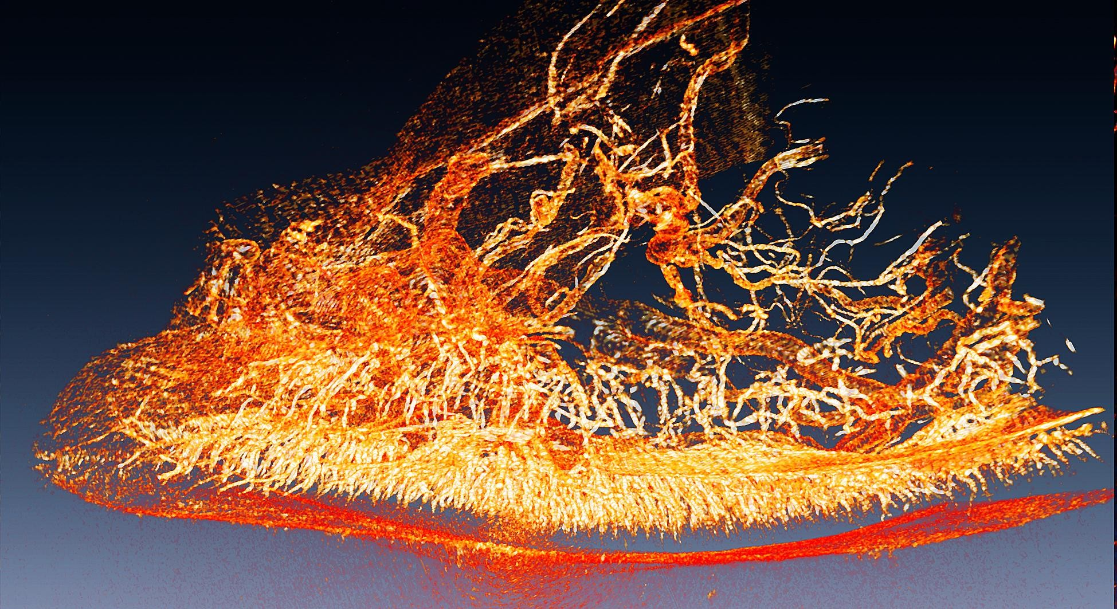

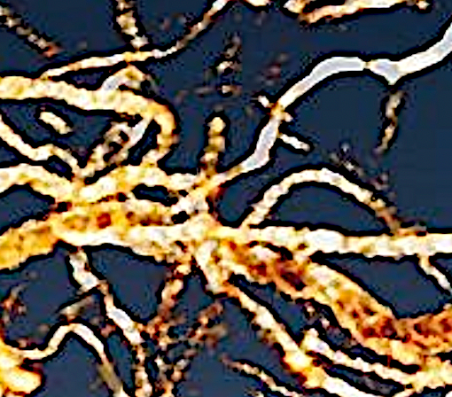
An example of what can be done with phase contrast imaging: exploring the "miracle" of fireflies
Synchrotron phase-contrast microtomography image
of a firefly “lantern”
[Y. L. Tsai, Y. Hwu et al., Phys. Rev. Letters 113, 258103 (2014)]
…being able to detect even the smallest vessels, we could quantitatively evaluate the incredibly effective light emission mechanism: a similar effect happening in a plane would crash it!

Slide 37
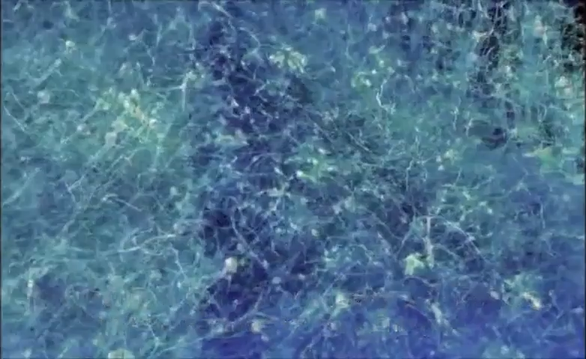
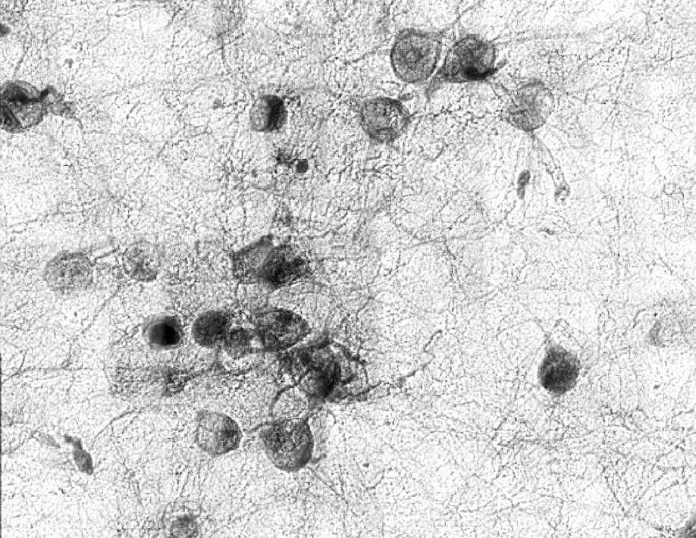
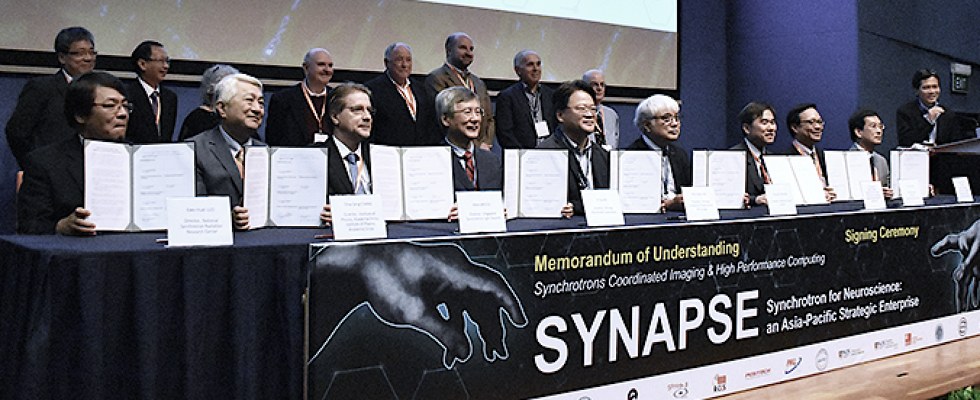

Microscopy with coherent x-rays: exploring the brain, neuron by neuron
SYnchrotrons for Neuroscience –
an Asia-Pacific Strategic Enterprise
(SARI/SSRF-China, PAL-Korea, AS-Taiwan, RIKEN/Spring8-Japan,
NUS/SSLS-Singapore, ANSTO-Australia, SLRI-Thailand, SESAME-Jordan)
Goal: first map of a full human brain

Slide 38
Our next subject: x-ray absorption spectra and their
core-level edges:
conduction band
photon absorption
K-edge
photon absorption
gap
L-edge
valence band
E_{B}
photon energy
electron energy
what causes
such edges?
core-level edge
Consider the energies of electrons in an (insulating) solid
core
levels
hν
electron
E_{B}
_{"binding energy"}
hν

Slide 39
The binding energy E_{B} of a core-level edge identifies the corresponding chemical element and reveals its presence. Plus, the edge provodes information on the chemical status of the element …and more
X-ray absorption
NaH₂PO₄
phosphorus K-edge
In particular, the so-called
“EXAFS” = Extended X-ray Absorption Fine Structure
above the edge yields precious information on the local microscopic environment of the x-ray absorbing atom
EXAFS
edge
E_{B}
Photon energy

Slide 40
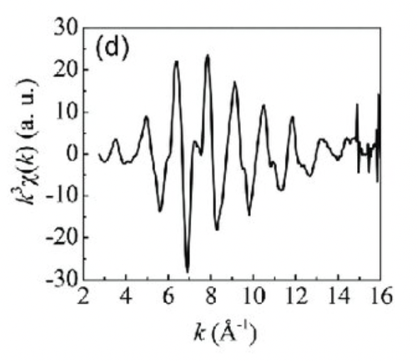
EXAFS mechanism:
The outgoing excited-electron wave and the backscattered electron wave interfere
constructively or destructively depending
on the distance d and on the electron
wavelength, which corresponds to the
electron energy and therefore to the
photon energy hν
backscattered electron wave
photon
neighbor atom
d
CRYSTAL
This causes oscillations in the absorption vs. hν plots: the EXAFS
photon- absorbingatom
outgoing wave of the excited
electron
From these oscillations, one
can derive the local interatomic
distance d, a very valuable piece of information

Slide 41
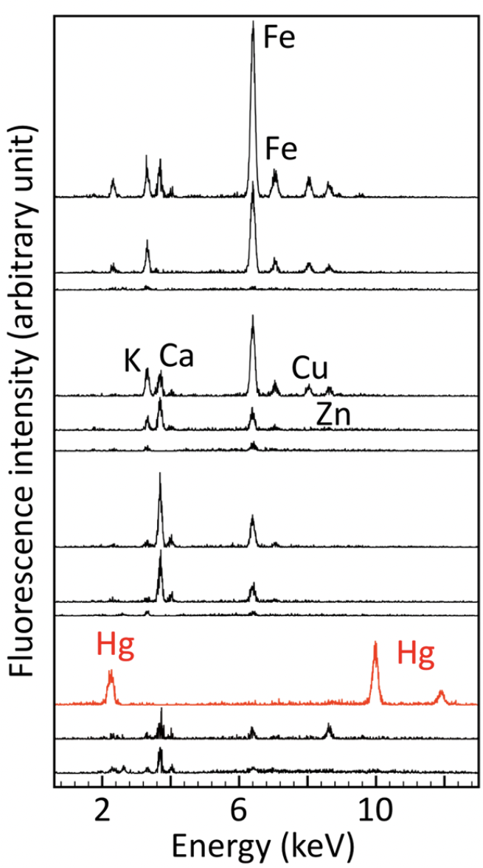
What happens to the energy of x-ray photons absorbed by a solid? One possibility is to cause the emission of other photons
(x-ray fluorescence)
ssynchrotron x-rays
emitted x-rays
Electron Energy
Fluorescence
spectra of ancient inks revealing their chemical composition
Incoming photon
emitted x-ray photon: its energy shows the presence of the element corresponding to the core levels
unstable situation

Slide 42
Photoemission: another set of key synchrotron techniques based on absorption
photoelectric effect:
...which exploit the photoelectric effect, the leading photon absorption process at the typical x-ray wavelengths of synchrotron light
photon, hν
photoelectron
solid
...to probe the energies of electrons in chemical bonds:
atom
solid
electrons
vacuum
The effect adds hν to the electron energy: by subtracting hν from photoelectron energies measured in vacuum, one can derive the electron
energies in the solid
electron energy
hν
creation of chemical bonds
Photoelectric effect

Slide 43
Solid-state photoemission detects
valence electrons and core electrons:
photoelectron energy, minus the photon energy
valence electrons
electron energy
photoemission spectrum
core electrons
captured photoelectrons
…synchrotron photoemission transformed my bookish quantum notions like core levels into tangible realities!

Slide 44
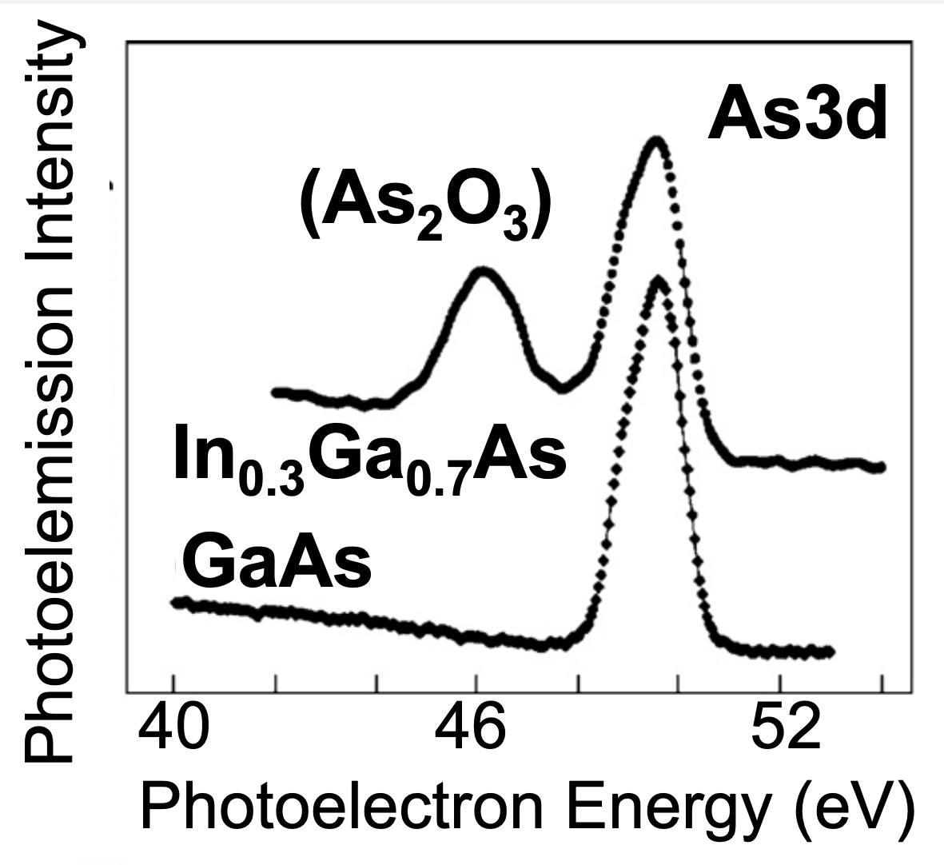
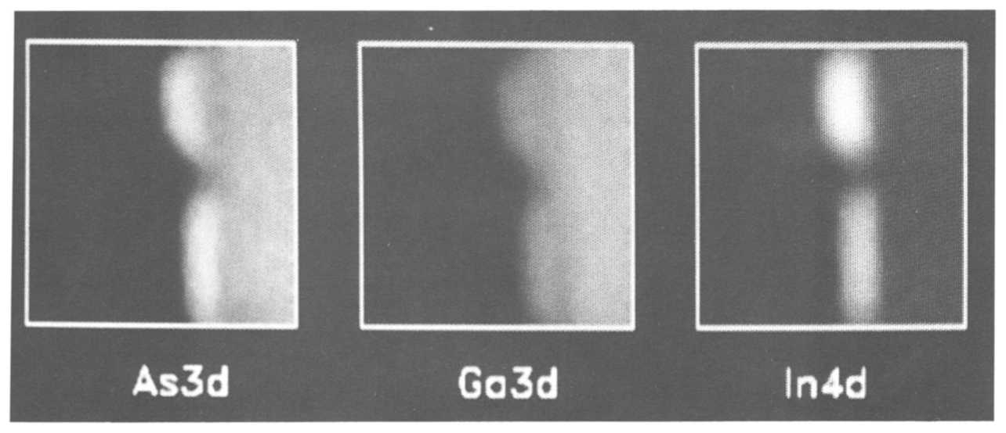
Photoemission spectroscopy and spectromicroscopy:
SPECTROSCOPY
(energy and momentum resolution):
chemical information
MICROSCOPY (spatial resolution): structural information
Their combination is made possible by the high brightness of synchrotron sources
SPECTROMICROSCOPY: structural + chemical information
Example: photoelectron spectra and phptoemission intensity images (“chemical maps”)
of different parts of a
patterned InGaAs layer
over a GaAs substrate
[W. Ng et al., Nucl. Instrum.
Meth. A347, 422 (1994)]
As3d Ga3d In4d

Slide 45
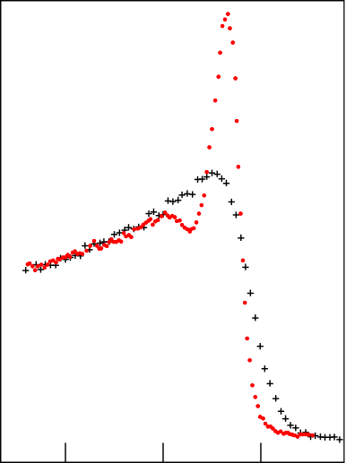
Photoemission reveals the gap of a
high-temperature superconductor
superconducting state
Superconducting
state
electrons
Superconducting gap
…which finally became visible in high-resolution spectra taken with ultrabright synchrotron light
Normal
state
normal state
energy
Photoemission did not have, in the past, enough resolution in energy to see the gap
-0.2 -0.1 0
Energy (eV)
This is now a key technique to study high-temperature supeconductors

Slide 46
We shall now discuss synchrotron light experiments
based on phase effects: a leading example is
elastic x-ray scattering, which reveals the electron charge distributions of microscopic structures
Electronic charge distribution, F (r )
scattered
x-ray k-vector, k’
→
→
incoming
x-ray k-vector, k
→
→
d³ r
elementary volume
→
→
→
Theory: defining the "scattering vector" as s = k ’ – k, one can show that the scattered wave W (s ) is proportional to ⎰F (r )exp(ir ・s )d³r , which is the Fourier transform of the charge distribution F
→
→
→
→
→
Conversely, F is proportional to
⎰W (s )exp(-ir ・s )d³s , the inverse Fourier transform
→
→
→
→

Slide 47
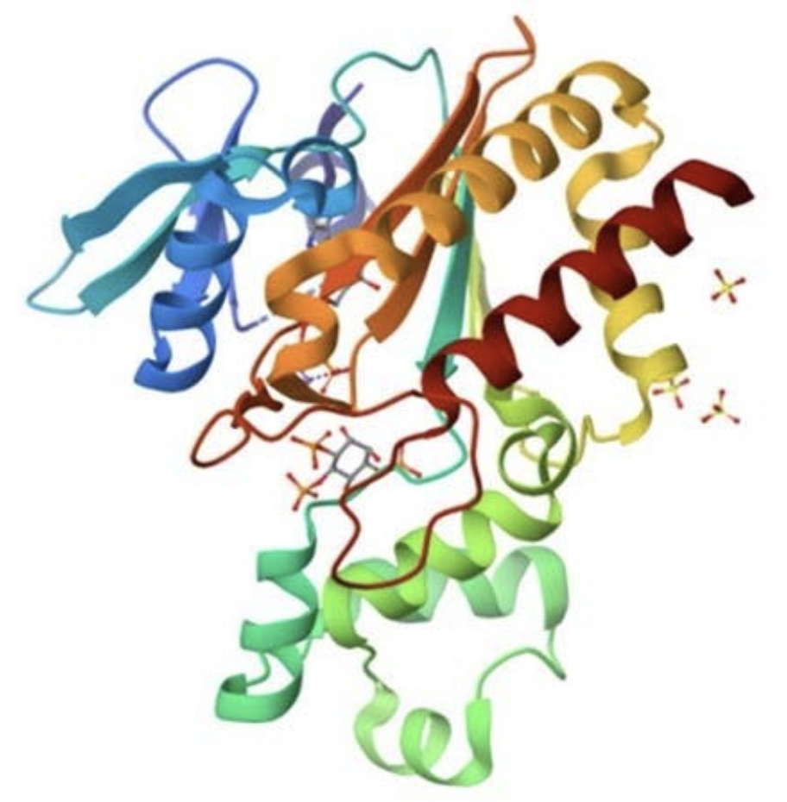
In principle, therefore, we can find the electronic charge distribution of a microscopic object
by performing the inverse Fourier
transform of scattered x-rays
detector
???
This strategy faces serious
obstacles like the “phase
problem” (due to the fact that scattered intensities
are measured and not waves), but it does
lead to several powerful techniques:
Inverse Fourier transform
Large-angle scattering,
Small-angle scattering
Powder diffraction
Pprotein crystallography …and much more

Slide 48
Small-angle and large-angle x-ray scattering
In a real experiment, the detector has a finite size and captures only a limited solid angle, i.e., only a fraction of the scattered x-rays
Small-angle scattering only gives the general structure
Consequences of Fourier transforms: if scattered x-rays are only detected at small angles, the inverse transform gives the general shape of the object but not its fine details
inverse
Fourier
transforms
Large-angle scattering gives the details
So, small-angle scattering is specifically useful for a first look at microstructures

Slide 49
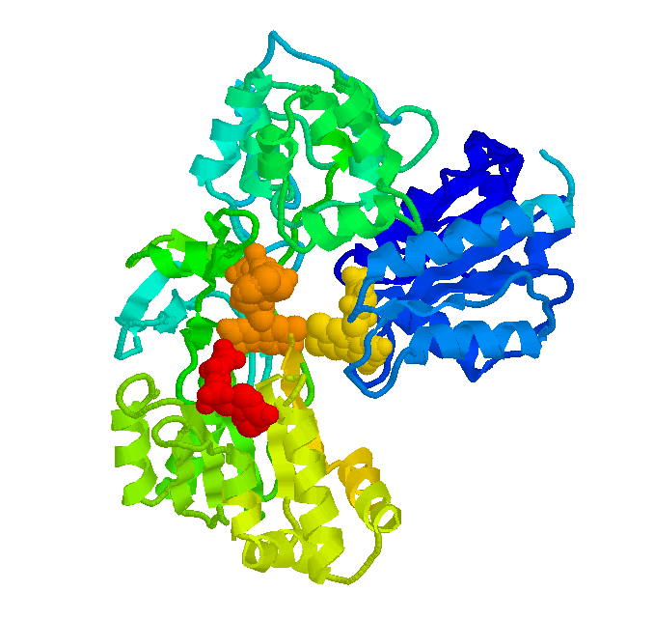

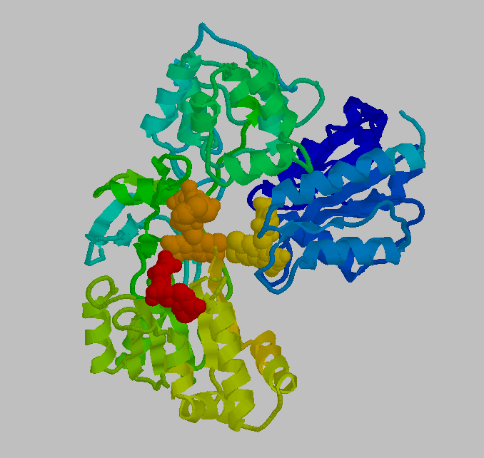
X-ray crystallography
The identification of the atomic structures of macromolecules (e.g., of proteins or viruses like the COVID) formed by tens of thousands of atoms is a most important and
challenging task for
science today
...but damage induced by x-rays is a major problem. The solution is to simultaneously probe many molecules organized in an artificial “crystal”: the signal from undamaged molecules prevails
The bank now stores >200,000 structures obtained with x-ray crystallography
Problem: obtaining large stable crystals, in particular of hydrophobic molecules – for example, of many membrane proteins. But crystallography does steadily determine
a huge number of macromolecular structures

Slide 50
(1) Fundamentals of Synchrotron Radiation from Storage Rings
(2) Fundamentals of X-ray Interaction with Matter
Giorgio Margaritondo
Ecole Polytechnique Fédérale de Lausanne (EPFL)
and Istituto Italiano di Tecnologia (IIT)
(3) Bonus: Free Electron Lasers, a short primer

Slide 51
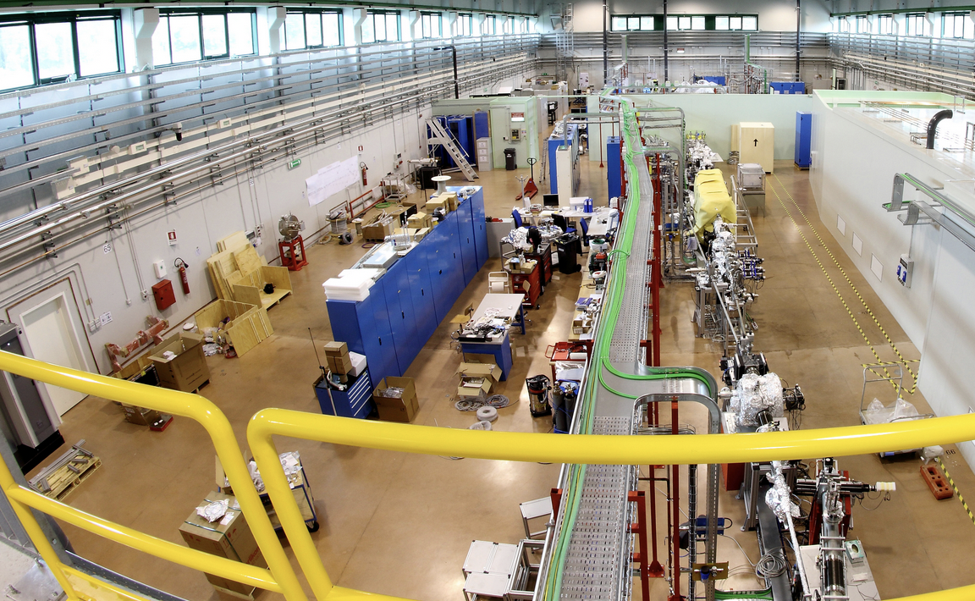
X-ray Free Electron Lasers (X-FELs): the New Generation of
Synchrotron Radiation Sources
Storage-ring synchrotron sources have several laser-like features, such as strong collimation, high intensity, high brightness and excellent coherence: are they lasers?
A visible/infrared laser:
Storage-ring synchrotron radiation sources:
Active medium, where optical amplification occurs
NO optical amplification
NO good mirrors for x-rays, thus NO optical cavities
They are NOT lasers
Two-mirror optical cavity, increasing the photon path and the optical amplification

Slide 52
But there are now the X-FELs, which are based on a laser-like optical amplification process:
To understand it, consider not a single electron but the collective behavior of many electrons in a bunch and their emission
Very long
undulator
period = wavelength
The waves from microbunched electrons are coordinated,
causing
amplification
One electron emits a wave
A high-density bunch of
relativistic electrons
enters the undulator
Traveling with the bunch, the wave acts on the electrons confining them to periodic microbunches (slices) with period equal to the wavelength

Slide 53
What pushes the electrons towards the “slices”?
…the so-called “ponderomotive forces”, caused by the interaction of the electrons with the wave and the undulator: complicated, but their basic features can be easily grasped
emitted wave
The wave is zero at the nodes and so are the ponderomotive forces: the nodes are where the electrons could accumulate
But accumulation does not occur at all nodes since the wave field has two directions that cause forces with opposite orientations:
no accumulation
electron accumulation
…so, electrons accumulate at
every other node: the microbunch period is indeed one wavelength
λ_{L}
λ_{L}

Slide 54
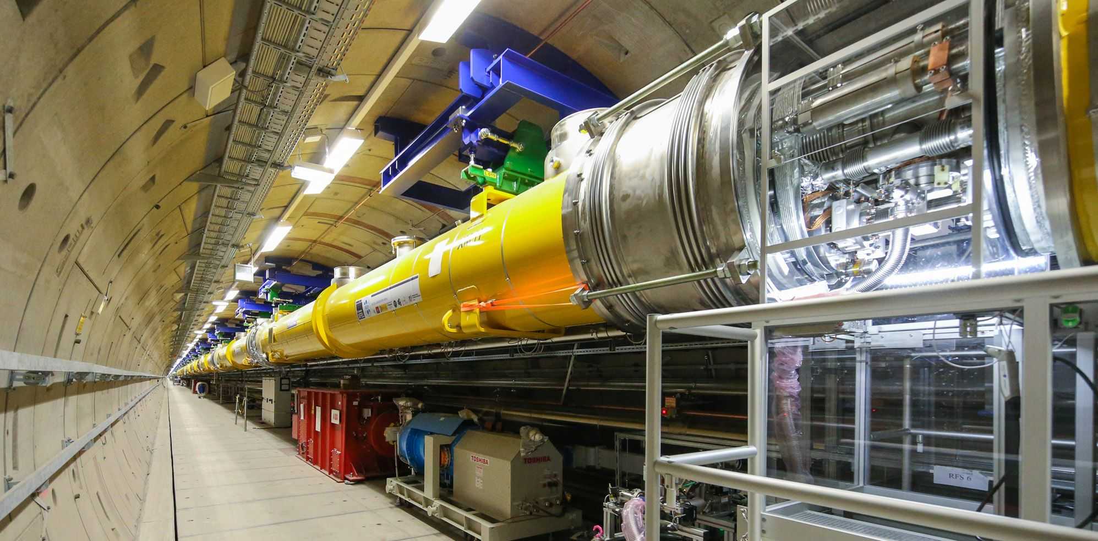
General scheme of an X-FEL:
X-ray pulse
Very long undulator
Electron bunch,
What are the
necessary ingredients
for this scheme to function?
progressively microbunched
LINAC (linear accelerator of electrons)

Slide 55
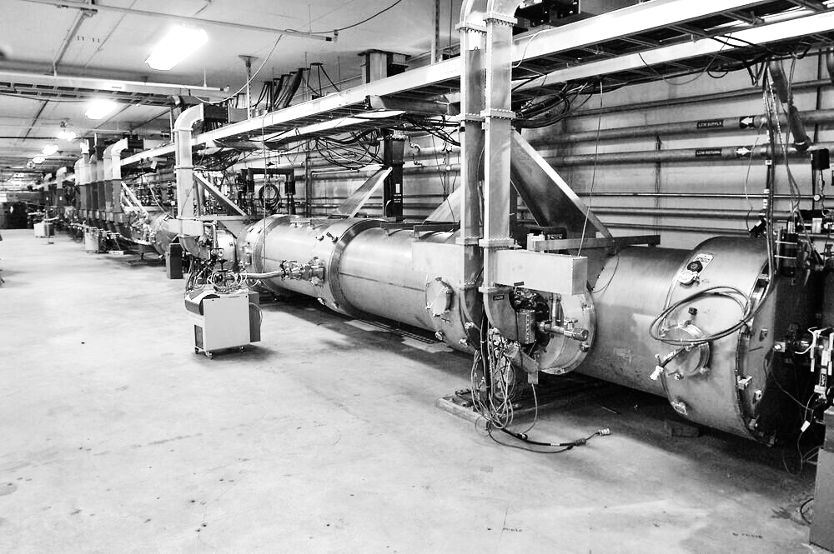
The three essential ingredients of an X-FEL
1. To emit x-rays, high-energy electrons with a large γ are needed, whose relativistic “longitudinal mass” γ ³m_{o} is very heavy: it takes a (rather) long time to shift them to the microbunches, requiring a very long undulator
Note that – (a) most undulators do not have all three ingredients: this explains why they do not function as X-FELs.
2. Plus, the microbunching period is very short (x-ray wavelengths): the resulting structure is delicate, easily destroyed.
(b) And also note that free-electron lasers for infrared light with long wavelengths do not need the three ingredients, so they could be realized several decades before the X-FELs
The undulator and the electron beam must be extremely accurate.
3. And: contrary to a visible laser, a two-mirror optical
cavity cannot be used in an X-FEL to increase the optical path and
the amplification: mirrors do not exist for x-rays, due to weak reflectivity.
λ_{L}
Thus, enough optical amplification must occur in a single pass of the electrons, requiring electron bunches with very high density

Slide 56
Effects of high electron density: X-FEL photon pulses with short duration, small cross section
A high electron density requires a very short electron bunch length H
H
A
v ≈ c
…causing a very short x-ray
pulse, with duration H/v ≈ H/c (femtoseconds or less, shorter than the synchrotron radiation pulses from a storage ring synchrotron source)
Microbunched electron bunch
Plus, a high electron density also requires a very small cross section A of the electron bunch and therefore of the x-ray pulse, producing high brightness
[Note: most x-FELs are not based on storage rings but on LINACs, which can produce smaller cross sections A]

Slide 57
Space Coherence of x-FELs: excellent...
but the time coherence is problematic
Why problematic? Because the waves that are amplified are emitted at random when the electron bunch enters the undulator (SASE = Self-Amplified Spontaneous Emission)
Thus, the time structure is different for different photon pulses: this broadens the wavelength bandwidth Δλ and limits the time coherence
time
Solution: “seeding” -- i.e., using the x-FEL undulator to amplify waves with high time coherence produced by an external source
External source
A complicated technology, recently realized

Slide 58
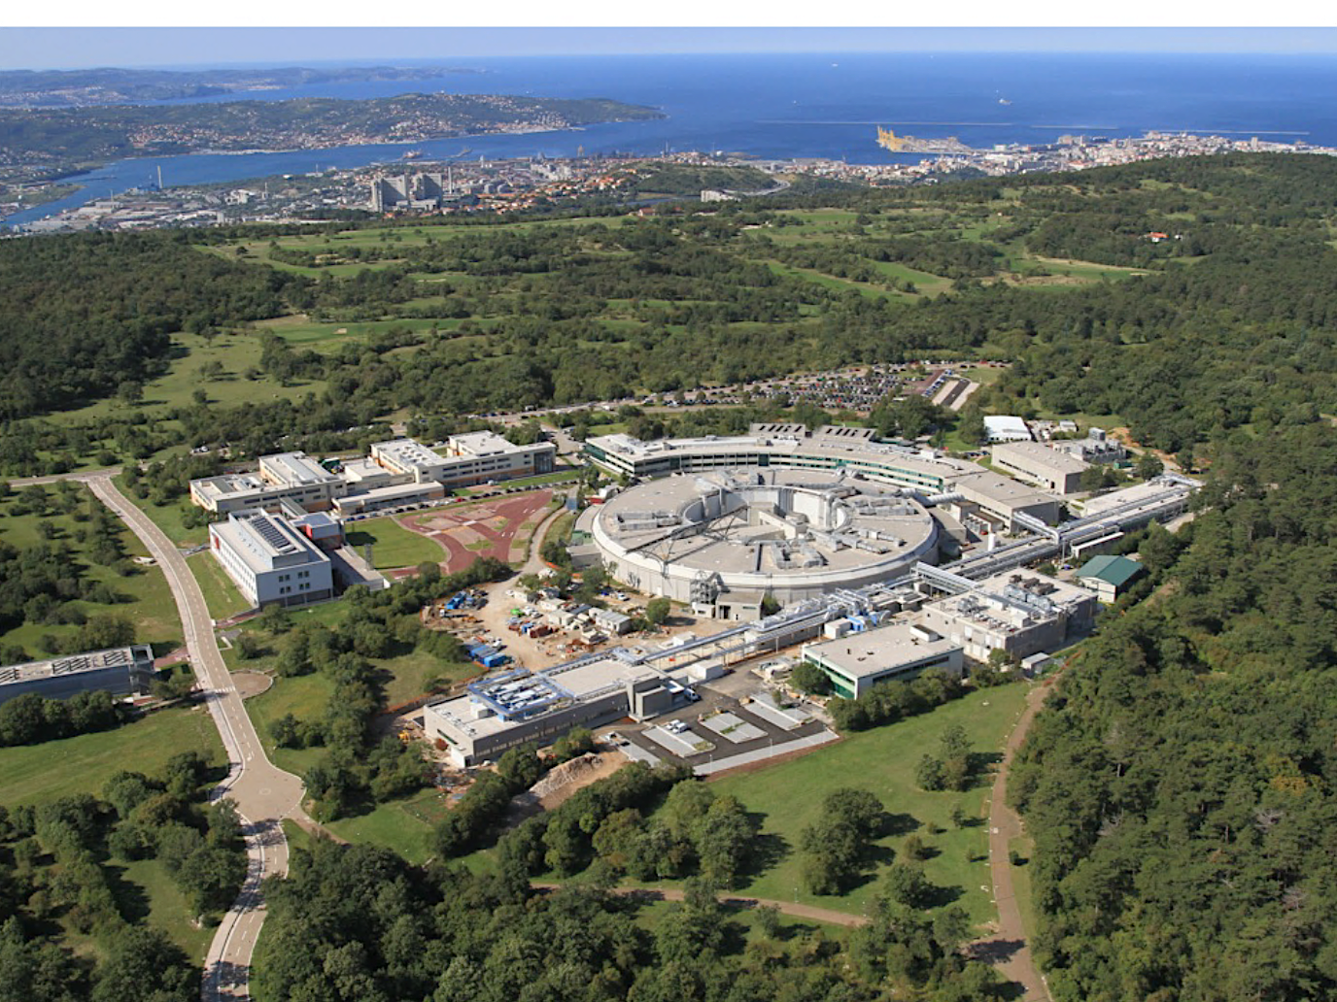
X-ray Free Electron Lasers are now a fantastic reality, notably at ELETTRA
This building houses
the seeded X-FEL“FERMI” (Free
Electron Radiation for Multidisciplinary Investigations)

Slide 59

X-FELs have higher average brightness than storage rings. And their emission is concentrated in ultrashort pulses, boosting the peak brightness.
Problem: X-FEL pulses pack tens of gigawatts in femtoseconds -- can we manage this tremendous concentrated power and use it?
…sent into a molecule or a nanoparticle, causes its explosion:
boom!
…but, with ultrafast x-FEL pulses
we can monitor the structure in real
time during the explosion and try to retrieve by computer processing the initial structure, eliminating the need to use crystals

Slide 60
Some examples of what can be investigated at the femtosecond time scale of an x-FEL pulse:
Fast chemical reactions
In 100 femtoseconds shock and sound waves travel in solids over atomic distances
X-FEL experiments on these and many other ultrafast phenomena open very exciting new opportunities in science and technology!
A water molecule dissociates in 10 femtoseconds
Photons propagate over hundreds of nanometers
Typical periods of molecular vibrations: 10-100 femtoseconds
Laser surgery without collateral damage
Novel micromachining techniques, etc…

Slide 61
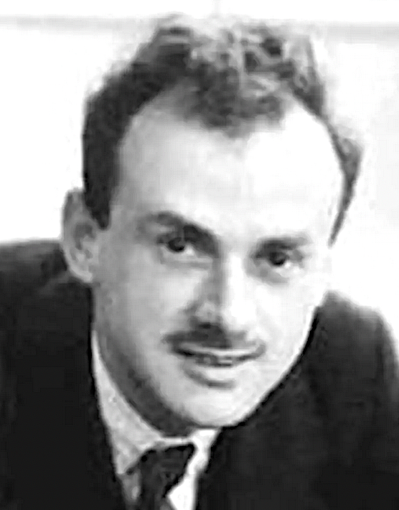
A fascinating final aspect: X-ray FELs and the foundations of quantum physics
What causes the interference and diffraction of photons?
First-order Quantum Electrodynamics (QED):
As initially argued by Paul Dirac, wave effects like interference or diffraction are caused by interactions of each photon only with itself. Indeed, they happen even when, on the average, there is only one photon in the apparatus: multiple-photon effects are negligible
BUT: with the concentrated electromagnetic energy of ultrabright “seeded” X-FEL plulses, multi-photon higher-order QED effects are detected, leading to new types of experiments! [J. Stöhr, Synchr. Rad. News 32 , 48 (2019)]

Slide 62
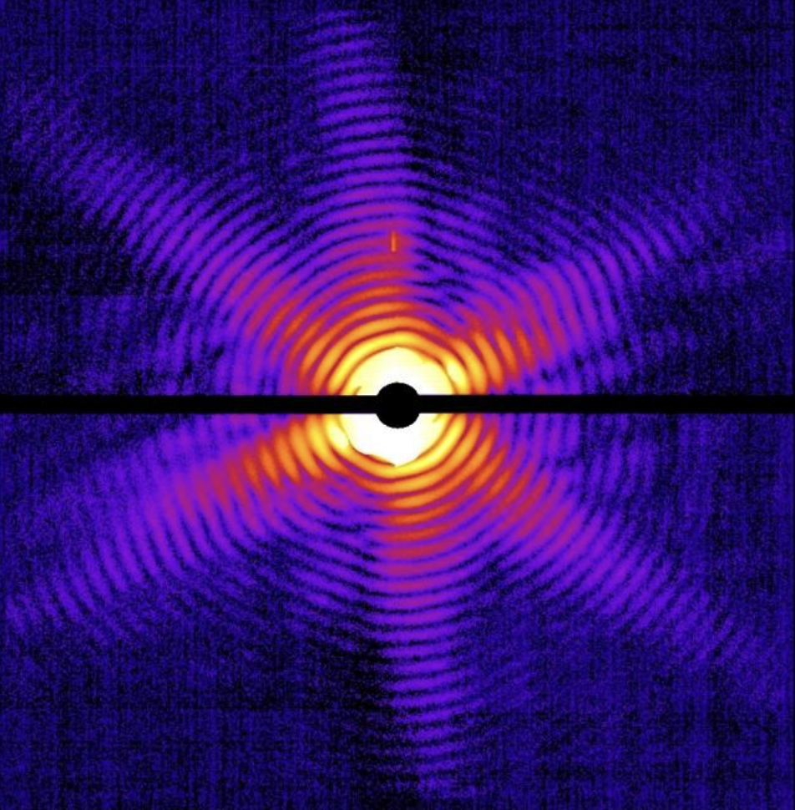
Thanks to the school organizers!
…and thank you, folks, for your attention: your future looks brighter than ever!
For further reading:
G. Margaritondo: “Teaching about the Birth of Synchrotron Light: the Role of Frascati and a Missed Opportunity”, J. Synchrotron Radiation 31, 987 (2024)
G. Margaritondo: “Who Were the Founders of Synchrotron Radiation? Historical Facts and Misconceptions”, J. Vacuum Sci. Technol. A40, 033204 (2022)
Y. Hwu and G. Margaritondo: “Synchrotron Radiation and X-ray Free Electron Lasers (X-FELs) Explained to all Users, Active and Potential ”, J. Synchrotron Radiation 28, 1014 (2021)
G. Margaritondo: “An Enlightening Procedure to Explain the Extreme Power of Synchrotron Radiation”, J. Synchrotron Radiation 26, 2094 (2019)
G. Margaritondo: “The Simple Physics of the Bending Magnet Spectrum”, J. Synchrotron Radiation 25, 1271 (2018)
G. Margaritondo: “Synchrotron Light: a Success Story over Six Decades”, Rivista Nuovo Cimento 40, 411 (2017)
G. Margaritondo and J. Rafelski: “The Relativistic Fundations of Synchrotron Radiation”, J. Synchrotron Radiation 24, 898 (2017)

