Slide 1
Design and operation of accelerator chain and storage rings
Simone Di Mitri
Elettra Sincrotrone Trieste
University of Trieste, Dept. of Physics

Slide 2
Outline
Motivations to Synchrotron Light Sources
Beam Energy
Magnetic Lattice
Diffraction-Limited Storage Rings
Accelerator Chain
Conclusions

Slide 3
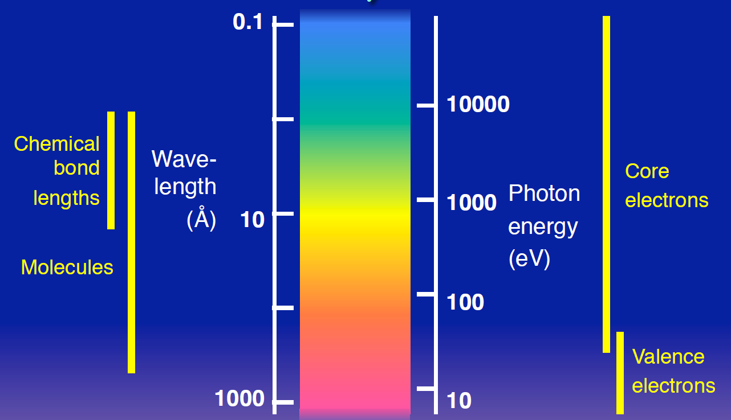
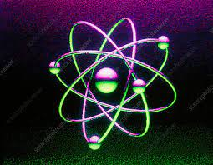
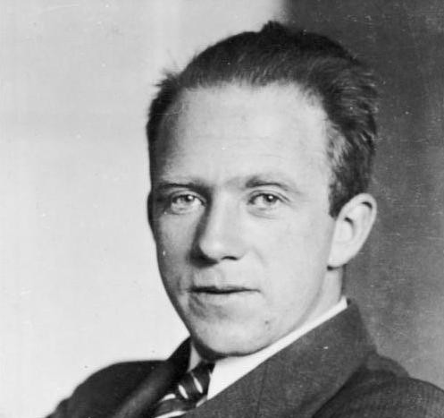
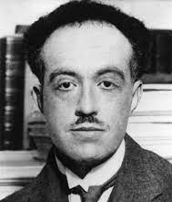
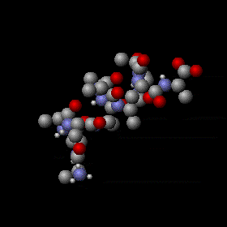
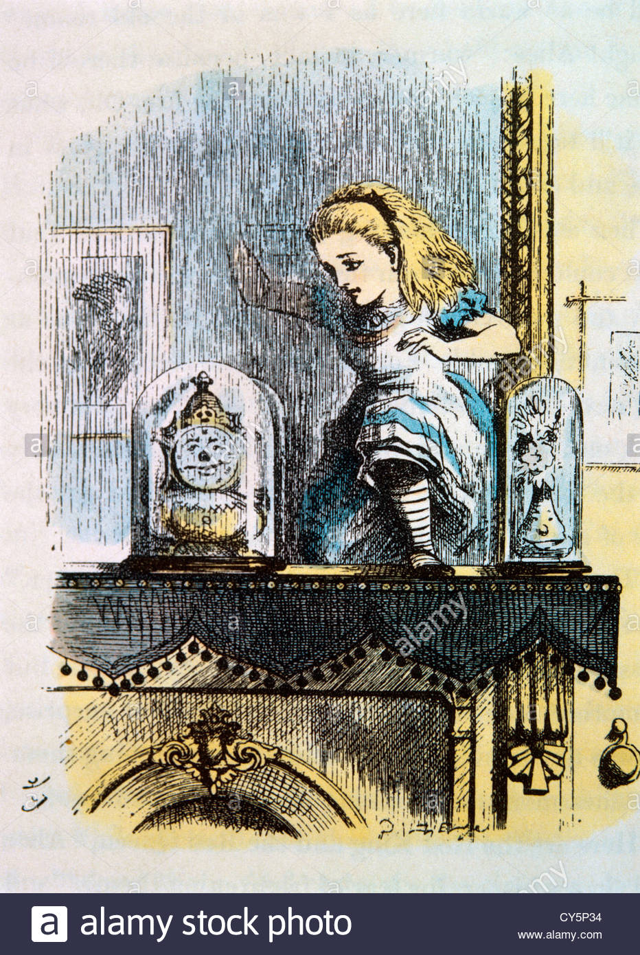
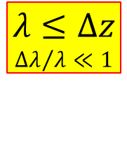


Why do we need X-rays?
photon energy ∼ spatial resolution
Atoms
W. Heisenberg
$Δz∙Δp≥ \frac{h}{2}$
$p= \frac{h}{λ}$
L. De Broglie
$$λ≤Δz$$
$${Δλ}/λ≪1$$
Proteins
EUV and X-rays are ideal probes of chemical bonds, where most of science is rooted. They can be used to visualize proteins structure, molecular dynamics, atomic levels and orbitals…

Slide 4
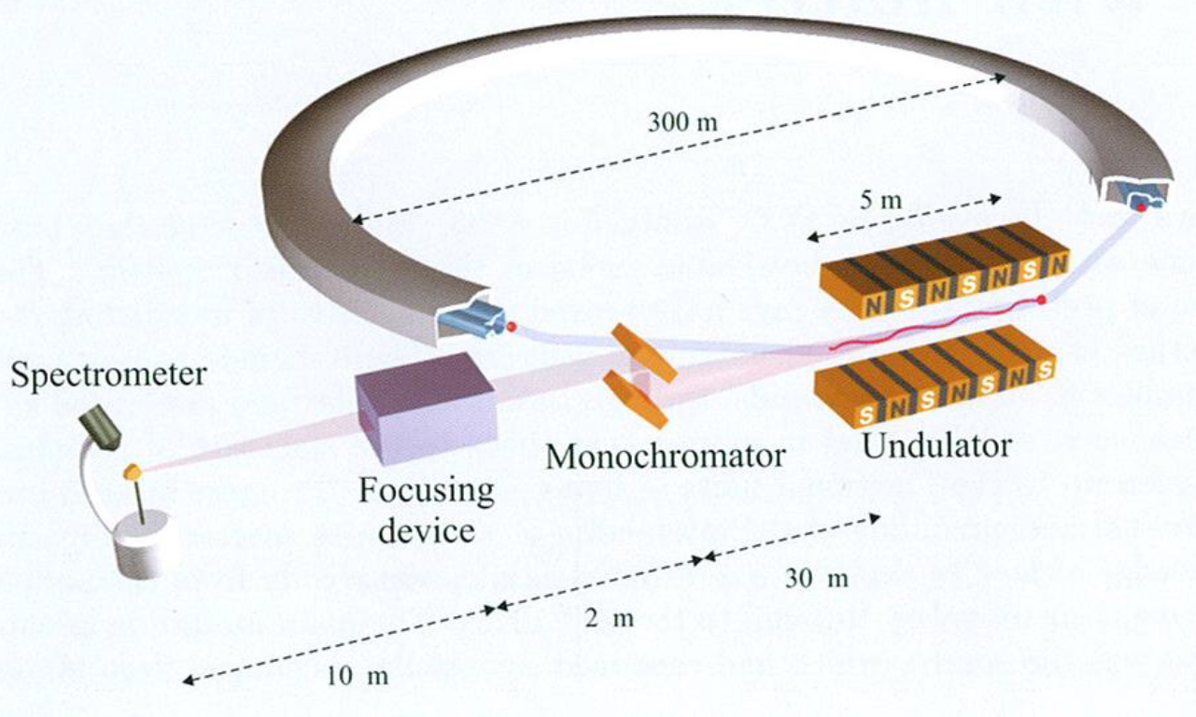

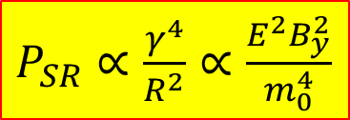
How do we generate and use X-rays?
$P_{SR}∝\frac{γ^{4}}{R^{2}}$ $∝\frac{E^{2}B_{y}^{2}}{m_{0}^{4}}$
High energy electrons
Strong magnetic field
e- PHOTO-EMISSION
electronic structure
SRLS = storage ring light source
SCATTERING
SAXS
DIFFRACTION
Cristallography
ABSORPTION
Spectroscopy, EXAFS, XANES
FLUORESCENCE
Courtesy J. Als-Nielsen, D. McMorrow
EXAFS, XRF

Slide 5
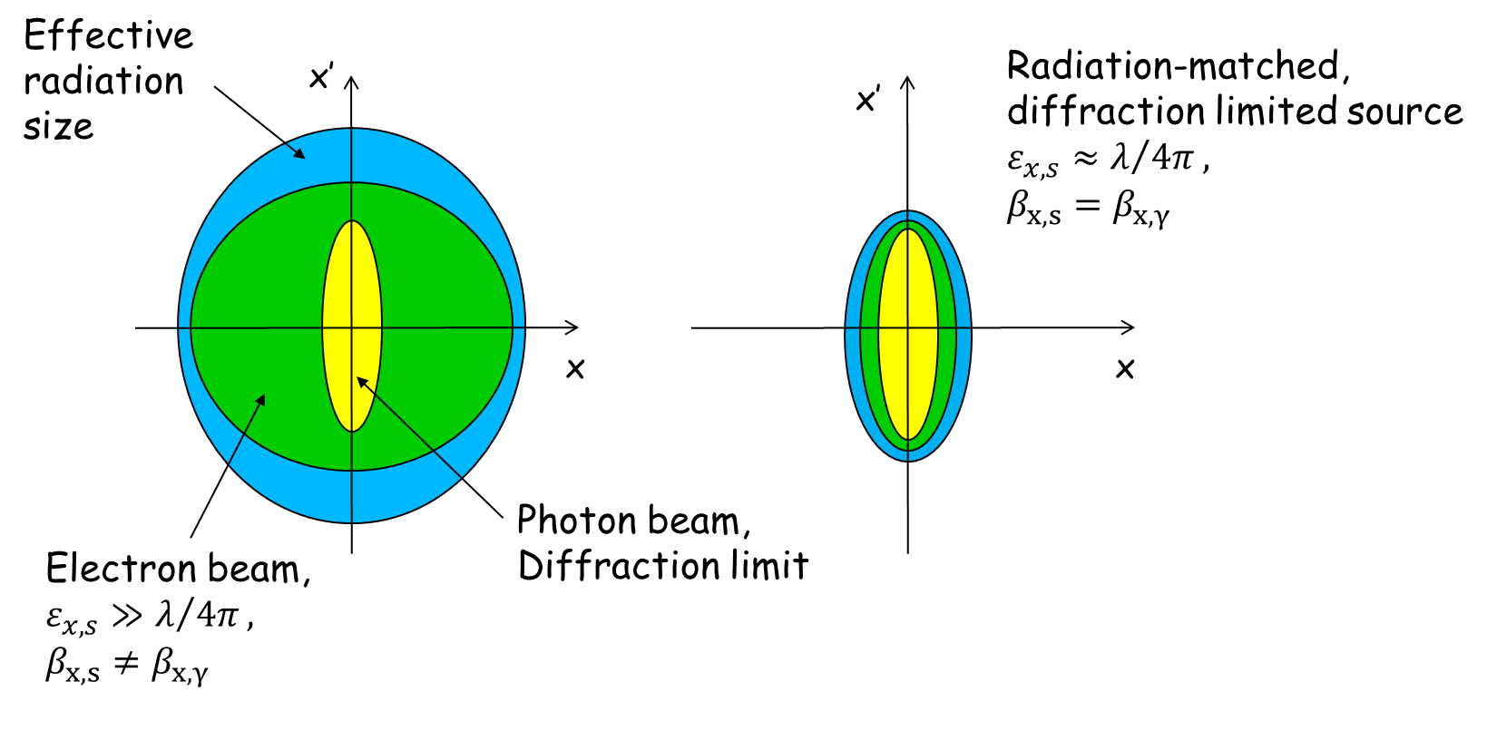
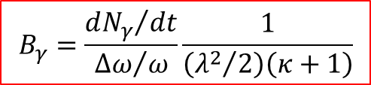
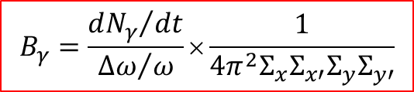

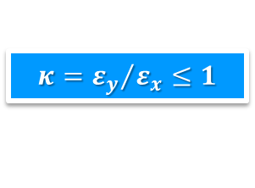
Why accelerator-based light sources?
Almost all experimental techniques gain from a large 6-D photon density, or brilliance (also, spectral brightness)
$$σ_{u}σ_{u^{′}}=ε_{x,y}≤\frac{λ}{4π}$$
$$B_{γ}=\frac{{dN_{γ}}/{dt}}{{Δω}/ω}×\frac{1}{4π^{2}Σ_{x}Σ_{x′}{Σ_{y}Σ}_{y′}}$$
$$B_{γ}=\frac{{dN_{γ}}/{dt}}{{Δω}/ω}\frac{1}{\left({λ^{2}}/2\right)\left(κ+1\right)}$$
Diffraction Limit
COUPLING:
$$κ={ε_{y}}/{ε_{x}}≤1$$
This drives the race to 4th generation synchrotron light sources, for ultra-low emittance, matched beams.

Slide 6
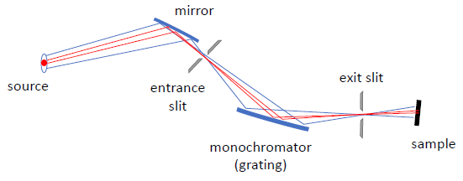
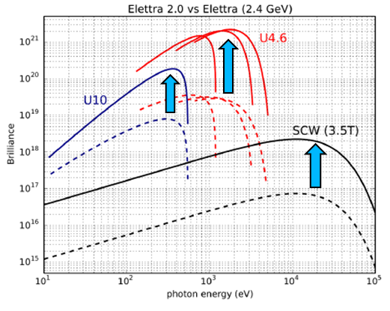
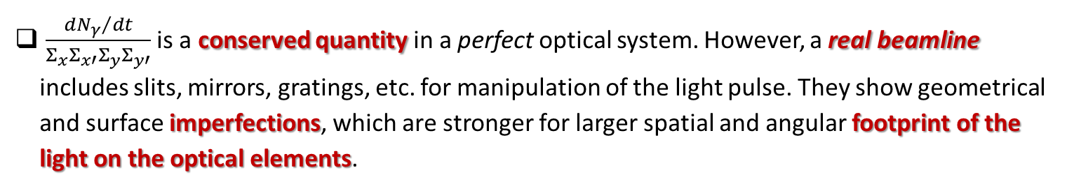
The importance of being brilliant
$\frac{{dN_{γ}}/{dt}}{Σ_{x}Σ_{x′}{Σ_{y}Σ}_{y′}}$ is a conserved quantity in a perfect optical system. However, a real beamline includes slits, mirrors, gratings, etc. for manipulation of the light pulse. They show geometrical and surface imperfections, which are stronger for larger spatial and angular footprint of the light on the optical elements.
Courtesy A. Bianco
Machine design at the state-of-the-art is a good investment because the higher the brilliance at the source is, the higher the brilliance at the sample is!
Courtesy B. Diviacco

Slide 7
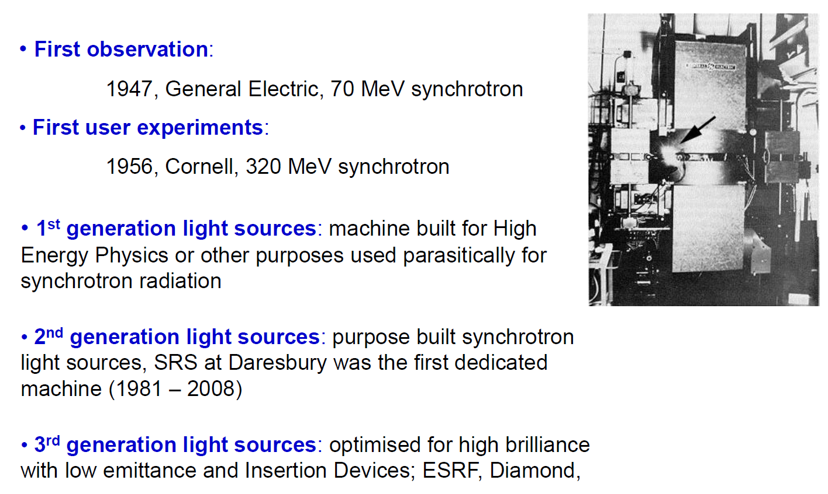
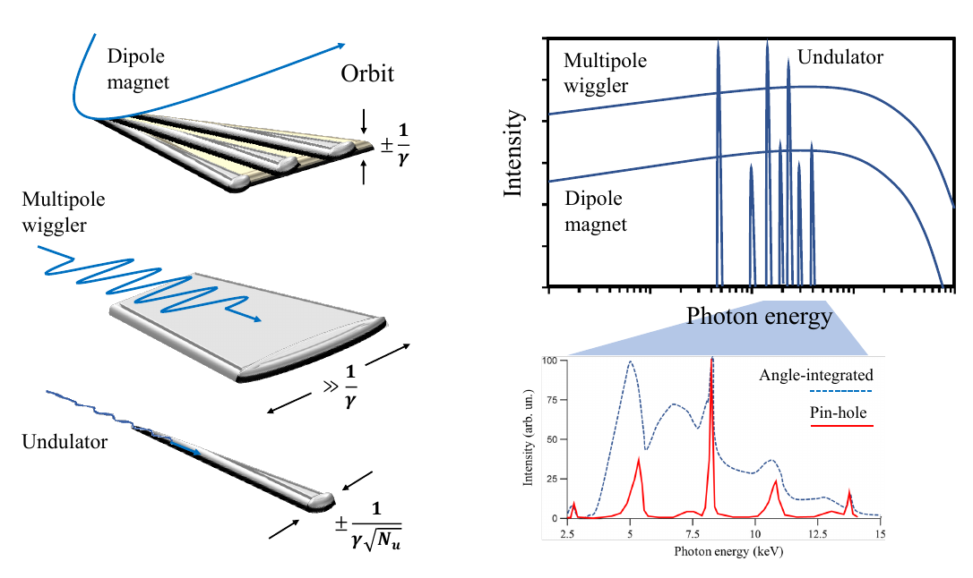
Development of SRLS

Slide 8
Outline
Motivations to Synchrotron Light Sources
Beam Energy
Magnetic Lattice
Diffraction-Limited Storage Rings
Accelerator Chain
Conclusions

Slide 9
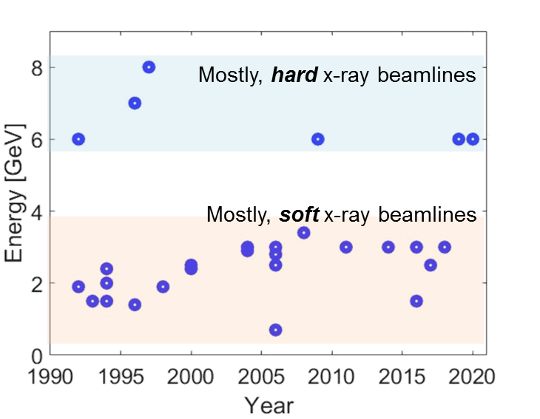
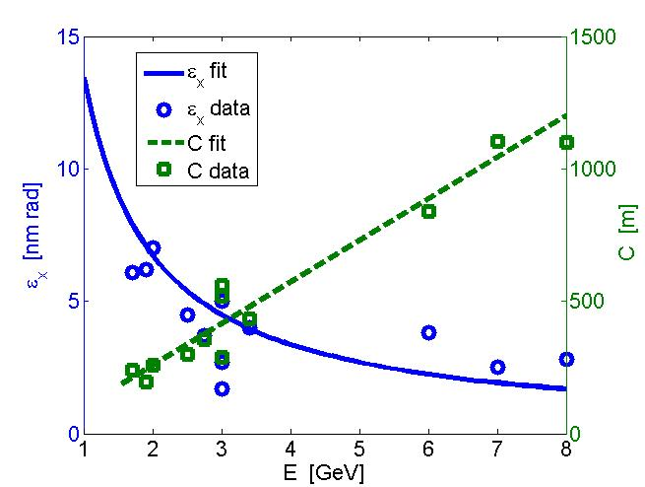



Accelerator size
The e-beam energy determines the photon energy range:
The beam energy roughly sets the SRLS size:
$ω_{c}≈\frac{cγ^{3}}{R}$
$$\frac{mv_{z}^{2}}{R}=F_{L,x}=ev_{z}B_{y}$$
$$p_{z}=eB_{y}R$$

Slide 10
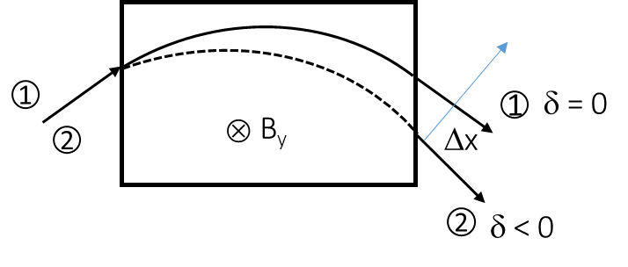
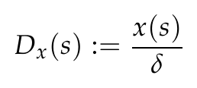

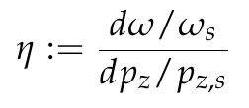





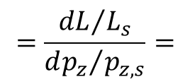
Dispersion function
High energy electrons on a circular path:
Dispersion function:
$E⟶E−E_{sr}$+…
$$δ≔ΔE/E$$
$$p_{z}=eB_{y}R$$
Path length and revolution frequency difference, per unit of energy deviation:
“MOMENTUM COMPACTION”
“SLIP FACTOR”
$$=\frac{{dL}/{L_{s}}}{{dp_{z}}/{p_{z,s}}}=$$

Slide 11
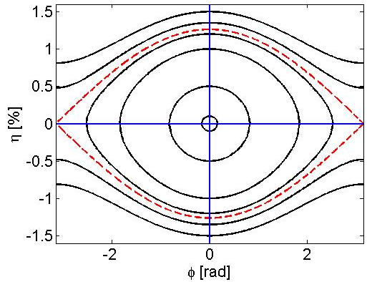
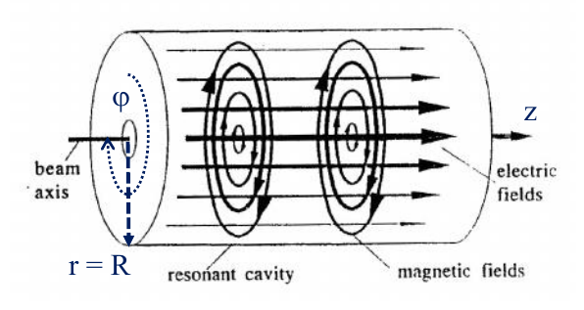

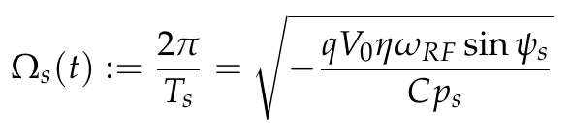
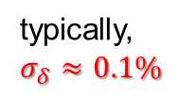
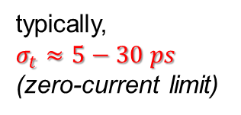
Synchrotron oscillations
RF cavities replenish the energy lost every turn ⇒ beam energy is constant on average in a turn:
PILL-BOX (standing-wave):
“RF bucket”
“RF acceptance”
δ
Synchrotron oscillations:
typically,
$σ_{t}≈5−30 ps$
(zero-current limit)
typically,
$$σ_{δ}≈0.1\%$$

Slide 12
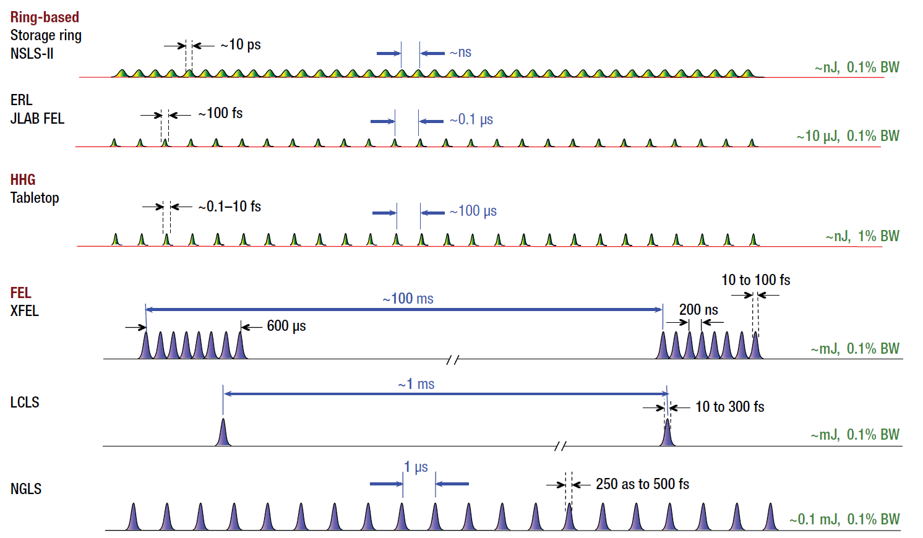


Filling pattern: “multibunch”
RF field imposes a synchronization with the particles’ arrival time:
  The harmonic number h is the max. number of “spaces” to be filled (RF buckets)
$$ω=hω_{riv},$$
$$h∈\dot{ℕ}(≫1)$$
Shorter photon pulses can be produced in dedicated schemes of few bunches, or with advanced e-beam manipulations.
T_{riv} ∼ 1 – few µs
Adapted from NGLS CDR
1.5 - 8 GeV, 200 – 500 mA, 100 – 1000 bunches per turn
10 – 50 photon beamlines operating simultaneously
> 5000 hours per year (24h, 7/7 ), ∼1000 hours reserved for machine physics
> 1000 users / year

Slide 13
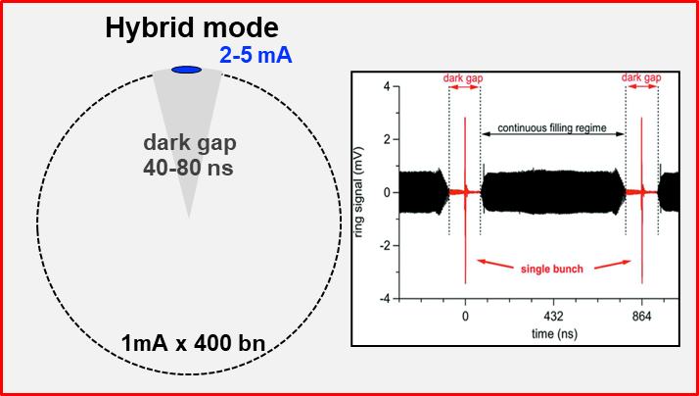
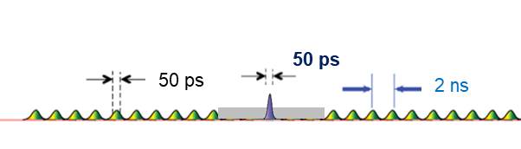
Filling pattern: “hybrid”
~4×10¹¹ ph/sec/0.1%bw
~3×10⁵ ph/pulse/0.1%bw
@sample
~10¹⁴ ph/sec/0.1%bw
@sample

Slide 14
Outline
Motivations to Synchrotron Light Sources
Beam Energy
Magnetic Lattice
Diffraction-Limited Storage Rings
Accelerator Chain
Conclusions

Slide 15
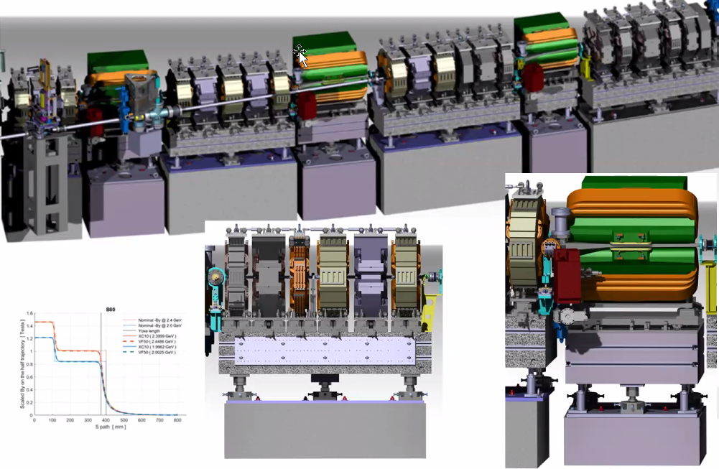
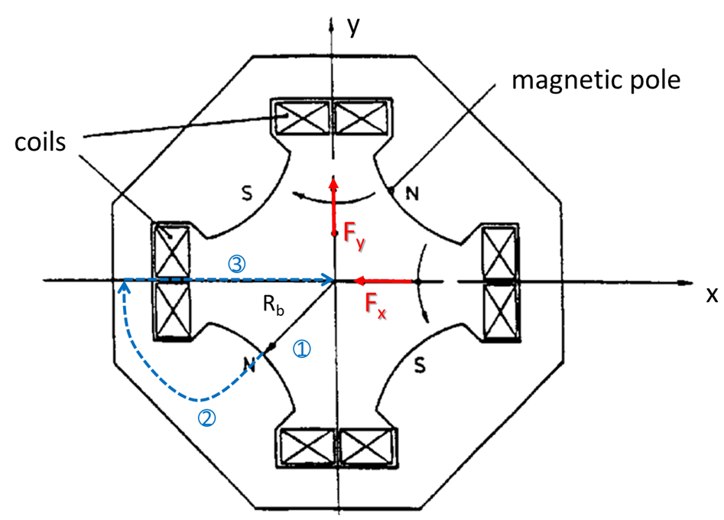
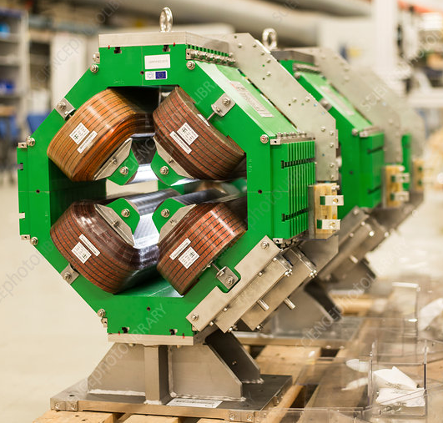


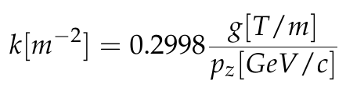
Strong focusing
Courtesy I. Cudin
Vacuum chamber (Al, Cu, Steel) at ultra-low pressure (< 10⁻⁹ mbar), to avoid gas-scattering
Particle beam must be kept in!
→ external magnetic focusing
300 MV/m !
Normalized quad strength:
1 Tesla…

Slide 16
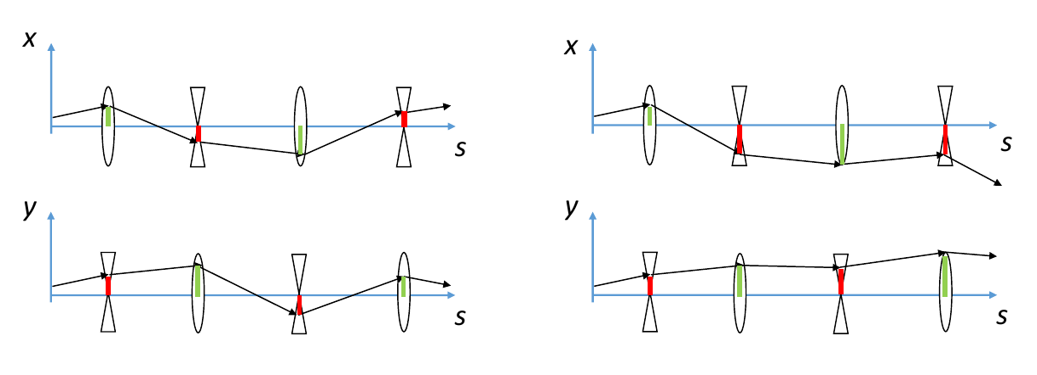
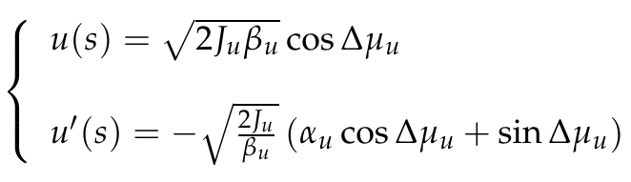
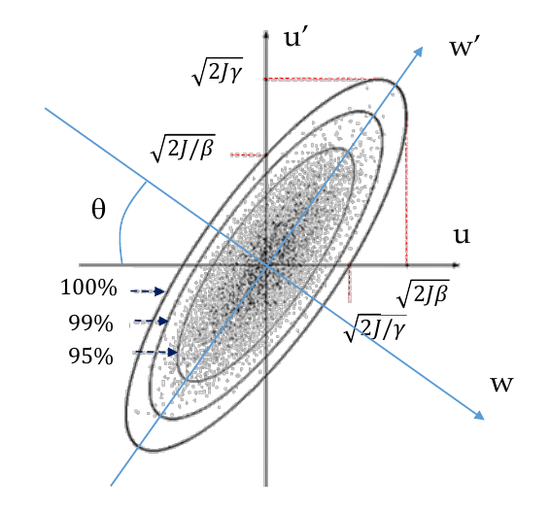
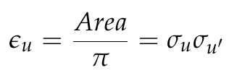
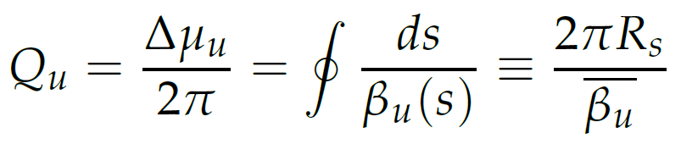

Betatron motion
Alternated focusing and defocusing quads can provide effective focusing, i.e. stability, simultaneously in both planes.
$$f=\frac{1}{kl_{q}}$$
focal length
Hill’s eqs. (pseudo-oscillators) assume linear motion & no frictional forces:
Emittance:
Betatron tune = # oscillations per turn

Slide 17
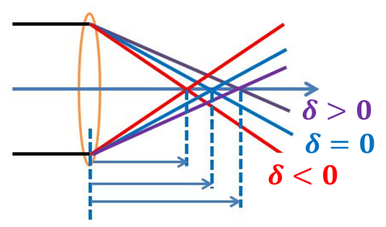

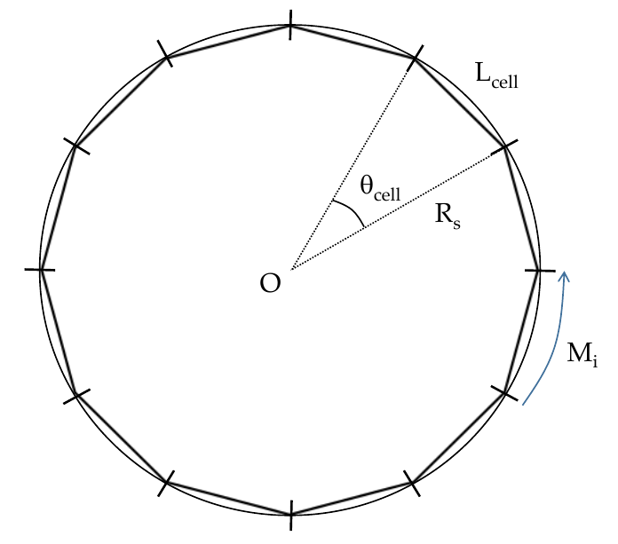
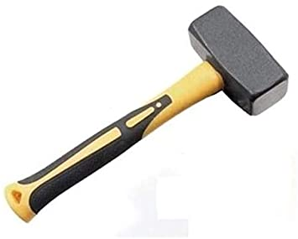
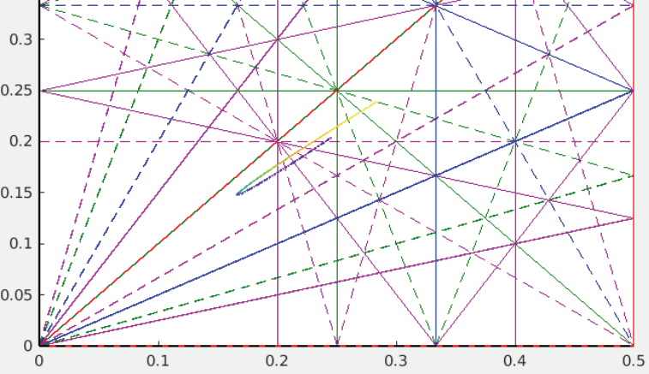
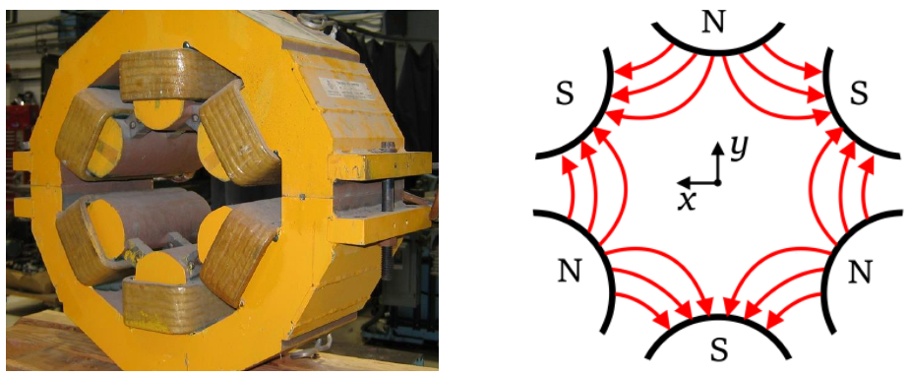
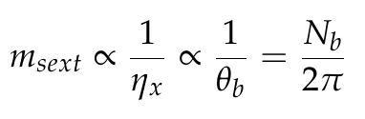


Nonlinearities
Particles at (slightly) different energies are focused differently – linear chromaticity:
Magnets’ misalignment and field errors “resonate” with rational tunes – resonances can lead to beam loss!
effect enhanced by many strong quads
Sextupole magnets correct the chromaticity, but at the cost of higher order aberrations!
$$Q_{y}$$
$$Q_{x}$$
effect enhanced by many dipoles

Slide 18
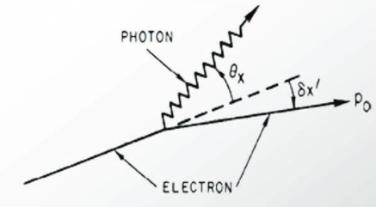
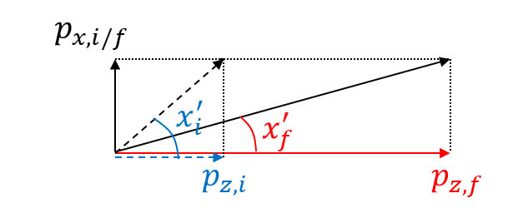



Radiation Damping, Quantum Excitation
Radiation quanta emitted with small but non-zero angle. Total momentum of electrons is reduced.
RF cavities restore the longitudinal momentum only. Transverse divergence of electrons is reduced.
Average variation of oscillation amplitude² in a turn:
Characteristic damping time:
Radiated power & dispersive motion
$$τ≈T_{0}\frac{E_{0}}{U_{0}}$$

Slide 19
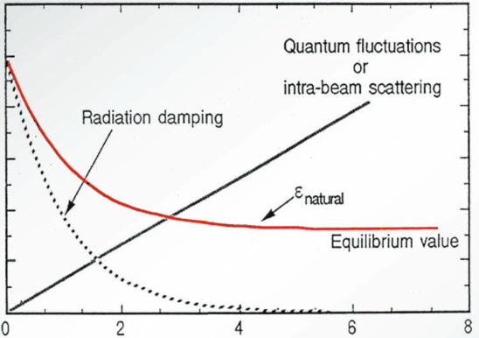




Equilibrium emittance
This is driving world-wide upgrades to multi-bend lattices (4th generation). Radiation is far more collimated and more intense – higher “brilliance”!
damping times

Slide 20


Liouville’s theorem
The dynamics of a non-dissipative system obeys Hamilton’s equations:
The phase space area (hyper-volume) in proximity of an orbit is a constant of motion.
A storage ring is not a Hamiltonian system because of radiation emission and acceleration.
However, it behaves as if it were a Hamiltonian system.
⇒ The “phase space” emittance is a constant of motion
A storage ring is not a linear system because of high order magnetic field components.
However, it behaves as a linearized system.
⇒ The “statistical” emittance is a constant of motion

Slide 21
Outline
Motivations to Synchrotron Light Sources
Beam Energy
Magnetic Lattice
Diffraction-Limited Storage Rings
Accelerator Chain
Conclusions

Slide 22




Multi-bend lattices
$$ε_{x,eq}∝F(k){γ^{2}}/{N_{b}^{3}}$$
From relatively sparse to tight, dense, strong focusing lattices
Complex dipoles with transverse and/or longitudinal gradients
Combined multipole magnets
Fringe-field interference
DIPOLE–QUAD
COMPLEX BEND
3-D “AI”-driven optimization of magnets design
Courtesy I. Cudin, G. Le Bec, T. Shaftan

Slide 23





Emittance landscape
10⁻⁵
$$ε_{x}∝{γ^{2}}/{N_{b}^{3}}$$
3rd generation: DBA, TBA
10⁻⁶
10⁻⁷
magnets
technology
$$ε_{x}/γ^{2} [nm rad]$$
10⁻⁸
10⁻⁹
4th generation:
MBA + RB
10⁻¹⁰
Courtesy L. Hoummi
Higher E_{ph}

Slide 24







Undulators
Stronger field by shorter poles
technological challenge
$$λ=\frac{λ_{u}}{2γ^{2}}\left(1+\frac{K^{2}}{2}+γ^{2}θ^{2}\right)$$
Shorter poles permit lower beam energies
energy & cost saving
Courtesy B. Diviacco, H. Tarawneh, M. Valleau, S. Casalbuoni, M. Calvi
Superconducting
HTS
Cryogenic
Compact
APPLE-X

Slide 25






4th generation SRLS are running already!

Slide 26




…and more are coming!
Upgrade plans ongoing also in UK, Germany, France, Spain,…

Slide 27
Outline
Motivations to Synchrotron Light Sources
Beam Energy
Magnetic Lattice
Diffraction-Limited Storage Rings
Accelerator Chain
Conclusions

Slide 28




e-Beam lifetime
Dynamic aperture:
Quantum lifetime:
Touschek lifetime:
Gaussian
Gaussian w/ cut
Due to physical or dynamic boundaries, the beam current decreases exponentially with time.
  Top-up = frequent refill to keep the current constant, beam is more stable, and thermal drift of components is minimized

Slide 29



Injection chain
Thermoionic gun + RF buncher + linac (“injector”):
  high charge, single bunch or
  low charge, train of bunches
  ∼ 100 MeV
Booster ring:
  energy ramp to GeV scale (magnets, RF)
  ∼ Hz rep. rate
  emittance control for injection efficiency
Booster-to-Storage ring transfer line:
  dc and pulsed electro-magnets for injection
  optics matching
  collimation and diagnostics
Courtesy of SOLEIL

Slide 30




Injection: Ring-driven
Courtesy A. Carniel
Structured synchronization system is essential to satisfy diverse fill pattern in the storage ring
  single or few bunches, trains, alternated bunches, etc.
Large variety of injection schemes, exploring 6-D separation of stored and injected beam, and eventually coalescence in a damping time or so.
  Transverse separation
  Energy/phase separation
  Swap-out (on-axis beam out–beam in)
Stored beam should not be disturbed by injection.
  Tiny beams in DLSRs make this a challenge.
  Sub-μm accuracy in orbit control
Courtesy R. Bartolini, P. Tosolini

Slide 31



Injection: Linac-driven
MAX IV
SACLA
PAL
High energy e-linacs provide short, low emittance beams, well suited to high injection efficiency.
  Often shared with FELs.

Slide 32
Outline
Motivations to Synchrotron Light Sources
Beam Energy
Magnetic Lattice
Diffraction-Limited Storage Rings
Accelerator Chain
Conclusions

Slide 33

Light sources
Accelerator-based light sources are the most brilliant sources on Earth, largely coherent.
Other strong points are polarization, repetition rate and diversified radiation sources at SRLS.
Light sources drive technology: RF, magnets, ultra-vacuum mechanics, lasers.
Light sources are multi-purpose science drivers. No one ideal source: pick the one most suited to your experiment!
Brightness

Slide 34
Strong points of SRLS
Synchrotrons provide light up to tens of beamlines simultaneously, each beamline receiving light from a dedicated insertion device.
Large flexibility in tuning or selecting radiation wavelength and intensity. Spectrum from IR to hard x-rays.
High average radiation power at the expense of low peak power (incoherent emission) and long pulses (several 10s ps).
Extremely stable.
Now approaching transverse coherence in X-rays.

Slide 35
Promises of DLSR
Reduction in the source emittance, thus increase in brilliance, will lead to:
significant gain in the emitted or transmitted signals from the samples;
reduced acquisition time for all types of spectroscopies and x-ray scattering techniques;
implementation of photon-hungry techniques such as: high pressure experiments with anvil cells and dilute samples, and spin-resolved ARPES;
improvement of the lateral resolution with focusing optics down to a few-nm scale (e.g. nano-PES, nano-ARPES)
Higher degree of transverse coherence will open unique opportunities for:
Coherent Diffraction Imaging (CDI) with chemical specificity
Ptychography
X-ray photon correlation spectroscopy (XPCS)

Slide 36




What does the future look like?

Slide 37


Bibliography
Cern Accelerator School, Yellow Books (1994, 2024) – online
USPAS lectures by W. Barletta – online
S. Di Mitri, Fundamentals of Particle Accelerator Physics, Springer (2023)

Slide 38
Thank you for your attention
Questions are very welcome

Slide 39

Accelerator science is expanding
Circular colliders: Standard Model and beyond
Accelerators contributed to Nobel in Physics on average every ∼3 years (1950 -)
Cyclotron:
artificial radioactive elements
Synchrotron:
μ-neutrino, CP violation, J/Ψ, etc.…
Light Sources: viruses, new materials, planetary processes,…

Slide 40



Synchrotron radiation
Synchrotron radiation is e.m. energy de-coupled from a charge by centripetal acceleration. For example, an ultra-relativistic electron in a magnetic dipole field.
Bunch self-field
e-bunch
Synchrotron radiation
Courtesy of
A. Novokatsky

Slide 41





Degeneracy parameter
Coherence of radiation ∼ in-phase photons ∼ more effective light-matter interaction
The fraction of spectral flux transversally coherent is the one emitted by a source at, or below, the diffraction limit: ${Σ_{x}Σ}_{y}Σ_{x′}Σ_{y′}≈{\left(\frac{λ}{4π}\right)}^{2}$
$${\left(\frac{dN_{γ}/dt}{{Δω}/ω}\right)}_{⊥, coh}=B×{\left(\frac{λ}{2}\right)}^{2}$$
The number of photons transversally and longitudinally coherent is:
${n_{coh}=\left(\frac{dN_{γ}/dt}{{Δω}/ω}\right)}_{⊥, coh}∙Δt_{coh}∙\frac{Δω}{ω}=B{\left(\frac{λ}{2}\right)}^{2}\frac{λ^{2}}{2cΔλ}\frac{Δλ}{λ}$ $=\frac{Bλ^{3}}{8c}$
Number of photons in the “coherent volume” $λ^{3}$
It is more difficult to get full coherence at shorter wavelengths

Slide 42









Transverse coherence
Interference fringes
Collimated, monochromatic light
Phase-correlated field
Classical model: path length over which two waves become out of phase
Uncertainty Principle: the smallest phase space area occupied by the light pulse
$$∆x∆p_{x}≥\frac{ℏ}{2}$$
$$ {\frac{d}{2}θ}_{c}=\frac{λ}{4π}$$
$$and θ=\frac{∆p_{x}}{p_{z}}≅\frac{∆p_{x}}{(h/λ)}$$
Minimum transverse phase space area (“emittance” ) of a transversally coherent light pulse

Slide 43




Bunch length
Intrabeam scattering (multiple small angle events) enlarges the emittances through diffusion, in proportion to the 3D charge density.
  Mitigated through higher harmonic RF cavity, used to flatten the beam longitudinal phase space and make 3–10 × longer bunches.
    Still, (sub-)ps X-ray pulses are being considered. Flux and transparency to standard operation remain a challenge.
I. Martin, PhD Thesis (2011)
S.C. Leemann, PRST-AB 17, 050705 (2014)
$$Δt_{b}∝\sqrt{\frac{α_{c}}{ω_{RF}V_{0}}}\sim \frac{1}{\sqrt{{V_{0}ω_{RF}N}_{b}}}$$

