Slide 2
Bending magnets and insertion devices
Gaël LE BEC
4th ICTP School on Synchrotron Light Sources and their Applications
January 13th, 2026

Slide 3
Introduction to synchrotron radiation
Bending magnets and wigglers
Undulators
Technology

Slide 4
Introduction to synchrotron radiation

Slide 5
Introduction to synchrotron radiation
What is synchrotron radiation?
Electromagnetic radiation
Emitted by relativistic charges accelerated in a magnetic field
First observed with 70 MeV electrons on a synchrotron¹ in 1947, so its name
The synchrotron radiation is collimated, i.e. emitted in a narrow angle, and tangent to the particle’s trajectories
It is a has a high energy, typically in the keV range and up to a few hundreds of keV for bending magnet radiation
¹A synchrotron is an accelerator where the field of the magnets is synchronized with the acceleration of the particles.

Slide 6

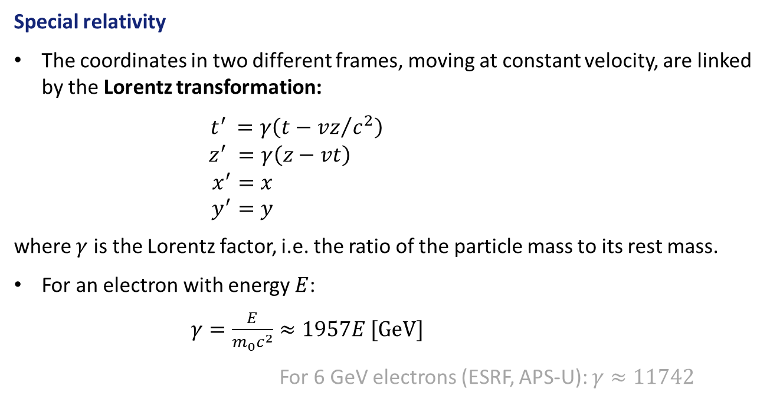
Introduction to synchrotron radiation
Special relativity
The coordinates in two different frames, moving at constant velocity, are linked by the Lorentz transformation:
$\begin{matrix}{ t}^{′} =γ\left(t−{vz}/{c^{2}}\right) \\ z^{′} =γ\left(z−vt\right) \\ \begin{aligned}x^{′}=x \\ y^{′}=y\end{aligned}\end{matrix}$
where $γ$ is the Lorentz factor, i.e. the ratio of the particle mass to its rest mass.
For an electron with energy $E$:
$γ=\frac{E}{m_{0}c^{2}}≈1957E [GeV]$
For 6 GeV electrons (ESRF, APS-U): $γ≈11742$
(velocity along the $z$ direction)

Slide 7
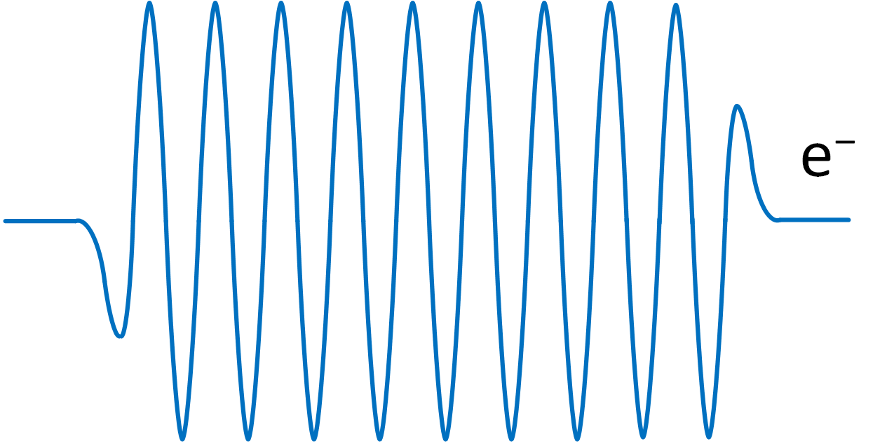








Introduction to synchrotron radiation
Emission angle
The synchrotron radiation is emitted in a cone with a narrow aperture $±\frac{1}{γ}$
For 6 GeV electrons, $\frac{1}{γ}≈85 μrad.$
$$x$$
$$x′$$
$$θ^{′}≈\frac{x′}{z′}≈\frac{θ}{γ}$$
$$\frac{θ}{γ}$$
$$θ$$
Lorentz transformation
$$z$$
$$z′$$

Slide 8


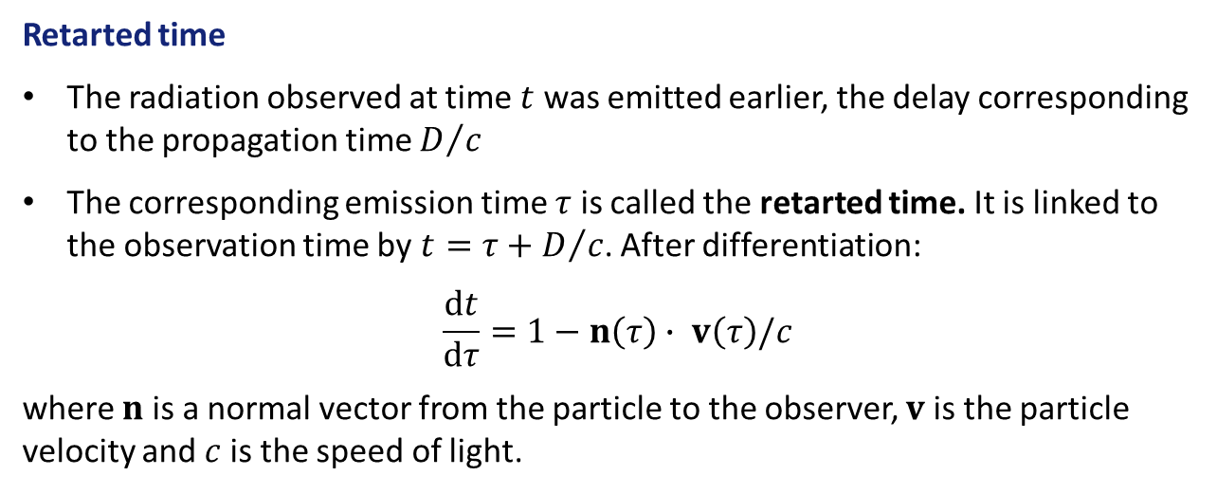



Introduction to synchrotron radiation
Retarted time
The radiation observed at time $t$ was emitted earlier, the delay corresponding to the propagation time $D/c$
The corresponding emission time $τ$ is called the retarted time. It is linked to the observation time by $t=τ+D/c$. After differentiation:
$$\frac{dt}{dτ}=1−n\left(τ\right)∙ v\left(τ\right)/c$$
where $n$ is a normal vector from the particle to the observer, $v$ is the particle velocity and $c$ is the speed of light.
$$n$$
$$r$$
$$t$$
$$v$$
Observer
$$τ$$
Electron
(See [Feynman, 1963] for a deeper introduction to the retarted time.)

Slide 9




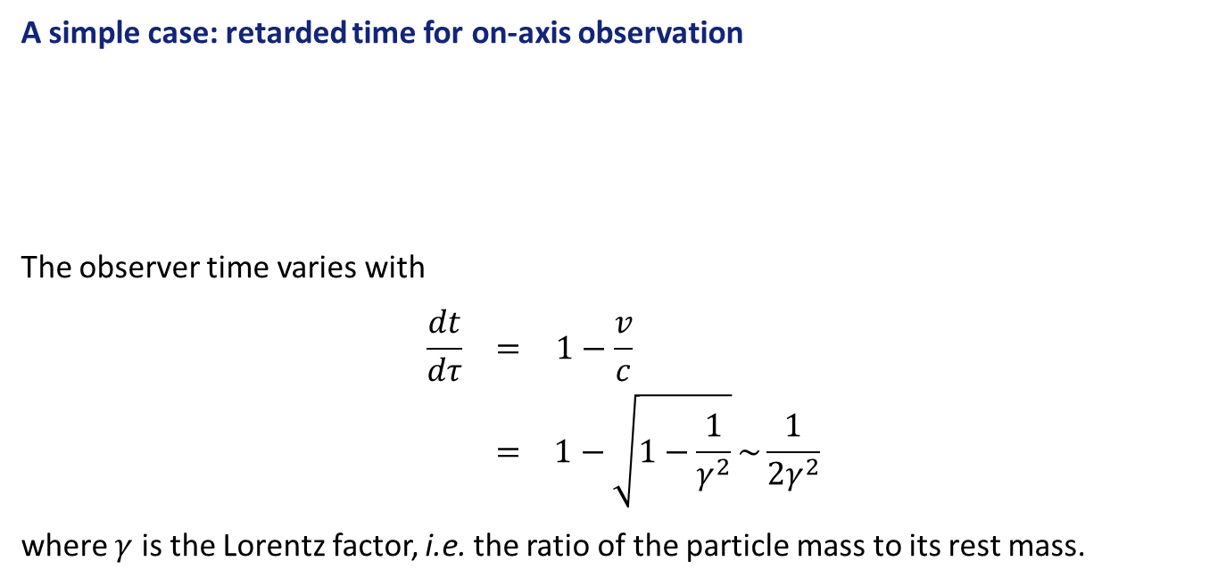

Introduction to synchrotron radiation
A simple case: retarded time for on-axis observation
The observer time varies with
$$\begin{matrix}\frac{dt}{dτ} & = & 1−\frac{v}{c} \\ & = & 1−\sqrt{1−\frac{1}{γ^{2}}}\sim \frac{1}{2γ^{2}}\end{matrix}$$
where $γ$ is the Lorentz factor, i.e. the ratio of the particle mass to its rest mass.
$$n$$
$$v$$
$$τ$$
$$r$$
$$t$$

Slide 10
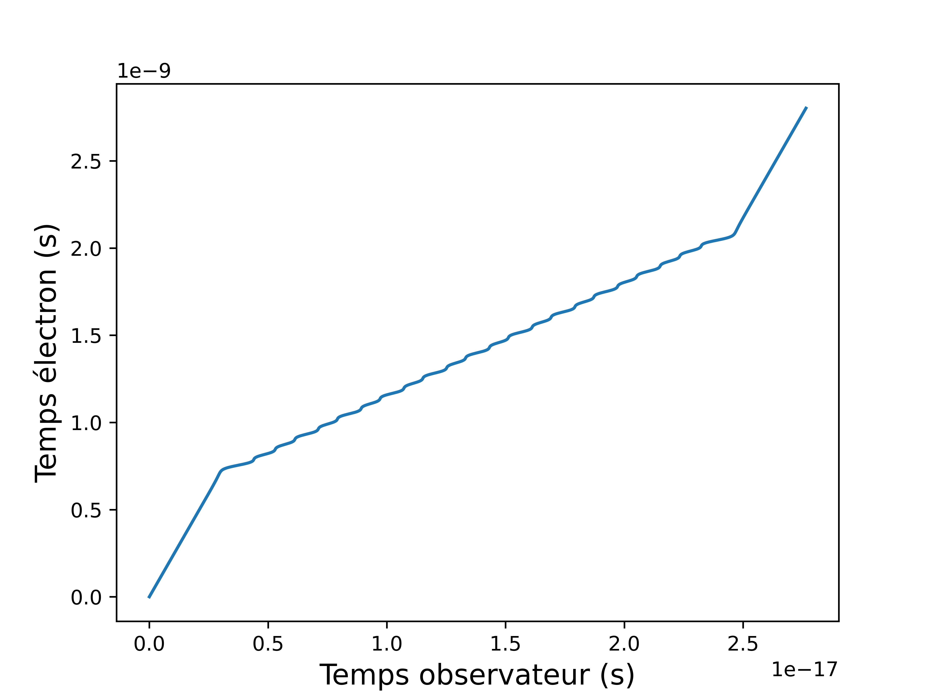

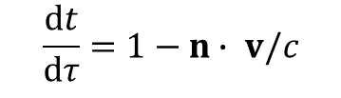







Introduction to synchrotron radiation
Retarded time in an undulator
$$v$$
$$n$$
$$r$$
$$2.5 ×{10}^{−9}$$
$$\frac{dt}{dτ}=\frac{1}{2γ^{2}}$$
Retarted time $τ$ (s)
$$\frac{dt}{dτ}=1−n∙ v/c$$
$${2.5 × 10}^{−17}$$
Observer time $t$ (s)

Slide 11
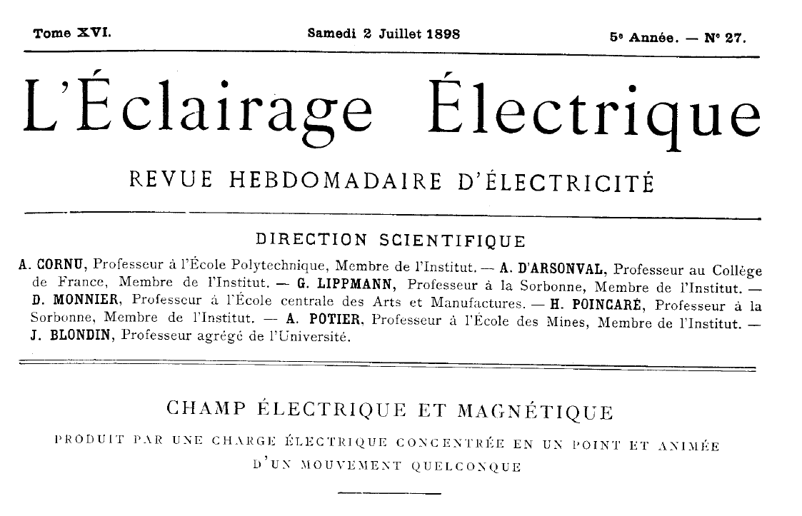
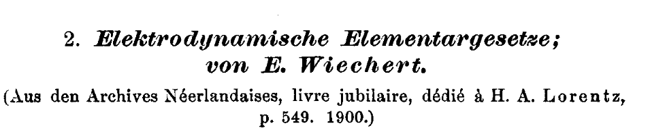
Introduction to synchrotron radiation
Retarded fields and potential
The exact expression of the retarded potentials was published before the discovery of the special relativity and photons!
E. Wiechert, 1901
This is the so-called Liénard-Wierchert potential,
or retarded potential
A. Liénard, 1898

Slide 12
Bending magnets and wigglers

Slide 13

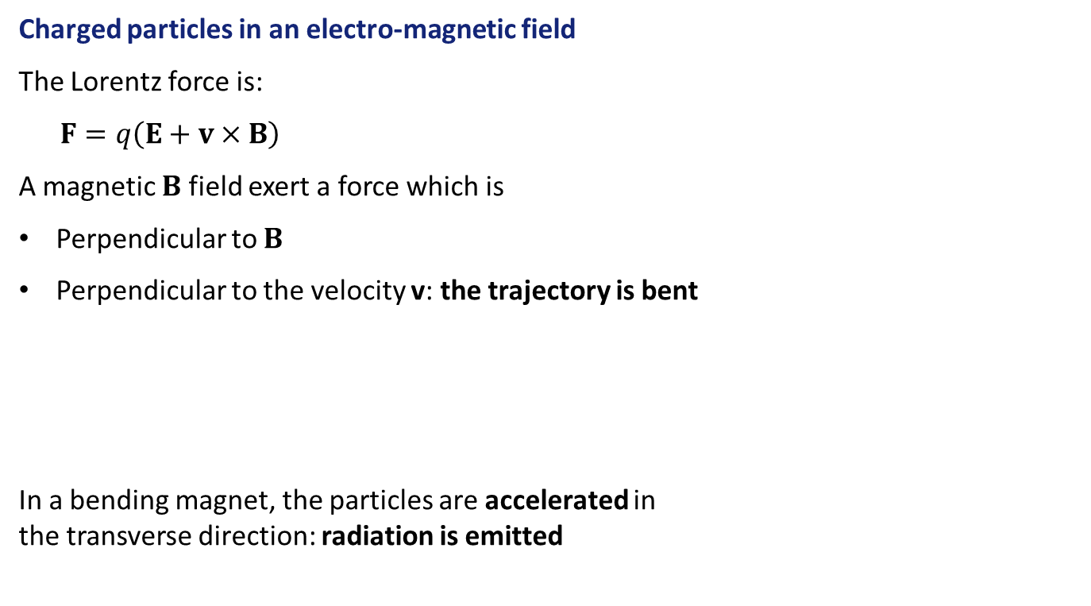

What are bending magnets?
Charged particles in an electro-magnetic field
The Lorentz force is:
$F=q\left(E+v×B\right)$
A magnetic $B$ field exert a force which is
Perpendicular to $B$
Perpendicular to the velocity v: the trajectory is bent
In a bending magnet, the particles are accelerated in the transverse direction: radiation is emitted
$$e^{−}$$
$$B$$

Slide 14



What are bending magnets?
Bending magnets in accelerators
Bending magnets are used in accelerator rings
They ensure a close trajectory for the particles
They radiate a high power as synchrotron radiation
Bending magnets radiation $\sim 0.5 MW$
ESRF storage ring power
Undulator radiation $\sim 0. 1MW$
Others $\sim 3.7 MW$

Slide 15
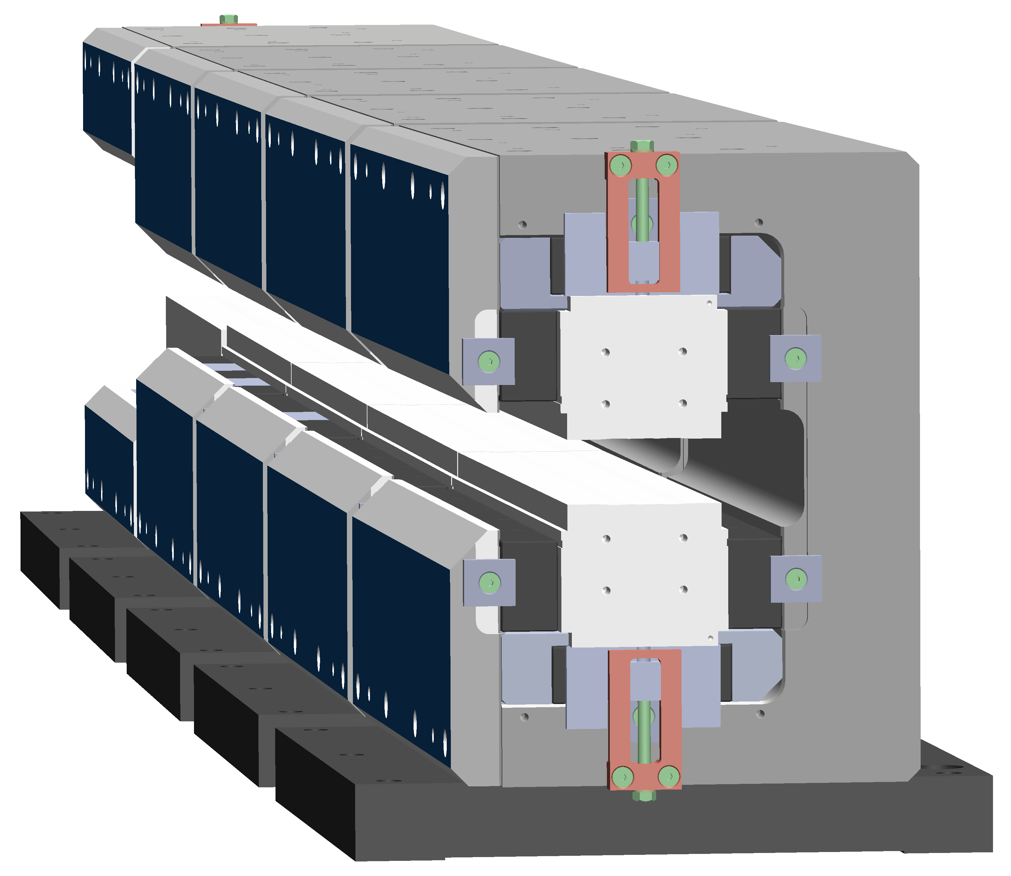
What are bending magnets?
Dipole magnets
Bending magnets typically have an homogeneous field
This is done by two magnetic poles, i.e. a magnetic dipole
For this reason bending magnets are also called dipole magnets
Bending magnets at the ESRF-EBS
More than 200 bending magnets
These magnets are low field. This ensure a low emittance
Some of bending magnets are also focusing magnets
N
S
ESRF bending magnet

Slide 16




Bending magnet radiation: critical energy
Light pulse duration
The observer starts to see the radiation emitted at retarted time $τ_{0}$
The radiation emitted after retarted time $τ_{1}$ is not seen by the observer
$$\frac{2}{γ}$$
$$B$$
$$B$$

Slide 17


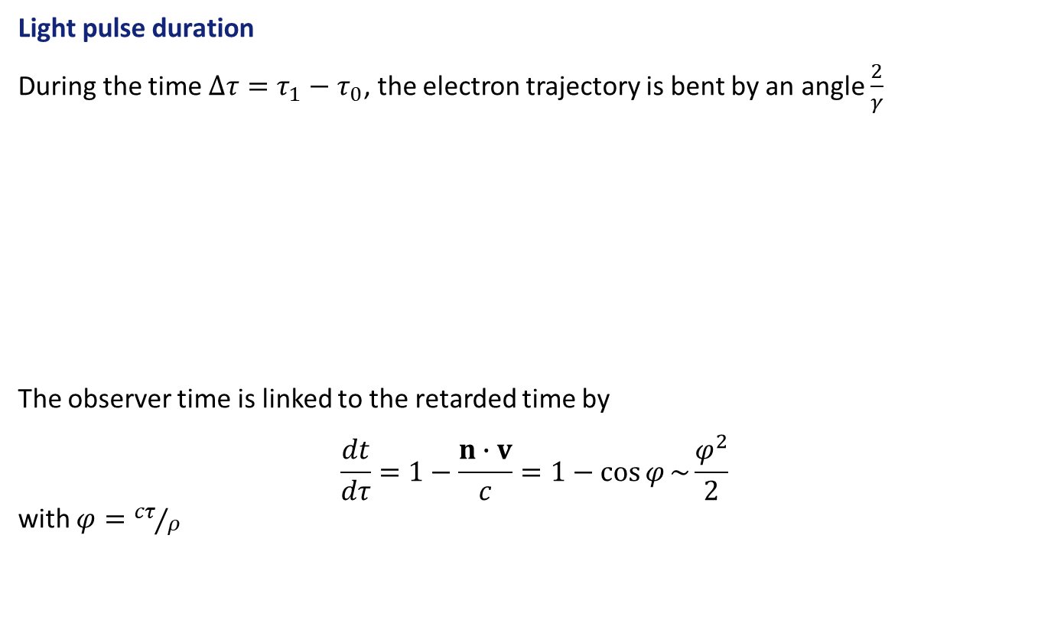


Bending magnet radiation: critical energy
Light pulse duration
During the time $∆τ=τ_{1}−τ_{0}$, the electron trajectory is bent by an angle $\frac{2}{γ}$
The observer time is linked to the retarded time by
$$\frac{dt}{dτ}=1−\frac{n∙v}{c}=1−\cos{φ}\sim \frac{φ^{2}}{2}$$ with $φ={cτ}/ρ$
$$\frac{2}{γ}$$
$$B$$
$$B$$
Radius $ρ$
$$\frac{2}{γ}$$

Slide 18
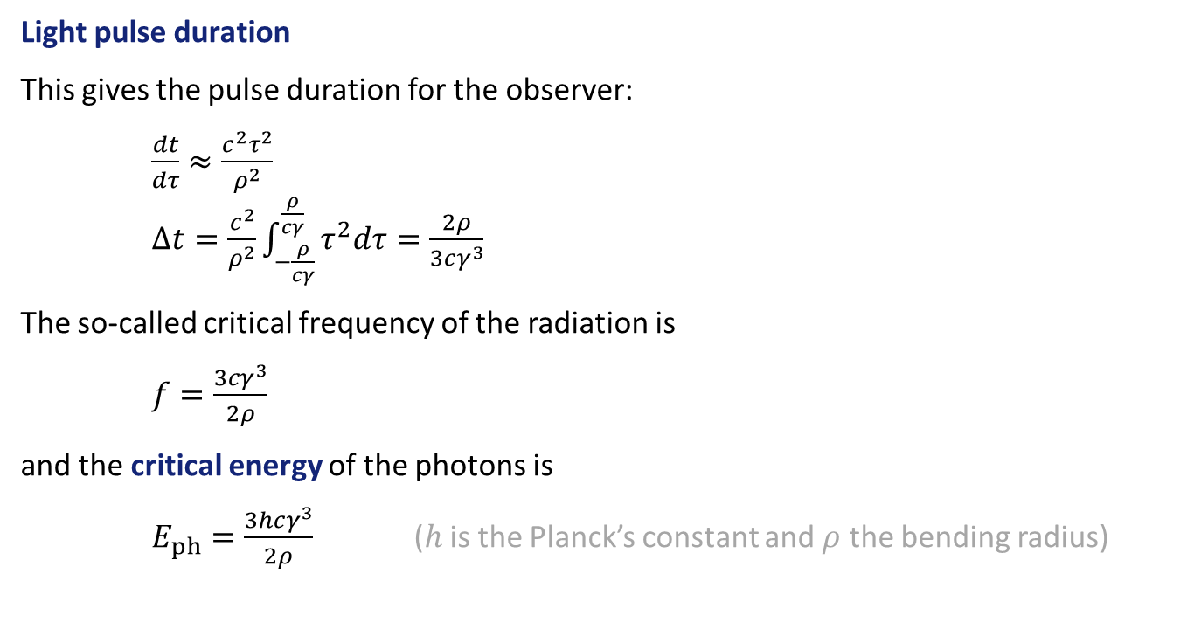
Bending magnet radiation: critical energy
Light pulse duration
This gives the pulse duration for the observer:
$\frac{dt}{dτ}≈\frac{c^{2}τ^{2}}{ρ^{2}}$ $∆t=\frac{c^{2}}{ρ^{2}}\int_{−\frac{ρ}{cγ}}^{\frac{ρ}{cγ}}{τ^{2}dτ}=\frac{2ρ}{3cγ^{3}}$
The so-called critical frequency of the radiation is
$f=\frac{3cγ^{3}}{2ρ}$
and the critical energy of the photons is
$E_{ph}=\frac{3hcγ^{3}}{2ρ}$ ($h$ is the Planck’s constant and $ρ$ the bending radius)

Slide 19

Bending magnet radiation
Radiated power
For a relativistic electron on a circular orbit:
$$P=\frac{e^{2}c}{6πε_{0}}\frac{{\left(v/c\right)}^{4}γ^{4}}{ρ^{2}}∝\frac{γ^{4}}{ρ^{2}}∝γ^{2}B^{2}$$
This explain the large size of the high energy accelerators!
Energy
Magnetic field
Bending radius

Slide 20
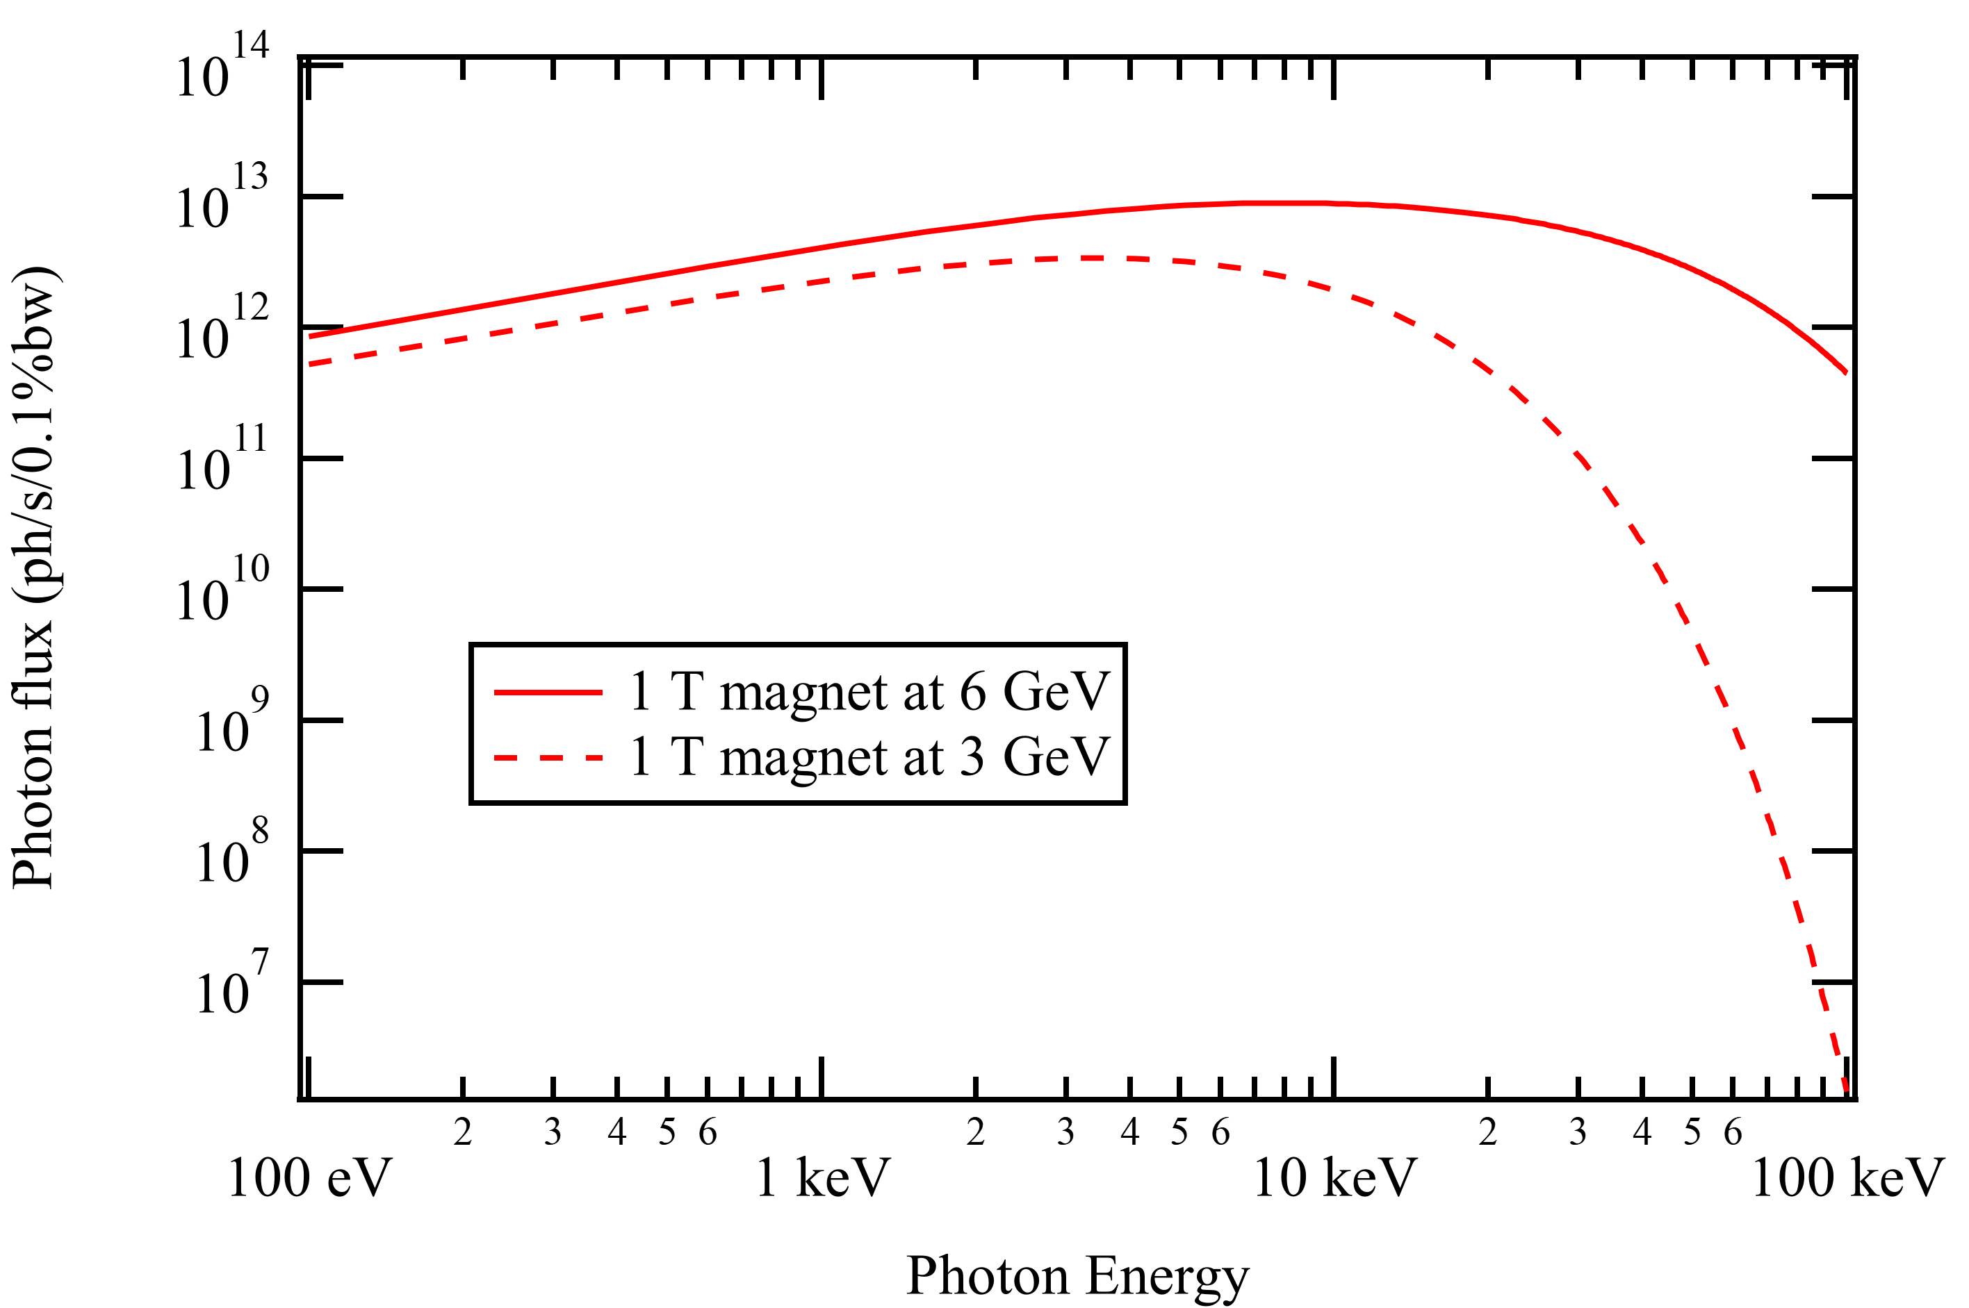


Bending magnet radiation
Radiated spectrum
$$4.7$$
1.7
$$7.1×{10}^{3}$$

Slide 21
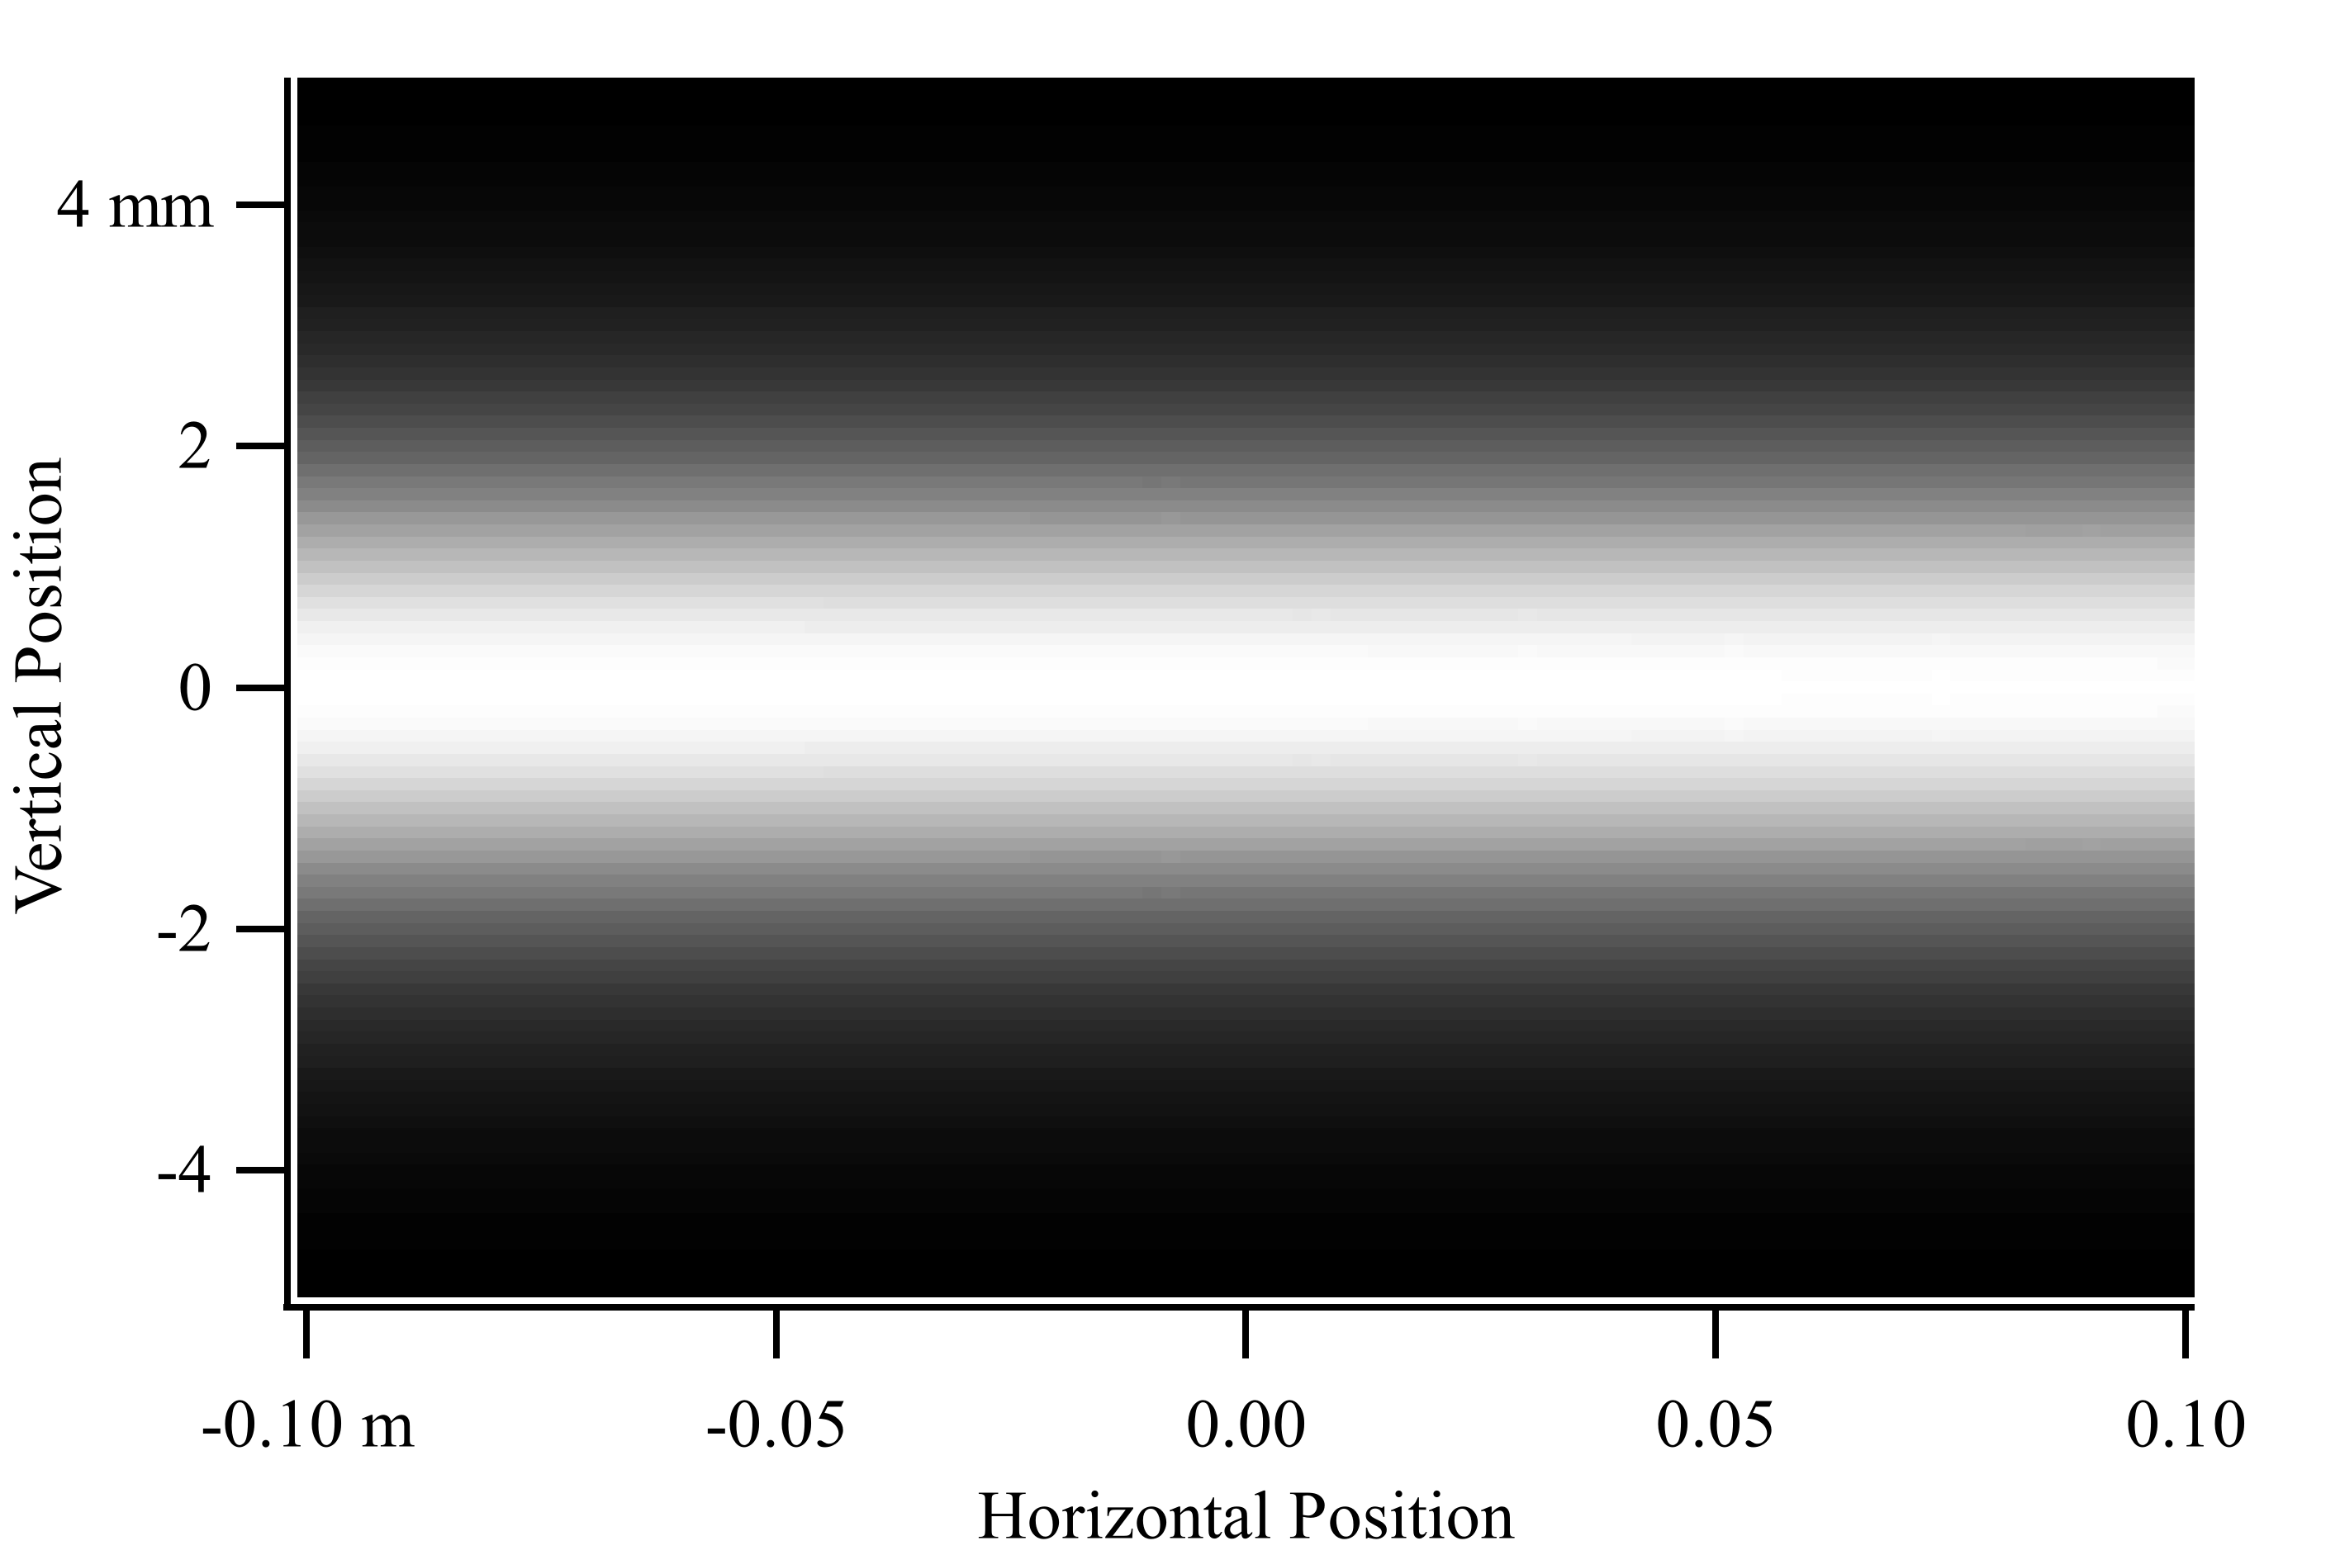
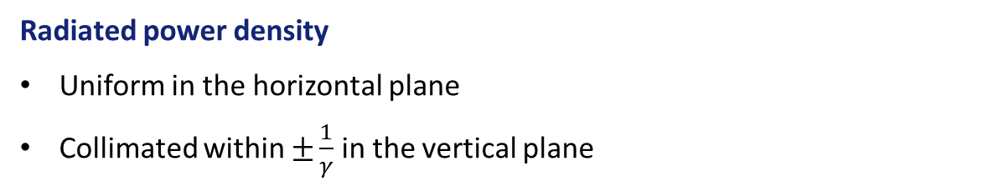

Bending magnet radiation
Radiated power density
Uniform in the horizontal plane
Collimated within $±\frac{1}{γ}$ in the vertical plane
$±\frac{1}{γ}×D$
Radiated power density of a $1 T$ magnet at $D=30 m$, for $6 GeV$ electrons

Slide 22



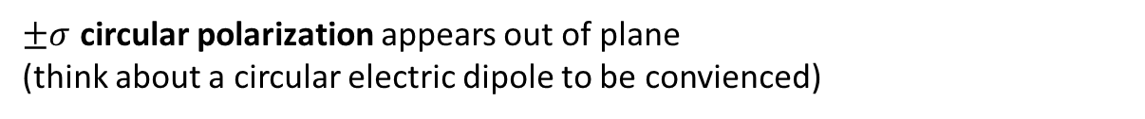
Bending magnet radiation
Polarization
$$a$$
$$v$$
$$v$$
$$E$$
In the symmetry plane, the polarization is purely linear
$±σ$ circular polarization appears out of plane (think about a circular electric dipole to be convienced)

Slide 23
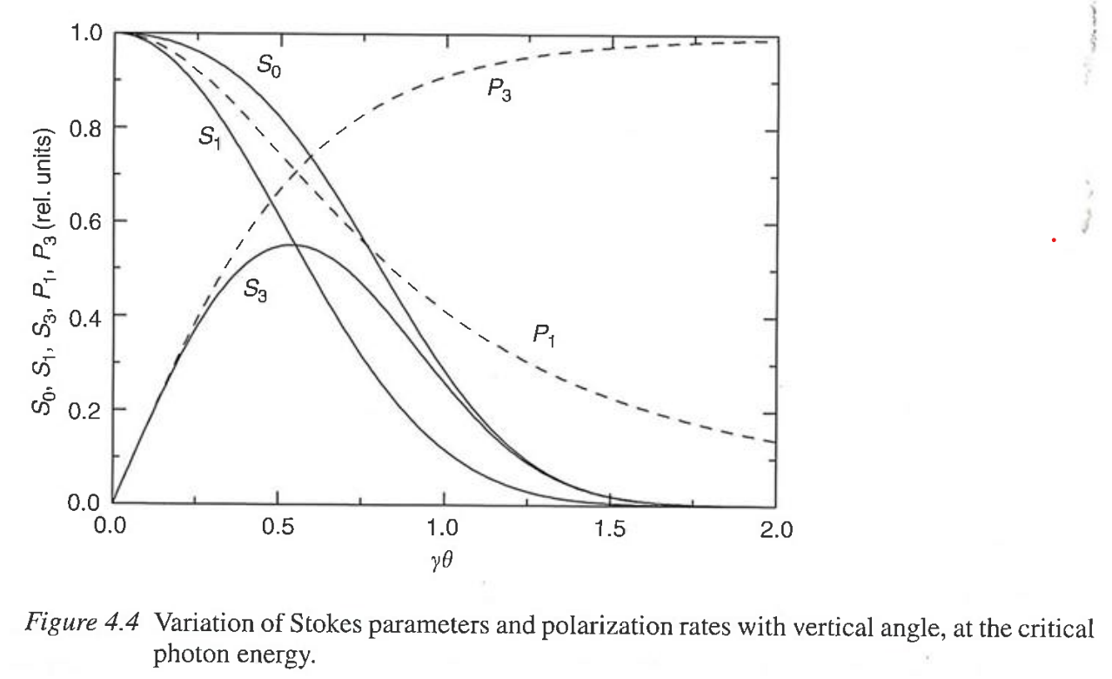
Bending magnet radiation
Polarization
Linear pol.
Circular pol. rate
Linear pol. rate
Circular pol.
(Figure from [R. Walker, 2003])

Slide 24
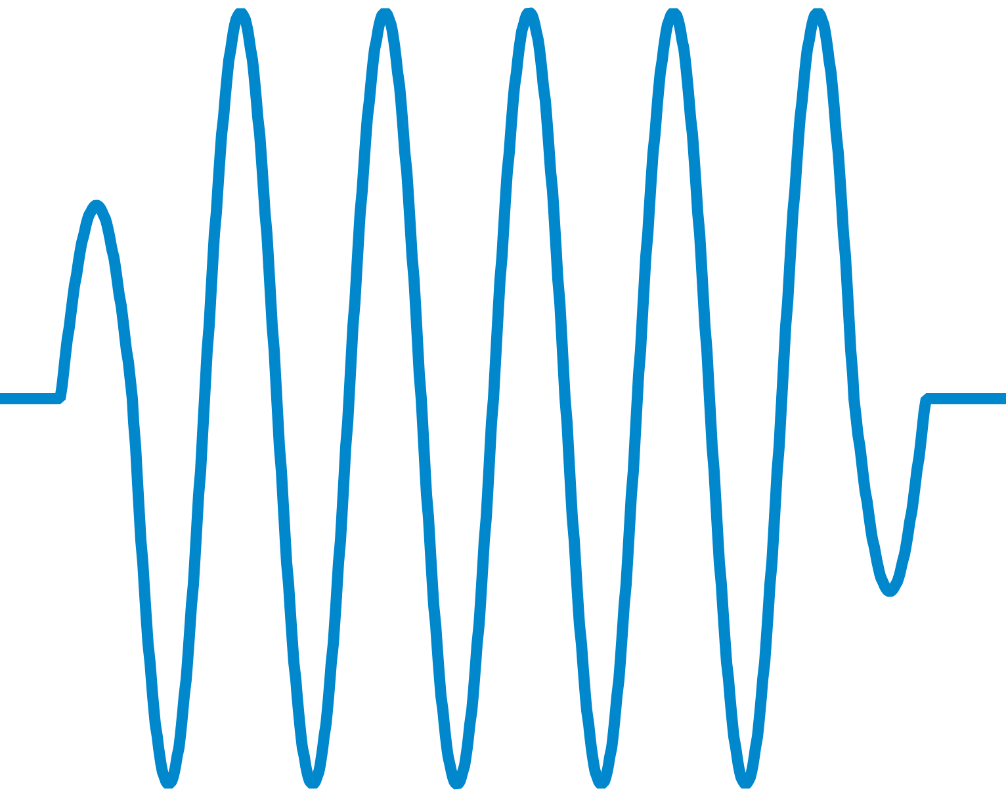
Wigglers
Main ideas
Stack a few bending magnets to increase the photon flux
Alternate the magnet polarities to wiggle around a straight line

Slide 25
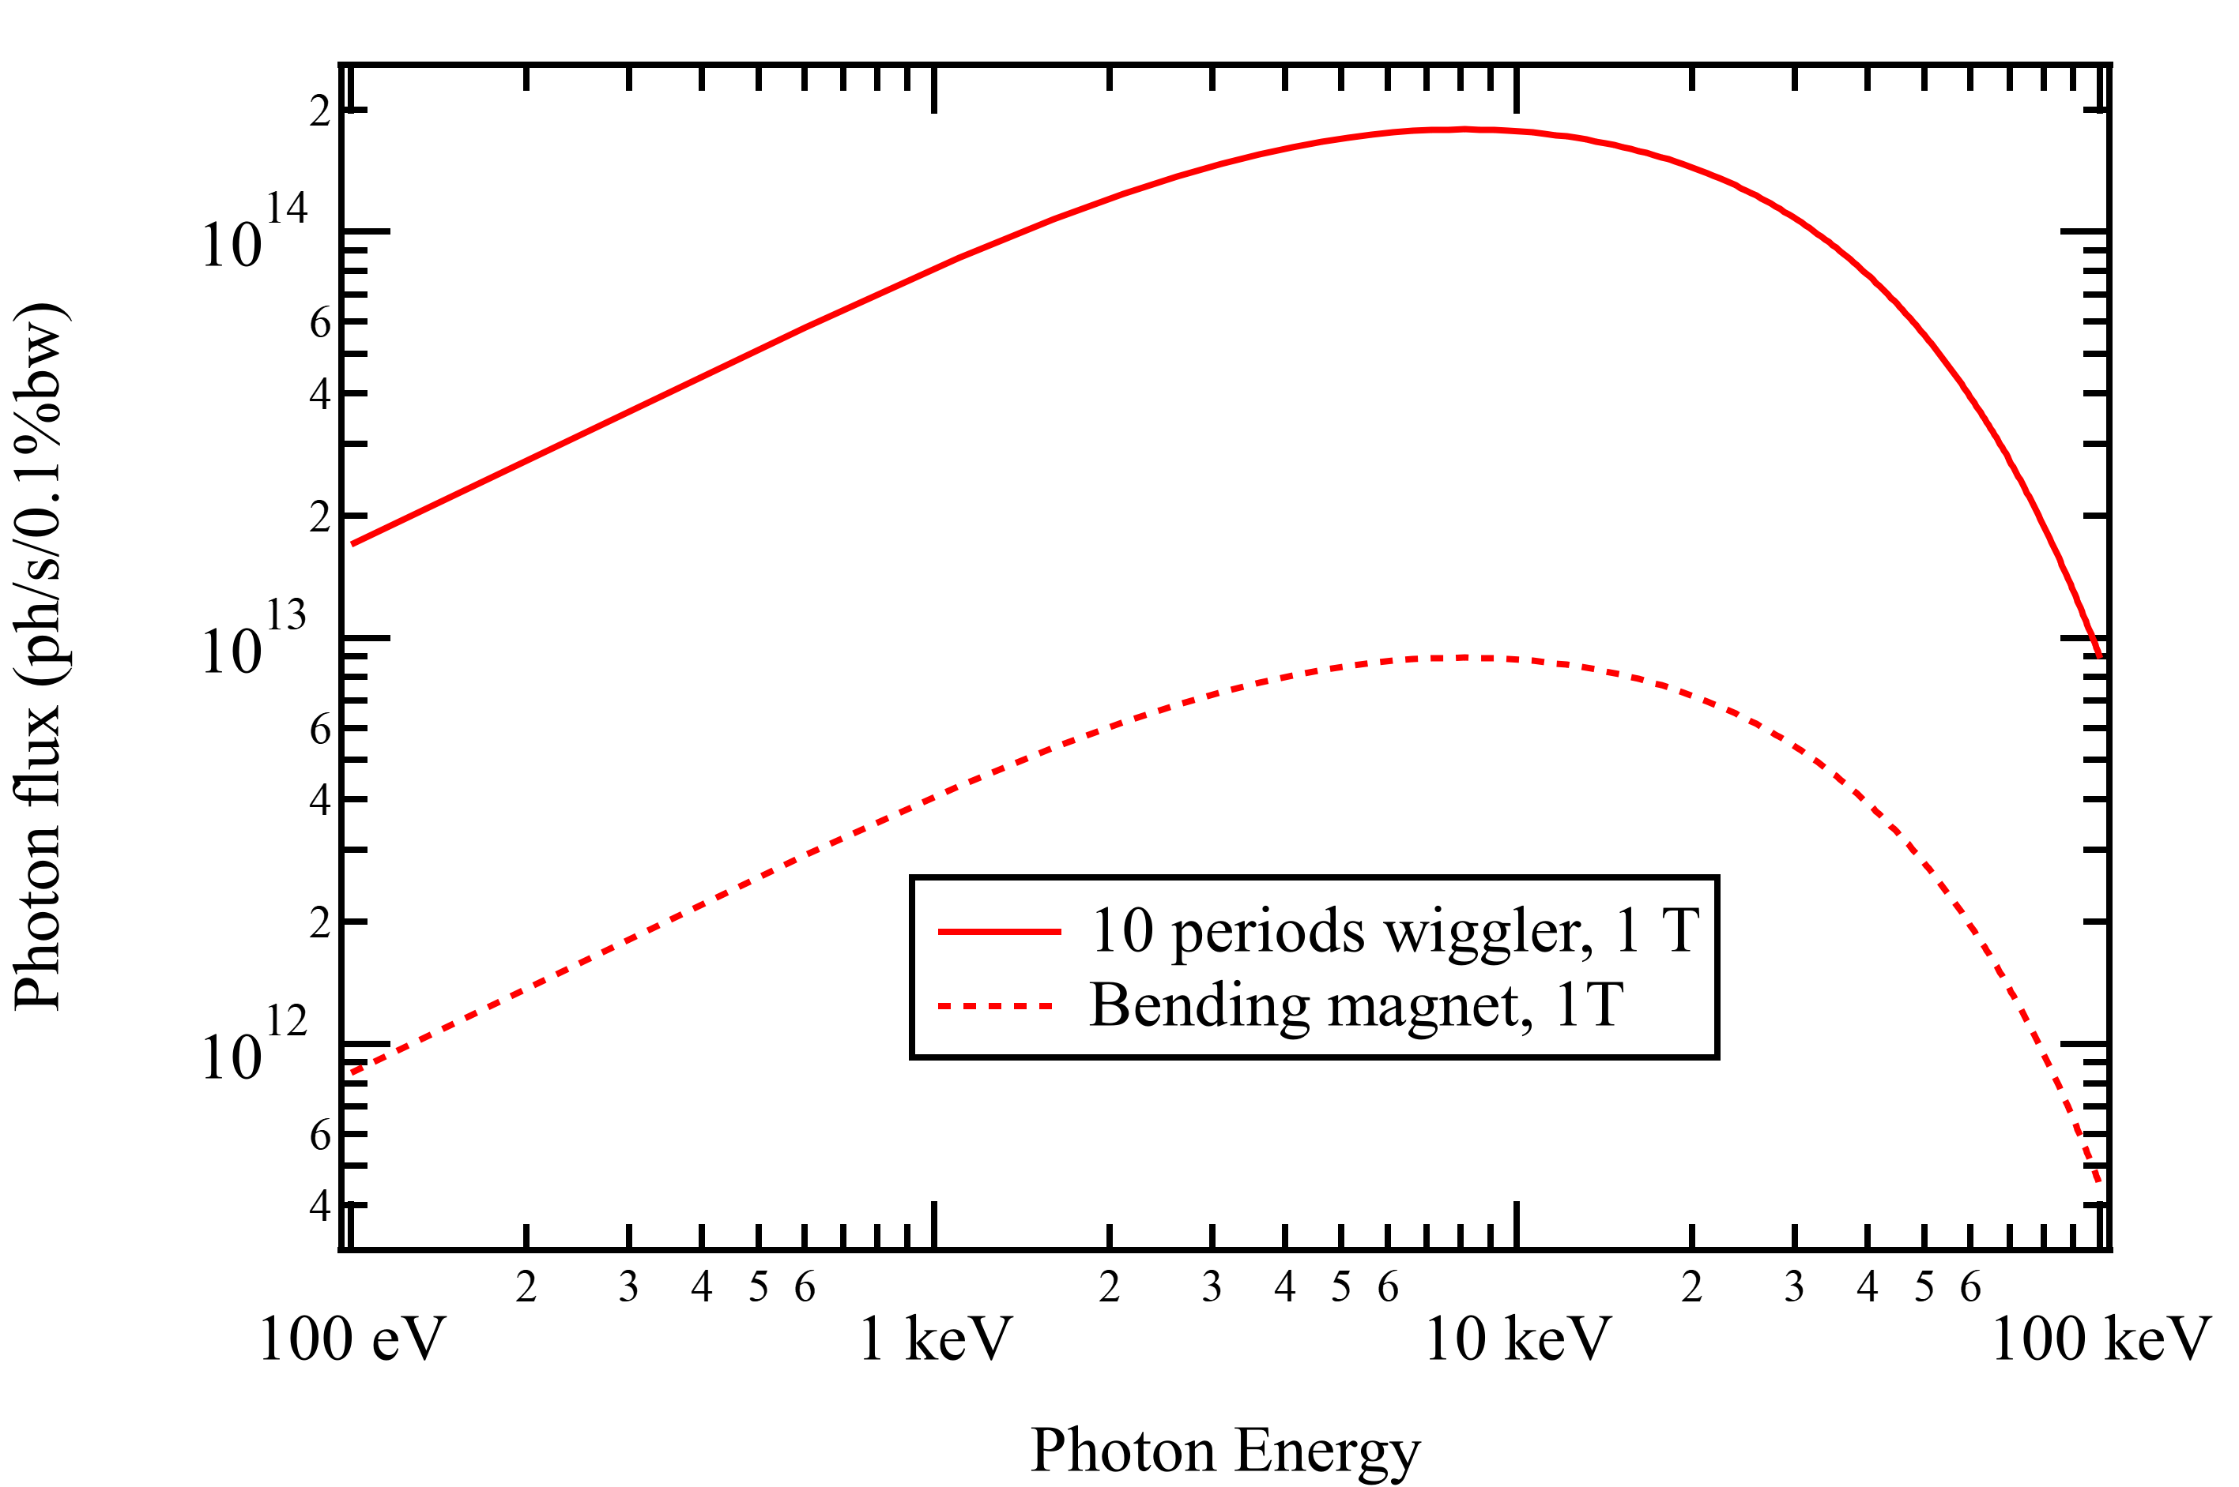


Wigglers
Radiated spectrum
Flux $×20$
Poles $×20$
Note: the interferences between periods are neglected here.
This is not true at low energy, but wigglers are typically used at high energy

Slide 26
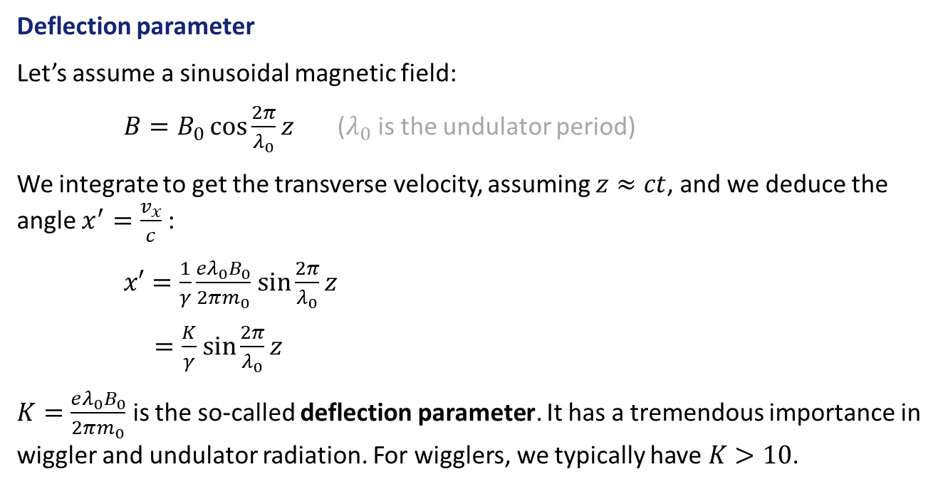
Wigglers
Deflection parameter
Let’s assume a sinusoidal magnetic field:
$B=B_{0}\cos{\frac{2π}{λ_{0}}z}$ ($λ_{0}$ is the undulator period)
We integrate to get the transverse velocity, assuming $z≈ct$, and we deduce the angle $x^{′}=\frac{v_{x}}{c}$ :
$x′=\frac{1}{γ}\frac{eλ_{0}B_{0}}{2πm_{0}}$ $\sin{\frac{2π}{λ_{0}}z}$
$=\frac{K}{γ}$ $\sin{\frac{2π}{λ_{0}}z}$
$K=\frac{eλ_{0}B_{0}}{2πm_{0}}$ is the so-called deflection parameter. It has a tremendous importance in wiggler and undulator radiation. For wigglers, we typically have $K>10$.

Slide 27
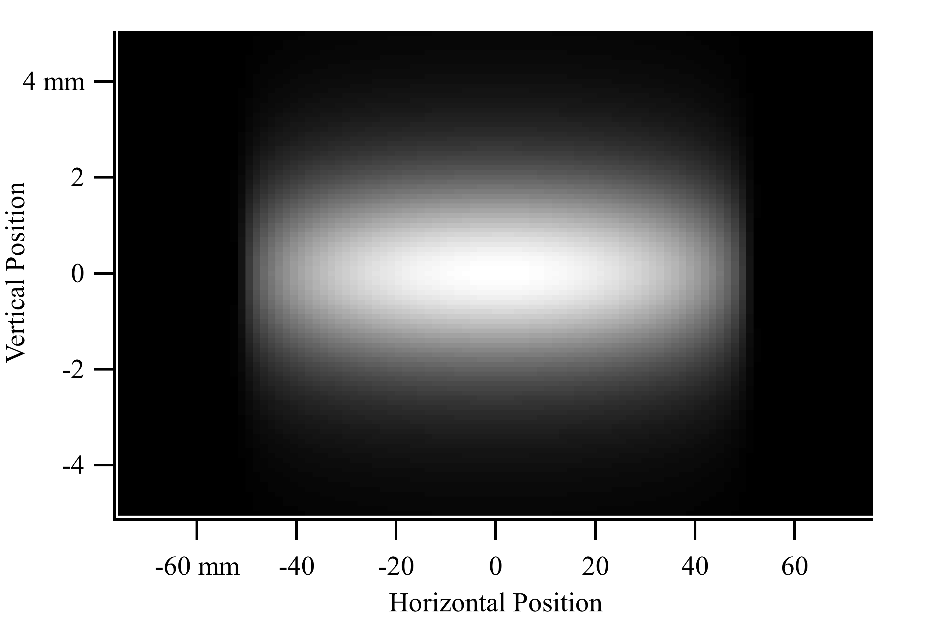
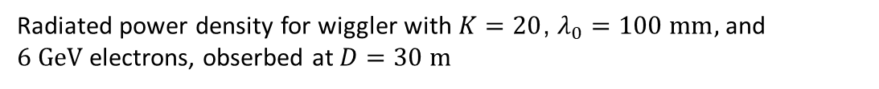


Wigglers
Radiation power density
$±\frac{K}{γ}×D$
$±\frac{1}{γ}×D$
Radiated power density for wiggler with $K=20$, $λ_{0}=100 mm,$ and $6 GeV$electrons, obserbed at $D=30 m$

Slide 28
Undulators

Slide 29
Undulators
Undulators vs wigglers
Undulators and wigglers are similar devices
Undulators benefit from period to period interferences
$$\frac{2}{γ}$$
This is a wiggler

Slide 30

Undulators
Undulators vs wigglers
Undulators and wigglers are similar devices
Undulators benefit from period to period interferences
This is an undulator
$$\frac{2}{γ}$$

Slide 31
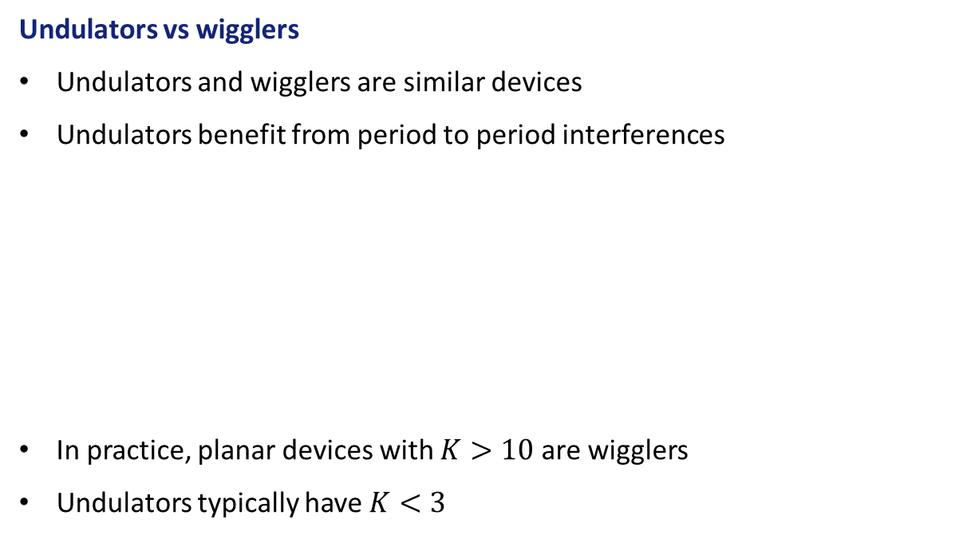
Undulators
Undulators vs wigglers
Undulators and wigglers are similar devices
Undulators benefit from period to period interferences
In practice, planar devices with $K>10$ are wigglers
Undulators typically have $K<3$
This is an undulator
$$\frac{2}{γ}$$

Slide 32
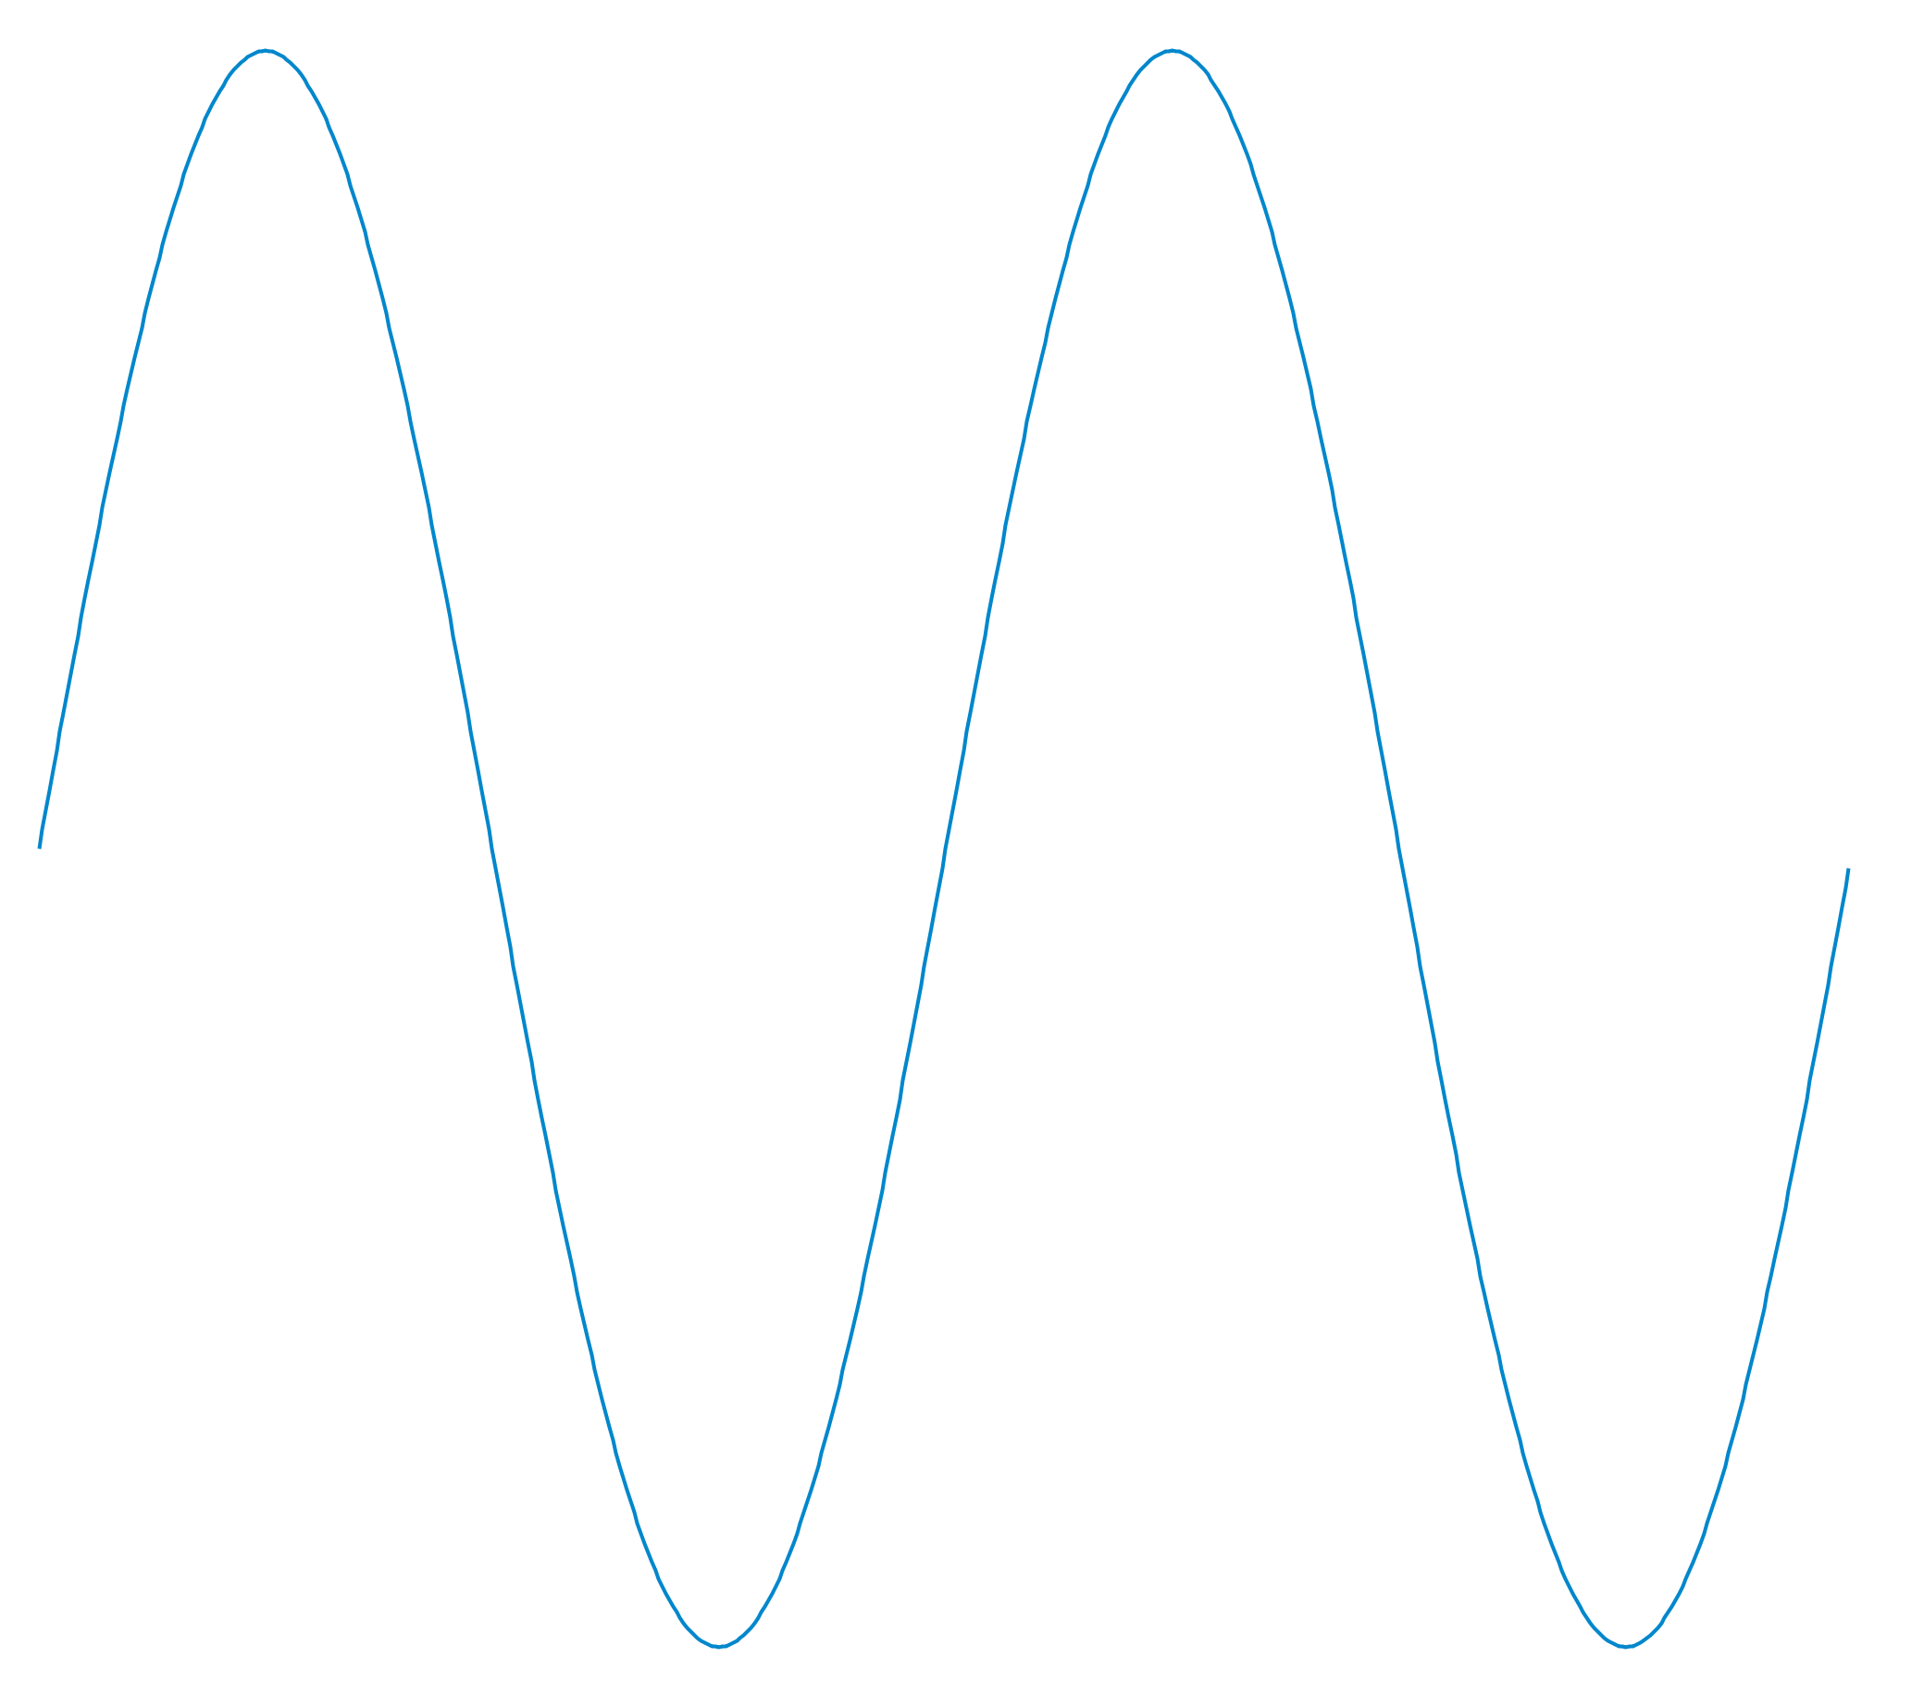
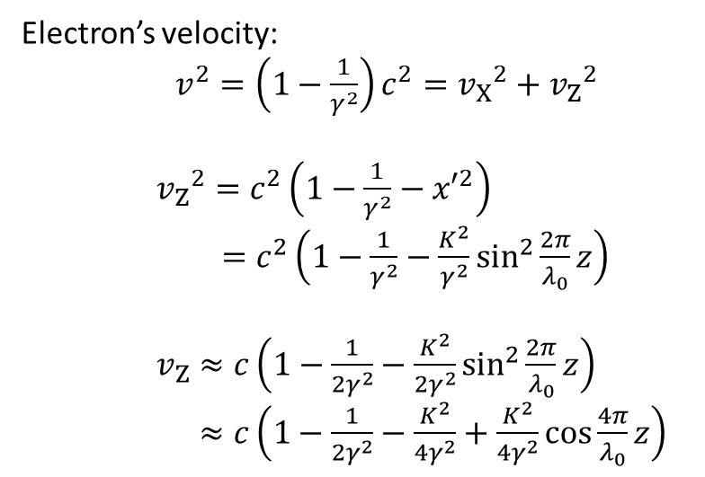

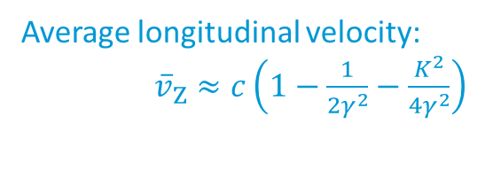



Undulators
by definition of the Lorentz factor
Electron’s velocity:
$v^{2}=\left(1−\frac{1}{γ^{2}}\right)c^{2}={v_{X}}^{2}+{v_{Z}}^{2}$
${v_{Z}}^{2}=c^{2}\left(1−\frac{1}{γ^{2}}−{x′}^{2}\right)$
$=c^{2}\left(1−\frac{1}{γ^{2}}−\frac{K^{2}}{γ^{2}}\sin^{2}\frac{2π}{λ_{0}}z\right)$
$v_{Z}≈c\left(1−\frac{1}{{2γ}^{2}}−\frac{K^{2}}{2γ^{2}}\sin^{2}\frac{2π}{λ_{0}}z\right)$
$≈c\left(1−\frac{1}{{2γ}^{2}}−\frac{K^{2}}{{4γ}^{2}}+\frac{K^{2}}{{4γ}^{2}}\cos{\frac{4π}{λ_{0}}z}\right)$
Resonance condition
$e^{−}$
$$x$$
$$λ_{0}$$
$$z$$
Average longitudinal velocity:
${\overline{v}}_{Z}≈c\left(1−\frac{1}{{2γ}^{2}}−\frac{K^{2}}{4γ^{2}}\right)$

Slide 33

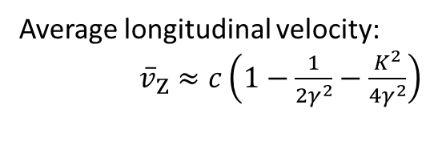

Undulators
Resonance condition
at $t=0$
$$photon$$
$e^{−}$
$$x$$
$$λ_{0}$$
$$z$$
Average longitudinal velocity:
${\overline{v}}_{Z}≈c\left(1−\frac{1}{{2γ}^{2}}−\frac{K^{2}}{4γ^{2}}\right)$

Slide 34


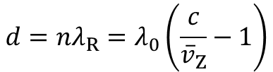

Undulators
Resonance condition
at $t=\frac{λ_{0}}{{\overline{v}}_{Z}}$
$$photon$$
$e^{−}$
Electron to photon distance after one period
$$d=nλ_{R}=λ_{0}\left(\frac{c}{{\overline{v}}_{Z}}−1\right)$$
$$x$$
On-axis resonance
$$λ_{0}$$
$$λ_{R}=\frac{λ_{0}}{2nγ^{2}}\left(1+\frac{K^{2}}{2}\right)$$
$$z$$
Average longitudinal velocity:
${\overline{v}}_{Z}≈c\left(1−\frac{1}{{2γ}^{2}}−\frac{K^{2}}{4γ^{2}}\right)$

Slide 35

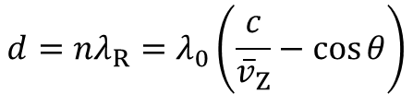

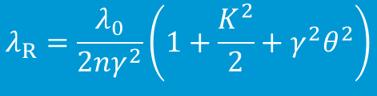


Undulators
Resonance condition – off-axis
$$photon$$
$$d=nλ_{R}=λ_{0}\left(\frac{c}{{\overline{v}}_{Z}}−\cos{θ}\right)$$
$$θ$$
$e^{−}$
Undulator resonance
$$x$$
$$λ_{R}=\frac{λ_{0}}{2nγ^{2}}\left(1+\frac{K^{2}}{2}+γ^{2}θ^{2}\right)$$
$$λ_{0}$$
$$z$$
The wavelength can be tuned with $K∝B_{0}$
The wavelength increases off-axis

Slide 36
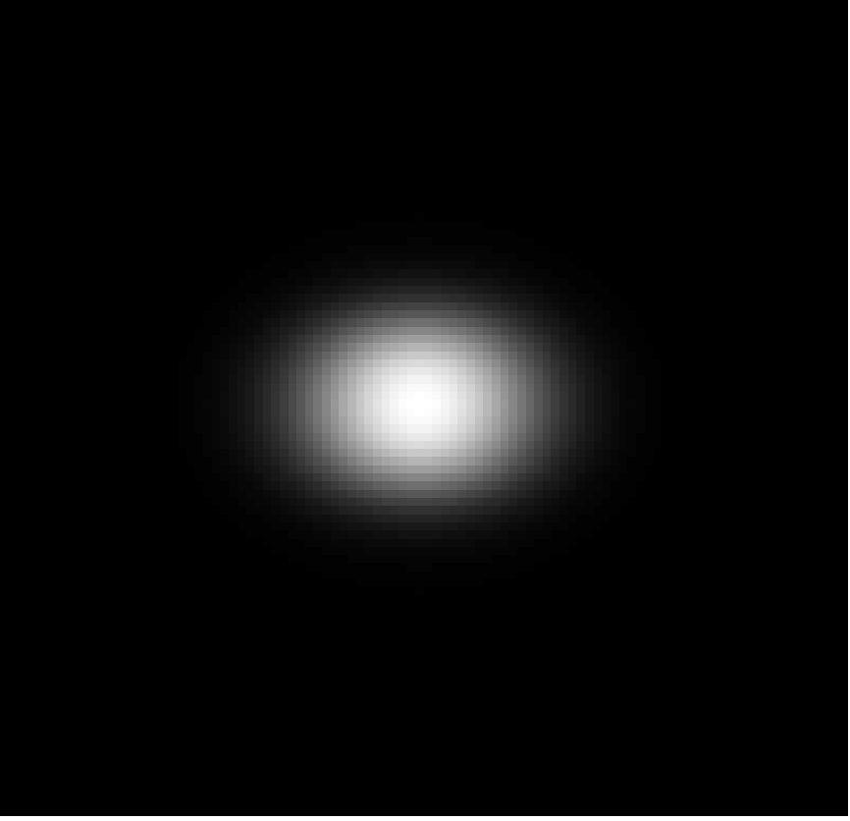
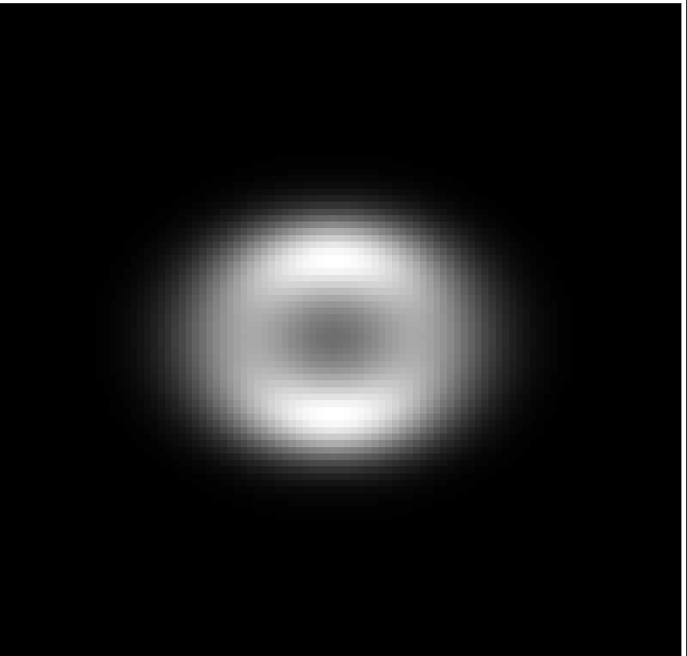

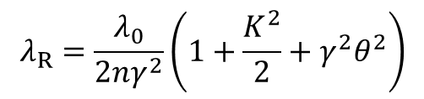
Undulators
Resonance
Resonace condition – off-axis
Detuned
$$λ_{R}=\frac{λ_{0}}{2nγ^{2}}\left(1+\frac{K^{2}}{2}+γ^{2}θ^{2}\right)$$
Beam size
Energy

Slide 37
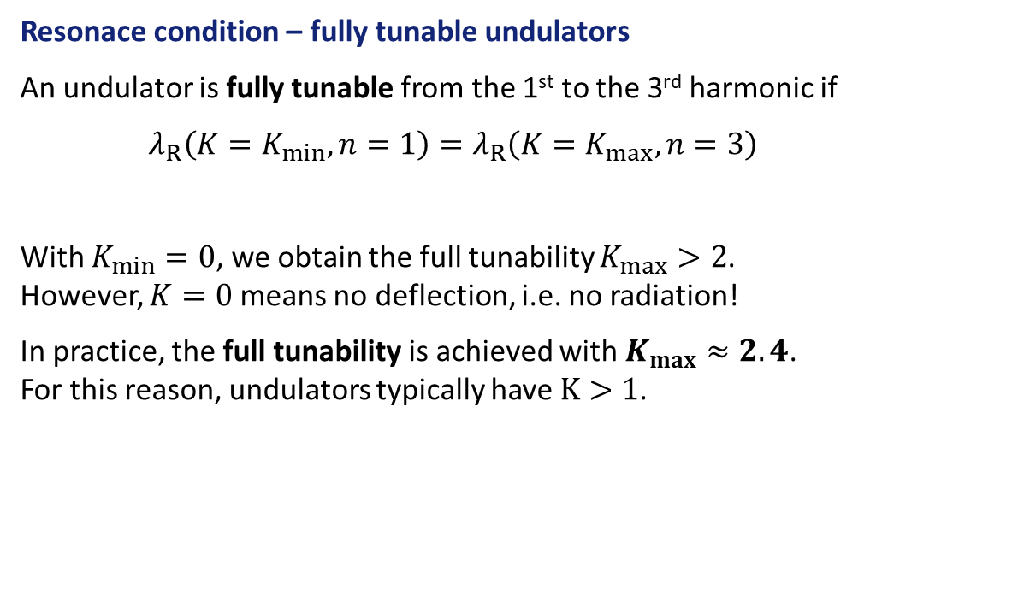
Undulators
Resonace condition – fully tunable undulators
An undulator is fully tunable from the 1st to the 3rd harmonic if
$λ_{R}\left(K=K_{min},n=1\right)=λ_{R}\left(K=K_{max},n=3\right)$
With $K_{min}=0$, we obtain the full tunability $K_{max}>2$. However, $K=0$ means no deflection, i.e. no radiation!
In practice, the full tunability is achieved with $K_{max}≈2.4$. For this reason, undulators typically have $K>1$.

Slide 38
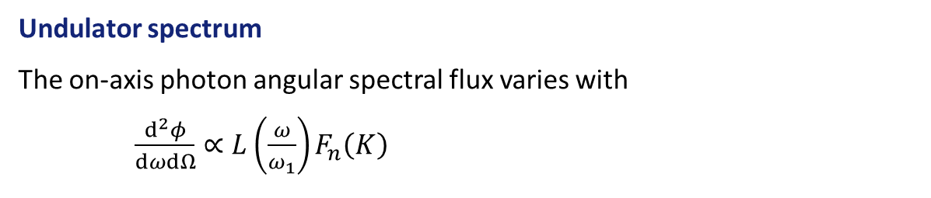
Undulators
Undulator spectrum
The on-axis photon angular spectral flux varies with
$\frac{d^{2}φ}{dωdΩ}∝L\left(\frac{ω}{ω_{1}}\right)F_{n}\left(K\right)$
For more details, see [Walker, 1998] or [Elleaume, 2003]

Slide 39
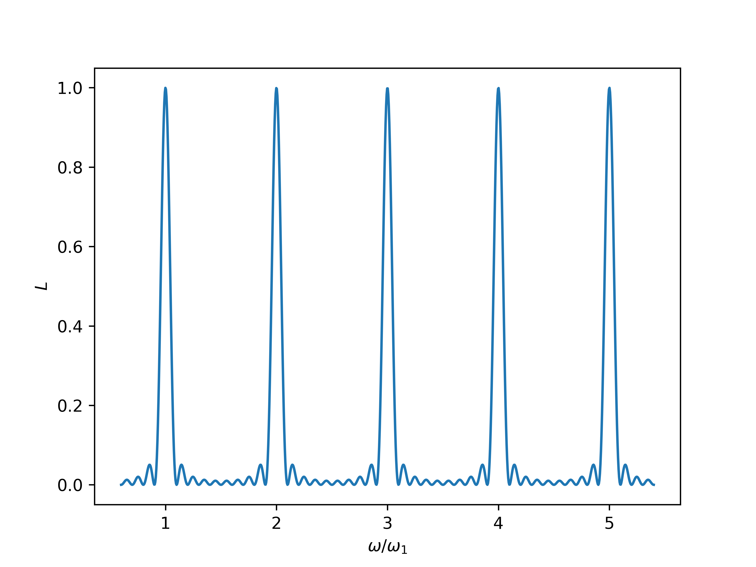

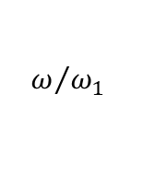
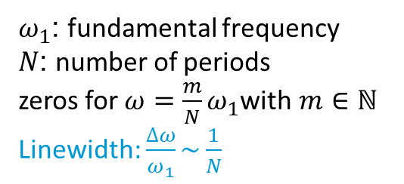

Undulators
Undulator spectrum
The on-axis photon angular spectral flux varies with
$\frac{d^{2}φ}{dωdΩ}∝L\left(\frac{ω}{ω_{1}}\right)F_{n}\left(K\right)$
For more details, see [Walker, 1998] or [Elleaume, 2003]
$N=5$ periods
$ω_{1}$: fundamental frequency
$N$: number of periods
zeros for $ω=\frac{m}{N}ω_{1}$with $m∈ℕ$
Linewidth: $\frac{∆ω}{ω_{1}}\sim \frac{1}{N}$
$$L$$
1
5
$$ω/{ω_{1}}$$

Slide 40
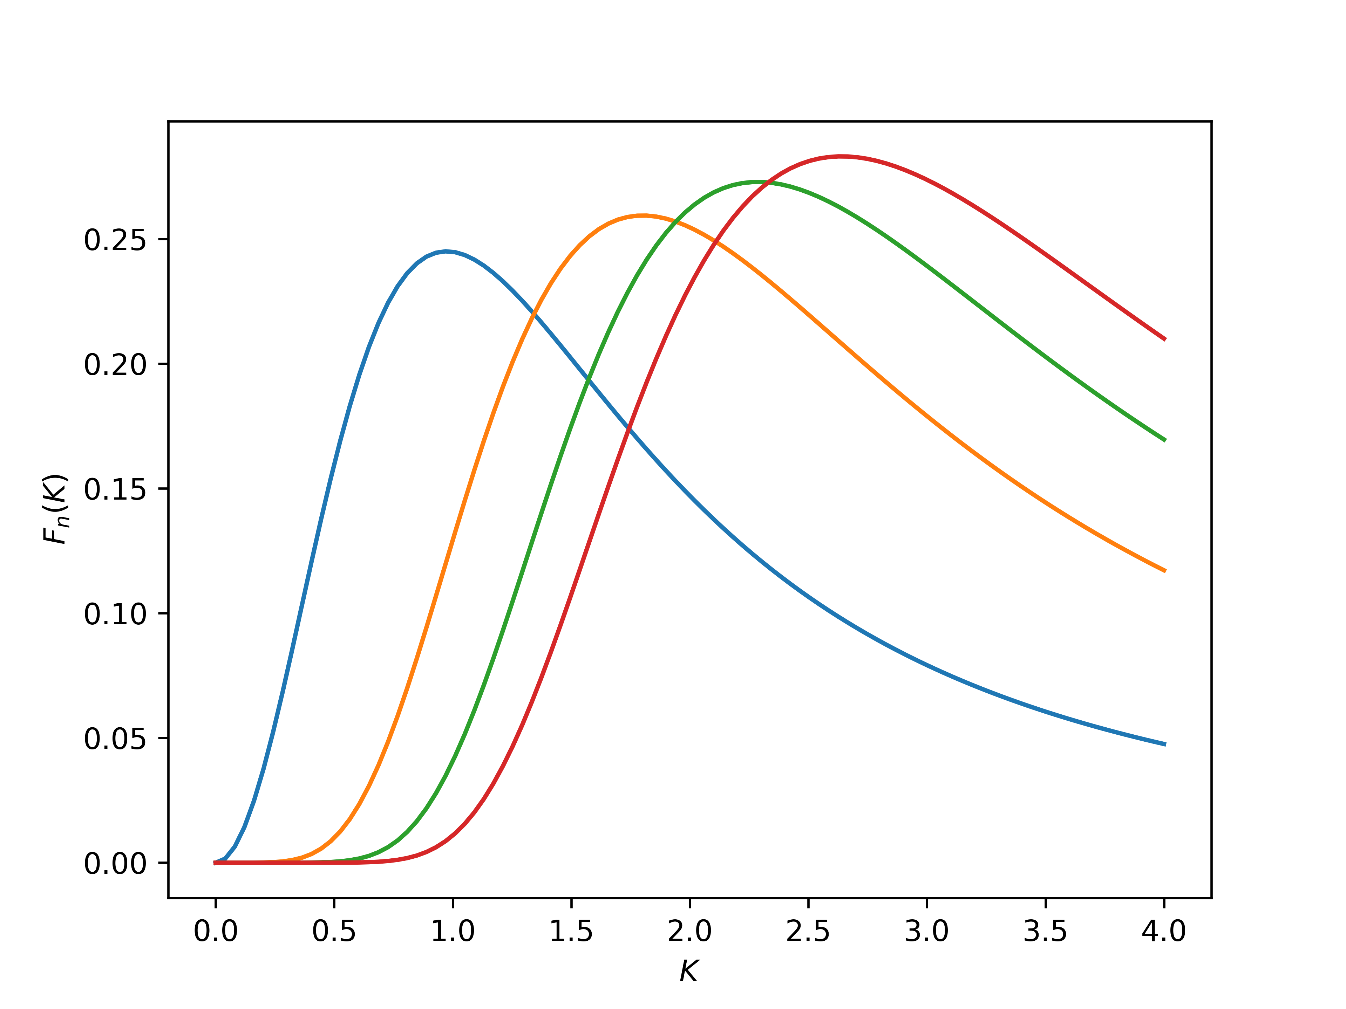


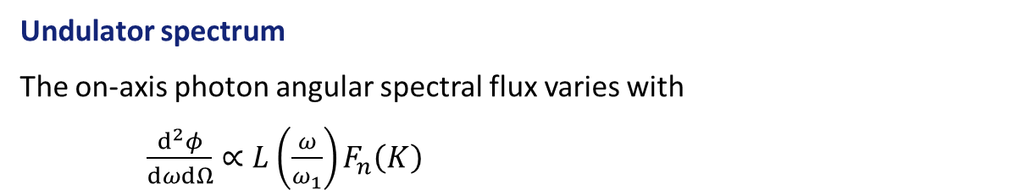




Undulators
Undulator spectrum
The on-axis photon angular spectral flux varies with
$\frac{d^{2}φ}{dωdΩ}∝L\left(\frac{ω}{ω_{1}}\right)F_{n}\left(K\right)$
For more details, see [Walker, 1998] or [Elleaume, 2003]
$$5$$
$$n=1$$
$$3$$
$$7$$
$F_{n}$
1
3
4
$$K$$

Slide 41
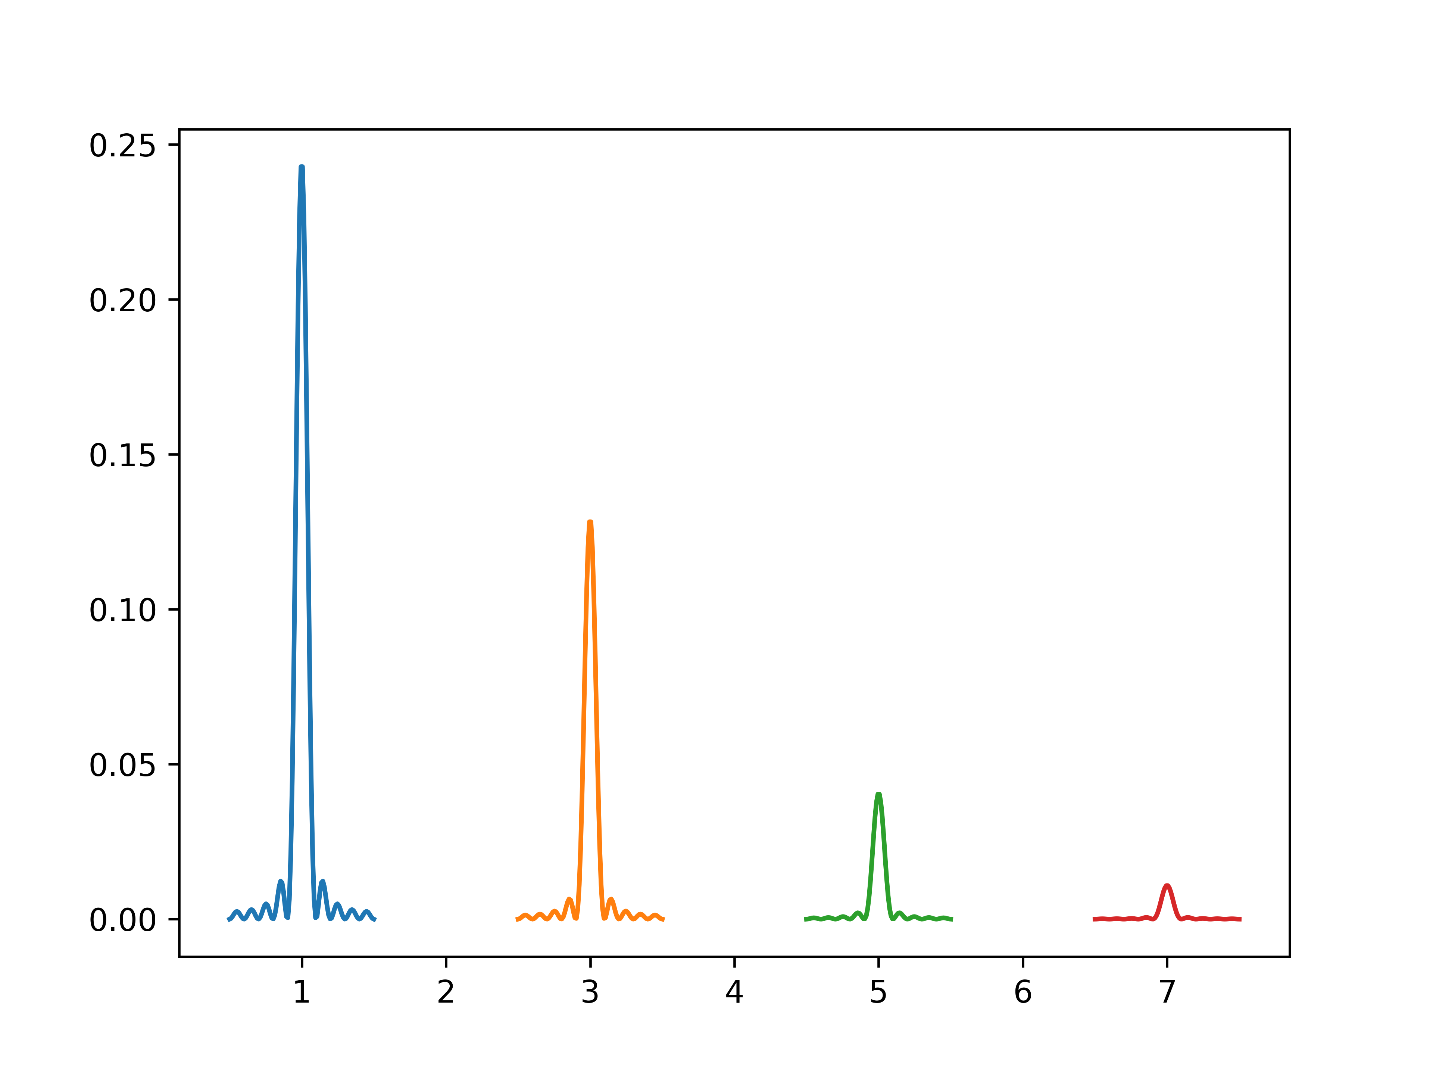


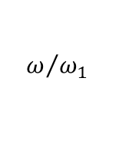




Undulators
Undulator spectrum
$$K=1$$
$$L$$
$$L\left(\frac{ω}{ω_{1}}\right)F_{n}\left(K\right)$$
$$ω/{ω_{1}}$$
$F_{n}$
$$ω/{ω_{1}}$$
$$K$$

Slide 42
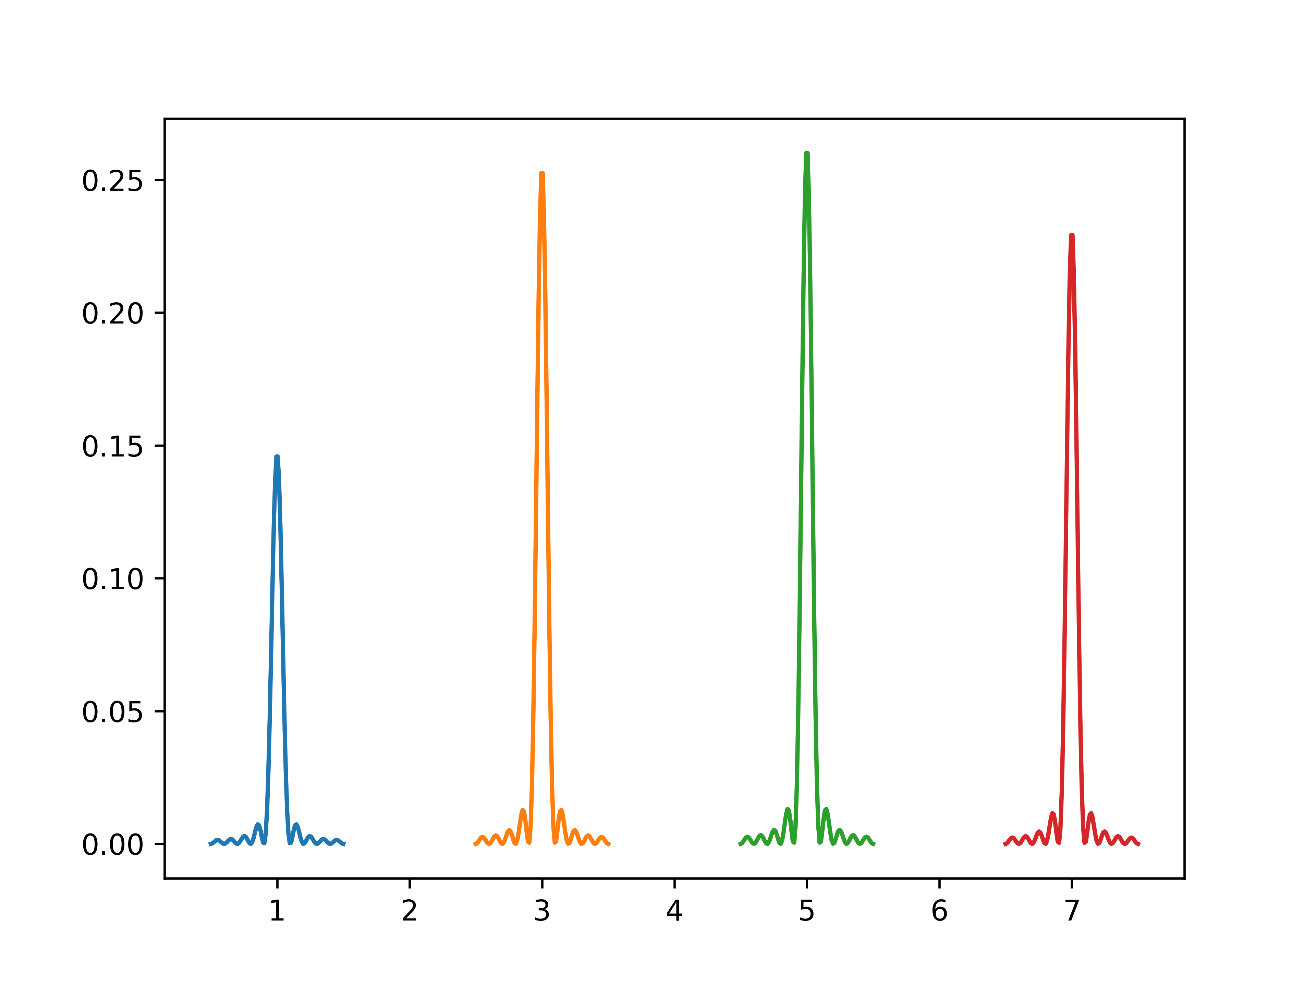

Undulators
Undulator spectrum
$$K=2$$
$$L$$
$$L\left(\frac{ω}{ω_{1}}\right)F_{n}\left(K\right)$$
$$ω/{ω_{1}}$$
$F_{n}$
$$ω/{ω_{1}}$$
$$K$$

Slide 43
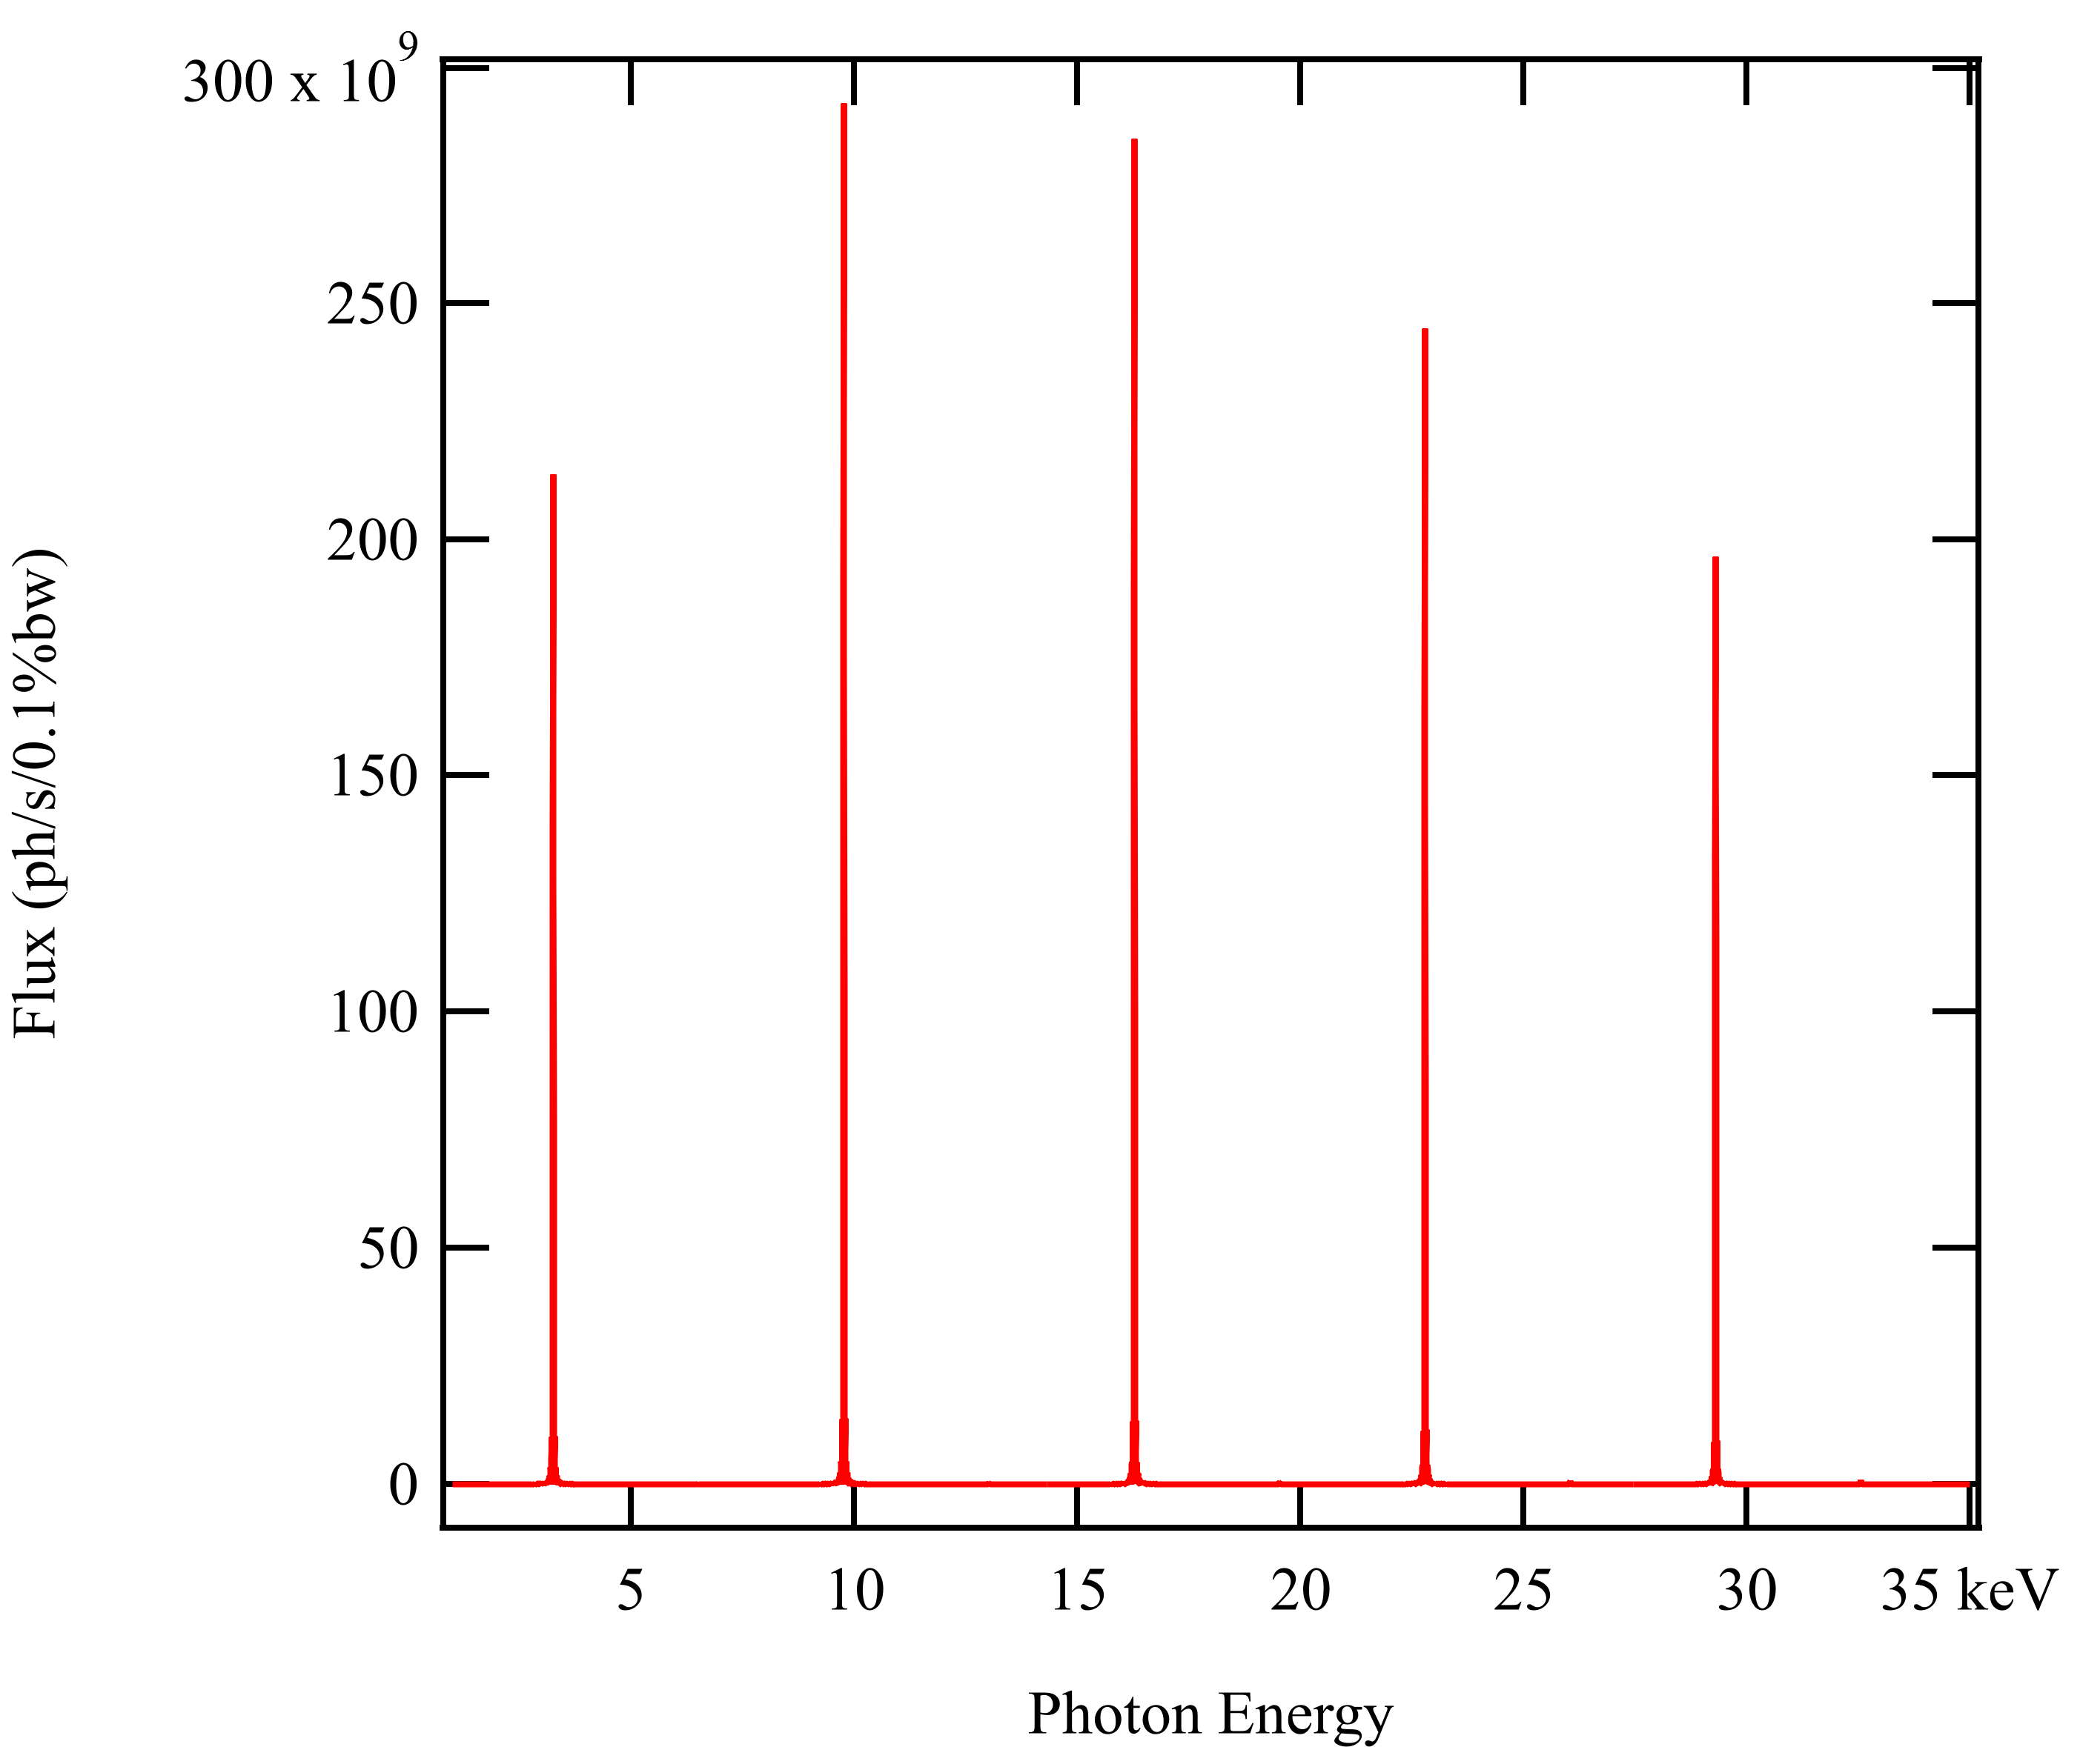
Undulators
3
5
Undulator spectrum
7
1
9
Photon flux (ph/s/0.1%bw)
Photon energy (keV)
$5 m$ long, $λ_{0}=35 mm$, $K=2,$ $6 GeV$, on-axis, filament beam

Slide 44
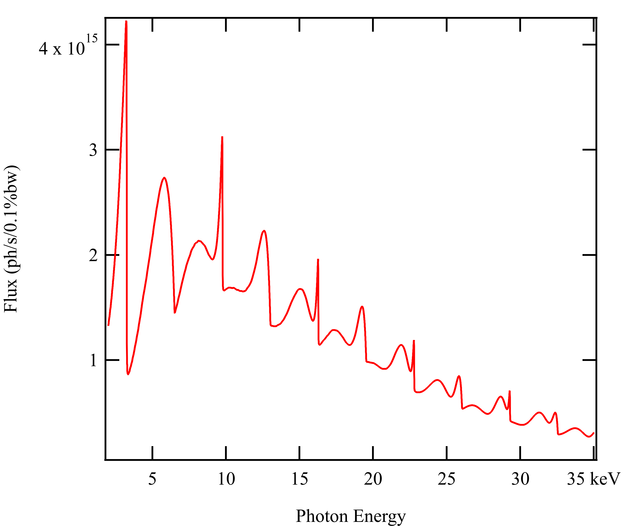
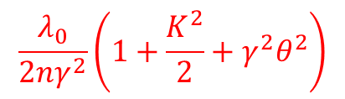

Undulators
Spectral flux through slits
$$\frac{λ_{0}}{2nγ^{2}}\left(1+\frac{K^{2}}{2}+γ^{2}θ^{2}\right)$$
$$\frac{λ_{0}}{2nγ^{2}}\left(1+\frac{K^{2}}{2}\right)$$
Slits
Off-axis photons have lower energy
This broadens the spectrum peaks!
Integration on finite slits

Slide 45






Undulators
Spectral flux through slits – fundamental
$$2θ$$
$$2γθ=1$$
$$0.5$$
$$0.25$$
Photon flux (ph/s/0.1%bw)
Angular aperture
$$0.1$$
Photon energy (eV)
$5 m$ long, $λ_{0}=35 mm$, $K=2,$ $6 GeV$, on-axis, filament beam

Slide 46










Undulators
Radiation patern at resonance
Flux at the 3rd harmonic resonace wavelength
$$\frac{λ_{0}}{2×5γ^{2}}\left(1+\frac{K^{2}}{2}+γ^{2}{θ_{5}}^{2}\right)$$
$$h_{5}$$
$$\frac{λ_{0}}{2×4γ^{2}}\left(1+\frac{K^{2}}{2}+γ^{2}{θ_{4}}^{2}\right)$$
$$h_{3}$$
$$h_{4}$$
$$h_{4}$$
Photon flux
$$h_{5}$$
$$h_{3}$$
$$\frac{λ_{0}}{2×3γ^{2}}\left(1+\frac{K^{2}}{2}\right)$$
Photon energy (keV)

Slide 47


Undulator
Tuning curves
$$K=2$$
Photon flux (ph/s/0.1%bw)
Photon energy (keV)
$5 m$ long, $λ_{0}=35 mm$, $K=2$, at $6 GeV$, $2γθ=0.04$, filament beam

Slide 48


Undulator
Tuning curves
$$K=1.75$$
Photon flux (ph/s/0.1%bw)
Photon energy (keV)
$5 m$ long, $λ_{0}=35 mm$, $K=2$, at $6 GeV$, $2γθ=0.04$, filament beam

Slide 49


Undulator
Tuning curves
$$K=1.5$$
Photon flux (ph/s/0.1%bw)
Photon energy (keV)
$5 m$ long, $λ_{0}=35 mm$, $K=2$, at $6 GeV$, $2γθ=0.04$, filament beam

Slide 50


Undulator
Tuning curves
$$K=1.25$$
Photon flux (ph/s/0.1%bw)
Photon energy (keV)
$5 m$ long, $λ_{0}=35 mm$, $K=2$, at $6 GeV$, $2γθ=0.04$, filament beam

Slide 51


Undulator
Tuning curves
$$K=1$$
Photon flux (ph/s/0.1%bw)
Photon energy (keV)
$5 m$ long, $λ_{0}=35 mm$, $K=2$, at $6 GeV$, $2γθ=0.04$, filament beam

Slide 52


Undulator
Notice that the on-axis flux reaches a maximum
Tuning curves
$$K↘$$
Photon flux (ph/s/0.1%bw)
Angular flux (ph/s/0.1%bw/mrad²)
This is a tuning curve, here for the angular flux
Photon energy (keV)
Photon energy (keV)
$5 m$ long, $λ_{0}=35 mm$, $K=2$, at $6 GeV$, $2γθ=0.04$, filament beam

Slide 53







Undulator key parameters
Radiated power
The total power radiated from an insertion device is
$P≈1.26 IE^{2}\int{B^{2}dz}$
$$[kW]$$
$$[A]$$
$$[GeV]$$
$$[T]$$
$$[m]$$
For an in-vacumm undulator at the ESRF:
$I=200 mA$, $E=6 GeV$
$B=1 T$, $L=2 m$
$P≈9.1 kW$

Slide 54




Undulator key parameters
Electron beam parameters
$σ_{X,Y}=\sqrt{ε_{X,Y}β_{X,Y}+η^{2}{σ_{P}}^{2}}$
${σ′}_{X,Y}=\sqrt{ε_{X, Y}/β_{X,Y}}$
$ε_{X,Y}$ are the emittance
The $β_{X,Y}$ define the beam enveloppe
Photon beam size
$Σ_{X,Y}=\sqrt{{σ_{ph}}^{2}+{σ_{X,Y}}^{2}}$
where $σ_{X,Y}$ is the electron beam size and $σ_{ph}$ is the photon beam size for an filament beam
For Gaussian photon beams
$σ_{ph}=\sqrt{\frac{2λ_{R}L}{2π}}$
${σ′}_{n}=\sqrt{\frac{λ_{R}}{2L}}$
where $L$ undulator length.
Photon beam divergence
${Σ′}_{X,Y}=\sqrt{{{σ′}_{ph}}^{2}+{{σ′}_{X,Y}}^{2}}$
where ${σ′}_{X,Y}$ is the electron beam divergence and ${σ′}_{ph}$ is the photon beam divergence for a filament beam

Slide 55

Undulator key parameters
Brilliance
The brilliance is often* defined as
$ℬ=\frac{φ}{Σ_{X}{Σ′}_{X}Σ_{Y}{Σ′}_{Y}}$
High brilliance means high flux for a small and collimated photon beam.
A high brilliance is needed for coherence experiments.
*Other definitions of brilliance exists
Photon flux per unit bandwidth
Source size and divergence

Slide 56
Technology

Slide 57



Periodic magnetic fields
Permanent magnets
Typically 4 magnets per period. This layout is called a Halbach array
$$g$$
The field is tuned with the gap $g$. It varies as $B≈2B_{0}\exp\left(−\frac{πg}{λ_{0}}\right)$
$$λ_{0}$$
In some cases, adding iron poles increase the performances
Main limitations
The peak field is limited by the minimum gap
At a given gap, short period undulators produce lower field
(This is true whatever the undulator technology.)

Slide 58




Undulator technology
Standard permanent magnet undulators
Vacuum chamber
$$e^{−}$$
$$λ_{0}$$
Permanent magnet assembly
Design view of an undulator

Slide 59

Undulator technology
In-vacuum permanent magnet undulators
Vacuum chamber
$$e^{−}$$
Minimum gap reduced by a factor of two compared to standard undulators
Design view of an in-vacuum undulator

Slide 60

Undulator technology
Cryogenic permanent magnet undulators
Stronger field
Better resistance to demagnetization
Cooling down
Magnetization
Coercitive field
Design view of an in-vacuum undulator

Slide 61
Electromagnetic insertion devices
Normal conductors cannot compete with permanent magnets at short periods
Superconducting devices
Much higher current densities are reached
Used for high field wigglers
SC undulators developped by some institutes since the early 2000
Low temperature superconducting undulators (LTS) have similar performances as cryogenic permanent magnet undulators
High temperature superconductors (HTS) can change the game if used at low temperature
Developments in progress!

Slide 62
References
References in the presentation
[Feynman, 1963] R.Feynman et al., The Feynman lectures on physics, Volume 1, Chapter 34, 1963
[Walker, 2003] R. Walker, Bending magnet and wiggler radiation, in Undulators, wigglers and their applications, Ed. H. Onuki and P. Elleaume, Taylor and Francis, 2003
[Walker, 1998] R. Walker, Insertion Devices: undulators and wigglers, in Proc. CERN Accelerator School on Synchrotron Radiation and Free Electron Laser, 1998
[Elleaume, 2003] P. Elleaume, Undulator radiation, in Undulators, wigglers and their applications, Ed. H. Onuki and P. Elleaume, Taylor and Francis, 2003
Others
J. A. Clarke, The science and technology of undulators and wigglers, Oxford University Press, 2004
A. Hofmann, Characteristics of synchrotron radiation, in Proc. CERN Accelerator School on Synchrotron Radiation and Free Electron Laser, 1998

Slide 63
Thank you!

