Slide 1

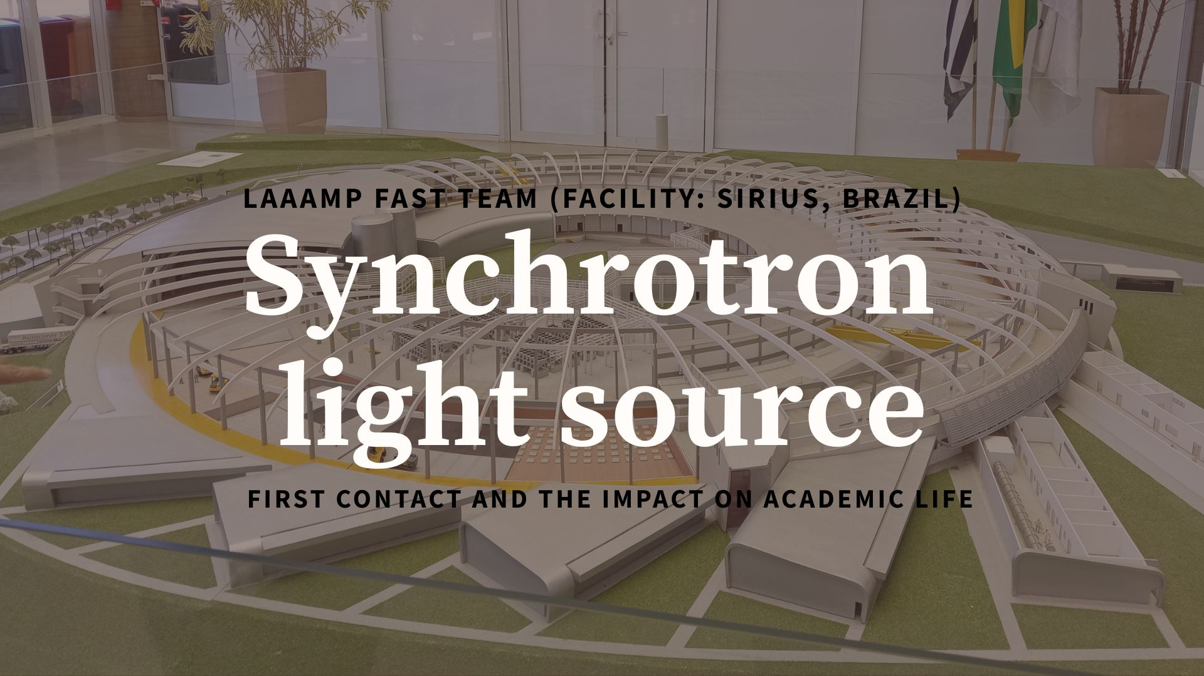






Celeste Aquino Ayala
Research and Technological Development Center - Polytechnic Faculty - National University of Asunción
January 2026

Slide 2
What am I going to talk about?
International training under the LAAAMP FAST program
Capacity building in synchrotron techniques for Paraguay
QUATI beamline (XAS) and Paineira beamline (XRD)
Experiments performed at LNLS (CNPEM, Brazil)

Slide 3
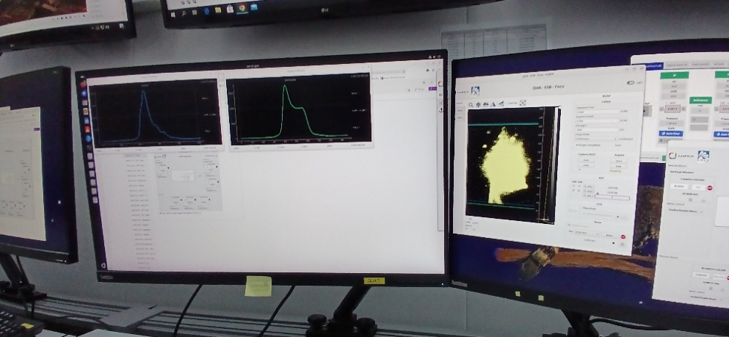
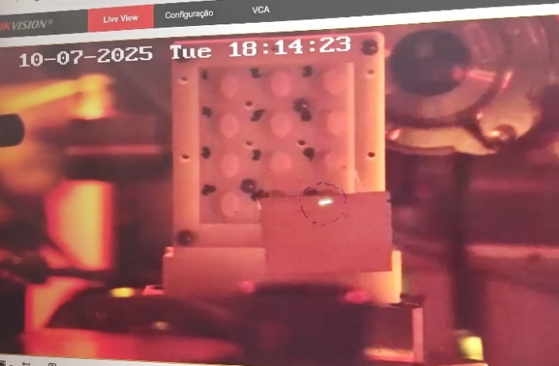
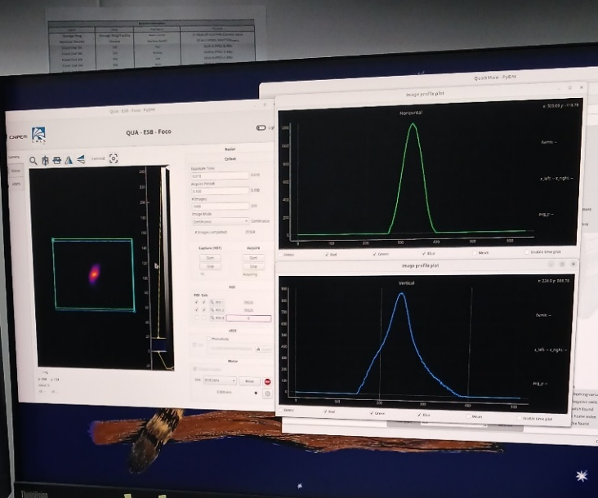
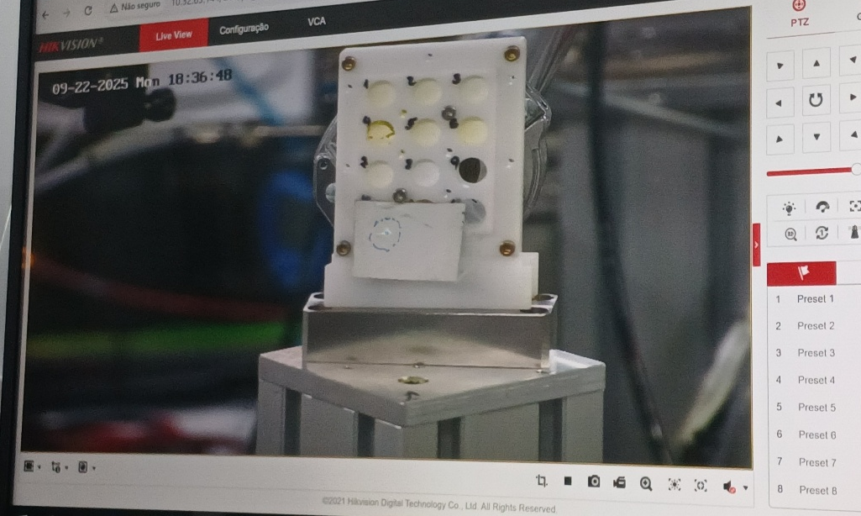
International training under the LAAAMP FAST program
Training at the experimental cabin- QUATI BEAMLINE
1- Focusing the beam
2- Place the beam on a fluorescent foil
3-Position the beam over the sample

Slide 4
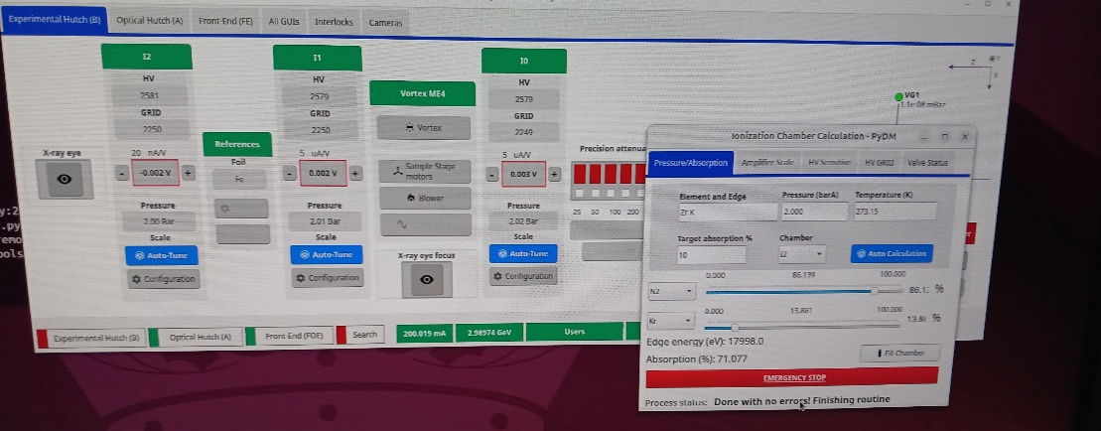
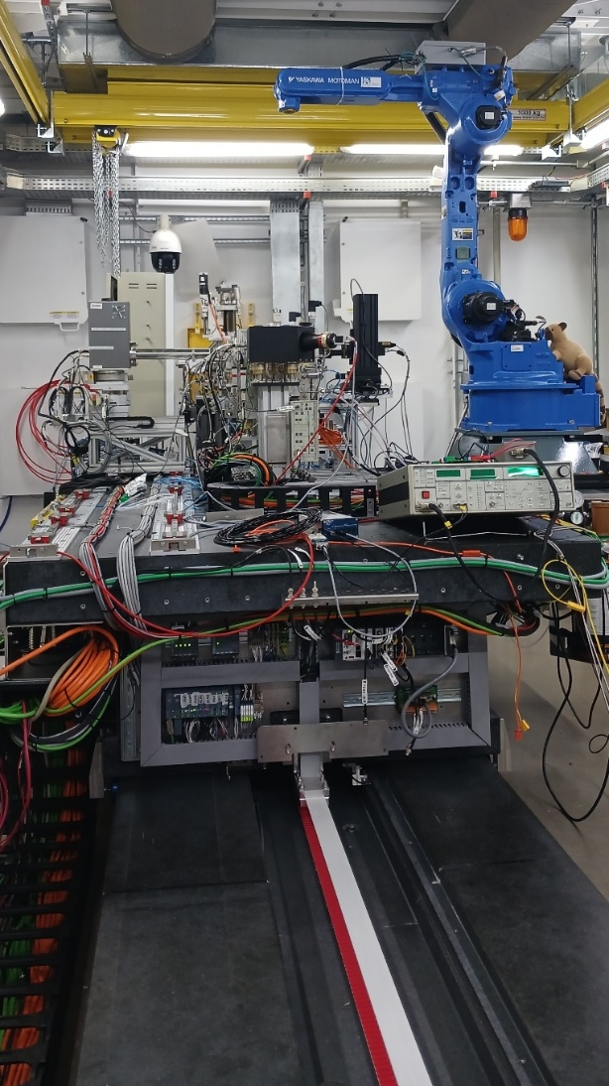
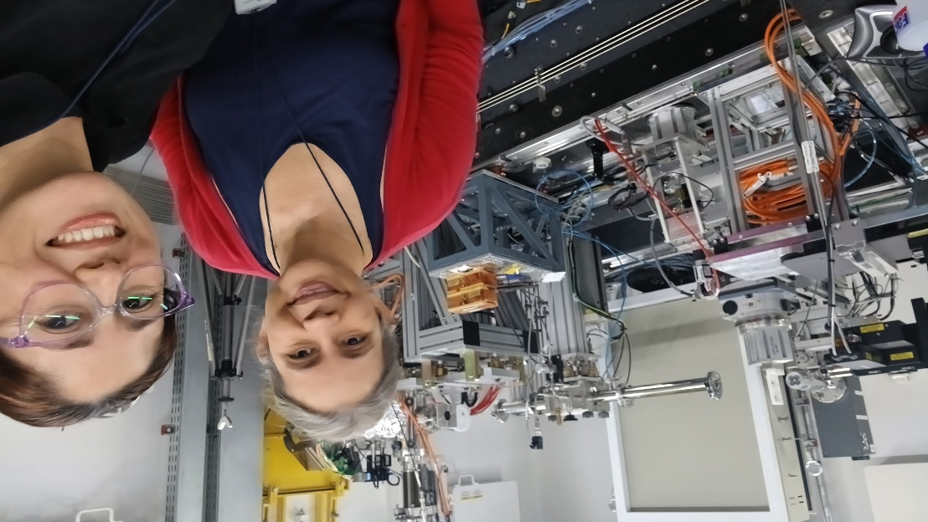
International training under the LAAAMP FAST program
4- Adjust the ionization chambers according to the gases required
5- Adjust the coordinate system for both the table and the sample position
6-Adapt the conditions of the measure

Slide 5
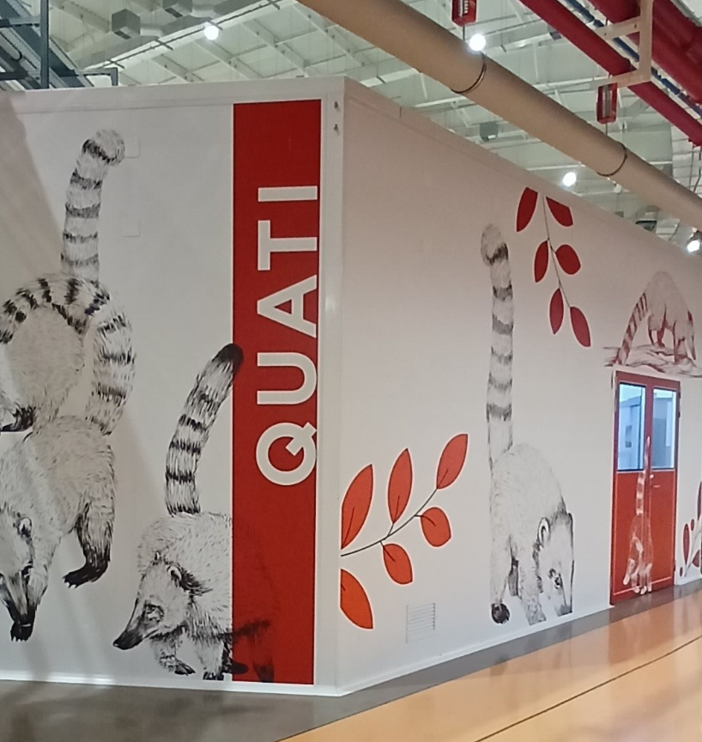
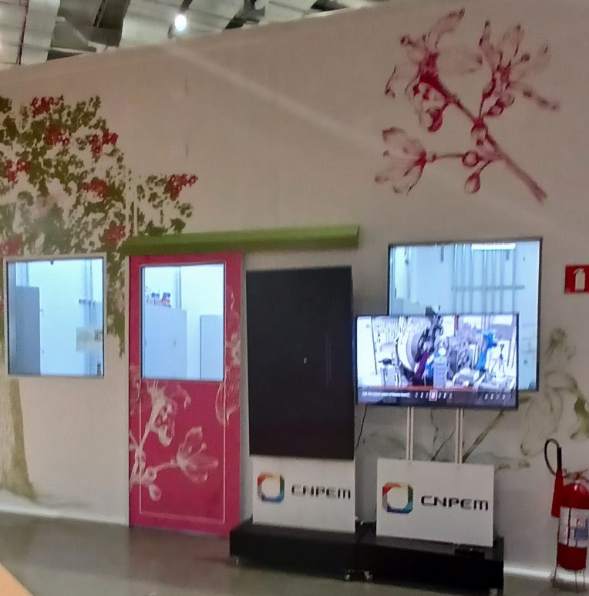
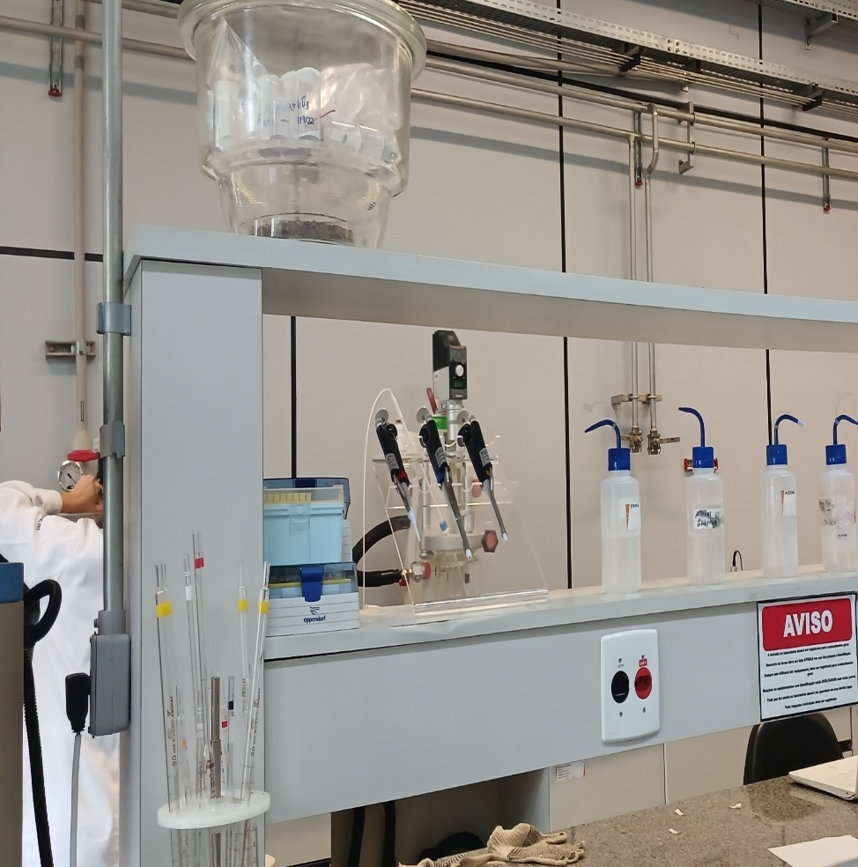
International training under the LAAAMP FAST program
Training in sample preparation
QUATI
We were trained in the chemistry laboratory for the samples to be analyzed at the quati beamline
PAINEIRA
We were trained to prepare samples that will be measured using X-ray diffraction
LNANO- Ceramics Laboratory
We were trained to prepare samples using isostatic pressing for sintering our samples for impedance measurements

Slide 6
International training under the LAAAMP FAST program
Studied Samples
Ce–Zr, Ce–Zr–Ca systems
Ce–Sm–Ca and Ce–Gd–Ca systems
Multiple heat treatments
Reference CeO2

Slide 7
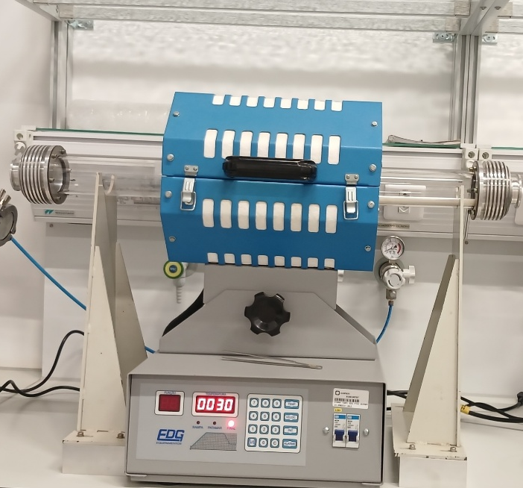
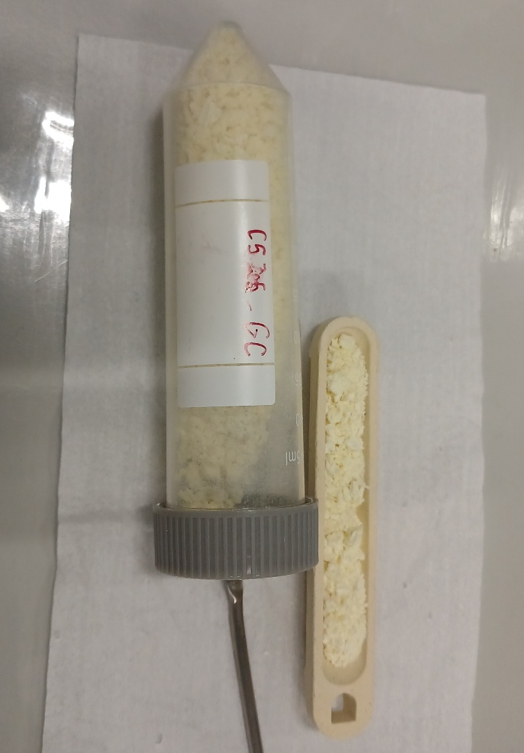
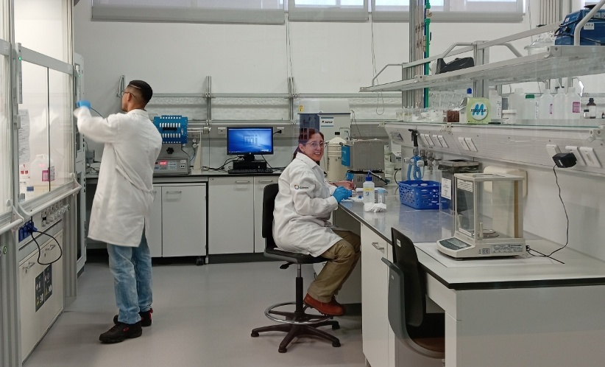
Experiments performed at LNLS (CNPEM, Brazil)
QUATI- Sample preparation
1- Uncalcined samples
2- Heat Treatments
- Calcination at 500, 800 and 1000 °C
- Heating rate: 5 °C/min
- Plateau: 2 hours

Slide 8
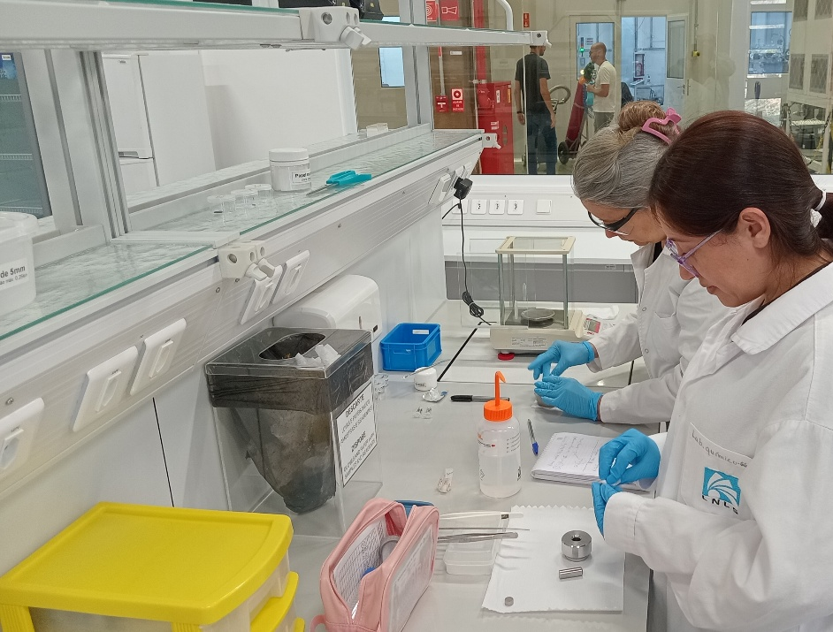
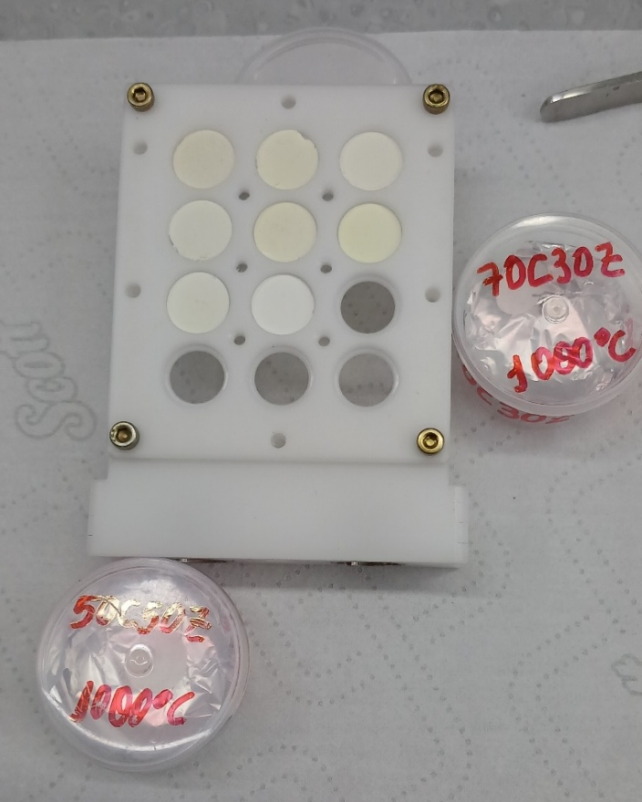
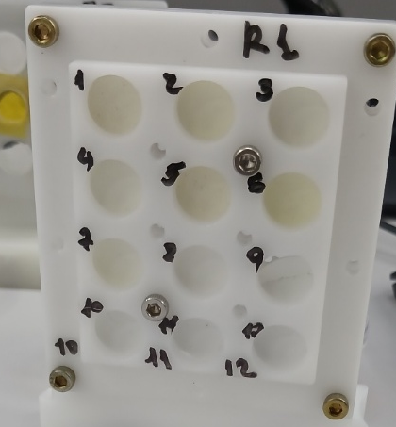
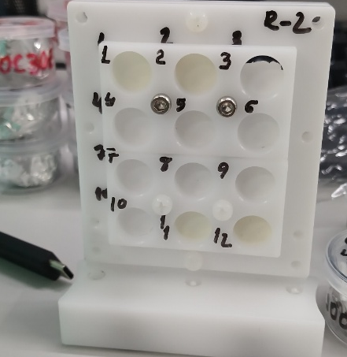
Experiments performed at LNLS (CNPEM, Brazil)
QUATI- Sample preparation
1- Stoichiometric calculations for transmission mode
2- Dilution with boron nitride (BN)
3- Pellet pressing (13 mm diameter, ~1 mm thickness)
4- Avoidance of self-absorption effects
The samples were stored in a desiccator.

Slide 9
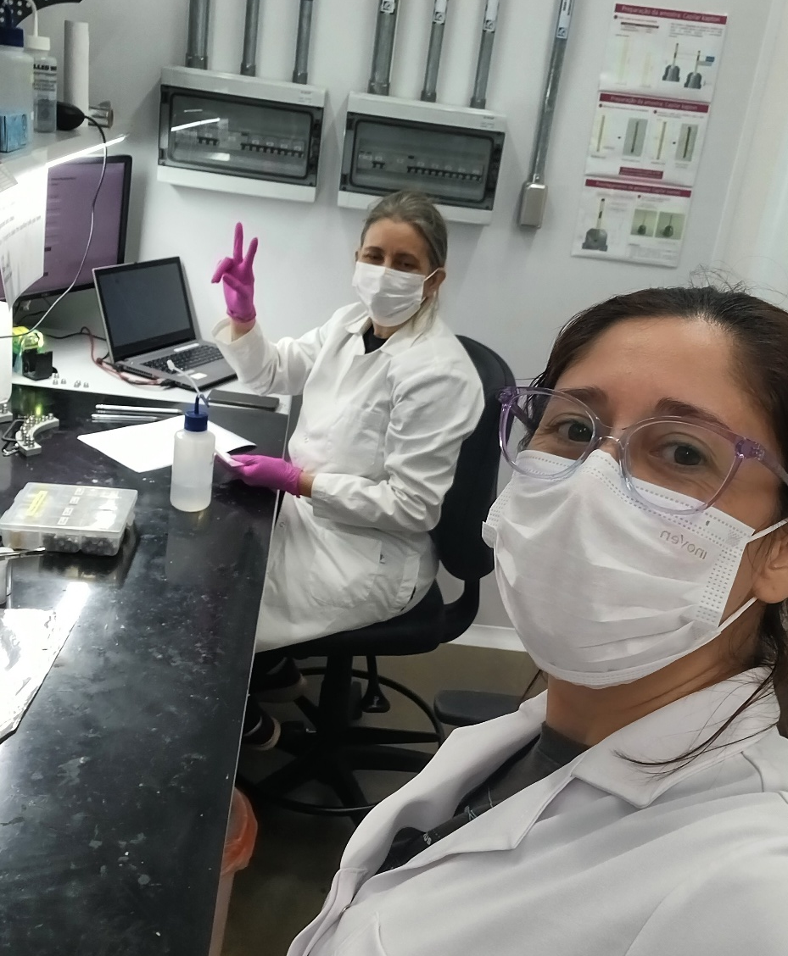
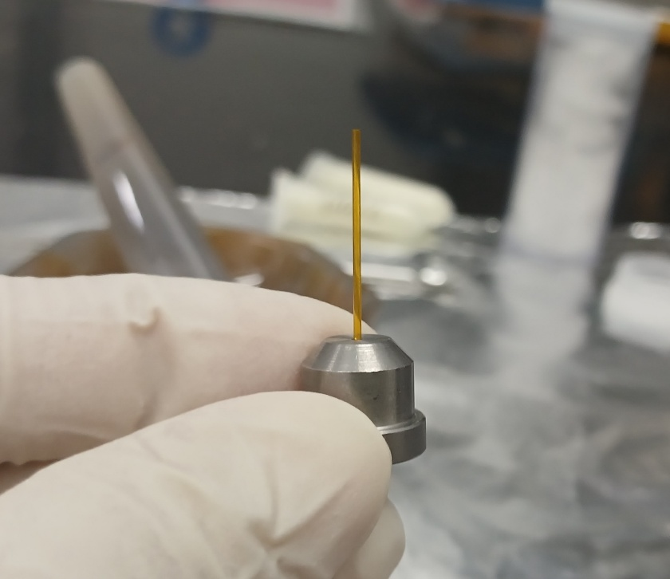
Experiments performed at LNLS (CNPEM, Brazil)
PAINEIRA- Sample preparation
1- Grinding with glass wool
2- Loading into Kapton capillaries (0.7 mm)
3- Sealed and labeled samples
4- Measurements scheduled after visit

Slide 10
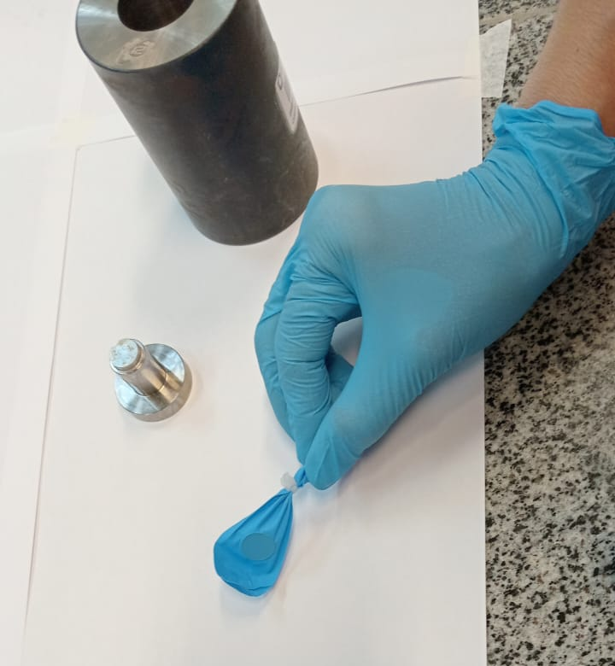
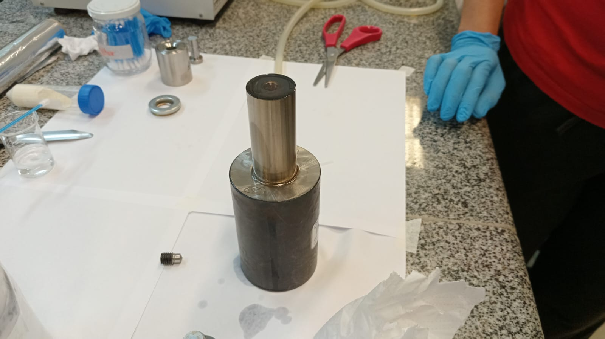
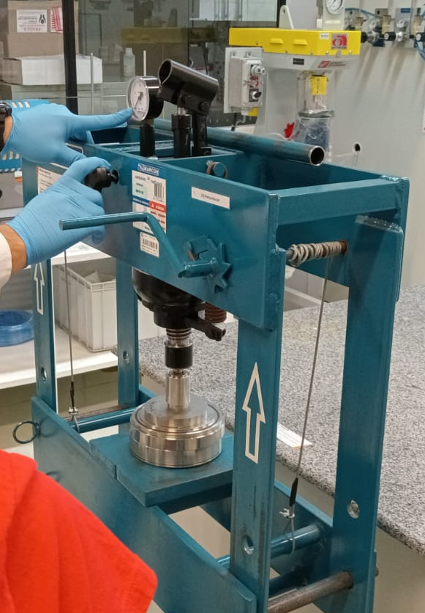
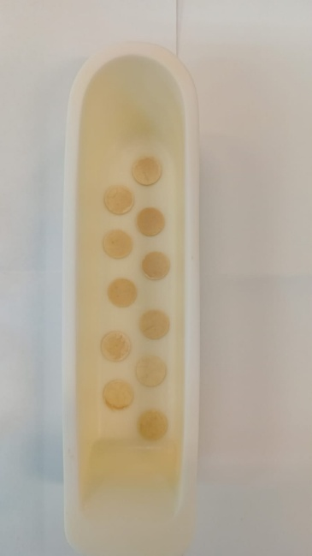
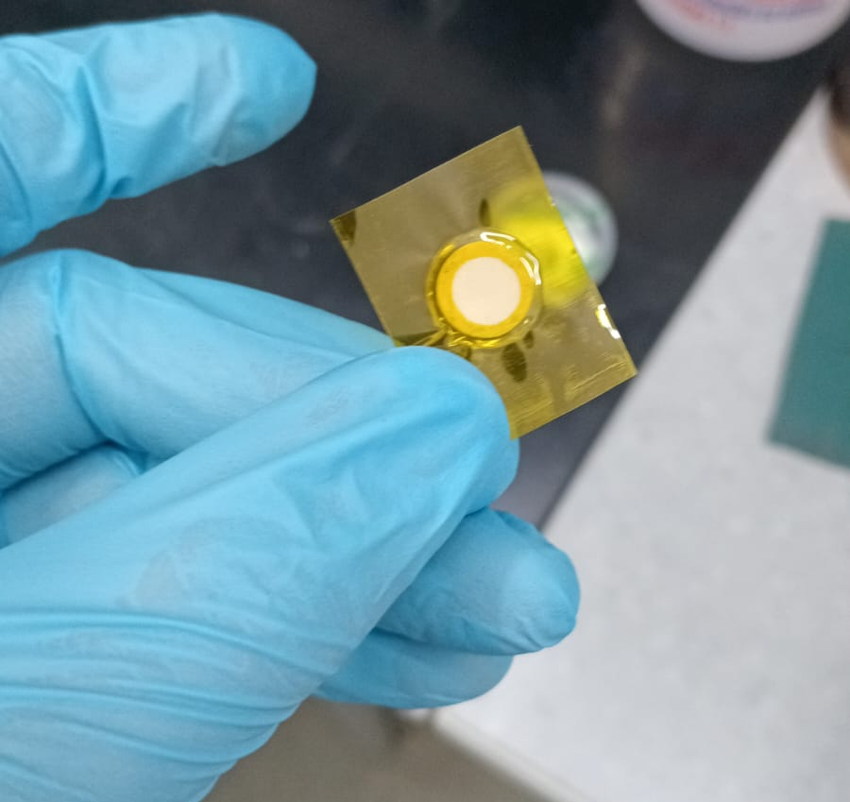
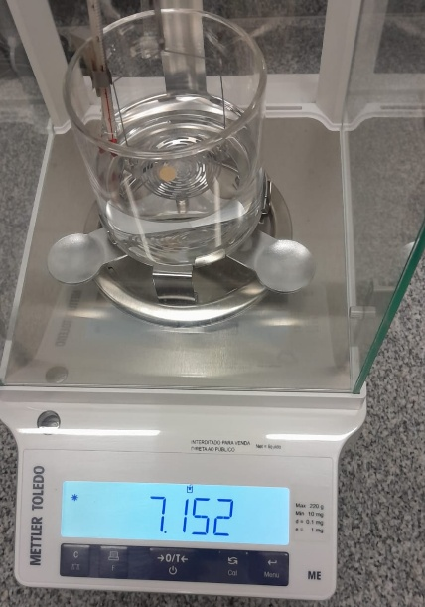
Experiments performed at LNLS (CNPEM, Brazil)
Ceramic laboratory- Sample preparation
Electrolyte Preparation (GDC20)
1- Tablet pressing and isostatic compaction
2- Calcination at 1350 °C
3- Density optimization (5.5–10.8 tons)
4- Density evaluated by Archimedes’ method
4- Preparation for platinum deposition

Slide 11
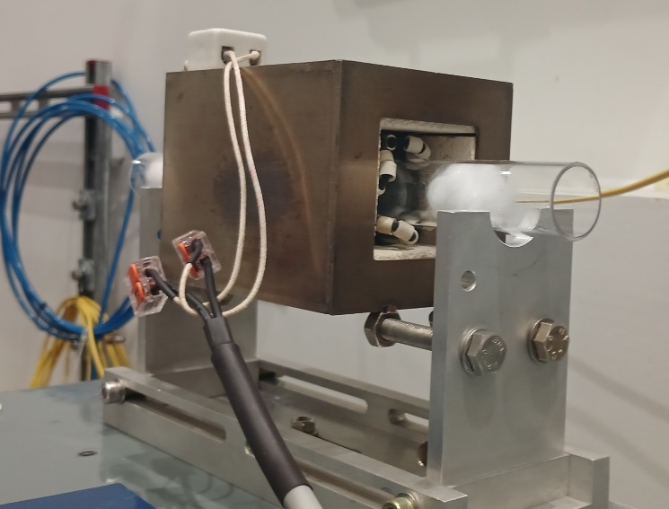
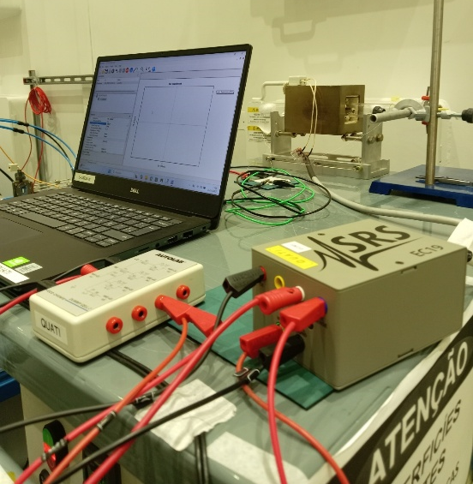
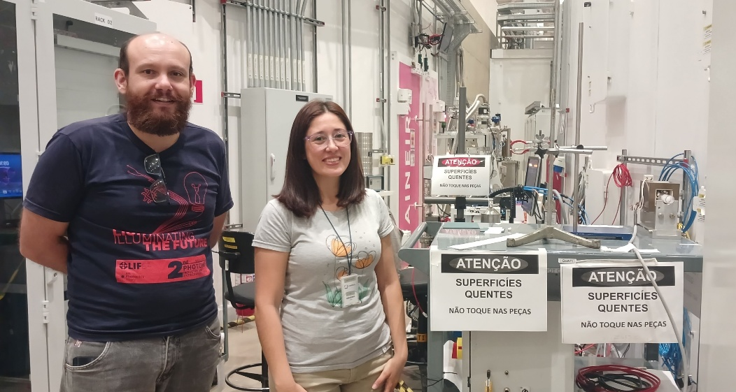
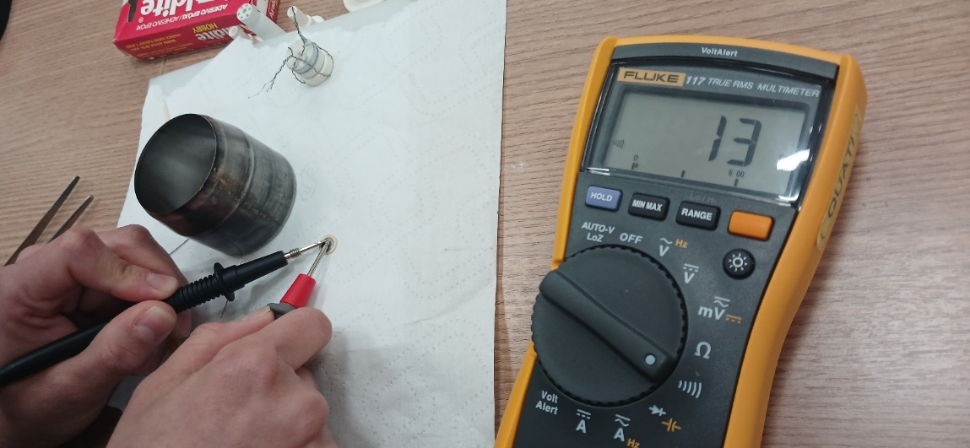
Experiments performed at LNLS (CNPEM, Brazil)
QUATI- mounting for impedance measurements
Measurement configuration
Equipment: Stanford EC301 potentiostat
Software: SRSLabApp
Conditions:
Atmosphere: air
Temperature: 400 °C

Slide 12
QUATI beamline (XAS) and Paineira beamline (XRD)
QUATI Beamline Configuration
Transmission mode geometry
PAINEIRA
Three ionization chambers
Gas mixtures optimized for each edge
Energy calibration using reference foils
The samples prepared for Paineira will be measured in high resolution, and this has been scheduled for January 2026.

Slide 13
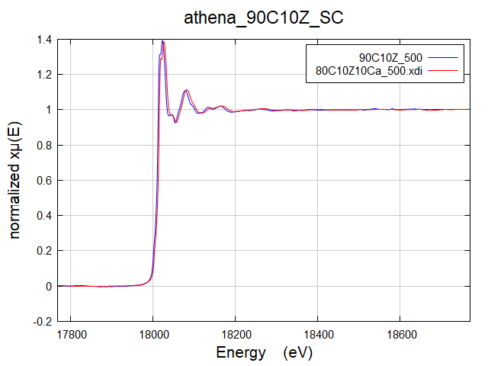
QUATI beamline (XAS)
Zr K-edge preliminary results
Ca doping increases local disorder around Zr
Decrease in Zr–O peak amplitude
Higher Debye–Waller factor (σ²)
Zr oxidation state remains +4

Slide 14
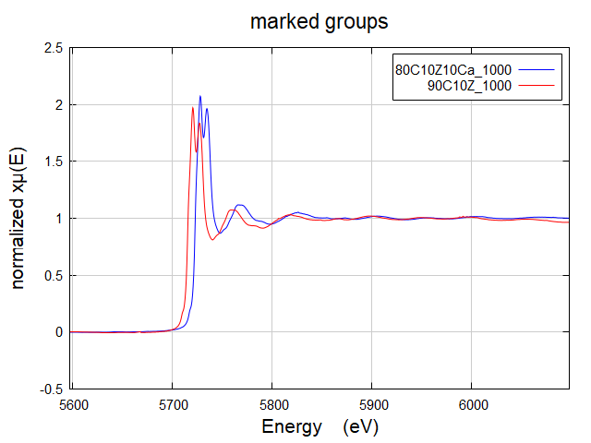
QUATI beamline (XAS)
Ce L3-edge preliminary results
Predominance of Ce4+ in undoped samples
Increase of Ce3+ component with Ca doping
Charge compensation via oxygen vacancies
Mixed valence behavior observed

Slide 15
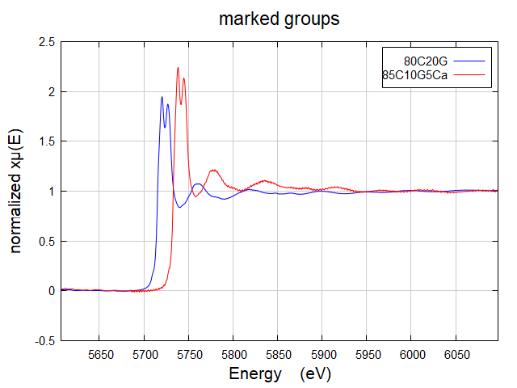
QUATI beamline (XAS)
Effect of Sm and Gd Doping
Increased local structural disorder
Mixed Ce3+/Ce4+ states depending on composition
Impact on redox and transport properties

Slide 16
Training in experimental design, beamline configuration and safety procedures
Practical experience in operating the beamline, sample preparation, and data acquisition
Basis for future beamtime proposals
Capacity building in synchrotron techniques for Paraguay

Slide 17
Concluding remarks
Hands-on training in synchrotron techniques
XAS revealed dopant-induced disorder and valence changes
Optimized sample preparation protocols
Strengthened synchrotron research capacity in Paraguay

Slide 18



Thank you for your attention
celes.aquino@fpuna.edu.py

