Slide 1
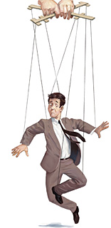
Bell inequalities…
From curiosity to security
Exploring the limits of secure communication
Artur Ekert

Slide 2
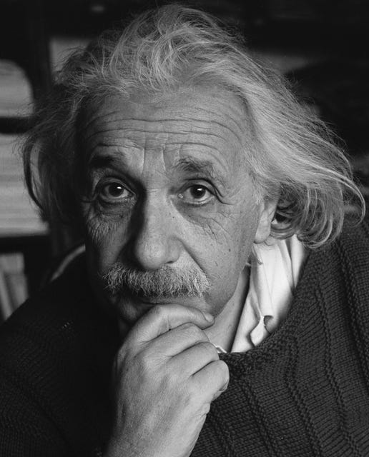
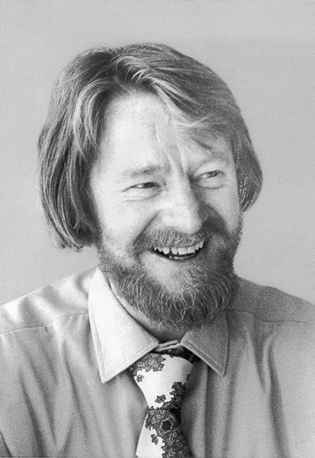
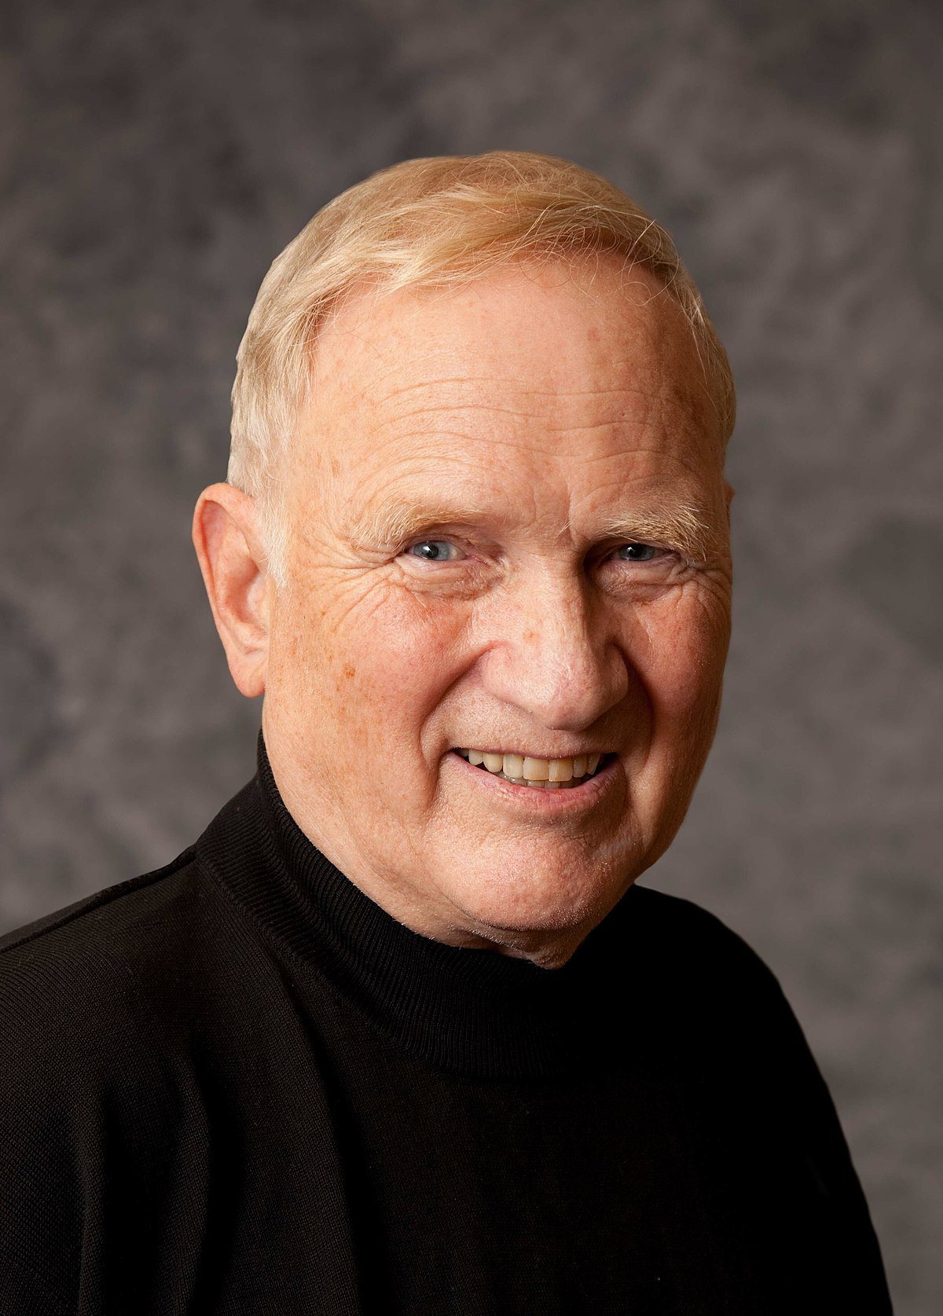
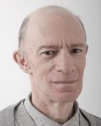
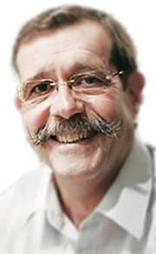
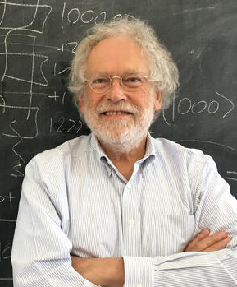
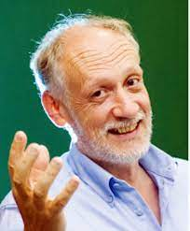
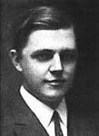
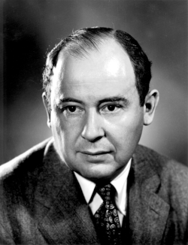
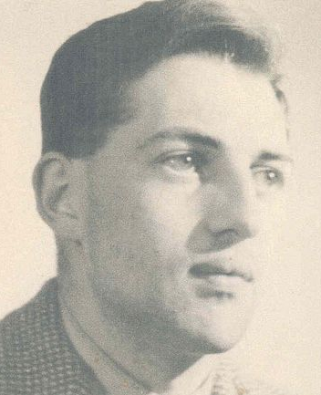
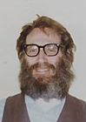
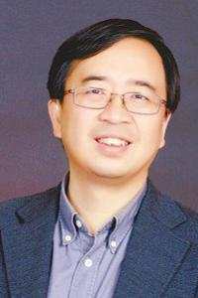
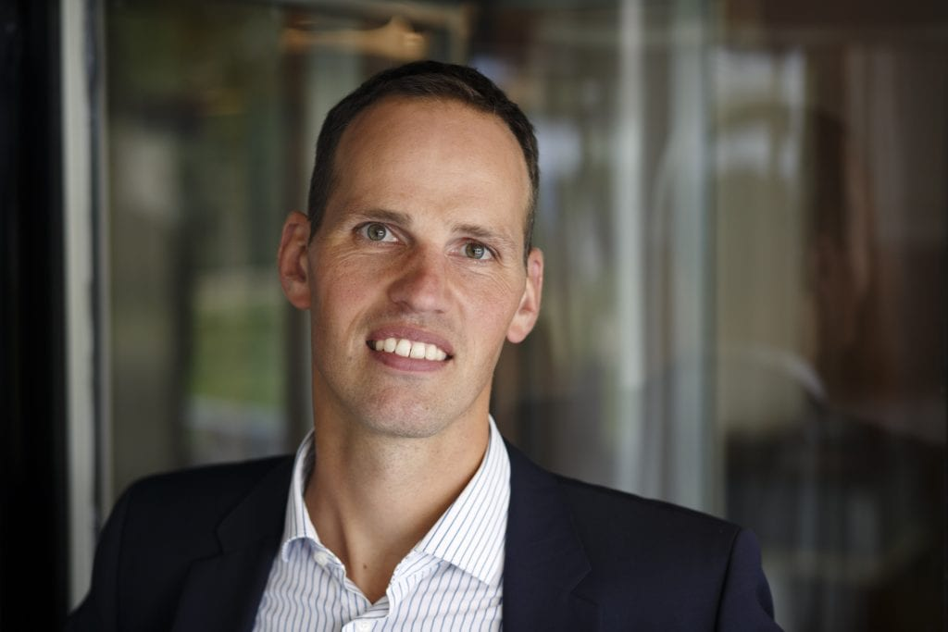
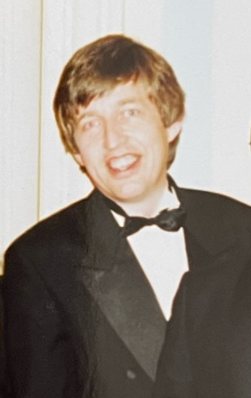
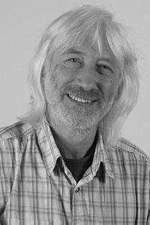
Two narratives
1935
1964
1972
1980
1982
CURIOSITY
1918
1950
1970
1980
E91
Gilbert Vernam
James Ellis
Stephen Wiesner
SECURITY
BB84

Slide 3
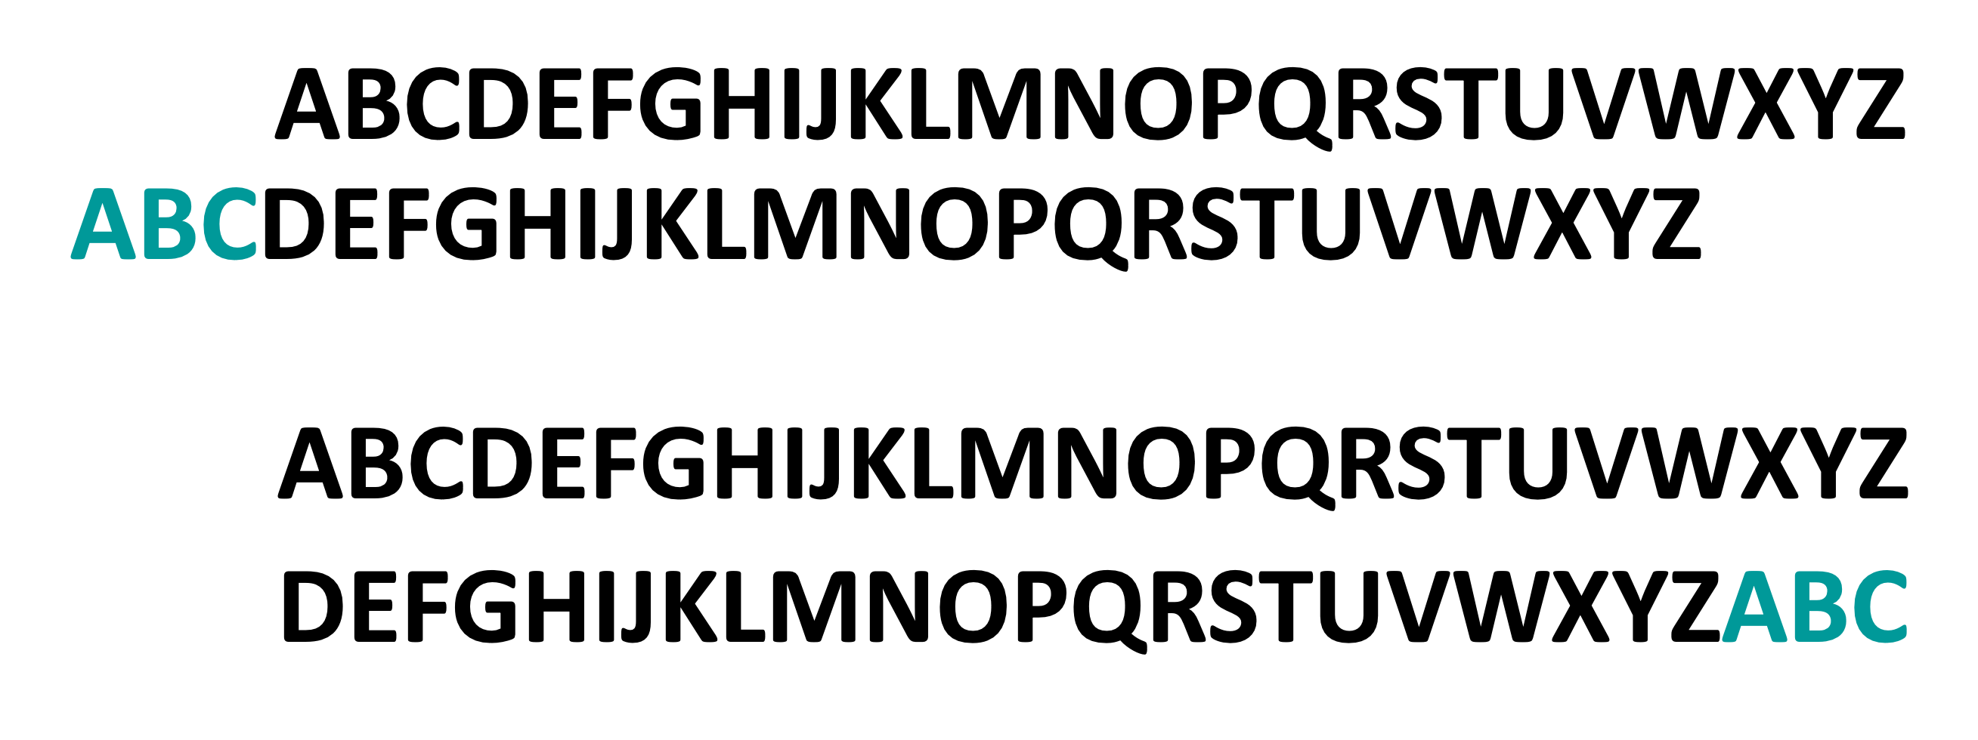
Basic techniques
PERMUTATIONS
SCYTALE (400 BC)
SUBSTITUTIONS
CAESAR (50 BC)
A T T A C K T O M O R R O W
D W W D F N W R P R U U R Z

Slide 4
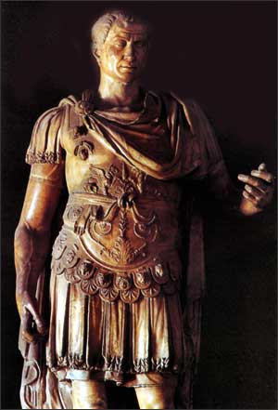
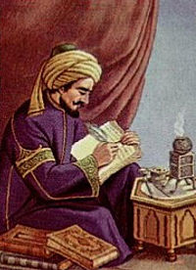
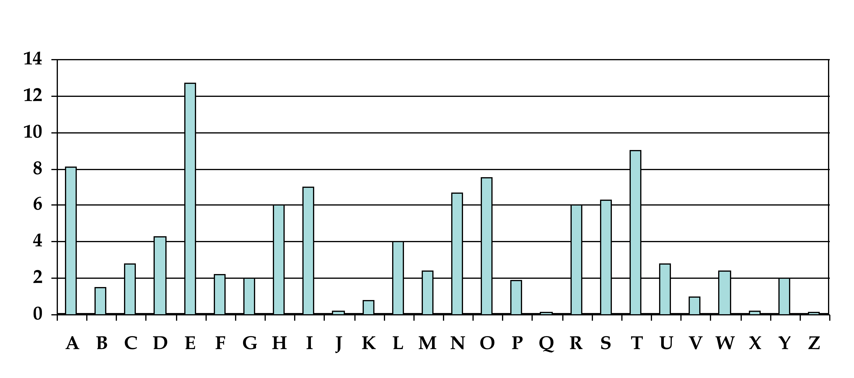
Code-makers versus code-breakers
Julius Caesar
(100-44 BC)
Al Kindi
(800-873)
ABCDEFGHIJKLMNOPQRSTUVWXYZ
NWDEAPYFGTIJUKLMOZQRSBVCXH
SUBSTITUTIONS

Slide 5
Counterexamples - Lipograms
That's right - this is a lipogram - a book, paragraph or similar thing in writing
that fails to contain a symbol, particularly that symbol fifth in rank out of 26
(amidst 'd' and 'f') and which stands for a vocalic sound such as that in 'kiwi'.
I won't bring it up right now, to avoid spoiling it…
The most famous lipogram: Georges Perec, La Disparition (1969) 85000 words without the letter e:
Tout avait l'air normal, mais tout s'affirmait faux. Tout avait l'air normal, d'abord, puis surgissait l'inhumain, l'affolant. Il aurait voulu savoir où s'articulait l'association qui l'unissait au roman : sur son tapis, assaillant à tout
instant son imagination, …
English translator, Gilbert Adair, in A Void, succeeded in avoiding the letter e as well
Gottlob Burmann (1737-1805) R-LESS POETRY. An obsessive dislike for the letter r; wrote 130 poems without using that letter, he also omitted the letter r from his daily conversation for 17 years…

Slide 6
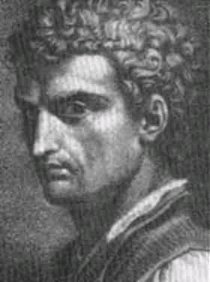
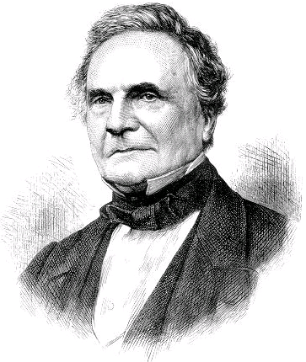
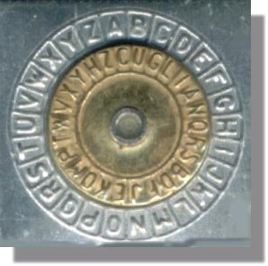
Polyalphabetic ciphers
CODEMAKERS
CODEBREAKERS
Leone Battista Alberti (1404-1472)
Alberti’s encryption disk
Charles Babbage
(1791-1871)
Johannes Trithemius
(1462-1516)
Blaise de Vigenere
(1523-1596)
Sequence of substitutions e.g.
7, 14, 19
Plaintext: S E L L
Cryptogram: Z S E S

Slide 7
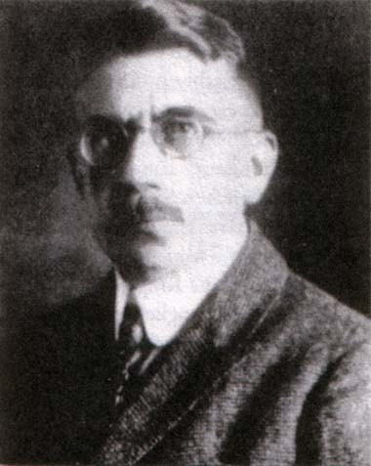
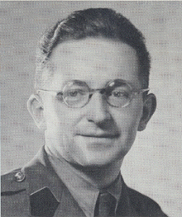
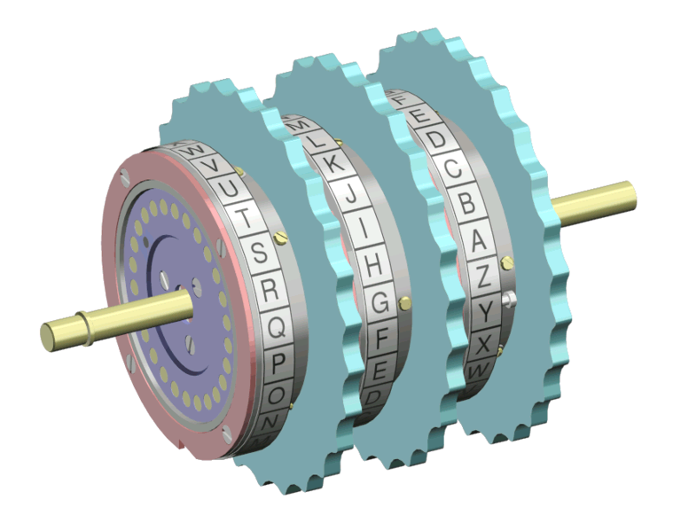
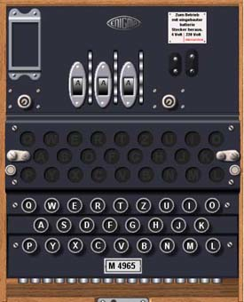
From Alberti’s disk to rotor machines
CODEMAKERS
CODEBREAKERS
Arthur Scherbius
(1878-1929)
Marian Rejewski
(1905-1980)

Slide 8
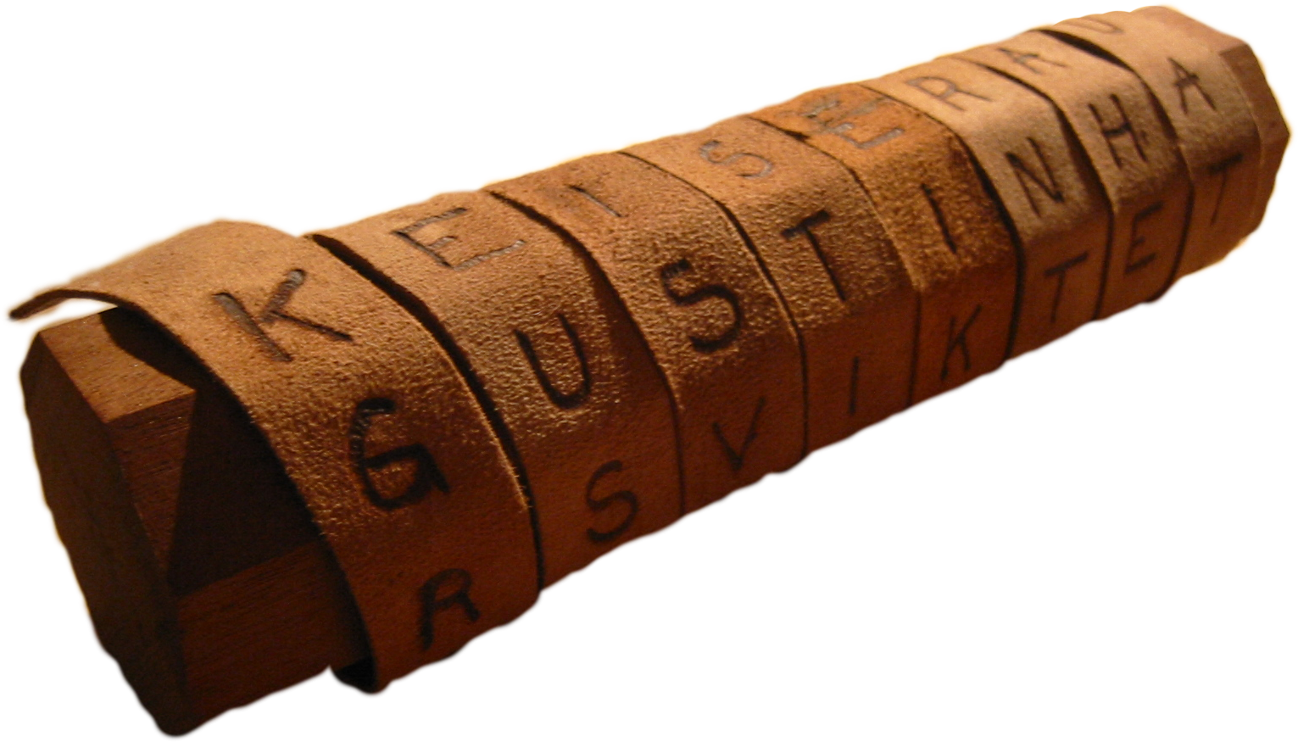
Is there a perfect cipher ?
SCYTALE 400BC
ALBERTI’S DISC 1450
ENIGMA 1940

Slide 9
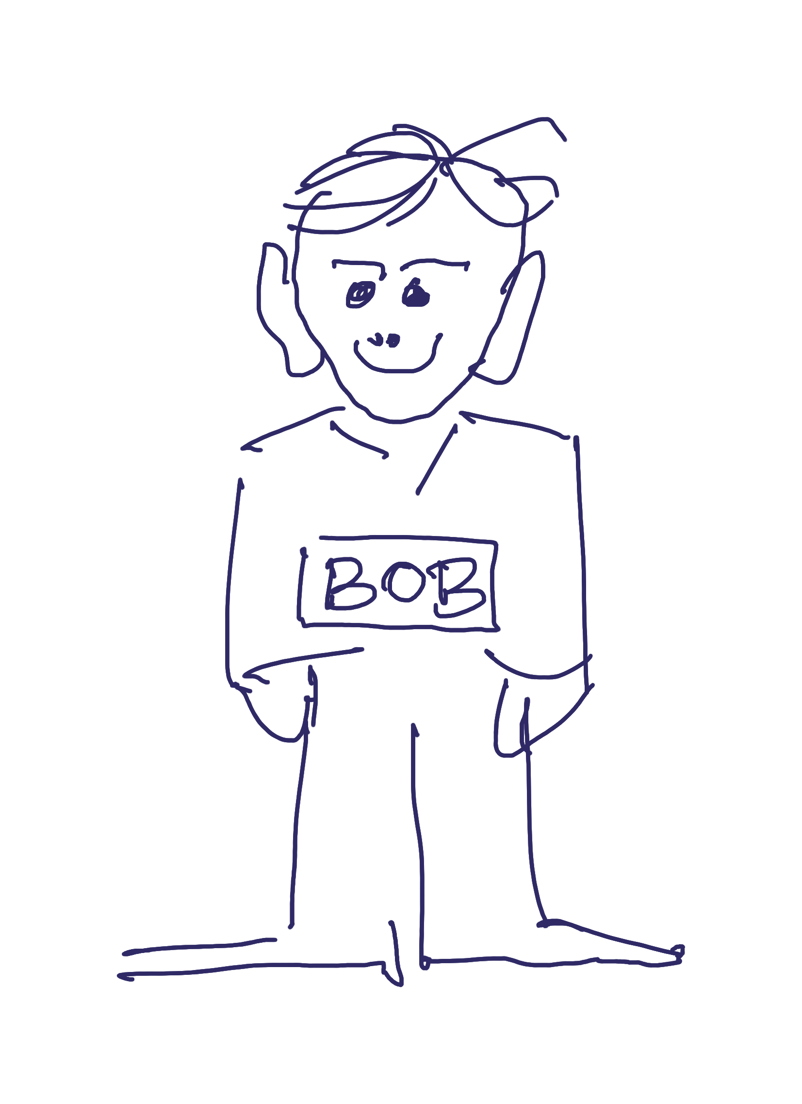
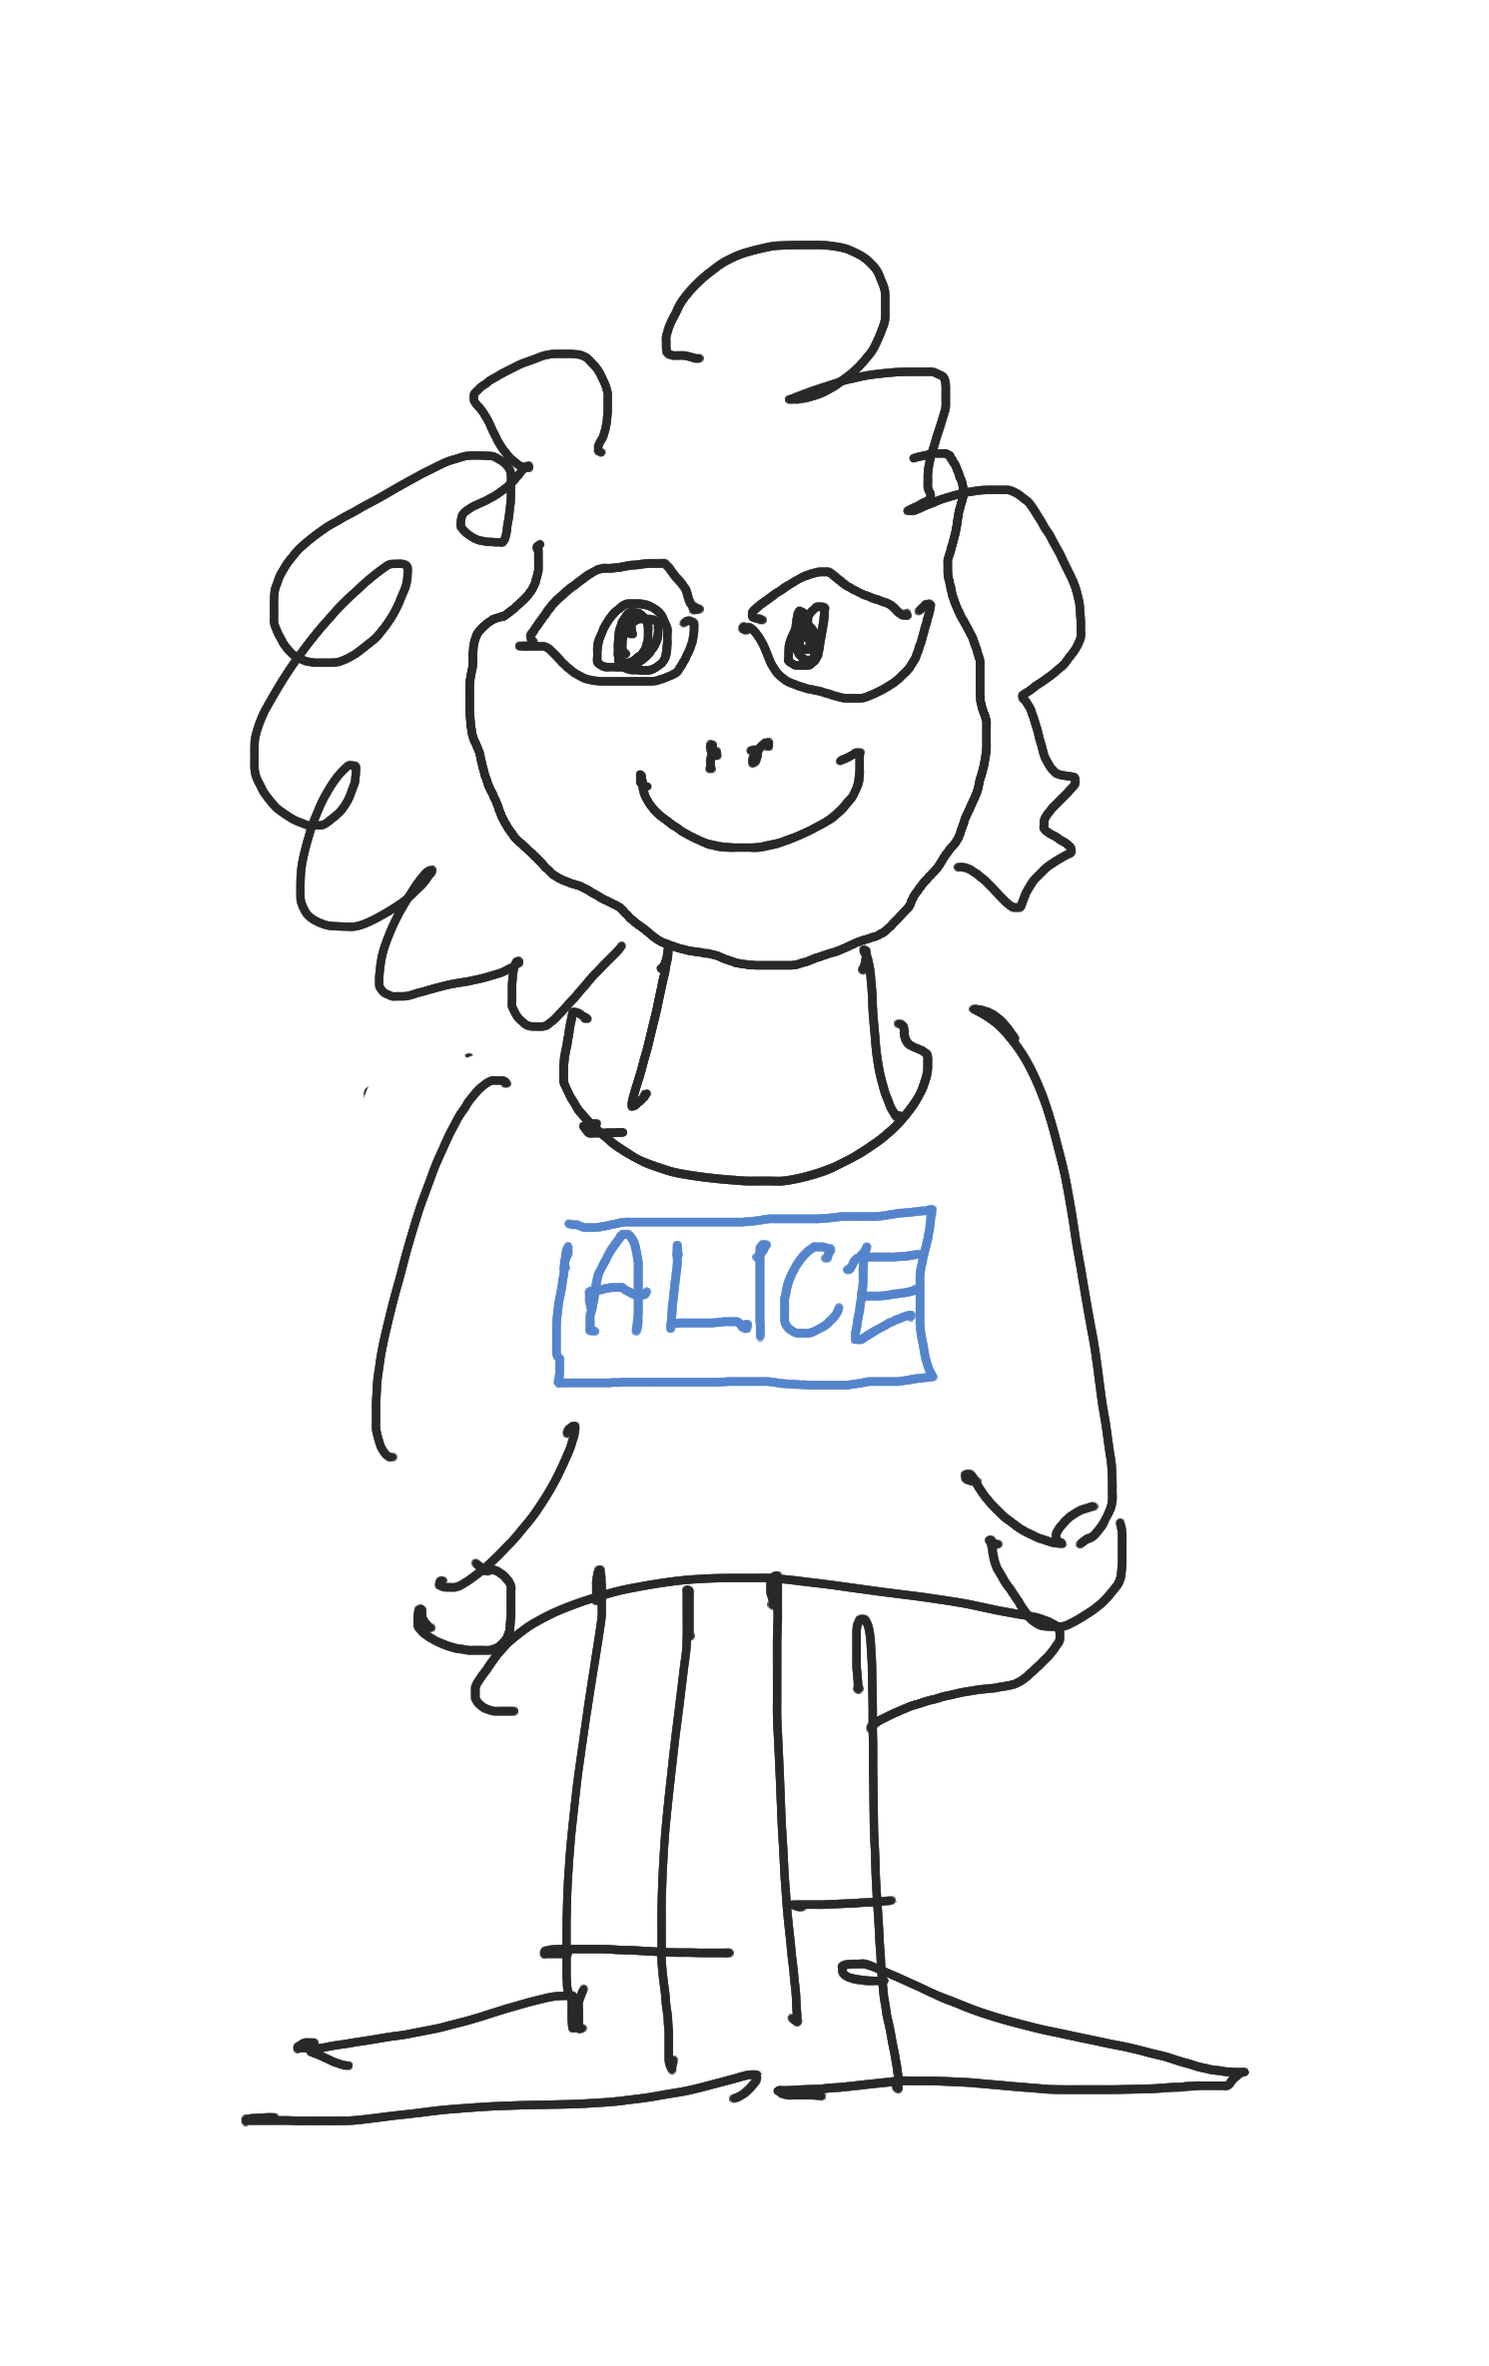
One-time pad
message
key
cryptogram
0 | 1 | 1 | 1 | 0 | 1 | 0 | 0 | 1 | 1
0 | 1 | 0 | 1 | 1 | 1 | 0 | 0 | 1 | 0
0 | 0 | 1 | 0 | 1 | 0 | 0 | 0 | 0 | 1
0 | 0 | 1 | 0 | 1 | 0 | 0 | 0 | 0 | 1
0 | 0 | 1 | 0 | 1 | 0 | 0 | 0 | 0 | 1
0 | 0 | 1 | 0 | 1 | 0 | 0 | 0 | 0 | 1
0 | 1 | 0 | 1 | 1 | 1 | 0 | 0 | 1 | 0
0 | 1 | 1 | 1 | 0 | 1 | 0 | 0 | 1 | 1
cryptogram
key
message
KEY DISTRIBUTION PROBLEM

Slide 10
Is there a perfect cipher ?
SCYTALE 400BC
ALBERTI’S DISC 1450
ENIGMA 1940

Slide 11
One-time pad
message
key
cryptogram
0 | 1 | 1 | 1 | 0 | 1 | 0 | 0 | 1 | 1
0 | 1 | 0 | 1 | 1 | 1 | 0 | 0 | 1 | 0
0 | 0 | 1 | 0 | 1 | 0 | 0 | 0 | 0 | 1
0 | 0 | 1 | 0 | 1 | 0 | 0 | 0 | 0 | 1
0 | 0 | 1 | 0 | 1 | 0 | 0 | 0 | 0 | 1
0 | 0 | 1 | 0 | 1 | 0 | 0 | 0 | 0 | 1
0 | 1 | 0 | 1 | 1 | 1 | 0 | 0 | 1 | 0
0 | 1 | 1 | 1 | 0 | 1 | 0 | 0 | 1 | 1
cryptogram
key
message
KEY DISTRIBUTION PROBLEM

Slide 12

But how much does Eve know?

Slide 13
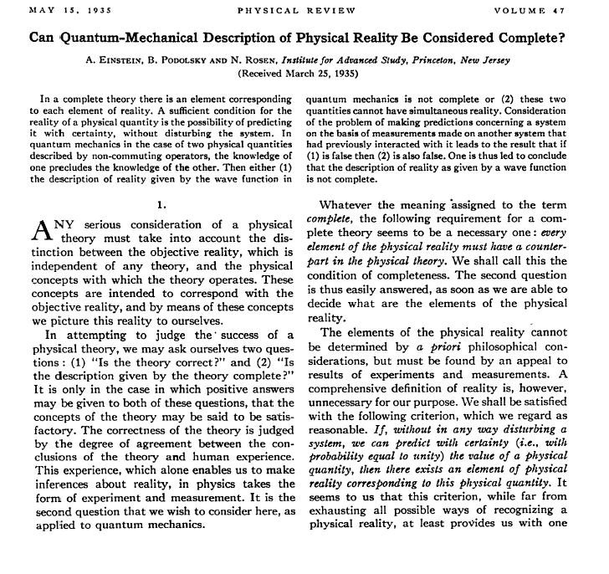
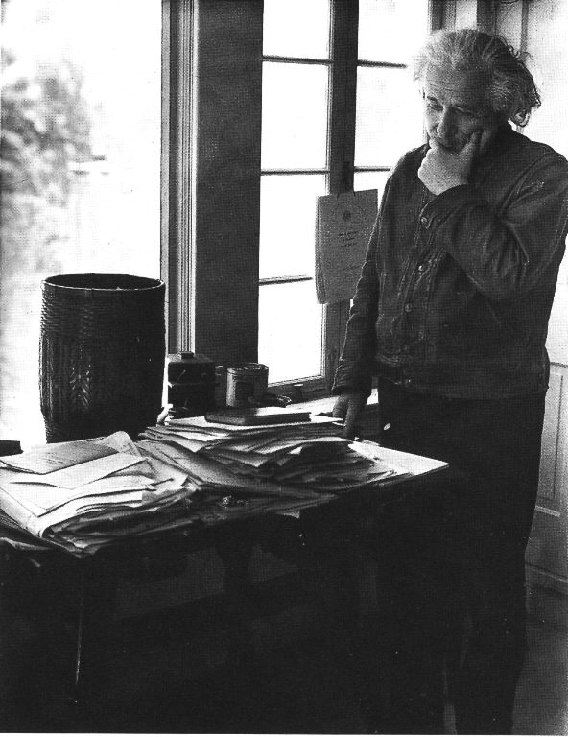
Is the quantum description complete?

Slide 14








Quantum randomness seems to be different
Identical preparations
different outcomes

Slide 15
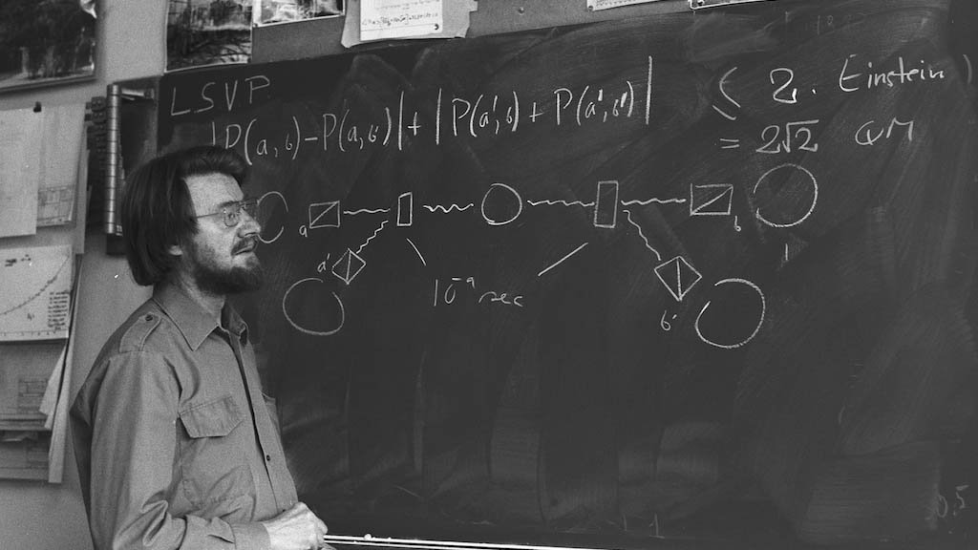
Enter John Bell
Hmmmmmm…..
It is a testable proposition…
year 1964

Slide 16
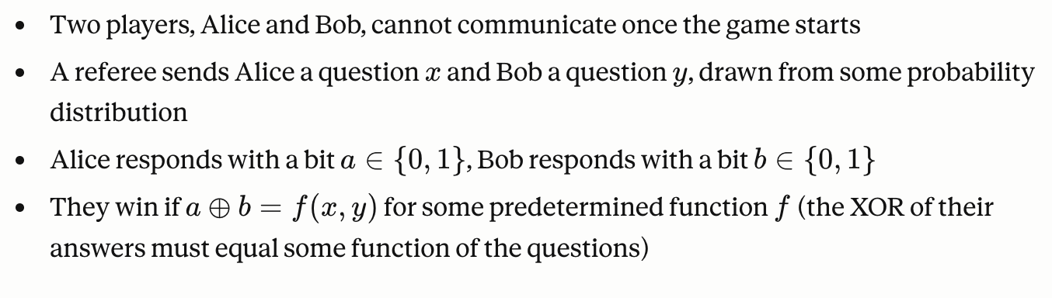
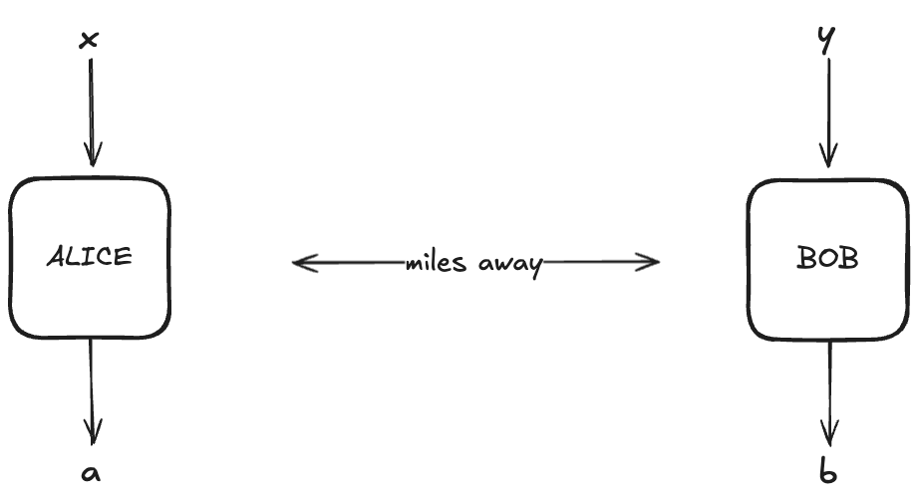

Bell’s games…

Slide 17
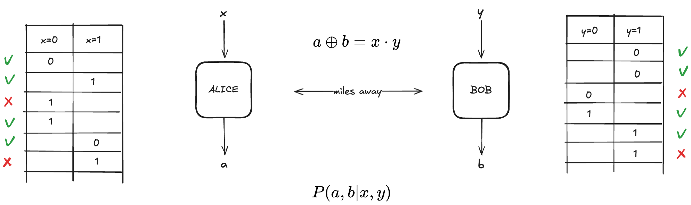
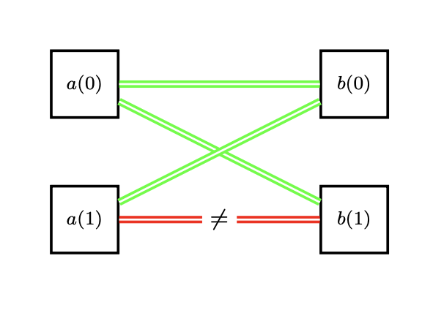
CHSH challege…

Slide 18


LHV boxes

Slide 19
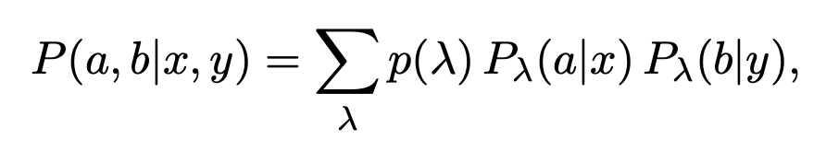
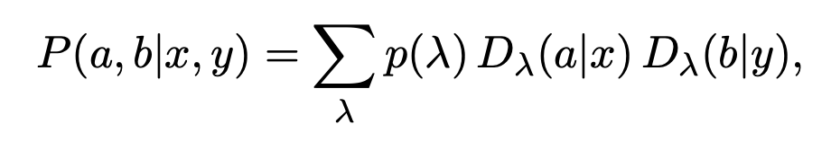
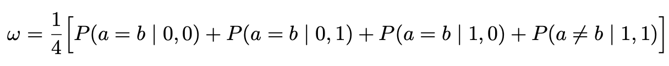
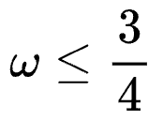
Einstein’s dream
we can push local randomness to instructions
success rate in the CHSH game

Slide 20

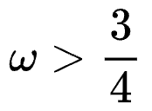
Einstein’s nightmare
success rate in the CHSH game

Slide 21
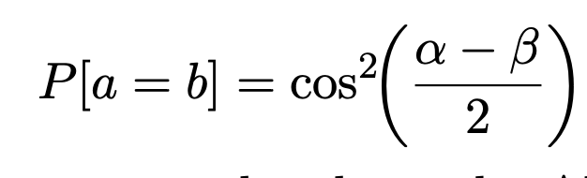
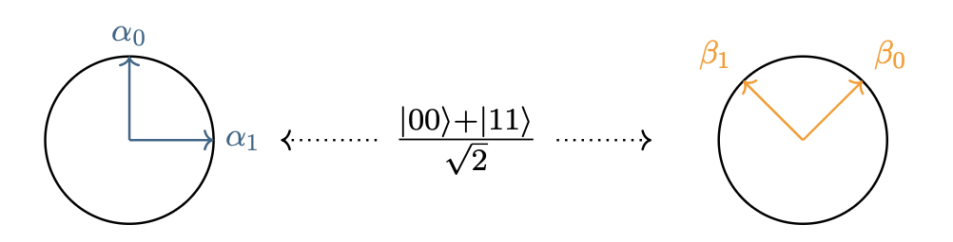
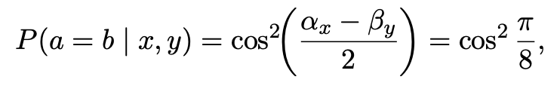
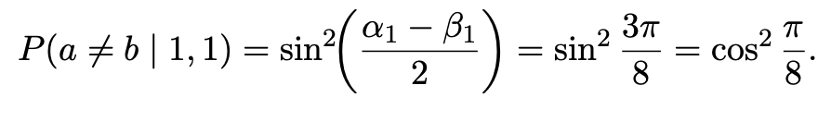
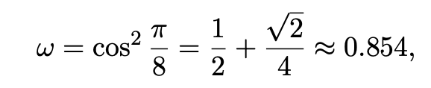
Einstein’s nightmare

Slide 22
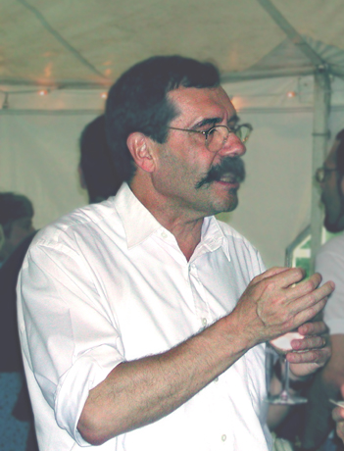
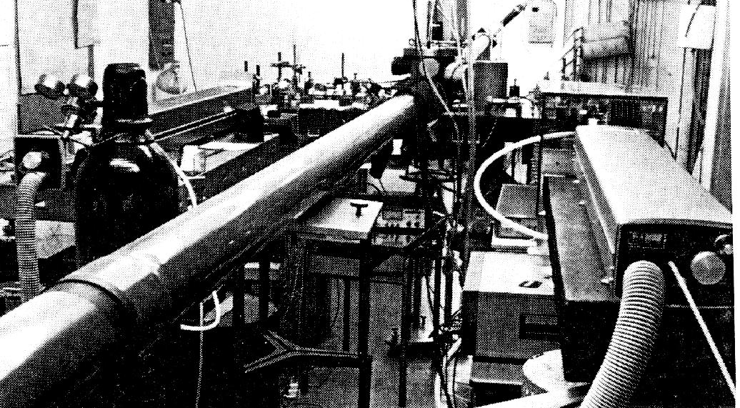

Alain Aspect and his quantum magic
Et voilà!
$$S>2$$
Institut d’Optique d’Orsay (1982)

Slide 23
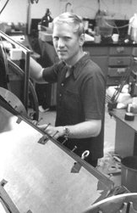
Violated, it is official (Nobel 2022)
Alain Aspect
Jianwei Pan
Ronald Hansen
John Clauser
Nicolas Gisin
Anton Zeilinger
Paul Tapster
John Rarity

Slide 24
Bringing the two narratives together
1932
1935
1964
1972
1982
CURIOSITY
1918
1950
1970
1980
E91
Gilbert Vernam
James Ellis
Stephen Wiesner
SECURITY
BB84

Slide 25

But how much does ANYONE know?

Slide 26


Alice and Bob know how much Eve knows
Eve’s knowledge
CHSH violation

Slide 27



DRA Malvern 1991
Parametric down conversion
Entangled photons
Optical fibers
Polarizing filters
& photodetectors
DRA MALVERN – OXFORD 1991
Polarizing filters
& photodetectors

Slide 28


Then a commercial proposition…
67 km
Installed multiplexed quantum
channel for commercial users.
Nicolas Gisin – IDQ -- 2001

Slide 29
and finally…
Jianwei Pan and his team

Slide 30





Quantum cryptography
Device independence etc

Slide 31

Secure as long as…
Eve controls the source and distributes the key
Alice and Bob control and trust devices in their labs
Alice and Bob have “free will” and can choose their observables
Alice’s and Bob’s labs are secure - no information leaks

Slide 32

A bit of convex geometry

Slide 33



LHV vs Quantum…

Slide 34


Extreme is good…. (sometimes)
SELF TESTING – UNIQUE UP TO LOCAL ISOMETRIES

Slide 35

At the mercy of Eve
Eve controls the source and distributes the key
Alice and Bob control and trust devices in their labs
Alice and Bob have “free will” and can choose their observables
Alice’s and Bob’s labs are secure - no information leaks

Slide 36




EAT…
Entropy Accumulation Theorem (EAT) allows us to reduce arbitrary strategies to i.i.d. strategies and enables simple device-​independent security proofs.
Rotem Arnon-​Friedman, Renato Renner and Thomas Vidick.
Simple and tight device-​independent security proofs.
SIAM J. Comput. 48, 181 (2019). doi: 10.1137/18M1174726

Slide 37



Practical challenges
Security ?
Long distance ?
Applications!
Overcome the security loopholes caused by imperfection of realistic devices
Overcome the exponential photon loss in fiber:
For 1000 km commercial fiber, even with a perfect 10 GHz single-photon source and ideal detectors, only 0.3 photon can be transmitted on average per century!
F. Xu, X. Ma, Q. Zhang, H. –K. Lo, J. –W. Pan, Rev. Mod. Phys. 92, 025002 (2020)

Slide 38



It works…
95884 secret bits in 8 hours
It is because of quantum crypto
we still keep testing Bell
inequalities…

Slide 39

Most recent…

Slide 40

Demonstrating DI-QKD using entangled atoms separated by 100 km ( 2025)
Long-lived Rubidium atom quantum memories
Telecom quantum frequency conversion
Single-photon interference entanglement
Optical tweezers
Collision blockade loading
Push up measurement
780 to 1315 nm
from 3 dB/km to 0.3 dB/km
Single-photon interference entanglement
Telecom quantum frequency conversion
Long-coherence atom quantum memories
Asymptotic key rate remains positive beyond 100 km
1.2 million entanglement events over ~624 hours at 11 km with finite-size secure
Notes:
We also have demonstrated DI-QKD using entangled atoms separated by 100 km. We achieved heralded entanglement with a fidelity of over 0.9 over 100 kilometers of fiber. Based on the long-distance and high fidelity entanglement, the asymptotic key rate of DI-QKD remains positive beyond 100 km, showing the feasibility of long-distance DI-QKD. At shorter distances, around 11 km, we performed a finite-size security analysis, confirming that secure key generation is practical under realistic conditions. This work brings us closer to loophole-free DI-QKD. However, a practical quantum repeater might still need 5-10 years.

Slide 41

End of worries?

Slide 42
Superdeterminism
In the superdeterministic world the notion of privacy or security makes no sense…

Slide 43


LHV boxes

Slide 44

Refute LHV

Slide 45

Few numbers…

Slide 46

Herallded entanglement…

Slide 47

Everett, Everett, Everett,…
SECURITY AND RANDOMNESS IN THE MULTIVERSE

Slide 48


It is not true that nothing changes in Oxford
From Oxford in 1991…
…to Oxford 2021

