Slide 1
REVIEW OF ELECTRODYNAMICS
Imrana Ashraf Zahid
Quaid-i-Azam University Islamabad Pakistan
Preparatory School to Winter College on Optics: 8rd February - 12th February 2016

Slide 2
Layout
Electrostatic : Revisited
Magneto- static : Revisited
Introduction to Maxwell’s equations
Maxwell’s correction to Ampere’s law
Maxwell’s equations in vacuum
Maxwell’s equations inside matter

Slide 3
Nomenclature
E = Electric field
D = Electric displacement
B = Magnetic flux density
H = Auxiliary field
ρ= Charge density
j = Current density
μ₀ (permeability of free space) = 4π×10⁻⁷T-m/A
ε₀ (permittivity of free space) = 8.854×10⁻¹²N-m²/ C²
c (speed of light) = 2.99792458×10⁸ m/s

Slide 4
Introduction
Electrostatics
Electrostatic field : Stationary charges produce electric fields that are constant in time. The theory of static charges is called electrostatics.
Stationary charges Constant Electric field;

Slide 5
Electrostatic :Revisited
Coulombs Law
Test Charge
Source Charge
Permittivity of free space

Slide 6
The Electric Field
Field Point
- the electric field of the source charges.
Physically E(P) Is force per unit charge exerted on a test charge placed at P.

Slide 7
The Electric Field
is the line charge density
is the surface charge density

Slide 8
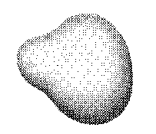
The Electric Field
is the volume charge density

Slide 9
Electric Potential
The work done in moving a test charge Q in an electric field from point P₁ to P₂ with a constant speed.
negative sign - work done is against the field.
For any distribution of fixed charges.
The electrostatic field is conservative

Slide 10
Electric Potential
Stokes’s Theorem gives
where V is Scalar Potential
The work done in moving a charge Q from infinity to a point P₂ where potential is V
V = Work per unit charge
= Volts = joules/Coulomb

Slide 11
Electric Potential
Field due to a single point charge q at origin

Slide 12
Gauss’s Law
Differential form of Gauss’s Law
Poisson’s Equation
Laplace's Equation

Slide 13
Electrostatic Fields in Matter
Matter: Solids, liquids, gases, metal, wood and glasses - behave differently in electric field.
Two Large Classes of Matter
Conductors
Dielectric
Conductors: Unlimited supply of free charges.
Dielectrics:
Charges are attached to specific atoms or molecules- No free charges.
Only possible motion - minute displacement of positive and negative charges in opposite direction.
Large fields- pull the atom apart completely (ionizing it).

Slide 14
Polarization
A dielectric with charge displacements or induced dipole moment is said to be polarized.
E=0
+
E
+
+
+
+
+
+
Induced Dipole Moment
The constant of proportionality α is called the atomic polarizability
P ≡ dipole moment per unit volume

Slide 15
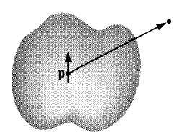
The Field of a Polarized Object
Potential of single dipole p is
Potential due to dipoles in the dielectric

Slide 16
The Field of a Polarized Object
Bound charges at surface
Bound charges in volume
The total field is field due to bound charges plus due to free charges

Slide 17
Gauss’s law in Dielectric
Effect of polarization is to produce accumulations of bound charges.
The total charge density
From Gauss’s law
-Free charges enclosed
Displacement vector

Slide 18
Magneto-statics
Magnetostatics
Steady current produce magnetic fields that are constant in time. The theory of constant current is called magnetostatics.
Steady currents Constant Magnetic field;

Slide 19
Magnetic Forces
Lorentz Force
The magnetic force on a segment of current carrying wire is

Slide 20
Equation of Continuity
The current crossing a surface S can be written as
Charge is conserved whatever flows out must come at the expense of that remaining inside - outward flow decreases the charge left in v
This is called equation of continuity

Slide 21
Equation of Continuity
In Magnetostatic steady currents flow in the wire and its magnitude I must be the same along the line- otherwise charge would be pilling up some where and current can not be maintained indefinitely.
In Magnetostatic and equation of continuity
Steady Currents: The flow of charges that has been going on forever - never increasing - never decreasing.

Slide 22
Magnetostatic and Current Distributions
Biot and Savart Law
is an element of length.
vector from source to point p.
Permeability of free space.
Unit of B = N/Am = Tesla (T)

Slide 23
Biot and Savart Law for Surface and Volume Currents
For Surface Currents
For Volume Currents

Slide 24
Force between two parallel wires
The magnetic field at (2) due to current I₁ is
Points inside
Magnetic force law

Slide 25
Force between two parallel wires
The total force is infinite but force per unit length is
If currents are anti-parallel the force is repulsive.

Slide 26
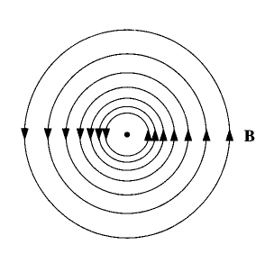
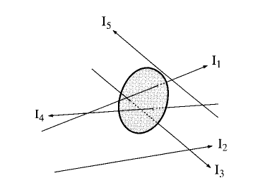
Straight line currents
The current is out of the page
The integral of B around a circular path of radius s, centered at the wire is
For bundle of straight wires. Wire that passes through loop contributes only.
Applying Stokes’ theorem

Slide 27
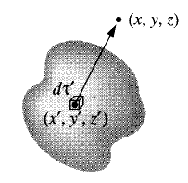
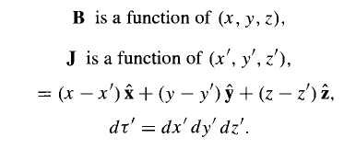
Divergence and Curl of B
Biot-Savart law for the general case of a volume current reads
and

Slide 28
Ampere’s Law
Ampere’s law
Integral form of Ampere’s law
Using Stokes’ theorem

Slide 29
Vector Potential
The basic differential law of Magnetostatics
B is curl of some vector field called vector potential
Coulomb’s gauge

Slide 30
Magnetostatic Field in Matter
Magnetic fields- due to electrical charges in motion.
Examine a magnet on atomic scale we would find tiny currents.
Two reasons for atomic currents.
Electrons orbiting around nuclei.
Electrons spinning on their axes.
Current loops form magnetic dipoles - they cancel each other due to random orientation of the atoms.
Under an applied Magnetic field- a net alignment of - magnetic dipole occurs- and medium becomes magnetically polarized or magnetized

Slide 31
Magnetization
If m is the average magnetic dipole moment per unit atom and N is the number of atoms per unit volume, the magnetization is define as
or

Slide 32
Magnetic Materials
Paramagnetic Materials
The materials having magnetization parallel to B are called paramagnets.
Diamagnetic Materials
The elementary moment are not permanent but are induced according to Faraday’s law of induction. In these materials magnetization is opposite to B.
Ferromagnetic Materials
Have large magnetization due to electron spin. Elementary moments are aligned in form of groups called domain

Slide 33
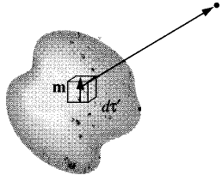
The Field of Magnetized Object
Using the vector potential of current loop
Bound Surface Current
Bound Volume Current

Slide 34
Ampere’s Law in Magnetized Material
where
Integral form

Slide 35
Faraday’s Law of Induction
Faraday’s Law - a changing -magnetic flux through circuit induces an electromotive force around the circuit.
Є – Induced emf
E – Induced electric field intensity
Differential form of Faraday’s law

Slide 36
Faraday’s Law of Induction
Induced Electric field intensity in terms of vector potential
V – Scalar potential
For steady currents
Induced emf in a system moving in a changing magnetic field

Slide 37
Maxwell’s Equations
Imrana Ashraf Zahid
Quaid-i-Azam University Islamabad Pakistan
Preparatory School to Winter College on Optics: 8rd February - 12th February 2016

Slide 38
Introduction to Maxwell’s Equation
In electrodynamics Maxwell’s equations are a set of four equations, that describes the behavior of both the electric and magnetic fields as well as their interaction with matter
Maxwell’s four equations express
How electric charges produce electric field (Gauss’s law)
The absence of magnetic monopoles
How currents and changing electric fields produces magnetic fields (Ampere’s law)
How changing magnetic fields produces electric fields (Faraday’s law of induction)

Slide 39
Electrodynamics Before Maxwell
Gauss’s Law
No name
Faraday’s Law
Ampere’s Law

Slide 40
Electrodynamics Before Maxwell
Apply divergence to (iii)
Apply divergence to (iv)

Slide 41
Electrodynamics Before Maxwell
The left hand side is zero, because divergence of a curl is zero.
The right hand side is zero for steady currents i.e.,
In electrodynamics from conservation of charge
is constant at any point in space which is wrong.

Slide 42
Maxwell’s Correction to Ampere’s Law
Consider Gauss’s Law
Displacement current
This result along with Ampere’s law and the conservation of charge equation suggest that there are actually two sources of magnetic field.
The current density and displacement current.

Slide 43
Maxwell’s Correction to Ampere’s Law
Amperes law with Maxwell’s correction

Slide 44
General Form of Maxwell’s Equations
Differential Form
Integral Form

Slide 45
Maxwell’s Equations in vacuum
The vacuum is a linear, homogeneous, isotropic and dispersion less medium
Since there is no current or electric charge is present in the vacuum, hence Maxwell’s equations reads as
These equations have a simple solution in terms of traveling sinusoidal waves, with the electric and magnetic fields direction orthogonal to each other and the direction of travel

Slide 46
Maxwell’s Equations Inside Matter
Maxwell’s equations are modified for polarized and magnetized materials. For linear materials the polarization P and magnetization M is given by
And the D and B fields are related to E and H by

Slide 47
Maxwell’s Equations Inside Matter
For polarized materials we have bound charges in addition to free charges
For magnetized materials we have bound currents

Slide 48
Maxwell’s Equations Inside Matter
In electrodynamics any change in the electric polarization involves a flow of bound charges resulting in polarization current J_{P}
Polarization current density is due
to linear motion of charge when the
Electric polarization changes

Slide 49
Maxwell’s Equations Inside Matter
Maxwell’s equations inside matter are written as

Slide 50
Maxwell’s Equations Inside Matter
In non-dispersive, isotropic media ε and µ are time-independent scalars, and Maxwell’s equations reduces to

Slide 51
Maxwell’s Equations Inside Matter
In uniform (homogeneous) medium ε and µ are independent of position- Maxwell’s equations reads as
Generally, ε and µ can be rank-2 tensor (3X3 matrices) describing anisotropic materials.

Slide 52
Potential Formulation of Electrodynamics 1
In electrostatic
Putting this in Faraday’s Law
In electrodynamics
But

Slide 53
Potential Formulation of Electrodynamics 2
and from
Explain Maxwell’s ii and iii Equations

Slide 54
Potential Formulation of Electrodynamics 3
Now consider Maxwell’s i and iv equations
As
Gauss’s Law
This replaces Poisson’s Equation in electrodynamics

Slide 55
Potential Formulation of Electrodynamics 4
Now consider Ampere’s Law:
with:
and:

Slide 56
Potential Formulation of Electrodynamics 5
Using vector identity:
Re-arranging:
These equation carry all information in Maxwell’s Equations

Slide 57
Potential Formulation of Electrodynamics 6
Four Maxwell’s equations reduced to two equations using potential formulation.
Potentials V and A are not uniquely defined by above equations.

Slide 58
Coulomb’s and Lorentz Gauges
Coulomb Gauge
Using this we get
It is Poisson’s equation, setting
we get
Scalar potential is easy to calculate in Coulomb’s gauge but vector potential is difficult to calculate

Slide 59
Coulomb’s Gauge
The differential equations for V and A in Coulombs gauge reads

Slide 60
Lorentz Gauge
The Lorentz gauge:
This is design to eliminate the middle term in eqn. for A
And equation for V will become

Slide 61
Lorentz Gauge
The Lorentz gauge treats V and A on equal footing. The same differential operator
called the d’Alembertian
and

Slide 62
Maxwell’s Equations and Boundary Conditions at Interfaces in Matter
Maxwell’s equations in integral form:
Gauss’ Law:

Slide 63
Maxwell’s Equations and Boundary Conditions at Interfaces in Matter
No Magnetic Monopoles:
Faraday’s Law:

Slide 64
Maxwell’s Equations and Boundary Conditions at Interfaces in Matter
Ampere’s Law:
Auxiliary Relation:

Slide 65
Maxwell’s Equations and Boundary Conditions at Interfaces in Matter
1) Apply the integral form of Gauss’ Law at a dielectric interface/boundary using infinitesimally thin Gaussian pillbox extending slightly into dielectric material on either side of interface:
Gives:
(at interface)

Slide 66
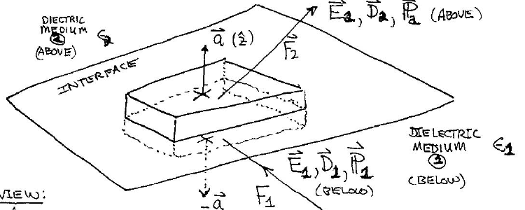
Maxwell’s Equations and Boundary Conditions at Interfaces in Matter

Slide 67
Maxwell’s Equations and Boundary Conditions at Interfaces in Matter
The positive direction is from medium 1 (below) to medium 2 (above)
(at interface)
Likewise:
(at interface)

Slide 68
Maxwell’s Equations and Boundary Conditions at Interfaces in Matter
Similarly, for
(no magnetic monopoles), then at an interface:
(at interface)

Slide 69
Maxwell’s Equations and Boundary Conditions at Interfaces in Matter
3) For Faraday’s Law: EMF,
At interface between two different media, taking a closed contour C of width l extending slightly into the material on either side of interface.

Slide 70
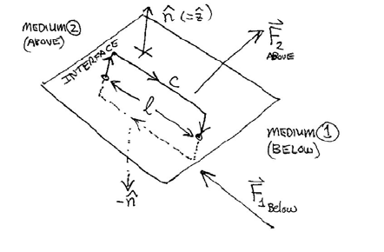
Maxwell’s Equations and Boundary Conditions at Interfaces in Matter
where

Slide 71
Maxwell’s Equations and Boundary Conditions at Interfaces in Matter
(in limit area of contour loop → 0, magnetic flux enclosed → 0)

Slide 72
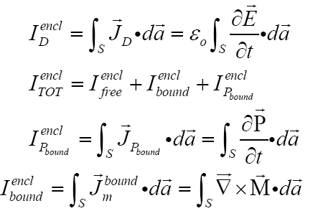
Maxwell’s Equations and Boundary Conditions at Interfaces in Matter
4) Finally, for Ampere’s Law:

Slide 73
Maxwell’s Equations and Boundary Conditions at Interfaces in Matter
Where
= TOTAL current (free + bound + polarization) passing through enclosing Amperian loop contour C
In the limit that the enclosing Amperian loop contour C shrinks to zero height above/below interface- the enclosed area of loop contour → 0,
Then:

Slide 74
Maxwell’s Equations and Boundary Conditions at Interfaces in Matter
Similarly:
If is unit normal/perpendicular to interface, note that is normal/perpendicular to plane of the Amperian loop contour.

Slide 75
Maxwell’s Equations and Boundary Conditions at Interfaces in Matter
In the limit that the enclosing Amperian loop contour C (of width l) shrinks to zero height above/below interface, causing area of enclosed loop contour → 0, then:

