Slide 1
ELECTROMAGNETIC WAVES IN VACUUM
Imrana Ashraf Zahid
Quaid-i-Azam University Islamabad Pakistan
Preparatory School to Winter College on Optics: 8th January-12rd February 2016

Slide 2
ELECTROMAGNETIC WAVES IN VACUUM
THE WAVE EQUATION
In regions of free space (i.e. the vacuum) - where no electric charges - no electric currents and no matter of any kind are present - Maxwell’s equations (in differential form) are:
Set of coupled first-order partial differential equations

Slide 3
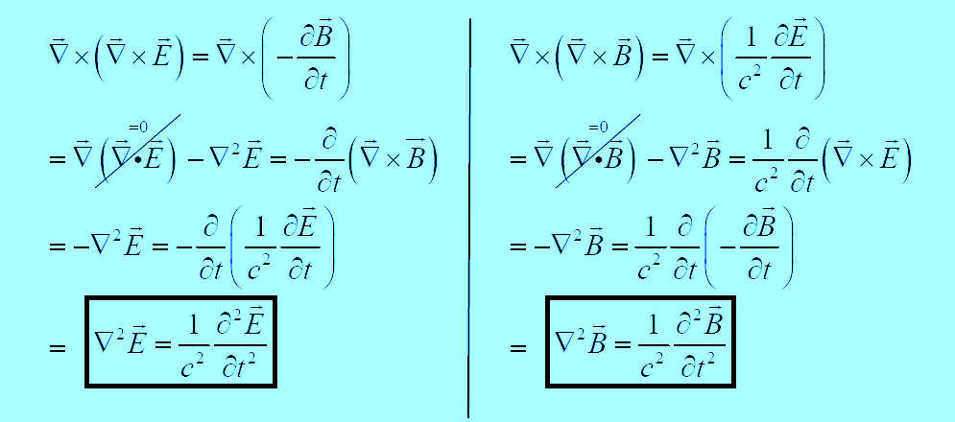
ELECTROMAGNETIC WAVES IN VACUUM ...
We can de-couple Maxwell’s equations -by applying the curl operator to equations 3) and 4):

Slide 4
ELECTROMAGNETIC WAVES IN VACCUM…
These are three-dimensional de-coupled wave equations.
Have exactly the same structure – both are linear, homogeneous, 2nd order differential equations.
Remember that each of the above equations is explicitly dependent on space and time,

Slide 5
ELECTROMAGNETIC WAVES IN VACUUM…
Thus, Maxwell’s equations implies that empty space – the vacuum {which is not empty, at the microscopic scale} – supports the propagation of {macroscopic} electromagnetic waves - which propagate at the speed of light {in vacuum}:

Slide 6
MONOCHROMATIC EM PLANE WAVES
Monochromatic EM plane waves propagating in free space/the vacuum are sinusoidal EM plane waves consisting of a single frequency f , wavelength λ =c f , angular frequency ω = 2π f and wave-number k = 2π /λ . They propagate with speed c= fλ =ω k.
In the visible region of the EM spectrum {~380 nm (violet) ≤ λ ≤ ~ 780 nm (red)}- EM light waves (consisting of real photons) of a given frequency / wavelength are perceived by the human eye as having a specific, single colour.
Single- frequency sinusoidal EM waves are called mono-chromatic.

Slide 7
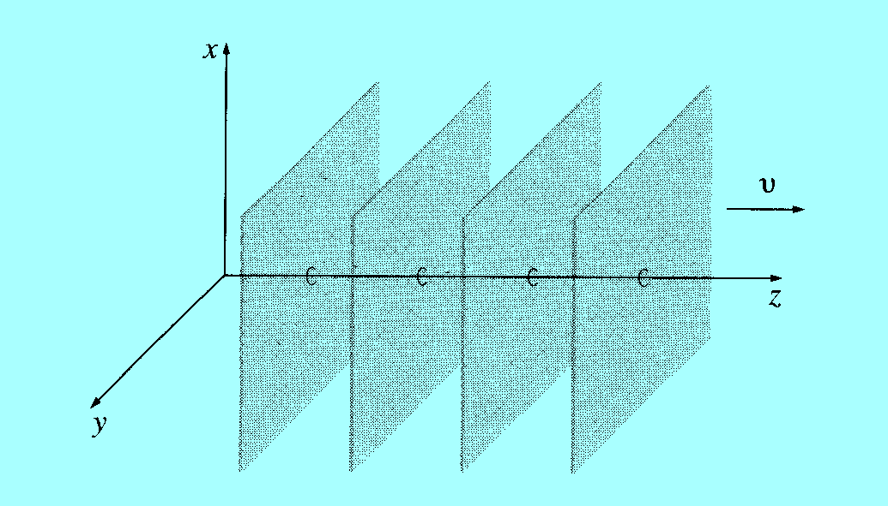
MONOCHROMATIC EM PLANE WAVES
EM waves that propagate e.g. in the +zˆ direction but which additionally have no explicit x- or y-dependence are known as plane waves, because for a given time, t the wave front(s) of the EM wave lie in a plane which is ⊥ to the ˆz -axis,

Slide 8
MONOCHROMATIC EM PLANE WAVES
There also exist spherical EM waves – emitted from a point source – the wave-fronts associated with these EM waves are spherical - and thus do not lie in a plane ⊥ to the direction of propagation of the EM wave

Slide 9
MONOCHROMATIC EM PLANE WAVES
If the point source is infinitely far away from observer- then a spherical wave → plane wave in this limit, (the radius of curvature → ∞); a spherical surface becomes planar as R_{C}→∞.
Criterion for a plane wave:
Monochromatic plane waves associated with and

Slide 10
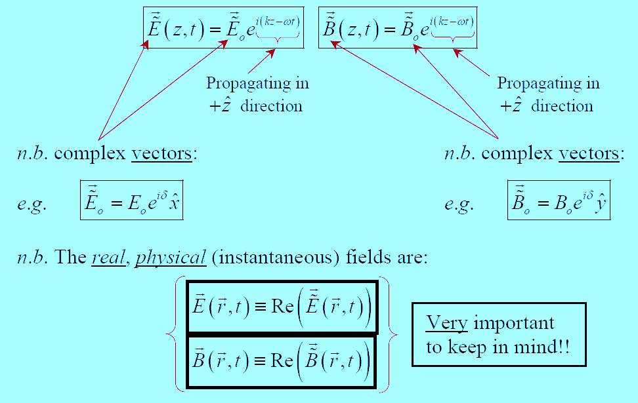
MONOCHROMATIC EM PLANE WAVES

Slide 11
MONOCHROMATIC EM PLANE WAVES
Maxwell’s equations for free space impose additional constraints on
These two relations can only be satisfied
In Cartesian coordinates:

Slide 12
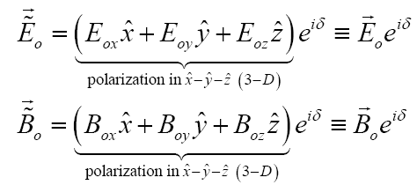
MONOCHROMATIC EM PLANE WAVES
Now suppose we do allow:
Then

Slide 13
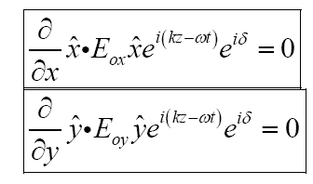
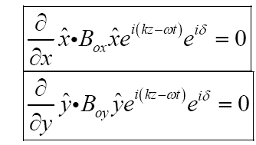
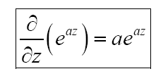
MONOCHROMATIC EM PLANE WAVES
E_{ox} , E_{oy} , E_{oz} = Amplitudes (constants) of the electric field components in x, y, z directions respectively.
B_{ox} , B_{oy} , B_{oz} =Amplitudes (constants) of the magnetic field components in x, y, z directions respectively.

Slide 14
MONOCHROMATIC EM PLANE WAVES…
Maxwell’s equations additionally impose the restriction that an electromagnetic plane wave cannot have any component of E or B || to (or anti- || to) the propagation direction (in this case here, the z -direction)
Another way of stating this is that an EM wave cannot have any longitudinal components of E and B (i.e. components of E and B lying along the propagation direction).

Slide 15
MONOCHROMATIC EM PLANE WAVES…
Thus, Maxwell’s equations additionally tell us that an EM wave is a purely transverse wave (at least for propagation in free space) – the components of E and B must be ⊥ to propagation direction.
The plane of polarization of an EM wave is defined (by convention) to be parallel to E.

Slide 16
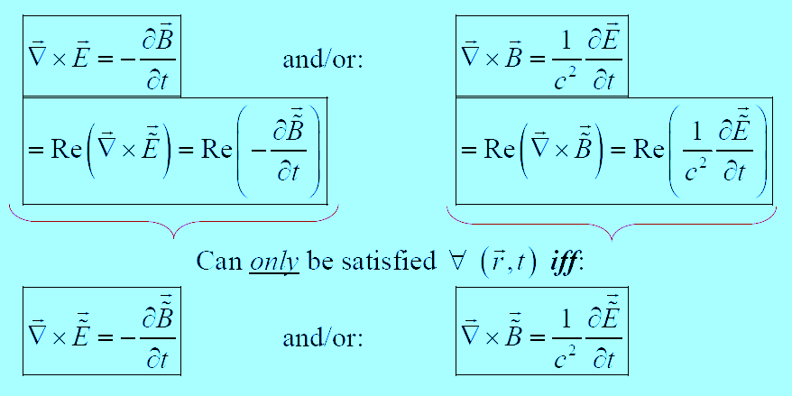
MONOCHROMATIC EM PLANE WAVES…
Maxwell’s equations impose another restriction on the allowed form of E and B for an EM wave:

Slide 17
MONOCHROMATIC EM PLANE WAVES…

Slide 18
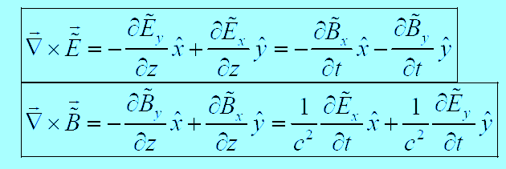
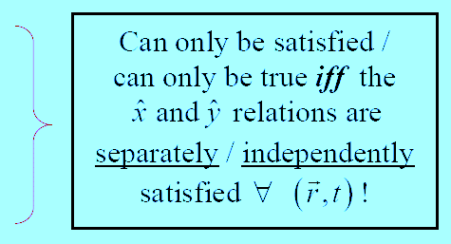
MONOCHROMATIC EM PLANE WAVES…

Slide 19
MONOCHROMATIC EM PLANE WAVES…

Slide 20
MONOCHROMATIC EM PLANE WAVES…

Slide 21
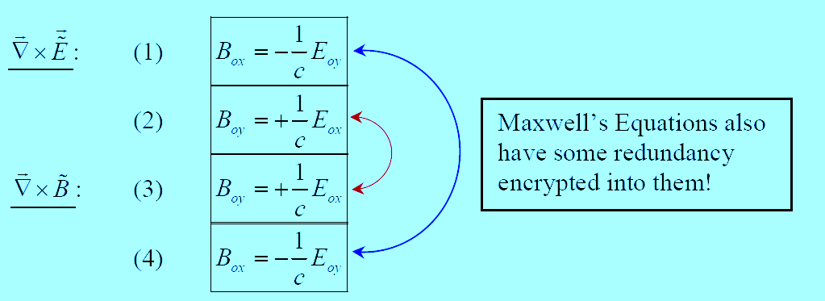
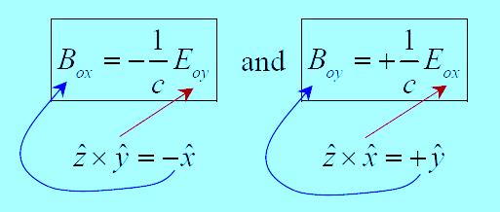
MONOCHROMATIC EM PLANE WAVES . . .
Actually we have only two independent relations:
But:

Slide 22
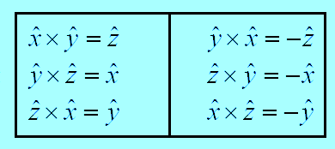
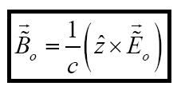
MONOCHROMATIC EM PLANE WAVES…
Very Useful Table:
Two relations can be written compactly into one relation:
Physically this relation states that E and B are:
in phase with each other.
mutually perpendicular to each other - (Ε⊥B)⊥ zˆ

Slide 23
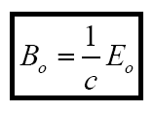
MONOCHROMATIC EM PLANE WAVES…
The E and B fields associated with this monochromatic plane EM wave are purely transverse { n.b. this is as also required by relativity at the microscopic level – for the extreme relativistic particles – the (massless) real photons travelling at the speed of light c that make up the macroscopic monochromatic plane EM wave.}
The real amplitudes of E and B are related to each other by:
with

Slide 24
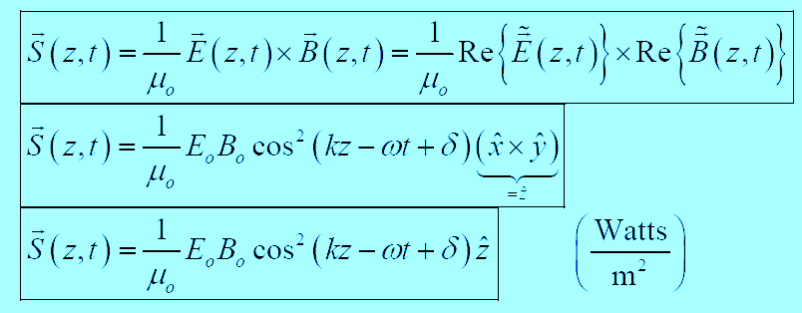
Instantaneous Poynting’s Vector for a linearly polarized EM wave
EM Power flows in the direction of propagation of the EM wave (here, the +zˆ direction)

Slide 25
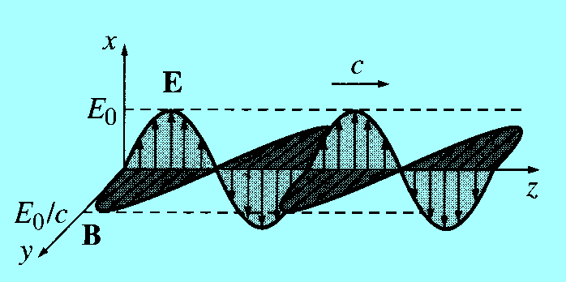
Instantaneous Poynting’s Vector for a linearly polarized EM wave
This is the paradigm for a monochromatic plane wave. The wave as a whole is said to be polarized in the x direction (by convention, we use the direction of E to specify the polarization of an electromagnetic wave).

Slide 26
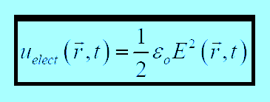
Instantaneous Energy & Linear Momentum & Angular Momentum in EM Waves
Instantaneous Energy Density Associated with an EM Wave:
where
and

Slide 27
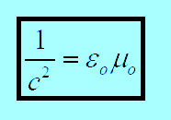
Instantaneous Energy & Linear Momentum & Angular Momentum in EM Waves
But
- EM waves in vacuum, and
- EM waves propagating in the vacuum !

Slide 28
Instantaneous Poynting’s Vector Associated with an EM Wave
For a linearly polarized monochromatic plane EM wave propagating in the vacuum,
But

Slide 29
Instantaneous Poynting’s Vector Associated with an EM Wave
The propagation velocity of energy
Poynting’s Vector = Energy Density * Propagation Velocity
Instantaneous Linear Momentum Density Associated with an EM Wave:

Slide 30
Instantaneous Linear Momentum Density Associated with an EM Wave
For linearly polarized monochromatic plane EM waves propagating in the vacuum:
But:

Slide 31
Instantaneous Angular Momentum Density Associated with an EM wave
But:
For an EM wave propagating in the +zˆ direction:
Depends on the choice of origin

Slide 32
Instantaneous Power Associated with an EM wave
The instantaneous EM power flowing into/out of volume v with bounding surface S enclosing volume v (containing EM fields in the volume v) is:
The instantaneous EM power crossing (imaginary) surface is:
The instantaneous total EM energy contained in volume v

Slide 33
Instantaneous Angular Momentum Density Associated with an EM wave
The instantaneous total EM linear momentum contained in the volume v is:
The instantaneous total EM angular momentum contained in the volume v is:

Slide 34
Time-Averaged Quantities Associated with EM Waves
Usually we are not interested in knowing the instantaneous power P(t), energy / energy density, Poynting’s vector, linear and angular momentum, etc.- because experimental measurements of these quantities are very often averages over many extremely fast cycles of oscillation. For example period of oscillation of light wave
We need time averaged expressions for each of these quantities - in order to compare directly with experimental data- for monochromatic plane EM light waves:

Slide 35
Time-Averaged Quantities Associated with EM Waves
If we have a “generic” instantaneous physical quantity of the form:
The time-average of Q(t) is defined as:

Slide 36
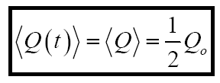
Time-Averaged Quantities Associated with EM Waves
The time average of the cos² (ωt) function:
Thus, the time-averaged quantities associated with an EM wave propagating in free space are:

Slide 37
Time-Averaged Quantities Associated with EM Waves
EM Energy Density:
Total EM Energy:
Poynting’s Vector:
EM Power:

Slide 38
Time-Averaged Quantities Associated with EM Waves
Linear Momentum Density:
Linear Momentum:
Angular Momentum Density:
Angular Momentum:

Slide 39
Time-Averaged Quantities Associated with EM Waves
For a monochromatic EM plane wave propagating in free space / vacuum in ˆz direction:

Slide 40
Time-Averaged Quantities Associated with EM Waves
Intensity of an EM wave:
The intensity of an EM wave is also known as the irradiance of the EM wave – it is the radiant power incident per unit area upon a surface.

Slide 41
ELECTROMAGNETIC WAVES IN Matter
Imrana Ashraf Zahid
Quaid-i-Azam University Islamabad Pakistan
Preparatory School to Winter College on Optics: 8th January-12rd February 2012

Slide 42
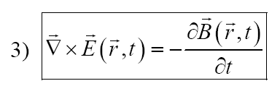
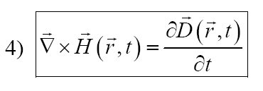
Electromagnetic Wave Propagation in Linear Media
Consider EM wave propagation inside matter - in regions where there are NO free charges and/or free currents ( the medium is an insulator/non-conductor).
For this situation, Maxwell’s equations become:

Slide 43
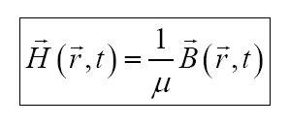
Electromagnetic Wave Propagation in Linear Media
The medium is assumed to be linear, homogeneous and isotropic- thus the following relations are valid in this medium:
and
ε = electric permittivity of the medium.
ε = ε_{o} (1 +χ_{e}), χ_{e} = electric susceptibility of the medium.
μ = magnetic permeability of the medium.
μ = μ_{o} (1 +χ_{m}), χ_{m} = magnetic susceptibility of the medium.
ε_{o} = electric permittivity of free space = 8.85 × 10⁻¹² Farads/m.
μ_{o} = magnetic permeability of free space = 4π × 10⁻⁷ Henrys/m.

Slide 44
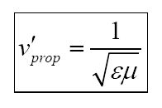
Electromagnetic Wave Propagation in Linear Media
Maxwell’s equations inside the linear, homogeneous and isotropic non-conducting medium become:
In a linear /homogeneous/isotropic medium, the speed of propagation of EM waves is:

Slide 45
Electromagnetic Wave Propagation in Linear Media
The E and B fields in the medium obey the following wave equation:

Slide 46
Electromagnetic Wave Propagation in Linear Media
For linear / homogeneous / isotropic media:
If
thus

Slide 47
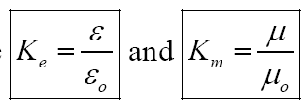
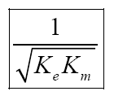
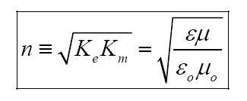
Electromagnetic Wave Propagation in Linear Media
Note also that since
are dimensionless
quantities, then so is
Define the index of refraction { a dimensionless quantity} of the linear / homogeneous / isotropic medium as:

Slide 48
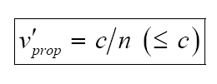
Electromagnetic Wave Propagation in Linear Media
Thus, for linear / homogeneous / isotropic media:
because
Now for many (but not all) linear/homogeneous/ isotropic materials:
( True for many paramagnetic and diamagnetic-type materials)
Thus

Slide 49
Electromagnetic Wave Propagation in Linear Media
The instantaneous EM energy density associated with a linear/homogeneous/isotropic material
with

Slide 50
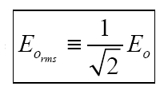
Electromagnetic Wave Propagation in Linear Media
The instantaneous Poynting’s vector associated with a linear/homogeneous/isotropic material
The intensity of an EM wave propagating in a linear/homogeneous /isotropic medium is:
Where

Slide 51
Electromagnetic Wave Propagation in Linear Media
The instantaneous linear momentum density associated with an EM wave propagating in a linear/homogeneous/isotropic medium is:
The instantaneous angular momentum density associated with an EM wave propagating in a linear/homogeneous/isotropic medium is:

Slide 52
Electromagnetic Wave Propagation in Linear Media
Total instantaneous EM energy:
Total instantaneous linear momentum:
Instantaneous EM Power:
Total instantaneous angular momentum:

Slide 53
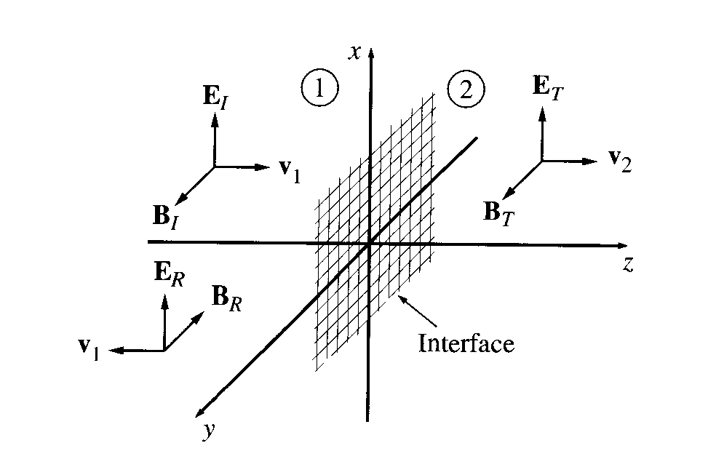
Reflection & Transmission of Linear Polarized Plane EM Waves at Normal Incidence
Suppose the x-y plane forms the boundary between two linear media. A plane wave of frequency ω- travelling in the z- direction and polarized in the x- direction- approaches the interface from the left

Slide 54
Reflection & Transmission of Linear Polarized Plane EM Waves at Normal Incidence
Incident EM plane wave (in medium 1):
Reflected EM plane wave (in medium 1):

Slide 55
Reflection & Transmission of Linear Polarized Plane EM Waves at Normal Incidence
Transmitted EM plane wave (in medium 2):
Note that {here, in this situation} the E -field / polarization vectors are all oriented in the same direction, i.e.
or equivalently:

Slide 56
Reflection & Transmission of Linear Polarized Plane EM Waves at Normal Incidence
At the interface between the two linear / homogeneous / isotropic media -at z = 0 {in the x-y plane} the boundary conditions 1) – 4) must be satisfied for the total E and B -fields immediately present on either side of the interface:

Slide 57
Reflection & Transmission of Linear Polarized Plane EM Waves at Normal Incidence
( ⊥ to x-y boundary, i.e. in the +zˆ direction)
(║ to x-y boundary, i.e. in x-y plane)

Slide 58
Reflection & Transmission of Linear Polarized Plane EM Waves at Normal Incidence
For plane EM waves at normal incidence on the boundary at z = 0 lying in the x-y plane- no components of E or B (incident, reflected or transmitted waves) - allowed to be along the ±zˆ propagation direction(s) - the E and B-field are transverse fields {constraints imposed by Maxwell’s equations}.
BC 1) and BC 3) impose no restrictions on such EM waves since:
The only restrictions on plane EM waves propagating with normal incidence on the boundary at z = 0 are imposed by BC 2) and BC 4).

Slide 59
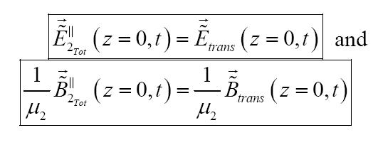
Reflection & Transmission of Linear Polarized Plane EM Waves at Normal Incidence
At z = 0 in medium 1) (i.e. z ≤ 0) we must have:
While at z = 0 in medium 2) (i.e. z ≥ 0) we must have:

Slide 60
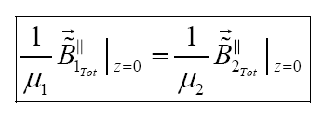
Reflection & Transmission of Linear Polarized Plane EM Waves at Normal Incidence
BC 2) (Tangential E is continuous @ z = 0) requires that:
BC 4) (Tangential H is continuous @ z = 0) requires that:

Slide 61
Reflection & Transmission of Linear Polarized Plane EM Waves at Normal Incidence
Using explicit expressions for the complex E and B fields
into the above boundary condition relations- equations become

Slide 62
Reflection & Transmission of Linear Polarized Plane EM Waves at Normal Incidence
Cancelling the common e^{−iωt} factors on the LHS & RHS of above equations - we have at z = 0 { everywhere in the x-y plane- must be independent of any time t}:

Slide 63
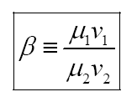
Reflection & Transmission of Linear Polarized Plane EM Waves at Normal Incidence
→ Solve above equations simultaneously for
First (for convenience) let us define:

Slide 64
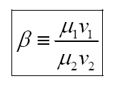
Reflection & Transmission of Linear Polarized Plane EM Waves at Normal Incidence
BC 4) (Tangential H continuous @ z = 0) relation becomes:
BC 2) (Tangential Ε continuous @ z = 0):
BC 4) (Tangential H continuous @ z = 0):
with

Slide 65
Reflection & Transmission of Linear Polarized Plane EM Waves at Normal Incidence
Add and Subtract BC 2) and BC 4) relations:
Insert the result of eqn. (2+4) into eqn. (2−4):

Slide 66
Reflection & Transmission of Linear Polarized Plane EM Waves at Normal Incidence

Slide 67
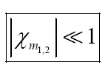
Reflection & Transmission of Linear Polarized Plane EM Waves at Normal Incidence
Now if the two media are both paramagnetic and/or diamagnetic, such that
Very common for many (but not all) non-conducting linear/ homogeneous/isotropic media
Then

Slide 68
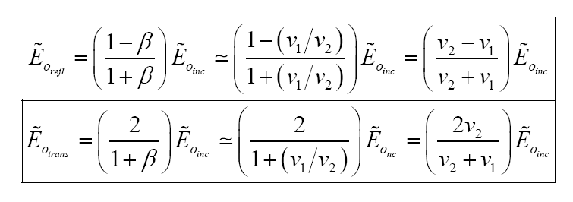
Reflection & Transmission of Linear Polarized Plane EM Waves at Normal Incidence
Then
We can alternatively express these relations in terms of the indices of refraction n₁ & n₂:

Slide 69
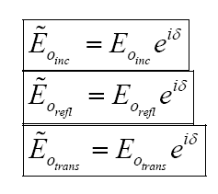
Reflection & Transmission of Linear Polarized Plane EM Waves at Normal Incidence
Now since:
δ = phase angle (in radians) defined at the zero of time - t = 0
Then for the purely real amplitudes
these relations become:

Slide 70
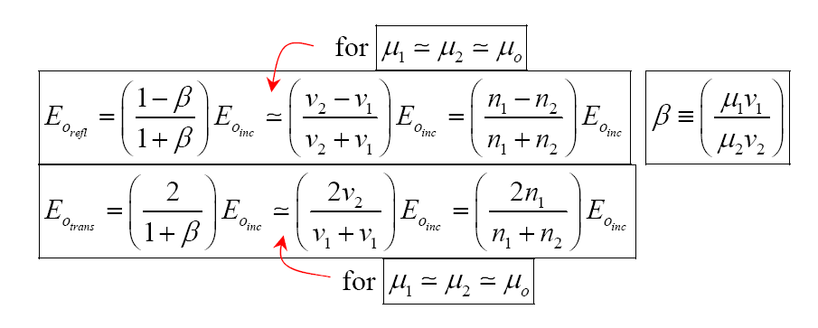
Reflection & Transmission of Linear Polarized Plane EM Waves at Normal Incidence
Monochromatic plane EM wave at normal incidence on a boundary between two linear / homogeneous / isotropic media

Slide 71
Reflection & Transmission of Linear Polarized Plane EM Waves at Normal Incidence
For a monochromatic plane EM wave at normal incidence on a boundary between two linear / homogeneous / isotropic media, with
note the following points:

Slide 72
Reflection & Transmission of Linear Polarized Plane EM Waves at Normal Incidence

Slide 73
Reflection & Transmission of Linear Polarized Plane EM Waves at Normal Incidence

Slide 74
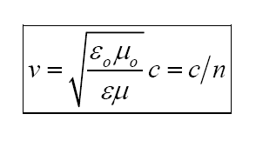
Reflection & Transmission of Linear Polarized Plane EM Waves at Normal Incidence
What fraction of the incident EM wave energy is reflected?
What fraction of the incident EM wave energy is transmitted?
In a given linear/homogeneous/isotropic medium with
The time-averaged energy density in the EM wave is:

Slide 75
Reflection & Transmission of Linear Polarized Plane EM Waves at Normal Incidence
The time-averaged Poynting’s vector is:
The intensity of the EM wave is:
Note that the three Poynting’s vectors associated with this problem are such that

Slide 76
Reflection & Transmission of Linear Polarized Plane EM Waves at Normal Incidence
For a monochromatic plane EM wave at normal incidence on a boundary between two linear /homogeneous / isotropic media, with

Slide 77
Reflection & Transmission of Linear Polarized Plane EM Waves at Normal Incidence
Take the ratios - then square them:
and

Slide 78
Reflection & Transmission of Linear Polarized Plane EM Waves at Normal Incidence
Define the reflection coefficient as:
Define the transmission coefficient as:

Slide 79
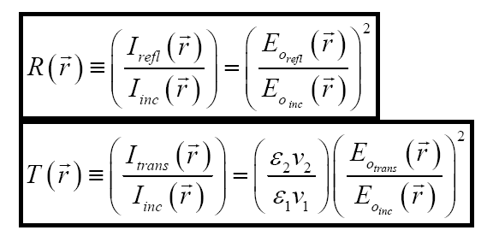
Reflection & Transmission of Linear Polarized Plane EM Waves at Normal Incidence
For a linearly-polarized monochromatic plane EM wave at normal incidence on a boundary between two linear / homogeneous / isotropic media, with
Reflection coefficient:
Transmission coefficient:

Slide 80
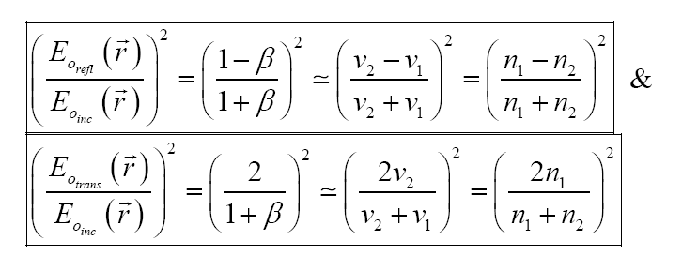
Reflection & Transmission of Linear Polarized Plane EM Waves at Normal Incidence
But:
Thus Reflection and Transmission coefficient:

Slide 81
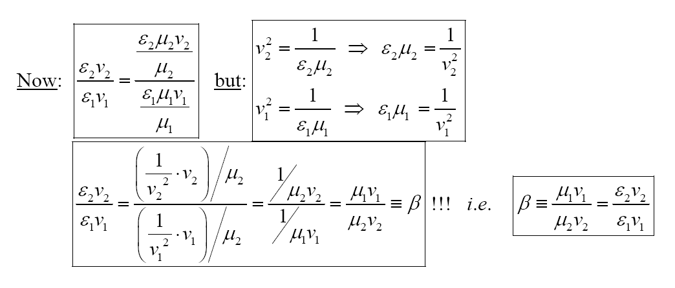
Reflection & Transmission of Linear Polarized Plane EM Waves at Normal Incidence

Slide 82
Reflection & Transmission of Linear Polarized Plane EM Waves at Normal Incidence
Thus:
EM energy is conserved at the interface/boundary between two L/H/I media

Slide 83
Reflection & Transmission of Linear Polarized Plane EM Waves at Normal Incidence
For a linearly-polarized monochromatic plane EM wave at normal incidence on a boundary between two linear / homogeneous / isotropic media, with
Reflection coefficient:
Transmission coefficient:

Slide 84
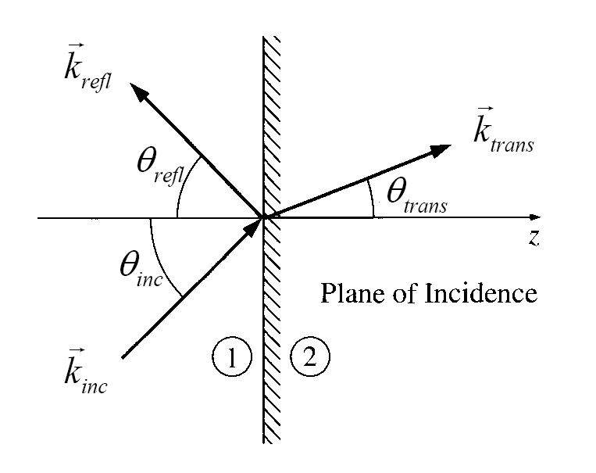
Reflection & Transmission of Monochromatic Plane EM Waves at Oblique Incidence
A monochromatic plane EM wave incident at an oblique angle θ_{inc} on a boundary between two linear/ homogeneous/isotropic media, defined with respect to the normal to the interface- as shown in the figure below:

Slide 85
Reflection & Transmission of Monochromatic Plane EM Waves at Oblique Incidence
The incident EM wave is:
The reflected EM wave is:
The transmitted EM wave is:

Slide 86
Reflection & Transmission of Monochromatic Plane EM Waves at Oblique Incidence
All three EM waves have the same frequency-
The total EM fields in medium 1

Slide 87
Reflection & Transmission of Monochromatic Plane EM Waves at Oblique Incidence
Must match to the total EM fields in medium 2:
Using the boundary conditions BC1) → BC4) at z = 0.
At z = 0- four boundary conditions are of the form:
They must hold for all (x,y) on the interface at z = 0 - and also must hold for all times, t. The above relation is already satisfied for arbitrary time, t - the factor e^{−iωt} is common to all terms.

Slide 88
Reflection & Transmission of Monochromatic Plane EM Waves at Oblique Incidence
The following relation must hold for all (x,y) on interface at at z = 0:
When z = 0 - at interface we must have:
@ z = 0
The above relation can only hold for arbitrary (x, y, z = 0) iff ( = if and only if):

Slide 89
Reflection & Transmission of Monochromatic Plane EM Waves at Oblique Incidence
The above relation can only hold for arbitrary (x, y, z = 0) iff ( = if and only if):

Slide 90
Reflection & Transmission of Monochromatic Plane EM Waves at Oblique Incidence
The problem has rotational symmetry about the z –axis- then without any loss of generality we can choose k to lie entirely within the x-z plane, as shown in the figure
The transverse components of are all equal and point in the +xˆ direction.

Slide 91
Reflection & Transmission of Monochromatic Plane EM Waves at Oblique Incidence

Slide 92
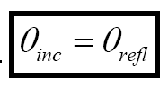
Reflection & Transmission of Monochromatic Plane EM Waves at Oblique Incidence
The First Law of Geometrical Optics:
The incident, reflected, and transmitted wave vectors form a plane (called the plane of incidence), which also includes the normal to the surface (here, the z axis).
The Second Law of Geometrical Optics (Law of Reflection):
From the figure, we see that:
Angle of Incidence = Angle of Reflection
Law of Reflection!

Slide 93
Reflection & Transmission of Monochromatic Plane EM Waves at Oblique Incidence
The Third Law of Geometrical Optics (Law of Refraction – Snell’s Law):
For the transmitted angle, θ_{trans} we see that:
In medium 1):
where
and
In medium 2):

Slide 94
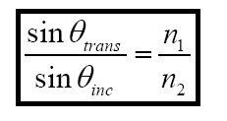
Reflection & Transmission of Monochromatic Plane EM Waves at Oblique Incidence
Which can also be written as:
Since θ_{trans} refers to medium 2) and θ_{inc} refers to medium 1)

Slide 95
Reflection & Transmission of Monochromatic Plane EM Waves at Oblique Incidence
Because of the three laws of geometrical optics, we see that:
everywhere on the interface at z = 0 {in the x-y plane}
Thus we see that:
everywhere on the interface at z = 0 {in the x-y plane}, valid also for arbitrary/any/all time(s) t, since ω is the same in either medium (1 or 2).

Slide 96
Reflection & Transmission of Monochromatic Plane EM Waves at Oblique Incidence
The BC 1) → BC 4) for a monochromatic plane EM wave incident on an interface at an oblique angle between two linear/homogeneous/isotropic media become:
BC 1): Normal ( z-) component of D continuous at z = 0 (no free surface charges):
BC 2): Tangential (x-, y-) components of E continuous at z = 0:

Slide 97
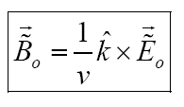
Reflection & Transmission of Monochromatic Plane EM Waves at Oblique Incidence
BC 3): Normal (z-) component of B continuous at z = 0:
BC 4): Tangential (x-, y-) components of H continuous at z = 0 (no free surface currents):
Note that in each of the above, we also have the relation

Slide 98
Reflection & Transmission of Monochromatic Plane EM Waves at Oblique Incidence
For a monochromatic plane EM wave incident on a boundary between two L / H/ I media at an oblique angle of incidence, there are three possible polarization cases to consider:
Transverse Electric (TE) Polarization
Transverse Magnetic (TM) Polarization

Slide 99
Reflection & Transmission of Monochromatic Plane EM Waves at Oblique Incidence
Case I): Electric Field Vectors Perpendicular to the Plane of Incidence: Transverse Electric (TE) Polarization
A monochromatic plane EM wave is incident on a boundary at z = 0 -in the x-y plane between two L/H/I media - at an oblique angle of incidence.
The polarization of the incident EM wave is transverse (⊥ ) to the plane of incidence {containing the three wave-vectors and the unit normal to the boundary nˆ = +zˆ }).
The three B-field vectors are related to their respective E -field vectors by the right hand rule - all three B-field vectors lie in the x-z plane {the plane of incidence},

Slide 100
Reflection & Transmission of Monochromatic Plane EM Waves at Oblique Incidence
The four boundary conditions on the {complex} E and B fields on the boundary at z = 0 are:
BC 1) Normal (z-) component of D continuous at z = 0 (no free surface charges)
BC 2) Tangential (x-, y-) components of E continuous at z = 0:

Slide 101
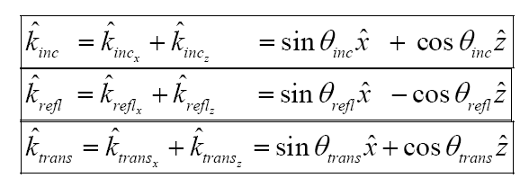
Reflection & Transmission of Monochromatic Plane EM Waves at Oblique Incidence
BC 3) Normal (z-) component of B continuous at z = 0:

Slide 102
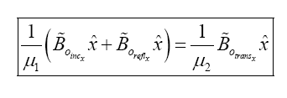
Reflection & Transmission of Monochromatic Plane EM Waves at Oblique Incidence
BC 4) Tangential (x-, y-) components of H continuous at z = 0 (no free surface currents):
Using the Law of Reflection on the BC 3) result:

Slide 103
Reflection & Transmission of Monochromatic Plane EM Waves at Oblique Incidence
Using Snell’s Law / Law of Refraction:
From BC 1) → BC 4) actually have only two independent relations for the case of transverse electric (TE) polarization:

Slide 104
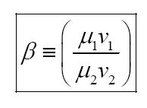
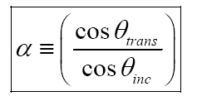
Reflection & Transmission of Monochromatic Plane EM Waves at Oblique Incidence
Now we define:
Then eqn. 2) becomes:
Adding and subtracting Eqn’s 1 &2 to get:

Slide 105
Reflection & Transmission of Monochromatic Plane EM Waves at Oblique Incidence
Plug eqn. (2+1) into eqn. (2−1) to obtain:

Slide 106
Reflection & Transmission of Monochromatic Plane EM Waves at Oblique Incidence
with

Slide 107
Reflection & Transmission of Monochromatic Plane EM Waves at Oblique Incidence
For TE polarization:
Incident Intensity
Reflection Intensity
Transmission Intensity

Slide 108
Reflection & Transmission of Monochromatic Plane EM Waves at Oblique Incidence
Reflection and Transmission coefficients for transverse electric (TE) polarization

Slide 109
Reflection & Transmission of Monochromatic Plane EM Waves at Oblique Incidence
The reflection and transmission coefficients for transverse electric (TE) polarization

Slide 110
Reflection & Transmission of Monochromatic Plane EM Waves at Oblique Incidence
Case II): Electric Field Vectors Parallel to the Plane of Incidence:
Transverse Magnetic (TM) Polarization
A monochromatic plane EM wave is incident on a boundary at z = 0 in the x-y plane between two L / H/ I media at an oblique angle of incidence.
The polarization of the incident EM wave is now parallel to the plane of incidence {containing the three wavevectors and the unit normal to the boundary nˆ = +zˆ }).
The three B -field vectors are related to E -field vectors by the right hand rule –then all three B-field vectors are ⊥ to the plane of incidence {hence the origin of the name transverse magnetic polarization}.

Slide 111
Reflection & Transmission of Monochromatic Plane EM Waves at Oblique Incidence

Slide 112
Reflection & Transmission of Monochromatic Plane EM Waves at Oblique Incidence
The four boundary conditions on the {complex}E and B-fields on the boundary at z = 0 are:
BC 1) Normal (z-) component of D continuous at z = 0 (no free surface charges)
BC 2) Tangential (x-, y-) components of E continuous at z = 0:

Slide 113
Reflection & Transmission of Monochromatic Plane EM Waves at Oblique Incidence
BC 3) Normal (z-) component of B continuous at z = 0:
BC 4) Tangential (x-, y-) components of H continuous at z = 0 (no free surface currents):

Slide 114
Reflection & Transmission of Monochromatic Plane EM Waves at Oblique Incidence
From BC 1) at z = 0:
From BC 4) at z = 0:
where:

Slide 115
Reflection & Transmission of Monochromatic Plane EM Waves at Oblique Incidence
From BC 2) at z = 0:
where:
Thus for the case of transverse magnetic (TM) polarization:
Solving these two above equations simultaneously, we obtain:

Slide 116
Reflection & Transmission of Monochromatic Plane EM Waves at Oblique Incidence

Slide 117
Reflection & Transmission of Monochromatic Plane EM Waves at Oblique Incidence
Reflected & transmitted intensities at oblique incidence for the TM case

Slide 118
Reflection & Transmission of Monochromatic Plane EM Waves at Oblique Incidence
Reflection and Transmission coefficients

Slide 119
Reflection & Transmission of Monochromatic Plane EM Waves at Oblique Incidence

Slide 120
Reflection & Transmission of Monochromatic Plane EM Waves at Oblique Incidence

Slide 121
Reflection & Transmission of Monochromatic Plane EM Waves at Oblique Incidence
Alternate versions of the Fresnel Relations

Slide 122
Reflection & Transmission of Monochromatic Plane EM Waves at Oblique Incidence
Ignoring the magnetic properties of the two media
the Fresnel Relations become:

Slide 123
Reflection & Transmission of Monochromatic Plane EM Waves at Oblique Incidence
Using Snell’s Law and various trigonometric identities

Slide 124
Reflection & Transmission of Monochromatic Plane EM Waves at Oblique Incidence
Use Snell’s Law
to eliminate

Slide 125
Reflection & Transmission of Monochromatic Plane EM Waves at Oblique Incidence
Now explore the physics associated with the Fresnel Equations -the reflection and transmission coefficients.
Comparing results for TE vs. TM polarization for the cases of external reflection (n1 < n2) and internal reflection n1 > n2)
Comment 1):
When (E_{refl} /E_{inc})< 0 - E_{orefl} is 180º out-of-phase with E_{oinc} since the numerators of the original Fresnel Equations for TE & TM polarization are (1−αβ ) and (α − β ) respectively.

Slide 126
Reflection & Transmission of Monochromatic Plane EM Waves at Oblique Incidence
Comment 2):
For TM Polarization (only)- there exists an angle of incidence where (E_{refl} /E_{inc})= 0 - no reflected wave occurs at this angle for TM polarization!
This angle is known as Brewster’s angle θ_{B} (also known as the polarizing angle θ_{P} - because an incident wave which is a linear combination of TE and TM polarizations will have a reflected wave which is 100% pure-TE polarized for an incidence angle θ_{inc} =θ_{B} =θ_{P} !!).
Brewster’s angle θ_{B} exists for both external (n₁ < n₂) & internal reflection (n₁ > n₂) for TM polarization (only).

Slide 127
Reflection & Transmission of Monochromatic Plane EM Waves at Oblique Incidence
Brewster’s Angle θ_{B} / the Polarizing Angle θ_{P} for Transverse Magnetic (TM) Polarization
From the numerator of -the originally-derived expression for TM polarization- when this ratio = 0 at Brewster’s angle θ_{B} = polarizing angle θ_{Ρ} - this occurs when (α −β)=0 , i.e. when α = β .
and Snell’s Law:

Slide 128
Reflection & Transmission of Monochromatic Plane EM Waves at Oblique Incidence
Brewster’s Angle θ_{B} / the Polarizing Angle θ_{P} for Transverse Magnetic (TM) Polarization

Slide 129
Reflection & Transmission of Monochromatic Plane EM Waves at Oblique Incidence

Slide 130
Reflection & Transmission of Monochromatic Plane EM Waves at Oblique Incidence
So what’s so interesting about this???
Comment 3):
For internal reflection (n₁ > n₂) there exists a critical angle of incidence past which no transmitted beam exists for either TE or TM polarization. The critical angle does not depend on polarization – it is actually dictated / defined by Snell’s Law:

Slide 131
Reflection & Transmission of Monochromatic Plane EM Waves at Oblique Incidence
no transmitted beam exists → incident beam is totally internally reflected.
For
the transmitted wave is actually exponentially damped – becomes a so-called:
For
Evanescent Wave:

Slide 132
Reflection & Transmission of Monochromatic Plane EM Waves at Oblique Incidence
Brewster’s angle for TE polarization:

Slide 133
THE END

