Slide 1
REVIEW OF QUANTUM MECHANICS
IMRANA ASHRAF ZAHID
DEPARTMENT OF PHYSICS
QUAID-I-AZAM UNIVERSITY
ISLAMABAD, PAKISTAN

Slide 2
Layout
Quantum Mechanics: Revisited
Radiative Processes for isolated atoms
Transition rates: Semi-classical
Line-broadening Mechanisms
  Homogeneous broadening
  Inhomogeneous broadening

Slide 3
Quantum Mechanics: Revisited

Slide 4
Wave Mechanics
  Quantum mechanical systems ( such as atoms, molecules, ions etc.) are given by wave function ψ(r, t).
  Itself ψ(r, t) has no physical meaning- it allows to calculate the expectation values of all observables of interest.
  Measurable quantities are called observable and are represented by hermition operator Ô. Expectation values is given by

Slide 5
Probability
The probability of finding the system in volume element d³r is.
If system exist, its probability of being somewhere has to equal 1.

Slide 6
The time development of wave function is determined by Schrödinger equation,
H- the Hamiltonian of the system. The energy of the unperturbed system- an atom not interacting with light is

Slide 7
Stationary States
Stationary states of Schrödinger equation are those for which space and time dependence are separated
Time independent equation,
Eigen functions having same eigen values are normal

Slide 8
Completeness
The wave function
- Expansion coefficients
-constant for problems related with free Hamiltonian
-time dependent for interaction Hamiltonian

Slide 9
Gives the probability of finding the system in state n.
Where

Slide 10
DIRAC’S NOTATION
The wave function of wave mechanics corresponds to the state vector of the Dirac’s formulation of the quantum mechanics.
The relation between state vector and wave function is analogous to using vectors instead of coordinates.

Slide 11
A vector V can be expanded as,
In Dirac Notation
X-component of a vector is obtained by
In Dirac Notation

Slide 12
Using these equations we can write
For n dimensions

Slide 13
The expectation value of the operator
Hermitian
The set of eigen vectors of a hermitian operator is complete. This means that any arbitrary vector can be expressed as a sum of orthogonal eigen vectors.

Slide 14
Eigen vectors are orthonormal
Completeness relation for discrete case is

Slide 15
State vectors obey the Schrödinger's equation
Expectation value can be written as

Slide 16
Two-level Atomic System
Wave function
State vector

Slide 17
        Radiative Processes for
        Isolated Atoms

Slide 18
Spontaneous Emission
Atom is in state of given material.
E₂ >E₁ – atom will tend to decay to state
The corresponding energy difference (E₂-E₁) is released by the emission of a photon.

Slide 19
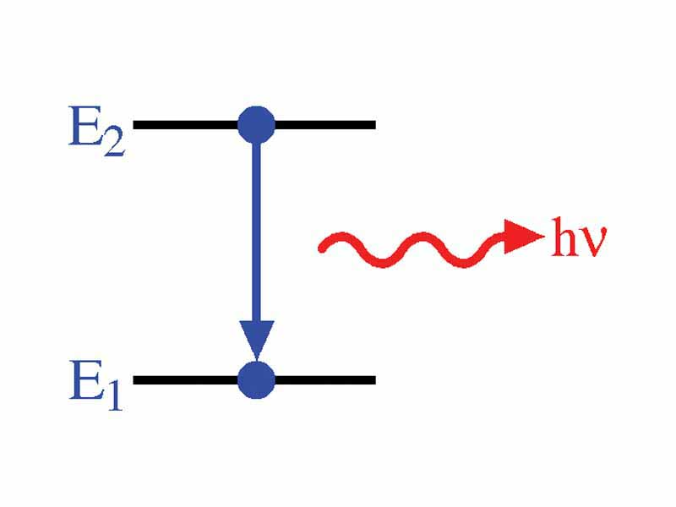

Slide 20
Two possible ways for atom to decay
1.Radiative: Spontaneous emission
2.Non-radiative:
Energy difference
  Is delivered in some other form than electromagnetic radiation e.g. it may go into kinetic energy of the surrounding molecules.

Slide 21
Let N₂ number of atoms in level 2 per unit volume
    The rate of decay of these atoms are

Slide 23
STIMULATED EMISSION
Atom is initially in level 2
An electromagnetic wave of frequency υ given by
incident on it.
Finite probability of emission of another in phase photon.
Rate of transition

Slide 24
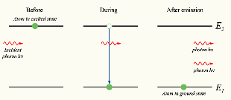

Slide 25
W₂₁- stimulated transition probability or rate- (time)⁻¹
W₂₁- depends on intensity of electromagnetic wave.
STIMULATED ABSORPTION:
Atom is in level 1
Electromagnetic wave of frequency υ incident on the material.
Finite probability that atom will be raised to level 2.
Energy of incident wave is absorbed by the atom
Process is called the stimulated absorption.

Slide 26
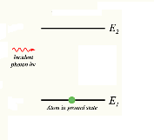

Slide 27
Stimulated Transition Rate
N₁ -number of atoms at a given time lying in level 1

Slide 28
Transition Rates

Slide 29
TRANSITION RATES OF STIMULATED EMISSION AND ABSORPTION
Semi-classical Theory
Atom is quantized
Field is treated classically (using Maxwell’s equations)
System: Two-Level Atomic System

Slide 30
u₁(r) & u₂(r) - eigen -function of unperturbed Hamiltonian(H₀).
satisfies time-independent equation.
a₁(t) - probability amplitudes.
- probability of finding atoms in state i.
- Transition frequency

Slide 31
A monochromatic electromagnetic wave incident on atom.
Atom acquire an additional energy H’ during interaction
Total Hamiltonian
TIME EVOLUTION OF THE SYSTEM
Schrodinger equation

Slide 32
Putting value of ψ(r,t)
Multiplying with
and integrating over whole space.

Slide 33
Using

Slide 34
Similarly
INTERACTION HAMILTONIAN:
-dominates
-due to the Interaction of the electric dipole moment of the atom with the electric field of the electromagnetic wave called- Electric-dipole interaction.

Slide 35
DIPOLE APPROXIMATION
= vector indicating the electron’s position with respect to
the nucleus
ELECTRIC FIELD IN TERMS OF PLANE WAVE
Distance of electron from the nucleus is given by Bohr radius.
<< Optical wavelength

Slide 36
The spatial variation of the electric field across the dimensions of the atom is very small - neglecting it for long wave-lengths - is called dipole approximation.

Slide 37
Interaction Hamiltonian
Using this
where
is the matrix element of electric dipole operator.

Slide 38
Similarly
A level does not have a dipole moment.
er- has odd parity
and
- has even parity
Electric dipole transition only occurs between states of
opposite parity.

Slide 39
Using these we get
Two differential equations- can be solved by using initial
conditions.
Let at
, atom is in level 1
Assume transition probability is weak--- perturbation analysis
can be used.

Slide 40
According to Perturbation theory
As atom is initially in level 1

Slide 41
First order corresponds to the probability that atom go to level 2 from level 1.
Putting value of
ω ~ field frequency and ω₀ ~ atomic frequency

Slide 42
At resonance
is rapidly oscillating term.
Neglecting
This is called “Rotating wave approximation (RWA)”.

Slide 43
The second order of
is obtained by substituting the
value of
function of time
Then putting this in
, we get the third order of
= series is even powers of E₀
= series is odd powers of E₀
First order is enough for transition rates.

Slide 44
Probability of finding the atom in state 2 is
Expand

Slide 45
For limit
As t increases, the maximum in the curve moves upwards proportional to t² and zeros of the function move in along the horizontal axis towards the origin.

Slide 46
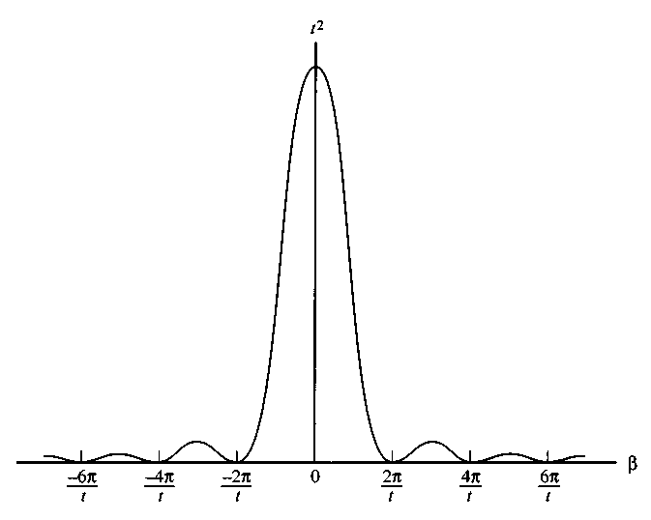

Slide 47
For the area under the curve equal to unity it can be replaced by Dirac delta function with properties
can be replaced by Dirac delta function

Slide 48
Using
This is for a single atom.
Electromagnetic wave interact with an ensemble of atoms with randomly oriented dipole moment with respect to field.
If θ is the angle between p and E₀,
Take average over all the random orientations of dipole moment.

Slide 49
If all angles θ are equally probable, then

Slide 50
Putting

Slide 51
The energy density of electromagnetic wave is
At
This is physical unacceptable result

Slide 52
Reason:
We have assumed that the interaction between the electromagnetic wave and system could continue coherently for an infinite time.
There are of number of phenomena that prevent the interaction of atom with electromagnetic wave for long time. For example collision, Spontaneous emission.
Above equations are valid only in time interval between one collision and the next.
After each collision the relative phase between the atom’s wave-function and electric field of the wave under go a random jump.
The problem is to find the interaction of atom with a broadband field

Slide 53
is valid provided the Dirac delta function - an infinitely
sharp function centered at
and of unit area such that
Is replaced by a new function
again centered at
, again of unit area.
but with a finite spectral width.

Slide 54
The shape of function and value of its line width depends
Upon the particular broadening mechanism involved.
Stimulated emission rate is obtained by changing
initial conditions.
and
As

Slide 55
Line-broadening Mechanisms

Slide 56
Line- Broadening Mechanisms
Broadening
The term is used to denote the finite spectral width of the response of the atomic systems to the electromagnetic fields.
Two Types of Line Broadening
1. Homogeneous Broadening
2. Inhomogeneous Broadening

Slide 57
Homogeneous Broadening
Broadening mechanism is homogeneous when it broadens the line of each individual atom and therefore of the whole system in the same way.
Atoms are indistinguishable
All atoms have same transition frequency and same energy spectrum
Examples: Collision and Natural Broadening

Slide 58
Inhomogeneous broadening
A Broadening mechanism is said to be inhomogeneous when it broadens the atomic lines by different amount for different atoms.
In this case different atoms in an ensemble has different transition frequency and frequencies are distributed over a range.
Example: Doppler Broadening

Slide 59
Collision Broadening
Broadening in Gases
Due to collision of an atom with other atoms, ions, free electrons or the walls of the container.
Broadening in Solids
Due to the interaction of with the phonons of the lattice
It leads to the change of relative phase between atomic dipole moment and that of a incident wave
Collision interrupt the process of coherent interaction between the atom and the incident wave
Atom no longer sees a monochromatic wave instead a broadband field

Slide 60
Collision Broadening cont’d
How to deal with this?
Add all the frequencies of jump during collision.
Use Fourier theory to handle multiple frequencies.
Assume no collision for time interval T₂ –mean free path

Slide 69
Times of flight are distributed according to
Total intensity is made up of large number of time segments

Slide 70
Such that
Function is maximum for

Slide 71
Doppler broadening
This is due to the random motions of the atoms.
It only occurs in gasses
Consider a field of frequency incident on an atom with transition frequency which is moving with a velocity v in the propagation direction of the wave. Atom will see a wave of frequency
Due to Doppler effect

Slide 72
The negative and positive sign applies whether the velocity is in the same or opposite direction to that of the wave. If the atom is moving in the opposite direction to that of wave the frequency observed by the atom is higher than the value observed in lab. frame.
The absorption will occur only when the apparent frequency as seen from the atom is equal to the atomic transition frequency

Slide 73
Rewriting above equation
This is equivalent to say that atom is not moving but has a
resonant frequency equal to
Or

Slide 74
Incident field sees a shifted transition frequency of the atom.
Absorption will occur when the frequency of e.m.wave is
equal to
If atom is moving away from the field ( same direction)
Incident field sees a shifted frequency of the atom and
And absorption occur when this where

Slide 75
We need to find the spectral function for Doppler broadening

Slide 76
As atoms are moving with different velocities, therefore field
Sees different transition frequencies.
Using kinetic theory of gasses that an atom of mass M in
a gas at temperature T has a velocity component between
v and v+ dv is given by Maxwellian distribution

Slide 77
gives the probability that the transition frequency
lies between and
The frequency function is related to
That is the number of atoms absorbing with in the frequency
interval from to is equal to the fraction of
Atoms moving with velocity between v and v+ dv as

Slide 78
The shape of curve corresponding to this equation is called
Gaussian. The maximum again occurs at
Find FWHM

Slide 79
Spontaneous Emission Rate

Slide 80
SPONTANEOUS EMISSION TRANSITION RATE
where A is called the Einstein A co-efficient or spontaneous emission transition rate.
Assume that the material is placed is blackbody cavity
whose walls are kept at a constant temperature T.
Once thermodynamic equilibrium is reached, an electromagnetic energy density with spectral distribution
Established

Slide 81
Material will immersed in this radiation.
Both stimulated emission and absorption processes will occur in addition to the spontaneous process.
In thermal equilibrium, number of transitions per second from level 1 to level 2 must be equal to number of transition per second from level 2→1.

Slide 82
Define
and
where B₂₁ and B₁₂ - called Einstein B co-efficient.
From Boltzmann statistics
for

Slide 83
Putting value of
, we get

Slide 84
For a medium,
n- refractive index of the medium

Slide 85
Comparing two values we get,
Probability of absorption and stimulated emission due to black body radiation are equal.

Slide 86
Once the value of B, due to black body radiation is known
We can find the value of A as we know
This is true for monochromatic field.

Slide 87
For black body radiation, the elemental spectral energy density
of radiation whose frequency lies between and

Slide 88
This is same result as obtained from Quantum Electrodynamics approach because her we use Planck’s law (which is quantum electrodynamically correct). As A increases as the cube of the frequency, so the process of spontaneous emission increases rapidly with frequency.
It is easy to produce infrared laser as compared to UV laser If frequency increases by a factor 10¹⁰, then A increases by 10¹⁰⁰⁰.

Slide 89
The order of magnitude of spontaneous emission at optical
frequency
where a is Bohr radius
Putting these values, we get
For magnetic dipole transitions, A is approximately
10⁵ times small.

Slide 90
SPECTRUM OF THE SPONTANEOUS EMISSION
Line shape due to natural broadening
For any transition, the spectrum of the emitted radiation is the same as that observed in absorption
Assume that an ideal electromagnetic filter- transmitting only those frequencies between ω and ω + dω is placed between the material and the walls of the black body cavity.
If the material, the filter, and the black body cavity are kept at the same temperature T, then ratio between the populations of the two levels will again be given by

Slide 91
The density of electromagnetic radiation
at any point inside the cavity will also be given by
and the net exchange of the energy between the material and the cavity within the transmission bandwidth of the filter must be zero.

Slide 92
This means that the energy emitted by the material in the bandwidth dω around ω due to spontaneous and stimulated emission must be equal to energy absorbed.
Define a spectral co-efficient Aω such that
-Number of atoms per unit time which upon decay
emit a photon of frequency between ω and ω+dω.

Slide 93
Similarly,
represents the number of transitions per unit absorption or stimulated emission induced by black body radiation with frequency between ω and ω+dω.
Equilibrium condition
Using above equations we get,

Slide 94
where
can be obtained from
The spectrum of the radiated wave is the same as for absorption
or stimulated emission.

Slide 95
THANK YOU

