Slide 1
QUANTUM ELECTRONICS LECTURE NOTES
DR. IMRANA ASHRAF ZAHID

Slide 2
Layout ( Part 1)
Introductory Concepts
Historical sketch
Quantum Mechanics: Revisited
Electromagnetic waves and photons
Wavelength and frequencies of electromagnetic radiation.

Slide 3
Introductory Concepts
Quantum Electronics can be defined as a branch of electronics where phenomena of quantum nature play a fundamental role.
LASER: Light Amplification by Stimulated Emission of Radiation.
MASER: Microwave Amplification by stimulated Emission of Radiation.
The principle of Laser emerged from Maser

Slide 4
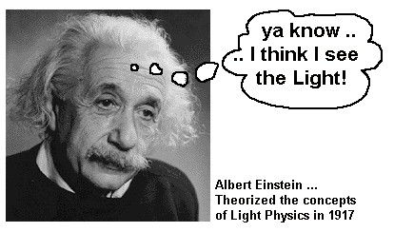
Concept of stimulated emission was introduced by Einstein in 1917.

Slide 5
Historical sketch 1
Almost after 40 years it was recognized that this process can be used in a device producing coherent light.
The idea of Maser was proposed by Basov and Prokhorav( 1954-1955).
Charles H. Townes build a device called “ Maser” in 1955.

Slide 6
Historical sketch 2
Extension of Maser principle to optical region was proposed by Schalow and Townes in 1958.
First laser ( ruby- Alumina) was built by Maiman in 1960. It was pulsed laser.
First CW ( He-Ne) laser was built by Javan.
We think of Laser as emitting visible light, but laser principle is valid through much of the electromagnetic spectrum.
Lasers range from Infrared to soft X-rays region.

Slide 7
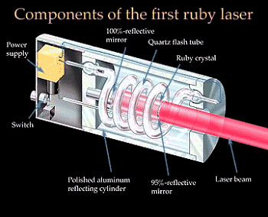

Slide 8
Quantum Mechanics:
Revisited

Slide 9
Wave Mechanics
  Quantum mechanical systems ( such as atoms, molecules, ions etc.) are given by wave function ψ(r, t).
  Itself ψ(r, t) has no physical meaning- it allows to calculate the expectation values of all observables of interest.
  Measurable quantities are called observable and are represented by hermition operator Ô. Expectation values is given by

Slide 10
Probability
The probability of finding the system in volume element d³r is
If system exist, its probability of being somewhere has to equal 1

Slide 11
The time development of wave function is determined by Schrödinger equation,
H- the Hamiltonian of the system. The energy of the unperturbed system- an atom not interacting with light is

Slide 12
Stationary States
Stationary states of Schrödinger equation are those for which space and time dependence are separated
Time independent equation,
Eigen functions having same eigen values are normal

Slide 13
Completeness
The wave function
- Expansion coefficients
-constant for problems related with free Hamiltonian
-time dependent for interaction Hamiltonian

Slide 14
Gives the probability of finding the system in state n.
Where

Slide 15
DIRAC’S NOTATION
The wave function of wave mechanics corresponds to the state vector of the Dirac’s formulation of the quantum mechanics.
The relation between state vector and wave function is analogous to using vectors instead of coordinates.

Slide 16
A vector V can be expanded as,
In Dirac Notation
X-component of a vector is obtained by
In Dirac Notation

Slide 17
Using these equations we can write
For n dimensions

Slide 18
Where
are complete set of vectors- a basis
For continuous basis
The wave vector
Where the wave function

Slide 19
The expectation value of the operator
Hermitian
The set of eigen vectors of a hermitian operator is complete. This means that any arbitrary vector can be expressed as a sum of orthogonal eigen vectors.

Slide 20
Eigen vectors are orthonormal
Completeness relation for discrete case is

Slide 21
The normalization of eigen vectors for a continuous set of eigen values is done with the help of Dirac delta function

Slide 22
State vectors obey the Schrödinger's equation
Expectation value can be written as

Slide 23
Electromagnetic waves and photons 1
Isaac Newton- Light consists of tiny particles called photon.
Christian Huygens- Light made up of waves.
Both theories are right. Light has dual nature.
When light behave like wave it is called an electromagnetic wave because it is composed of both electric and magnetic fields.
Both fields oscillate perpendicular to each other and to the direction of propagation.
Electromagnetic waves are Transverse waves

Slide 24
Electromagnetic waves and photons 2
Electromagnetic waves are identify by:
Wavelength- the distance between successive peaks- measured in units of length.
Frequency- the number of wave peaks passing a point in a second- measured in cycles( peaks) per second- hertz
Speed of Wave= wavelength x frequency- always a constant.

Slide 25
Electromagnetic waves and photons 3
Some time light acts as if it is made of particles called photon.
Each photon has energy proportional to the frequency of the light wave , or inversely proportional to the wavelength.
Energy= Planck’s constant x frequency

Slide 26
Electromagnetic waves and photons 4
A wave can be described by- a photon energy or a wavelength or a frequency. The numbers are different but the descriptions are equivalent.
For example
Light of 1 micrometer wavelength
Has frequency
Photon energy is
One electron volt = 1.6 022x 10⁻¹⁹ joules

Slide 27
Electromagnetic waves and photons 5
Some Rules:
Higher the frequency, shorter the wavelength.
Higher the frequency, larger the photon energy.
Shorter the wavelength, larger the photon energy.

Slide 28
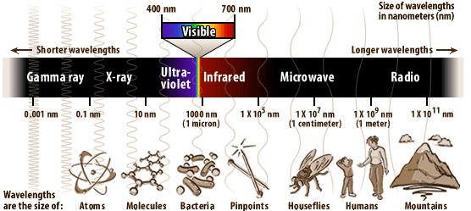

Slide 29
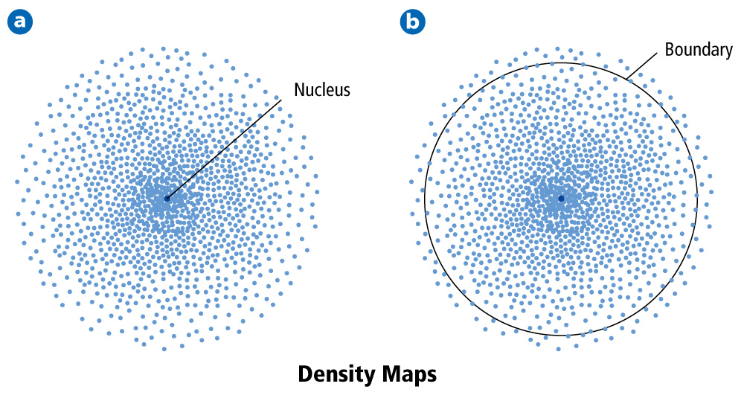
The Quantum Mechanical Model of the Atom
The wave function predicts a three-dimensional region around the nucleus called the atomic orbital.

Slide 30
Hydrogen Atomic Orbitals
Electrons cannot exist between energy levels (just like the rungs of a ladder).
Principal quantum number (n) indicates the relative size and energy of atomic orbitals.
n specifies the atom’s major energy levels, called the principal energy levels.

Slide 31
Electron Energy Level Notes
Energy levels are broken up into sublevels:
There are at least 4 possible types of sublevels—given labels: s, p, d, or f

Slide 32
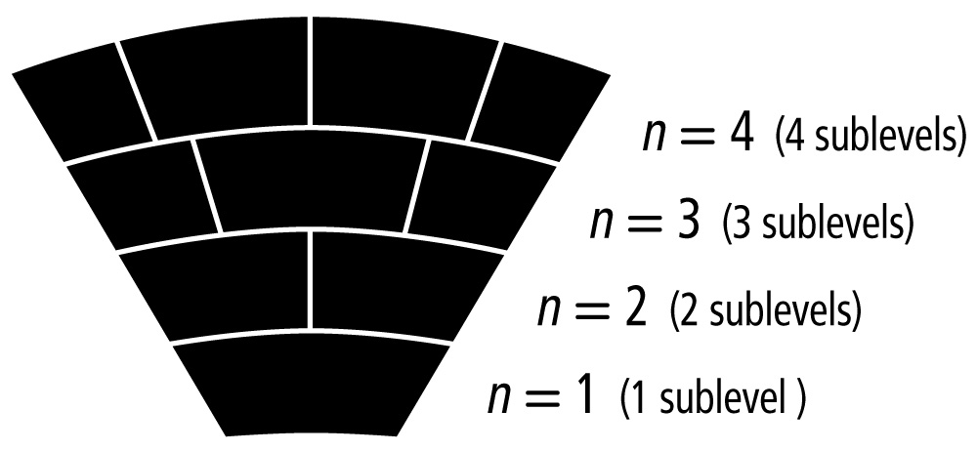
Hydrogen Atomic Orbitals
Energy sublevels are contained within the principal energy levels.

Slide 33
Electron Energy Level Notes
In each energy level, electrons fill sublevels in a certain order
Level 1:
only has one s sublevel (a spherical shape)
2 electrons may fit in this sublevel--each one has an opposite “spin”, allowing them to take up the same space
Pauli exclusion principle—no more than 2 electrons may be found in the same orbital (“orbital” means a particular location)

Slide 34
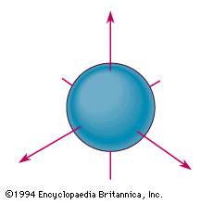
s-Orbital Image

Slide 35
Electron Energy Level Notes
Level 2:
has two sublevels: s and p
2 electrons in s
there are 3 different p orbitals, and may hold 2 electrons each—6 total.
total of 8 overall in Level 2

Slide 36
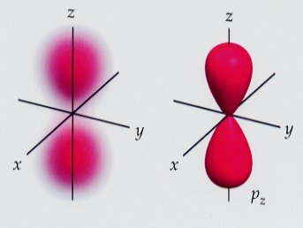
p-Orbital Image

Slide 37
Electron Energy Level Notes
Level 3:
has 3 sublevels: s, p, and d
2 electrons in s
6 electrons in p
there are 5 different d orbitals, and 2 electrons can fit in each—total of 10. (look at picture of d orbitals, imagine how they can fit together)
total of 18

Slide 38
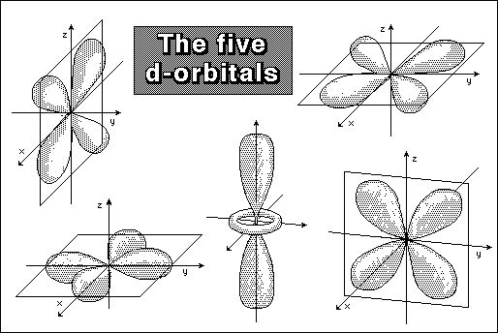
d-orbital notes

Slide 39
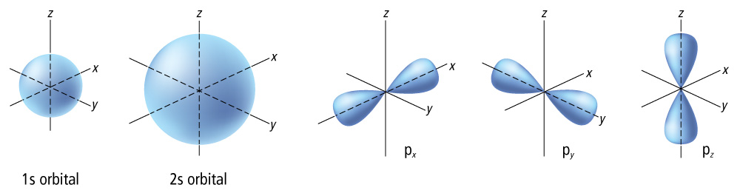
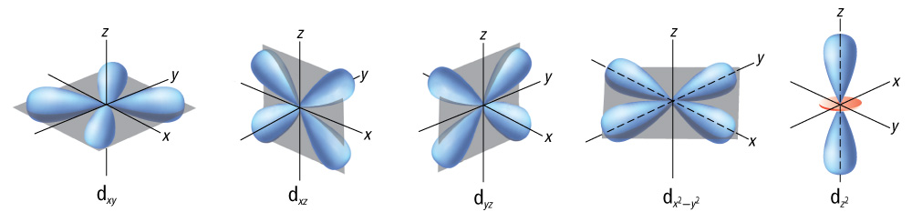
Hydrogen Atomic Orbitals
Each energy sublevel relates to orbitals of different shape.

Slide 40
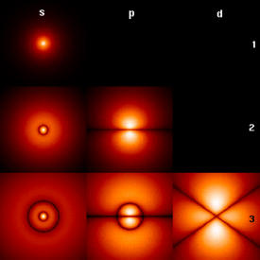
Image of orbitals

Slide 41
Electron Energy Level Notes
Level 4:
has 4 sublevels: s, p, d , and f
2 electrons in s
6 electrons in p
10 electrons in d
14 electrons in f (7 different orbitals for f)
total of 32

Slide 42
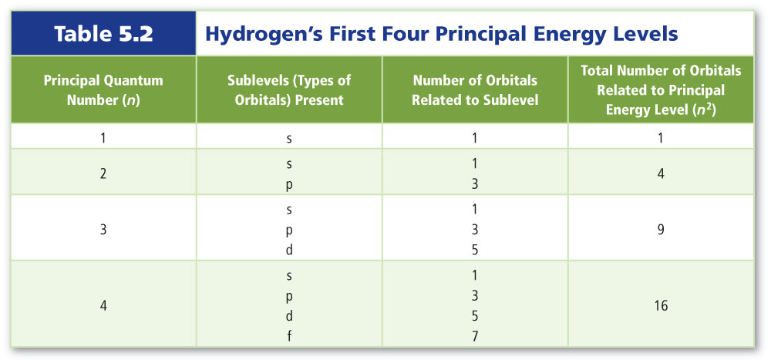
Hydrogen Atomic Orbitals

Slide 43
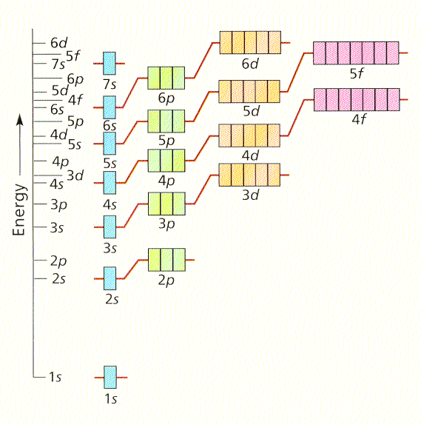
Order of Orbitals

Slide 44
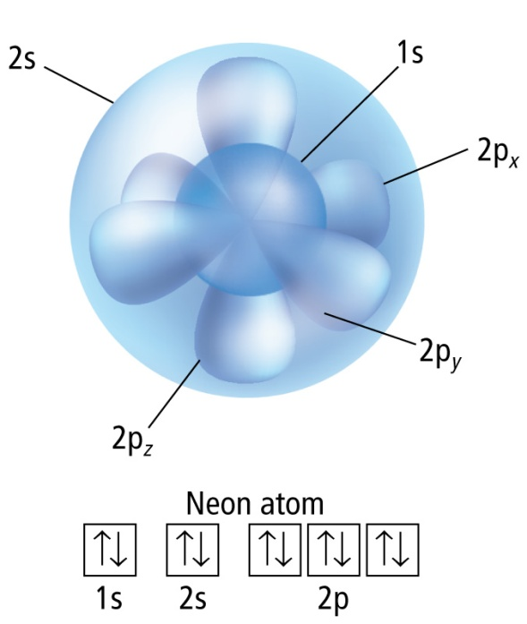
Ground-State Electron Configuration
The Pauli exclusion principle states that a maximum of two electrons can occupy a single orbital, but only if the electrons have opposite spins.
Hund’s rule states that single electrons with the same spin must occupy each equal-energy orbital before additional electrons with opposite spins can occupy the same energy level orbitals.

Slide 45
Electron Energy Level Notes
Hund’s rule is used for filling orbitals with electrons. It states that only one electron will be put in each orbital of a sublevel until all of them are filled, and after that, they may be paired up until the sublevel is full.

Slide 46
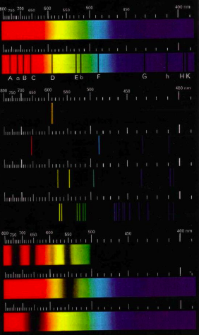
Introduction to Atomic Spectroscopy
Line spectra
  Emission spectra
  Absorption spectra
Hydrogen spectrum
  Balmer Formula
  Bohr’s Model
Bulb
Sun
Na
Emission
spectra
H
Hg
Cs

Slide 47
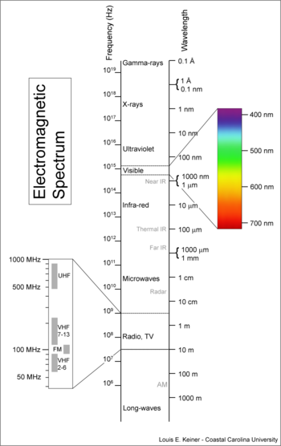
Wavelengths and frequencies of e.m.wave

Slide 48
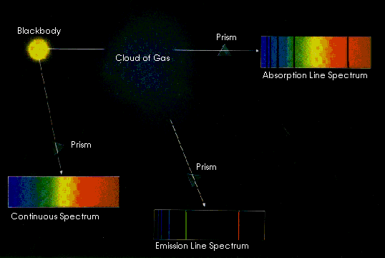
Emission and Absorption Spectroscopy
Gas cloud
3
1
2

Slide 49
Types of Spectra
  Continuous spectrum: Produced by solids, liquids & dense gases produce - no “gaps” in wavelength of light produced:
  Emission spectrum: Produced by rarefied gases – emission only in narrow wavelength regions:
  Absorption spectrum: Gas atoms absorb the same wavelengths as they usually emit and results in an absorption line spectrum:

Slide 50
Line Spectra
Electron transition between energy levels result in emission or absorption lines.
Different elements produce different spectra due to differing atomic structure.
H
He
C
← λ

Slide 51
Simplest Atomic Spectrum: Hydrogen
In ~1850’s, optical spectrum of hydrogen was found to contain strong lines at 6563, 4861 and 4340 Å.
Lines found to fall closer and closer as wavelength decreases.
Line separation converges at a particular wavelength, called the series limit.
Balmer found that the wavelength of lines could be written
where n is an integer >2, and R_{H} is the Rydberg constant.

Slide 52
Simplest Atomic Spectrum: Hydrogen
If n =3, =>
Called H_{α} - first line of Balmer series.
Other lines in Balmer series:
Balmer Series limit occurs when n →∞.
Name | Transitions | Wavelength (Å)
H_{α} | 3 - 2 | 6562.8
H_{β} | 4 - 2 | 4861.3
H_{γ} | 5 - 2 | 4340.5
Å

Slide 53
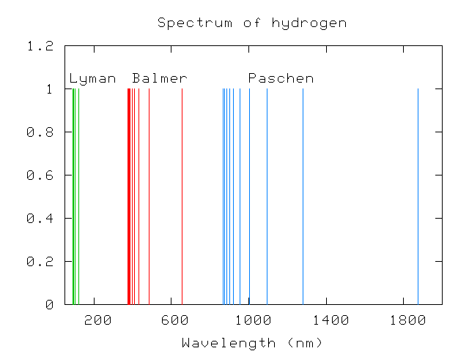
Simplest Atomic Spectrum: Hydrogen
Other series of hydrogen:
Rydberg showed that all series above could be
reproduced using
Series limit occurs when n_{i} = ∞, n_{f} = 1, 2, …
Lyman | UV | n_{f} = 1, n_{i}≥2
Balmer | Visible/UV | n_{f} = 2, n_{i}≥3
Paschen | IR | n_{f} = 3, n_{i}≥4
Brackett | IR | n_{f} = 4, n_{i}≥5
Pfund | IR | n_{f} = 5, n_{i}≥6
Series Limits

Slide 54
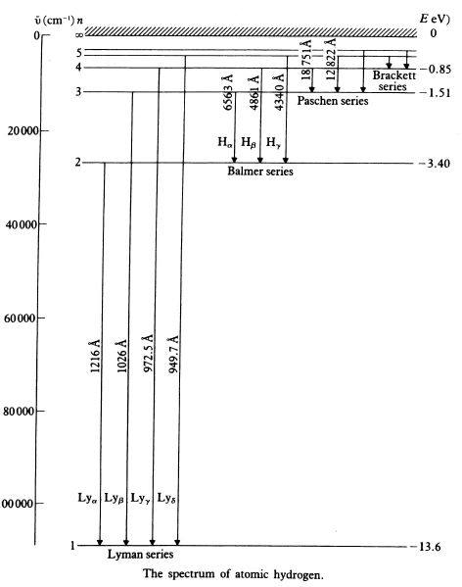
Simplest Atomic Spectrum: Hydrogen
Term or Grotrian diagram for hydrogen.
Spectral lines can be considered as transition between terms.
A consequence of atomic energy levels, is that transitions can only occur between certain terms. Called a selection rule. Selection rule for hydrogen: Δn = 1, 2, 3, …

Slide 55
Bohr Model for Hydrogen
Simplest atomic system, consisting of single electron-proton pair.
First model put forward by Bohr in 1913. He postulated that:
  Electron moves in circular orbit about proton under Coulomb attraction.
  Only possible for electron to orbits for which angular momentum is quantised, ie., n = 1, 2, 3, …
  Total energy (KE + V) of electron in orbit remains constant.
  Quantized radiation is emitted/absorbed if an electron moves changes its orbit.

Slide 56
Bohr Model for Hydrogen
Consider atom consisting of a nucleus of charge +Ze and mass M, and an electron on charge -e and mass m. Assume M>>m so nucleus remains at fixed position in space.
As Coulomb force is a centripetal, can write (1)
As angular momentum is quantised (2nd postulate): n = 1, 2, 3, …
Solving for v and substituting into Eqn. 1 =>
The total mechanical energy is:
(2)
n = 1, 2, 3, … (3)

Slide 57
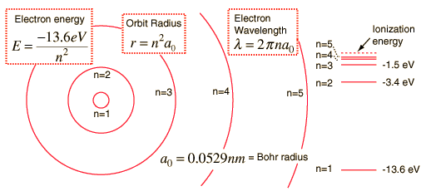
Bohr Model for Hydrogen
Substituting in for constants, Eqn. 3 can be written eV
and Eqn. 2 can be written where a₀ = 0.529 Å = “Bohr radius”.
Eqn. 3 gives a theoretical energy level structure for hydrogen (Z=1):
For Z = 1 and n = 1, the ground state of hydrogen is: E₁ = -13.6 eV

Slide 58
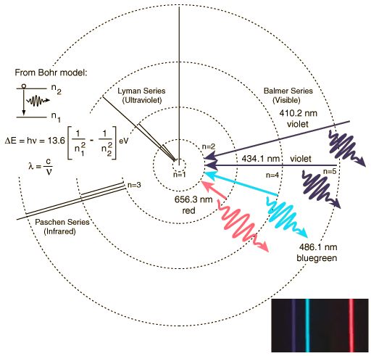
Bohr Model for Hydrogen
The wavelength of radiation emitted when an electron makes a transition, is (from 4th postulate):
or (4)
where
Essential predictions of Bohr model
are contained in Eqns. 3 and 4.

Slide 59
LASER
Light Amplification by Stimulated Emission of Radiation.
An optical source that emits photons in a coherent beam.
In analogy with optical lasers, a device which produces any particles or electromagnetic radiations in a coherent state is called “Laser”, e.g., Atom Laser.
In most cases “laser” refers to a source of coherent photons i.e., light or other electromagnetic radiations. It is not limited to photons in the visible spectrum. There are x-rays, infrared, UV lasers etc.

Slide 60
Properties of Laser Light
The light emitted from a laser is monochromatic, that is, it is of one color/wavelength. In contrast, ordinary white light is a combination of many colors (or wavelengths) of light.
Lasers emit light that is highly directional, that is, laser light is emitted as a relatively narrow beam in a specific direction. Ordinary light, such as from a light bulb, is emitted in many directions away from the source.
The light from a laser is said to be coherent, which means that the wavelengths of the laser light are in phase in space and time. Ordinary light can be a mixture of many wavelengths.

Slide 61
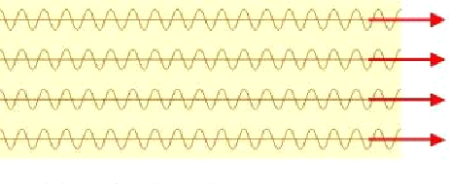
Ordinary Light vs. Laser Light
Laser Light
Ordinary Light

Slide 62
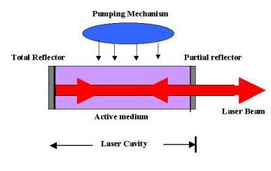
Basic Components of Laser 1
Laser system consists of three important parts.
Active medium or laser medium
An energy source (referred to as the pump or pump source)
An optical resonator consisting of a mirror or system of mirrors

Slide 63
Basic Components of Laser 2
Active Medium
Major determining factor of the wavelength of operation and other properties of laser.
Hundreds of different gain media in which laser operation has been achieved.
The gain medium may be solid crystals such as ruby or Nd:YAG, liquid dyes, gases like CO₂ or Helium-Neon, and semiconductors such as GaAs.
Pumping Mechanism
The pump source is the part that provides energy to produce a population inversion.
Pump sources include electrical discharges, flash lamps, light from another laser, chemical reactions.
The type of pump source used principally depends on the gain medium.
Optical Resonator
Its simplest form is two parallel mirrors placed around the gain medium.
Light from the medium produced by the spontaneous emission is reflected by the mirrors back into the medium where it may be amplified by stimulated emission
. One of the mirrors reflects essentially 100% of the laser light while the other reflects less than 100% of the laser light and transmits the remainder.

Slide 64
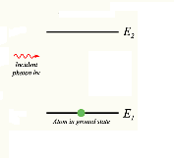
Basic Principles of Light Emission and Absorption 1
In 1916, Einstein considered various transition rates between atomic states (say, 1 and 2) involving light of intensity, I.
Absorption:
Absorption is the process by which the energy of the photon is taken up by another entity, e.g., by an atom whose valence electrons make transition between two electronic energy levels. The photon is destroyed in the process.
Rate of Stimulated Absorption =B N₁ I
B Einstein's Coefficient for Stimulated Absorption
N₁ Population in the Ground S

Slide 65
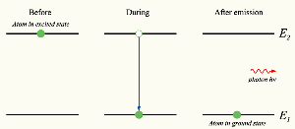
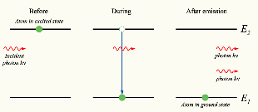
Basic Principles of Light Emission and Absorption 2
Stimulated Emission:
A process by which, when perturbed by a photon, matter may lose energy resulting in the creation of another identical photon.
Rate of stimulated emission = B N₂ I
B Einstein's Coefficient for Stimulated Emission
N₂ Population in the Excited State
Spontaneous Emission:
A process by which an atom, molecule in an excited state drops to a lower energy level.
Rate of spontaneous emission = A N₂
A Einstein’s Coefficient for Spontaneous Emission

Slide 66
Threshold Condition
I₀
I₁
I₃
Laser medium with gain, G
I₂
R = 100%
R < 100%
A laser action will be achieved if the beam increases in intensity during a round trip: that is, if
Usually, additional losses in intensity occur, such as absorption, scattering, and reflections. In general, the laser will lase if, in a round trip:
Gain > Loss This is called achieving Threshold.

Slide 67
Laser Gain
Laser medium
I(0)
I(L)
z
Neglecting spontaneous emission:
0
L
[Stimulated emission minus absorption]
Proportionality constant is the absorption/gain cross-section, σ
There can be exponential gain or loss in intensity.
Normally, N₂ < N₁, and there is loss (absorption). But if N₂ > N₁, there’s gain, and we define the gain, G:
If N₂ > N₁:
If N₂ < N₁ :

Slide 68
Two-, Three-, and Four-Level Systems
Two-level system
Three-level system
Four-level system
Fast decay
Fast decay
Pump Transition
Laser Transition
Laser Transition
Pump Transition
Fast decay
At best, you get equal populations. No lasing.
If you hit it hard, you get lasing.
Lasing is easy!

Slide 69
Natural broadening
The line width (full width at half maximum) of the Lorentz profile is the damping parameter, γ.
For an isolated molecule the damping parameter can be interpreted as the inverse of the lifetime of the excited quantum state.
This is consistent with the Heisenberg Uncertainty Principle
If absorption line is dampened solely by the natural lifetime of the state this is natural broadening

Slide 70
Pressure broadening
For an isolated molecule the typical natural lifetime is about 10⁻⁸ s, 5x10⁻⁴ cm⁻¹ line width
However as the pressure increases the distance between molecules becomes shorter. We can view the outcome in two ways
(1) Collisions between molecules can shorten the lifetime, and hence the line width becomes larger.
(2) As the molecules get closer their potential fields overlap and this can change the ‘natural line width’.
The resultant line shape leads to a Lorentz line shape.
Except at very high pressures when the fields overlap strongly - assymetric line shapes - Holtzmach broadening.

Slide 71
Pressure broadening
Clearly the line width will depend on the number of collisions per second,i.e. on the number density of the molecules (Pressure) and the relative speed of the molecules (the square root of the temperature)

Slide 72
Doppler broadening
Second major source of line broadening
Molecules are in motion when they absorb. This causes a change in the frequency of the incoming radiation as seen in the molecules frame of reference
Let the velocity be v, and the incoming frequency be ν, then

Slide 73
Doppler broadening
In the atmosphere the molecules are moving with velocities determined by the Maxwell Boltzmann distribution

Slide 74
Doppler broadening
The cross section at a frequency ν is the sum of all line of sight components

Slide 75
Doppler broadening
We now define the Doppler width as

Slide 76
Voigt profile
In general the overall broadening is a mixture of Lorentz and Doppler. This is known as the Voigt profile

Slide 77
Voigt profile
For small damping ratios, a → 0, we retrieve the Doppler result. For a > 1 we retrieve the Lorentz result
In general the Voigt profile shows a Doppler-like behavior in the line core, and a Lorentz-like behavior in the line wings.
The Voigt profile must be evaluated by numerical integration

Slide 78
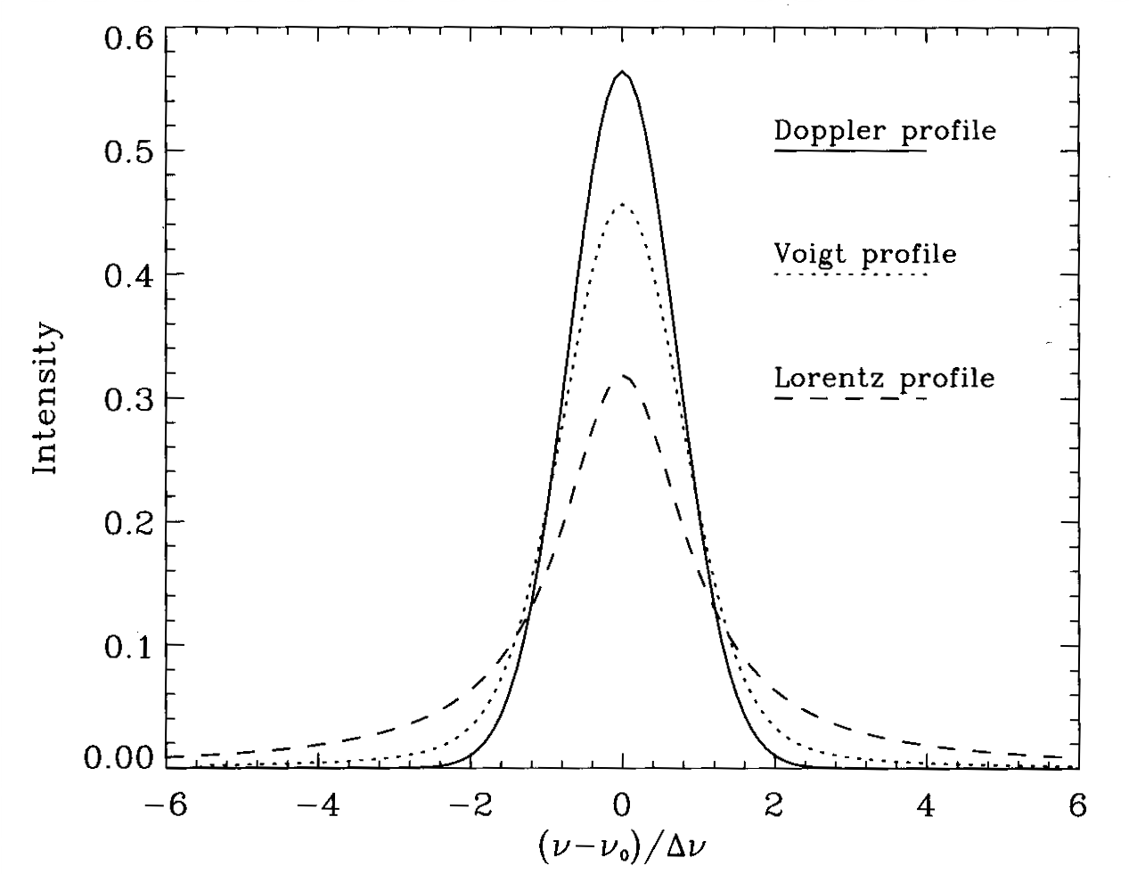
Comparison of the line shapes

