Slide 1
Exact Renormalization group 2016, 19 September, ICTP
Spectral functions in functional renormalization group approach
- analysis of the collective soft modes at the QCD critical point -
Takeru Yokota (Dept. of Phys., Kyoto Univ., Japan)
Collaborators
Teiji Kunihiro (Dept. of Phys., Kyoto Univ.)
Kenji Morita (YITP, Kyoto Univ.)
PTEP 2016, 073D01 (2016)

Slide 2
Contents
1. Spectral function in functional renormalization group
2. QCD phase diagram, QCD critical point and the soft mode
3. Our model and procedure
4. Result

Slide 3
Contents
1. Spectral function in functional renormalization group
2. QCD phase diagram, QCD critical point and the soft mode
3. Our model and procedure
4. Result

Slide 4
Spectral function
● Spectral function for a field $φ(x)$:
where $G_{φR}(p)$ is the retarded Green’s function
● Spectral functions have many information about a system.
● Collective modes
● Dispersion relations
● Susceptibilities
● Cross section
● Transport coefficients
When there is a mode with energy $ω_{0}$
$$ρ_{φ}\left(ω\right)$$
mode with the
quantum number of $φ$
$ω$ plane
×
Pole of $G_{φR}(ω)$
$$ω$$
● The theme of this talk is calculation of spectral functions in the functional renormalization group (FRG)
to investigate the non-perturbative properties of a system.

Slide 5
Effective action and the derivative
● To obtain the spectral functions, two-point functions are needed.
● In the sentence of FRG, the effective action is an important quantity.
● Consider the system composed of fields $\left\{φ_{i}\right\}$. Suppose that the average values are $\left\{φ_{i}\right\}=\left\{φ_{0i}\right\}$.
● The derivatives of the effective action $Γ\left[\left\{φ_{i}\right\}\right]$ at $\left\{φ_{i}\right\}=\left\{φ_{0i}\right\}$ give vertex functions.
● Especially, the second order derivative gives the inverses of the two-point functions.
Inverse of two-point function
Three-point function
Four-point function
…
…

Slide 6
Two point function in FRG
● In FRG, the effective average action (EAA) is introduced to describe the flow of theory.
● We introduce the scale dependent vertex functions corresponding to the EAA.
● The derivatives of Wetterich eq. give the infinite series of coupled flow equation for vertex functions.
Wetterich equation
C. Wetterich, PLB 301 (1993)
where $Γ_{k}$ is the EAA and $R_{k}$ is a regulator.
$Γ_{k}^{(n)}$ is the $n$th derivative with respect to the fields.
Derivative at $\left\{φ_{i}\right\}=\left\{φ_{0i}\right\}$
Flow equations for scale dependent vertex functions
…

Slide 7
Approximation scheme
● To use the flow equations for two-point functions, an approximation to simplify
the coupling of the equations is needed. In addition, the average value is necessary.
● One of the ways is using a truncated EAA for evaluating $\left\{φ_{i}\right\}=\left\{φ_{0i}\right\}$ and the RHS of the flow equation.
Truncated EAA
$$\left\{φ_{i}\right\}=\left\{φ_{0i}\right\}$$
Two-point function
● Such calculations of spectral functions have been done in some models.
O(4) model
K. Kamikado, N. Strodthoff, L. Smekal, J. Wambach, EPJ C74 (2014)
Quark-meson model
R. Tripolt, N. Strodthoff, L. Smekal, J. Wambach, PRD89 (2014); R. Tripolt, et. al., PRD90 (2014)
● We later apply such a method to investigate the behavior of modes around the QCD critical point.

Slide 8
Contents
1. Spectral function in functional renormalization group
2. QCD phase diagram, QCD critical point and the soft mode
3. Our model and procedure
4. Result

Slide 9
QCD and Chiral symmetry
● The system consisting of quarks and gluons (QCD matter) is a strongly correlated system and
its fundamental theory is QCD.
current quark mass
● One of the key concept of QCD is the chiral symmetry, which is the invariance
under the product of two unitary transformations ($U_{L}\left(N_{f}\right)×U_{R}\left(N_{f}\right)$):
$U_{L}\left(N_{f}\right)$:
where $ψ_{L}=\left(1−γ_{5}\right)ψ/2$ and $ψ_{R}=\left(1+γ_{5}\right)ψ/2$,
$N_{f}$ is the number of flavors and
$T^{i}$ is the generator of U($N_{f}$) transformation for flavor index.
$U_{R}\left(N_{f}\right)$:
The QCD Lagrangian has this symmetry except for the mass term $\overline{ψ}mψ$.
● A part of the chiral symmetry, $U_{A}(1)$ symmetry corresponding to the transformation when $θ_{L}^{0}=−θ_{R}^{0}$
and other parameters are zero is actually broken due to quantum anomaly.
$$θ_{L}^{0}=θ_{R}^{0}$$
broken

Slide 10
Chiral symmetry breaking and Chiral effective model
● The scalar quark condensate $σ=〈\overline{ψ}ψ〉$, called chiral condensate, is one of the order parameters
for the SSB of chiral symmetry and used to describe the phase transition related
to the chiral symmetry.
Effective potential
Effective potential
$$σ$$
$$σ$$
Symmetric phase
Broken phase
● Such a phase transition is investigated using chiral effective models,
which respects the chiral symmetry.
● Example: Nambu-Jona-Lasinio model (2-flavor case)
Y. Nambu, G. Jona-Lasinio PR 122 (1961);PR 124 (1961)
$U_{V}\left(1\right)×SU_{L}\left(2\right)×SU_{R}(2)$ invariant
except for the mass term.
$σ$ field
$π^{i}$ field

Slide 11
Soft mode in the chiral limit
● If the current quark masses are zero (chiral limit), the chiral symmetry is an exact symmetry.
● In $N_{f}=2$ case, O(4) critical line is considered to appear in the phase diagram of
quarks and gluons (QCD phase diagram).
● The phase transition is of second order
at a critical point (CP) and
the effective potential becomes flat.
Phase diagram when quark mass = 0
$$T$$
O(4) critical line
Quark-gluon plasma phase
At a CP
tri CP
Effective potential
$$σ=0$$
$$σ≠0$$
●
1st order phase boundary
Hadronic phase
Order parameter
$$μ$$
Flat potential
● At a CP, the mode corresponding to the fluctuation of the order parameter
becomes gapless and long lived (soft mode).
● At the O(4) critical line, the soft mode is the sigma mesonic mode,
i.e. mesonic mode with the quantum number of $\overline{ψ}ψ$.

Slide 12
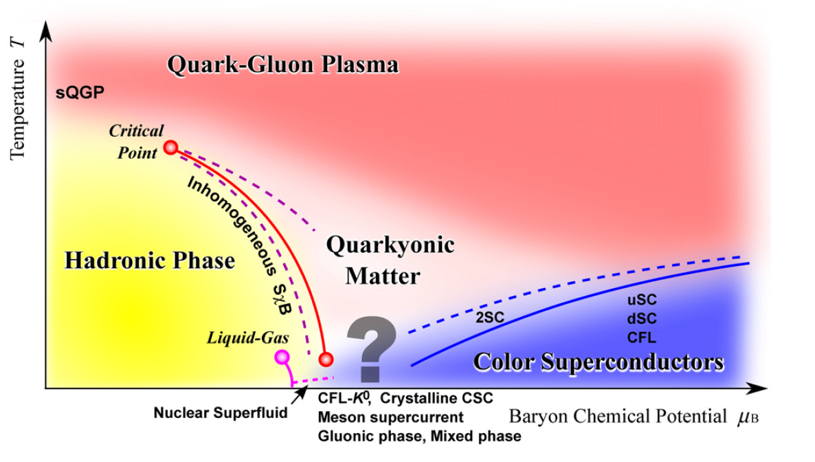
QCD phase diagram with nonzero quark masses
K. Fukushima, T. Hatsuda, RPP74 (2011)
$$σ∼0$$
Crossover
$$σ≠0$$
● The chiral symmetry is broken explicitly and the nature of the phase transition becomes complex.
● The O(4) critical line does not appear. There is first order phase boundary as the remnant of the case
of zero quark mass and a CP appears at the endpoint of the boundary, which is called the QCD CP.
● The nature of the soft mode at the QCD CP is nontrivial in contrast to
the case of zero quark mass.

Slide 13
Soft mode at nonzero quark mass
● The nature of soft mode will be different from that in zero quark mass
because sigma channel couples to density fluctuations ($\left\langle \overline{ψ}ψ\overline{ψ}γ^{0}ψ\right\rangle ≠0$).
$$ω$$
Prediction of soft mode in previous researches:
Hydrodynamical modes
$$ω<|\vec{p}|$$
H. Fujii, M. Ohtani, PRD70 (2004)
TDGL and RPA for NJL model
D. T. Son, M. A. Stephanov, PRD70 (2004)
Langevin equation
$$\left|\vec{p}\right|$$
Y. Hatta, T. Ikeda, PRD67 (2003)
QCD effective potential
Dispersion relation of
hydrodynamical modes
●
● These modes are interpreted as particle-hole
excitation modes and their dispersion relations
have supports in the space-like momentum region.
●
$$ω$$
Fermi sphere
● The sigma mesonic mode is considered not to be
the soft mode in contrast to the case of chiral limit.
$$ω>|\vec{p}|$$
$$\left|\vec{p}\right|$$
Our purpose is to investigate the nature of the soft mode
at nonzero quark mass in FRG.
Dispersion relation of
sigma mesonic modes

Slide 14
Contents
1. Spectral function in functional renormalization group
2. QCD phase diagram, QCD critical point and the soft mode
3. Our model and procedure
4. Result

Slide 15
Quark-meson model and Local potential approximation
● We employ the 2-flavor quark-meson model as our chiral effective model.
● 2-flavor quark-meson model (in imaginary-time formalism)
D. U. Jungnickel, C. Wetterich, PRD53 (1996)
Effect of the current quark mass
● Our method is based on the following truncated EAA
(local potential approximation (LPA) for meson part):
$k$ dependence
$U_{k}$ is the lowest order of the derivative expansion of the flow of meson terms and
this approximation is expected to be a good starting point for describing the behavior of low-momentum modes.

Slide 16
Procedure of calculation
Step 1. Solve the flow equation for $U_{k}$.
● We solve the partial differential equation.
● $U_{k}$ gives static properties.
Step 2. Calculate the retarded Green’s functions in the meson channels
using the flow equations for two-point functions.
● We use $U_{k}$ given in Step 1 to evaluate the RHS of the flow equations.
● The spectral functions are obtained from the imaginary part
of the retarded Green’s functions.

Slide 17
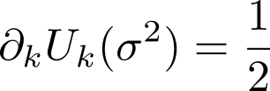
Details of Step 1
Step 1. Solve the flow equation for $U_{k}$.
$$∂_{k}R_{k}^{B}$$
$$∂_{k}R_{k}^{F}$$
● The flow eq. for $U_{k}$ is derived from the Wetterich eq.
●
●
●
$$U_{Λ}$$
$$U_{0}$$
$$σ$$
$$π$$
$$ψ$$
● We solve this nonlinear partial differential
equation with variables $k$ and $σ$ numerically.
● From $U_{k=0}$, static properties of the system can be obtained.
● Chiral condensate $σ_{0}$:
● Meson screening masses:
● Constituent quark mass:
● Pressure:
$σ$ that minimizes $U_{0}\left(σ^{2}\right)−cσ$.
$M_{σ}^{2}=\frac{∂^{2}U_{0}}{∂σ^{2}}(σ_{0})$, $M_{π}^{2}=\frac{1}{σ}\frac{∂U_{0}}{∂σ}(σ_{0})$.
$M_{q}=g_{s}σ_{0}$.
$P=U_{0}\left(σ_{0}^{2}\right)−cσ_{0}$.
…

Slide 18
Details of Step 2
Step 2. Calculate the retarded Green’s functions in the meson channels
using the flow equations for two-point functions.
● Definitions
● Scale dependent Matsubara Green’s function
$${\left.\frac{δ^{2}Γ_{k}}{δσ\left(ip_{0}, \vec{p}\right)δσ\left(iq_{0}, \vec{q}\right)}\right|}_{σ=σ_{0}}=\frac{1}{T}δ_{p_{0},{ q}_{0}}{\left(2π\right)}^{3}δ^{\left(3\right)}\left(p+q\right)G_{σ,k }^{−1}(ip_{0},\vec{p})$$
$ip_{0}$, $iq_{0}$ are Matsubara
frequencies.
$${\left.\frac{δ^{2}Γ_{k}}{δπ^{a}\left(ip_{0}, \vec{p}\right)δπ^{a}\left(iq_{0}, \vec{q}\right)}\right|}_{σ=σ_{0}}=\frac{1}{T}δ_{p_{0},{ q}_{0}}{\left(2π\right)}^{3}δ^{\left(3\right)}\left(p+q\right)G_{π,k }^{−1}(ip_{0},\vec{p})$$
● Scale dependent retarded Green’s functions
$$ip_{0}→ω$$
so that the analyticity in the upper half plane of $ω$ is satisfied.
$$G_{σ(π),k}(ip_{0},\vec{p})$$
$$G_{σ(π),k}^{R}(ω,\vec{p})$$
G. Baym, N. D. Mermin, J. Math. Phys. 2 (1961)
$G_{σ(π),k}^{R}(ω,\vec{p})$ becomes the retarded Green’s function at $k→0$.

Slide 19
Details of Step 2
Step 2. Calculate the retarded Green’s functions in the meson channels
using the flow equations for two-point functions.
● Flow equations for $G_{σ(π),k}(ip_{0},\vec{p})$
R. Tripolt, N. Strodthoff, L. Smekal,J. Wambach,PRD89 (2014)
R. Tripolt, L. Smekal, J. Wambach, PRD90 (2014)
● The flow eqs for $G_{σ(π),k}(ip_{0},\vec{p})$ are obtained from the second derivatives of Wetterich eq.
● We use $U_{k}$ and $σ_{0}$ given in Step 1 to evaluate the propagators and vertex functions
in the RHS of the flow equations.
Propagators and vertex functions contain $U_{k}$ and $σ_{0}$.
$$σ$$
$$π$$
$$ψ$$
Propagators
Vertex functions

Slide 20
Details of Step 2
Step 2. Calculate the retarded Green’s functions in the meson channels
using the flow equations for two-point functions.
● Flow equations for $G_{σ(π),k}^{R}(ω,\vec{p})$
R. Tripolt, N. Strodthoff, L. Smekal,J. Wambach,PRD89 (2014)
R. Tripolt, L. Smekal, J. Wambach, PRD90 (2014)
analytic continuation
The analyticity in
the upper half plane
of $ω$ must be satisfied.
$$ip_{0}→ω$$
● Such an analytic continuation can be performed analytically.
G. Baym, N. D. Mermin,
J. Math. Phys. 2 (1961)
● This is due to the choice of 3D regulator.
D. F. Litim, PRD 64 (2001)
● One can calculate the retarded Green’s functions $G_{σ(π)}^{R}(ω,\vec{p})$ and their spectral functions $ρ_{σ(π)}(ω,\vec{p})$
using these flow equations.

Slide 21
Contents
1. Spectral function in functional renormalization group
2. QCD phase diagram, QCD critical point and the soft mode
3. Our model and procedure
4. Result

Slide 22
Initial condition and parameter setting
● We determine the parameters in the initial conditions to reproduce the vacuum values of
chiral condensate, meson masses and constituent quark mass.
R. Tripolt, L. Smekal, J. Wambach, PRD90 (2014)
$$Λ$$ | $${m_{Λ}}/Λ$$ | $$λ_{Λ}$$ | $$c/{Λ^{3}}$$ | $$g_{s}$$
1000MeV | 0.794 | 2.00 | 0.00175 | 3.2
$M_{q}$ is the constituent quark mass.
Vacuum value
$$M_{q}=g_{s}σ_{0}$$
$$M_{q}$$ | $$M_{π}$$ | $$M_{σ}$$ | $$σ_{0}$$
286MeV | 137MeV | 496MeV | 93MeV
$M_{π}$ and $M_{σ}$ are the screening masses.
$$M_{π}^{2}=\frac{1}{σ_{0}}\frac{∂U_{0}}{∂σ}(σ_{0})$$
$$M_{σ}^{2}=\frac{∂^{2}U_{0}}{∂σ^{2}}(σ_{0})$$

Slide 23
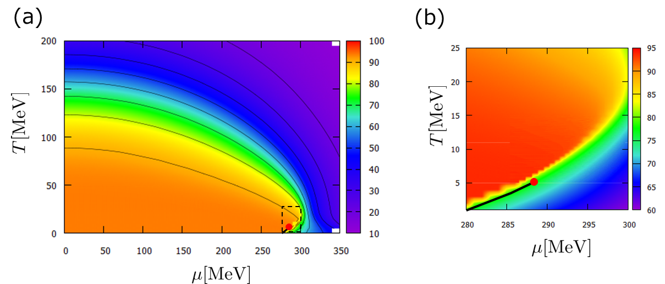
Step 1: The location of the QCD CP
Contour map of Chiral condensate
CP
● The location of the CP is determined by the min. point
of the inverse of the chiral susceptibility $∂^{2}U_{0}/∂σ^{2}$.
$$(T_{c},μ_{c})=(5.1±0.1\text{MeV}, 286.\text{7}±\text{0.2}\text{MeV}\text{)}$$

Slide 24
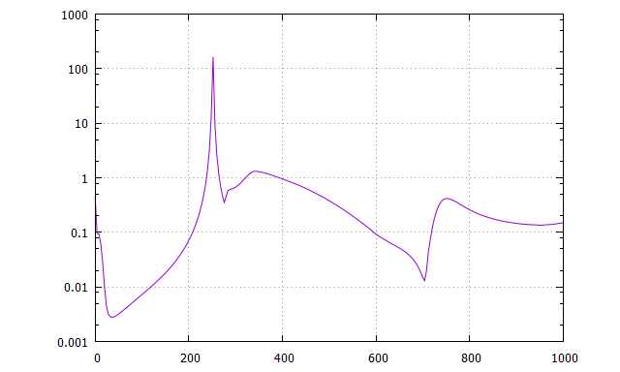
Step 2: An example of the sigma channel spectral function $ρ_{σ}$ near the QCD CP
● We fix $T=5.1 \text{MeV}$ below. (At this temperature, the transition chemical potential is $μ_{t}=286.69 \text{MeV}$)
Contour map of $ρ_{σ}$
$ρ_{σ}$ when $\left|\vec{p}\right|=50 \text{MeV}$
Time-like momentum region
Peak of sigma mesonic mode
Dispersion relation of
sigma mesonic mode
Threshold of $2σ$ decay
Bump of particle-hole mode
Ⓢ
Ⓟ
Dispersion relation of
particle-hole mode
Threshold of $2π$ decay
Space-like momentum region
Space-like momentum region

Slide 25
Step 2: Contour maps of the sigma channel spectral function $ρ_{σ}$ near the QCD CP
● We fix $T=5.1 \text{MeV}$. (At this temperature, the transition chemical potential is $μ_{t}=286.69 \text{MeV}$)
$$μ$$
●
$$μ_{t}$$
Merge
● As the system approaches the QCD CP, the dispersion relation of sigma mesonic mode shifts
to low-energy region and merges with the bump of the particle-hole modes in the space-like momentum region.

Slide 26
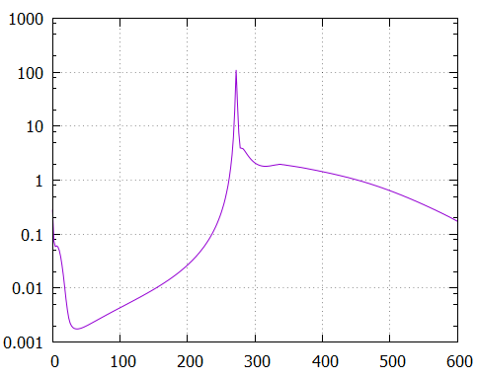
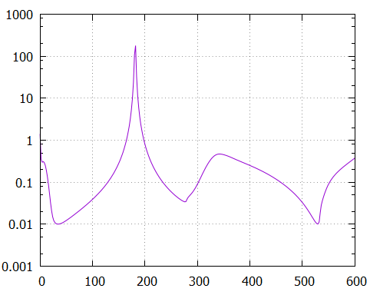
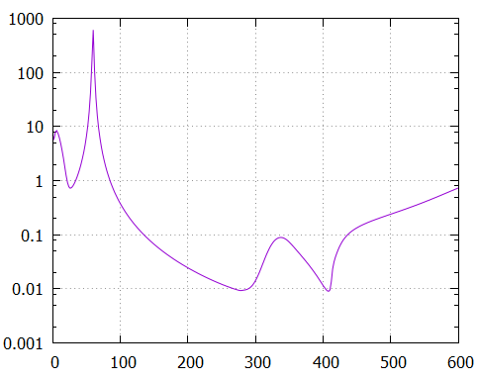
Position and strength of peaks and bumps of $ρ_{σ}$ near the QCD CP
● We fix $T=5.1 \text{MeV}$ and $\left|\vec{p}\right|=50 \text{MeV}$. (At this temperature, the transition chemical potential is $μ_{t}=286.69 \text{MeV}$)
$$μ$$
●
$$μ=286.0 \text{MeV}$$
$$μ=286.5 \text{MeV}$$
$$μ=286.57 \text{MeV}$$
$$μ_{t}$$
Ⓟ
Ⓟ
Ⓟ
Threshold of $2π$ decay
Threshold of $2σ$ decay
Ⓢ
Ⓢ
Space-like momentum region
● The particle-hole mode becomes soft.

Slide 27
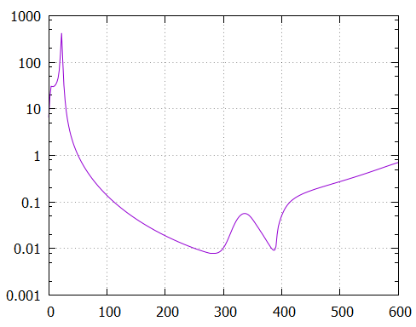
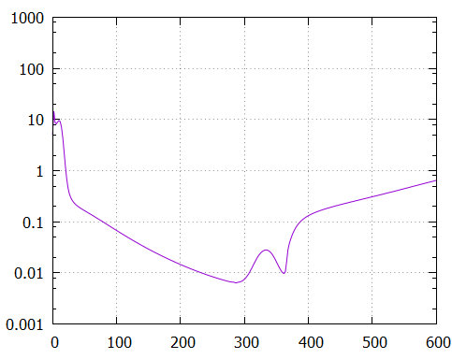
Position and strength of peaks and bumps of $ρ_{σ}$ near the QCD CP
-In much closer to CP-
● We fix $T=5.1 \text{MeV}$ and $\left|\vec{p}\right|=50 \text{MeV}$. (At this temperature, the transition chemical potential is $μ_{t}=286.69 \text{MeV}$)
$$μ$$
●
$$μ=286.57 \text{MeV}$$
$$μ=286.58 \text{MeV}$$
$$μ=286.59 \text{MeV}$$
$$μ_{t}$$
Merge
Threshold of $2π$ decay
Ⓟ
Ⓟ
Ⓟ
Threshold of $2σ$ decay
Ⓢ
Ⓢ
Ⓢ
Space-like momentum region
● The sigma mesonic mode penetrates into the space-like region and merges
with the bump of the particle–hole mode.
The softening of the sigma mesonic mode
● We have discussed the softening from the viewpoint of the level repulsion
between $σ$ and $2σ$ mode.
T. Y., T. Kunihiro, K. Morita, PTEP 2016

Slide 28
Summary & Future work
● We have shown the procedure to calculate the spectral functions in the mesonic channels
in the functional renormalization group.
● We have calculated the spectral function in the sigma channel
to investigate the soft mode at QCD CP in the two-flavor quark-meson model.
● The mesonic mode and the collective particle-hole mode have been emerged in the spectral functions
in the framework of the functional renormalization group.
● When the system approaches the QCD CP, the particle-hole mode is enhanced.
In more close region, the sigma mesonic mode penetrates into the space-like momentum region
and merges with the bump of the particle–hole mode.
Suggests that not only the particle-hole mode but also the sigma mesonic mode
becomes soft.
● Future work
Calculation of the spectral functions using more improved method
(such as inclusion of wave-function renormalization) is important to confirm the nature of the soft mode.

Slide 29
Back up

Slide 30
Contour maps of the pion channel spectral function $ρ_{π}$ near the QCD CP
● We fix $T=5.1 \text{MeV}$ below. (At this temperature, the transition chemical potential is $μ_{t}=286.69 \text{MeV}$)
$$μ$$
●
$$μ_{t}$$

Slide 31
The location of the QCD CP
Quark number susceptibility
(normalized by those of a free quark gas)
$M_{σ}$
3
$$T [\text{MeV}]$$
6
$$μ [\text{MeV}]$$
● Quark number susceptibility enhances near
the QCD CP as well as the chiral susceptibility $M_{σ}^{−2}$.

Slide 32
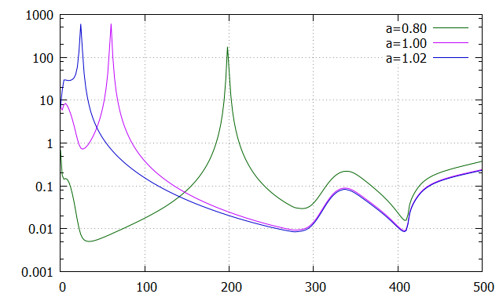
Interpretation with level repulsion
● Does the level repulsion between sigma mode and
two sigma mode leads to the softening of
the sigma mode?
Two sigma mode
Energy
Repulsion
Sigma mesonic mode
● The three point vertex $Γ_{σσσ}^{\left(3\right)}$ will determine the strength
of repulsion between the sigma mesonic and
two sigma modes.
Lowering caused by strong repulsion
$$a=1.02$$
$$T=5.1\text{MeV}, μ=286\text{MeV}, \left|\vec{p}\right|=50\text{MeV}$$
$$a=1$$
$$a=0.80$$
We have investigated the behavior of $ρ_{σ}$
when the strength of $Γ_{σσσ}^{\left(3\right)}$ is changed to ${aΓ}_{σσσ}^{\left(3\right)}$ by hand in the flow equations.
Large $a$
Small $a$
$$ρ_{σ}$$
$$σ$$
$$σ$$
$$Γ_{σσσ}^{\left(3\right)}→aΓ_{σσσ}^{\left(3\right)}$$
$$σ$$
Space-like momentum region
$$ω [\text{MeV}]$$
● Actually the strength of $Γ_{σσσ}^{\left(3\right)}$ strongly affects the level of the sigma mesonic mode.

Slide 33
Problem about the group velocity of the sigma mesonic mode
$T=5.1 \text{MeV}$
● There is a region where the group velocity of the sigma mesonic mode
exceeds the speed of light.
● What is the cause? LPA ansatz? 3D regulator?
The improvement is one of the future works.
Velocity$≥c$
● Inclusion of wave-functional renormalization
● Methods without 3D regulator

