Slide 1
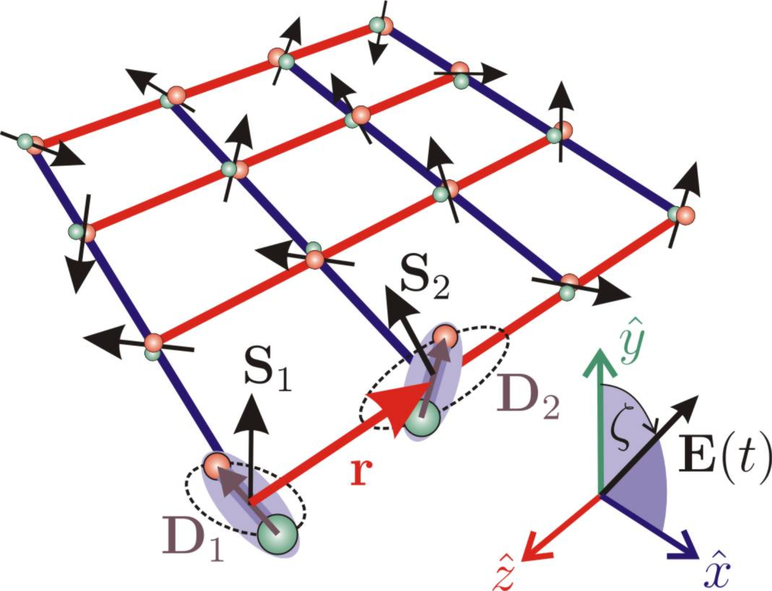



Long-range interactions in cold atomic systems
Igor Lesanovsky
Trieste 25/07/16
Nature Physics 2, 341 (2006)

Slide 2
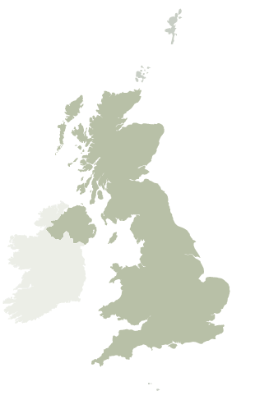
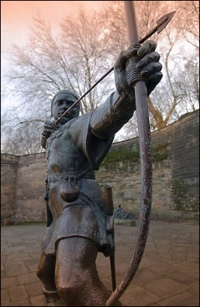
Nottingham
Postdocs
Carlos Espigares Perez
Ricardo Gutierrez
Alexander Karabanov
Zhihao Lan
Emanuele Levi
Matteo Marcuzzi
Jiri Minar
Pietro Rotondo
PhD-students
Ben Everest
Andreas Kouzelis
Katarzyna Macieszcziak
Dominic Rose
Daniel Wisniewski
Local collaborators
A. Armour
J. P. Garrahan
M. Guta
W. Köckenberger
W. Li
B. Olmos

Slide 3
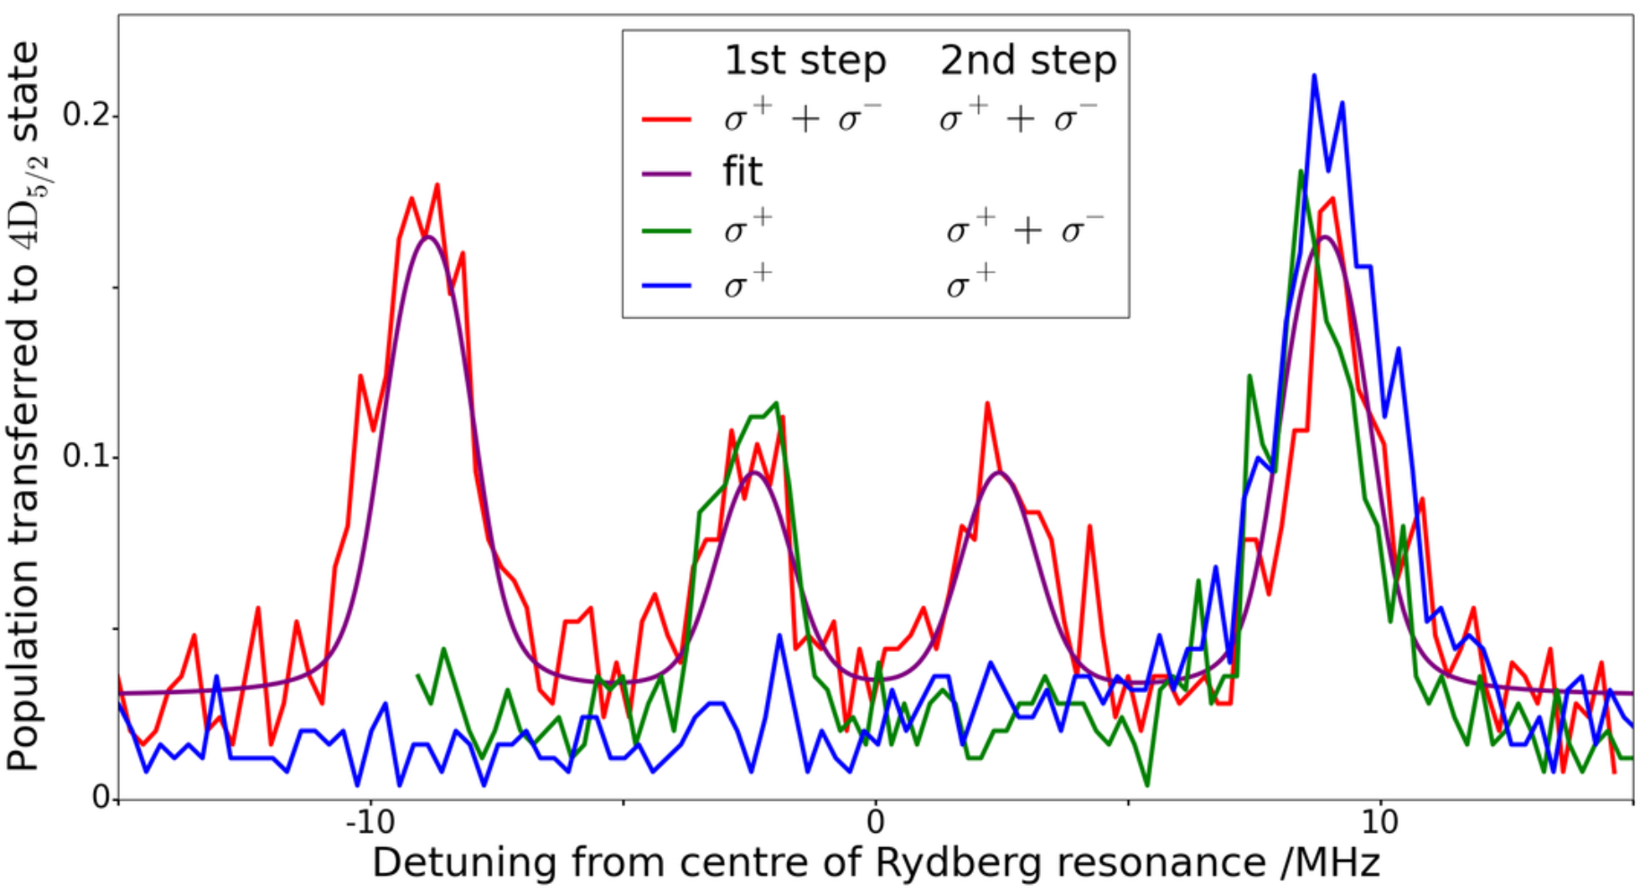
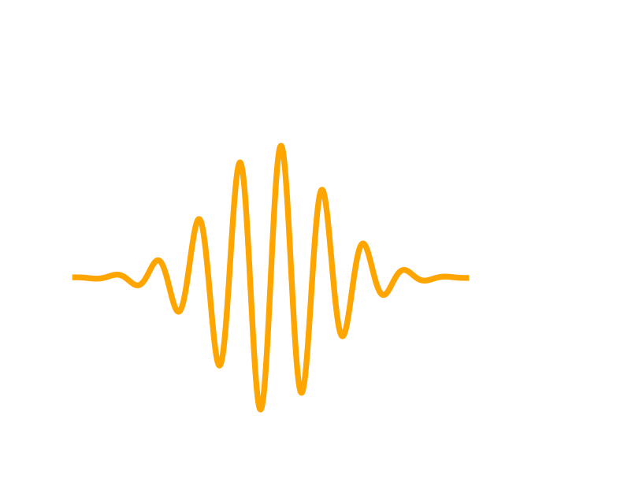
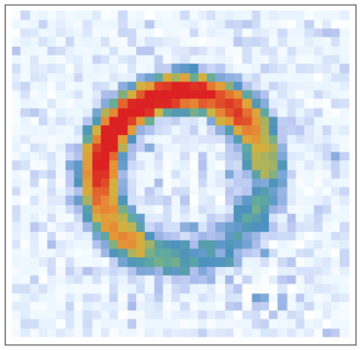
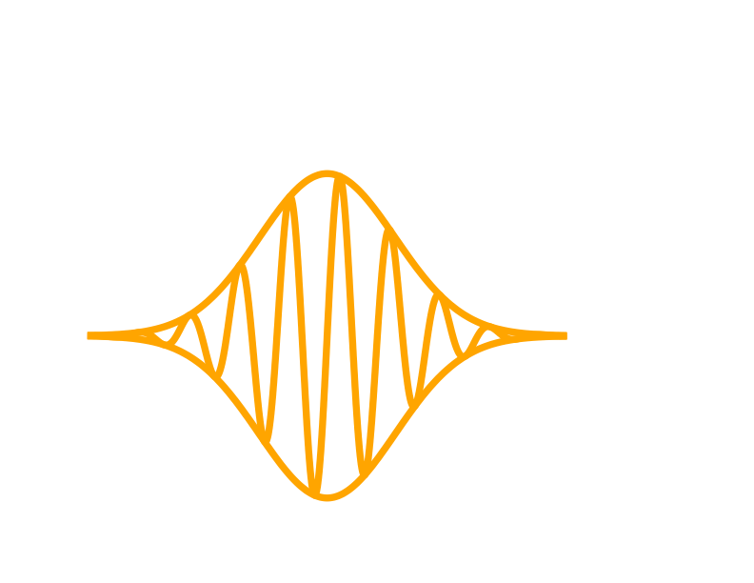
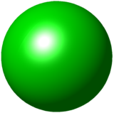


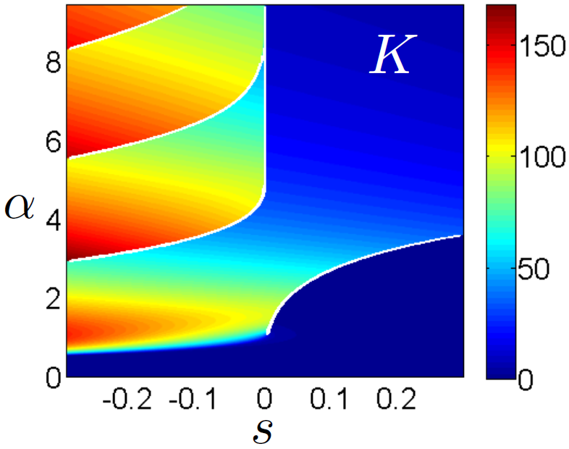
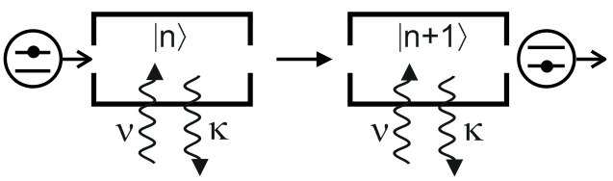
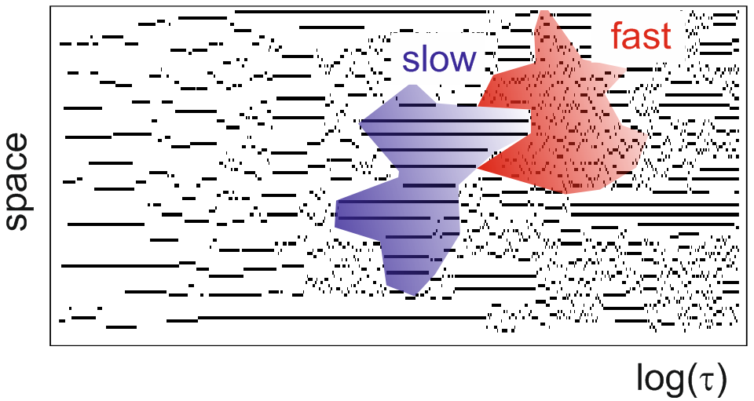
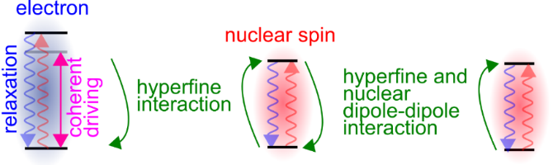
Research at Nottingham
Atomic physics and quantum optics
excited atoms and ions in fields
atom-photon interactions
atom interferometry
Many-body physics (mainly out of equilibrium)
phase transitions in open
many-body quantum systems
strongly correlated
dynamics
Hyperpolarisation
of nuclear ensembles
Open Position

Slide 4
Outline
Cold atomic systems
- Energy scales and length scales
- What does one seek to achieve?
Disclaimer
Long-range interactions
=
interactions that
extend over some distance
Long-range interactions in trapped ions
- few-level systems
- spin-phonon coupling
- effective spin models
(see C. Roos‘ talk on Wednesday)
Atoms and polar molecules
- coupling to the radiation field
- long range interactions and dissipation
- super- and sub-radiance (see R. Kaiser‘s and R. Bachelard‘s talks)
- van-der-Waals vs. dipole-dipole interaction
Static dipoles and dressed interactions

Slide 5
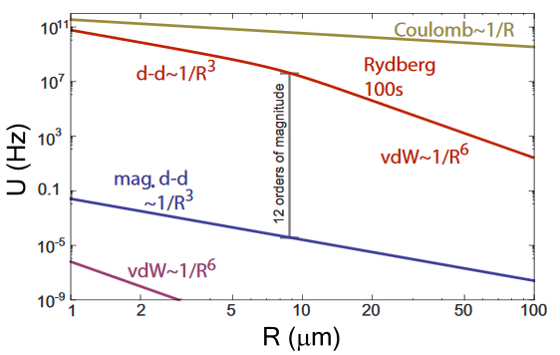
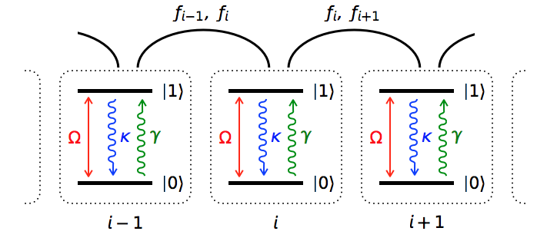
Energy scales and length scales
Rev. Mod. Phys. 82, 2313 (2010)
Trapped ions
5K
pol. mol. d-d
Rydberg atoms
Atoms with large
magnetic moment
Ground state
atoms
Polar molecules
LiCs
KRb
Cr
Dy
Er

Slide 6
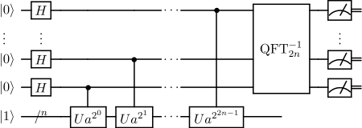
What does one seek to achieve?
Implementation of quantum
computation protocols
Quantum simulation of
many-body spin systems
A. Micheli et al., Nature Physics 2, 341 (2006)

Slide 7













Quantum simulation of spin systems
Polar molecules
J=3
Few level approximation
J=2
Rotational spectrum
(rigid rotor)
$$∣↑〉$$
fictitious
spin particle
J=1
$$H=B J^{2}$$
$$∣↓〉$$
J=0
$$E\left(J\right)=ℏB J(J+1)$$
Local fields, e.g. laser
Interactions
exchange
density-density
$$∣↑〉$$
$$∣↓〉$$
$$H=V_{12}(∣↑_{1}〉〈↓_{1}∣⊗∣↓_{2}〉〈↑_{2}∣+h.c.)$$
$$H=U_{12}∣↑_{1}〉〈↑_{1}∣⊗∣↑_{2}〉〈↑_{2}∣$$
$$H=Ω(∣↑〉〈↓∣+∣↓〉〈↑∣)$$
$$=V_{12}(σ_{1}^{+}σ_{2}^{−}+σ_{1}^{−}σ_{2}^{+})$$
$$=U_{12}n_{1}n_{2}$$
$$=Ωσ_{x}$$
$=\frac{U_{12}}{4}(σ_{z}^{1}+1)$ $(σ_{z}^{2}+1)$

Slide 8
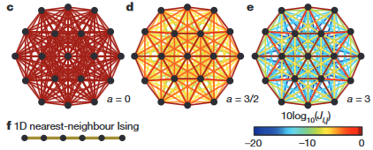
Long-range spin interactions in trapped ion systems

Slide 9
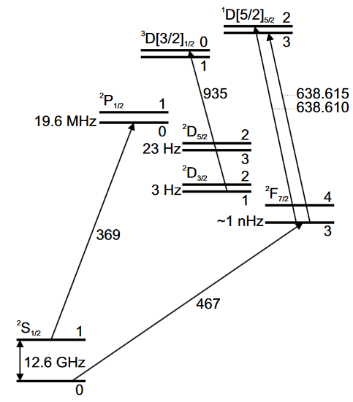




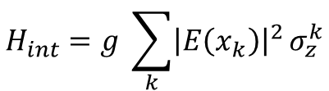
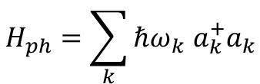



Emergent long-range interactions
Trapped ions
External dynamics – Phonons
$$H_{ph}=\sum_{k}{ℏω_{k} a_{k}^{+}a_{k}}$$
Goal: create coupling between electrons and phonons
to create effective spin-spin interaction
¹⁷¹Yb⁺
AC Stark shift
E(x)…electric field of laser
$$∼\frac{{\left|E\left(x\right)\right|}^{2}}{Δ}$$
$$∣↑〉$$
$$Δ$$
$$∣↓〉$$
$$∼−\frac{{\left|E\left(x\right)\right|}^{2}}{Δ}$$
$$∣↑〉=∣F=1,m_{F}=0〉$$
Position dependent
energy shift:
$$H_{int}=g \sum_{k}{{\left|E\left(x_{k}\right)\right|}^{2}}σ_{z}^{k}$$
$$∣↓〉=∣F=0,m_{F}=0〉$$

Slide 10


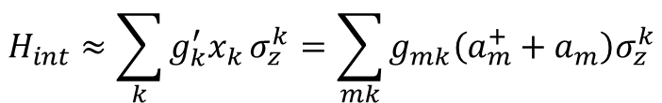
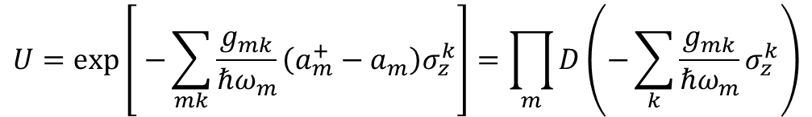
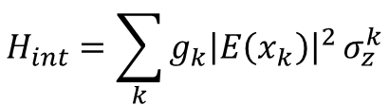
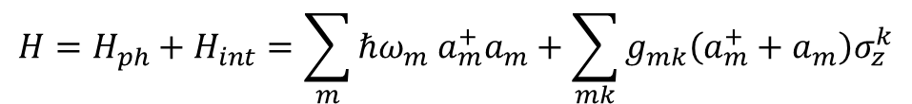

Emergent long-range interactions
Spin-phonon coupling
$$H_{int}=\sum_{k}{{g_{k}\left|E\left(x_{k}\right)\right|}^{2}}σ_{z}^{k}$$
$${\left|E\left(x\right)\right|}^{2}$$
- linear approximation
Ions positioned at nodes of
standing wave laser field
$$H_{int}≈\sum_{k}{{g_{k}^{′}x}_{k}}σ_{z}^{k}=\sum_{mk}{g_{mk}\left(a_{m}^{+}+a_{m}\right)σ_{z}^{k}}$$
Full Hamiltonian
$$H=H_{ph}+H_{int}=\sum_{m}{ℏω_{m} a_{m}^{+}a_{m}+\sum_{mk}{g_{mk}\left(a_{m}^{+}+a_{m}\right)σ_{z}^{k}}}$$
Decoupling between spin and phonon degrees of freedom
Displacement operator
$$U=exp\left[ −\sum_{mk}{\frac{g_{mk}}{ℏω_{m}}\left(a_{m}^{+}−a_{m}\right)σ_{z}^{k}}\right]=\prod_{m}{D\left(−\sum_{k}{\frac{g_{mk}}{ℏω_{m}}σ_{z}^{k}}\right)}$$
$$D^{+}\left(α\right)a D\left(α\right)=a+α$$

Slide 11
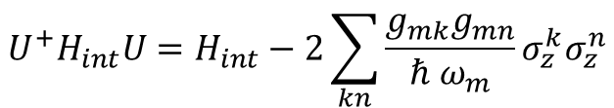
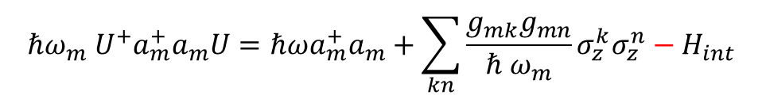
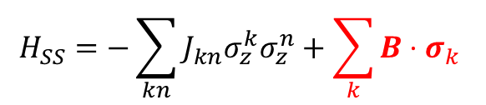
Emergent long-range interactions
…after the unitary transformation
Porras and Cirac, Phys. Rev. Lett. 92, 207901 (2004)
$$ℏω_{m} U^{+}a_{m}^{+}a_{m}U=ℏωa_{m}^{+}a_{m}+\sum_{kn}{\frac{g_{mk}g_{mn}}{ℏ ω_{m}}σ_{z}^{k}σ_{z}^{n}−H_{int}}$$
$$U^{+}H_{int}U=H_{int}−2\sum_{kn}{\frac{g_{mk}g_{mn}}{ℏ ω_{m}}σ_{z}^{k}σ_{z}^{n}}$$
interaction Hamiltonian gets cancelled out
phonons decouple from the spins
Effective spin-spin interaction
$$H_{SS}=−\sum_{kn}{J_{kn}σ_{z}^{k}σ_{z}^{n}}+\sum_{k}{B⋅σ_{k} }$$
interaction coefficients J_{kn} can give rise to long-range interactions
J_{kn} can be tuned (ferromagnetic, antiferromagnetic, frustrated)

Slide 12
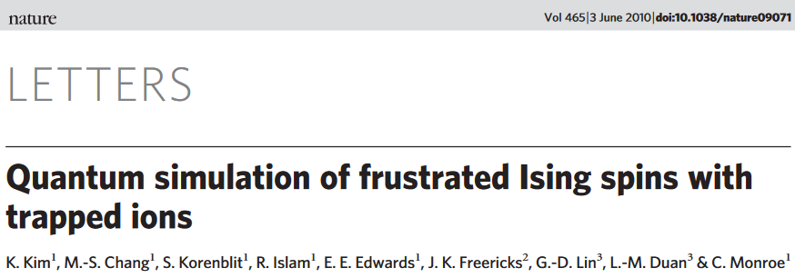
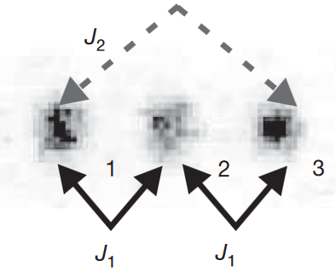
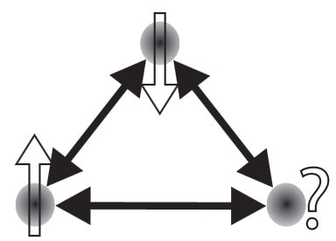
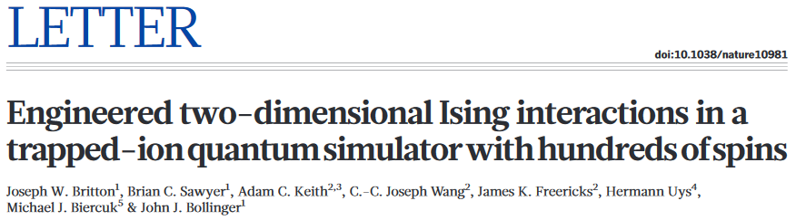
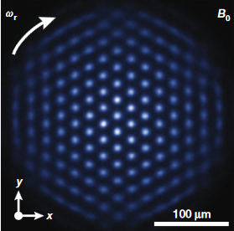
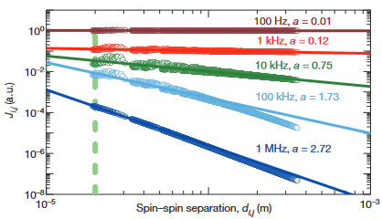
Experiments
see also C. Roos’
talk on Wednesday

Slide 13
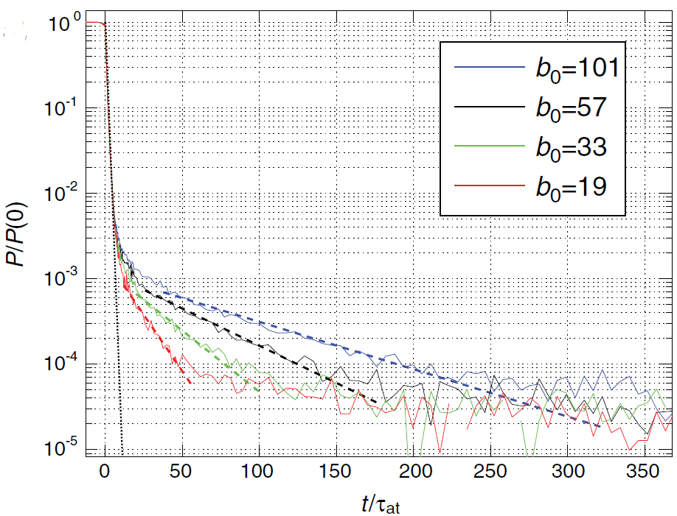
Long-range interactions through photon exchange
---
Collective dissipation

Slide 14
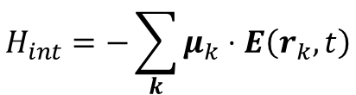
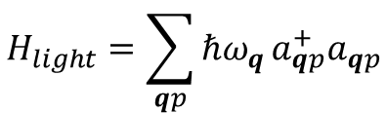
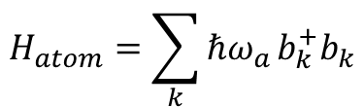



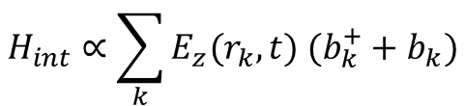

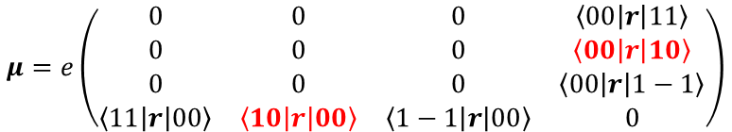
Atoms and molecules in free space
Prototypical example: J=0 → J=1 transition
Lehmberg, Phys. Rev. A 2, 883 (1970)
m=-1
m=0
m=1
$$H_{light}=\sum_{qp}{ℏω_{q}}a_{qp}^{+}a_{qp}$$
J=1
$$ω_{a}$$
q…wave vector
p…polarization
$$ω_{q}=c|q|$$
J=0
single transition
$$H_{atom}=\sum_{k}{ℏω_{a}}b_{k}^{+}b_{k}$$
with
$$b_{k}={|J=0,m=0〉}_{k}〈J=1,m=0|$$
Interaction between atoms and light
dipole coupling:
$$H_{int}=−\sum_{k}{μ_{k}}⋅E\left(r_{k},t\right)$$
$$μ=e\left(\begin{matrix}0 & 0 & 0 & \left\langle 00 | r | 11\right\rangle \\ 0 & 0 & 0 & \left\langle 00 | r | 10\right\rangle \\ 0 & 0 & 0 & \left\langle 00 | r | 1−1\right\rangle \\ \left\langle 11 | r | 00\right\rangle & \left\langle 10 | r | 00\right\rangle & \left\langle 1−1 | r | 00\right\rangle & 0\end{matrix}\right)$$
for |00$〉$ → |10$〉$ transition
$$H_{int}∝\sum_{k}{E_{z}(r_{k},t) (b_{k}^{+}+b_{k})}$$

Slide 15
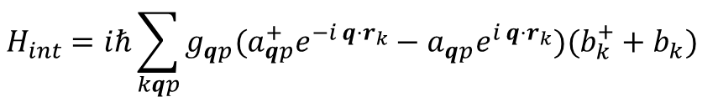
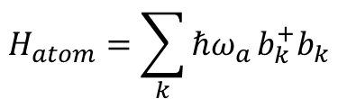

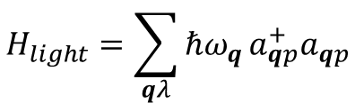

Atoms and molecules in free space
Lehmberg, Phys. Rev. A 2, 883 (1970)
m=-1
m=0
m=1
J=1
q…wave vector
p…polarization
$$ω_{a}$$
J=0
free dynamics
$$H_{int}=iℏ\sum_{kqp}{g_{qp}(a_{qp}^{+}e^{−i q⋅r_{k}}}−a_{qp}^{}e^{i q⋅r_{k}})(b_{k}^{+}+b_{k})$$
$$H_{atom}=\sum_{k}{ℏω_{a}}b_{k}^{+}b_{k}$$
~ electric field
$$g_{qp}=\sqrt{\frac{ω_{q}}{2ε_{0} Vℏ}} μ⋅e_{qp}$$
$$H_{light}=\sum_{qλ}{ℏω_{q}}a_{qp}^{+}a_{qp}$$
coupling constant
…we will find that:
interaction with light mediates dipole-dipole interaction
interaction is not only coherent, but also dissipative (collective decay)
figure of merit for interaction strength and dissipation character:
(transition wavelength)/(interatomic distance)

Slide 16
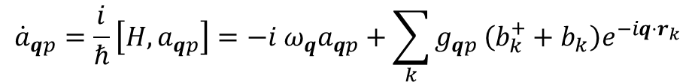
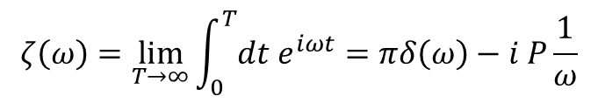

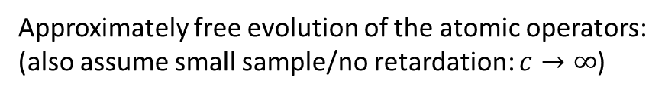
Atoms and molecules in free space
Goal: obtain effective equation of motion for atoms only
Strategy outline:
formally solve Heisenberg equation of motion of radiation field
$${\dot{a}}_{qp}=\frac{i}{ℏ}\left[H,a_{qp}\right]=−i ω_{q}a_{qp}+\sum_{k}{g_{qp }\left(b_{k}^{+}+b_{k}\right)e^{−iq⋅r_{k}}}$$
$$a_{qp}\left(t\right)=e^{−iω_{q}t}a_{qp}\left(0\right)+\sum_{k}{e^{−iq⋅r_{k}}g_{qp}\int_{0}^{t}{dτ e^{iω_{q}(τ−t)}}}\left(b_{k}^{+}(τ)+b_{k}\left(τ\right)\right)$$
Approximately free evolution of the atomic operators:
(also assume small sample/no retardation: $c→∞$)
$$b_{k}\left(τ\right)≈b_{k}\left(t\right)e^{−{iω}_{a}\left(τ−t\right)}$$
$$ζ\left(ω\right)=\lim_{T→∞}\int_{0}^{T}{{dt e}^{iωt}}=πδ\left(ω\right)−i P\frac{1}{ω}$$
then using
(Heitler zeta-function)
dissipation’
$$a_{qp}\left(t\right)=e^{−iω_{q}t}a_{qp}\left(0\right)+\sum_{k}{e^{−iq⋅r_{k}}g_{qp}}\left(b_{k}^{+}\left(t\right)ζ(ω_{q}−ω_{a})+b_{k}\left(τ\right)ζ(ω_{q}+ω_{a})\right)$$
→ relation between electromagnetic field and atomic
operators that is local in time

Slide 17


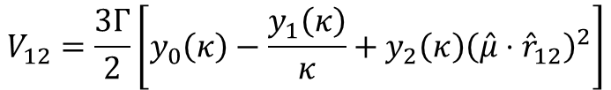
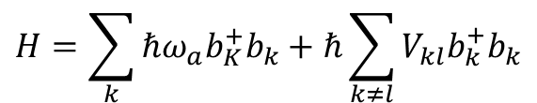

Interaction vs. dissipation
Equation of motion for atomic density matrix $ρ$
Coherent dynamics
Lindblad master equation
$$\dot{ρ}=−\frac{i}{ℏ}\left[H,ρ\right]+D(ρ)$$
Hamiltonian
“Flip-Flop” interaction
$$H=\sum_{k}{ℏω_{a}b_{K}^{+}b_{k}+ℏ\sum_{k≠l}{V_{kl}b_{k}^{+}b_{k}}}$$
…only resonant contributions
V_{kl}
Interaction strength
y_{k}(x) = spherical Bessel
function of 2nd kind
1/r³
$$V_{12}=\frac{3Γ}{2}\left[y_{0}\left(κ\right)−\frac{y_{1}\left(κ\right)}{κ}+y_{2}\left(κ\right){\left(\hat{μ}⋅{\hat{r}}_{12}\right)}^{2}\right]$$
V₁₂/Γ₀
reduced
distance
$$κ=\frac{2π|r_{12}|}{λ}$$
r₁₂/λ

Slide 18
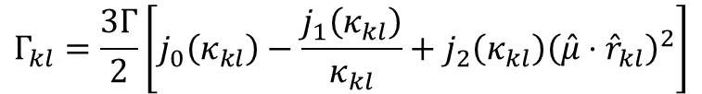
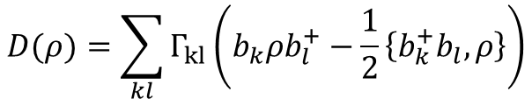



Interaction vs. dissipation
Equation of motion
Dissipative dynamics
Lindblad master equation
$$\dot{ρ}=−\frac{i}{ℏ}\left[H,ρ\right]+D(ρ)$$
Dissipator
Photon emission
- coupling to mode continuum leads to
irreversible decay
$$D(ρ)=\sum_{kl}{Γ_{kl}}\left(b_{k}ρb_{l}^{+}−\frac{1}{2}\left\{b_{k}^{+}b_{l},ρ\right\}\right)$$
Decay rate
$$Γ_{kl}=\frac{3Γ}{2}\left[j_{0}\left(κ_{kl}\right)−\frac{j_{1}\left(κ_{kl}\right)}{κ_{kl}}+j_{2}\left(κ_{kl}\right){\left(\hat{μ}⋅{\hat{r}}_{kl}\right)}^{2}\right]$$
for $κ_{kl}≫1$ atoms
decay at rate $γ=Γ_{}$
For $κ_{kl}≪1$ decay
becomes collective
with
$$κ_{kl}=\frac{2π|r_{kl}|}{λ}$$
and
j_{k}(x) = spherical Bessel
function of 1st kind

Slide 19








Super and sub-radiance
Collective decay
- Example: two atoms
interaction
Γ₁₂/Γ
$$D(ρ)=\sum_{kl=1,2}{Γ_{kl}}\left(b_{k}ρb_{l}^{+}−\frac{1}{2}\left\{b_{k}^{+}b_{l},ρ\right\}\right)$$
V₁₂/Γ
- extreme case: $κ_{12}→0$
Coefficient matrix:
$$Γ=Γ_{}\left(\begin{matrix}1 & 1 \\ 1 & 1\end{matrix}\right)$$
r₁₂/λ
- dissipator is brought into diagonal
form by introducing collective modes
$$S_{1}=\frac{{(b}_{1}+b_{2})}{\sqrt{2}}$$
$$S_{2}=\frac{{(b}_{1}−b_{2})}{\sqrt{2}}$$
$$D(ρ)=\sum_{k=1,2}{γ_{k}}\left(S_{k}ρS_{k}^{+}−\frac{1}{2}\left\{S_{k}^{+}S_{k},ρ\right\}\right)$$
$$γ_{1}=2 Γ_{}$$
$$γ_{2}=0$$
Superradiant
mode
Subradiant
modes

Slide 20

Super and sub-radiance
Subradiant states show up in
fluorescence spectrum S(ω)
Phys. Rev. Lett. 110,
143602 (2013)
Subradiant
modes
d in unit of 200 nm
Superradiant
modes

Slide 21


Light scattering off dense atomic gases
talk on Wednesday
increasing
density
Single atom
decay signal

Slide 22




Light scattering off dense atomic gases
$$∣↑〉$$
$$Δ$$
$$∣↓〉$$
Position of atomic resonance line
exp. data
$$Δ/Γ$$
increasing
density
Conventional meanfield theory predicts lineshift proportional to density
however: lineshift absent in experiment
Shift can be (theoretically) produced by assuming inhomogeneous broadening

Slide 23




Dipole-dipole, van-der-Waals and dressed interactions
E/($\frac{{2Ω}^{4}}{Δ^{3}}$)
$$∝1/r_{12}^{3}$$
$$r_{12}/R_{c}$$

Slide 24





van der Waals vs. dipole-dipole
- Near field: static dipole-dipole interactions
$$V_{dd}=\frac{1}{4πε_{0}}\frac{d_{1}⋅d_{2}−3 (d_{1}⋅ {\hat{r}}_{12})(d_{2}⋅ {\hat{r}}_{12})}{{|r}_{12}{\left.​\right|}^{3}}$$
$$d_{k}$$
…dipole operator
- Interaction between two polar molecules in their ground state
J=3
Polar molecules
$$∣↑〉$$
$$∣↑〉$$
J=2
$$ω_{a}$$
$$∣↓〉$$
$$∣↓〉$$
J=1
Dipole operator:
$$d_{k}=d σ_{x}e_{x}$$
J=0
Hamiltonian
$$H=ℏ\left(\begin{matrix}{2 ω}_{a} & 0 & 0 & 0 \\ 0 & ω_{a} & 0 & 0 \\ 0 & 0 & ω_{a} & 0 \\ 0 & 0 & 0 & 0\end{matrix}\right)+\frac{d^{2}}{{4πε_{0}r}_{12}^{3}}\left(\begin{matrix}0 & 0 & 0 & 1 \\ 0 & 0 & 1 & 0 \\ 0 & 1 & 0 & 0 \\ 1 & 0 & 0 & 0\end{matrix}\right)$$

Slide 25





van der Waals vs. dipole-dipole
Ground state energy
characteristic
length scale
$$E_{↓↓}={ℏω}_{a}−\sqrt{{\left(\frac{d^{2}}{{4πε_{0}r}_{12}^{3}}\right)}^{2}+{\left(ℏω_{a}\right)}^{2}}=\left\{\begin{matrix}−\frac{d^{2}}{{4πε_{0}r}_{12}^{3}}, { r}_{12}≪{\left(\frac{d^{2}}{4πε_{0}ℏω_{a}}\right)}^{\frac{1}{3}} \\ −\frac{1}{2 ℏω_{a}}{\left(\frac{d^{2}}{{4πε_{0}r}_{12}^{3}}\right)}^{2},r_{12}≫{\left(\frac{d^{2}}{4πε_{0}ℏω_{a}}\right)}^{\frac{1}{3}}\end{matrix}\right.$$
Dipole-dipole interaction
$$\frac{1}{r_{12}^{3}}$$
Van-der-Waals interaction
interaction is not large enough
to overcome single particle energy
gap $ω_{a}$→ van-der-Waals interaction
$$\frac{1}{r_{12}^{6}}$$

Slide 26



Polar molecules and static dipoles
Polar molecule in strong electric field (z-direction)
$$H={BJ}^{2}+d E z$$
Strong field
- hybridises states
- energy proportional
to field strength
- static dipole moment
θ
Field-free states
- spherically symmetric
- no permanent dipole moment
$$V_{dd}=\frac{d^{2}}{4πε}\frac{1−3 \cos^{2}(θ)}{r^{3}}$$

Slide 27











Dressed interactions
select state with static dipole moment
to state without static dipole moment
couple them off-resonantly with laser
|10>
$$∣↓〉$$
$$∣↑〉$$
|00>
$$Δ$$
$$Ω$$
$$∣↓〉$$
$$∣↑〉$$
$H_{1}=Δ∣↑〉〈↑∣+$ $Ω(∣↑〉〈↓∣$+ $∣↓〉〈↑∣)$
only $∣↑〉$-states interact
$$H_{int}=\frac{d^{2}}{4πε_{0}r_{12}^{3}}∣↑_{1}〉〈↑_{1}∣⊗∣↑_{2}〉〈↑_{2}∣$$
prepare particles in $∣↓〉$-state
calculate effective interaction through virtual excitation to $∣↑〉$-states
(4th order perturbation theory in $Ω/Δ)$

Slide 28











Dressed interactions
Dressed state potential
E/($\frac{{2Ω}^{4}}{Δ^{3}}$)
$$∝1/r_{12}^{3}$$
long-range: 1/r³ – tail
short-range: flat top
$$R_{c}={\left(\frac{4πε_{0}Δ}{d^{2}}\right)}^{\frac{1}{3}}$$
length scale:
$$r_{12}/R_{c}$$
blockade regime
dressed regime
$$∣↑↑〉$$
$$∣↑〉$$
dressed atomic state
$$Δ$$
$$|G〉=∣↓〉−i\frac{Ω}{Δ}∣↑〉$$
- interacting level too far off-resonant
(even virtual excitation strongly
suppressed)
$$∣↓〉$$
interaction energy
$$∣↓↑〉$$
$$∣↑↓〉$$
$$\left\langle G_{1}G_{2} | H_{int} | G_{1}G_{2}\right\rangle =\frac{Ω^{4}}{Δ^{4}}\frac{d^{2}}{4πε_{0}r_{12}^{3}}$$
$$∣↓↓〉$$

Slide 29



Experimental realisation
¹³³Cs
tomorrow’s subject (see also R. Löw)
MW-spectroscopy

Slide 30





Dressed interactions - Outlook
- Ensemble of bosons in 2d form crystals of
superfluid droplets at low enough temperature
- dressed potentials can be used to engineer
many-body interactions

Slide 31

Summary
cold atoms, molecules and ions allow to engineer spin systems
tuneable power-law interactions
  exchange interactions
  dipole-dipole interactions
  van-der-Waals interactions
  dressed-state interactions
Rydberg atoms
interactions mediated through photon exchange
  collective dissipation → super and sub-radiance
tomorrow:
interacting atoms in Rydberg states
many-body dynamics with competing
classical and quantum dynamics
dynamics in more than statics
non-equilibrium phase transitions

