Slide 1
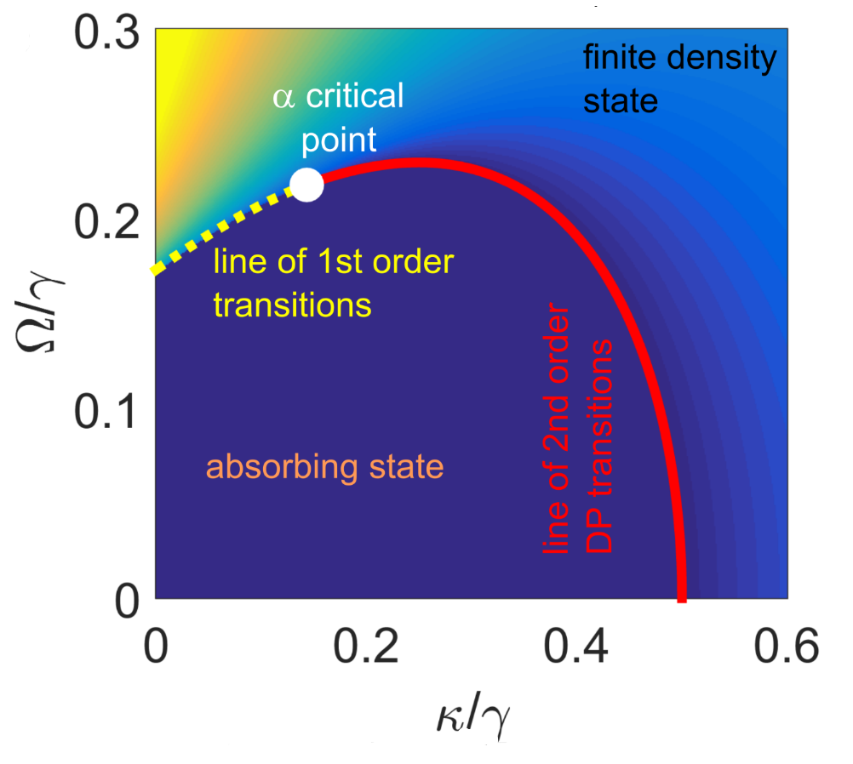
Out-of-equilibrium dynamics of long-range interacting Rydberg gases
Igor Lesanovsky
Trieste 26/07/16

Slide 2
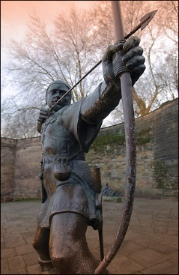
Nottingham
Postdocs
Carlos Espigares Perez
Ricardo Gutierrez
Alexander Karabanov
Zhihao Lan
Emanuele Levi Matteo Marcuzzi
Jiri Minar Pietro Rotondo
PhD-students
Ben Everest
Andreas Kouzelis
Katarzyna Macieszcziak
Dominic Rose
Daniel Wisniewski
Local collaborators
B. Olmos
J. P. Garrahan M. Guta
A. Armour
W. Li
W. Köckenberger

Slide 3
Outline
1) ,Soft-matter‘ physics with excited atoms
- dynamics is more than statics (kinetic constraints)
- atomic physics (Rydberg atoms)
- limit of strong noise and emergent kinetic constraints
2) Self-similar relaxation dynamics
- connection of Rydberg gas dynamics to deposition problem
- scaling solution
3) Non-equilibrium phase transition
- signatures of directed percolation universality
- quantum effects
4) Connection to a problem of ,the real world‘
- Dynamical Nuclear Polarisation as constrained diffusion

Slide 4
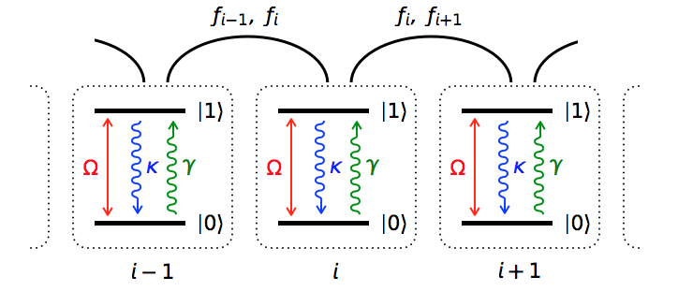
Dynamics is more than statics...
Non-interacting system
Kinetically constrained system
- Spins flip only if their left neighbour is excited
- Spins flip independently
Different dynamics
Stationary state is the same
Idealized Models of glasses (FA, East)

Slide 5
,Rydberg soft-matter‘
Are there actual systems with manifest kinetic contraints?
Slow/glassy relaxation
emergence of new timescales
transient phenomena – metastability
non-equilibrium stationary states
Cold gases of interacting excited (Rydberg) atoms
Collective dynamics
nucleation, aggregation, growth
Quantum effects
degree of „quantumness“ is controllable
Exotic interactions

Slide 6
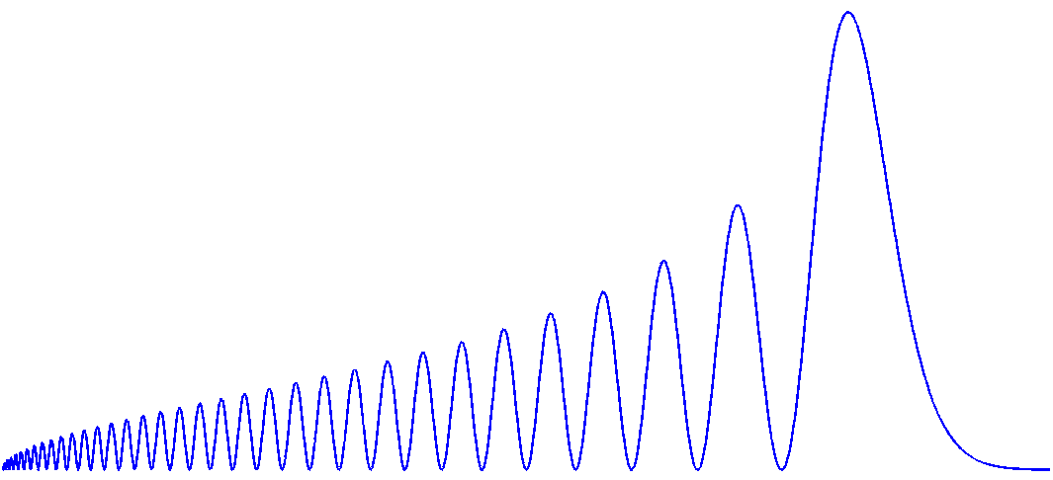
Atoms in Rydberg states
Energy level spectrum
-
n+1
Core
+
100 nm – 1 µm
n
ns
n-1
121 nm
Rubidium 39s
radial density
quantum defect: δ(l>4)$≈$0
r

Slide 7
Atoms in Rydberg states
- hydrogen-like
- simple level structure
long lifetime τ ~ n^{3...5} (τ $≈$100 µs)
large displacement between charges
Rydberg atoms s-states interact via van-der-Waals interaction
- scaling analysis shows: C₆ $∝$ n¹¹ !!!!!
- for typical n-values (n=40…80) the interaction is 10 orders of magnitudes stronger than between ground state atoms

Slide 8
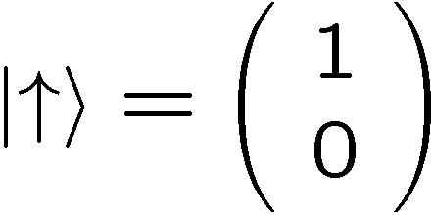
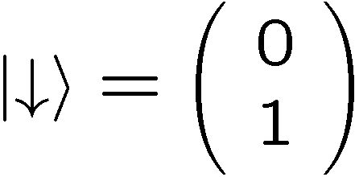
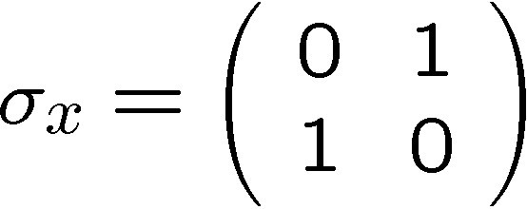
Rydberg atoms as (pseudo)spins
Energy level spectrum
n+1
n
Rydberg states
ns
n-1
Hamiltonian
Rabi frequency
Detuning
Excitation laser
Ground state

Slide 9
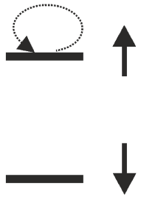
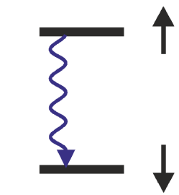
Quantum many-body dynamics
- Spin ½ approximation: |$\left.↓\right\rangle$=ground state, |$↑〉$=Rydberg state
- dynamics is described by a Lindblad Master equation
Hamiltonian (atoms at positions r_{k})
Jump operators
$$γ$$
dephasing
Rabi frequency
detuning
interaction
van-der-Waals interaction
decay
Γ

Slide 10
Effective dynamics @ strong noise
evolution governed by Q-Master equation → difficult to solve
exploit separation of time-scales
fast
slow
‚classical‘ energy
dephasing noise
take into
account
perturbatively
laser excitation
only classical configurations
remain

Slide 11
Effective (slow) dynamics
Goal: obtain effective evolution in classical subspace by
„Integrating out the fast degrees of freedom“
State space
Liouville space
γ+i(Δ+V)
States featuring coherent superpositions
that dephase fast
Ω
Weak couplings
Ω
$$μ$$
classical
configurations
=
space we are interested in
... the rest is second order perturbation theory

Slide 12
Effective master equation
- formal derivation in [Marcuzzi et al., J. Phys. A 47, 482001 (2014)]
Kinetic constraint
Flipping dynamics of
non-interacting spins
- non-trivial dynamics
- trivial stationary state

Slide 13
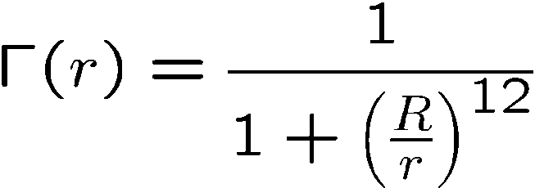
Kinetic constraints/facilitation
Resonant excitation
Off-resonant excitation (detuning ±)
Constraint function
blockaded/slow
free/fast
resonant atom
excited atom
excited atom
r
r
Interaction parameter
(,,blockade length’’)
Facilitation radius
Exp (Stuttgart): Urvoy et al. PRL 114, 203002 (2015)

Slide 14
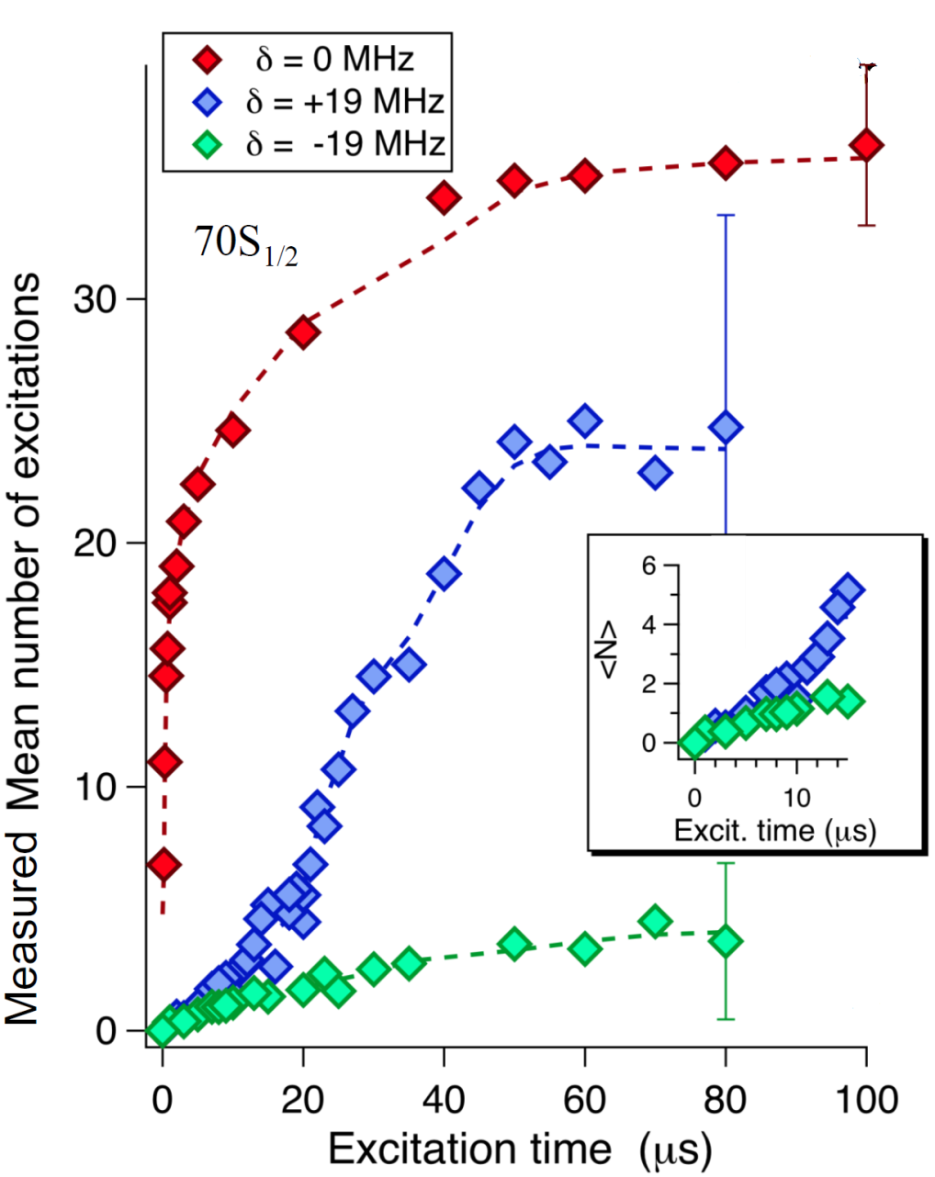
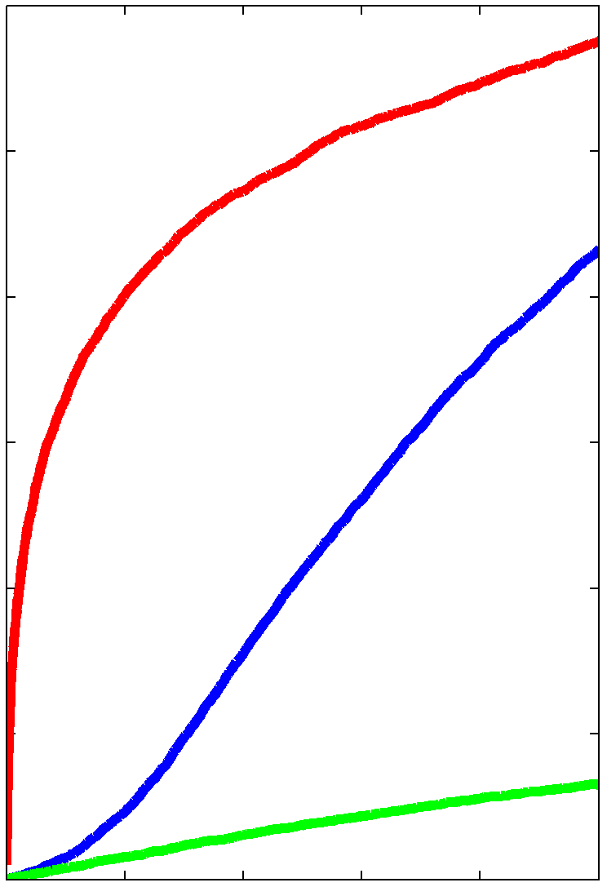
Kinetic constraints are real
Pisa experiment (O. Morsch) Phys. Rev. A 93, 040701 (2016)
resonant
resonant
facilitation
facilitation
Number of excitations
always off-resonant
always off-resonant
time

Slide 15
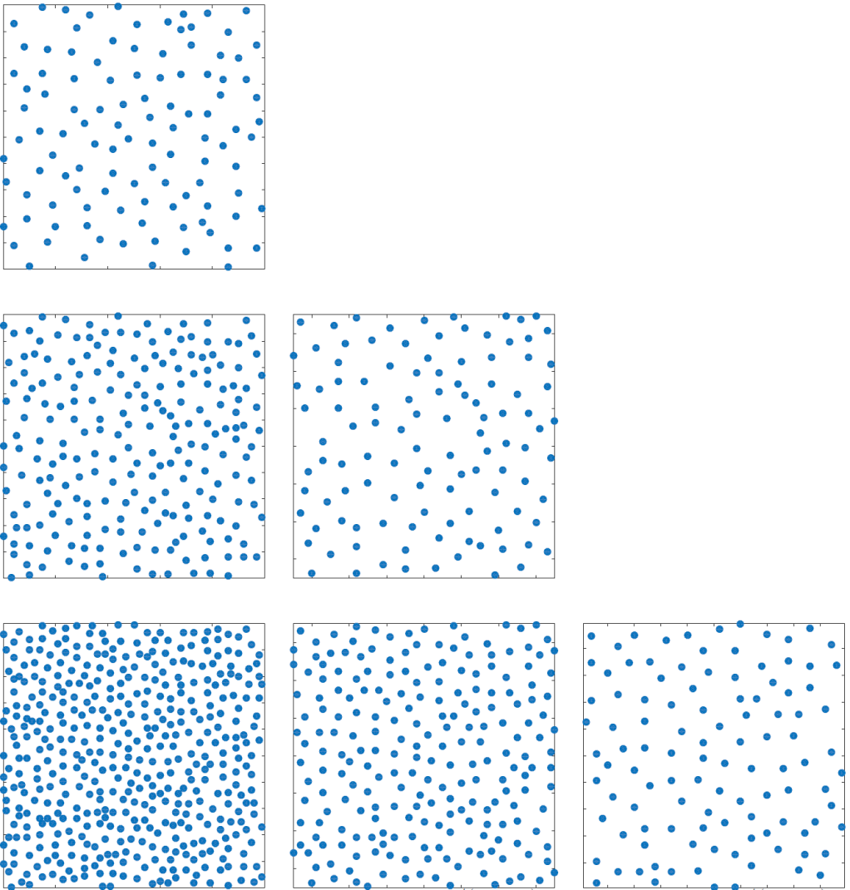
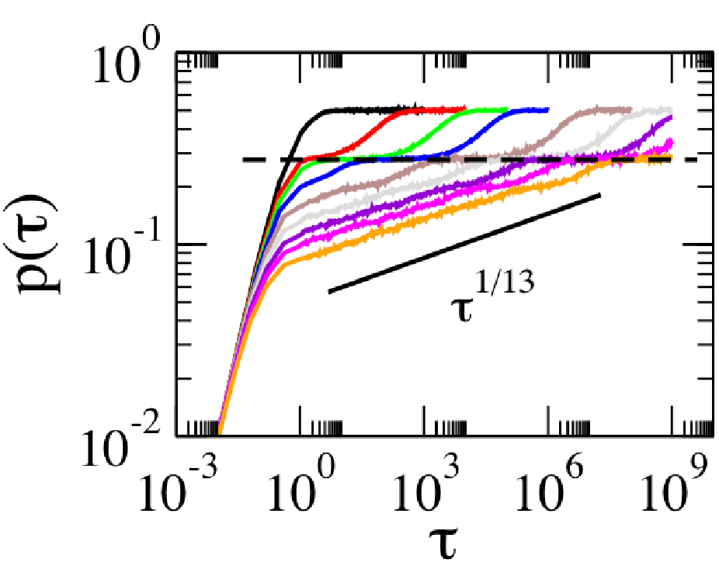
...closer look at resonant dynamics
Snapshots of two-dimensional system (driven on resonance)
Power-law growth of density (1d)
Increasing interaction
R=1
R=8
time
initially
uncorrelated
PRL 111, 215305 (2013)
PRE 92, 062144 (2015)
,self-similar’
evolution
inverse length scale

Slide 16
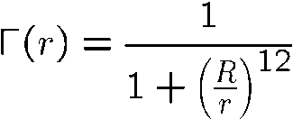
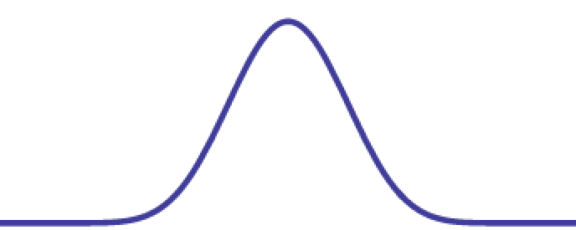
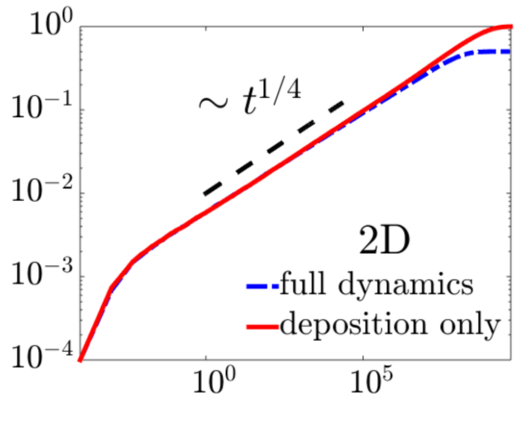
Relaxation dynamics
Why this scale invariant relaxation?
rate function highly peaked
excitation is dominant process (reminiscent of deposition dynamics)
rate
Position of excitation
density
...dynamics proceeds more or less like this
time

Slide 17
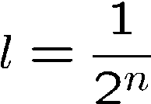
Analytical solution
Think in term of particle distances
Approximations
l
Excitation rate in strongly interacting limit:
l/2
l/2
l/4
l/4
l/2
Distances are ,quantised’
Rate equation for interparticle distance distribution $π_{n}\left(t\right)$
PRE 92, 062144 (2015)
connected to interaction
power law: 2α+1
$$V\left(r\right)=\frac{C_{α}}{r^{α}}$$
Continuum limit (n$→$x):

Slide 18
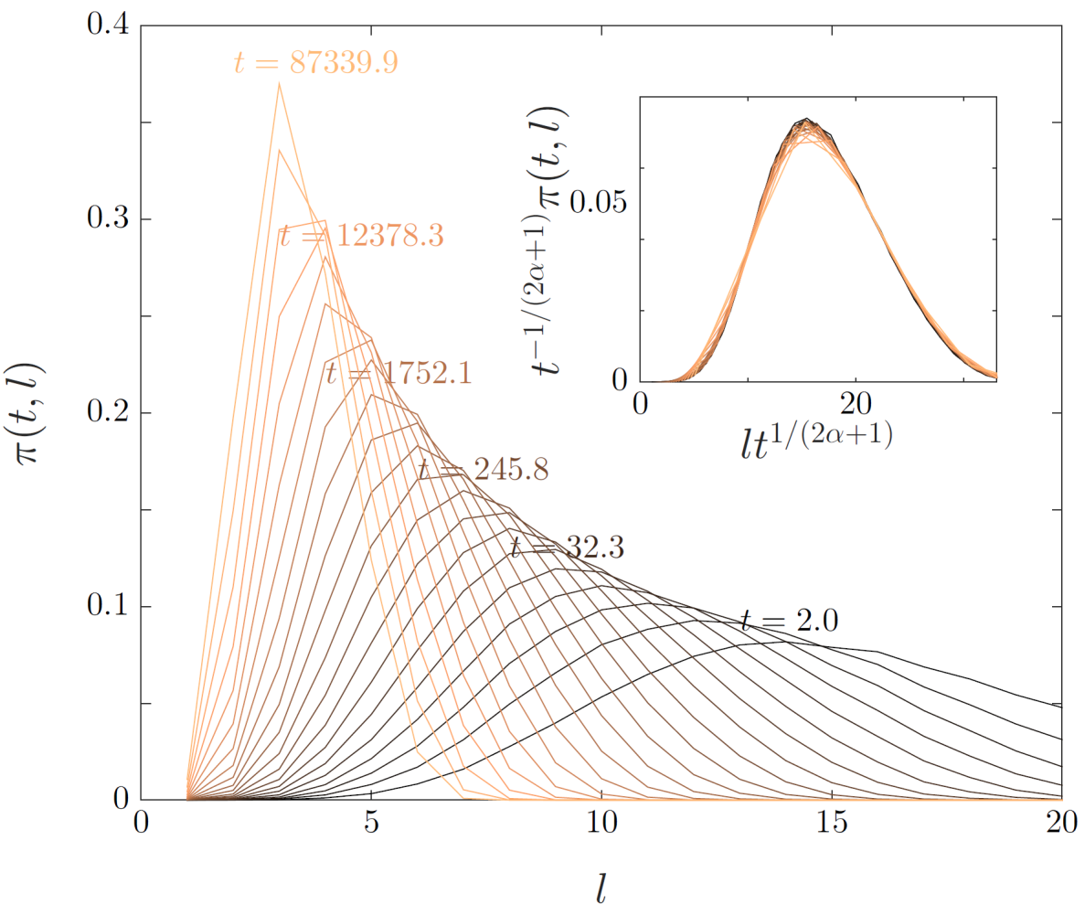
Self-similar evolution
Self-similar solution
Conclusions
surprisingly non-trivial behaviour in ,most basic’ experiment with interacting Rydberg atoms
long times
at short times the excitations are created randomly
once interparticle spacing is below blockade length R the system looks the same at all times provided that one rescales the lengths accordingly
short times

Slide 19
Higher dimensions
reasoning works equally well also in higher dimensions
self-similar evolution is also present here

Slide 20
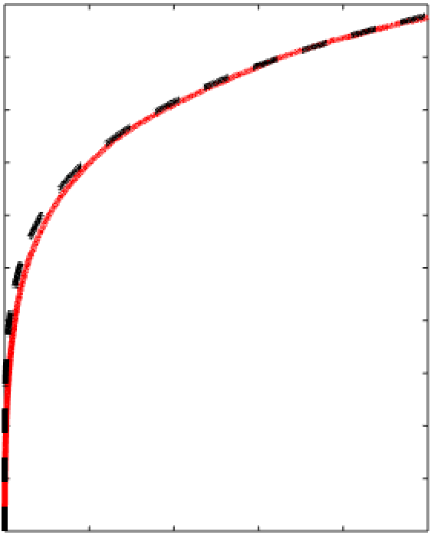
Experimental signatures?
Pisa experiment
3D Data
- expected exponent: 1/5
resonant
Number of excitations
red: numerics black: t^{1/5} curve
time

Slide 21
Off-resonant excitation dynamics and a non-equilibrium phase transition

Slide 22
A non-equilibrium phase transition
The contact process
Local dynamical rules:
Unique absorbing state (no active sites)
$$Γ$$
$$λ$$
single-component order parameter:
density of active sites
DECAY
BRANCHING

Slide 23
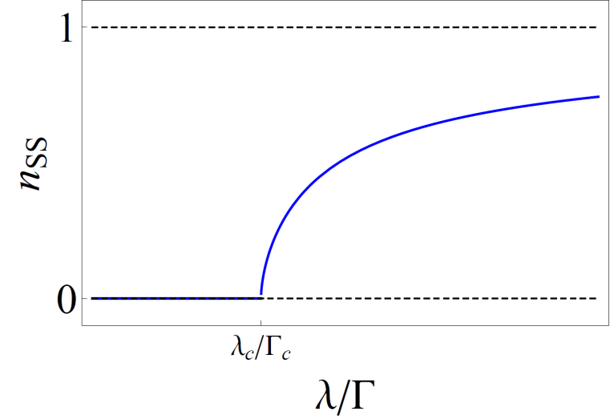
A non-equilibrium phase transition
The contact process
Local dynamical rules:
Unique absorbing state (no active sites)
$$Γ$$
$$λ$$
single-component order parameter:
density of active sites
DECAY
INACTIVE PHASE
ACTIVE PHASE
BRANCHING
- transition belongs to directed percolation universality class

Slide 24
Non-equilibrium phase transition
Why is this interesting ?
M Marcuzzi et al., NJP 17, 072003 (2015)
simplest non-equilibrium universality class
currently only one realisation in 2D [Takeuchi et al. PRL 99, 234503 (2007)] and one in 1D [Shi et al. Nat. Phys. 12, 254 (2016)]
How about Rydberg atoms…
branching (facilitated excitation)
$$λ$$
decay (radiative decay)
$$Γ$$
unique absorbing state does not exist, due to
interactions extend beyond nearest neighbour
finite size effects

Slide 25
Numerical experiment
1D System (clean contact process, 50 sites)
Dynamics
Statics
critical curve
collapsed
data
1D System (Rydberg, van-der-Waals interaction, 50 sites)
critical curve bends up after some time
due to spontaneous ,birth’-processes

Slide 26
Quantum vs. classical fluctuations
…so far effective classical model
Coherent excitation and interaction
Decay
Dephasing
Ω
$$γ$$
- remove dephasing to enter the quantum regime
Model Hamiltonian
quantum branching
,Quantum kinetic constraint’

Slide 27
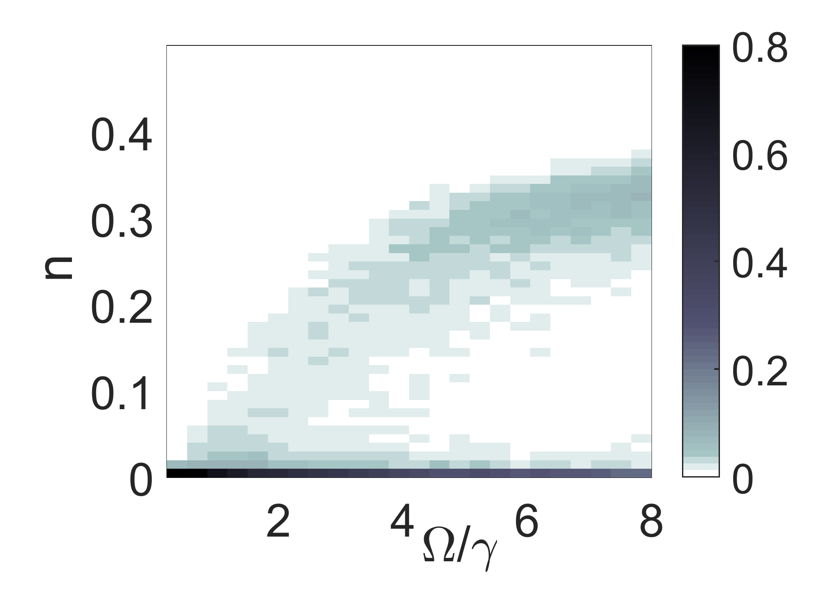
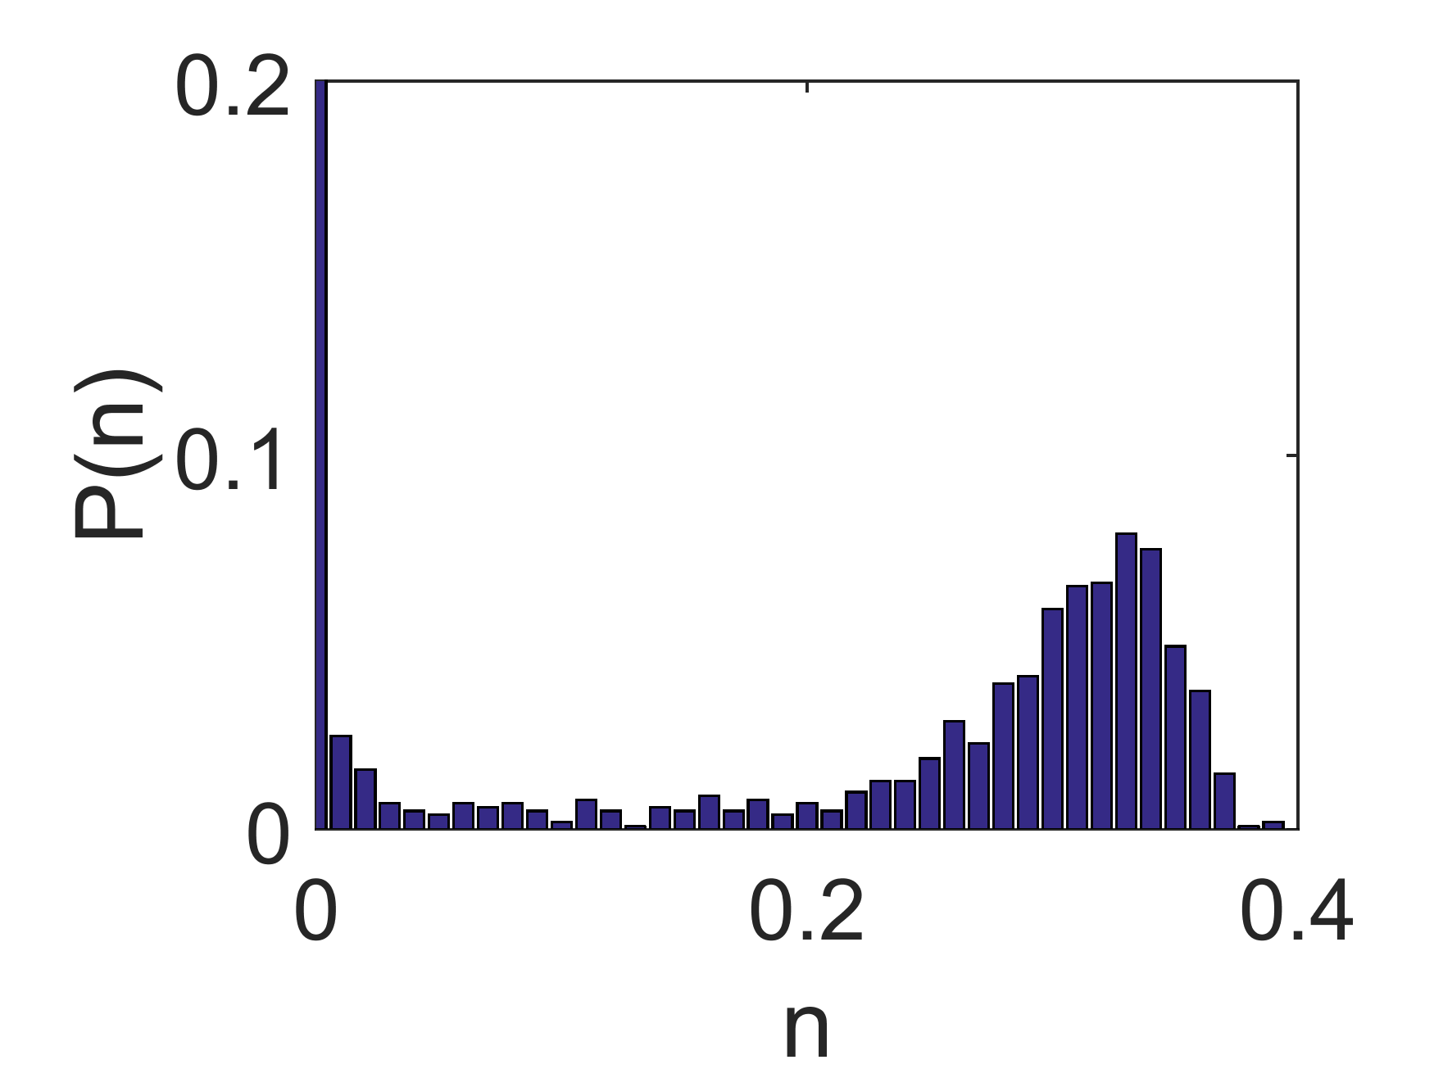
Quantum vs. classical fluctuations
Mean field treatment (stationary density)
n
stable solution
- transition present also in quantum case and is of ,,1st order”
absorbing state
Numerics (12 sites in 1D)
$$Ω/γ$$
- ,steady state’ distribution function
- initial state with n=1
P(n)
$Ω/γ$ = 8
- bimodal distribution suggests 1st order transition

Slide 28
Quantum vs. classical fluctuations
- what if quantum and classical branching compete?
POSTER BY MATTEO MARCUZZI
Phase diagram
First order transition
in limit where quantum processes dominate
quantum
Continuous transition in classical limit
classical
Phys. Rev. Lett. 116, 245701 (2016)

Slide 29
Hyperpolarisation --- Dynamical Nuclear Polarisation

Slide 30
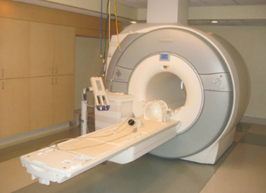
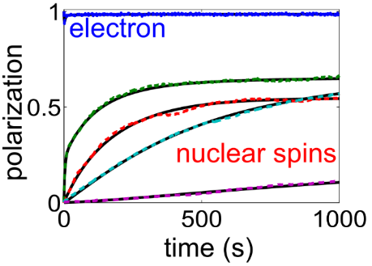
Hyperpolarisation
Magnetic Resonance Imaging
sensitivity depends on polarisation strength
strong B-fields required
Thermal equilibrium:
10⁻⁶ at 300K and B=7 T
brute force: 0.1 at 0.01K and B=14 T
Out of equilibrium: 0.6-0.8 at 1K and B=3-4 T
Dynamical Nuclear Polarisation
|$↑〉$
|$\left.↓\right\rangle$
Paramagnetic centres (electrons) are driven by microwave radiation
Polarisation is transferred to nuclei
Nuclear polarisation spreads

Slide 31
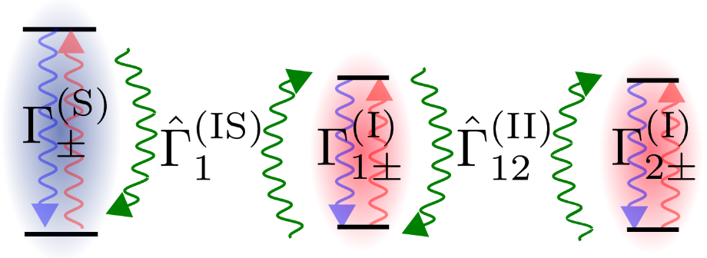
Hyperpolarisation
Challenges for theory
solid: exact
Dashed: effective
understanding of the role of diffusion
simulation of large scale systems
optimisation of Dynamical Nuclear Polarisation
Solution
employ ,Rydberg gas methodology’
analytical forms for diffusion rates
reduction of quantum many-body dynamics to classical kinetically constrained spin system
A. Karabanov, D. Wisniewski, IL, W. Kockenberger, PRL 115, 020204 (2015)
Journal of Magnetic Resonance 264, 30 (2016)

Slide 32
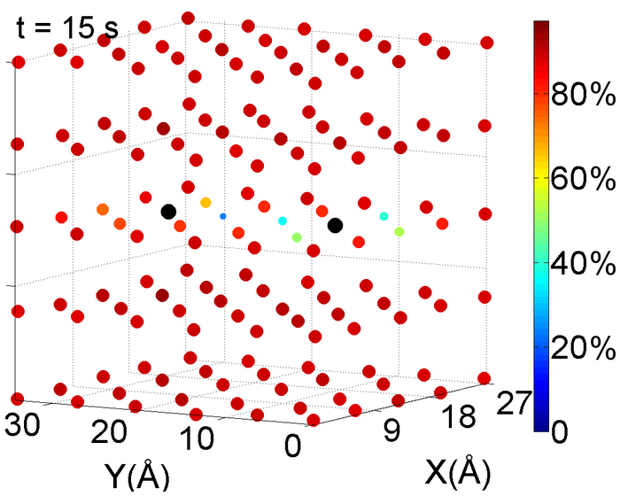
Hyperpolarisation
Example: 1330 ¹³C spins coupled to a single electron (solid effect)
Polarisation buildup
work in progress
two interacting electrons (cross effect)
three-spin interactions accelerate build up
strong dependence on e⁻-e⁻ interaction
three-body processes more important than
two-body processes

Slide 33
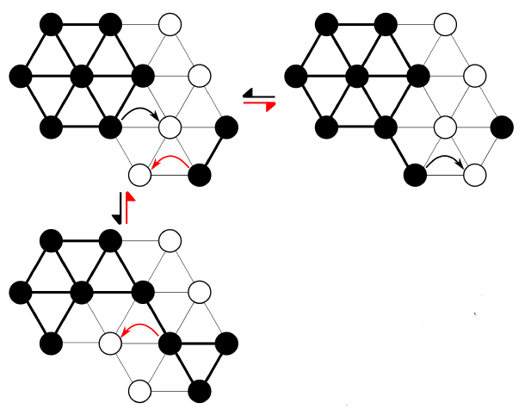
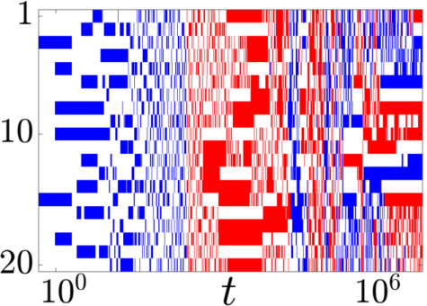
Summary
Rydberg soft matter – kinetic constraints
Most recent …
Classification of kinetic constraints
arXiv:1602.05839 (2016)
M.M. Valado et al., PRA 93, 040701 (2016)
Self-similar relaxation
R. Gutierrez et al., PRE 92, 062114 (2015)
Non-equilibrium phase transition
M. Marcuzzi et al., NJP 17, 072003 (2015)
B. Everest et al., PRA 93, 023409 (2016)
M. Marcuzzi et al., PRL 116, 245701 (2016)
Future
Multi-species systems
Practical applications for NMR Dynamical nuclear polarisation
A. Karabanov et al., PRL 115, 020204 (2015)
D. Wisniewski et al., J. Mag. Res. 264, 30 (2016)

