Slide 1
Parallelism
Overview and Concepts
Notes:
Please feel free to ask questions as we go along

Slide 2
Outline
Decomposition
Geometric decomposition
Task farm
Pipeline
Loop parallelism
General parallelisation considerations
Parallel code performance metrics and evaluation
Parallel scaling models

Slide 3
Why use parallel programming?
It is harder than serial so why bother?

Slide 4
Why?
Parallel programming is more difficult than it’s sequential counterpart
However we are reaching limitations in uniprocessor design
Physical limitations to size and speed of a single chip
Developing new processor technology is very expensive
Some fundamental limits such as speed of light and size of atoms
Parallelism is not a silver bullet
There are many additional considerations
Careful thought is required to take advantage of parallel machines

Slide 5
Performance
A key aim is to solve problems faster
To improve the time to solution
Enable new a new scientific problems to be solved
To exploit parallel computers, we need to split the program up between different processors
Ideally, would like program to run N times faster on N processors
Not all parts of program can be successfully split up
Splitting the program up may introduce additional overheads such as communication

Slide 6
Parallel tasks
How we split a problem up in parallel is critical
Limit communication (especially the number of messages)
Balance the load so all processors are equally busy
Tightly coupled problems require lots of interaction between their parallel tasks
Embarrassingly parallel problems require very little (or no) interaction between their parallel tasks
E.g. ensemble simulations
In reality most problems sit somewhere between two extremes

Slide 7
Decomposition
How do we split problems up to solve efficiently in parallel?

Slide 8
Decomposition
One of the most challenging, but also most important, decisions is how to split the problem up
How you do this depends upon a number of factors
The nature of the problem
The amount of communication required
Support from implementation technologies
We are going to look at some frequently used decompositions

Slide 9
Geometric decomposition
Take advantage of the geometric properties of a problem

Slide 10
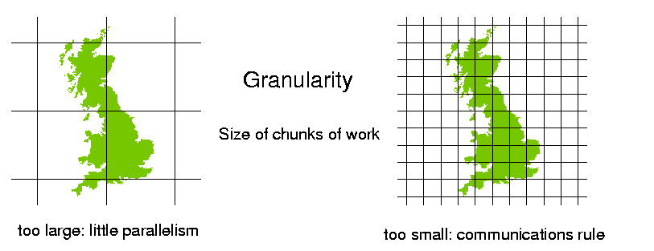
Geometric decomposition
Splitting the problem up does have an associated cost
Namely communication between processors
Need to carefully consider granularity
Aim to minimise communication and maximise computation

Slide 11
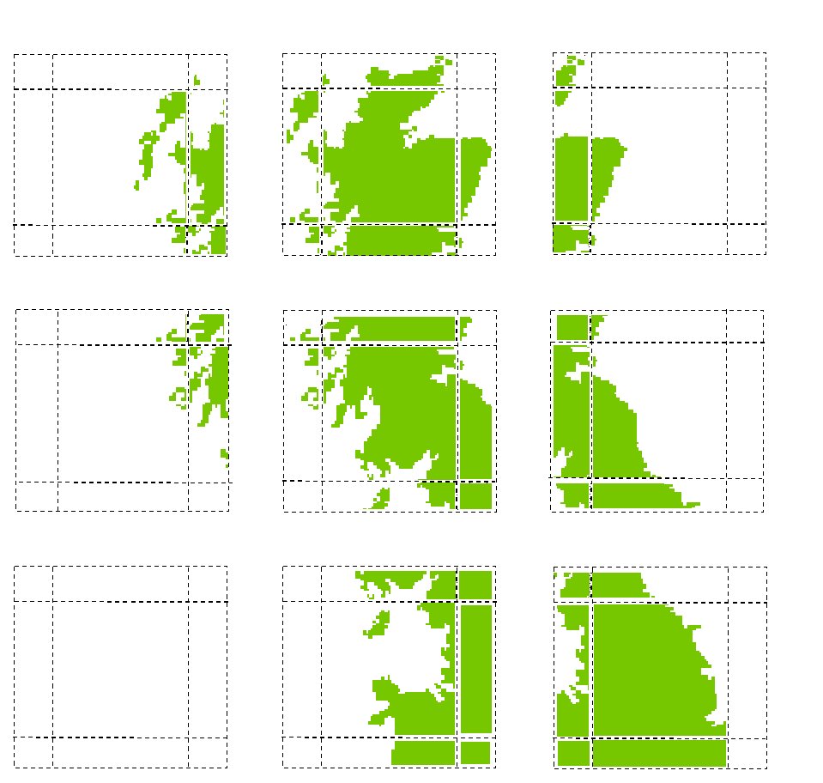
Halo swapping
Swap data in bulk at pre-defined intervals
Often only need information on the boundaries
Many small messages result in far greater overhead

Slide 12
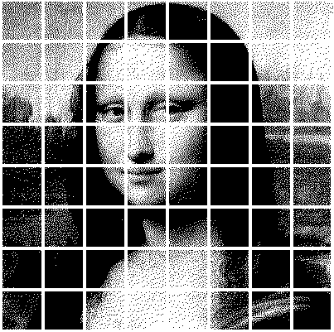
Load imbalance
Execution time determined by slowest processor
each processor should have (roughly) the same amount of work, i.e. they should be load balanced
Address by multiple partitions per processor
Additional techniques such as work stealing available

Slide 13
Task farm (master worker)
Split the problem up into distinct, independent, tasks
Master process sends task to a worker
Worker process sends results back to the master
The number of tasks is often much greater than the number of workers and tasks get allocated to idle workers
If known in advance, order jobs and send largest jobs first
Master
Worker 1
Worker 2
Worker 3
…
Worker n

Slide 14
Task farm considerations
Communication is between the master and the workers
Communication between the workers can complicate things
The master process can become a bottleneck
Workers are idle waiting for the master to send them a task or acknowledge receipt of results
Potential solution: implement work stealing
Resilience – what happens if a worker stops responding?
Master could maintain a list of tasks and redistribute that work’s work

Slide 15
Pipeline
A problem involves operating on many pieces of data in turn. The overall calculation can be viewed as data flowing through a sequence of stages and being operated on at each stage.
Each stage runs on a processor, each processor communicates with the processor holding the next stage
One way flow of data
Data
Result
Stage 1
Stage 2
Stage 3
Stage 4
Stage 5

Slide 16
Examples of pipeline
CPU architectures
Fetch, decode, execute, write back
Intel Pentium 4 had a 20 stage pipeline
Unix shell
i.e. cat datafile | grep “energy” | awk ‘{print $2, $3}’
Graphics/GPU pipeline
A generalisation of pipeline (a workflow, or dataflow) is becoming more and more relevant to large, distributed scientific workflows
Can combine the pipeline with other decompositions

Slide 17
Loop parallelism
Serial programs can often be dominated by computationally intensive loops.
Can be applied incrementally, in small steps based upon a working code
This makes the decomposition very useful
Often large restructuring of the code is not required
Tends to work best with small scale parallelism
Not suited to all architectures
Not suited to all loops
If the runtime is not dominated by loops, or some loops can not be parallelised then these factors can dominate (Amdahl’s law.)

Slide 18
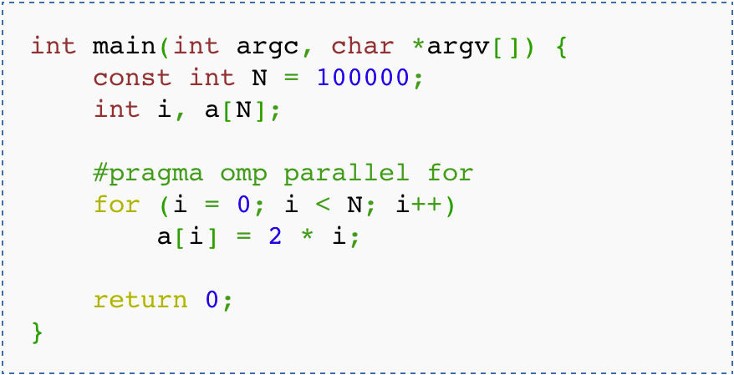
Example of loop parallelism:
If we ignore all parallelisation directives then should just run in serial
Technologies have lots of additional support for tuning this

Slide 19
Performance metrics
How is my parallel code performing and scaling?

Slide 20
Performance metrics
A typical program has two categories of components
Inherently sequential sections: can’t be run in parallel
Potentially parallel sections
Speed up
typically S(N,P) < P
Parallel efficiency
typically E(N,P) < 1
Serial efficiency
typically E(N) <= 1
Where N is the size of the problem and P the number of processors

Slide 21
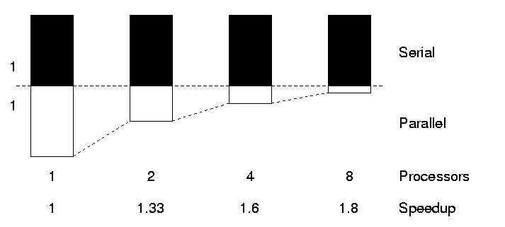
The serial section of code
“The performance improvement to be gained by parallelisation is limited by the proportion of the code which is serial”
Gene Amdahl, 1967

Slide 22
Amdahl’s law
Sharpen & CFD
A fraction, α, is completely serial
Parallel runtime
Assuming parallel part is 100% efficient
Parallel speedup
We are fundamentally limited by the serial fraction
For α = 0, S = P as expected (i.e. efficiency = 100%)
Otherwise, speedup limited by 1/ α for any P
For α = 0.1; 1/0.1 = 10 therefore 10 times maximum speed up
For α = 0.1; S(N, 16) = 6.4, S(N, 1024) = 9.9

Slide 23
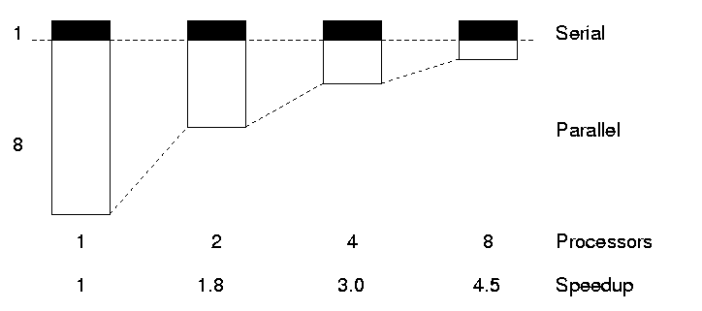
Gustafson’s Law
We need larger problems for larger numbers of CPUs
Whilst we are still limited by the serial fraction, it becomes less important

Slide 24
Gustafson’s Law
If you can increase the amount of work done by each process/task then the serial component will not dominate
Increase the problem size to maintain scaling
This can be in terms of adding extra complexity or increasing the overall problem size.
For instance, =0.1
S(16*N, 16) = 14.5
S(1024*N, 1024) = 921.7
Due to the scaling of N, effectively the serial fraction becomes $∝$/P

Slide 25
Scaling
Scaling is how the performance of a parallel application changes as the number of processors is increased
There are two different types of scaling:
Strong Scaling – total problem size stays the same as the number of processors increases
Weak Scaling – the problem size increases at the same rate as the number of processors, keeping the amount of work per processor the same
Strong scaling is generally more useful and more difficult to achieve than weak scaling

Slide 26
Strong scaling
Runtime (s)
No. of processors

Slide 27
Weak scaling

Slide 28
Summary
There are a variety of considerations when parallelising code
Scaling is important, as the more a code scales the larger a machine it can take advantage of
Metrics exist to give you an indication of how well your code performs and scales
A variety of patterns exist that can provide well known approaches to parallelising a serial problem

