Slide 1
Indian Summer Monsoon simulation by
Superparameterized CFS
P. Mukhopadhyay
Contributing Scientists: Dr. Bidyut B. Goswami (Univ. of Victoria, Canada),
Dr. R. Phani Murali Krishna (IITM Pune), Sourav Taraphdar, Penn State. Univ
Dr. Marat Khairoutdinov (SOMAS, New York Univ. Stony Brook)
ICTP-IITM-COLA Targeted Training Activity (TTA): ICTP, 16 June 2016

Slide 2
MoES Initiative on Short range weather scale forecast using GEFS
ICs ot be provided by NCMRWF for T574 L64
Starting with GFS T574 (SL) L64
Implement EPS
If No
Validation metric and evaluation with control and estimation of skill: check whether satisfactory
Necessary modification (Test bed)
If YES
Implement the whole system in High resolution GEFS T1534

Slide 3
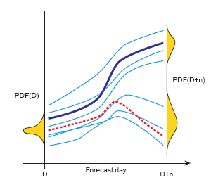
Basis for EPS
Schematic of ensemble prediction. The initial probability PDF(D) represents the initial uncertainties. From the best estimate of the initial state a single deterministic forecast (bold blue solid curve) is performed. This single deterministic forecast fails to predict correctly the future state (red dotted curve). An ensemble of perturbed forecasts (thin blue solid curves) starting from perturbed initial conditions designed to sample the initial uncertainties can be used to estimate the probability PDF(D+n) at the future time D+n.
ECMWF Newsletter No. 90

Slide 4
Scientific Basis
Taraphdar et al.

Slide 5
Outline
What is super in super-parameterization
Superparameterized GCM and ISM
Superparameterized CFS
Lesson Learned

Slide 6
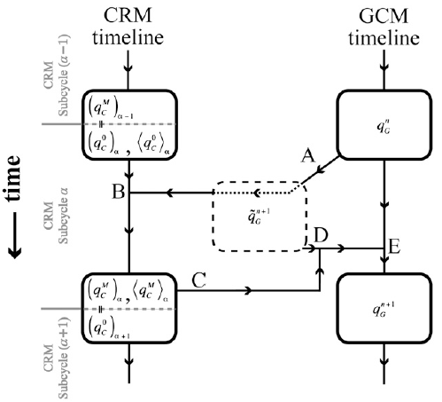
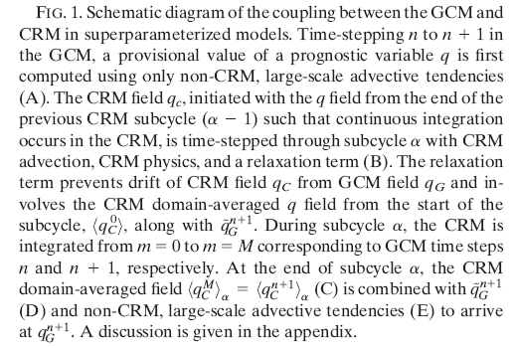
The Concept of Superparameterization
Adopted from BENEDICT AND RANDALL, JAS 2009

Slide 7
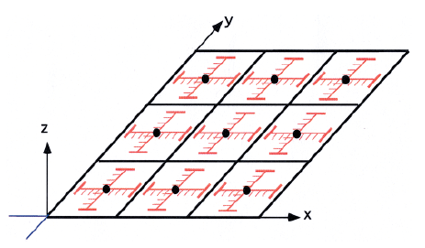
About Superparameterization
The concept first put forward by Grabowski (2001, JAS) and Khaidrotdinov and Randal (2001, GRL). KR01 has coined the word ‘Super parameterization’
Randal et al (2003, BAMS)
A typical grid in super parameterizattion
3D CRM
Randal et al. 2003, BAMS

Slide 8
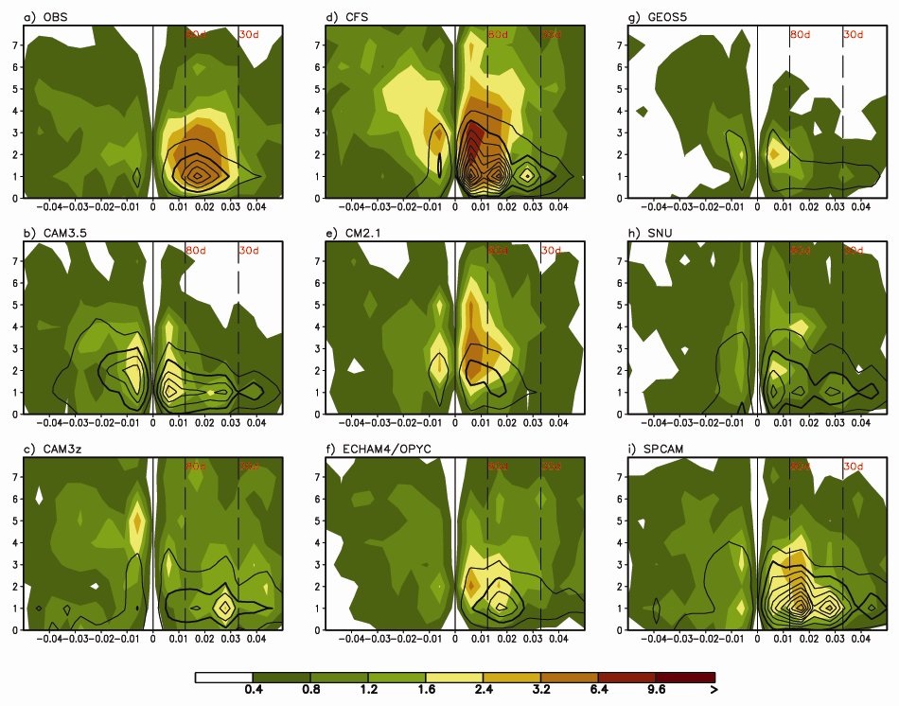
MJO Simulation Diagnostics: W-F Precip & U850
Figure 4 : November-April wavenumber-frequency spectra of 10oN-10oS averaged precipitation (shaded) and 850hPa zonal wind (contoured). a) CMAP/NCEP1, b) CAM3.5, c) CAM3z, d) CFS, e) CM2.1, f) ECHAM4/OPYC, g) GEOS5 h) SNU and i) SPCAM. Individual November-April spectra were calculated for each year, and then averaged over all years of data. Only the climatological seasonal cycle and time mean for each November-April segment were removed before calculation of the spectra. Units for the precipitation (zonal wind) spectrum are mm2 day-2 (m2 s-2) per frequency interval per wavenumber interval. The bandwidth is (180 d)-1.
Kim et al. 2009, Jour. Of Cli.
Notes:
- Variance map includes all of the zonal wavenumber components and it is not able to examine what is the prefer time scale for model’s subseasonal variability. (need for wavenumber-frequency diagram)‏
- In the case of models here, U850 is better than precipitation, consistent to Zhang et al. (2006).
- For precipitation, models (SNU, GEOS5, CAM3.5, ECHAM4/OPYC, CM2.1 and CFS) have spectral peak within the sub-seasonal time scale smaller than that in the low frequency (period longer than 80 day) part.
- General statement which has been used in many literature “model has faster and weaker MJO signal” seems not to be appropriate at least for U850.
8

Slide 9
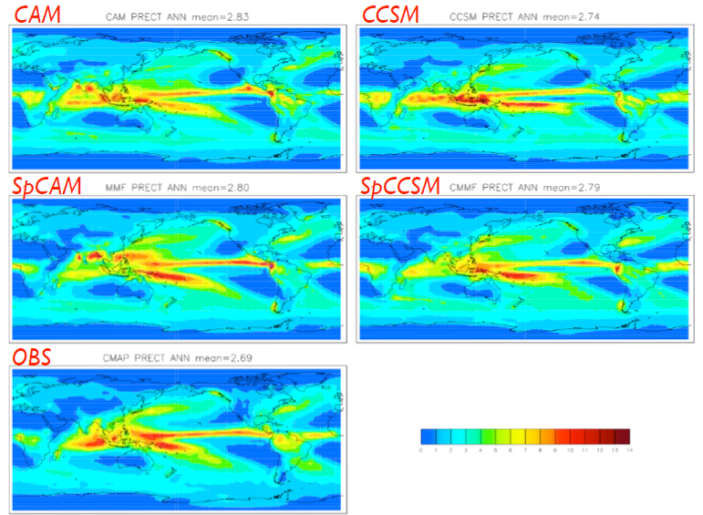
Adopted from DeMott et. al., 2010

Slide 10
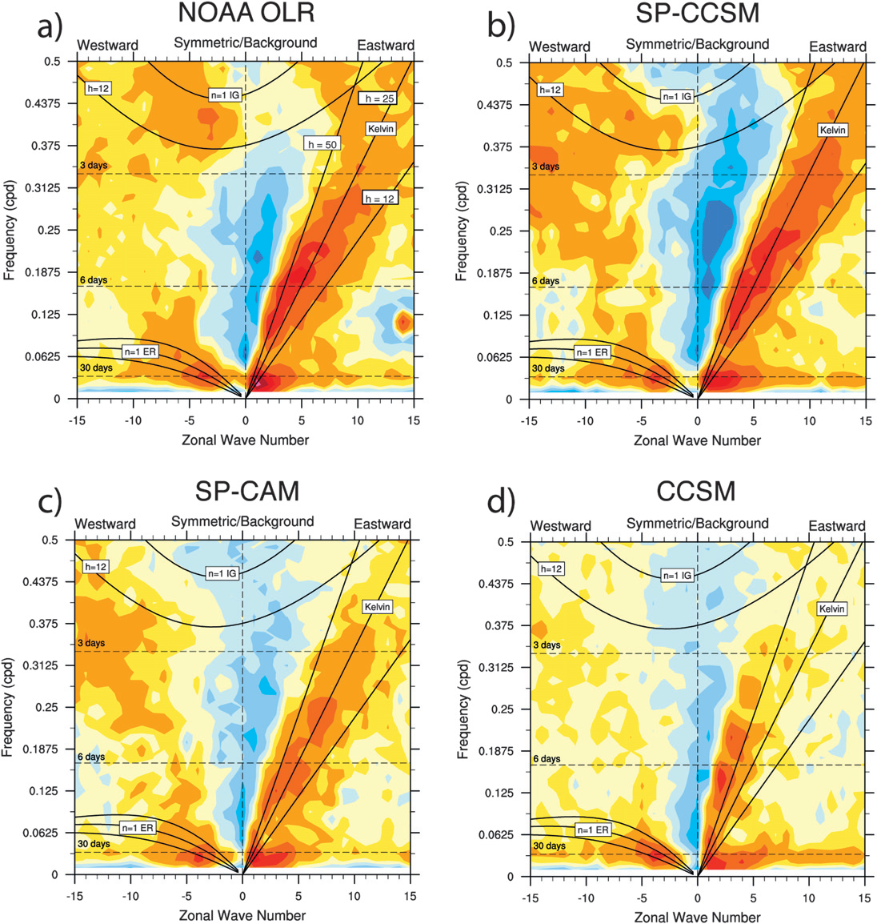
DeMott et. al., JoC 2011

Slide 11
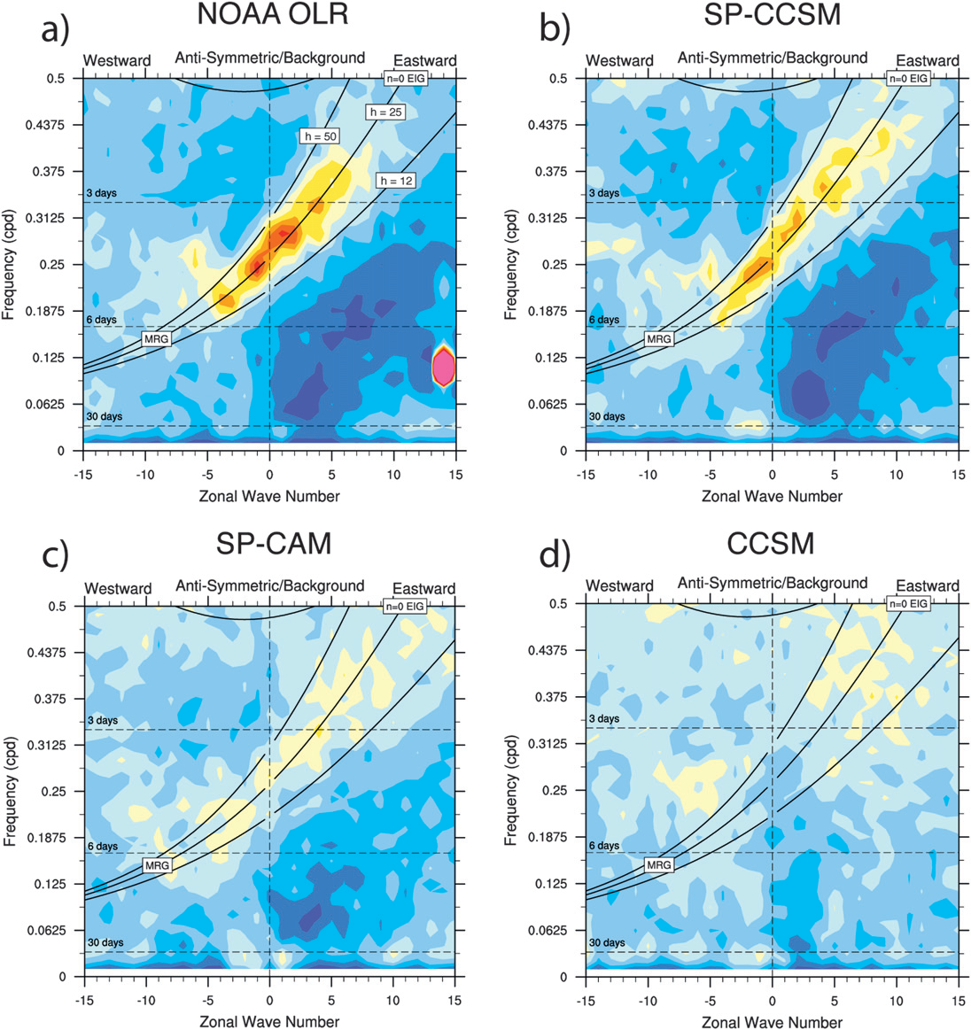
DeMott et. al., JoC 2011

Slide 12
JJAS Clim for SPCAM & SPCCSM
Goswami et al. 2012
SPCAM:
Wet bias
Too Zonal ITCZ.
SPCCSM:
Wet bias improved
Too Zonal ITCZ.

Slide 13
Intra-seasonal Variability (ISV) [The standard deviation of the 10–90 day band-pass filtered daily precipitation anomaly during JJAS ]
ISV is better captured by SPCCSM.
ISV is too strong in SPCAM.
For all the cases, the ISV pattern follows the mean seasonal precipitation pattern.

Slide 14
Latitude-height cross section of Zonal averaged (over 40-100E) QC&QI for JJA 2002-2004 from SP-CAM-SOM
Deep cloud associated with strong low level maxima typically represent the monsoon flow across the equator

Slide 15
Latitude-height cross section of Zonal averaged (over 200-240E) QC&QI for JJA 2002-2004 (east of dateline; distinctly different than the other two region; dominant shallow regime)

Slide 16
One of the key improvement of SP-CCSM over SP-CAM : SP-CCSM captures the PDF of rainfall better.

Slide 17
Figure: Peak active monsoon composite of barotropic component of band-pass filtered vorticity (5 × 10⁻⁶ s⁻¹) anomaly (blue), and corresponding OLR (Wm−2) (red) for HFM and LFM, averaged over 70°–90°E.
Following Jiang (2004), the unrealistic northward propagation of the simulated ISOs is associated with unrealistic simulation of relative positions barotropic vorticity and the convection maximum.
Relative position of Vorticity & Convection
 | HFM | LFM
OBS | Collocated | Vorticity leads
SP-CAM | Vorticity leads | Collocated
SP-CCSM | Vorticity leads | Conv. leads
The northward propagation of monsoon ISOs is associated with low-level convergence a few degrees north of the convection maximum. This low-level convergence could be caused by barotropic vorticity. [Jiang 2004].

Slide 18
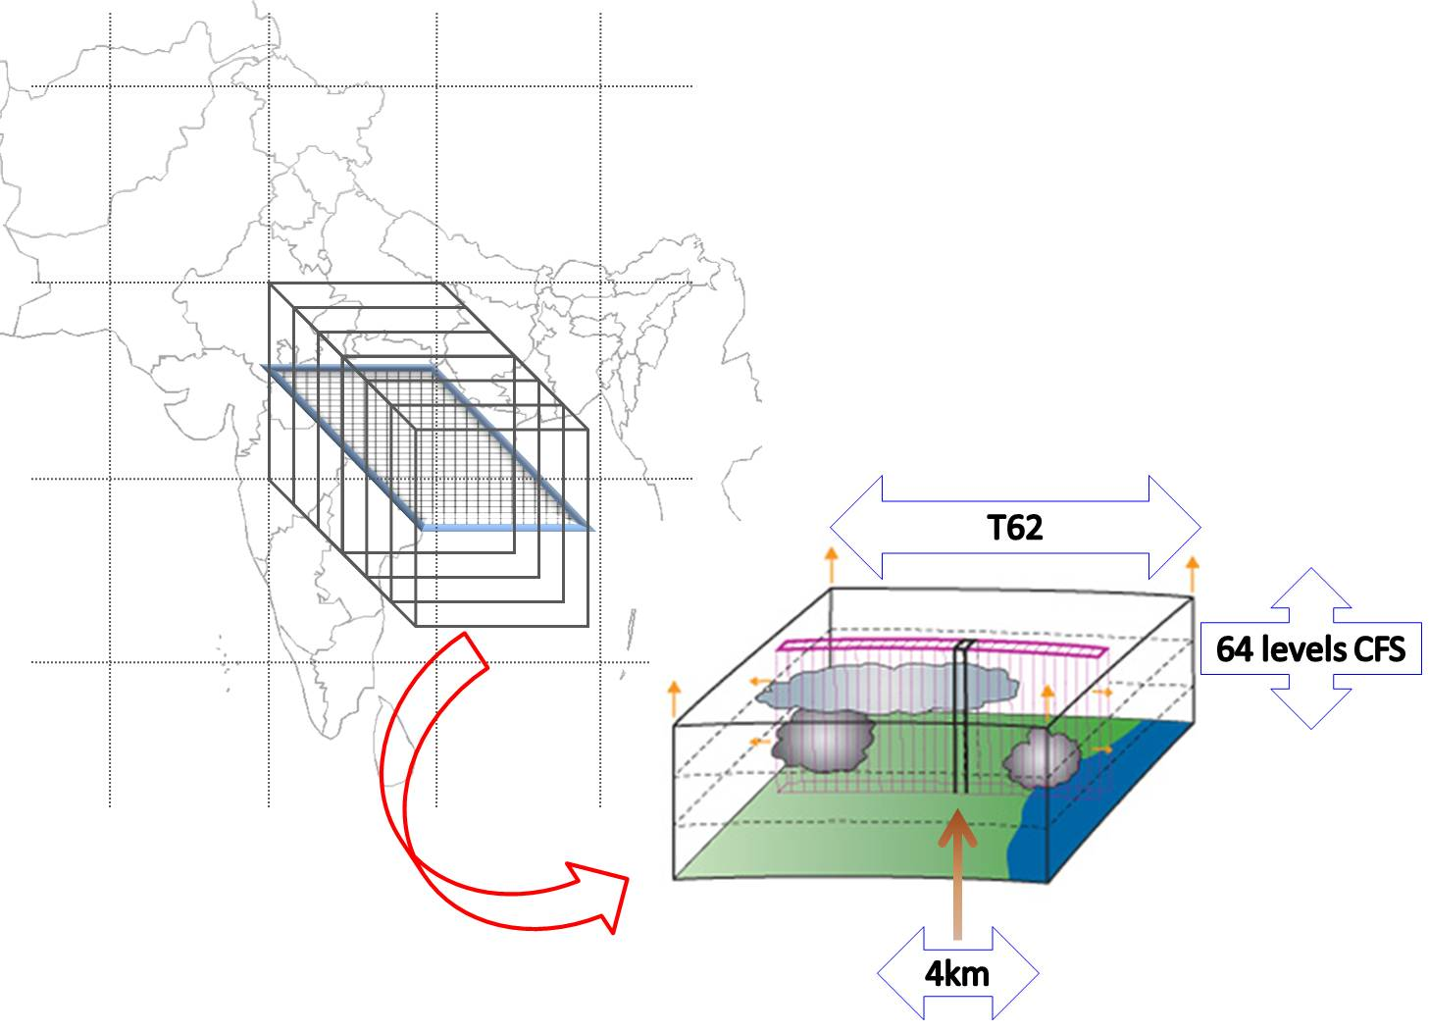
Superparameterized Climate Forecast System (SP-CFS) Model
32 CRMs (SAM) in each GCM (CFS-V2.0) grid
60 levels of CRM collocated with first 60 levels of GCM

Slide 19
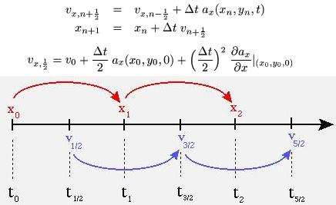
The Concept of Superparameterization
Requirement for CFS for Leap-Frog
BENEDICT AND RANDALL, JAS 2009

Slide 20
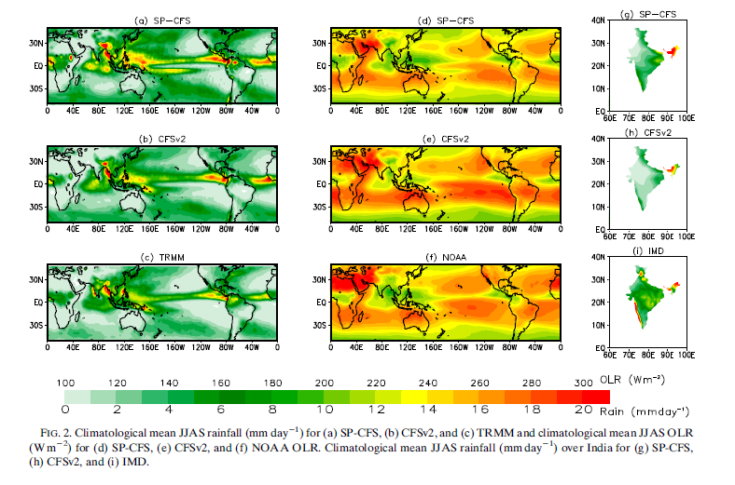
Goswami et al. 2015, JCLI

Slide 21
RED line is SP-CFS_RAD
BLACK line is NCEP
GREEN line is SP-CFS (with radiation not coupled with SP)
BLUE line is CFSv2-T62

Slide 22
Boreal summer (JJAS) climatological Tropospheric temperature bias of (a) CFSv2 and (b) SP-CFS, relative to NCEP. (Averaged between 600hPa-300hPa). (c) Vertical profile of JJAS mean climatological temperature for tropics (30°S-30°N; 0°E-360°E).

Slide 23
Northward migration of ITCZ is much better captured in SP-CFS

Slide 24
Figure 5

Slide 25
Figure 6

Slide 28
T126
T382
Space-Time spectra (Wheeler-Kiladis diagram [Wheeler and Kiladis, 1999]) of OLR showing the symmetric component for (a) CFSv2-T126, (b) CFSv2-T382 and the anti-symmetric component for (c) CFSv2-T126, (d) CFSv2-T382.
Goswami et al. 2015

Slide 29
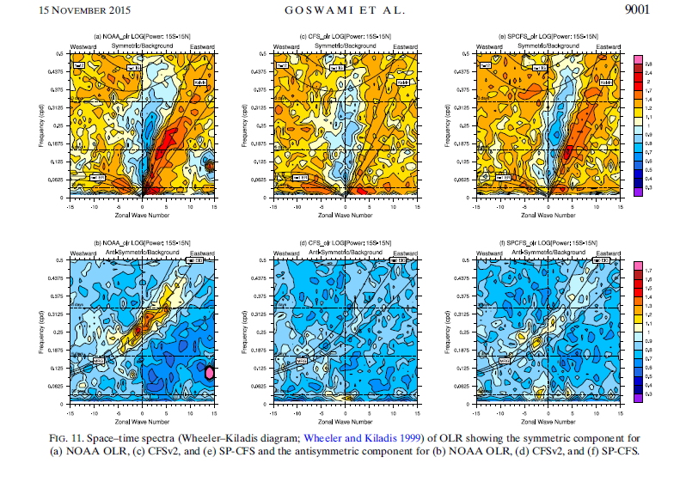

Slide 30
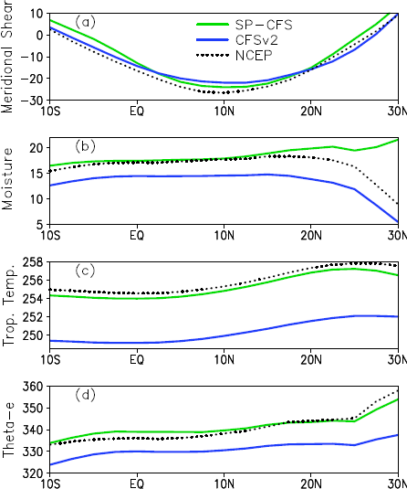
Mean state in SP-CFS has improved due to improvement in moist instability and convective coupling as evident in the subsequent slides
Climatological Seasonal mean meridional distribution of (a) easterly wind shear (U200–U850, m s-1), (b) surface level specific humidity (g kg-1), (c) tropospheric temperature (averaged between 200 and 600 hPa) and (d) equivalent potential temperature (averaged between 1000 to 850 hPa and 65º to 95ºE.

Slide 31
Joint distribution of rainfall (mm day⁻¹), along y-axis, and OLR (W m⁻²), along x-axis, computed for each grid point, (a) & (b) over the monsoon domain bounded by 15°S-30°N and 50°E-110°E and (c) & (d) over the entire Tropics within 15°S-15°N, for the 5 boreal summers (JJAS). For observation we have taken TRMM rainfall and NOAA OLR. Model simulated values are contoured and overlaid on observation (in shading). The values are in multiples of 100.

Slide 32
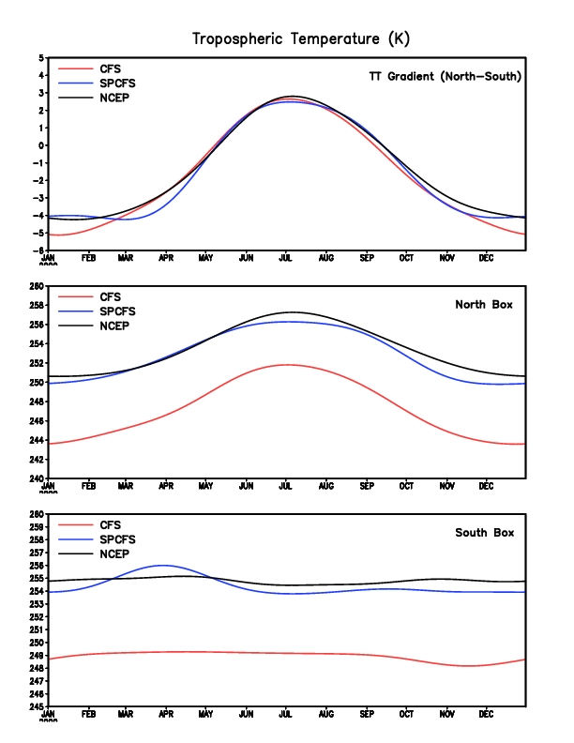
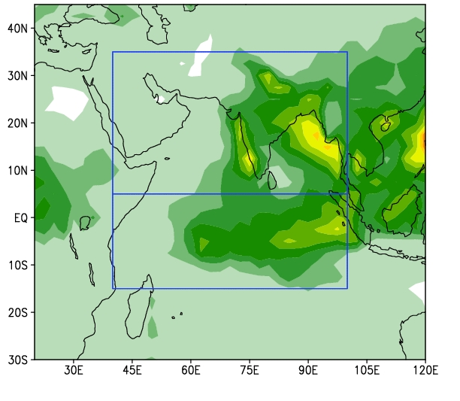
North box : 40-100E; 5-35N
South box : 40-100E;15S-5N
600-200hPa (Xavier et. al. 2007)
Right result due to wrong reason in CFSv2
Improvement in tropospheric temperature bias is seen in TT gradient. Even though the Gradient looks reasonable in both CFS and SPCFS, but the bias is seen when we see the North and South boxes individually. The TT-gradient in a cooler background in CFS perhaps is consistent with reasonable circulation pattern (Fig-12 in manuscript) but deficient moisture (Fig-13b in manuscript) leading to dry monsoon.

Slide 33
Boreal summer (JJAS) climatological Tropospheric temperature bias of (a) CFSv2 and (b) SP-CFS, relative to NCEP. (Averaged between 600hPa-300hPa). (c) Vertical profile of JJAS mean climatological temperature for tropics (30°S-30°N; 0°E-360°E).

Slide 34
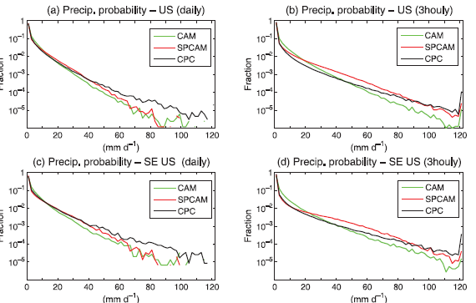
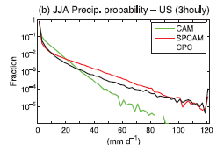
What is the use of SP framework apart from demonstrating the role of resolving the cloud processes in the GCM?
‘‘Super-parameterization’’: A better way to simulate regional extreme precipitation?, by Li et al., JGR 2012

Slide 35
Summary
Superparameterization is promising in improving sub-grid scale variability in coupled model
SP demonstrates the importance of resolving cloud processes in Climate model and impacts its mean and intraseasonal variabilities.
SP approaches could be explored for high impact ranfall variabiltiy.

Slide 36
Thank You !

