Slide 1
ICTP and UNITS: an example of fruitful collaboration in science, technology and society.
Maurizio Fermeglia
rettore@units.it

Slide 2
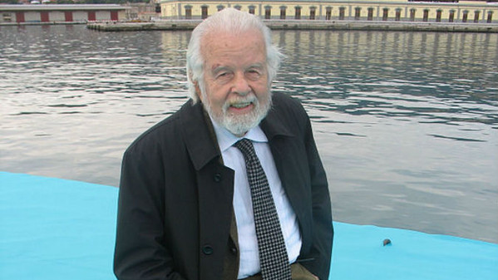
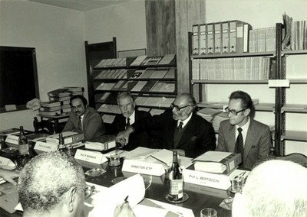
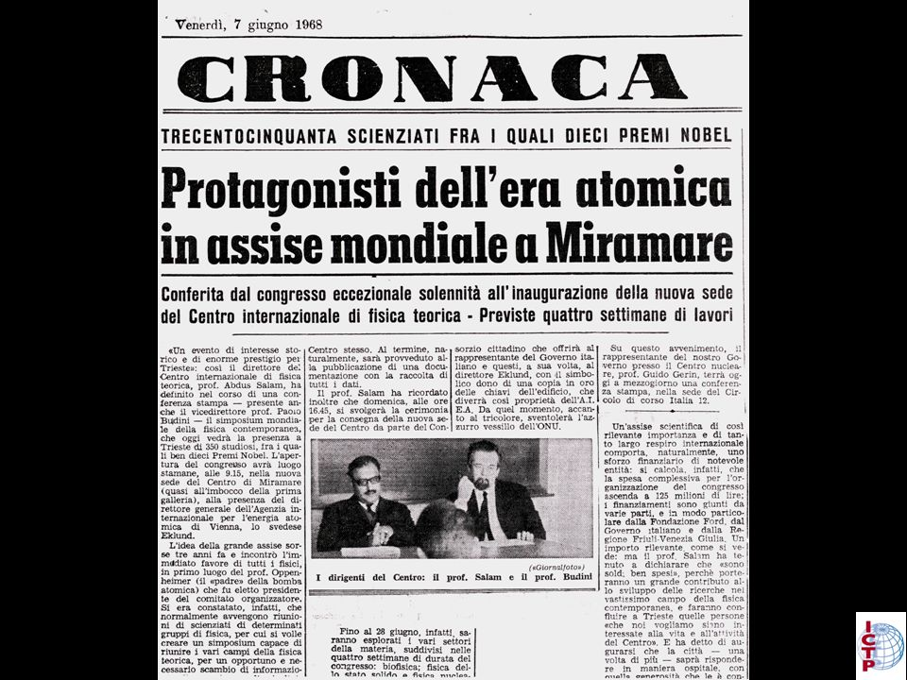
Where everything started ….

Slide 3
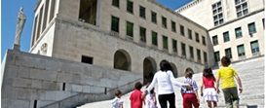
The Trieste System
CBM
TWAS
Thirld World
Academy of Science
LNCIB
Natiolnal Lab
Interuniv. cons
Biotecnology
ICTP
International Centre
For Theoretical
Physics
ICGEB
International Centre
For Genetics and
Biotechnology
OGS
National Institute
For Oceanography and
Exp. Geophysics
Trieste
University
Elettra
Synchrotron
ISMAR-CNR
Marine Science
Over 30 researchers every 1,000 active citizens (8.1 in USA, 9.1 in Japan, 5.7 in Europe)
Area
Science Park
INAF
Astrophysics
Astronomy
TASC
Surface Physics
INFN
Nuclear Physics
SISSA
1841
Sea Observatory
1898
Astronomical Observatory
1924-1938 University
1981 Area Science Park
1993 ELETTRA
1978 SISSA
1987 ICGEB
1964 ICTP
1983TWAS
1850
1900
2000

Slide 4
Science, technology & society

Slide 5
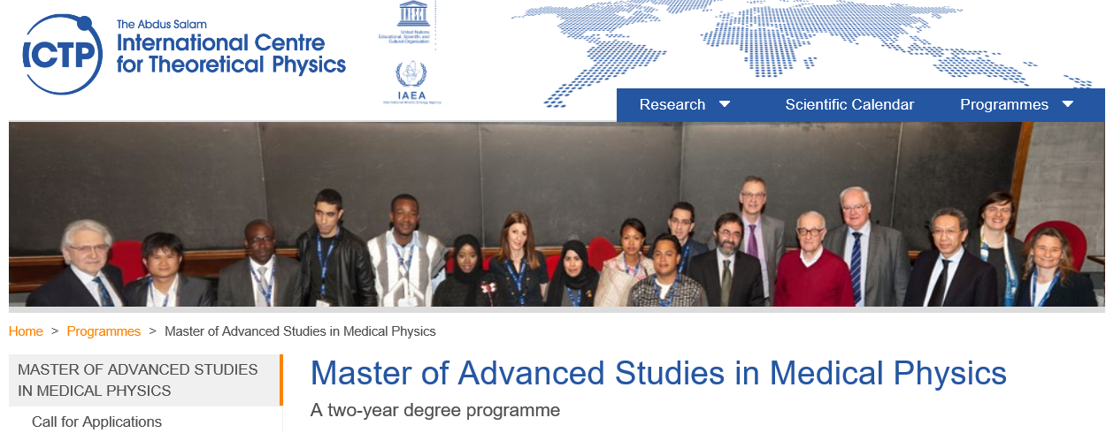
ICTP & UNITS: Teaching activities

Slide 6
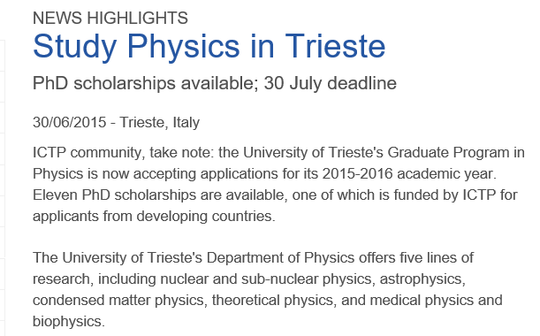
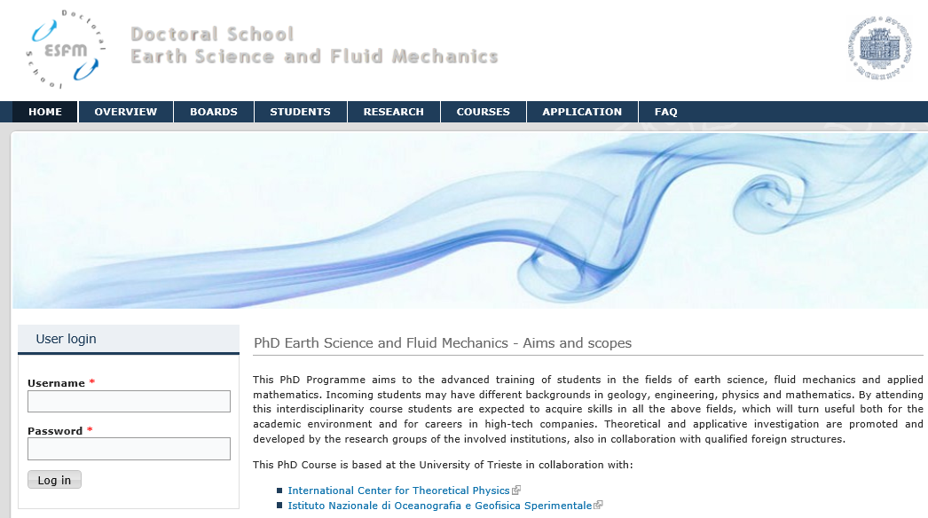
ICTP & UNITS: PHD opportunities

Slide 7
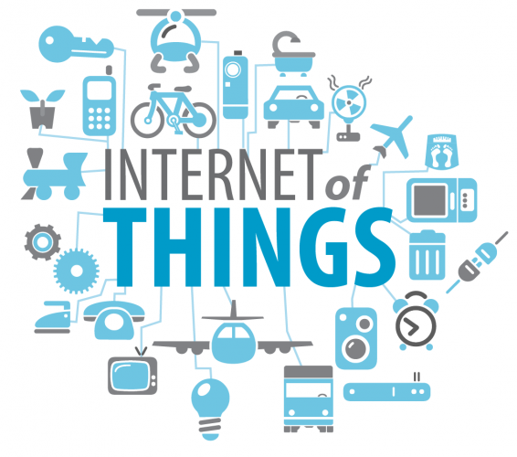
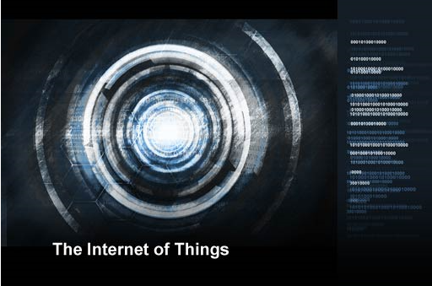
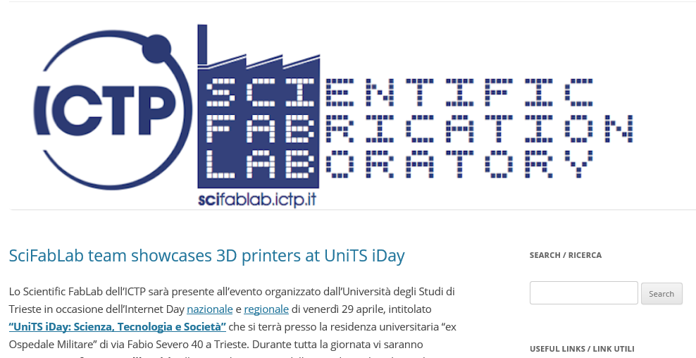
… and in the future!
Master in Internet of things

Slide 8
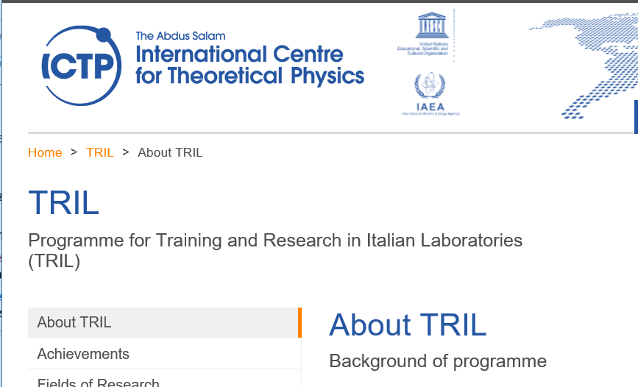
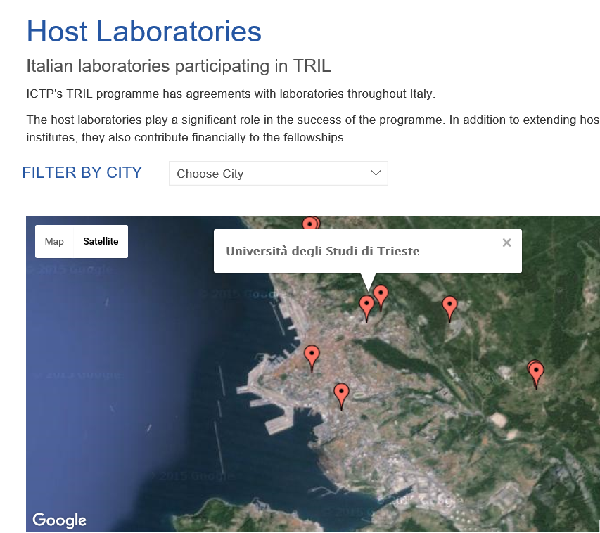
Training and research in Italian laboratories

Slide 9
The workshops in Losinj ….

Slide 10
Dissemination initiatives …

Slide 11
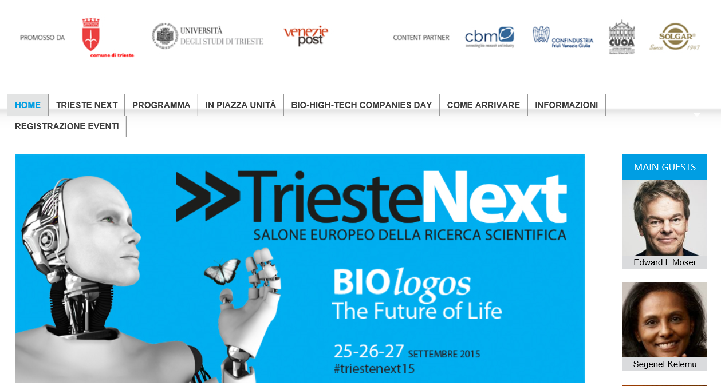
Trieste Next

Slide 12
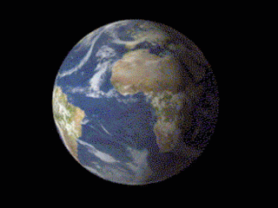
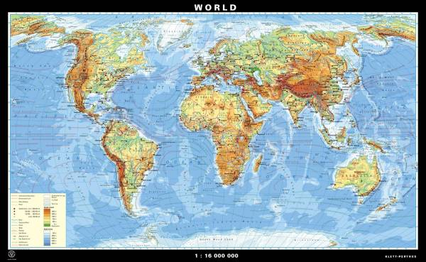
International relationships …

Slide 13
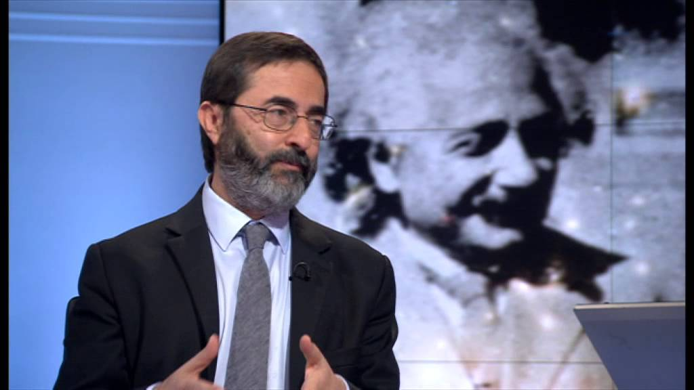
The importance of people …

Slide 14
… their relationships and friendships

