Slide 1
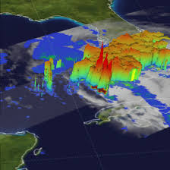
1. Analysis and Reanalysis Products
Adrian M Tompkins, ICTP
Tompkins@ictp.it
picture from Nasa

Slide 2
Climate impacts on society
  Climate impacts are multifaceted and can occur over many timescales
    Severe weather: floods, droughts
    Impacts on health:
      Vector borne diseases
      Heat stress
      parasites
      Food security
    Infrastructure, economy, sea level rise...
  But how can we get climate data for the present day?

Slide 3
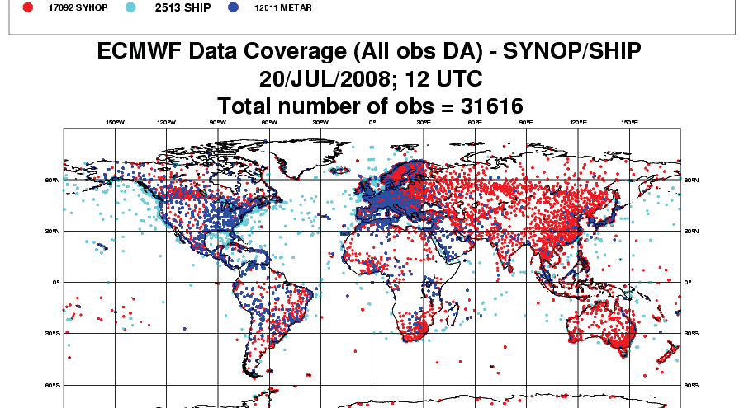
Sources of data: stations

Slide 4
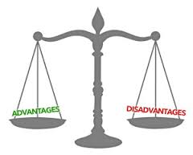

Slide 6
For Satellite – coverage can be less of an issue
(polar or geostationary – resolution, swathe, return times)

Slide 7
Satellite – advantages and disadvantages

Slide 8

What to use?
What is best?

Slide 9
But some variables in contrast are difficult to get directly from Satellite
Surface temperature: reliable over oceans using microwave. Some products over land, but uncertainty is large and not available daily
Winds: reasonable over oceans using scatterometer data, surface winds over lands not possible. Upper level winds from feature tracking (cloud, humidity) but uncertainties high.
Humidity: near surface only indirectly.
Take home message: most (near) surface variables over land very difficult to infer from remote sensing

Slide 11
A supplement source of climate information: analysis and reanalysis
To make forecasts of the future weather, knowledge of the present state is required
This “picture” of the atmosphere needs to be “balanced” – Simple spatial and temporal interpolation of observations doesn’t work
Hence the development of analysis systems

Slide 13
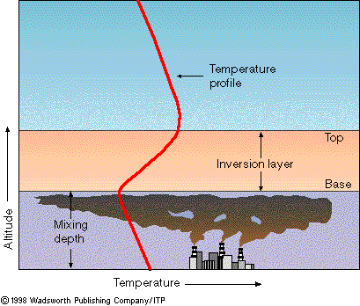

Slide 14
Use of a forecast model is required to obtain balanced state

Slide 15
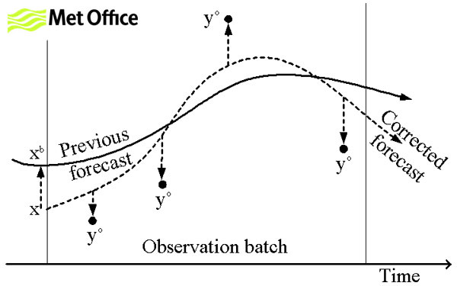
recipe in a nutshell
1. Make a short forecast from previous “analysis”, call the “control”

Slide 16
recipe in a nutshell
2. Throw out “bad” data automatically
departure too large

Slide 17
recipe in a nutshell
3. Using a clever technique, find set of initial condition perturbations that minimize the departure of a revised LINEAR forecast from both the control and the set of “good” observations (translate model to observation space where necessary)
Linear model

Slide 18
recipe in a nutshell
4. Perform revised “control” forecast starting from this new initial condition

Slide 19
recipe in a nutshell
5. Repeat step 1-4 until (if!) the process converges (e.g. 3 cycles)

Slide 20
recipe in a nutshell
6. Now take any time point of the final “control” and use this as the “analysis”
06Z analysis
12Z analysis
00Z
06Z
12Z

Slide 21
Fluxes and instaneous fields
Instaneous fields such as temperature are taken from the “analysis”
Pointless to do this for fluxes as can not calculate water and energy budgets – these are obtained from short-range forecasts (0-24hrs)
06Z analysis
e.g. T2m
12Z analysis
fluxes – e.g. rainfall
00Z
06Z
12Z

Slide 22
Go to reanalysis

Slide 30
Advantages of analysis system
all observations contribute to all variables
Poor data can be automatically “sifted”
Example: Data denial experiments conducted over West Africa by Tompkins et al. 2003 QJRMS:

Slide 31
Observations assimilated in 2000

Slide 32
Root mean square wind errors – compared to independent data
Sonde data removed
local
global
5 day forecast
Default analysis
All winds removed
Conclusion: Sonde temperature information more important for wind analysis than winds!

Slide 33
But what is REanalysis?
Operational forecasting systems change their systems 3 or 4 times a year
  New observation sources to be incorporated
  Improvements to the physics in the forecast models
  Improvements to the data assimilation techniques.
This means that the analyses are not “coherent” in time
  e.g. Could a temperature trend be due to changes in data and/or assimilation system
One way to improve the coherency in reanalysis: The same system is run for all past dates.

Slide 34


Slide 35
To give you an idea
Reanalysis of ERA-40 uses a model cycle that was operational in 2000
Reanalysis of ERA-Interm uses a model cycle that was operational in approximately 2006
operational analysis
Improvements in model and assimilation software
RE-analysis
New satellite data platforms
No Improvements in model and assimilation software – fixed at 2006
New platforms only til 2006 in general
1979
2006
present

Slide 36
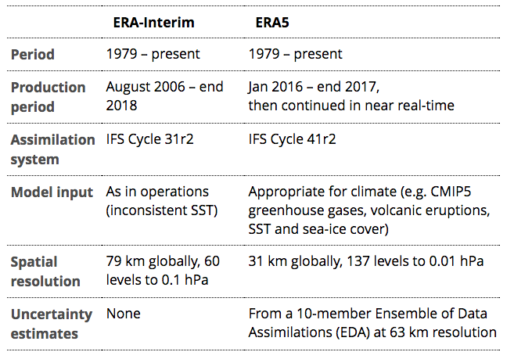
ERA5 – A product of EU Copernicus programme

Slide 37
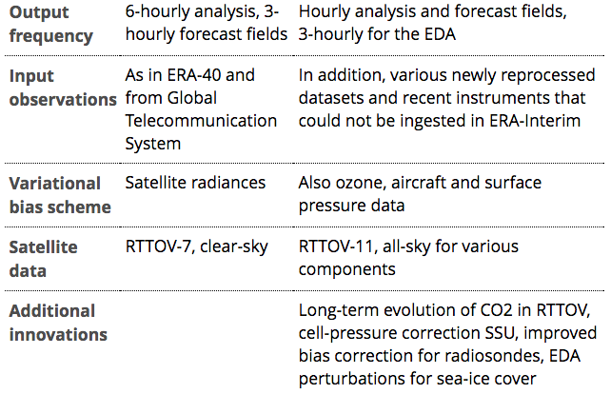
ERA5 – A product of EU Copernicus programme

Slide 38
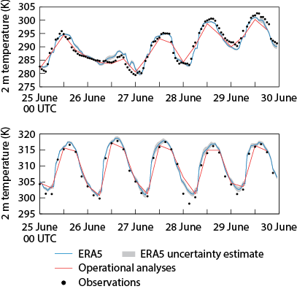
ERA5
Krakow
Sahara
Note shading giving estimate of uncertainty

Slide 40
http://apps.ecmwf.int/datasets/data/interim_full_daily/
We will now try to download some fields using the reanalysis server
and post-process them using cdo

