Slide 1
Nuclear Security
[Fundamentals, Infrastructure and Recommendations]
IAEA-ICTP Nuclear Energy Management School
[21 August – 01 September 2017]
Presented by
Division of Nuclear Security

Slide 2
Outline
Nuclear Security – Definition, Threats, and Responsibilities
Nuclear Security Objectives and Fundamental Principles
Nuclear Security Infrastructure for Nuclear Power Programme
Nuclear Security Recommendations
IAEA Activities related to Nuclear Security

Slide 3
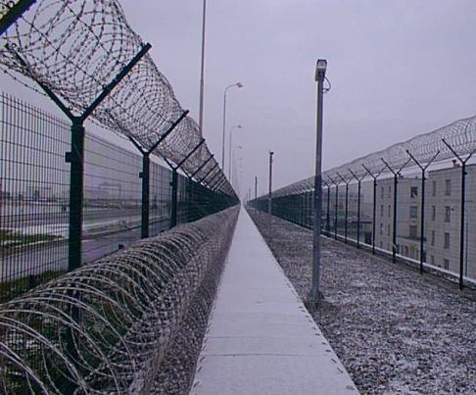
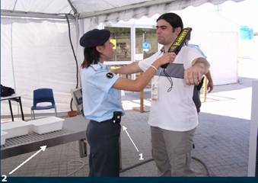
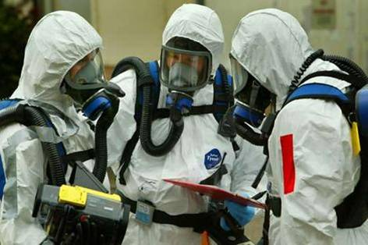
What is Nuclear Security?
The prevention of, detection of, and response to, criminal or intentional unauthorized acts involving or directed at nuclear material, other radioactive material, associated facilities, or associated activities.
Historically, the term ‘physical protection’ has been used to describe what is now known as “Nuclear Security of Nuclear Material and Nuclear Facilities.”
Notes:
Examples : theft, sabotage, unauthorized access, illegal transfer or other malicious acts
Glossary definition.
- Historically, the term ‘physical protection’ has been used to describe what is now known as “Nuclear Security of Nuclear Material and Nuclear Facilities.” In NSS 13 the term ‘physical protection’ continues to be used throughout the publication.¹
Nuclear Security is a more broad term that includes topics such as:
Nuclear Security Culture
Information Security
Cyber Security
Personnel Security
¹NSS 13, Introduction, footnote page 1

Slide 4
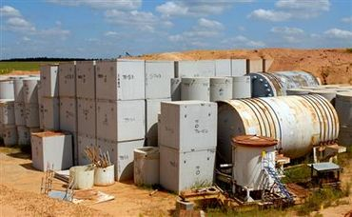
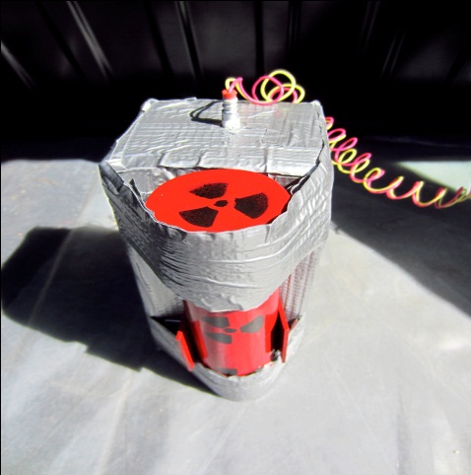
Understanding the Threat
What is the threat?
criminals or terrorists acquiring and using for malicious purposes:
Nuclear weapons
Nuclear material to make IND
- Radioactive material for RDD or RED
- Sabotage of nuclear installations or transport
Notes:
The threat of Nuclear terrorism is real. What is the Threat: Theft of Nuclear Material, including that used in nuclear weapons and for use in Improvised Explosive devices. Theft of other radioactive material for use in radiological dispersal devices (RDDs) and sabotage of nuclear installations or transport.
Abbreviations
IND = Improvised Nuclear Explosive Devise
RDD = Radiological Dispersal or explosive Devise
RED = Radiological Emitting Devise

Slide 5
Nuclear Security - the Reality
447 operating nuclear power plants in 30 countries
Nearly 250 research reactors
Over 300 fuel cycle facilities
60 new nuclear power plants are being built
About 30 new countries embarking on nuclear power programmes
Millions of radioactive sources used in medicine, agriculture, industry, research…etc.
Establishing an effective and sustainable nuclear security infrastructure is crucial for the protection of individual, people, society and the environment
Notes:
The Nuclear Sector is vast and its applications many.
447 Nuclear Power plans are now operating in 30 countries. Read the slide…
With material and interest, there is a risk that demands continuous attention. Establishing an effective and sustainable…

Slide 6
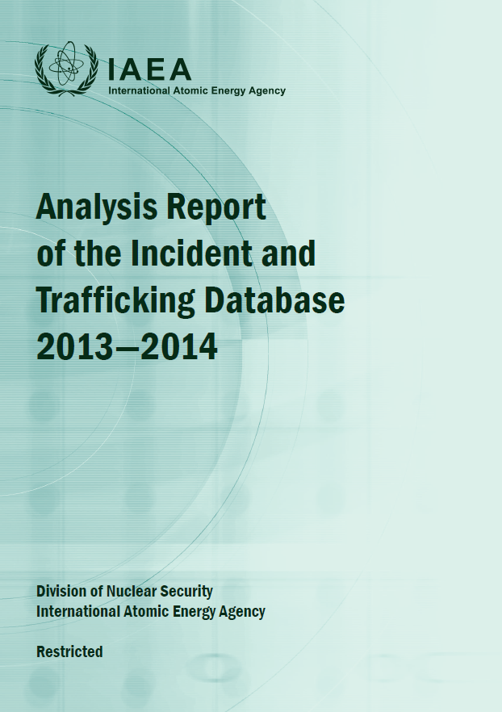
Nuclear Security – the Reality (cont.)
Incident and Trafficking Database
Established in 1995, information collected from official sources in 131 participating States and supplemented by open-source reports
ITDB information is restricted to State POCs, limited information shared with
international organizations, and no public dissemination
  Over 2890 confirmed incidents
  451 incidents involved unauthorized possession and related criminal activities
  762 incidents involved theft or loss of materials
  16 confirmed incidents involved unauthorized possession of high enriched uranium or plutonium
Notes:
Incident and Trafficking Database was established in 1995 to record and analyze incidents of illicit trafficking in nuclear and other radioactive material.
Read slide…

Slide 7
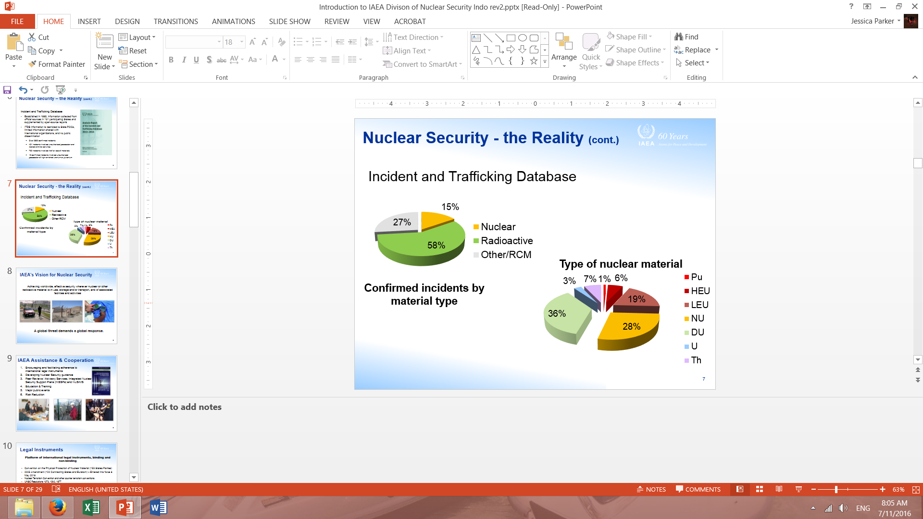
Nuclear Security - the Reality (cont.)
Notes:
ITDB scope covers all types of NM as defined by the Statue of the IAEA (i.e uranium, plutonium and thorium) naturally occurring and artificially produced radioisotopes and radioactively contaminated material, such as scrap metal.
Information reported to the ITDB demonstrates that:
The availability of unsecured nuclear and other radioactive material persists
Effective border control measures help to detect illicit trafficking, although effective control is not uniformly implemented at all international border points
Individuals and groups are prepared to engage in trafficking this material

Slide 8
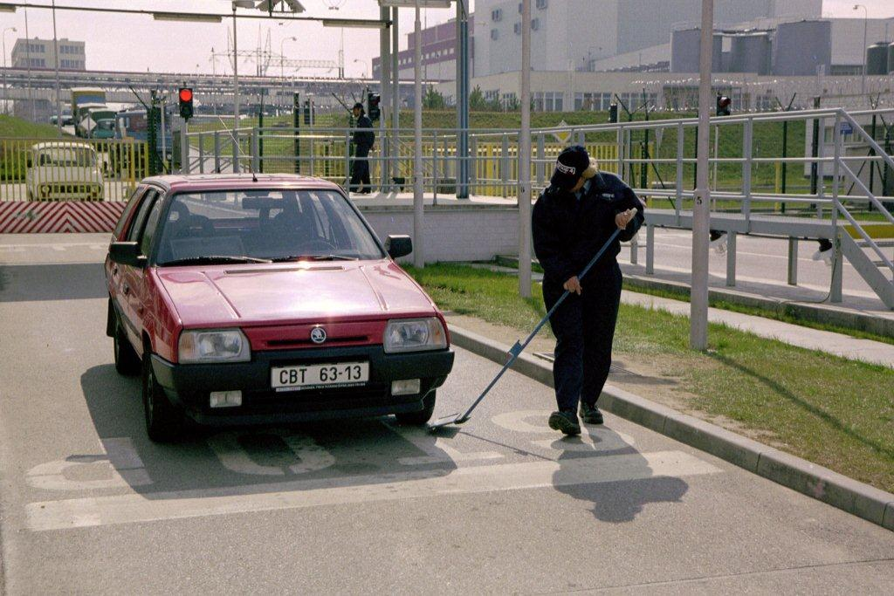
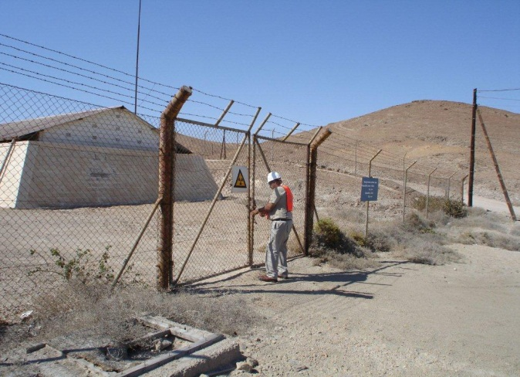
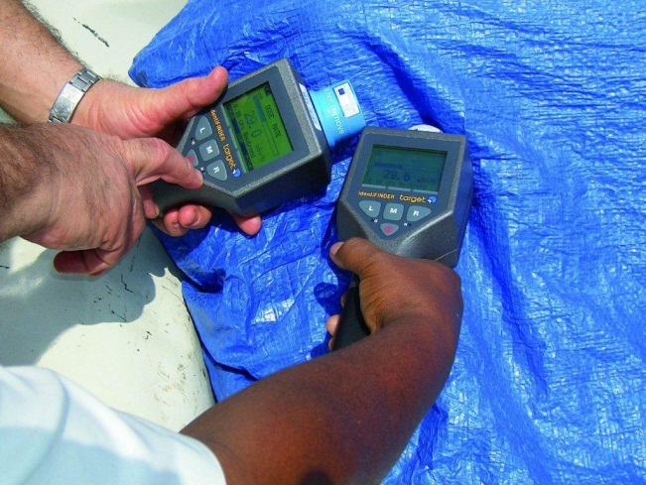
IAEA’s Vision for Nuclear Security
Achieving worldwide, effective security wherever nuclear or other radioactive material is in use, storage and/or transport, and of associated facilities and activities
A global threat demands a global response.

Slide 9
^
Nuclear Security Fundamentals:
Objective and Essential Elements of a State’s Nuclear Security Regime

Slide 10
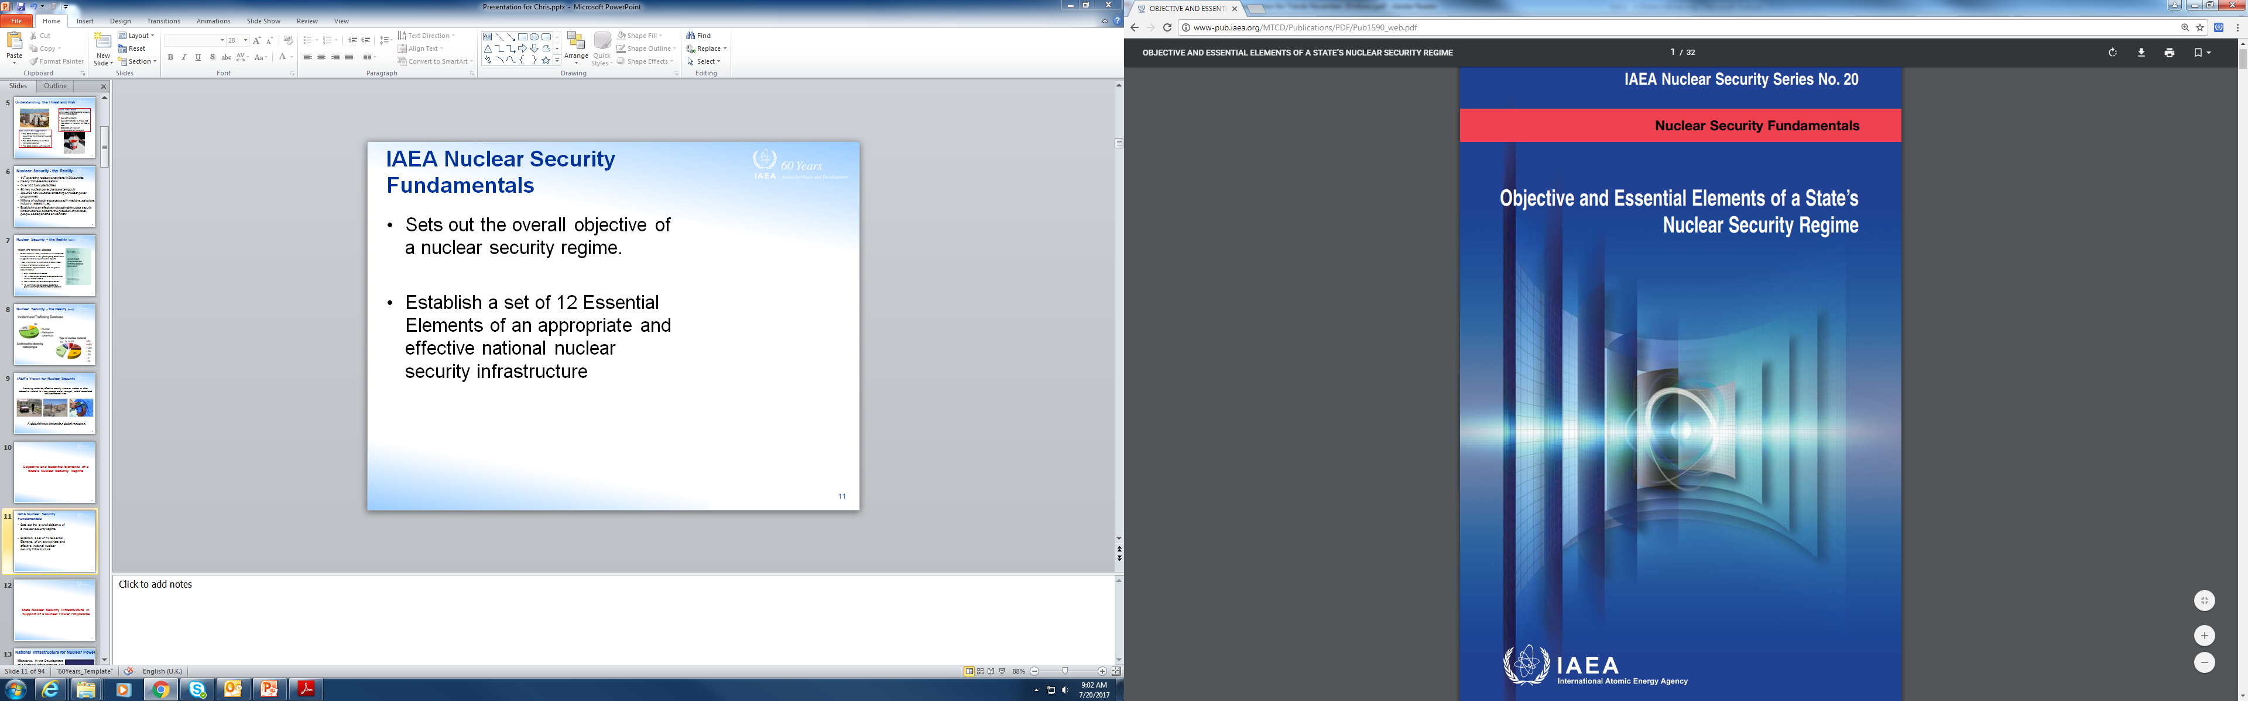
IAEA Nuclear Security Fundamentals
Sets out the overall objective of a nuclear security regime.
Establish a set of 12 Essential Elements of an appropriate and effective national nuclear security regime

Slide 11
Objectives of a State’s Nuclear Security Regime
The objective of a States nuclear security regime is to protect persons, property, society, and the environment from the harmful consequences of a nuclear security event.
With the aim of achieving this objective, States should establish, implement, maintain and sustain an effective and appropriate nuclear security regime to prevent, detect and respond to such nuclear security events.
The nuclear security regime is part of the State’s overall security regime. The nuclear security regime covers nuclear material and other radioactive material whether it is under or out of regulatory control and associated facilities and associated activities.

Slide 12
Nuclear Security Regime
The Nuclear Security Regime is defined as:
A regime comprising
  The legislative and regulatory framework and administrative systems and measures governing the nuclear security of nuclear material, other radioactive material, associated facilities and associated activities;
  The institutions and organizations within the State responsible for ensuring the implementation of the legislative and regulatory framework and administrative systems of nuclear security;
  Nuclear security systems and measures for the prevention of, detection of, and response to nuclear security events.

Slide 13
Overview of the 12 Essential Elements
1. State responsibility
2. Identification and definition of nuclear security responsibilities
3. Legislative and regulatory framework
4. International transport of nuclear material and other radioactive material
5. Offences and penalties including criminalization
6. International cooperation and assistance
7. Identification and assessment of nuclear security threats
8. Identification and assessment of targets and potential consequences
9. Use of risk informed approach
10. Detection of nuclear security events
11. Planning for, preparedness for, and response to, a nuclear security event
12. Sustaining a nuclear security regime

Slide 14
Essential Element 1: State Responsibility
Responsibility rests with the State to establish, implement, maintain and sustain a nuclear security regime applicable to nuclear material, other radioactive material, associated facilities, and associated activities under a State’s jurisdiction.

Slide 15
Essential Element 2: Identification and Definition of Nuclear Security Responsibilities
Identification and definition of nuclear security responsibilities of competent authorities designated by the State, including regulatory bodies, border control and law enforcement, and responsibilities of all authorized persons:
  Integration and coordination of responsibilities
  State’s oversight to ensure continued appropriateness of the nuclear security responsibilities

Slide 16
Key Competent Authorities with Responsibilities for Nuclear Security
Coordinating Body or Mechanism
Policy Authorities
Law Enforcement Agencies
Customs
Intelligence Services
Legislative Authorities
Police
Border Guards
Regulators
Civil Defense
Emergency Services
Judiciary
Notes:
The multi-disciplinary nature of the nuclear security is depicted by this slide. It presents an example of the competent authorities that may have responsibilities within the nuclear security regime.
The establishment of a coordinating body or mechanism can ensure that the roles and responsibilities of the competent authorities are clearly defined and possible conflicts in roles as well as areas that require close cooperation are identified and resolved.
An example of a coordinating body is a committee with representatives of all relevant competent authorities. If the State has a federal structure, the coordinating body could be established at federal and at the state level. Sometimes these bodies or mechanisms are established in the legislation and other times they are purely administrative arrangements.

Slide 17
Essential Element 3: Legislative and Regulatory Framework (1)
A legislative and regulatory framework, and associated administrative measures to govern the nuclear security regime
Establish competent authorities, including regulatory bodies
Assign nuclear security responsibilities and provide the authorities with sufficient financial, human and technical resources
Ensure proper coordination and communication
Establish regulations and procedures for evaluating applications and granting authorizations;
Establish regulations and requirements for protecting sensitive information/assets
Notes:
Before talking about the national legislative and regulatory framework, it is important to highlight that States should become Parties to all the international legal instruments relevant for nuclear security in order to enhance nuclear security regime both nationally and internationally.
National legislation should therefore be in compliance with the international legal instruments and implement the provisions of such instruments.
Competent authorities are designated through legislation and their roles and responsibilities for nuclear security are assigned through legislation.
Essential element 3 lists the key nuclear security related elements that should be reflected in the national legislative and regulatory framework.

Slide 18
Essential Element 3: Legislative and Regulatory Framework (2)
Legislative and regulatory framework to govern the nuclear security regime
  Ensure that there are procedures for the State to assume the prime responsibility for security in the absence of authorized persons
  Establish nuclear material and other radioactive material accounting or registering and ensure control and protection
Establish law enforcement systems and measures relevant for nuclear security, including measures for export, import and border control of nuclear material & other radioactive materials
  Establish verification and enforcement measures to ensure compliance with applicable laws and regulations, including imposition of sanctions

Slide 19
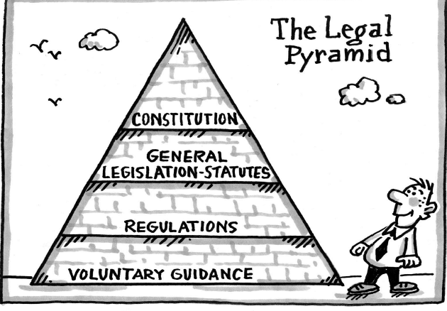
Legal Hierarchy: An Example
The legal hierarchy in a State will influence the legislative and regulatory framework for nuclear security

Slide 20
Essential Element 4: International Transport of Nuclear Material and Other Radioactive Material
The responsibility of a State for ensuring that nuclear material and other radioactive material are adequately protected extends to the international transport thereof, until that responsibility is properly transferred to another State.
Notes:
For the transport of nuclear material, a State should follow the provisions of the CPPNM and the Amendment thereto.
A State should enter into arrangements with other States for the purpose of international transport to ensure that nuclear material is adequately protected.
For the transport of radioactive sources, a State should follow the provision of the Code of Conduct for the Safety and Security of Radioactive Sources and the Import/Export Guidance.

Slide 21
Essential Element 5: Offences and Penalties Including Criminalization
A State should ensure that its penal or criminal legislation includes provisions that:
  Define criminal or intentional unauthorized acts involving or directed at nuclear material, other radioactive material, associated facilities or associated activities as offenses under domestic laws;
  Deal with other acts that have an adverse impact on nuclear security;
  Establish the jurisdiction of the State over such offenses or violations;
  Provide for the prosecution/extradition of alleged offenders.
Notes:
Criminalization provisions and appropriate penalties assigned to criminal offences have also the function of prevention and deterring any criminal or unauthorized acts that have an impact on nuclear security.
In order to ensure that criminals are brought before justice, it is important that a State establishes its jurisdiction over such offences or violation and that it employs the principle of extradition or prosecution of alleged offenders.
Mutual legal assistance agreements between States also support nuclear security.

Slide 22
Essential Element 6: International Cooperation and Assistance
A national nuclear security regime may provide for cooperation and assistance between and among States, either directly or through the IAEA or other international organizations, by:
  Making known designated point of contacts for notification, assistance & cooperation;
  Providing timely information to States concerned about events or credible threats;
  Providing timely response to requests for assistance (recovery, technical assistance, including nuclear forensics or mutual legal assistance);
  Cooperating and exchanging of experience & information
  Ensuring protection of exchanged sensitive information.
Notes:
States have recognized that a nuclear security event occurring in one State may have implications for other States, given the transnational nature of the movement of nuclear and other radioactive material and the proximity of nuclear facilities to the borders of neighboring States.
The decision of States to cooperate internationally in relation to nuclear security or to provide or receive assistance from other States is entirely voluntary. Any cooperation and assistance between and among States have to occur having regard to each State’s legal framework and take account of any limiting factors such as national laws related to protection of sensitive information, requirements of the criminal law, etc.
Nuclear security systems and measures, nuclear security culture, sustainability of nuclear security infrastructure may all be enhanced by a State’s access to, collaboration with and learning from other States.
International cooperation and assistance may occur on a bilateral or multilateral basis, may be regional or international.
For example, regional cooperation may create a regional self-reliance. Not all the States in a specific region need to have expertise is every area in nuclear security. In certain circumstances they may need to cooperate with another State to provide relevant expertise (e.g. nuclear forensics).

Slide 23
Essential Element 7: Identification and Assessment of Nuclear Security Threats
A nuclear security regime ensures that:
  Nuclear threats are identified and assessed regardless of whether the targets of internal nuclear security threats are within or outside the jurisdiction of the State;
  State’s assessments of nuclear security threats are kept up-to-date and are used in implementing the State’s nuclear security regime.

Slide 24
Essential Element 8: Identification and Assessment of Targets and Potential Consequences
A nuclear security regime ensures that:
  Targets are identified and assessed to determine if they require protection from nuclear threats;
  Assessment is based on potential consequences should the targets be compromised;
  An up-to-date assessment of such targets is maintained.

Slide 25
Essential Element 9: Use of Risk Informed Approach
Use of risk-informed approaches, based on a graded approach and defence in depth, taking into account:
State’s current assessment of the nuclear security threats;
Relative attractiveness of identified targets to threats
Characteristics of the material, facilities and activities;
Potential harmful consequences from criminal acts involving or directed at nuclear material, other radioactive material, associated facilities, associated activities;
*Graded approach: The application of nuclear security measures proportional to the potential consequences of such acts.
**Defence in depth: The combination of successive layers of systems & measures for the protection of targets from nuclear security threats.

Slide 26
Essential Element 10: Detection of Nuclear Security Events
A nuclear security regime ensures that nuclear security systems and measures are in place to:
Detect and assess nuclear security events;
Notify the relevant competent authorities for initiating appropriate response actions:
    at facilities;
    at major public events or strategic locations;
    in searches for, recoveries of, or discoveries of such material that is missing or lost or otherwise out of regulatory control;
    within the State’s territory or on board its ships or aircraft and at its international borders.

Slide 27
Essential Element 11: Planning for, Preparedness for and Response to, a Nuclear Security Event
A nuclear security regime ensures that competent authorities are prepared to respond, at local, national & international levels to events by:
Developing arrangements and response plans to ensure:
  Effective rapid mobilization of resources to an event;
  Effective coordination and cooperation during response;
  Effective use of relevant international assistance and response systems;
  Investigation of any nuclear security event and prosecution/extradition of alleged offenders;

Slide 28
Essential Element 11: Planning for, Preparedness for and Response to, a Nuclear Security Event
A nuclear security regime ensures that competent authorities are prepared to respond, at local, national & international levels to events by:
Exercising, testing and evaluating the plans for effectiveness:
  To mitigate and minimize harmful consequences from nuclear security events,
  To locate, recover, and secure nuclear material and other radioactive material that is out of regulatory control.
  Feed back into the preparedness process, including into the response plans, the results of exercises and tests of the plans, and of experience.

Slide 29
Essential Element 12: Sustaining a Nuclear Security Regime
A nuclear security regime ensures that each organization with nuclear security responsibilities contributes to the sustainability of the regime by:
  Maintaining integrated management systems and quality management systems;
  Demonstrating leadership in nuclear security matters
  Maintaining a robust nuclear security culture;
  Allocating sufficient human, financial and technical resources to carry out nuclear security responsibilities,
  Conducting maintenance, training and evaluation to ensure effectiveness of the nuclear security systems;
  Using best practices and lessons learned from experience;
  Minimizing insiders threats;
  Identifying and addressing issues that may affect capacity to provide adequate nuclear security at all times.

Slide 30
^
Establishing a Nuclear Security Infrastructure in Support of a Nuclear Power Programme (NSS-19)

Slide 31
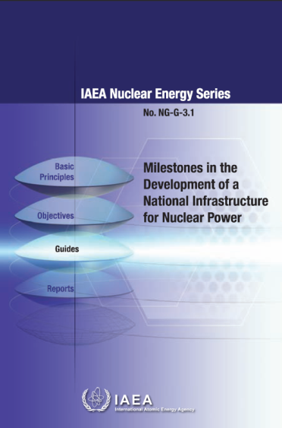
National Infrastructure for Nuclear Power
Milestones in the Development of a National Infrastructure for Nuclear Power,
IAEA Nuclear Energy Series
NG-G-3.1, Vienna (2008),
provides guidance on the preparations needed to implement a nuclear power programme
Notes:
31

Slide 32
IAEA NG-G-3.1
Infrastructure Development Phases for a Nuclear Power Programme
MILESTONE 1
Ready to make knowledgeable commitment to a nuclear programme
MILESTONE 2
Ready to invite bids for the first NPP
MILESTONE 3
Ready to commission and operate the first NPP
Phase 1
Phase 2
Phase 3
1~3 years
3~7 years
7~10 years

Slide 33
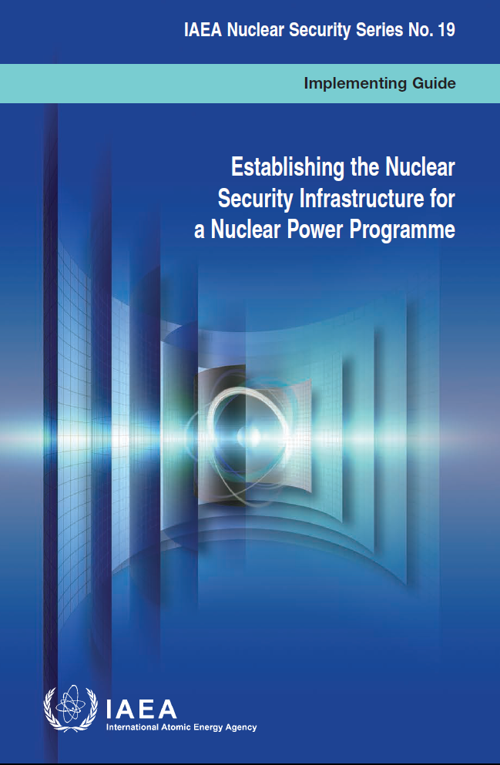
Nuclear Security Infrastructure
Implementing Guide
Implementing Guide on “Establishing the Nuclear Security Infrastructure for a Nuclear Power Programme” provides a systematic approach to progressively apply nuclear security measures during phases and prior to the milestones set out for implementation of a nuclear power programme.
Establishing the Nuclear Security Infrastructure for a National Nuclear Power Programme

Slide 34

Nuclear Security Infrastructure
Implementing Guide
“Establishing the Nuclear Security Infrastructure for a Nuclear Power Programme”
Basic Elements
National policy and strategy
Legal and regulatory framework
Threat Assessment
Management systems
Nuclear Security Measures for Nuclear Material and Nuclear Facilities
Nuclear Security Measures for Radioactive Material, Associated Facilities and Activities
Nuclear Security Measures for Nuclear and other Radioactive Material out of Regulatory Control
International Cooperation

Slide 35
Nuclear Security Infrastructure
POLICY
LEGISLATION
ORGANIZATION
National Legal and Regulatory Framework for Nuclear Security
National Coordination Mechanism for Nuclear Security
Competent Authorities for Nuclear Security
Operational Aspects for Nuclear Security
National Policy and Strategy for Nuclear Security
Nuclear Security Systems and Measures
Prevention – First Line of Defence
Detection – Second Line of Defence
Response

Slide 36




National Policy and Strategy for Nuclear Security
12 Actions
The national policy and strategy for nuclear security should be based on the State’s overarching national security strategy and should identify all competent authorities that have a role in nuclear security infrastructure. It should establish a coordinating mechanism among competent authorities and establish the policy for bilateral, regional and international cooperation and assistance.
Notes:
The importance of nuclear security needs to be recognized and reflected in every State’s strategy. The national strategy for nuclear security should be based on the State’s overarching national security strategy and should identify all competent authorities that have a role in nuclear security infrastructure. It should foresee a coordinating mechanism among competent authorities and establish the policy for bilateral, regional and international cooperation and assistance.
Based on the national strategy, the legal and regulatory framework as well as the design and implementation of nuclear security systems and measures can be initiated by the competent authorities.

Slide 37
Legal Framework for Nuclear Security
16 Actions
States should become parties to all relevant international legal instruments and be aware of obligations imposed by binding UNSC Resolutions (13 counter terrorism instruments)
Legal framework should establish the functions and powers of all competent authorities, including regulatory body

Slide 38
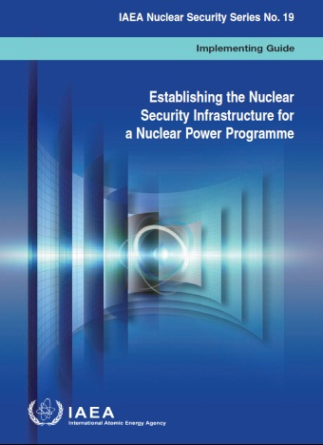
Regulatory Framework for Nuclear Security
10 Actions
Regulatory body with adequate legal authority and appropriate functional and financial independence
Established nuclear security regulations and requirements and associated procedures for evaluating applications and granting authorizations or licenses
Established systems to account for or register and effectively control and protect nuclear and other radioactive material
Established regulations and requirements for protecting sensitive information and sensitive information assets
Notes:
Effective implementation of the necessary nuclear security systems and measures relies on the appropriate legal and regulatory framework supporting competent authorities that have responsibilities for all actions that relate to assessment, authorization ( or approval), inspection and verification as well as enforcement.
The regulatory authority(ies) should have the legal authority to implement the regulatory framework. In particular, the regulatory authority(ies) should require an applicant to demonstrate appropriate nuclear security systems and measures in the context of an application for each type of authorization and thereby ensure the proper protection of nuclear and other radioactive material in use and storage .

Slide 39

Threat Assessment for Nuclear Security
18 Actions
National threat assessment
Design Basis Threat for facilities
Nuclear security systems and measures to be designed and implemented based on the assessed threat

Slide 40
Management Systems for Nuclear Security
43 Actions
Integrated Management System
Protection of Sensitive Information
Trustworthiness of Personnel
Human Resources for Nuclear Security
Promotion of Nuclear Security Culture
Sustaining the Nuclear Security Infrastructure

Slide 41
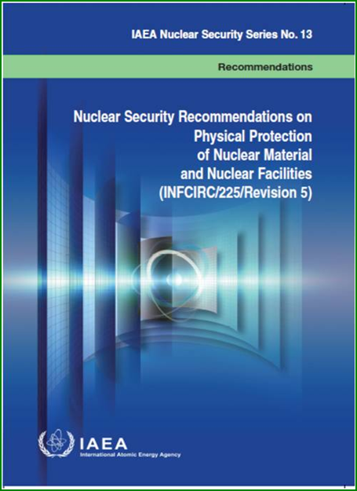

Nuclear Security Measures for Nuclear Material and Nuclear Facilities
39 Actions
Measures against unauthorized removal of nuclear material in use and storage and sabotage of nuclear facilities
Measures against unauthorized removal of nuclear material and sabotage of nuclear material during transport

Slide 42
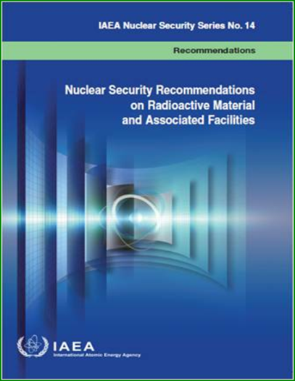

Nuclear Security Measures for Radioactive Material and Associated Facilities
23 Actions
General measures
Security of radioactive material in use and storage
Security of radioactive material in transport
Measures to prevent theft or unauthorized removal of other radioactive material and to prevent the sabotage of material, associated facilities and activities.

Slide 43
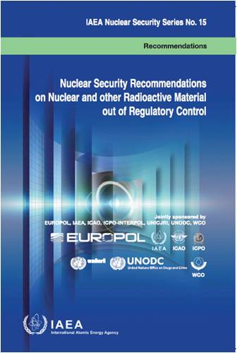

Nuclear Security Measures for Nuclear and other Radioactive Material out of Regulatory Control
31 Actions
Measures to prevent, detect and respond to criminal or unauthorized acts with nuclear security implications involving nuclear or other radioactive material out of regulatory control

Slide 44

Nuclear Security Measures for Nuclear and other Radioactive Material out of Regulatory Control
31 Actions
Prevention:
Deterrence
Information security
Trustworthiness
Detection:
Detection by instrument alarms
Detection by information alert
Initial assessment of alarms/alerts
Response:
Assessment of alarms/alerts
Crime scene management
Nuclear Forensics
Recovery and return of material
National response plan
Preparedness

Slide 45

International Cooperation
18 Actions
The global implications of a nuclear security event underlines the importance of international cooperation and assistance
Cooperation and assistance includes notification of nuclear security events, exchange of information, recovery and return of seized items and technical cooperation and assistance

Slide 46
^
Nuclear Security Recommendations
on Physical Protection of Nuclear Material and Nuclear Facilities
NSS-13/INFCIRC/225/Rev.5

Slide 47
History of INFCIRC/225
INFCIRC/225 has has been the key guidance on physical protection of nuclear material and nuclear facilities for decades
Originally prepared by a panel of experts convened by the IAEA Director General in 1972
First published in the INFCIRC series in 1975
Subsequently revised by member-state experts in
  1977 (Rev.1)
  1989 (Rev.2)
  1993 (Rev.3)
  1998 (Rev.4)
  2011(Rev.5)
Revision 5 is also IAEA Nuclear Security Series No. 13

Slide 48
Why Revision 5?
The 9/11/2001 attack resulted in greater recognition of the risk of nuclear terrorism
The IAEA Board of Governors (BOG) and General Conference GC(45)/INF/14 approved on September14, 2001
  Objectives of State Physical Protection Regime
  12 Fundamental Principles of Physical Protection of Nuclear Material and Nuclear Facilities

Slide 49
Why Revision 5? (continued)
The IAEA Convention on the Physical Protection of Nuclear Material, INFCIRC/274/Rev.1 (CPPNM)
  Opened for Signature in 1980. The scope of the Convention is physical protection of nuclear material used for peaceful purpose during international transport. Entered into force in 1987
  Amendment to the CPPNM GOV/INF/10-GC(49)INF/6, IAEA, Vienna [2005]) – Entered into force 8 May 2016
  Extends the scope of the CPPNM to nuclear material used for peaceful purposes in use, storage and transport; and to nuclear facilities used for peaceful purposes; protection from sabotage; & expands punishable acts and includes
    BOG Physical Protection Regime Objectives
    BOG 12 Fundamental Principles of Physical Protection
Notes:
49

Slide 50
General Approach to
Revision 5
Achieve consistency with endorsement by the IAEA BOG (September 2001) and the text of the Amendment to the CPPNM (2005)
Introduce the risk management approach and the tie to the graded approach, defence in depth, nuclear material categorization, and radiological consequence categorization
Forge a stronger connection between security and safety; and security and safeguards, which includes nuclear material accountancy and control (NMAC) measures

Slide 51
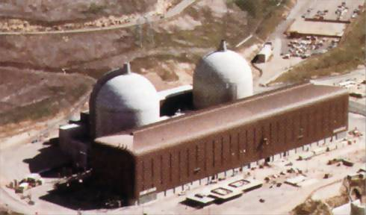
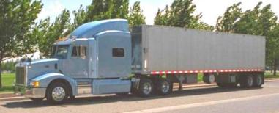
Scope of INFCIRC/225/Revision 5
Nuclear Material and Nuclear Facilities Used for Civil Purposes
In Use and Storage/During Transport

Slide 52
Structure of Revision 5
Introduction
Objectives (now 4)
Elements of a State’s Physical Protection Regime
Unauthorized Removal of Material in Use and Storage (Includes categorization of material and the addition of measures to locate/recover missing/stolen material)
Sabotage of Facilities and Material in Use and Storage (Includes addition of process for graded measures for protection against sabotage and measures to mitigate/minimize consequences)
Unauthorized Removal and Sabotage of Nuclear Material During Transport (Includes addition of measures to locate/recover and mitigate/minimize consequences)
Definitions

Slide 53
Objectives of State’s Physical Protection Regime
To protect against unauthorized removal: protecting against theft and other unlawful taking of nuclear material.
To locate and recover missing nuclear material: ensuring the implementation of rapid and comprehensive measures to locate and, where appropriate, recover missing or stolen nuclear material.
To protect against sabotage: protecting nuclear material and nuclear facilities against sabotage.
To mitigate or minimize effects of sabotage: mitigating or minimizing the radiological consequences of sabotage.

Slide 54
PP Objectives and Fundamental Principles
OBJECTIVES
Protect against theft
Protect against sabotage
Locate and recover stolen material
Mitigate radiological consequences of sabotage
FUNDAMENTAL PRINCIPLES
A: State responsibility
B: Responsibilities during transport
C: Legislative / regulatory framework
D: Competent authority
E: Responsibility of license holder
F: Security culture
G: Consideration of threat
H: Graded approach
I: Defense in depth
J: Quality assurance
K: Contingency plans
L: Confidentiality

Slide 55
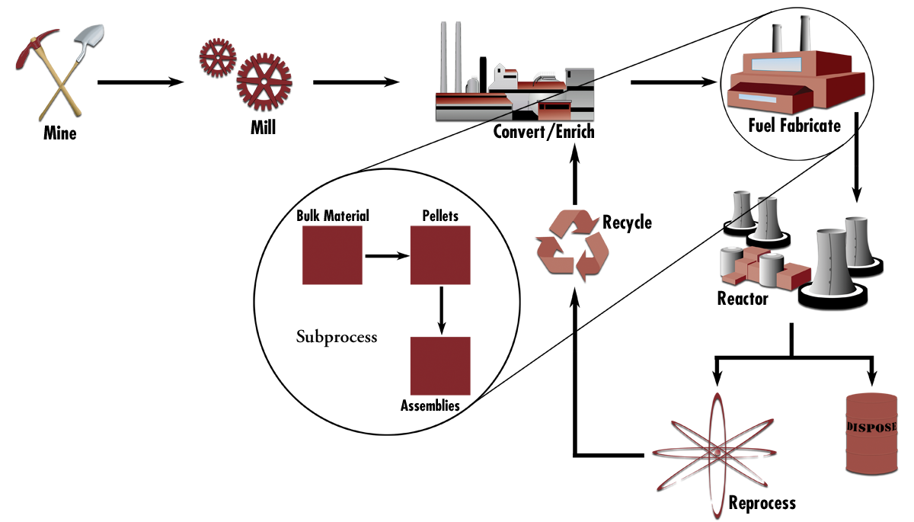
Nuclear Facility
A Facility (including associated buildings and equipment) in which nuclear material is produced, processed, used, handled, stored, or disposed of; and for which a specific
License is required from competent authority

Slide 56
Physical Protection Regime
Legislative and Regulatory Framework
Institutions and Organizations
Physical Protection Systems
+
+

Slide 57
Physical Protection
State / Competent Authority
Physical Protection Regime
Nuclear Security Culture Crosses All Three Levels
Licence Holders
Physical Protection System
Physical Protection Measures
People
Procedures
Equipment
Notes:
[18] Nuclear Security Culture – The assembly of characteristics, attitudes, and behaviours of individuals, organizations and institutions which serves as means to support, enhance and sustain nuclear security.
Might need to clarify each of the different terms in this slide, so there is no confusion regarding the subtle differences between terms

Slide 58
Physical Protection Regime Entities
State
Competent Authority or Authorities
Licence Holders
  Operator(s) of nuclear facilities
  Carrier, Shipper and Receiver for transport of nuclear materials
Nuclear Security Culture crosses all three levels

Slide 59
State Responsibilities
STATE
Legal and Regulatory Framework
Assignment of Responsibilities
Physical Protection Requirements
International Transport
International Cooperation

Slide 60
State Responsibility
Establishment, implementation, maintenance and sustainability of a physical protection regime for:
  All nuclear material in use and storage
  During transport
  For all nuclear facilities
Protection of nuclear material and nuclear facilities
  Unauthorized removal
  Sabotage
State

Slide 61
State Responsibility (continued)
Regular updates to reflect
  Changes in threat
  Advances in physical protection
    Approaches
    Systems
    Technology
  Introduction of new types of nuclear material and nuclear facilities
State

Slide 62
Additional State Responsibilities
Section 4 – Requirements for Measures to Locate and Recover Missing or Stolen Nuclear Material
Section 5 – Requirements for Associated Measures to Mitigate or Minimize the Radiological Consequences of Sabotage
Section 6 – Nuclear Materials During Transport, Locate and Recover
Section 6 – Nuclear Materials During Transport, Mitigate/Minimize
State

Slide 63
Competent Authority
Designated by the State with clearly defined legal status and independent from
  Applicants
  Operators
  Shippers
  Carriers
Provided adequate
  Legal authority
  Competence
  Financial resources
  Human resources

Slide 64
Competent Authority (continued)
Have access to State’s system for nuclear material accountancy and control
Be responsible for verifying continued compliance
Ensure evaluations based on performance testing (including exercises) are conducted
Ensure corrective actions are taken when needed
Be provided with timely reports of nuclear security events

Slide 65
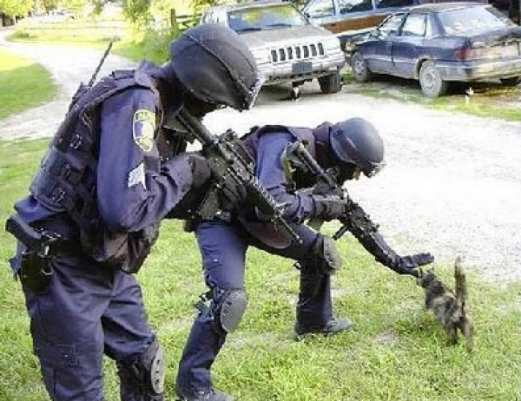
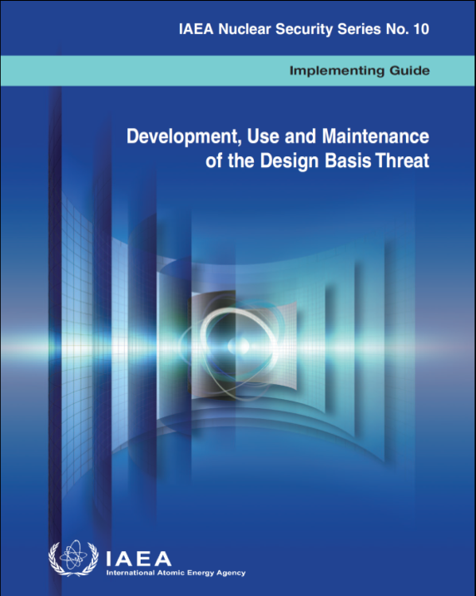
Threat Assessment and DBT
Identification and Assessment of Threats
The appropriate State authorities should define the threat and associated capabilities in the form of a threat assessment and, if appropriate, a design basis threat (DBT)
A DBT is developed from an evaluation by the State of the threat of unauthorized removal and of sabotage

Slide 66
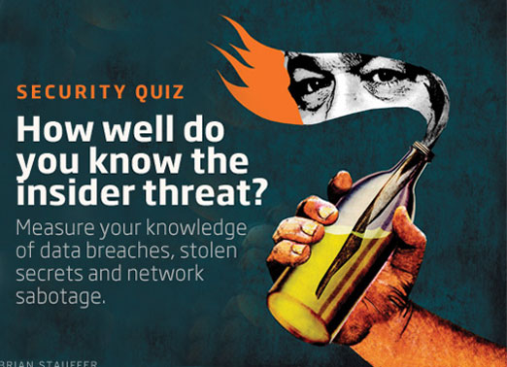
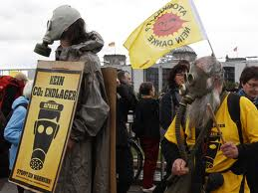
DBT: Basis for PP System Design
The State’s competent authority should require the use of a threat assessment and/or a DBT as a common basis for the design and implementation of the PP system by the operator
When considering the threat, due attention should be paid to insiders

Slide 67
Risk Management
State required to manage the risk of unauthorized removal and sabotage to keep the risk at acceptable levels
Requires assessing threat and potential consequences
Developing a legislative, regulatory, and programmatic framework ensures that appropriate effective physical protection measures are put in place
Notes:
3.41 The State should ensure that the State’s physical protection regime is capable of establishing and maintaining the risk of unauthorized removal and sabotage at acceptable levels through risk management. This requires assessing the threat and the potential consequences of malicious acts, and then developing a legislative regulatory and programmatic framework that ensures appropriate effective physical protection measures are put in place.

Slide 68
Risk Management
Risk can be managed by
  Reducing the threat
  Improving the effectiveness of the physical protection system
  Reducing the potential consequences of malicious acts by modifying specific contributing factors
68
Notes:
3.42 Risk can be managed by:
Reducing the threat. The threat may be reduced, for example, by the deterrence of robust physical protection measures, or through the confidentiality of sensitive information;
Improving the effectiveness of the physical protection system. The physical protection system effectiveness may be increased, for example, by defence in depth or establishing and maintaining nuclear security culture.
Reducing the potential consequences of malicious acts by modifying specific contributing factors, for example, the amount and type of nuclear material and the design of the facility.

Slide 69
Graded Approach
Fundamental Principle H
Physical protection requirements should be based on a graded approach, taking into account the current evaluation of the threat, the relative attractiveness, the nature of the nuclear material, and potential consequences associated with the unauthorized removal of nuclear material and with the sabotage against nuclear material or nuclear facilities.

Slide 70
CATEGORIZATION OF NUCLEAR MATERIAL
Category I
-- 2 kg or more Plutonium;
-- 5 kg or more HEU
-- 2 kg or more U-233
Category II
-- 500 grams to 2 kg Plutonium;
-- 1 to 5 kg HEU;
-- 10 kg or more LEU enriched 10-20% U235;
-- 500 g to 2 kg U-233;
-- Irradiated fuel (depleted uranium, natural uranium, thorium or LEU with fissile content of uranium less than 10%)
Category III
-- 15 to 500 grams Plutonium;
-- 15 g to 1 kg HEU;
-- 1 to 10 kg LEU enriched 10-20%;
-- 10 kg or more LEU enriched up to 10% U-235
70

Slide 71
Sabotage Consequences - URC and HRC
Identify vital areas and protect as specified in NSS13.
High
Radiological
Consequences
State to determine
Consequences
Graded protection requirements based on level of potential consequences
Unacceptable
Radiological
Consequences
Secure and control access to safety-related equipment
Notes:
3.37
There may be a question about onsite or offsite consequences. High radiological consequences typically are considered offsite or at the border of the facility.

Slide 72
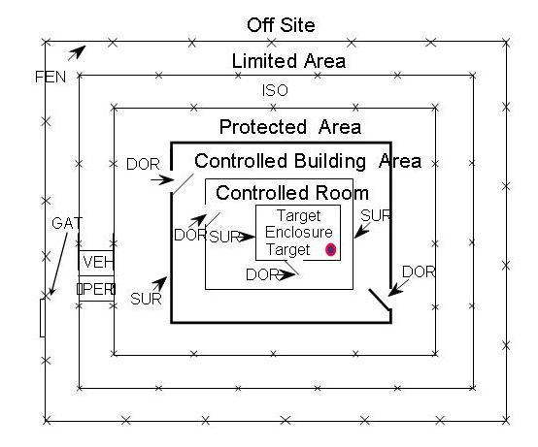

Defense in Depth Concept
Defence in depth is a concept used to design physical protection systems that requires an adversary to overcome or circumvent multiple obstacles, either similar or diverse, in order to achieve his/her objective

Slide 73
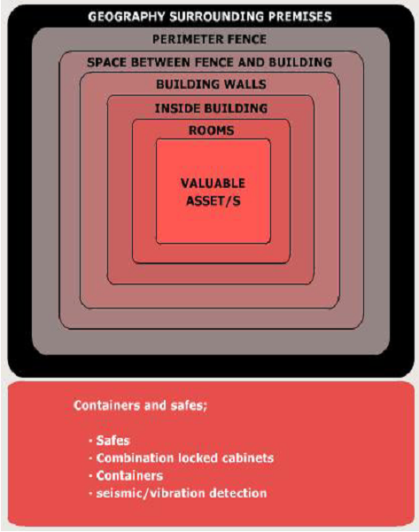

Other Important Elements of PP Regime
Contingency Plans
Nuclear Security Culture
Quality Assurance
Confidentiality
Sustainability Program

Slide 74
Responsibilities of Licence Holders
Defined as operators or shipper/carriers
Compliance with regulations
Cooperation & coordination with State entities having physical protection responsibilities
Nuclear material accountancy and control
Development of security plan, including contingency plan
Optimum site selection and design
Development and implementation of means and procedures for evaluation and maintenance of the PPS
Compensatory measures

Slide 75
Physical Protection System
An integrated set of physical protection measures intended to prevent the completion of a malicious act
For a successful system design, the total time for detection, delay, and response must be less than adversary task time to complete his or her goal
Response Force Time
Limited
Access
Area
Protected Area
Inner/Vital
Area
Hardened Enclosure
Sensitive
Material
Task
1
Task
2
Task
3
Task
4
Task
5
Task
6
Task
7
Task 8

Slide 76
Physical Protection Functions
Detection
Sensor
Alarm
Alarm
Alarm
Activated
Signal
Reported
Assessed
Initiated
“An alarm without assessment is not detection.”
Delay
Provide obstacles to increase adversary task time after detection
Response
Deploy Response Force
Interrupt and Neutralize Adversary Attempt
Communicate to Response Force

Slide 77
Physical Protection Layers
Limited Access Area — designated area containing nuclear facility and nuclear material to which access is limited and controlled for physical protection purposes
Protected Area — inside limited access area containing Cat I or II NM and/or sabotage targets surrounded by physical barrier with additional physical protection measures
Inner Area — inside protected area with additional measures where Cat I nuclear material is used and/or stored
Vital Area — inside protected area containing equipment, systems or devices or NM, the sabotage of which could directly or indirectly lead to high radiological consequences

Slide 78
Physical Protection Layers (continued)
Site
Limited Access Area
Protected Area
Protected Area
Inner Area
Vital Area
Category III Material
Category II Material
Category I Material

Slide 79
^
Agency’s Activities related to Nuclear Security

Slide 80
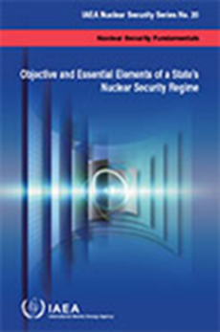
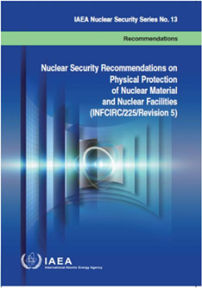
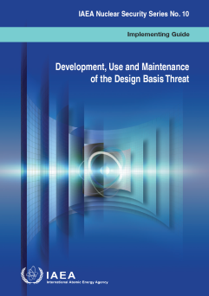
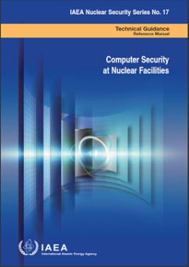
IAEA Nuclear Security Series
26 Documents published.
Based on the International legal framework for nuclear security
Fundamentals
Recommendations
Implementing Guides
Technical Guidance
What a nuclear security regime is for, and what it should include
What States should achieve
How States should implement recommendations
How to do it (in more details)
http://www-pub.iaea.org/books/IAEABooks/Series/127/ Nuclear-Security-Series
80
Notes:
80
80

Slide 81
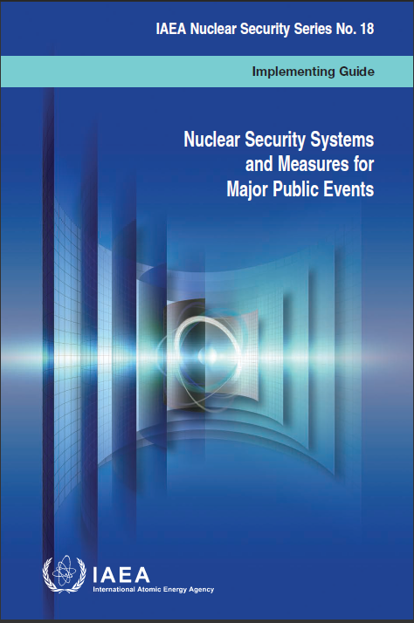
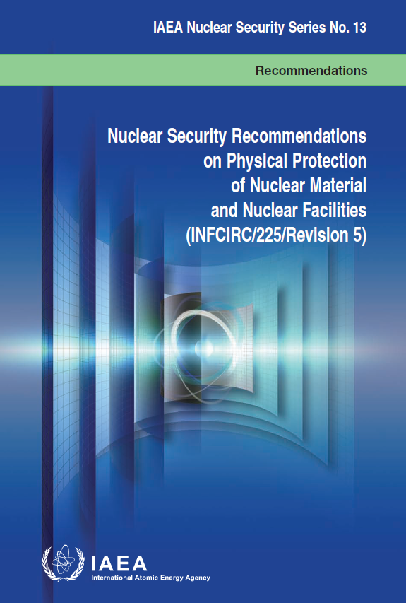
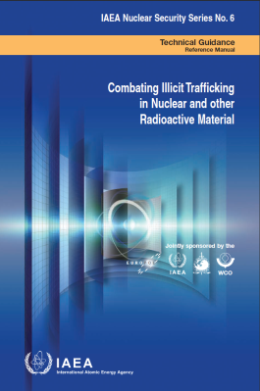
IAEA Nuclear Security Series
The Nuclear Security Series (NSS), developed in close consultation with Member States’ experts, bring together best practices acceptable to the international community for broad implementation.
The Nuclear Security Guidance Committee (NSGC), open to all Member States, makes recommendations on the development and review of the Nuclear Security Series.
26 NSS Publications include:
1 Fundamentals
3 Recommendations
14 Implementing Guides
8 Technical Guidance
81
Notes:
The Nuclear Security Series helps States to meet the requirements set out in International legal instruments. They are developed in close consultation with States’ experts, and bring together best practices which are acceptable to the international community for broad implementation. They cover a range of issues such as security culture, design basis threat methodology and nuclear forensics methodology, as well as physical protection measures.
They are published in four categories…

Slide 82
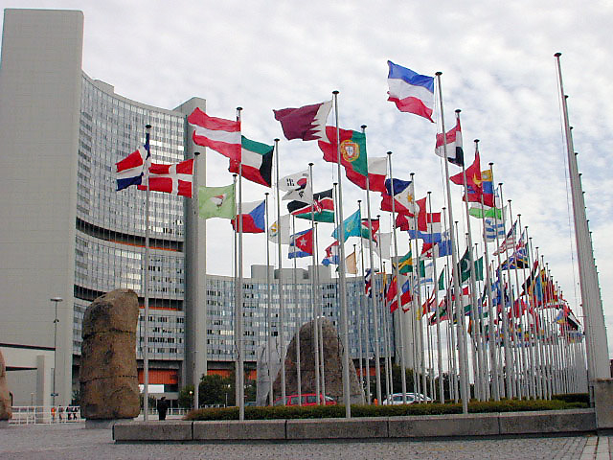
IAEA Nuclear Security Activities
Responsibility for nuclear security within a State rests entirely with that State
  The IAEA supports States, upon their request, in their efforts to establish and maintain effective nuclear security through (Nuclear Security Plan 2014-2017*):
  Needs assessment
  External coordination
  Supporting nuclear security framework globally
  Coordinated Research Projects (CRP)
  Assessment through self-assessment and/or through peer review
  Human resource development
  Risk reduction and security improvements
Some of these activities contribute to capacity building
*GOV/2013/42
82

Slide 83
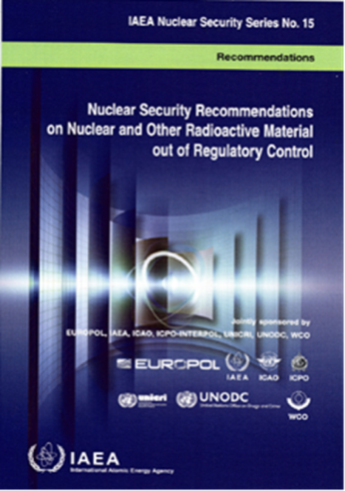
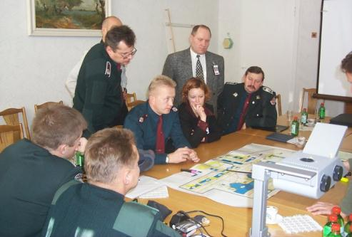
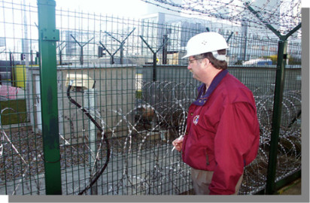
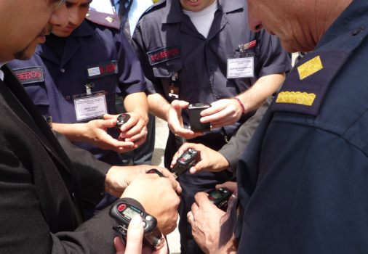
IAEA Assistance & Cooperation
  Encouraging and facilitating adherence to international legal instruments
  Developing Nuclear Security guidance
  Peer Reviews / Advisory Services, Integrated Nuclear Security Support Plans (INSSPs), IPPAS and NUSIMS
  Education & Training
  Major public events
  Risk Reduction
Notes:
IPPAS = International Physical Protection Advisory Service
NUSIMS = Nuclear Security Information Management System

Slide 84
Peer Reviews / Advisory Services
  Provided upon request from States
  International Nuclear Security Advisory Service (INSServ)
  International Physical Protection Advisory Service (IPPAS)
  Focuses on:
  nuclear and other radioactive material out of regulatory control
  general overview of key elements of national nuclear security regime
  Identification of needs for improvement of legal and institutional framework and technical means
  77 INSServ to date
  Focuses on:
  nuclear and other radioactive material under regulatory control
  in depth review of physical protection regime
  Identification of needs for enhancement at state and facility (activity) level, including transport
  71 IPPAS to date and in the IAEA Laboratories in Seibersdorf
  12 requests for 2016-2017
Notes:
IAEA experts assist, upon request, in identifying ways to enhance nuclear security measures by undertaking Field visits and assessing States’ individual needs.
INSSERV- International Nuclear Security Advisory Service missions are presented in flexible modules that can be tailored to provide a general overview of the nuclear security regime in a State or a specific area of interest, such as detection and response systems and measures, major public events and nuclear forensics.
International Physical Protection Advisory Service (IPPAS) missions serve as the IAEA’s chief tool for evaluating existing physical protection arrangements, States’s systems and arrangements at facilities and locations.

Slide 85
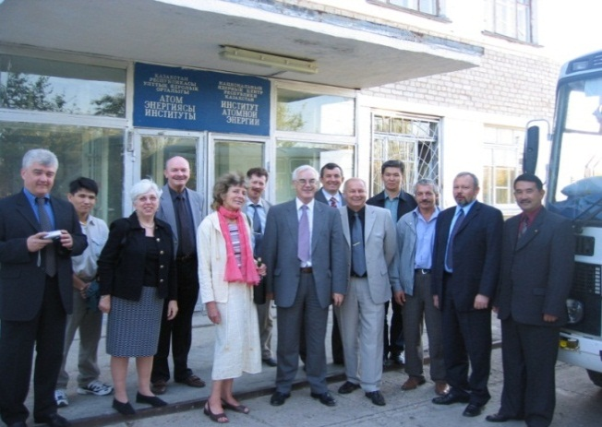
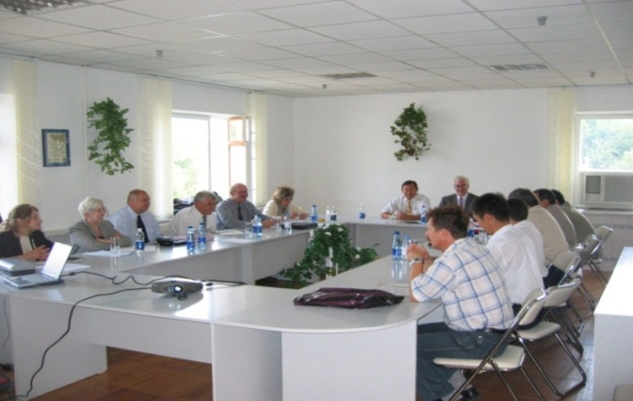
IPPAS Process
AWARENESS AND Informal Consultations
Formal
Request
3-6 months
Preparatory
Meeting
IPPAS MISSION
4-8 months
IPPAS
Mission
IPPAS WORKSHOPS
2-3 months
Final Mission Report
6-12 months
Follow-up
IPPAS Mission Report is highly confidential
Notes:
International Physical Protection Advisory Service (IPPAS) missions serve as the IAEA’s chief tool for evaluating existing physical protection arrangements, States’s systems and arrangements at facilities and locations.
Focuses on:
nuclear and other radioactive material under regulatory control
in depth review of physical protection regime
Identification of needs for enhancement at state and facility (activity) level, including transport
71 IPPAS to date and in the IAEA Laboratories in Seibersdorf
12 requests for 2016-2017

Slide 86
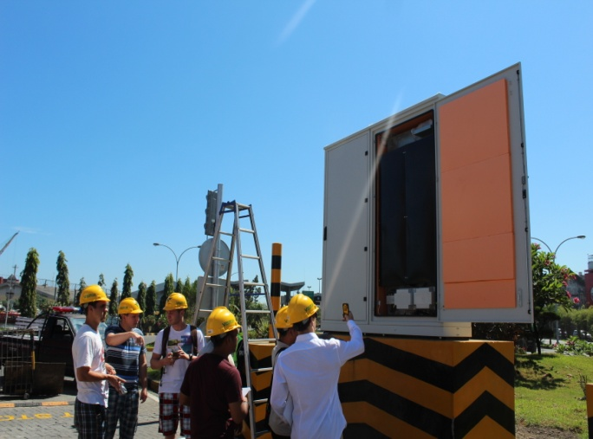
Education & Training: Overview
Human resource development is the key to sustainability
Education:
Master of Science program in nuclear security (IAEA NSS.12)
Master program rolled-out in six Universities in 2013
International Nuclear Security Education Network, 2010, providing a forum for collaboration in activities for nuclear security education
Training:
Over 30 different nuclear security training courses designed
More than 80 training events run per year
Over 19,000 participants from 120 States trained since 2002
Nuclear Security Support Centers
Notes:
Human resource development is the key to sustainability
Commitment to education and training enables States to further improve their national nuclear security regimes and reaffirms their commitment to robust and sustainable nuclear security infrastructure. An important component of such sustainability is for the State to have a sufficient number of well-educated and trained staff with the right competence, skills and security culture to advance and maintain nuclear security across many different disciplines.
Since 2002 over 19,000 participants from 120 States were trained.

Slide 87
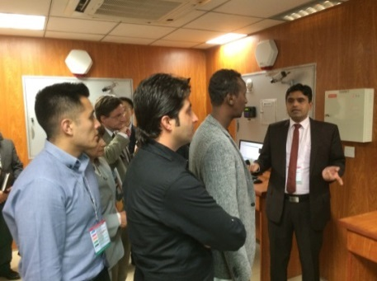
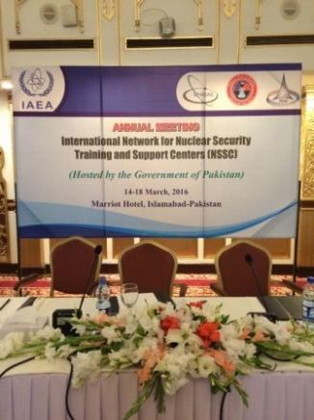
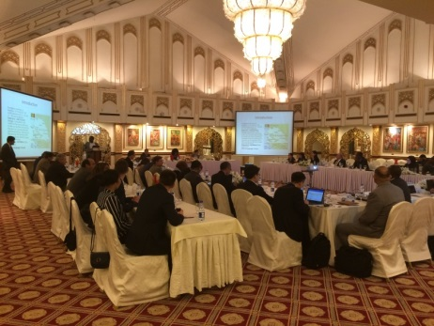
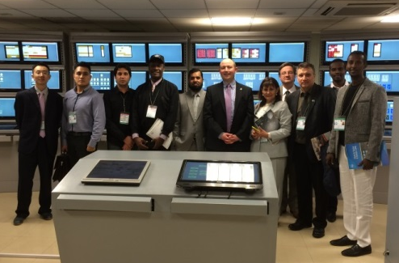
International Network for Nuclear Security Training and Support Centers (NSSC Network)
  Established in 2012
Mission
To contribute to the global efforts to enhance nuclear security capacity building through an effective and collaborative network of nuclear security training and support centers
Priorities
Coordination among NSSCs
Identification of needs and capabilities
Sharing best practices, lessons learned, and resources
NSSC exchange visits
Facilitating regional collaboration
Encouraging link with higher education
Membership
  Currently 57 member-states
  Membership open to all IAEA Member States through official channels
Vision for Future Activities
  Network as a stronger tool for States
  Expanded NSSC involvement in nuclear security training, equipment maintenance and repair activities currently performed by IAEA
Strengthened regional NSSC collaboration
*Photos: 2016 NSSC Network Annual Meeting, held in Islamabad Pakistan

Slide 88
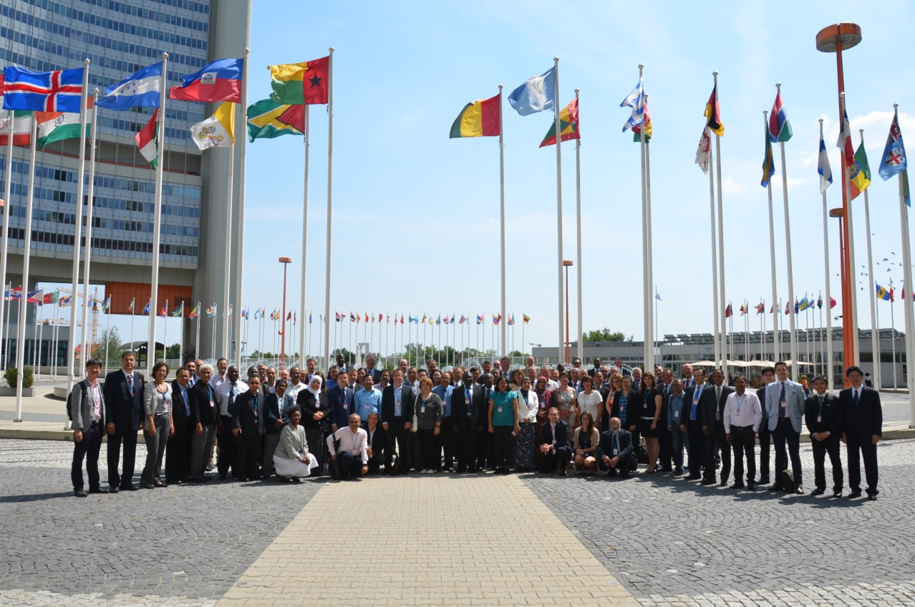
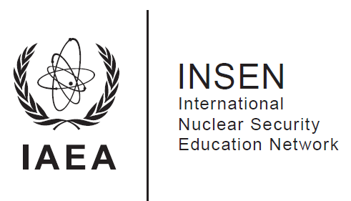
International Nuclear Security Education Network (INSEN)
Established in 2010
Membership is informal and open to any educational and research institution already involved or planning to be involved in nuclear security education in the future, or any competent authority that is interested or involved in nuclear security education
155 registered institutions from 54 Member States
Professional Development Courses (PDCs) for faculty members in the different areas of nuclear security
Degree programmes, courses, and modules
Teaching materials, textbooks and methodological tools
Mission: to enhance global nuclear security by developing, sharing and promoting excellence in nuclear security education

Slide 89
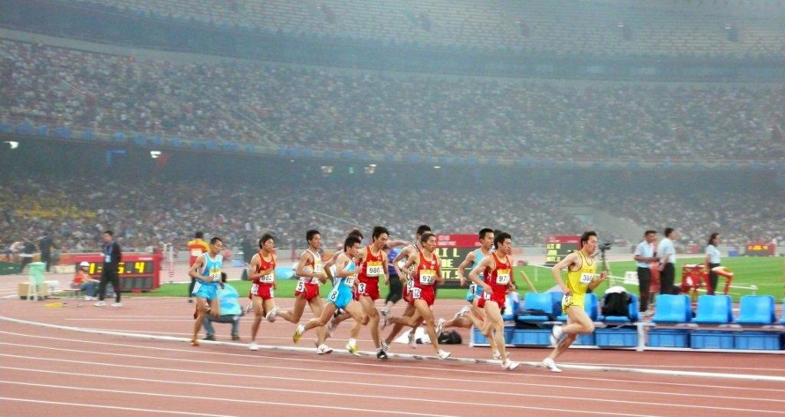
Major Public Events
With a large number of participants and spectators, the scale of major public events (MPEs) makes them a vulnerable target
The IAEA assists States in planning, training, and equipping themselves to address this reality (NSNS can assist in MPE in Arab States (i.e. 2022 FIFA World Cup in Qatar).
“Guards, guns and gates” are no longer enough
IAEA support provided to:
Olympic Games (Greece, China)
Football World Cup (Germany, South Africa)
Pan American Games (Brazil, Mexico)
South American Games (Colombia)
UEFA Cup (Poland, Ukraine)
Africa Cup of Nations (Gabon)
2014 FIFA World Cup (Brazil)
2016 Olympic Games (Brazil)
2016 Para-Olympic Games (Brazil)
Notes:
Major public events, with their many participants and spectators could be vulnerable target for RDDS or improvised nuclear explosive devices. States must put nuclear security measures in place to ensure that nuclear or radioactive material is not used to disrupt events such as the Olympics or the Football World Cup
The IAEA provides assistance to States that host such events, including provision of detection equipment and training of staff and the sharing of expertise and knowledge.

Slide 90
Risk Reduction
Over 180 PP upgrades since 2002
Over 6000 radioactive sources secured
More than 4300 instruments provided
Notes:
Over 180 physical protection upgrades were carried out since 2002
Over 6000 radioactive sources secured and more than 4300 instruments provided
Secured means = with IAEA assistance the sources are accounted for and safely stored.

Slide 91
  Integrated Nuclear Security Support Plans (INSSPs)
IAEA works with states upon request to establish Integrated Nuclear Security Support Plans as a key modality to:
  provide a comprehensive assessment of a State’s nuclear security needs,
  plan for the necessary nuclear security improvements to meet such needs
Five Functional Areas:
  Legislative and Regulatory Framework
  Prevention
  Detection
  Response
  Sustainability

Slide 92
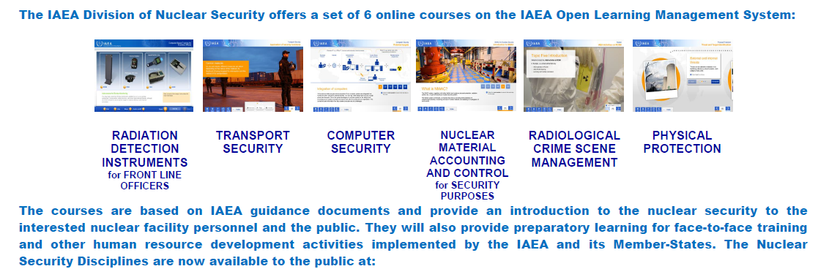
Nuclear Security e-Learning
http://olms-nkm.iaea.org/nsns/training
Notes:
Six E-Learning Modules: Radiation Detection Instruments for Front Line Officers, Transport Security, Computer Security, Radiological Crime Scene Management, Nuclear Material Accounting and Control, and Physical Protection

Slide 93
Nuclear Security of Material and Facilities Section
Implementing Programmes in the Following Areas:
International Physical Protection Advisory Service (IPPAS)
Nuclear Fuel Cycle
  Research Reactors
Nuclear Materials Accounting and Control
Radioactive Sources and Associated Facilities
Transport Security

Slide 94
Research Reactors Programme
Develop a comprehensive, systematic, and focused approach to assist member states to establish, enhance, and sustain nuclear security at research reactors.
Notes:
The simpler design, enriched fuel, and less constrained access to as well as the location of research reactors may make them much more prone to malicious activities, thereby requiring the implementation of robust security measures to prevent or mitigate threats.
Consequently, new entrants to research reactor programmes need to take early action to ensure that their nuclear installations are secure against all of the vulnerabilities and threats anticipated from the very initial stages of the programme.
In recent years, the interest of Member States in developing research reactors has grown significantly.

Slide 95


Nuclear Material Accounting and Control
Technical Programme Components:
Guidance Documents
Development of Training Material
NMAC Training
NMAC Services (expert review of state’s or facility’s NMAC system)
Assistance in developing regulations at State competent authority and facility levels
Coordinated Research Project on NMAC Technical Topic

Slide 96
Nuclear Material Accounting and Control
Purpose of “NMAC system” is to maintain and report accurate, timely, complete and reliable information on all activities and operations (including movements) involving nuclear material.
This information should include the locations, quantities and characteristics of nuclear material at the nuclear facility.

Slide 97
Nuclear Material Accounting and Control- continued
A system that responds to nuclear security concerns
Physical protection measures can be taken to protect against theft and other possible misuse of nuclear material, but physical protection measures cannot ordinarily resolve these questions:
“Has nuclear material been stolen?”
“Has nuclear material been lost?”
“Has unauthorized production of nuclear material occurred?”
These questions can only be answered by an accounting system with complete and up-to-date records of the facility’s nuclear material.
Effective control over nuclear material is essential for mitigating the risk of theft or unauthorized removal.
Notes:
Physical measures can be taken to protect against theft, but physical protection measures cannot resolve allegations or questions of theft.
The question “Has an item been stolen?” can only be answered by an accounting system with complete and up-to-date records of the facility’s nuclear material.
Accounting records of nuclear material locations and quantities are necessary for resolving questions of theft.

Slide 98

Radioactive Sources and Associated Facilities
The Programmeconsists of five primary activities:
Peer review and advisory missions supporting comprehensive needs assessment (following the IPPAS format)
Developing training materials to support competency building in States
Detailed, practical technical guidance that supports the relevant NSS recommendations and implementing guides
Technical improvement to the physical protection and control of high activity radioactive sources
Other activities including ad hoc technical missions, workshops, and regional review meetings

Slide 99


Transport Security
Elements of Nuclear Security Programme for Transport:
Peer review and advisory missions supporting comprehensive needs assessment (following the IPPAS format)
Training materials to support competency building in States
Technical Guidance that supports the relevant NSS recommendations and implementing guides
Technical improvement to the physical protection of shipments
Other activities including ad hoc technical missions, workshops and regional review meetings.

Slide 100
Conclusion
National efforts can be enhanced if they are implemented in synergy with international programmes for strengthening global nuclear security

Slide 101


…Thank you for your attention
101
101
101
Notes:
The IAEA was established in 1957.

