Slide 1
The TALYS nuclear model code I
Arjan Koning
Nuclear Data Section, NAPC
International Atomic Energy Agency, Vienna
ICTP-IAEA Workshop on the Evaluation of Nuclear Reaction Data for Applications, Trieste, Italy, October 2-13 2017

Slide 2
Acknowledgements
Stephane Hilaire and Eric Bauge, CEA-DAM Bruyeres-le-Chatel, France,
Stephane Goriely, Univ. Libre Brussels, Belgium,
Dimitri Rochman, NRG Petten, the Netherlands,
Jura Kopecky, JUKO Research, Alkmaar, the Netherlands,
Stephan Pomp, Univ. Uppsala, Sweden,
for lecture material and useful discussions.

Slide 3
First, an advertisement……

Slide 4

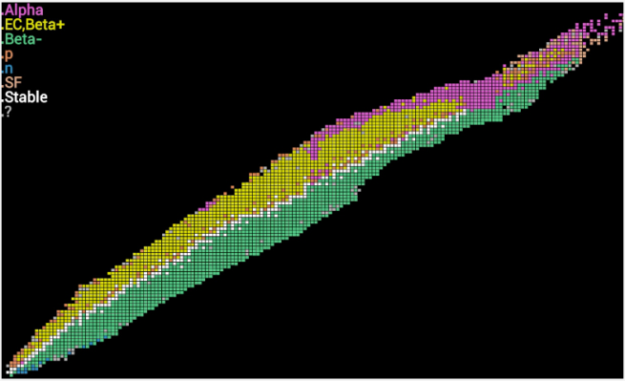
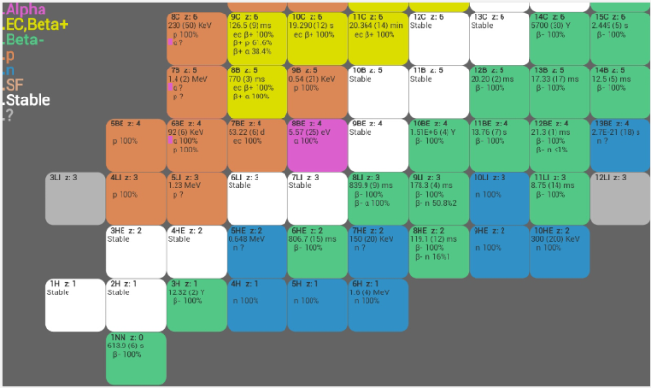
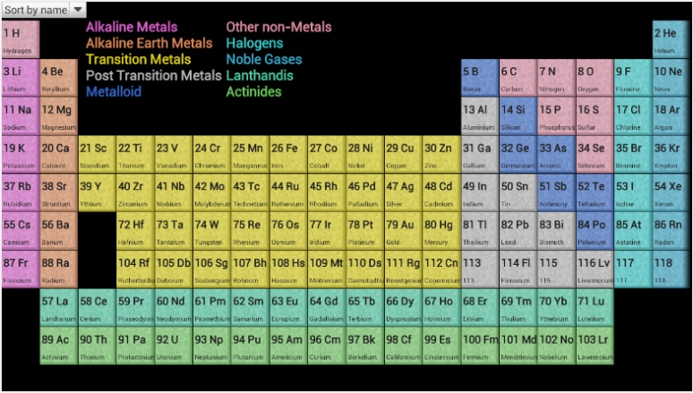
Isotope Browser – App for smart phones
Interactive App for Tablet or phone
Provides nuclide properties for 4,000 nuclides and isomers (data from ENSDF)
Android , Apple and Amazon Kindle
~49,000 downloads so far (~1,200 x month)
2 new releases per year
  https://play.google.com/store/apps
  https://itunes.apple.com
Now available in 10 languages:
  English, Arabic, Chinese, French*, Spanish, Russian (6 UN languages), Japanese, Italian, Slovenian, traditional Chinese
*French about to be deployed

Slide 5
Outline
Nuclear data
General overview of TALYS
A glimpse of some important nuclear models:
  Optical model
  Level densities
  Compound nucleus reactions
  Pre-equilibrium reactions
  Gamma-ray strength functions
  Fission
Installing and running the code

Slide 6
Nuclear data for applications
All effects of an interaction of a particle (usually: neutron) with a nucleus in numerical form:
Cross sections (total, elastic, inelastic, (n,2n), fission, etc.)
Angular distributions (elastic, inelastic, etc.)
Emission energy spectra
Gamma-ray production
Fission yields, number of prompt/delayed neutrons
Radioactive decay data
Etc.
Complete nuclear data libraries can be obtained through a combination of experimental and theoretical (computational) nuclear physics

Slide 7
Introduction
Nuclear data is crucial for reactor and fuel cycle analysis:
  Energy production, radiation damage, radioactivity, etc.
  Currently large emphasis on uncertainties: nuclear data uncertainites lead to uncertainties in key performance parameters
More complete and accurate nuclear data for advanced reactor systems does not prove the principle, but
  Accelerates development with minimum of safety-justifying steps
  improves the economy whilst maintaining safety
The nuclear industry claims that improved nuclear data, and associated uncertainty assessment, still has economical benefits of hundreds of million per year

Slide 8
Nuclear data needs and tools
A well-balanced effort is required for:
High accuracy differential measurements (Europe: IRMM Geel + CERN-nTOF + others)
Nuclear model development and software (e.g. TALYS)
Data evaluation, uncertainty assessment and library production and processing (Europe: JEFF, TENDL)
Validation with simple (criticality, shielding) and complex (entire reactors) integral experiments
All this is needed for both fission and fusion: the approach is similar, the energy range is different.

Slide 9
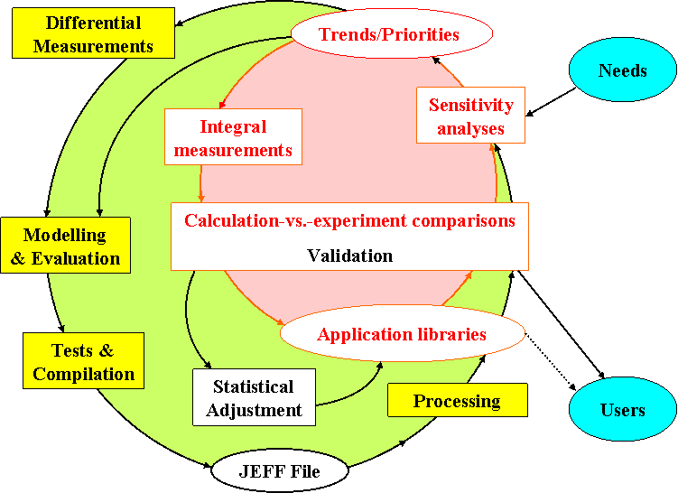
Nuclear data cycle
Or TENDL!!

Slide 10
EXFOR database (Nuclear Reaction Data Center Network: IAEA, NEA, NNDC, JAEA, Obninsk, etc)
Total estimated cost of EXFOR (AK, private comm.): between 20 – 60 Billion Euro
Total estimated value of EXFOR : priceless

Slide 11
TYPES OF NUCLEAR REACTION DATA NEEDED
Cross sections :
total, reaction, elastic (shape & compound), non-elastic, inelastic (discrete levels & total)
total particle (residual) production
all exclusive reactions (n,nd2a)
all exclusive isomer production
all exclusive discrete and continuum g-ray production
Spectra :
elastic and inelastic angular distribution or energy spectra
all exclusive double-differential spectra
total particle production spectra
compound and pre-equilibrium spectra per reaction stage.
Fission observables :
cross sections (total, per chance)
fission fragment mass and isotopic yields
fission neutrons (multiplicities, spectra)
Miscellaneous :
recoil cross sections and ddx
particle multiplicities
astrophysical reaction rates
covariance information

Slide 12
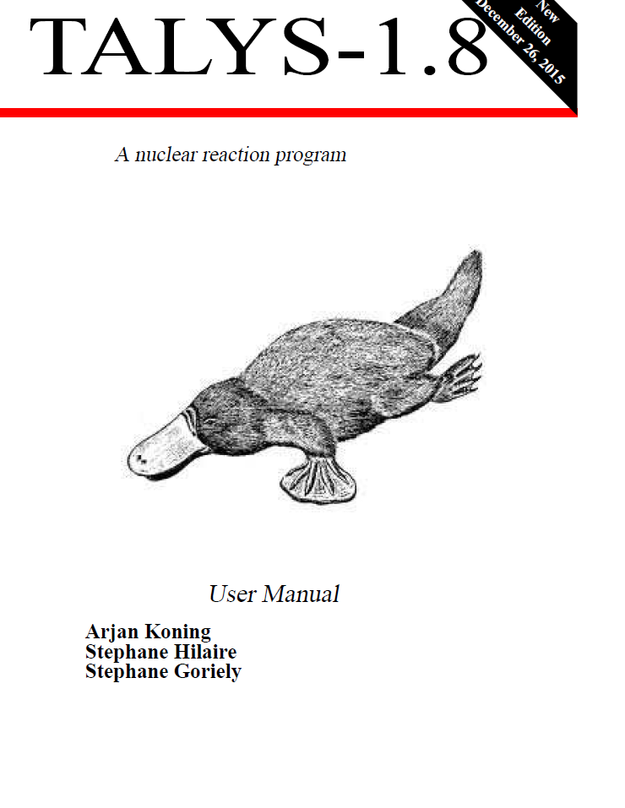
PLATYPUS

Slide 13
GENERAL FEATURES
Situation in 1998 !
ALICE – LLNL – 1974 – Blann
(Mc-)GNASH – LANL – 1977 – Young, Arthur & Chadwick
TNG – ORNL – 1980 – Fu
STAPRE – Univ. Vienna – 1980 – Uhl
UNF,MEND – CIAE, Nanking Univ. – 1985 – Cai, Zhang
EXIFON – Univ. Dresden – 1989 – Kalka
EMPIRE – ENEA/IAEA/BNL – 1980 – Herman
TALYS – NRG/CEA – 1998 – Koning, Hilaire & Duijvestijn
Modern computers (i.e. speed and memory)
available when the code conception was started

Slide 14
GENERAL FEATURES
GNASH Input file before 1998

Slide 15
GENERAL FEATURES
Ideas behind TALYS conception
- TALYS mantra : “ First Completeness then Quality”
No NaNs
No Crash
Warnings to identify malfunctions
Default « simple » models which will later be improved (anticipation)
All output channels smoothly described
- Transparent programming
No unnecessary assumptions
No equation simplification (one can recognize a general expression)
Many comments
No implicit definition of variables
The variables are defined following the order of appearance in subroutines

Slide 16
GENERAL FEATURES
What TALYS does !
- Simulates a nuclear reaction
projectiles : n,p,d,t,³he, ⁴he and gamma
targets : 3 ≤ Z ≤ 124 or 5 ≤ A ≤ 339 (either isotopic or natural)
- Incident projectile energy from a few keV up to 200 MeV
(code “works” up to1 GeV)
- TALYS can be used :
. In depth single reaction analysis
. Global nuclear reaction network calculation (eg astrophysics)
. Within a more global code system (reactor physics)
. Without reaction calculation (only structure data provided)
TALYS is always under development, while a stable version is released
every 2 years.

Slide 17
GENERAL FEATURES
Technical details
- Fortran 77 , gradually evolving into full Fortran95
- ≈ 110000 lines (+ 20000 lines of ECIS)
- Modern programming
- modular (312 subroutines)
- Explicit variable names and many comments (30% of total number of lines)
- Transparent programming (few exceptions)
- Flexible use and extensive validation
- Flexibility : default ⇒ 4 line idiot proof input (element, mass, projectile, energy)
adjustment ⇒ 400 keywords
- Random input generation to check stability
- Drip-line to drip-line calculations help removing bugs
- >500 pages manual
- Compiled and tested with several compilers and OS

Slide 18

GENERAL FEATURES
Typical calculation times
Numbers based on a single Intel Xeon X5472 3.0 GhZ processor
Time needed to get all cross sections, level densities, spectra, angular distributions. gamma production etc.:
  14 MeV neutron on non-deformed target: 3 sec.
  60 incident energies between 0 and 20 MeV:1 min. (Al-27)
        4 min. (Pb-208)
        10 min. (U-238)
  100 incident energies between 0 and 200 MeV:20 min. (Al-27)
        3-100 hours (U-238) depending on OMP
  60 incident energies between 0 and 20 MeV for all 2808 nuclides, stable or with t> 1 sec: about 200 hours
  To obtain credible Monte Carlo based covariance data: multiply the above numbers by 50-500.

Slide 19
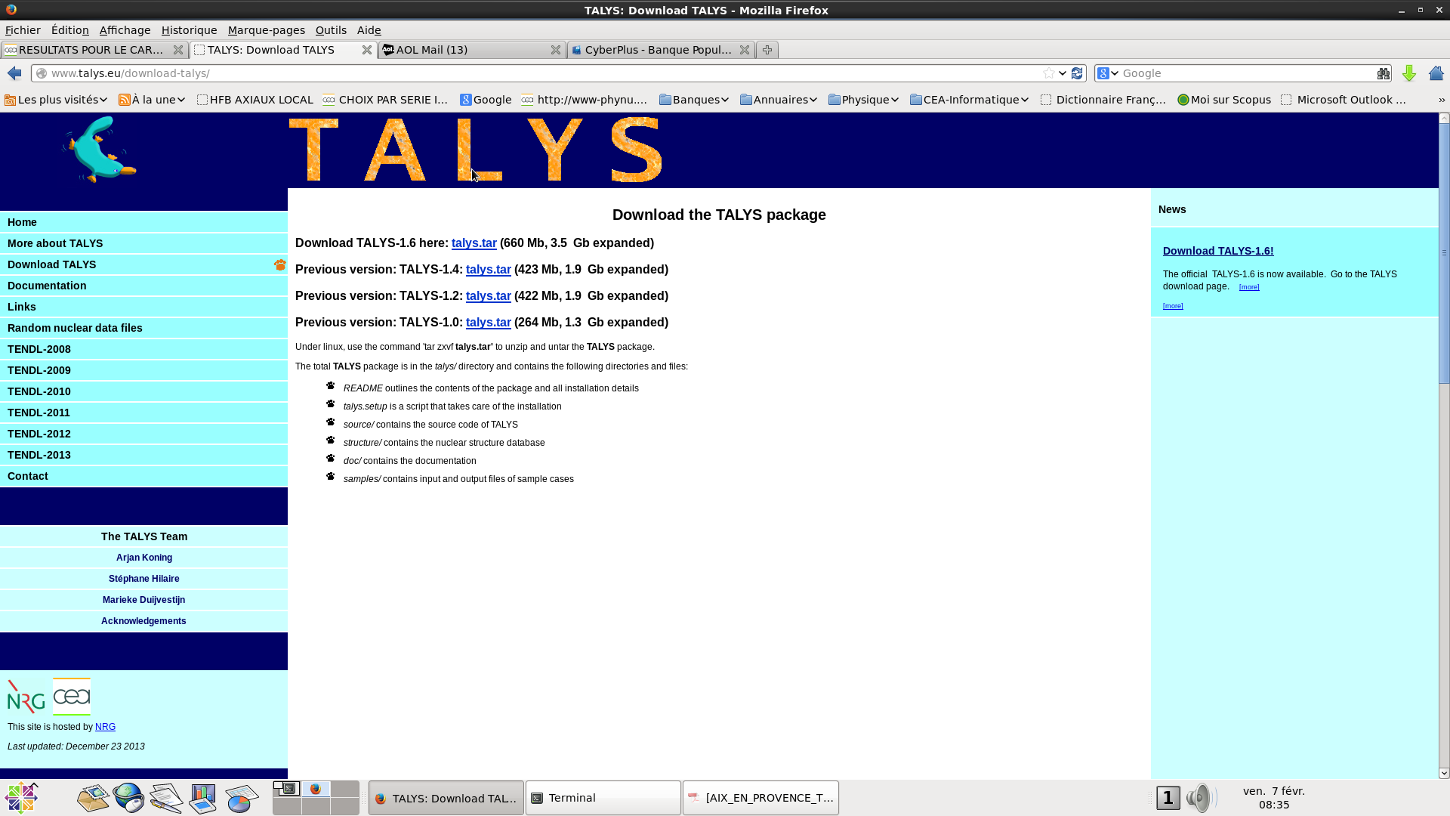
GENERAL FEATURES
TALYS versions online
http://www.talys.eu

Slide 20
GENERAL FEATURES
TALYS users and publications
User feedback via talys mailing list : info@talys.eu to be added to mailing list
: talys-l@nrg.eu to inform mailing list
PUBLICATIONS

Slide 21
GENERAL FEATURES
TALYS versions online
http://www.talys.eu
TALYS 1.0 (ND 2007)
TALYS 1.2 (End of 2009)
- new keywords (mainly to improve fitting possibilities)
- bugs corrected to solve crashes or unphysical results
- inclusion of microscopic ph level densities
- inclusion of Skm-HFB structure information (def., masses, g strengths)
- inclusion of D1M
TALYS 1.4 (End of 2011)
- new alpha and deuteron OMP
- URR extension
TALYS 1.6 (End of 2013)
- non-equidistant excitation energy binning possible (extension to energies > 200 MeV)
- direct and semi-direct capture added
- new microscopic lds from D1M
- medical isotope production implemented
- coupling to GEF for fission yields done
TALYS 1.8 (End of 2015)
    Resolved resonance range added
    More extensive GEF and fission possibilities (PFNS) added

Slide 22
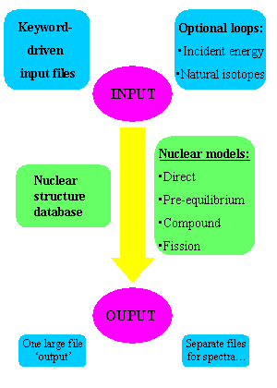
GENERAL FEATURES
TALYS Scheme

Slide 23
TALYS code scheme

Slide 24
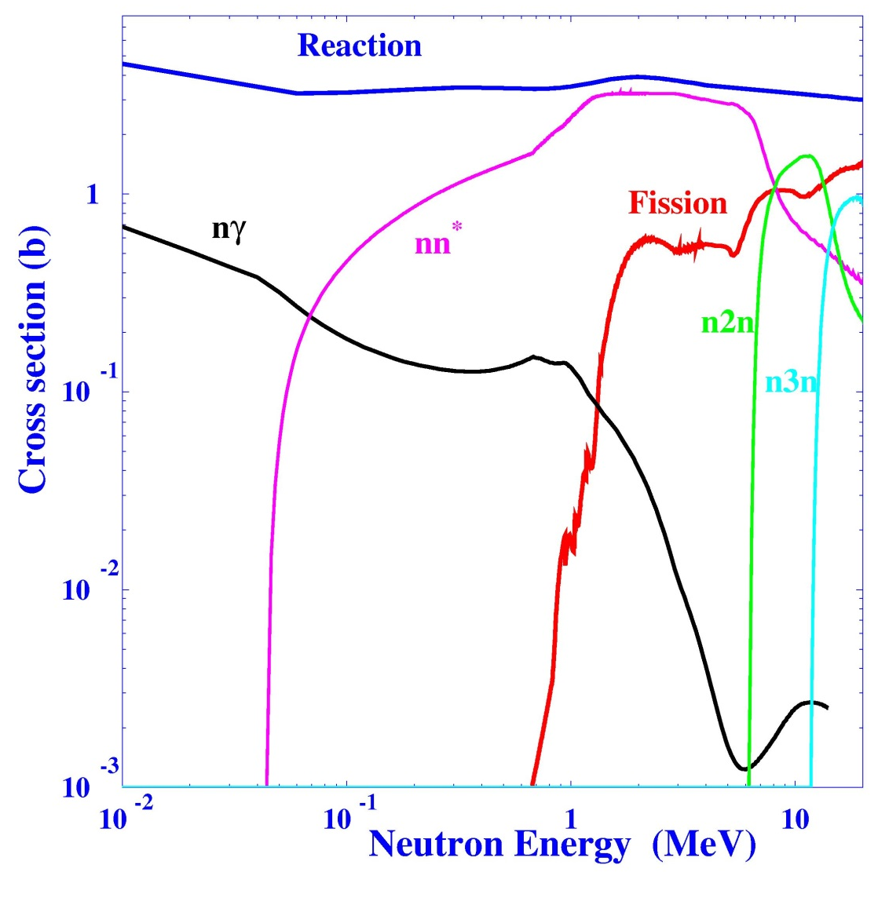
REACTION MODELS & REACTION CHANNELS
(REMINDER)
n + ²³⁸U
Optical model
+
Statistical model
+
Pre-equilibrium model
s_{R} = s_{d} + s _{PE} + s_{CN}
Cross section (barn)
= s_{nn’} + s_{nf} + s_{ng} + ...
Neutron energy (MeV)

Slide 25
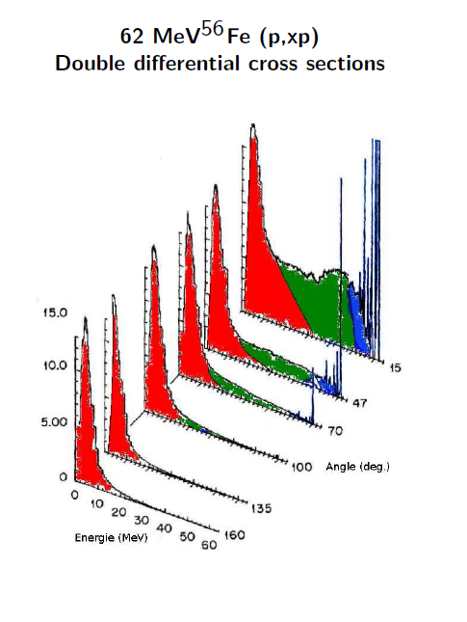
TIME SCALES AND ASSOCIATED MODELS (1/4)
Typical spectrum shape
Always evaporation peak
Discrete peaks at forward angles
Flat intermediate region

Slide 26
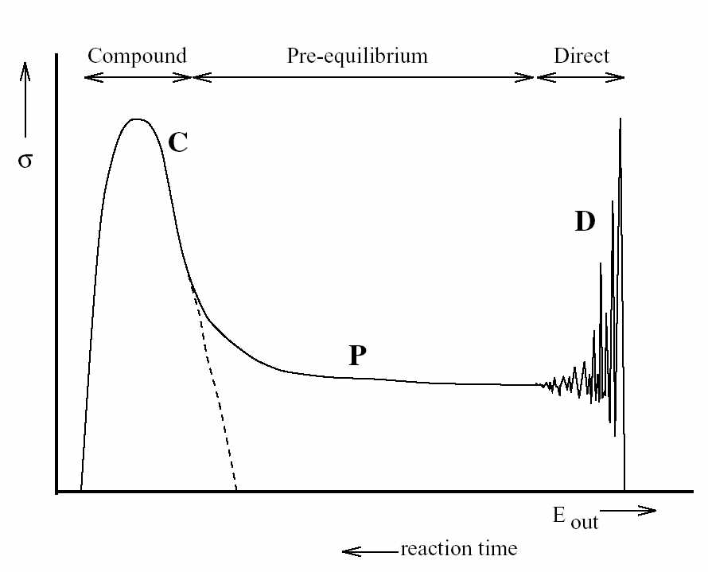
TIME SCALES AND ASSOCIATED MODELS (2/4)
d²σ / dΩdE
Compound
Nucleus
Direct
components
Pre-equilibrium
MSC
MSD
Intermediate emission energy
Intermediate reaction time
Anisotropic angular distribution smoothly
increasing to forward peaked shape
with outgoing energy
Low emission energy
Reaction time ≈ 10⁻¹⁸ s
Isotropic angular distribution
High emission energy
Reaction time ≈ 10⁻²² s
Anisotropic angular distribution
- forward peaked
- oscillatory behavior
⇒ spin and parity of
residual nucleus
Emission energy
Reaction time

Slide 27
TIME SCALES AND ASSOCIATED MODELS (3/4)
Direct (shape) elastic
Elastic
σ_{Reaction}
σ_{NC}
OPTICAL
MODEL
PRE-EQUILIBRIUM
COMPOUND
NUCLEUS
Fission
T_{lj}
Inelastic
Direct components
(n,n’), (n,α),
(n,γ), etc…

Slide 28
TIME SCALES AND ASSOCIATED MODELS (4/4)

Slide 29
GENERAL FEATURES
What TALYS yields
Cross sections :
total, reaction, elastic (shape & compound), non-elastic, inelastic (discrete levels & total)
total particle production
all exclusive reactions (n,nd2a)
all exclusive isomer production
all exclusive discrete and continuum g-ray production
Spectra :
elastic and inelastic angular distribution or energy spectra
all exclusive double-differential spectra
total particle production spectra
compound and pre-equilibrium spectra per reaction stage.
Fission observables :
cross section (total, per chance)
fission fragment mass and isotopic yields
Miscellaneous :
recoil cross sections and ddx
particle multiplicities
s and p wave functions and potential scattering radius r’
nuclear structure only (levels, Q, ld tables, …)
specific pre-equilibrium output (ph lds, decay widths …)
astrophysical reaction rates

Slide 30
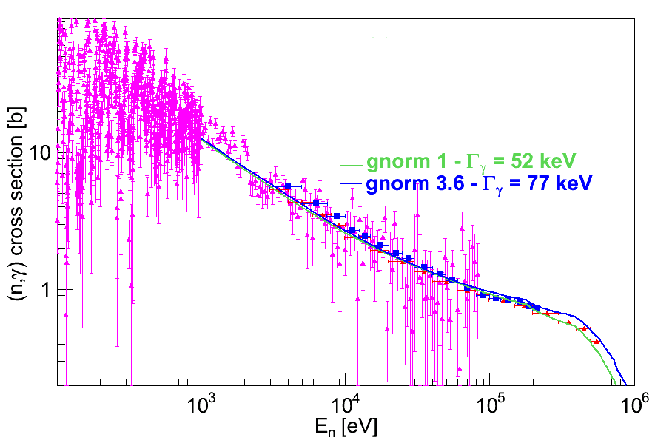
Microscopic / Phenomenologic
TALYS simulation by CEA - DAM

Slide 31
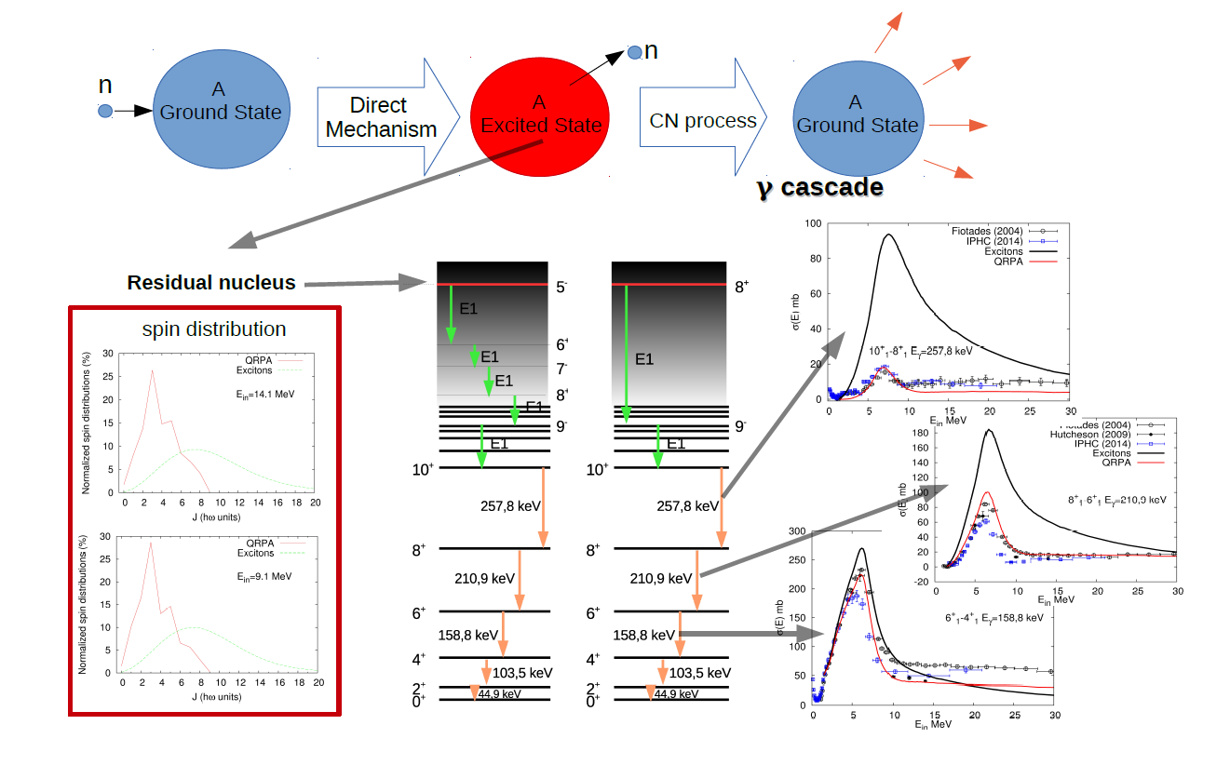
Microscopic / Phenomenologic
Simulation by CEA-DAM

Slide 32
GENERAL FEATURES
TALYS validation
- Validation with the drip code
Drip (not released) performs drip line to drip line calculation
⇒ No Crash
⇒ Checking results smoothness
- Validation with the monkey code
Monkey (not released) creates random input for TALYS
⇒ No Crash
⇒ Checking robustness with respect
to crazy input (within allowed ranges) values
- Validation of level density models with the kh05 code
kh05 (not released) automatically adjust level densities to data
⇒ global and local level density models
TALYS has then be used to perform extensive comparisons between theoretical and experimental
cross sections for (n,g), (n,2n), (n,p), (n,d) and (n,a) with all possible ld models
- Statistical analysis of cross sections - SACS (J. Kopecky)
Extensive comparison of cross section with data from EXFOR
⇒ C/E values
⇒ Shape analysis (maximum xs, energy of maximum, half width at maximum)

Slide 33
Statistical Analysis of Cross Sections (SACS) by J. Kopecky: (n,p)
Trend line
Discrepant reactions
S=(N-Z)/A

Slide 34
Nuclear models
Only few slides per model.
See Stephane Hilaire and Stephane Goriely for more details

Slide 35
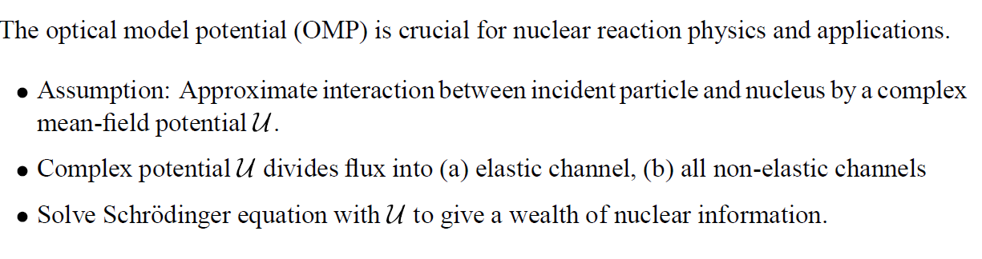
Optical model

Slide 36
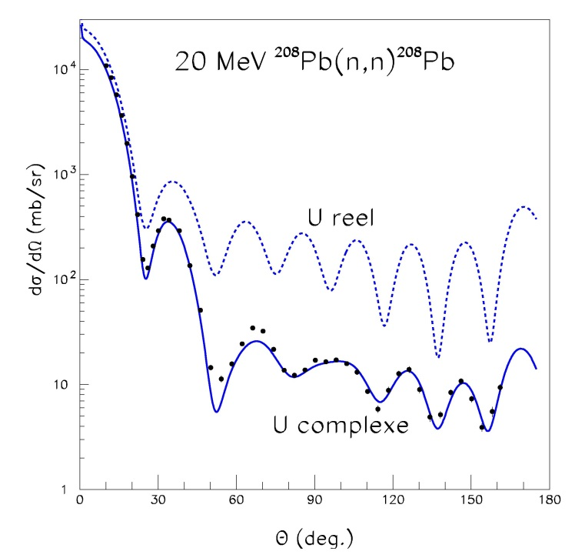
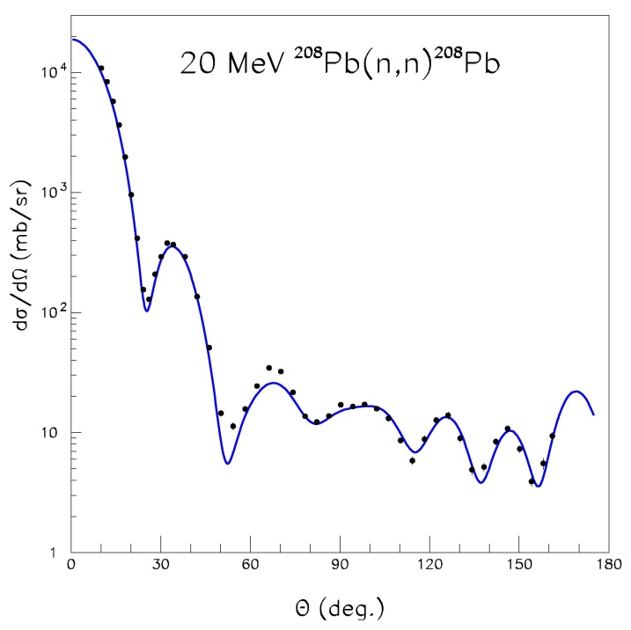
THE OPTICAL MODEL
Direct interaction of a projectile with a target nucleus considered as a whole
Quantum model → Schrödinger equation
U
Complex potential:
U = V + iW
Refraction
Absorption

Slide 37
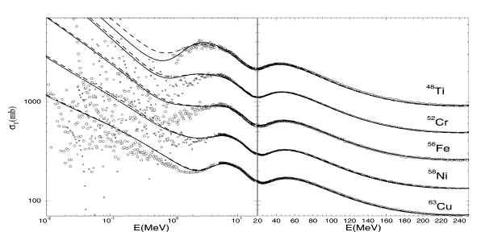
Neutron total cross sections
A.J. Koning and J.P. Delaroche, KD03 OMP, Nucl. Phys. A713 (2003) 231

Slide 38
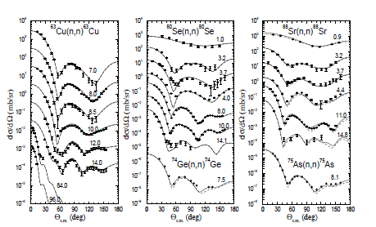
Neutron elastic scattering angular distributions
A.J. Koning and J.P. Delaroche, KD03 OMP, Nucl. Phys. A713 (2003)

Slide 39
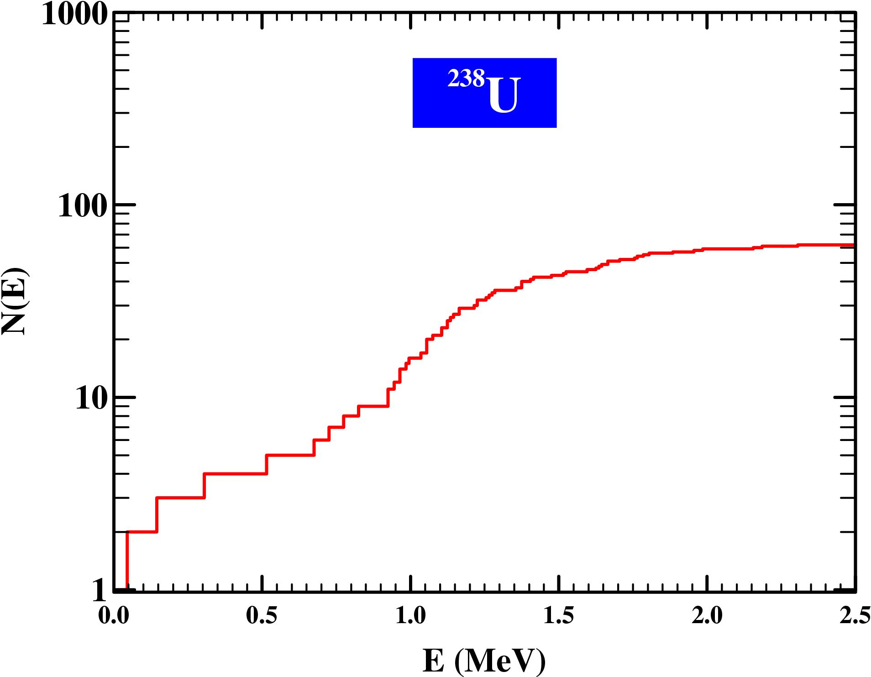
Level density
?

Slide 40
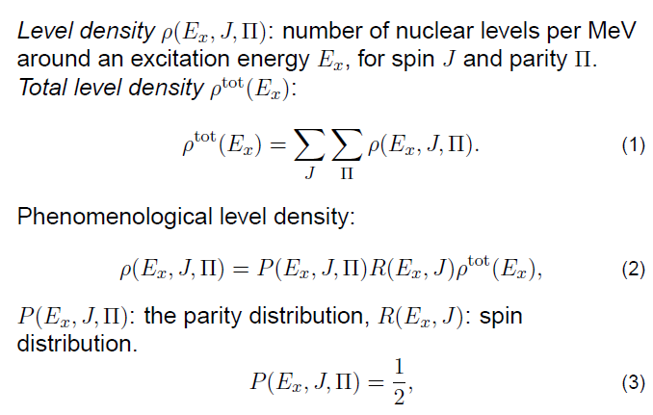
Level density definition

Slide 41
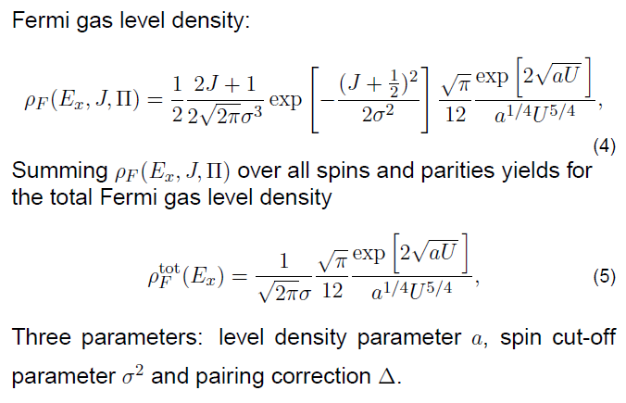
Fermi gas level density

Slide 42
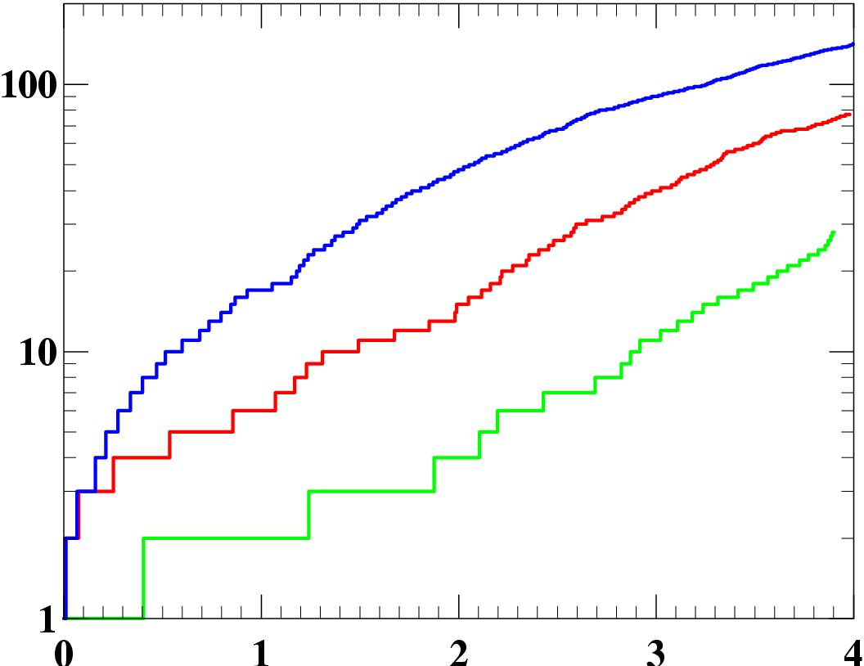
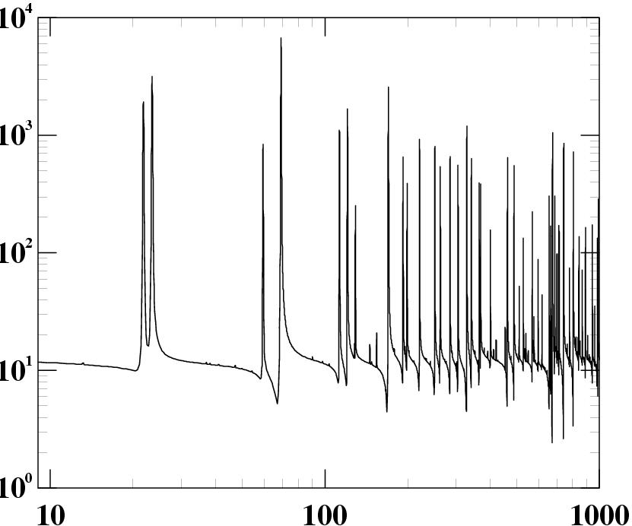
THE LEVEL DENSITIES
(Qualitative aspects 1/2)
⁵⁶Mn
n+²³²Th
N(E)
⁵⁷Fe
⁵⁸Fe
Total cross section (b)
E (MeV)
Incident neutron energy (eV)
Exponential increase of the cumulated number of discrete levels N(E) with energy
  ⇒ rho(E)=
  ⇒ odd-even effects
Mean spacings of s-wave neutron resonances at B_{n} of the order of few eV
  ⇒ rho(B_{n}) of the order of 10⁴ – 10⁶ levels / MeV
dN(E)
dE
increases exponentially

Slide 43
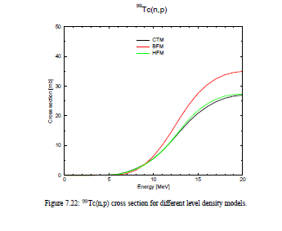

Slide 44
THE COMPOUND NUCLEUS MODEL
(basic formalism)
Compound nucleus hypothesis
Continuum of excited levels
Independence between incoming channel a and outgoing channel b
σ_{ab}
σ^{(CN)} P_{b}
=
σ_{a}
T_{b}
p
σ^{(CN)} = T_{a}
P_{b}=
σ_{a}
₂
S T_{c}
k_{a}
_{c}
⇒ Hauser- Feshbach formula
T_{a} T_{b}
p
σ_{ab}
=
₂
S T_{c}
k_{a}
_{c}

Slide 45
THE COMPOUND NUCLEUS MODEL
(qualitative feature)
Compound angular distribution & direct angular distributions
45° 90° 135°

Slide 46
THE COMPOUND NUCLEUS MODEL
(multiple emission)
Target
Compound Nucleus
fission
E
S_{a}
n’
S_{p}
g
S_{a}
g
S_{p}
S_{n}
n₍₂₎
S_{a}
n’
g
S_{n}
+ Loop over CN spins and parities
n
p
S_{n}
Z
J^{p}
d
S_{p}
n
Z_{c}
S_{a}
S_{p}
S_{p}
S_{n}
S_{a}
S_{a}
S_{n}
S_{n}
a
Z_{c}-1
N
N_{c}-2
N_{c}-1
N_{c}

Slide 47
THE PRE-EQUILIBRIUM MODEL
(Exciton model principle)
E
0
E_{F}
Compound
Nucleus
1p
2p-1h
3p-2h
4p-3h
time
1n
3n
5n
7n

Slide 48
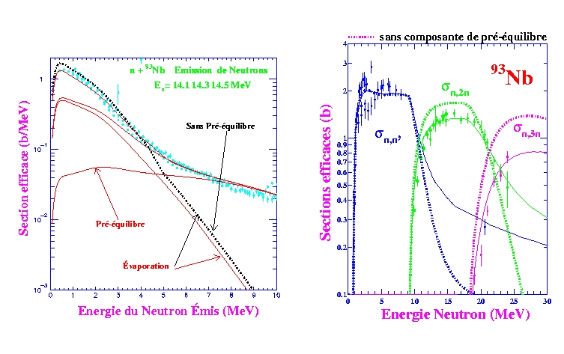
THE PRE-EQUILIBRIUM MODEL
14 MeV neutron + ⁹³ Nb
without pre-equilibrium
without pre-equilibrium
dσ/dE(b/MeV)
σ(barn)
pre-equilibrium
Compound nucleus
Outgoing neutron energy (MeV)
Incident neutron energy (MeV)

Slide 49
Conclusions
TALYS is the most versatile (subjective) and most used (objective) model code in the world for nuclear reactions up to 200 MeV.
Exciting new nuclear structure developments can go straight into the code.
The road to technology (nuclear data libraries) and applied science (astrophysics) is entirely automated.

Slide 50
Thank you!
Notes:
Thank you!

