Slide 1
Preliminary results of the neutron inelastic cross section measurements on ⁵⁴Fe
Adina Olacel
Horia Hulubei National Institute for Physics and Nuclear Engineering (IFIN-HH), Magurele, Romania
Joint ICTP-IAEA Workshop on the Evaluation of Nuclear Reaction Data for Applications, 2-13 October 2017
1

Slide 2
Outline
Motivation
Experimental setup
Experimental particularities
Preliminary results
Conclusions
Joint ICTP-IAEA Workshop on the Evaluation of Nuclear Reaction Data for Applications, 2-13 October 2017
2

Slide 3
Motivation
The need of energy increases with the development of human civilization.
As the energy sources are getting low, the nuclear energy becomes the most reliable type of energy despite all the issues.
A new generation of nuclear reactors is currently under development requiring a better understanding and precise cross sections of all neutron-induced reactions that may occur during operation.
Iron is an important structural material in the design of nuclear. Around 6% of natural iron is ⁵⁴Fe.
⁵⁴Fe is part of a project that addresses issues in connection to nuclear criticality safety and reactor physics.
The measured data are needed to improve shielding calculations for which iron is an essential component.
The results will be evaluated at IRSN (Institute for Radiological Protection and Nuclear Safety), France to generate nuclear data libraries and uncertainty.
Joint ICTP-IAEA Workshop on the Evaluation of Nuclear Reaction Data for Applications, 2-13 October 2017
3

Slide 4
Experimental setup
GELINA
Joint ICTP-IAEA Workshop on the Evaluation of Nuclear Reaction Data for Applications, 2-13 October 2017
4

Slide 5
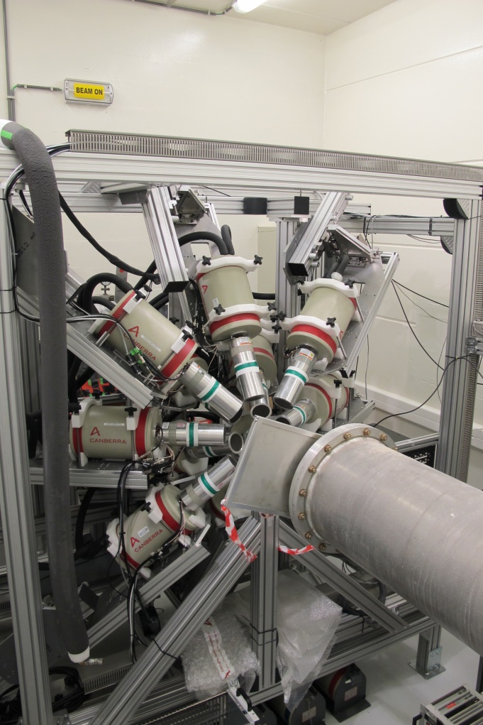
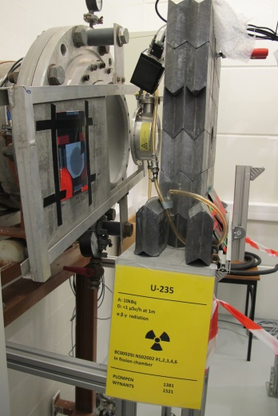
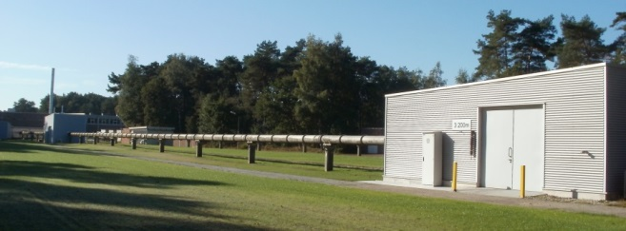
Experimental setup
GAINS
Flight path 100 m
12 HPGe detectors @ 110º, 150º and 125º
Relative efficiency: 100%
FWHM ≈ 2.8 keV for the 1332 keV of ⁶⁰Co
Fission chamber to monitor the neutron flux
Digital acquisition (ACQIRIS digitizers)
12 bit amplitude resolution (4096 channels)
420 MS/s (2.38 ns)
Time of flight technique:
n time of flight → E_{n}
pulse amplitude → E_{γ}
²³⁵U fission chamber
Joint ICTP-IAEA Workshop on the Evaluation of Nuclear Reaction Data for Applications, 2-13 October 2017
4

Slide 6
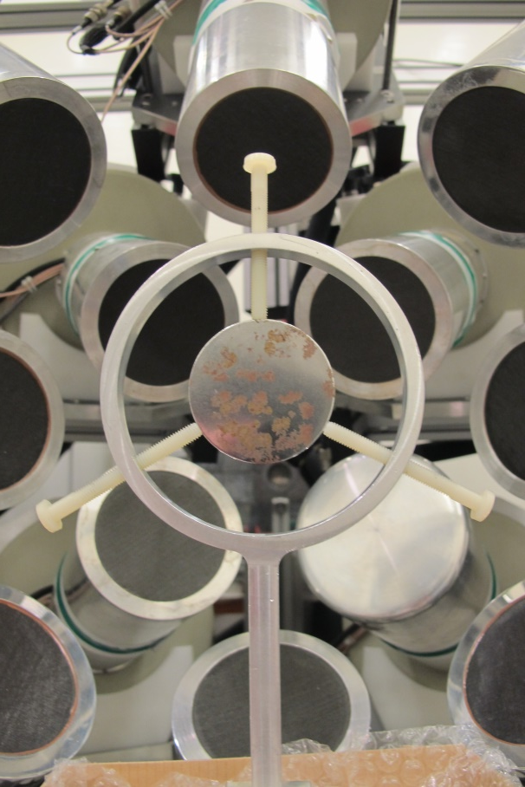
Experimental setup
Experimental particularities
⁵⁴Fe sample:
Enrichment - 97.68%
Mass – 19.5 g
Thickness – 0.932 g/cm²
Diameter - 50 mm
1 year lease
15 568 $
To return with < 0.6 Bq/g.
(activity measurements at HADES underground facility)
Joint ICTP-IAEA Workshop on the Evaluation of Nuclear Reaction Data for Applications, 2-13 October 2017
5

Slide 7
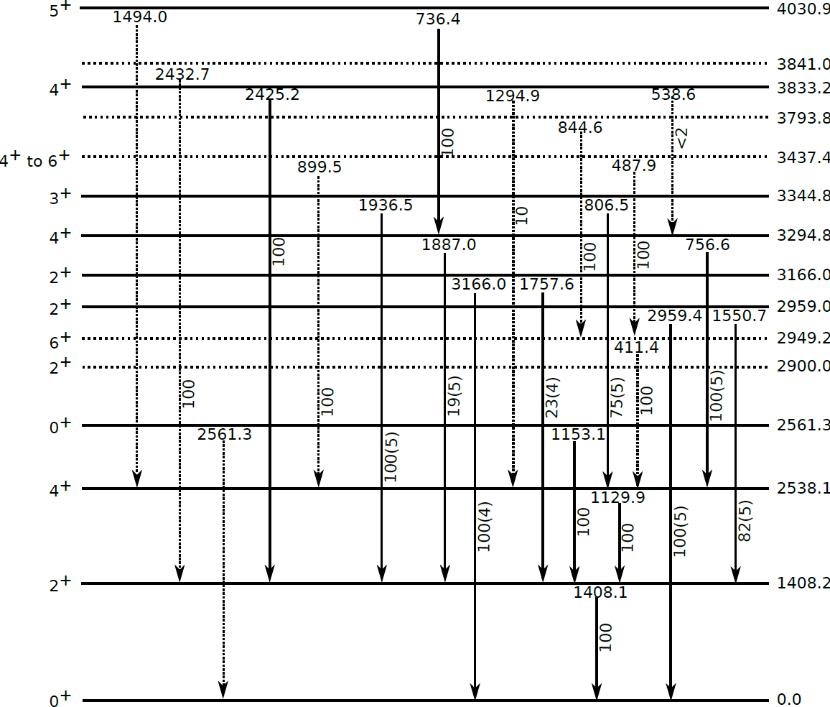
Preliminary results
Joint ICTP-IAEA Workshop on the Evaluation of Nuclear Reaction Data for Applications, 2-13 October 2017
6

Slide 8
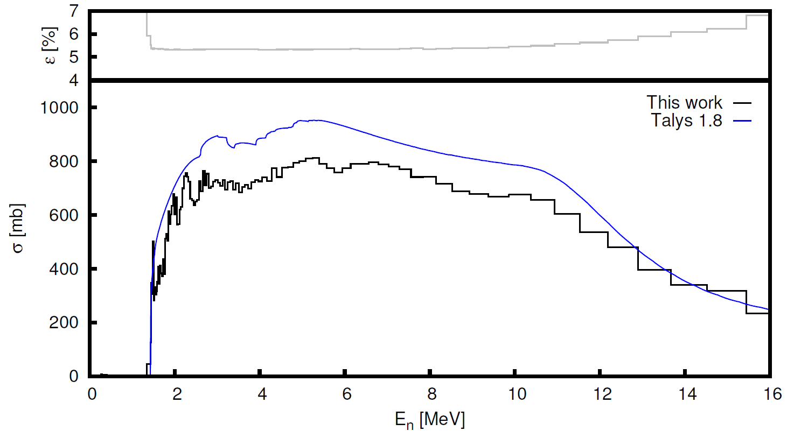
Gamma production cross sections
E_{γ}=1408.1 keV
Preliminary
Joint ICTP-IAEA Workshop on the Evaluation of Nuclear Reaction Data for Applications, 2-13 October 2017
7

Slide 9
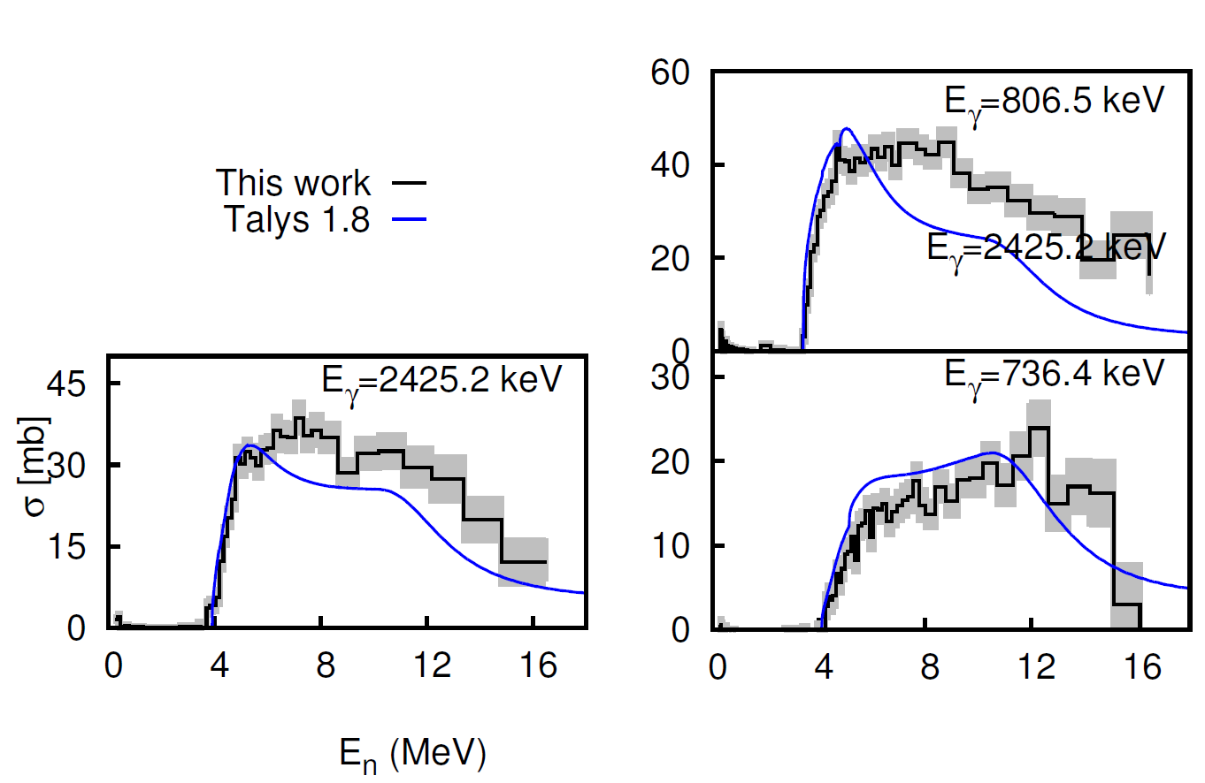
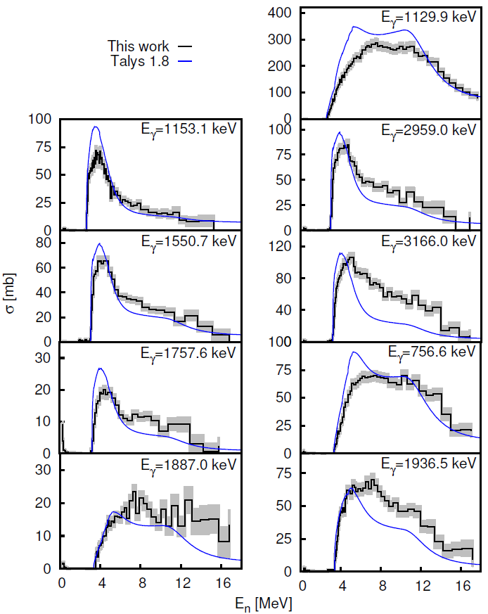
Gamma production cross sections
Preliminary
Joint ICTP-IAEA Workshop on the Evaluation of Nuclear Reaction Data for Applications, 2-13 October 2017
8

Slide 10
Level cross sections
Joint ICTP-IAEA Workshop on the Evaluation of Nuclear Reaction Data for Applications, 2-13 October 2017
9

Slide 11
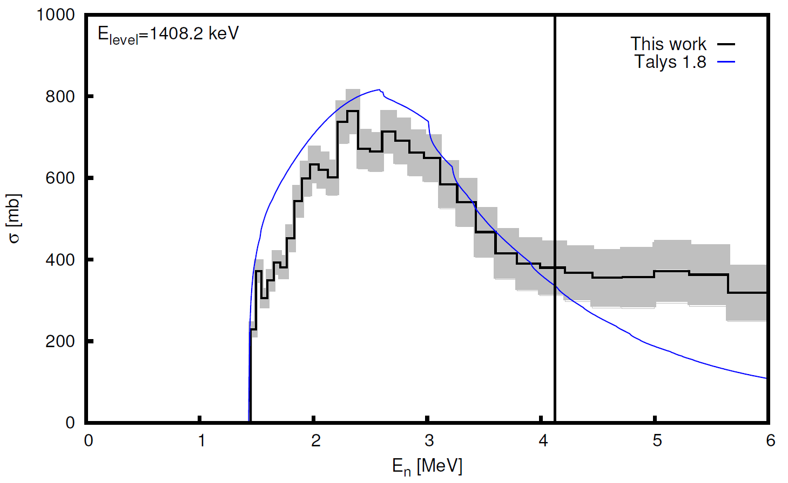
The cross section of the first excited level
Preliminary
Joint ICTP-IAEA Workshop on the Evaluation of Nuclear Reaction Data for Applications, 2-13 October 2017
10

Slide 12
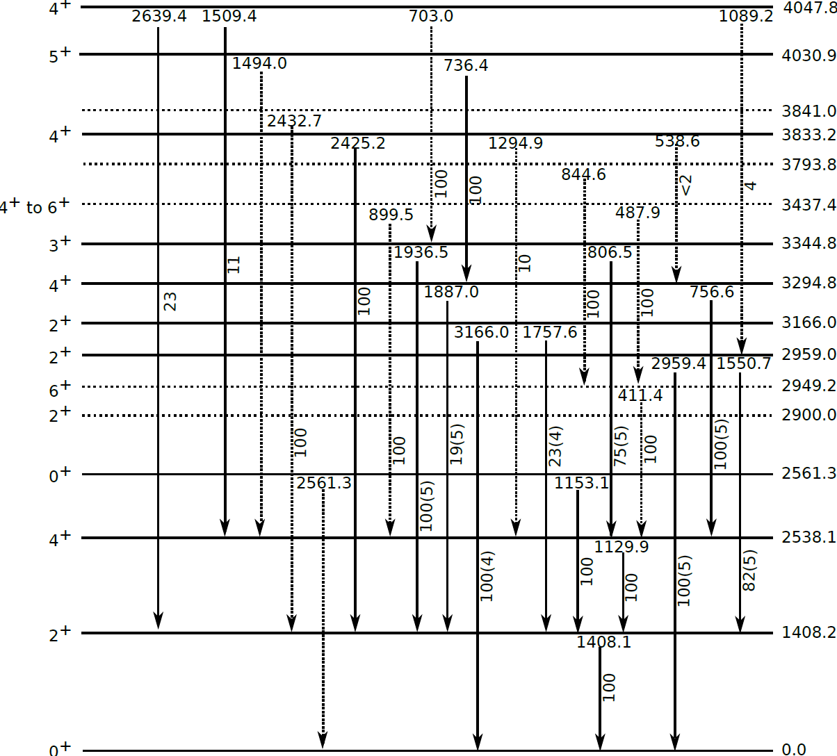
Total inelastic cross section
Joint ICTP-IAEA Workshop on the Evaluation of Nuclear Reaction Data for Applications, 2-13 October 2017
11

Slide 13
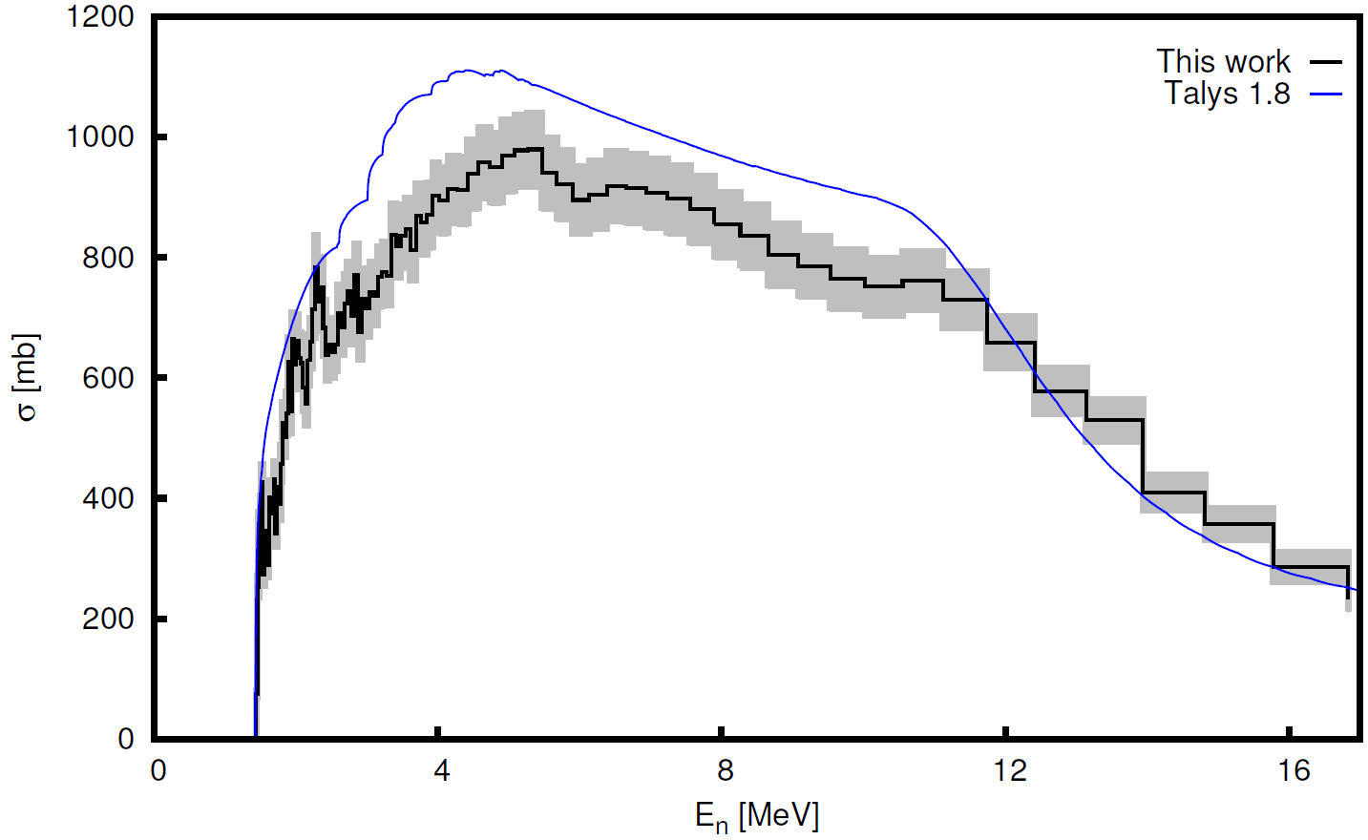
Total inelastic cross section
Preliminary
Joint ICTP-IAEA Workshop on the Evaluation of Nuclear Reaction Data for Applications, 2-13 October 2017
12

Slide 14
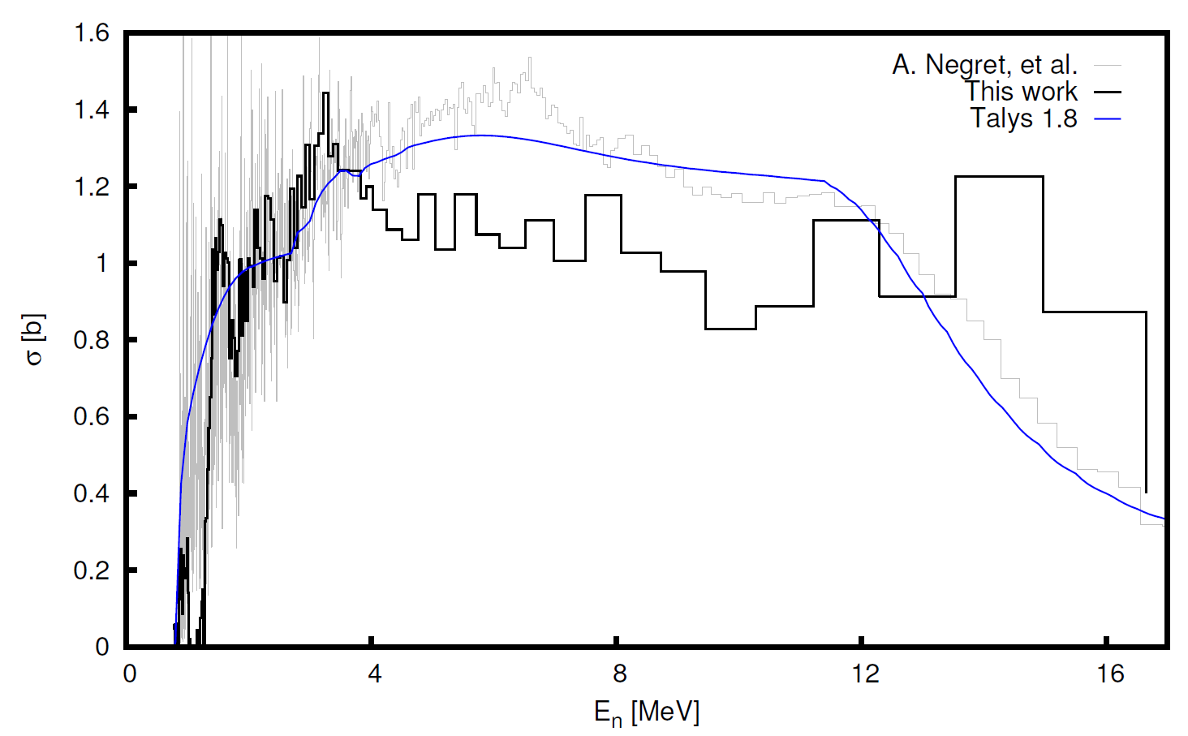
Bonus – ⁵⁶Fe
2.24% ⁵⁶Fe in the sample
The gamma production cross section of the first transition in ⁵⁶Fe
Joint ICTP-IAEA Workshop on the Evaluation of Nuclear Reaction Data for Applications, 2-13 October 2017
13

Slide 15
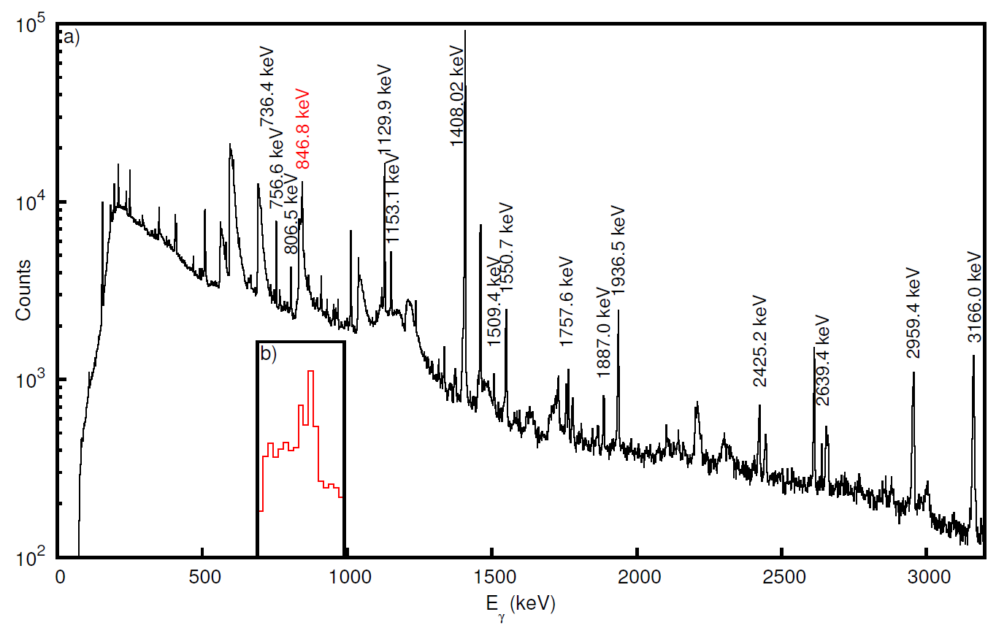
The amplitude spectrum of a HPGe detector
Joint ICTP-IAEA Workshop on the Evaluation of Nuclear Reaction Data for Applications, 2-13 October 2017
14

Slide 16
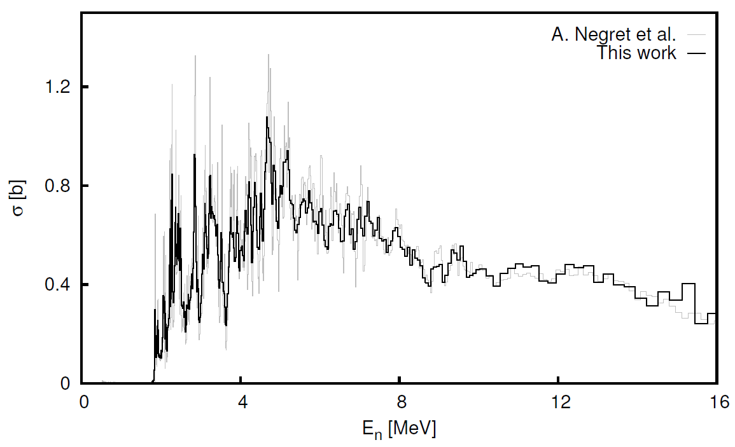
Check – ²⁸Si
The gamma production cross section of the first transition in ²⁸Si
Joint ICTP-IAEA Workshop on the Evaluation of Nuclear Reaction Data for Applications, 2-13 October 2017
15

Slide 17
Conclusions
13 gamma rays were observed from the inelastic scattering of neutrons on 54Fe
We calculated the corresponding gamma production cross section, the level cross section and the total inelastic cross section
The results were compared with TALYS 1.8 theoretical calculations using the default input parameters.
Preliminary results - still things to be done.
Joint ICTP-IAEA Workshop on the Evaluation of Nuclear Reaction Data for Applications, 2-13 October 2017
16

Slide 18
Thank you!
Joint ICTP-IAEA Workshop on the Evaluation of Nuclear Reaction Data for Applications, 2-13 October 2017

