Slide 1
Optical Model with Extended Couplings for Actinides
D. Martyanov*, E. Soukhovitskii, R. Capote, J.M. Quesada, S. Chiba
The Joint Institute for Power and Nuclear Research – Sosny, Minsk, Belarus

Slide 2
Optical model with coupled channels
Common approach
Soft spherical nucleus
(vibrational excitations)
Rigid deformed nucleus
(rotational excitations)
But actinides are both considerably deformed in GS and soft for vibrations

Slide 3
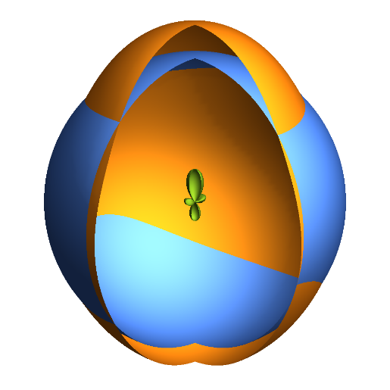
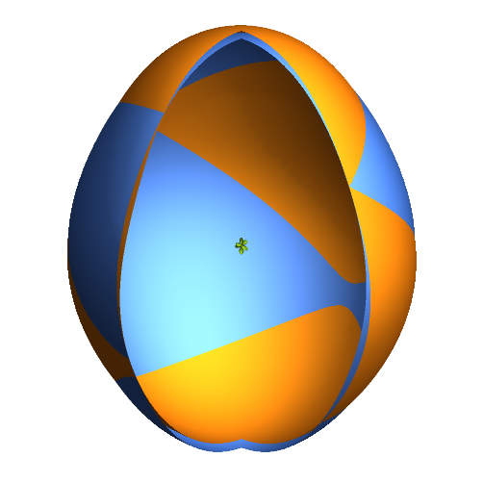
Nucleus form
$$R_{i}\left(θ^{′},φ^{′}\right)$$
$$=R_{0i}\left\{1+\sum_{λ=2,3;even μ}{β_{λμ}Y_{λμ}\left(θ^{′},φ′\right)}+\sum_{λ=4,6}{β_{λ0}Y_{λ0}\left(θ^{′}\right)}\right\}$$
Common approach
$$=R_{i}^{zero}\left(θ^{′}\right)+$$
$$δR_{i}\left(θ^{′},φ^{′};δβ_{2}, γ, β_{3}\right)$$
$$=R_{0i}\left\{1+\sum_{λ=2,4,6}{β_{λ0}Y_{λ0}\left(θ′\right)}\right\}$$
$$β_{2}=β_{20}+δβ_{2}$$
$$\left\langle δβ_{2}\right\rangle ≪β_{20}$$
$$+R_{0i}\left\{β_{20}\left[\frac{δβ_{2}}{β_{20}}\cos{γ}+\cos{γ}−1\right]Y_{20}\left(θ^{′}\right)+\right.\frac{\left(β_{20}+δβ_{2}\right)\sin{γ}}{\sqrt{2}}\left[Y_{22}\left(θ^{′},φ^{′}\right)+Y_{2−2}\left(θ^{′},φ^{′}\right)\right]+\left.β_{3}Y_{30}\left(θ^{′}\right)\right\}$$
New model

Slide 4
Optical potential: dispersive, Lane-consistent
$$V\left(r,R\left(θ,φ\right),E\right)$$
$$=−V_{HF}\left(E\right)f_{WS}\left(r,R_{HF}\left(θ,φ\right)\right)$$
$$−\left[ΔV_{v}\left(E\right)+iW_{v}\left(E\right)\right]f_{WS}\left(r,R_{v}\left(θ,φ\right)\right)$$
$$−\left[ΔV_{s}\left(E\right)+iW_{s}\left(E\right)\right]g_{WS}\left(r,R_{s}\left(θ,φ\right)\right)$$
$$+V_{Coul}\left(r,R_{c}\left(θ,φ\right)\right)$$
$$+{\left(\frac{ℏ}{m_{π}c}\right)}^{2}\left[V_{so}\left(E\right)+ΔV_{so}\left(E\right)+iW_{so}\left(E\right)\right]× \frac{1}{r}\frac{d}{dr}f_{WS}\left(r,R_{so}\right)\left(\hat{l}⋅\hat{σ}\right)$$

Slide 5
Potential expansion near axially deformed shape
$$V\left(r,R\left(θ^{′},φ^{′}\right)\right)≈V\left(r,R^{zero}\left(θ^{′}\right)\right)+{\left.\frac{∂}{∂R}V\left(r,R \left(θ^{′},φ^{′}\right)\right)\right|}_{R^{zero}\left(θ^{′}\right)}δR\left(θ^{′},φ^{′};δβ_{2}, γ, β_{3}\right)≈V\left(r,R^{zero}\left(θ^{′}\right)\right)+\frac{ν_{2}(r)}{R_{0}β_{20}}δR\left(θ^{′},φ^{′};δβ_{2}, γ, β_{3}\right)$$
$$ν_{λ}\left(r\right)=2π\int_{0}^{π}{V\left(r,R^{zero}\left(θ^{′}\right)\right)Y_{λ0}\left(θ′\right)\sin{θ′}dθ′}$$
E.S. Soukhovitskiĩ et al, PRC 94 (2016) 64605

Slide 6
Additional coupling: volume conservation
Nuclear volume conservation during vibrations
(incompressible nuclear matter/saturated nuclear density)
Dynamic deformations → correction to radius:
$$β_{00}(δβ_{2},γ,β_{3})=−\left(2β_{20}δβ_{2}+δβ_{2}^{2}+β_{3}^{2}\right)$$
D. Martyanov et al, EPJ Web Conf. 146 (2017) 12031 (ND2016)

Slide 7
Coupled channels matrix elements
Rigid rotor
$$\left\langle i | V\left(r,θ,φ\right) | f\right\rangle =\sum_{K}^{I}{\sum_{K^{′}}^{I^{′}}{A_{K}^{Iτ}A_{K′}^{I^{′}τ^{′}}\left\{\sum_{λ=0,2,4,… }{ν_{λ}\left(r\right)\left\langle IK | \left|D_{;0}^{λ} \right| | I^{′}K\right\rangle }A\left(ljI;l^{′}j^{′}I^{′};λJ\frac{1}{2}\right)δ_{KK^{′}}+ν_{2}\left(r\right)\left\{\left[{\left[β_{2}\right]}_{eff}+{\left[γ_{20}\right]}_{eff}\right]\left\langle IK | \left|D_{;0}^{2} \right| | I^{′}K\right\rangle A\left(ljI;l^{′}j^{′}I^{′};2J\frac{1}{2}\right)δ_{KK^{′}}+{\left[γ_{22}\right]}_{eff}\left\langle IK | \left|D_{;2}^{2}+D_{;−2}^{2}\right| | I^{′}K\right\rangle A\left(ljI;l^{′}j^{′}I^{′};2J\frac{1}{2}\right)+{\left[β_{3}\right]}_{eff}\left\langle IK | \left|D_{;0}^{3}\right| | I^{′}K\right\rangle A\left(ljI;l^{′}j^{′}I^{′};3J\frac{1}{2}\right)δ_{KK^{′}}−\left[{2\left[β_{2}\right]}_{eff}+{\left[β_{2}^{2}\right]}_{eff}+{\left[β_{3}^{2}\right]}_{eff}\right]\frac{β_{20}}{\sqrt{4π}}δ_{KK^{′}}δ_{II^{′}}δ_{jj^{′}}δ_{ll^{′}}\right\}\right\}}}$$
$β$-vibrations
$γ$-vibrations
Octupole coupling
(negative parity)
Volume conservation correction

Slide 8
Soft-rotator model for even-even nuclei and ²³⁸U level structure
$$\hat{H}=\frac{ℏ^{2}}{2B}\left\{{\hat{T}}_{β_{2}}+\frac{1}{β_{2}^{2}}{\hat{T}}_{γ}\right\}+\frac{ℏ^{2}}{2}{\hat{T}}_{r}+\frac{ℏ^{2}}{2B_{3}}{\hat{T}}_{β_{3}}+\frac{β_{20}^{4}}{β_{2}^{2}}V\left(γ\right)+V\left(β_{2}\right)+V\left(β_{3}\right)$$

Slide 9
Saturation of coupling scheme
Saturation: addition of more levels to coupling scheme do not change the results
Even-even actinides: 21 level from 5 rotational bands are needed
Odd actinides: ~10 levels from the main rotational band seems to be sufficient
J.M. Quesada et al, EPJ Web Conf. 146 (2017) 12013 (ND2016)

Slide 10
Experimental data to fit
²³⁸U and ²³²Th targets
$σ_{tot}$ for E_{n}= 50 keV…200 MeV
$\frac{dσ}{dΩ}\left(θ\right)$ for (n,n’),(p,p’),(p,n)
S₀, S₁, R’
$σ_{CN}^{}, σ_{el}$ for some E_{n}
$R=2\frac{σ_{tot}\left({}_{}^{232}{Th}\right)−σ_{tot}\left({}_{}^{238}U\right)}{σ_{tot}\left({}_{}^{232}{Th}\right)+σ_{tot}\left({}_{}^{238}U\right)}$

Slide 11
Towards the other even-even actinides
So we have regional optical potential from ²³⁸U and ²³²Th data. What do we need for other even-even actinides?
Level structure (levels missing in ENSDF can be evaluated with soft-rotator model)
Deformation parameters $β_{2}, { β}_{4}, { β}_{6}$ (need to take from mass models, e.g. FRDM or WS4).
WS4 deformations is better than FRDM2012
for available exp data in even-even actinides
D.S. Martyanov et al, Chinese Phys. C. 41 (2017) 94105

Slide 12
Results: direct levels excitations

Slide 13
Results: total XS ratio for ²³⁸U and ²³²Th

Slide 14
Results: compound nucleus XS

Slide 15
Conclusions
New model allows coupling of levels from different rotational bands
Saturated coupling scheme requires 21 level from 5 bands for even-even actinides and 10 levels from main rotational band for odd actinides
Effects suggested by the model are important for accurate nuclear reaction data estimation
Good description of all available experimental data
Prediction of optical observable for many even-even actinides (with scarce experimental data) can be obtained using the suggested optical potential and WS4 deformations

Slide 16
Thank you for the attention!

Slide 17
Effective deformations
$${\left[β_{2}\right]}_{eff}=\left\langle n_{i}\left(β_{2}\right) | \frac{δβ_{2}}{β_{20}} | n_{f}\left(β_{2}\right)\right\rangle$$ | $${\left[β_{2}^{2}\right]}_{eff}=\left\langle n_{i}\left(β_{2}\right) | \frac{δβ_{2}^{2}}{β_{20}^{2}} | n_{f}\left(β_{2}\right)\right\rangle$$
$${\left[γ_{20}\right]}_{eff}=\left\langle n_{i}\left(γ\right) | \cos{γ}−1 | n_{f}\left(γ\right)\right\rangle$$ | $${\left[β_{3}\right]}_{eff}=\left\langle n_{i}\left(β_{3}\right) | \frac{β_{3}}{β_{20}} | n_{f}\left(β_{3}\right)\right\rangle$$
$${\left[γ_{22}\right]}_{eff}=\left\langle n_{i}\left(γ\right) | \frac{\sin{γ}}{\sqrt{2}} | n_{f}\left(γ\right)\right\rangle$$ | $${\left[β_{3}^{2}\right]}_{eff}=\left\langle n_{i}\left(β_{3}\right) | \frac{β_{3}^{2}}{β_{20}^{2}} | n_{f}\left(β_{3}\right)\right\rangle$$

Slide 19
Plan
Extended couplings: soft deformed nuclei
Potential expansion
Potential form
Coupled channels matrix elements: effective deformations
Experimental data used
Saturation of the coupling scheme
Even-even nuclei
Soft-rotator model
Calculation of effective deformations
Additional couplings due to nuclear volume conservation
Corrections for non-axial nucleus form
Even-even Actinides: phenomenological deformation parameters
Calculation results
Direct level excitation
Ratio of total cross section ratio
CN formation XS

