Slide 1
Effects of Deformation Parameter on Reaction Cross Section
Ismail Hakki SARPUN
Abdullah AYDIN
Mahmut BOYUKATA

Slide 2
Objective
Deformation parameter of the nuclei is one of the important arguments for the nuclear structure studies. We focused on the effects of the deformation parameter on the cross sections.
We first determined the deformation parameters of target nuclei within IBM (interacting boson model). For this process, the energy levels of the target nucleus have been calculated by fitting the Hamiltonian parameters and then these parameters were used in the formalism of the potential energy surface to find the deformation parameter (β).
We later used this parameter in the TALYS 1.8 code for the calculation of the cross sections on the some reactions up to various energy to see its effects.
Moreover, we used other deformation parameters obtained TALYS default for the cross section calculation and compared with each other and also the experimental data from EXFOR nuclear data library.

Slide 3
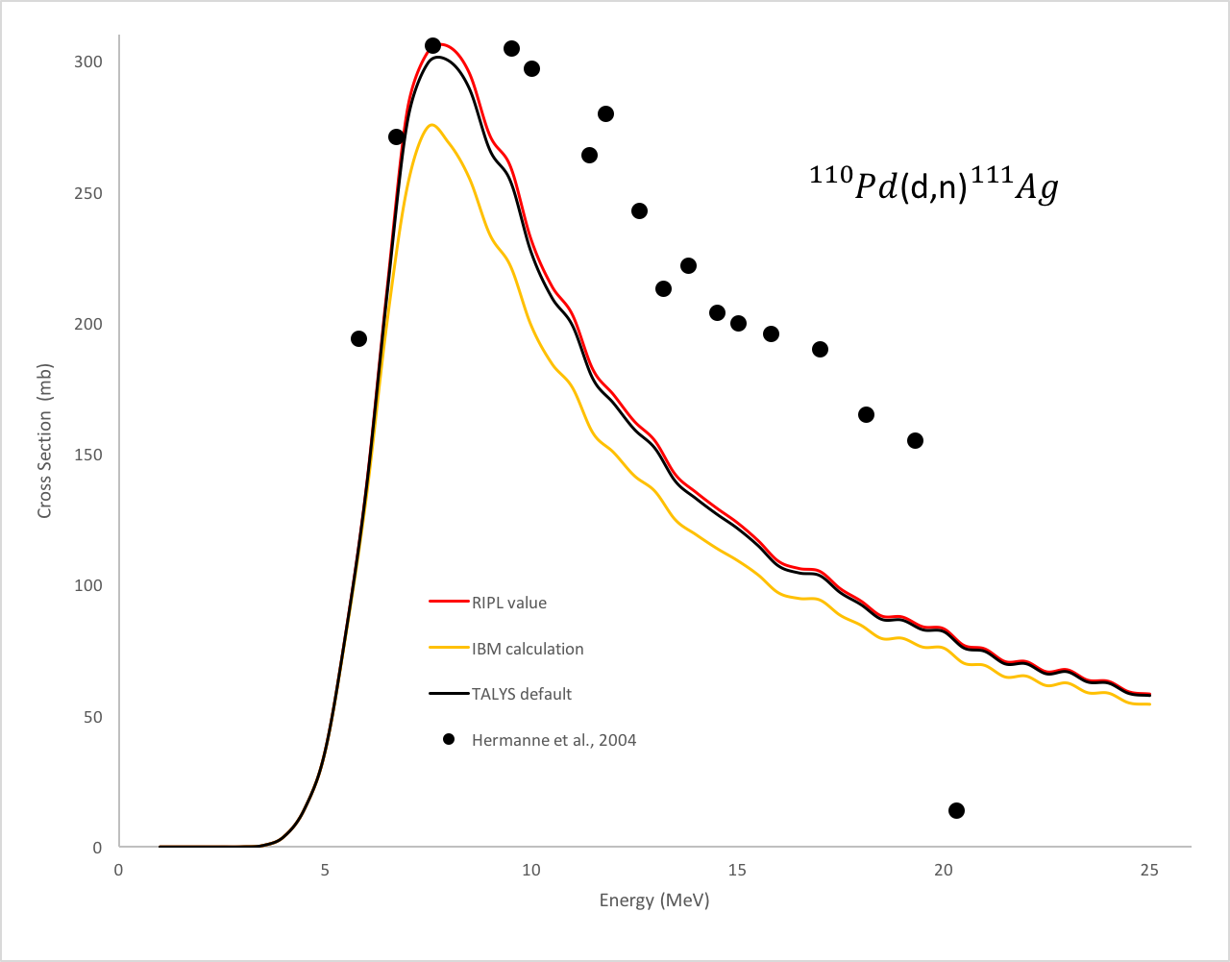
¹¹⁰Pd(d,n)¹¹¹Ag Reaction
Three deformation parameters were used in theoretical calculations which are
TALYS 1.8 default value (equal to 0.257 and shown as black solid line),
RIPL value (equal to 0.212 and shown as red solid line) and
calculated value (equal to 0.439 and shown as yellow solid line).

Slide 4
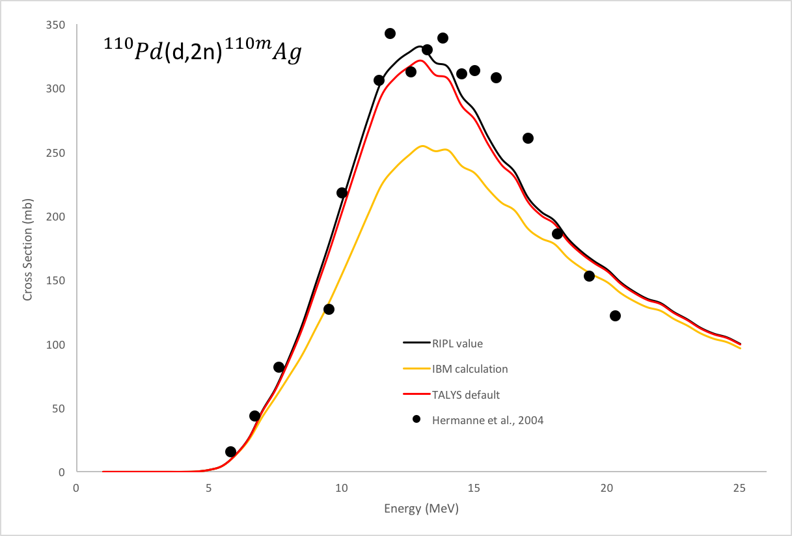
¹¹⁰Pd(d,2n)^{110m}Ag Reaction
With same parameters
*This work accepted to publish in Physics of Atomic Nuclei…

Slide 5
First Conclusion
The target nucleus ¹¹⁰Pd shows axially deformed shape and its geometry is like prolate since the deformation parameter is bigger than zero.
After determine this parameter, we calculated cross sections of these two reactions to see effects of deformation parameter on reaction cross section.
The realistic shape of the coulomb barrier is an individual property of each nuclei and depends on the collective degrees of freedom such as deformation and shell-model degrees of freedom. Therefore, in realistic shape of the coulomb barrier, there are double-humped or in some nuclei, three-humped barrier for deformed nuclei which effect the reaction cross section.
As expected, when the deformation parameter increased, reaction cross sections decreased, which is the same situation in our calculations as shown in Figs.

Slide 6
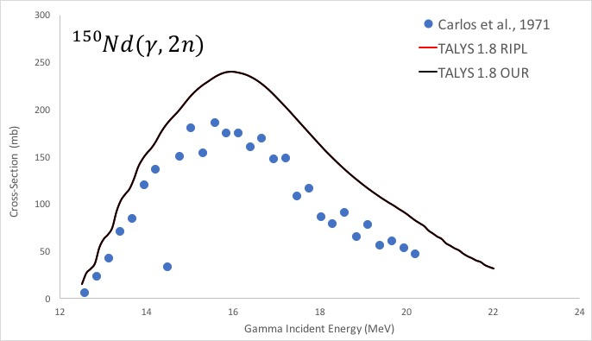
¹⁵⁰Nd(g,2n)¹⁴⁸Nd Reaction

Slide 7
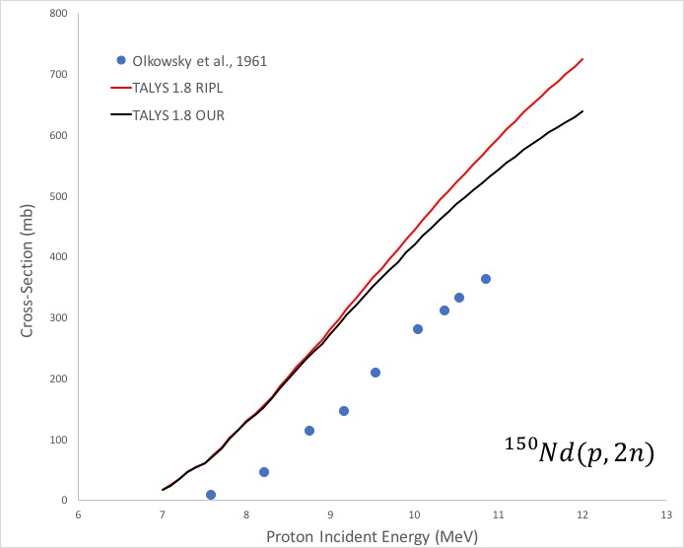
¹⁵⁰Nd(p,2n)¹⁴⁹Pm Reaction

Slide 8
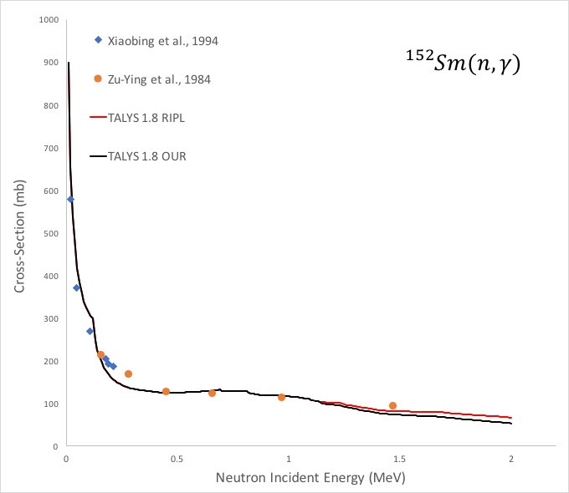
¹⁵²Sm(n,g)¹⁵³Sm Reaction

Slide 9
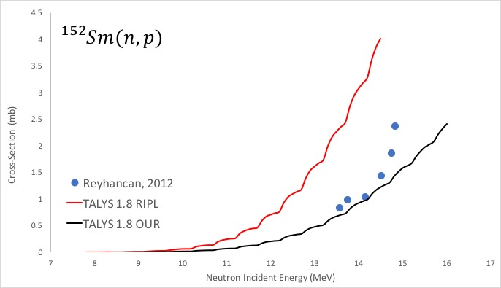
¹⁵²Sm(n,p)¹⁵²Pm Reaction

Slide 10
Last Conclusion
Deformation parameter – Coulomb barrier – Cross Section relations have observed again…
For future study: Selection of oblate and prolate nuclei
: What about neutron induced reactions
: What about neutron emission

Slide 11
TESNAT 2018
20-22 April 2018, Antalya, Turkey www.tesnat.org
4th International Conference on
Theoretical and
Experimental
Studies in
Nuclear
Applications and
Technology

