Slide 1
TALYS exercises I
Arjan Koning
Nuclear Data Section, NAPC
International Atomic Energy Agency, Vienna
ICTP-IAEA Workshop on the Evaluation of Nuclear Reaction Data for Applications, Trieste, Italy, October 2-13 2017

Slide 2
Getting TALYS (thanks Michael Fleming)
Open a terminal from the pull up menu on the left
cd /scratch
cp /home/nfs1/smr3151/TALYS-1.8/talys.tar .
tar zxf talys.tar (and wait 2 minutes or so)
mkdir talys/bin

Slide 3
Installing TALYS

Slide 4
TALYS setup
compiler=‘gfortran’
bin=‘/scratch/talys/bin’

Slide 5
Alternative (manual) setup
cd talys/source
edit machine.f
replace the pathname by the total pathname of the structure database on your system
save machine.f
gfortran –c *.f
gfortran *.o –o talys
mv talys ~/bin or wherever you want to have the executable

Slide 6
Running the TALYS sample cases
Go to the samples/ directory
verify
Wait for 1-2 hours before all 27 sample cases have finished…….or try your own input files
All 27 sample cases are described in the manual, with input files, output files, plots etc.
See talys/doc/talys1.8.pdf

Slide 7
TALYS sample cases (see manual)
232Th

Slide 8
TALYS sample cases (see manual)

Slide 9
TALYS sample cases (see manual)

Slide 10
TALYS sample cases (see manual)
19. Unresolved resonance range parameters: n + 136Ba
20. Maxwellian averaged cross section at 30 keV: n + 138Ba
21. Medical isotope production with p + 100Mo
22. Calculations up to 500 MeV for p + 209Bi
23. Neutron multiplicities and fission yields for n + 242Pu
24. Local parameter adjustment for n + 93Nb
25. Direct neutron capture for n + 89Y

Slide 11
Sample 1A: simplest case (1 energy)
Cd talys/samples/1/a/new
All important results are in the output file

Slide 12
Sample 1: output

Slide 13
Sample 1: output (continued)

Slide 14
Sample 8: residual production with protons
cd talys/samples/8/new; talys <input > output
(pre-calculated results in talys/samples/8/org)

Slide 15
Residual production c.s. for Fe
Plot: xmgrace rp027056.tot

Slide 16
Sample 16: optical model for 120Sn
Study impact of changing parameters
talys < input >output (about 20-30 seconds)
cp totalxs.tot totalxs.org
Edit the input file and add the following line:
  rvadjust n 1.05
  This means: increase the radius of the real volume potential by 5%
xmgrace totalxs.tot totalxs.org (to see the difference)
TALYS has 250 parameters like this (RT*M)

Slide 18
Cu-65: Optical model
Copy previous sample case for Sn-120, and change into Cu-65
talys < input >output
Retrieve experimental data for total cross sections from EXFOR at IAEA and compare.
Sample case 16 has 4 different sub-cases, for 4 different OMP’s. See what the effect is for Cu-65 (i.e. 4 TALYS curves)

Slide 19
Medical isotope production
Calculate isotopic yields for p + Sr-88 (case of Haleema Zainab)
As function of energy
Producing both wanted isotope and impurities
For several accelerator characteristics
mkdir mysample
cd mysample

Slide 20
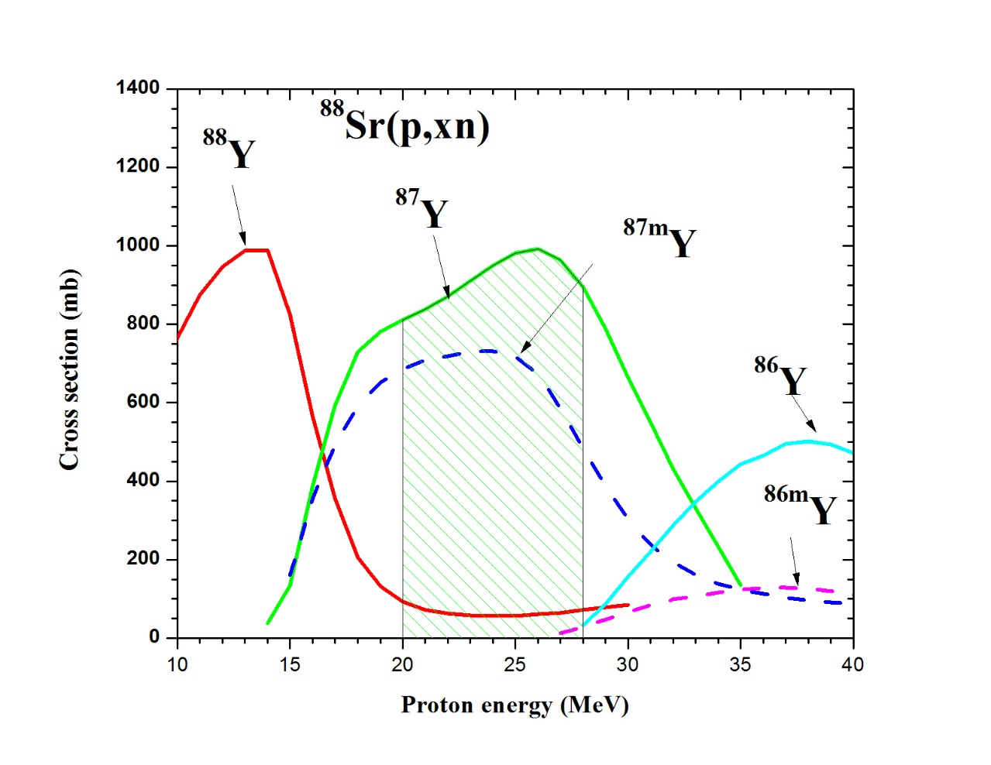

Slide 21
TALYS input file
#Reaction
Projectile p
Element Sr
Mass 88
Energy 1. 40. 0.5
#Medical isotope production
Production y
Ibeam 0.15
Ebeam 28.
Eback 20.
Save this input file in ‘input’ and run
talys < input > output
Next
xmgrace rp039087.L01
xmgrace –settype nxy Y039087.tot
xmgrace –help for options

Slide 22
Thank you!
Notes:
Thank you!

