Slide 1
Introduction to JANIS software
O. Cabellos
NEA Data Bank
oscar.cabellos@oecd.org
ICTP-IAEA Workshop on the
“Evaluation of Nuclear Reaction Data for Applications”
October 9-13, 2017. Trieste, Italy

Slide 2
Outline
JANIS Software
  What?
  Features
      Online info Plots/Tables/Matrices
      Databases/Format
      Search
      Comparing data
      Computations
  Users
    Evaluators
    Application
  Future developments
    Databases
    Formats
    Plotting
    Computations
  JANIS exercise
    EXERCISE 1: Display of your own data (specific formats to be used)
    EXERCISE 2: Create a new database
    EXERCISE 3: Open a local database

Slide 3

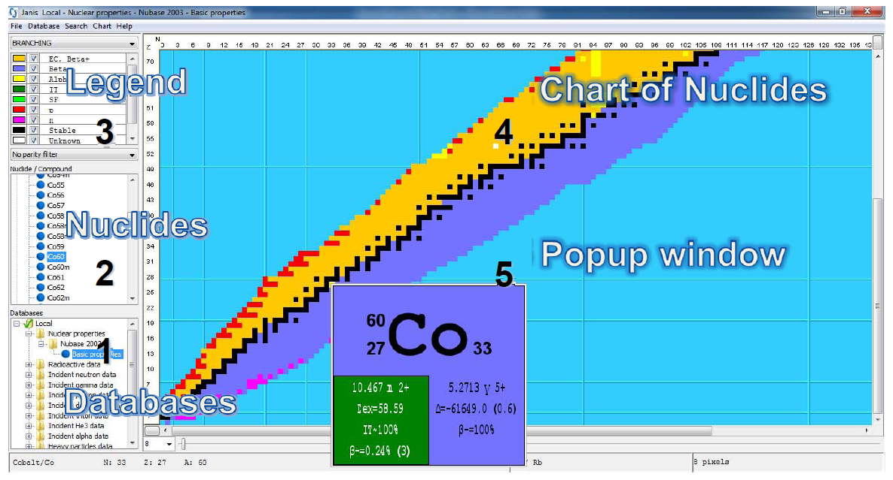
I. JANIS
What?
Features
  Online info P/T/M
  Databases/Format
  Search
  Comparing data
  Computations
Users
  Evaluators
  Application
Future developments
  Databases
  Formats
  Plotting
  Computations
JAva-based Nuclear Data Information Software designed to facilitate the visualisation and manipulation of nuclear data
http://www.oecd-nea.org/janis/

Slide 4
II. JANIS
What?
Features
  Online info P/T/M
  Databases/Format
  Search
  Comparing data
  Computations
Users
  Evaluators
  Application
Future developments
  Databases
  Formats
  Plotting
  Computations
Mainly a graphical interface giving access to:
  Bibliographical nuclear reaction data (CINDA)
  Experimental nuclear reaction data (EXFOR)
  Evaluated nuclear reaction and decay data (e.g. JEFF, ENDF/B)
  Basic properties of nuclei (NUBASE)
Provides ways for:
  exploring nuclear data libraries and databases
  visualisation and comparison of data
  arithmetic operations(normalisation, ratio, linear combination)
  some processing (ratios, linear combinations, weighted average)
Plots and numerical values can be exported in several formats:
  PNG for images
  WMF/EMF, PS, PDF for vectorial images
  CSV, copy & paste to Excel for numerical values

Slide 5
II. JANIS
What?
Features
  Online info P/T/M
  Databases/Format
  Search
  Comparing data
  Computations
Users
  Evaluators
  Application
Future developments
  Databases
  Formats
  Plotting
  Computations
User file
User Database
Translator
(ENDF-6 , BOXER, …)
Search
External
Plots
Searching
EXFOR
Database
Tables
Visualization
(plots&tables)
Plot information
(JNS)
JANIS Database
Computations
& Weighting
File with tables (CSV,XML)

Slide 6
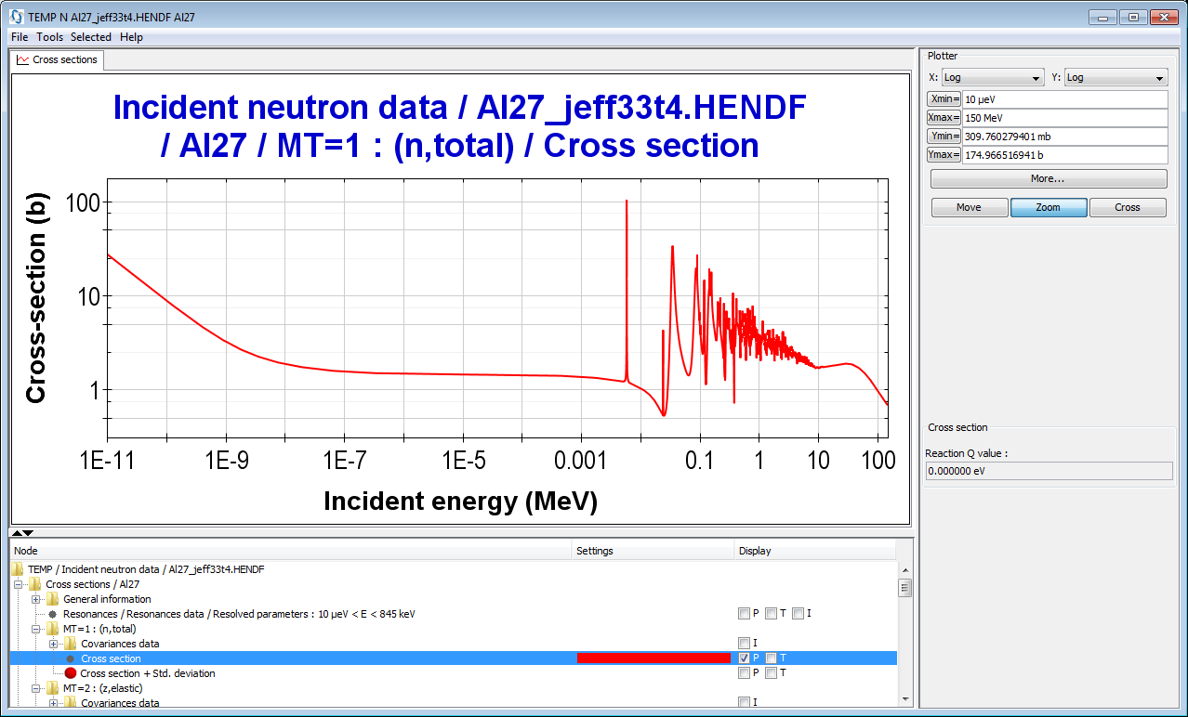
II. JANIS
What?
Features
  Online info P/T/M
  Databases/Format
  Search
  Comparing data
  Computations
Users
  Evaluators
  Application
Future developments
  Databases
  Formats
  Plotting
  Computations
JANIS – Plot (renderer) window
2 Display pane(s)
3 Display settings
4 Data param.
1 Selection tree
1- Selection tree: To select the data you want to display
2- Display panes: To display textual information, tabulated values, plots, decay paths
3- Display pane (plot) settings: To adjust the settings of the plot or table
4- Data parameters: To display additional information on the selected data, and select variable values for distributions, yields..

Slide 7
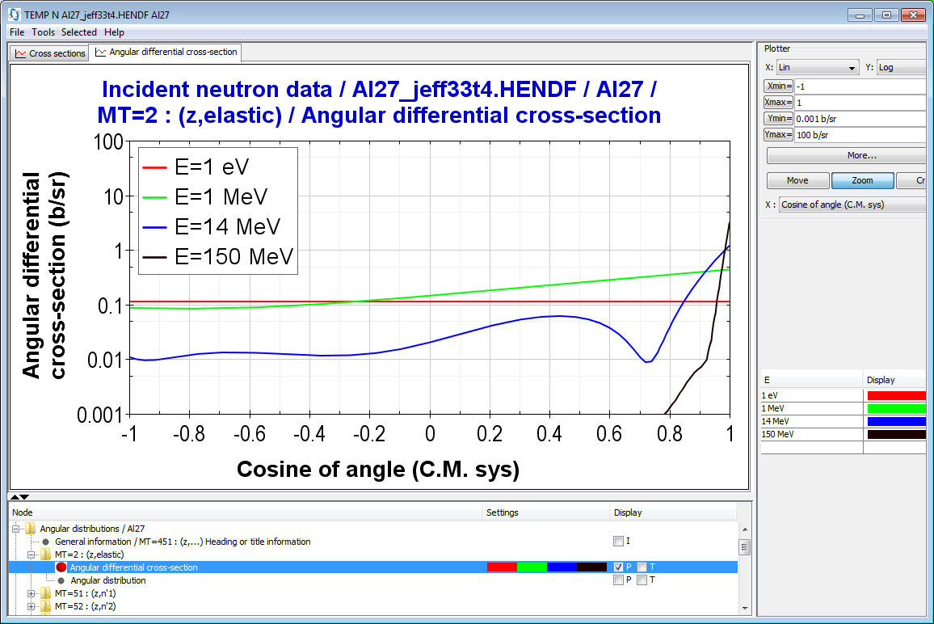
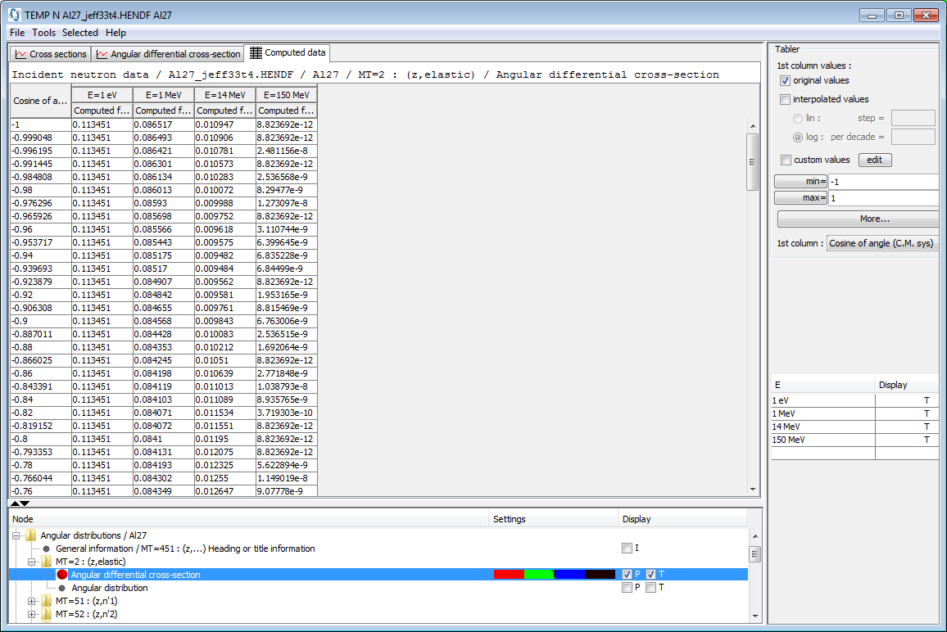
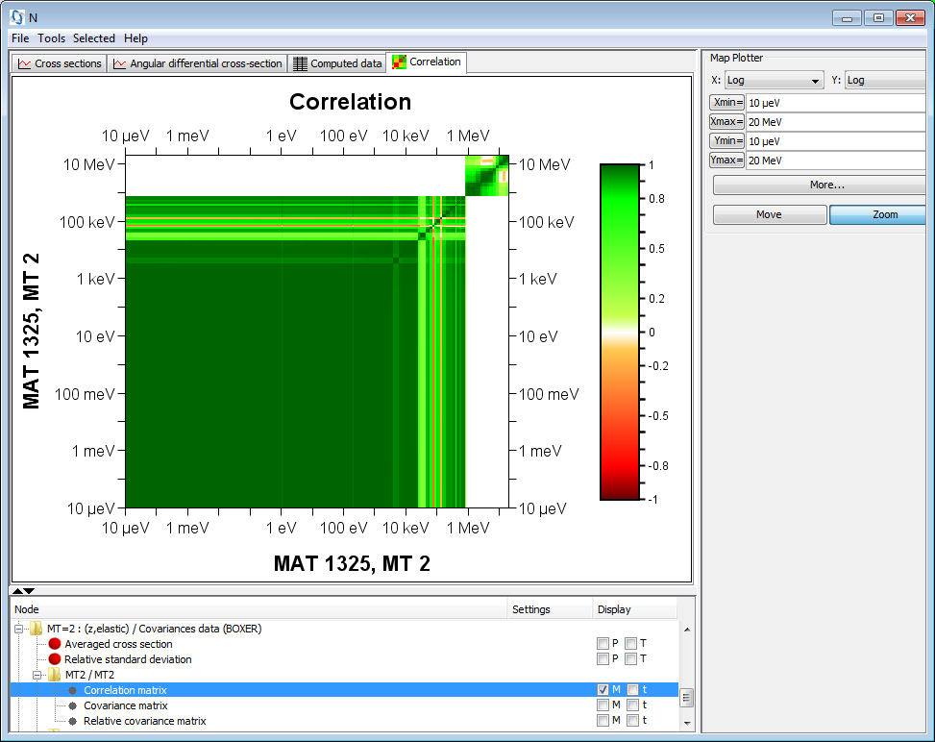
II. JANIS
What?
Features
  Online info P/T/M
  Databases/Format
  Search
  Comparing data
  Computations
Users
  Evaluators
  Application
Future developments
  Databases
  Formats
  Plotting
  Computations
Others panels
  Text panels
  Decay paths
  Color maps
Save/Export
  JNS File to open
  Figures in PNG or PS
Save/Export:
Run command line
C:\java -jar janis.jar -o XX.png -render XX.jns png 1024 768

Slide 8
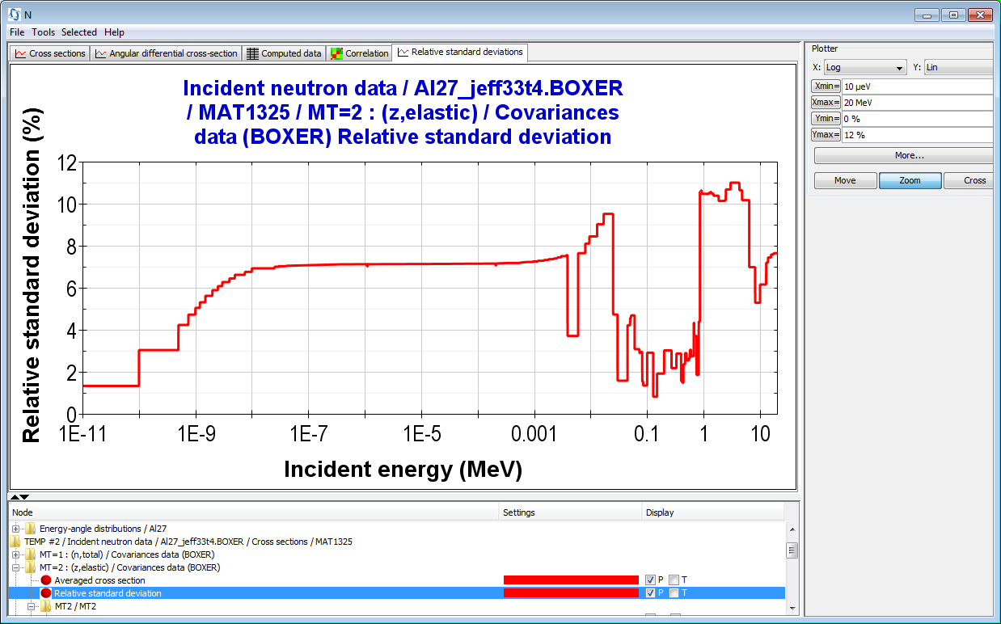
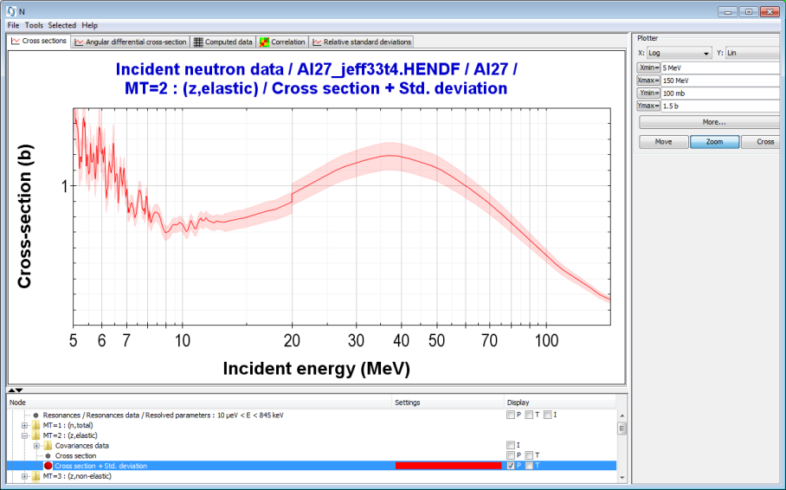
II. JANIS
What?
Features
  Online info P/T/M
  Databases/Format
  Search
  Comparing data
  Computations
Users
  Evaluators
  Application
Future developments
  Databases
  Formats
  Plotting
  Computations
Plotting covariance information
Formats: ENDF/MF33, BOXER, ERRORR, COVERX

Slide 9
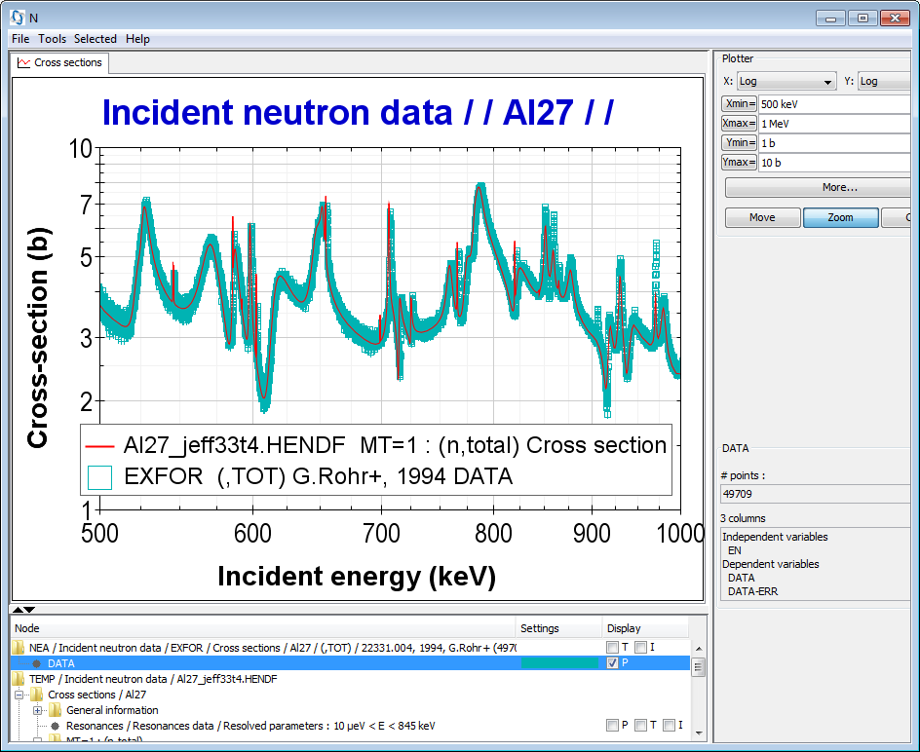
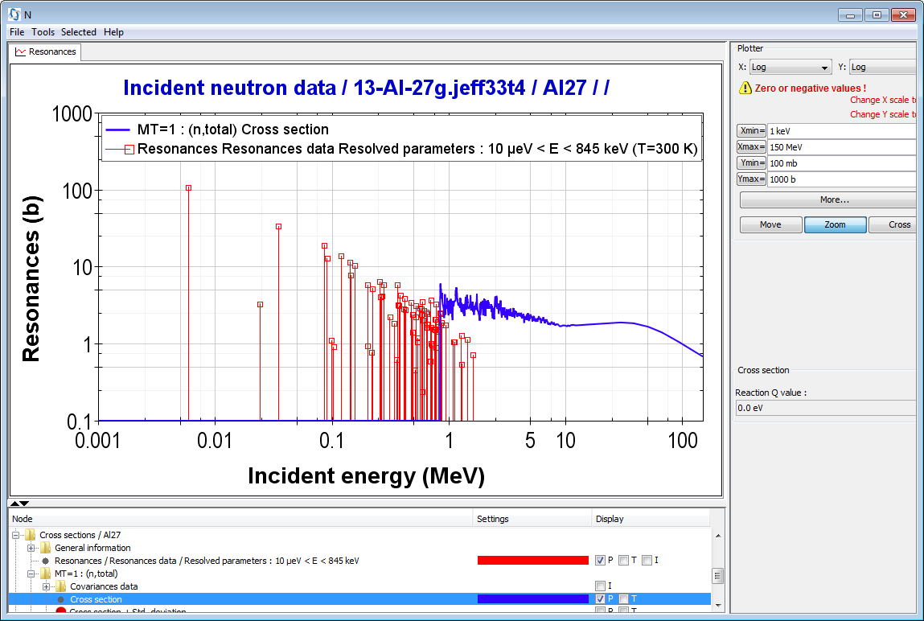
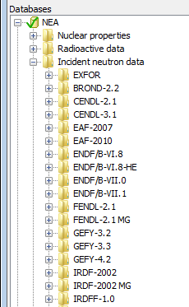
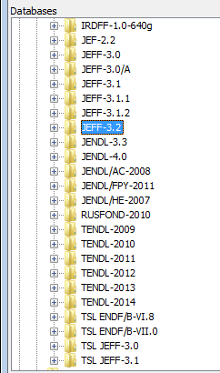
II. JANIS
What?
Features
  Online info P/T/M
  Databases/Format
  Search
  Comparing data
  Computations
Users
  Evaluators
  Application
Future developments
  Databases
  Formats
  Plotting
  Computations
ENDF6
EXFOR
Formats
  EXFOR, CINDA
  ENDF, PENDF, GENDF
  ERRORR, BOXER, COVERX
  INTER, NUBASE
Current Databases (e.g. n-XS)

Slide 10
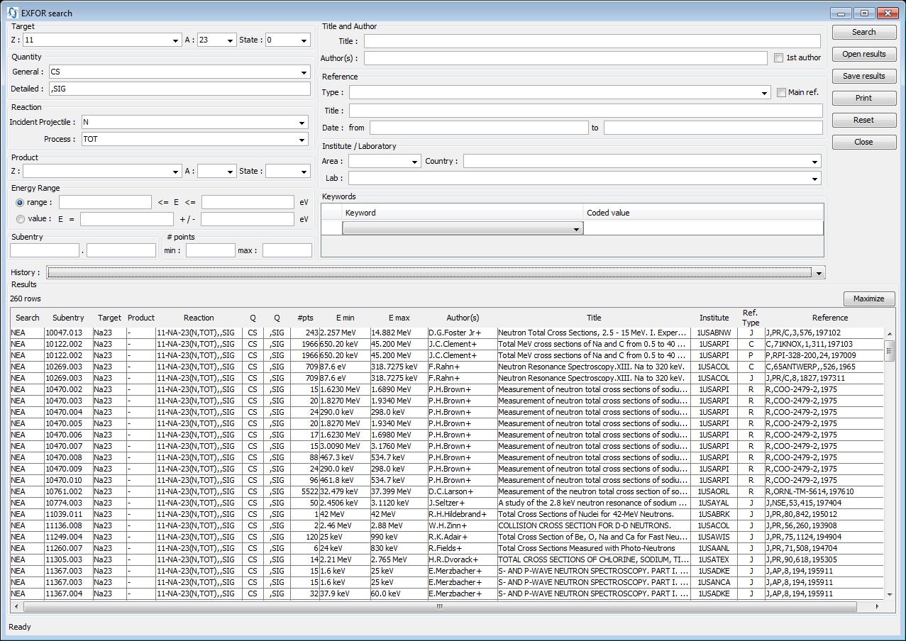
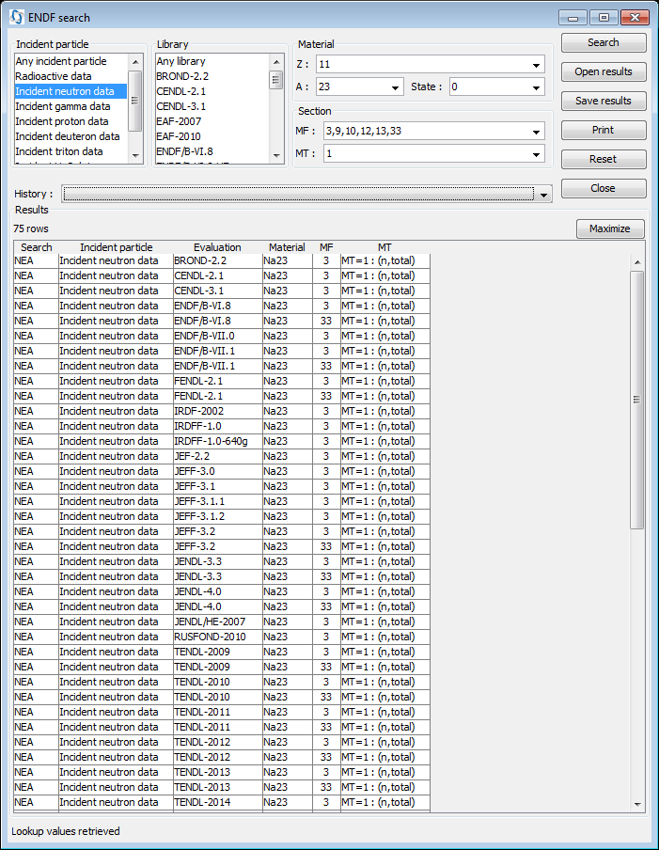
II. JANIS
What?
Features
  Online info P/T/M
  Databases/Format
  Search
  Comparing data
  Computations
Users
  Evaluators
  Application
Future developments
  Databases
  Formats
  Plotting
  Computations
Search EXFOR
SEARCH tool:
  EXFOR
  Evaluated/processed data
  Resonances
  Decay lines
  Covariances
  Bibliographic data CINDA
Search ENDF

Slide 11
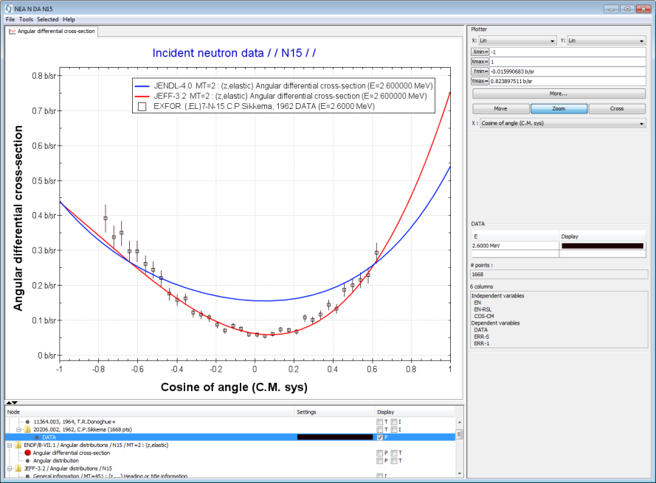
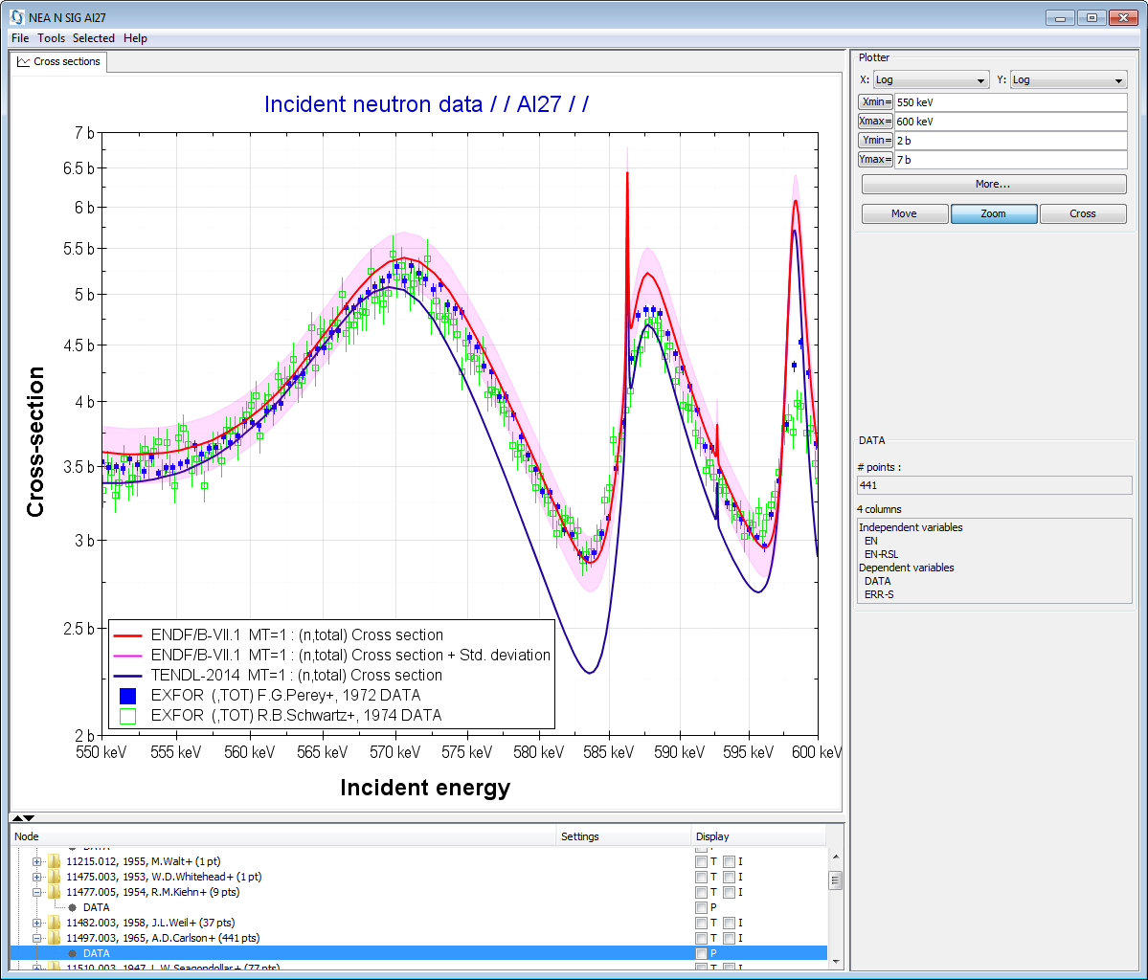
II. JANIS
What?
Features
  Online info P/T/M
  Databases/Format
  Search
  Comparing data
  Computations
Users
  Evaluators
  Application
Future developments
  Databases
  Formats
  Plotting
  Computations
Angular distributions
Cross-sections
and XS±1σ

Slide 12
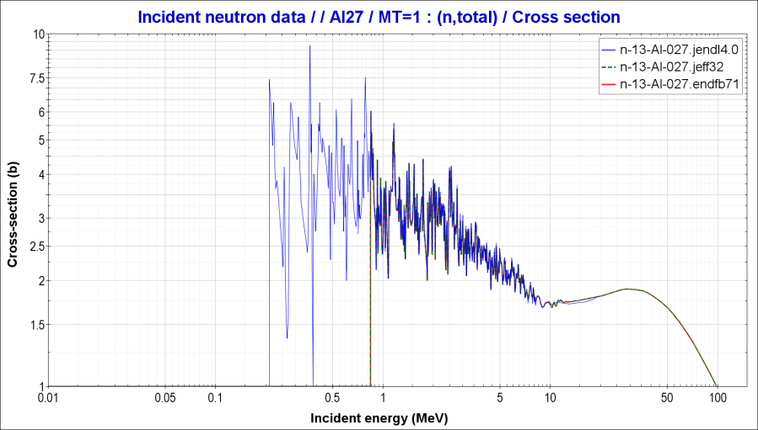
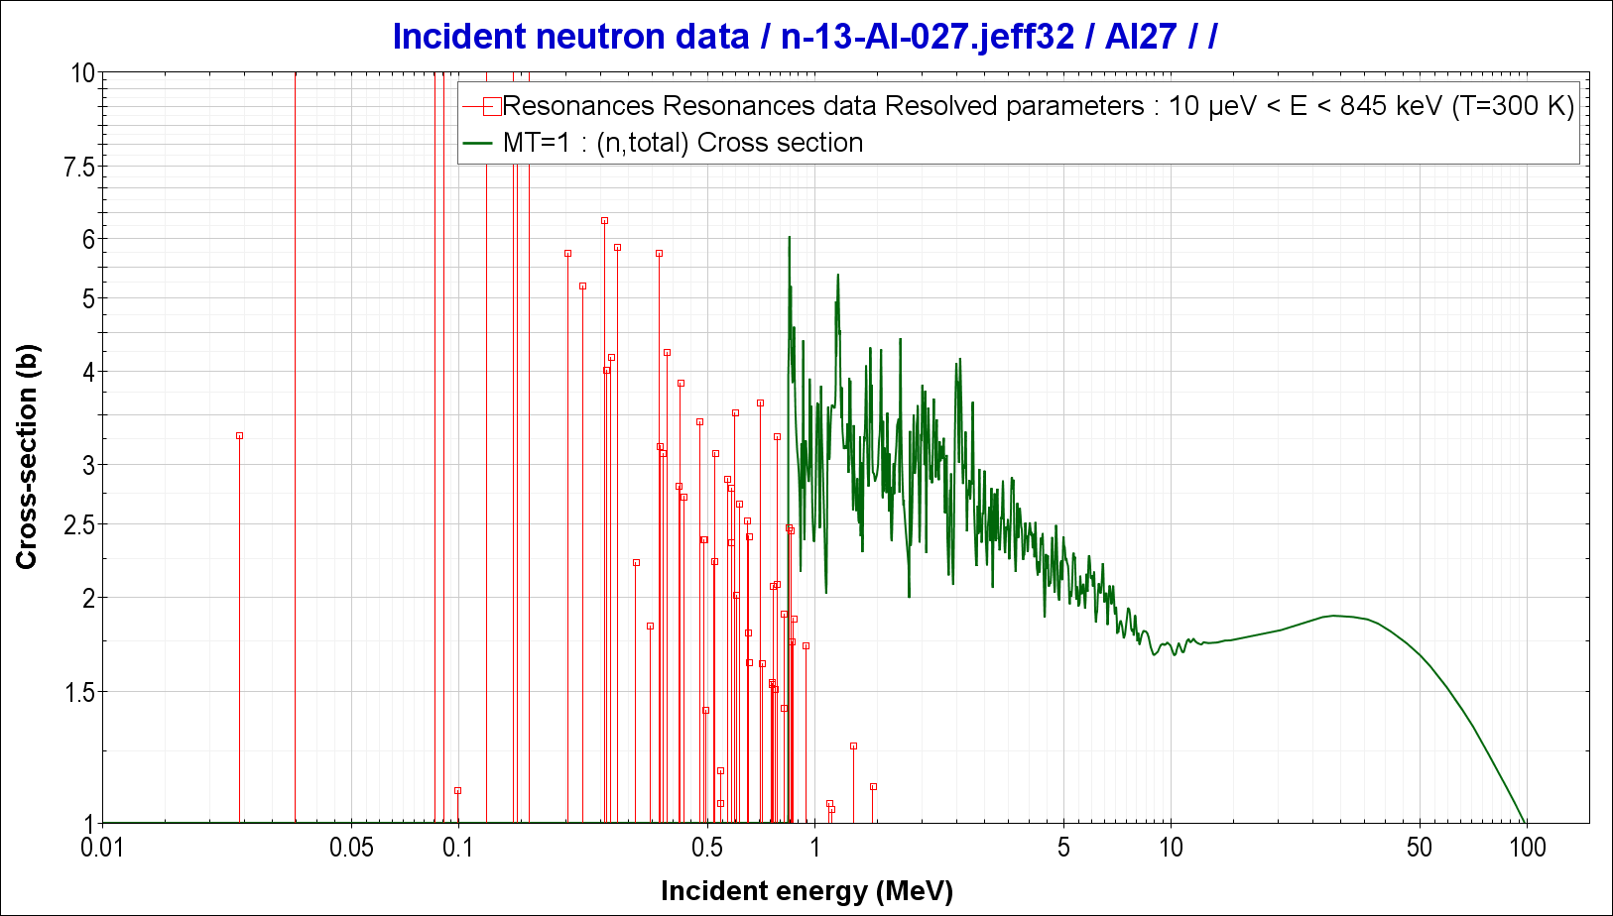
II. JANIS
What?
Features
  Online info P/T/M
  Databases/Format
  Search
  Comparing data
  Computations
Users
  Evaluators
  Application
Future developments
  Databases
  Formats
  Plotting
  Computations
Visualization of Evaluated Files
Fig. ²⁷Al (n,total) reaction= MF3/MT1
Fig. ²⁷Al (n,total) reaction= MF3/MT1 and MF2 (resonance data in the RRR)

Slide 13
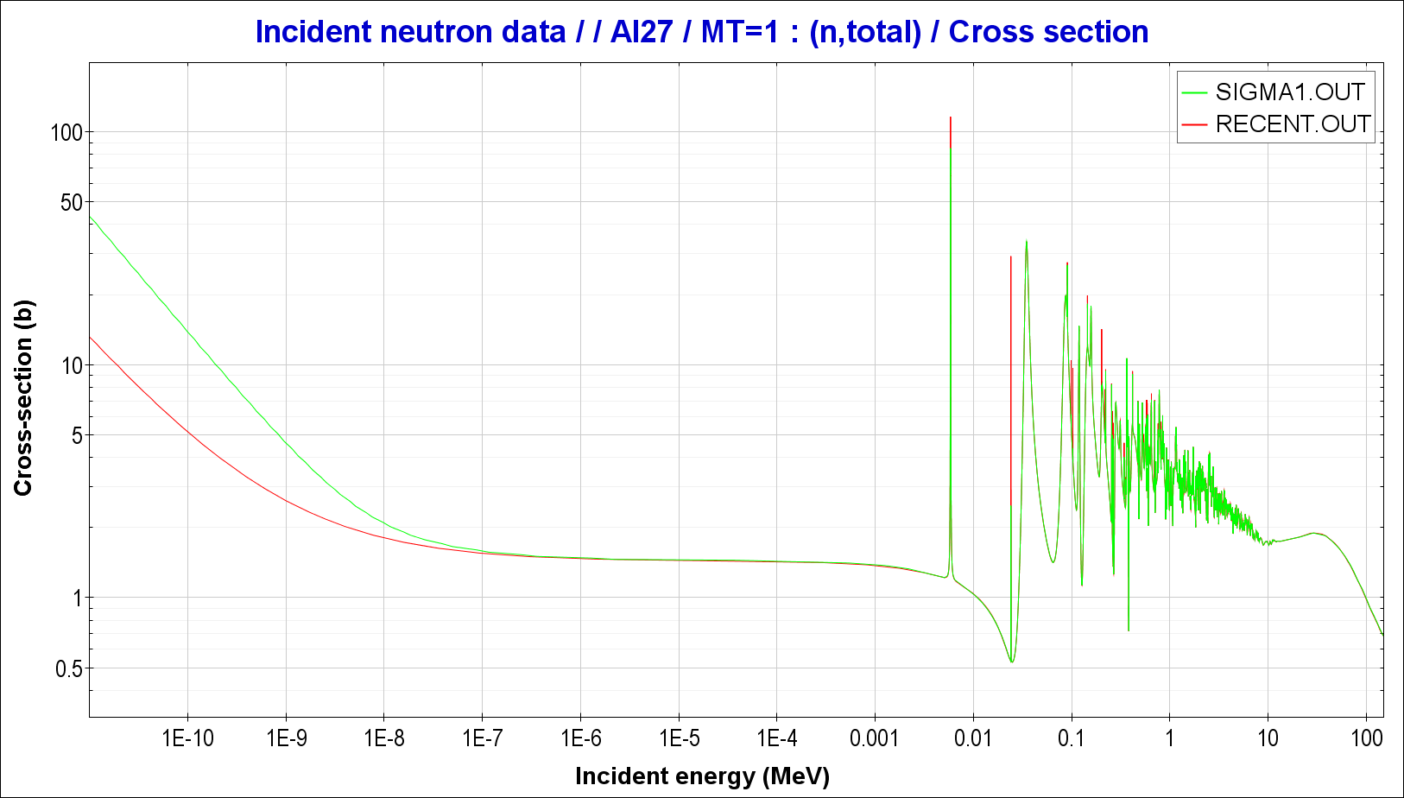
II. JANIS
What?
Features
  Online info P/T/M
  Databases/Format
  Search
  Comparing data
  Computations
Users
  Evaluators
  Application
Future developments
  Databases
  Formats
  Plotting
  Computations
Visualization of Processed Files
Fig. ²⁷Al (n,total) reaction= MF3/MT1
PREPRO/SIGMA1 output: at 300 K
PREPRO/RECENT output: at 0 K

Slide 14
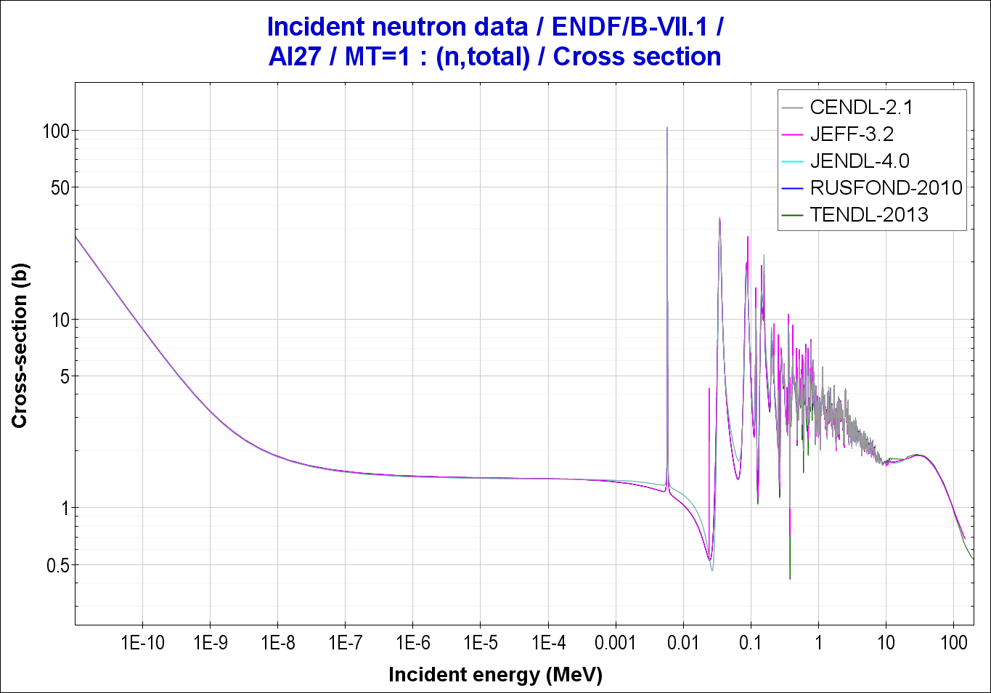
II. JANIS
What?
Features
  Online info P/T/M
  Databases/Format
  Search
  Comparing data
  Computations
Users
  Evaluators
  Application
Future developments
  Databases
  Formats
  Plotting
  Computations
Comparing Evaluated data
Fig. ²⁷Al (n,total) reaction= MF3/MT1 at 300 K

Slide 15
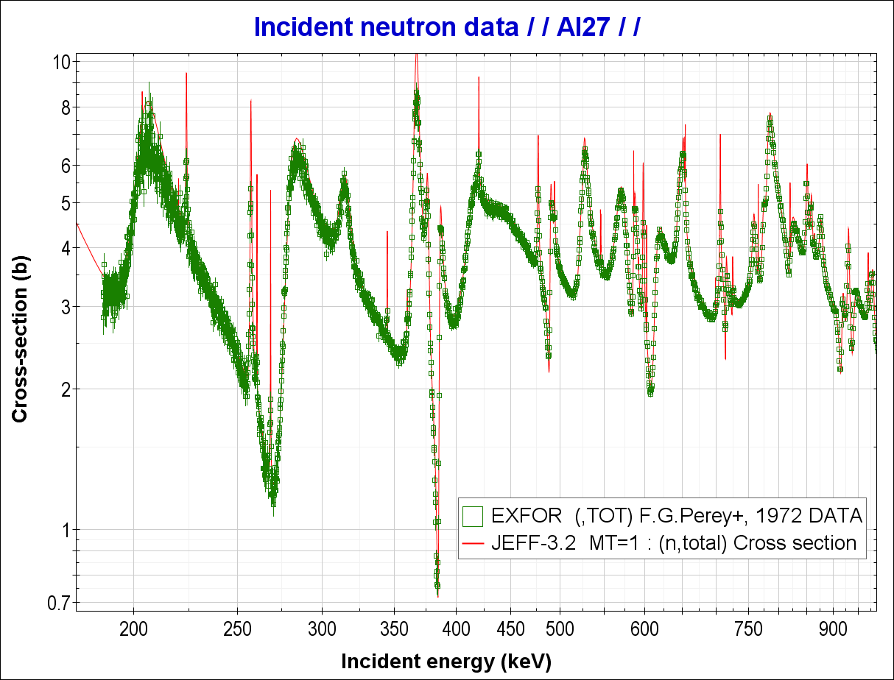
II. JANIS
What?
Features
  Online info P/T/M
  Databases/Format
  Search
  Comparing data
  Computations
Users
  Evaluators
  Application
Future developments
  Databases
  Formats
  Plotting
  Computations
Comparing Evaluated Data vs. EXFOR
“Compare with Evaluated data” functionality
Fig. ²⁷Al (n,total) reaction= MF3/MT1 at 300 K

Slide 16
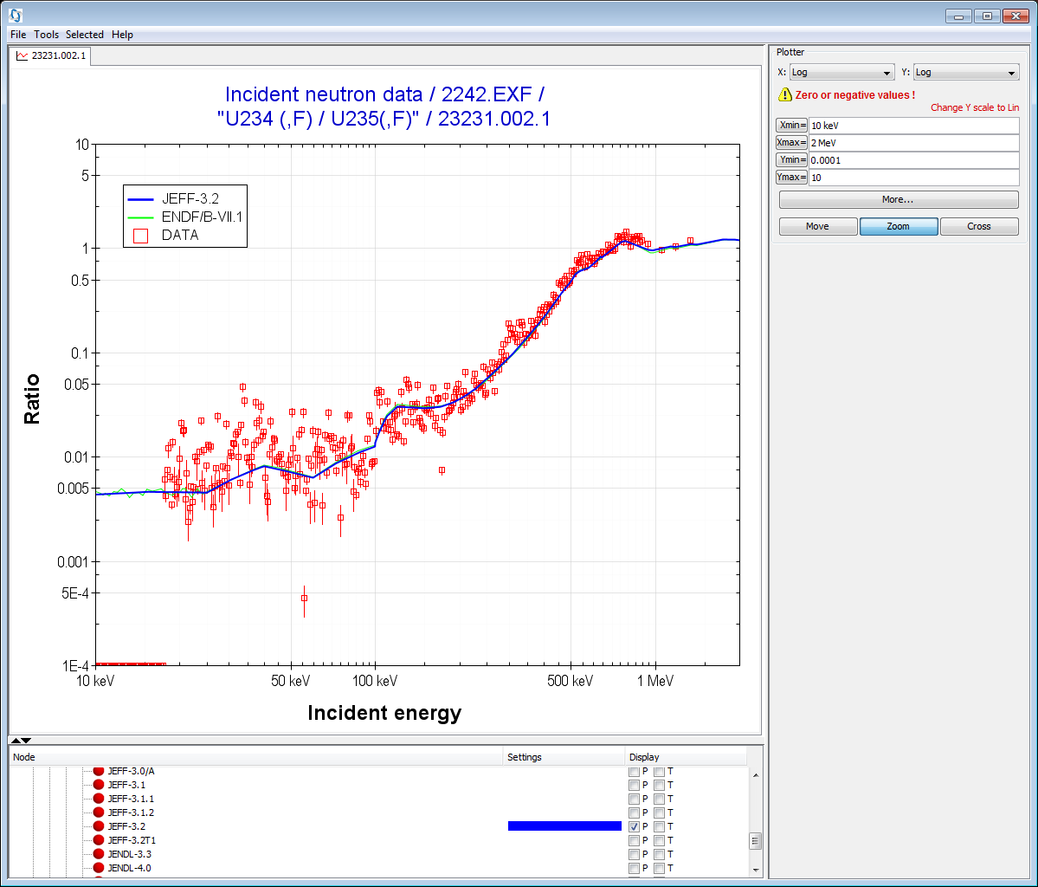
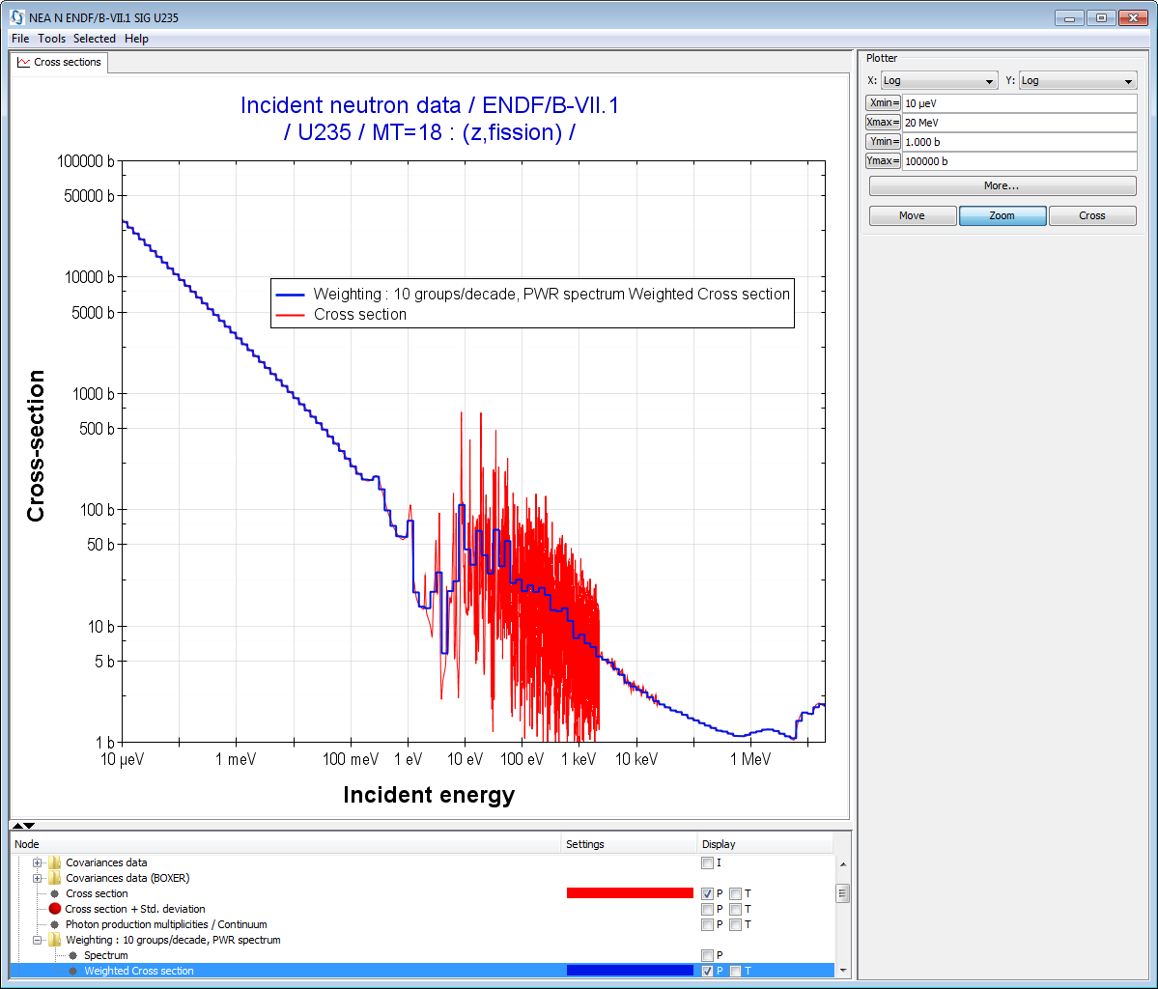
II. JANIS
What?
Features
  Online info P/T/M
  Databases/Format
  Search
  Comparing data
  Computations
Users
  Evaluators
  Application
Future developments
  Databases
  Formats
  Plotting
  Computations
User Defined: η, ratio, …(basic arithmetic operations: +,-,*,/)
Weighting cross-section
calculation of averaged cross-sections using various weighting spectra and energy group structures

Slide 17
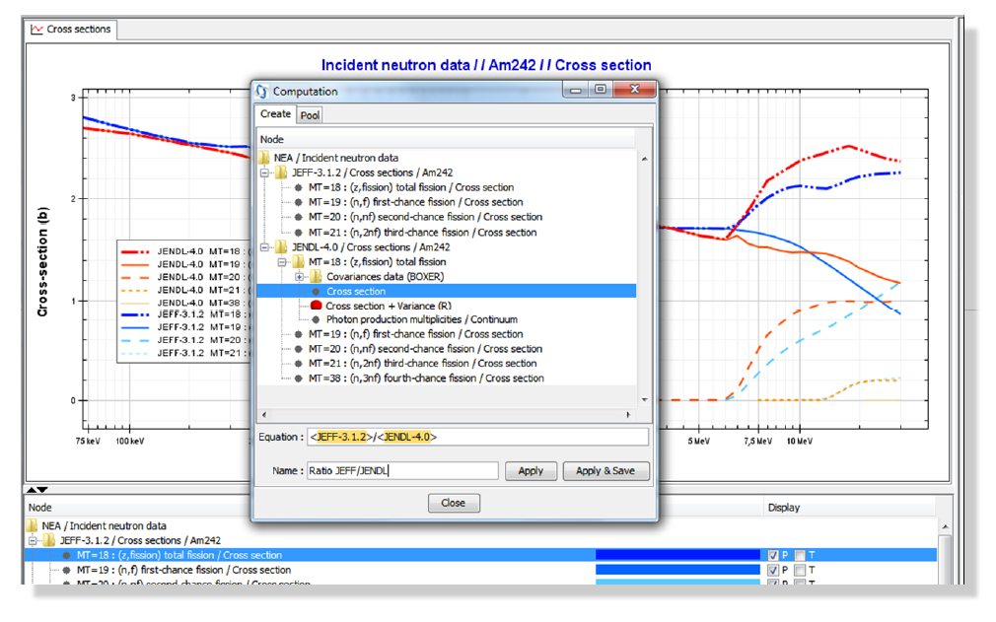
II. JANIS
What?
Features
  Online info P/T/M
  Databases/Format
  Search
  Comparing data
  Computations
Users
  Evaluators
  Application
Future developments
  Databases
  Formats
  Plotting
  Computations
Example of computation: ratio of evaluations

Slide 18
II. JANIS
What?
Features
  Online info P/T/M
  Databases/Format
  Search
  Comparing data
  Computations
Users
  Evaluators
  Application
Future developments
  Databases
  Formats
  Plotting
  Computations
Nuclear Data Experimentalist
    Check visually content of experiment
    Compare with other EXFOR data
    Compare with previous evaluations
    Assess experimental uncertainties
Nuclear Data EXFOR compilers
    Checking format and data for new EXFOR entries
    TRANS-Checker: www.oecd-nea.org/janis/trans-checker/
Nuclear Data Evaluators:
  Check visually content of evaluations
  Perform comparisons with other data
  Compare with EXFOR data
  Assess uncertainties
    Relative error(%)
    Covariances and correlations

Slide 19
II. JANIS
What?
Features
  Online info P/T/M
  Databases/Format
  Search
  Comparing data
  Computations
Users
  Evaluators
  Application
Future developments
  Databases
  Formats
  Plotting
  Computations
Neutronic design
  Visualize content of nuclear data
  Perform manipulations. However, they cannot be exported in ENDF-6 format
  Address differences in integral results due to differences in nuclear data
Safety/Radioactive Waste management
  Visualize nuclear data (related to its field)
  Decay chains, fission yields, …
Radiation damage in materials
  Damage energy cross-sections
  Gas production cross-sections
    IAEA-CRP on Damage Primary Energy
    https://www-nds.iaea.org/CRPdpa/
Academia
  Introduction to nuclear data
  Basic nuclear interactions

Slide 20
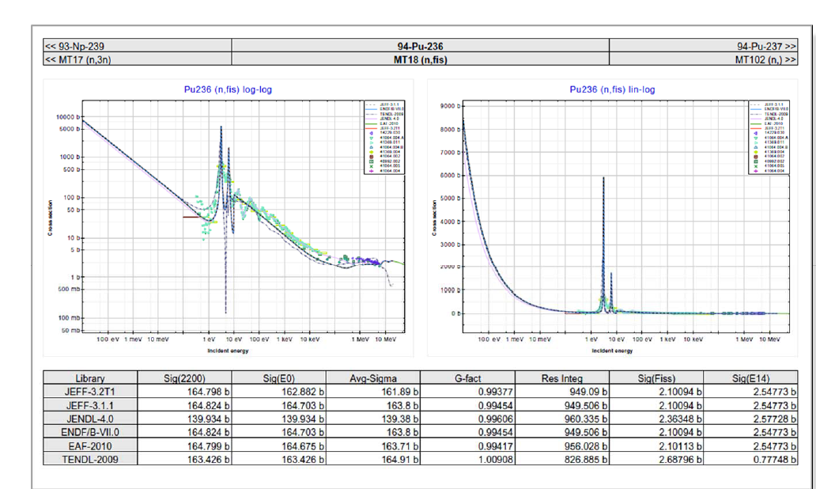
II. JANIS
What?
Features
  Online info P/T/M
  Databases/Format
  Search
  Comparing data
  Computations
Users
  Evaluators
  Application
Future developments
  Databases
  Formats
  Plotting
  Computations
JANIS Books
One page per isotope and reaction
Plots of main nuclear data
Allow quick visual comparison of many data
http://www.oecd-nea.org/janis/book/

Slide 21
II. JANIS
What?
Features
  Online info P/T/M
  Databases/Format
  Search
  Comparing data
  Computations
Users
  Evaluators
  Application
Future developments
  Databases
  Formats
  Plotting
  Computations
Database, capabilities and input/output information flow in JANIS:
- USER database!!

Slide 22
II. JANIS
What?
Features
  Online info P/T/M
  Databases/Format
  Search
  Comparing data
  Computations
Users
  Evaluators
  Application
Future developments
  Databases
  Formats
  Plotting
  Computations
Databases
  Improve management of on-line databases
  Implement cross-checking tools of ENDF and EXFOR databases
  User external databases (e.g. Safety and Waste Management)
Formats
  To read INTER8.8
  Implement WPEC/SG38 recommendations: GND format
  ACE format, SCALE format,…
Computation
  To compute weighted covariance data
  To compute integral resonances based on EXFOR data
  To implement SCM new algorithm generating a flag/score
  To compute cross-section for natural elements
  To allow edit equations
Plotting
  Development of advanced display functions
  3-D double-differential cross-sections
  Angular distributions (e.g. 3D renderable data)
  New template for reaching publication’s standard
  GNUPLOT integration
  Plotting INTER parameters/INTER values
  Plotting/Table of SCM scoring
  Plotting covariance (page with 3 plots) as NJOY does

Slide 23
II. JANIS
What?
Features
  Online info P/T/M
  Databases/Format
  Search
  Comparing data
  Computations
Users
  Evaluators
  Application
Future developments
  Databases
  Formats
  Plotting
  Computations
Nuclear Databases at the NEA/JANIS server
Nuclear Properties | NUBASE-1997/2003/2012
radioactive data | ENDF/B-VI.8/VII.0/VII.1 GEFY-3.2/3.3/4.2/5.2 JEF-2.2, JEFF-3.1/3.1.1 JENDL-4.0, JENDL-FPDD2000, JENDL/FPD-2011, JENDL/FPY-2011 TENDL-2010
neutron data | EXFOR BROND-2.2/*3.1 CENDL-2.1/3.1 EAF-2007/.2010 ENDF/B-VI.8/VI.8-HE/VII.0/VII.1 FENDL-2.1/2.1MG/ *3.1b GEFY-3.2/3.3/4.2/5.2/5.3 IRDF-2002/2002MG, IRDFF-1.0/1.0640g/*1.05 JEF-2.2, JEFF-3.0/3.0A/3.1/3.1.1/3.1.2/3.2 JENDL3.3/4.0/HE*, JENDL-AC-2008, JENDL-FPY-2011, JENDL-HE-2007, RUSFOND-2010 TENDL-2009/10/… /14/15 TSL-ENDF/B-VI.8 TSL ENDF/B-VII.0 TSL-JEFF3.0/3.1
gamma data | EXFOR ENDF/B-VII.0/VII.1 JENDL-PD-2004 TENDL-2009/10/…/14/15
proton data | EXFOR ENDF/B-VI.8/VI.8-HE/VII.0/VII.1 JENDL-HE-2007, JENDL-4.0/HE* JEFF-3.1 PADF-2007 TENDL-2009/10/…/14/15
deuteron and triton data | EXFOR, ENDF/B-VI.8/ VII.0/VII.1 TENDL-2009/10/…/14/15
³He data | EXFOR ENDF/B-VII.0/VII.1 TENDL-2009/10/…/14/15
alpha data | EXFOR JENDL-AN-2005, TENDL-2009/10/…/14/15
heavy particles, electron, antiprotons, kaons and pions | EXFOR

Slide 24
II. JANIS
What?
Features
  Online info P/T/M
  Databases/Format
  Search
  Comparing data
  Computations
Users
  Evaluators
  Application
Future developments
  Databases
  Formats
  Plotting
  Computations
Integration with other NEA tools
  NDaST: Computing ratios of cross-sections for perturbation analysis
  NDaST: Computing weighted covariances
  NDEC: Generation of JANIS database (e.g. TENDL2015,…)
Integration with other NEA databases
  EXFOR: To automatize the pre-checking of prelim EXFOR data, automatic plot option with evaluate/experiments
  EXFOR: Scoring EXFOR data
  JANIS: Annual release JANIS-handbooks
Long-term challenge for JANIS developers
    How about playing puzzles with nuclear data?!
      1) Mapping of current MAT/MF/MT
      2) Adding new partial evaluations: RRR, Fast Energy,...
      3) Generate a new evaluation

Slide 25

Summary of Handling ND at NEA
SINBAD
SFCOMPO
JEFF
EXFOR
JANIS
Processing
DICE
IDAT
Evaluation
XS - var(XS)
FY - var(FY)
...
Validation
&
Benchmarking
NDEC
WPEC
WPEC
SG40
WPEC
SG38
WPEC
SG37
S/U
&
UQ
WPEC
SG39
NDaST
WPEC
SG42
WPEC
HPRL
WPEC
SG41

Slide 26
II. JANIS
Exercises
Visualization
  ENDF
  PENDF
  GENDF
  ACE?
  EXFOR
  BOXER-ERRORR
  COVERX
Export
  JNS
  Command line
Create personal databases
  WIZARD tool
EXERCISE 1: Display of your own data (specific formats to be used)
  Using “File > Open...”
Content:
.\ENDF\.......... ENDF6 files
.\PENDF\......... PENDF files
.\GENDF\......... GENDF files in 238 energy groups (SCALE format)
.\ACE\........... ACE files
.\ACE-to-ENDF\... ACE files converted into ENDF format with ACELST/DICTIN codes
.\EXFOR\......... EXFOR entries in URR energy region
.\ERRORR-BOXER\.. Covariances in BOXER and ERRORR format
.\COVERX\........ COVERX format (SCALE6)
.\COVERX\CONVERT_SCALE_TO_ENDF\... COVERX to ENDF format(ANGELO/LAMBDA/NJOY codes)
.\INTER\........ INTER file
.\HENDF\........ HENDF file to be used in JANIS
.\JNS\.......... Example JNS file
.\DBDATA-JANIS-Al27-JEFF33T4\.... Example of “db.h2.db”
.\Appendix\.... JANIS manual and JANIS-groups
.\Software\ ... Example to run in command-line

Slide 27
II. JANIS
Exercises
Visualization
  ENDF
  PENDF
  GENDF
  ACE?
  EXFOR
  BOXER-ERRORR
  COVERX
Export
  JNS
  Command line
Create personal databases
  WIZARD tool
Visualization of evaluated and processed data
  FILE, OPEN Tool
  ENDF, PENDF, GENDF, ACE2ENDF
  Plot covariance data
  ENDF/MF33 and ERRORR-BOXER
  COVERX
  EXPORT (PNG, EPS) and SAVE (JNS)
  JANIS’s COMMAND LINE:
    “C:\java -jar janis.jar -o FILE.png -render FILE.jns png 1024 768”
  COMPUTATION
    Ratio of (n, g) cross-sections
  WEIGHTING:
    (n,γ) in 238 energy groups
    (n,γ) Ratio of cross-sections
  SEARCH and COMPARISON: (n,g) in the URR energy range
    SEARCH, EXFOR Tool
    COMPARISON with other evaluations

Slide 28
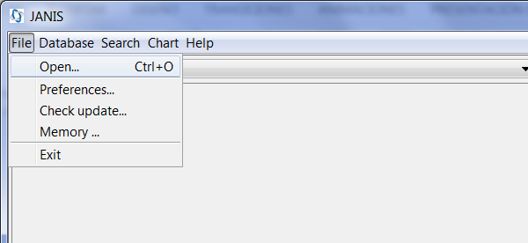
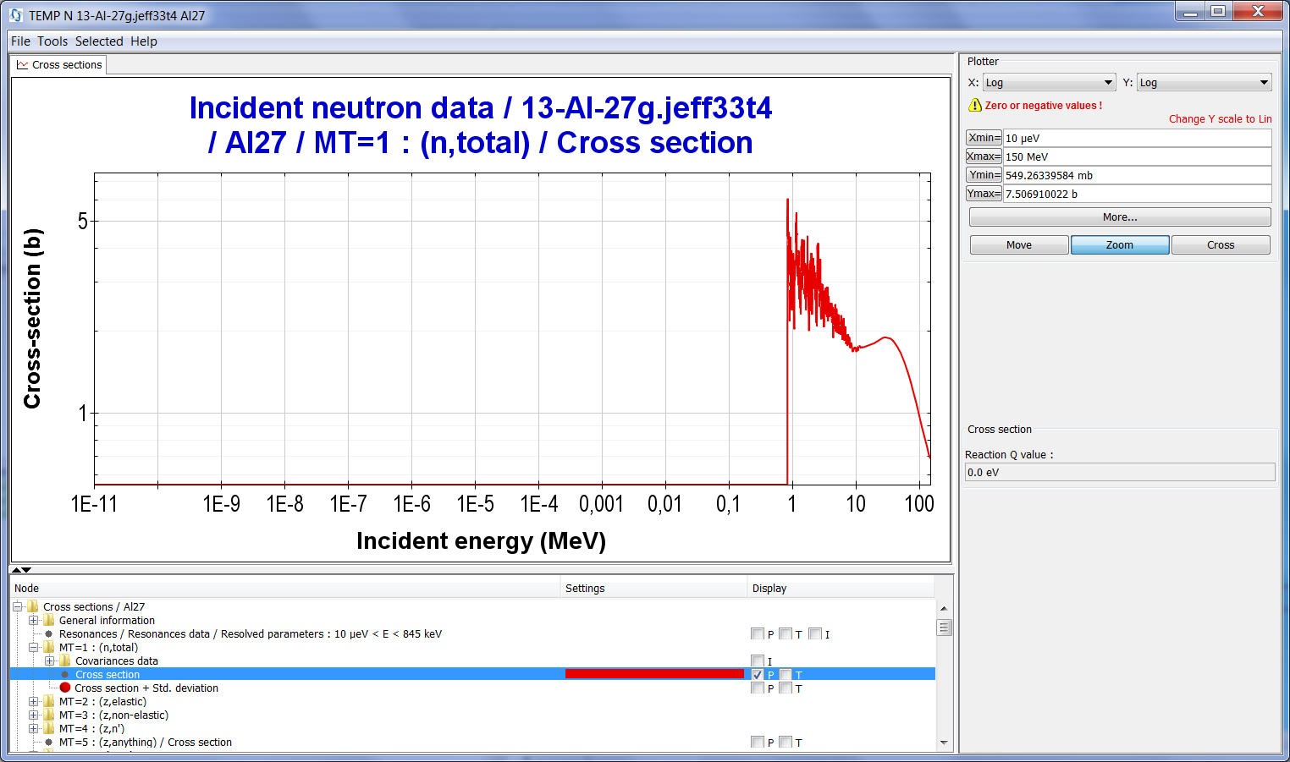
II. JANIS
Exercises
Visualization
  ENDF
  PENDF
  GENDF
  ACE?
  EXFOR
  BOXER-ERRORR
  COVERX
Export
  JNS
  Command line
Create personal databases
  WIZARD tool
Visualization of evaluated and processed data
  FILE, OPEN Tool
  ENDF
Content:
.\ENDF\.......... ENDF6 files
13-Al-27g.jeff33t4

Slide 29
II. JANIS
Exercises
Visualization
  ENDF
  PENDF
  GENDF
  ACE?
  EXFOR
  BOXER-ERRORR
  COVERX
Export
  JNS
  Command line
Create personal databases
  WIZARD tool
Visualization of evaluated and processed data
  FILE, OPEN Tool
  PENDF
Content:
.\PENDF\......... PENDF files
Input NJOY
moder / Extract/convert neutron evaluated data
1 -21
'13-Al-27 from JEFF33T1'/ Comment line about file
20 1325 /
0/
reconr / Reconstruct XS from resonance parameters
-21 -22
'13-Al-27 PENDF from JEFF33T1'/
1325 2 / ncards = 2, two comment lines added to the new MF1
0.001 0.0 / err tempr errmax (default = err*10)
'Reconstructed 13-Al-27 PENDF from JEFF33T1'/
'Processed with NJOY2012.89 NEA updates, at NEA 2017-07-04'/
0/
broadr / Perform Doppler-broadening
-21 -22 -23
1325 1 0 0 0./ IMAT, #temps, restart?, bootstrap?, restart from?
0.001 / errthn thnmax errmax
293.6 / Description of temperatures
0/
...

Slide 30
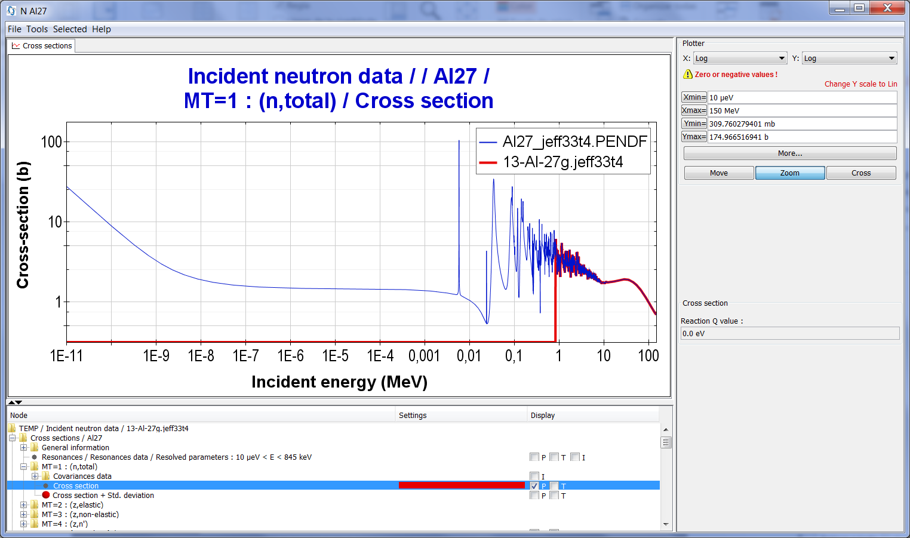
II. JANIS
Exercises
Visualization
  ENDF
  PENDF
  GENDF
  ACE?
  EXFOR
  BOXER-ERRORR
  COVERX
Export
  JNS
  Command line
Create personal databases
  WIZARD tool
Visualization of evaluated and processed data
  FILE, OPEN Tool
  PENDF
Content:
.\PENDF\......... PENDF files
Script/batch file to run NJOY
copy ..\ENDF\13-Al-27g.jeff33t4 tape20
..\njoy2012_50.exe < 13-Al-27g.jeff33t4-njoy.inp
copy tape28 Al27_jeff33t4.PENDF
del tape20 tape21 tape22 tape23 tape24 tape25 tape26 tape27 tape28
del tape30
del tape61

Slide 31
II. JANIS
Exercises
Visualization
  ENDF
  PENDF
  GENDF
  ACE?
  EXFOR
  BOXER-ERRORR
  COVERX
Export
  JNS
  Command line
Create personal databases
  WIZARD tool
Visualization of evaluated and processed data
  FILE, OPEN Tool
  GENDF
Content:
.\GENDF\......... GENDF files in 238 energy groups (SCALE format)
Input NJOY
groupr / Generate multigroup cross section data
-21 -30 0 35/
1325 1 0 2 6 1 1 1 /
'13-Al-27 GENDF 238 JEFF33T1,NJOY2012.89 NEA updates, at NEA 2017-07-04'/
293.6
1.E10
238 /
1.000E-05, 1.000E-04, 5.000E-04, 7.500E-04, 1.000E-03,
..
1.455E+07, 1.568E+07, 1.733E+07, 2.000E+07/
3/
3 221 Free Gas/
3 251 mubar/
3 252 xi/
3 253 gamma/
3 259 1/v /
6/
6 221 Free Gas /
0/
0/
stop

Slide 32
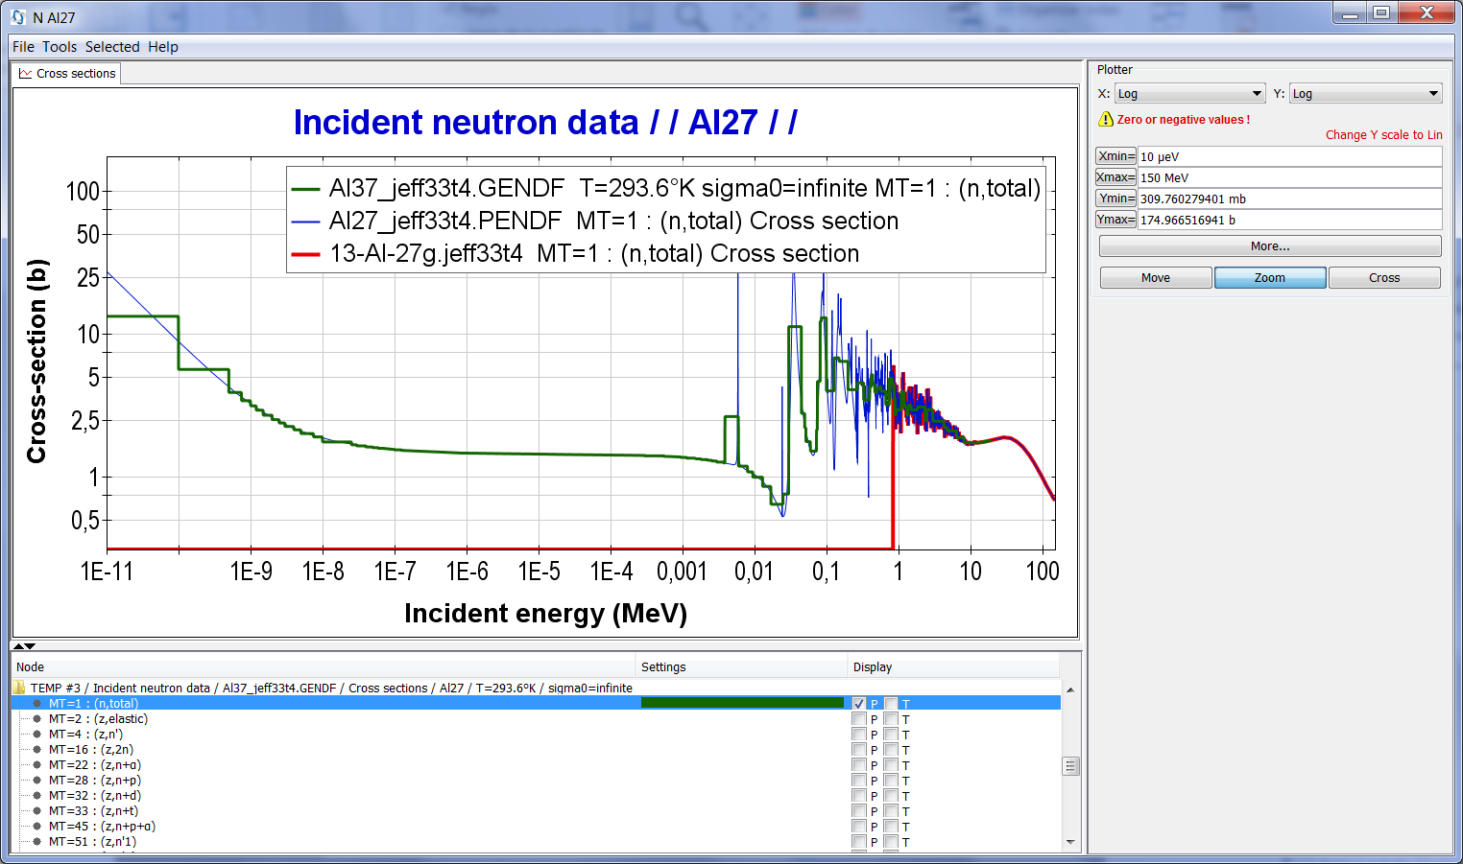
II. JANIS
Exercises
Visualization
  ENDF
  PENDF
  GENDF
  ACE?
  EXFOR
  BOXER-ERRORR
  COVERX
Export
  JNS
  Command line
Create personal databases
  WIZARD tool
Visualization of evaluated and processed data
  FILE, OPEN Tool
  GENDF
Content:
.\GENDF\......... GENDF files in 238 energy groups (SCALE format)
Script/batch file to run NJOY
copy ..\ENDF\13-Al-27g.jeff33t4 tape20
..\njoy2012_50.exe < 13-Al-27g.jeff33t4-njoy.inp
copy tape35 Al37_jeff33t4.GENDF
del tape20 tape21 tape22 tape23 tape24 tape25 tape26 tape27 tape28
del tape30 tape35
del tape61

Slide 33
II. JANIS
Exercises
Visualization
  ENDF
  PENDF
  GENDF
  ACE?
  EXFOR
  BOXER-ERRORR
  COVERX
Export
  JNS
  Command line
Create personal databases
  WIZARD tool
EXERCISE 1: Display of your own data (specific formats to be used)
  Using “File > Open...”
Content:
.\ACE\........... ACE files
.\ACE-to-ENDF\... ACE files converted into ENDF format with ACELST/DICTIN codes
Input NJOY
acer / Prepare ACE files
-21 -30 0 31 32 /
1 0 1 .03 / Create fast data (for neutrons), if change to 2 for TSL. Add suffix for ACE file
'13-Al-27 ACE from JEFF33T1,NJOY2012.89 NEA updates,at NEA 2017-07-04'/
1325 293.6
1 1/
/
acer / Check ACE files
0 31 0 33 34 /
7 1 1 -1 /
''/
Script/batch file to run NJOY
copy ..\ENDF\13-Al-27g.jeff33t4 tape20
..\njoy2012_50.exe < 13-Al-27g.jeff33t4-njoy.inp
copy tape31 Al27_jeff33t4.ACE
copy tape32 Al27_jeff33t4.dir
del tape20 tape21 tape22 tape23 tape24 tape25 tape26 tape27 tape28
del tape30 tape31 tape32 tape33 tape34
del tape61

Slide 34
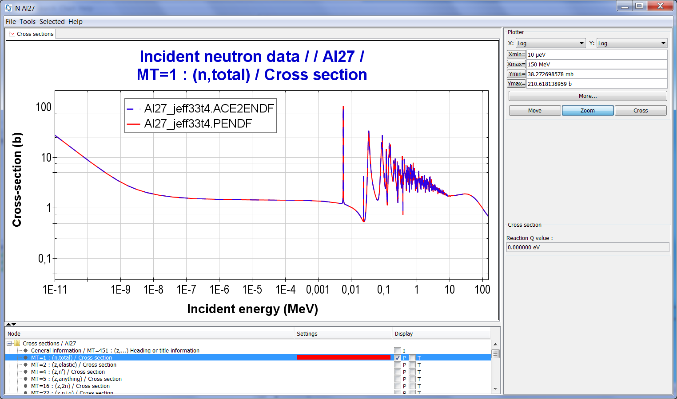
II. JANIS
Exercises
Visualization
  ENDF
  PENDF
  GENDF
  ACE?
  EXFOR
  BOXER-ERRORR
  COVERX
Export
  JNS
  Command line
Create personal databases
  WIZARD tool
EXERCISE 1: Display of your own data (specific formats to be used)
  Using “File > Open...”
Content:
.\ACE\........... ACE files
.\ACE-to-ENDF\... ACE files converted into ENDF format with ACELST/DICTIN codes
Script/batch file to run ACELST and DICTIN codes
copy ..\ACE\Al27_jeff33t4.ACE .\Al27_jeff33t4.ACE
rem = case1
acelst.exe < ACELST.INP
dictin.exe
del Al27_jeff33t4.ENDF0 DICTIN.LST

Slide 35
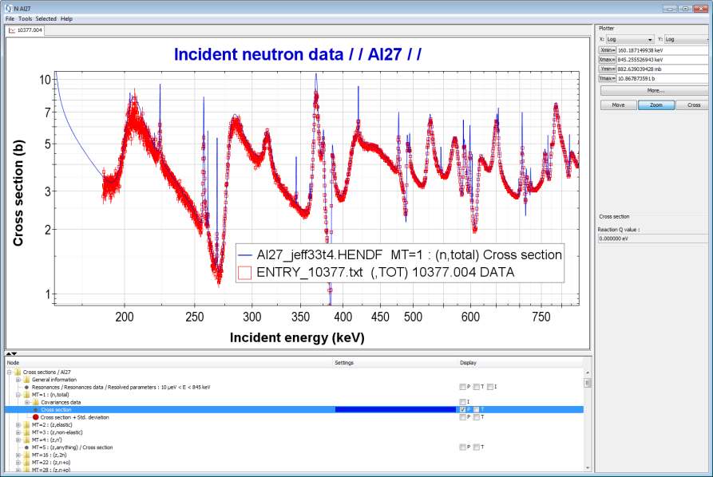
II. JANIS
Exercises
Visualization
  ENDF
  PENDF
  GENDF
  ACE?
  EXFOR
  BOXER-ERRORR
  COVERX
Export
  JNS
  Command line
Create personal databases
  WIZARD tool
EXERCISE 1: Display of your own data (specific formats to be used)
  Using “File > Open...”
Content:
.\EXFOR\......... EXFOR entries in URR energy region
ENTRY 10377 20021206 20030219 20050926 0000
SUBENT 10377001 20021206 20030219 20050926 0000
BIB 11 19
INSTITUTE (1USAORL)
REFERENCE (R,ORNL-4823,197212)
AUTHOR (F.G.Perey,T.A.Love,W.E.Kinney)
TITLE A test of neutron total cross-section evaluations from
0.2 to 20 MeV for C, O, Al, Si, Ca, Fe, and Si02
FACILITY (LINAC) ORELA
INC-SPECT Resolution of about 0.12 nsec/m.
METHOD (TOF) Over path length of 47.35 meters.
Neutron energy determined at center of 2 nsec time
channels not corrected for transit time spread in
detector.
DETECTOR (SCIN) NE-110 plastic scintillator.
ERR-ANALYS (ERR-S) Statistical uncertainty.
STATUS (APRVD) Approved by author
Data received on magnetic tape, Kinney, December 1973.
HISTORY (19740515C)
(19830422A) Converted to REACTION formalism
(20021206A) Converted to new date formats, lower case.
Error heading updated.
ENDBIB 19
NOCOMMON 0 0
ENDSUBENT 22
SUBENT 10377004 20021206 20030219 20050926 0000
BIB 2 2
REACTION (13-AL-27(N,TOT),,SIG)
...
EXFOR entry#10377
https://www-nds.iaea.org/exfor/exfor.htm

Slide 36
II. JANIS
Exercises
Visualization
  ENDF
  PENDF
  GENDF
  ACE?
  EXFOR
  BOXER-ERRORR
  COVERX
Export
  JNS
  Command line
Create personal databases
  WIZARD tool
EXERCISE 1: Display of your own data (specific formats to be used)
  Using “File > Open...”
Content:
.\ERRORR-BOXER\.. Covariances in BOXER and ERRORR format
Input NJOY
errorr
21 0 31 77 /
1325 1 2 1 1 /
1 293.6 / Just only one temperature
0 33 /
238 /
1.000E-05, 1.000E-04, 5.000E-04, 7.500E-04, 1.000E-03,
…
1.455E+07, 1.568E+07, 1.733E+07, 2.000E+07/
covr
77 78 /
3 1
'jeff33t4' /
' in BOXER format ' /
1325 0 0 0 /
Script/batch file to run NJOY
copy ..\ENDF\13-Al-27g.jeff33t4 tape20
..\njoy2012_50.exe < 13-Al-27g.jeff33t4-njoy.inp
copy tape77 Al27_jeff33t4.ERRORR
copy tape78 Al27_jeff33t4.BOXER
del tape20 tape21 tape22 tape23 tape24 tape25
del tape31
del tape61
del tape77 tape78

Slide 37
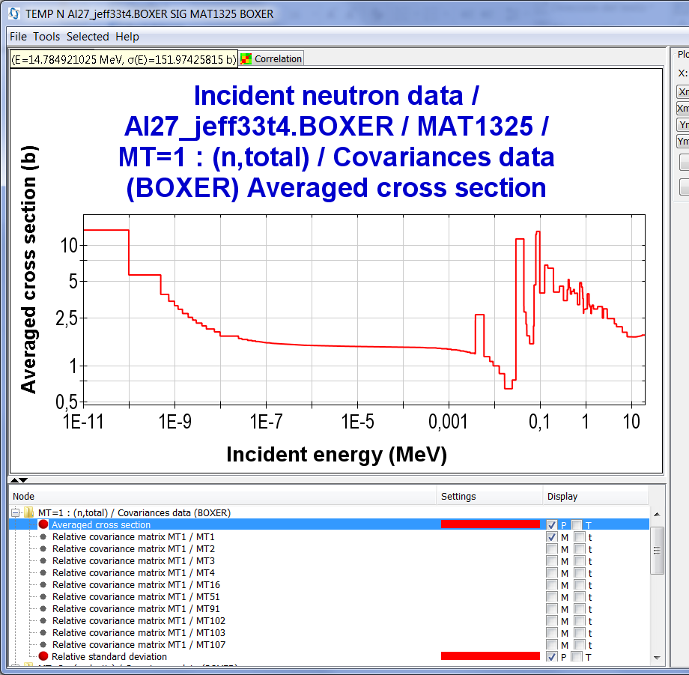
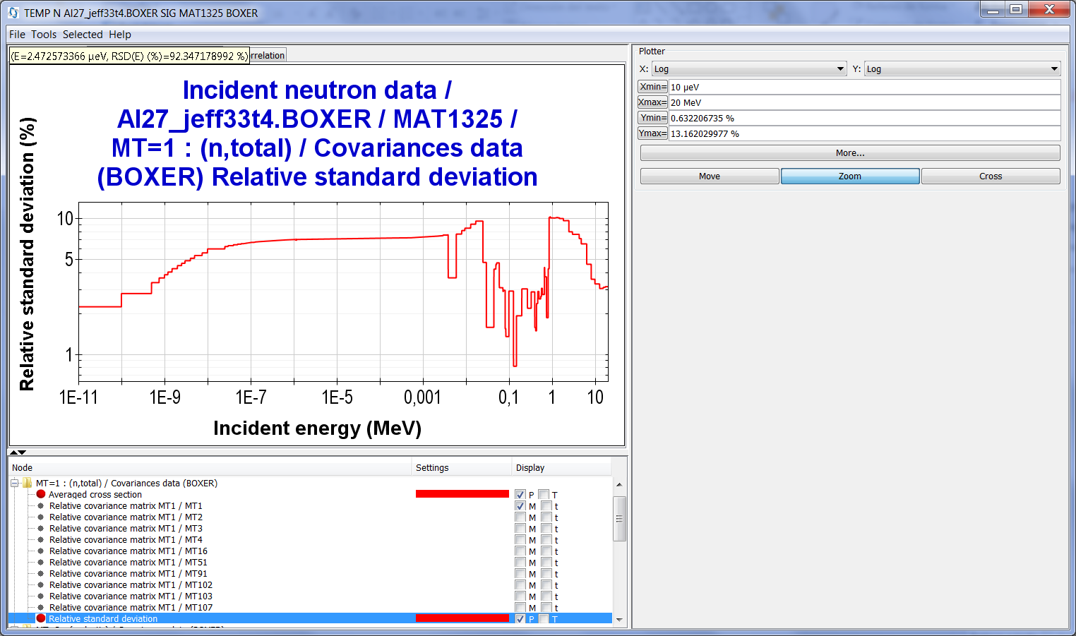
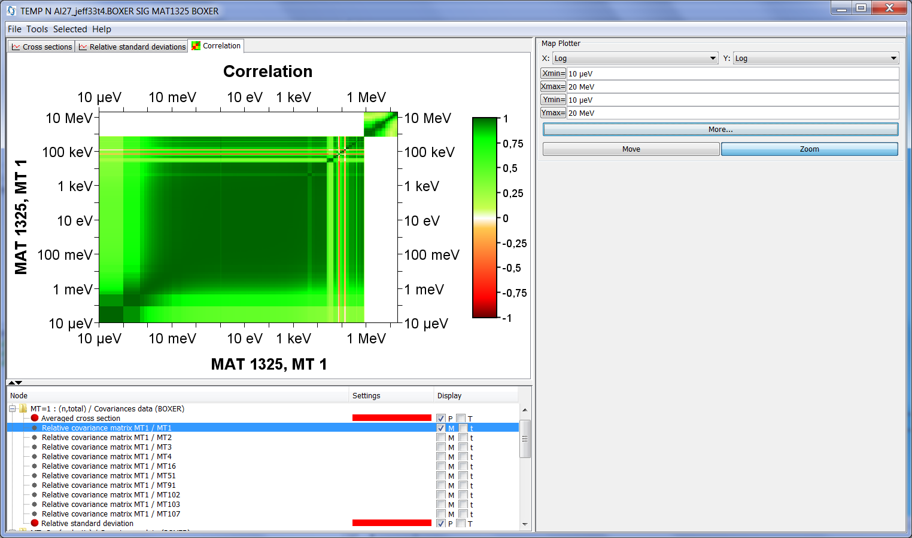
II. JANIS
Exercises
Visualization
  ENDF
  PENDF
  GENDF
  ACE?
  EXFOR
  BOXER-ERRORR
  COVERX
Export
  JNS
  Command line
Create personal databases
  WIZARD tool
Plotting BOXER files

Slide 38
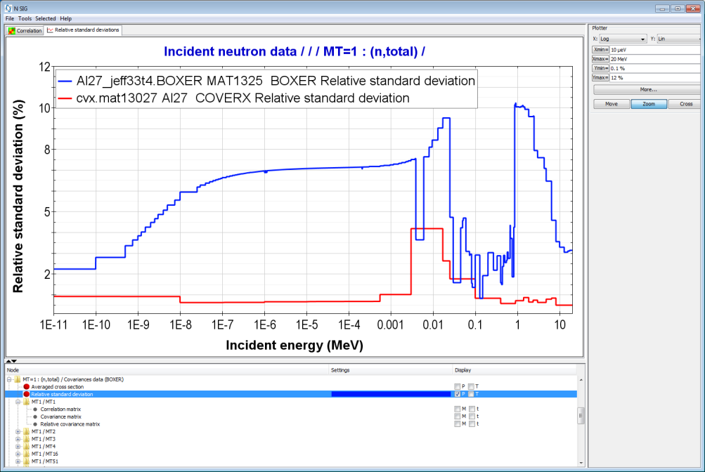
II. JANIS
Exercises
Visualization
  ENDF
  PENDF
  GENDF
  ACE?
  EXFOR
  BOXER-ERRORR
  COVERX
Export
  JNS
  Command line
Create personal databases
  WIZARD tool
EXERCISE 1: Display of your own data (specific formats to be used)
  Using “File > Open...”
Content:
.\COVERX\........ COVERX format (SCALE6)
.\COVERX\CONVERT_SCALE_TO_ENDF\... COVERX to ENDF format(ANGELO/LAMBDA/NJOY codes)
JEFF-33T4 versus SCALE6.2(COVERX)

Slide 39
II. JANIS
Exercises
Visualization
  ENDF
  PENDF
  GENDF
  ACE?
  EXFOR
  BOXER-ERRORR
  COVERX
Export
  JNS
  Command line
Create personal databases
  WIZARD tool
EXERCISE 1: Display of your own data (specific formats to be used)
  Using “File > Open...”
Content:
.\COVERX\........ COVERX format (SCALE6)
.\COVERX\CONVERT_SCALE_TO_ENDF\... COVERX to ENDF format(ANGELO/LAMBDA/NJOY codes)
Script/batch file to covert COVERX into BOXER format
rem = Copy librery in format COVERX (SCALE6)
copy ..\cvx.mat13027 cova.lib
rem = Run ANGELO y LAMBDA
.\Programas\angelo2-dos.exe < angelo2.inp > angelo2.out
.\Programas\lambda2p3.exe < angelo2.inp > lambda.out
copy cova.new tape24
rem = Run NJOY
..\..\njoy2012_50.exe < input.njoy > output.njoy
move tape24 Al027_SCALE.ENDF
del tape25
move tape26 Al027_SCALE.ps
move tape50 Al027_SCALE.BOXER
move output Al027_covr.out
del angelo2.out cova.lib cova.new output.njoy

Slide 40
II. JANIS
Exercises
Visualization
  ENDF
  PENDF
  GENDF
  ACE?
  EXFOR
  BOXER-ERRORR
  COVERX
Export
  JNS
  Command line
Create personal databases
  WIZARD tool
EXERCISE 1: Display of your own data (specific formats to be used)
  Using “File > Save...”
Content:
.\JNS\.......... Example JNS file
Al_27_XS_tot.jns
<data refs="~N~ENDF/B-VII.1~SIG~Al27~MT1~xs">
<layer>
<color>#ff0000</color>
<stroke>1.0|2|0|10.0|null|0.0</stroke>
</layer>
</data>
<data refs="~N~JEFF-3.2~SIG~Al27~MT1~xs">
<layer>
<color>#00ff00</color>
<stroke>1.0|2|0|10.0|null|0.0</stroke>
</layer>
</data>
<data refs="~N~JENDL-4.0~SIG~Al27~MT1~xs">
<layer>
<color>#0000ff</color>
<stroke>1.0|2|0|10.0|null|0.0</stroke>
</layer>
</data>
...
JANIS identifiers

Slide 41
II. JANIS
Exercises
Visualization
  ENDF
  PENDF
  GENDF
  ACE?
  EXFOR
  BOXER-ERRORR
  COVERX
Export
  JNS
  Command line
Create personal databases
  WIZARD tool
EXERCISE 2: Create a new database
2.1 FILE (HENDF – Hybrid ENDF files)
  PENDF+MF2 (resonances)
  BOXER
  INTER
Flowchart of processing JANIS database from ENDF tapes

Slide 42
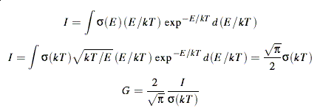
II. JANIS
Exercises
Visualization
  ENDF
  PENDF
  GENDF
  ACE?
  EXFOR
  BOXER-ERRORR
  COVERX
Export
  JNS
  Command line
Create personal databases
  WIZARD tool
INTER
INTER is a program for calculating thermal cross sections, g-factors, resonance integrals, fission spectrum averaged cross sections and 14.0 MeV (or other energy) cross sections for major reactions. To operate properly, the cross sections must be given pointwise in File 3 and have been linearized.
Definition: g-factor
The conventional thermal energy is 0.0253 eV. If the cross section has a 1/v shape, its integral weighted against a Maxwellian spectrum for 0.0253 eV is given by
where the factor-G provides a measure of the deviation from a 1/v shape. It will be unity for a pure 1/v.
Content: .\INTER\
.\Al27_jeff33t4.PENDF ... PENDF libraries
.\inter.exe ... Executable
.\run.bat ... Procedure to run in Windows

Slide 43
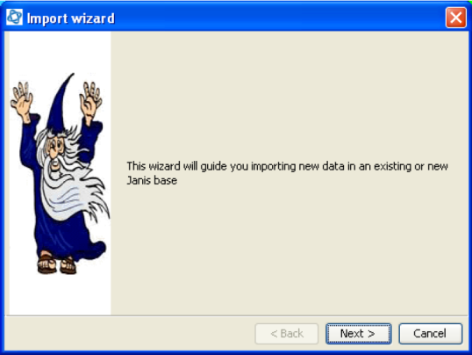
II. JANIS
Exercises
Visualization
  ENDF
  PENDF
  GENDF
  ACE?
  EXFOR
  BOXER-ERRORR
  COVERX
Export
  JNS
  Command line
Create personal databases
  WIZARD tool
EXERCISE 2: Create a new database
2.2 Import WIZARD tool
  Use the “Database > Import Wizard” to create a permanent database
Following steps:
New folder shall be created with three sub-folders, one per type of file (i.e. hendf, boxer and inter). Then, the files generated shall be copied to their corresponding sub-folders. IMPORTANT! Delete those empty files
Open JANIS, and at the toolbar click on “database -> import wizard“
Add HENDF files. For that use either “Add directory" or “add files" options. Then, click on “next“
“Automatic detection” should work fine. Click on “next"
Choose a library name, e.g. JEFF-3.3T4, (less than 20 characters). Click on “next“
Select “a new base“ when importing HENDF, that means for the first import. For BOXER and INTER files, “an existing base" shall be selected, and then, selecting the created database for HENDF files
Choose “path to the folder” where the database will be created. Click on “next"

Slide 44
II. JANIS
Exercises
Visualization
  ENDF
  PENDF
  GENDF
  ACE?
  EXFOR
  BOXER-ERRORR
  COVERX
Export
  JNS
  Command line
Create personal databases
  WIZARD tool
EXERCISE 2: Create a new database
Following steps:
….
The “base root" shall point to the folder created with the three sub-folders (one for each kind of file type). Click on “next"
Type a “database" name, e.g. TRIESTE, for showing later in JANIS. Click on “next"
A summary of the task to do, plus input parameters, is presented before importing data from files. Click on “Finish"
Once imported HENDF files, for BOXER and INTER files repeat these instructions until step (5), where to change to “existing base" option
Errors might arise if empty files are read, so remove them from the importing list
Check that once the BOXER files have been imported into the database, a “Others" tag does not appear in the “Nuclide / Compound tree". If this tag exists, then, there is an issue in regard to cross-correlation covariance data, likely to be missing data for one of the two isotopes present in the cross-correlation matrix
At the end of this process, a “db.h2.db” le is created, plus the importing logs

Slide 45
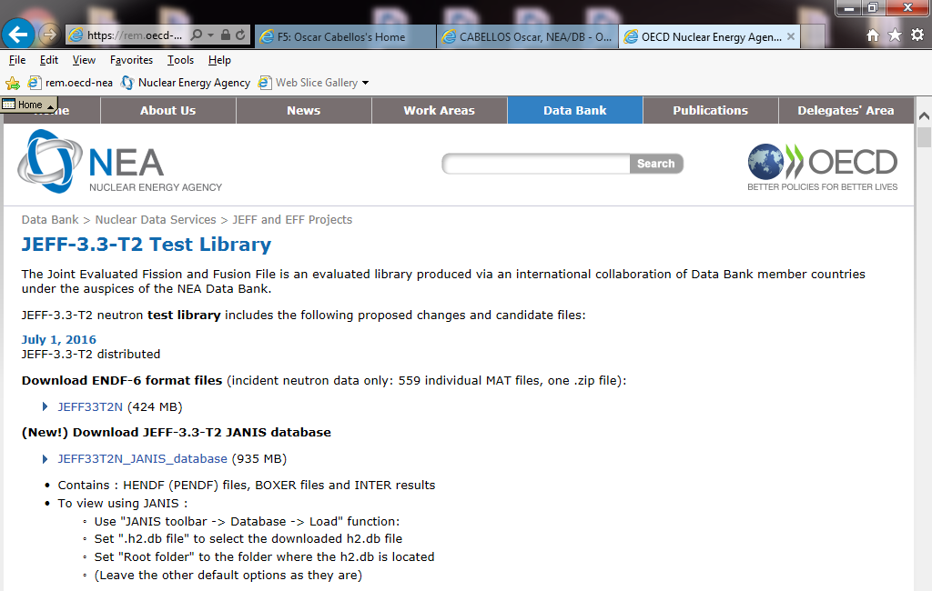
II. JANIS
Exercises
Visualization
  ENDF
  PENDF
  GENDF
  ACE?
  EXFOR
  BOXER-ERRORR
  COVERX
Export
  JNS
  Command line
Create personal databases
  WIZARD tool
EXERCISE 3: Open a local database
.\DBDATA-JANIS-Al27-JEFF33T4\
2.3 Download JANIS database
  Use the “Database > Load” to open a personal database
http://www.oecd-nea.org/dbdata/jeff-beta/JEFF33T2/neutrons/

Slide 46
THE END

