Slide 1
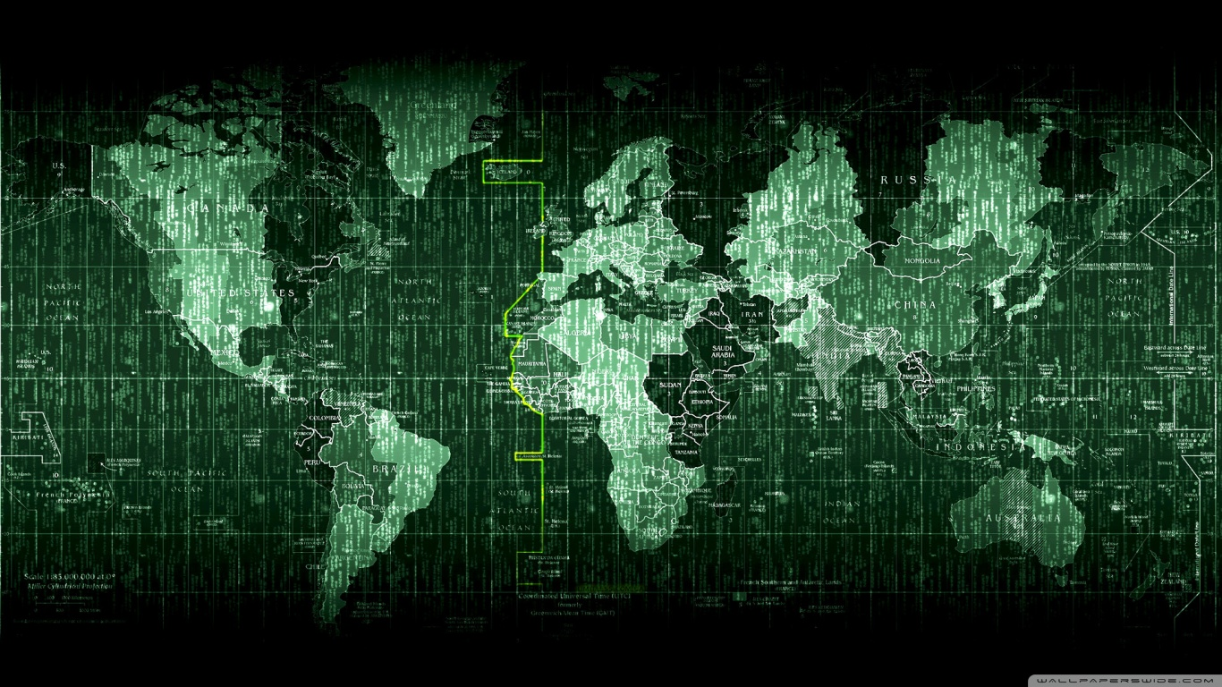

THE EARTH’S MATRIX
(A POLICYMAKERS’ DREAMWORLD…)

Slide 2
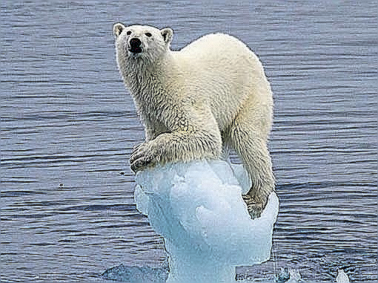
THE BUTTERFLY EFFECT
Poincaré, Turing,

Slide 3
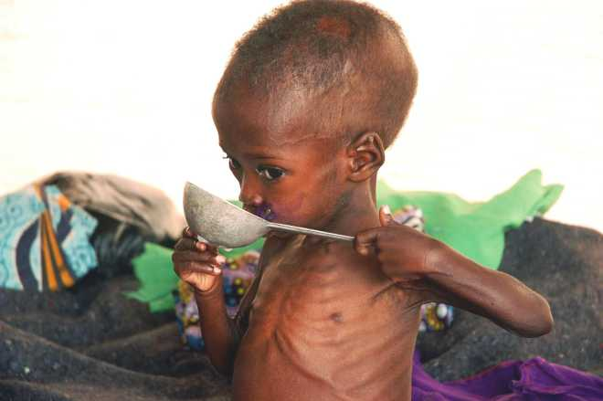
The same butterfly…

Slide 4
Planet Earth: a global and closed (forced) balance
A struggle between
CHAOS
and
BALANCE

Slide 5

BALANCE…
Who cares?

Slide 6
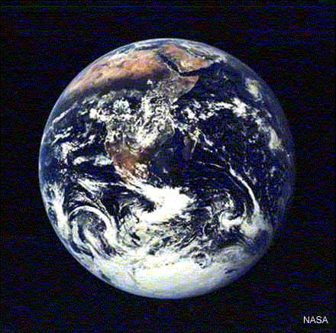
NO BOUNDARIES
Geographic globality

Slide 7
SYSTEMIC GLOBALITY
No isolated sector
Environment
Peace H. Rights
Development

Slide 8
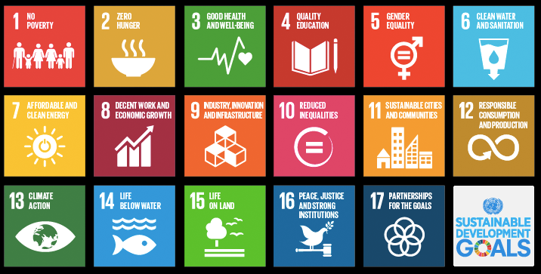
A coherent balance with no trade offs?
(coherent feedback loops)

Slide 9
THE MATRIX IN MOTION
Scenario 1
If we do not protect the environment

Slide 10
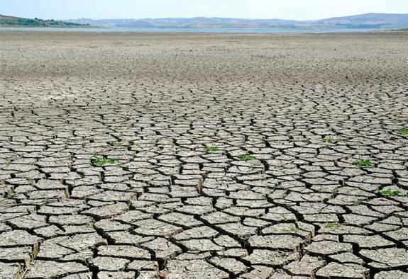
ECOSYSTEM – ECOSYSTEM RESONANCE
Just an example…
CLIMATE CHANGE

Slide 11
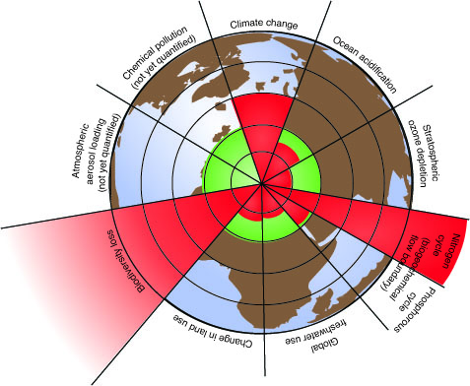
Ecosystem-Ecosystem positive feedback loops and resonance

Slide 12
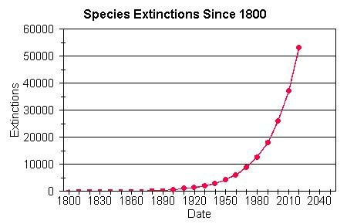

Slide 13
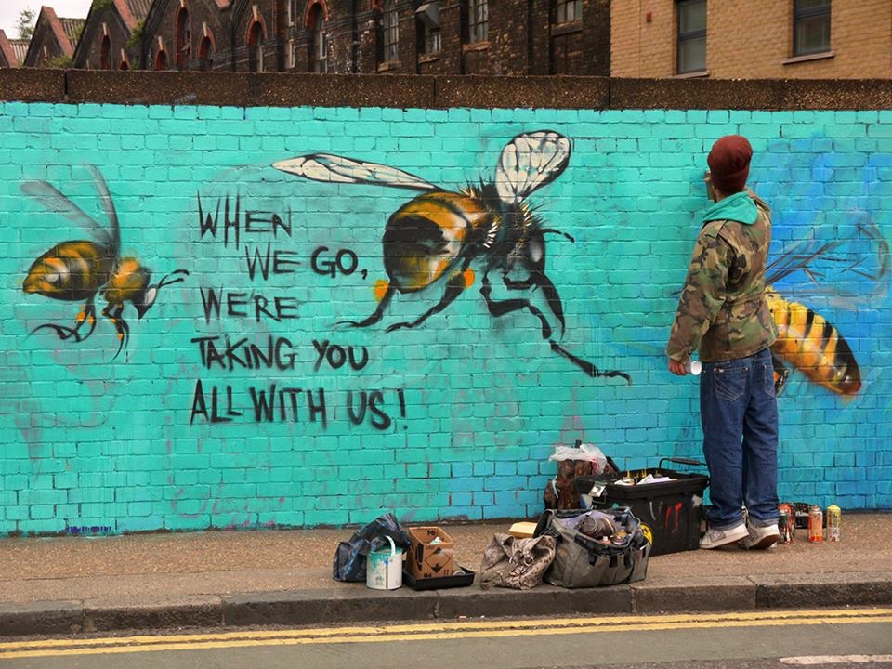
Not only a loss of «presence»… (conservationism), a loss of function

Slide 14

Ecosystemic trans-sector tipping points

Slide 15
Not so scary figures…
Daily overintake of non dissipated solar energy equals…

Slide 16
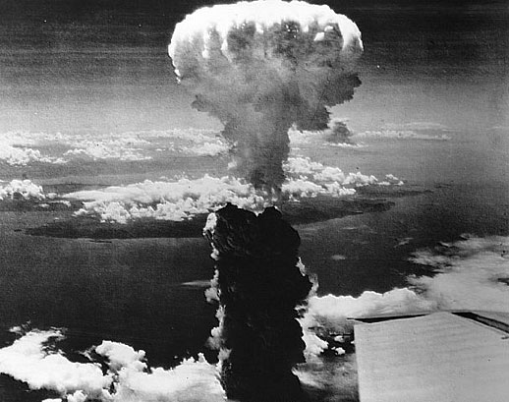
400.000 HIROSHIMA BOMBS PER DAY…
Calculated by J. HANSEN in 2012 = 0,60 watt per sq meter

Slide 17
ECOSYSTEM – ECOSYSTEM RESONANCE
Present Average Increase in Temperature
0,78°C - 0,85°C – 1° C = 408 ppm
Conventional Catastrophy Treshold
2° C = +/- 550 ppm
Worst Case Scenario
5,8° C

Slide 18
Ecosystem – Ecosystem Geometric Positive Feedback Loops
Permafrost
Clathrates
Albedo
Albedo > Heat > Lightening > burning boreal forest > particulate > albedo
Albedo – waves – albedo
Heat – Desertification - Heat

Slide 19
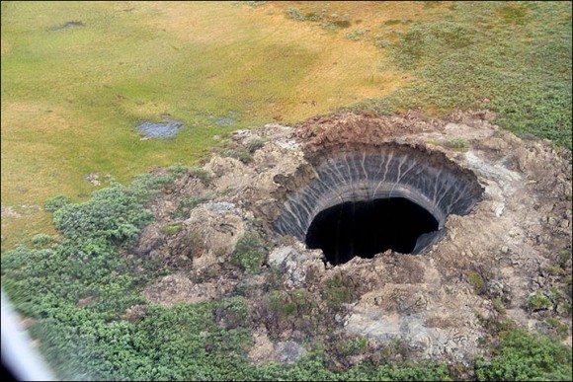

Slide 20
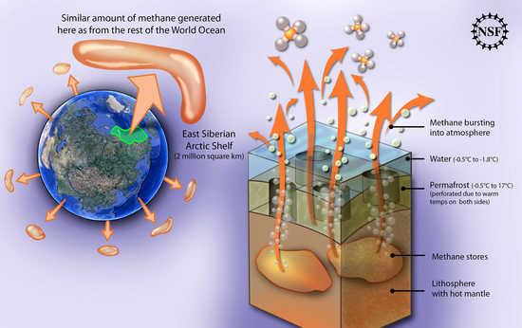

Slide 21
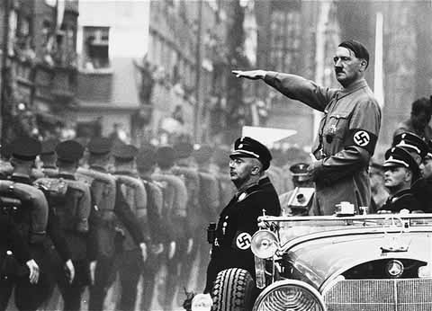
Ecosystem – Mankind Resonance
Lessons learnt from a century of horrors
And the true nature of peace…

Slide 22
Le lezioni di un secolo di orrori
E la vera natura della pace…

Slide 23
Non linear Impacts
Impacts
Temperature Increase

Slide 24
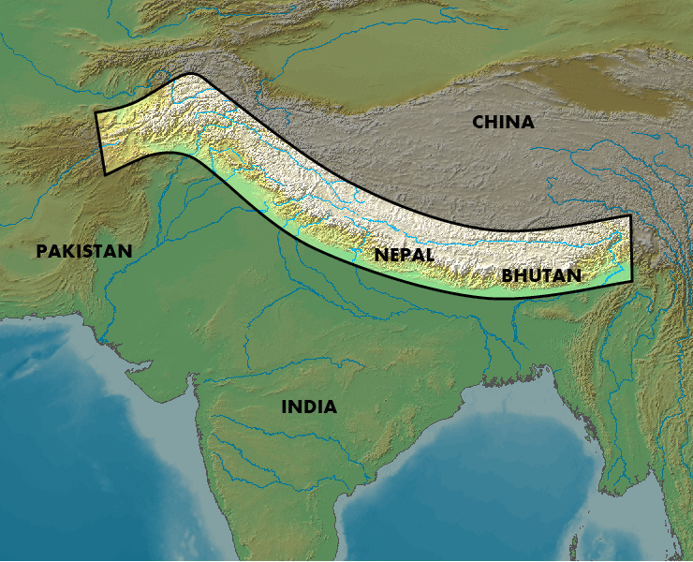
THE HIMALAYA SCENARIO
Millions on the move…

Slide 25
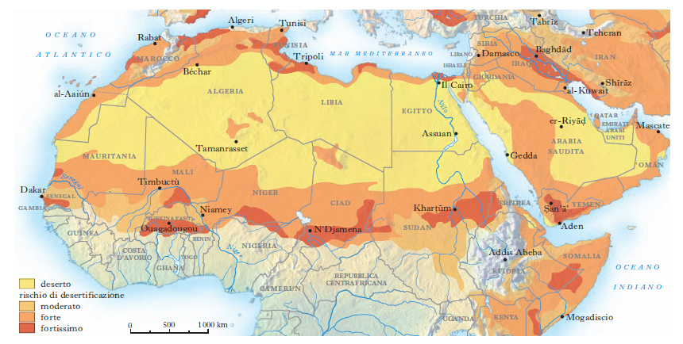

Slide 26
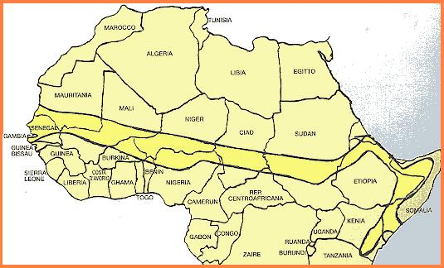
Sahel: the Active Zone

Slide 27
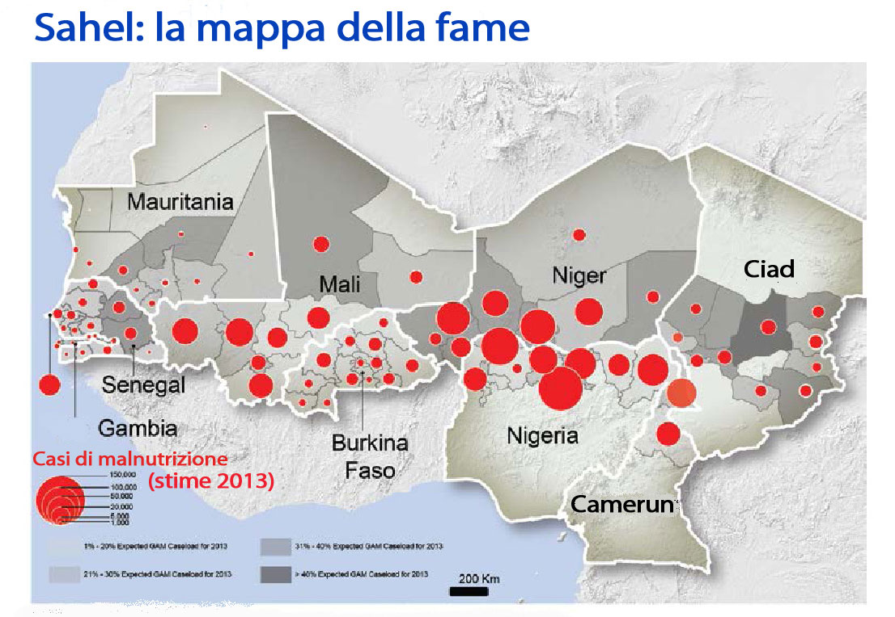
SAHEL: A MAP OF HUNGER AND CONFLICTS

Slide 28
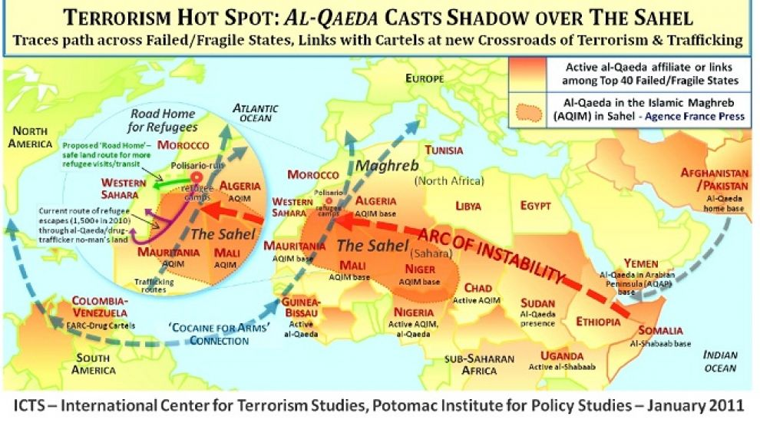

Slide 29
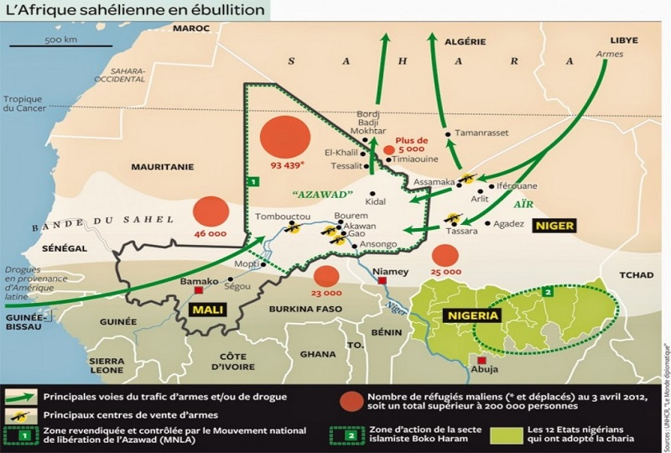

Slide 30
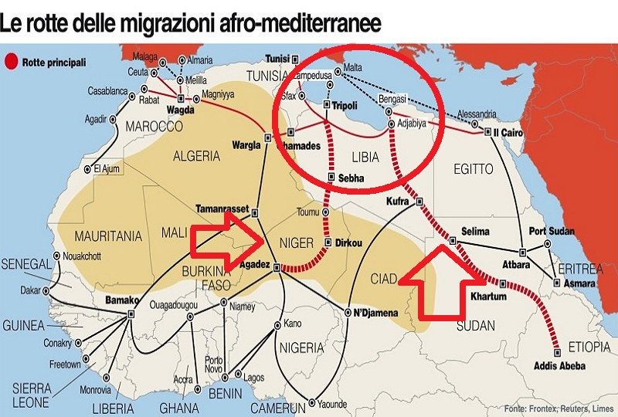
MIGRATIONS

Slide 31
1. THE ENVIRONMENT – STABILITY NEXUS
ENVIRONMENTAL MODIFICATIONS CAUSE THE CONTRACTION, LOSS OR DISPLACEMENT OF ECOSYSTEM SERVICES:
Productivity, but also purification, bio-sanitary, local climate regulation services, and others, that extend to include empowerment and cultural identity services

Slide 32
THE WORST FEEDBACK LOOP:
NATURE – MANKIND - NATURE
environmental stress
social cohesion collapse and conflict
loss of mitigation and adaptation capability
more environmental stress

Slide 33
The Fragility Nexus…
Environmental stress strikes developing regions more, where the social collapse threshold is lower
It is like putting the flame where the bomb has its fuse
HOTSPOTS OF GLOBAL INSTABILITY
(US concept of “conflict accelerator”)

Slide 34
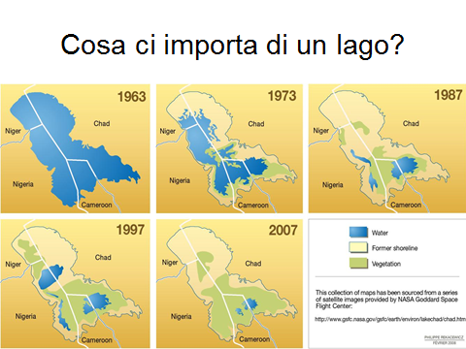
JUST A LAKE… SHOULD WE CARE?

Slide 35

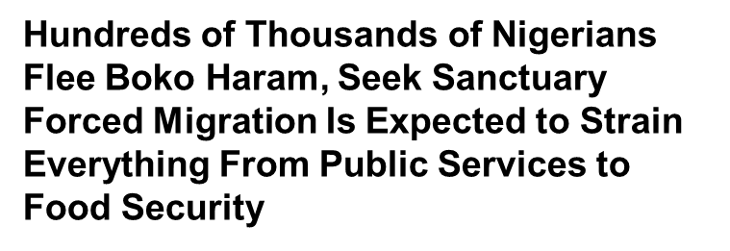
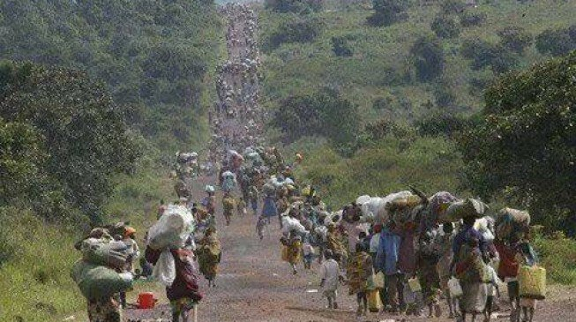
12


Slide 36
THE MATRIX IN MOTION
Scenario 2
If we do protect the environment

Slide 37
The Nutrition Pyramid
WHAT’S GOOD FOR YOU IS GOOD FOR YOUR PLANET

Slide 38
PLANET EARTH’S EQUATION environment = justice = development = peace

Slide 39
ENERGIES AND SYNERGIES: WHY COOPERATE FOR LAND RECOVERY
The perception of the environmental challenge is focused on replacing fossil fuels, an indeed essential line of intervention both in rich and poorer areas
(food – water - energy nexus, access to off-grid supply by renewables, etc.)
But…

Slide 40
The Value of Our Lands
The costs of recovering one acre of degraded land are variable, ranging from 80U$ in semi-degraded fertile areas to 22.000U$ for complex coastal biomes
In most of the lands where the degradation-insecurity nexus is emerging, the cost is around 200 U$
There, recovery of each acre turns it into a very effective “carbon well”

Slide 41
And an incredible investments multiplier…
The recovery of land ecosystems – especially if they are given to trained small scale family farmers- leads to:
create effective carbon absorption mechanisms,
local mitigation
Hydric balance protection
protect biodiversity,
restore productivity,
an agricoltural surplus that enables manufacturing activities,
local family and gender empowerment,
a stronger civil cohesion and lessened migratory impulse ,
lifestyles and dignity dimensions that delegitimate fanatisms
valorize traditional know how, modernize it, strenghtening local identity

Slide 42
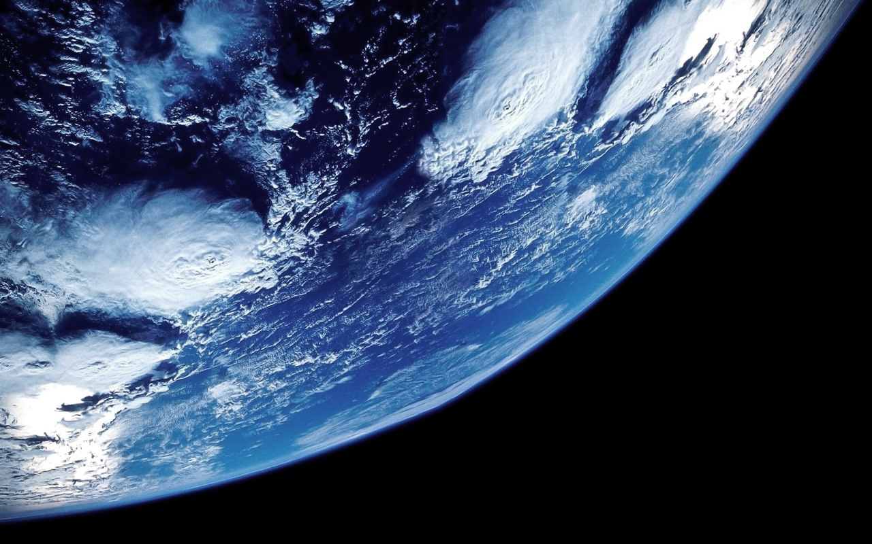
THE MATRIX… In a policymakers’ dreamworld
In search of a planetary «theory of all», with quantitative instruments, it would not be surprising if the ultimate solution lies with a simple and elegant subjacent equation.
ENVIRONMENT = JUSTICE ?

