Slide 1
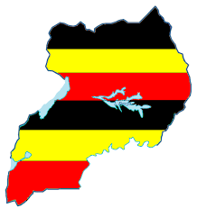
CLEWS Summer School: Uganda Country introductory presentation
ICTP – Trieste
12 - 30 June 2017
Anthelem Iragena (MWE), Pamela Agaba (MWE), Allen Tebugulwa (NPA), Francis Wasswa (MAK)

Slide 2
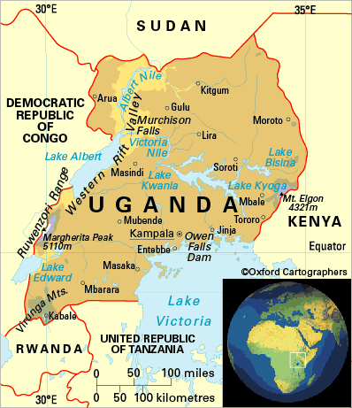
Country Uganda
Basic information
Latitude:4º12’N & 1º29’S
Longitude: 29º34’E & 35º0’W
Altitude (asl): 620 - 5,111 meters
Total surface area: 241,550.7 km²
Area under land: 200,523.2 km²
Area under water and swamps: 41,027 km²

Slide 3
Country Uganda
Basic information
Population: 36.6Miillion (Mid year 2016 projection), ave. annual growth rate of 3.0%.
Poverty: how widespread poverty is, how poor the poor are and, how severe poverty is:
Proportion of the poor population reduced from 24.5% in 2009/10 to 19.7% in 2012/13… That is: about 6.7Million Ugandans living in poverty in 2012/2013.
18 percent of the population in Uganda was chronically poor
Income Inequality: Distribution of income across individuals:
Overall, income inequality as measured by the Gini coefficient reduced from 0.426 to 0.395 in the period 2009/10 - 2012/13
Socio-economic performance: GPD growth rate = 5.4%

Slide 4
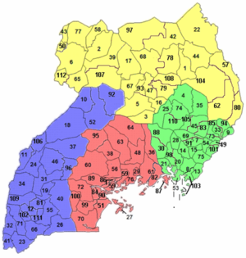
Country Uganda
Four Regions (Western, Eastern, Northern, Central)
112 districts, 193 Counties, 290 Constituencies, 1,395 Sub-Counties, 7,505 Parishes and 57,759 LC1s.
a relatively humid equatorial climate zone.
Rainfall 2015: 1000 -1639 mm/year:
Topography, prevailing winds, and water bodies cause large differences in rainfall patterns
Two distinct seasons in the south (March-May and September-November), and in one season in the north (April-October)
Temperature 2015: 16-31ºC
Overview - CLIMATE

Slide 5
Country Uganda
Overview - LAND
Land area is 200,523.2 square kilometers (83.0 percent of Uganda’s total area).
Agricultural land : 91,151.8 sq. km in 2010.
Area planted for Food crops stood at 926,362Ha in 2015.
2.6 million hectares of forest land
Built up land area increased by more than 10-Fold between 2005 and 2010.

Slide 6
Country Uganda
NDP II
Increase % of the population with access to electricity from 14% to 30%
Increase power generation capacity from 825MW in 2012 to 2,500MW by 2020
Promote energy efficiency to reduce technical power losses
Promote and facilitate the use of renewable energy technologies
Overview - ENERGY
The total installed capacity of electricity power plants increased by 1.2% from 885 MW in 2014 to 895.5MW in 2015.
Hydro: 695MW
Thermal: 136MW
Bagasse: 64.5MW
Units Energy purchases by UETC: 3,335 GWh in 2015.
667,483 UMEME customers in 2015.
Ave. weighted domestic tariff: 538.0Ug.Shs/kwh in 2015
Ave. weighted commercial tariff: 484.2Ug.Shs/kwh in 2015

Slide 7
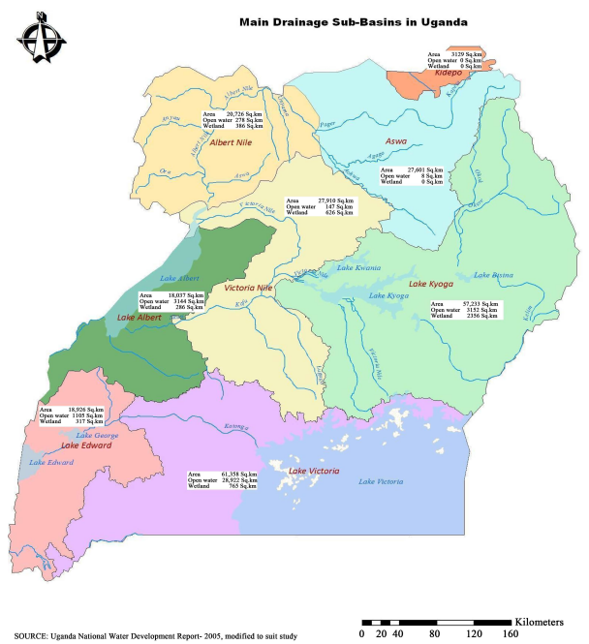
Country Uganda
Overview - WATER
Open Water bodies cover 36,527.4 square kilometers (15.3% of Uganda’s total area).
Wetlands cover 4,500 square kilometers (1.9% of Uganda’s total area).
Ave. access to safe water: yr 2015
67% in rural
71% in urban
access to sanitation:
84.6% Urban areas
79% Rural areas
NDPII
Increase access to safe water supply in rural areas from to 79% and urban areas to100% by 2019/20
Increase access to improved sanitation in rural and urban areas

Slide 8
Country Uganda
Overview - Main objectives of relevant sectoral policies and challenges posed by interlinkages challenges
Governance mechanism and tools:
National Planning Authority (NPA) responsible for the coordinating of national and decentralized development planning in Uganda. The
National Vision 2040.
Three 10-year Development Plans.
5-year Development Plans.
Sector Master Plans and Strategies
Challenges and opportunities:
Multi-stakeholder process are very slow.

Slide 9
Country Uganda
Overview - Main objectives of relevant sectoral policies and challenges posed by interlinkages challenges
Integration of SDGs into DPs:
Uganda was one of the first countries to develop its 2015/16–2019/20 national development plan in line with the SDGs.
The current planning cycle was able to incorporate the current SDG list.
76% of the SDGs targets are reflected in the plan and adapted to the national context.
SDGs integrated into sub-national development plans, in line with the national plan.
Uganda Parliamentary Forum on Sustainable Development Goals
To ensure that National Policies and legislation on SDGs are implemented
To advocate for adequate for National Resource allocation for SDGs
To monitor for the appropriate utilization of resources allocated for SDGs interventions
To ensure that the Central, Local authorities and communities work towards achieving SDGs

Slide 10
Country Uganda
Overview - Information of modelling to inform policies in countries; in capacity development projects
Modelling tools to support
evidence-based policy
decision making for
sustainable development - UN-DESA
Key conclusions from modelling exercise in Uganda:
Social service provision not always the best policy to accelerate MDG achievement
Larger improvements in the MDGs are more strongly associate with public investment in physical infrastructure (e.g. rural feeder roads).
Public infrastructure investment is an important driver of household income growth, with knock-on implications for the other MDGs.
Investment in physical infrastructure is at the core of the Government’s strategy to deliver its Vision 2040
Capacities used to inform;
the NDP-2 in Uganda,
the Poverty Status Report 2014
the MDG Report for Uganda 2013

Slide 11
ENd
aig732@gmail.com

