Slide 1
Introduction to energy sector representation in the template CLEW model

Slide 2
Template model energy system
Standardized model structure
Customizable to country data
Structure customizable for country projects
Focus on power sector
More technology detail
Simplified demand representation
Fuel projections based on selected drivers
Simplified primary energy supply representation
Single source representation

Slide 3
Energy sector model structure
Primary Energy Supply
Energy Transformation
Final energy demand
Agricultural sector
Fuel demand
Domestic extraction
Fossil fuels
Electricity
Power sector
Commercial sector
Fuel demand
Renewable resources
Renewable fuels
Refined products
Industrial sector
Fuel demand
Oil
Refinery
Fuels
Residential sector
Fuel demand
Energy
imports
Biofuel production
Renewable fuels
Transport sector
Fuel demand
Energy exports
Fuels

Slide 4
List of sectors, commodities and abbreviations
Sector name | Sector abbreviation | Commodity name | Commodity abbreviation | Commodity name | Commodity abbreviation
Agriculture | AGR | Biomass | BIO | Kerosene | KER
Commerce | COM | Charcoal | CHC | Liquid petroleum gas | LPG
Industry | IND | Coal | COA | Natural gas | NGS
Power | PWR | Crude oil | CRU | Other hydro carbons | OHC
Residential | RES | Diesel | DSL | Petroleum coke | PCK
Transformation | UPS | Geothermal | GEO | Solar energy | SOL
Transport | TRA | Gasoline | GSL | Uranium | URN
 |  | Heat | HET | Waste | WAS
 |  | Fuel Oil | HFO | Wind energy | WND
 |  | Hydro | HYD
Notable exception: Electricity before transmission (ELC001) and after transmission (ELC002)

Slide 5
Naming conventions
Commodity naming convention in Osemosys model:
At “wholesale” level 3 letter code as per table on previous slide
At sector level: 3 letter sector abbreviation + 3 letter commodity abbreviation
Examples:
Diesel (DSL) used in agriculture (AGR) = AGR+DSL=“AGRDSL”
Natural gas (NGS) used in industry (IND) = IND+NGS=“INDNGS”
Coal (COA) used in industry (IND) = IND+COA=“INDCOA”
Gasoline (GSL) used in transportation (TRA) = TRA+ GSL=“TRAGSL”
Wind energy (WND) used in power generation (PWR) = PWR+ WND=“PWRWND”

Slide 6
Demand side
No technology representation on demand side
Projected fuel demand in 5 economic sectors
Agriculture (AGR), Commerce (COM), Industry (IND), Residential (RES), Transport (TRA)
Endogenous demand for some fuels
Excel energy demand template available for data management, simple projections
Includes MoManI import tables.

Slide 7
Power sector
11 technology fuel groups (e.g. coal, hydro, natural gas, wind)
2-6 technologies per group
Naming:
“PWR” + 3 letter fuel abbreviation + 3 digit Number
E.g. Wind power plant #3: PWRWND003
Hydro power plant #6: PWRHYD006
Diesel power plant #1: PWRDSL001
Power sector excel template available for data entry and management
Includes MoManI import tables.

Slide 8
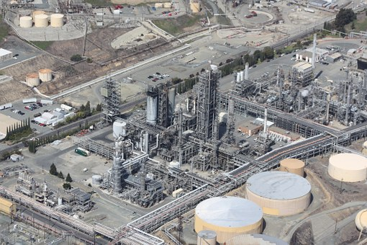
Transformation sector
Oil refinery
Converts crude oil to refined products
Technology: UPSCRU001
Charcoal production
Converts biomass to charcoal
Technology: UPSBIO001
Biofuel production
Converts a crop (from the land-use model component) to biofuels
Technology: UPSBIO002

Slide 9
Additional notes on technologies and naming
Distribution technologies for sectoral demand
Allows for accounting of sectoral demand, sector specific distribution costs and energy requirements for distribution
Naming convention: “DEM” + 3 letter sector abbreviation + 3 commodity abbreviation
Example: Natural gas distributed to the commercial sector: DEMCOMNGS
Mining/Extraction technologies
Naming: “MIN” + 3 commodity abbreviation, e.g. MINCOA (Coal mining)
Renewable resource technologies
Naming: “RNW” + 3 commodity abbreviation, e.g. RNWSOL (Solar energy resource)
Import technologies
Naming: “IMP” + 3 commodity abbreviation, e.g. IMPCRU (Crude oil imports)
Export technologies
Naming: “EXP” + 3 commodity abbreviation, e.g. EXPNGS (Natural gas exports)

