Slide 2
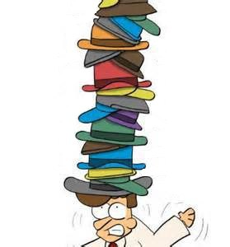
Balancing Multiple Roles as a Scientist
Data producer
Data user and/or collaborator
Author
Employee
Teacher/mentor
Recipient of public funds
Recipient of public trust
Citizen/legally-obligated individual
Notes:
What we can see from the answers is that scientists wear many hats – these all come with different responsibilities

Slide 3
Creating, Managing and Disseminating Data
Beneficence
Non-maleficence (FFP, harm)
Accountability
Transparency
Justice
Collegiality
Open, sustainable, reusable, responsible

Slide 4
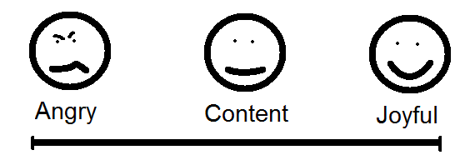
Exercise
Think of how you and your colleagues create, manage and share research data. What makes you happy, and what makes you angry? Write one thought down on each post-it. Pink for angry and green for happy.

Slide 6
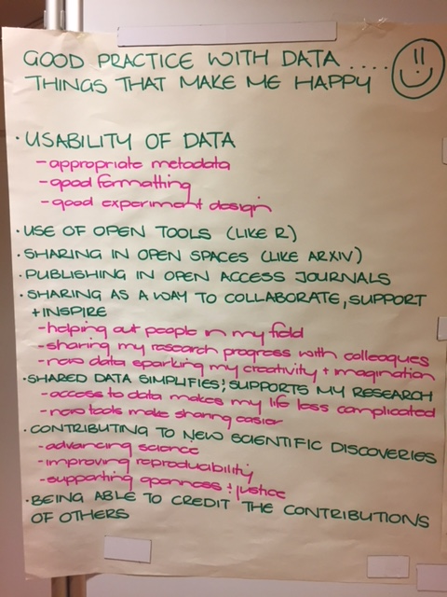
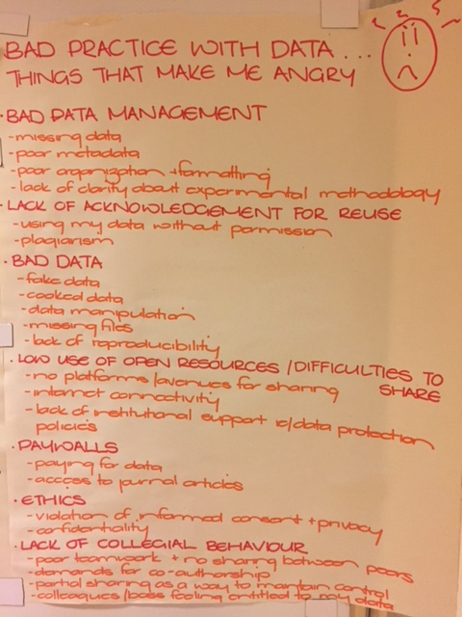

Slide 7
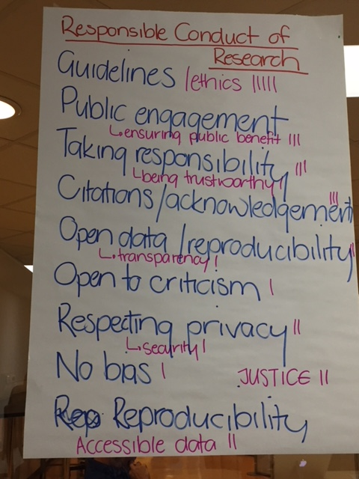

Slide 8
Discussion
How do you think the tools you have learnt contribute to open, responsible research?
Do you anticipate any problems implementing these tools in your daily work?
Infrastructure problems?
Getting colleagues to use these formats?
Security, privacy and other concerns?
How would you encourage other people to transform their data reporting practices?
Notes:
Plain text, portable, transparent,

Slide 10
Some Useful Resources to Consider

Slide 11
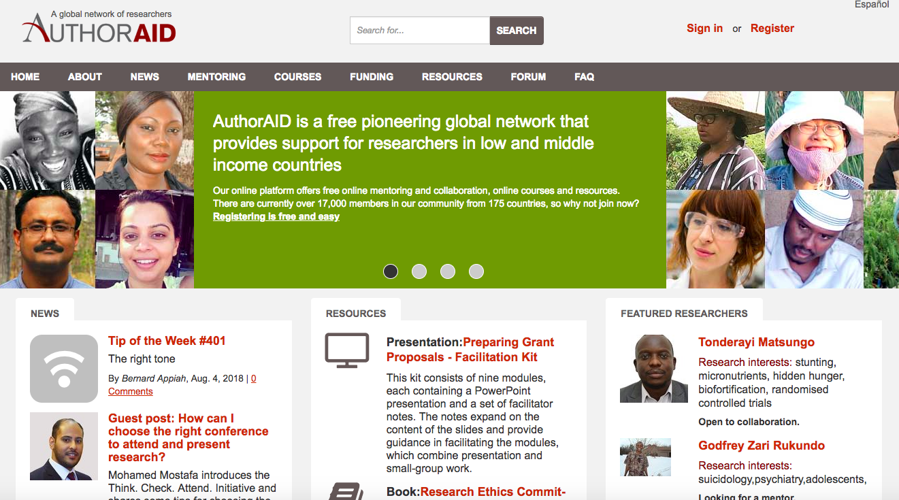

Slide 12
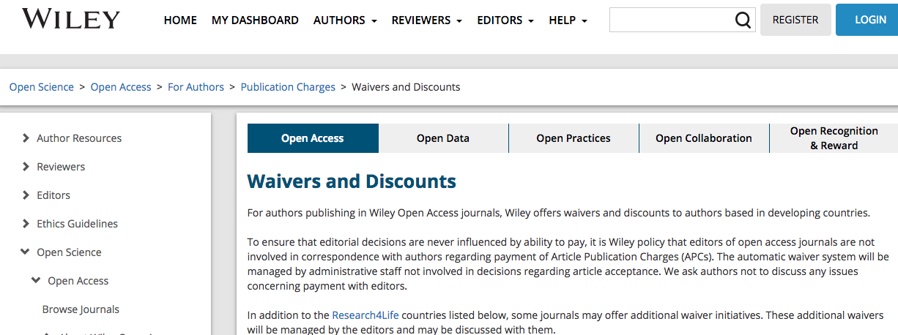
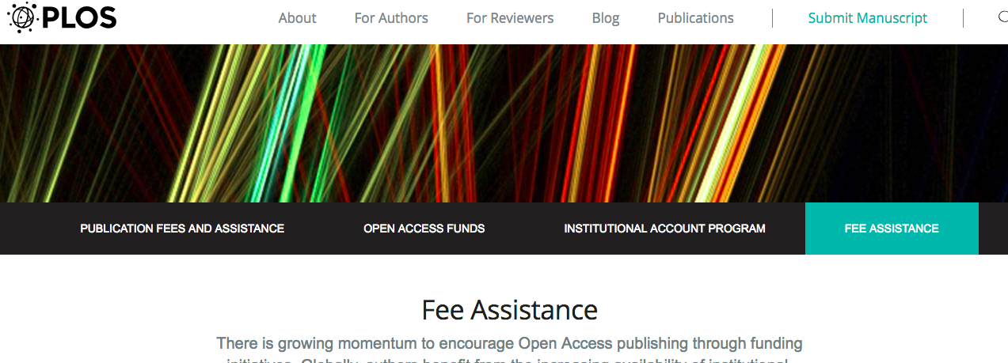
APC waivers

Slide 13
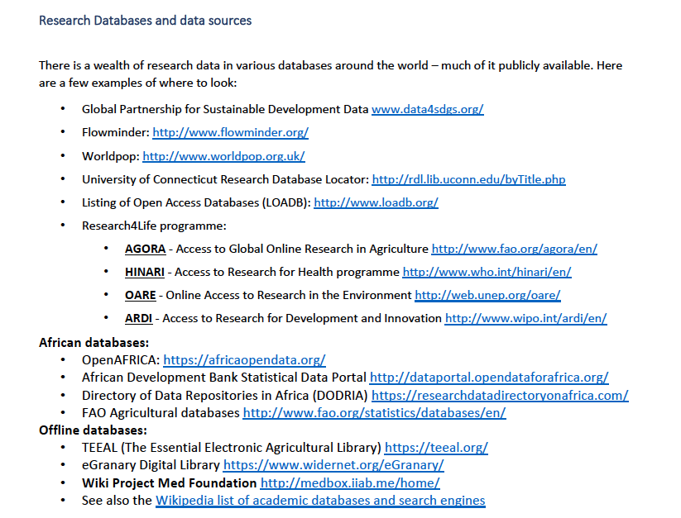
Access to resources
Thanks to Andy Nobes, INASP

Slide 14
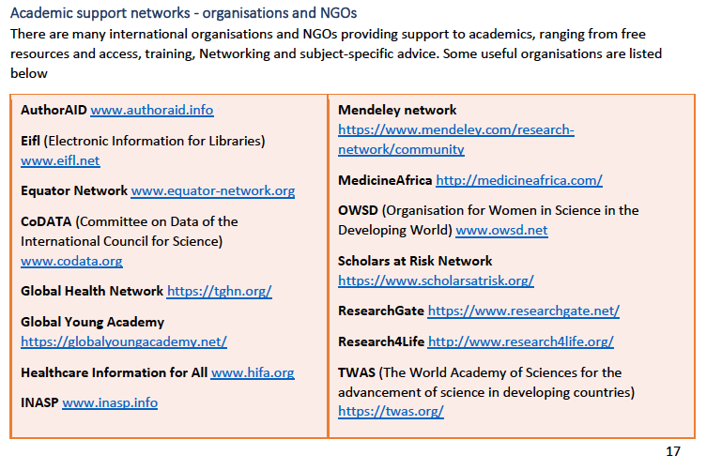
Support Networks
Thanks to Andy Nobes, INASP

Slide 15
Support networks
Thanks to Andy Nobes, INASP

Slide 17
What Have We Learned This Week?
What it means to be a responsible and open science citizen
The tools to be able to start engaging with data (CLI, R)
The tools to start engaging with the data community (RDM, DMP, reproducible reporting)

Slide 18
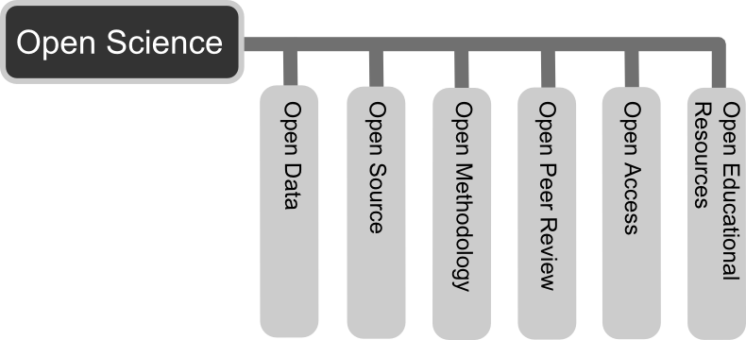
Tools for Responsible, Open Science Citizenship

Slide 19
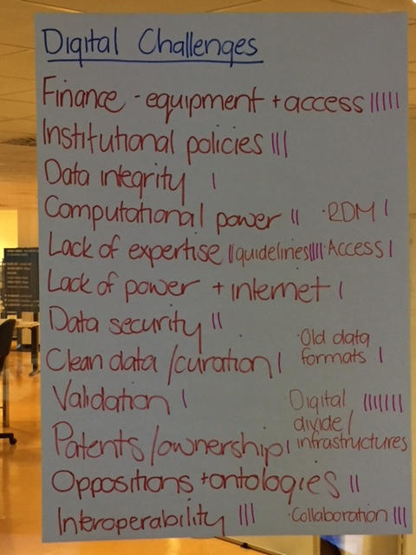
Implementing Tools at Home
Institutional cultures
Promotion criteria
Incentivization schemes
Cultural specificities
Institutional support
Facilities
Traditions
IP etc
Resources
Time
Money
Infrastructure
Career pressures
Time
Being scooped

Slide 20
Experiencing challenges is normal
What specific challenges do you anticipate encountering when you return home in terms of your data work and your quest to be open and responsible?
Can we think of ways in which you can address some of these issues? Did any of the tools we learned this week provide potential solutions?

Slide 21
Individual Activities … Global Impact
Being a responsible and open science citizen involves more than just making sure that your data practices are ethical
Being part of the data community comes with responsibilities to the community, public and future
Not just about responsible and critical use of data, also about scrutinizing evolving systems

Slide 22
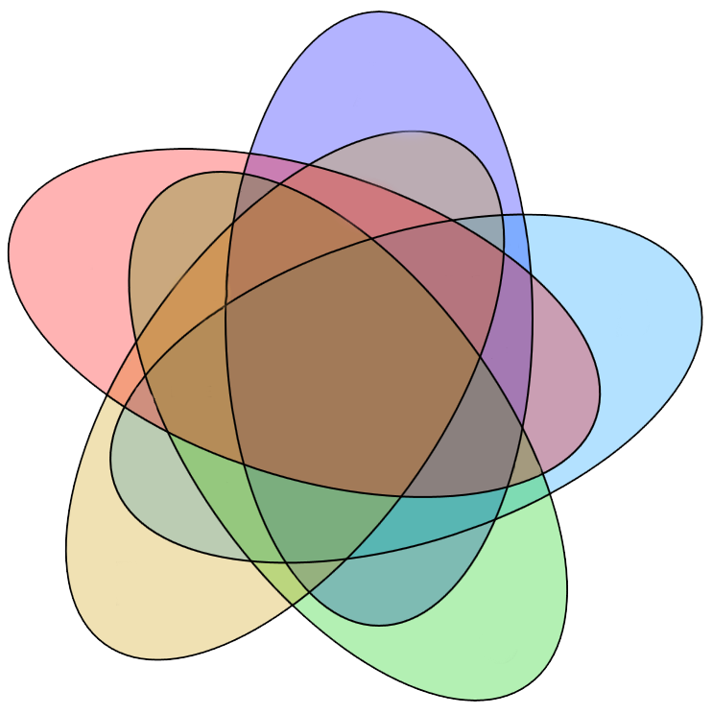
Extending Citizenship Responsibilities
Encourage development of open storage facilities
Institutional repositories, centralized departmental sharing
Physical
environment
Engage with public on data-related issues
Use expertise to engage with common concerns and misconceptions
Contribute to public skill development
Cultural
enviro
Work
culture
Open and
responsible
research
practices
Improve openness and responsibility in your work environment
Advocate for RDM practices
Engage colleagues in discussions on RCR, RDM, FAIR
Encourage data dissemination beyond disciplines
Scrutinize data and platforms currently in use for biases
and re-use data
Carefully scrutinize your own code and design for biases
Flag up platforms are exclusionary
Biases in algorithms etc
Advocate for improving community resources
Online
environment
Advocate for development of data regulatory frameworks
- Encourage development of data policies at institutional and policy level
Bureaucratic
enviro
Notes:
Of particular interest to this group, of course, is the online environment
While it is often tempting to think of the online environment as a neutral and international space, it is important to recognize the limitations of such thought
The cultural assumptions that are embedded into algorithms, the security criteria designed to safeguard sets of data, the design choices that underpin the design of platforms – these all have the potential to marginalize, stigmatize or override groups of users and it is very important that we pay attention to these issues when we design, use or scrutinize online platforms
Design choices are therefore not only important for efficiency, but also for the ethical functioning of the online environment
Furthermore, these choices have long-term implications as they shape in real time a highly dynamic space with limitless potential

Slide 23
Global Impact of Digital Sciences
technology affects communication, collaboration and knowledge exchange within scientific, work and home settings.
people adapt to the rapid social changes brought by innovation and need to be assisted to use those innovations more productively and safely.
need to consider the ways in which new technologies can be designed and developed to be more responsive to societal acceptability and desirability.
Need to promote improved design and responsible development of technologies
Notes:
Some of the concrete outcomes we pursue in our work incl, improved design and resp develop – so in addition to design might be issues such as user education, policy and regulation of tech

Slide 24
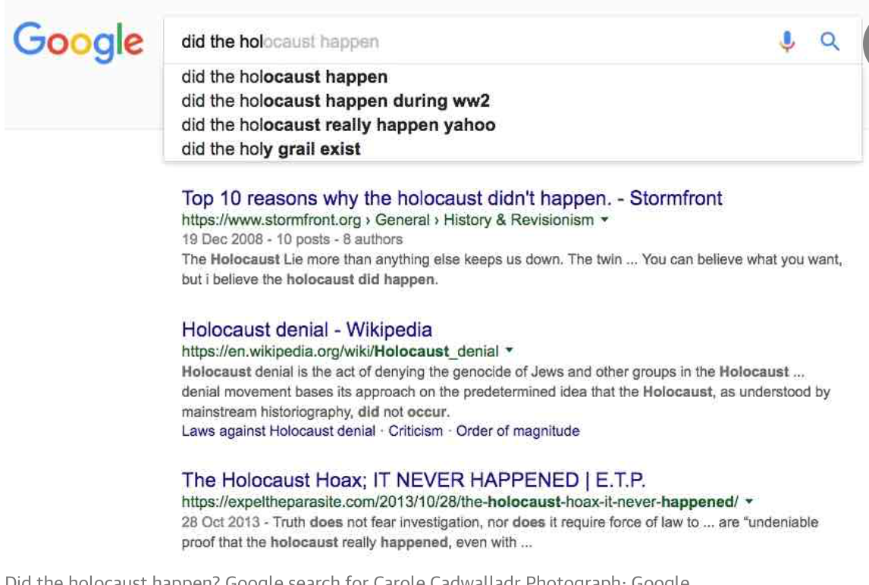
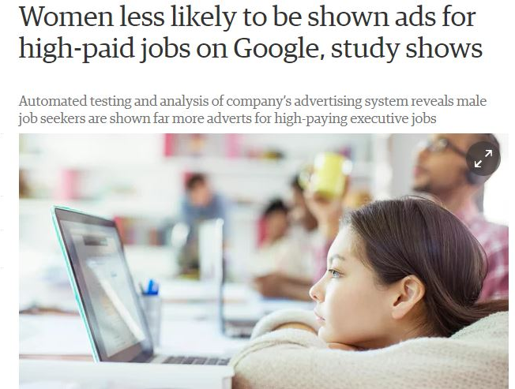
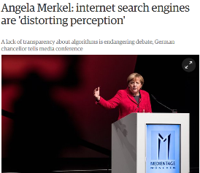
Current Challenges
Notes:
UnBias – user experience of alg driven internet platforms

Slide 25
Bias
= unjustified and/or unintended deviation in the distribution of algorithm outputs, with respect to one or more of its parameter dimensions
= inclination or prejudice for or against one person or group, especially in a way considered to be unfair.
Discrimination
= unequal treatment of persons on the basis of ‘protected characteristics’ such as race, sexual identity etc.
Notes:
Will orient more to the second definition as that’s what debate around controversies attend to and questions given by discussion organisers

Slide 26
What causes bias?
data
values encoded into the algorithm
“Algorithms are inescapably value-laden. Operational parameters are specified by developers and configured by users with desired outcomes in mind that privilege some values and interests over others…[O]peration within accepted parameters does not guarantee ethically acceptable behaviour… for example, profiling algorithms that discriminate against marginalised populations”
(Mittelstadt, Allo, Taddeo, Wachter, Floridi, 2016)
Notes:
Key points = a series of questions and challenges presented by these issues
Data or choice of what data to include as relevant – choice to include race or proxies for race etc.
Where we have humans developing the tech, there will be existence of values and with values potential for bias. Incr aware of unconscious bias so alsohave to consider this

Slide 27
What causes bias?
…. among the major factors the contribute to bias in the results that [systems] produce is because there is bias in the data. So you actually have to look at the data as far as the performance is concerned, to make sure you have a representative sample of the population you are trying to model.

Slide 28
we have to think about how to rebalance the data so that that discrimination is not propagated through the algorithms. How does one come up with a fair set of data, which can actually challenge the biases that might naturally be there …

Slide 29
Risk assessments for offenders: COMPAS
Notes:
In the early 2000s the US criminal justice system began using risk assessments to assist decision-making. These assessments are based on algorithmic calculations to predict, for instance, how likely an individual is to re-offend or fail to attend court for sentencing.
They are drawn on by the courts to help determine whether an individual should be granted bail or how long their sentence should be – with ‘low risk’ offenders given shorter sentences and perhaps even kept out of jail entirely.
Risk assessments are now used across a wide number of states at all stages of the legal process.
Advocates suggest that they provide an objective measure of offender risk that overcomes potential human bias and that they can help to reduce prison overcrowding.
Risk assessment scores are usually made available to the defendant’s legal team but the criteria through which the scores are generated are typically regarded as proprietary to the companies that develop them and are not released.

Slide 30
only 20% of those predicted to commit a violent crime had gone on to do so;
of those deemed likely to re-offend, 61% went on to be arrested, when misdemeanours such as driving with an expired license were included;
black people were almost twice as likely to be falsely labelled as at risk of future offending than white people;
white people were mislabelled as low risk more often than black people;
even when statistical tests were run to isolate the effect of race from criminal history, recidivism, age and gender, black people were still 77% more likely to be labelled as at risk of committing a future violent crime than white people and 45% more likely to be labelled as at risk of committing any kind of crime.
Notes:
So stated that ultimately the algorithm systematically less fair to black population – so was biased as either intended or unintended characteristic of the algorithm

Slide 31
Bigger Picture … Designing Algorithms
An exploration of trust, transparency and bias in law enforcement and judicial decision support systems
What are the consequences of using this algorithm in decision making by the US criminal justice system?
One of the arguments for using the algorithm is that it will be less biased than humans. Do you think humans or algorithms will be more biased when it comes to making decisions related to sentencing?
What are tensions that exist between making the algorithm more transparent on one hand, and the proprietary status of algorithms on the other?
How is it possible to assess to the extent to which the algorithm is fair? What is fairness in this situation?
Which other areas of law & justice are algorithmic systems being applied to (e.g. predictive policing, legal ‘expert systems’ and information retrieval systems for case preparation? What are the pros and cons?
What are the implications of the debate over bias in judicial decision support algorithms for public trust in law enforcement and judicial rulings?
What are the minimum levels of transparency and output audit-ability that a decision support system must have in order to maintain trust in a fair application of the law?

Slide 32
We want our algorithms in a sense to follow a higher values, moral values that we think are more important than giving an exact reflection of the world. And that I think is a very interesting, but also in a sense very shady area in which, are we going to use the data as it is? Or are we going to change the data, or not change but adapt the way we look at the data to serve our purpose of being non-discriminatory…algorithms are inherently politicised [as connected to social policy and political power]

Slide 33
On correcting for ‘real world’ bias
….that component reflects our current world view, our current social policy, and if we are not explicit about that as well, if we are not transparent about that, that we value equality between men and women, then we are again creating bias at another level of the system

Slide 34
Anticipating futures through design and practice
Important to be vigilant about the consequences of design decisions – implement RRI into design practices
Is the system open and transparent?
Is it inclusive and diverse?
Does it promote gender balance and protect against biases?
Has it got the capacity to respond to unintended harms?
Does it address societal needs and/or problems?

Slide 35
Becoming an Advocate for Open and Responsible Digital/Research Futures
What can YOU do to be an advocate for the development of an ethical digital future?

Slide 36
Thanks!
Thanks to Helena Well and UNBIAS for the case study and notes
Any concerns and/or comments about ethics, feel free to contact me at: louise.bezuidenhout@insis.ox.ac.uk

