Slide 1
Two Dimensional Critical Curves Scale free random paths and critical Phenomena
Shahin Rouhani
Physics Department
Sharif University of Technology
Tehran, Iran.

Slide 2
Overview Of this course
Examples of critical curves and geometric approach to a thermal problem,
Critical phenomena, the renormalization group, conformal field theory, fractals,
Schramm Loewner Evolution (SLE),
Calculation with SLE,
Surface growth,
Level sets of surfaces,
Loop models.

Slide 3
General references
Specific references have been given in the main text of my lecture notes but for students who like to read reviews on the topics covered in these lectures the following references are suggested:
Critical Phenomena :
Sornette, D. Critical phenomena in natural sciences: chaos, fractals, self-organization and disorder: concepts and tools. Springer Science & Business Media, 2006.
Stanley, H. Eugene. "Scaling, universality, and renormalization: Three pillars of modern critical phenomena." Reviews of modern physics 71.2 (1999): S358.

Slide 4
General references
Conformal Field Theory
Schellekens, A. N. "Introduction to conformal field theory." Fortschritte der Physik/Progress of Physics 44.8 (1996): 605-705.
Francesco, Philippe, Pierre Mathieu, and David Sénéchal. Conformal field theory. Springer Science & Business Media, 2012.
The renormalization group
Goldenfeld, Nigel. Lectures on phase transitions and the renormalization group. CRC Press, 2018.

Slide 5
General references
SLE
2D growth processes:SLE and Loewner chains:Michel Bauer and Denis Bernard, arxiv:0602049v1
SLE for Theoretical Physicists , John Cardy, arxiv: 0503313
Surface growth
Barabási, A-L., and Harry Eugene Stanley. Fractal concepts in surface growth. Cambridge university press, 1995.
Family, Fereydoon, and Tam s Vicsek. Dynamics of fractal surfaces. World Scientific, 1991.
loop models and conformal loop ensembles
Duplantier, Bertrand. "Two-dimensional fractal geometry, critical phenomena and conformal invariance." Physics reports184.2-4 (1989): 229-257.
Gruzberg, Ilya A. "Stochastic geometry of critical curves, Schramm–Loewner evolutions and conformal field theory." Journal of Physics A: Mathematical and General 39.41 (2006): 12601.

Slide 6
Overview of this lecture
Scale free random paths
Critical Phenomena
Order parameter, symmetry breaking
Ergodicity
Universality
Renormalization Group

Slide 7
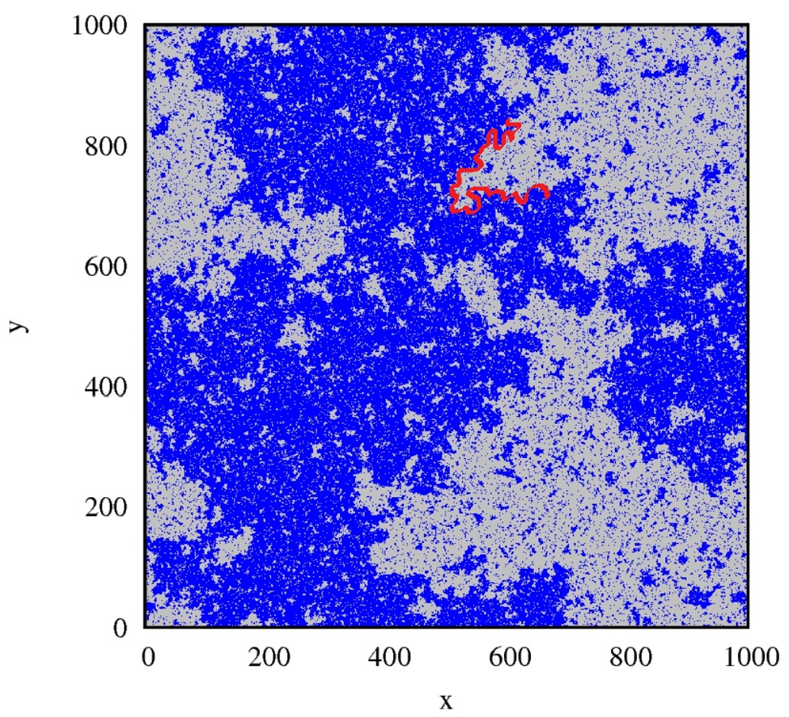
Domain Walls in the 2d Ising

Slide 8
Ising model example for an interface
On a triangular lattice
The start point for the interface is marked “a”. The interface γ separates the up spins + from the down spins - .
There is a midpoint “c” as well , the path goes from a to c then to b .
Markov property requires that the combination ac then cb equal ab in a sense to be defined later

Slide 9
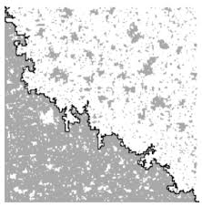
An Interface in the Ising model
Picture Credit: Hao Wu

Slide 10
Interfaces in the Ising Model
In the 2d Ising model depending on the temperature three things can happen,
for T>Tc; spins are uncorrelated so the path is the same as cluster boundary of site percolation (Hull) hence a fractal of dimension 7/4.
For T<Tc ; one direction of spins dominates, the path is a fluctuation around the shortest distance between end points and smooth line.
For T=Tc; spins are correlated but random so the path is a fractal of dimension 11/8.

Slide 11
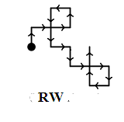
Other scale free curves: Simple random walk on 2d square lattice
At any time step the walker chooses between 4 possible directions randomly (p=1/4)

Slide 12
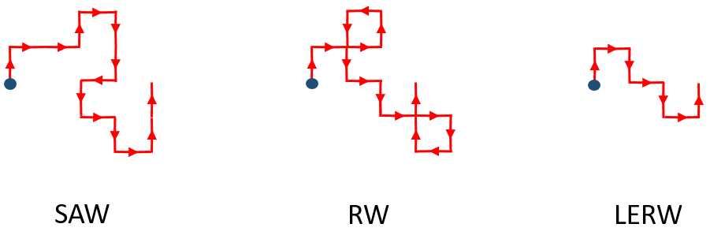
Other scale free curves
Self Avoiding Walk (SAW)
a self-avoiding walk (SAW) is a sequence of moves on a lattice (a lattice path) that does not visit the same point more than once.
Loop Erased Random Walk (LERW)
A loop-erased random walk is a simple random walk with its loops erased.

Slide 13
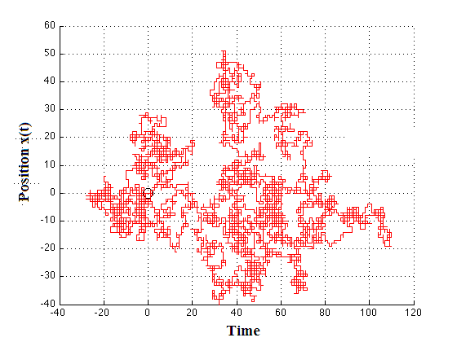
Computer simulation of a simple random walk
10000 steps

Slide 14
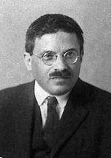
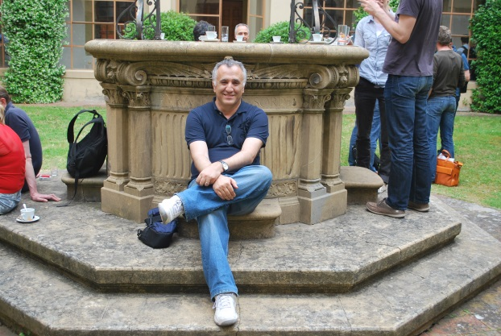
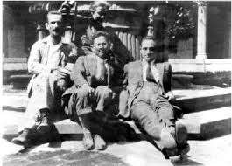
Critical Phenomena
Phase Transitions were classified by Ehrnfest by their “Order” which is the order at which the derivative of free energy becomes singular. Today this classification is not adopted anymore.
Paul Ehrenfest
1880-1933

Slide 15
Phase Diagram
Matter can exist in many phases
liquid, solid, gas, Paramagnetic , BEC, ..
These phases come to an end on an interface, this happens due to immiscibility of matter in different phases
Critical
Point
Liquid
Pressure
Solid
Phase
boundary
Vapor
Temperature

Slide 16
Magnetic Phase Diagram
h
Non zero magnetization
Second order transition
T
Critical Point
In contrast to magnetization,
the Vapor-Water transition is first order,
the order parameter is the density.
It jumps in value across the phase transition point

Slide 17
Low Temp | High Temp
More Order | Less Order
Less Symmetry | More Symmetry
Scale invariance at the symmetry breaking point
Even larger symmetry Conformal
T=T_{c}

Slide 18
Three seemingly different concepts
Spontaneous Symmetry breaking
Ergodicity breaking
Renormalization group flow

Slide 19
Spontaneous symmetry breaking (SSB)
Symmetry operator S:
[S,H]=0
Vacuum is not symmetric :
S|0> =0 or S|0> =|0’>

Slide 20
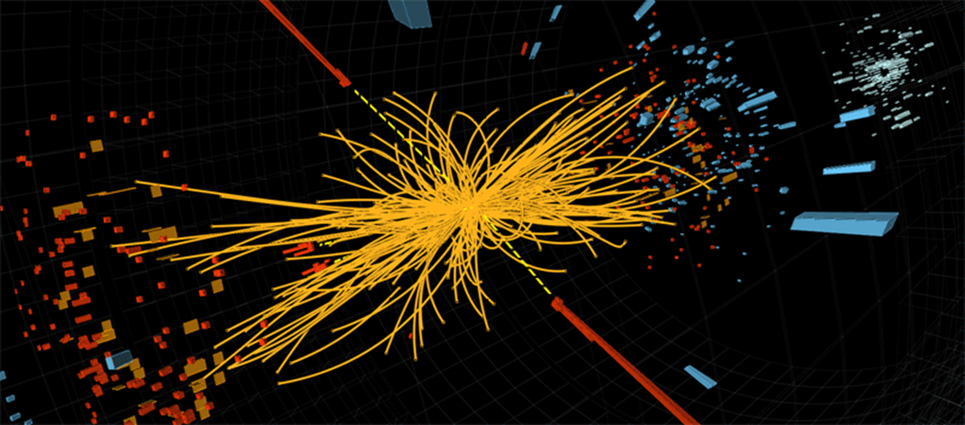
SSB
A proton-proton collision event in the CMS experiment producing two high-energy photons (red towers). An even showing the decay of a Higgs boson but also consistent with background Standard Model physics processes.
(simulation, CERN)

Slide 21
SSB
example of a double well potential is:
$$V\left(φ\right)={\frac{g}{4}φ}^{4}+\frac{t}{2}φ^{2}$$
For t>0 this potential has one minimum at
$$φ=0$$
For t<0 has minima at
$$φ^{2}=\frac{−t}{g}$$
We can choose $t=\frac{T−T_{c}}{T_{c}}$ , so that the above conditions refer directly to a critical point.

Slide 22
Spontaneous symmetry breaking
$$T>T_{c}$$
$$T≲T_{c}$$
$$T<T_{c}$$

Slide 23
Order Parameter for 2d Ising model Magnetization
$$M=\left\langle φ\right\rangle =\frac{1}{N} \sum_{n}{σ_{i}}$$
Magnetization is a good order parameter for the Ferromagnetic/
Paramagnetic Transition
For any given critical behavior finding a good order parameter is challenging.
M
$$\begin{matrix}M\sim {\left(−t\right)}^{β} , T<T_{c} \\ M=0 , T>T_{c}\end{matrix}$$
T
Tc

Slide 24
Ergodic Theorem
Ergodic Theorem:
Over time the phase space of a dynamical system is uniformly covered.
$$\lim_{t→∞}\frac{1}{T}{\int_{0}^{T}{f\left(T_{t}x\right)dt=\frac{1}{Ω}}}\iint{dμ f(p,q)}$$
Therefore ensemble averages can be replaced
with time averages.

Slide 25
Problems with the Ergodic theorem
In fact a path cannot cover a space so we can only hope that it comes close to a point.
Liouville’s theorem states that the volume remains constant, so how can it cover the whole phase space?
The solution is coarse graining

Slide 26
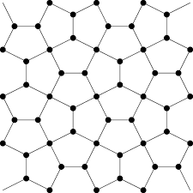
Coarse graining
We don’t talk about points in the phase space rather neiborhoods at scales given by λ.
Once the flow passes through
a cell we take that as counted.
$$\frac{ds}{dt}=\frac{d}{dt}\left(k Log\left(Ω\right)\right)≥0$$

Slide 27
Ergodic Theorem
Symmetry breaking means that the Phase space is no longer path connected, so Ergodic theorem must fail too

Slide 28
Bunimovich Stadium
$$T_{t}:Ω→Ω tεℝ$$
with randomly chosen initial position and velocity, over time its position becomes uniformly distributed over the whole stadium.

Slide 29
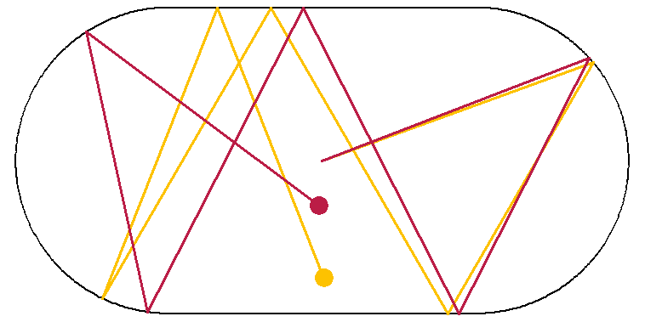
Bunimovich Stadium Ergodic hypothesis
Leonid A. Bunimovich, On the ergodic properties of nowhere dispersing billiards, Comm. Math. Phys. 65 (1979), 295–312

Slide 30
Animation by Phillipe Roux : blogs.ams.org/visualinsight/2016/11/15/bunimovich-stadium/

Slide 31
Critical exponents
Changes of the physical observables near the critical point are given by power laws:
$$M\sim {(−t) }^{β}$$
$$t=\frac{T−T_{c}}{T_{c}}$$
here M is magnetization, $T$ temperature, $T_{c}$ critical temperature, and t is called the reduced temperature

Slide 32
Critical exponents
Exponent | Physical quantity | expression
α | Specific heat (at zero field) | $$C_{v}\sim t^{−α}$$
β | Order Parameter (below T_{c} ,zero field) | $$m\sim {(−t)}^{β}$$
γ | Susceptibility | $$χ\sim t^{γ}$$
δ | Order Parameter at T_{c} (non zero field ) | $$m \sim h^{1/δ}$$
η | Correlation function at T_{c} | $$C\left(r\right)\sim r^{2−d−η}$$
ν | Correlation length | $$ξ\sim t^{−ν}$$
z | Time scale $τ$ | $$τ\sim ξ^{z}$$

Slide 33
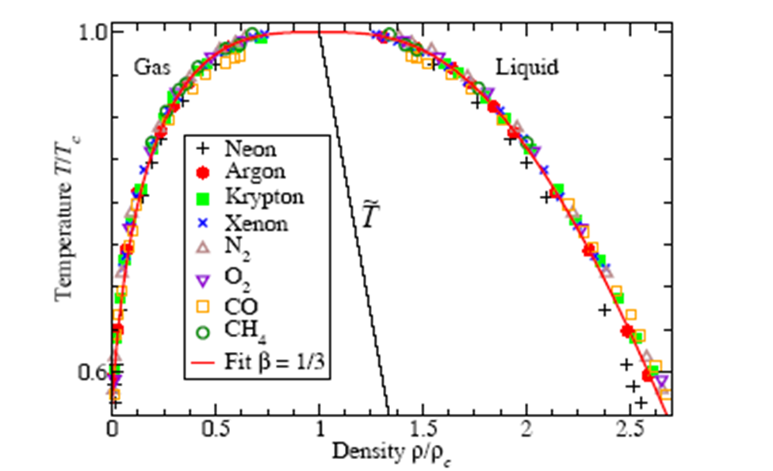
Universality
critical exponents of many seemingly very diﬀerent physical systems, are the same
E. A. Guggenheim, J. Chem. Phys., vol. 13, p. 253, 1945.

Slide 34
Scale invariance
Many spin systems within statistical mechanics are characterized by a correlation length $ξ$, which is the scale by which two random variables remain in “contact” :
$$C(r)=\left\langle φ(r)φ(0)\right\rangle \sim e^{−{\left|r\right|}/ξ}$$
However near the critical point we know that the correlation length diverges $ξ\sim t^{−ν}$

Slide 35
Scale invariance
In this situation , distributions and correlations take on a power law format :
$\left\langle φ(r)φ(0)\right\rangle \sim r^{2−d−η}\sim r^{−η}$ (for d=2 T=Tc)
or
$$C_{v}\left(λ t\right)\sim λ^{−α} C_{v}\left( t\right)$$

Slide 36
Scaling relations
$$F\left(h,t\right)=t^{2−α} g(ht^{Δ})$$
then:
$$C_{v}=\frac{∂^{2}f}{{∂t}^{2}}\sim t^{−α}$$
$$m=\frac{∂f}{∂h}\sim t^{2−α−Δ}$$
$$χ=\frac{∂^{2}f}{{∂h}^{2}}\sim t^{−2+α+Δ}$$
Resulting in:
$$α+2β+γ=2$$

Slide 37
Test of scaling relations
A. lense and M. Lagues, scale invariance: From Phase transitions to Turbulance. Berlin: Springer, 2008.
 | Xe | Binary mixture
α | 0 | 0.113
β | 0.35 | 0.32
γ | 1.3 | 1.239
δ | 4.2 | 4.85
η | 0.1 | 0.017
ν | 0.57 | 0.625
α+2β+γ=2 | 2.00 | 1.99
α+β δ+β=2 | 1.82 | 2.00
η+γ/ν=2 | 2.38 | 2.00
α+νd=2 | 1.71 | 1.99

Slide 38
The Renormalization Group (RG)
Dynamics at scale $λ$ :
$$H=\sum_{n}{C_{n}\left(λ\right)}\hat{O_{n}}$$

Slide 39
The RG Equation
$$λ\frac{dC_{n}}{dλ}= β_{n}(\vec{C},λ)$$
The beta functions $β_{n}$ will be given by the system in question.
It is possible that the beta functions admit a fixed point:
$$β_{n}\left(C^{∗},λ\right)=0$$

Slide 40
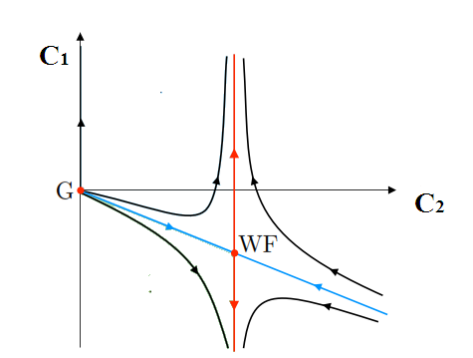
A typical RG flow diagram. The Wilson-Fisher (WF) point is attractive in the IR limit in one direction only (blue line), the critical manifold. For the Gaussian point all directions are repulsive so no critical manifold exists. The black lines depict experimental observation.

Slide 41
Near the critical point
Expand RG equation near the fixed point:
$$δ_{n}=C_{n}−{C^{∗}}_{n}$$
$$λ\frac{dδ_{n}}{dλ}= M_{n,m}δ_{m}+…$$
$$M_{n,m}=∂_{n}β_{m}$$

Slide 42
The RG Equation
The eigenvalues of $M$are :
$$λ^{y_{n}}$$
Where $y_{n }>0$ relevant operators
$y_{n }<0$ irrelevant operators
$y_{n }>0$ marginal operators

Slide 43
Scale invariance of the free energy
Now scale invariance of physical observables requires the free energy to have the form scalig form:
$$F\left(t,h\right)=t^{\frac{d}{{ y}_{t}}} f(\frac{h}{t^{{y_{h}}/{y_{t}}}})$$
of course this applies to only systems which have just two relevant operators.

Slide 44
Scale invariance of the free energy
The two variables which are important are
reduced temperature: $t$
applied magnetic field: $h$
So expanding RG near the Gaussian point we must get :
$$\begin{matrix}t→ {λ }^{y_{t}} t \\ h→ {λ }^{y_{h}} h\end{matrix}$$

Slide 45
Scale invariance of the free energy implies scaling relations
A simple calculation with the free energy on previous slide will determine the critical exponents. e.g.
$$C_{v}=\frac{∂^{2}}{{∂T}^{2}}F$$
Hence at h=0 we have :
$$C_{v}\sim t^{−α}$$
$$α=2−\frac{d}{y_{t}}$$

Slide 46
Scaling form of the free energy implies scaling relations
This observation has many consequences:
1-All critical exponents are determined by two quantities $y_{t}$ and $y_{h }$.
Which means all critical exponents are not independent. In fact there are linear relations among them e.g.
$α+2β+γ=2$
B. Widom, Equation of state in neighborhood of critical point. J. Chem. Phys. 43, 3898 (1965)

Slide 47
Scaling form of the free energy implies scaling relations
Later Wilson showed that the scaling form of the free energy near Tc can be obtained from RG
The full set of scaling relations are:
$$\begin{matrix}α+dν=2 \\ α+2β+γ=2 \\ \begin{matrix}β\left(δ−1\right)=γ \\ ν\left(2−η\right)=γ\end{matrix}\end{matrix}$$
K.G. Wilson, Phys. Rev. B 4, 3174 (1971); 4, 3184 (1971)

Slide 48
Scaling form of the free energy implies scaling relations
All physical systems that share the same RG fixed point will have the same set of critical exponents (Universality) . That is the details of their interactions are irrelevant (irrelevant operators)
For each universality class there exists infinitely many physical systems which share the same RG fixed point. (they differ in their irrelevant operators)

Slide 49
Question
What physical properties are shared between the physical systems that share the same fixed point ?

Slide 50
Next Lecture : CFT, fractals and self-similarity

