Slide 1
generalized synchronization &
phase synchronization
between chimera states
Ralph G. Andrzejak
Nonlinear time series analysis group
http://ntsa.upf.edu
Dept. Information and Communication Technologies, Universitat Pompeu Fabra, Barcelona, Spain
Institute for Bioengineering of Catalonia (IBEC), Barcelona, Spain
School and Workshop on Patterns of Synchrony:
Chimera States and Beyond
Trieste, May 2019

Slide 2
generalized synchronization &
phase synchronization
between chimera states

Slide 3
identical synchronization,
generalized synchronization &
phase synchronization
between chimera states

Slide 4
identical synchronization,
generalized synchronization &
phase synchronization
between chimera states
-
analogies to
low-dimensional chaotic dynamics

Slide 5
identical synchronization,
generalized synchronization &
phase synchronization
between chimera states
-
analogies to
low-dimensional chaotic dynamics

Slide 6
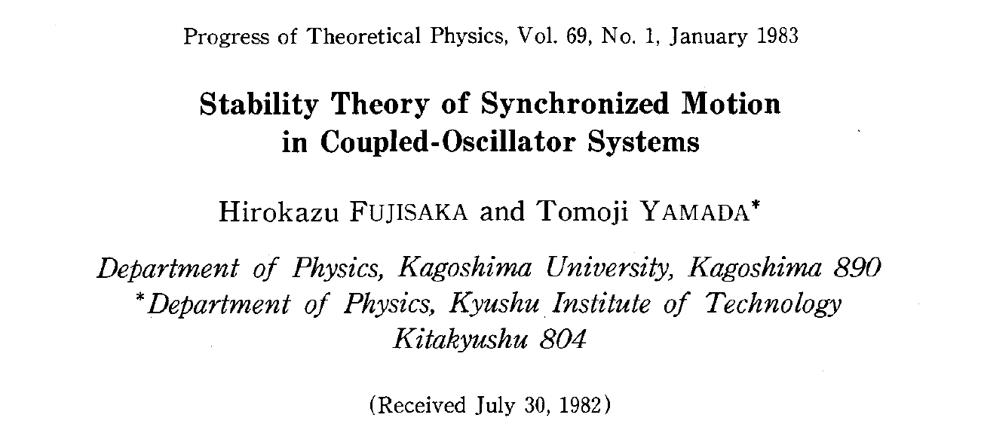
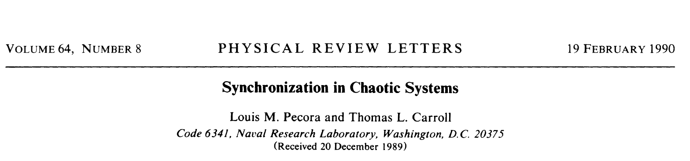

Slide 7
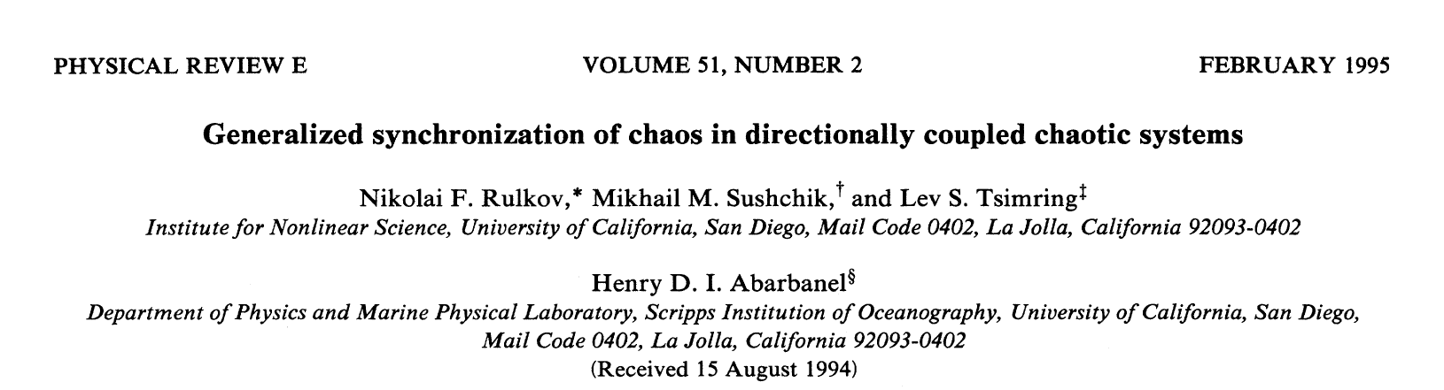

Slide 8
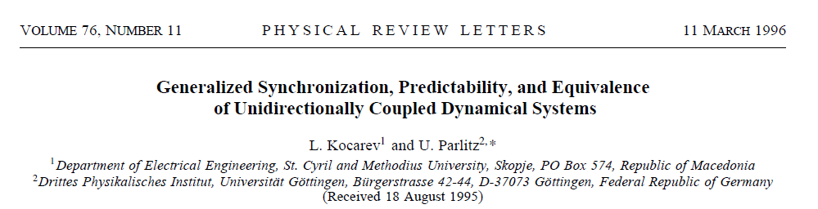
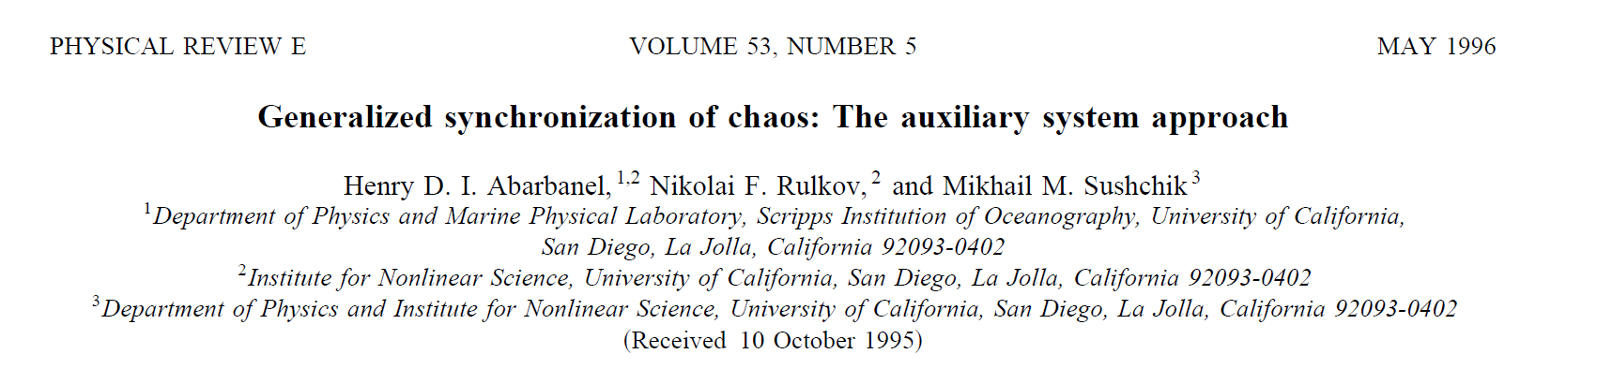

Slide 9
identical synchronization,
generalized synchronization &
phase synchronization
between chimera states
-
analogies to
low-dimensional chaotic dynamics

Slide 10
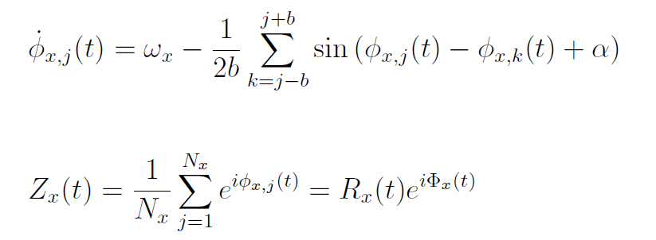
Two-layer
Ring network of non-locally coupled identical phase oscillators
Wolfrum & Omel’chenko Phys. Rev. E, 2011

Slide 11
Chimera states are chaotic
(Andrzejak et al. Chaos 2018)
Omel’chenko, et al. Phys. Rev. E, 2010
Wolfrum & Omel’chenko Phys. Rev. E, 2011
Omel’chenko, Nonlinearity, 2018
(and references therein)

Slide 12
identical synchronization,
generalized synchronization &
phase synchronization
between chimera states
-
analogies to
low-dimensional chaotic dynamics

Slide 13
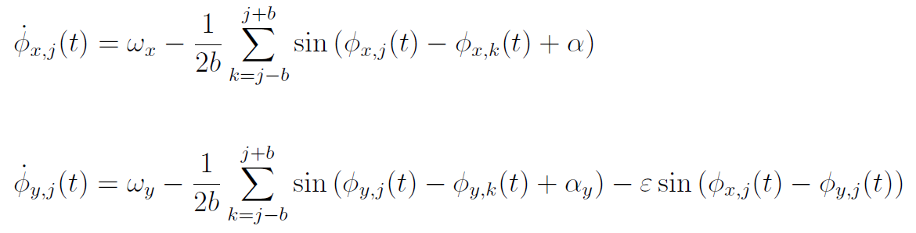
Two-layer
Ring network of non-locally coupled identical phase oscillators

Slide 14
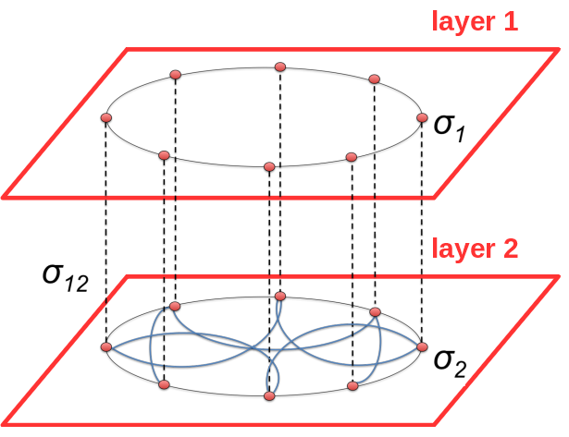

Two-layer
Ring network of non-locally coupled identical phase oscillators
layer X
layer Y

Slide 15
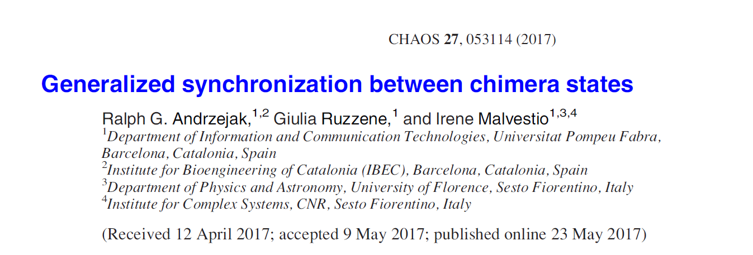

Slide 16
identical synchronization,
generalized synchronization &
phase synchronization
between chimera states
-
analogies to
low-dimensional chaotic dynamics

Slide 17
identical synchronization,
generalized synchronization &
phase synchronization
between chimera states
-
analogies to
low-dimensional chaotic dynamics

Slide 18
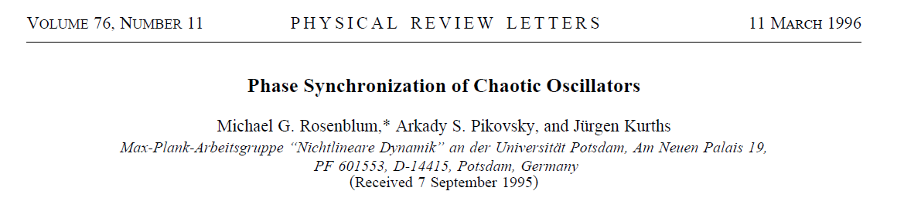

Slide 19
Interplay of chimeras in multilayer networks
V.A. Maksimenko et al. Physical Review E 94, 052205 (2016)
S. Ghosh et al. Europhysics Letters 115, 60005 (2016)
S. Majhi et al. Scientific Reports 6, 39033 (2016)
S. Majhi et al. Chaos 27, 073109 (2017)
V. A. Maksimenko et al. Bulletin of the Russian Acad. Sci. Phys. 81, 110 (2017)
R.G. Andrzejak et al. Chaos 27, 053114 (2017)
M.V. Goremyko et al. Technical Physics Letters 43, 712 (2017)
A. Bukh et al. Chaos 27, 111102 (2017)
N. Frolov et al. Cybernetics and Physics 6, 121 (2017)
S. Ghosh et al. Chaos, Solitons & Fractals 106, 56 (2018)
F. Xu et al. Nonlinear Dynamics 1, (2018)
J. Sawicki et al. Eur. Phys. J. Special Topics 227, 1161 (2018)
Q. Dai et al. Nonlinear Dynamics 92, 741 (2018)
G.I. Strelkova et al. Reg. Chaotic Dyn. 23, 948 (2018)
E.V. Rybalova et al. Chaos 29, 033134 (2019)
M Mikhaylenko et al. Chaos 29, 023122 (2019)

Slide 20
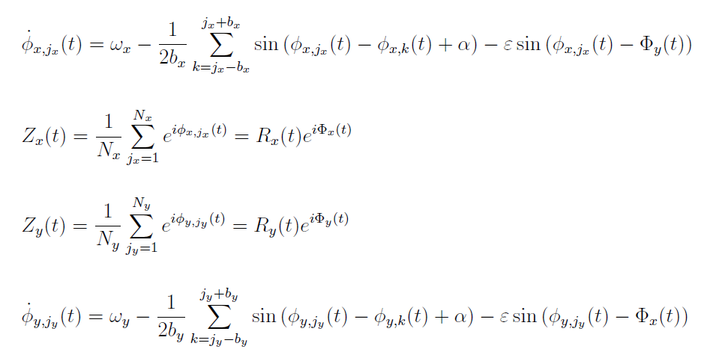
Two-layer
Ring network of non-locally coupled identical phase oscillators

Slide 21
Two-layer
Ring network of non-locally coupled identical phase oscillators

Slide 22
Two-layer
Ring network of non-locally coupled identical phase oscillators

Slide 23
Uncoupled networks
(Andrzejak et al. Chaos 2018)

Slide 24
Mean field phase synchronization
(Andrzejak et al. Chaos 2018)

Slide 25
Uncoupled networks
(Andrzejak et al. Chaos 2018)

Slide 26
Mean field phase synchronization
(Andrzejak et al. Chaos 2018)

Slide 27
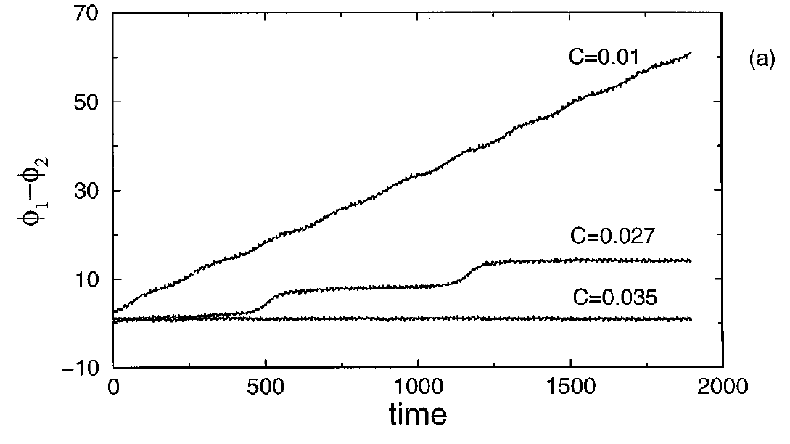
Transition to synchronized motion
Top: Rössler dynamics
(Rosenblum et al. Phys. Rev. Lett. 1996)
Left: Networks in chimera states
(Andrzejak et al. Chaos 2018)

Slide 28
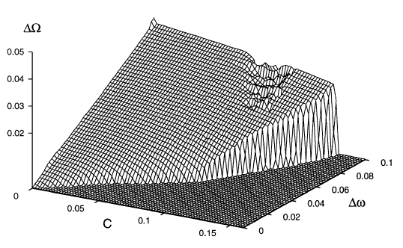
Arnold tongues
SYNC
NO
SYNC
NO
SYNC
Top: Rössler dynamics
(Rosenblum et al. Phys. Rev. Lett. 1996)
Left: Networks in chimera states
(Andrzejak et al. Chaos 2018)
SYNC
NO
SYNC

Slide 29
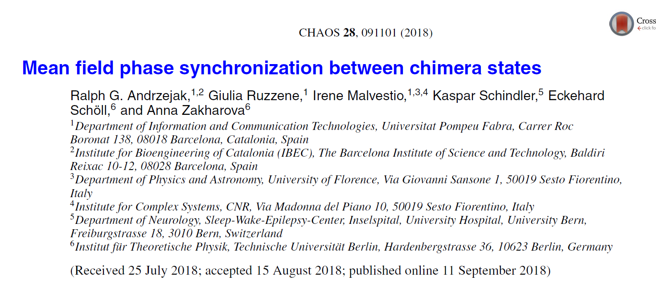

Slide 30
identical synchronization,
generalized synchronization &
phase synchronization
between chimera states
-
analogies to
low-dimensional chaotic dynamics

