Slide 1
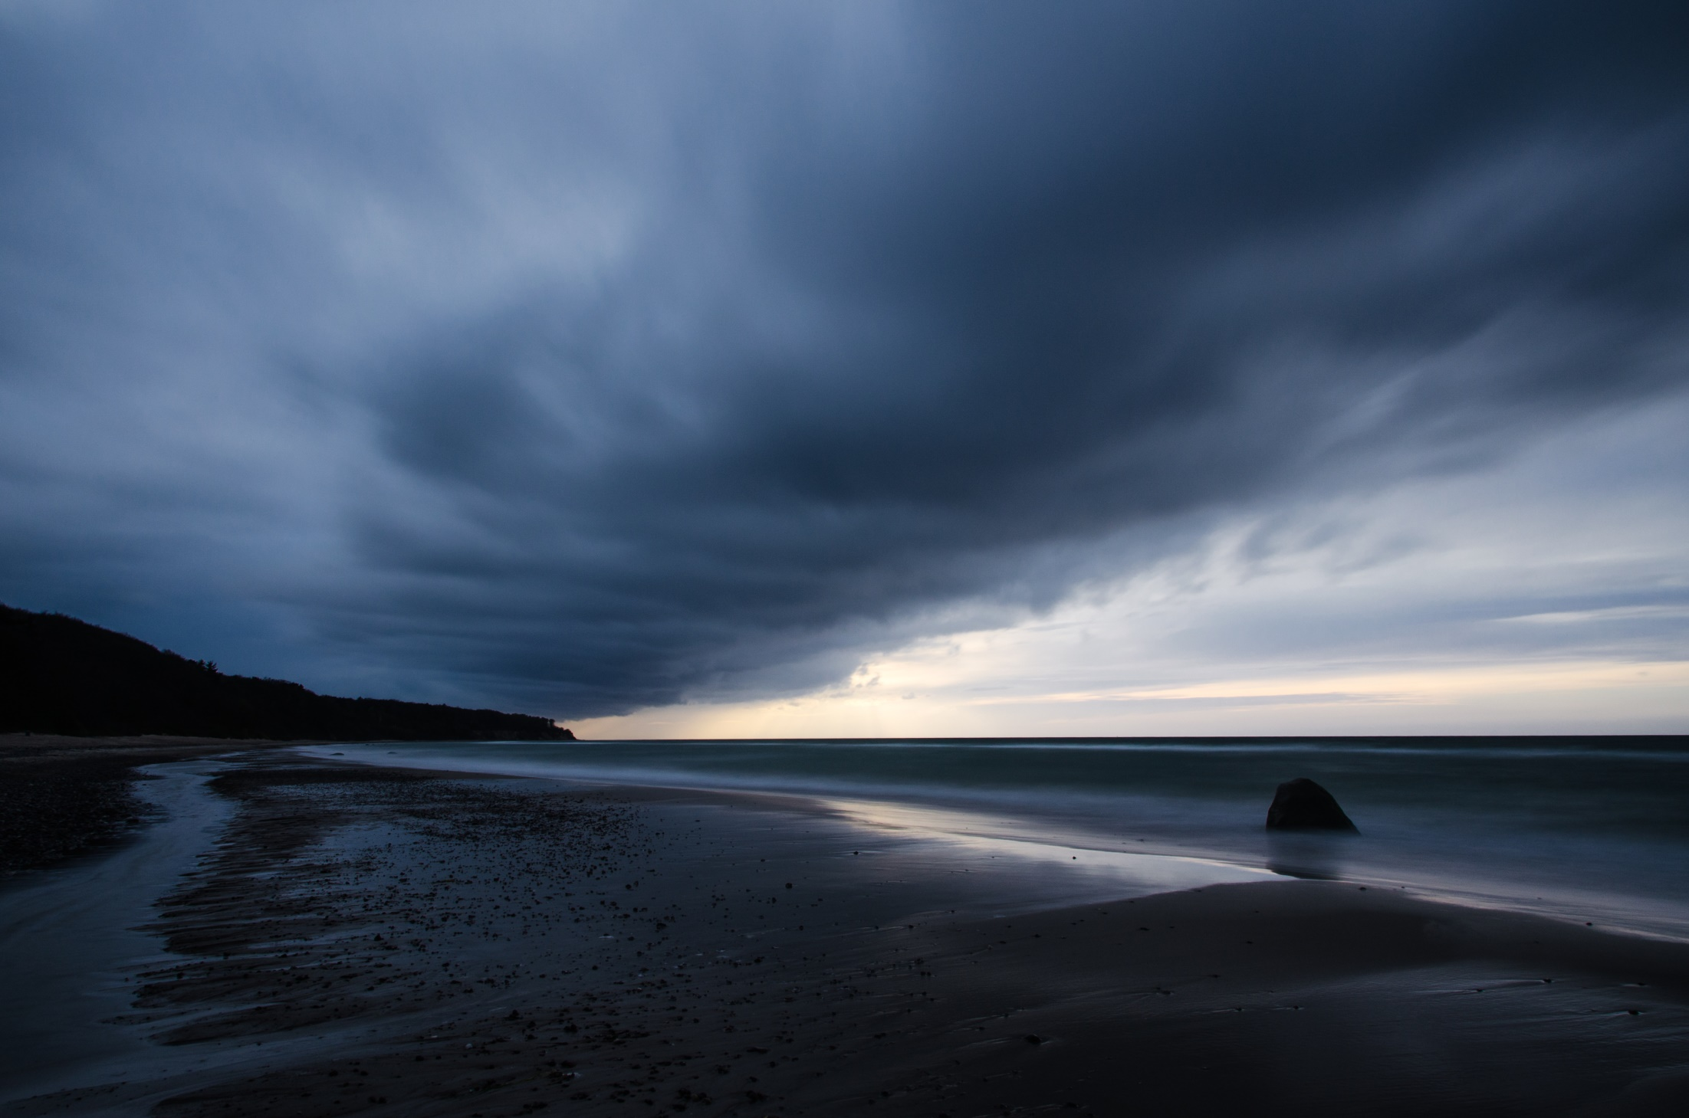
Workung with large gridded data sets
- formats and access methods
Martin Schmidt
Leibniz-Institute for Baltic Sea Research Warnemuende
martin.schmidt@io-warnemuende.de
Notes:
1
1

Slide 2
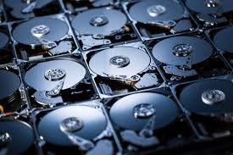
1
Distributing or accessing huge data sets
- satellite data
- model results
Problem: data volume TByte – Pbyte
“I use to keep all data on my laptop ...”
Notes:
1
20 Minuten Vortrag (davon das meiste zur IOWDB und ODIN)
25 Minuten ausprobieren
1

Slide 3
How to publish such huge data sets?
Ask for help:
“Could you please kindly provide that image with another label?“
Work together!
Share the data!
Do it Yourself!

Slide 4
1
Motivation
Complete switch from paper based data storage to digital data storage
Growing amount and complexity of data to be managed for scientific work (satellite data, input and results of numerical models)
International and interdisciplinary data exchange
Different data formats between programming languages, architectures
- need for separate read/write procedures for each data set
- incomplete metadata
- error prone
Notes:
<number>
20 Minuten Vortrag (davon das meiste zur IOWDB und ODIN)
25 Minuten ausprobieren
<number>

Slide 5
1
Unidata’s network Common Data Form
Requirements
suitable for data defined on a grid
selfdescribing: includes data and metadata defining the meaning of the data, keep data and metadata strictly together
scalable: easy and fast access to subsets
portable: platform and system independent treatment of data, follow standards and conventions
sharable: read and write of many processes possible the same time (supercomputing)
compatible: early data versions stay supported
efficient storage (compression, packing)
Notes:
<number>
20 Minuten Vortrag (davon das meiste zur IOWDB und ODIN)
25 Minuten ausprobieren
<number>

Slide 6
1
Unidata’s network Common Data Form
Craetors
Glenn Davis, Russ Rew, Ed Hartnett, John Caron, Dennis Heimbigner, Steve Emmerson, Harvey Davies, and Ward Fisher at the Unidata Program Center in Boulder, Colorado
Origin
NASA’s CDF data model
Home
University Corporation for Atmospheric Research.
Funding
NSF
Notes:
<number>
20 Minuten Vortrag (davon das meiste zur IOWDB und ODIN)
25 Minuten ausprobieren
<number>

Slide 7
1
Unidata’s network Common Data Form
Realisation
- Read/write access through a well defined interface
netCDF-library.
- Easy install, documented, support
- available for all systems (UNIX, linux, mac, windows, android)
( from supercomputer to smartphone)
- interface for many programming and scripting languages
FORTRAN, C, C++, python, java, octave (matlab)
- implemented in most data processing and visualisation tools
Notes:
<number>
20 Minuten Vortrag (davon das meiste zur IOWDB und ODIN)
25 Minuten ausprobieren
<number>

Slide 8
1
Climate and Forecast metadata conventions
Self-describing language is impossible. Conventions on the meaning of elements are needed.
Data are valid in the context of a grid.
Coordinates are strictly monotonic!
- latitude, longitude
- depth, pressure density
- time
- forecast time
- ensemble number
…..
Notes:
<number>
20 Minuten Vortrag (davon das meiste zur IOWDB und ODIN)
25 Minuten ausprobieren
<number>

Slide 9
1
Climate and Forecast metadata conventions
Metadata
- part of the data file structure, no external files.
- units should use SI-conventions
- readable by humans and machines (programs)
Notes:
<number>
20 Minuten Vortrag (davon das meiste zur IOWDB und ODIN)
25 Minuten ausprobieren
<number>

Slide 10
1
Climate and Forecast metadata conventions
Dimensions and coordinates
- define an index space
- coordinates are independent variables
(lat, lon, distance depth, pressure, time, forecast time, ensemble)
- appropriate time usage (calendar, beware of years and months)
Data:
- defined on grid spanned by the dimensions
- depend on coordinates
- cell bounds and cell method can be addressed
Notes:
<number>
20 Minuten Vortrag (davon das meiste zur IOWDB und ODIN)
25 Minuten ausprobieren
<number>

Slide 11
1
ncdump -h hix_data.nc
netcdf hix_data {
dimensions:
altitude = 1 ;
latitude = 1 ;
longitude = 1 ;
time = 1529 ;
variables:
float longitude(longitude) ;
longitude:units = "degree_east" ;
longitude:point_spacing = "even" ;
longitude:axis = "X" ;
longitude:standard_name = "Longitude" ;
float latitude(latitude) ;
latitude:units = "degree_north" ;
….
double time(time) ;
time:units = "days since 1800-01-01 00:00:00" ;
time:axis = "T" ;
time:calendar = "GREGORIAN" ;
time:time_origin = "01-Jan-1800" ;
time:standard_name = "Time" ;
float HIX(time, latitude, longitude) ;
HIX:units = " " ;
HIX:long_name = "St. Helena Island Climate Index (HIX)" ;
float SLP(time, latitude, longitude) ;
SLP:units = "hPa" ;
SLP:long_name = "Sea level pressure" ;
…...
Notes:
<number>
20 Minuten Vortrag (davon das meiste zur IOWDB und ODIN)
25 Minuten ausprobieren
<number>

Slide 12
1
File structure internal compression, chunking
Direct and strided access
- single or groups of data items can be addressed directly
Internal compression
- no packed and unpacked file versions any more
- chunking
Access through a MPI-layer
- parallel writing from many processes → supercomputer application
Notes:
<number>
20 Minuten Vortrag (davon das meiste zur IOWDB und ODIN)
25 Minuten ausprobieren
<number>

Slide 13
1
Remote access
How to share Tbyte to Pbyte of data?
Local file server?
- duplicate and double data sets, build local data bases
- hardware and energetic costs, (wo)manpower
- legal issues, data ownership?
Remote distributed storage
- keep data sets local, avoid duplication and transfer
- distributed data bases
- keep responsibility and control over data
Notes:
<number>
20 Minuten Vortrag (davon das meiste zur IOWDB und ODIN)
25 Minuten ausprobieren
<number>

Slide 14
1
Unidata’s Thematic Real-time Environmental Distributed Service
Concept
keep data on a server → THREDDS data server, TDS
web access over standard, widespread web services
searchable
keep data and metadata strictly together
use a markup language (ncml) to serve all data in a unified standard data format (netCDF – free supported for all platforms)
a data set can be a reference to another TDS → build distributed data bases, share data without copying and multiplying PByte
Notes:
<number>
20 Minuten Vortrag (davon das meiste zur IOWDB und ODIN)
25 Minuten ausprobieren
<number>

Slide 15
1
OpenDAP Open Source project for a Network Data Access Protocol
Concept
libdap: provides web access to netCDF formated data over a web interface
user view: use an URL as filename
part of the netcdf library
all software using the netCDF library inherits this capability
Notes:
<number>
20 Minuten Vortrag (davon das meiste zur IOWDB und ODIN)
25 Minuten ausprobieren
<number>

Slide 17
Example data set access
Access for catalog browsing
web-browser https://thredds-iow.io-warnemuende.de
click through the catalog entries
find the data set you are interested in
inspect the services available for this data set
find the URL for data access (retrieval)

Slide 18
Example data set access

Slide 19
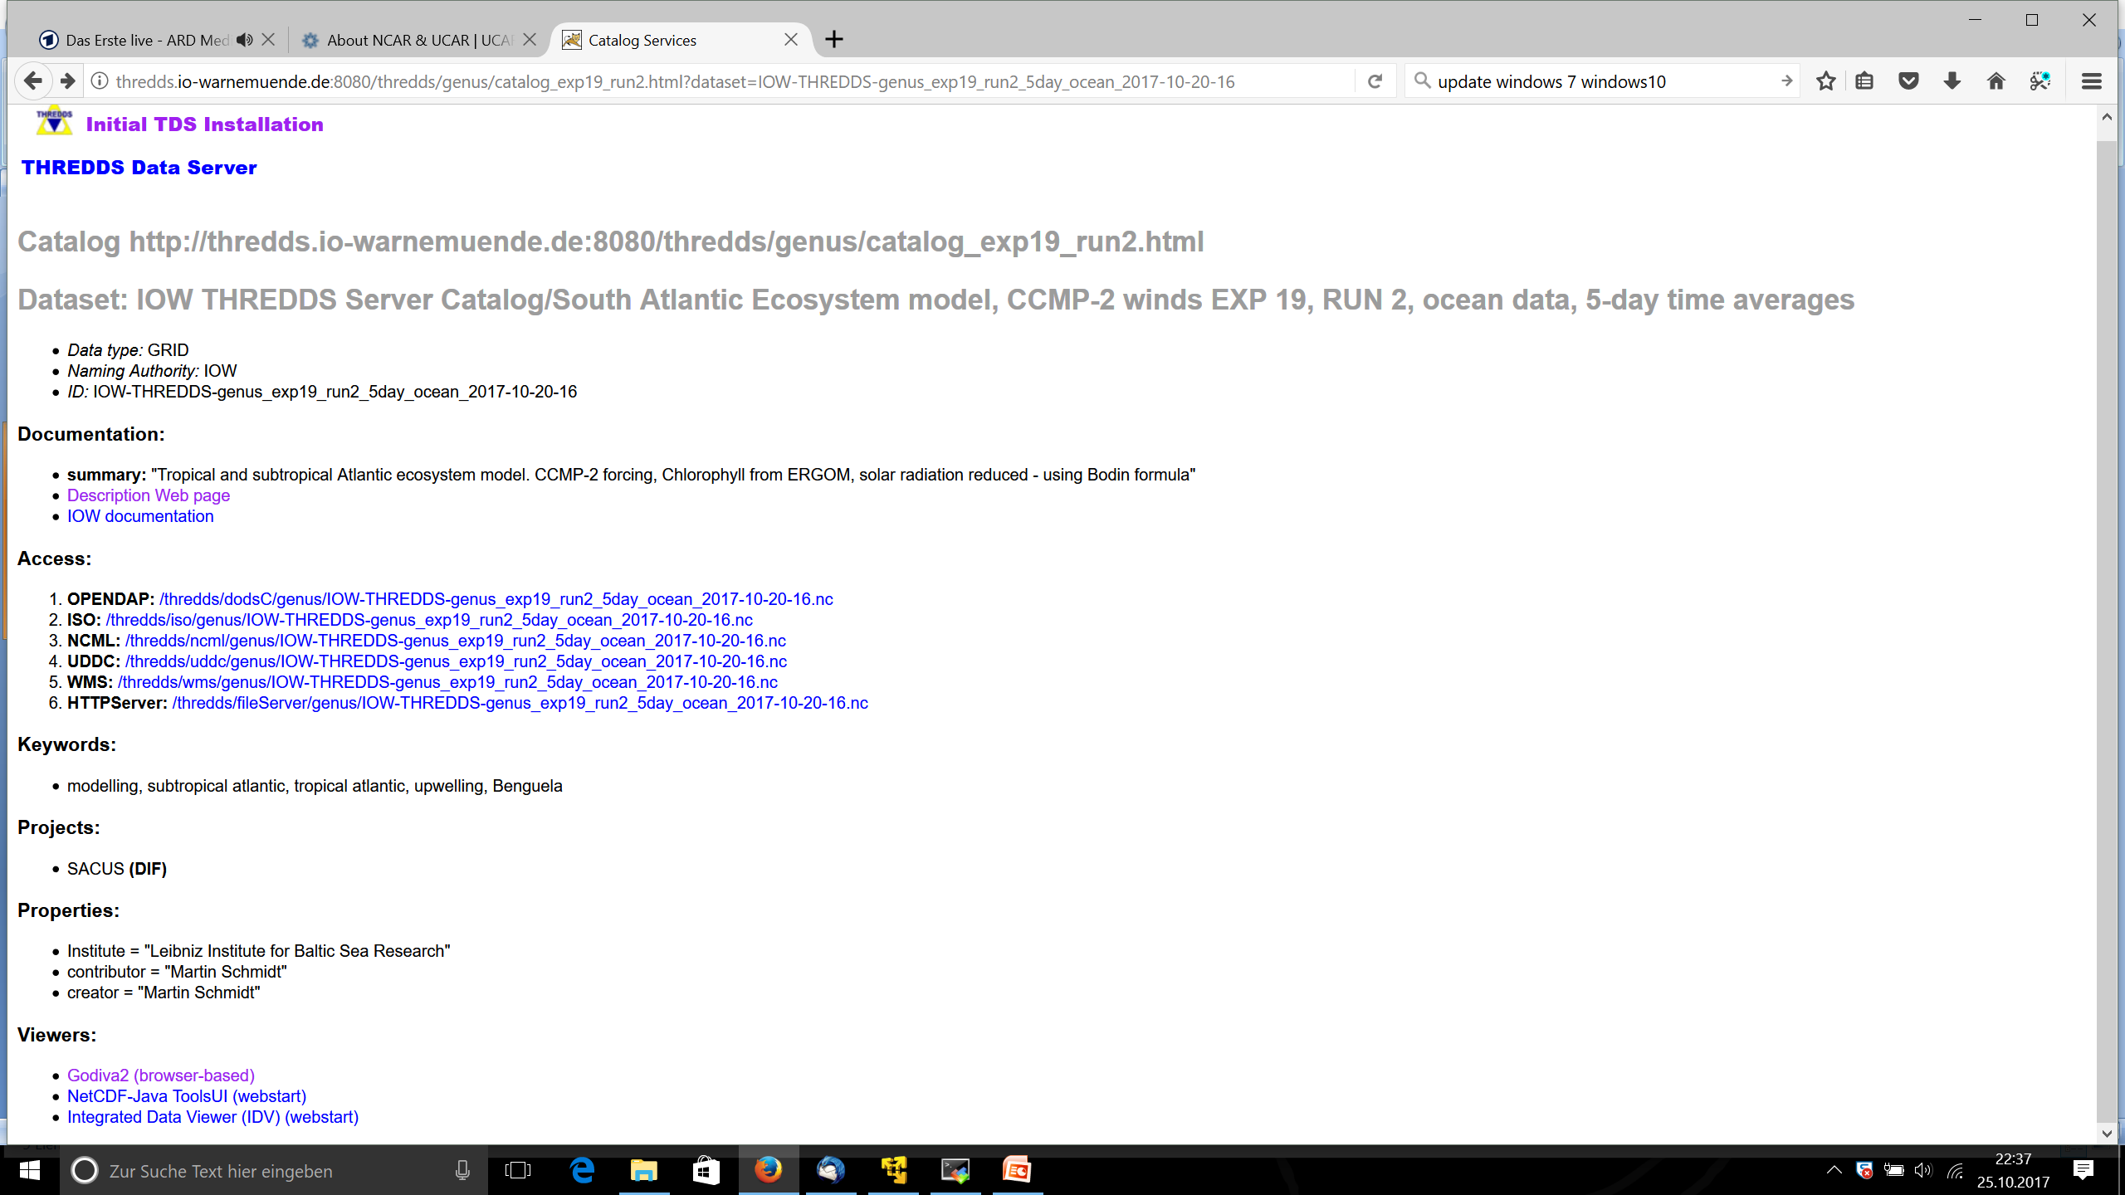

Slide 20
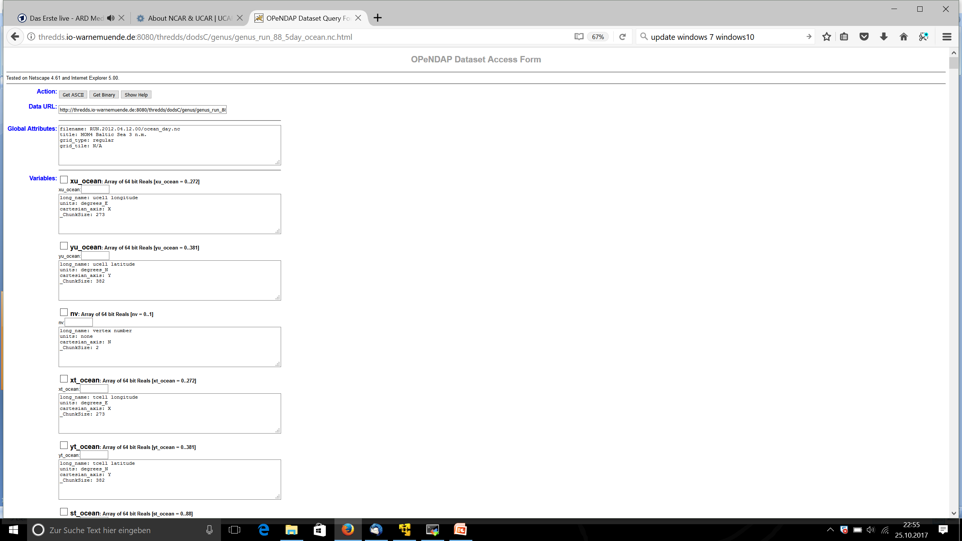
The URL

Slide 21
Example data set access
Access for searching the metadata
Use the ISO-service to get the metadata of the data sets hosted by the THREDDS
(lengthy xml-code, not human readable)
use a “harvester” to seach the TDS and add the metadata to the IOW data base. Data are left on the THREDDS.
Metadata from any THREDDS of interest can be added to the IOW data base. Strong extension of the “search radius” without extending the data base.
TDSs allow for distributed data bases.
Huge model generated data sets become member of the IOW data base → found when data base is seached

Slide 22
Example data set access
Access for data retrieval
web browser to retrieve data? Works but not recommended
open the data set with your beloved visualisation program, use URL as file name
Behind the scene:
your tool must be able to read netCDF-files openDAP access must be enabled
(Open-source Project for a Network Data Access Protocol)
Excel is not able to read netcdf, strong reason to learn something else

Slide 23
Example data set access
Software examples
Free software for reading netcdf files
https://www.unidata.ucar.edu/software/netcdf/software.html
Linux: ferret, R, grADS, GMT, cdo, nco, python, ncview, octave ….
Windows: R, python, octave
Commercial packages (may be expensive!)
Matlab, IDL, Surfer

Slide 24
Example for TDS data access: POC from MODIS
Access with ferret:
step 1: find the data set URL in the THREDDS catalog (web browser)
http://oceanwatch.pfeg.noaa.gov/thredds/catalog.html
→ http://oceanwatch.pfeg.noaa.gov/thredds/dodsC/satellite/MPOC/mday
step 2: start ferret and open the data set and have a look at the data set structure
Yes? use
yes? show data
yes?
1>
yes? shade/x=10:16/y=-28:-10 /l=100 POC
https://thredds-iow.io-warnemuende.de/thredds/dodsC/balticA1B_3nm/joined_ocean.nc
netcdf-bug: use [fillmismatch]http://oceanwatch.pfeg.noaa.gov/thredds/dodsC/satellite/MPOC/mday

Slide 25
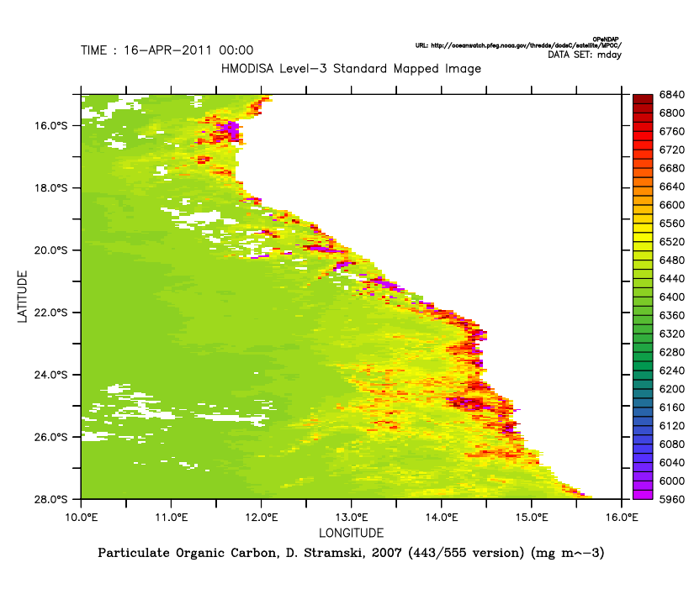
Example for TDS data access
step 3: make an example plot (for the Benguela upwelling system)
yes? shade/x=10:16/y=-28:-10 /t=16-apr-2011 POC
yes? frame/file=poc_example.png
step 4: scientific work with the data

Slide 26
Example for TDS data access: Model results
Access with R:
step 1: find the data set URL in the THREDDS catalog (web browser)
step 2: start R and open the data set and show content
>library(ncdf4)
>file.1 <- "https://thredds-iow.io-warnemuende.de/thredds/dodsC/balticA1B_3nm/joined_ocean.nc"
>nc.1 <- nc_open(file.1)
>print(nc.1)
https://thredds-iow.io-warnemuende.de/thredds/catalogs/regions/baltic/climate_projections/catalog_climate_projections.html

Slide 27
Example for TDS data access: Model results
Remarks – sophisticated subsetting:
Data set size about 5GByte
Only the netCDF header was read.
For the plot 200 Kbyte are transferred.

Slide 28
The IOW THREDDS server
How to make your data visible - delivering data via the IOW THREDDS
Two IOW-THREDDS servers:
internal: thredds.io-warnemuende.de:8080/thredds
visible withing the IOW domain (switch on vpn for access from outside)
public: thredds-iow.io-warnemuende.de/thredds
public, data sets may be password protected
step 1:
- contact the modelling group (Martin Schmidt), later the EDV group
- read the documentation on phywiki.io-warnemuende.de (15 min)
step 2: put the data into the IOW storage system
step 3: produce a catalog file describing the data set (metadata)
step 4: be happy that your data are useful for others

Slide 29
Summary
huge data sets like model results or satellite data can be distrubuted via a THREDDS data server (TByte – PByte)
a data set in THREDDS can be a reference to another data set in another THREDDS -> build linked data bases
metadata from model results on THREDDS can be added to metadata base

Slide 30
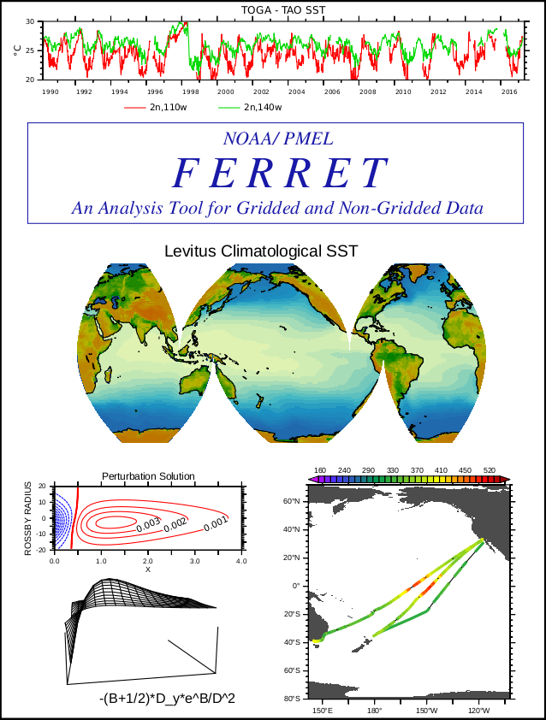
Data visualisation and analysis with Ferret
authors: Thermal Modeling and Analysis Project (TMAP)
PMEL in Seattle
S. Hankin, D.E. Harrison, J. Sirott, A. Manke,
J. Callahan, J. Davison, K. O'Brien ….
Operating systems: X11 based (Linux, MacOS)
(Windows → virtual machine)
Download, support, license, installation:
https://ferret.pmel.noaa.gov/Ferret/
Open Source Definition
statically linked binaries
build it yourself (prerequisite netcdf)
ongoing python integration

Slide 31
Getting startet
environment: before ferret starts set some environment variables
FER_DIR, FER_PATH, FER_DSETS ….
command line start:
> ferret
NOAA/PMEL TMAP
PyFerret v7.4 (optimized)
Linux 4.4.126-48-default - 04/29/18
14-Jul-19 07:32
yes?
Check your environment:
yes? use coads_climatology
yes? show data
yes? shade/l=1 sst
yes? go fland 20
yes? vec/over/l=1 uwnd,vwnd
yes? frame/file=sst_wind_jan.png/xpixels=1024

Slide 32
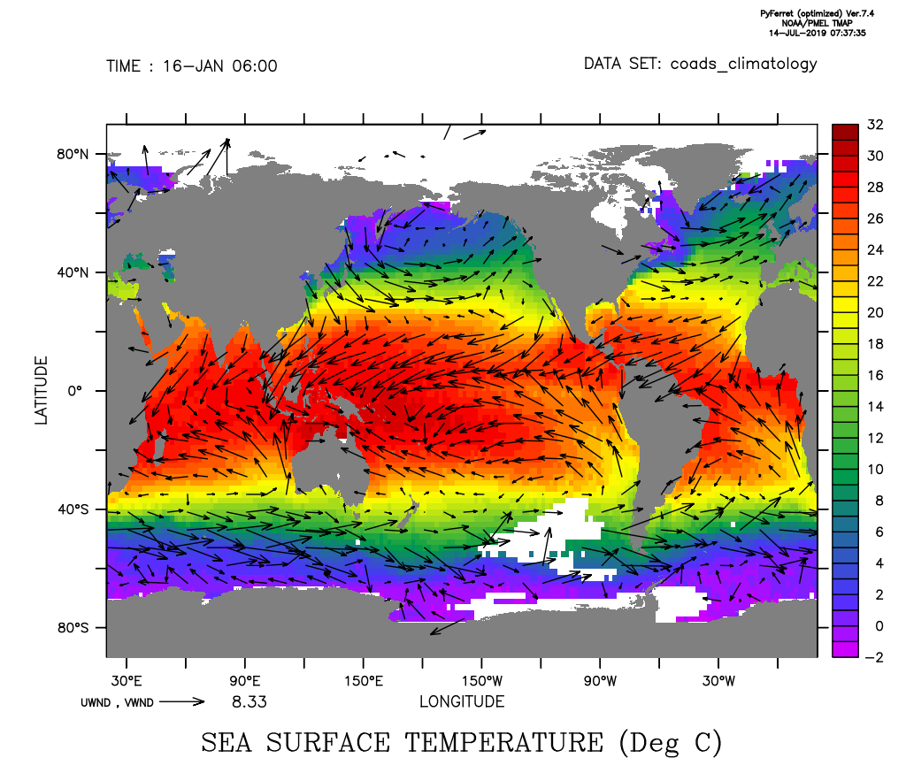

Slide 33
What is special?
data set analysis when opening:
explores the data set automatically uning netcdf features
units:
output has units, taken from the netcdf input file
coordinates and data together:
output is in geographical coordinates
dense command syntax:
one line for a figure
→ reasonable defaults
Context dependent variables:
yes? shade/l=1 sst
yes? shade/x=0 sst
yes? plot/x=0/y=0 sst
yes? list/l=12/x=10/y=-23:-15 sst

Slide 34
Accessing data?
files:
yes? use <filename>
DAP-datasets:
yes? use https://thredds-iow.io-warnemuende.de/thredds/dodsC/genus/IOW- THREDDS-genus_exp19_run3_5day_ocean_2017-10-20-16.nc
file sets with aggregation:
yes? go aggregate sst_*.nc 1
Show the available data sets:
yes? Show data
yes? Show /brief data
yes? stat temp

Slide 35
Using your own coordinates?
See coordinates of variables:
yes? list x[gx=temp] ! show zonal coordinate
yes? list t[gt=temp] ! show time coordinate
To serve as a coordinate, a sequence must be monotonic!
Define axes:
yes? define axis/x=-10:16:1/unit=degrees_east lons
yes? define axis/y=-28:6:1/unit=degrees_north lats
yes? define axis/t=1-jan-2010:1-jan-2011:1/unit=days/t0=1-jan-2000/cal=gregorian times
Define a new grid:
Keep the original time and vertical axis!
yes? define grid/like=temp/x=lons/y=lats new_grid
Put velocity vector onto the coarser grid for plotting:
yes? let u_1 = u[g=new_grid@ave]; let v_1 = v[g=new_grid@ave];
yes? shade/t=1-jan-2011/k=1 (u^2+v^2)^.5
yes? vec/over/k=1/t=1-jan-2011 u_1, v_1

Slide 36
Make a climatology
See climatological axes:
yes? sh axis/all
name axis # pts start end
MONTH_IRREG TIME 12mi 16-JAN 12:00 15-DEC 17:49
MONTH_REG TIME 12mr 16-JAN 06:00 16-DEC 01:20
SEASONAL_REG TIME 4mr 15-FEB 15:43 15-NOV 14:05
MONTH_GREGORIAN TIME 12mi 16-JAN 12:00 15-DEC 17:49
MONTH_NOLEAP TIME 12mi 16-JAN 12:00 16-DEC 12:00
MONTH_360_DAY TIME 12mr 16-JAN 00:00 16-DEC 00:00
MONTH_ALL_LEAP TIME 12mi 16-JAN 12:00 16-DEC 12:00
MONTH_JULIAN TIME 12mi 16-JAN 12:00 15-DEC 18:00
To serve as a coordinate, a sequence must be monotonic!
Use the modulo-transformation:
yes? say `sst,return=calendar`
yes? let sst_climatology = sst[gt=month_julian@MOD]

Slide 37
Make a climatology
Use the modulo-transformation:
yes? say `sst,return=calendar`
yes? let sst_climatology = sst[gt=month_julian@MOD]
Find the anomaly:
yes? let sst_anomaly = sst - sst_climatology[gt=sst@lin]
Make a plot for the Benguela system (off Walvis Bay):
yes? plot/x=13.5/y=-23 sst_anomaly
Be careful with the discussion of the result! Be aware, the model is a forced one and forced with CCMP2.

Slide 38
Analyse data on density surfaces
Use the @weq-transformation:
yes? let sig262 = sig[z=@WEQ:26.2]
yes? let sig = rho_un(salt,temp,0) - 1000
yes? shade/l=1/x=0/z=0:800 sig262 ! see the mask properties
yes? shade/l=1 sig262[k=@sum] ! see the completeness
Find temperature and salinity on these cells:
yes? let temp262 = temp*sig262
yes? shade/l=1 temp262[k=@sum]
Make a plot for the Benguela system (off Walvis Bay):
yes? shade/l=1/x=5:16/y=-25:-15 temp262[k=@sum]

