Slide 1
Resonant Photovoltaic Effect in Doped Topological Materials
Dimi Culcer
UNSW
Pankaj Bhalla – CSRC & FLEET
Allan MacDonald – UT Austin & FLEET
Reza Asgari – UNSW & FLEET
arXiv: 1910.06570

Slide 2
Motivation
Non-linear response is very rich
Hall effect without explicit time-reversal breaking
Many experimental groups setting up non-linear capabilities
FLEET: Lan Wang, Semonti Bhattacharya, Mark Edmonds, Michael Fuhrer
Basic science
FLEET Theme 1: Characterise topological materials & understand dissipation
Inter-band coherence: interplay of Berry curvature effects and disorder
Applications
Solar cells, photodetectors, energy harvesters and wireless networks
What is missing?
AC response most often discussed independently of disorder
AC response most often discussed when the conduction band is empty
Theory: Nagaosa, Sodemann, Golub, Fu, Polini, Lu, Vignale
Experiment: Pablo Jarillo-Herrero, Kin Fai Mak, Hyunsoo Yang, Elaine Li, Lan Wang
There is plenty of room at the bottom in non-linearity

Slide 3
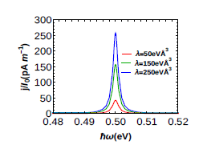
Outline of talk
Non-linear response: background & recent work
Higher harmonics
Rectification, shift and injection currents
Brief theory of 2nd-order response
Resonant photovoltaic effect (RPE)
Occurs in doped materials
Kramers degeneracy needs to be broken
Resonant excitation at the Fermi edge
Interplay of Berry connection and disorder
Experimental observation
Conclusions and Outlook
arXiv: 1910.06570

Slide 4
Linear vs Non-linear Responses
In linear response theory, the electric current is considered to linear order in the field
$$j_{e,a}=\sum_{b}{σ_{ab}}E_{b},$$
where $σ_{ab}$ is the conductivity tensor and $E_{b}$ is the applied electric field.
However, the current has contributions to higher powers of the field
$$j_{e,a}= \sum_{b}{σ_{ab}E_{b}}+\sum_{b,c}{σ_{abc}E_{b}E_{c}}+…$$
DC field: non-linear Hall voltage in the presence of TR (Sodemann, Fu, Lu groups)
AC field: many possibilities including non-reciprocal currents – next slide
Symmetry considerations often kill 2nd-order response
Needs broken inversion symmetry
It is strong in topological materials

Slide 5
Non-linear Optical Response
Consider an AC electric field $E=E_{0}\cos{ωt}$
Naively square $\cos{ωt}→$ $\cos^{2}{ωt}=\frac{1}{2}+\frac{1}{2}$ $\cos{2ωt}$
In general there are two sets of non-linear AC terms
AC with twice the frequency ~ 2nd-harmonic generation
Large SHG in Weyl semimetals e.g. TaAs
DC ~ Photocurrents ~ photogalvanic/photovoltaic effects
All effects known to have topological contributions
Role of disorder hardly discussed at all

Slide 6
Photocurrents: Rectification, Shift, Injection
Rectification and shift are closely related – non-resonant photogalvanic currents
Optics people like these: signal same/similar at all frequencies, large integrated signal
Rectification current
Non-resonant polarisation at frequencies below gap (E_{g}) or effective gap (E_{g} + 2E_{F})
Isobe, Xu & Fu arXiv:1812.08162 High-frequency rectification
Shift current
Light frequency above the gap (E_{g}) or effective gap (E_{g} + 2E_{F})
Carriers excited from the valence band to the conduction band
Center-of-mass shift due to Berry connection, which is different in VB and CB
Injection current
Non-symmetric electron distribution in momentum space by circularly polarised light
Kim, Morimoto, Tokura, Nagaosa, Murakami; Rappe; Sipe, Shkrebtii; Lyanda-Geller; Belinicher & Sturman; Durnev, Tarasenko; Rostami, Polini

Slide 7
Experimental Highlights
AC current ω = 178 Hz
Lock-in amplifier
50K and 10K

Slide 8
Experimental Highlights

Slide 9
Non-linear Response Formalism
Density matrix averaged over impurity configurations $\left\langle ρ\right\rangle$ [PRB 96, 035106 (2017)]
Satisfies the quantum Liouville equation
$H_{E}=e\vec{E}(t)∙\vec{r}$ is the interaction with the time-dependent external electric field
$\vec{E}\left(t\right)=$ $\vec{E}\cos{ωt}$
J is the scattering term, here in the Born approximation
with U a disorder potential having form and we assume $\frac{ε_{F}τ}{ℏ}≫1$

Slide 10
Linear and Non-linear Response
The shift current comes from RR f₀ in 2nd order
It is purely INTRINSIC – no disorder

Slide 11
Topological insulator Bi2Te3
$$H_{0}=H_{R}+H_{M}+H_{W}$$
$H_{R}=A\left(σ_{x}k_{y}−σ_{y}k_{x}\right)$Rashba spin-orbit interaction
$H_{M}=σ.M$ in-plane magnetisation
$H_{W}=λσ_{z}\left(k_{x}^{3}−3k_{x}k_{y}^{2}\right)$hexagonal warping
In-plane magnetisation irrelevant UNLESS warping is present
$ε_{k}^{±}=\sqrt{A^{2}k^{2}+M^{2}+2AkM\cos{θ}+λ^{2}k^{6}\cos^{2}3θ}$
$\text{θ}{=tan}^{−1}{{(k}_{y}/{(k}_{x})}$ is the polar angle of the wave-vector k
$±$represent the two band indices.
Henceforth focus on $ωτ≫1$

Slide 12
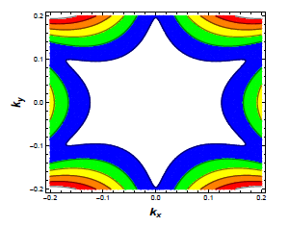
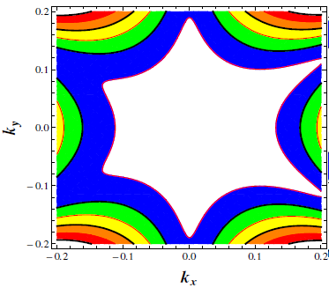
Topological insulator Bi2Te3
Without an in-plane magnetisation
With an in-plane magnetisation
The material is DOPED – there is a Fermi surface

Slide 13
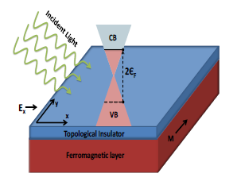
Bi2Te3 Topological insulator
Figure: Schematic of the generation of the Resonant Photovoltaic effect (RPE).

Slide 14
Resonant Photovoltaic Effect
Resonant peak at 2$ε_{F}$
Increasing warping distorts the Fermi contour more, leads to larger current
Increasing asymmetry of Fermi surface leads to larger peak
Figure: RPE for a topological insulator with warping coefficient λ, with $I_{0}$ the intensity in $W/m^{2}$. We have used $ε_{F}=250$meV, A = 2.55 eVÅ, T=1K, M=10 meV and τ = 1ps.

Slide 15
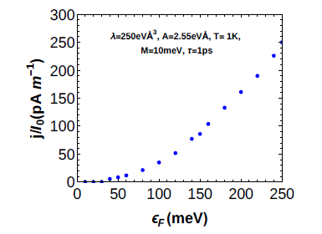
Resonant Photovoltaic Effect
Peak value of the RPE as a function of the Fermi energy at in Bi2Te3.

Slide 16
Origin of RPE: Essential constituents
What are the key ingredients?
Linearly polarised light
Finite doping: Fermi surface
Hexagonal warping – here Bi₂Te₃
Time-reversal breaking
By in-plane magnetisation
Removes Kramers degeneracy
FS has no inversion symmetry
Particle-hole symmetry important
Otherwise different 𝞽

Slide 17
Origin of RPE: Formalism
As $T →0$:
$\frac{∂f_{+\vec{k}}^{0}}{∂k_{x}}→− δ$($ε_{F}$ $−$ $ε_{\vec{k}}^{+}$) $\frac{∂ε_{\vec{k}}^{+}}{∂k_{x}}$
At $ℏω=2ε_{F}$ the integrand $∝$ $τ$ as long as particle-hole symmetry present.
If $ε_{\vec{k}}^{+}=ε_{−\vec{k}}^{+}$, displacements cancel.
To make the effect finite, Kramers degeneracy needs to be broken.
The current is $∝$ net SHIFT in the FS in a similar way to an ordinary DC current
Extra disorder contribution enhances RPE: VB $→$ CB k – k’ transitions due to disorder
This is NOT a Berry curvature effect
Particle-hole symmetry maximises the effect $→$ topological materials are good

Slide 18
How does it work?
Light excites e– from –E_{F} to E_{F}
Mirror FS in VB cannot move
Real FS in CB is shaken by light
FS movement asymmetric
As E oscillates, the contributions from the left and right of the FS do NOT cancel out
As e– excited VB $→$ CB its centre of mass is shifted
Because the group velocity in the CB has the opposite sign to that in the VB
Centre of mass shift = $\frac{2}{ℏ}\frac{∂ε_{\vec{k}}^{+}}{∂\vec{k}} τ$
Hence peak at ℏ𝛚 = 2E_{F}
Below 2E_{F} no excitation
Above 2E_{F} no FS so no movement

Slide 19
Another way of looking at it
Two factors of the electric field
One causes VB – CB transition
One accelerates e– at the Fermi surface
Consider $\vec{E} cos{ωt}$
The first-order Fermi-surface response has an out-of-phase contribution, for $ωτ≫1$ this is
$f_{+\vec{k}}^{1}= \frac{eE_{x}}{ω}\frac{∂f_{+\vec{k}}^{0}}{∂k_{x}}\sin{ωt}$
The set of occupied k oscillates out of phase with E
The response of an occupied k to $\vec{E} cos{ωt}$ also contains an out-of-phase part $∝sin{ωt}$
Because $\dot{\vec{k}}=\vec{E} cos{ωt}$ so $\vec{k}∝sin{ωt}$
This is resonant at the interband transition energy
FUNDAMENTALLY: Bloch state velocity and Fermi surface shift both oscillate in time, but there is a current with a nonzero time average

Slide 20
Origin of RPE: Physics
How is it different from shift current?
Shift current purely intrinsic
1st order in warping
Time-reversal symmetric
RPE is 2nd order in warping
TR breaking needed
In our geometry there is no shift current
Bi₂Te₃: k_{x}, k_{y} not equivalent
For E//x no shift current
For E//y no RPE, there is a shift current

Slide 21
Origin of RPE: Physics
RPE ∝ 𝞽 so could be very large
Disorder keeps the effect finite
It must be treated thoroughly
UNUSUAL – disorder typically suppressed by at least $1/ωτ$
Part of AC response behaves just like DC response
May be sensitive to other disorder effects e.g. WL, Kondo
Applications
Could work as a light detector
Could serve as a probe of E_{F}

Slide 22
Experimental observation
Optics – typically mid-IR
Relying on magnetic proximity effect
TI film should be thin
To maximise proximity effect
Theory strictly speaking valid for thickness > 3nm
But > 3nm very similar @ large E_{F}
Could use magnetic field
But much weaker because of 𝛍_{B}
Other materials – work in progress
Should work in Bi_{2-x}Mn_{x}Te₃
Expect large signal in TMDs
Because of trigonal warping

Slide 23
Summary
Developed general formalism for 2nd order optical response
New, sizable extrinsic contribution to the current ~ RPE
Resonance in DC photocurrent at 2E_{F}
Height, width determined by relaxation time/part-hole asymmetry
Outlook
Complete the theory of 2nd-order response
Temperature dependence: include phonons
Circularly polarised light
Extensions to 2nd–order Hall response
Role of electron-electron interactions
What happens in the ballistic limit?
Can we use Landauer-Buttiker?
Third harmonic generation?

