Slide 1
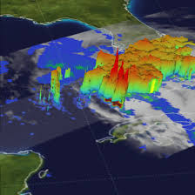
An Introduction to ERA-5 and the Eurosip seasonal forecasts: overview of the products and the system
Adrian M Tompkins, ICTP
Tompkins@ictp.it
picture from Nasa

Slide 2
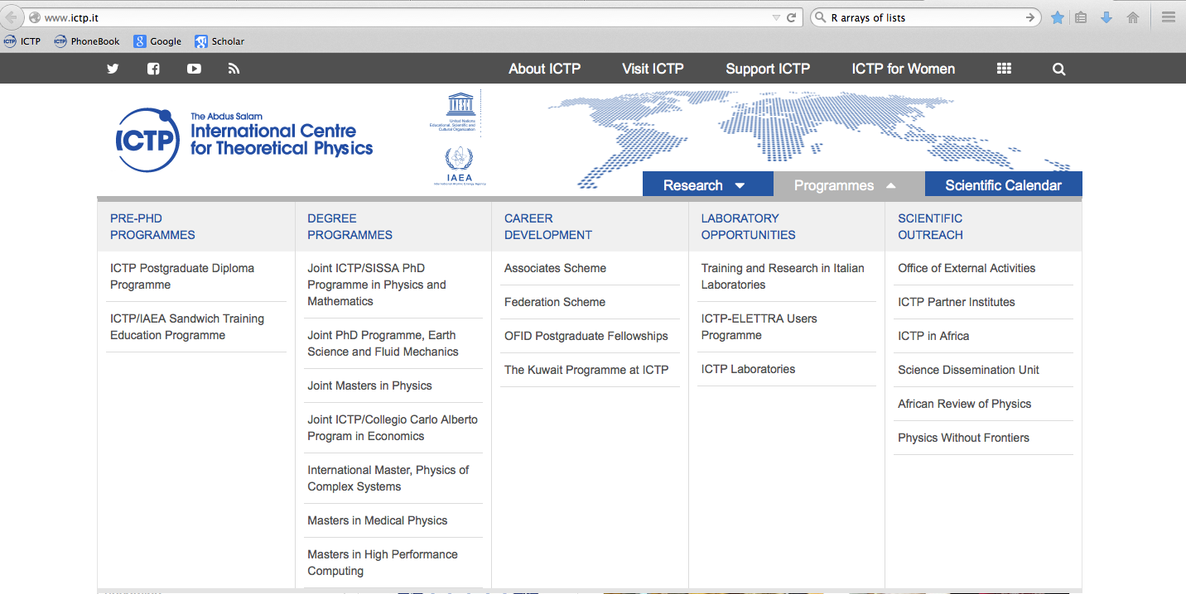
Oceangraphy
Regional climate modelling
Aerosols (REGCM)
Teleconnections (Speedy)
Health Applications (VECTRI)
Hydrology (CHYM)
Solid earth geophysics
Computing
ICTP Diploma – one year fully masters-like programme in earth system sciences.
STEP – sandwich PhD programme. joint supervisors, 6 months visit each year
Associate programme – junior to senior, 3 visits in 6 years.

Slide 3
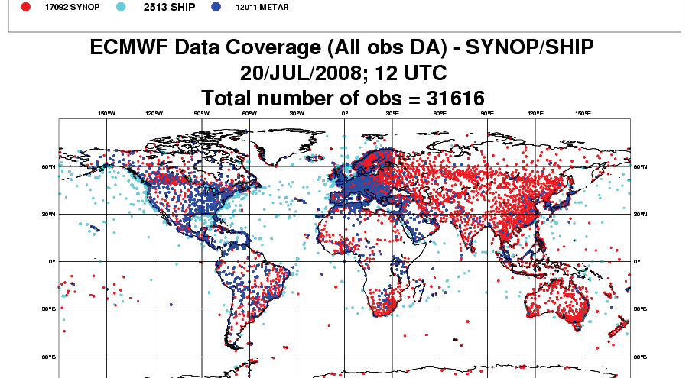
Sources of data: stations

Slide 4
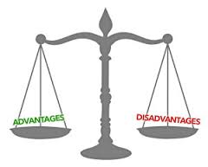

Slide 6
For Satellite – coverage can be less of an issue
(polar or geostationary – resolution, swathe, return times)

Slide 7
Satellite – advantages and disadvantages

Slide 8

What to use?
What is best?
since 2014: GPM@10km!!!

Slide 9
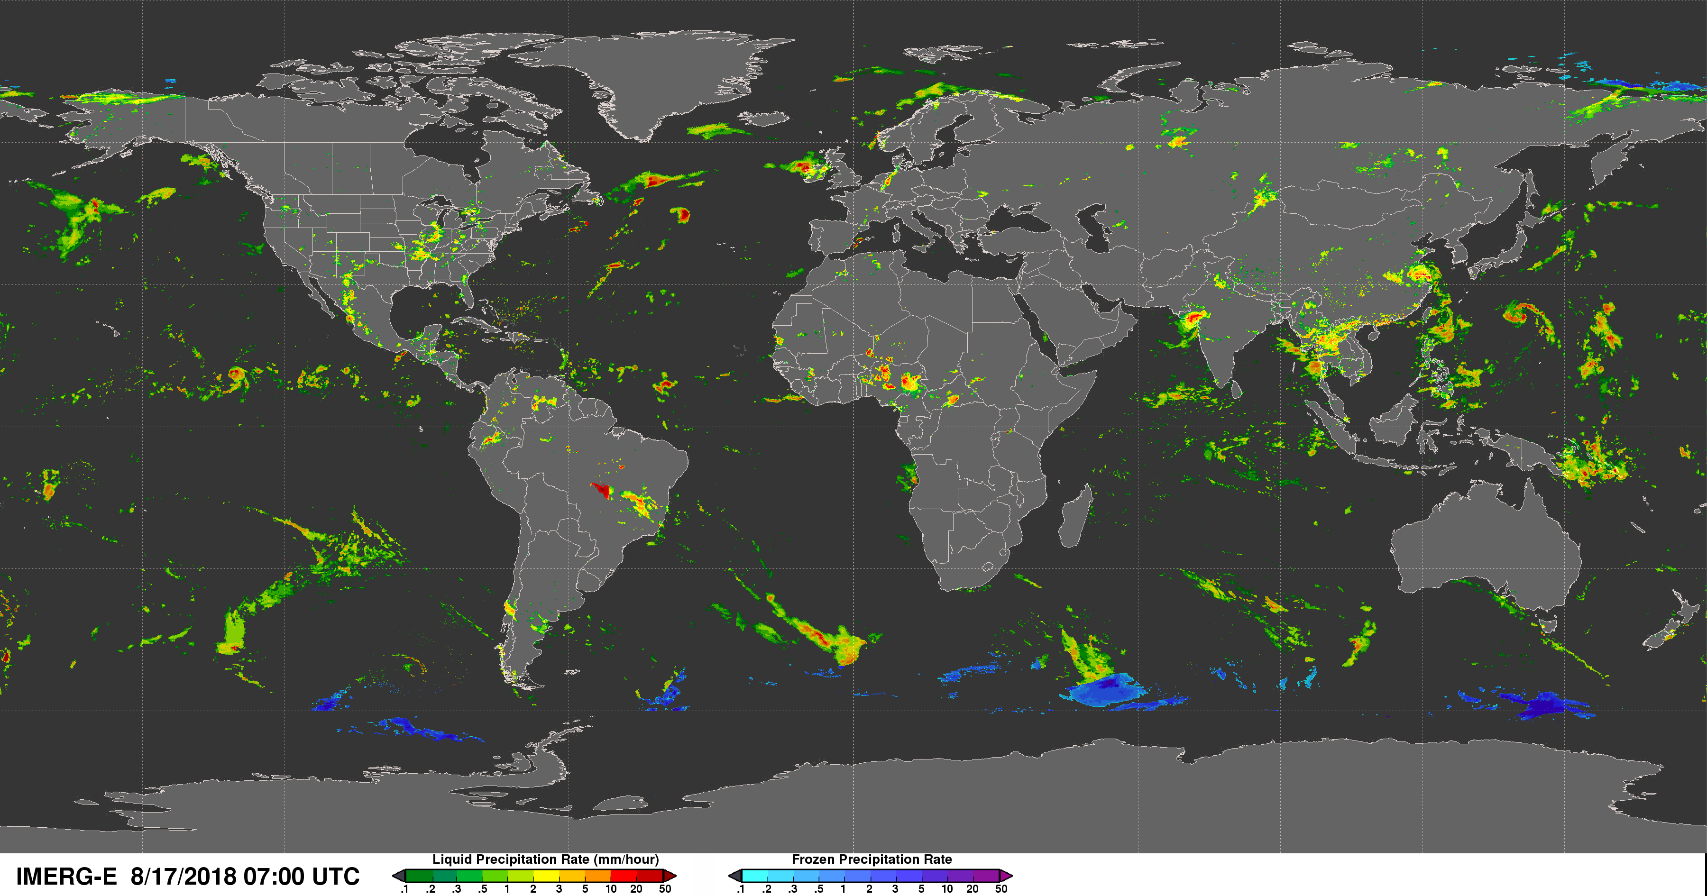
A GPM example
is this better?

Slide 10
But some variables in contrast are difficult to get directly from Satellite
Surface temperature: reliable over oceans using microwave. Some products over land, but uncertainty is large and not available daily
Winds: reasonable over oceans using scatterometer data, surface winds over lands not possible. Upper level winds from feature tracking (cloud, humidity) but uncertainties high.
Humidity: near surface only indirectly.
Take home message: most (near) surface variables over land very difficult to infer from remote sensing

Slide 12
A supplement source of climate information: analysis and reanalysis
To make forecasts of the future weather, knowledge of the present state is required
This “picture” of the atmosphere needs to be “balanced” – Simple spatial and temporal interpolation of observations doesn’t work
Hence the development of analysis systems

Slide 19
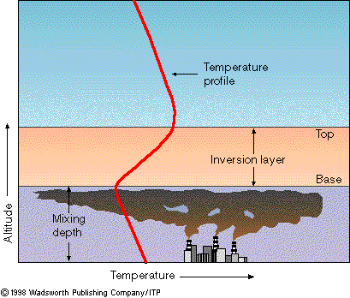

Slide 23
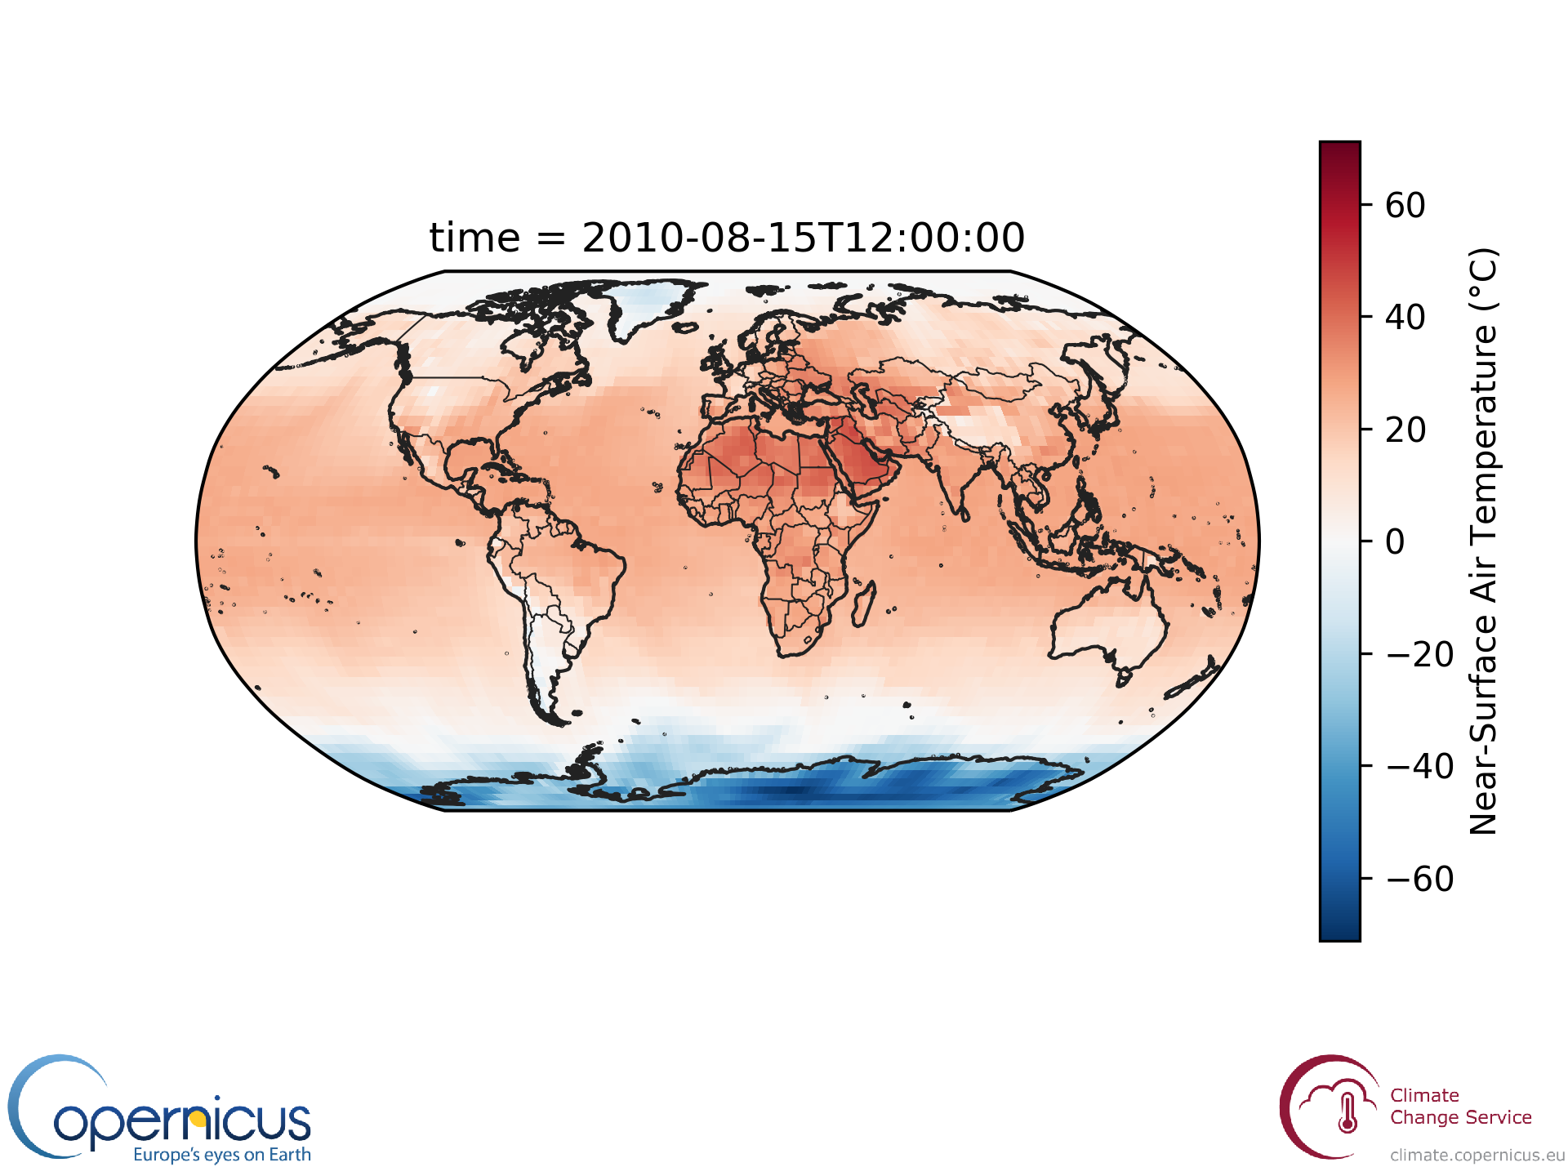
Example: ERA5 surface temperature from C3S toolbox

Slide 24
Let’s take a look at the monitoring
https://www.ecmwf.int/en/forecasts/charts/monitoring/dcover?facets=undefined&time=2019052406,0,2019052406&obs=synop-ship&Flag=all

Slide 28
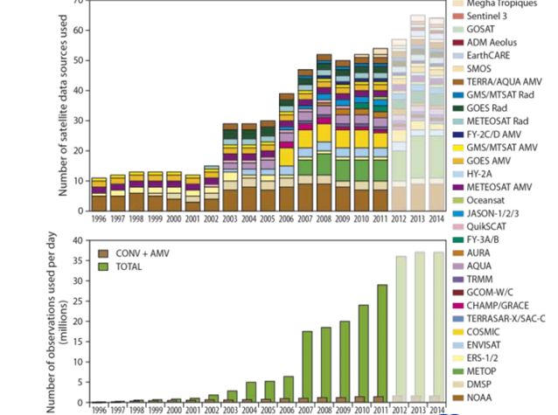
Satellite data usage at ECMWF
Only about 6% of available observations are used

Slide 30


Slide 31
But what is REanalysis?
Operational forecasting systems change their systems 3 or 4 times a year
  New observation sources to be incorporated
  Improvements to the physics in the forecast models
  Improvements to the data assimilation techniques.
This means that the analyses are not “coherent” in time
  e.g. Could a temperature trend be due to changes in data and/or assimilation system
One way to improve the coherency in reanalysis: The same system is run for all past dates.

Slide 32


Slide 33
Reanalysis of ERA-40 uses a model cycle that was operational in 2000
Reanalysis of ERA-Interim uses a model cycle that was operational in approximately 2006
ERA5 uses a model from 2017
operational analysis
Improvements in model and assimilation software
RE-analysis
New satellite data platforms
No Improvements in model and assimilation software – fixed at 2006
New platforms only til 2006 in general
1979
2006
present

Slide 34
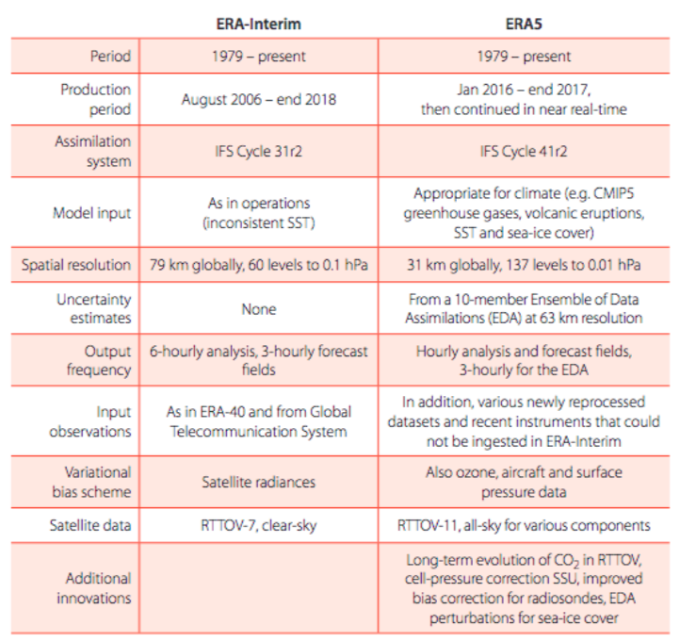
ERA5 – A product of EU Copernicus programme

Slide 35
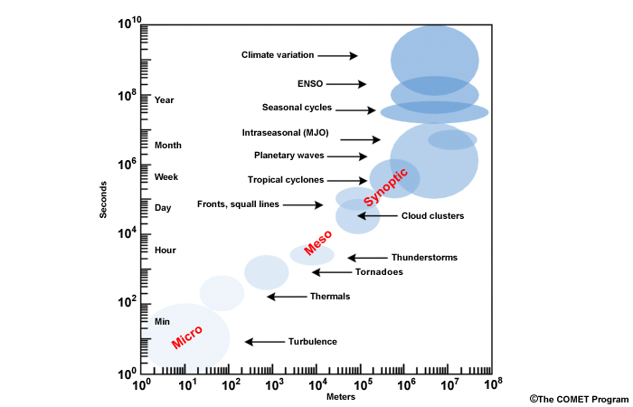
Decadal
Seasonal
Aim of this workshop
Subseasonal
Short-medium
range
Nowcasting

Slide 36
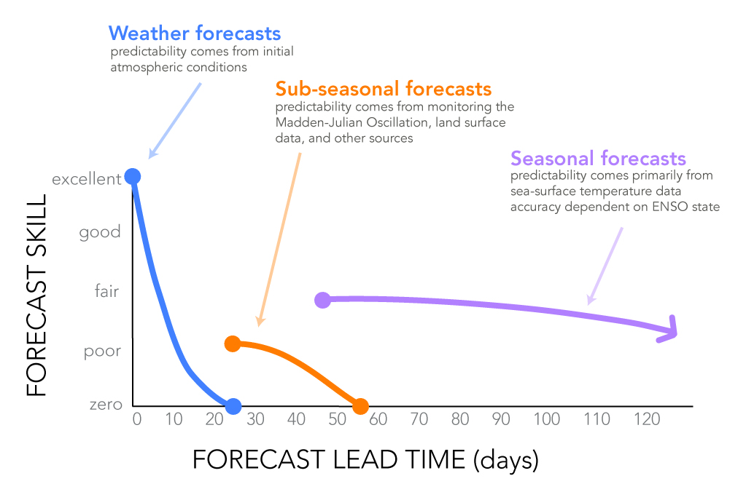
processes and skill...

Slide 37
These gains can only be realized if these systems and/or initialization that is not in the shorter range system

Slide 38
The Madden-Juilian Oscilliation

Slide 39
This is important as the MJO skill has been improving in models

Slide 40
Seasonal prediction: ENSO

Slide 41
La Nino and El Nino conditions
Thermocline deepens to the as as a result of the Eastward propagating Ocean Kelvin wave

Slide 42
S2S week 3-4 correlation high skill over ENSO region
But does it beat persistence?

Slide 43
Seasonal Forecasting systems Eurosip
Why so many lines?
What are the causes of the uncertainty?

Slide 44
Seasonal Forecasting systems Eurosip
Initial Condition uncertainty (from where?)
Model physics uncertainty
How are these treated?

Slide 45
An introduction to the ECMWF framework
10 days
Deterministic run (highest resolution)
15 days
48 days (twice per week)
Dynamic “on the fly” hindcast
20 previous years
extended EPS (progressive intermediate resolution)
51 members
7 months
13 months (4 times/year)
51 members
Seasonal forecast (even lower resolution)
Fixed hindcast period

Slide 46
Why do we need the hindcast suite?
time
Forecast
Real world

Slide 47
Why do we need the hindcast suite?
Corrected
Forecast
time
Forecast
Real world
Model world

Slide 48
Why do we need the hindcast suite?
Corrected
Forecast
time
Forecast
Real world
[ Real ] Model world!

Slide 49
Example for temperature forecasts from SYS5

Slide 50
Hindcast Strategies
“On the fly” – Each forecast is accompanied by a set of hindcasts starting on the same date for the previous N years
  GOOD: same model version and set up
  GOOD: Always same start date
  BAD: Expensive to run, smaller ensemble sizes
“Fixed” – Hindcast data set run once for a particular model cycle
  GOOD: Cheaper (if system not updated too frequently), larger ensemble sizes possible
  BAD: Not always matching dates
18/03/2015
15/03/2015
18/03/2014
15/03/2014
18/03/2013
15/03/2013
18/03/2012
15/03/2012
18/03/2011
ALSO: “Burst” (large ensemble on set days) versus “lagged” (trickle of few forecasts each day) [see Bill’s lecture]

Slide 51
The Met Office system
from MacLachlan
et al, QJRMS, 2015
Four forecast members initialized each day are combined in a lagged ensemble.
Sub-seasonal products are generated from 7 days of forecast members.
Seasonal products use 3 weeks of forecast members in the ensemble.
Each week a hindcast set for a given initialization date is completed.
The same hindcast is used to bias correct both seasonal and sub-seasonal products.

Slide 52
Seasonal forecasting within the C3S
The C3S seasonal forecast products are based on data from several state-of-the-art seasonal prediction systems.
Multi-system combinations, as well as predictions from the individual participating systems, are available.
The centres currently providing forecasts to C3S are
  ECMWF,
  The Met Office
  Météo-France
  DWD
  CMCC

Slide 53
SYSTEM |  | FORECASTS |  | HINDCASTS
 |  | ENSEMBLE SIZE and START DATES | PRODUCTION | ENSEMBLE SIZE and START DATES | PRODUCTION
ECMWF | System 4 (CDS system: 4) | 51 members start on the 1st | real-time | 15 members start on the 1st | fixed dataset
 | SEAS5 (CDS system: 5) | 51 members start on the 1st | real-time | 25 members start on the 1st | fixed dataset
Météo-France | System 5 (CDS system: 5) | 51 members ^{(a)} 26 start on the first Wednesday after the 19th 25 start on the first Wednesday after the 12th | real-time | 15 members start on the first Wednesday after the 19th ^{(a)} | fixed dataset
 | System 6 (CDS system: 6) | 51 members 1 starts on the 1st 25 start on the 25th 25 start on the 20th | real-time | 25 members 1 starts on the 1st 12 start on the 25th 12 start on the 20th | fixed dataset
Met Office | GloSea5 ^{(b)} (CDS system: 12,13, 14 ^{(d)}) | 2 members start each day ^{(c)} | real-time | 7 members on the 1st 7 members on the 9th 7 members on the 17th 7 members on the 25th | on-the-fly produced around 4-6 weeks in advance
CMCC | SPSv3 (CDS system: 3) | 50 members start on the 1st | real-time | 40 members start on the 1st | fixed dataset
DWD | GCFS2.0 (CDS system: 2) | 50 members start on the 1st | real-time | 30 members start on the 1st

Slide 54

Bewildering array of data access choices
Web Portal
data order
(NOAA)
FTP server
(NCEP)
Thredds servers
(ISIMIP)
Web Portal
graphical interface
(Climate explorer)
Python API
data interface
(ECMWF, C3S)
remote processing
toolboxes
(IRIDL, C3S)

Slide 55

Common go-to locations, many of which will be introduced this week
Now: observations
  IRI data library
  Data originator portal
Reanalysis (ERAI/ERA5)
  ECMWF
  Copernicus C3S
Short range (TIGGE)
  ECMWF (research only, not real time)
Subseasonal S2S
  ECMWF (research only, not real time)
Seasonal
  NMME (USA systems, monthly)
  CHFP (global centres, monthly, hindcast only)
  ECWMF (EUROSIP)
  Copernicus C3S
Decadal to Climate change (CMIP)
  CMIP on the earth system grid (ESG)
  KNMI climate explorer
  Copernicus C3S
Where is the data?

Slide 56
TIGGE: the THORPEX Interactive Grand Global Ensemble
TIGGE is a key component of THORPEX (the Observing System Research and Predictability Experiment): a World Weather Research Programme (WWRP) programme to accelerate the improvements in the accuracy of 1-day to 2 week high-impact weather forecasts.
The TIGGE archive consists of ensemble forecast data from ten global NWP centres, starting from October 2006
Available for scientific research (not real-time)
THORPEX programme finishes at the end of 2014, TIGGE will continue for a further 5 years, when its future will be reviewed.

Slide 57
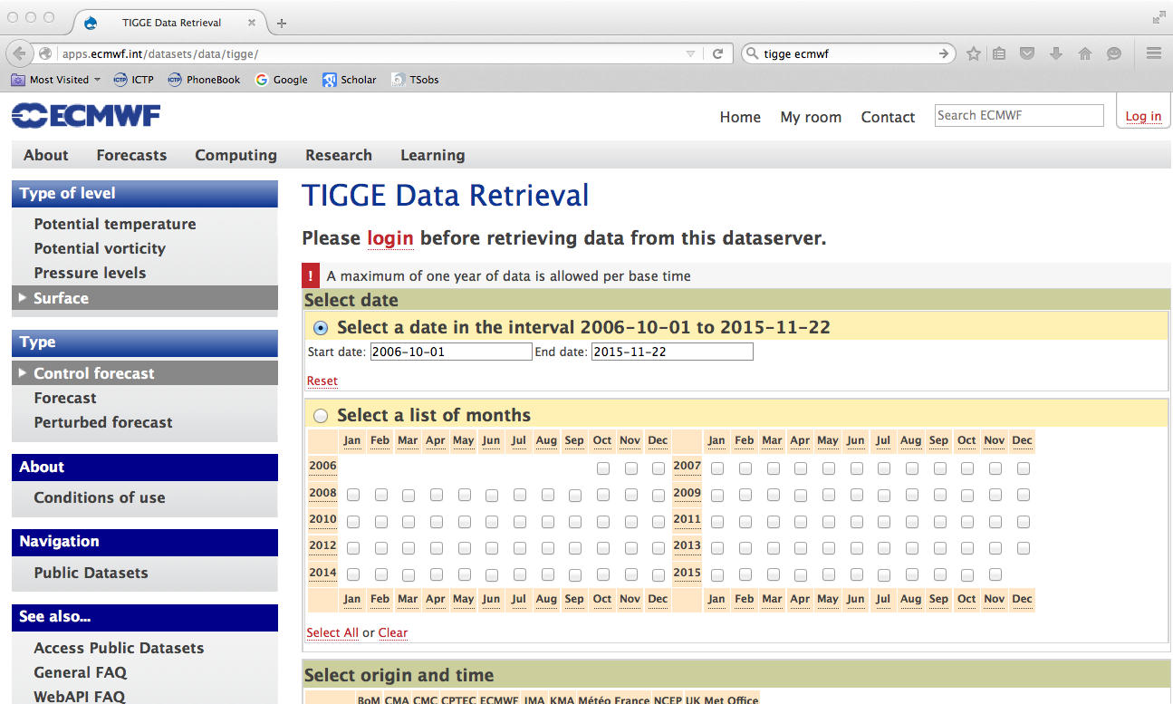
Data portal: http://apps.ecmwf.int/datasets/data/tigge/

Slide 58
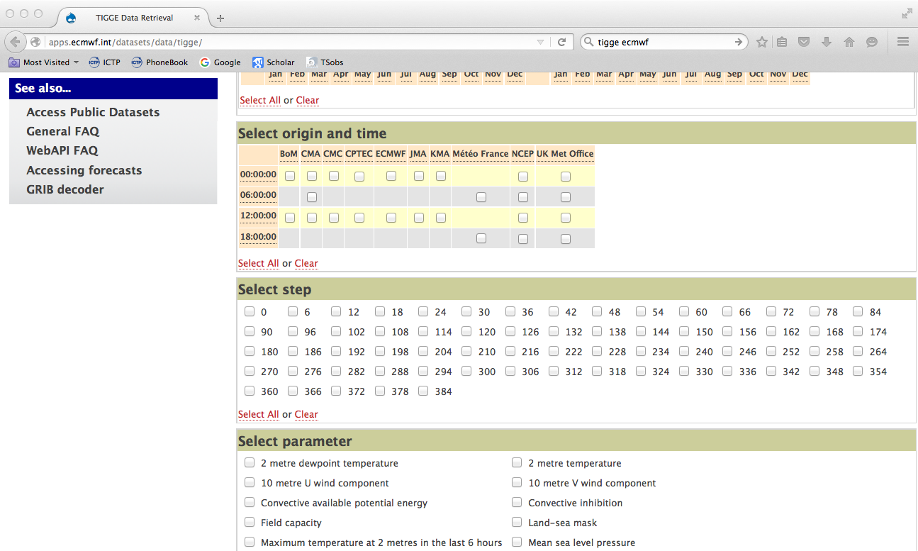

Slide 59
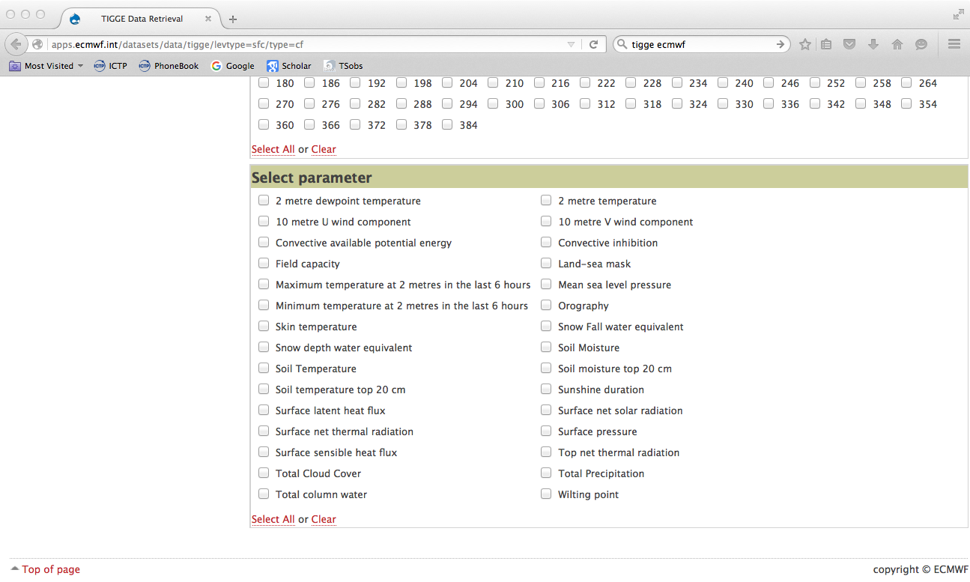

Slide 60
3. The TIGGE ensembles
The 9 TIGGE operational, medium-range, global ensembles use different methodologies to simulate initial-time and model uncertainties. Every day, the 7 ensembles that are still operational, put 436 forecasts into the TIGGE archive. These forecasts have horizontal resolution ranging from about 210 km to about 32 km, and forecast length between 10 and 16 days. They all simulate initial/observation and model uncertainties in different ways.
Notes:
The 9 TIGGE operational, global, medium-range ensembles use different methodologies to simulate initial-time and model uncertainties, that can be grouped since some of the methods are similar or related. Note that BMRC has stopped issuing medium-range ENS forecasts at the end of 2010, and UKMO stopped in July 2014. Thus today, every day 436 global forecasts spanning a forecast range of up to 16 days, are generated and exchanged within TIGGE. These forecasts are available, with a 48-hour delay, from the TIGGE archive.
In the next slides we will first discuss the key characteristics of the different methods, and then show how ensemble design affects performance.

Slide 61
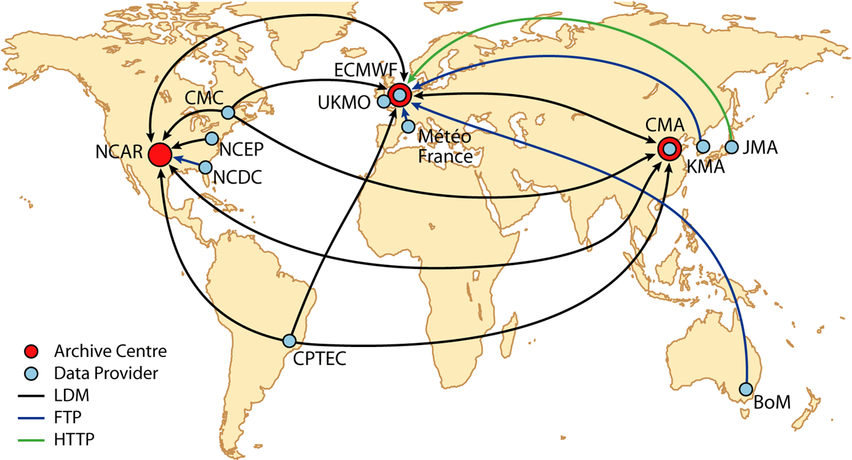
TIGGE data flows
The ensemble prediction data is transferred from the data providers to one of the data centres (using LDM, FTP or HTTP).
After checking, the data is then sent on to the other data centres.
The data is archived and made available to users 48 hours after initial forecast time.

Slide 62
TIGGE features
All data are archived at native resolution (on native grid when possible)
Data may be interpolated on any limited-area lat-lon grid defined by the user just before download
Field names, definitions, units, accumulation times, (etc.) are fully standardized
Data gaps are continuously monitored and every effort is made to repair them quickly
All data provided in GRIB2 (WMO standard data format)
Predictability
science
Applications
academic
NHMS
other
users
NCAR
ECMWF
CMA
EPS 1
EPS 2
EPS n
AMS - IIPS - 2012
Slide 62
Notes:
62
62

Slide 63
Subseasonal to Seasonal (S2S) Database
Daily real-time forecasts + re-forecasts: 48 to 62 days lead time
3 weeks behind real-time
Common grid (1.5x1.5 degree)
Variables archived: about 80 variables including ocean variables, stratospheric levels and soil moisture and temperature
Archived in GRIB2 – NETCDF conversion planned
Database opened in May 2015, now 9 models available

Slide 64
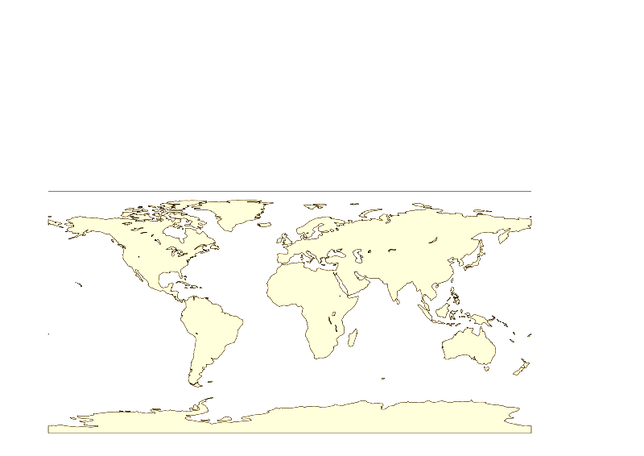
Contributing centres to S2S
Data provider (11)
Archiving centre (2)
ECMWF
EC
UKMO
HMCR
KMA
NCEP
Météo
France
ISAC
CMA
JMA
BoM

Slide 65
S2S partners
 | Time-range | Resol. | Ens. Size | Freq. | Hcsts | Hcst length | Hcst Freq | Hcst Size
ECMWF | D 0-46 | T639/319L91 | 51 | 2/week | On the fly | Past 20y | 2/weekly | 11
UKMO | D 0-60 | N216L85 | 4 | daily | On the fly | 1989-2003 | 4/month | 3
NCEP | D 0-44 | N126L64 | 4 | 4/daily | Fix | 1999-2010 | 4/daily | 1
EC | D 0-35 | 0.6x0.6L40 | 21 | weekly | On the fly | Past 15y | weekly | 4
BoM | D 0-60 | T47L17 | 33 | weekly | Fix | 1981-2013 | 6/month | 33
JMA | D 0-34 | T159L60 | 50 | weekly | Fix | 1979-2009 | 3/month | 5
KMA | D 0-60 | N216L85 | 4 | daily | On the fly | 1996-2009 | 4/month | 3
CMA | D 0-45 | T106L40 | 4 | daily | Fix | 1992-now | daily | 4
Met.Fr | D 0-60 | T127L31 | 51 | monthly | Fix | 1981-2005 | monthly | 11
CNR | D 0-32 | 0.75x0.56 L54 | 40 | weekly | Fix | 1981-2010 | 6/month | 1
HMCR | D 0-63 | 1.1x1.4 L28 | 20 | weekly | Fix | 1981-2010 | weekly | 10
See ICTP S2S school: http://indico.ictp.it/event/a14264/

Slide 66
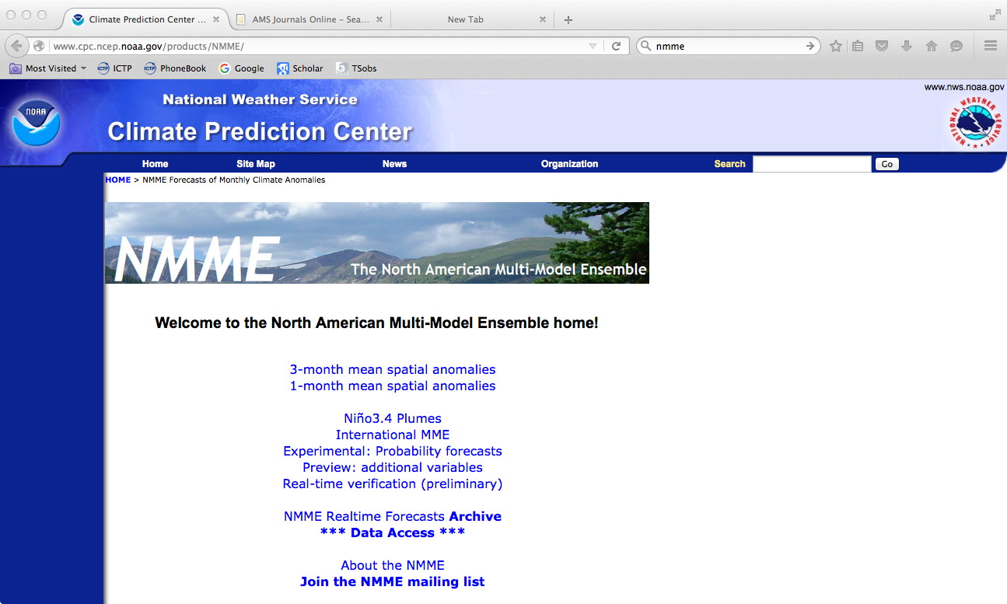
NMME

Slide 67
NMME
Read the user guide!
Refer to Kirtman et al. 2014 BAMS article
Who is involved?
  NOAA NCEP CFSv1 (retired October, 2012)
  NOAA NCEP CFSv2
  IRI ECHAMA and ECHAMF (retired August, 2012)
  NASA Goddard Space Flight Center (GSFC) GEOS5
  NCAR/University of Miami CCSM3.0
  GFDL CM2.1
  GFDL CM2.5 [FLORa06 and FLORb01] (joined March, 2014)
  Environment Canada CanCM3 and CanCM4 (joined September, 2012)
Each real-time forecast available by the 9th of the month

Slide 68
What’s available for real-time?
Spatial anomaly forecasts
  one-month: ensemble mean monthly anomaly forecasts for each model based on their climatology from the hindcasts. The models are equally weighted, meaning the ensemble means for each model are calculated first, then averaged together to form the multi-model mean. Forecasts for the following seven months are available. (also 3 month averages)
Skill maps are based on the monthly/three-month anomaly correlation for each variable's ensemble mean from the 1982-2010 hindcasts. Skill maps are available for the individual models and for the NMME.
Nino Plumes
International MME: EUROSIP (maps only, no digital data)
Experimental probability forecasts: probability forecasts are a different representation of the model data, and are prepared in parallel to the the anomaly forecasts.
Preview of additional variables: Five variables are available in "preview" mode: 200 mb height, maximum and minimum 2 m surface temperature, runoff, and soil moisture.
Preliminary real-time verification: Skill assessments of the real-time forecasts are updated monthly between the 6th - 8th.

Slide 69
Hindcasts (phase 1)
Each model has a complete set of retrospective forecasts for 1982-2010 (CFSv1=1982-2009)
These hindcasts are used for model calibration and for studies.
Only monthly means are available, for the three variables: sea-surface temperature, 2 meter temperature, and precipitation rate, at a global, 1-degree latitude by 1-degree longitude resolution.
The phase 1 hindcasts are available on the IRI datalibrary: http://iridl.ldeo.columbia.edu/SOURCES/.Models/.NMME/

Slide 70
Hindcasts phase 2
Many more variables are available on the earth system grid: https://www.earthsystemgrid.org/search.html?Project=NMME
Hindcast period covers 1980-2015 but the core period is 1982-2012
Files can be:
  downloaded through a Web Browser,
  downloaded in bulk via a WGET script,
  requested from the Deep Storage Archives (SRM).
list of variables available here: http://www.cpc.ncep.noaa.gov/products/ctb/nmme/NMME_Data_Strategy.pdf

Slide 71
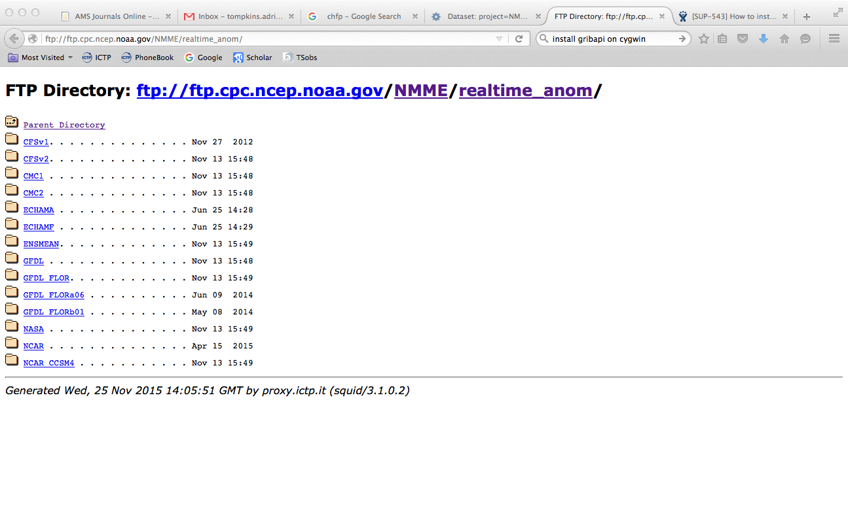
Real time forecasts:
These are available on an ftp archive: ftp://ftp.cpc.ncep.noaa.gov/NMME/realtime_anom/
Access through the web interface or ftp
To retrieve absolute fields, then you need the climatologies: ftp://ftp.cpc.ncep.noaa.gov/NMME/clim/

Slide 72
Data locations for realtime
MODEL
VARIABLE
(rain, temperature, SST)
ENSEMBLE
MEMBER
OBVIOUS!
CFSv2/2011110800/prate.2011110306.01.CFSv2.anom.avrg.1x1.grb
FORECAST ISSUE DATE
FORECAST START DATE

Slide 73
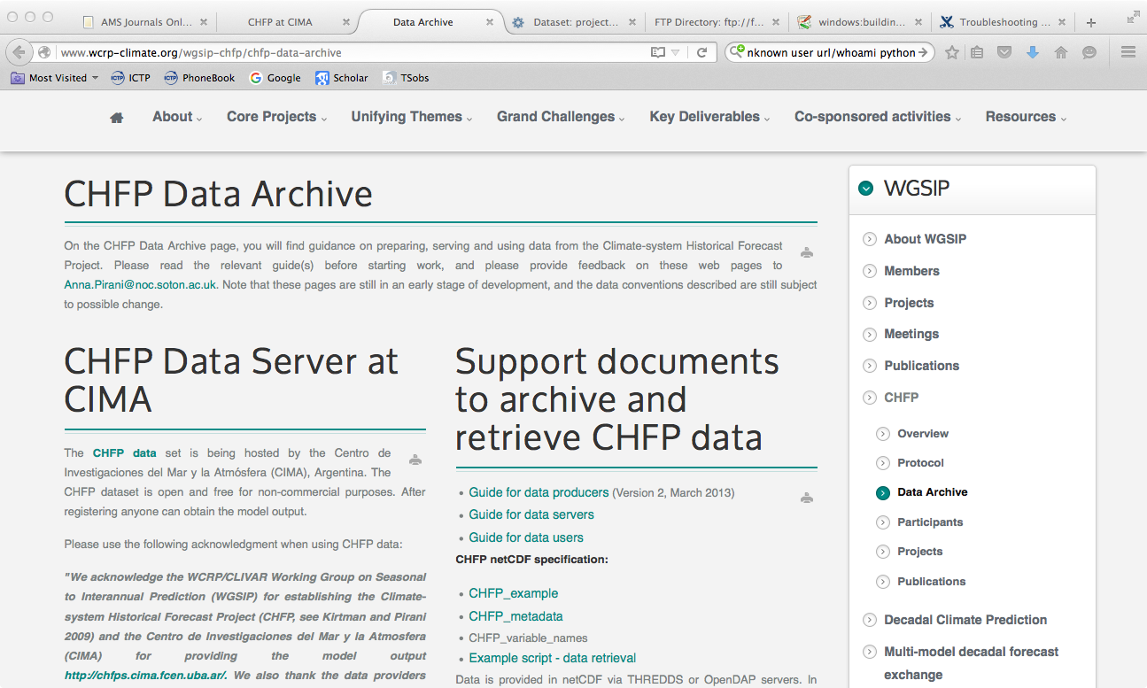
CHFP: Climate-system Historical Forecast Project

Slide 74
CHFP
A WGSIP (working group on [sub]seasonal to internannual[decadal] prediction) project
Idea is to create a long-term archive for seasonal prediction model’s hindcast (reforecast) datasets.
No operational data archived, used as a research tool
Idea is for a “living” archive, that is updated as newer model versions come online to document long-term improvements in seasonal prediction
http://www.wcrp-climate.org/wgsip-chfp/chfp-data-archive
http://chfps.cima.fcen.uba.ar/

Slide 75
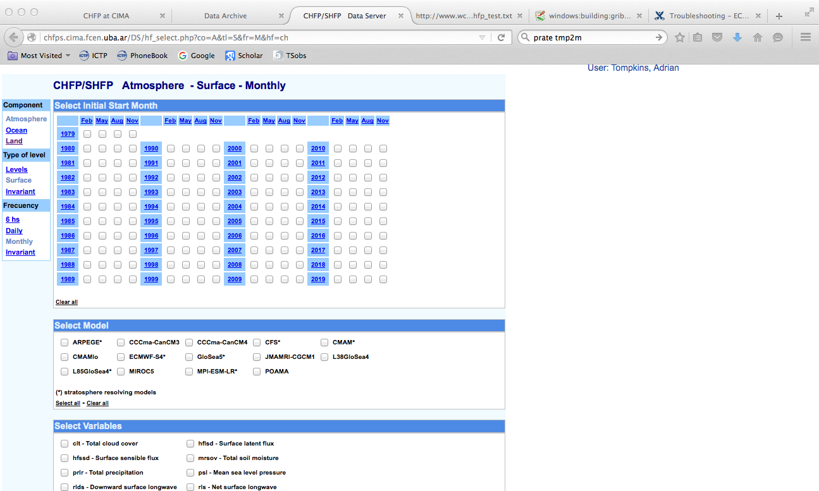
What is in there?
4 start dates a year
Mostly monthly mean variables
limited daily data

Slide 76
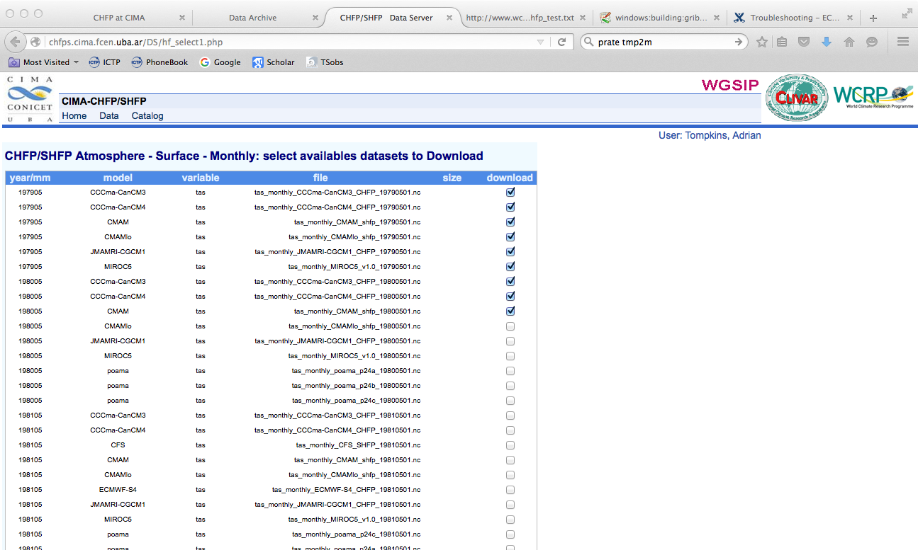
Web data interface

Slide 77
KNMI climate explorer
Provides easy access to CMIP3 (daily&monthly) and CMIP5 (monthly) model output
Some observational data also available
Simple functionality allow online calculation of anomalies, trends and apply filters.
Simple exercise sheet on the s2s clima-dods site

Slide 78
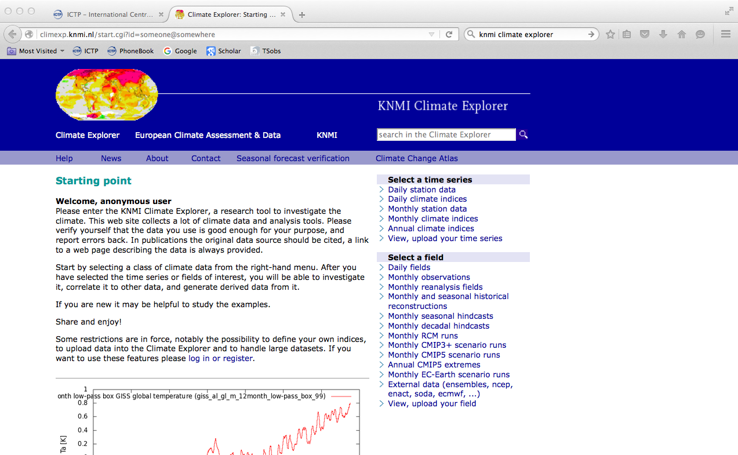
http://climexp.knmi.nl

Slide 79
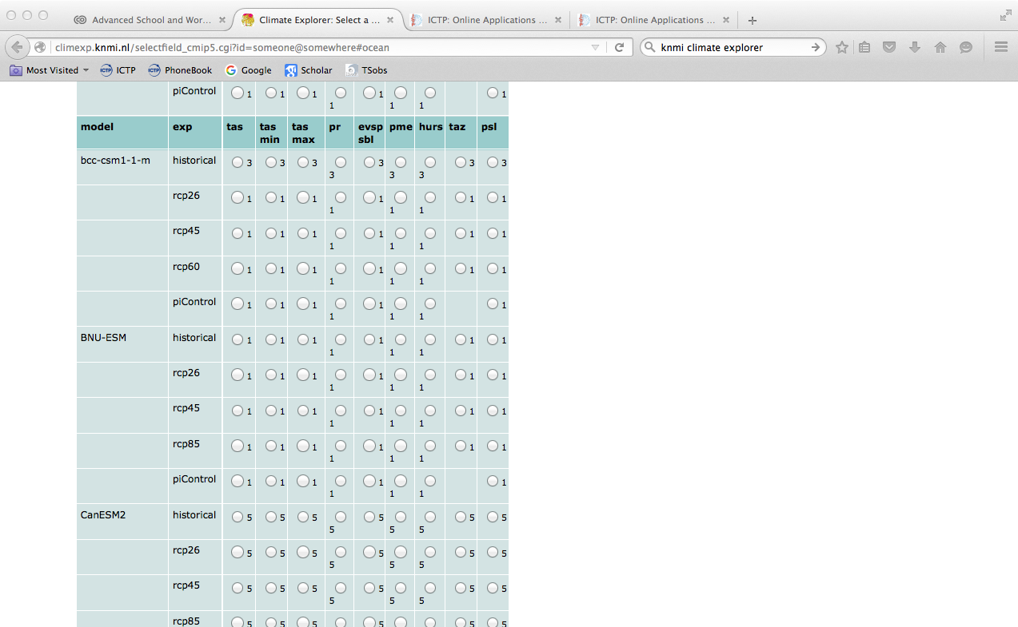
variable (tas=T2m,pr=precip)
model
Ensemble number
Emission Scenario

Slide 80
EUROSIP multi-model ensemble
Four seasonal forecast models archived at ECMWF:
  ECMWF – SYSTEM 4
  Met Office – HADGEM model, Met Office ocean analyses
  Météo-France – Météo-France model, Mercator ocean analyses
  NCEP – CFSv2
Unified system
  Real-time since mid-2005
  All data in ECMWF operational archive
  Common operational schedule (products released at 12Z on 15th)
  Recent changes at Met Office have limited the system somewhat
  See “EUROSIP User Guide” on web for details, and also the ECMWF Newsletter article (Issue No. 118, Winter 2008/09)

Slide 81
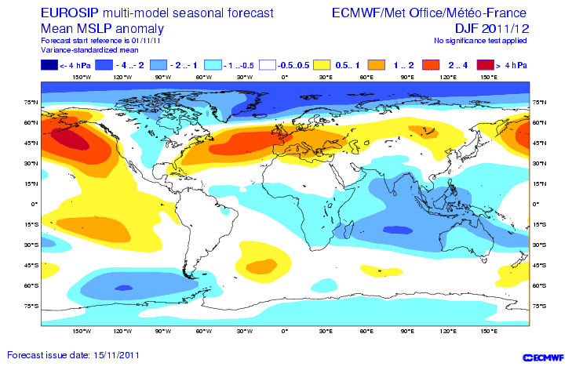
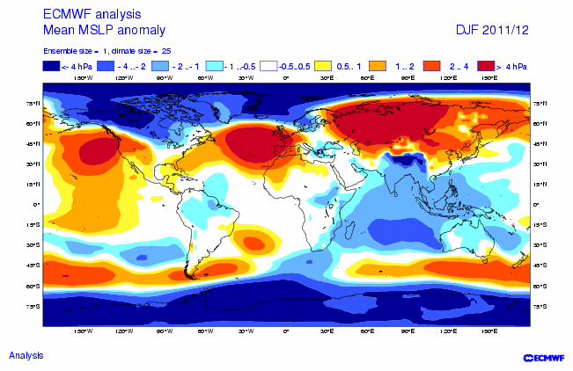
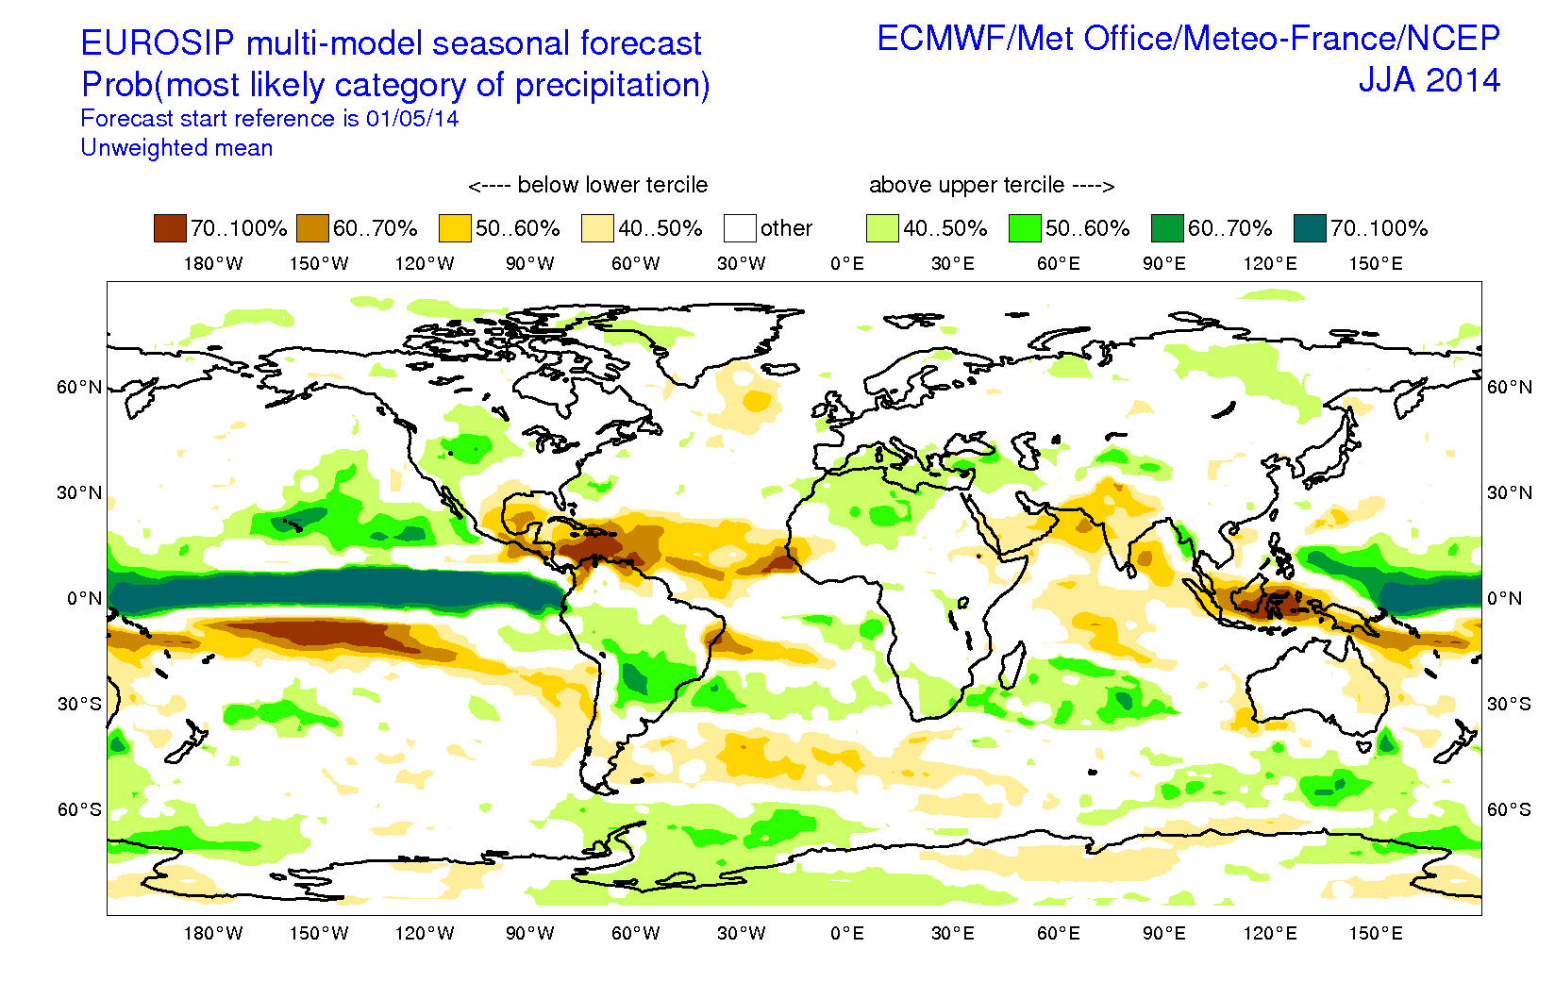
EUROSIP web products

Slide 82
EUROSIP data
Individual model data archived in MARS
  NEW! Available in realtime, with ECMWFAPI and C3S API access...
  C3S toolbox beta release for remote processing
Multi-model data products
  Created and archived in MARS
  Available for dissemination, also for commercial customers

Slide 83
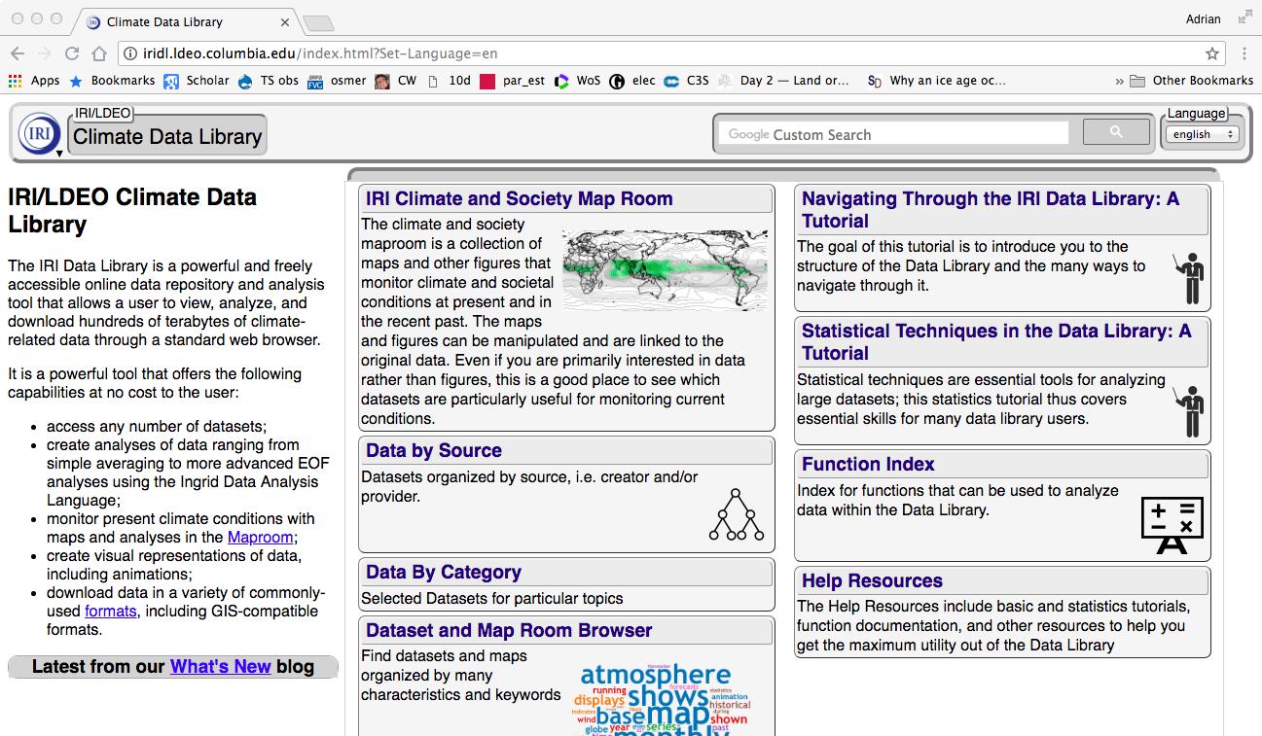
Observations and IRI data library
data repository – data visualization - data analysis tool - Q: What are the advantages and disadvantages of such a platform?

