Slide 1
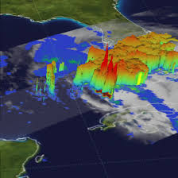
NWP and climate model uncertainty
Adrian M Tompkins, ICTP
Tompkins@ictp.it
picture from Nasa

Slide 4
The continium hypothesis
How large?
computing power
Domain of simulation?
Length of problem (5 days forecast of 100 year climate projection?)

Slide 5
Progression in resolution
CMIP5/AR5 was not a great increase relative to AR4, due to increase in ensemble sizes

Slide 6
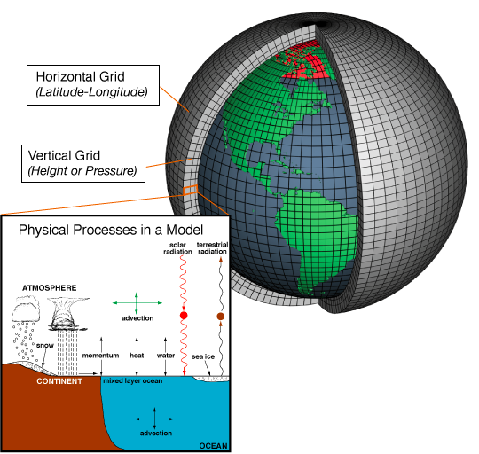
What is the issue concerning finite grid scales?
Many processes are subgrid-scale!
They must therefore be represented by parametrizations – simple models that represent the effect of the small scales in terms of the grid-resolved variables.

Slide 7
Key physical processes to be parametrized in NWP

Slide 9
Again, in such models the effects of subgrid-scale and non-local turbulent transports need to be represented

Slide 11
Why are we worried about parametrizations?
  Not always derivable from theory
  May contain ad-hoc assumptions, particularly to close the equation set.
  May contain parameters that are difficult to measure from observations or derive from theory.
Result: model uncertainty
Example: in CMIP3/AR4 cloud parametrization schemes were the larges cause of differences in climate sensitivity between the models. This has not changed in CMIP5/AR5.

Slide 12
This leads to uncertainty in forecasts due to an imperfect model
observed state

Slide 13
This leads to uncertainty in forecasts due to an imperfect model
observed state
forecast

Slide 14
But uncertainty is also a result of inaccurate initial conditions
Question: how can we account for this uncertainty?

Slide 15
We run ensembles of forecasts...
Differences due to initial condition uncertainty AND model uncertainty

Slide 16
Example: 3 day forecasts of the 2000 storms in USA from Buizza and Chessa, 2002, MWR

Slide 17
9 member regional model rainfall seasonal forecasts for East Africa (Diro et al. 2012)

Slide 18
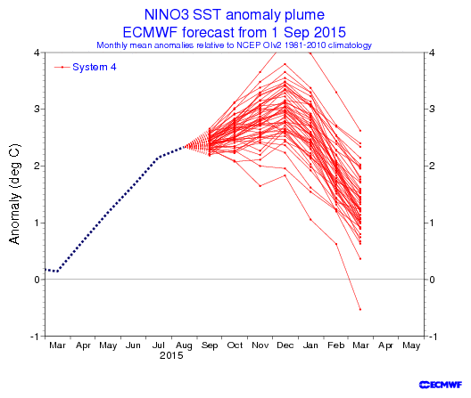

Slide 19
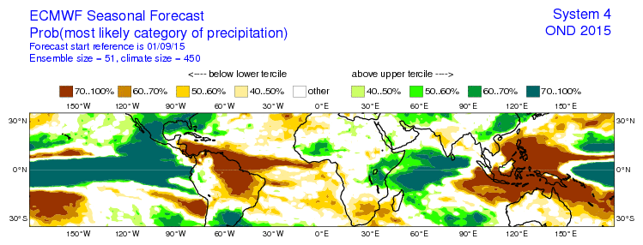

Slide 20
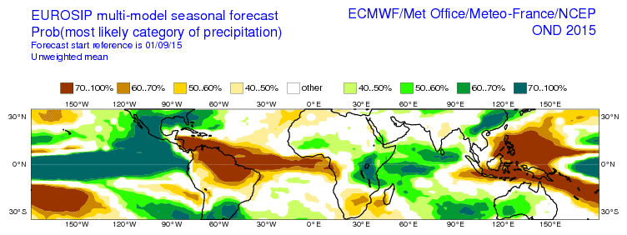
EuroSIP: ECMWF, MeteoFrance, Met Office, NCEP
ECMWF
EUROSIP

Slide 21
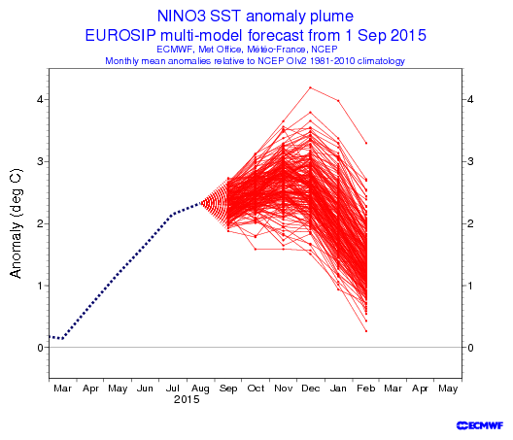
Single Model – Can add other modelling systems e.g. EUROSIP (ECMWF, MeteoFrance, UKMO, NCEP)
EUROSIP
ECMWF
WHAT IS STRANGE HERE ?

Slide 22
The standard deviation between the forecasts is referred to as the inter-ensemble “spread”
QUESTION: How large should the spread be?

Slide 23
In general, for any given forecast lead time, we want the spread to be comparable to the RMS forecast error

Slide 24
“Over-confident” forecasting system – observations often lie outside the ensemble

Slide 25
“Under-confident” system – perturbations are too strong and overestimate the system error

Slide 26
QUESTION: forecast states 70% chance of rain – and it rains – is this a good forecast?
no rain
rain

Slide 27
Uncertainty in climate modelling

Slide 28
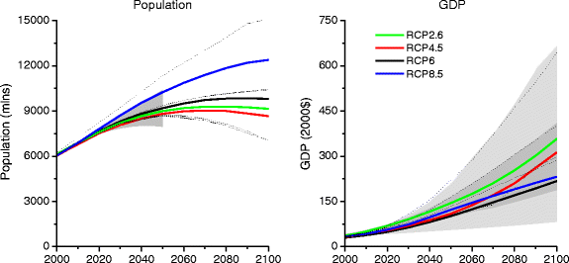
Emissions scenarios in CMIP5

Slide 29
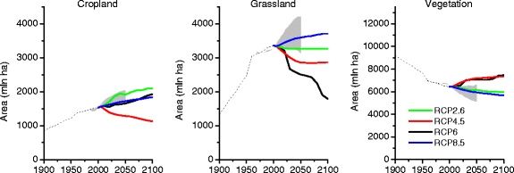
RCP2p6 is not all good news...
RCP2p6 and 8p5 are surprisingly similar due to high use of biofuels needed to respect 2p6 Wm⁻²

Slide 30
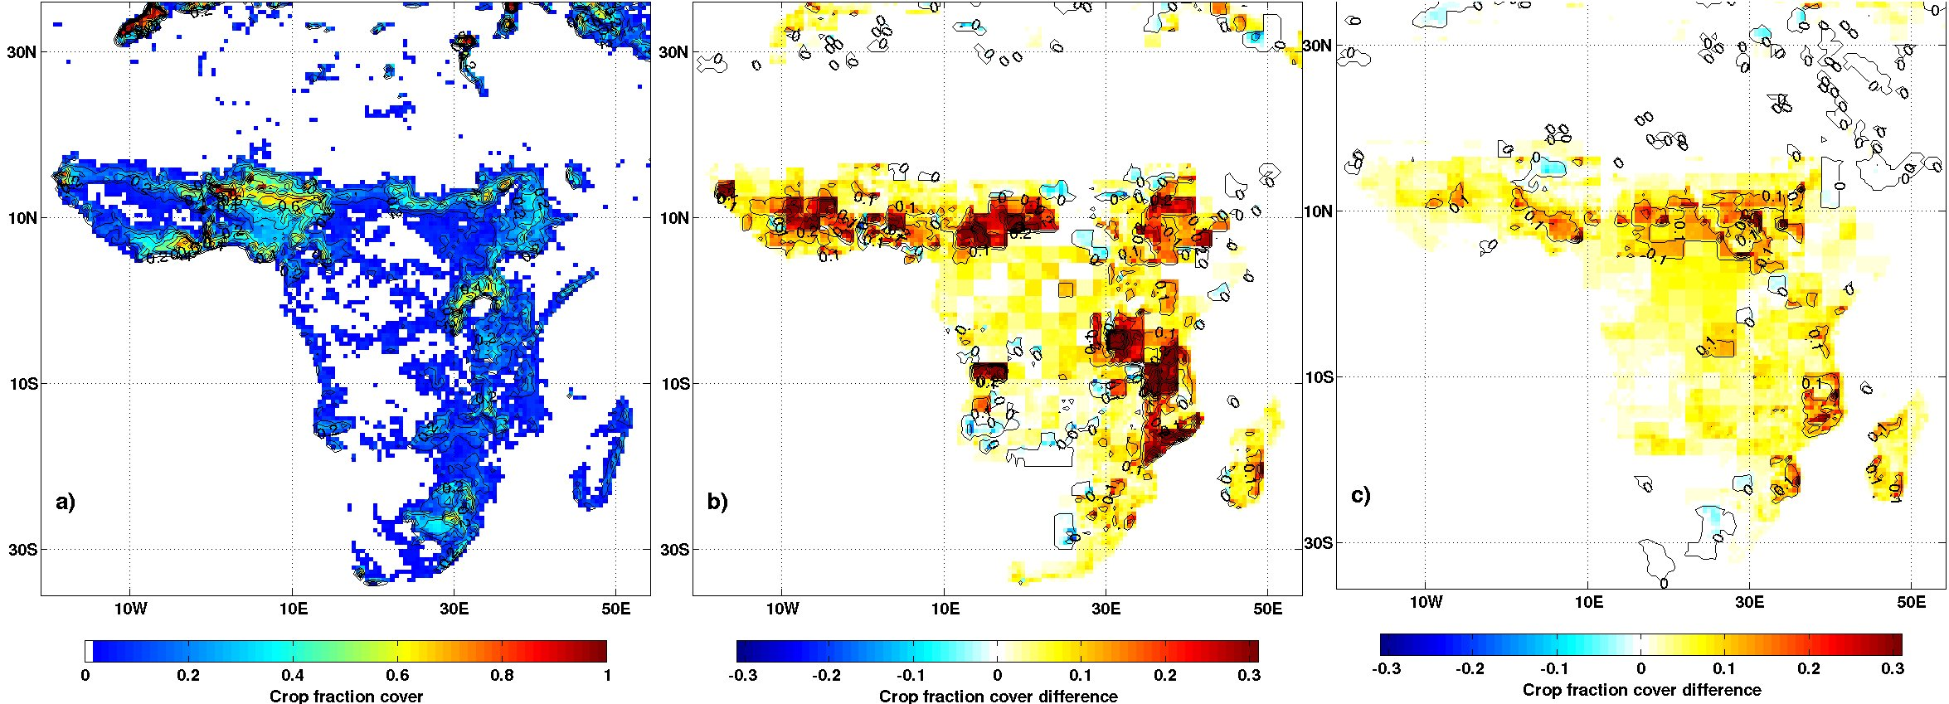
HYDE output example (using CLM)
RCP2p6 actually has one of the greatest conversation to cropland rates in Africa due to high use of biofuels.
RCP2p6
RCP8p5

Slide 31
Leads to emissions scenarios for major greenhouse gases
Question: Are these 4 scenarios all equally likely? Which one is the most likely?

Slide 32
RCP2p6 is not all good news...
RCP2p6 and 8p5 are surprisingly similar due to high use of biofuels needed to respect 2p6 Wm⁻²
Are these scenarios representative?

Slide 33
Uncertainty in climate modelling

Slide 34
Question:
Where is the initial condition uncertainty?

Slide 35
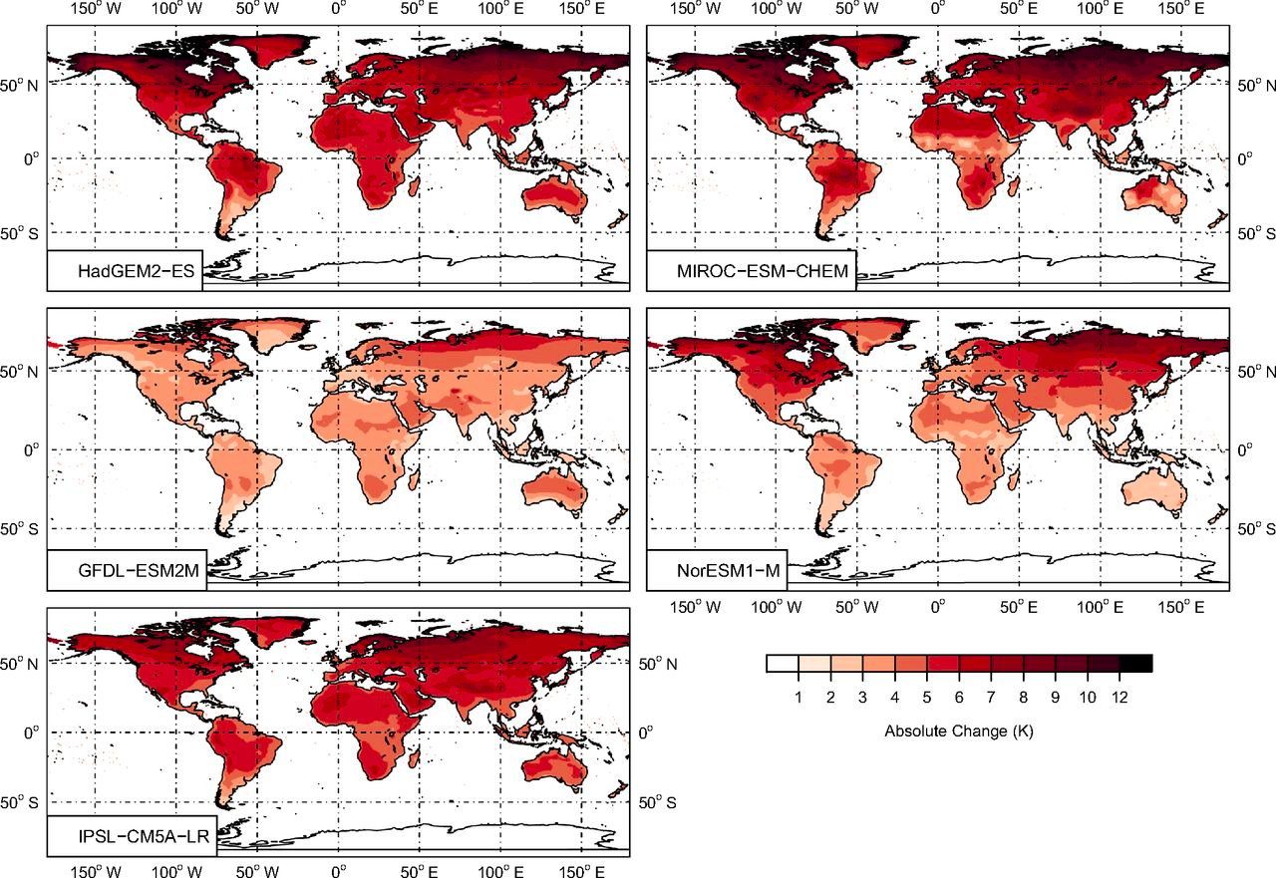
ISIMIP – PNAS special issues 2014 investigated multisectoral impacts of climate change using one member of 5 climate models

Slide 36
Ensemble techniques in climate modelling

Slide 37
However, model error and initial condition “sampling” error are often confused.
Large ensemble climate change experiments
30 ensemble members – historical and RCP8p5
Single climate model
Key et al. BAMS to appear 2015: http://dx.doi.org/10.1175/BAMS-D-13-00255.1

Slide 38
First 16 members: 2013-2046 temperature trend
http://dx.doi.org/10.1175/BAMS-D-13-00255.1

Slide 39
Inter-ensemble temperature “spread” – what is the difference between the left and right?

Slide 40
Left: 30 members single model = sampling uncertainty
Right: 38 CMIP5 models, one member per model
Question: Are the differences on the right due to model uncertainty or initial condition sampling? And why is this important?

Slide 41
Small ensembles may lead to overestimate of uncertainty due to model error, but...
...are models “genetically” diverse enough?
see also in GRL (2013):

Slide 42
Temperature projections to 2100
to 2030 – scenario is unimportant
at 2100 – scenario uncertainty dominates sampling/model uncertainty

Slide 43
The source of uncertainty depends how far ahead you look...
Note: small ensembles in CMIP5 may leading overestimation of model component of uncertainty

Slide 45
And Uncertainty...
Due to:
  Natural variability, initial conditions
  Model uncertainty
  Forcing (emissions) uncertainties
Large ensembles are required in an attempt to understand sources of uncertainty in predictions and projections

