Slide 1
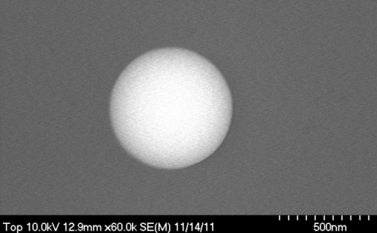
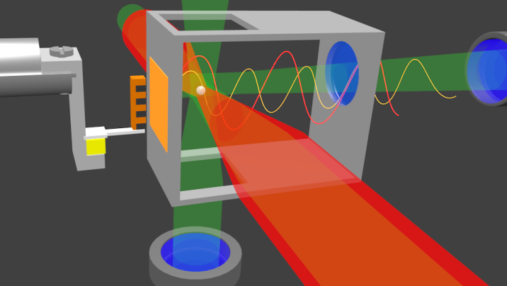
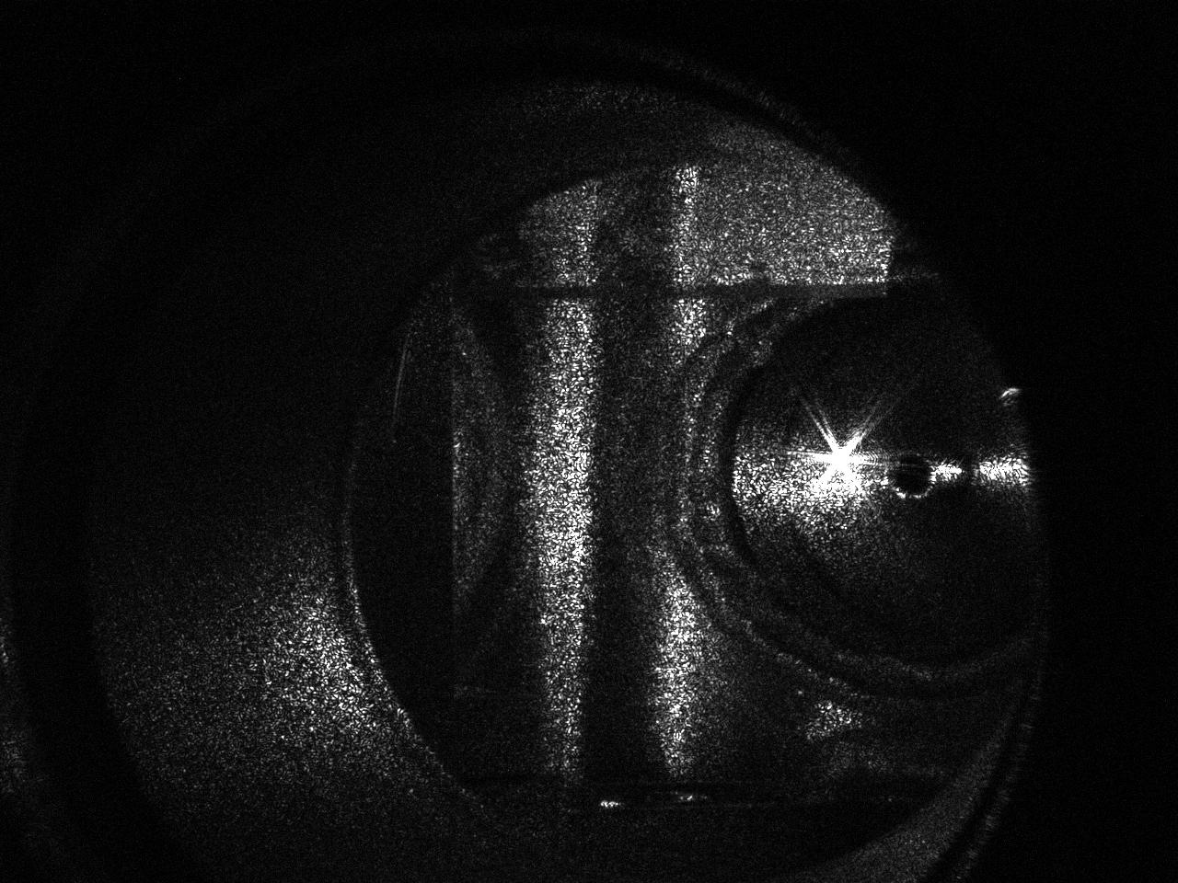
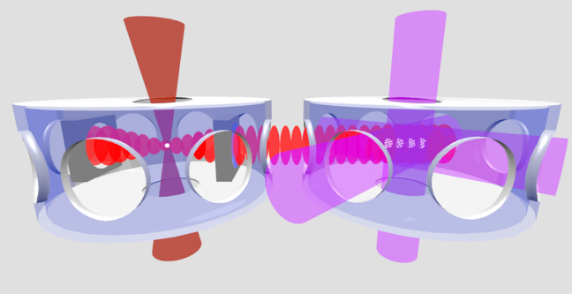





Detecting high-frequency gravitational waves with optically-levitated sensors
Challenges and Opportunities of High Frequency Gravitational Wave Detection
ICTP Oct. 15, 2019
A. Geraci, Northwestern University

Slide 2


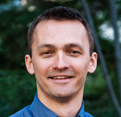
Center for Fundamental Physics (CFP)
Jerry Gabrielse group
Brian Odom group
g-2 of electron
electron EDM
Test of CPT with antihydrogen
Single molecule spectroscopy of trapped molecular ions
Tim Kovachy joined CFP September 2018!

Slide 3
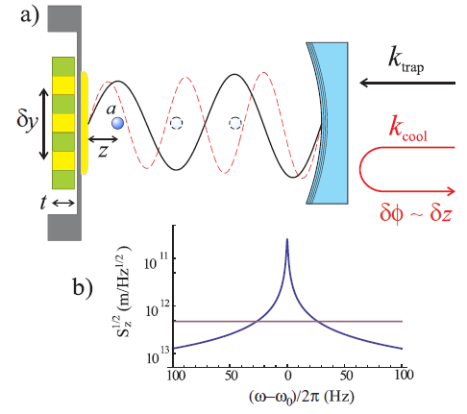
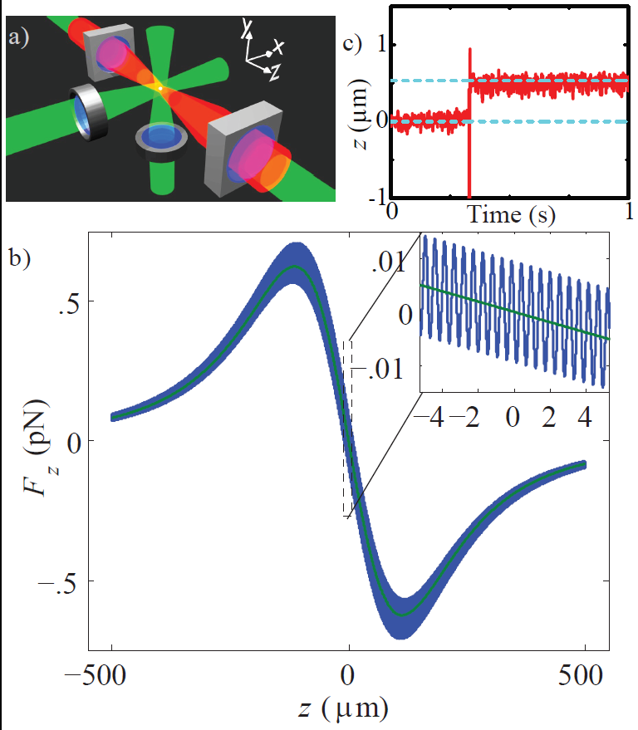
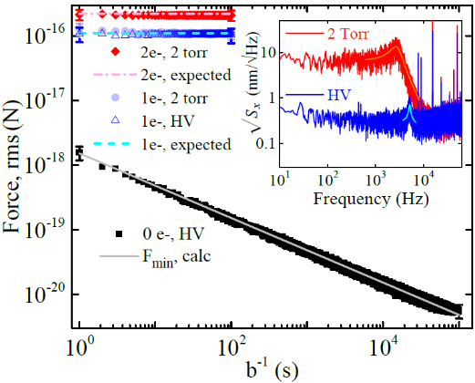
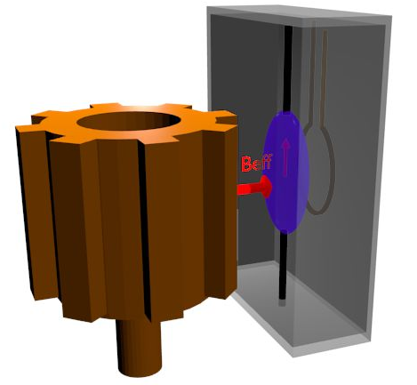
Our lab: fundamental physics with AMO sensors
Techniques
New Physics
Sensing with
Optically levitated nanospheres
Gravity at micron scales
AG., S. Papp, and J. Kitching, Phys. Rev. Lett.
105, 101101 (2010).
Gravitational Waves
G. Ranjit et.al., Phys. Rev. A 91, 051805(R) (2015).
G. Ranjit, M. Cunningham, K. Casey, and AG, Phys. Rev. A, 93, 053801 (2016).
Arvanitaki and AG., Phys. Rev. Lett.
110, 071105 (2013).
ARIADNE
Spin Resonance:
NMR –Laser polarized
gases or liquids
Spin-dependent forces
QCD Axion
Arvanitaki and AG., Phys. Rev. Lett.
113, 161801 (2014).

Slide 4
The Standard Model
Provides an adequate description of the
electromagnetic, weak, and strong interactions.
The Interactions:
Strong: Holds nucleons together
Electromagnetic: Acts between charged particles
Weak: Causes certain decays
Gravity: Attraction between masses
For two protons in nucleus:
P
P
-7
-36
Strong : Electromagnetic : Weak : Gravity= 20 : 1 : 10 : 10
The Hierarchy Problem: Why is Gravity so small?

Slide 5
Testing gravity at short range
Exotic particles (new physics)
r
λ < 1 mm
Supersymmetry/string theory
(moduli, radion, dilaton)
Particles in large extra dimensions
(Gravitons, scalars, vectors?)
m
m
1
2

Slide 6
Landscape for non-Newtonian corrections
Adapted from Ann. Rev. Nucl. Part. Sci. 53 77 (2003),
PRL 98, 021101 (2007),
PRD 78, 022002 (2008),
arXiv:1410.7267 (2014)
Laboratory
Terrestrial and satellites
Lunar laser ranging
Planetary
E.G. Adelberger, B.R. Heckel, A.E. Nelson, Ann. Rev. Nucl. Part. Sci. 53 77, (2003)

Slide 7
Experimental challenge: scaling of gravitational force
2r
m
m
for
1
2
In the range of experimental interest:
r~10 µm ;

Slide 8
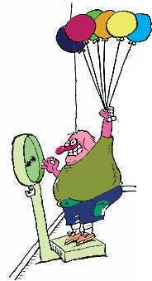
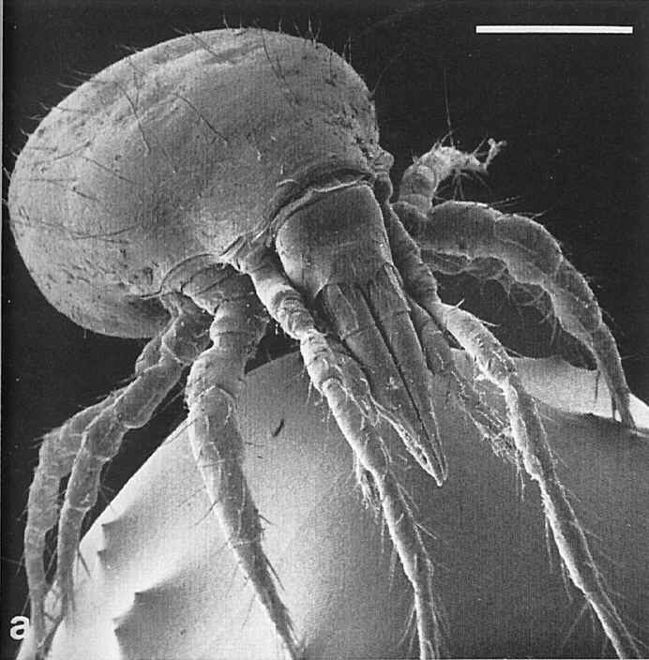

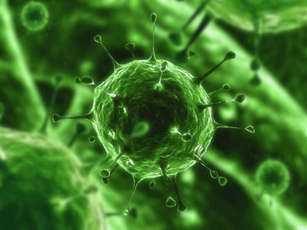
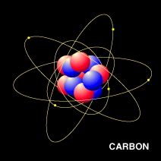
Small forces
Bathroom scales measure 10⁻¹ N
Dust mite 10⁻⁷ N
E. coli 10⁻¹⁵ N
70 kg ~ 700 N
Virus 10⁻¹⁹ N
Carbon atom 10⁻²⁵ N
AFM measures 10⁻¹¹ N

Slide 9
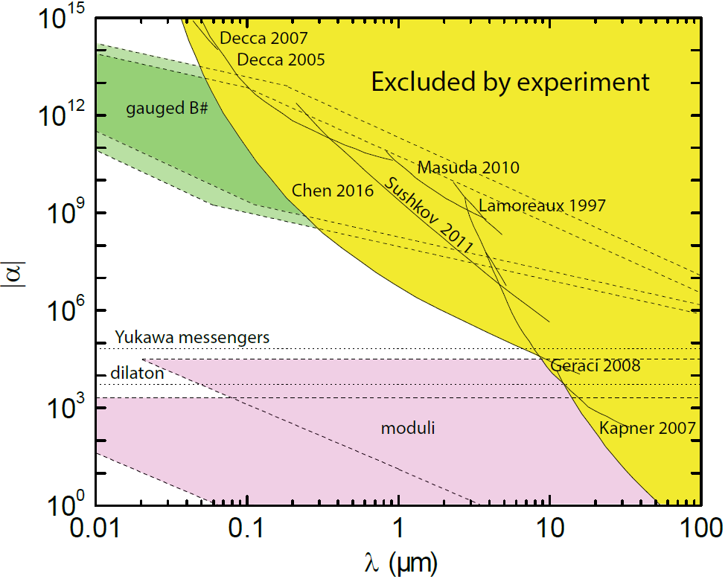
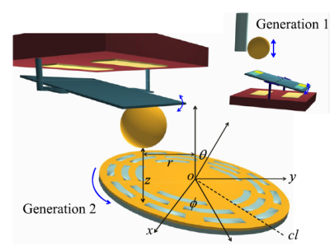
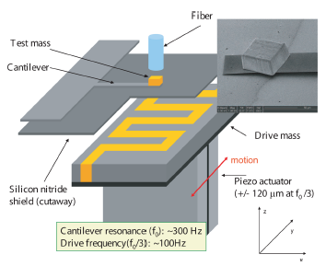
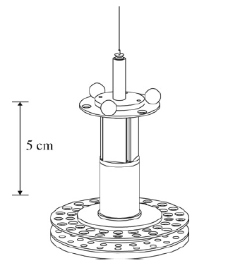
Force-distance parameter space
Casimir measurements (Indiana)
Cantilevers
(Stanford)
Torsion balance
experiments
(U Washington)

Slide 10
Fundamental limitation: thermal noise
Brownian motion – random “kicks” given to particle due to thermal bath
fluid molecule
dust particle
Random “kicks” are given to cantilever due to finite T of oscillator
Notes:
Skip brownian motion

Slide 11
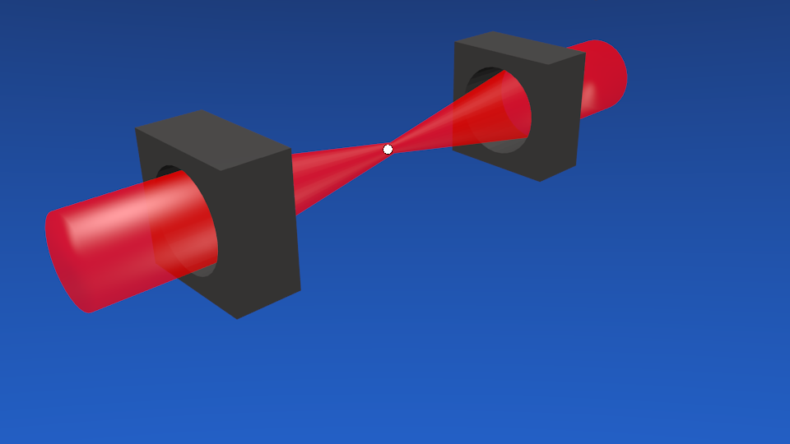
Improving sensitivity
Levitate the force sensor!
Fiber
Lens
Cantilever
CM motion decoupled from environment –
no clamping, materials losses
Limitations on Q: Clamping, surface
imperfections, internal materials losses

Slide 12
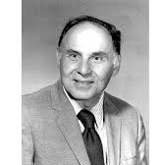
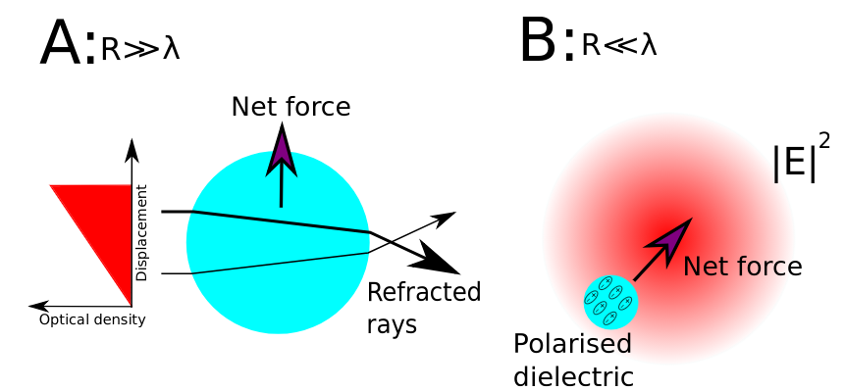
Levitated optomechanics
Optical tweezers → biology, biophysics
Ashkin, Bell Labs, 1970s
Ashkin (76) Levitation in high vacuum
Recently → proposals/experiments for ground state cooling
Arthur Ashkin,
Nobel prize 2018
D.E. Chang et. al., PNAS (2009)
O. Romero-Isart et.al. New J. Phys. (2010)
Notes:
Add McGloin reference

Slide 13
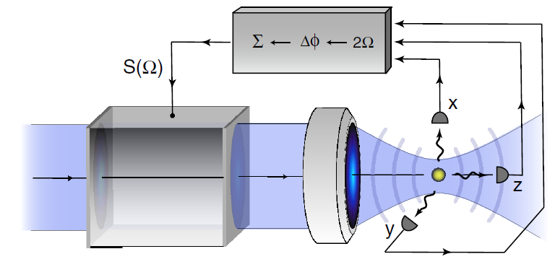
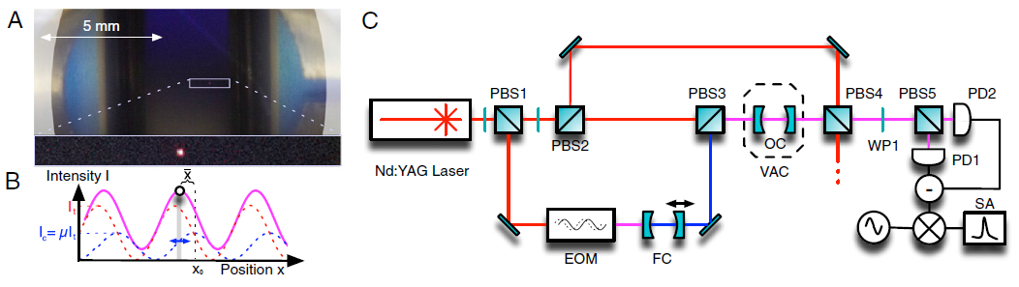
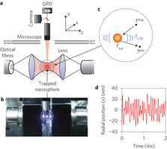
Levitated bead experiments
J. Gieseler, B. Deutsch, R. Quidant et. al.,
PRL 109, 103603 (2012).
B. Rodenburg et. al, Optica 3, 318-323 (2016)
N. Kiesel, F. Blaser, U. Delic, D. Grass, R. Kaltenbaek, M. Aspelmeyer, doi: 10.1073/pnas.1309167110
J. Millen, T. Deesuwan, P. Barker, J. Anders. Nature Nanotechnology, 2014; DOI: 10.1038/nnano.2014.82
Also: Slezak, B. R., Lewandowski, C. W., Hsu, J., D'Urso, B. R. (2018) NEW JOURNAL OF PHYSICS: v. 20

Slide 14
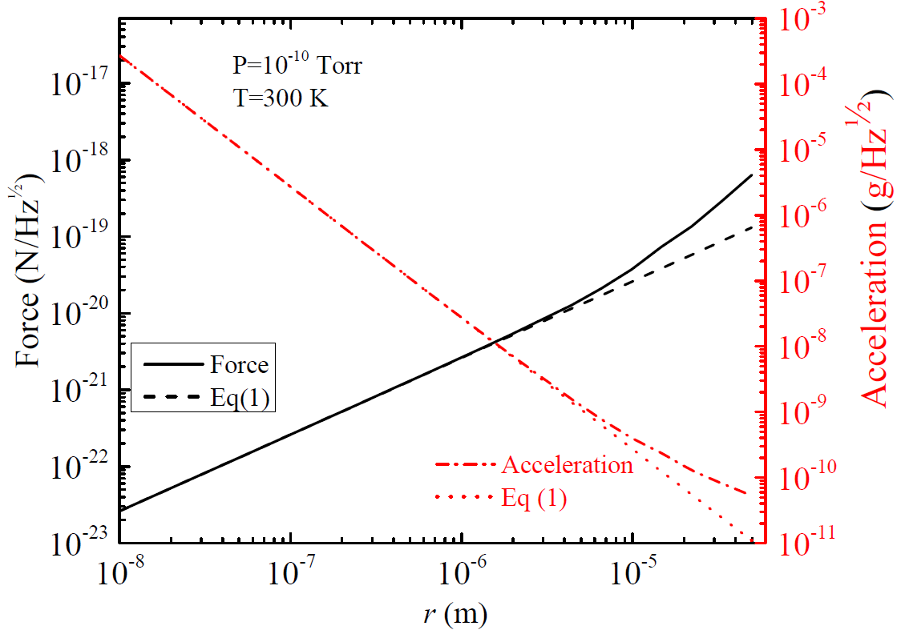
Projected force sensitivity
Photon recoil heating
Seen recently by
Novotny group
V. Jain et. al.,
PRL 116, 243601 (2016)
Cantilevers
20 zN/Hz^{1/2} Gieseler, Novotny, Quidant (Nature Phys. 2013)
Z. Yin, A. Geraci, T. Li, Int. J. Mod. Phys. B 27,1330018 (2013).

Slide 15
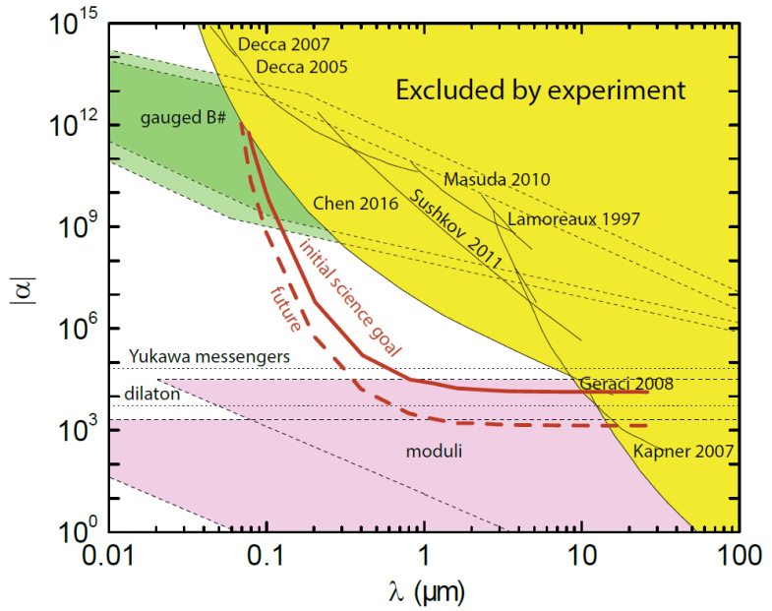
Projected sensitivity
nanosphere, d < λ/2
Drive mass
device (Au/Si)
gold coated SiN membrane
(stationary)
AG, S.B. Papp, and J. Kitching, Phys. Rev. Lett. 105, 101101 (2010)

Slide 16
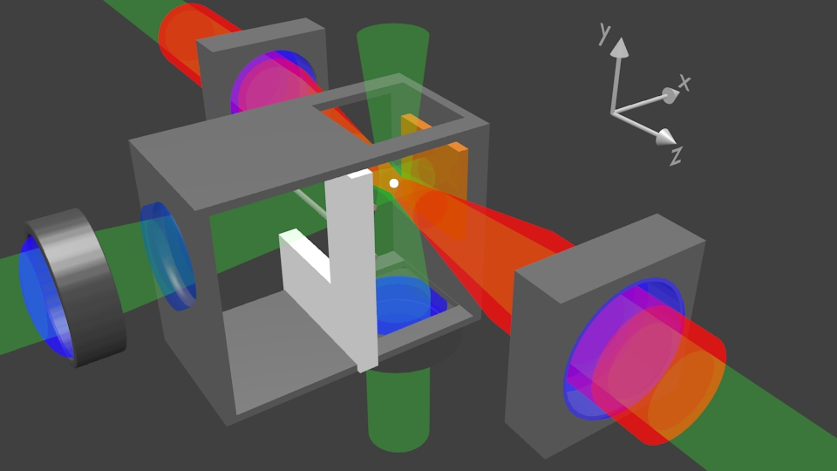
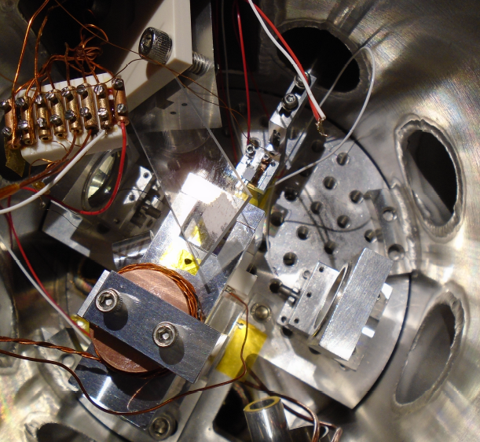
Experimental Setup
Drive mass
actuator
Dipole beams
Cavity beams
300 nm silica bead
300 nm silica bead
Cavity beams
Dipole beams
feedback beams
AG, S.B. Papp, and J. Kitching, Phys. Rev. Lett. 105, 101101 (2010)
G. Ranjit et.al., PRA 91, 051805(R) (2015).
G. Ranjit et.al. , Phys. Rev. A, 93, 053801 (2016).

Slide 17
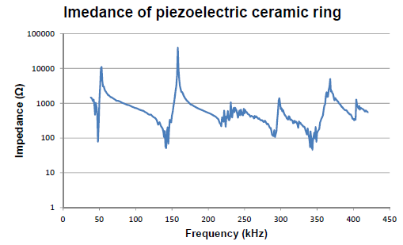
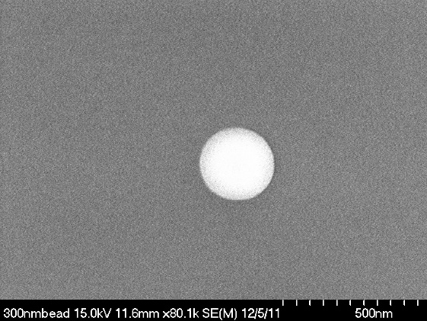
Trap loading
V_{driver}
Acceleration required to release a nanometer-sized sphere from a substrate
~10⁷ g for R=150nm!

Slide 18
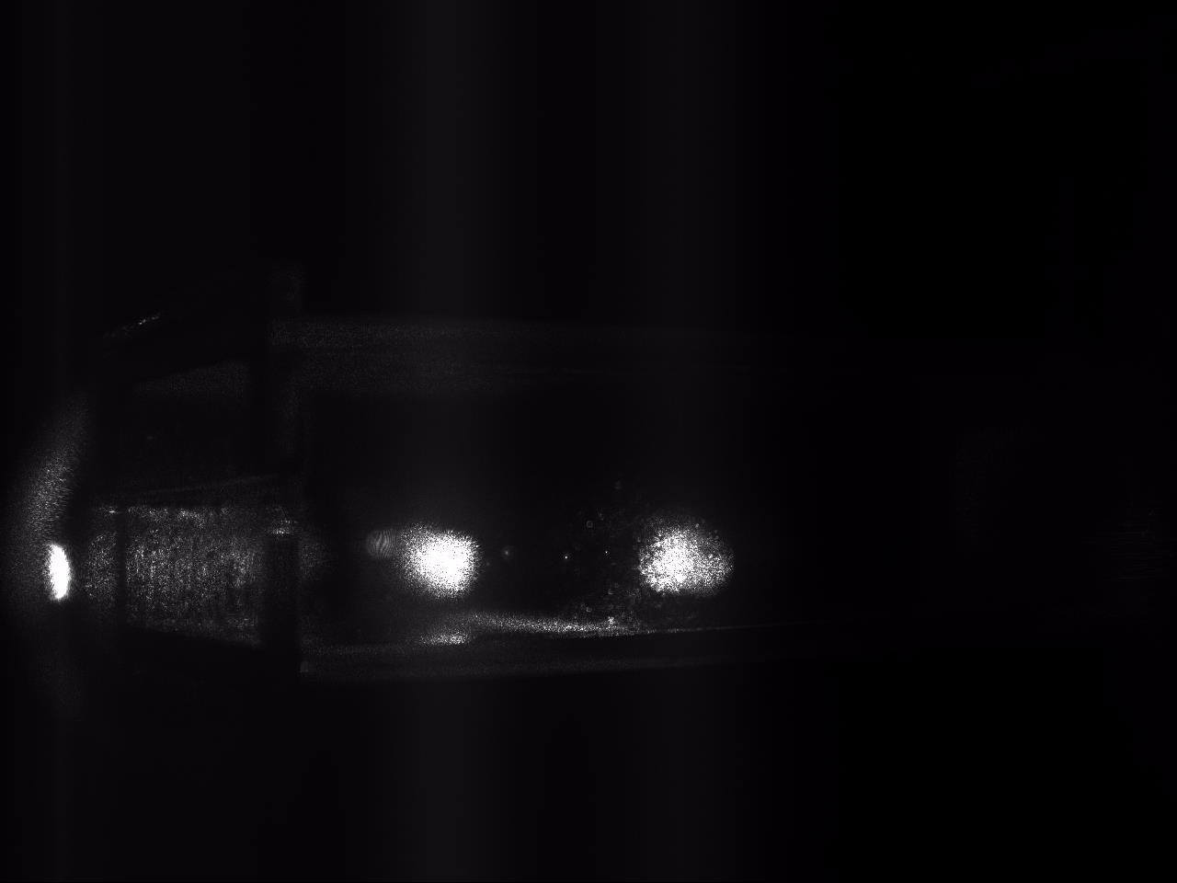
Loading optical trap
Optical
dipole trap
lasers

Slide 19
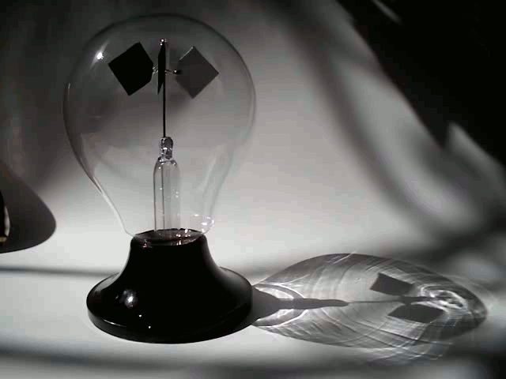
Trapping instabilities
Radiometric forces
Trap instabilities arise from uneven heating of the sphere surface
Important when mean free path ~ object size
Crooke’s Radiometer

Slide 20
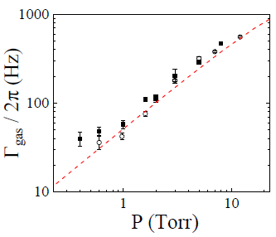
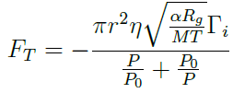
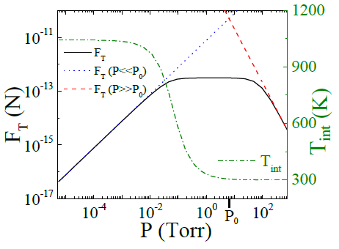
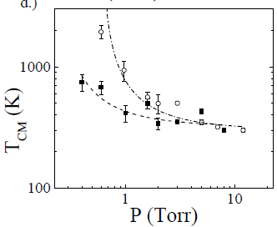
Radiometric forces
1% temp gradient across surface
R=1.5 μm, I=2 x 10⁹ W/m²
Heating rate > gas damping rate
→ Particle loss → Need feedback!
Ranjit et.al., PRA 91, 051805(R) (2015).

Slide 21
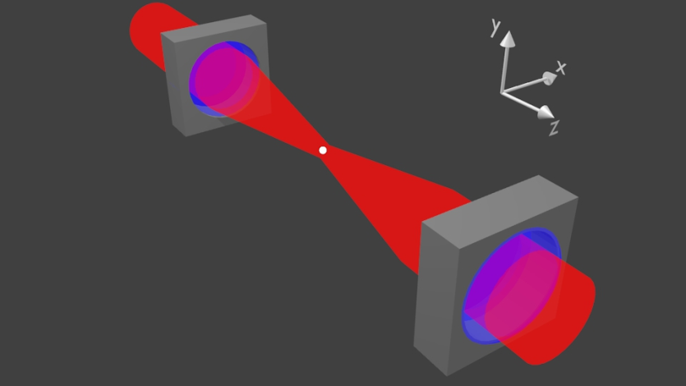
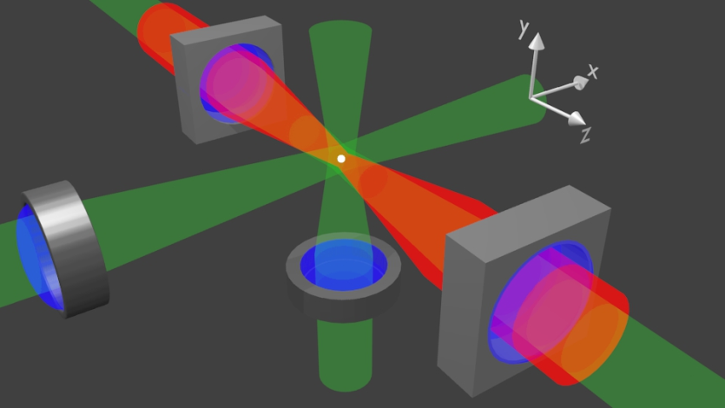
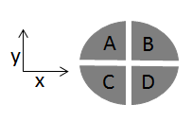
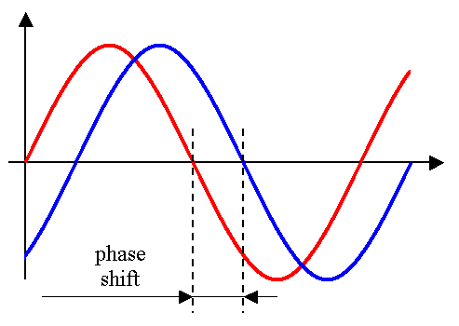


3D feedback cooling of a nanosphere
Needed to stabilize the particle, damp and cool it
Mitigate photon recoil heating
AOM
$$x(t)$$
780 nm
$$v_{x}\left(t\right)$$
Ranjit et.al., PRA 91, 051805(R) (2015).

Slide 22

Zeptonewton force sensing
6 zN
Sensitivity
G. Ranjit, et.al. , Phys. Rev. A, 93, 053801 (2016).

Slide 23
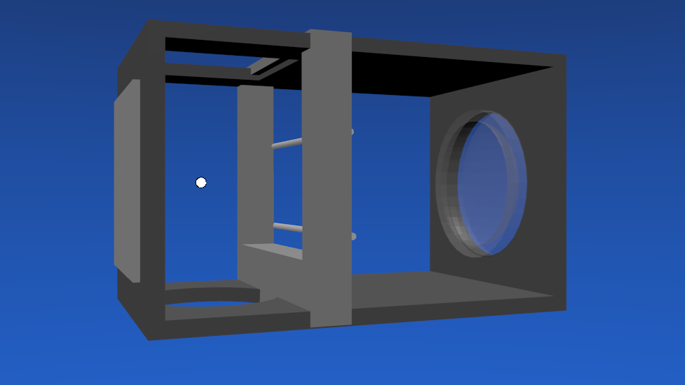
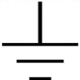
Zeptonewton force sensing
Electrostatic
Calibration
90% of beads are neutral
Neutral beads stay neutral
Charge stays constant over days
6 zN
Calibration electrodes
Sensitivity
G. Ranjit, et.al. , Phys. Rev. A, 93, 053801 (2016).

Slide 24
Zeptonewton force sensing
Optical lattice
calibration
6 zN
Useful for neutral objects
Method consistent with
electric field approach
Sensitivity
G. Ranjit, et.al. , Phys. Rev. A, 93, 053801 (2016).

Slide 25
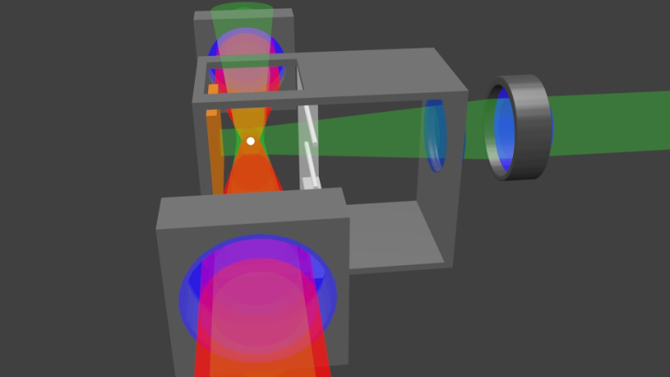
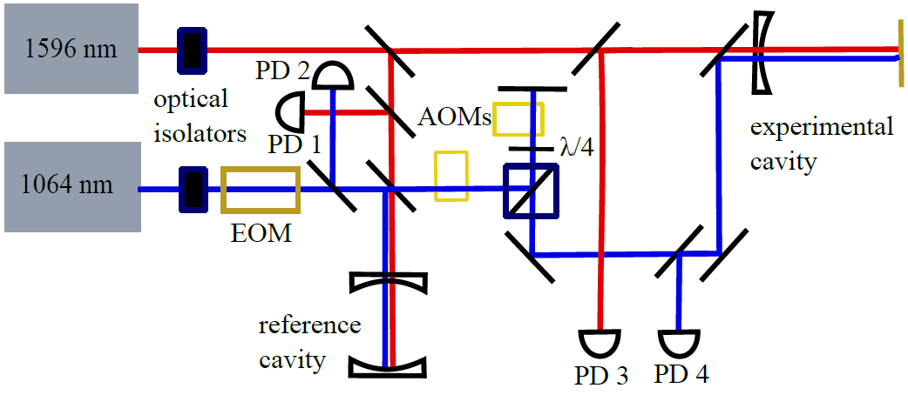
Cavity Trapping and cooling
1596nm beam to trap a bead at its antinode → localization
1064nm beam to cavity cool the CM of bead → position readout
300 nm bead

Slide 26
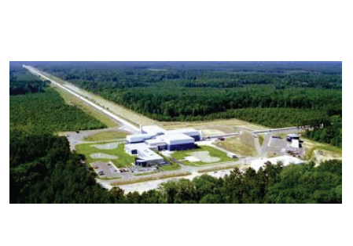
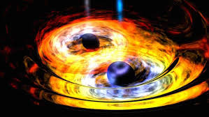
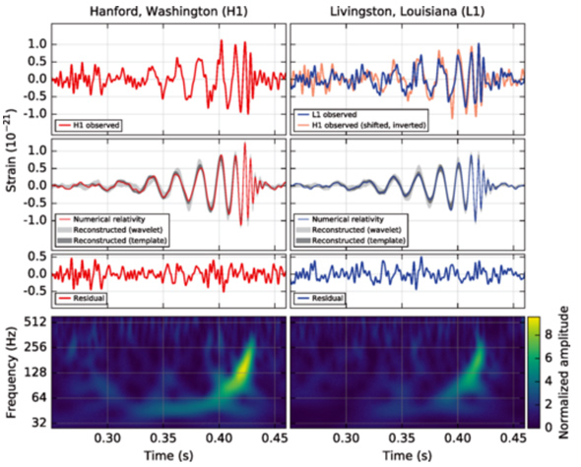
Gravitational waves
Ripples in space-time
Discovered by LIGO Sep 2015 !!
Sources:
  Inspirals of astrophysical objects
  Inflation, Phase transitions, etc.
B. P. Abbott et al. (LIGO Scientific Collaboration and Virgo Collaboration)
Phys. Rev. Lett. 116, 061102 (2016).

Slide 27
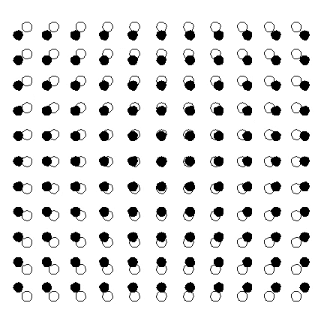
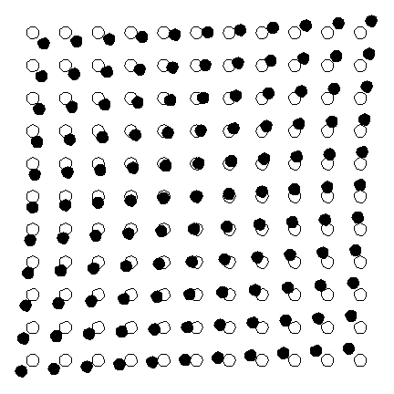
Gravitational Waves: how do we detect them on earth?
L
Stretch and squeeze the space between test masses
Strain h = ΔL/L
2 polarizations (+ and x)
Strain typically very small e.g. h ~ 10-21 for the first LIGO BH inspiral detection!

Slide 28
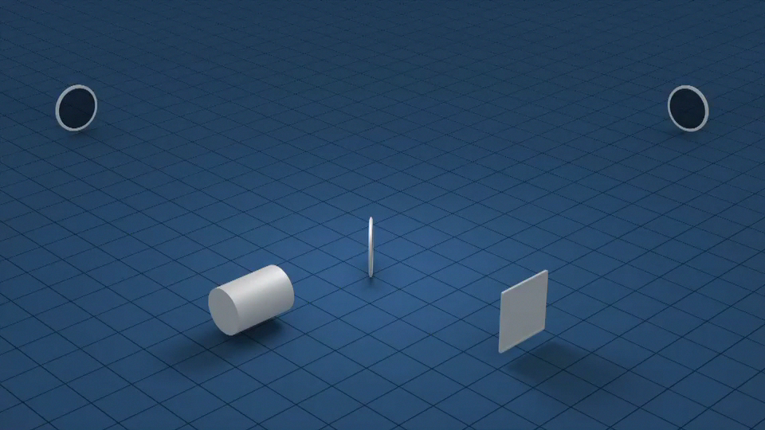
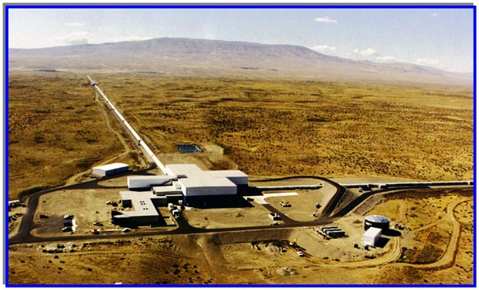
Interferometer detectors

Slide 29
Strain sensitivity of advanced LIGO
Seismic noise
Laser shot noise
Coating thermal noise

Slide 30

Frequency landscape for gravitational waves
Unexplored
to date

Slide 31


Dark Matter
Zwicky detected its influence on cluster motions in the mid-1930s, Rubin detected it in galaxy rotation curves in the 1960s
Its nature and origin is one of the most vexing problems in physics and astronomy
One of strongest hints of physics beyond the Standard Model
Galactic Rotation Curves: much more gravity than from ordinary matter
Gravitational Lensing: “Bullet” cluster – separation of lensing from visible matter
Also: Structure formation, Cosmic Microwave background, …
Corbelli, E.; Salucci, P. (2000), Monthly Notices of the Royal Astronomical Society. 311 (2): 441–447
Notes:
Many lines of

Slide 32


Dark Matter
Particle physicists use energy units (eV) for particle masses (E = mc²)
Field-like
1eV/c²
Particle-like
Neutrinos
Dark Energy
Standard Model
Hubble
LHC
Planck
10⁻³³
10⁻²¹
10⁻³
10⁵
10¹¹
10²⁸
Axions
PBHs
WIMPs
~10⁻²eV to 10⁻¹¹eV
~10-1000 GeV
10⁻²²
Possible Dark Matter Mass Range

Slide 33

The Dark Sector
High-frequency GW detector is a new probe of the Dark Sector
Axions
Primordial Black Holes (PBHs)
Peccei-Quinn Axion (QCD) solves “strong-CP problem”
Dark matter candidate
R. D. Peccei and H. R. Quinn, Phys. Rev. Lett. 38, 1440 (1977); S. Weinberg, Phys. Rev. Lett. 40, 223 (1978); F. Wilczek, Phys. Rev. Lett. 40, 279 (1978).
Remnant from early universe
Wide range of possible masses (sub-M_{sun})

Slide 34
GW sources at high-frequency
Astrophysical Sources
Inspirals and mergers have higher frequency GW emission for lower masses
Natural upper bound on GW frequency → M_{sun} mass BH ~ 30 kHz
Could be lighter Primordial black holes (PBHs) at > 30 kHz
Beyond standard model physics
- QCD Axion → Annihilation to gravitons in
cloud around Black holes
black hole
A. Arvanitaki et. al, PRD, 81, 123530 (2010)
A. Arvanitaki et al. PRD 83, 044026 (2011)
Black hole superradiance
axion cloud
- String cosmology
- The unknown?
R. Brustein et. al. Phys. Lett. B, 361, 45 (1995)

Slide 35


A novel high-frequency GW detector
Optically-levitated particles in vacuum have very little friction –
Ideal for ultrasensitive force detection
1-100m
GW Strain h = ΔL/L
Laser intensity changed to match trap frequency to GW frequency
For a 10m cavity, h ~ 10⁻²² Hz ^{-1/2} at high frequency (100kHz)
Limited by thermal noise in sensor (not laser shot noise) → much better at high frequency!!
J. Weber (1969)
A. Arvanitaki and AG, Phys. Rev. Lett. 110, 071105 (2013)

Slide 36
1-m prototype detector layout
Laser
N. Aggarwal, G. Winstone, M. Baryakhtar, M.H. Teo, S. Larson, V. Kalogera, AG, in preparation (2019)

Slide 37

Fiber based FP Cavity
Trapped microdisk
High reflectivity mirror
or distributed bragg reflector
60 mW 1550 nm
Target finesse ~10
L_{free}
L
~ 4 mm
~ 100 m
$$ω=2π×100 kHz$$
κ = 2π x 51 kHz
A. Pontin, L.S. Mourounas, AG, and P.F. Barker, arXiv:1706.10227New. J. Phys (2018)

Slide 38


Improved levitated objects: discs
Images of disc fabrication go here

Slide 39

Dark Matter search – Axions and PBHs
PBHs:
Distance to source: 100 pc
(within our galaxy)
Axions:
black hole
axion cloud
Distance to source: 10 kpc
(within our galaxy)
Integration time: 10⁶ sec
Axion at the Grand-Unified Theory (GUT) scale
N. Aggarwal, G. Winstone, M. Baryakhtar, M.H. Teo, S. Larson, V. Kalogera, AG, in preparation (2019)

Slide 40
Search range for axion signals
Curve shown for 1 Solar Mass BH
Range (kpc)
100 m
10 m
1 m
Axion mass (eV/c²)
N. Aggarwal, G. Winstone, M. Baryakhtar, M.H. Teo, S. Larson, V. Kalogera, AG, in preparation (2019)

Slide 41
Comparison with LIGO
Comparison with
projected LIGO sensitivity curve
1m system will surpass LIGO > 100 kHz
10m future instrument will beat by 10x
100 m observatory
will beat by 100x
LIGO sensitivity decreases at high frequency (laser shot noise limited )
levitated sensors improve (thermal noise limited)

Slide 42

Vision for HF gravitational wave astronomy

Slide 43
Conclusions
Calibrated zeptonewton force sensing with optically levitated nanospheres
→ Micron-distance gravity tests
→ High frequency gravitational waves
Future directions:
→ Improved levitated geometries e.g. discs
→ Quantum regime of nanoparticle motion
→ Source for matter wave interferometry, other gravitational sensing protocols

Slide 44


Acknowledgements
Center for Fundamental Physics (CFP)
Geraci Lab 2017
Geraci Lab Summer 2018
Collaborators (GW):
Peter Barker (UCL)
Astro Theory:
Asimina Arvanitaki (Perimeter)
Masha Baryakhtar (Perimeter)
Mae Hwee Teo (Stanford)
Shane Larson (NU)
Vicky Kalogera (NU)
Group Members (left to right): Chloe Lohmeyer (G), Evan Weisman (PD), George Winstone (PD), Nancy Aggarwal (PD), Cris Montoya (PD), Daniel Grass (UG), Chethn Galla (G), Eduardo Allejandro (G), William Eom (G), Andy Geraci (PI)

Slide 46





A novel high-frequency GW detector
A modern resonant bar detector
1-100m
GW Strain h = ΔL/L
Laser intensity changed to match trap frequency to GW frequency
For a 10m cavity, h ~ 10⁻²² Hz ^{-1/2} at high frequency (100kHz)
Limited by thermal noise in sensor (not laser shot noise)-> much better at high frequency!!
J. Weber (1969)
A. Arvanitaki and AG, Phys. Rev. Lett. 110, 071105 (2013)
Notes:
Mention mass in the equation, bigger disc is better - - more masssive lower photon recoil object, therefore disc
Γg is gas damping, γsc is photon recoil,

