Slide 1
Information Security Live Session
Rob Quick () Raphael Cobé () Hannah Short (CERN)
August, 2020 CODATA-RDA Data Science School

Slide 2
Information Security
Three 10m videos available
Course recap
Advanced topics
How to teach security concepts
Today you will play the role of Data Security Officer at a new experiment
Information Security: Live Session

Slide 3
Questions for you!
Notes:
Who knows and uses 2FA in their accounts?
Who uses some form of cryptography to protect their data?

Slide 4
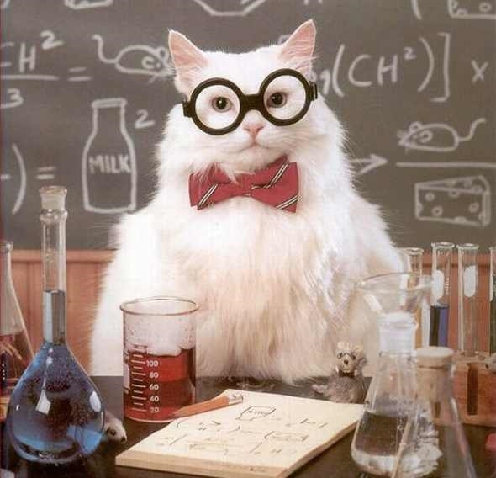
This is you...
You are the Data Security Officer for a new experiment that is studying intelligence differences between dogs and cats.
Information Security: Live Session

Slide 5
The experiment...
Data is being collected from thousands of dogs and cats around the world including,
DNA samples
Laboratory test results
Data will be stored in the “open-global-cloud”, an infrastructure for shared research with data centres in Asia, the Americas and Africa
Much of the initial funding for the experiment came from the cats and already there are conspiracy theories forming about the type of studies being done
Information Security: Live Session

Slide 6
Discussion Points
Attacks by Hacktivists
2FA Data Access
Open publishing
Hypothesis bias due to funders
Data replication
Software Security
Anonymisation
Traceable data access
Data encryption
Data availability
Data confidentiality
Data retention
Identity Vetting
Password Provisioning

Slide 7
Breakout Rooms
You will be divided into breakout rooms
Pick a couple of topics to discuss
You have 20 minutes to discuss your concerns in these areas
Don’t forget to nominate a note-taker and a speaker to give a brief summary when you come back.
Please join the 2nd Zoom Room
Information Security: Live Session

Slide 8
Welcome Back

Slide 9
August, 2020 CODATA-RDA Data Science School

