Slide 1
Macro and micro perspectives to understand deep learning:
Frequency principle and phase diagram
Zhiqin Xu 许志钦
xuzhiqin@sjtu.edu.cn
Shanghai Jiao Tong University
2020.07.30
CSRC-ICTP Joint Workshop on Big Data, Machine Learning and Complexity Research
https://ins.sjtu.edu.cn/people/xuzhiqin/

Slide 2
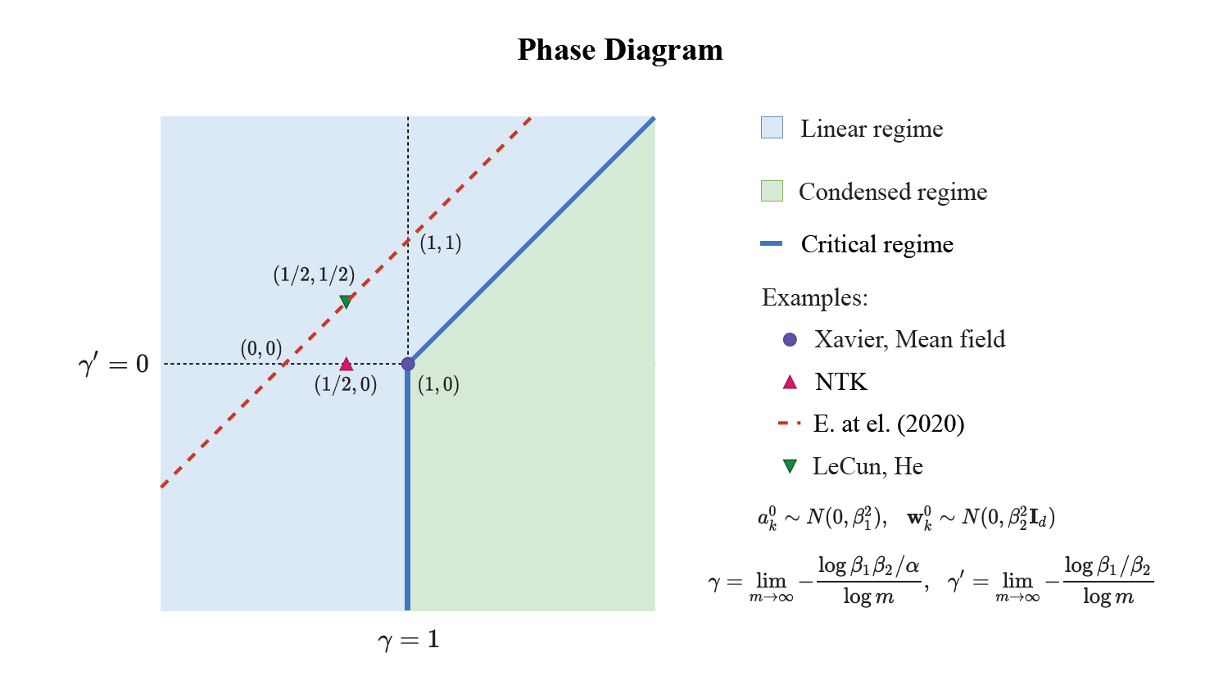
Take away
F-Principle：DNN prefers low frequencies
  MscaleDNN: Uniform convergence for each frequency
Phase-diagram for two-layer ReLU NN:
[1] Xu*, Zhang, Xiao, arXiv: 1807.01251
[2] Xu*, Zhang, Luo, Xiao, Ma, arXiv: 1901.06523
[3] Zhang, Xu*, Luo, Ma, arXiv: 1905.10264
[4] Liu, Cai, Xu*, arXiv:2007.11207
[5] Luo*, Xu*, Ma, Zhang, arXiv: 2007.07497
https://ins.sjtu.edu.cn/people/xuzhiqin/

Slide 3
Macro perspective

Slide 4
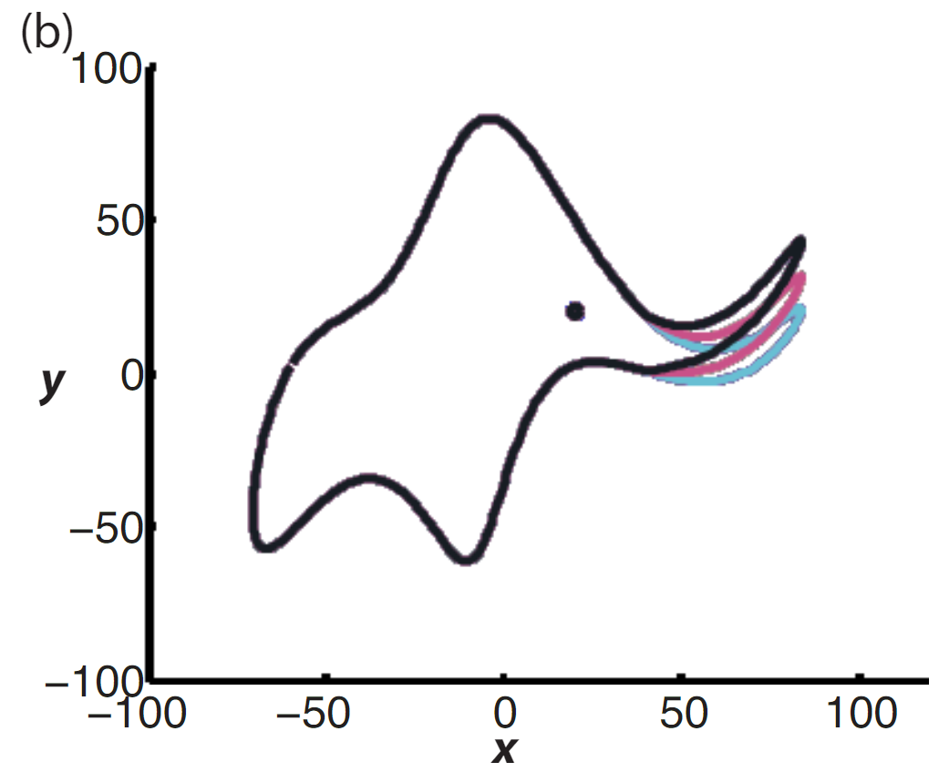
Mystery of generalization in deep learning
"With four parameters you can fit an elephant to a curve; with five you can make him wiggle his trunk.”
-- John von Neumann
Mayer et al., 2010

Slide 5
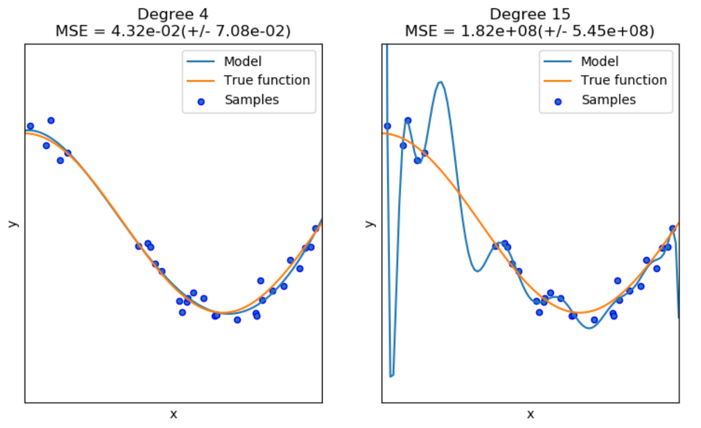
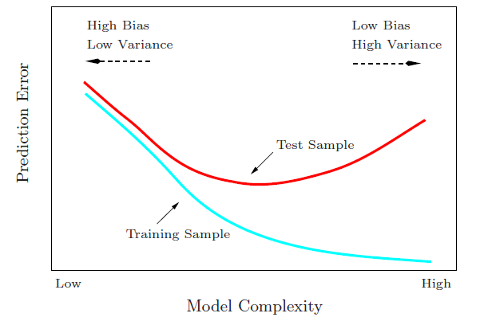
Generalization error
Deep Learning Puzzle:
generalize well even # of para >> # of training data
Zhang et al., 2016
Notes:
Need to explain what is generalization, what is overfitting.
*

Slide 6
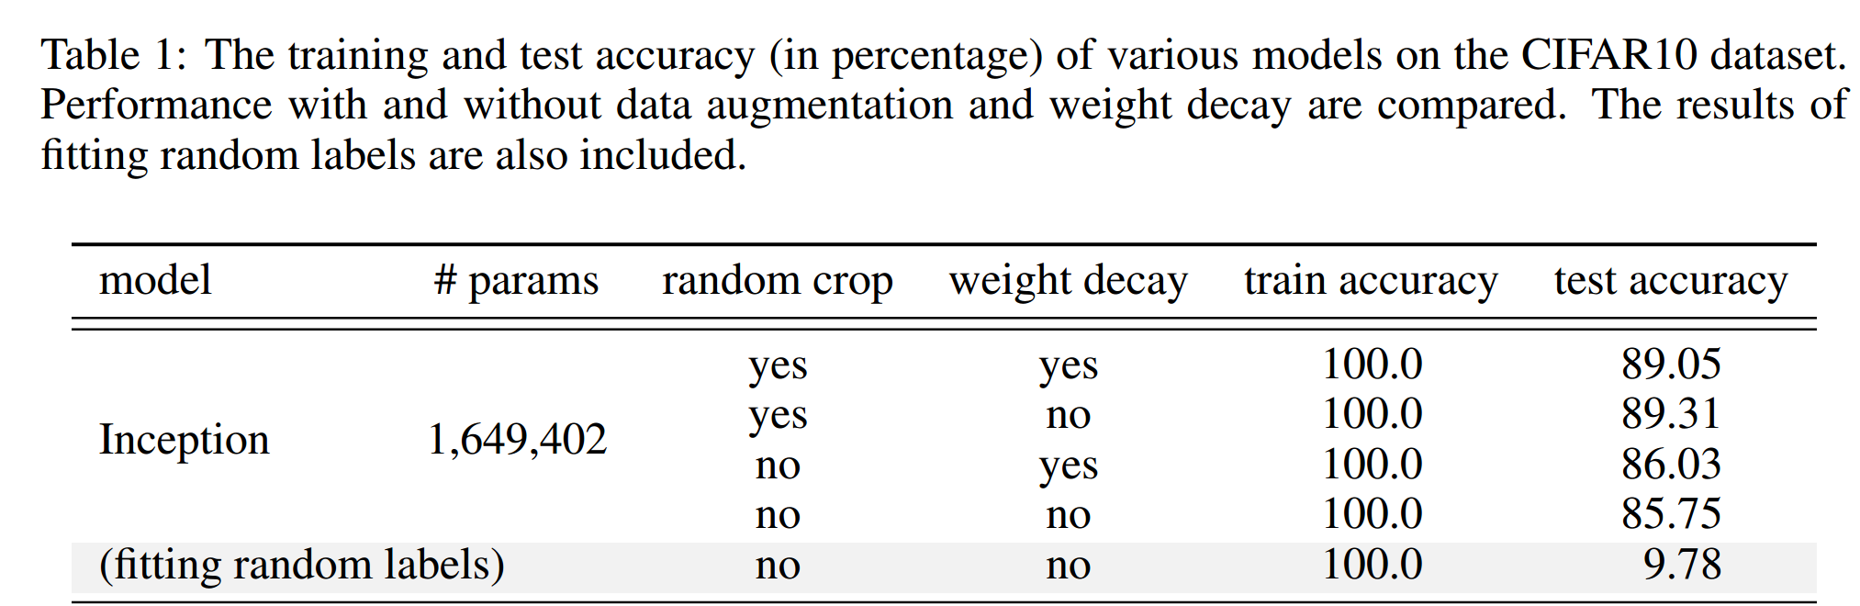
Large complexity? But good generalization!
Puzzle: generalize well even # of para >> # of training data
60000 32x32 colour images in 10 classes
Zhang et al., 2016
Notes:
Need to explain what is random shuffled data

Slide 7

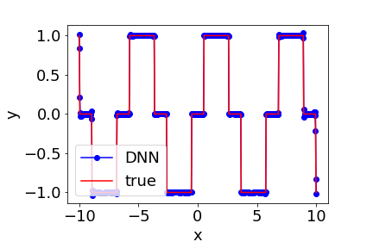
Macro perspective: Frequency Principle
Red: target function
Blue: DNN fitting
Zhiqin Xu et al., Training behavior of deep neural network in frequency domain, 2018

Slide 8
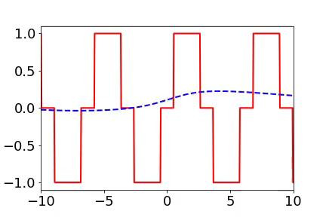
Macro perspective: Frequency Principle
Red: target function
Blue: DNN fitting
Zhiqin Xu et al., Training behavior of deep neural network in frequency domain, 2018

Slide 9
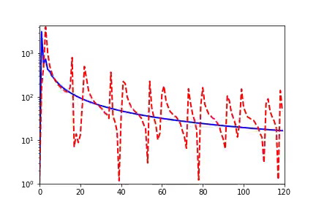
Macro perspective: Frequency Principle
Red: target function
Blue: DNN fitting
Red: FFT of target function
Blue: FFT of DNN fitting
Each frame is several training steps
Amplitude
Frequency
Zhiqin Xu et al., Training behavior of deep neural network in frequency domain, 2018

Slide 10
Macro perspective: Frequency Principle
i) Captures low-frequency components while keeping high-frequency ones small.
ii) Gradually captures high-frequency components.
Red: target function
Blue: DNN fitting
Red: FFT of target function
Blue: FFT of DNN fitting
Each frame is one training step
Amplitude
Frequency
Xu, Zhang, Xiao, Training behavior of deep neural network in frequency domain, 2018

Slide 11
F-Principle
DNN prefers low frequencies
(explain why no much oscillation)

Slide 12
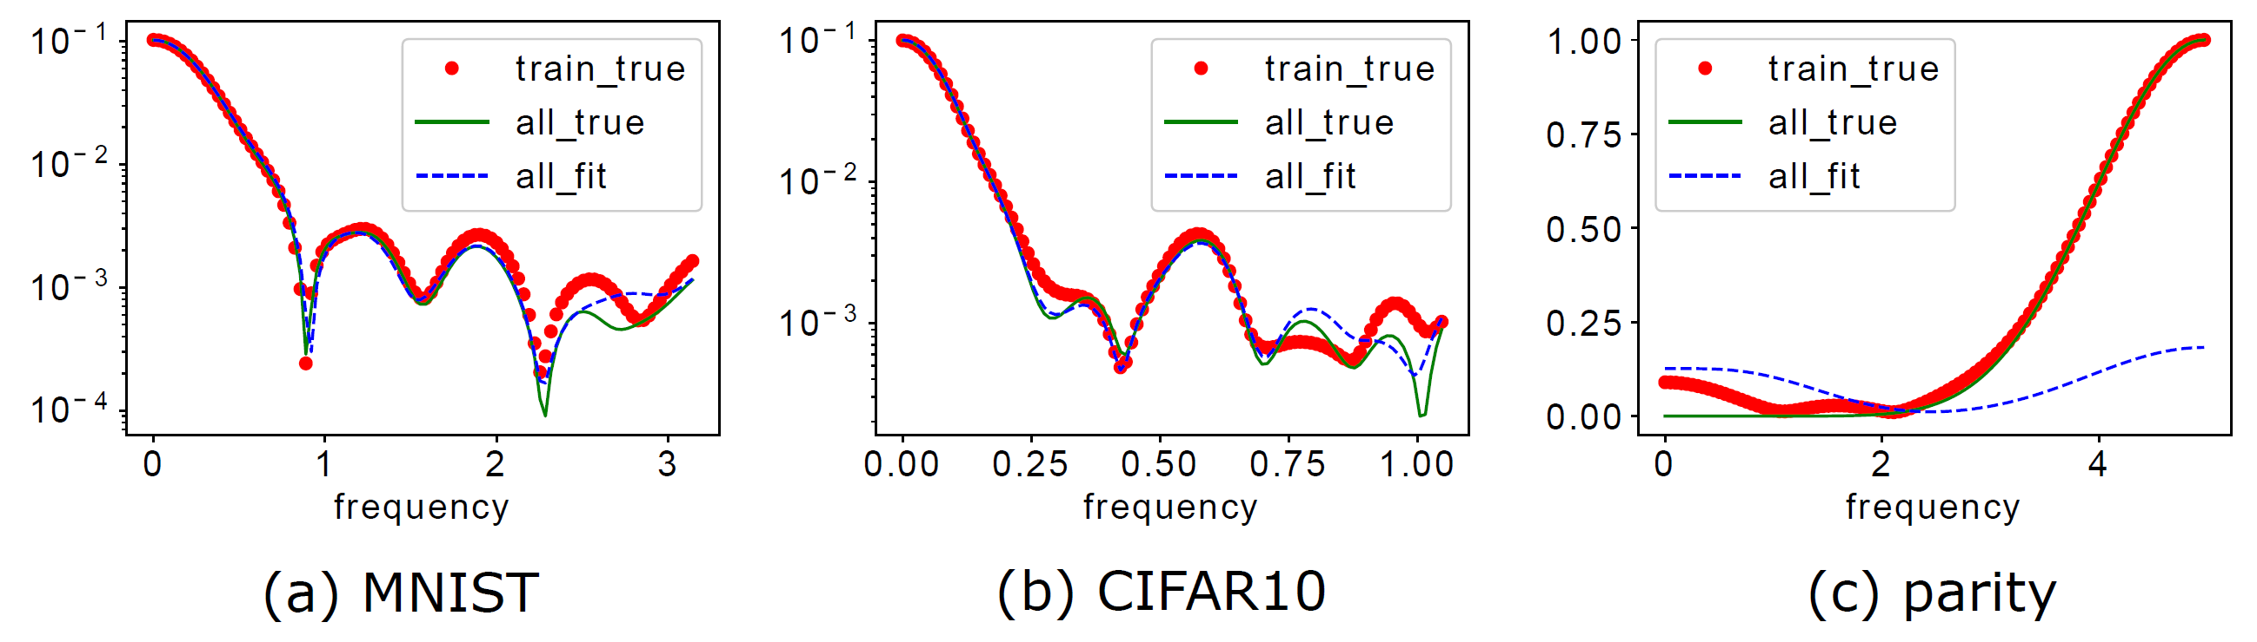
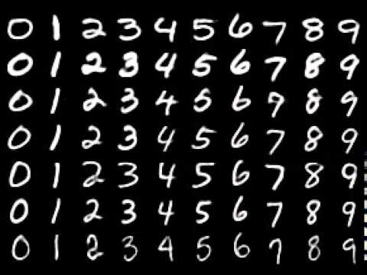
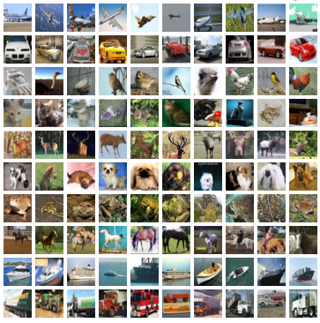
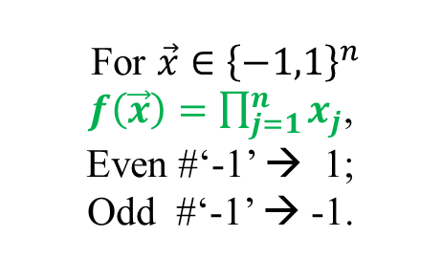
Generalization difference
F-Principe: DNN prefers low frequencies
For $\vec{x}∈{\left\{−1,1\right\}}^{n}$
$f\left(\vec{x}\right)=\prod_{j=1}^{n}{x_{j}}$,
Even #‘-1’ → 1;
Odd #‘-1’ → -1.
Test accuracy: 96.3%>>10%
Test accuracy: 72% %>>10%
Test accuracy: ~50%, random guess
Xu et al., (2019, 1901.06523)

Slide 13
Application

Slide 14
Slides from Prof. Weinan E at 第十二届全国计算数学年会

Slide 15
Slides from Prof. Weinan E at 第十二届全国计算数学年会

Slide 16
Suffer from high-frequency curse
Slides from Prof. Weinan E at 第十二届全国计算数学年会

Slide 17


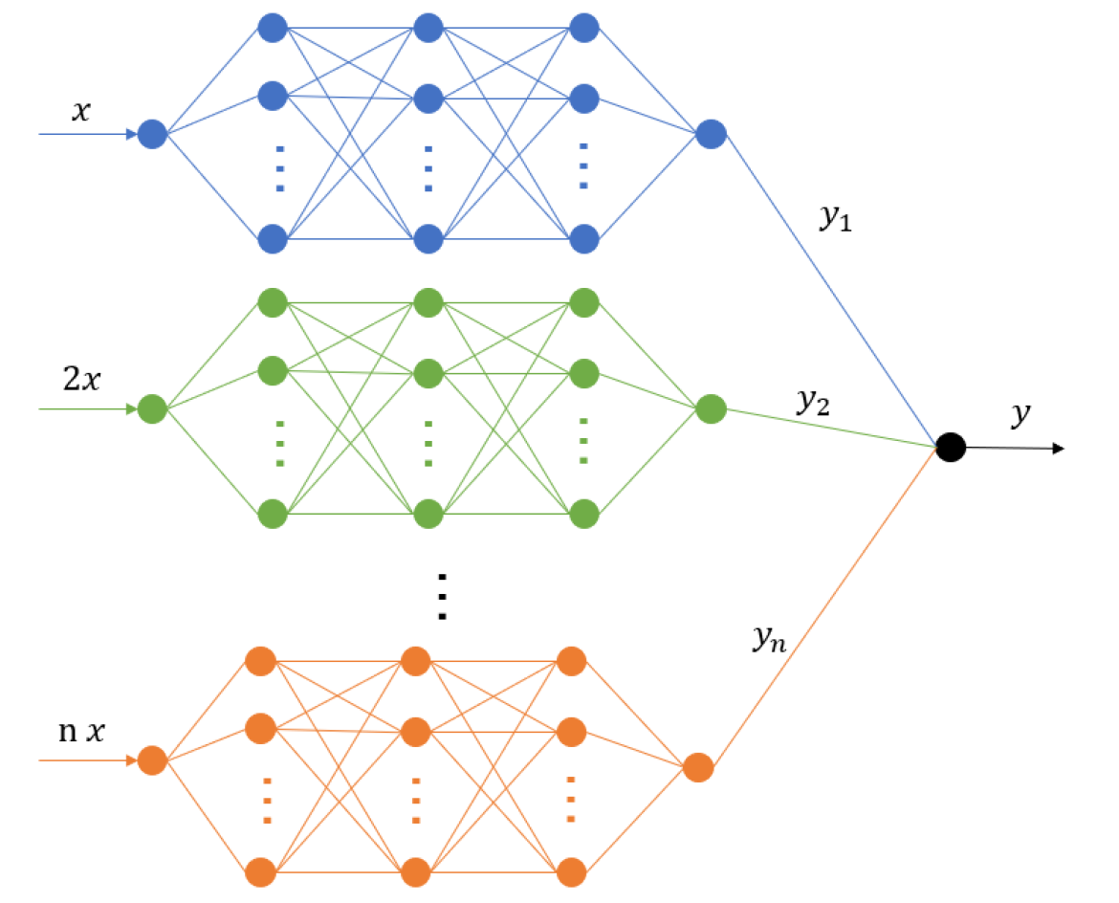
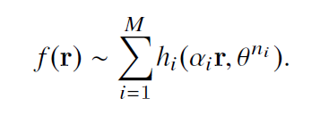
Goal: facilitate the learning of many frequencies while having the potential to overcome the curse of dimensionality.
MscaleDNN: Solve PDE
Liu, Cai, Xu*, 2020, arXiv:2007.11207

Slide 18
MscaleDNN: Solve PDE
Uniform convergence for each frequency
Mesh-free: complex domain
Easy implementation
Liu, Cai, Xu*, 2020, arXiv:2007.11207

Slide 19
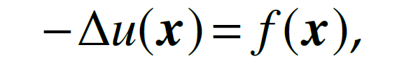
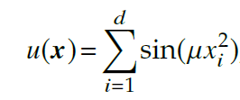
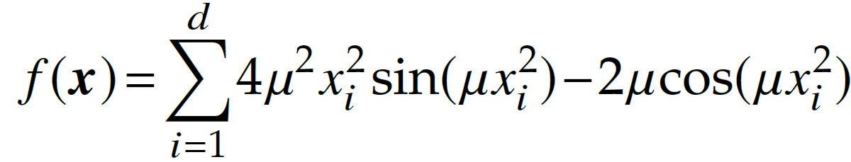
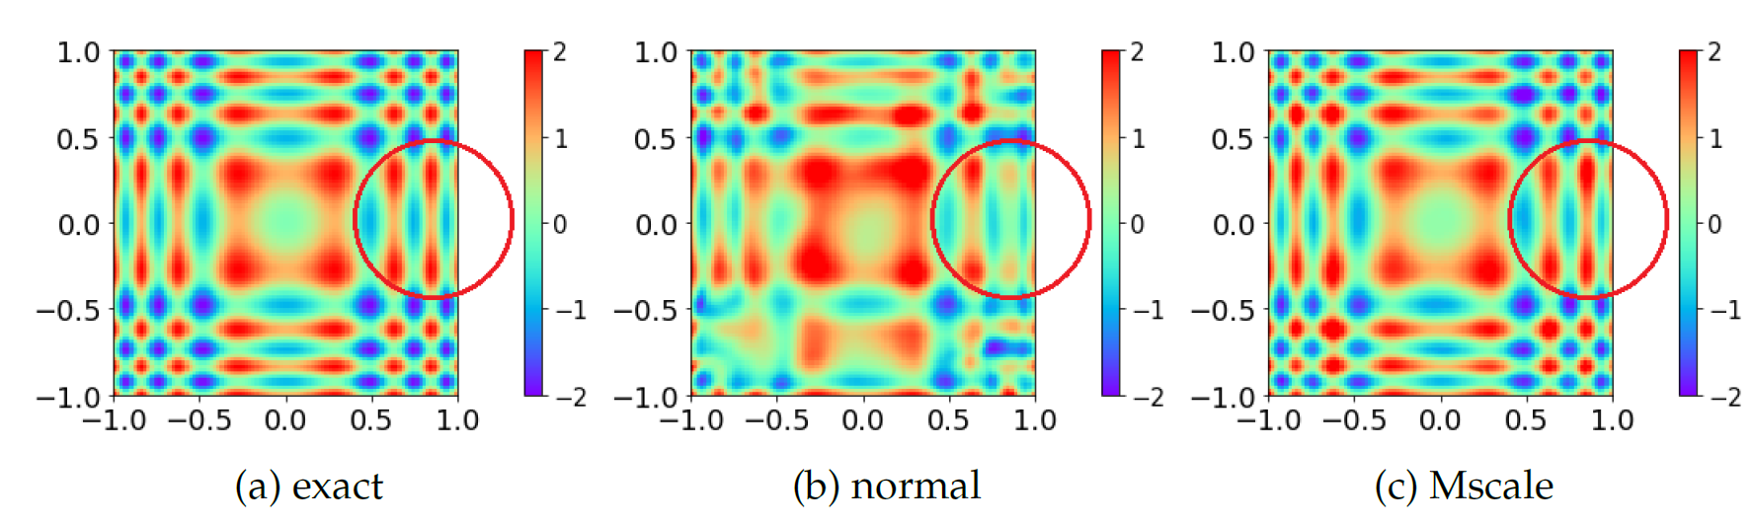
Poisson Equation
1. a fully-connected DNN with size 1-1000-1000-1000-1 (normal).
2. a MscaleDNN with five subnetworks with size 1-200-200-200-1, and scale coefficients 1,2,4,8,16. (Mscale)
Liu, Cai, Xu*, 2020, arXiv:2007.11207

Slide 20
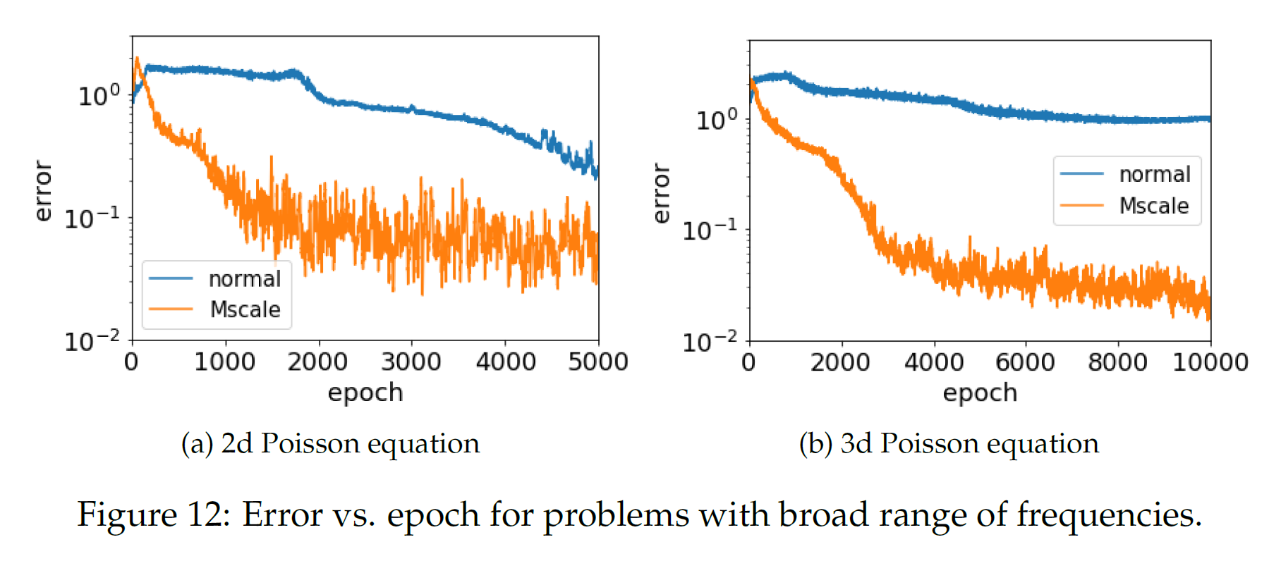
Poisson Equation
Liu, Cai, Xu*, 2020, arXiv:2007.11207

Slide 21
Micro perspective

Slide 22
Related works
Zhang, Xu, Luo, Ma (2019, 1905.10264): LFP
  Two-layer NTK, no assumption on data
Xu (2018, 1808.04295), Xu et al., (2019, 1901.06523)
  Tanh, two-layer
LMXZ (2019, 1906.09235)
  General DNN with sufficient large data
Rahaman et al., (2019, 1806.08734)
  Adopt analysis of Xu (2018) for ReLU
NTK and sufficient large data following uniform distribution
  Arora et al., (2019, 1901.08584)
  Basri et al., (2019, 1906.00425)
  Cao et al., (2019, 1912.01198)

Slide 23
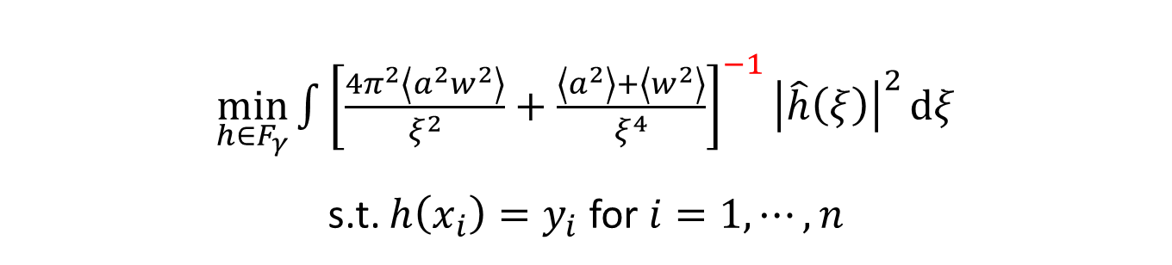
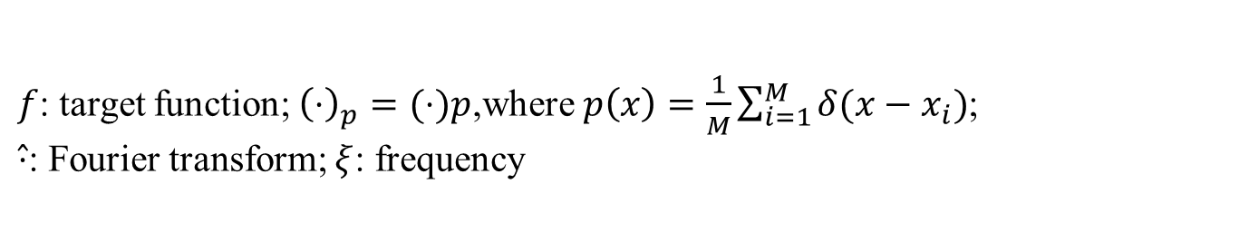

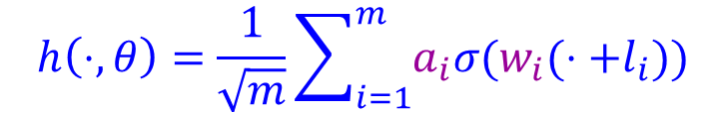
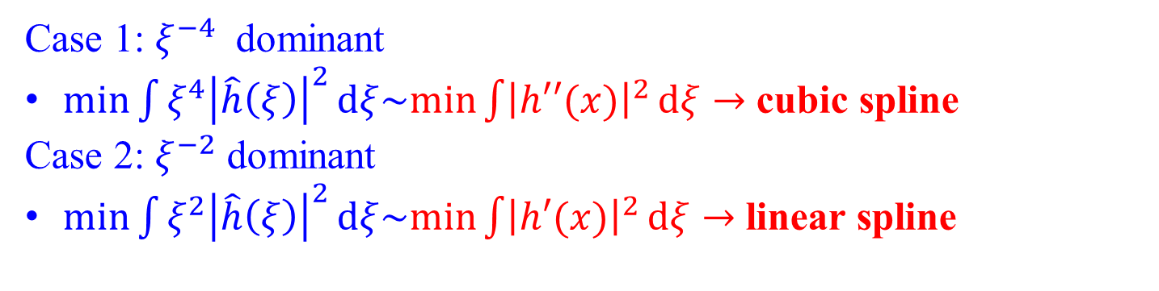
Preference induced by LFP dynamics
$$h\left(⋅,θ\right)=\frac{1}{\sqrt{m}}\sum_{i=1}^{m}{a_{i}σ(w_{i}(⋅+l_{i}))}$$
Sufficient large $m$
$$∂_{t} \hat{h}\left(ξ,t\right)=−\left[\frac{4π^{2}\left\langle a^{2}w^{2}\right\rangle }{ξ^{2}}+\frac{\left\langle a^{2}\right\rangle +\left\langle w^{2}\right\rangle }{ξ^{4}}\right]\left(\hat{h_{p}}\left(ξ,t\right)−\hat{f_{p}}\left(ξ,t\right)\right)$$
$\min_{h∈F_{γ}}{\int{{\left[\frac{4π^{2}\left\langle a^{2}w^{2}\right\rangle }{ξ^{2}}+\frac{\left\langle a^{2}\right\rangle +\left\langle w^{2}\right\rangle }{ξ^{4}}\right]}^{−1}{\left|\hat{h}\left(ξ\right)\right|}^{2}}}dξ$
s.t. $h\left(x_{i}\right)=y_{i}$ for $i=1,⋯,n$
low frequency preference
$f$: target function; ${\left(⋅\right)}_{p}=(⋅)p$,where$p\left(x\right)=\frac{1}{M}\sum_{i=1}^{M}{δ(x−x_{i})}$;
$\hat{⋅}$: Fourier transform; $ξ$: frequency
Case 1: $ξ^{−4}$ dominant
$min\int{ξ^{4}{\left|\hat{h}\left(ξ\right)\right|}^{2}}dξ\sim min\int{{\left|h′′(x)\right|}^{2}}dξ→$ cubic spline
Case 2: $ξ^{−2}$ dominant
$min\int{ξ^{2}{\left|\hat{h}\left(ξ\right)\right|}^{2}}dξ\sim min\int{{\left|h′(x)\right|}^{2}}dξ→$ linear spline
Zhang, Xu*, Luo, Ma (2019, 1905.10264)

Slide 24
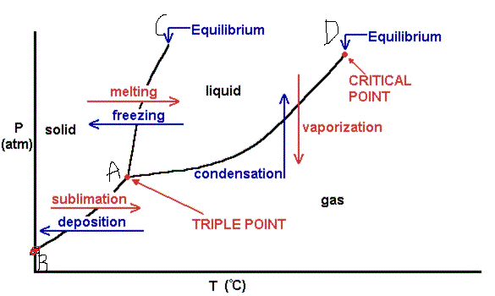
An example
In the thermodynamic limit.
https://sites.google.com/site/apchemistrypropertiesofliquids/phase-diagrams

Slide 25
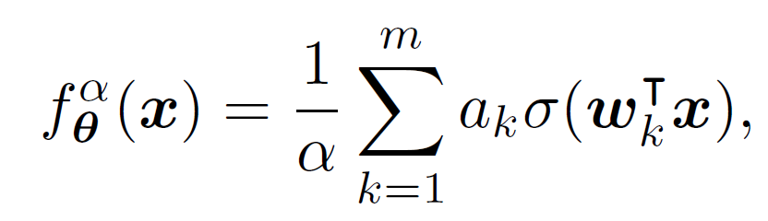
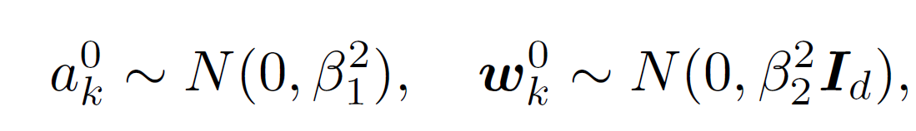
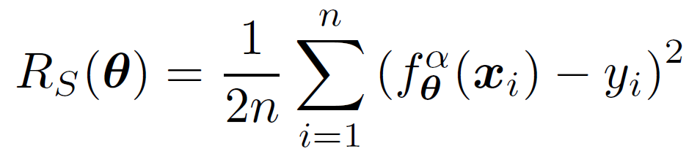
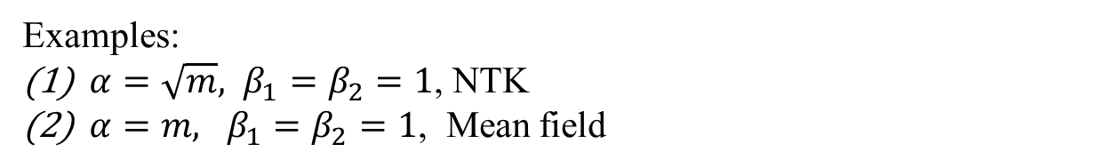
Two-layer ReLU NN
Examples:
$α=\sqrt{m}, β_{1}=β_{2}=1$, NTK
$α=m, β_{1}=β_{2}=1$, Mean field
Luo*, Xu*, Ma, Zhang, 2020, arXiv:2007.07497

Slide 26
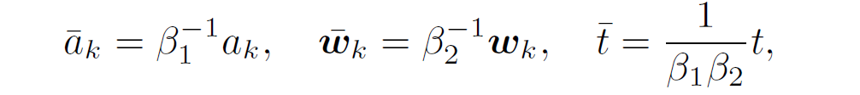
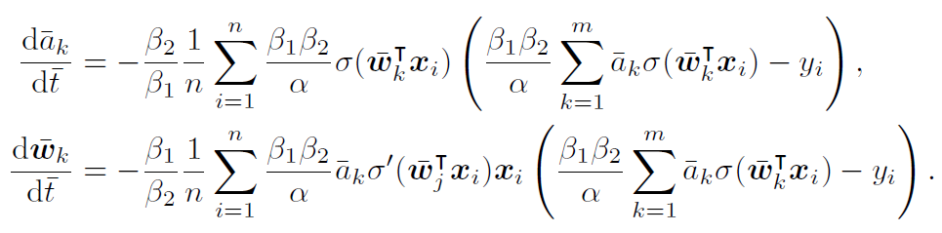
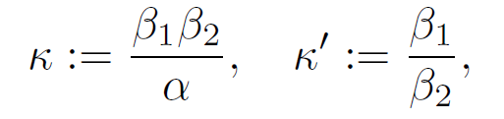
Rescaling and the normalized model
E.g., Reynolds number
Luo*, Xu*, Ma, Zhang, 2020, arXiv:2007.07497

Slide 27
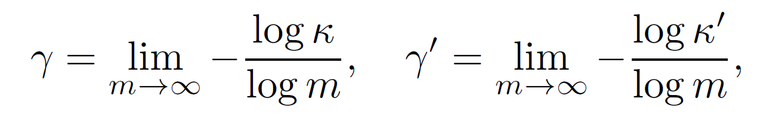
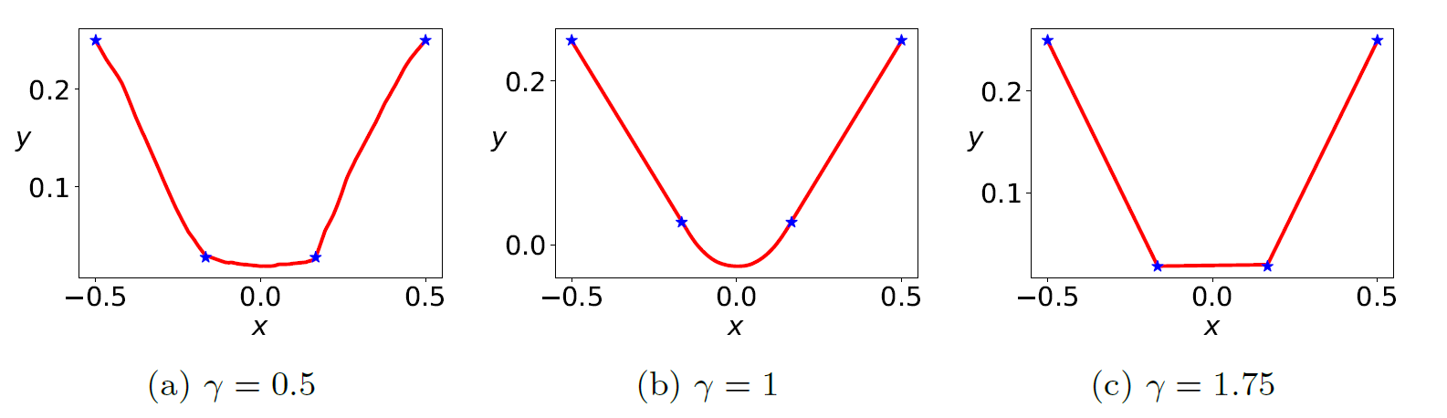
Examples
Luo*, Xu*, Ma, Zhang, 2020, arXiv:2007.07497

Slide 28
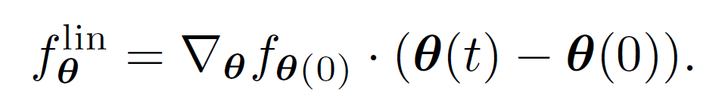
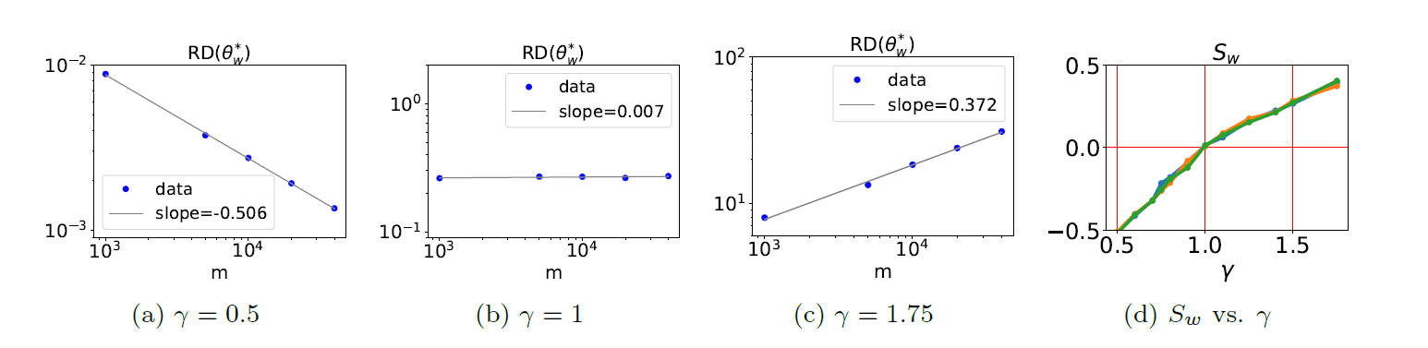
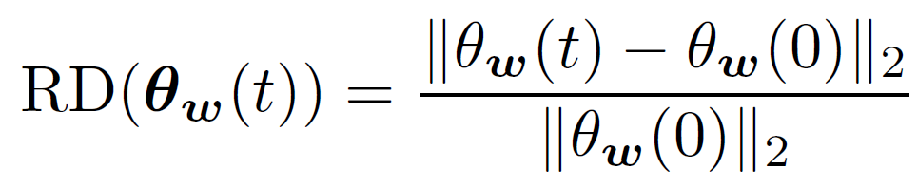
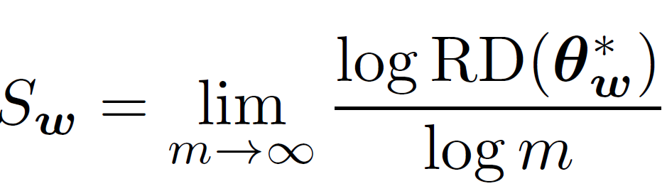
Regimes
Luo*, Xu*, Ma, Zhang, 2020, arXiv:2007.07497

Slide 29
Regimes
Luo*, Xu*, Ma, Zhang, 2020, arXiv:2007.07497

Slide 30
Luo*, Xu*, Ma, Zhang, 2020, arXiv:2007.07497

Slide 31
Take away
F-Principle：DNN prefers low frequencies
  MscaleDNN: Uniform convergence for each frequency
Phase-diagram for two-layer ReLU NN:
[1] Xu*, Zhang, Xiao, arXiv: 1807.01251
[2] Xu*, Zhang, Luo, Xiao, Ma, arXiv: 1901.06523
[3] Zhang, Xu*, Luo, Ma, arXiv: 1905.10264
[4] Liu, Cai, Xu*, arXiv:2007.11207
[5] Luo*, Xu*, Ma, Zhang, arXiv: 2007.07497
https://ins.sjtu.edu.cn/people/xuzhiqin/

Slide 32
Principles for finding the coordinates of a phase diagram
(i) Effectively independent.
(ii) Given a specific coordinate, learning dynamics should be similar up to a time scaling.
(iii) Differentiate dynamical differences except for the time scaling.
Luo*, Xu*, Ma, Zhang, 2020, arXiv:2007.07497

Slide 33

Examples
$$\left|a\right|\left|w\right|vs. \hat{w}$$
Luo*, Xu*, Ma, Zhang, 2020, arXiv:2007.07497

Slide 34


VS.
Condensation
Luo*, Xu*, Ma, Zhang, 2020, arXiv:2007.07497

Slide 35
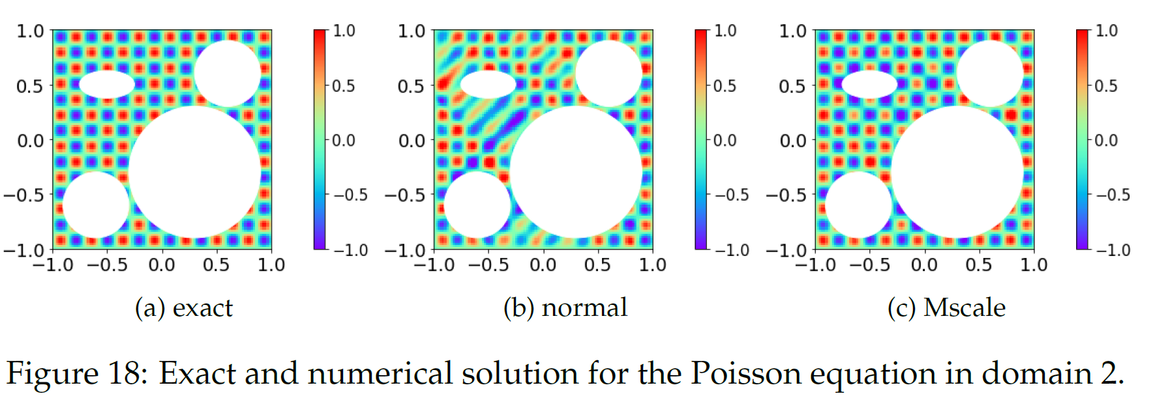
Poisson Equation
Liu, Cai, Xu*, 2020, arXiv:2007.11207

Slide 36
Conclusion
Reference:
Xu*, Zhang, Luo, Xiao, Ma, Frequency Principle: Fourier Analysis Sheds Light on Deep Neural Networks, 2019 ***
Xu*, Zhang, Xiao, Training behavior of deep neural network in frequency domain, 2018
Xu*, Understanding training and generalization in deep learning by Fourier analysis, 2018
Zhang, Xu*, Luo, Ma, Explicitizing an Implicit Bias of the Frequency Principle in Two-layer Neural Networks, 2019 **
Zhang, Xu*, Luo, Ma, A type of generalization error induced by initialization in deep neural networks, 2019**
Luo, Ma, Xu, Zhang, Theory on Frequency Principle in General Deep Neural Networks, 2019.
Cai, Xu*, Multi-scale Deep Neural Networks for Solving High Dimensional PDEs, 2019.
DNNs prefer low frequencies!
Joint work with Yaoyu Zhang, Tao Luo, Zheng Ma, Yanyang Xiao, Wei Cai (SMU)
Jiwei Zhang, Chengchao Zhao, Jihong Wang,
Yuheng Ma, Ziqi Liu
Acknowledge: Weinan E (Princeton), David W. McLaughlin (CIMS)
A summary note of the F-Principle can be found at my page https://ins.sjtu.edu.cn/people/xuzhiqin/

Slide 37
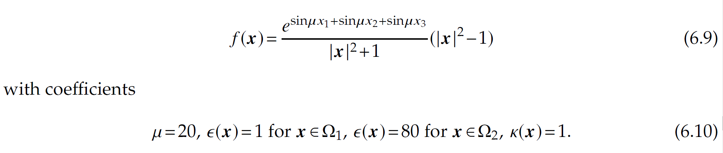
Poisson-Boltzmann equations
Liu, Cai, Xu*, 2020, arXiv:2007.11207

Slide 38
Poisson-Boltzmann equations
Liu, Cai, Xu*, 2020, arXiv:2007.11207

Slide 39
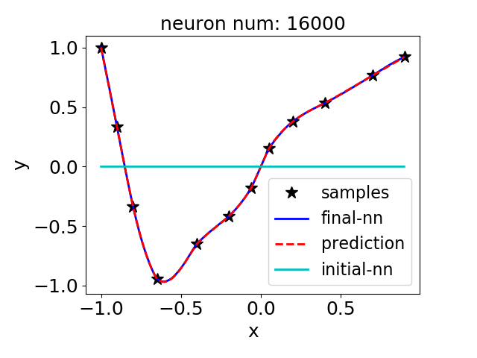
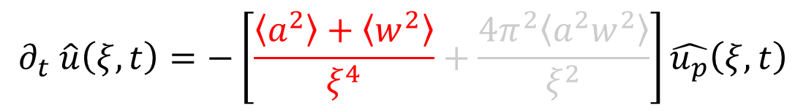
Two-layer relu-NN
$$∂_{t} \hat{u}\left(ξ,t\right)=−\left[\frac{\left\langle a^{2}\right\rangle +\left\langle w^{2}\right\rangle }{ξ^{4}}+\frac{4π^{2}\left\langle a^{2}w^{2}\right\rangle }{ξ^{2}}\right]\hat{u_{p}}\left(ξ,t\right)$$
w and a are initialized by uniform distributions on [ -0.1,0.1 ] and [ -0.25,0.25 ]
Zhang, Xu*, Luo, Ma (2019, 1905.10264)

Slide 40
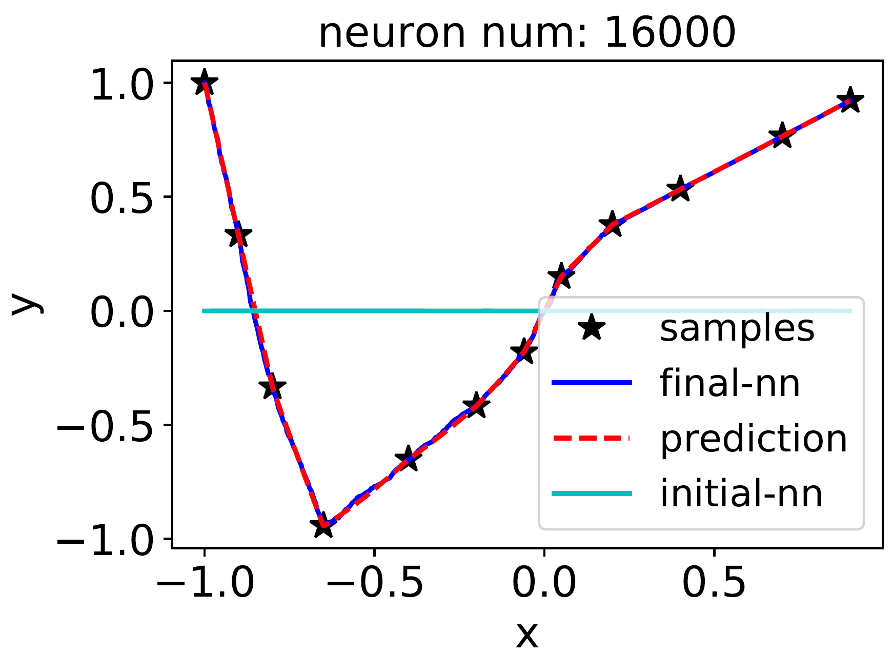
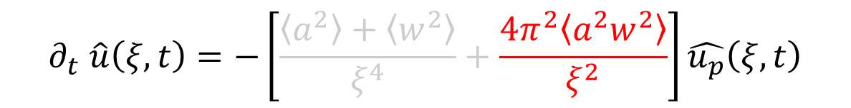
Two-layer relu-NN
$$∂_{t} \hat{u}\left(ξ,t\right)=−\left[\frac{\left\langle a^{2}\right\rangle +\left\langle w^{2}\right\rangle }{ξ^{4}}+\frac{4π^{2}\left\langle a^{2}w^{2}\right\rangle }{ξ^{2}}\right]\hat{u_{p}}\left(ξ,t\right)$$
w and a are initialized by uniform distributions on [ -2,2]
Zhang, Xu*, Luo, Ma (2019, 1905.10264)

