Slide 1

Universal Dynamics in Microbial Ecosystems
Amir Bashan
Physics Department
Bar-Ilan University
Israel
Notes:
Thanks, Birthday, Outline

Slide 2
Data integration
Traffic
Big data
Recommendations
Microbial communities
Complex networks
Image processing
Signal analysis
Deep learning
Machine learning
Smart cities
FinTech
NLP
Network inference
Classification
Crowd mining
Parameters tuning
Voice recognition
Dynamical systems
Bio-chemical reactions
Public health
Neural networks
Gene regulation
Computer vision
Web mining
Search engines
Artificial intelligence
Statistical models
Data mining
Training

Slide 3
Data integration
Traffic
Big data
Recommendations
Microbial communities
Complex networks
Image processing
Signal analysis
Deep learning
Machine learning
Smart cities
FinTech
NLP
Network inference
Classification
Crowd mining
Parameters tuning
Voice recognition
Dynamical systems
Bio-chemical reactions
Public health
Neural networks
Gene regulation
Computer vision
Web mining
Search engines
Artificial intelligence
Statistical models
Data mining
Training

Slide 4
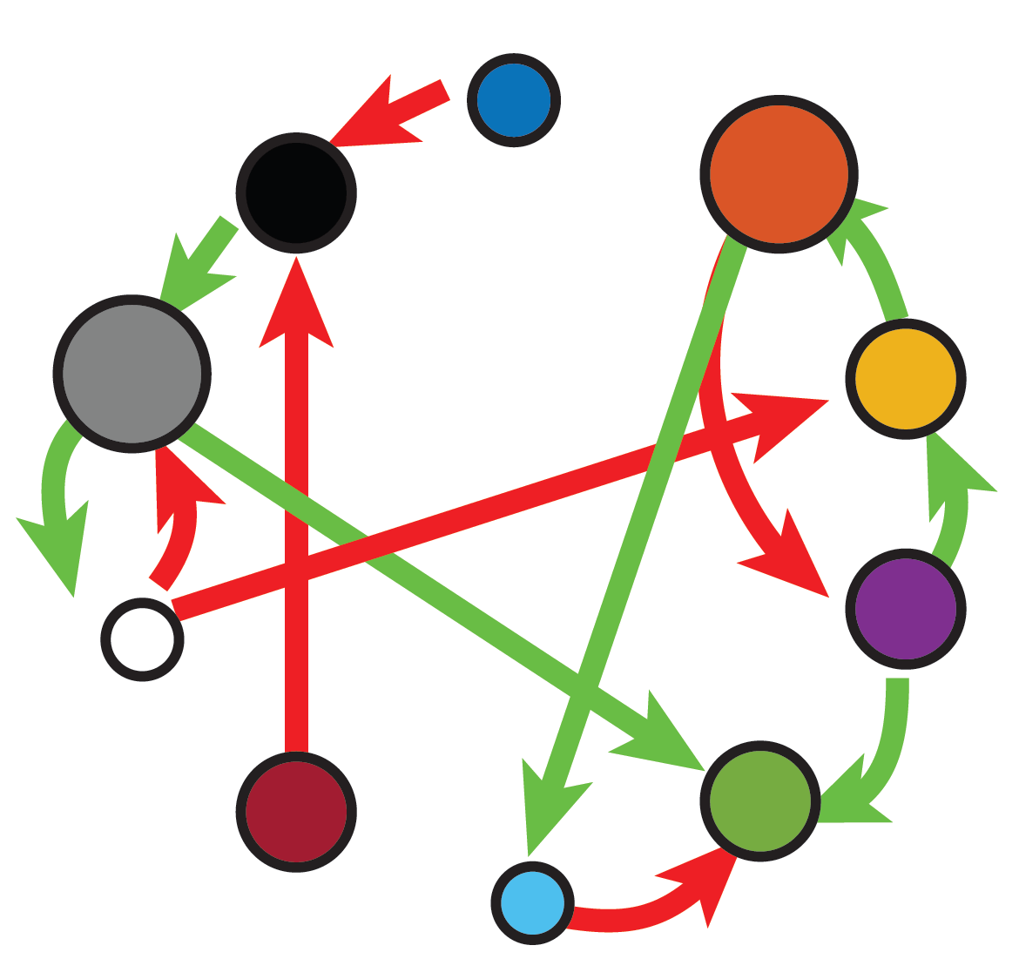
Behind any complex system there is an underlying network of interactions
System states
1,…,K
Elements
1,…,N
Human Microbiome, Gene regulation, Financial systems, Biochemical reactions…

Slide 5
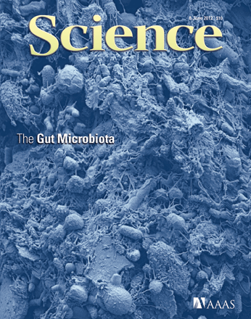
The human microbiome
Copyright Dennis Kunkel Microscopy, Inc. Science (2012)
~ 1μm

Slide 6
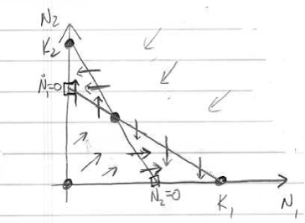
Do microbial populations follow mathematical laws?

Slide 7
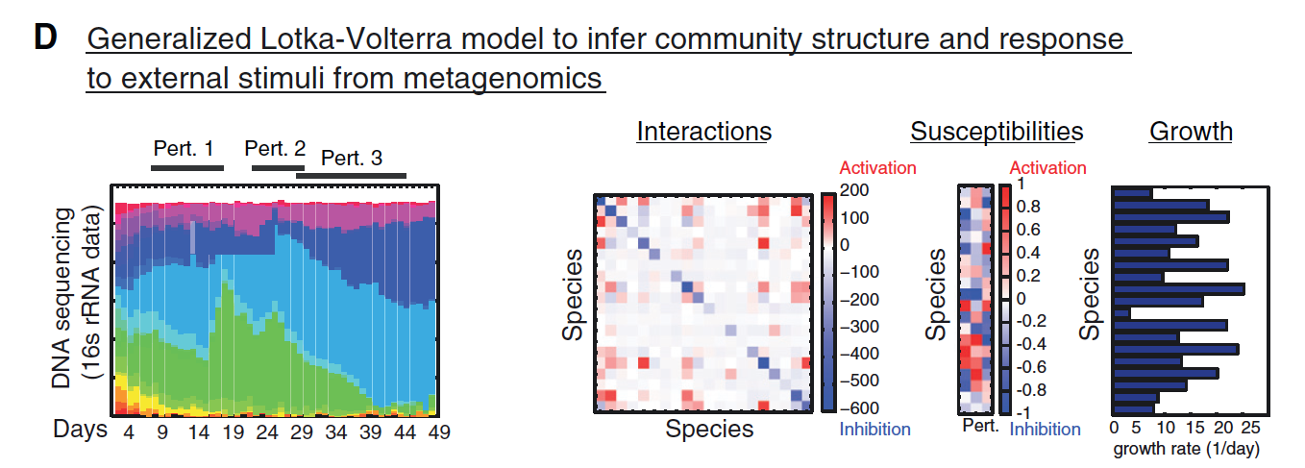
Abundance of a single bacterial species can mediate a critical physiological phenotype
Examples:
Individuals
Relative abundance of A. muciniphila is correlated with clinical responses to immune checkpoint inhibitors in human cancer patients.
Increased abundance of Klebsiella species boosts pro-inflammatory intestinal responses.
Microbiome
Phenotype
Routy, B. et al. Science (2018).
Zechner E. L. et al. Current Opinion in Microbiology, (2017).

Slide 8
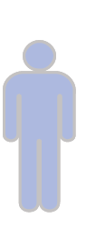
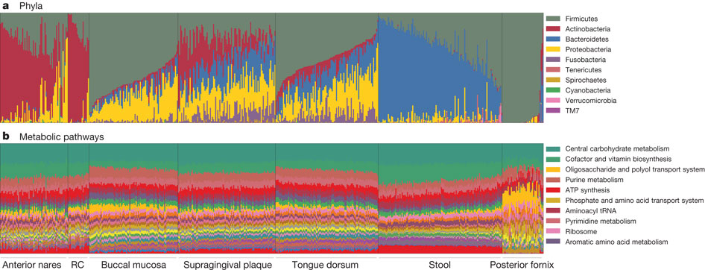
Our microbiome is highly personalized
Gut samples
subjects
Inter-personal variability of:
  (1) species assemblages
  (2) abundance profiles
The Human Microbiome Project Consortium, Nature 486 (2012).

Slide 9
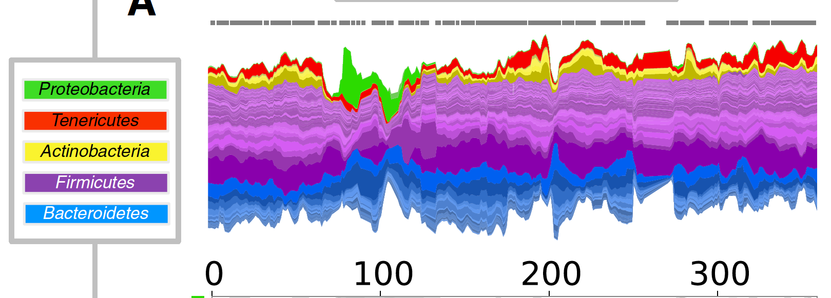
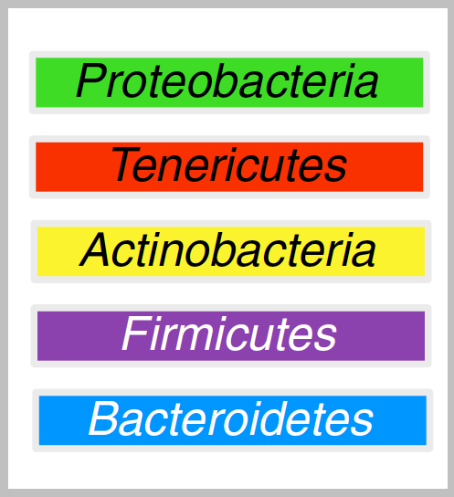
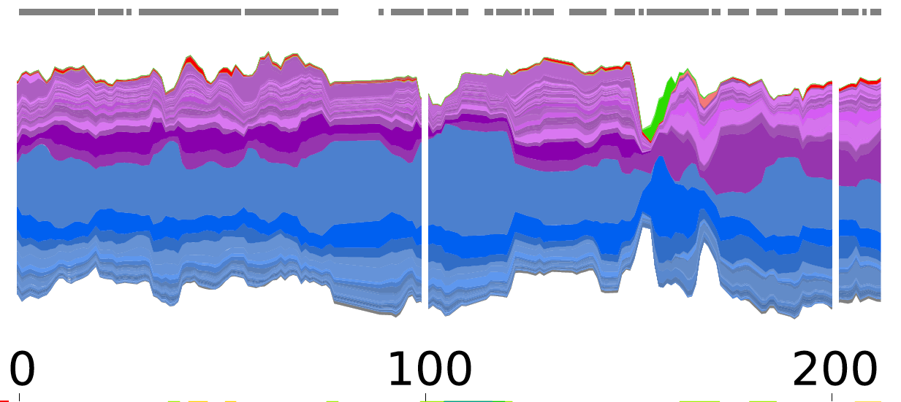
The microbiome is very stable. And alterable.
Subject A
Subject B
Days
David et al. Genome Biology 15 (2014)

Slide 10
The microbiome is very stable. And alterable.
Data from: David et al. Genome Biology 15 (2014)

Slide 11
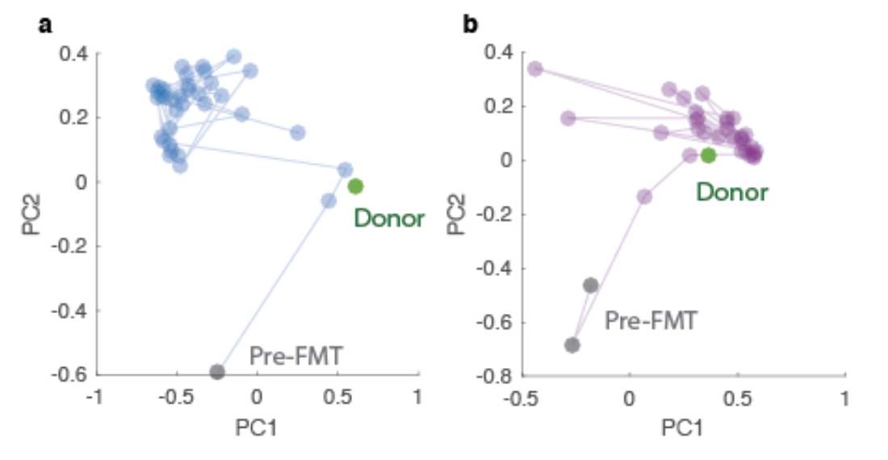
Patients microbiome after fecal transplant FMT

Slide 12
The microbiome is: i) highly personalized, ii) very stable, iii) alterable

Slide 13
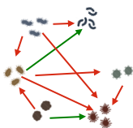
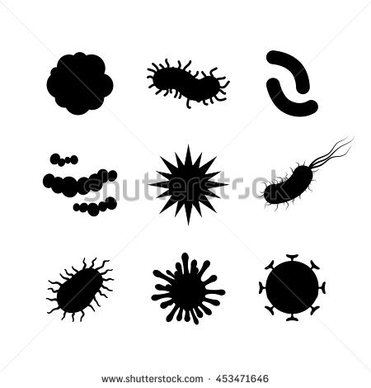
Species abundances are determined by an ecological network
Species-species interaction
+
Host-species interaction
Effective species-species interaction

Slide 14
Individual species assemblages and populations sizes

Slide 15
Individual species assemblages and populations sizes

Slide 16
THE ecological network ??

Slide 17
THE ecological network ??
Genetics

Slide 18
THE ecological network ??
Genetics
Immune

Slide 19
“Host-specific ecosystem” =
Each individual’s microbiota follows its own rules
Genetics
Immune
Diet
Life-style

Slide 20
Hint from the theory of complex systems:
Multiple steady states for the same system
Figure from Levy, M., et al. (2017)

Slide 21
Are different steady states consistent with the same dynamical system?
Figure from Levy, M., et al. (2017)

Slide 22
Are different steady states consistent with the same dynamical system?
Figure from Levy, M., et al. (2017)

Slide 23
Ecological network:
Universal or individual?
Individual
“Individual ecosystem” :
Each individual’s microbiome follows its own rules
OR
“Universal ecosystem” :
Consistent interactions across hosts
Universal
Bashan et al. Nature (2016)
Notes:
Not only that we don’t know the network – we don’t even know if there is one network, THE networks.

Slide 24
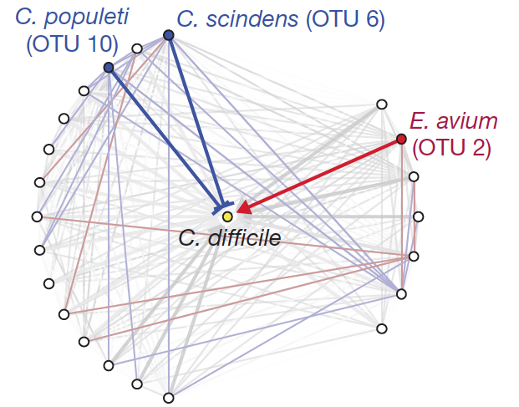
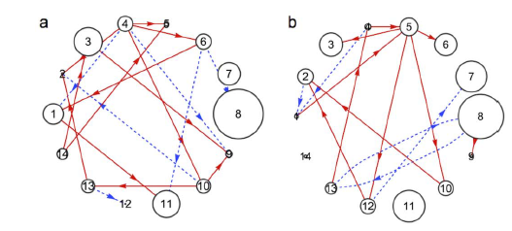
Ecological network of the microbiome:
Universal or individual?
?
Buffie et al. Nature (2015)
Fisher et al, Plos One (2014)

Slide 25
Computational method to detect universal dynamics
Individual
Dissimilarity
Overlap
OR
Universal
Dissimilarity
Overlap
Bashan et al. Nature (2016)
Notes:
Not only that we don’t know the network – we don’t even know if there is one network, THE networks.

Slide 26
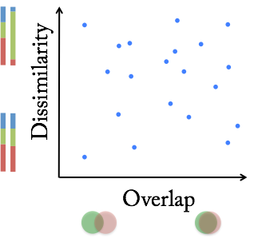
Dissimilarity-Overlap curve (DOC) analysis
Bashan et al. Nature (2016)
Notes:
Our method is called dissimilarity-overlap curve (DOC) analysis. Here dissimilarity captures the difference between the renormalized abundance profiles of shared species between two samples. Overlap captures the total relative abundances of the shared species, which can be considered as a weighted version of Jaccard index. Here I am showing you the basic steps of the DOC analysis.
1. we calculate overlap and dissimilarity of all the sample pairs and represent each sample pair as a point in the dissimilarity–overlap plane.
2. We use the standard non-parametric regression method: robust LOWESS (locally weighted scatterplot smoothing) to calculate the DOC, representing the average trend of the dependency between D and O.
3. To get the confidence interval, we use the standard bootstrap technique.
The key point is that: we can prove those two measures are mathematically independent. Hence, any dependency observed from real data deserves an dynamical or ecological explanation.
－－－－－－－－－－－－－－－－－－－－－－－－－－

Slide 27
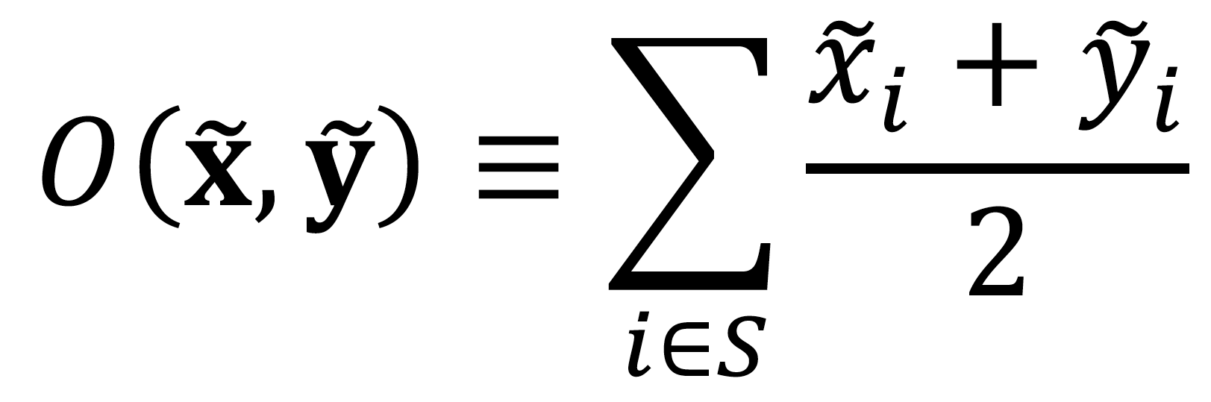
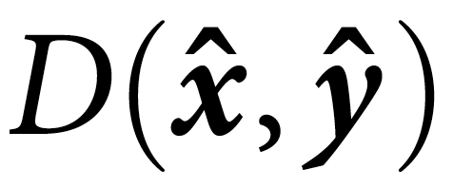
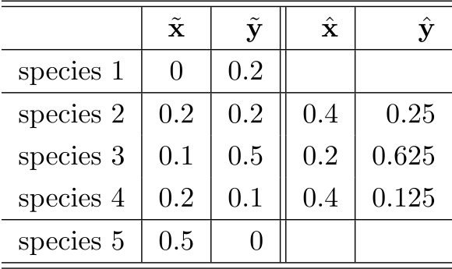
Dissimilarity-Overlap curve (DOC) analysis
Overlap : half of the total relative abundance of shared species
Dissimilarity : “distance” between the renormalized abundance profiles of shared species:
Bashan et al. Nature (2016)
Notes:
Recently we come up with a new method to extract dynamic information from microbiome data, called DOC analysis. Here, Overlap captures the total relative abundances of the shared species, which can be considered as a weighted version of Jaccard index. In the following example, you can easily calculate Overlap=(0.5+0.8)/2=0.65. Dissimilarity captures the difference between the renormalized abundance profiles of shared species between two samples. You can use any dissimilarity measures,
You many wonder why we should renormalize the abundance profiles of the shared species?
－－－－－－－－－－－－－－－－－－－－－－－－－－－－－－－－－－－
\begin{tabular}{l| c | r || r | r }
\hline
\hline
& $\tilde{\bf x}$ & $\tilde{\bf y}$
& $\hat{\bf x}$ & $\hat{\bf y}$
\\
\hline
species 1 & 0 & 0.2 & & \\
\hline
species 2 & 0.2 & 0.2 & 0.4 & 0.25\\
species 3 & 0.1 & 0.5 & 0.2 & 0.625 \\
species 4 & 0.2 & 0.1 & 0.4 & 0.125\\
\hline
species 5 & 0.5 & 0 & & \\
\hline
\hline
\end{tabular}

Slide 28
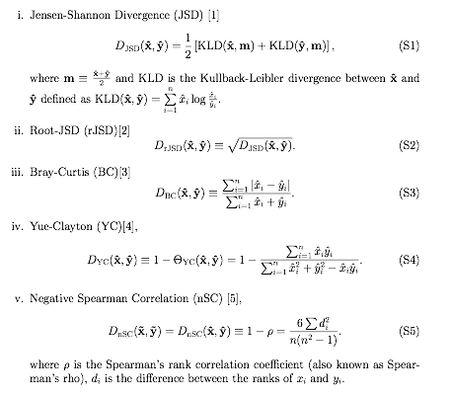
Dissimilarity measure
Notes:
We choose rJSD, because it is a distance metric that satisfies non-negativity; identity; symmetry; triangle inequality.

Slide 29
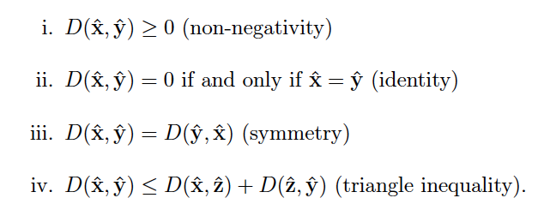
A dissimilarity measure is a distance metric if it satisfies the following conditions:
Notes:
A dissimilarity measure is a distance metric if it satisfies the following conditions:

Slide 30
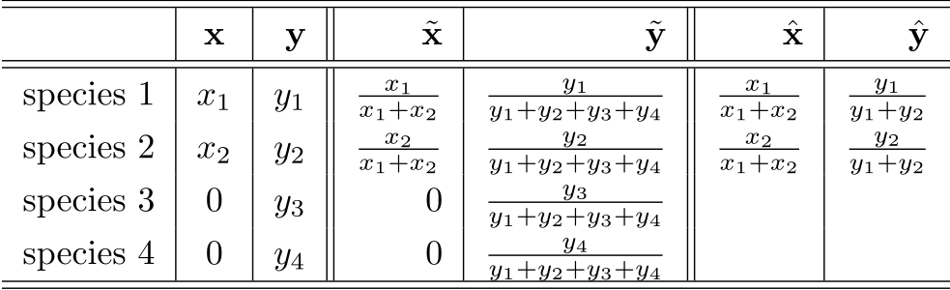
Why renormalization?
absolute
abundances
relative
abundances
renormalized
abundances
  The renormalized abundances of the shared species do NOT depend on the non-shared species abundances at all.
  Hence, the spurious dependence between the relative abundances of shared and non-shared species is removed.
Bashan et al. Nature (2016)
Notes:
First of all: the renormalized abundance of shared species do NOT depend on non-shared species abundance at all. Hence, …
－－－－－－－－－－－－－－－－－－－－
\begin{tabular}{l| c | r || r | r || r | r }
\hline
\hline
&{\bf x}&{\bf y}& $\tilde{\bf x}$ & $\tilde{\bf y}$ & $\hat{\bf x}$ & $\hat{\bf y}$ \\
\hline
\hline
species 1 & $x_1$ & $y_1$ & $\frac{x_1}{x_1+x_2}$ & $\frac{y_1}{y_1+y_2+y_3+y_4}$ & $\frac{x_1}{x_1+x_2}$ & $\frac{y_1}{y_1+y_2}$\\
species 2 & $x_2$ & $y_2$ & $\frac{x_2}{x_1+x_2}$ & $\frac{y_2}{y_1+y_2+y_3+y_4}$ & $\frac{x_2}{x_1+x_2}$ & $\frac{y_2}{y_1+y_2}$\\
species 3 & 0 & $y_3$ & 0 & $\frac{y_3}{y_1+y_2+y_3+y_4}$ & & \\
species 4 & 0 & $y_4$ & 0 & $\frac{y_4}{y_1+y_2+y_3+y_4}$ & & \\
\hline
\hline
\end{tabular}

Slide 31
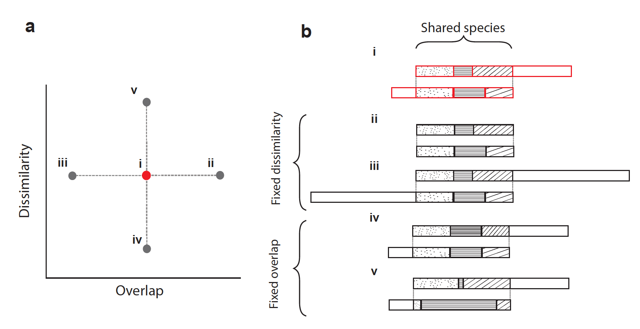
Amir Bashan, BIU
Why renormalization?
  The dissimilarity measure over the renormalized abundance profiles is mathematically independent of the overlap measure.
Bashan et al. Nature (2016)
Notes:
Secondly, and more importantly, this renormalization assures that the dissimilarity over the renormalized abundance profiles is mathematically independent of the overlap. This point can be seen from this figure. Any point over the dissimilarity-overlap plane can be horizontally shifted (i.e. change its overlap without changing its dissimilarity) by changing the ratio between the total abundance of the unique species and that of the shared species while fixing the ratios within the shared species. // Similarly, any point can be shifted vertically by doing the opposite, i.e. fixing the ratio between the total abundance of the unique species and that of the shared species while changing the ratios within the shared species.

Slide 32
Computational method to detect universal dynamics
Individual
Dissimilarity
Overlap
OR
Universal
Dissimilarity
Overlap
Bashan et al. Nature (2016)
Notes:
Not only that we don’t know the network – we don’t even know if there is one network, THE networks.

Slide 33
Consistent dynamics in the gut of healthy individuals
Bashan et al. Nature (2016)
Notes:
After the validation, we applied our DOC analysis to cross-sectional gut microbiome data from the HMP. We find…

Slide 34
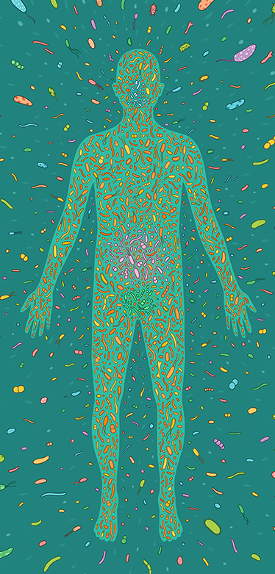
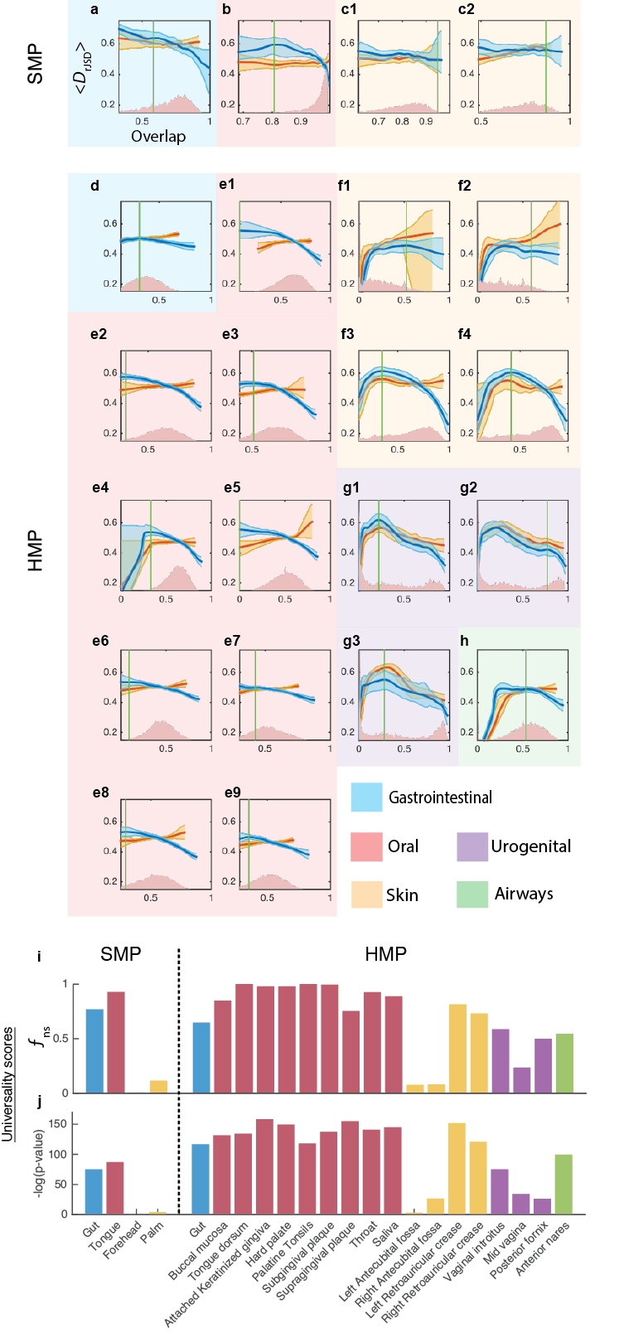
Universal dynamics in the gut of healthy individuals
Amir Bashan, BIU
Gut
http://www.amnh.org
Bashan et al. Nature (2016)

Slide 35
Universal dynamics in the gut of healthy individuals
Amir Bashan, BIU
Tongue
Gut
http://www.amnh.org
Bashan et al. Nature (2016)

Slide 36
Universal dynamics in the gut of healthy individuals
Amir Bashan, BIU
Tongue
Skin (Elbow)
Gut
Skin (Palm)
http://www.amnh.org
Bashan et al. Nature (2016)

Slide 37
Universality lost and recovery
Diseased patients (CDI)
Healthy patients
Dissimilarity
Data from Youngster et al. Clin. Infect. Dis. (2014).
Bashan et al. Nature (2016)

Slide 38
Universality lost and recovery
Diseased patients (CDI)
Healthy patients
Dissimilarity
Dissimilarity
Bashan et al. Nature (2016)

Slide 39
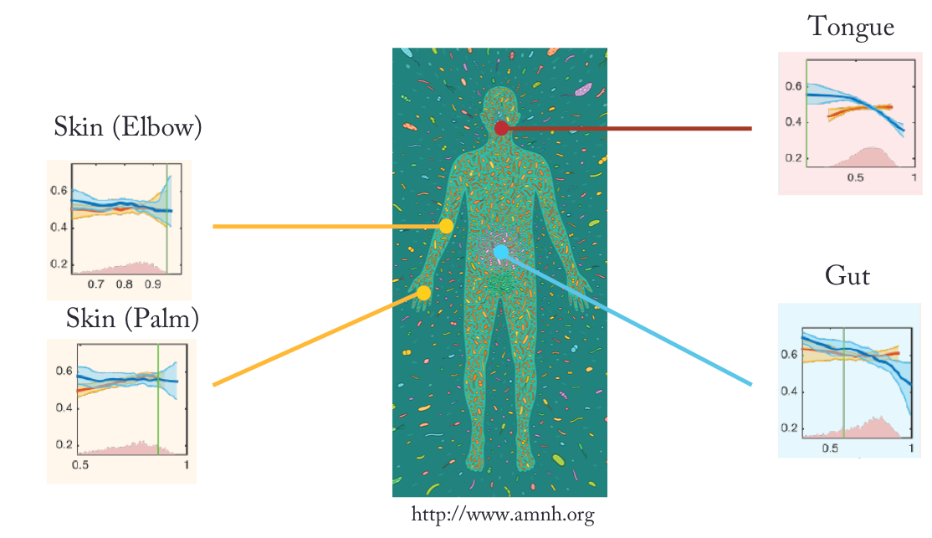

Thanks for listening
Bashan et al. Nature (2016)

