Slide 1
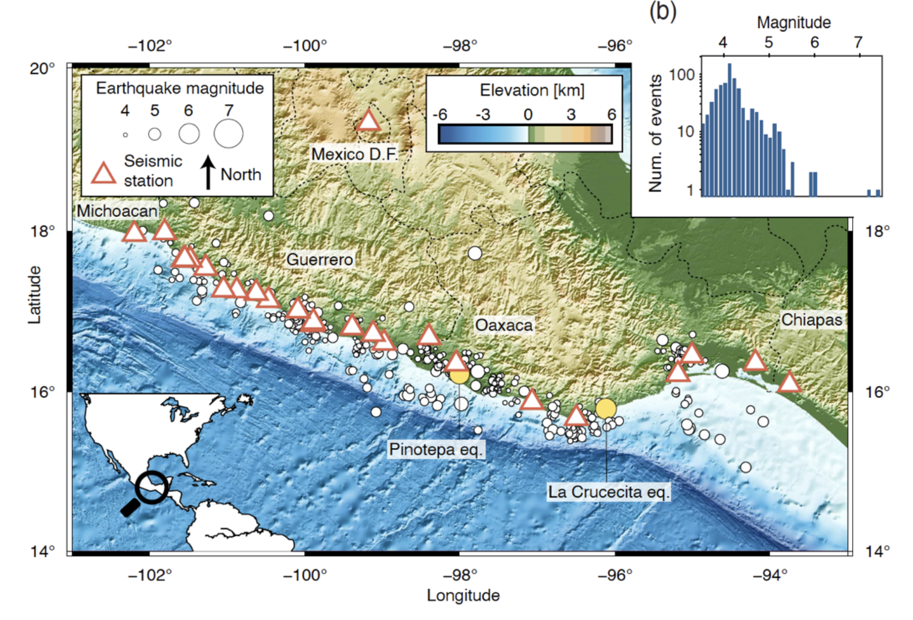
Grillo network in Mexico

Slide 2
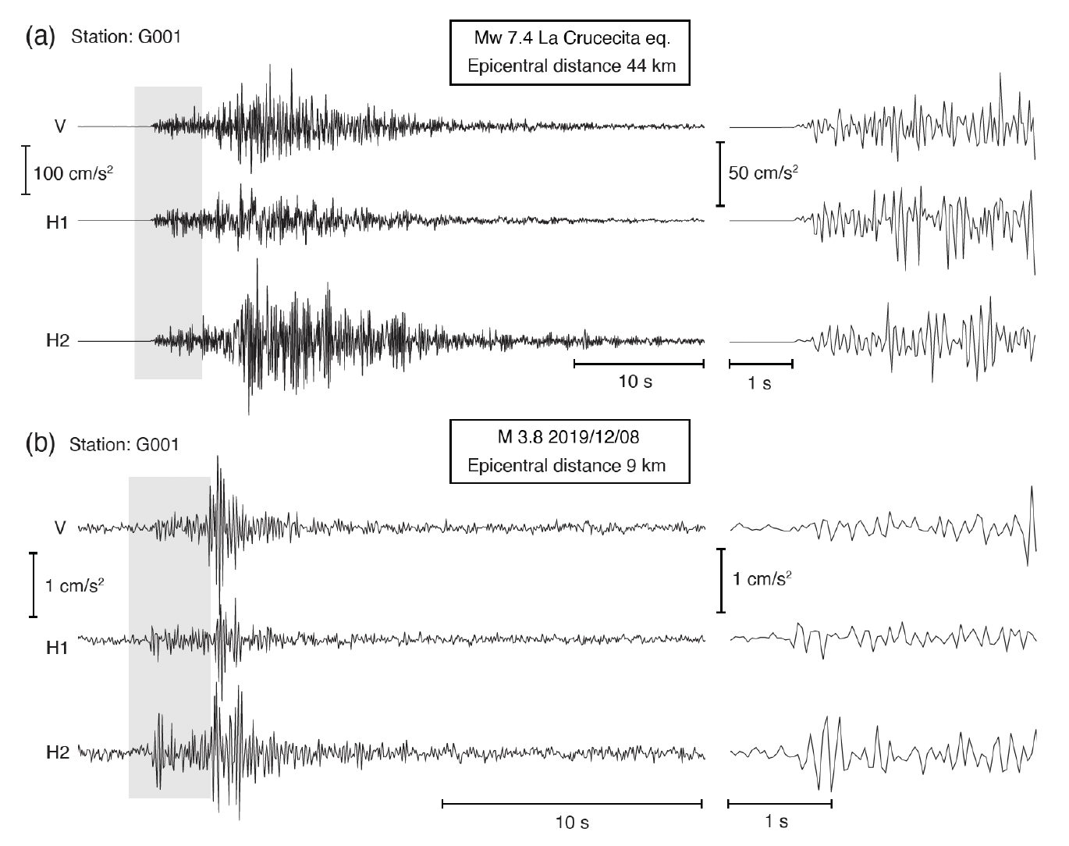
Earthquake
records
Strong motion
Weak motion

Slide 3
Capability to measure strong motion: Peak acceleration
Distance from the earthquake rupture [km]

Slide 4
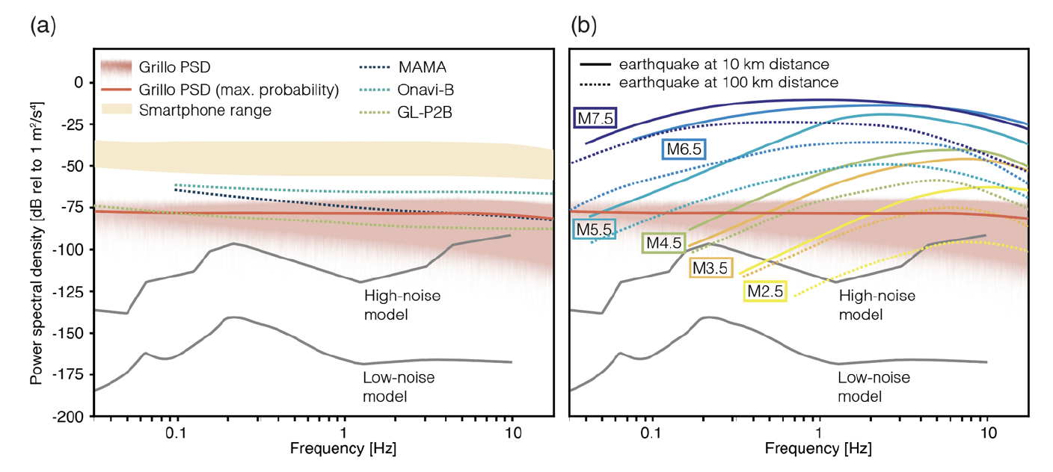
Capability to measure weak motion: Sensor self-noise

Slide 5
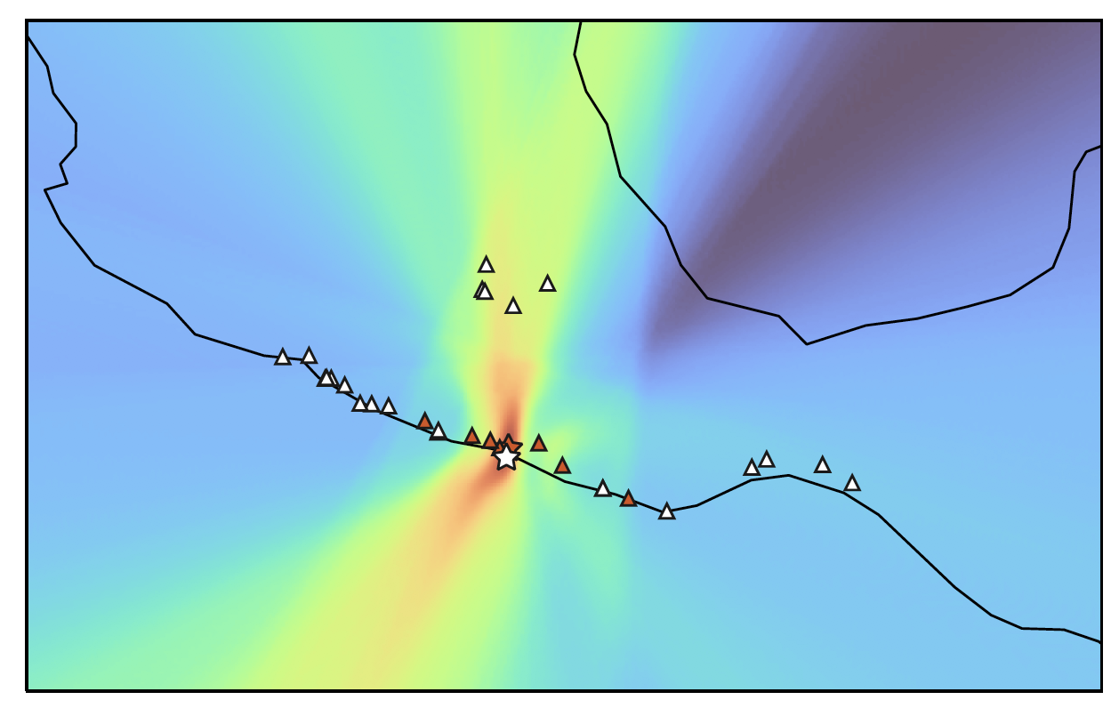
Mexico City
100 km

