Slide 1
Decadal variability of tropical Indian Ocean sea surface temperature and its impact on the Indian summer monsoon
Presented by
Amol Vibhute
Co-Authors : Subrota Halder^{1,2}, Prem Singh¹, Anant Parekh¹, Jasti S. Chowdary¹ & C. Gnanaseelan¹
Indian Institute of tropical Meteorology, Pune, India 411008
Savitribai Phule Pune University, Pune India 411007

Slide 2
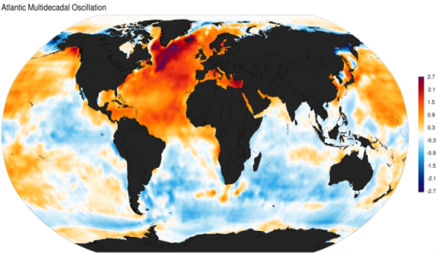
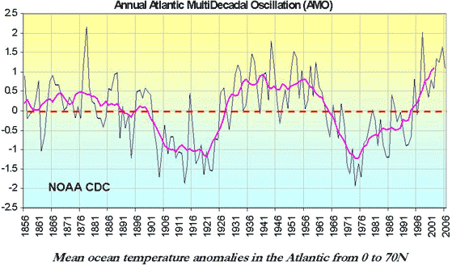
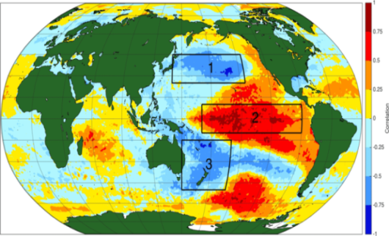
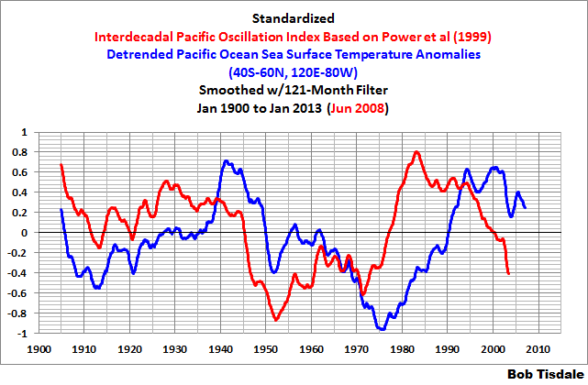
Impacts
Introduction
Dominant Decadal Variabilities
Spatial pattern of Atlantic Multidecadal Oscillation (AMO) and its time series (Source: NOAA)
Spatial pattern of Pacific decadal oscillation (PDO) and its PC (Source: NOAA)
Positive Phase
More frequency of El-Nino’s with high Magnitude
Below than normal ISMR
Spatial pattern of Inter-Decadal Pacific Oscillation (IPO) and its time series (Source: NOAA)

Slide 3
1. Temporal Evolution
Objectives
To Identify tropical Indian Ocean Sea Surface Temperature (TIO SST) and Indian Summer Monsoon Rainfall (ISMR) decadal variability temporal / spatial pattern.
Study the impact of strong and weak phase of TIO SST decadal variability on summer monsoon rainfall over India.
Study the linkages between TIO SST decadal variability with dominant decadal modes of global ocean.
2. Wavelet Analysis
TIO SST (ºC) from ERSST and IMSR(JJAS)
Results and Discussions
MCZR = Monsoon Core Zone rainfall
3. EOF Analysis
TIOSST first mode variance 51.6%, Having highest strength = 1940
ISMR = 21% Var.

Slide 4
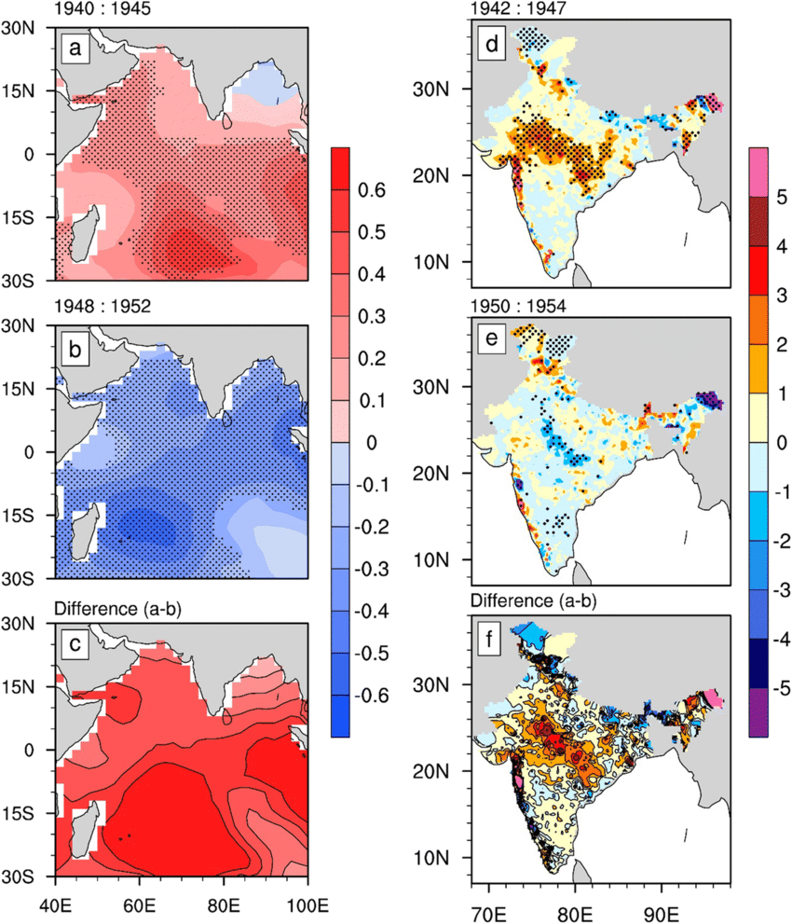
Impact of Dominant Positive And Negative Phases of TIO SST on Indian Rainfall
Band pass Filtered signal
Correln: upto year 1940 = -0.56, from 1940 to 1990 = 0.6 after year 1990 = -0.7
Dominant Positive Dominant Negative
(1940-1945) (1948-1952)
A strong positive phase is found during 1940 to 1945 (warm phase) with the amplitude of 0.36 °C and followed by negative phase with strength of − 0.2 °C (cold phase).
Over the MCZ rainfall also shows decadal variability, which has an amplitude of 2.5 to 3 mm/day; however, for the ISMR, it is 0.6 mm/day
It confirms that the TIO SST warming (cooling) brings out more (less) rainfall in MCZ region after two years of warming (cooling).
During the same period AMO and TIO SST also displayed dramatic change in their phases evolution.

Slide 5
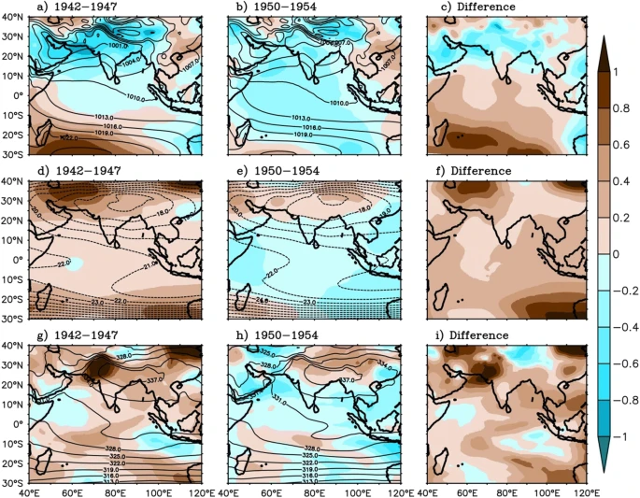
Figure support During the warm phase, wind speed difference is positive throughout the basin at 850-hPa level indicating strong southwesterly winds over the Arabian Sea, over the MCZ, and the Bay of Bengal than cold phase.
Excess moisture is transported to the monsoon region, which supports the formation of excess precipitation during this phase.
Spatial pattern of JJAS mean sea level pressure (hPa, contour) and sea level pressure anomaly (hPa, shaded) for the warm (a) and cold phase (b) and their difference (c, a-b). Troposphere temperature (°C, average over the 600 to 200 hPa, contour) and its anomaly (°C, shaded), for the warm phase (d) and cold phase (e) and their difference (f, d-e). Moist static energy (kJ/kg, average over the 1000 to 200 hPa, contour) and its anomaly (kJ/kg, shaded), for the warm phase (g) and cold phase (h) and their difference (i, g-h)

Slide 6
CONCLUSIONS
TIO SST decadal variability Linkages with PDO/IPO/AMO
PDO
Parameter | PDO | IPO | AMO
Correlation with TIO SST | 0.3 | 0.3 | 0.4
Strength of TIO SST | 40% | 30% | Similar
Magnitude of TIO SST | Weak | Weak | Similar
AMO
TIO SST’s correlation is weaker for ISMR but it is significant for MCZR having lag of two years.
TIO SST’s strength is equal to AMO having correlation 0.4 indicates good coherence with the AMO than PDO and IPO.
During recent period (after 1990), in phase relation between TIO SST with PDO and IPO is disturbed.
TIO SST decadal variability is independent of DMI indicates it does dependent on the AMO, PDO and IPO and also influence the MCZR rainfall.
This finding confirms that warm (cold) phase of TIO SST decadal variability favors positive (negative) rainfall anomaly over MCZR through air sea interaction and monsoon dynamics.
Decadal variability is existing in the TIO SST, ISMR, OHC and DMI.
MCZR and Western Ghats have noticeable strength of the decadal variability than strength of the ISMR.
TIO SST decadal signal shows basin wide dominant mode explains more than 50% variance, strongest positive phase 1939-1946 and negative 1948-1953.

Slide 7
THANK YOU
FOR YOUR ATTENTION !

