Slide 1
Fidelity in Representing Indian Summer Monsoon rainfall Variability and Teleconnections using Circulation Indices
Presented by
Yasmin Zahan
Email: yasmin.zahan3@gmail.com
Author(s)
Yasmin Zahan1, P. V. Rajesh1, B. Abida Choudhury1 and B. N. Goswami1
¹ Department of Physics, Cotton University, Guwahati-781001
Workshop on Indian Ocean Variability and Teleconnections 15 - 17 March 2021

Slide 2
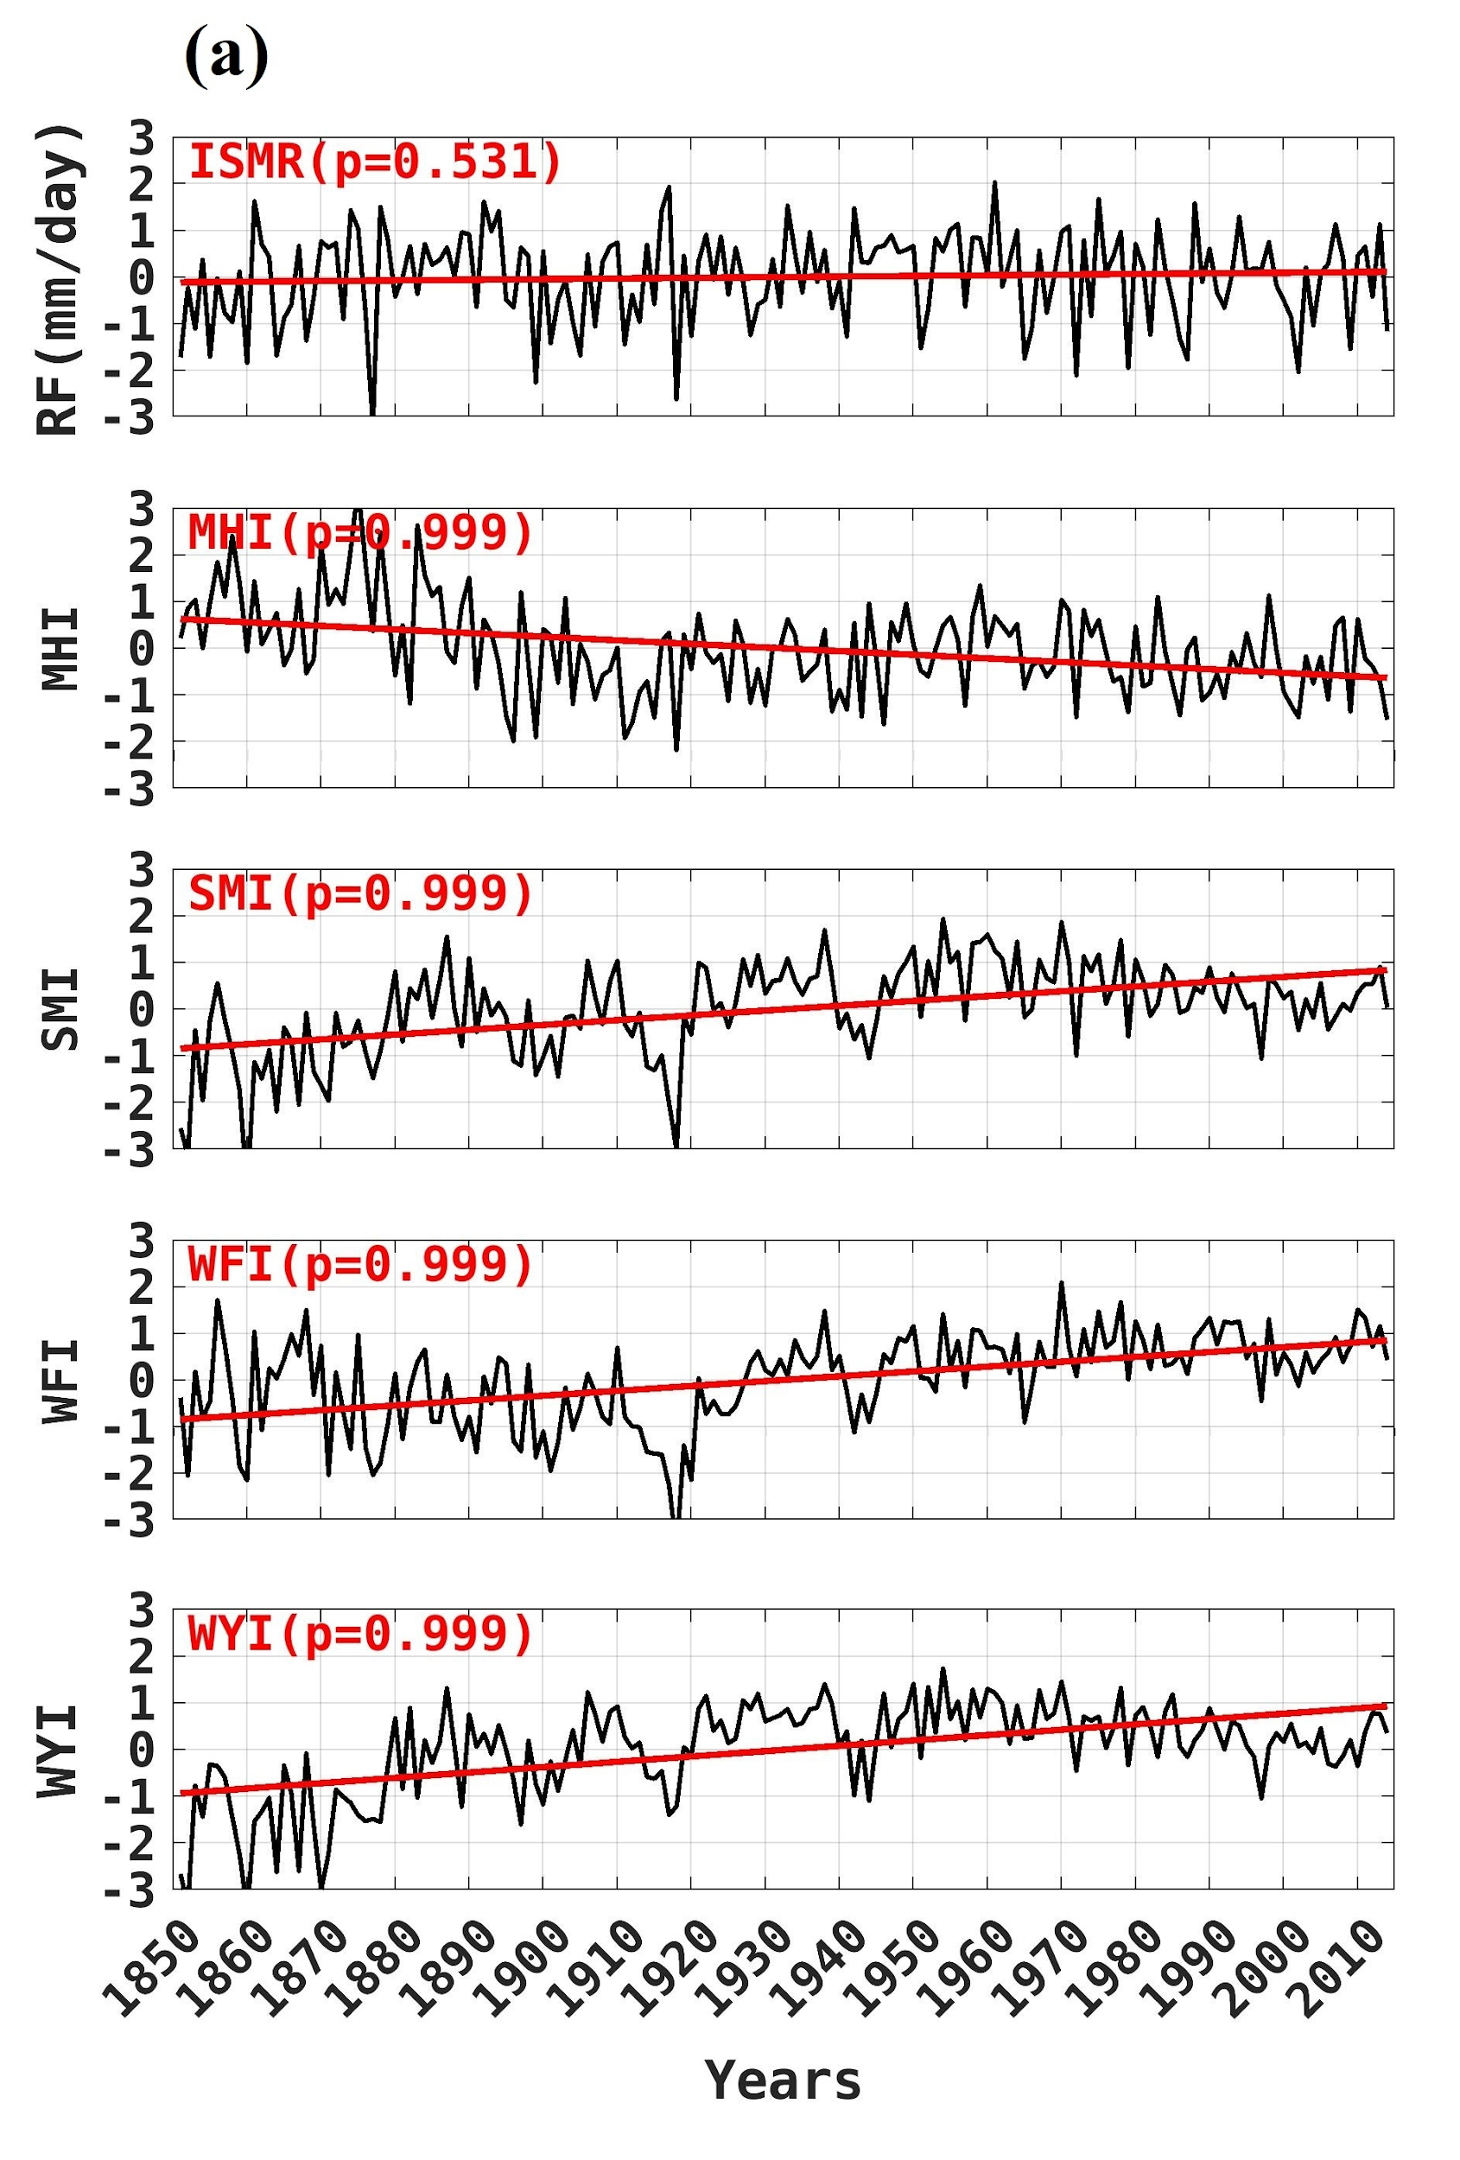
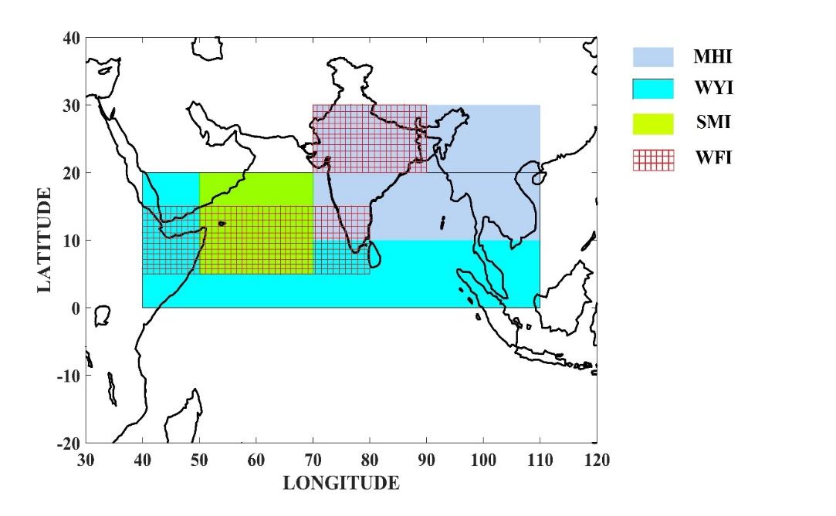
Introduction
Regions over which the wind indices constructed-
MHI=V850-V200 for the region 20N-30N, 70E-90E
SMI=U850(LLJ-core)-U200(TEJ-core) for the region 5N-20N, 50E-70E
WFI= U850 (5-15N, 40-80E) –U850(20N-30N, 70E-90E)
WYI=U850-U200 for the region 0N-20N, 40E-110E
Figure: Standardized Time series plot

Slide 3
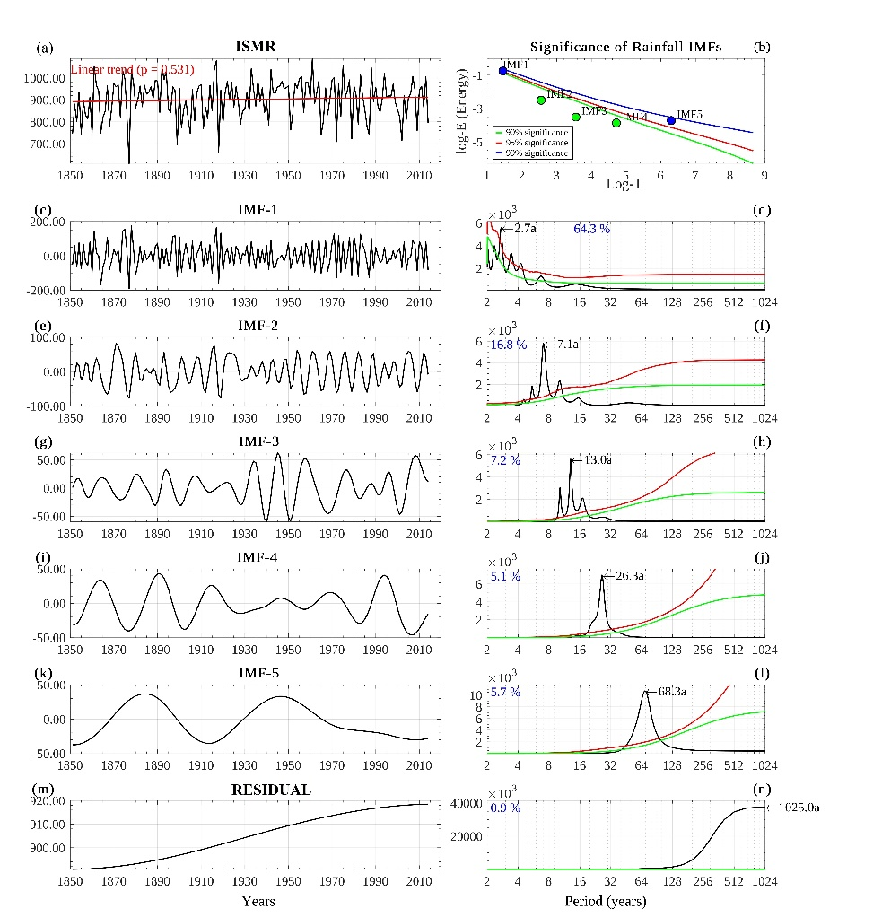
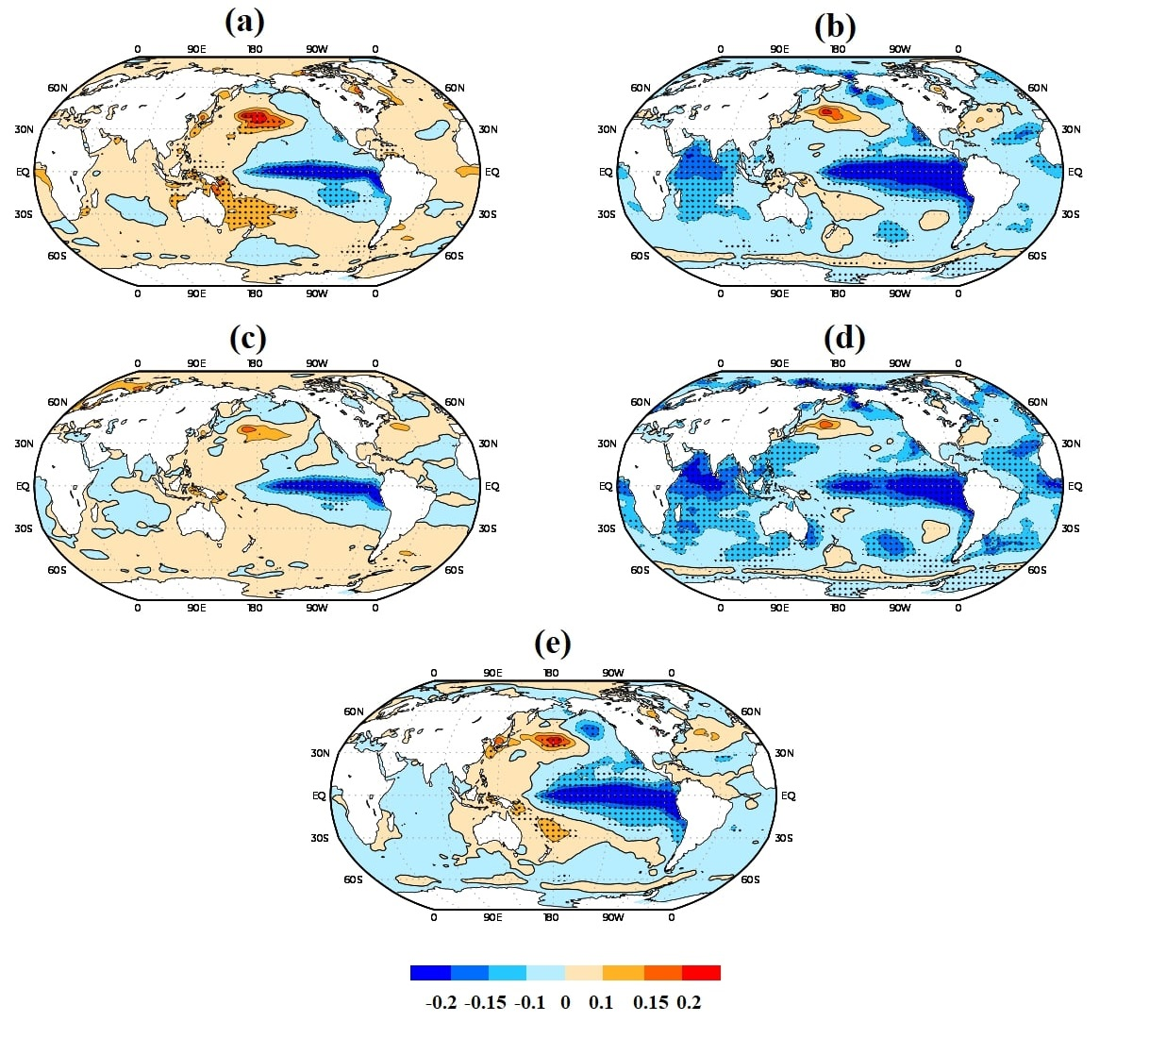
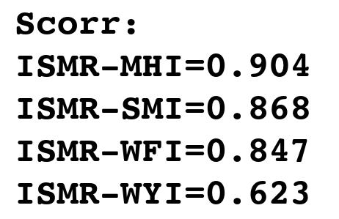
RESULTS
Figure: Regression of (a) MHI, (b) SMI, (c) WFI, (d) WYI (e) ISMR indices on global JJAS SST (k/mm) between 1851-2014.
Figure: ISMR time series (mm), (b) Statistical significance of IMFs against Gaussian white noise null hypothesis.

Slide 4
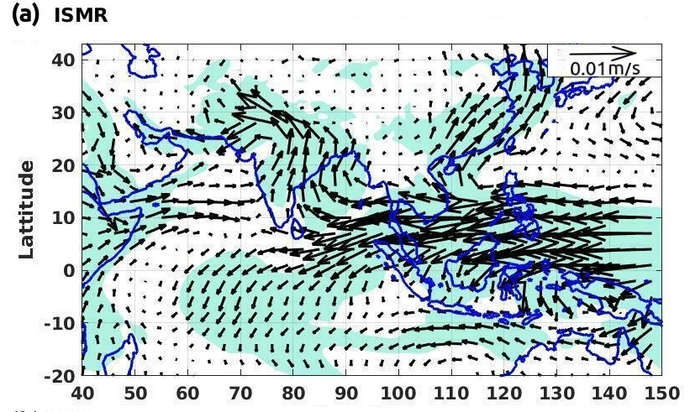
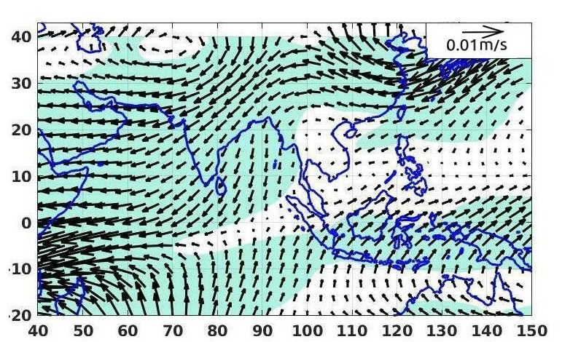
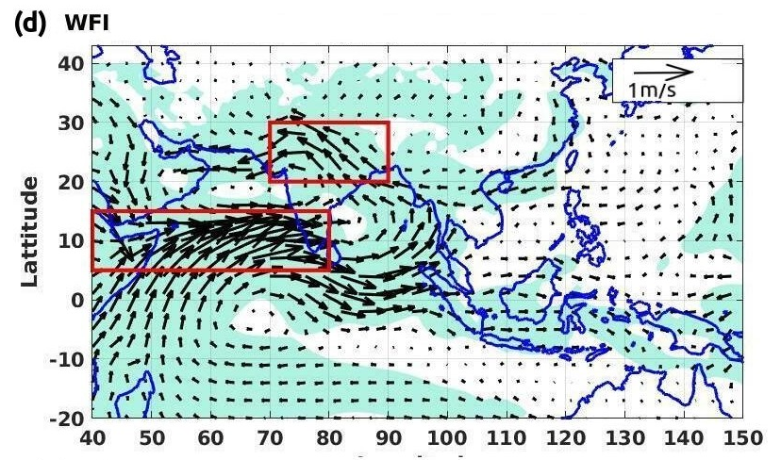
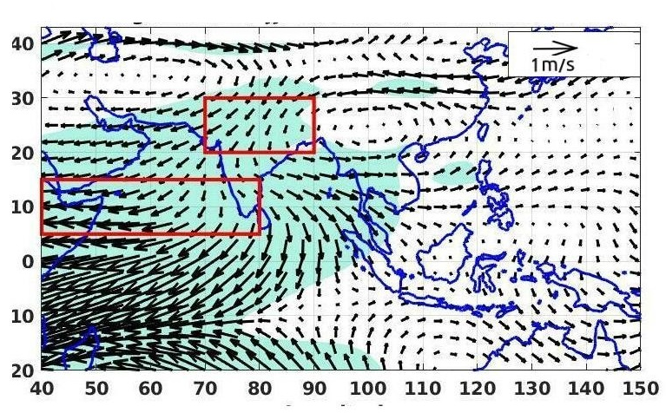
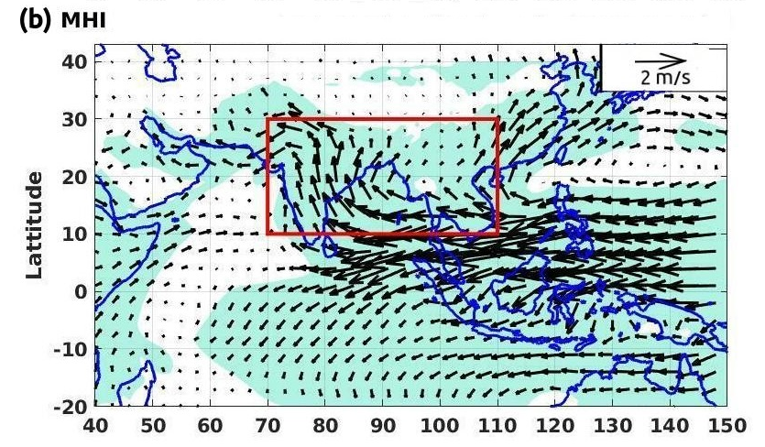
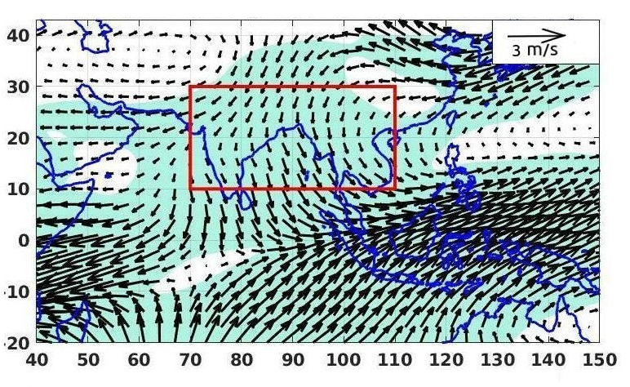
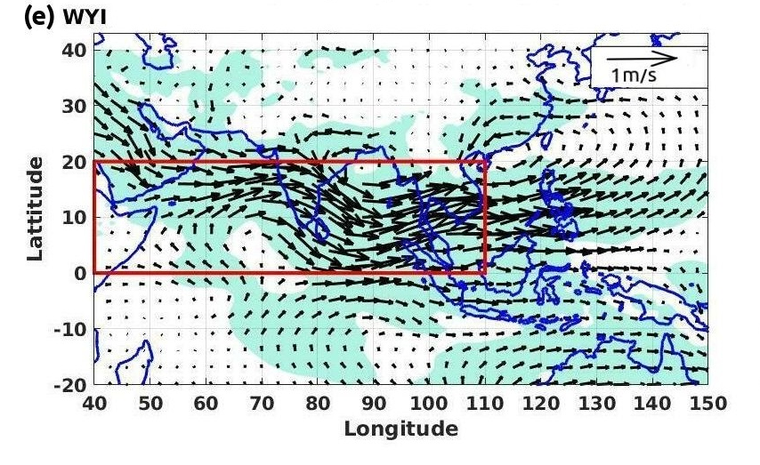
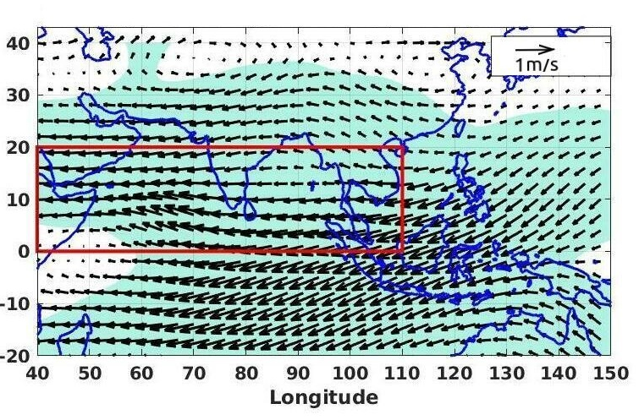
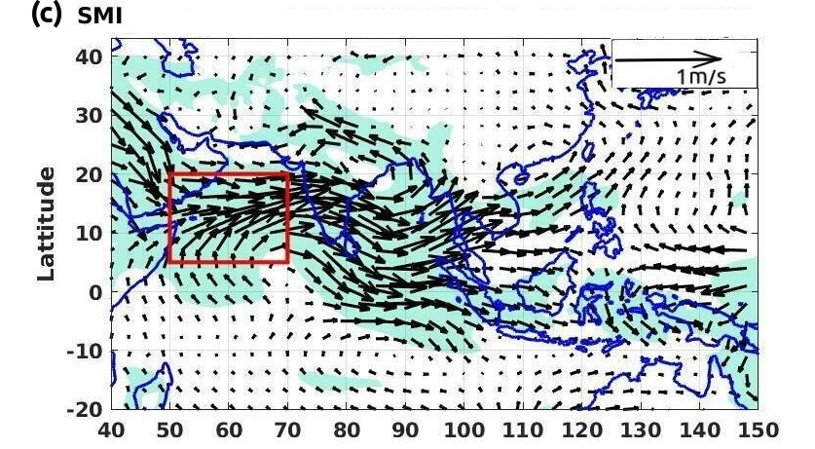
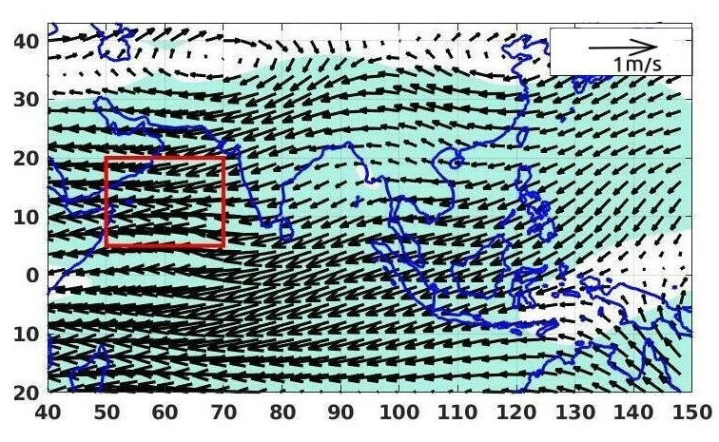
Figure: Regression of normalized (a)ISMR, (b)MHI (c)SMI, (d)WFI ,(e)WYI on winds at 850 hPa (left panel) and 200 hPa (right panel) between 1851-2014 from 20CR-V3.

Slide 5
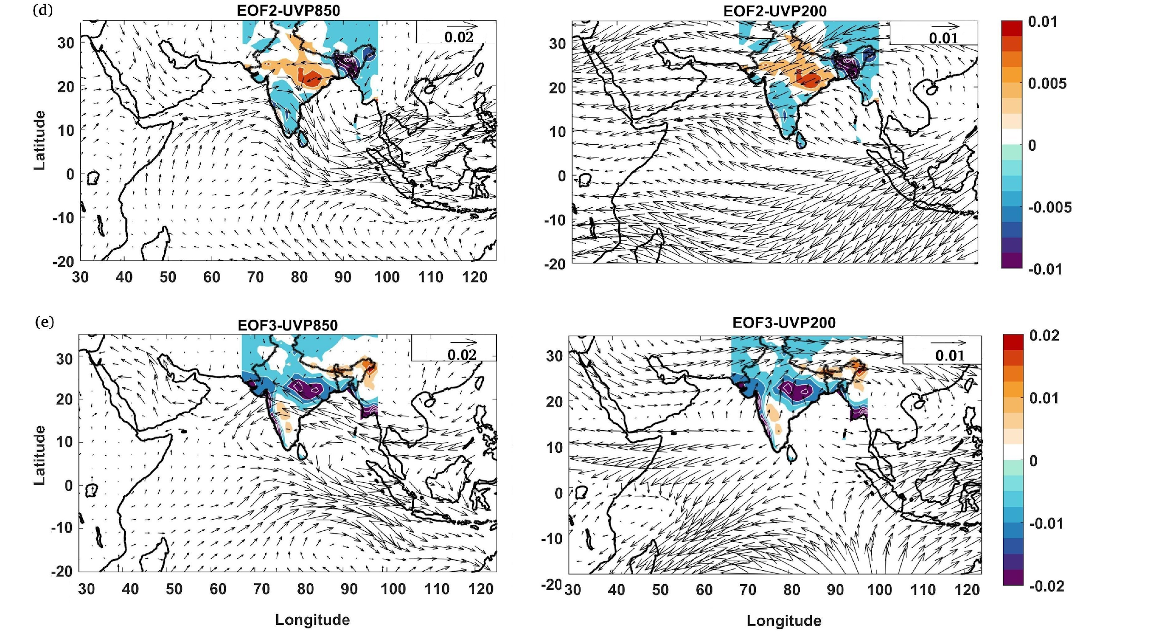
Figure: MVEOF between precipitation [5ºN-35ºN, 68ºE-99ºE], U-wind and V-wind of 850hPa as well as 200 hPa level of [20ºS- 35ºN, 30ºE-120ºE] for the period 1951-2007

Slide 6
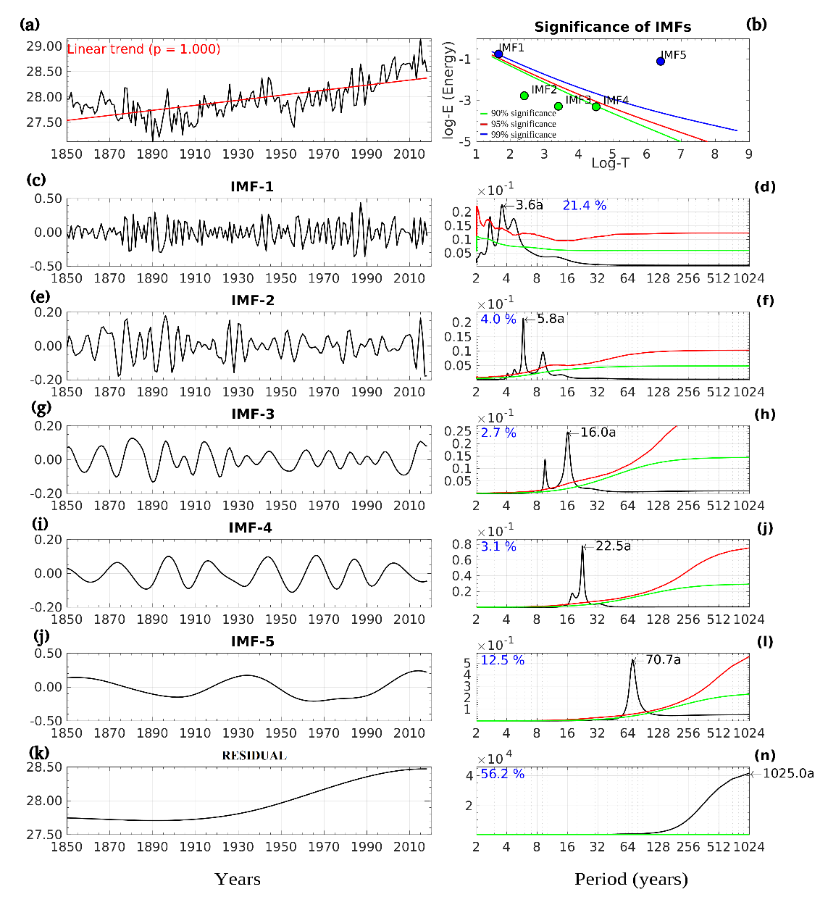
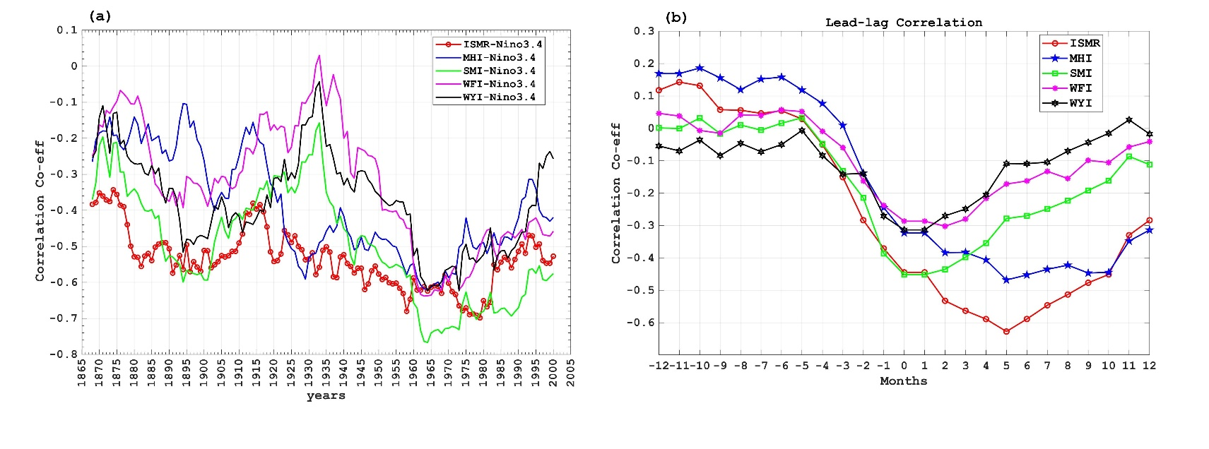
Fidelity in representing ENSO-monsoon relationship by circulation indices
Figure: 31 year sliding correlations between ISMR and JJAS Nino3.4 SST and similar correlations between wind indices and Nino3.4 SST, (b) Lead-lag correlations between ISMR and wind indices and monthly Nino3.4 SST with peak monsoon (July) as reference.
Figure (a) Indian Ocean (60ºE-90ºE,10ºS-15ºN) time series (mm), (b) Statistical significance of IMFs against Gaussian white noise null hypothesis.

Slide 7
Conclusions
The dominant period, variance and more importantly, the phases explained by the circulation modes differ significantly from those of the ISMR, resulting decorrelation between the indies with ISMR.
ISMR has a weak long-term increasing trend, the SMI, WFI and WYI have very strong long-term increasing trends. However, the MHI has a weak decreasing trend. The disparate trends of the wind indices with respect to that of the ISMR represent biases of the analysis in representing the rainfall variability.
The indices SMI, WFI and WYI depends on IO SST , it may add noise to the signal creating poor correlation between indices and ISMR.
Since the indices are constructed largely to represent the climatological mean Indian monsoon circulation. It turns out the wind pattern associated with the variability of ISMR does not project strongly on the climatological wind patterns in the region while those associated with wind indices project strongly on the climatological wind patterns.
The circulation indices fail to represent the ENSO-monsoon teleconnection.

Slide 8
Thank You!!

