Slide 1
Lecture 1:
Basic principles of soil moisture measurements using Cosmic Ray Neutron Sensor (CRNS) - Part 1
Trenton Franz
Assoc. Professor of Hydrogeophysics
School of Natural Resources
Faculty Fellow at the Daugherty Water for Food Global Institute
University of Nebraska-Lincoln

Slide 2
What do I study?
Hydrology: Conservation Equations
Ecology/Agronomy: Mechanisms, Processes
Geophysics:
Measurements, Tools

Slide 3
Prof. Trenton Franz
Grow up in Colorado, USA
2004-BS in Civil Engineering, University of Wyoming
2005-MS in Civil Engineering, University of Wyoming
2007-MS in Civil and Environmental Engineering, Princeton University
2011-PhD in Civil and Environmental Engineering, Princeton University
2011-2013-Postdoctoral researcher in Hydrology and Water Resources, University of Arizona
Sept. 2013- Asst. Professor University of Nebraska-Lincoln, Faculty Fellow of Daugherty Water for Food Global Institute
July 2018- Assoc. Professor UNL
Installed and worked with 60+ CRNS systems in the USA, South Africa, Australia, UK, Austria, Germany, Kenya, Spain, Oman, Saudi Arabia, Bolivia, China, Morocco …
Authored 30+ peer reviewed publications on CRNS
Authored 2 TEC-DOCs and 1 Springer Book on CRNS
Completed 1 week Expert Mission to Austria July 2017, Kuwait 2018, Oman 2019, developed virtual training for South America and Asia in 2020

Slide 4
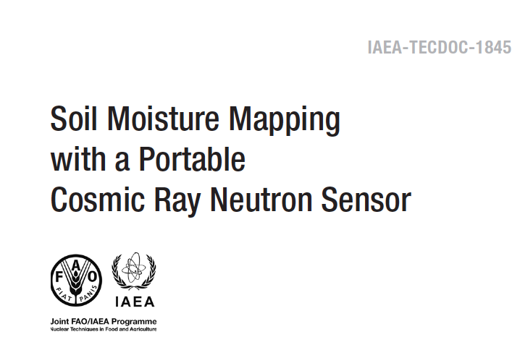
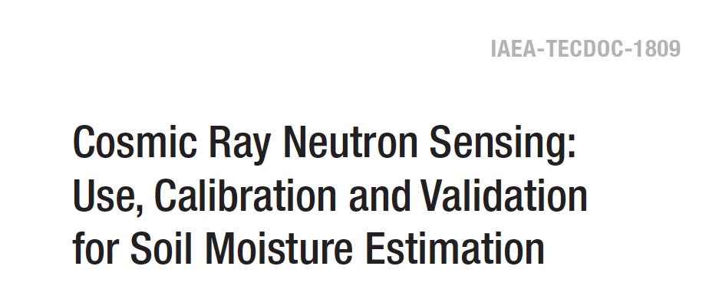
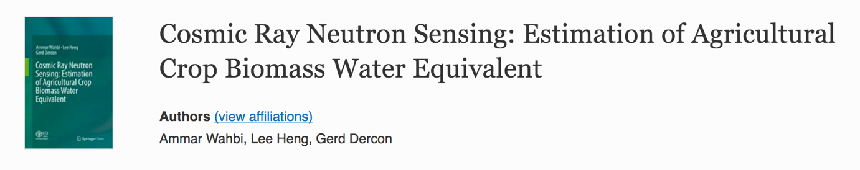

Slide 5
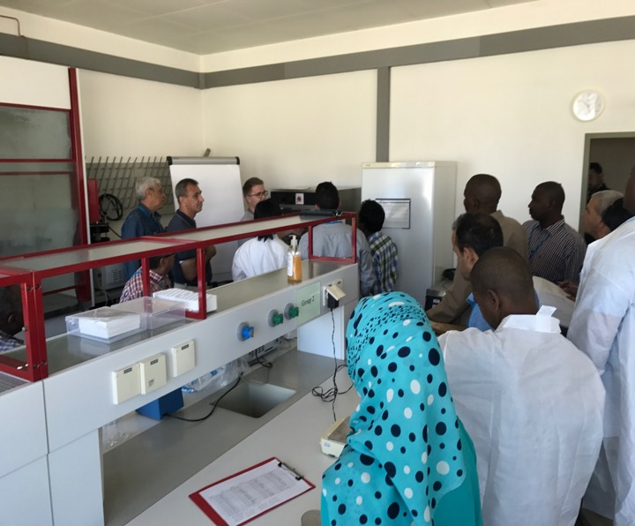
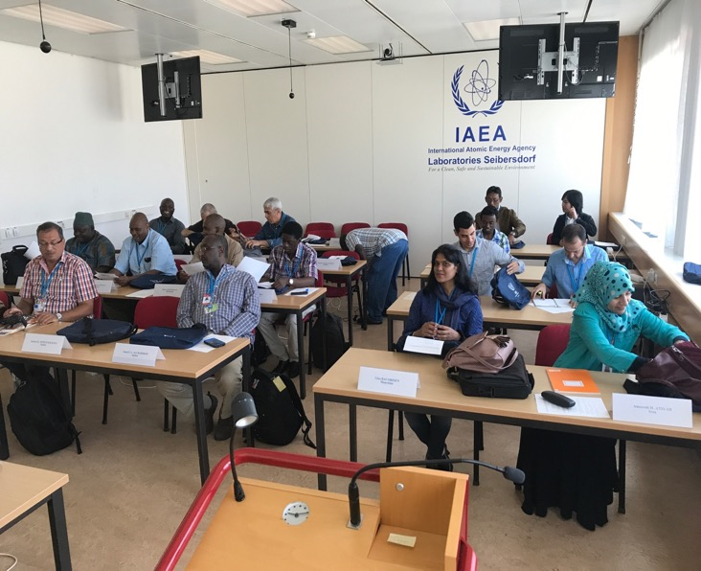
Completed 1-week expert training mission to Austria, July 2017 (20 participants).

Slide 6
Completed 1-week expert training mission to Austria, July 2017 (20 participants).

Slide 7
Goals and Objectives for this Training
Main Purpose
Virtual training activity on “Use of Cosmic Ray Neutron Sensor for Soil Moisture Management and Validation of Remote Sensing Soil Moisture Maps”

Slide 8
Goals and Objectives for this Training
Main Purpose
Virtual training activity on “Use of Cosmic Ray Neutron Sensor for Soil Moisture Management and Validation of Remote Sensing Soil Moisture Maps”
Specific Objectives in next 6 lectures
A full overview of the theory and methodology of the Cosmic-Ray Neutron Sensor (CRNS) for measuring area wide soil water content (L1 and L2)

Slide 9
Goals and Objectives for this Training
Main Purpose
Virtual training activity on “Use of Cosmic Ray Neutron Sensor for Soil Moisture Management and Validation of Remote Sensing Soil Moisture Maps”
Specific Objectives in next 6 lectures
A full overview of the theory and methodology of the Cosmic-Ray Neutron Sensor (CRNS) for measuring area wide soil water content (L1 and L2)
2. A full demonstration of data processing of the CRNS output (L3)

Slide 10
Goals and Objectives for this Training
Main Purpose
Virtual training activity on “Use of Cosmic Ray Neutron Sensor for Soil Moisture Management and Validation of Remote Sensing Soil Moisture Maps”
Specific Objectives in next 6 lectures
A full overview of the theory and methodology of the Cosmic-Ray Neutron Sensor (CRNS) for measuring area wide soil water content (L1 and L2)
2. A full demonstration of data processing of the CRNS output (L3)
3. Applications of CRNS for estimating rootzone soil moisture and rainfall (L4)

Slide 11
Goals and Objectives for this Training
Main Purpose
Virtual training activity on “Use of Cosmic Ray Neutron Sensor for Soil Moisture Management and Validation of Remote Sensing Soil Moisture Maps”
Specific Objectives in next 6 lectures
A full overview of the theory and methodology of the Cosmic-Ray Neutron Sensor (CRNS) for measuring area wide soil water content (L1 and L2)
2. A full demonstration of data processing of the CRNS output (L3)
3. Applications of CRNS for estimating rootzone soil moisture and rainfall (L4)
4. Spatial mapping with CRNS (L5)

Slide 12
Goals and Objectives for this Training
Main Purpose
Virtual training activity on “Use of Cosmic Ray Neutron Sensor for Soil Moisture Management and Validation of Remote Sensing Soil Moisture Maps”
Specific Objectives in next 6 lectures
A full overview of the theory and methodology of the Cosmic-Ray Neutron Sensor (CRNS) for measuring area wide soil water content (L1 and L2)
2. A full demonstration of data processing of the CRNS output (L3)
3. Applications of CRNS for estimating rootzone soil moisture and rainfall (L4)
4. Spatial mapping with CRNS (L5)
5. Applications of CRNS for irrigation agriculture (L6)

Slide 13
It is challenging to measure soil moisture across space and time

Slide 14
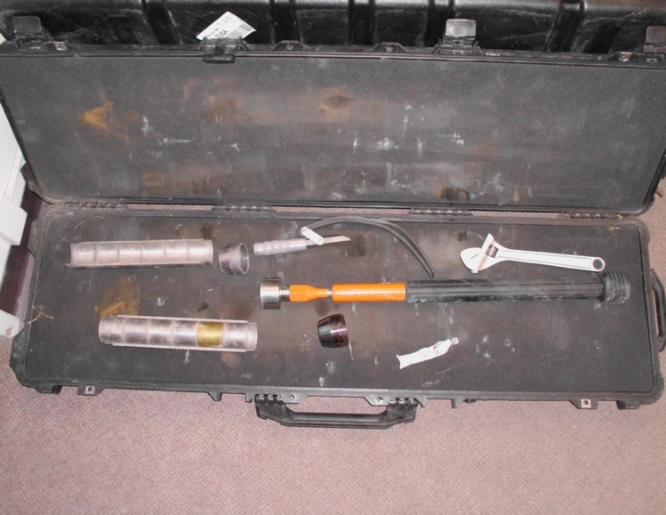
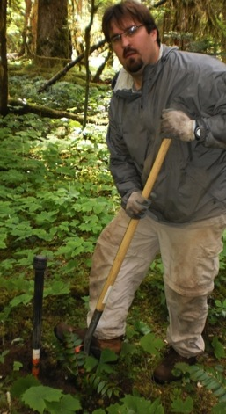
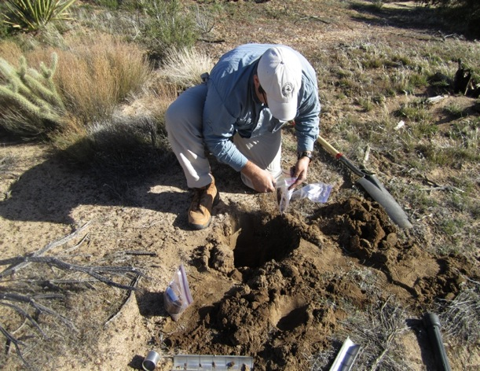
Soil Moisture Varies Across Space
*All data collected within a 200 m radius circle

Slide 15
Soil Moisture Varies Across Space

Slide 16
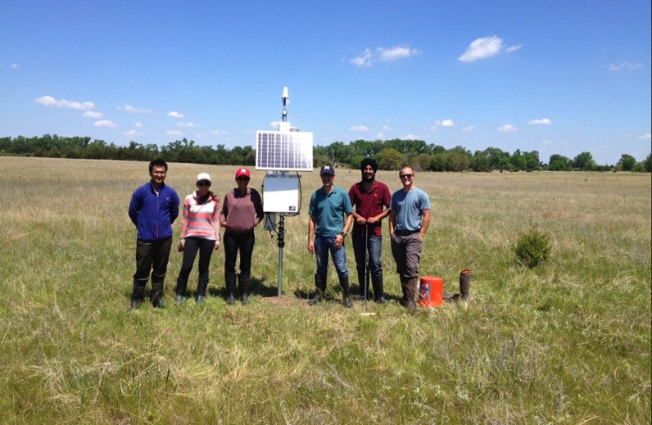
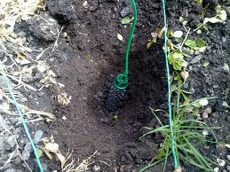
And Time
*All data collected within a 200 m radius circle in central NE

Slide 17
Current Methods
Labor intensive
Time intensive
Unreliable
Not representative of areas where water management decisions are made and hydrological models are run

Slide 18
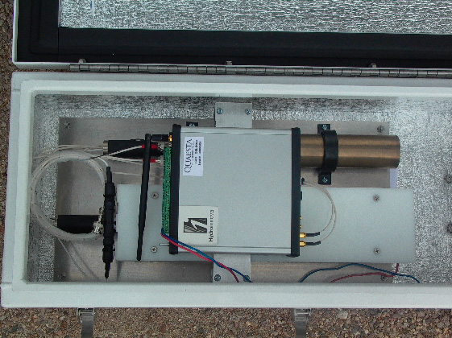
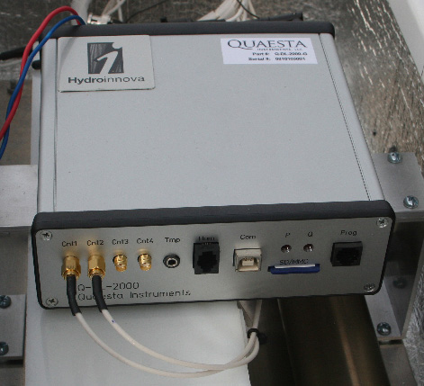
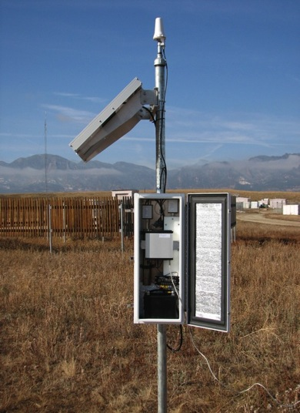
CRNS Overview

Slide 19
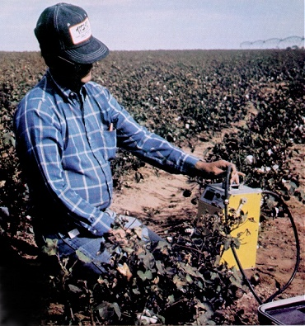
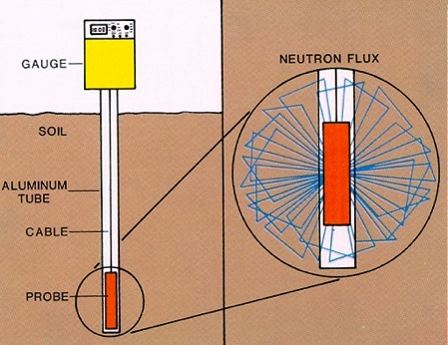
CRNS Overview
Essentially same detector but with updated electronics and high voltage NPMs
Same basic physics as in-situ neutron probe
Passive sensor, uses cosmic-ray neutrons as source
Relates fast neutrons to water content instead of slow or thermal neutrons
Footprint is ~1000x larger (density of soil vs. air)
Probe sees about top 30 cm
In-situ probe considered gold standard in agronomy and soil physics
http://sanangelo.tamu.edu/agronomy/sorghum/neutron.htm

Slide 20
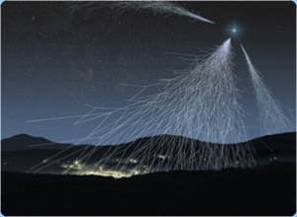
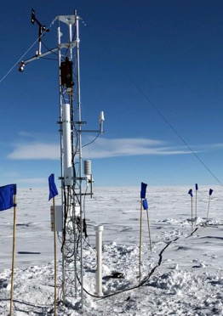
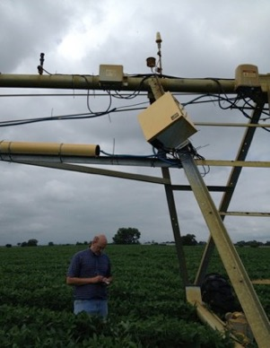
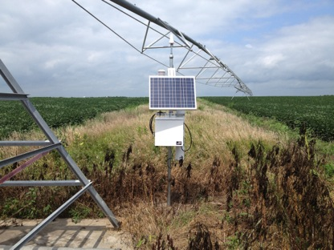
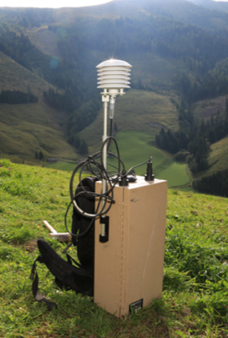
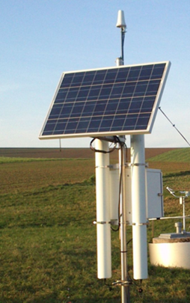
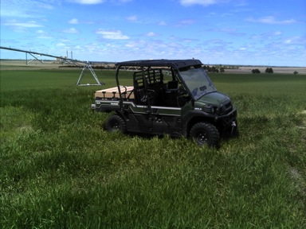
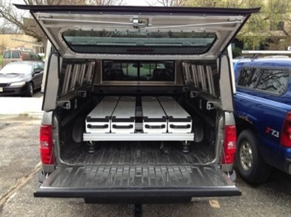
Cosmic-ray Neutron Sensors

Slide 21
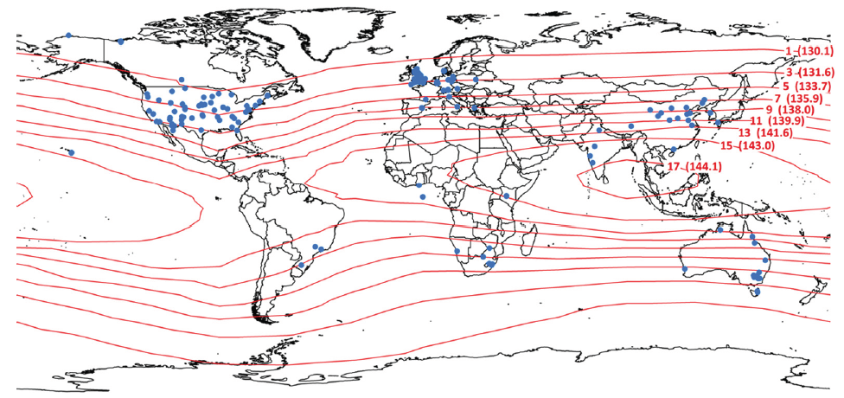
COSMOS Project
COSMOS data freely available at (http://cosmos.hwr.arizona.edu/) with some quality control, usually co-located with eddy covariance towers, over 90% reliability (2010-2014 project)
Probes: 70 COSMOS (10 UNL), 200 Independent networks around globe (CosmOz, TERENO, UK, South Africa), with more to come online (Saudi Arabia, Brazil, China?)
Andreasen, 2017 VZJ
21

Slide 22
Overview of basic physics

Slide 23
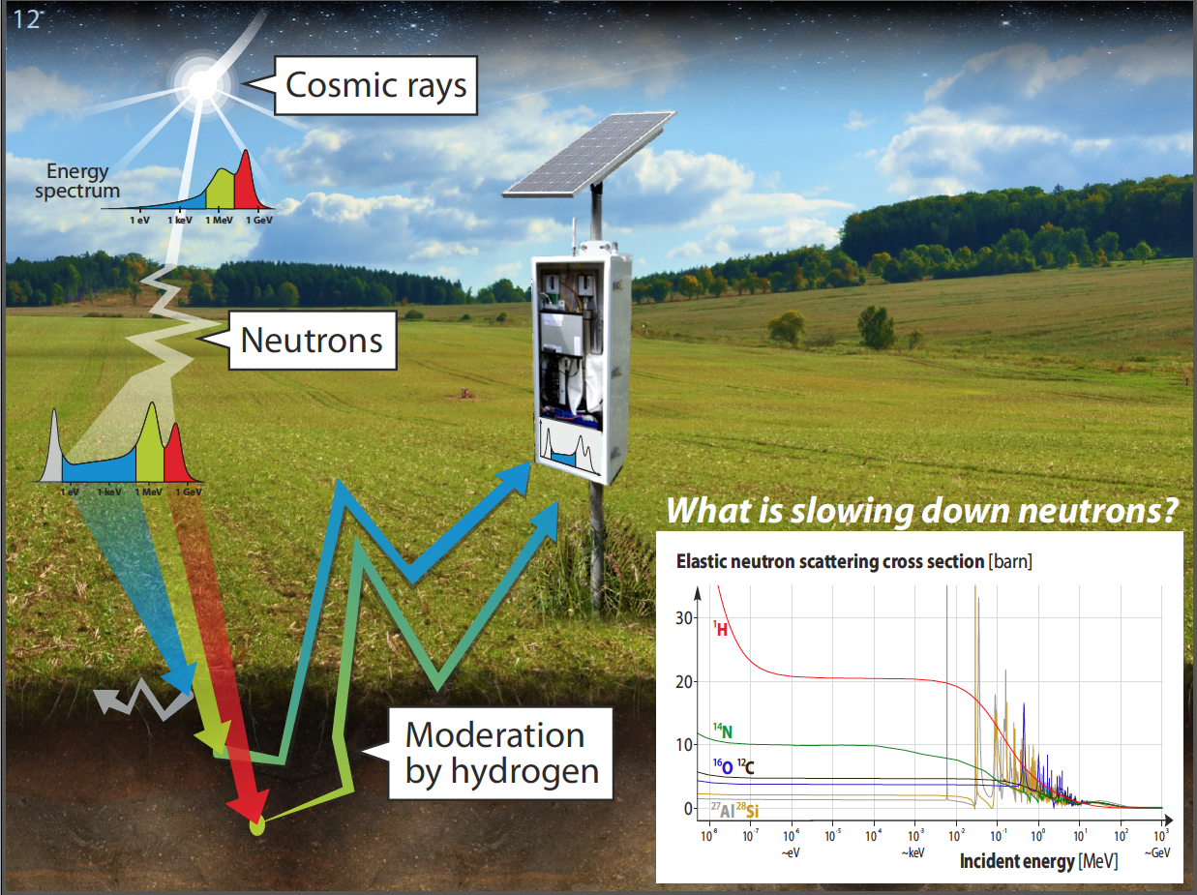
Slide courtesy of M. Schron

Slide 24
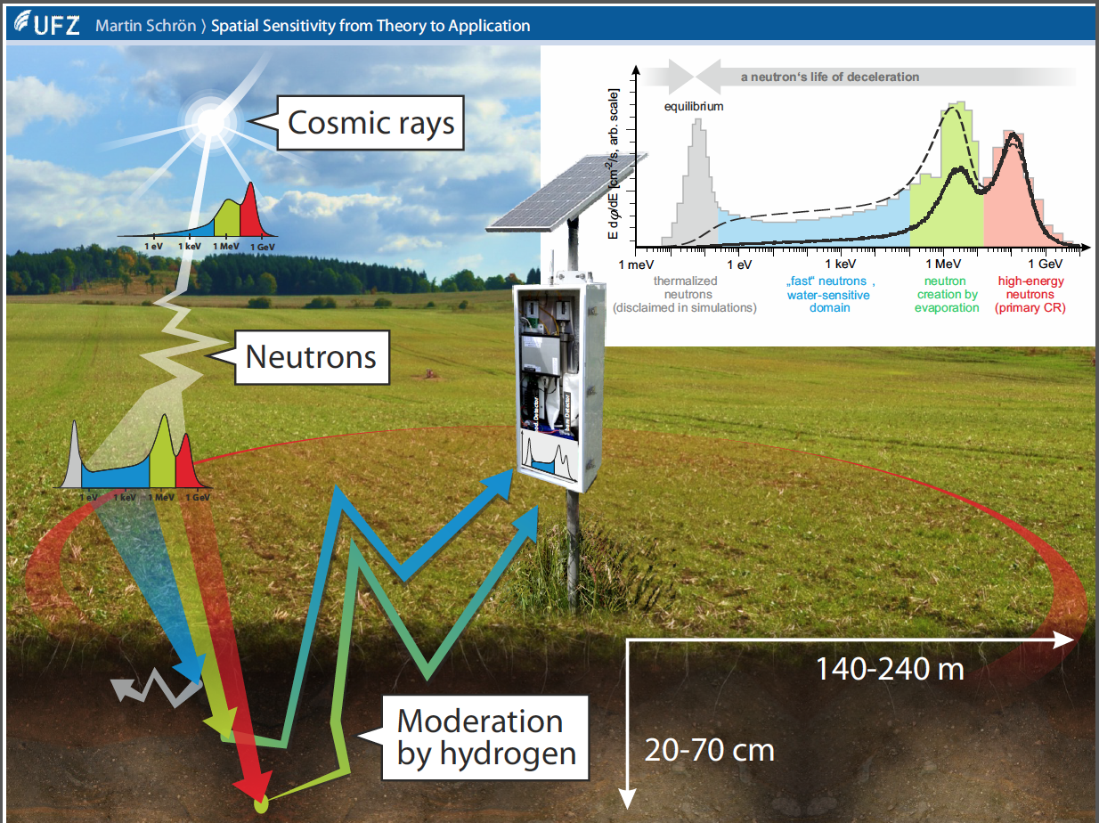
Slide courtesy of M. Schron

Slide 25
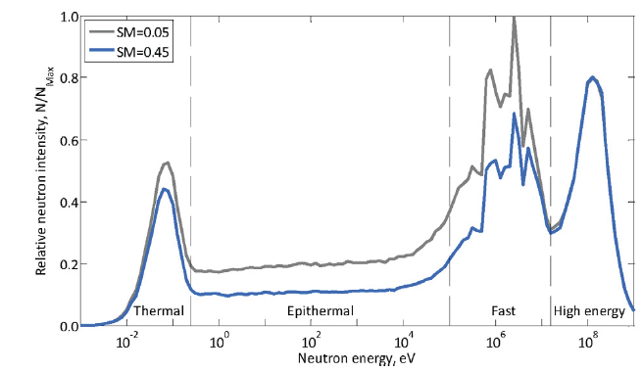
Andreasen, 2017 VZJ

Slide 26
Probe calibration function, need at least 1 known water content and neutron count rate (Desilets et al., 2010)

Slide 27
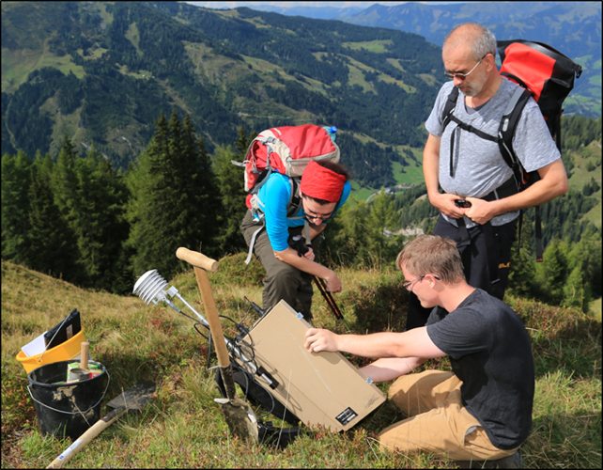
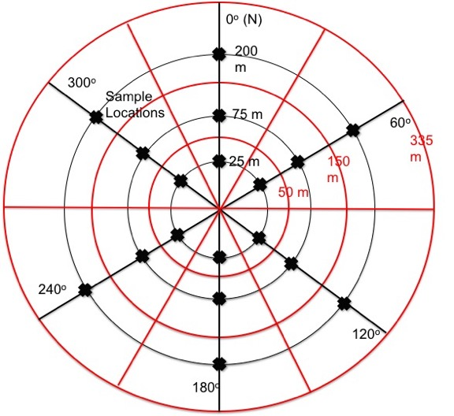
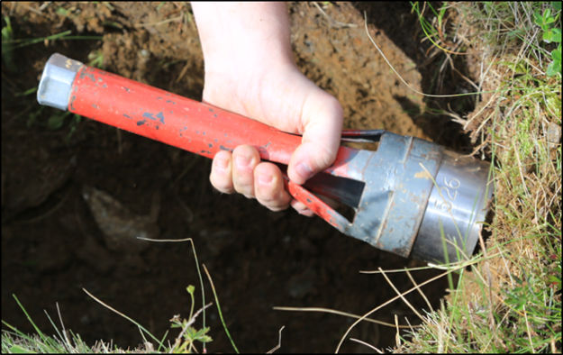
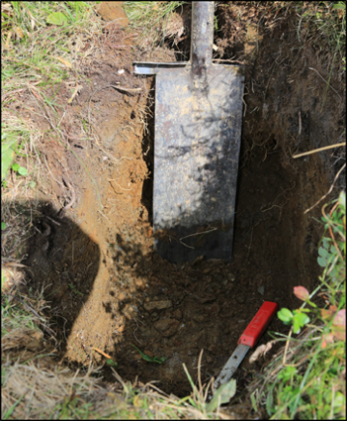
Calibration in the USA and Austria
Note recent work has shown samples should be taken at ~10, 50, 125 m

Slide 28
Detailed view of basic physics

Slide 29
Hendrick and Edge, 1966

Slide 30
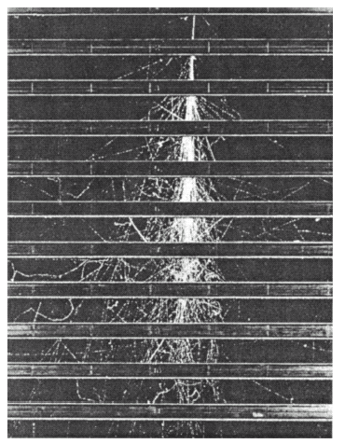
Secondary cosmic-ray particles produced in copper plates in a large cloud chamber. Skobeltzyn, 1927
Cascade initiated by a 10 GeV primary. All trajectories above 1 MeV are shown. (Simulations courtesy of D. Desilets, Sandia National Laboratories with MCNP)

Slide 31
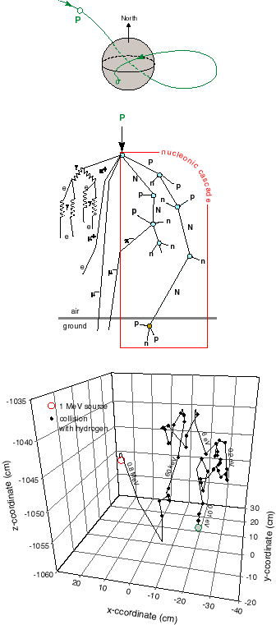
Space:
incoming high-energy cosmic-ray proton
Primary - mostly protons and alphas
Interact with magnetic field
- intensity depends on geomagnetic latitude (i.e. cutoff rigidity)
Interact with atmospheric nuclei
Produce secondary particles - cascade
- intensity depends on barometric pressure
Produce fast neutrons
- slowing down by elastic collisions
- leads to thermalization
- and then absorption
The last three processes depend on the chemical composition of the medium, in particular on its hydrogen content
Atmosphere:
generation of secondary cosmic rays
Ground:
scattering thermalization absorption
Summarized in Zreda et al., 2012

Slide 32
H

Slide 33
Gd

Slide 35
Element | Stopping Power
H | 22.016
C | 0.875
O | 0.508
Fe | 0.411
Mg | 0.297
Na | 0.277
Si | 0.151
Ca | 0.139
Al | 0.109
K | 0.099

Slide 36
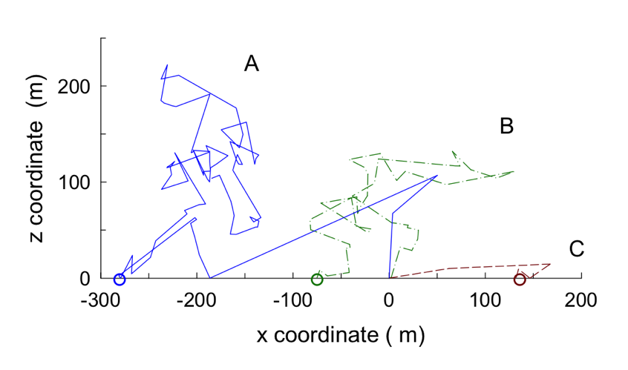
Three MCNPX random walks for particles emitted from the ground surface and
detected within 2 meters of the ground. Particles emitted from the ground at x,y,z = 0,0,0.
Desilets and Zreda, 2013, *1 MeV to 0.025 eV neutron life cycle

Slide 37
Atmospheric collisions for particles emitted from x,y,z=0,0,0 and recorded in a detector layer placed at 0 m, 50 m, and 100 m above the ground. Each plot shows 20,000 collisions.
Desilets and Zreda, 2013, *1 MeV to 0.025 eV neutron life cycle

Slide 38
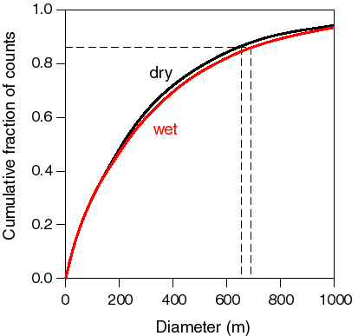
<5% reduction in footprint due to soil moisture, therefore controlled by atmosphere
Zreda et al., 2008, updated by Kohli et al. 2015

Slide 39
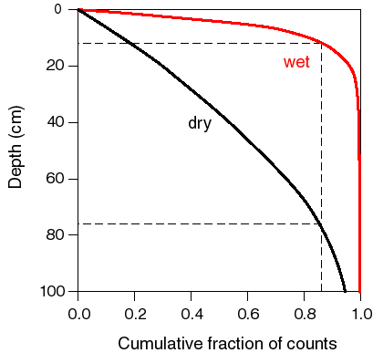
Zreda et al., 2008, updated by Kohli et al. 2015

Slide 40
Sources of hydrogen in CRNS footprint

Slide 42
Hydrogen in the Air
Can remove water vapor portion of signal with surface measurements of air pressure, temperature, relative humidity and assuming standard atmosphere (Rosolem et al., 2013)
mm

Slide 43
Defining the support volume
63% Cumulative Sensitivity Contour
86% Cumulative Sensitivity Contour
Effect of elevation (z) on support radius, P is air pressure (Pa)
Effect of specific humidity (q, kg/kg H2O) on support radius (Note: fully saturated air ~0.02 kg/kg leads to 15% reduction in L_{0,0})
Desilets and Zreda, 2013, updated by Kohli et al. 2015

Slide 44
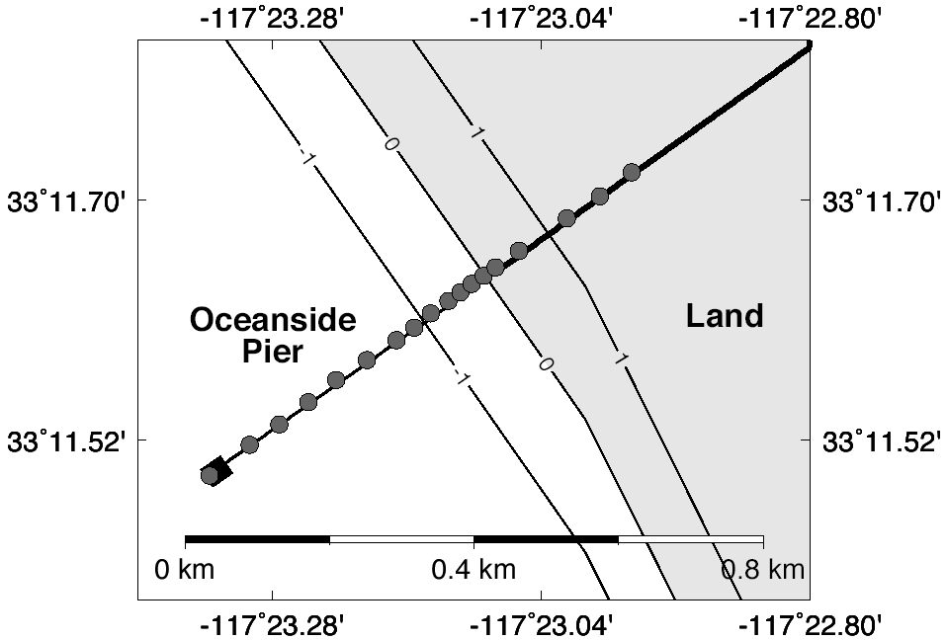
Empirical Footprint Confirmation, San Diego
Zreda Unpublished Data

Slide 45
Empirical Footprint Confirmation, San Diego
86% Reduction in Counts ~ 300m
Neutron Counts (cph)
Measurement into Ocean (m)
Zreda Unpublished Data

Slide 46
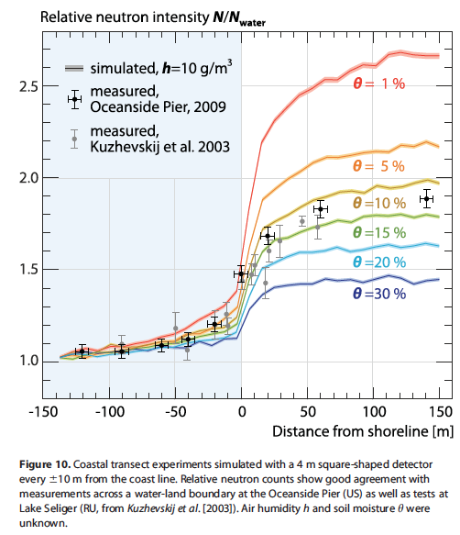
Empirical Footprint Confirmation, San Diego

Slide 47
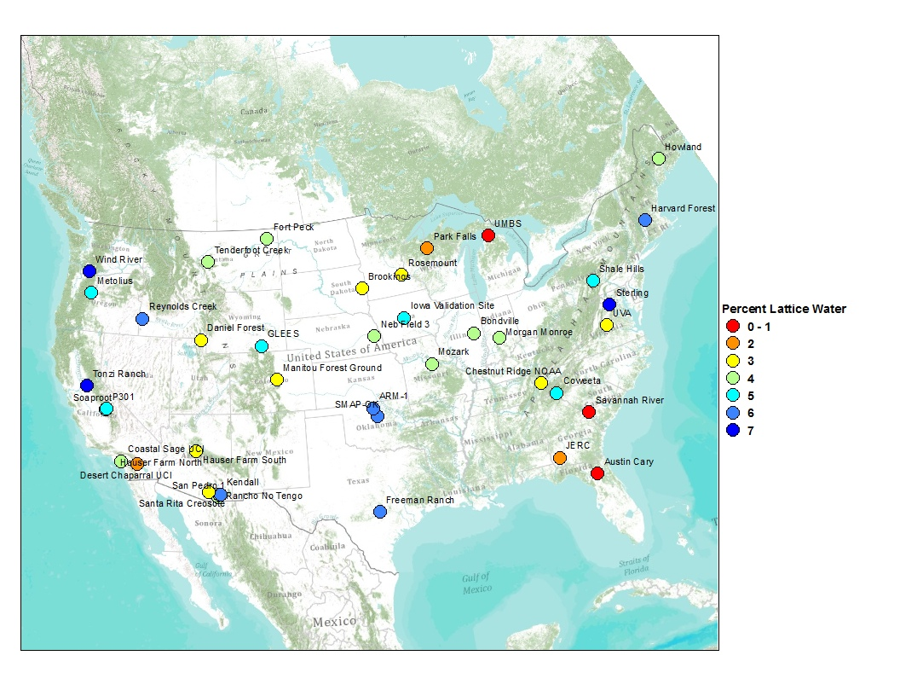
Hydrogen in the Soil
Lattice water: Water released from soil between 105 and 1000 Deg. C during drying
Function of soil formation and weathering (high in volcanic areas)
Generally higher lattice water with clay content but need to sample locally
Zreda et al. (2012)

Slide 48
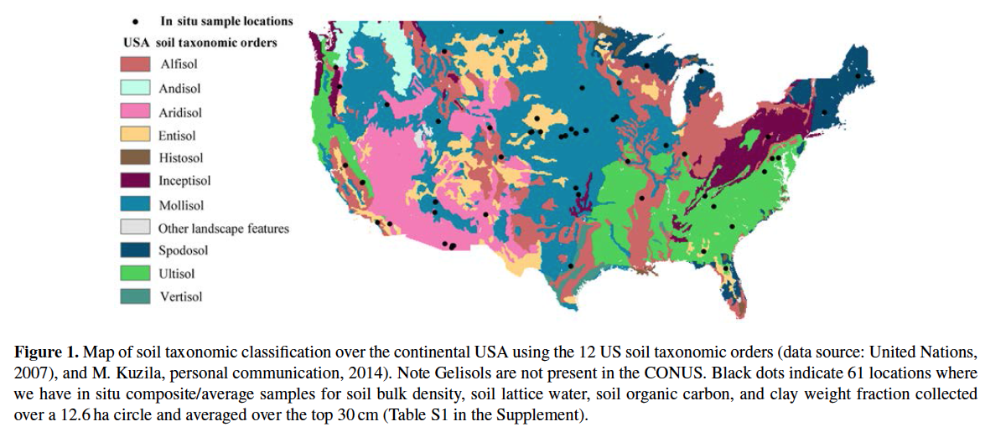
Hydrogen in the Soil
Combine local sampling with soil classifications and existing spatial data layers to generate needed inputs for CRNS
Avery et al. 2016

Slide 49
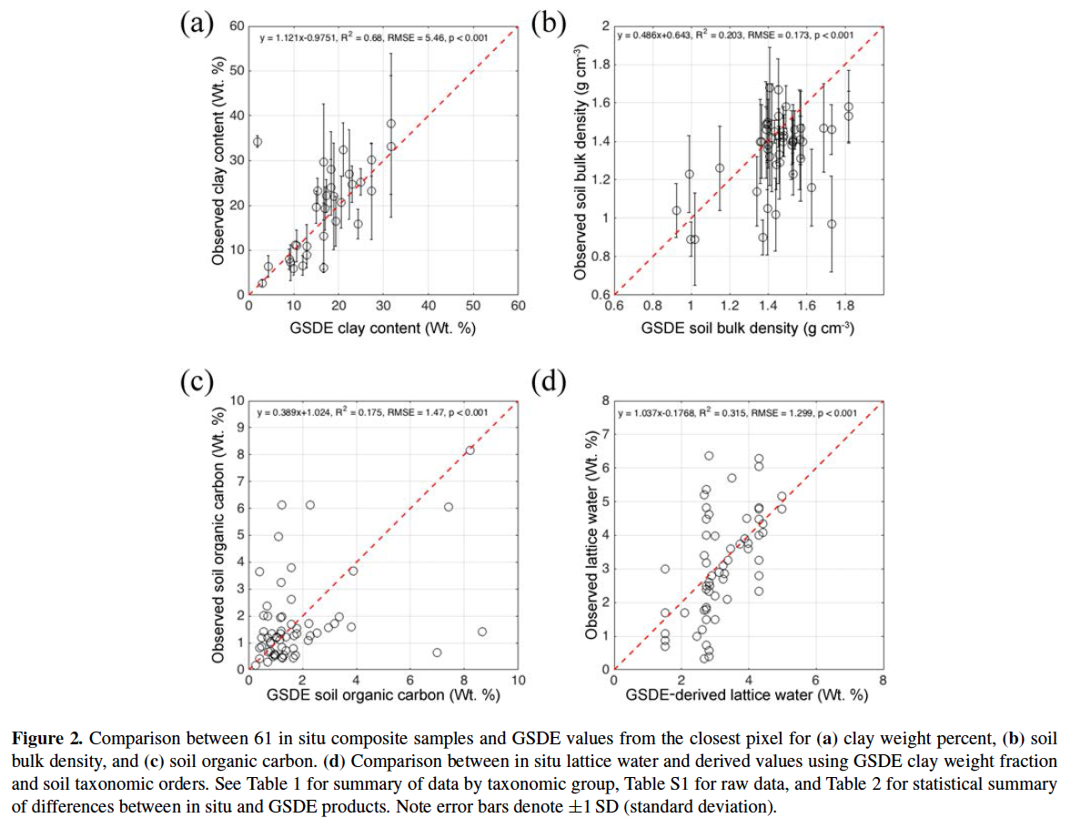
Hydrogen in the Soil
Avery et al. 2016

Slide 50
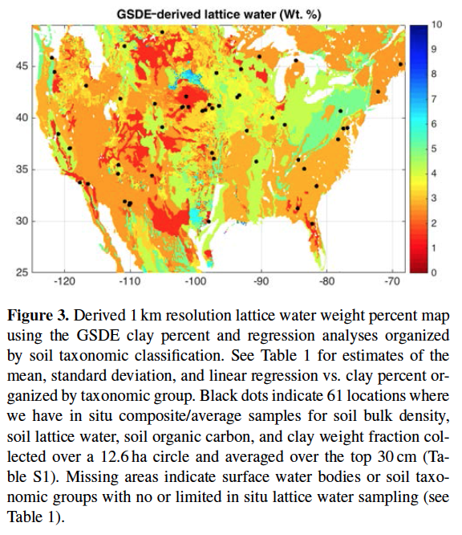
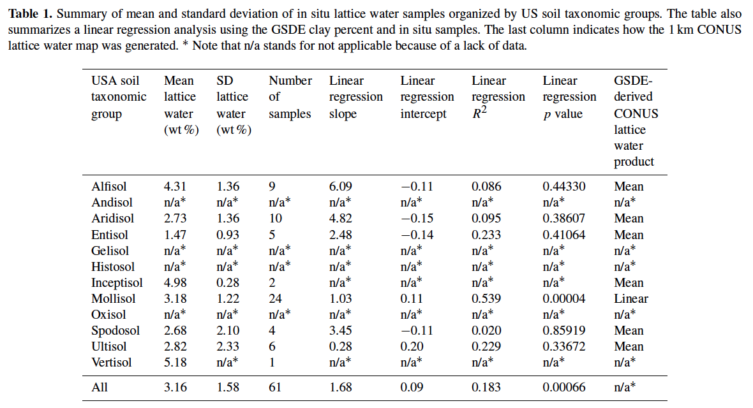
Hydrogen in the Soil
Avery et al. 2016

Slide 51
Variable vertical depth of CRNS

Slide 52
Layer Weight, wt
= dry bulk density of soil (g/cm³)
= gravimetric weight fraction of
lattice water (g/g)
SOC = gravimetric weight fraction of
soil organic carbon (g/g)
= volumetric water content (cm³/cm³)
z* = effective sensor depth (cm)
Note: Coefficients 5.8 and 0.0829 derived using MCNPx*
Z*
Soil Depth, z
Z*
Franz et al. (2012a), updated by Kohli et al. 2015*

Slide 53
1-D HYDRUS modeling of four different homogeneous isotropic in 2 m columns
Top BC: 2.54 cm rain event over 24 hours, switch to 2 mm/day PET
Lower BC: Free drainage
IC: Field capacity (-100 cm)
Van Genuchten Mualem Hydraulic Model
Franz et al. (2012a)

Slide 54
Weighted average VWC: linear depth weighting to effective sensor depth, z*
Franz et al. (2012a)

Slide 55
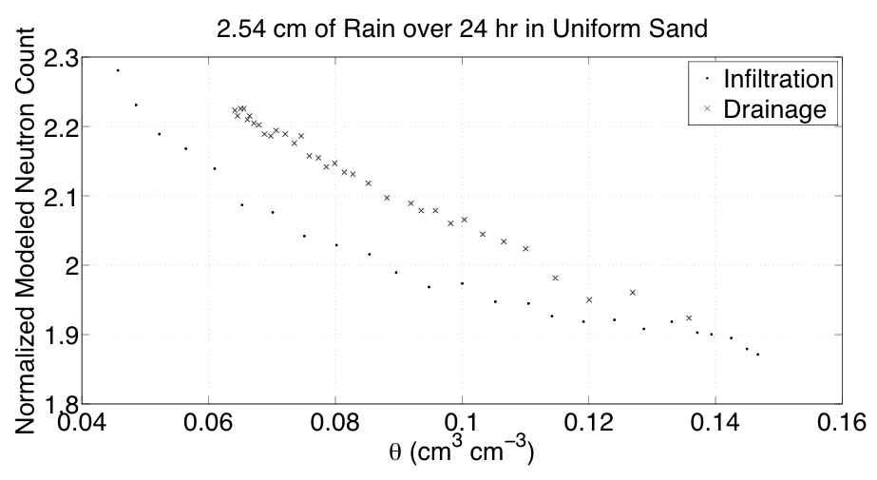
1. Defining the support volume
Use generated pore water profiles in MCNPx…
Franz et al. (2012a)

Slide 56
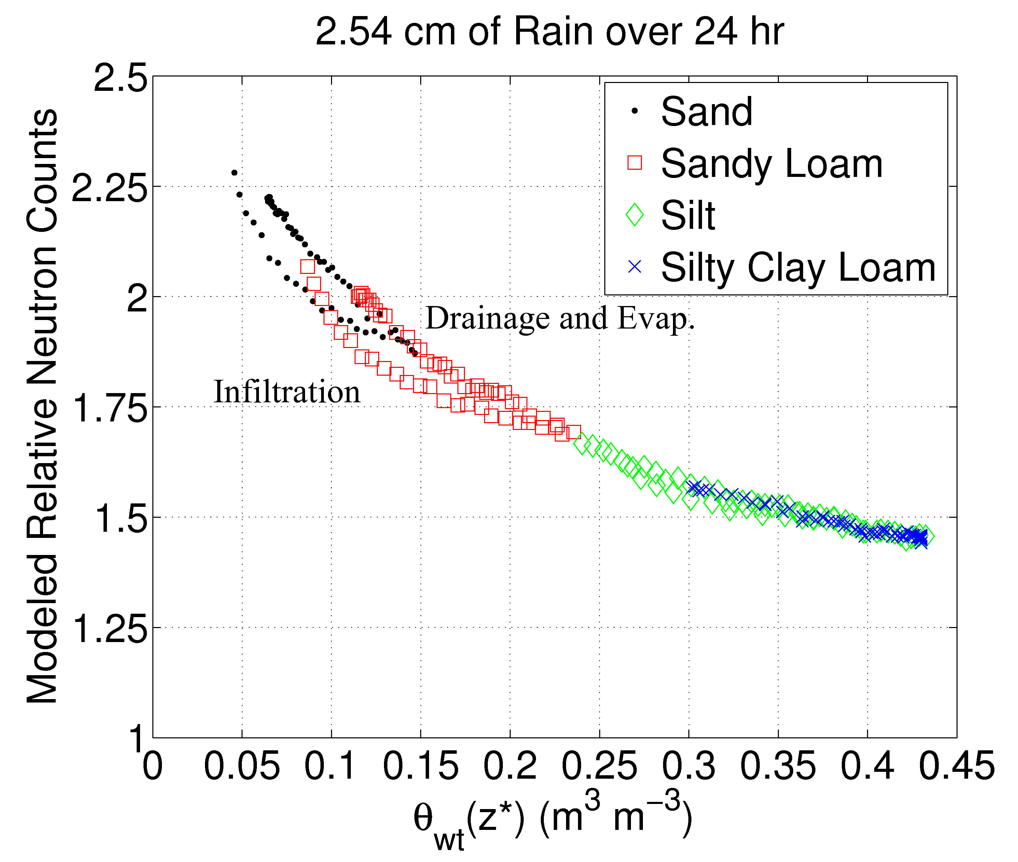
1. Defining the support volume
Franz et al. (2012a), updated by Kohli et al. 2015

Slide 57
Validation of CRNS with in-situ Sensors

Slide 58
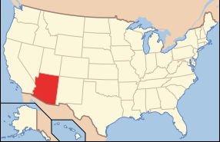
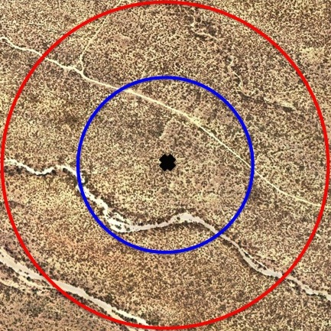
Santa Rita Experimental Range
35 km south of Tucson, AZ
~400 mm annual rainfall
50% of rainfall in July-Sep.
>35ºC Daily Temp. in July-Sep.
30-40% Fractional cover, mixed shrub and cactus
Deep sandy loams w/ gravel
(Cavanaugh et al., 2011)
700 m

Slide 59
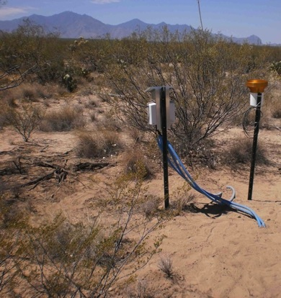
Santa Rita Experimental Range
Installed June 2011
Paired study: Open vs. Canopy
18 Locations: 180 Acclima TDT sensors, 18 rain gages (chosen by equal COSMOS sensitivity)
TDT probes inserted horizontally at 10, 20, 30, 50, 70 cm, 30 minute data (added 5 cm probe Jan. 2012)
~160 TDT probes worked consistently
TDT Profile Locations
EC, Cosmic-ray Probe
Franz et al., 2012b
59

Slide 60
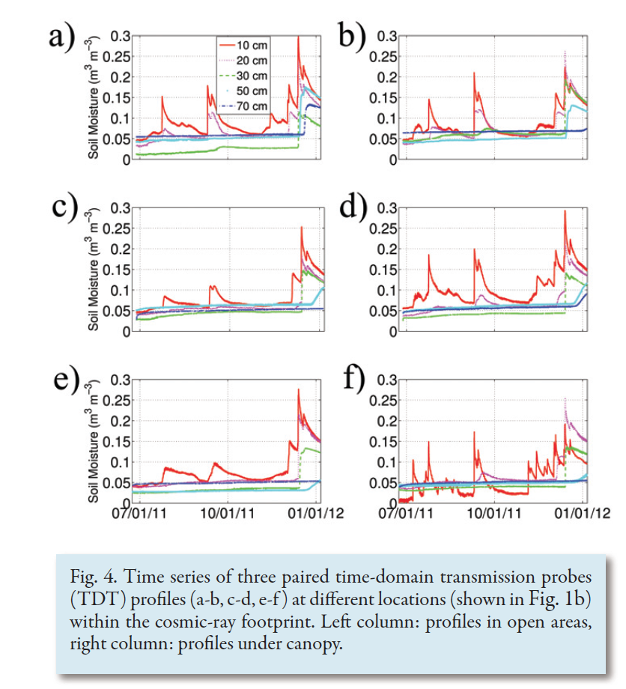
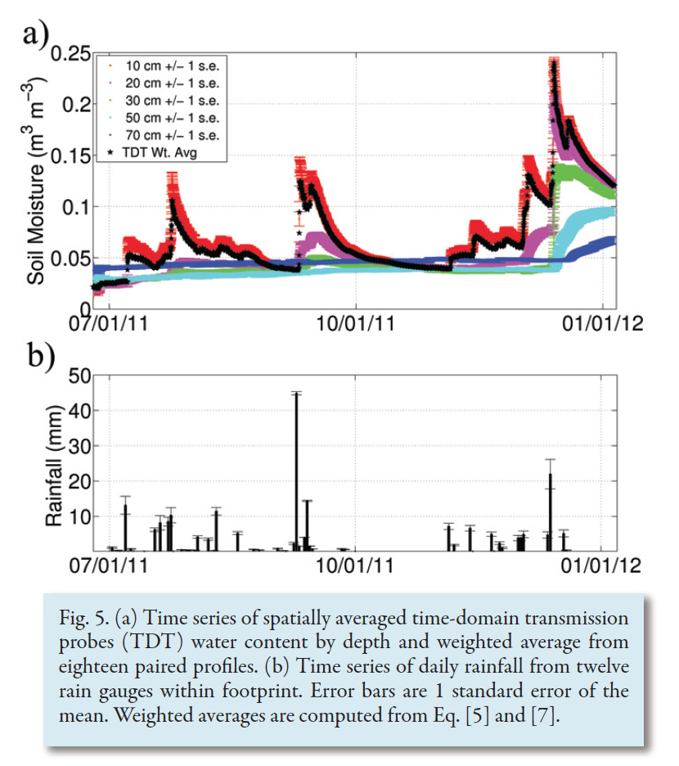
Santa Rita Experimental Range
Franz et al., 2012b

Slide 61

Santa Rita Experimental Range
Franz et al., 2012b

Slide 62

Santa Rita Experimental Range
Franz et al., 2012b

Slide 63
Santa Rita Experimental Range
Control Volume
Mass Balance
Rainfall, P
Evapotranspiration, ET
Runoff, Ro
z
Soil Moisture,
Leakage, L

Slide 64


Santa Rita Experimental Range
Franz et al., 2012b

Slide 65
Summary
In-situ soil moisture sensors may not be representative of larger areas where management and hydrological models operate

Slide 66
Summary
In-situ soil moisture sensors may not be representative of larger areas where management and hydrological models operate
Cosmic-ray physics and CRNS method well understood with basic principles

Slide 67
Summary
In-situ soil moisture sensors may not be representative of larger areas where management and hydrological models operate
Cosmic-ray physics and CRNS method well understood with basic principles
CRNS method has greatly matured over last 15 years (spatial and vertical footprints, calibration procedure, MCNP and URANOS model sim.)

Slide 68
Summary
In-situ soil moisture sensors may not be representative of larger areas where management and hydrological models operate
Cosmic-ray physics and CRNS method well understood with basic principles
CRNS method has greatly matured over last 15 years (spatial and vertical footprints, calibration procedure, MCNP and URANOS model sim.)
Validation with in-situ sensors has been conducted at numerous sites, countries, and in various soil/vegetation ecosystems (RMSE~ 0.01-0.03 cm³/cm³)

Slide 69
Key References
Avery, W., C. Finkenbiner, T. E. Franz, T. Wang, A. L. Nguy-Roberston, A. Suyker, T. Arkebauer, and F. Munoz-Arriola (2016), Incorporation of globally available datasets into the roving cosmic-ray neutron probe method for estimating field-scale soil water content, HESS, 20, 3859-3872. doi:10.5194/hess-20-3859-2016.
Desilets, D., M. Zreda, and T. P. A. Ferre (2010), Nature's neutron probe: Land surface hydrology at an elusive scale with cosmic rays, Water Resources Research, 46. doi:10.1029/2009wr008726.
Desilets, D. (2011), Sandia Report: SAND2011-1101, Radius of influence for a cosmic-ray soil moisture probe: Theory and Monte Carlo simulations, Sandia National Laboratories, Albuquerque, New Mexico 87185 and Livermore, California 94550.
Desilets, D., and M. Zreda (2013), Footprint diameter for a cosmic-ray soil moisture probe: Theory and monte carlo simulations, Water Resources Research. doi:10.1002/wrcr.20187.
Franz, T. E., M. Zreda, P. A. Ferre, R. Rosolem, C. Zweck, S. Stillman, X. Zeng, and W. J. Shuttleworth (2012), Measurement depth of the cosmic-ray soil moisture probe affected by hydrogen from various sources, Water Resources Research, 48. doi:10.1029/2012WR011871.
Franz, T. E., M. Zreda, R. Rosolem, and P. A. Ferre (2012), Field validation of cosmic-ray soil moisture sensor using a distributed sensor network, Vadose Zone Journal, 11(4). doi:10.2136/vzj2012.0046.
Franz, T. E., M. Zreda, R. Rosolem, and P. A. Ferre (2013), A universal calibration function for determination of soil moisture with cosmic-ray neutrons, Hydrology and Earth System Sciences, 17, 453-460. doi:10.5194/hess-17-453-2013.
Kohli, M., M. Schron, M. Zreda, U. Schmidt, P. Dietrich, and S. Zacharias (2015), Footprint characteristics revised for field-scale soil moisture monitoring with cosmic-ray neutrons, Water Resources Research, 51(7), 5772-5790. doi:10.1002/2015wr017169.
Rosolem, R., W. J. Shuttleworth, M. Zreda, T. E. Franz, X. Zeng, and S. A. Kurc (2013), The Effect of Atmospheric Water Vapor on the Cosmic-ray Soil Moisture Signal, J. Hydrometeorol. doi:10.1175/JHM-D-12-0120.1.
Zreda, M., D. Desilets, T. P. A. Ferre, and R. L. Scott (2008), Measuring soil moisture content non-invasively at intermediate spatial scale using
cosmic-ray neutrons, Geophysical Research Letters, 35(21), 5. doi:L21402 10.1029/2008gl035655.
Zreda, M., W. J. Shuttleworth, X. Xeng, C. Zweck, D. Desilets, T. E. Franz, and R. Rosolem (2012), COSMOS: The COsmic-ray Soil Moisture
Observing System, Hydrology and Earth System Sciences, 16, 4079-4099. doi:10.5194/hess-16-1-2012.

