Slide 1
Lecture 3:
Overview and demonstration of data download and data processing
Trenton Franz
Assoc. Professor of Hydrogeophysics
School of Natural Resources
Faculty Fellow at the Daugherty Water for Food Global Institute
University of Nebraska-Lincoln

Slide 2
1. Defining the support volume
Probe calibration function, need at least 1 known pore water content, lattice water, soil organic carbon, and neutron count rate (Desilets et al., 2010)

Slide 3
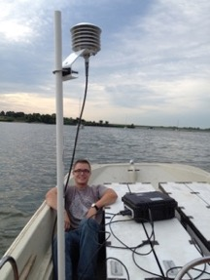
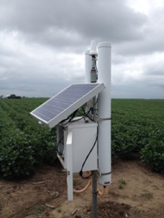
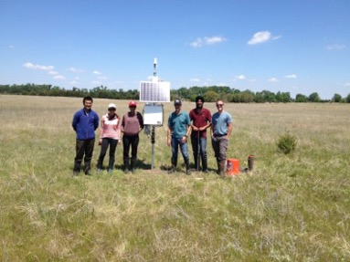
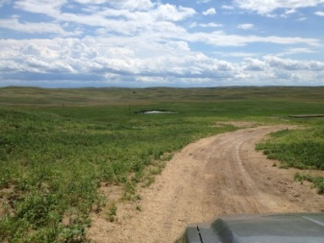
Rover Calibration Across Nebraska, USA

Slide 4
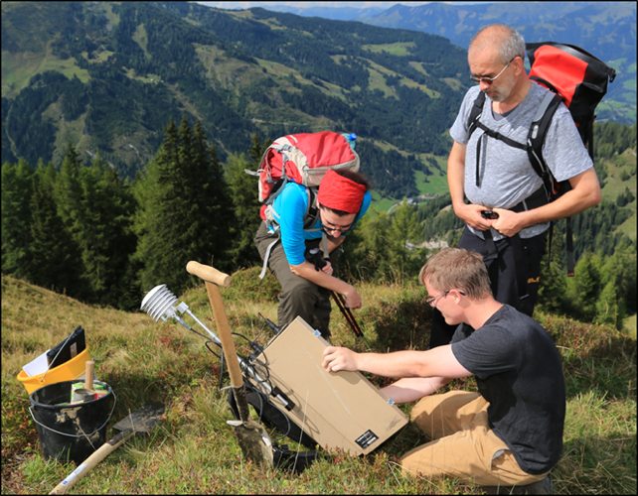
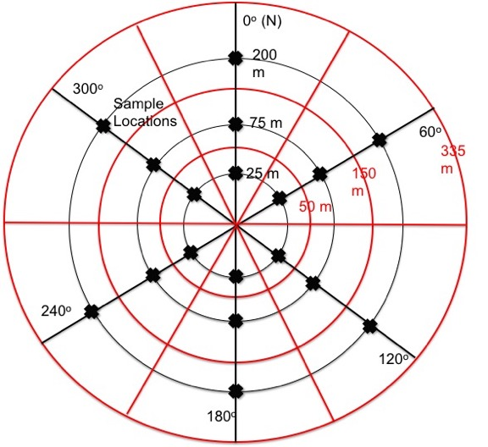
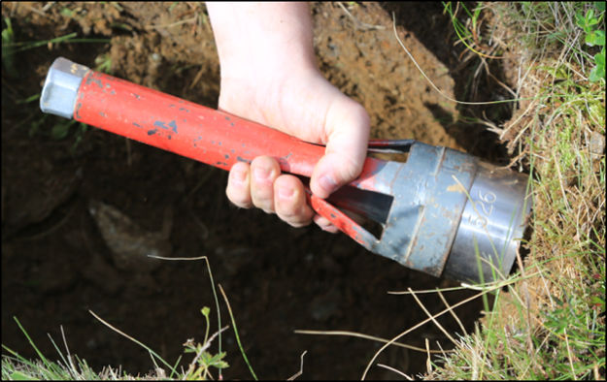
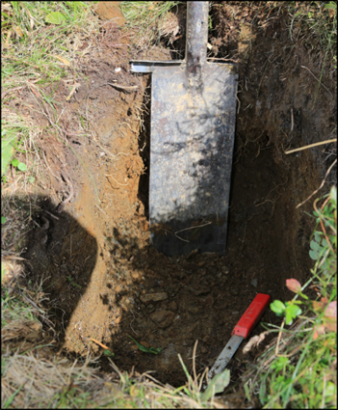
Sampling Pattern For Calibration
Note recent work has shown samples should be taken at ~10, 50, 125 m

Slide 5
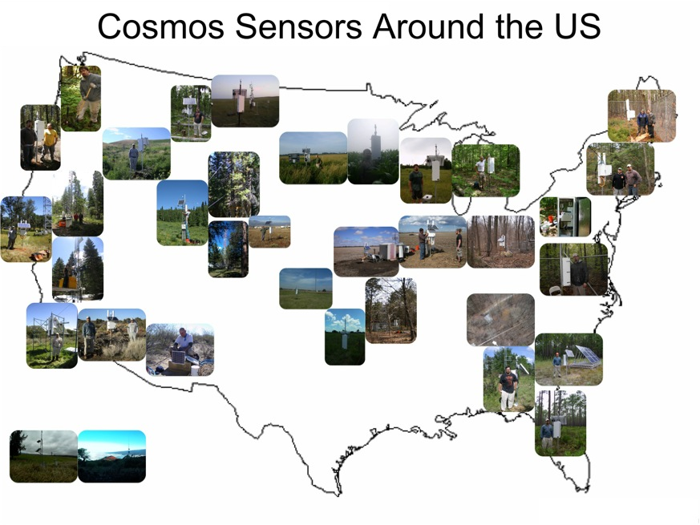
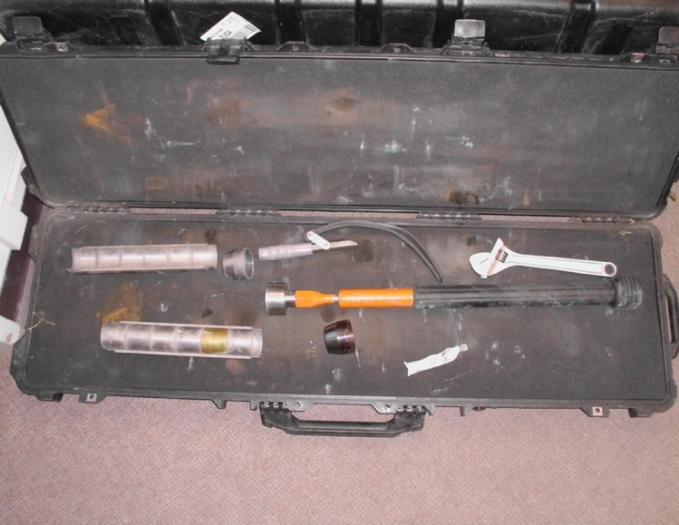
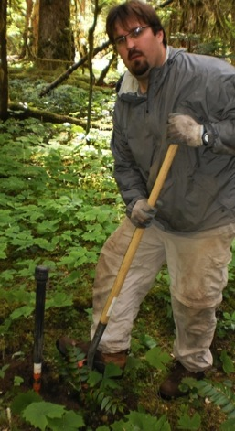
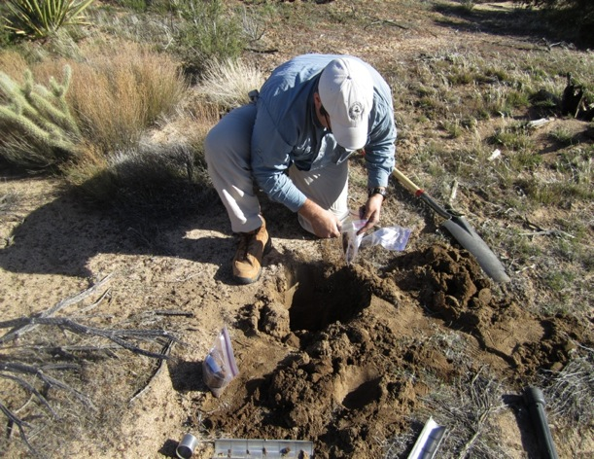
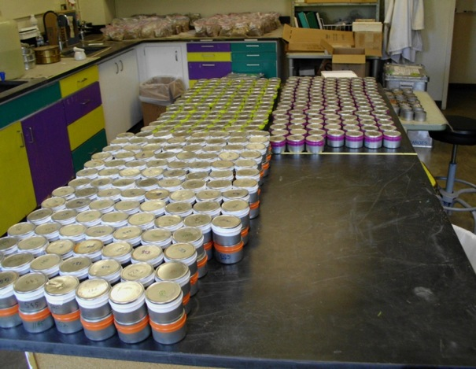
A Foot/Shovel in the CRNS Door

Slide 6
Point vs. Area Average?

Slide 7
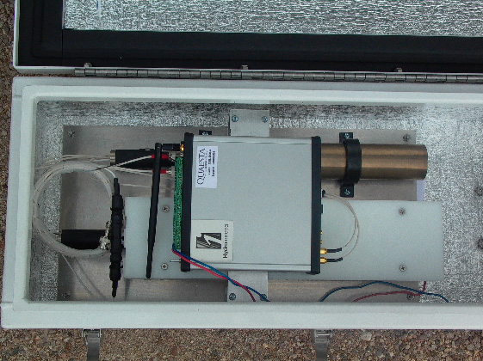
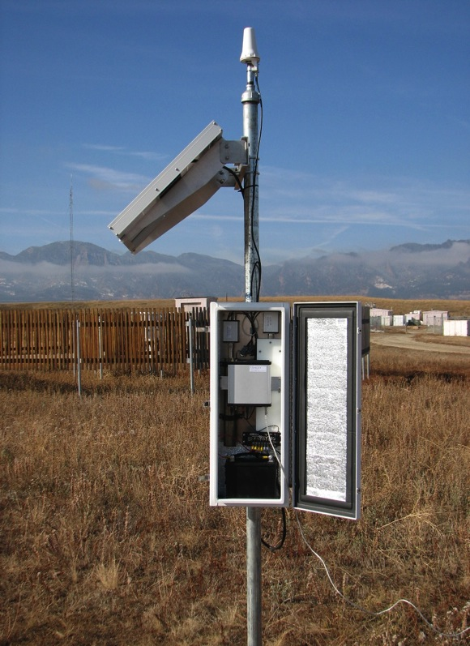
Detector

Slide 8
Summary of Equations
Move to spreadsheets and word document

