Slide 1
Lecture 6:
Use of CRNS data for irrigation agriculture
Trenton Franz
Assoc. Professor of Hydrogeophysics
School of Natural Resources
Faculty Fellow at the Daugherty Water for Food Global Institute
University of Nebraska-Lincoln

Slide 2
Overview
Water and agriculture
Irrigation scheduling and CRNS
Connection of CRNS to crop yield

Slide 3
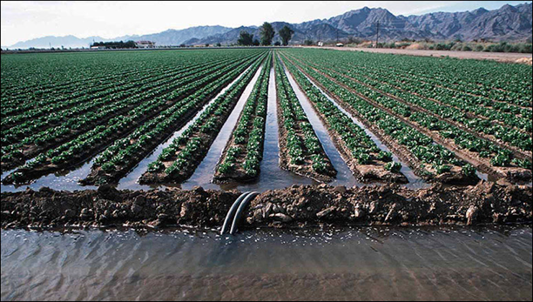
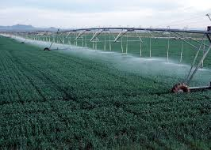
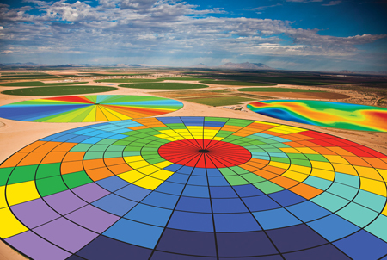
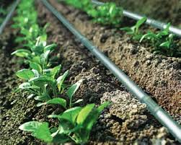
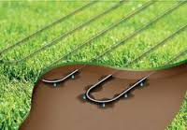
Types of Irrigation
Flood Irrigation
Center pivot Irrigation
Surface Drip Irrigation
Subsurface Drip Irrigation
Photo credit: Google search, Valmont Industries

Slide 4
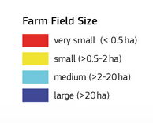
Average Farm Size Around the Globe
https://wad.jrc.ec.europa.eu/smallholderagriculture

Slide 5
Green vs. Blue Water
Global Water Footprint 1996-2005 was 7404 Gm³ yr⁻¹ (78% Green, 12% Blue, 10% Grey)
Blue water use relatively small but critical in localized areas
Mekonnen and Hoekstra 2011

Slide 6
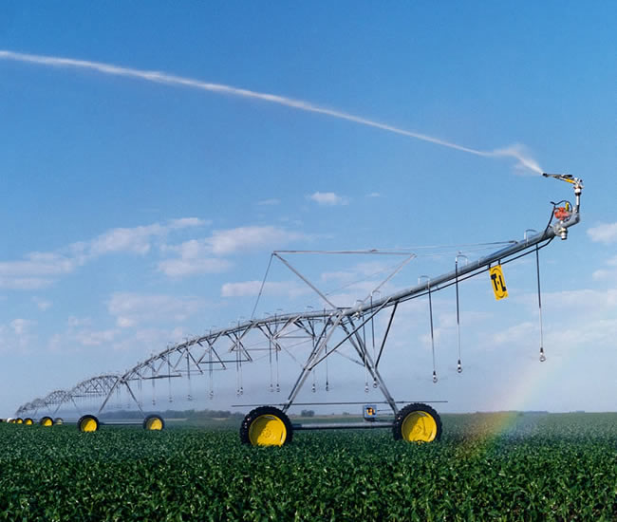
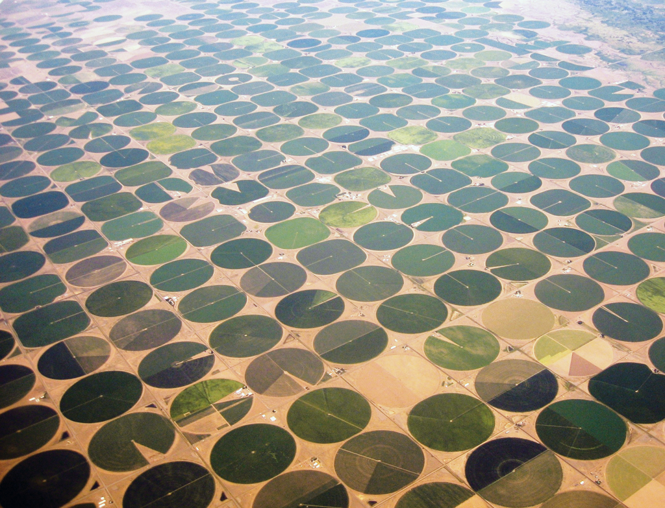
Center Pivot Irrigation

Slide 7
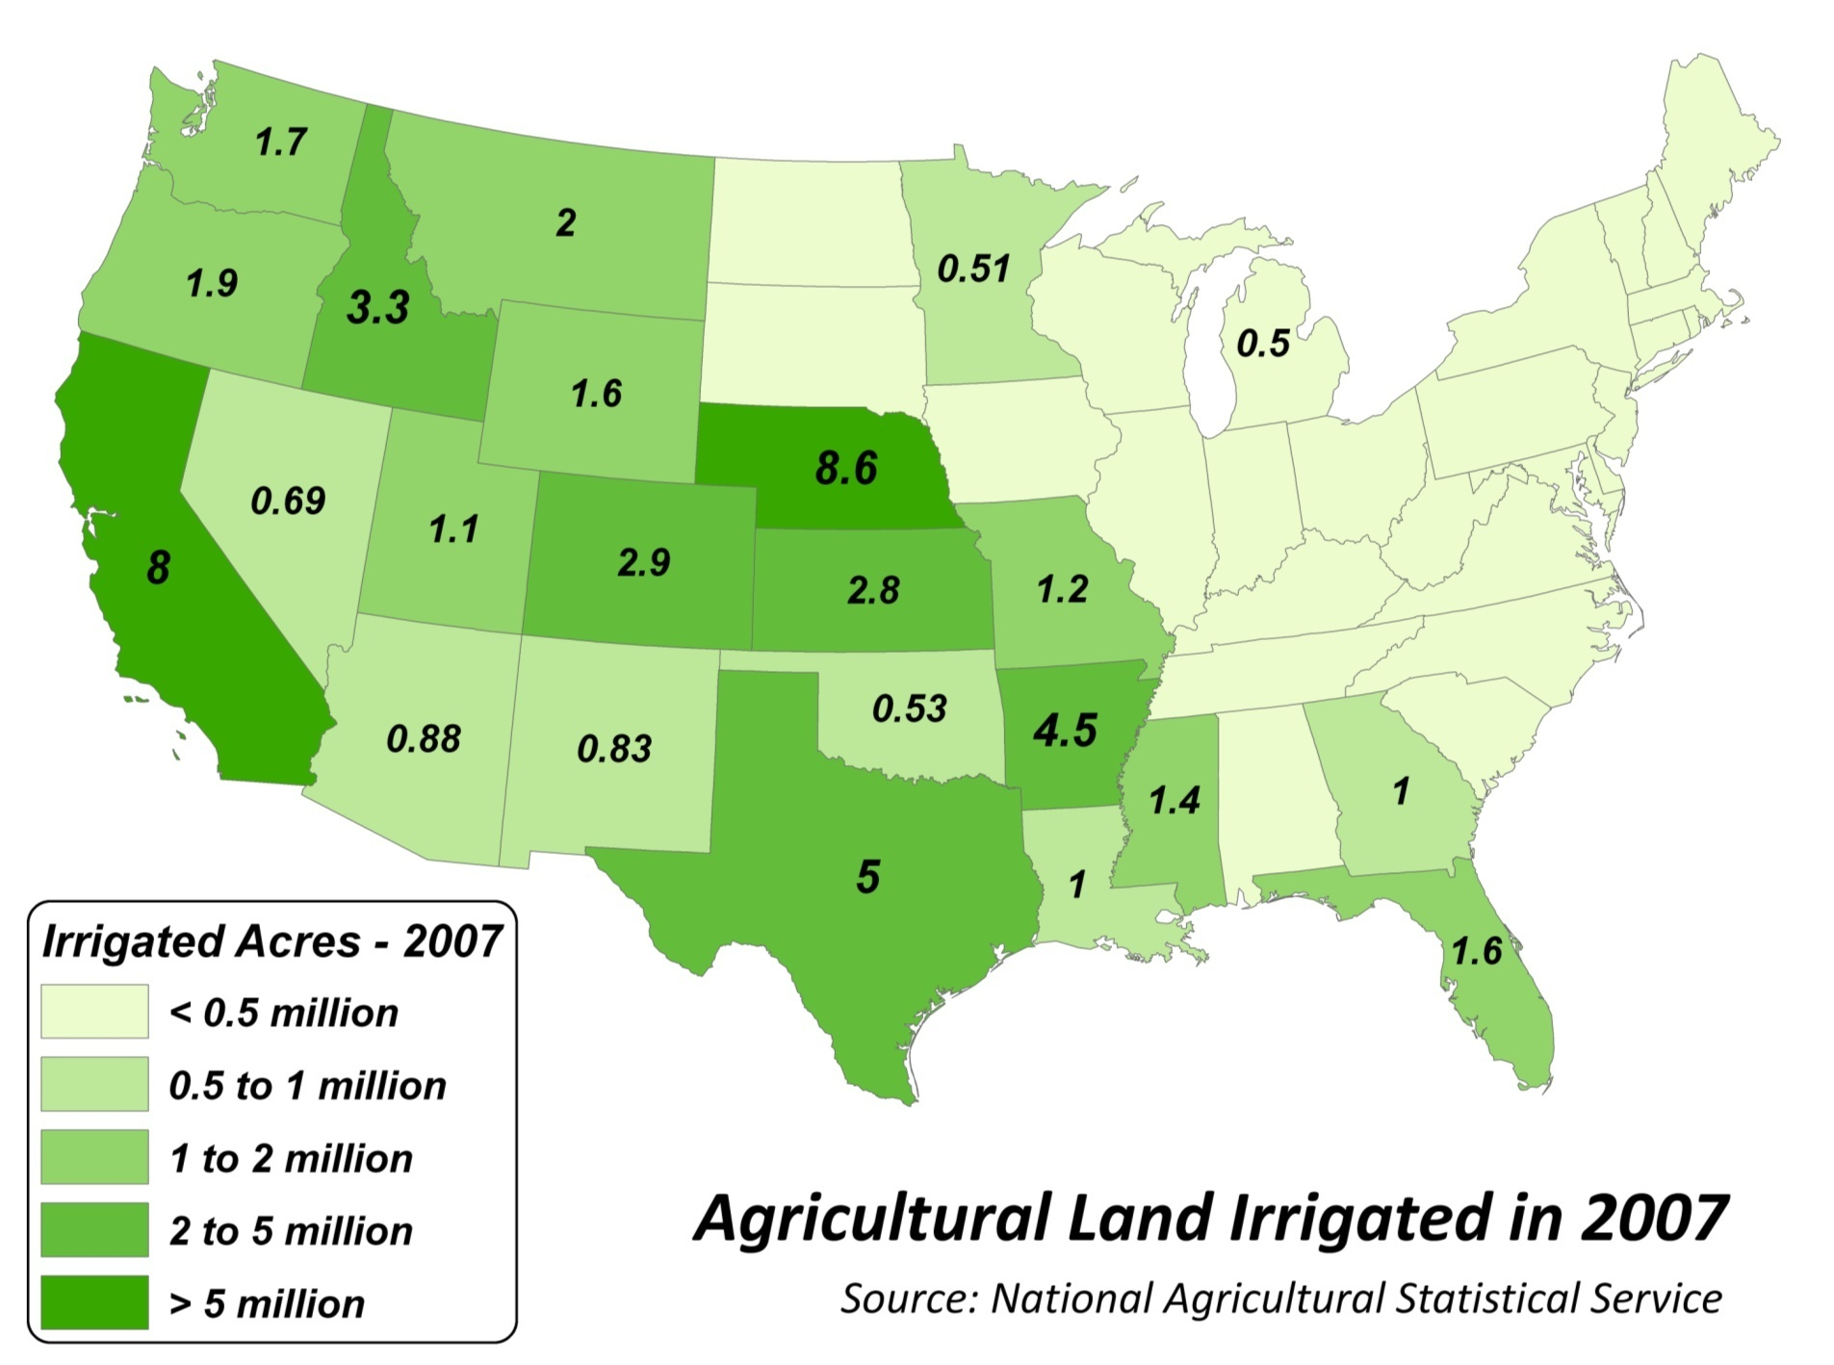
16% Of National Irrigated Land Is In Nebraska
90% Of Water Withdrawal Is For Irrigation
Probably more than 9 million acres now

Slide 8
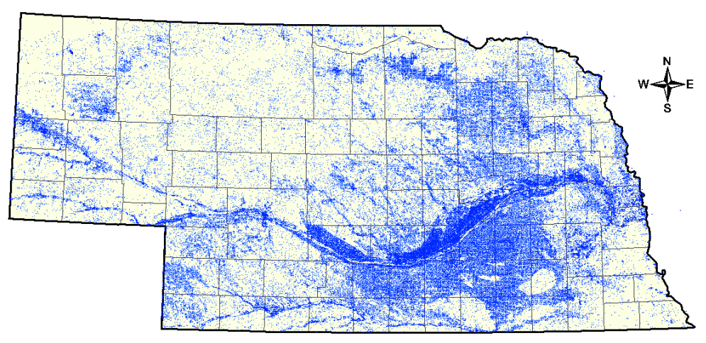
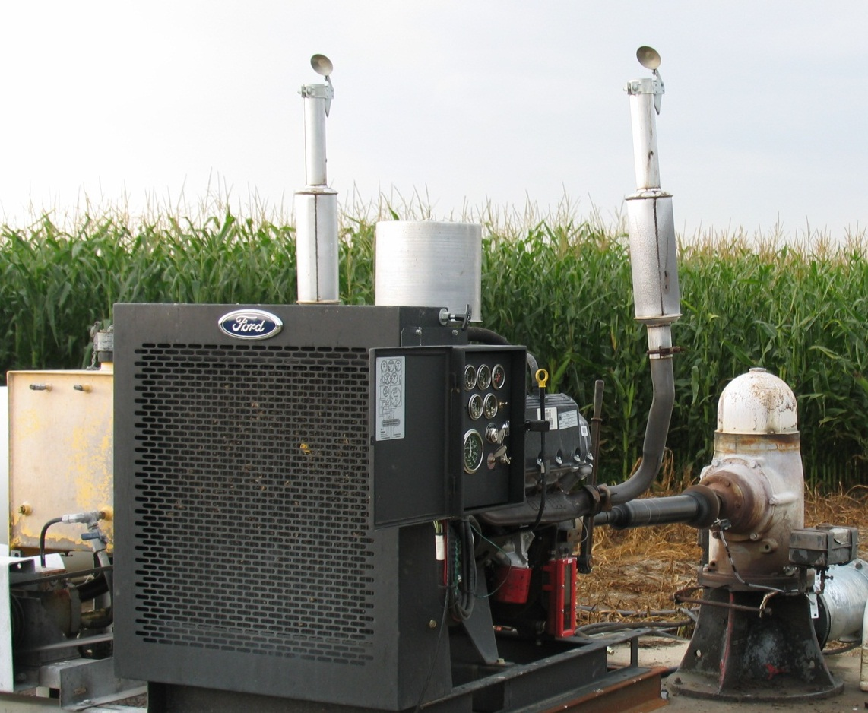
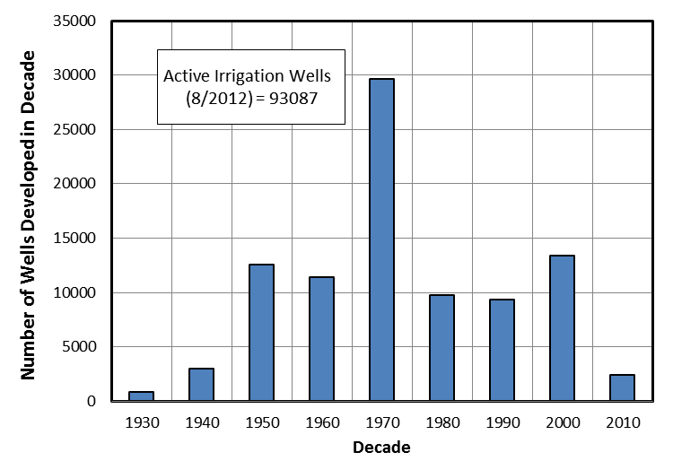
Active Irrigation Wells
~ 93,000
$6-8 Billion Investment
Irrigation
Development
Irrigation
Well
Major development occurred in 70’s, but growth continues at about 2000 wells per year

Slide 9
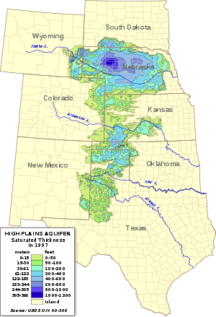
High Plains Aquifer
High Plains Aquifer
Extends through 8 states- Including Nebraska
174,000 square miles
  ~20,000 in NE alone
Unconfined aquifer
Shallow aquifer
  Surface water – ~1000 feet deep
Notes:
https://upload.wikimedia.org/wikipedia/commons/thumb/4/44/Ogallala_saturated_thickness_1997-sattk97-v2.svg/300px-Ogallala_saturated_thickness_1997-sattk97-v2.svg.png

Slide 10
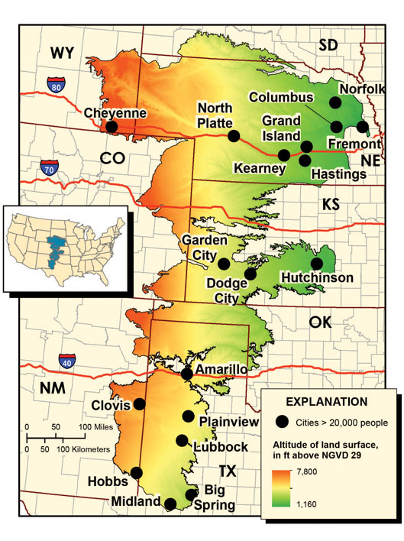
High Plains Aquifer
High Plains Aquifer
~3 Billion acre feet of water
  Amount of water to cover one acre one foot deep
Provides water to ~2.5 million people
Recharged by rainwater, snowmelt, and artificial recharge
  Limited by soil type, precipitation, weather patterns
  ~1 inch average recharge yearly

Slide 11
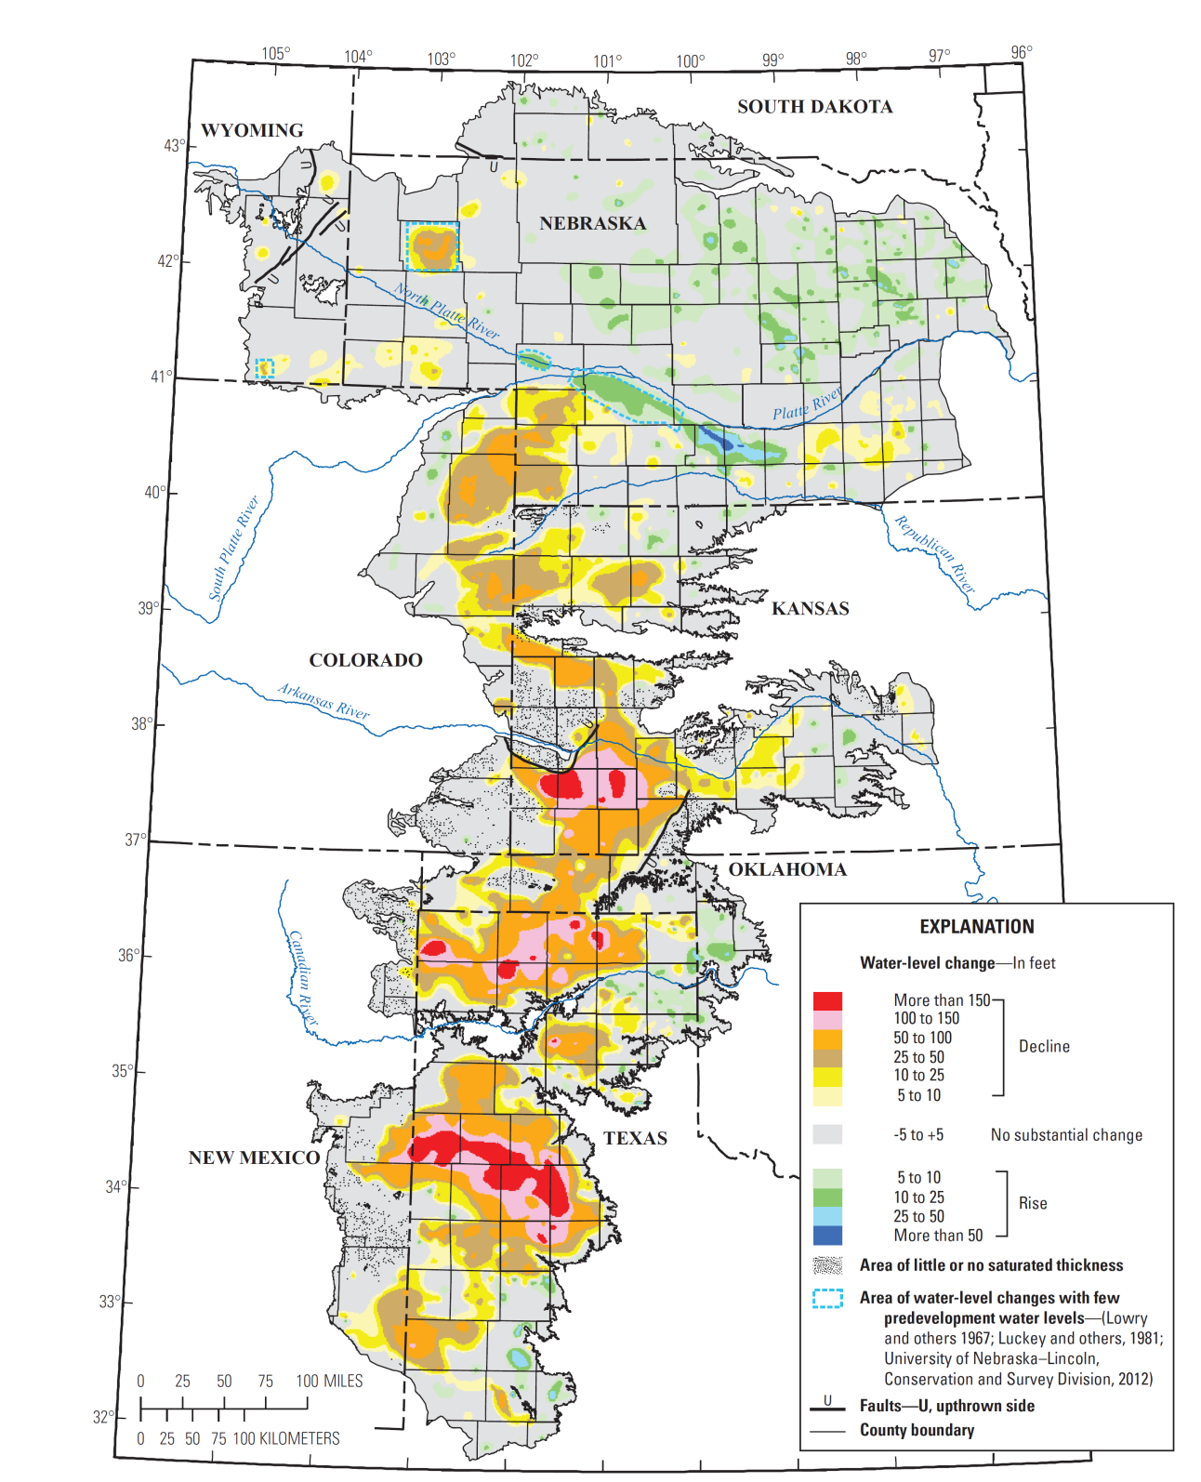
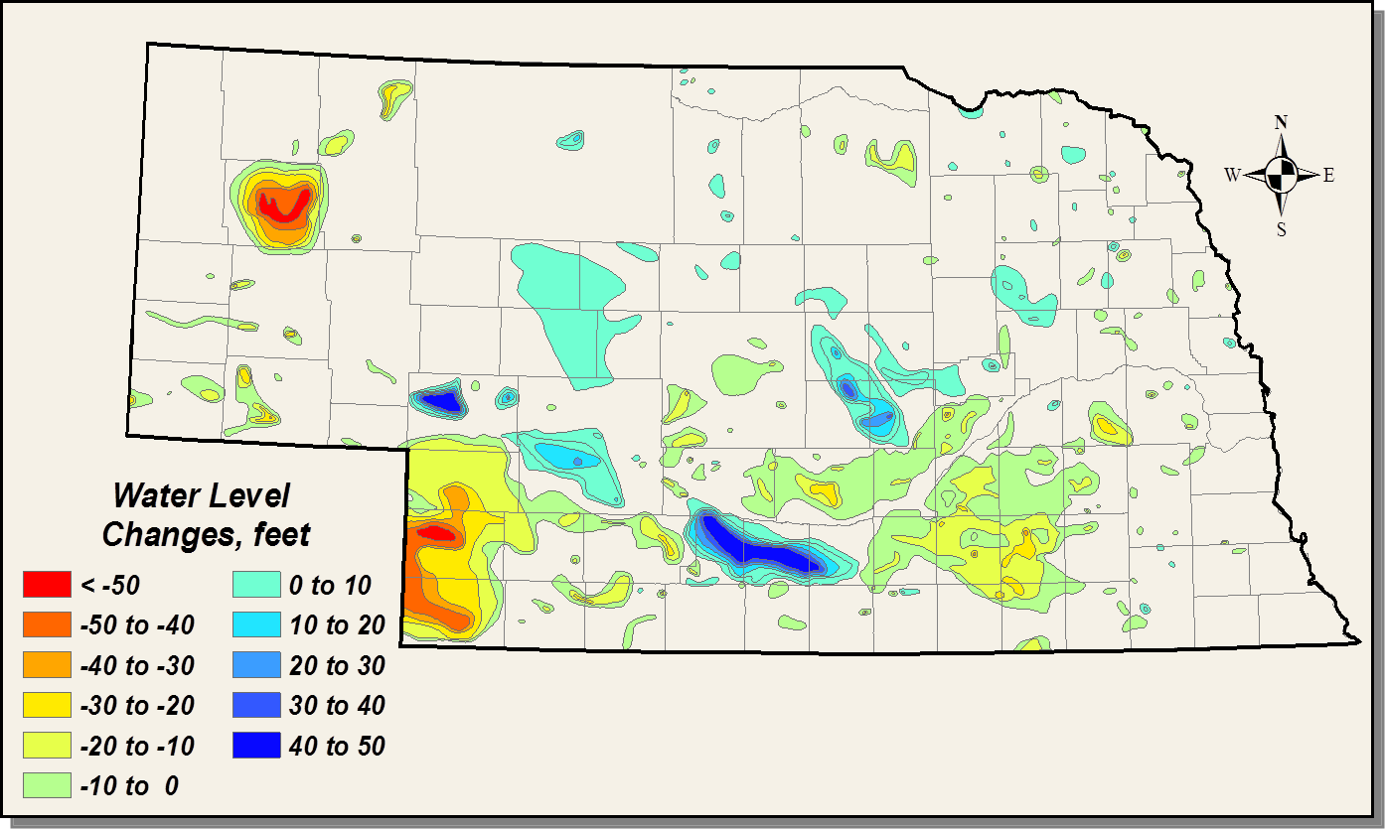
High Plains Aquifer
Groundwater Level Changes
Since Predevelopment
Aquifer Going Dry??

Slide 12
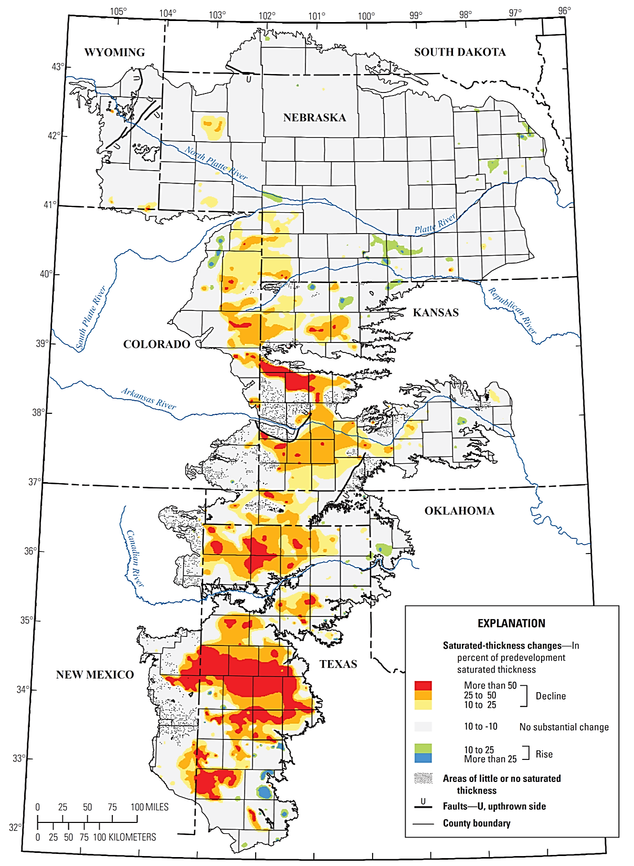
Depletion as Fraction of Saturated Thickness of the Aquifer
(McGuire , 2011)
High Plains Aquifer
Depletions in southern High Plains > 50% of saturated thickness
Small area in Nebraska > 25% of saturated thickness
Aquifer Going Dry??

Slide 13
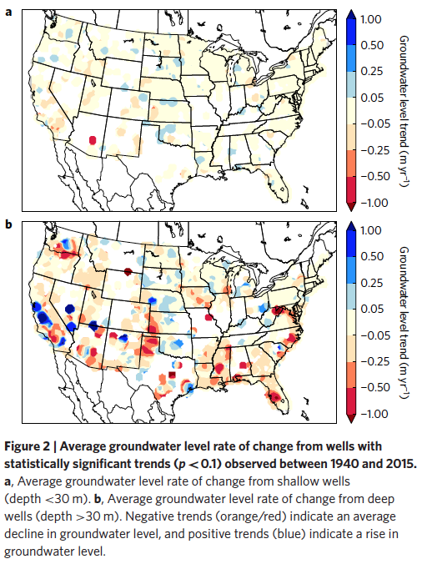
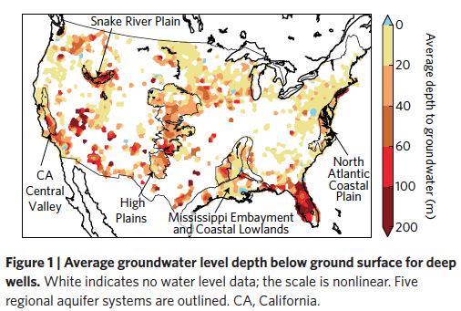
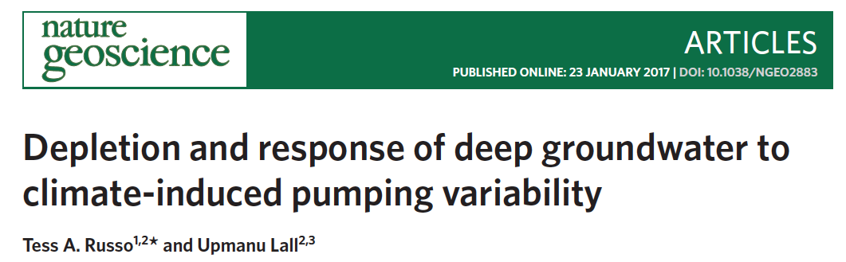
USA Aquifers
Notes:
https://upload.wikimedia.org/wikipedia/commons/thumb/4/44/Ogallala_saturated_thickness_1997-sattk97-v2.svg/300px-Ogallala_saturated_thickness_1997-sattk97-v2.svg.png

Slide 14
If soil moisture is so great why don’t all farmers use it schedule irrigation?

Slide 15
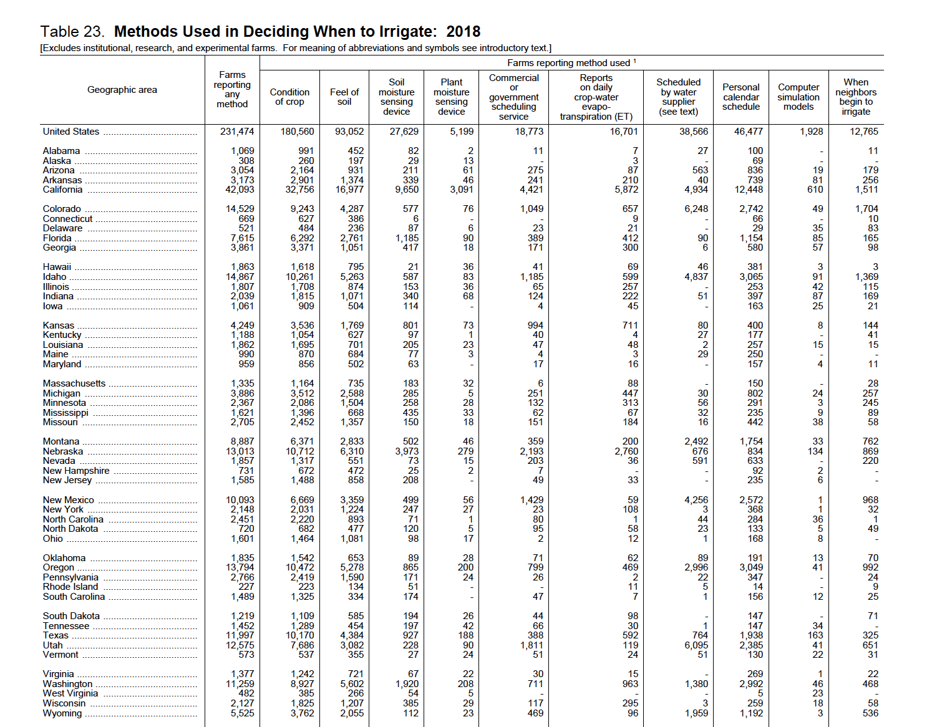

If soil moisture is so great why don’t all farmers use it schedule irrigation?

Slide 16
If soil moisture is so great why don’t all farmers use it schedule irrigation?
Only about 10% of people use SM probes!
Condition of crop and feel of soil overwhelmingly used
About twice as many people use personal calendar
About half as many people rely on their neighbor

Slide 17
If soil moisture is so great why don’t all farmers use it schedule irrigation?
Percentages (5-20%) not that much different even in regions with depleting GW resources

Slide 18
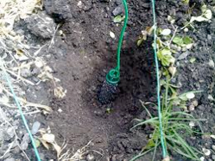
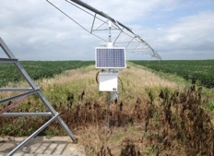
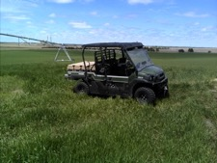
The Paradox of Soil Moisture Sensors, pick 2!
Inexpensive
Reliable/Easy to Use
Accurate
“Many ag. companies give away free soil moisture probes but they often never leave the barn”

Slide 19
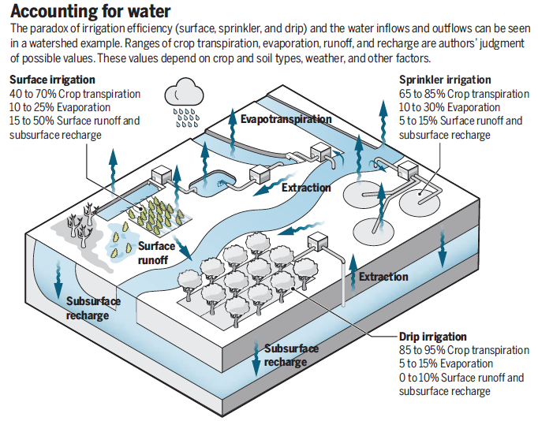
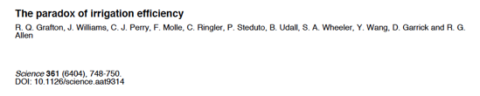
Paradox of Irrigation Efficiency
Many documented cases around the globe where introduction of technology leads to net increase in system water use!

Slide 20
Progression of CRNS
Basic Research
Applied Research
Operations

Slide 21

Progression of CRNS
Basic Research
Applied Research
Operations
Theory, transport modelling, calibration function, footprint size, processing algorithms, calibration procedure

Slide 22

Progression of CRNS
Basic Research
Applied Research
Operations
Theory, transport modelling, calibration function, footprint size, processing algorithms, calibration procedure
Value proposition, benefit to water and fertilizer applications, yield impact, decision and risk?

Slide 23
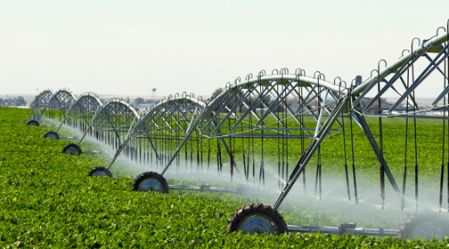
Research Area 1
Hypothesis: It is difficult to accurately measure water availability in the soil at the measurement scale of water application (individual nozzle and center-pivot) with existing point based technology. That uncertainty is 1 key factor that leads to overwatering as to not adversely affect yield.
Right photo courtesy of Valley Irrigation

Slide 24

Solution!
Duh, only apply water when and where we need to
Turns out that it is not that easy to measure plant water use (ET) and soil water storage at the same scale or the scale of water application (i.e. see myriad of ET and soil moisture monitoring methods)

Slide 25
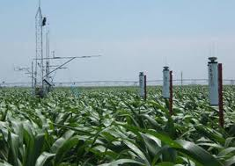
Measuring ET and Storage
We can measure required ET from temperature, energy, mass or combination approaches (Penman-Monteith, FAO reference crop). Value representative of field.
Source: S. Irmak with permission

Slide 26
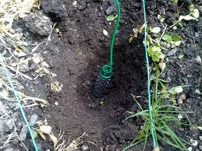
Measuring ET and Storage
We can measure required ET from temperature, energy, mass or combination approaches (Penman-Monteith, FAO reference crop). Value representative of field.
Source: S. Irmak with permission
However; we can only measure soil water storage at a point.
Source: www.shellypark.co.nz

Slide 27
Measuring ET and Storage
We can measure required ET from temperature, energy, mass or combination approaches (Penman-Monteith, FAO reference crop). Value representative of field.
$64,000?: How representative are point soil moisture measurements over entire field or watering section?
Source: www. Calmit.unl.edu
However; we can only measure soil water storage at a point.
Source: www.shellypark.co.nz

Slide 28
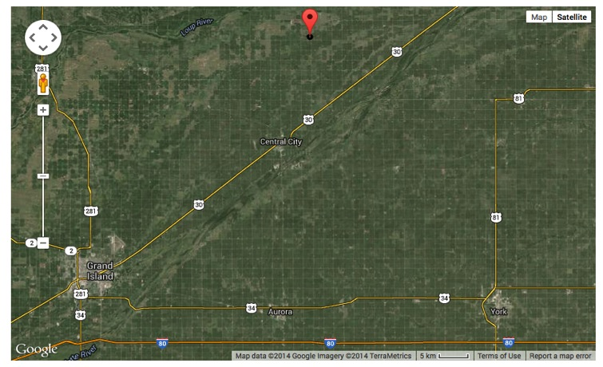
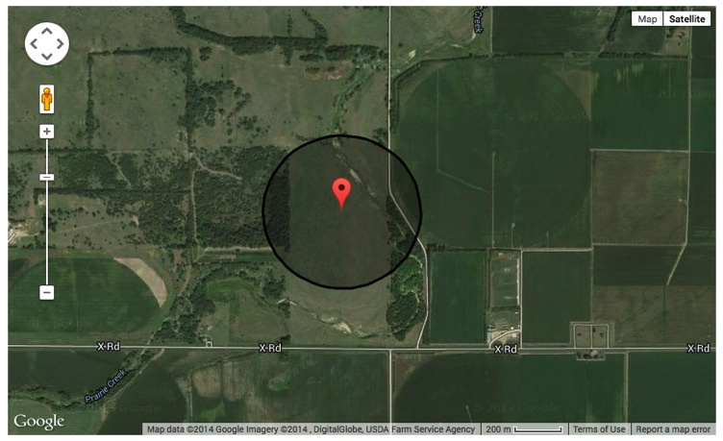
Supporting Evidence
June-July 2014, near Central City, NE
Installed 12 profiles of Watermark sensors and 1 cosmic-ray sensor
In collaboration with S. Irmak, A. Kilic, and A. Diotto

Slide 29
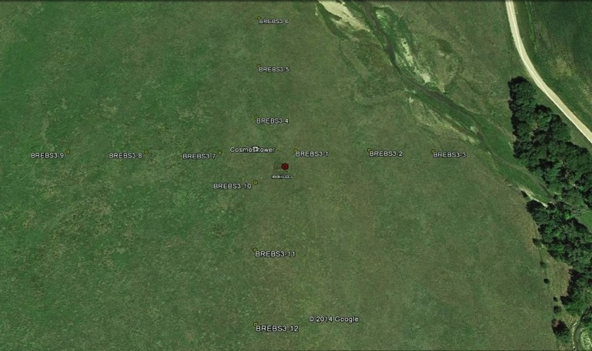
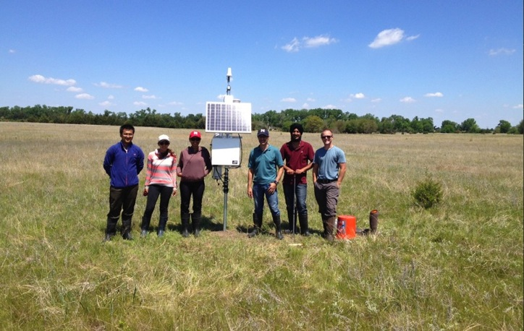
Supporting Evidence
Field is fairly flat, homogeneous vegetation, sandy loam soil texture, ideal setting for homogeneity?
200m
In collaboration with S. Irmak, A. Kilic, and A. Diotto

Slide 30
Supporting Evidence
In collaboration with S. Irmak, A. Kilic, and A. Diotto
In collaboration with S. Irmak, A. Kilic, and A. Diotto

Slide 31
Supporting Evidence
In collaboration with S. Irmak, A. Kilic, and A. Diotto
In collaboration with S. Irmak, A. Kilic, and A. Diotto

Slide 32
Supporting Evidence
In collaboration with S. Irmak, A. Kilic, and A. Diotto

Slide 33
Supporting Evidence
~ 8 Days
In collaboration with S. Irmak, A. Kilic, and A. Diotto

Slide 34
Supporting Evidence
In collaboration with S. Irmak, A. Kilic, and A. Diotto

Slide 35
Supporting Evidence
In collaboration with S. Irmak, A. Kilic, and A. Diotto

Slide 36
Supporting Evidence
In collaboration with S. Irmak, A. Kilic, and A. Diotto

Slide 37
Supporting Evidence
~ 3 Days
In collaboration with S. Irmak, A. Kilic, and A. Diotto

Slide 38
More Spins in Rainfall Roulette
By reducing Watermark point sensor uncertainty with CRS, this example showed a savings of 2.5 days without the need to water during this drying cycle.

Slide 39
More Spins in Rainfall Roulette
By reducing Watermark point sensor uncertainty with CRS, this example showed a savings of 2.5 days without the need to water during this drying cycle.
Yield:
How many inches of water can we save in May and June to apply in July and August? 1 inch of water = 12-15 bushels/acre, savings ~ $7k per 130 acres at $4 corn per inch of water

Slide 40
More Spins in Rainfall Roulette
By reducing Watermark point sensor uncertainty with CRS, this example showed a savings of 2.5 days without the need to water during this drying cycle.
Yield:
How many inches of water can we save in May and June to apply in July and August? 1 inch of water = 12-15 bushels/acre, savings ~ $7k per 130 acres at $4 corn per inch of water
Energy:
How much water/energy does that cost us over an entire growing season? 1 center-pivot rotation, ~$1k in energy pumping costs

Slide 41
More Spins in Rainfall Roulette
By reducing Watermark point sensor uncertainty with CRS, this example showed a savings of 2.5 days without the need to water during this drying cycle.
Yield:
How many inches of water can we save in May and June to apply in July and August? 1 inch of water = 12-15 bushels/acre, savings ~ $7k per 130 acres at $4 corn per inch of water
Energy:
How much water/energy does that cost us over an entire growing season? 1 center-pivot rotation, ~$1k in energy pumping costs
Fertilizer:
How much Nitrogen can we save from leaching out of the root zone? ~$0.4 per lb of N, need 200 lb per acre, savings ~$50 per lb of N per 130 acres

Slide 42
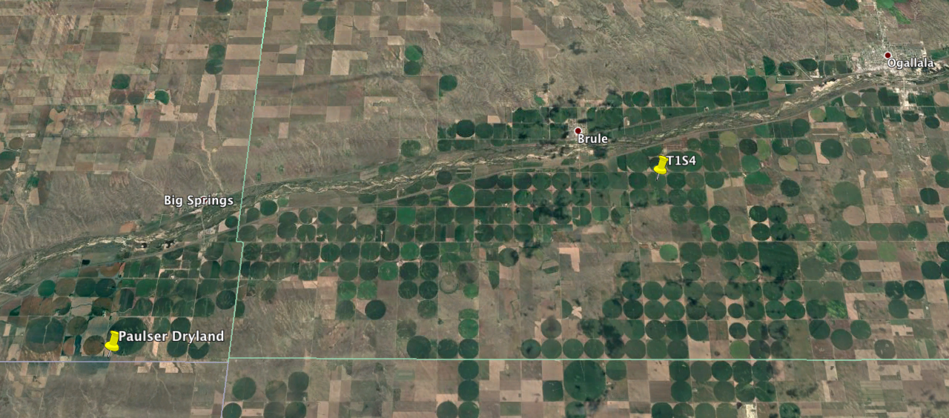
Irrigation Scheduling 101
Need to know size of soil bucket (field capacity and wilting point) and relative soil moisture status through time (trigger irrigation halfway between)
25 km

Slide 43
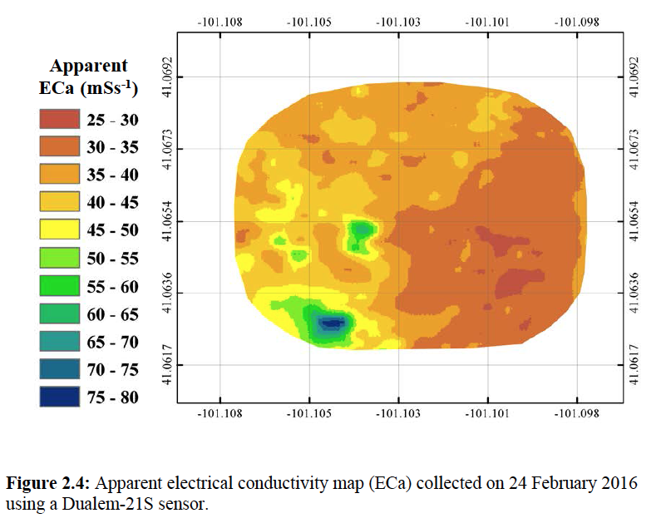
Hydrogeophysical Mapping

Slide 44
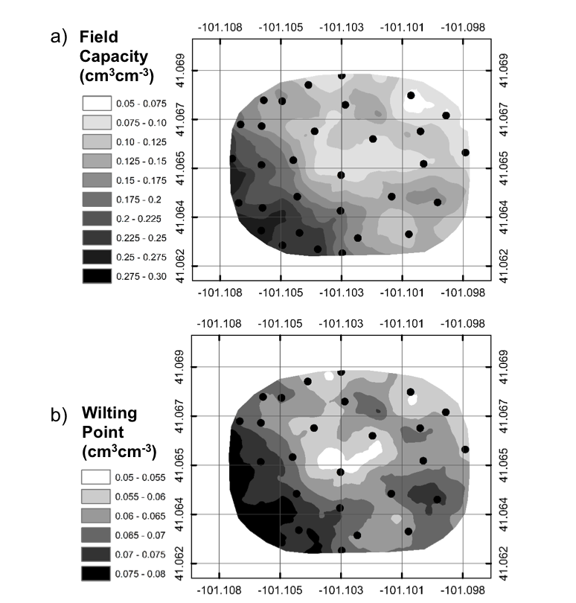
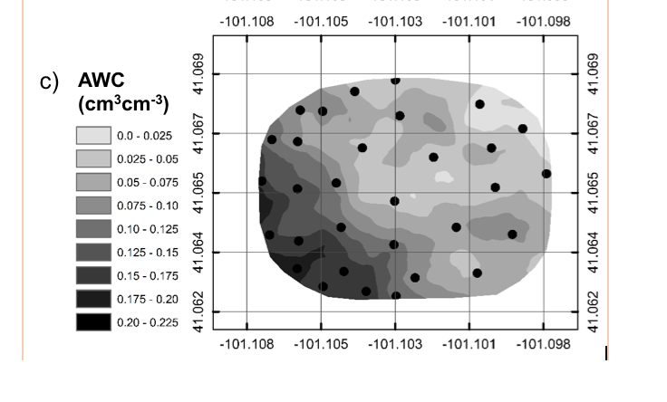
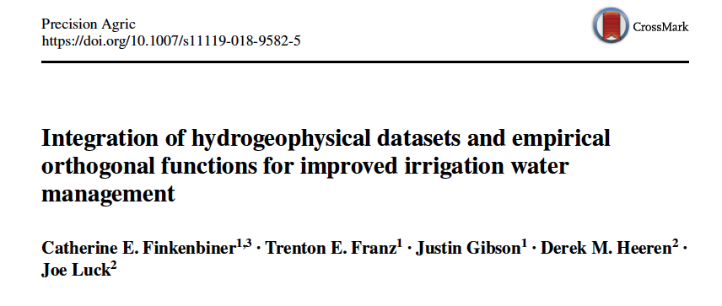
Spatial Products Useful for Irrigators
Notes:
Here is a new field capacity product I created for our field site. This product can be used to make prescription irrigation maps for the field that better characterize the soil spatial heterogeneity within the field.
Wetness Index! SSURGO with FC values

Slide 45
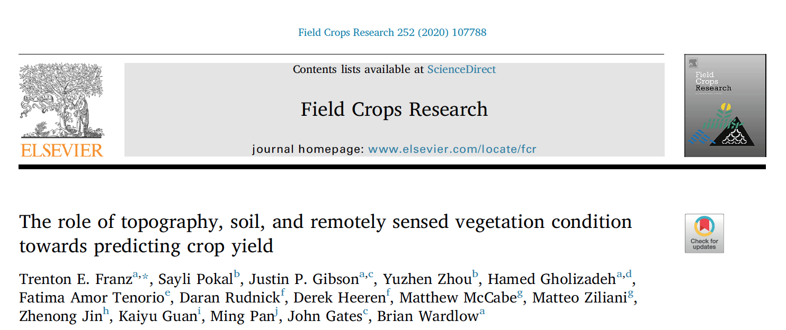
Understanding the spatiotemporal pattern of within field yield variation

Slide 46
Understanding the spatiotemporal pattern of within field yield variation
Research Questions:
1. What physical factors (weather, soils, topography, vegetative growth) are the most important for understanding and predicting within field spatiotemporal variation of maize and soybean yield?
2. How can we make improved spatiotemporal predictions of yield?
Methods: Combine high resolution (10m) hydrogeophyscial mapping, remote sensing, and topographic data, with historical yield maps of 8-130 acre study sites across NE using a variety of statistical methods.
Use statistics to understand:
1) spatial patterns of crop yield and relative covariate importance
2) spatiotemporal prediction of yield
Datasets: Weather (NE Mesonet Sites), Yield Data (combine data), Elevation (NE Lidar), Soil Texture/ Soil Moisture (electromagnetic induction and neutron intensity), Vegetation (Landsat peak GCVI). Statistical Methods (MLR, EOF, Random Forests).

Slide 47
Study Sites

Slide 48
Study Sites
*Higher ECa values typically indicate more clay rich soil

Slide 49
Site Description and Weather Data

Slide 50
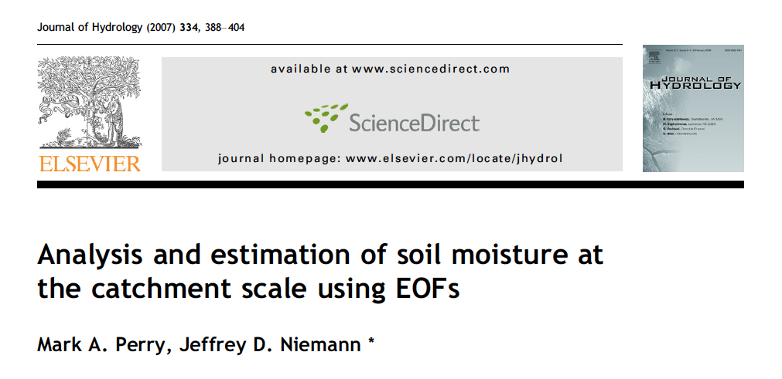
Use EOF framework to seperate spatial and temporal anomalies
  Spatial loadings map (EOFs) can be used to group sites of “like” soil moisture, soil texture, GCVI, and Yield patterns
  WRT to Yield, weather or crop models can be used to describe the temporal varying component (ECs) and field average yield
  Combine reduced number of spatial (EOFs) and time varying loadings (EC) to reconstruct spatial patterns across space and time
  Very similar to PCA
V*E = L*E

Slide 51
Use EOF to seperate spatial and temporal information

Slide 52
Use EOF to seperate spatial and temporal information

Slide 53
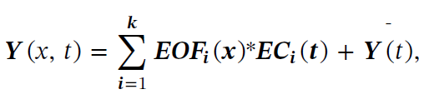
Use EOF to seperate spatial and temporal information
Varies in time: Build relationship with some temporal covariate, crop model, etc. to predict these values.
Static (after enough yield maps)

Slide 54
S2: BWL2

Slide 55
S8: CSP3

Slide 56
Understanding the spatiotemporal pattern of within field yield variation

Slide 57
Understanding the spatiotemporal pattern of within field yield variation
Yield patterns repeat over time with high explained variance from EOF across climatic zones and crop types (60-80% of 1st EOF, K_{eff} = 1 or 2)
Some evidence that pattern is different between crops within same field (CSP2 &3, Pearson R ~ 0.8)

Slide 58
Importance of covariates in predicting yield pattern
Use Multivariate Linear Regression and Random Forest Analysis to look at linear vs. nonlinear model performance
Random Forest analysis can determine covariate relative importance

Slide 59
Importance of covariates in predicting yield pattern
Relationship between yield pattern and covariates is nonlinear (RMSE reduction by 75%)
Relative importance of covariates is dominated by location in field
  Second and third order covariates vary by site (i.e. some sites flat or have minimal texture variation)

Slide 60
Importance of covariates in predicting yield pattern through time
Site 2
Including yield history linearizes statistical relationship
Adding GCVI, elevation and some metric of soil variation increases statistical power
Covariate set 2 contains information about historical yield

Slide 61
Spatiotemporal Yield Reconstruction and Prediction
Use EOF framework to model and reconstruct spatiotemporal yield data
1st step, try to relate basic growing season weather data to year to year average yield changes, and temporal component of EOF analysis
Following model selection make spatiotemporal yield predictions from growing season climate data (long term predictions of wet/dry or cold/hot growing season)

Slide 62
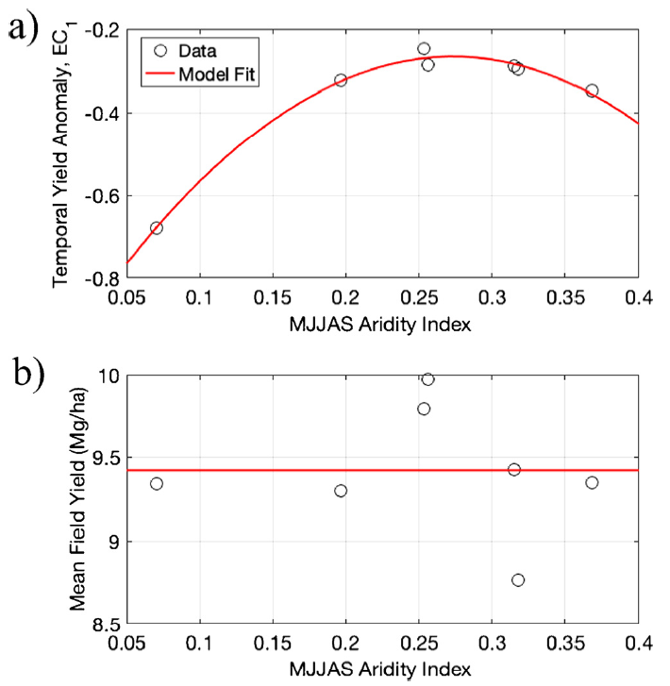
Spatiotemporal Yield Reconstruction: S2
Avg. field yield not well predicted by aridity index (P/ET₀).
May be better correlated to growing season soil moisture or a crop model

Slide 63
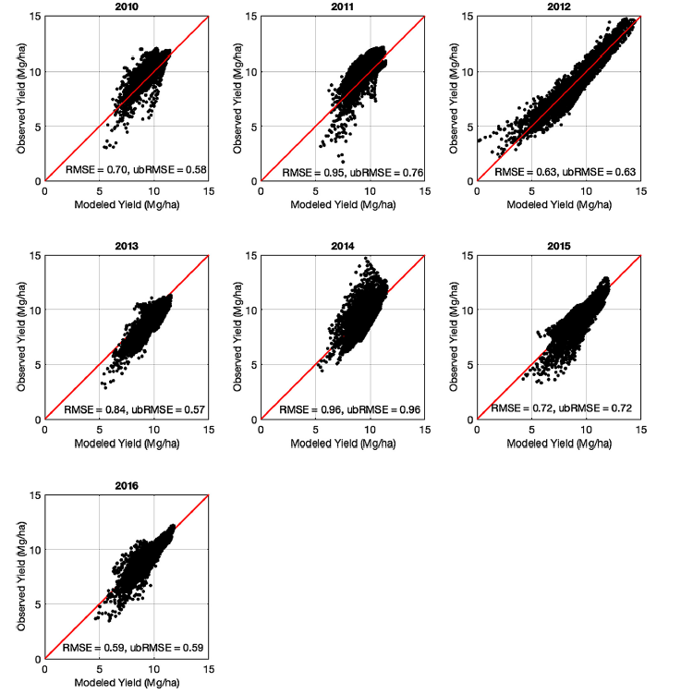
Spatiotemporal Yield Reconstruction: S2
From FCR paper RMSE of predicted yield ~ 12 bu/ac for corn
Mean yield not well predicted using aridity index

Slide 64
Key Findings
Need 3-5 years of yield data to understand EOF spatial anomalies (Cross-validation analysis), where 1st PCA explains 60-80% of variation
  Yield data available in developed countries but likely need Remote sensing data in developing countries (Burke 2017 PNAS)
  Adding GCVI and elevation layers as covariates is important and inexpensive
  Geophysical layers have value added info (smart soil sampling)

Slide 65
Key Findings
Need 3-5 years of yield data to understand EOF spatial anomalies (Cross-validation analysis), where 1st PCA explains 60-80% of variation
  Yield data available in developed countries but likely need Remote sensing data in developing countries (Burke 2017 PNAS)
  Adding GCVI and elevation layers as covariates is important and inexpensive
  Geophysical layers have value added info (smart soil sampling)
Grassini (2015 FCR), need 3-5 years of average yield data in irrigated fields to relate to year to year weather changes
  Need 5-8 years for rainfed systems
  Aridity index ok, but explore connections of growing season soil moisture (PDF) and crop models to improve pred. of avg. yield and EC

Slide 66
Summary
Irrigation accounts for 90+% water use in many agricultural regions, current and pressing issue is depletion of underlying aquifers
Scheduling irrigation is based on soil moisture but barriers of technology limit adoption to ~15%
CRNS useful for finding sampling locations and scaling up soil hydraulic properties
Some connection to crop yield but need to combine with statistical or crop models to tease out influence

Slide 67
Key References
Finkenbiner, C. E., T. E. Franz, J. Gibson, D. M. Heeren, and J. Luck (2019), Integration of hydrogeophysical datasets and empirical orthogonal functions for improved irrigation water management, Precis. Agric., 20(1), 78-100. doi:10.1007/s11119-018-9582-5.
Franz, T. E., S. Pokal, J. P. Gibson, Y. Z. Zhou, H. Gholizadeh, F. A. Tenorio, D. Rudnick, D. Heeren, M. McCabe, M. Ziliani, Z. Jin, K. Y. Guan, M. Pan, J. Gates, and B. Wardlow (2020), The role of topography, soil, and remotely sensed vegetation condition towards predicting crop yield, Field Crop. Res., 252, 17. doi:10.1016/j.fcr.2020.107788.
Gibson, J., and T. E. Franz (2018), Spatial prediction of near surface soil water retention functions using hydrogeophysics and empirical orthogonal functions, Journal of Hydrology, 561, 372-383. doi:10.1016/j.jhydrol.2018.03.046.

