Slide 1
Lecture 4:
Practical data products for use of CRNS: Time series filter, root zone extrapolation and rainfall estimation
Trenton Franz
Assoc. Professor of Hydrogeophysics
School of Natural Resources
Faculty Fellow at the Daugherty Water for Food Global Institute
University of Nebraska-Lincoln

Slide 2
Overview
Application of CRNS data for practical data products
Discuss error and design of experiments
Time series filter, estimation of rootzone SM, estimation of rainfall, use in hydrological models for GW and streamflow
How do we connect soil moisture with water fluxes!!!!!!

Slide 3
Uncertainty Analysis
Must deal with uncertainty in observations
CRNS follow Poisson Counting Statistics
Mean is equal to variance!
Counts around a mean are normally distributed

Slide 4
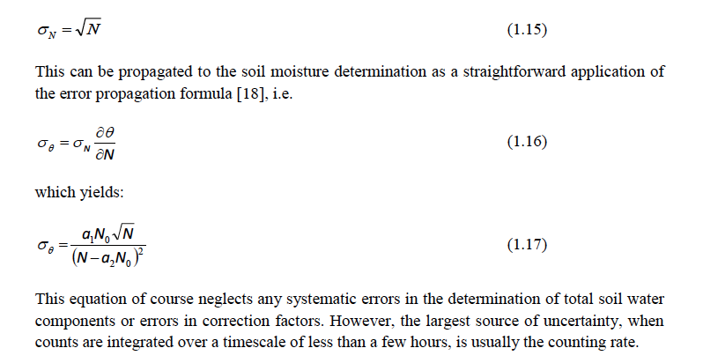
Design of Detectors and Experiments
TECDOC 1809

Slide 5
Design of Detectors and Experiments
If count rate is 1000 cph what is error?

Slide 6
Design of Detectors and Experiments
If count rate is 1000 cph what is error?
Std = 1000^0.5 = 31.6 cph

Slide 7
Design of Detectors and Experiments
If count rate is 1000 cph what is error?
Std = 1000^0.5 = 31.6 cph
CV = 31.6/1000 = 0.0316, about 3%

Slide 8
Design of Detectors and Experiments
What is largest sources of error in method?

Slide 9
Design of Detectors and Experiments
What is largest sources of error in method?
Count rate- minimum of 1000 counts, need large enough detector or integrate over multiple time periods (~6 hr avg.)

Slide 10
Design of Detectors and Experiments
What is largest sources of error in method?
Count rate- minimum of 1000 counts, need large enough detector or integrate over multiple time periods (~6 hr avg.)
Pressure correction then intensity correction then water vapor correction

Slide 11
Design of Detectors and Experiments
What is largest sources of error in method?
Count rate- minimum of 1000 counts, need large enough detector or integrate over multiple time periods (~6 hr avg.)
Pressure correction then intensity correction then water vapor correction
Soil bulk density! Then LW and SOC

Slide 12
Design of Detectors and Experiments
What is largest sources of error in method?
Count rate- minimum of 1000 counts, need large enough detector or integrate over multiple time periods (~6 hr avg.)
Pressure correction then intensity correction then water vapor correction
Soil bulk density! Then LW and SOC
Estimation of N₀ (like 3 calibration datasets (Iwema 2015)

Slide 13
Design of Detectors and Experiments
What is largest sources of error in method?
Count rate- minimum of 1000 counts, need large enough detector or integrate over multiple time periods (~6 hr avg.)
Pressure correction then intensity correction then water vapor correction
Soil bulk density! Then LW and SOC
Estimation of N₀ (like 3 calibration datasets (Iwema 2015)
Fast growing vegetation (maize, sugarcane, trees for lumber etc.)

Slide 14
Design of Detectors and Experiments
TECDOC 1845

Slide 15
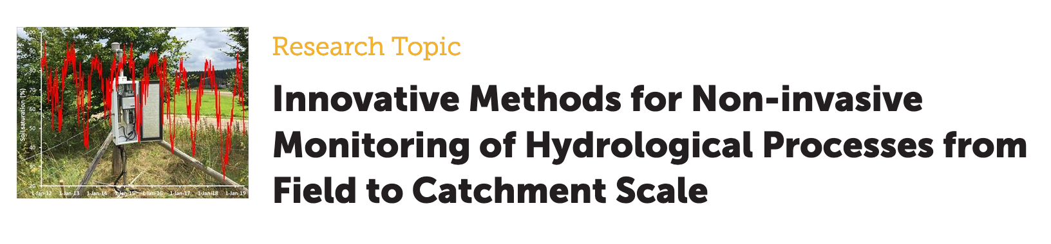
https://www.frontiersin.org/research-topics/11094/innovative-methods-for-non-invasive-monitoring-of-hydrological-processes-from-field-to-catchment-sca#articles

Slide 16
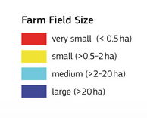
Average Farm Size Around the Globe
https://wad.jrc.ec.europa.eu/smallholderagriculture

Slide 17
What SWC products do producers want?
Cost effective, simple to use/understand and accurate/consistent daily rootzone (~0 to 1 m) soil water content at the field and subfield scale (~1 to 60 ha).

Slide 18
What SWC products do producers want?
Cost effective, simple to use/understand and accurate/consistent daily rootzone (~0 to 1 m) soil water content at the field and subfield scale (~1 to 60 ha).
Strategies:
Upscale point sensors/networks to areas (Temp. stability, Exp. Filter, landscape uniformity index, magic snake oil, etc.)

Slide 19
What SWC products do producers want?
Cost effective, simple to use/understand and accurate/consistent daily rootzone (~0 to 1 m) soil water content at the field and subfield scale (~1 to 60 ha).
Strategies:
Upscale point sensors/networks to areas (Temp. stability, Exp. Filter, landscape uniformity index, magic snake oil, etc.)
Downscale tens of km scale RS SWC products

Slide 20
What SWC products do producers want?
Cost effective, simple to use/understand and accurate/consistent daily rootzone (~0 to 1 m) soil water content at the field and subfield scale (~1 to 60 ha).
Strategies:
Upscale point sensors/networks to areas (Temp. stability, Exp. Filter, landscape uniformity index, magic snake oil, etc.)
Downscale tens of km scale RS SWC products
Combine finer scale RS ET and vegetation products with physically based water & energy models

Slide 21
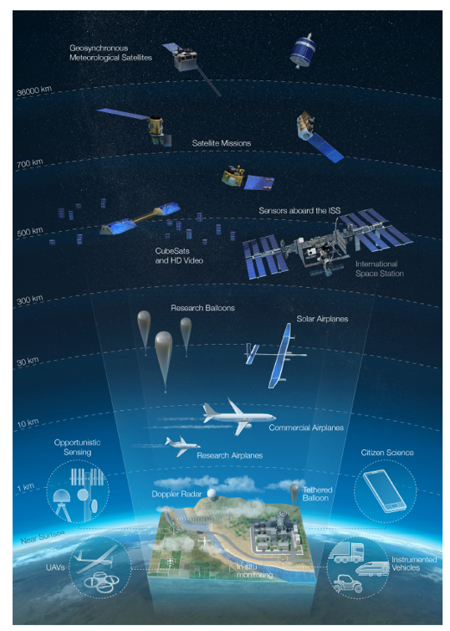
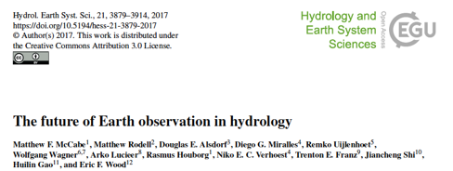
State of remote sensing and remaining gaps

Slide 22
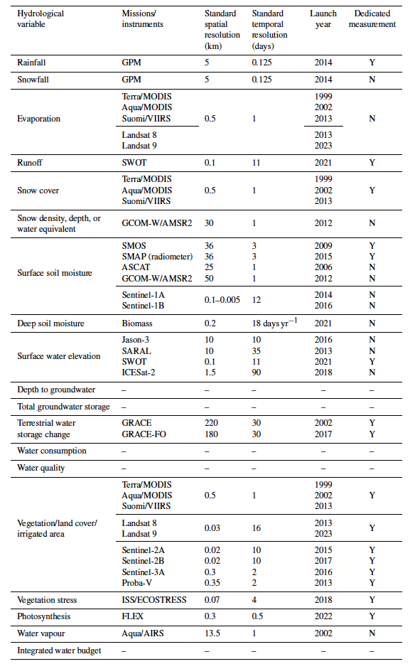
State of remote sensing and remaining gaps

Slide 23
State of remote sensing and remaining gaps
Field scale daily rainfall
Field scale daily rootzone soil moisture
Field scale daily evapotranspiration

Slide 24
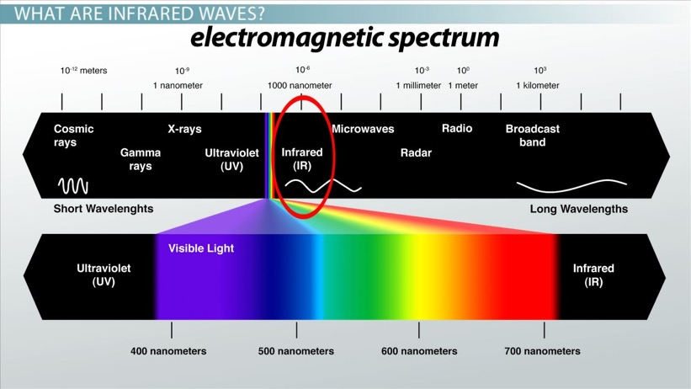
Motivation
Imagers from aircraft and UAVs (~UV to NIR) do an excellent job of characterizing the change in vegetation condition (i.e. NDVI, mSAVI, Ch. & Stress Indices etc.) across spatiotemporal scales and at low costs (< $1/acre)
Information on root zone SM more challenging to retrieve (equipment mass & size) at different EM wavelengths (i.e. gamma, neutron, microwave, radar, radio) needed to penetrate the soil beyond a few centimeters (< $10/acre)
  Satellite data often too coarse and/or infrequent in time

Slide 25
Soil Moisture Sensing Options
TDR Sensor Array
Satellite Remote Sensing
1 year
1 month
1 day
Airborne Remote Sensing
1 hour
1 minute
Stationary and Mobile Cosmic-ray Neutron Sensor
1 m
100 m
10 km
1000 km
Adapted from Robinson (2008)

Slide 26
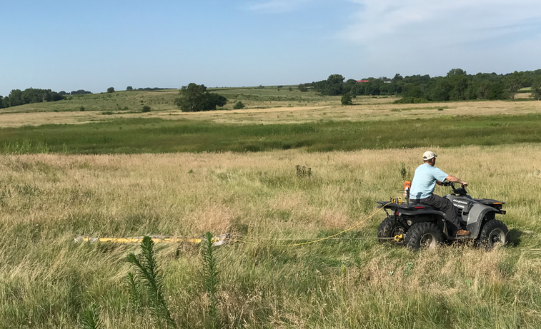

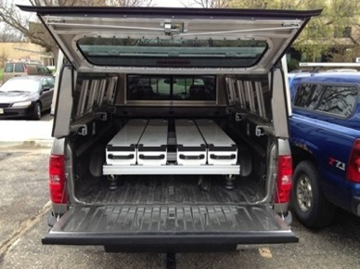
Measurements of Soil Moisture
TDR Sensor Array
Satellite Remote Sensing
Mobile TDR & EM
1 year
1 month
1 day
Airborne Remote Sensing
1 hour
1 minute
Cosmic-ray Probe and Rover
1 m
100 m
10 km
1000 km
Adapted from Robinson (2008)

Slide 27
Space and Time Process Scales
1)Human environments, floods
2)Droughts
3)Climate Change
4)Water supply, landscape productivity
5)Agricultural productivity
6)Transport process operate
CUAHSI-HMF-WC (2006)
Notes:
Description of hydrologic structure and processes

Slide 28
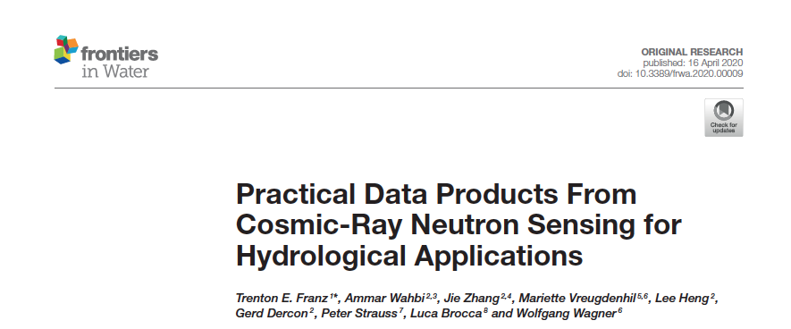
Improved CRNS Products for Hydrology

Slide 29
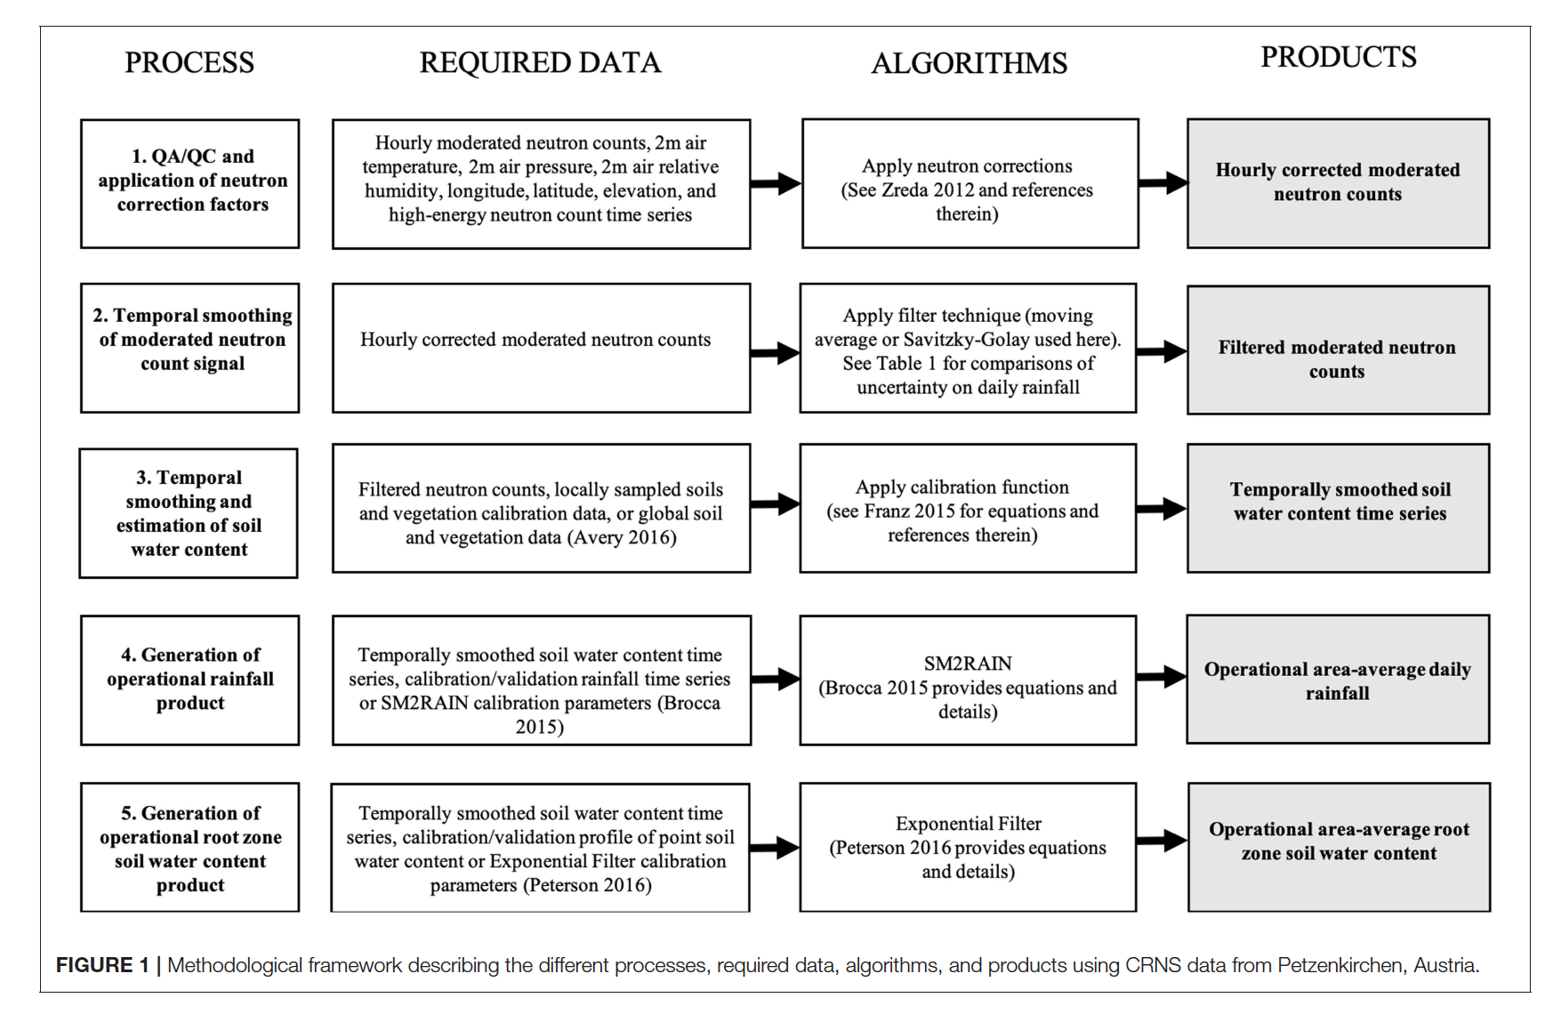
Improved CRNS Products

Slide 30
Improved CRNS Products

Slide 31
Improved CRNS Products

Slide 32
Improved CRNS Products

Slide 33
Improved CRNS Products

Slide 34
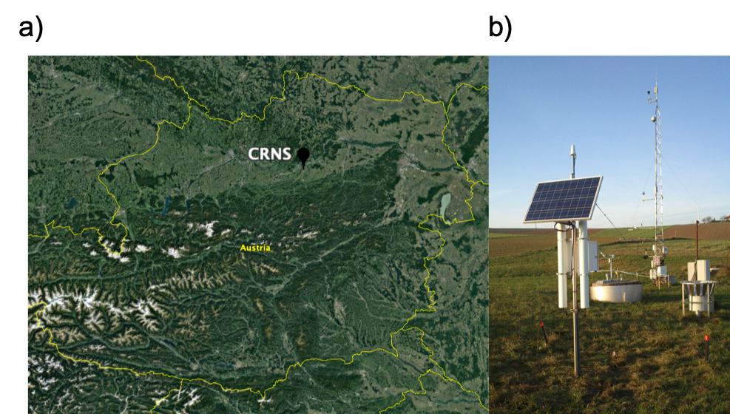
Improved CRNS Products
HOAL- Petzenkirchen
Figure 1.3. a) Location of the CRNS (48.1547°N, 15.1483°E) within a mixed agricultural land use area in northeast Austria. b) CRNS located at study site with weather station and eddy covariance tower. See Figure 2.1 for raw and processed neutron counts. Source Franz et al. 2016.

Slide 35
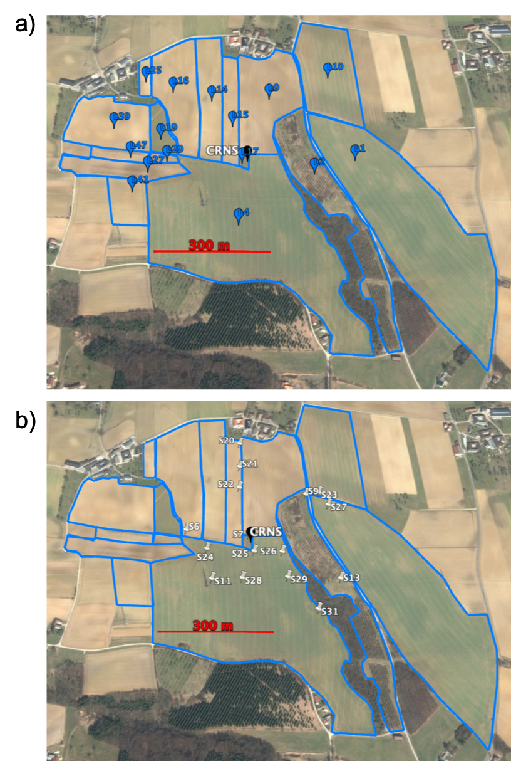
Improved CRNS Products

Slide 36
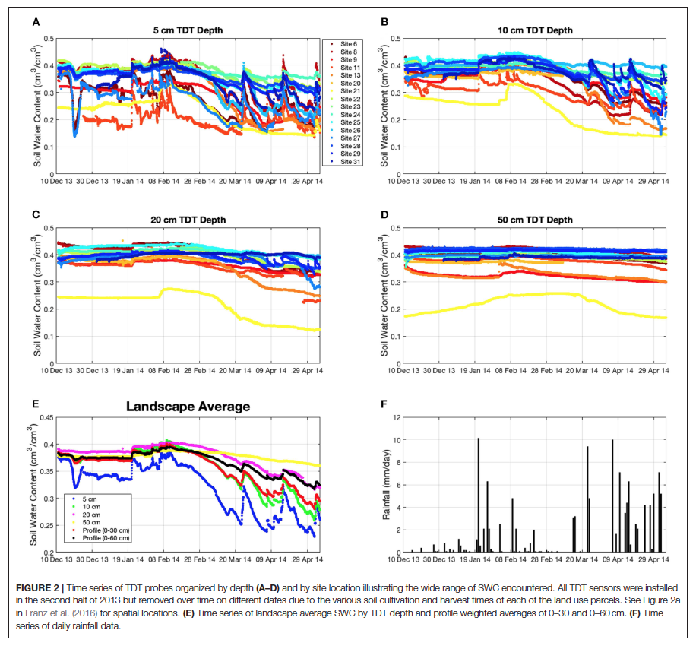
Improved CRNS Products

Slide 37
Improved CRNS Products
What is optimal time series filter for neutron counts?
Looked at:
Moving average with different window sizes
SG Filter with different window sizes

Slide 38
Improved CRNS Products

Slide 39
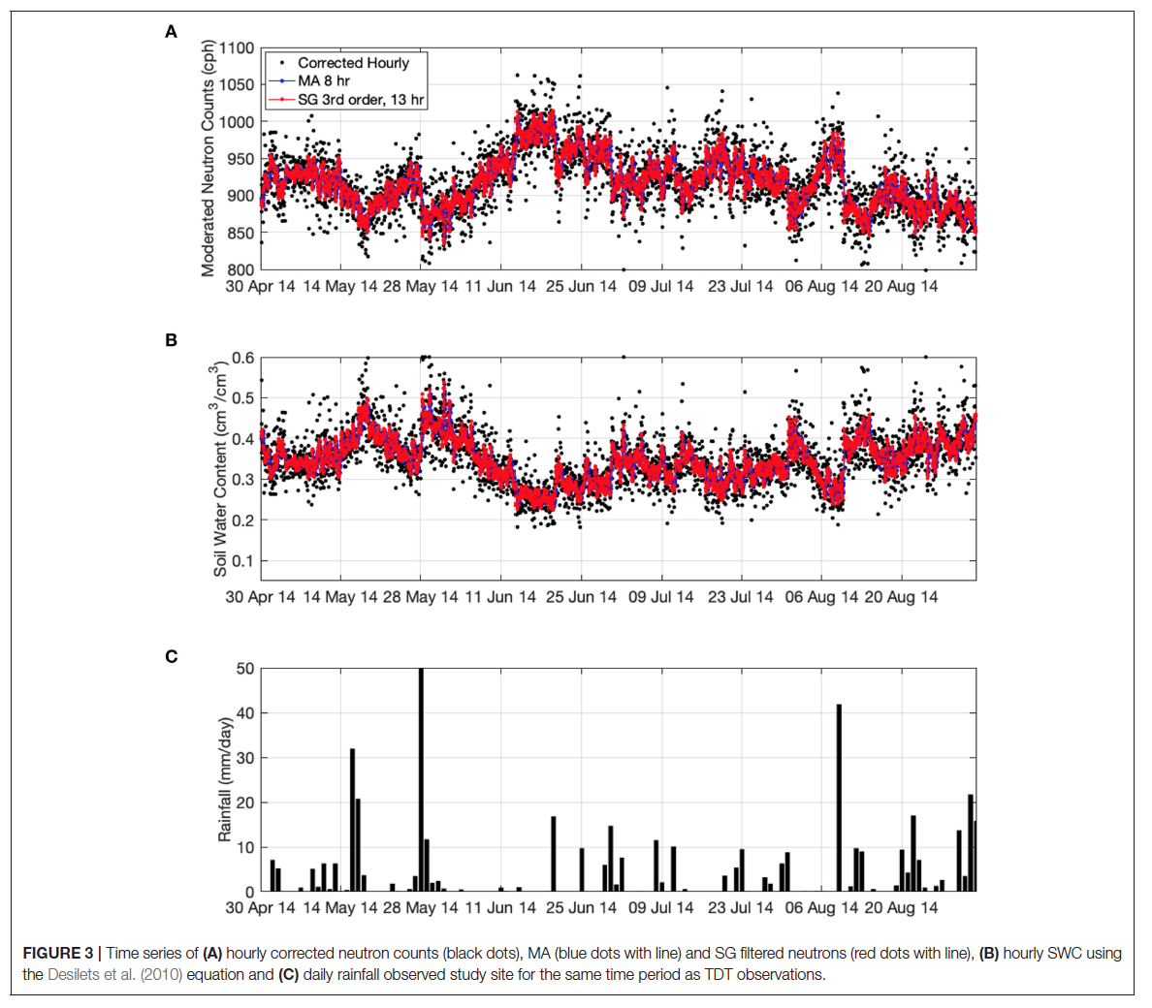
Improved CRNS Products

Slide 40
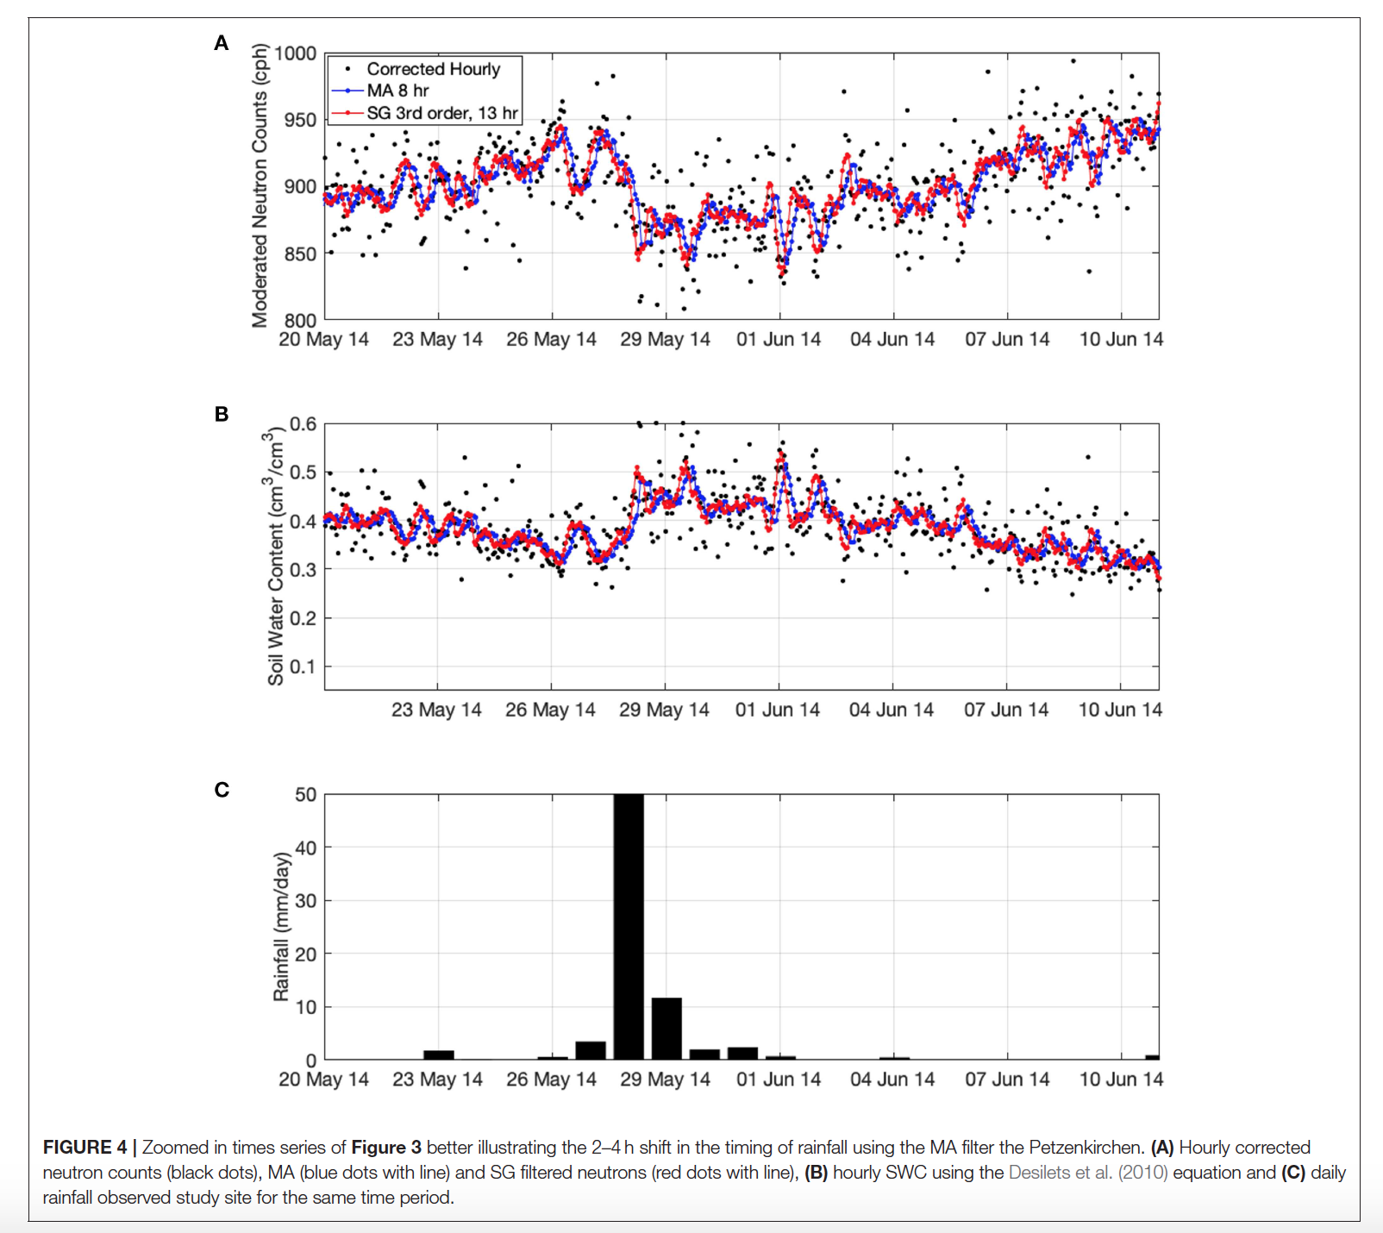
Improved CRNS Products

Slide 41
Improved CRNS Products
How do you evaluate accuracy of filtered soil moisture time series?
Compare and water fluxes and estimate mass balance!

Slide 42
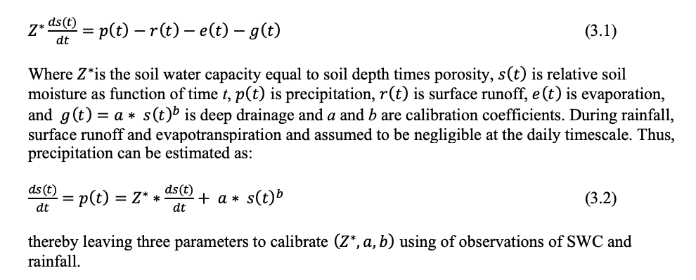
Improved CRNS Products
SM2RAIN Algorithm

Slide 43
Improved CRNS Products
Figure 3.1. Correlation maps for 5 days of accumulated rainfall (left column) and differences in mean annual rainfall (right column) obtained by comparing SM2RAIN vs. 5 global rainfall products at 1 degree spatial resolution during the period 1 March 2000 to 31 December 2013. Source Figure 5 from Ciabatta et al. 2017.

Slide 44
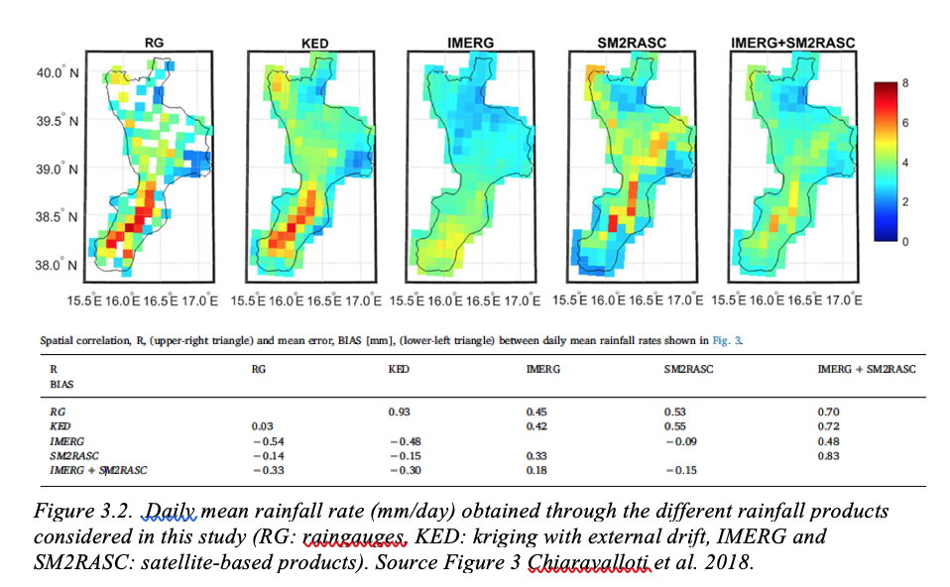
Improved CRNS Products

Slide 45
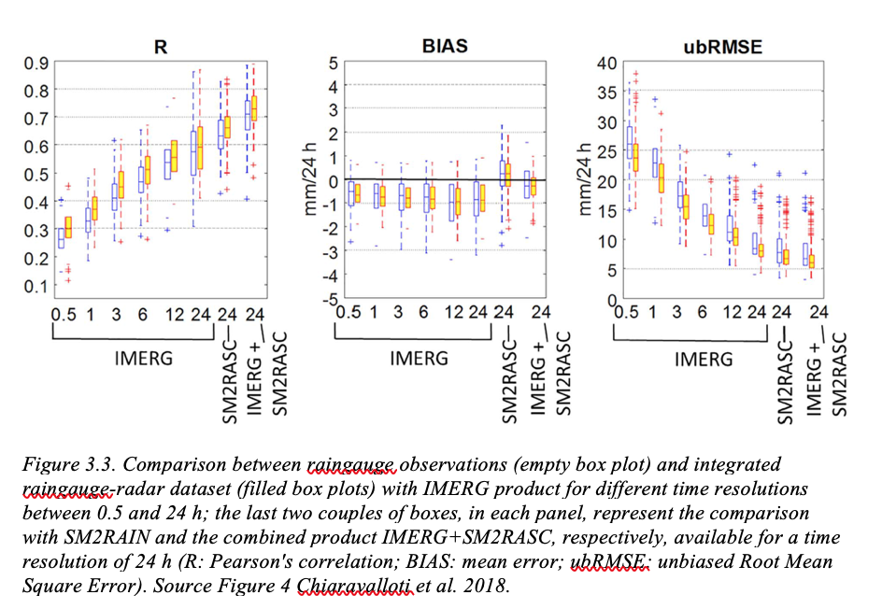
Improved CRNS Products

Slide 46
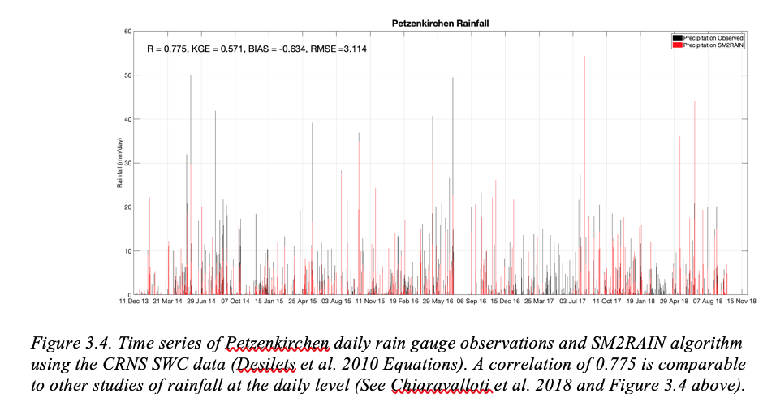
Improved CRNS Products

Slide 47
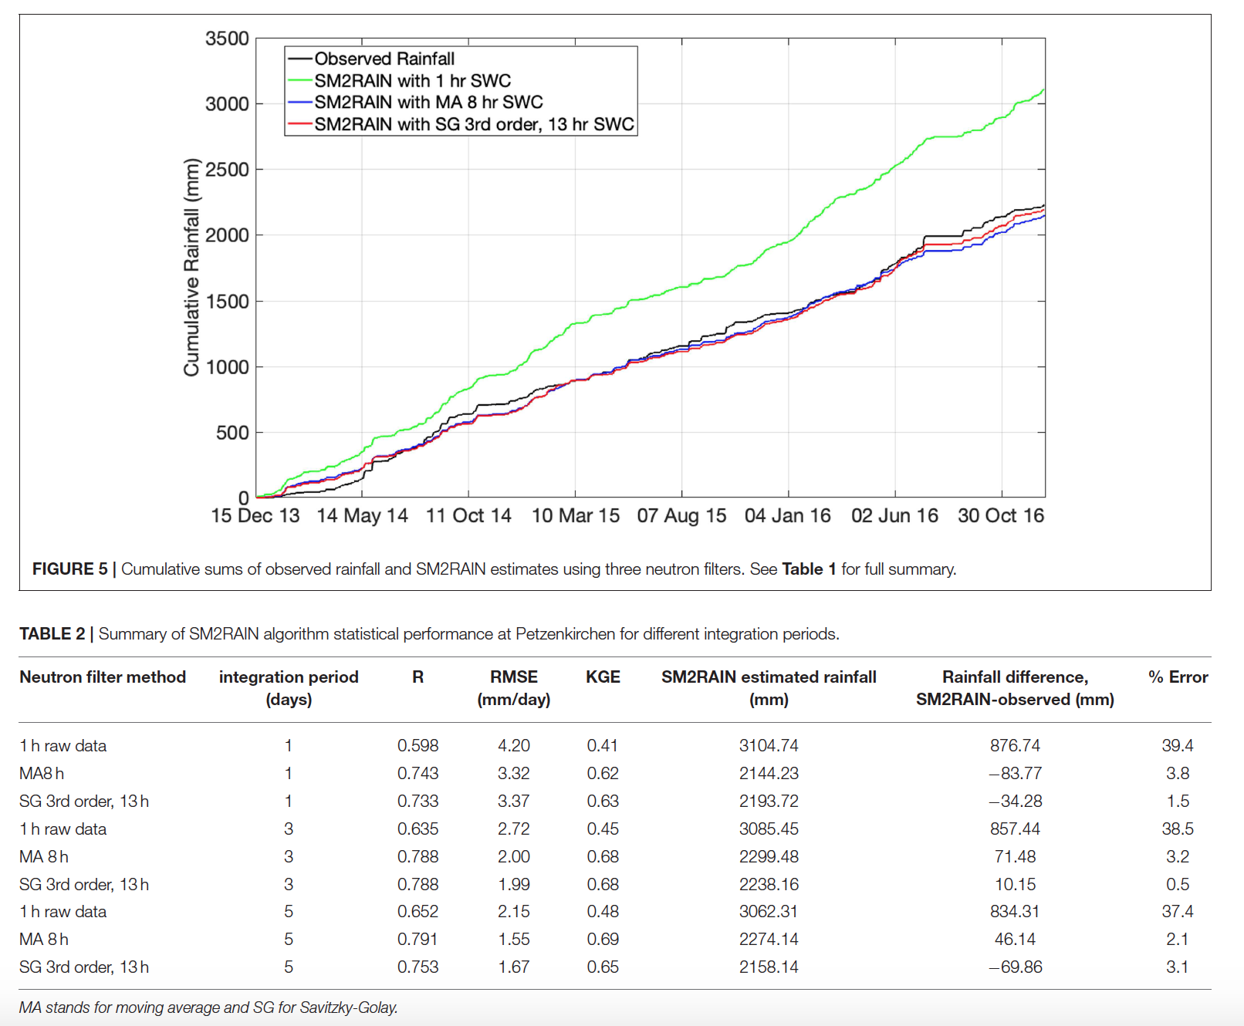
Improved CRNS Products

Slide 48
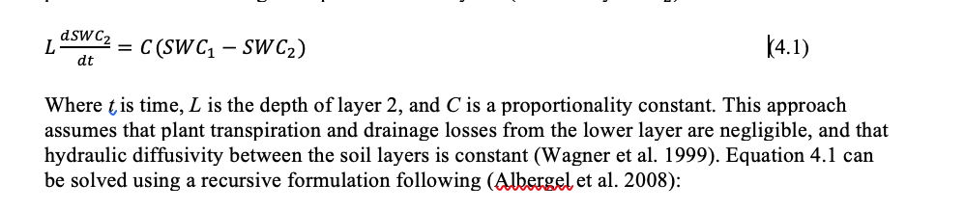
Improved CRNS Products
How do we extend shallow SM estimate to whole rootzone?
Exponential Filter
Method widely used in RS products

Slide 49
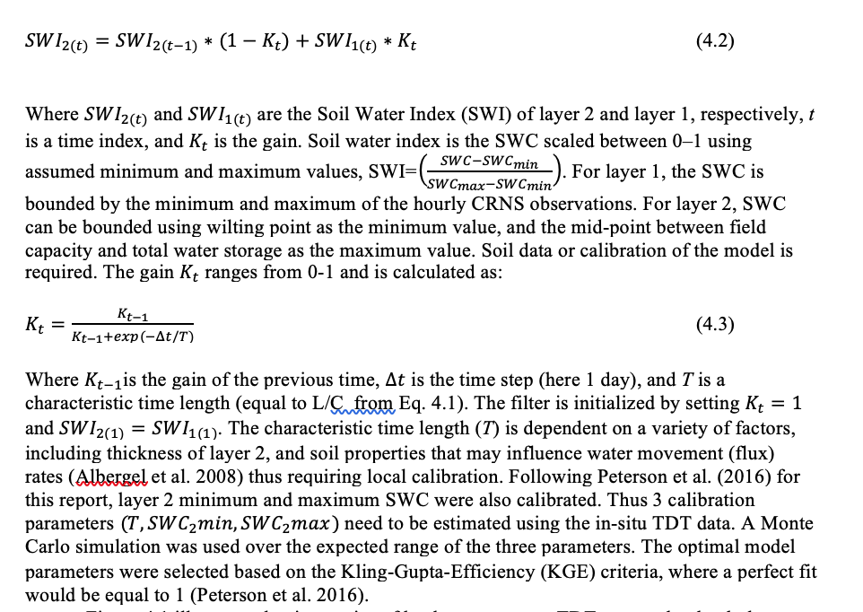
Improved CRNS Products

Slide 50
Improved CRNS Products
Figure 4.2. Monte Carlo results for the calibration of the exponential filter model for the 0-30 cm profile. The parameters corresponding to the maximum Kling-Gupta-Efficiency (KGE) value are used in the operational exponential filter. See Table 4.1 for results.

Slide 51
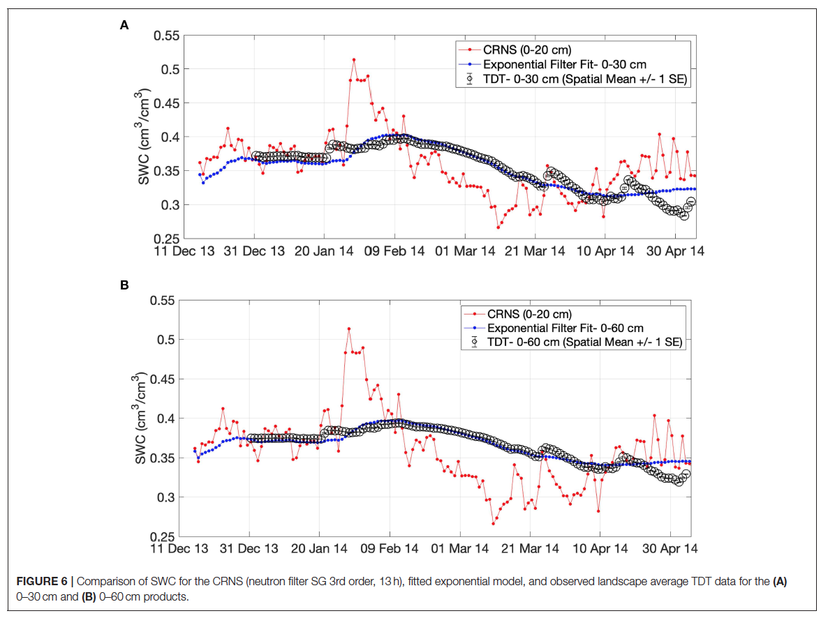
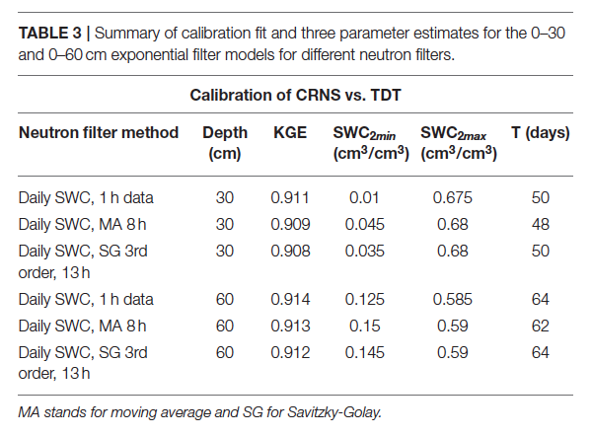
Improved CRNS Products

Slide 52
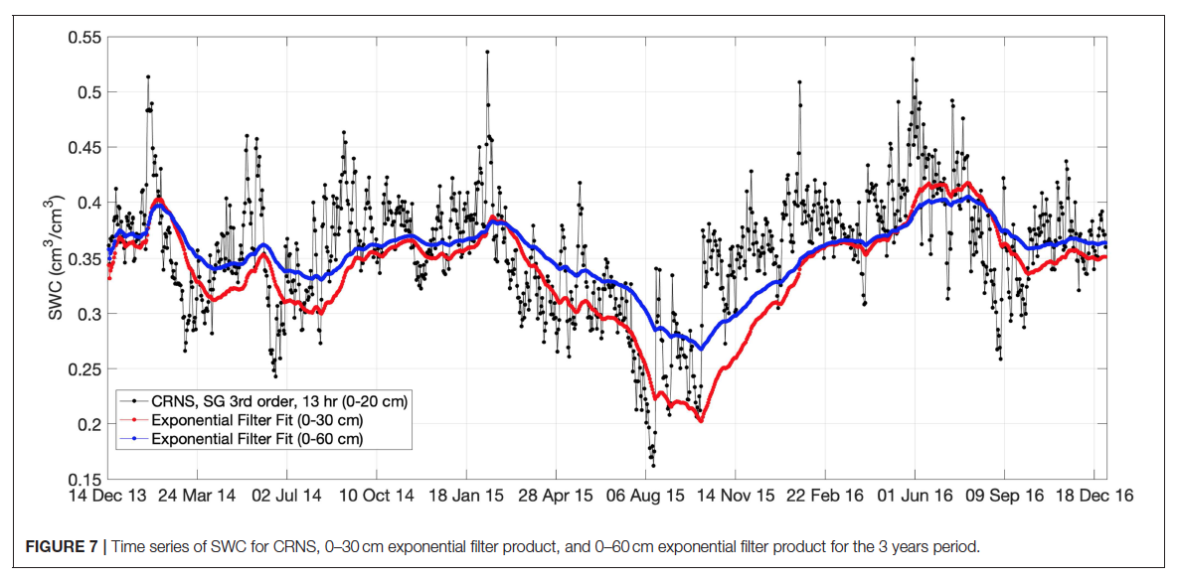
Improved CRNS Products

Slide 53
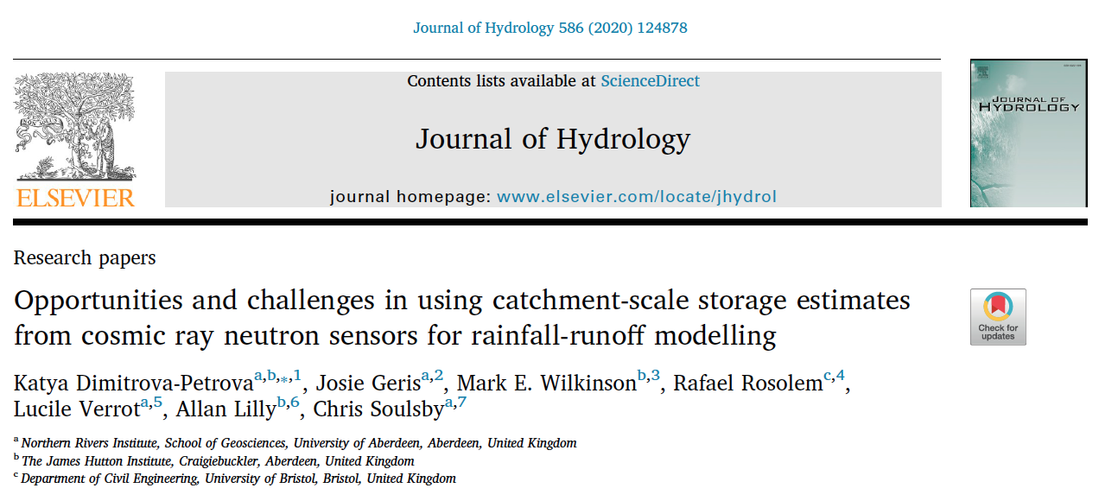
CRNS for Rainfall-Runoff Modelling

Slide 54
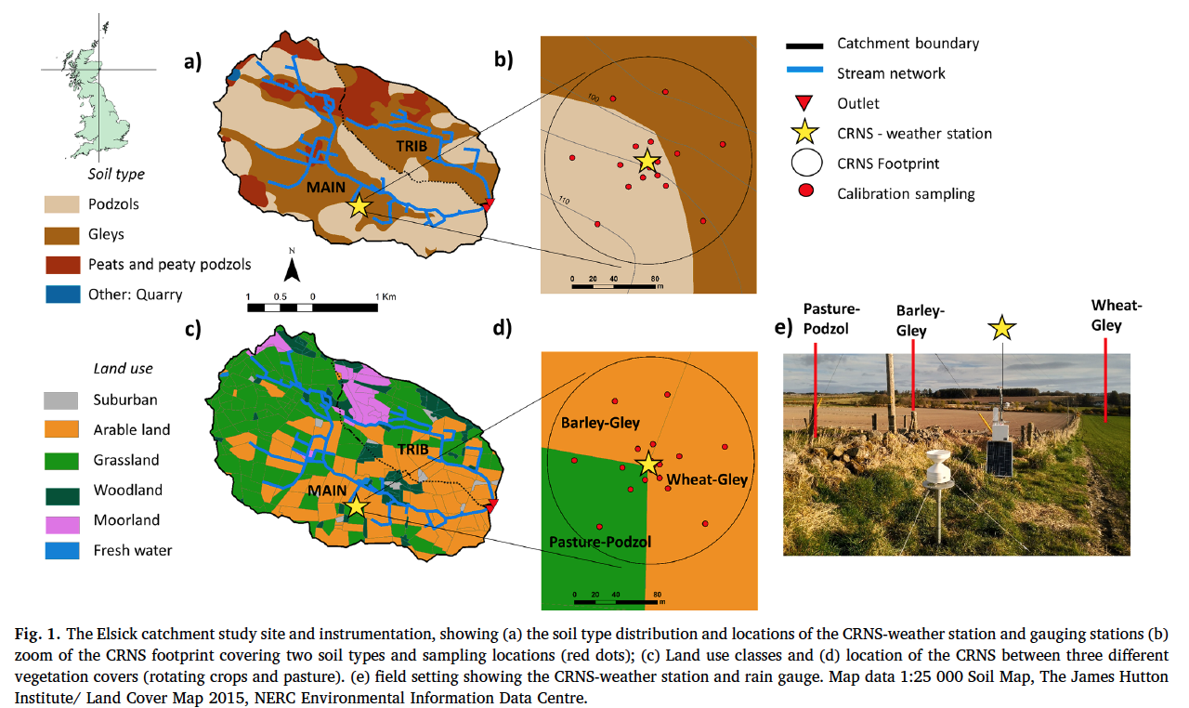
CRNS for Rainfall-Runoff Modelling

Slide 55
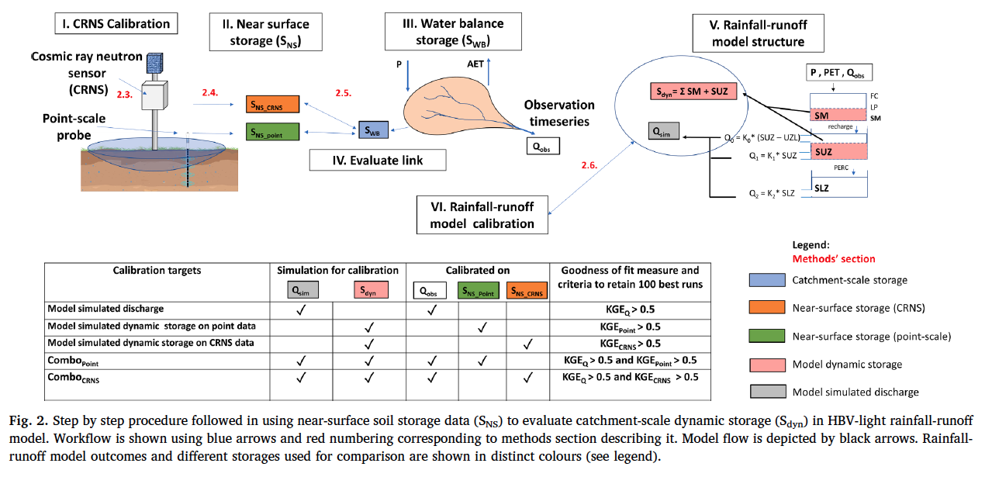
CRNS for Rainfall-Runoff Modelling

Slide 56
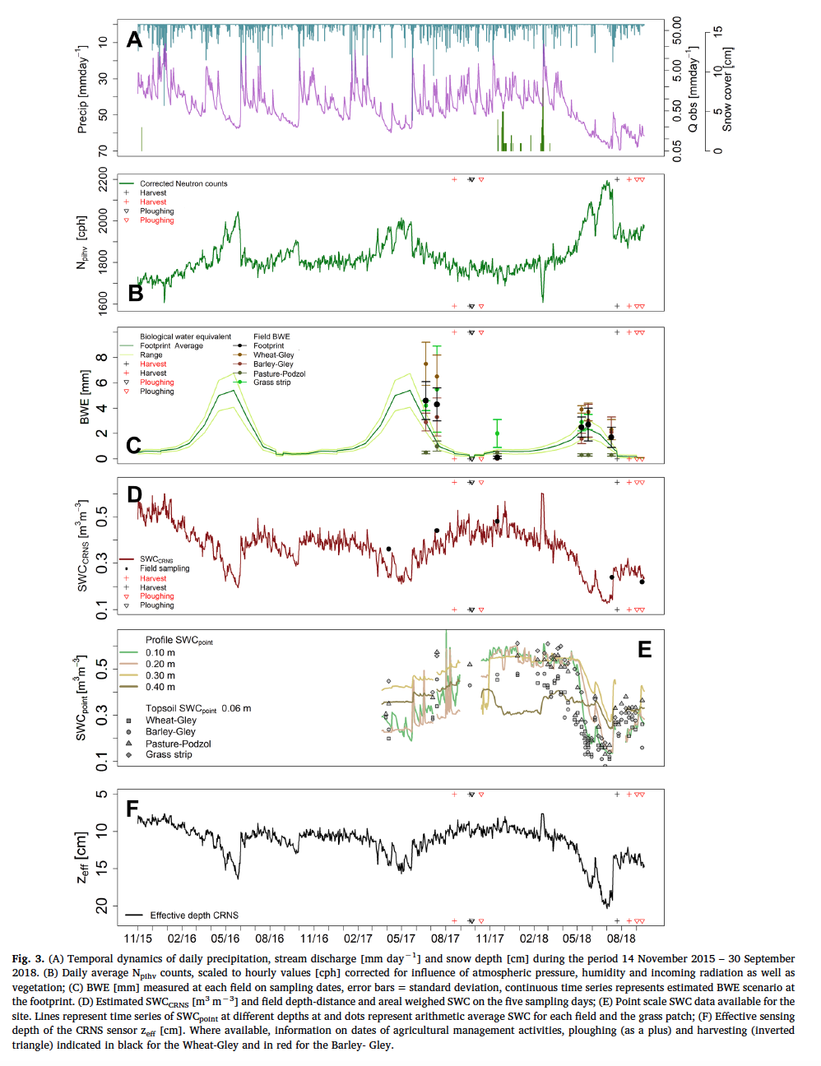
CRNS for Rainfall-Runoff Modelling

Slide 57
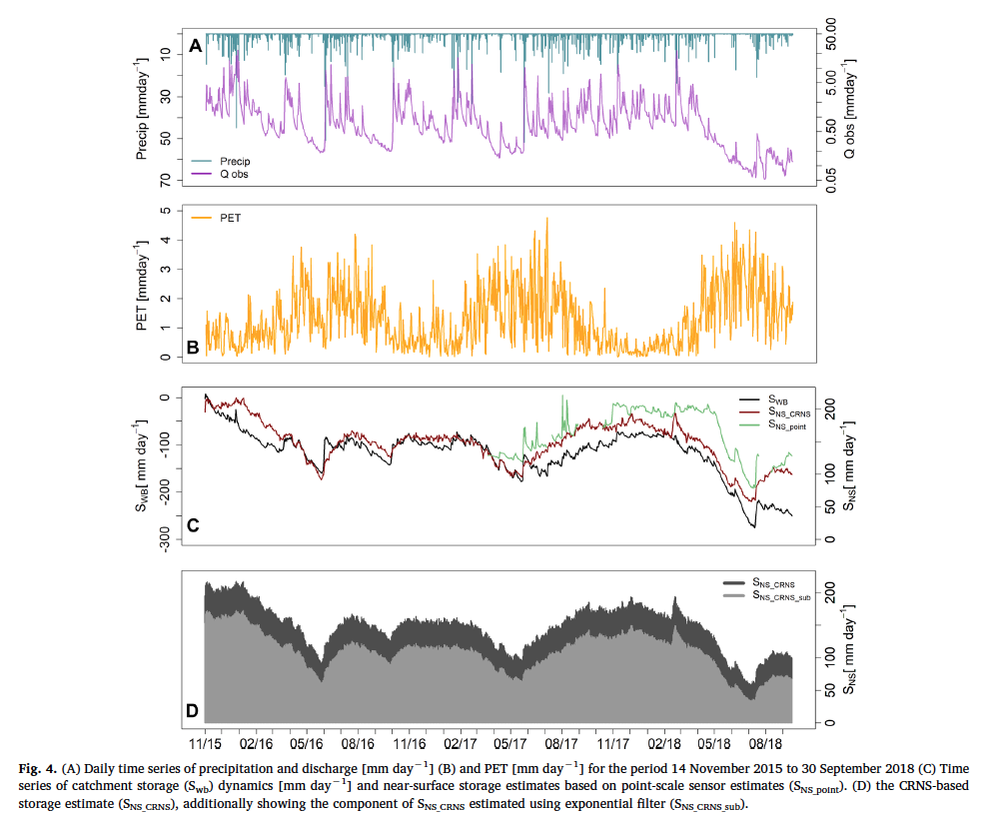
CRNS for Rainfall-Runoff Modelling

Slide 58
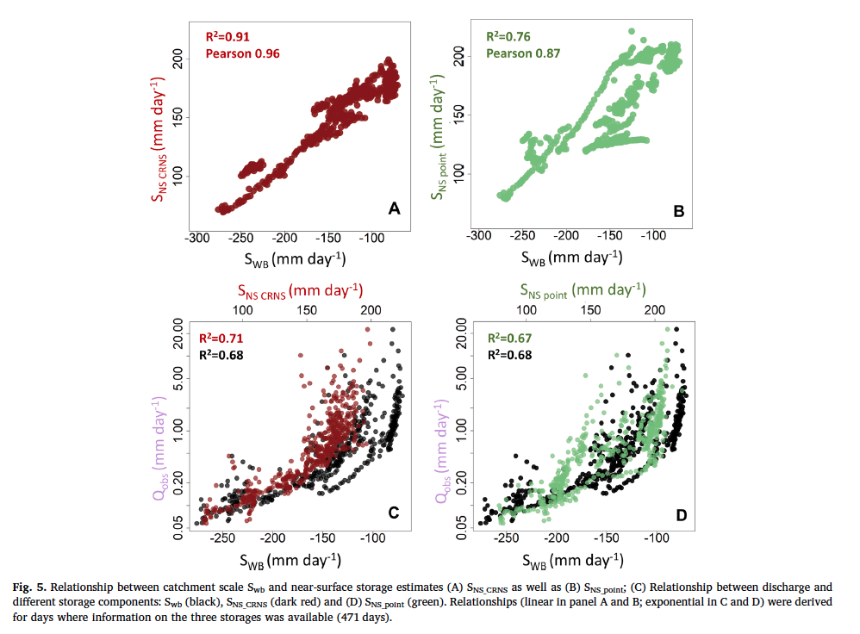
CRNS for Rainfall-Runoff Modelling

Slide 59
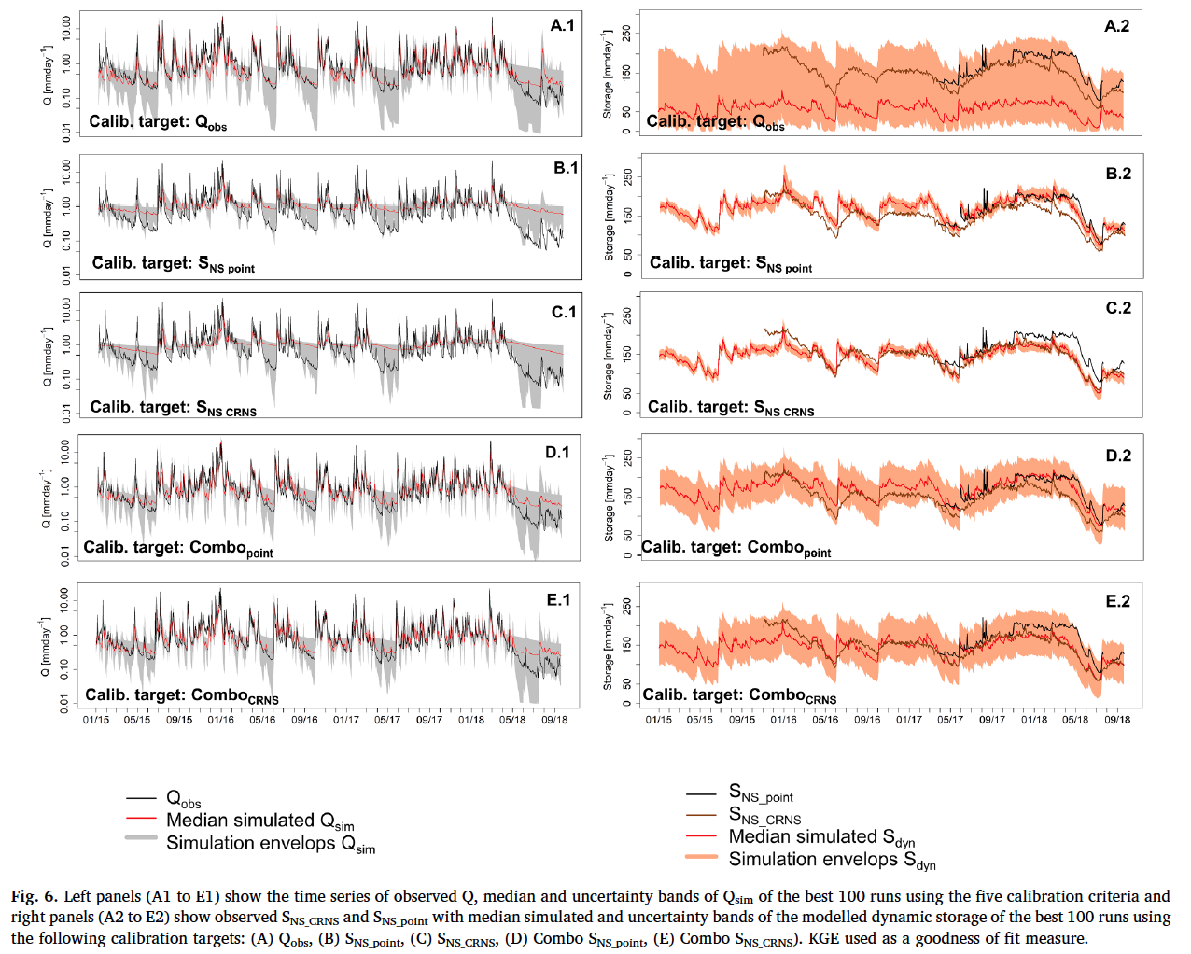
CRNS for Rainfall-Runoff Modelling

Slide 60
Summary
CRNS follows Poisson Counting Statistics, error can be propagated through to soil moisture and water fluxes

Slide 61
Summary
CRNS follows Poisson Counting Statistics, error can be propagated through to soil moisture and water fluxes
Challenging but possible to connect soil moisture and water fluxes with the aid of models

Slide 62
Summary
CRNS follows Poisson Counting Statistics, error can be propagated through to soil moisture and water fluxes
Challenging but possible to connect soil moisture and water fluxes with the aid of models
Suite of tools to filter neutron time series, estimate rainfall and rootzone soil moisture products

Slide 63
Summary
CRNS follows Poisson Counting Statistics, error can be propagated through to soil moisture and water fluxes
Challenging but possible to connect soil moisture and water fluxes with the aid of models
Suite of tools to filter neutron time series, estimate rainfall and rootzone soil moisture products
Progress on integrating CRNS data with GW storage and streamflow modelling (calibrate model simultaneously based on streamflow and CRNS)

Slide 64
Key References
IAEA- TECDOC-1809 (2017), Cosmic Ray Neutron Sensing: Use, Calibration and Validation for Soil Moisture Estimation. Joint FAO/IAEA Programme Nuclear Techniques in Food and Agriculture. 50 pg. Vienna, Austria. Online at http://www pub.iaea.org/books/IAEABooks/11097/Cosmic-Ray-Neutron-Sensing-Use-Calibration-and-Validation-for-Soil-Moisture-Estimation
IAEA- TECDOC-1845 (2018), Soil Moisture Mapping with a Portable Cosmic Ray Neutron Sensor. Joint FAO/IAEA Programme Nuclear Techniques in Food and Agriculture. 43 pg. Vienna, Austria. Online at https://www-pub.iaea.org/books/IAEABooks/12357/Soil-Moisture-Mapping-with-a-Portable-Cosmic-Ray-Neutron-Sensor
Albergel, C., C. Rudiger, T. Pellarin, J. C. Calvet, N. Fritz, F. Froissard, D. Suquia, A. Petitpa, B. Piguet, and E. Martin (2008), From near-surface to root-zone soil moisture using an exponential filter: an assessment of the method based on in-situ observations and model simulations, Hydrology and Earth System Sciences, 12(6), 1323-1337. doi:10.5194/hess-12-1323-2008.
Brocca, L., L. Ciabatta, C. Massari, T. Moramarco, S. Hahn, S. Hasenauer, R. Kidd, W. Dorigo, W. Wagner, and V. Levizzani (2014), Soil as a natural rain gauge: Estimating global rainfall from satellite soil moisture data, J. Geophys. Res.-Atmos., 119(9), 5128-5141. doi:10.1002/2014jd021489.
Chiaravalloti, F., L. Brocca, A. Procopio, C. Massari, and S. Gabriele (2018), Assessment of GPM and SM2RAIN-ASCAT rainfall products over complex terrain in southern Italy, Atmos. Res., 206, 64-74. doi:10.1016/j.atmosres.2018.02.019.
Ciabatta, L., C. Massari, L. Brocca, A. Gruber, C. Reimer, S. Hahn, C. Paulik, W. Dorigo, R. Kidd, and W. Wagner (2018), SM2RAIN-CCI: a new global long-term rainfall data set derived from ESA CCI soil moisture, Earth Syst. Sci. Data, 10(1), 267-280. doi:10.5194/essd-10-267-2018.
Franz, T., A. Wahbi, J. Zhang, M. Vreugdenhil, L. Heng, G. Dercon, P. Strauss, L. Brocca, and W. Wagner (2020), Cosmic-Ray Neutron Sensor: From Measurement of Soil Water Content Data to Practical Applications, Frontiers in Water, 2, 9.
McCabe, M. F., M. Rodell, D. E. Alsdorf, D. G. Miralles, R. Uijlenhoet, W. Wagner, A. Lucieer, R. Houborg, N. E. C. Verhoest, T. E. Franz, J. C. Shi, H. L. Gao, and E. F. Wood (2017), The future of Earth observation in hydrology, Hydrology and Earth System Sciences, 21(7), 3879-3914. doi:10.5194/hess-21-3879-2017.
Peterson, A. M., W. D. Helgason, and A. M. Ireson (2016), Estimating field-scale root zone soil moisture using the cosmic-ray neutron probe, Hydrology and Earth System Sciences, 20(4), 1373-1385. doi:10.5194/hess-20-1373-2016.
Wagner, W., G. Lemoine, and H. Rott (1999), A method for estimating soil moisture from ERS scatterometer and soil data, Remote Sens. Environ., 70(2), 191-207. doi:10.1016/s0034-4257(99)00036-x.
https://www.frontiersin.org/research-topics/11094/innovative-methods-for-non-invasive-monitoring-of-hydrological-processes-from-field-to-catchment-sca#articles

